Slide 1

Mastering Microsoft 365 Copilot, Copilot Chat and Agents – 2026
Engage in six interactive sessions designed to help you leverage the features of Microsoft 365 Copilot and develop effective prompting skills.
  Learn how to use Copilot Apps within various M365 applications
  Develop expertise in crafting prompts
  Participate in a guided demonstration on applying Copilot and Copilot Chat for everyday productivity
Join two practical sessions focused on unlocking the potential of Microsoft 365 Copilot agents.
  Explore a range of built-in agents such as Facilitator, Interpreter, and Coaches, and discover how to use Agent Builder in Microsoft 365 Copilot and SharePoint Online to create customized agents for your organization
  Gain insights into the Researcher and Analyst agents, understanding how they provide executive-level research and actionable insights by analyzing your work data and online sources
Participate in two hands-on sessions centered around the Microsoft 365 applications you use daily.
  Learn to create documents, presentations, and spreadsheets with Word, PowerPoint, and Excel Agents - from drafting and designing to data integration, explore how these agents help you work more efficiently
  Experience working collaboratively with Copilot in Copilot Cowork, where you can co-create, co-edit, and co-think with AI to address real tasks, transforming Copilot from a tool into a partner
Attend a multi-session training series focused on designing and managing AI agents with Microsoft Copilot Studio. Over five sessions, you will cover:
  An overview of Copilot Studio and its role within the Microsoft AI platform
  Techniques for writing effective agent instructions and prompts
  Understanding generative orchestration for coordinating AI, tools, and data
  Best practices for building and managing autonomous agents at scale
End-User webinars
(Free to all MFM Customers)
Session details and registration:
https://aka.ms/MasteringCopilotAndAgents2026
https://aka.ms/MasteringCopilotAgents2025Content - Content will be updated here
Notes:
Welcome everyone, and thank you for joining us today. This is part of the Mastering Microsoft 365 Copilot, Copilot Chat and Agents 2026 webinar series.
We have six interactive sessions planned, covering everything from Copilot apps in M365 to crafting effective prompts, plus hands-on agent building sessions.
This particular session is positioned as a Level 100 overview, so it's designed to be approachable, practical, and safe for anyone regardless of technical background.
You'll find the full calendar and registration links on this slide. Feel free to bookmark them and come back later for upcoming sessions.

Slide 2
Copilot for All:
Mastering Microsoft 365 Copilot Chat
Notes:
This session is all about Copilot Chat and making it accessible for everyone. The core message today is simple: Copilot Chat is for everyone.
You don't need to be technical, and you don't need a premium license to start getting value right away.
Think of today as a confidence-building exercise. We'll cover how to access Copilot Chat, how to use it responsibly, and how to ask questions that produce genuinely useful output.
Whether you've tried Copilot Chat before or you're completely new, you'll leave with simple steps you can use immediately.

Slide 3

Here’s what you’ll learn in this deck:
What Copilot Chat is and how it’s different from other AI chat tools
How to use Copilot Chat
What agents are in Copilot Chat and how to use them
Example Copilot Chat prompts
Notes:
Here's our roadmap for the session. We'll start with the basics: what Copilot Chat is and how it differs from other AI chat tools you may have used.
That difference matters because workplace use requires a different standard, especially around protecting your information.
Then we'll move into the practical stuff: the experience itself, how to get started, and how to use it effectively. After that, a quick introduction to agents, and finally, we'll spend quality time on prompting techniques.
Don't worry about memorizing everything. The goal is to give you repeatable patterns you can use later on your own.

Slide 4
What is Copilot Chat?
Notes:
Now let's lay the foundation: what exactly is Copilot Chat and why did Microsoft build it specifically for work scenarios?
If you've used consumer AI tools, you'll notice the chat format feels familiar. But the key difference is that Copilot Chat is designed with work expectations in mind: safe usage, organizational controls, and a productivity focus.
It's not about curiosity or entertainment; it's about getting real work done while keeping your data protected. Let's define it clearly.

Slide 5
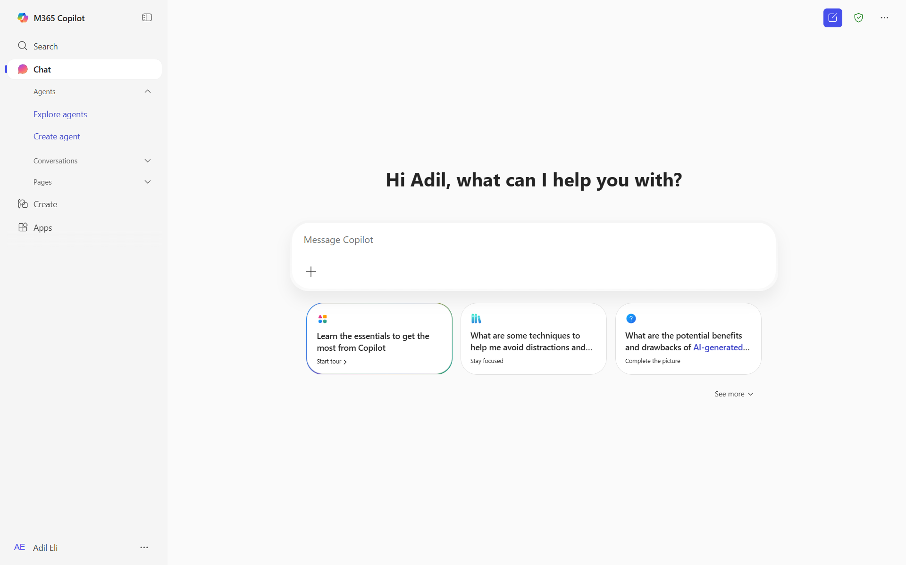
Cutting-edge, secure AI chat tool (new UI)
Microsoft 365 Copilot Chat is an AI chat tool built specifically for work. It uses the latest AI models and data from the web to answer your questions, generate content and ideas, and find information. It also protects your data so information from your chat conversation does not get exposed to the public.
In addition, with Copilot Chat you can:
Upload files to get responses based on information from your work documents, presentations, etc¹.
Generate images¹ and data visualizations.
Refine and collaborate on chat responses using Pages
Connect Copilot Chat to your organization data like team documents and internal SharePoint sites² using agents.
Get started by going to M365Copilot.com
¹Image generation and file upload limits apply.
²Connecting Copilot Chat to your organization data is only available if your organization admin has enabled this capability.
Notes:
Copilot Chat is an AI chat tool built specifically for work. It uses modern AI models and web information to help answer questions, generate content, and spark ideas.
The key difference from consumer tools is data protection. Your chat content isn't exposed publicly, which matters a lot when you're dealing with internal context, drafts, customer considerations, or planning notes.
You can also upload files like Word documents, PowerPoint decks, Excel sheets, or PDFs, and ask Copilot to summarize, extract key points, or draft something based on them. That's a major productivity boost because you're no longer starting from a blank page.
Think of Copilot as a first-draft partner. It gets you from zero to a usable starting point, and then you apply your judgment to finalize.

Slide 6
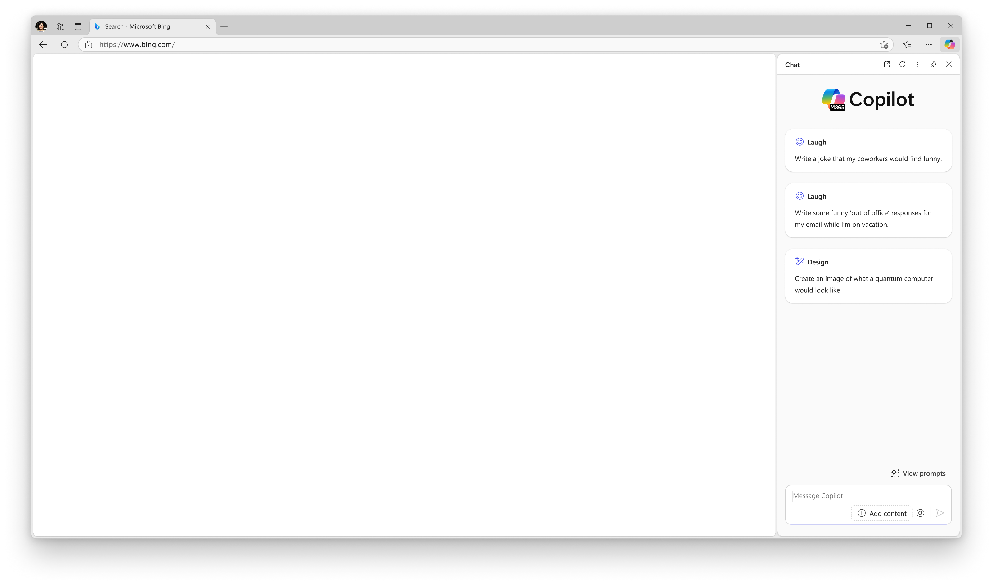
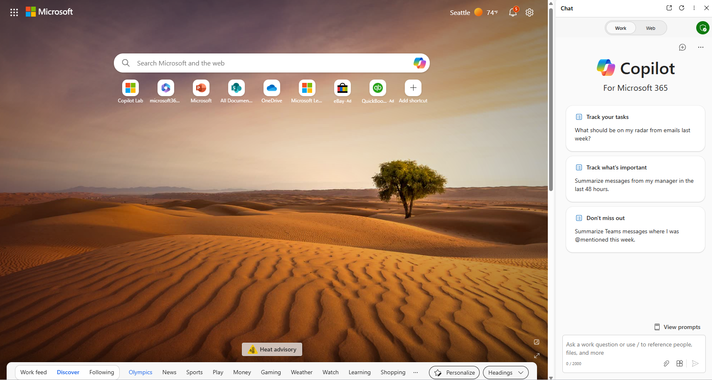
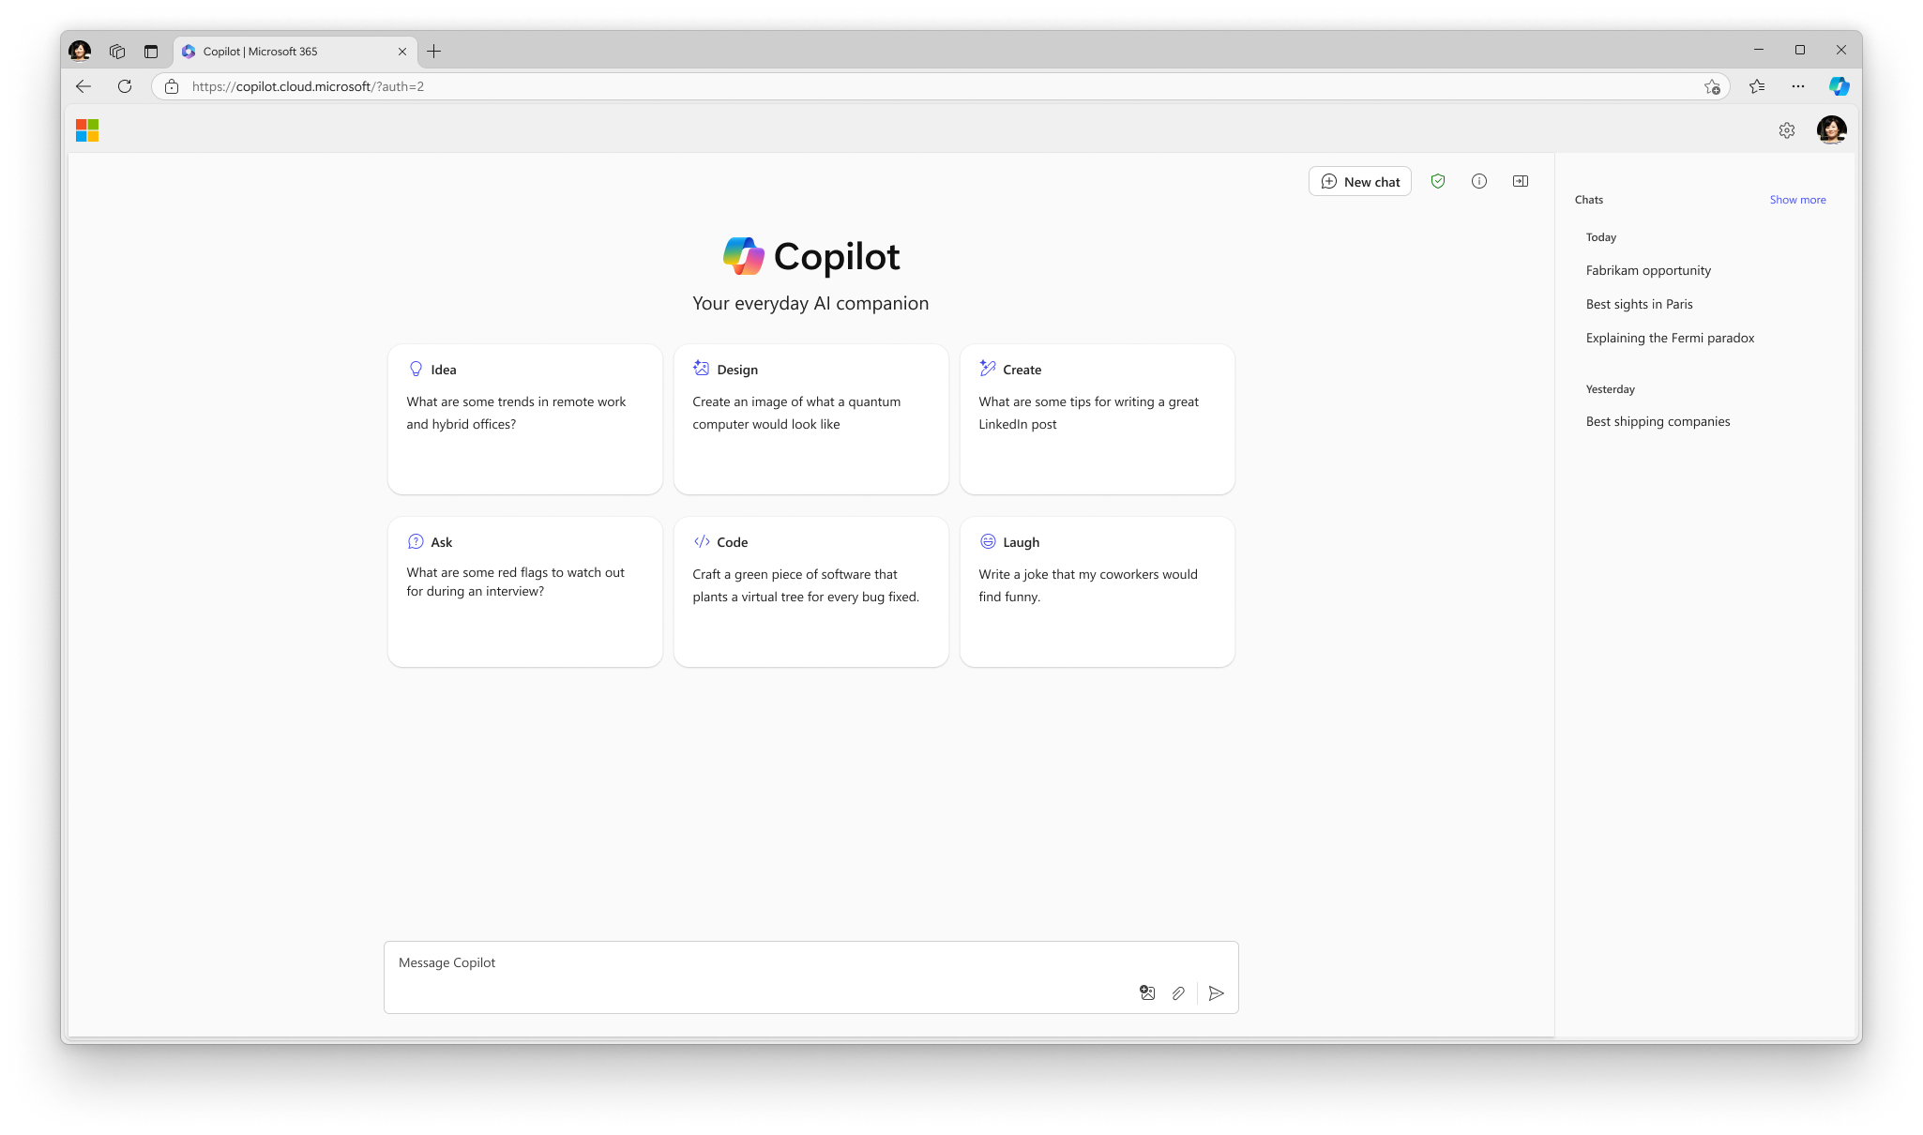
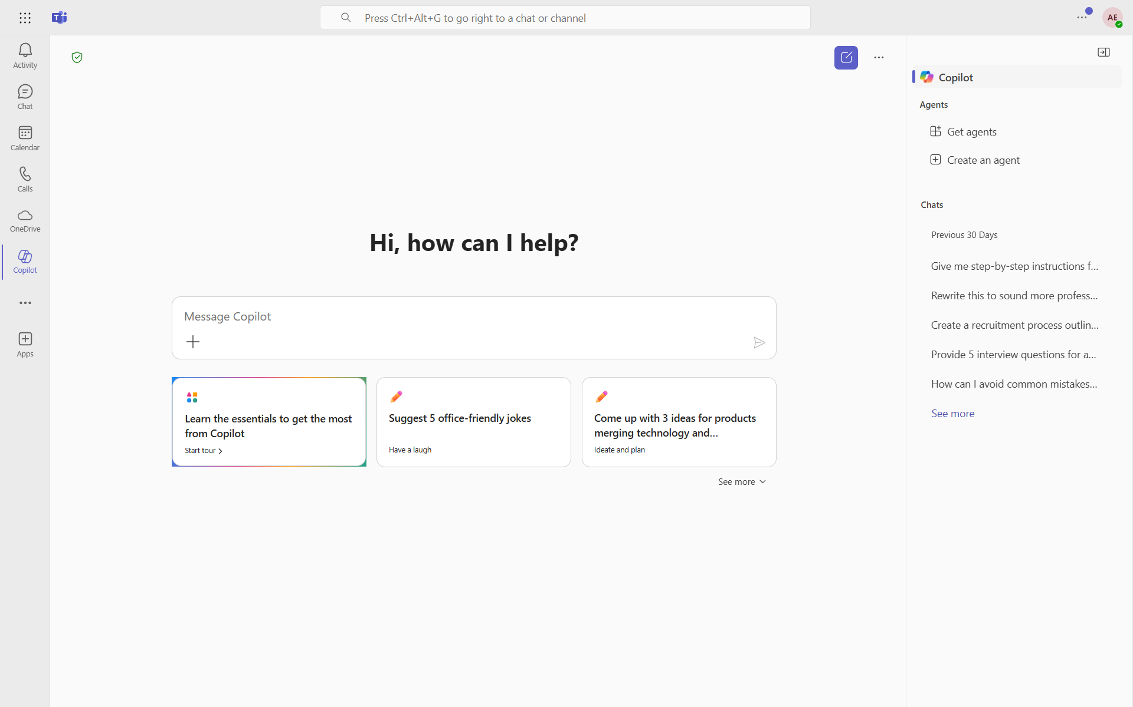
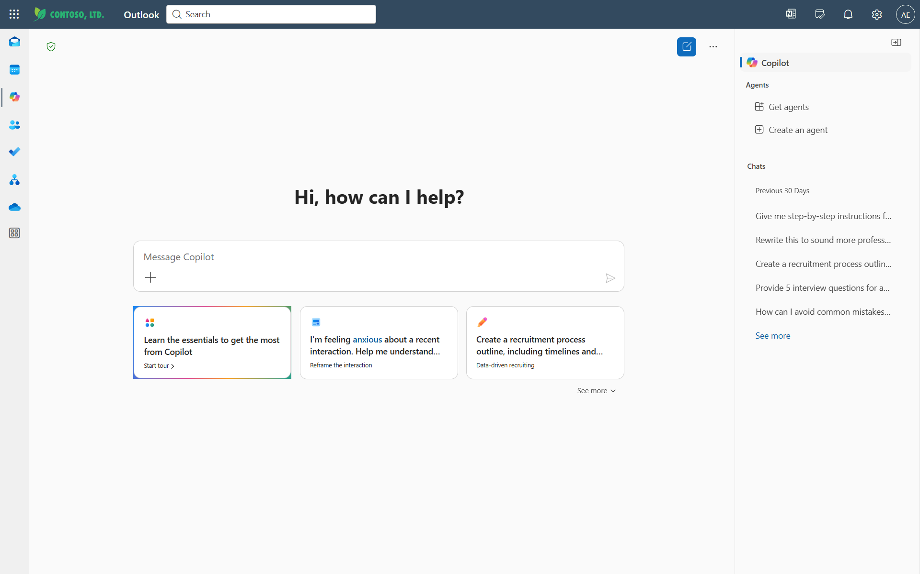
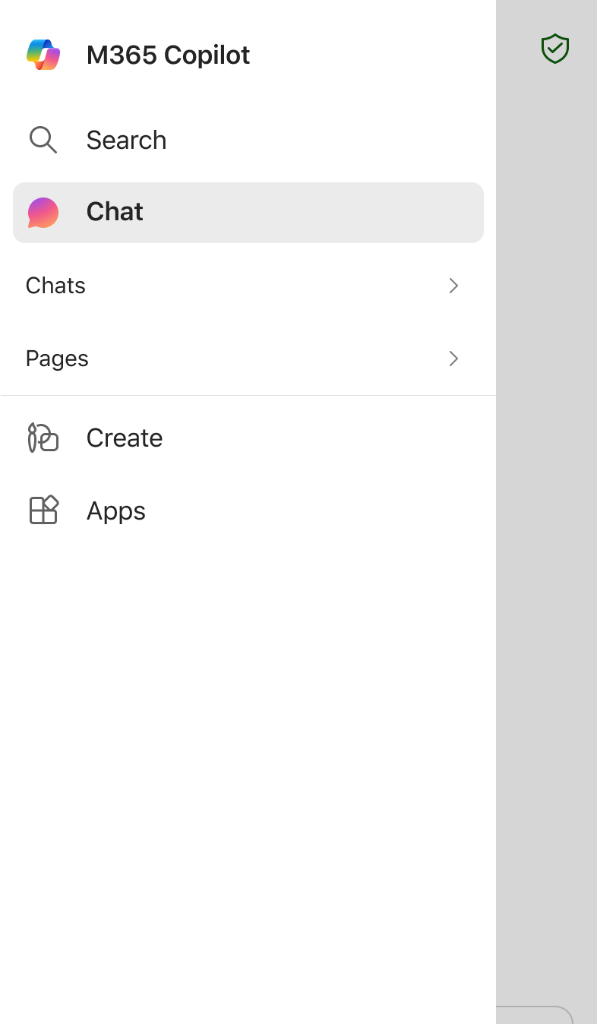
Access Copilot Chat from where you’re working (new UI)
Admin note: The Microsoft 365, Outlook, and Teams app Copilot experiences will only available if Copilot is pinned by the user or admin. Instructions on how to pin Copilot for your organization can be found here.
M365Copilot.com
Microsoft 365 Copilot app*
Edge browser sidebar
Microsoft 365 app
copilot.cloud.microsoft
Microsoft 365 app
Teams app*
Outlook app*
Microsoft 365 Copilot mobile app
*Ensure Copilot is pinned to your left navigation across Teams, Outlook, and the Microsoft 365 app.
Notes:
A major reason Copilot adoption grows quickly is that it's accessible from the places you already work. This slide shows all the common entry points.
You can access it through the M365 experience, the web, Edge browser sidebar, Teams, Outlook, and mobile. It's designed to be available where your work already happens.
If someone tells you they can't find Copilot, it's often a navigation or configuration issue. Copilot may need to be pinned depending on organizational settings, so that's something your admin can help with.
The point is: Copilot Chat isn't meant to be another separate tool you have to remember. It meets you where you are.

Slide 7
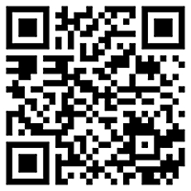
Use Copilot Chat on the go (new UI)
Download the Microsoft 365 Copilot mobile app and sign in with your work or school account to access Copilot Chat
Notes:
For those of you who work on the go, yes, there is a mobile path too. You can use the M365 Copilot mobile app and sign in with your work or school account.
This slide includes a QR code to make that easy. If you want to follow along live during the prompting section later, feel free, but no pressure.
Everything will still make sense if you just watch, and you can always try it afterwards on your own time.

Slide 8
Get started with Copilot Chat
Notes:
Alright, now let's shift into the practical view. This section is about actually getting started with Copilot Chat.
Imagine you're opening it for the first time. What should you do first? What should you expect? We'll walk through all of that step by step.
The key takeaway here is that getting started is straightforward, and you don't need any special training to begin.

Slide 9
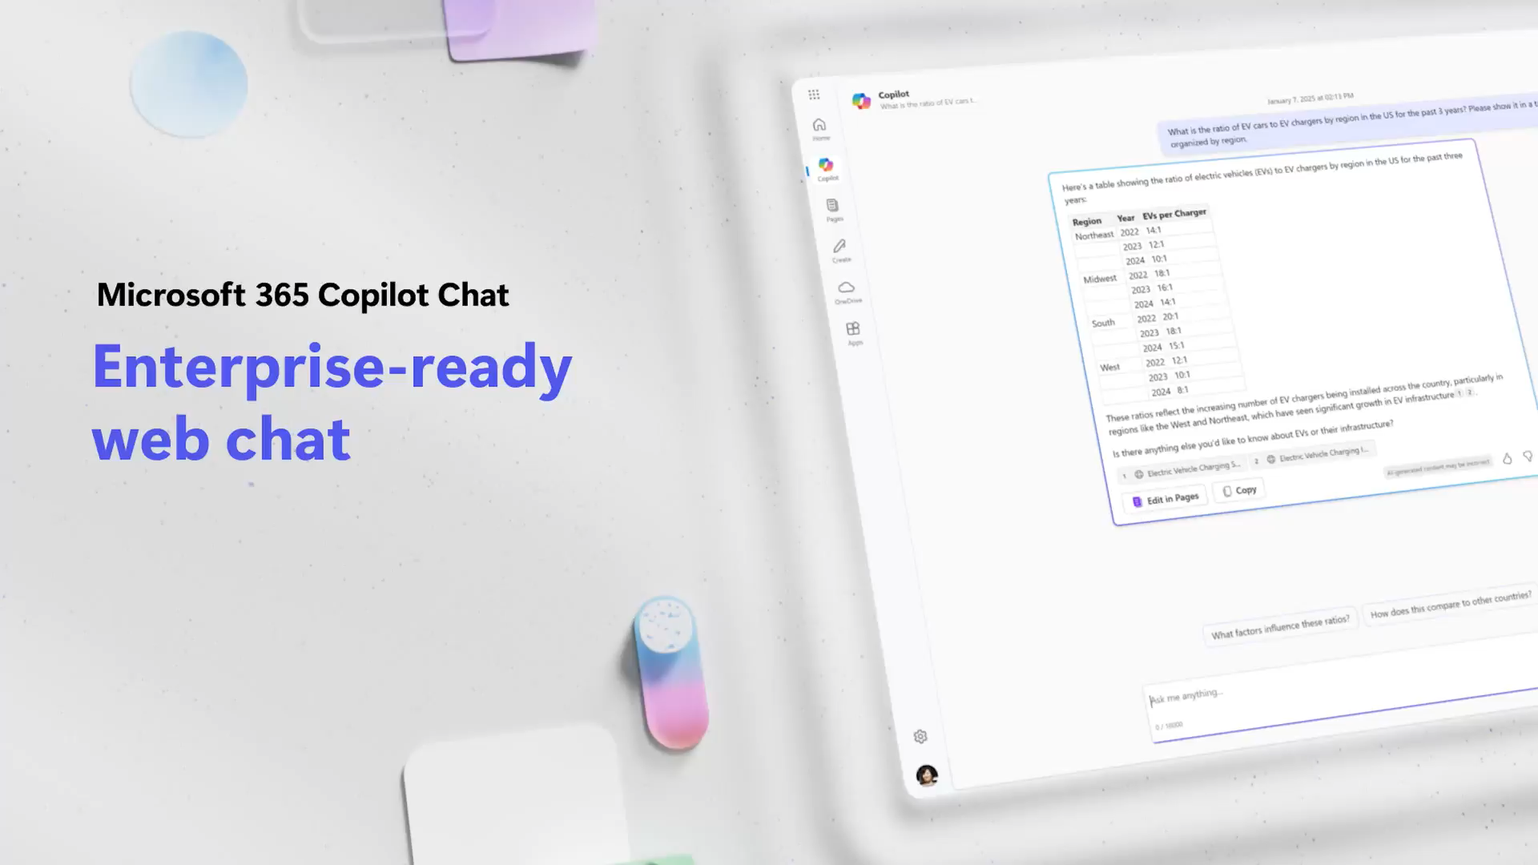
Video: Copilot Chat
Notes:
Here's a short video that brings the Copilot Chat experience to life. While watching, I want you to notice three things.
First, the interaction is conversational. You can ask, refine, and keep going naturally. Second, Copilot Chat is web-grounded, meaning it draws on web information for answers.
Third, pay attention to how naturally it supports real-world tasks. Not just Q and A, but drafting, summarizing, and organizing outputs. That's where the real productivity gains happen.

Slide 10
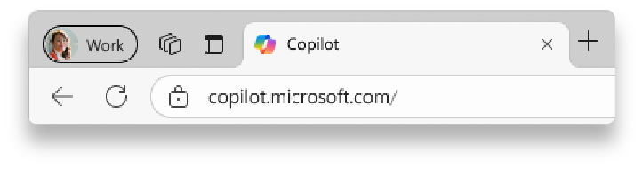
Sign in with your work account (new UI)
2
1
1
Navigate to M365Copilot.com on your preferred browser on your device to get to Copilot Chat.
https://M365Copilot.com
2
Ensure you’re signed in with your work account.
You will know you are successfully signed in to Copilot Chat when you see the green shield icon next to new chat icon at the top of the page.
If you are not signed in with your work account, Enterprise Data Protection does not apply.
Notes:
Before we go further, there's an important safety step: making sure you're properly signed in. Always sign in with your work account when using Copilot Chat for work.
Why does this matter? Because workplace protections only apply when you're working within the organizational sign-in boundary. It's the difference between a general AI chat and one designed for enterprise use.
Navigate to M365Copilot.com and confirm you're authenticated. You'll know you're good when you see the green shield icon next to the New Chat button.
Before you paste anything sensitive, always pause and check you're in the correct sign-in experience.

Slide 11
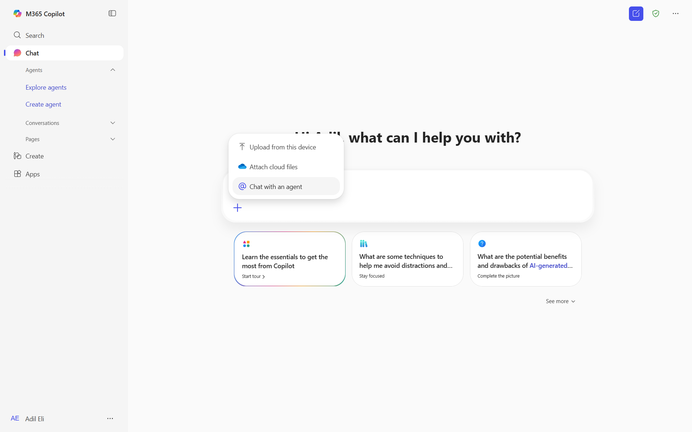

Get to know Copilot Chat (new UI)
Start at
M365Copilot.com
Start a new chat button
Clear your past chat and start a new conversation.
Here is a visual tour of Copilot Chat:
Agents
Open agent store, use existing agents or create new ones.
Chat with an agent
Add an agent to your Copilot prompt to chat with it.
Recent chats
Return to a previous chat to continue the conversation
Send your prompt!
Prompt box
Start your conversation here.
See more prompts and access Copilot Prompt Gallery
View additional prompt suggestions, including saved prompts.
Add content and agents
Expand to upload files, images or add an agent to a chat
Suggested prompts
If you’re not sure what to ask, try or modify a sample prompt!
Notes:
Let me give you a quick tour of what you'll see in the Copilot Chat interface. At the top, there's a New Chat option. Think of it as a reset; it's helpful when changing topics so previous context doesn't affect the next answer.
You'll also see recent chats, which makes Copilot feel more like a workspace. You can pick up where you left off instead of restarting every time.
If agents are enabled in your environment, you'll see an agent area. And most importantly, the prompt box at the bottom is where you type your requests.
Near the prompt box, you'll find options to add content like uploading a file, and there are suggested prompts and a prompt gallery for when you feel stuck.

Slide 12
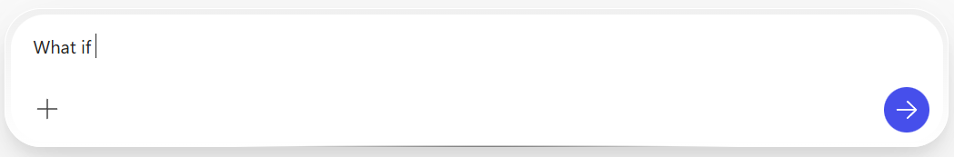

How to chat in 3 steps
1. Enter your prompt
2. Check sources
3. Continue the conversation
Enter your detailed prompt in the text box at the bottom. If you would like Copilot to source information from any reference files, you can upload them in your prompt by selecting the “Add content” button.
Copilot Chat is transparent about the sources of its information. See these sources listed underneath the answer.
Vet these sources and validate your answers.
You can ask follow-up questions as you would in a conversation. You can refine the answer too.
For example, try “Write a shorter answer" or "Give me more detail." You can also select suggested prompts.
Notes:
Here are three simple steps to use Copilot Chat effectively. First, enter your prompt. You don't have to overthink it, but do include the details you'd normally share with a coworker: what you need and what success looks like.
Second, check the sources. Copilot shows its sources under each response. If you're going to reuse the information in an email or presentation, do a quick validation step.
Third, continue the conversation. Follow up, ask for refinements like 'make it shorter,' 'add examples,' or 'rewrite in a more formal tone.' The best results often come from the second prompt.
Remember: refinement is not a failure, it's the workflow. That's how you get the most out of Copilot.

Slide 13
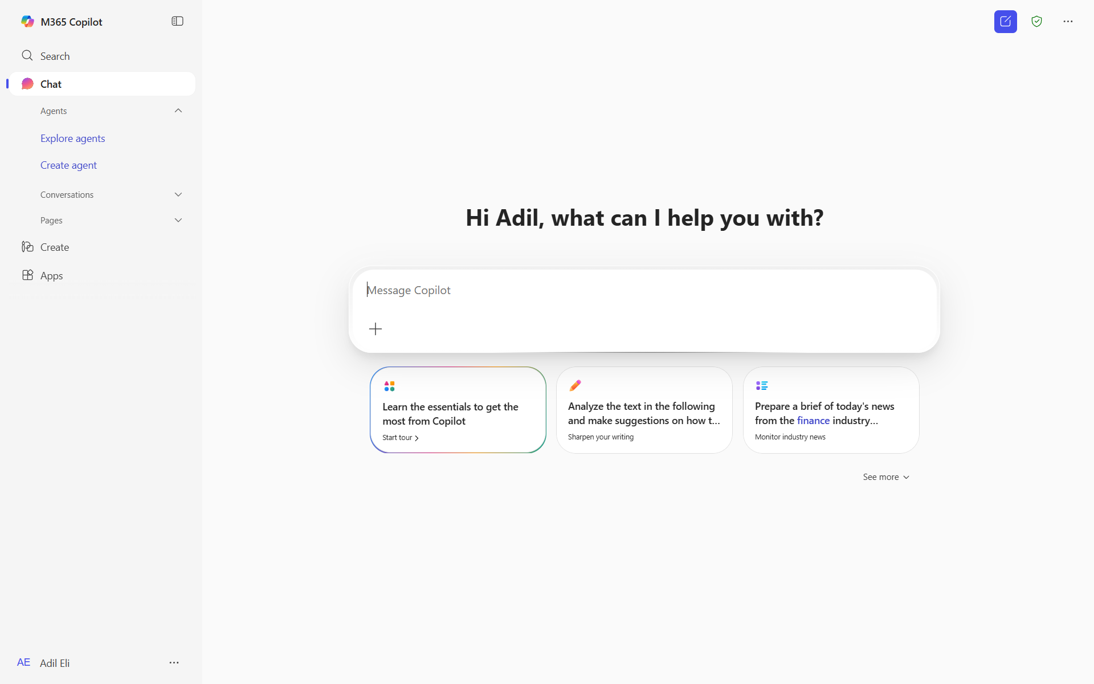
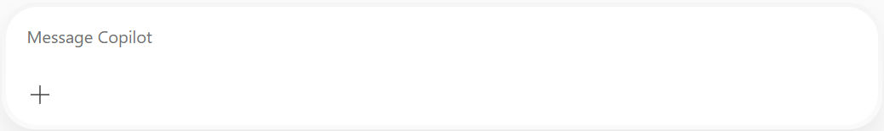
What is a “prompt?“ (new UI)
Prompts are how you have a conversation with Copilot
Use plain but clear language and provide context like you would with an assistant.
Enter your first prompt in the text box at the bottom of your screen, like “Draft a cold call email to a customer.”
Get started by entering your prompt in the text box
Notes:
So what exactly is a prompt? It's simply how you talk to Copilot. Think of it as giving a clear request, like you would to a trusted assistant.
This slide emphasizes plain language plus context. Here's an easy way to think about it: if you just say 'draft an email,' Copilot has to guess the recipient, the tone, the purpose, and the length.
Guessing is where responses feel generic. So instead, give the missing details upfront: Who is it for? What's the goal? What tone do you want? How long should it be?
A good mental model for prompting: give Copilot the same clarity you would give a person you trust to help you.

Slide 14
What makes an effective prompt?
Less Effective
More Effective
Vague
Just a few words
No context on preferred output
Example: Summarize news about [company name].
The recap may be more vague than desired, or in a format that you were not seeking.
Specific and detailed
In full sentences, with instructions
States the tone, purpose, preferred format, etc.
Example: I work in marketing and focus on competitor research. Give me a concise summary of recent news about [company name]. Focus on announcements about new product lines. Provide the answer in two to three paragraphs and use a business tone.
But there are no ‘wrong’ prompts because natural, conversational language is welcome.
Experiment away!
Notes:
This comparison is one of the most important slides in the deck. It makes the difference between vague and specific prompts very visible.
Less effective prompts are short, just a few words, with no context about what kind of output you want. More effective prompts do four things: they're specific about what you need, they provide context, they set expectations around formatting or tone, and they narrow the scope.
A simple way to remember this: Copilot is powerful, but it's not psychic. The clearer you are, the more useful the response becomes.
And remember, there are no truly wrong prompts. Natural, conversational language is always welcome. Experiment away!

Slide 15
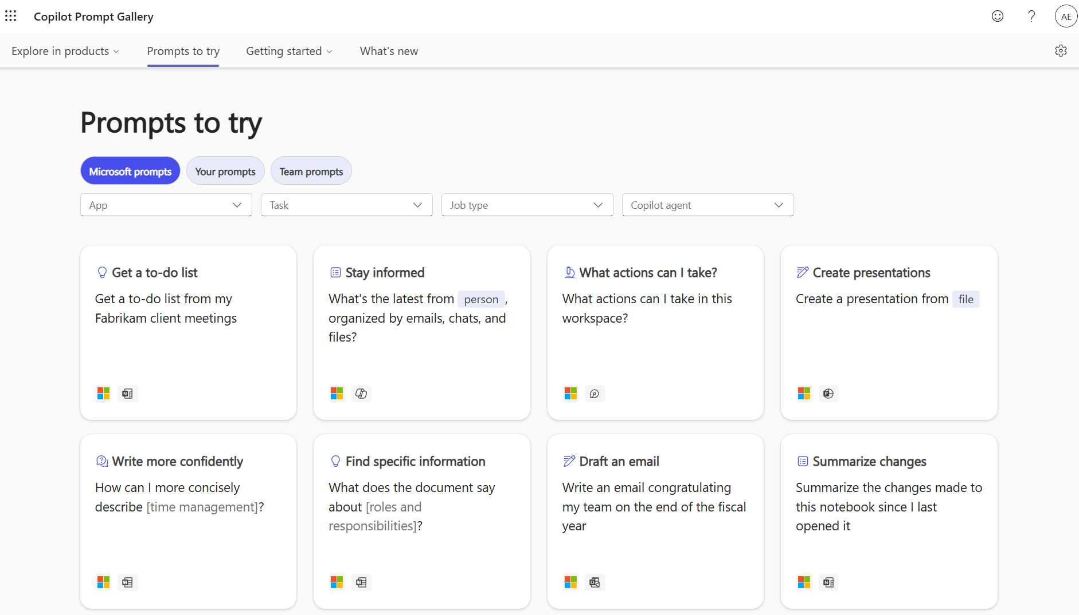
Discover and share Copilot prompts
Copilot Prompt Gallery (formerly known as Copilot Lab) helps you find prompting inspiration so you can take greater advantage of Copilot in your daily work.
Explore the curated selection of Copilot prompts
Save your favorite prompts
Share your favorite prompts with colleagues
Find prompting inspiration from others
Watch the video to see it in action
Notes:
If you're thinking 'okay, but I still don't know what to ask,' the Prompt Gallery is here to help. It's a curated set of prompts organized by common tasks.
The practical value is speed. You grab a sample prompt, tweak it to your situation, and you're off. It also helps teams share what works.
If someone on your team has a great prompt for a recurring activity, like a weekly status summary, they can save it and share it so others can reuse it.
Think of the Prompt Gallery as your cheat sheet for prompt patterns.

Slide 16
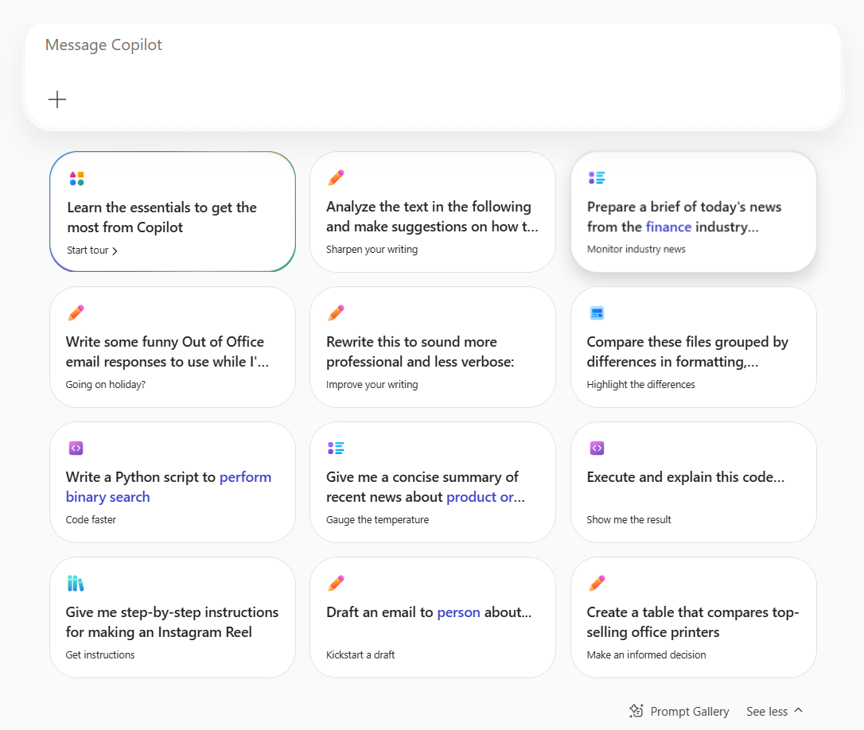
Navigating to the Copilot Prompt Gallery (new UI)
In-product experience
Select “See more” next to the Copilot prompt box, scroll down and click “Prompt Gallery”. Here, you’ll see suggested Copilot prompts and your saved prompts.
Prompt Gallery website
Go to aka.ms/Prompts to access the full Prompt Gallery experience. Here, you can find relevant Copilot prompt examples using the filters, view prompts that you and your team saved, and share useful prompts.
Notes:
There are two easy ways to reach the Prompt Gallery. The first is directly inside Copilot Chat: use the 'See more' option near the prompt box and then select Prompt Gallery.
The second is the website path shown on the right side of this slide, which takes you to the full experience. That's helpful when you want to browse by category or see what others are using.
Either way, it gives you instant inspiration so you don't have to start from scratch every time.

Slide 17
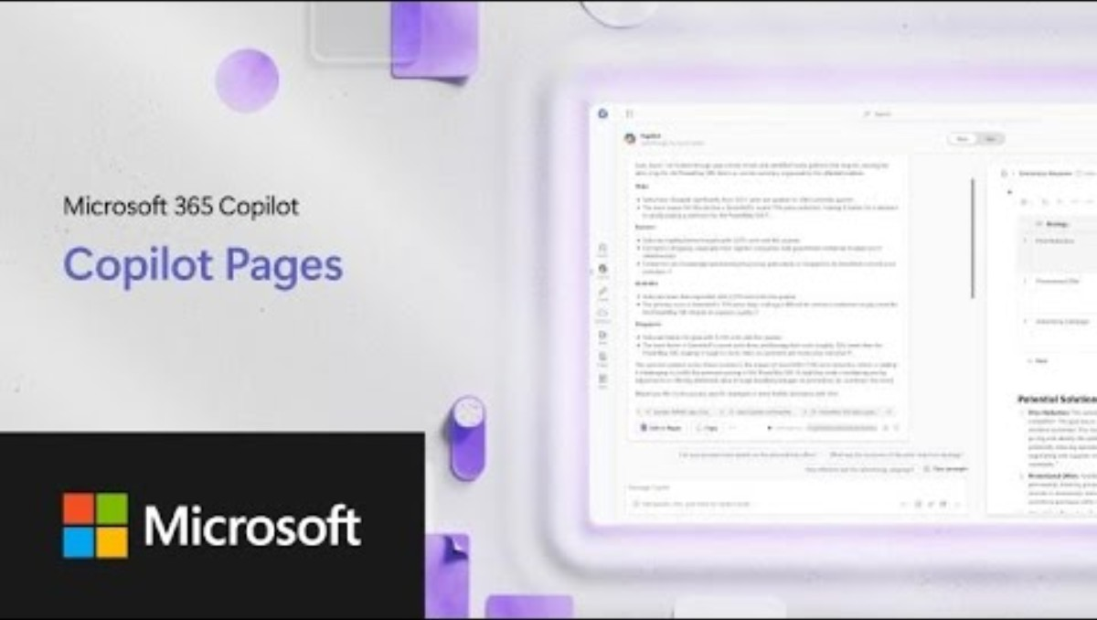
Edit and collaborate on Copilot responses with Copilot Pages
Did you know that you can format, fine-tune, and collaborate on Copilot responses directly in Copilot Chat?
With Copilot Pages, Copilot Chat becomes your workspace – so you don’t have to jump between surfaces to get a project done. Watch the video to see it in action!
Video
Notes:
Now let's talk about what happens after Copilot gives you an answer. How do you turn it into something you can actually collaborate on?
That's where Copilot Pages come in. They let you take a response from chat and treat it like a working document: something you can edit, format, and build on.
Instead of copying and pasting into multiple places, you can keep the thinking and drafting in one workflow. Prompt, response, page, refine, export.
This is particularly useful when you're creating something that takes iteration, like a plan, talking points, a process outline, or a draft announcement.

Slide 18
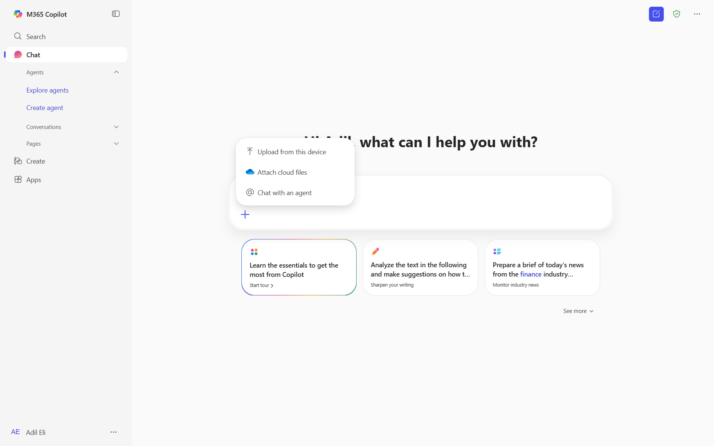
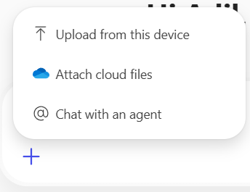
Upload a file to your prompt (new UI)
Want Copilot to respond using information from a Word document, PowerPoint deck, or other file? Select the “Add content” button in the Copilot Chat prompt box to upload a file. Uploaded files end up in your OneDrive for Business folder.
Example prompt: Summarize this document in 5 bullet points. <attach file>
Note: Copilot Chat supports uploads of Word documents, PowerPoint decks, Excel spreadsheets, images, and PDFs.
Notes:
File upload is one of the most immediately useful features. If you want Copilot to respond using your Word document, PowerPoint deck, Excel sheet, PDF, or image, just attach it using the Add Content button.
Then use a simple prompt like 'summarize this document in five bullet points.' You can also ask for key risks, action items, a rewrite for leadership, or a one-paragraph executive summary.
All from the same file. This is where Copilot really shines as a productivity tool, turning your existing content into whatever output format you need.

Slide 19
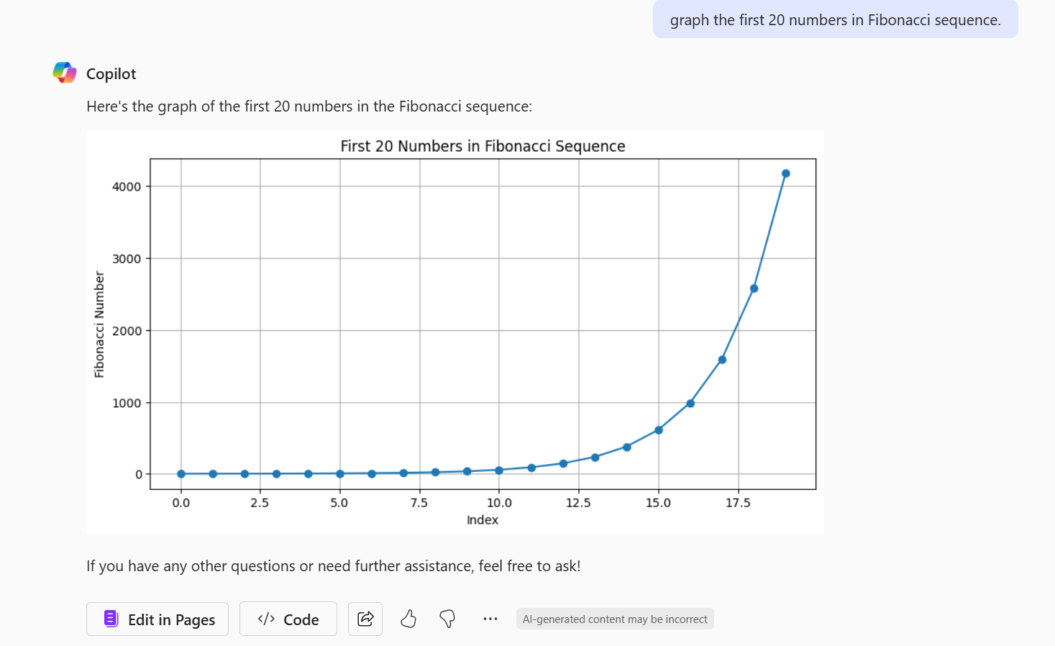
Use Copilot Chat to visualize data
Copilot Chat has built-in capabilities to graph and visualize data as it’s relevant to your prompt.
For example, use the prompt: “Graph the first 20 numbers in Fibonacci sequence”.
Notes:
Beyond text, Copilot can also help visualize information when it's relevant to your prompt. This slide shows a simple example of asking for a graph.
The bigger point isn't the chart itself, but that you can ask for visual output whenever a picture communicates better than paragraphs of text.
It's a great way to quickly make data more digestible, especially when preparing for meetings or presentations.

Slide 20

Top 10 to try first with Microsoft 365 Copilot Chat
1
2
3
4
5
Ask a question
Get insights and answers to your questions.
Draft an email
Generate an email draft and personalize the tone and length.
Summarize a document
Simplify a long document, article, or PDF.
Generate new ideas
Boost your creativity with ideas for your tasks such as agendas, image creation, social media posts, etc.
Draft a document
Start from a full draft rather than a blank page.
Draft an email to [name] that informs them that [Project X] is delayed two weeks. Make it short and casual in tone.
How does [product] compare to [competitor product]? Provide the comparison in a table.
Give me a bulleted list of key points from <insert file>.
Suggest 10 compelling taglines based on <insert file>.
Write an outline for a creative brief for a video project.
6
7
8
9
10
Improve your writing
Write and edit like a pro.
Learn something new
Quickly learn new skills and topics.
Create an image
Leave behind stock images and text-only reports by creating images easily.
Translate a message
Read and write content in other languages.
Lighten up your work
Add some fun to your emails, messages, and meetings.
Illustrate a romantic pop art image of an office worker experiencing a dramatic coffee crisis.
Generate three ways to say [text].
Explain how a large language model works in simple terms.
Translate the following text into French: [text].
Suggest 5 office-friendly jokes.
For more prompt examples, select “View prompts” above the Copilot Chat prompt box
Notes:
This is your starter pack: the ten quickest ways to see value from Copilot Chat without a steep learning curve.
You can ask questions with comparisons in table format, draft emails with specific tones, generate ideas for agendas or taglines, summarize documents, improve your writing, and translate messages for global teams.
Here's the mindset I'd recommend: use Copilot to get a first draft, then refine. The goal isn't perfection on the first answer. The goal is speed to a usable starting point.
If you're not sure where to begin, just pick one of these ten suggestions. That's usually the quickest win.

Slide 21





Automate tasks and processes with agents
Agents use AI to make Copilot Chat even more personalized and intelligent for your daily work. Agents automate repetitive tasks and processes – think of them like apps for Copilot. Copilot Chat comes with a set of agent templates to get started with, or you can create custom agents for your own needs¹.
Get started with agent templates by selecting “Get agents” in the right-side pane of Copilot Chat. Search for a specific template or browse the library.
Agents from Microsoft to try today:
Prompt coach
Idea coach
Writing coach
Career coach
Learning coach
Create effective Copilot prompts
Get brainstorming assistance
Refine your writing
Get personalized career advice and action plans
Learn about topics and refine your skills
Besides the agents from Microsoft, your organization may have created agents for you to use as well. You can view these in the “Built for your org” section in the agent library.
¹Agent creation is only available if your organization admin has enabled this capability.
Notes:
Now let's talk about agents. Agents are a way to make Copilot Chat more personalized and task-focused. Think of them as apps for Copilot.
Instead of using the same general chat for everything, agents help you apply Copilot to a specific type of work, like writing improvement, brainstorming, or learning a topic.
This slide lists several ready-made agents from Microsoft: the Prompt Coach, Idea Coach, Writing Coach, Career Coach, and Learning Coach. You can find them in the agent store.
Beyond using ready-made agents, your organization may have created agents for you to use as well. Check the 'Built for your org' section in the agent library.

Slide 22
Automate tasks and processes with agents
Create a custom agent by selecting “Create an agent” in the right-side pane of Copilot Chat¹. Describe what you’d like your agent to do or select “Configure” to further customize it. Creating an agent allows you to connect Copilot Chat to your organization’s shared data² to further unlock productivity – for example, you can connect the agent to a team SharePoint site and ask the agent questions about team documents.
Top ways to use custom agents:
Automate contract reviews
Assist new hires with onboarding
Review resumes
Retrieve research materials
Get answers about company policies
Create an agent to identify key clauses, ensure compliance with legal standards, assess potential risk, explain clauses, and summarize lengthy contracts.
Create an agent to greet new team members, assist them with technical issues, answer questions, and provide helpful resources.
Create an agent to analyze resumes stored in a SharePoint library, compare them with job criteria, score candidates, and answer questions about candidates.
Create an agent that connects to a SharePoint link with research documents so you can quickly find relevant information.
Create an agent to get answers about company policies such as time off, remote work, benefits, workplace conduct, and health and safety.
¹Agent creation is only available if your organization admin has enabled this capability.
²Shared data includes SharePoint files and data from your organization’s Microsoft Graph connectors. Learn more about Microsoft Graph connectors.
Notes:
Custom agents are where Copilot starts to scale beyond individual productivity into team productivity. You can create an agent, describe what you want it to do, and connect it to shared organizational data.
For example, you can connect an agent to a team SharePoint site and ask it questions about team documents. The real-world use cases include contract reviews, onboarding assistance, resume analysis, retrieving research materials, and policy Q and A.
The key takeaway for any end user is: even if you never build an agent yourself, you may benefit from agents that your organization publishes for common tasks.
Agent creation requires admin enablement, so check with your IT team if you don't see the option.

Slide 23
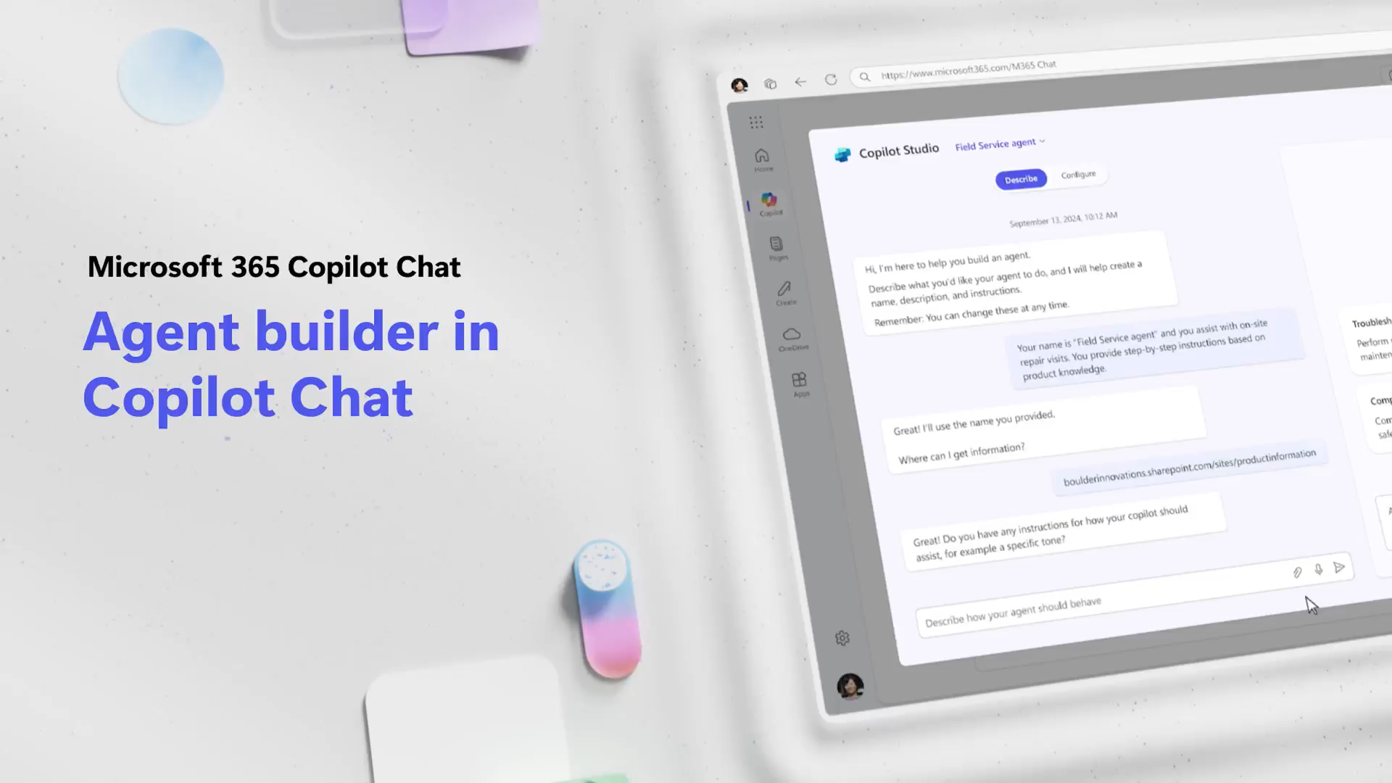
Video: Create an agent
Notes:
Here's a quick video example of what the agent creation experience looks like in practice.
You'll see how straightforward it is to describe what you want the agent to do and connect it to your data sources. The interface is designed to be approachable even if you're not technical.
This is a preview. We'll have a deeper dive on agent building in a later session in this series.

Slide 24
Copilot The Art Of The Prompt
Notes:
Now we're shifting into one of the most valuable skills in this entire session: the art and science of prompting.
Prompting is how you ask Copilot Chat to do something. Whether that's creating, summarizing, reviewing, or researching, it all starts with how you frame your request.
The easiest way to get better at prompting is to treat it like a conversation with a helpful coworker. Be clear about what you want and don't be afraid to refine. Let's dig in.

Slide 25
The art and science of prompting
Tell Copilot Chat what you need
Prompts are how you ask Copilot Chat to do something for you — like creating, summarizing, reviewing, or researching.
Think about prompting like having a conversation, using plain but clear language and providing context like you would with an assistant.
Review text:
"Check this product launch rationale for inconsistencies."
Summarize information:
"Write a session abstract of this [presentation]."
Create engaging content:
"Create a value proposition for our new product using [Product Info]."
Research what’s happening:
“Give me the latest industry news on Generational AI"
Notes:
So what are prompts? Prompts are the key to working with generative AI tools like Copilot Chat. They tell Copilot what you need it to do.
Think of prompting like a conversation between you and the AI. Talk to it like you would your coworker, using natural language to convey your request.
This slide gives examples: checking a product launch for inconsistencies, writing a session abstract, creating a value proposition, or getting the latest industry news. All of these are simple, clear prompts.
The bottom line: be conversational, be clear, and don't overthink it.

Slide 26

The Art and Science of Prompting
Include the right prompt ingredients
To get the best response, it’s important to focus on some of the key elements when phrasing your Copilot prompts.
Goal
Context
Expectations
Goal
Context
Source
Expectations
Source
What response do you want from Copilot Chat?
Why do you need it and who is involved?
Which information sources or samples should Copilot Chat use?
How should Copilot Chat respond
to best meet your expectations?
Notes:
To get the best responses, focus on four key ingredients when crafting your prompts. We call this the GCSE framework: Goal, Context, Source, and Expectations.
Goal is what you want Copilot to do. Always put it first or near the beginning of your prompt. Context is why you need it and who's involved. This feels strange at first, but it helps shape the response to your actual needs.
Source is which information or files Copilot should use. Think of it like narrowing a giant haystack down to a handful of hay. Expectations is how you want the response formatted: bullets, table, formal tone, specific length.
Expectations is the number one ingredient most people forget. Without it, Copilot has free rein to respond however it thinks is best, and that might not match what you need.

Slide 27
Include the right prompt ingredients
Goal
Context
What response do you want from Copilot Chat?
Why do you need it and who is involved?
Help me write an email to inform the customer about a product change. Since the customer is not a global administrator, I need to reference the URL that describes the change. The change can be found here: [Change URL]. Provide clear and concise information.
Which information sources or samples should Copilot Chat use?
How should Copilot Chat respond
to best meet your expectations?
Source
Expectations
Notes:
Here's a concrete example of a prompt that uses all four ingredients. It starts with a Goal: 'Help me write an email to inform the customer about a product change.'
Then it adds Context: 'Since the customer is not a global administrator, I need to reference the URL that describes the change.' And a Source: 'The change can be found here: [Change URL].'
Finally, it ends with Expectations: 'Provide clear and concise information.' This prompt would generate a strong response because it gives Copilot clear guardrails and direction.
Notice how natural and conversational it reads. You're not writing code; you're communicating clearly.

Slide 28
GCSE in practice
Notes:
Now let's put the GCSE framework into practice with some real examples. This section will help you see the difference that good prompt construction makes.
After walking through these examples, you should be able to build stronger prompts without overthinking. It becomes second nature once you get the hang of the four ingredients.

Slide 29
Prompt Engineering Skills
Bad prompt
Write about advancements in renewable energy technologies.
vs
Good prompt
Compose a detailed technical article for engineers and environmental scientists, with a focus on solar and wind energy. Discuss the scientific principles behind these technologies and real-world applications. Refer to recent research papers, patents, and industry reports for accurate and up-to-date information.
Goal
Context
Source
Expectations
Notes:
Here's a classic comparison between a weak prompt and a strong one. The bad prompt says: 'Write about advancements in renewable energy technologies.' It has a goal but nothing else. It's vague and will produce a generic response.
The good prompt says: 'Compose a detailed technical article for engineers and environmental scientists, focusing on solar and wind energy. Discuss scientific principles and real-world applications. Refer to recent research papers, patents, and industry reports.'
See the difference? The good prompt includes context on who it's for, provides a clear subject focus, references specific sources, and sets expectations for what the response should discuss.
Will the bad prompt generate a response? Yes. Will it be a good one? Not likely. We can always do better with a little more detail.

Slide 30
Example of GCSE framework
If you were to try the following two prompts and compare the responses you get.
Which prompt would give you a richer and more concise blog post draft?
Prompt 1: Write a job description for a senior project manager
Prompt 2: Generate a comprehensive job description for a senior project manager focused on technical project management for consumer electronic hardware. This role is urgent, and the candidate will join a dynamic team. Reference our company’s standard specs and industry norms here [Company Standards file]. The description should be concise, max two pages, including responsibilities, qualifications.
Goal
Context
Source
Expectations
Notes:
Here's another practical example using the GCSE framework. If you were to try both of these prompts, which one would give you a richer result?
Prompt 1 just says: 'Write a job description for a senior project manager.' It stops after the goal. No context, no sources, no expectations.
Prompt 2 goes much further: it specifies the role is for technical project management in consumer electronics hardware, references company standards as a source, and sets expectations for being concise, max two pages, with responsibilities and qualifications.
I think you're starting to get the hang of this. The more detail you provide upfront, the less editing you have to do afterward.

Slide 31
Provide specific instructions
Copilot is built to take action, so telling Copilot what “to do” or what “not to do” can be very effective.
Prompt 1: Summarize the latest Microsoft AI announcements.
Prompt 2: Summarize the latest Microsoft AI announcements for a keynote speech on stage at Ignite. Do not include announcements that aren’t from Microsoft and are older than 3 months. Provide the announcements in a table form. Include columns for the date, source, title and brief summary of each announcement.
Goal
Context
Source
Expectations
Notes:
Here's a powerful prompting habit: don't just tell Copilot what to do, also tell it what not to do. This can be very effective for narrowing down responses.
Prompt 1 simply asks to summarize the latest AI announcements. Prompt 2 adds real context: it's for a keynote speech, should only include Microsoft announcements from the last three months, and should be presented in a table with specific columns.
By providing both positive and negative instructions, you reduce noise and make the output more reliable. It also helps prevent accidental drift where Copilot includes things you didn't want.
Since generative AI responses vary each time, specific instructions help you consistently get what you need.

Slide 32
Copilot Chat prompt examples
Notes:
Now let's look at a collection of ready-to-use prompt examples. These are organized by common tasks so you can grab one and adapt it to your situation.
This section is designed to give you practical starting points. Whether you need to research, draft, summarize, or brainstorm, there's a prompt pattern here for you.

Slide 33
Get the answers you need to move forward
Get hiring tips
Retrieve buried info
How can I evaluate an interview candidate’s soft skills?
What are the deadlines mentioned in this file? <attach file>?
Summarize a file
Boost your knowledge
Summarize this document in 5 bullet points. <attach file>
Help me learn about [topic]. Provide 2 analogies & files to dig in.
Start your research
Highlight the differences
How have world literacy rates changed in the past 30 years?
Compare these two paragraphs grouped by differences in formatting, structure, and content: [paste content]
Calculate the answer quickly
Monitor your PR
At $X per unit, how many units to break even if costs are $Y
Give me a concise summary of recent news about [company]
Reach a broader audience
Stay on top of tech advances
How do you say [thank you for your time] in Japanese?
Summarize the main points of the latest research on AI
Discover synonyms
Make informed decisions
What are some other words for [exciting]?
Create a table that compares top-selling office printers
Understand trends
Make your code better
Share some trends in remote work and hybrid offices
Optimize and fix this code: [insert code]
Notes:
These prompt examples focus on getting answers and moving forward. From hiring tips to summarizing files, from research questions to quick calculations.
Notice how each example includes enough context to get a useful response. 'Summarize this document in five bullet points' is much better than just 'summarize this.'
You can also use Copilot for translation, discovering synonyms, understanding trends, retrieving specific information from files, and even optimizing code.
The key pattern: be specific about what you need and attach relevant files when you have them.

Slide 34
Brainstorm and draft content quickly
Co-create with Copilot
Start a conversation
Ask me 3 questions to help me draft an email about [OKRs]
Suggest ways to break the ice with my new colleague.
Going on holiday?
Jump-start a draft
Write some funny Out of Office email responses.
Create an FAQ based on this file <attach file>
Make it stand out
Draft an introduction
Suggest a few email subjects for the following email: [body]
Write a compelling intro paragraph for this speech <attach file>
Generate ideas
Make it better
List ideas for a fun remote team building event
Improve my writing in: <attach file>
Put info in a table
Disagree gracefully
Organize the world’s most valuable companies into a table
Provide a convincing counterargument to the following: [paste content]
Visualize the data
Rally the team
Create an image of a bar chart demonstrating growth
Draft an exciting email … using <attach files>
Track changes over time
Get started on a plan
Create a line chart showing the relationship between…
Draft a business plan based on [idea]
Notes:
This set of examples focuses on brainstorming and drafting content quickly. These are great for when you're stuck or starting from zero.
You can co-create with Copilot by asking it to help you draft, like 'Ask me three questions to help me draft an email about OKRs.' That's a powerful technique because it turns the drafting into a conversation.
Other examples include generating ideas for team events, putting information into tables, visualizing data, and even writing fun out-of-office responses.
The mindset here: Copilot is your brainstorming partner. Use it to get past the blank page, then refine with your own judgment.

Slide 35

Microsoft 365 Copilot Chat
Congratulations!
We want you to grow your skills in AI. We encourage you to keep exploring Copilot Chat with the resources below:
Check out the Copilot Prompt Gallery website for more learning videos and prompt examples.
Join the Microsoft 365 Copilot Community on LinkedIn to get more Copilot Chat tips and product updates and engage with other users.
Notes:
Congratulations on completing the session! We want you to keep growing your AI skills, so here are some resources to continue your journey.
Check out the Copilot Prompt Gallery website for more learning videos and prompt examples. And join the Microsoft 365 Copilot Community on LinkedIn for tips, product updates, and engagement with other users.
Remember, the goal isn't to master everything today. It's to build confidence and develop repeatable patterns you can use in your daily work.
Keep experimenting, keep refining, and don't be afraid to try new things with Copilot Chat.

Slide 36
Additional resources
Notes:
This section contains additional resources for deeper learning. These materials go beyond what we covered today.
If you want to dive deeper into any topic, whether it's prompting techniques, agent building, or advanced Copilot features, these resources are your next step.
We also offer an advanced prompting course that goes deeper into how prompts interact with the AI engine and how to craft really effective prompts for complex tasks.

Slide 37


Copilot Chat replaces Microsoft Copilot (new UI)
Admin note: Include slide for users who are familiar with Microsoft Copilot with Enterprise Data Protection.
Copilot Chat offers the chat experience you’re familiar with along with some added features like using and creating agents¹ to connect Copilot Chat to your shared organization data².
Other changes:
Access the Copilot Chat web app from the new URL: M365Copilot.com
The app icon has changed from the purple and blue icon to the rainbow icon with a “M365” tag.
¹Agent creation is only available if your organization admin has enabled this capability.
²Shared data includes SharePoint files and data from your organization’s Microsoft Graph connectors. Learn more about Microsoft Graph connectors.
Notes:
For those of you familiar with the previous Microsoft Copilot with Enterprise Data Protection, here's what's changed. Copilot Chat offers the same chat experience you know, along with added features like agents.
The web app has moved to a new URL: M365Copilot.com. The app icon has also changed from the purple and blue icon to the rainbow icon with an M365 tag.
The core functionality remains the same, but the new capabilities around agents and shared organizational data make it significantly more powerful for team productivity.

Slide 38
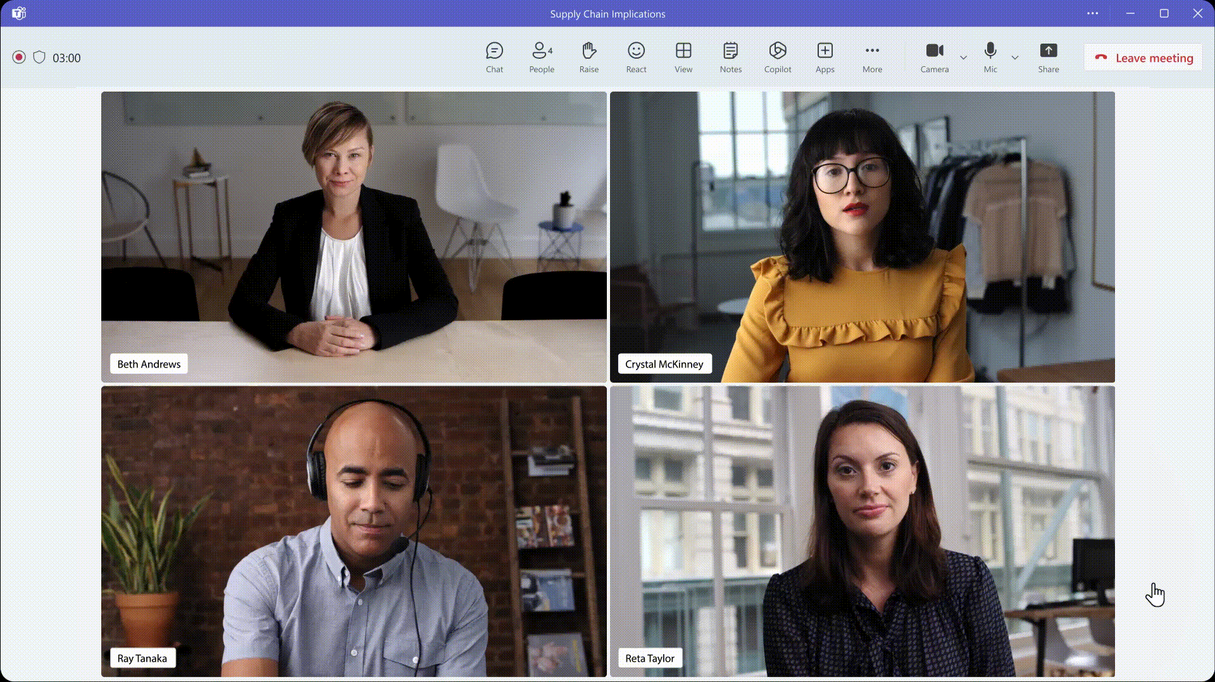
Did you know you could do more with Microsoft 365 Copilot?
Microsoft 365 Copilot is more than just Copilot Chat.
With a full Microsoft 365 Copilot license, you’ll have access to additional Copilot capabilities in the Microsoft 365 apps you use regularly, like:
Recapping a meeting in Teams
Revising an email in Outlook
Revising a document in Word
Creating a PowerPoint presentation from an outline
Formatting Excel spreadsheets
Notes:
Here's a reminder that Microsoft 365 Copilot is more than just Copilot Chat. With a full license, you get additional Copilot capabilities across all the M365 apps you use regularly.
That includes recapping meetings in Teams, revising emails in Outlook, revising documents in Word, creating presentations from an outline, and formatting spreadsheets in Excel.
Copilot Chat is a great starting point, and as you get comfortable, you'll find even more ways to use Copilot throughout your workflow.

Slide 39
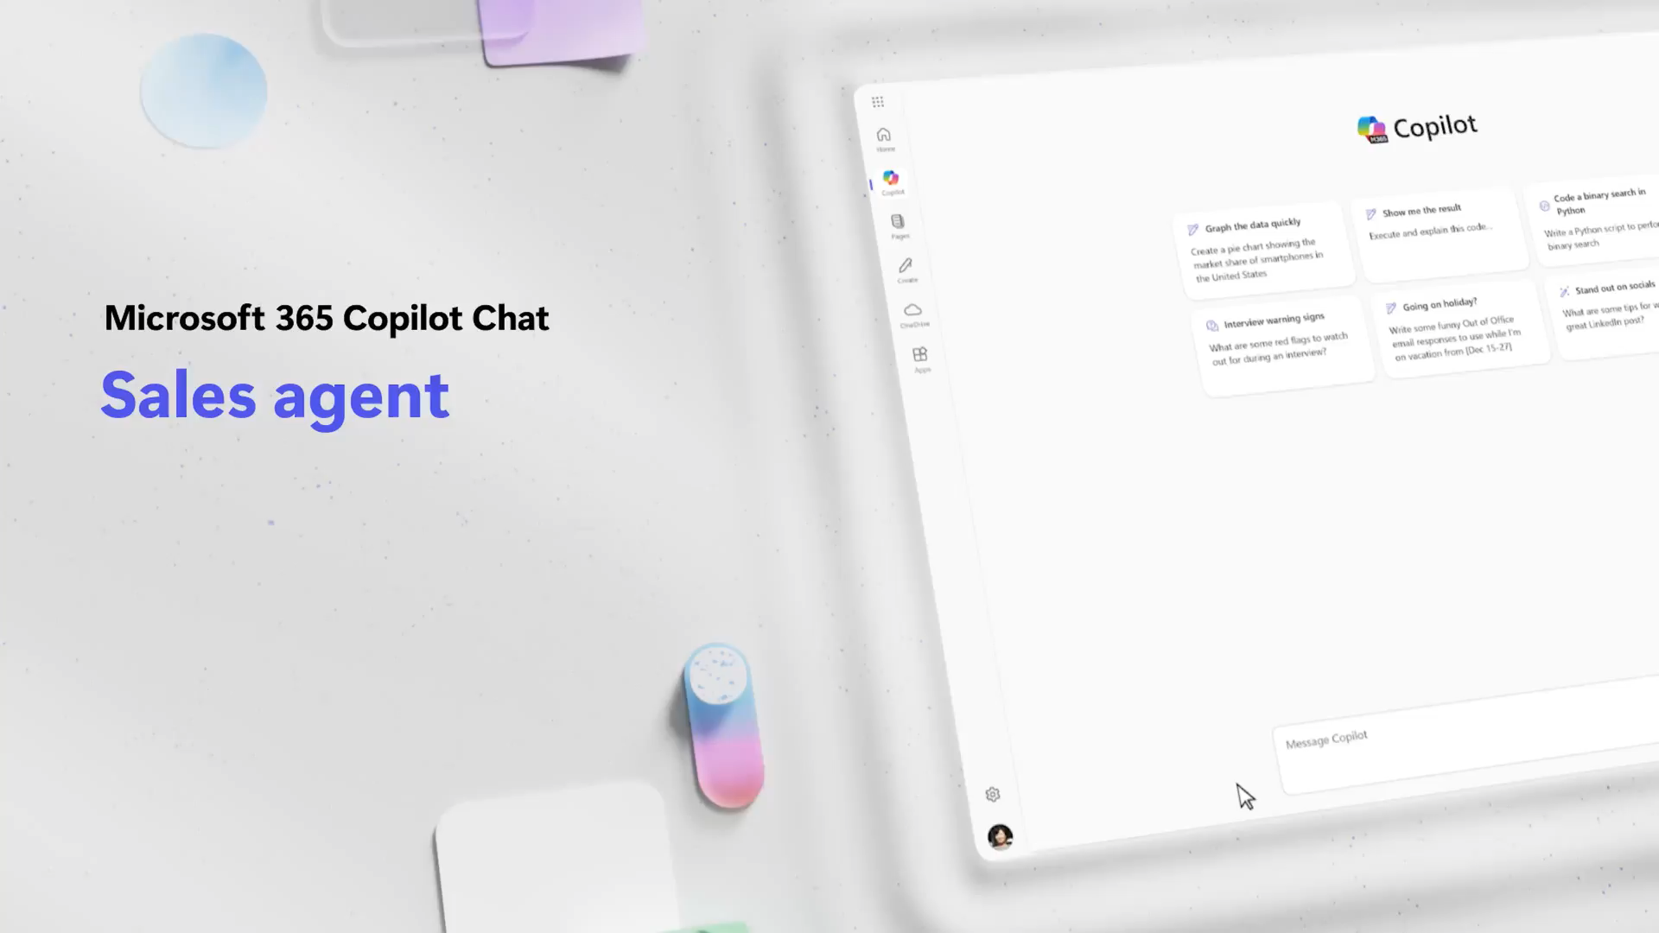
Microsoft 365 Copilot Chat Sales agent
Notes:
This slide covers the Copilot Chat Sales Agent, a specialized agent designed for sales-related workflows.
Sales agents can help with tasks like preparing for customer meetings, researching prospects, drafting outreach messages, and organizing sales-related information. It brings Copilot's power directly into the sales context.

Slide 40
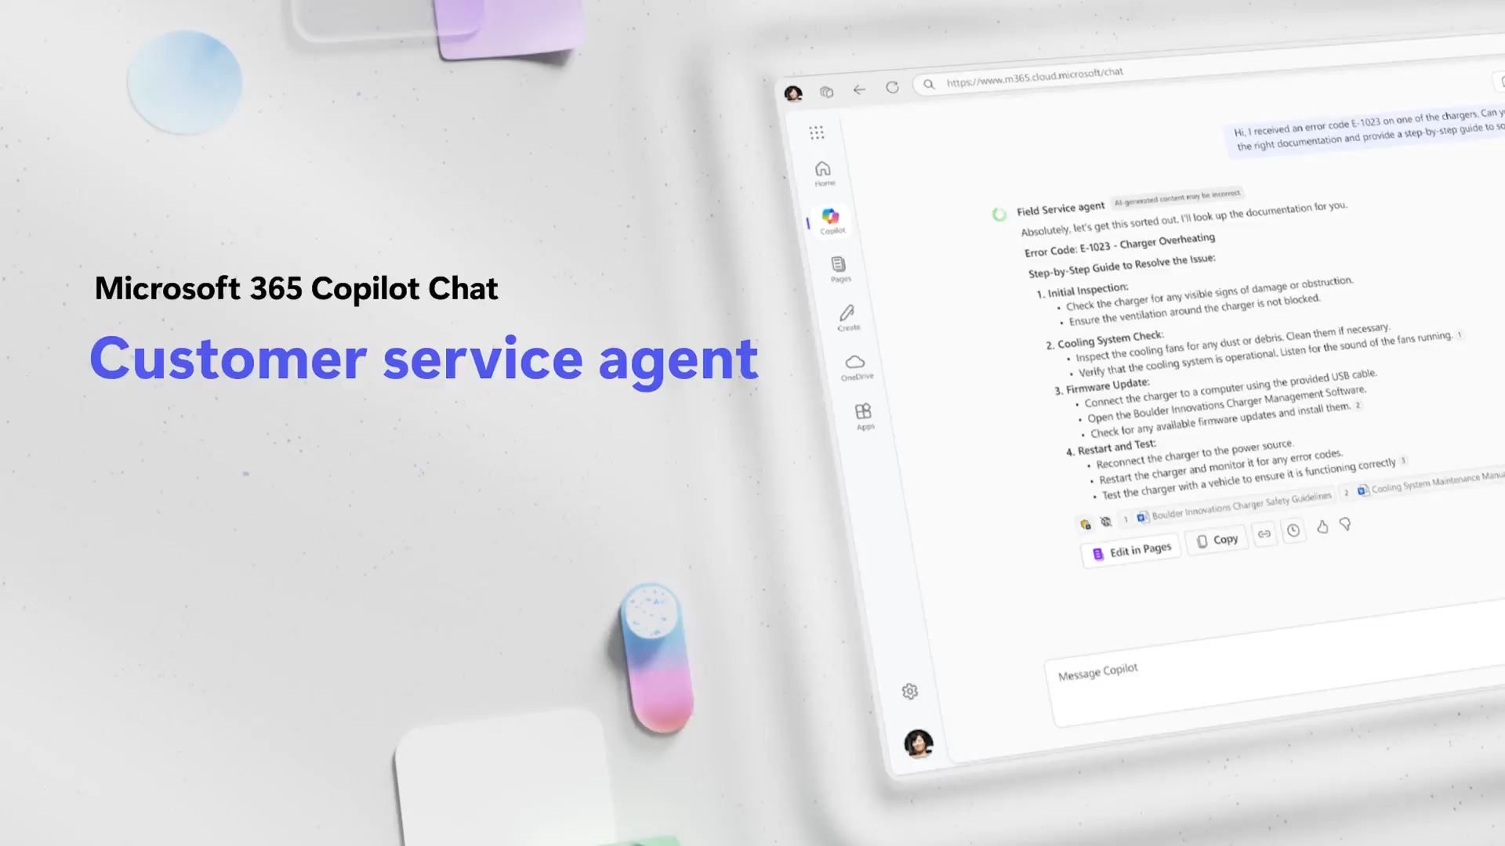
Microsoft 365 Copilot Chat – Customer service agent
Notes:
Here's the Copilot Chat Customer Service Agent. This agent is tailored for customer service workflows.
It can assist with drafting responses to customer inquiries, summarizing case histories, and helping service teams find the right information quickly. It's about applying Copilot's capabilities to the specific needs of customer-facing teams.

Slide 41
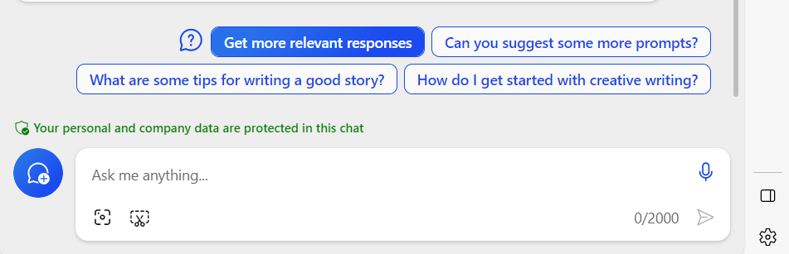
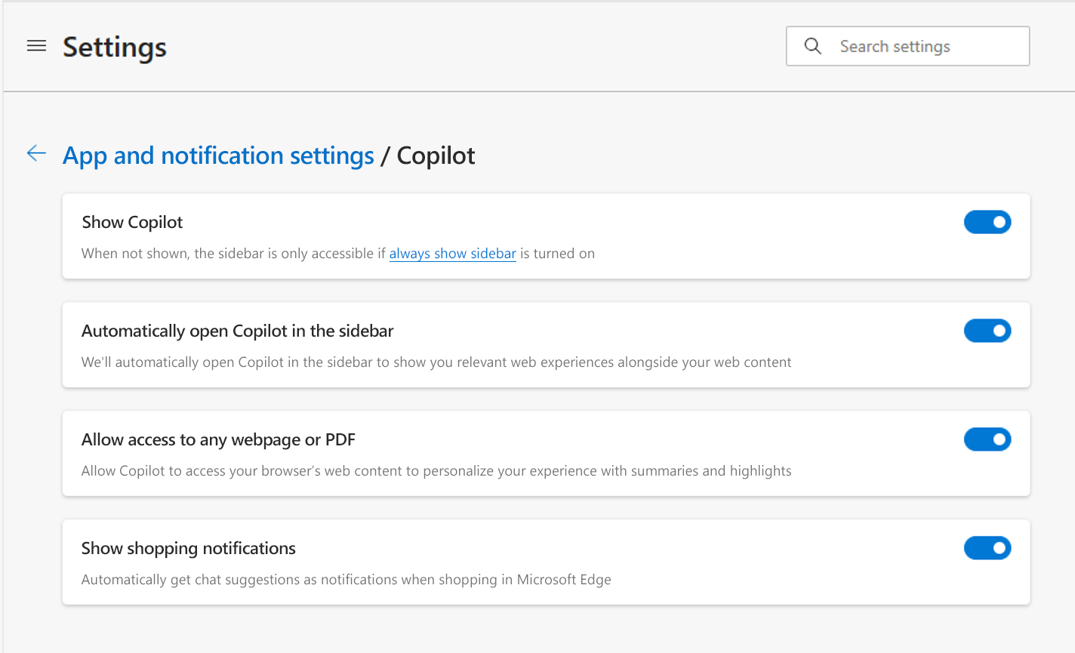
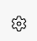
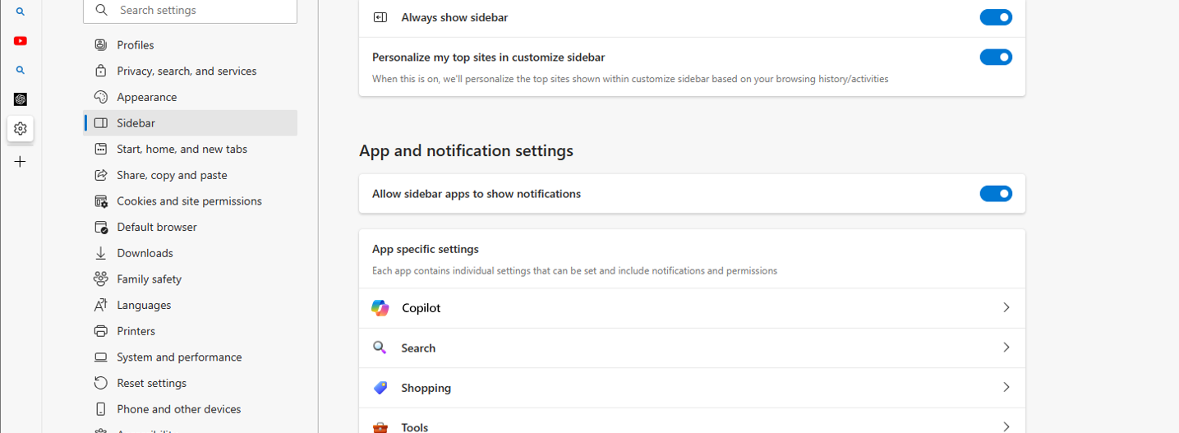
If Edge sidebar cannot “read” an open PDF or webpage, you may need to change your settings
Follow these steps to enable Copilot Chat to “read” the open PDF or webpage
1
First, select the gear icon at the bottom right of the Edge sidebar
3
Enable the “Allow access to any webpage or PDF” setting switch (see below)
2
Select “Copilot” within the list of apps
Notes:
This is a practical troubleshooting slide for Edge browser users. If the Copilot sidebar in Edge can't read an open PDF or webpage, you may need to adjust a setting.
Follow these steps: select the gear icon at the bottom right of the Edge sidebar, then select Copilot within the list of apps, and enable the 'Allow access to any webpage or PDF' setting.
This is a common setup issue that's easy to fix. Once enabled, Copilot can help you summarize and interact with whatever you're viewing in the browser.

Slide 42
FAQ
Why is data protection important when using AI chat tools at work?
Company data and intellectual property are crucial to our competitive advantage. The problem with using generative AI without enterprise data protection is that prompts or content you generate can be exposed to the public as part of another answer. That’s where Copilot Chat comes in: it’s protected with enterprise data protection, so what you put in and get out is not used to train the underlying AI model. Our company data stays safe.
How do I know I’m using Copilot Chat with Enterprise Data Protection?
You’ll know you’re using Copilot Chat with Enterprise Data Protection if you see a green shield icon next to the “New chat” button.
Can I trust the answers generated when using AI?
Copilot Chat aims to base all its responses on reliable sources, but AI can make mistakes, and third-party content on the internet may not always be accurate or reliable. Copilot will sometimes misrepresent the information it finds. This is why Copilot is transparent and shows the sources of information behind its answers. Always check the sources before making decisions or taking actions based on
Notes:
Let's address some frequently asked questions. First, why is data protection important? Your company data and intellectual property are crucial. Without enterprise data protection, your prompts or generated content could be exposed publicly.
With Copilot Chat, your data stays safe. It's protected with enterprise data protection, so what you put in and get out is not used to train the underlying AI model.
You'll know you're protected when you see the green shield icon. And remember: always check sources before making decisions based on AI-generated responses, because AI can make mistakes.

Slide 43
FAQ Continued
What can Copilot Chat access when I use it?
Copilot Chat leverages the latest web information to respond to your prompts. It does not have access to data from your device or your organization's information. You will need to use an agent to access work data. When using Copilot Chat in the Microsoft Edge sidebar, you can grant it permission to view content on your current page to generate summaries. However, Copilot Chat will not access or use other browser data, such as your browser history.
Are there limits for how much I can use Copilot Chat?
As with other AI tools, there are limits to how many turns (prompts and responses) you can do per chat conversation and per day. If you reach those limits, you will be notified within the experience.
Notes:
A couple more FAQs. Regarding what Copilot Chat can access: it leverages web information to respond, but does not access data from your device or organization's information without an agent.
When using Copilot in the Edge sidebar, you can grant permission to view your current page for summaries, but it won't access browser history or other data.
And yes, there are usage limits. Like other AI tools, there are limits to how many turns you can do per conversation and per day. You'll be notified within the experience if you reach them.
That wraps up our FAQ section. Thank you for joining, and remember the recordings and presentation will be shared via email to all registered attendees.

