Slide 1
Hello and welcome to Customer Hub
We’ll get started at 2 minutes past the hour
Microsoft confidential

Slide 2


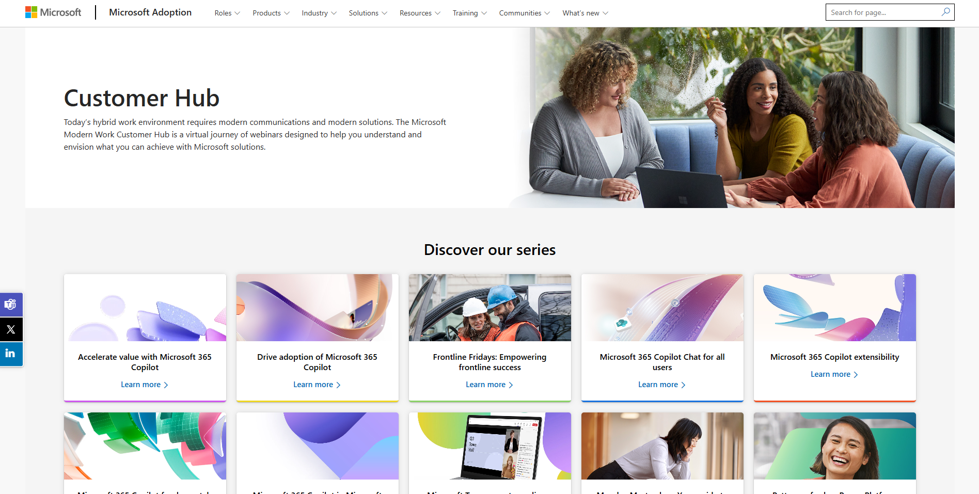
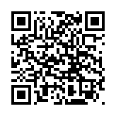
Visit Customer Hub website for upcoming sessions, updates, and on demand contents!
https://aka.ms/CustomerHubSessions​

Slide 3

Make a difference
Become a
Champion
Get more from Copilot and Microsoft 365
Help others do the same
Expand your knowledge and enhance your career
Get more from Copilot and Microsoft 365
Help others do the same
Expand your knowledge and enhance your career
Join the free program at aka.ms/M365Champions

Slide 4



After the presentation
During the presentation
We will mute your microphone for the first part of today’s call
Raise your hand and we will call on you
Ask your questions via chat, we will get to all of them, live or after. Common questions will get addressed out loud
Open mic – come off mute and ask away!

Slide 5
Teams Events Bridging online and in-person attendees: hybrid events with Microsoft Teams and Teams Rooms

Slide 6
Agenda
General Hybrid Considerations
MTR / Hybrid Feature Discussions
Hybrid Schematics
Microsoft Hybrid Support
A/V Vendor Checklist
Next Steps & Call to Action

Slide 7
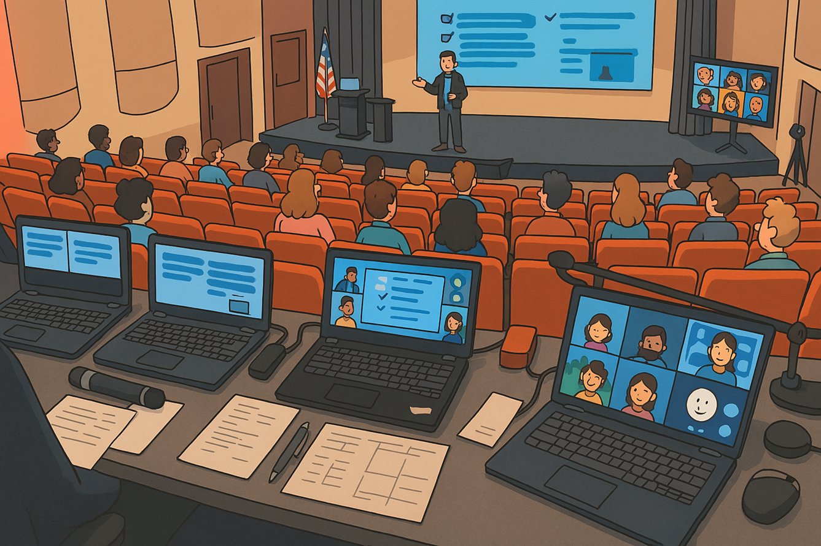
What are Hybrid Events?

Slide 8


Microsoft Teams Hybrid Event Considerations
Producing a Hybrid event with virtual participation will require an AV Team. Many equipment manufacturers have created simple and relatively inexpensive production tools that work easily with Microsoft Teams.
Depending on your workstream, you can connect to your Teams Event through an MTR or a Teams computer. The following documentation and schematics are meant to help customers lay out a variety of attainable scenarios for any event or production team.
Virtual Attendees
Decide on Platform: -Teams Meeting - Webinar, or Town Hall
Use event URL shortener to enable event configuration changes.
Plan the visual configuration of speakers/slides/videos/cameras to be displayed.
Physical Attendees
Detail appropriate plans for event displays - What Teams content: Chat, speakers, attendees, together mode will be displayed where.
Will physical participants be heard or seen virtually during QA’s?
Presenters / Moderators / MC
Physical Moderators are a great way to integrate Virtual and Physical attendees into Physical Q & A’s, and panel discussions.
Virtual Moderators are a great way to create online interaction while having a smaller physical AV impact.
Hybrid Plan
Decide how / when / if virtual attendees will interact with each other or physical attendees.
Create a detailed hybrid schematic.
Create a detailed Event Outline with AV notes for each phase.
AV Team
Producers and AV team discuss all AV pathways during Event Design.
Detail an AV Staffing plan
Execute proper rehearsals, ideally within the actual event space and on the event bandwidth.
Technical Schematics
Utilize the following schematic diagrams or create your own.
Detail where and what physical displays are needed.
Event Camera details
Audio plan for physical and virtual environments.
Equipment
AV to computer converters are necessary to integrate AV into Teams
Each unique Teams Display requires a computer.
HDMI distribution amplifiers and an HDMI switch with Picture in Picture may be required.

Slide 9
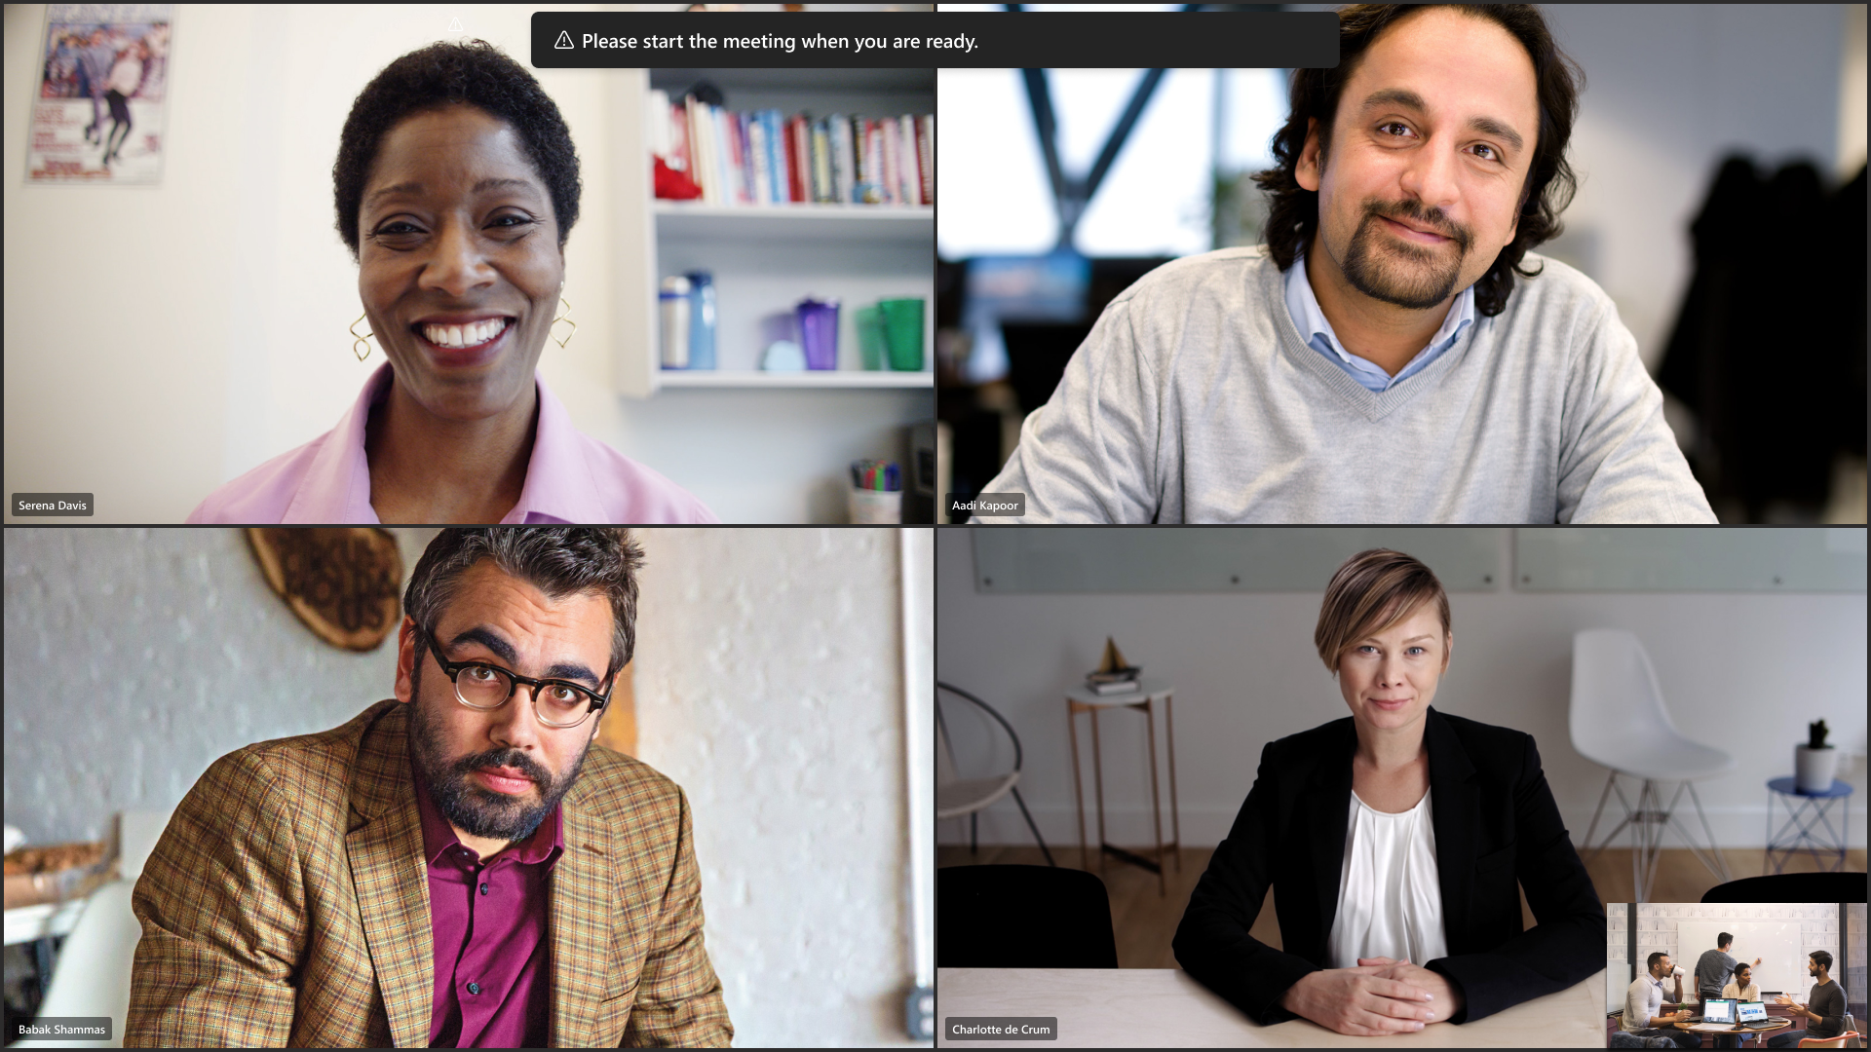
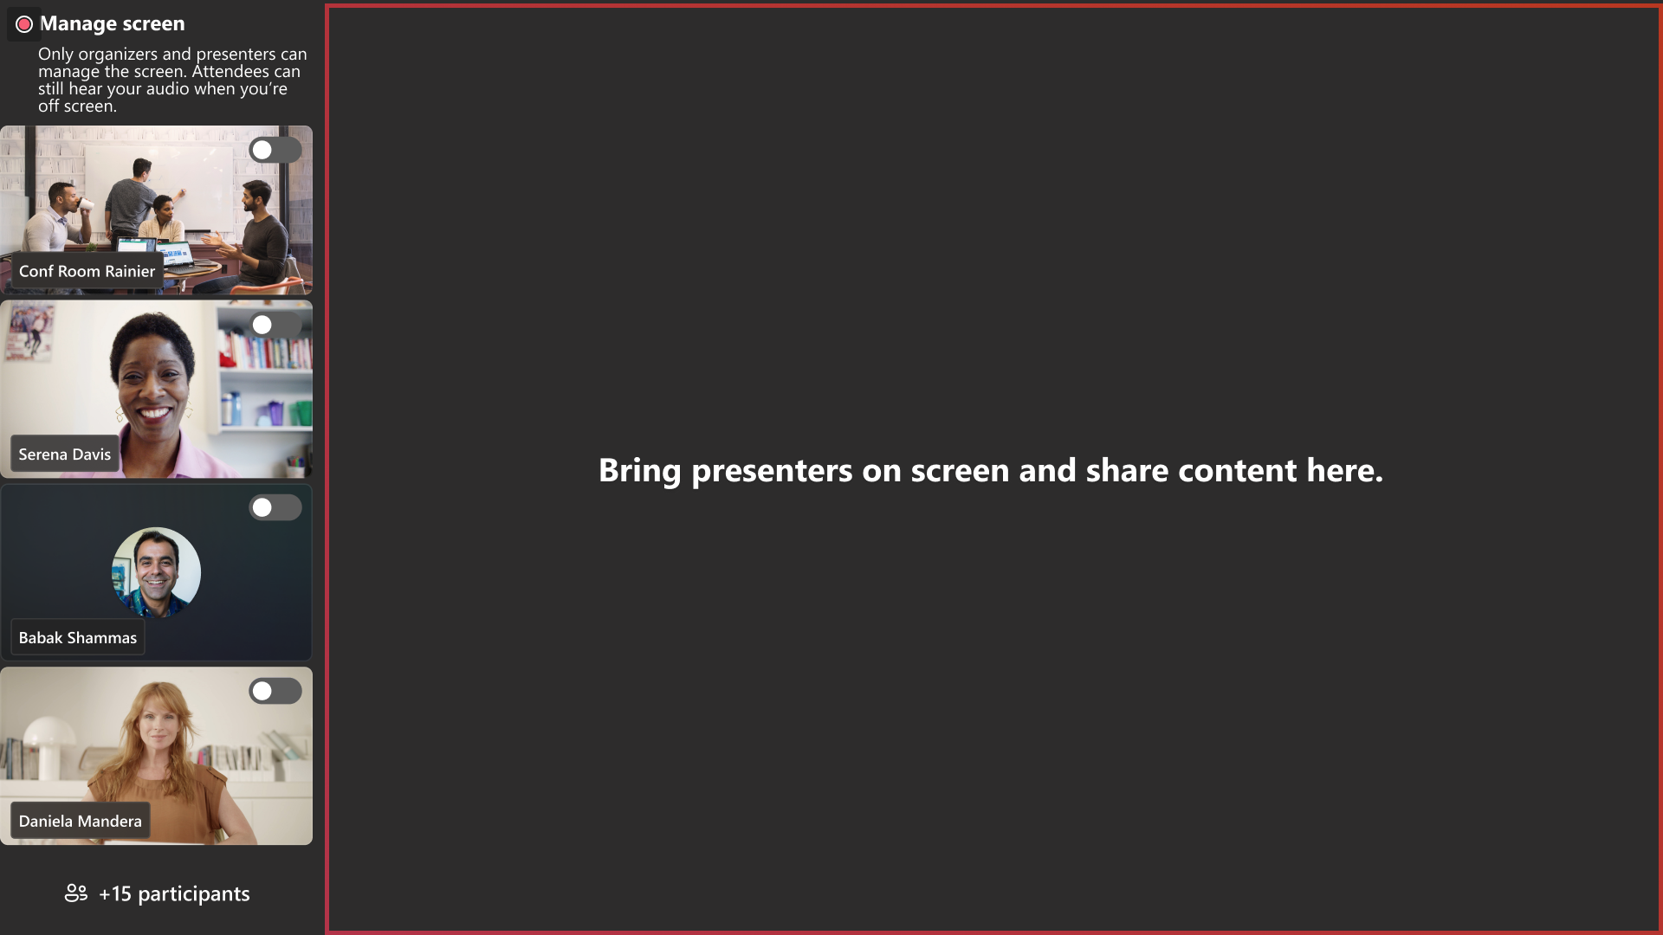
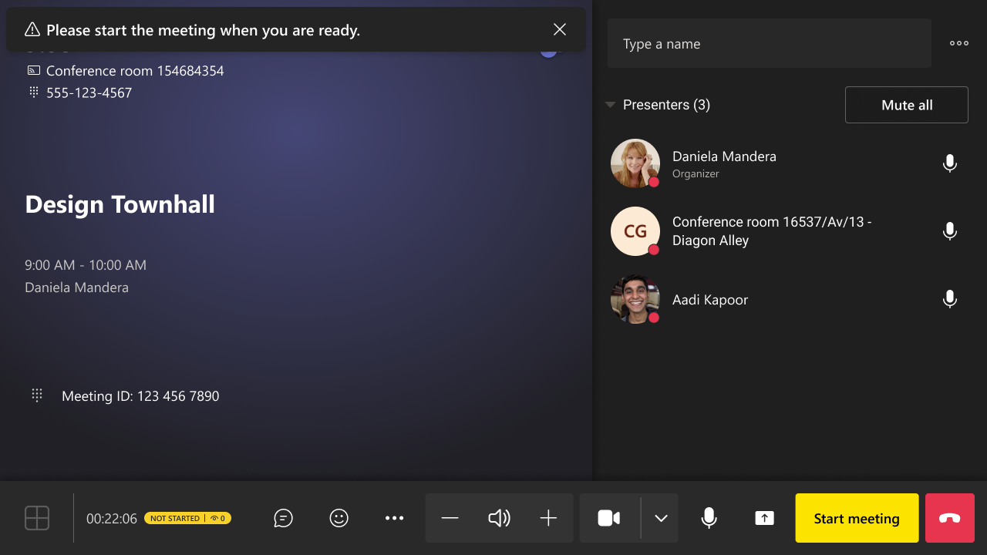
Build Your Hybrid Event Around Microsoft Teams Rooms
Teams Rooms on Windows devices can join events in Teams (webinars and town halls) as Presenters.
Green room access
Stage control

Slide 10
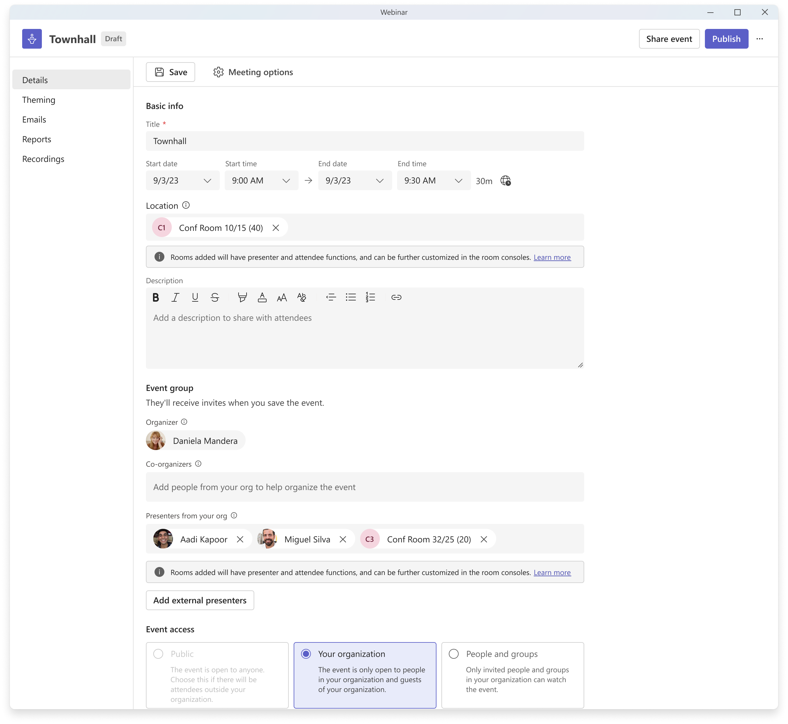
Microsoft Teams Room as a “Location” and as a “Presenter”
Scheduling Form for Teams Events
When the room is added in the Location field, it is auto-populated/assigned as a Presenter.

Slide 11
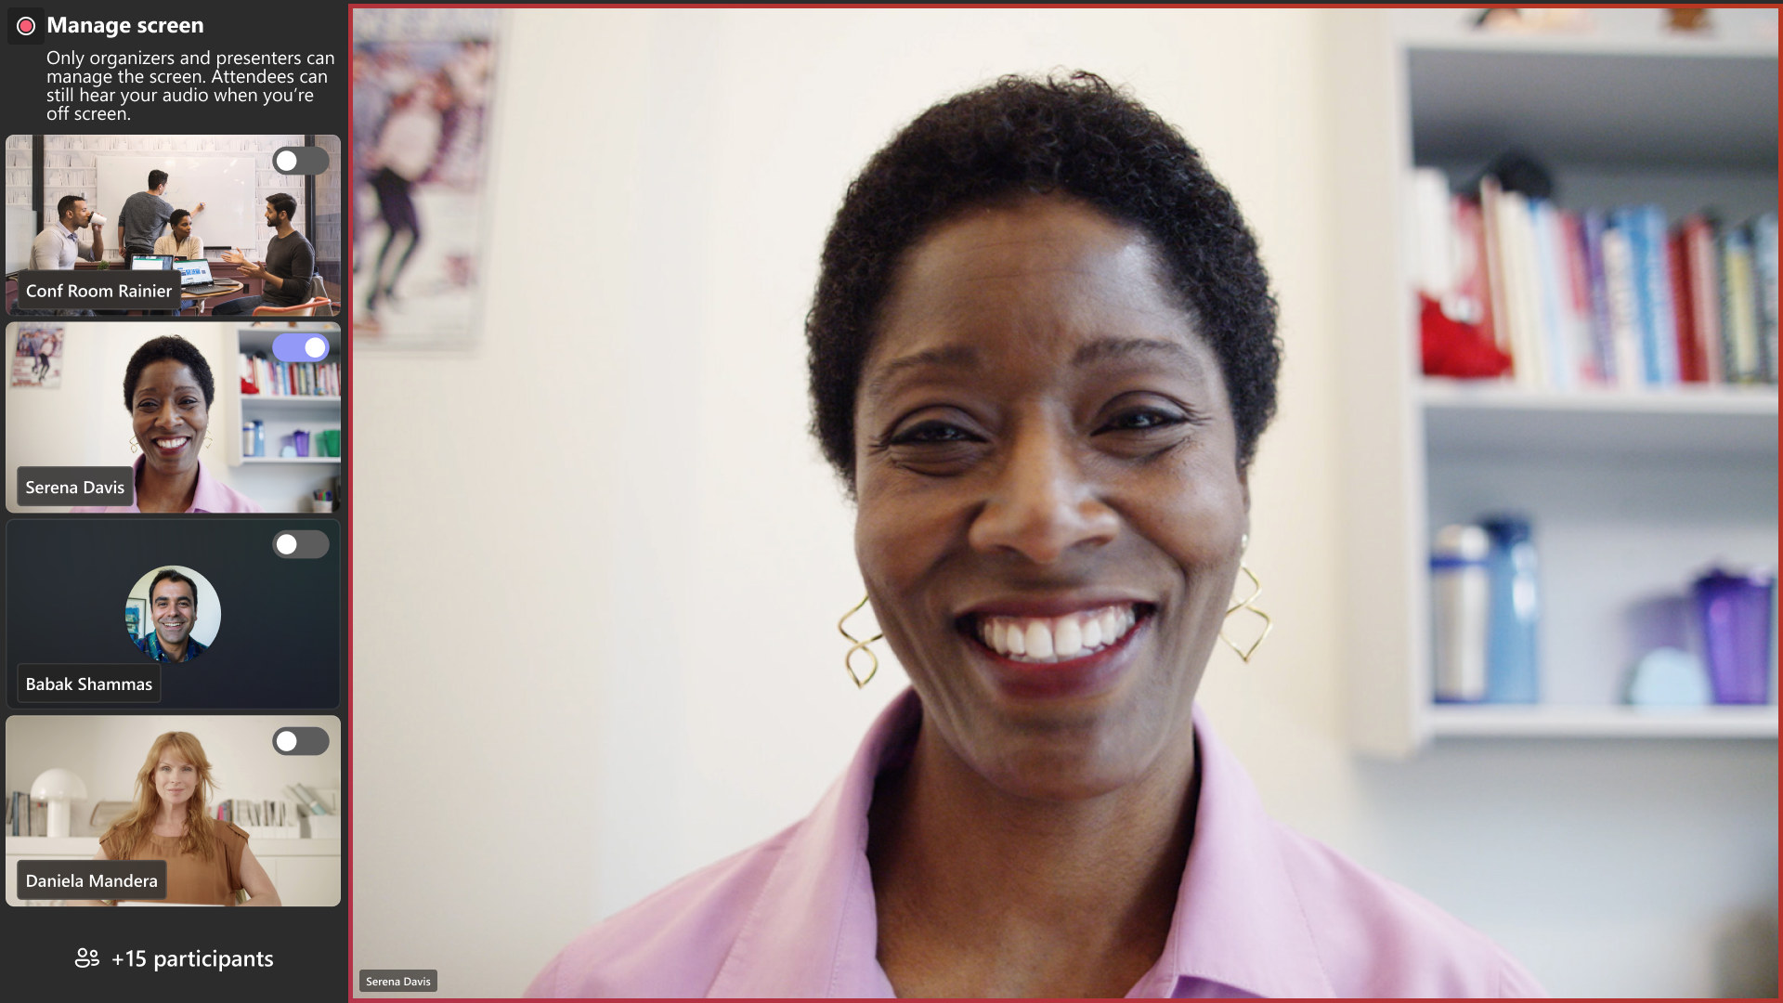
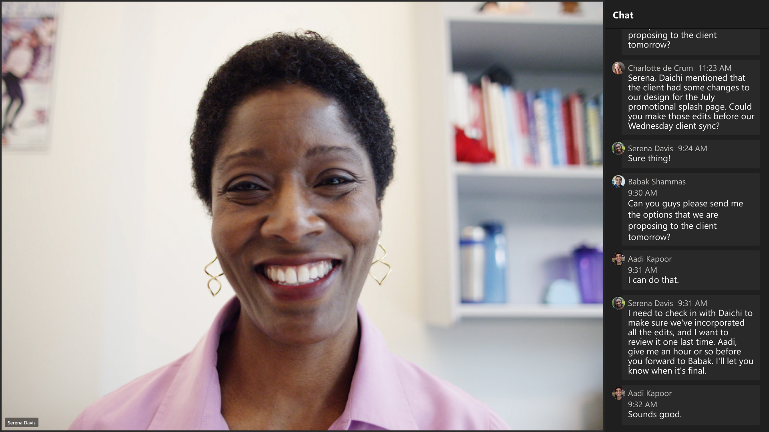
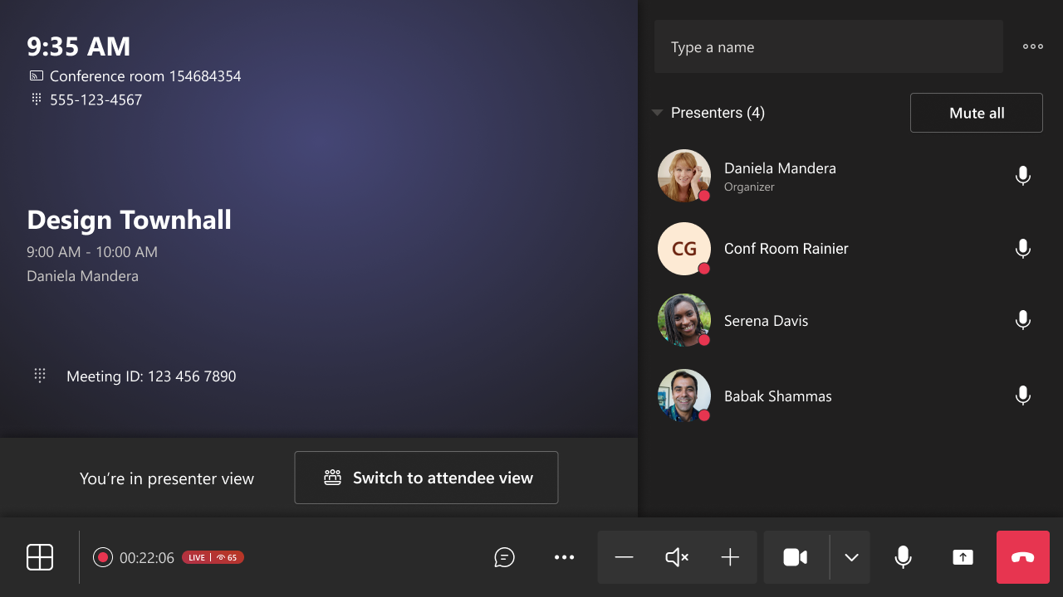

Feature Announcement: Co-located Mode

Slide 12
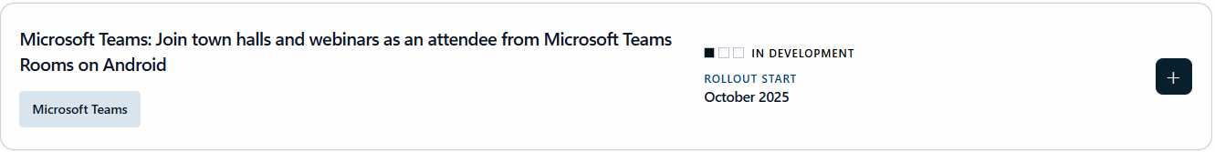
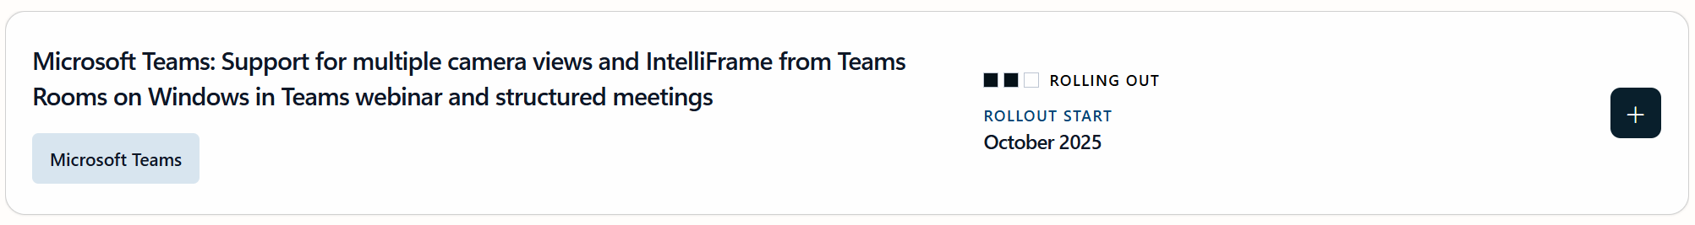
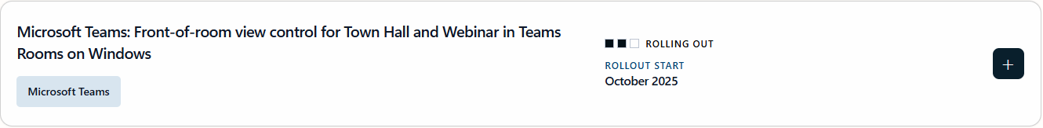

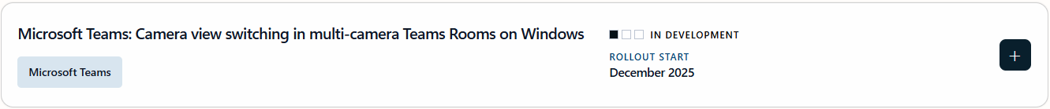
Microsoft Teams Rooms Public Roadmap for Events

Slide 13
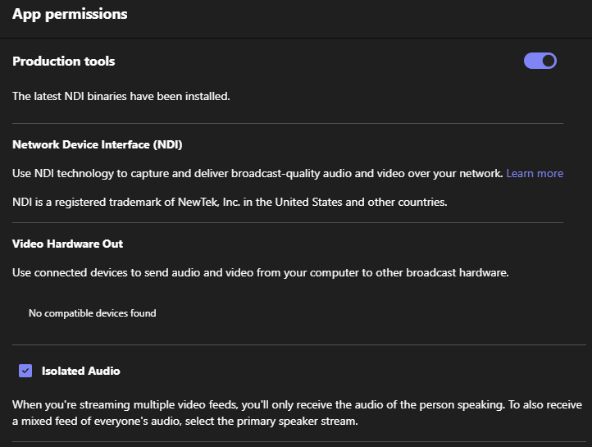
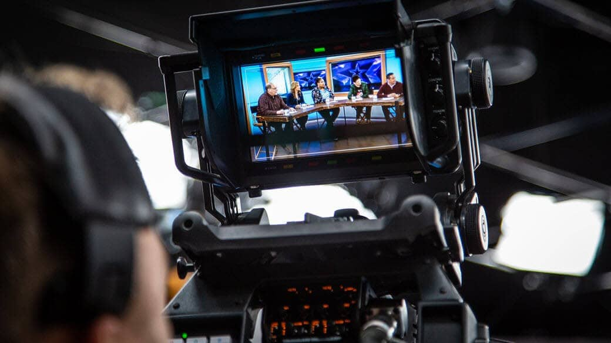
Native SDI/NDI Support within Microsoft Teams
Transmit local content with SDI/ NDI®
Easily integrate Teams videos sources into your production workflow

Slide 14





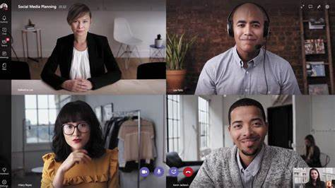




Use Teams NDI to Bring Virtual Presenters In-Room
Participants
Teams Event
Isolated
Video
NDI Application
(NDI Tools)
In-Room Display
Your website
graphics
NDI
Source
This computer joins the Teams Event and uses NDI to extract the isolated video feeds and mixed audio feed.
Producer
This computer runs the NDI Application (NDI Tools, OBS, Wirecast, vMix) to produce the desired layouts or pull clean video. From this computer, you can send the feed to an in-room.

Slide 15
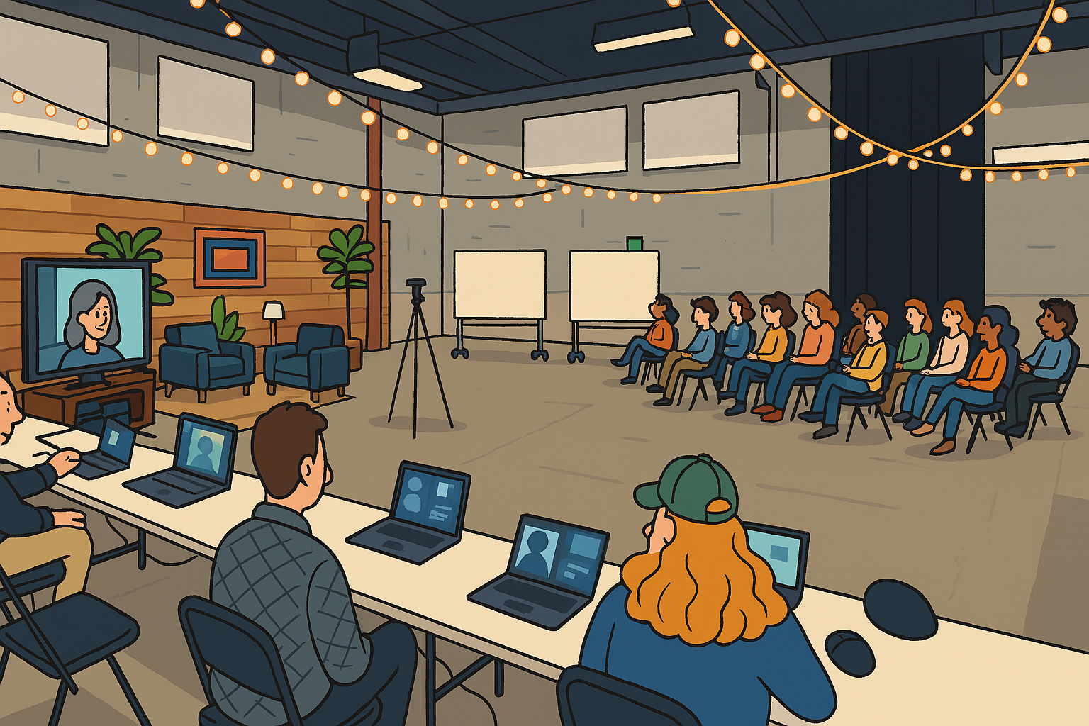
Fire-Side Chat Hybrid Event

Slide 16
General Hybrid Guidance
Microsoft Virtual Event Playbook
Consult the Microsoft virtual event playbook aka.ms/virtualeventplaybook
Audio
Ensure a good quality Audio system as this may be the most important part of your event
Video
Secure a camera configuration appropriate for your events, single focal length, zoom lens, or multi-camera
Screen Sharing
Allow for multiple monitors for producers as well as appropriate adapters
Accessibility
Design your spaces to accommodate a variety of accessibility features

Slide 17





Teams Device – Self Production
Virtual Presenters
Audio out
Video out
Virtual Presenter + Speaker Content
(PowerPoint Decks/Video)
In-Room
Speakers
Audio in
Video in
Teams Town hall
Teams Device
In-Room
Mics
In-Room
Cameras

Slide 18
Microsoft Teams Room – Self Production
Virtual Presenters
Audio out
Video out
Virtual Presenter + Speaker Content
(PowerPoint Decks/Video)
In-Room
Speakers
Audio in
Video in
Teams Town hall
MTR
MTR-W supports either Presenter or Attendee View
In-Room
Mics
In-Room
Cameras

Slide 19
Microsoft Teams Room – Enhanced Production
Virtual Presenters
Audio out
Video out
Speaker Content
(PowerPoint Decks/Video)
In-Room
Speakers
Audio in
Virtual Presenter
Video in
Teams Town hall
MTR
Audio Mixer
MTR-W supports either Presenter or Attendee View
In-Room
Cameras
In-Room
Mics

Slide 20

Microsoft Teams Room – Full Production
In-Room Camera
(Projecting In-Room Cameras)
Speaker Content
(PowerPoint Decks/Video)
Virtual Presenter
(In-Room Camera Display could also be utilized)
Virtual Presenters
SDI/NDI
Video
HDMI/SDI
Video
Teams Client
(Content Device)
Teams Town hall
In-Room Speakers
HDMI/SDI
Video
Audio
In-Room Mics
Audio Mixer
Audio
Bi-directional Audio
MTR
(A/V Device)
Video Switcher
HDMI/SDI
Video
HDMI/SDI
Video
In-Room Cameras

Slide 21

Microsoft Teams Room – Full Custom Production
Confidence Monitor
In-Room Camera
(Projecting In-Room Cameras)
Speaker Content
(PowerPoint Decks/Video)
Customized Content
(Virtual Presenters, etc.)
Virtual Presenters
HDMI
Video
Teams Town hall
VMix or Tricaster
(Encoder)
Teams Client
(Content Device)
Teams Meeting
In-Room Speakers
Audio
NDI Video
In-Room Mics
Audio Mixer
Audio
Bi-directional Audio
HDMI/SDI
Video
Teams Client
(A/V Device)
Video Switcher
HDMI/SDI
Video
HDMI/SDI
Video
In-Room Cameras

Slide 22

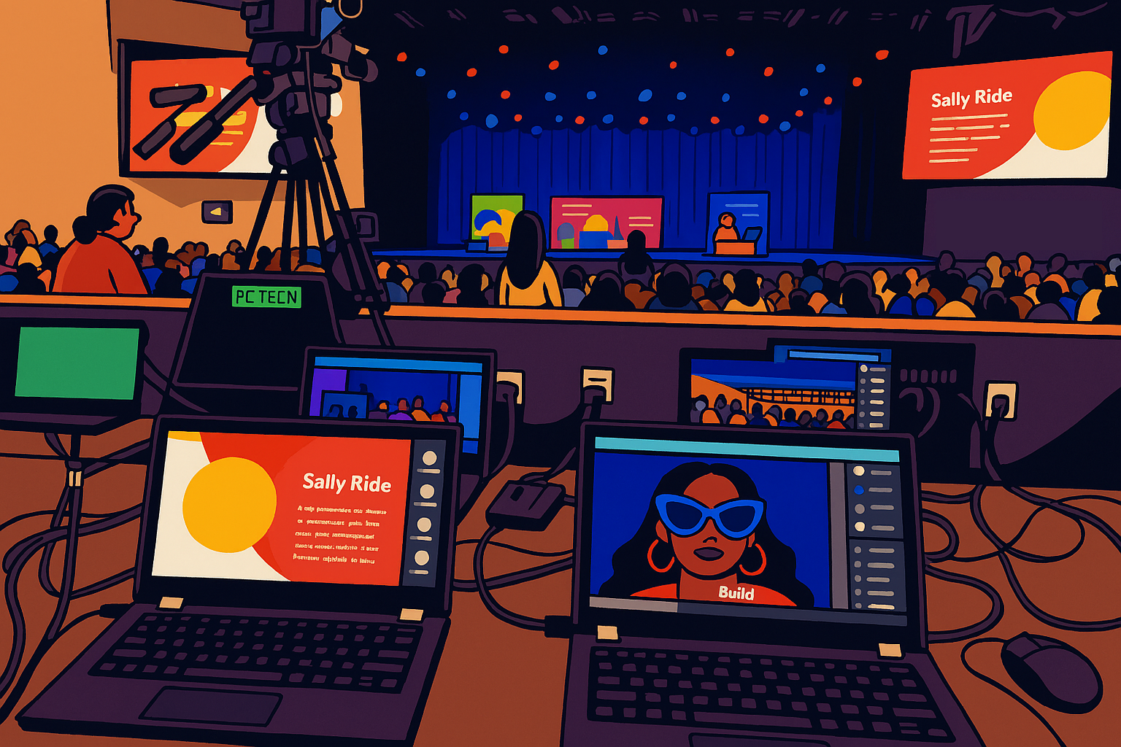
Fully Customized Hybrid Event Production

Slide 23

Hybrid Event Watch Parties with Microsoft Teams Rooms

Slide 24

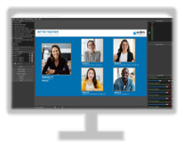

Microsoft Teams Rooms – Watch Party Scenario #1
Virtual Presenters
Primary Broadcast
Teams Town hall
Production Team Joins
Virtual Attendees Join
Presenter Meeting
Production PC
Teams Meeting
Presenters Join
Production Team Joins
NDI Audio
& Video
Program
Monitor
Microsoft Teams Room
Watch Party Broadcast
Teams Meeting
Production Team Joins
MTR devices Join
Microsoft Teams Rooms Presenters
Microsoft Teams Rooms (Android) Attendees

Slide 25
Microsoft Teams Rooms on Windows – Watch Party Scenario #2
Virtual Presenters
Virtual Attendees
Teams Town hall
Microsoft Teams Rooms (Windows) Presenters
Microsoft Teams Rooms (Windows) Attendees

Slide 26
Microsoft Teams Hybrid Event – Staffing and Equipment Plan
A successful custom production begins with a staffing and equipment plan that is closely aligned to your organization’s event goals, team structure, and technical requirements. Thoughtful consideration of production equipment and specialized roles ensures seamless execution and elevates the overall event experience.
Microsoft Teams Hybrid Event – Staffing Plan
Technical Director
Design and Manage all AV elements and staffing.
Video Technician
Operates the HDMI Switch
Teams Display Operator
Manages Microsoft Teams Display computers
Audio Technician
Manages On-Site and Teams Audio Feeds
Multiple Audio Technicians may be necessary depending on complexity of audio configuration.
Camera Operators
Multiple operators may be necessary depending on event design.
Microsoft Teams Hybrid Event – Production Equipment
Video switcher
Picture in Picture functionality if necessary.
Routing in-room video signals to in-room displays including confidence monitors
Video to computer interface
Allows the HDMI switched output to be used as a camera Microsoft Teams.
If using an ATEM Switcher this functionality is built in.
HDMI to USB
Audio Interface and Audio Mixer
Allows the Audio Mixer output to be used as a microphone in Microsoft Teams.
Teams SDI/NDI Output
Export individual video feeds with Teams approved Hardware output devices.
Event Computers
Each Teams display configuration will require a computer connected to Teams.
Event Video and Audio Output to Teams Computer
Presentation Content Playback Computer

Slide 27


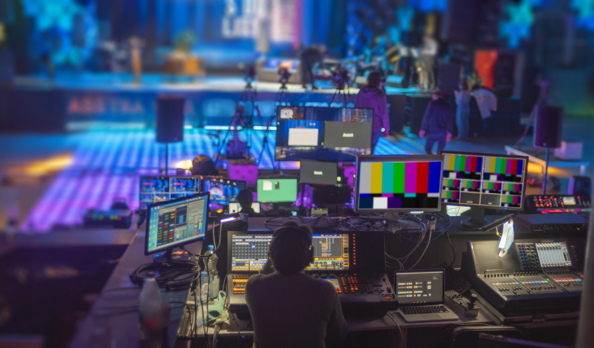
Advanced Events Team (AET) Hybrid Event Support
Leveraging the Microsoft Advanced Events Team (AET) for Hybrid Events
Objectives: Help strategic customers successfully transition to a virtual or hybrid world with Teams Events. Support for all event types, including leadership summits, learning & development, virtual offsites, complex hybrid, or even external-facing webinars.
How: Contact Your Local Microsoft Account or Email Us Directly:
AdvancedEventsTeam@microsoft.com
Activities:
Define event format and approach
Demonstrate the technology capabilities
Educate and transfer knowledge to your Production and/or Technology team
Advise on recommended best practices to create the ideal virtual event experience
Assist in the preparation activities for the event to best leverage our solutions
Provide Support and/or Moderation during practice sessions, dry runs and/or for the actual virtual event

Slide 28

Hybrid Event Example Roles & Responsibilities
Customer
Microsoft AET
Camera
Camera
Remote
Presenters
Presenter
Meeting
Remote
Presenters
Wireless Microphones
Video Switcher
Production Computer
Remote
Presenters
Rehearsal:
Switcher – Virtual Presenters on In room Screen
Multiple Outputs
Content Machine with videos going to in room and virtual event
Bring Program view to TLE – Test TLE
Communication
Graphic Layouts
In Room Display
Focusrite
Shared Content Computer
Unlocks
Individual
NDI
Production
Communication
Meeting
Unlocks
Individual
NDI
MSFT Technical Producer
Production
Machine
Backup Technical Producer
Production
Machine
Production Chat for message communication which may be more appropriate for certain scenarios.
Studio Producer Mobile
Producers Mobile
Production
Communication
CHAT
Customer QA Moderator
Teams Live Event
Computer
Teams Town Hall
Backup
Teams Live Event
Computer
Customer QC
Attendees

Slide 29

EDFC 2025 – Onsite Option 1
Jim’s Components List
5 Laptops
3 BMD – SDI to HDMI
1 BMD – HDMI to SDI
4 Elgato Capture Cards
6 Ethernet Adapters (MAC Addresses)
Audio
1 4i4
1 2i2
Accessory List
6 x HDMI Short (3 foot)
4 x HDMI Medium (6 foot)
2 x XLR Cables (3 foot)
1 Set Earbuds
1 HDMI Splitter
Accounts
Jim Garland - Microsoft
Camera One - JCG
Camera Two - JCG
Camera Three - JCG
Camera Four - JCG
Camera 1
Camera 2
Camera 3
AJA Converter
SDI
Room Projector
HDMI/SDI
HDMI/SDI
HDMI/SDI
BMD
BMD
BMD
HDMI Splitter
Pre-Recoded Content / NDI Audio
HDMI
HDMI
HDMI
Elgato
Room Speakers
4i4
vMix Audio Master
Elgato
Elgato
Elgato
USB
USB
USB
HDMI
Room Mics
4i4
vMix In-Room Mic Source
Virtual ASL
Camera One
Camera Two
Camera Three
Camera Four
In-Room Prod PC
In-Room Mic / Pre-Recoded Content / NDI Audio
2i2
NDI
vMix Audio A
Production Teams Meeting
Presenter Teams Meeting
In-Room Mic Only During Two-Way Dialog
vMix Audio B
In-Room Mic / Pre-Recoded Content / NDI Audio (Master - Except During Two-Way Dialog)
NDI
Blended Audio (Master - During Two-Way Dialog)
Virtual Camera
Pre-Recoded Content / In-Room Mic Except During Two-Way Dialog
Virtual Prod PC
NDI
Virtual Listener
vMix Audio Master
vMix Audio A
RTMP
Pre-Recoded Content / In-Room Mic Except During Two-Way Dialog
Audio Sync Issues During Two-Way Dialog:
Presenters Meeting – Video from Virtual Prod PC and Audio from In-Room Prod PC
Virtual Production – Video from EDFC Stage from Production Meeting but Audio from Presenters Meeting
Teams Town hall &
YouTube
Green Box = Computer

Slide 30
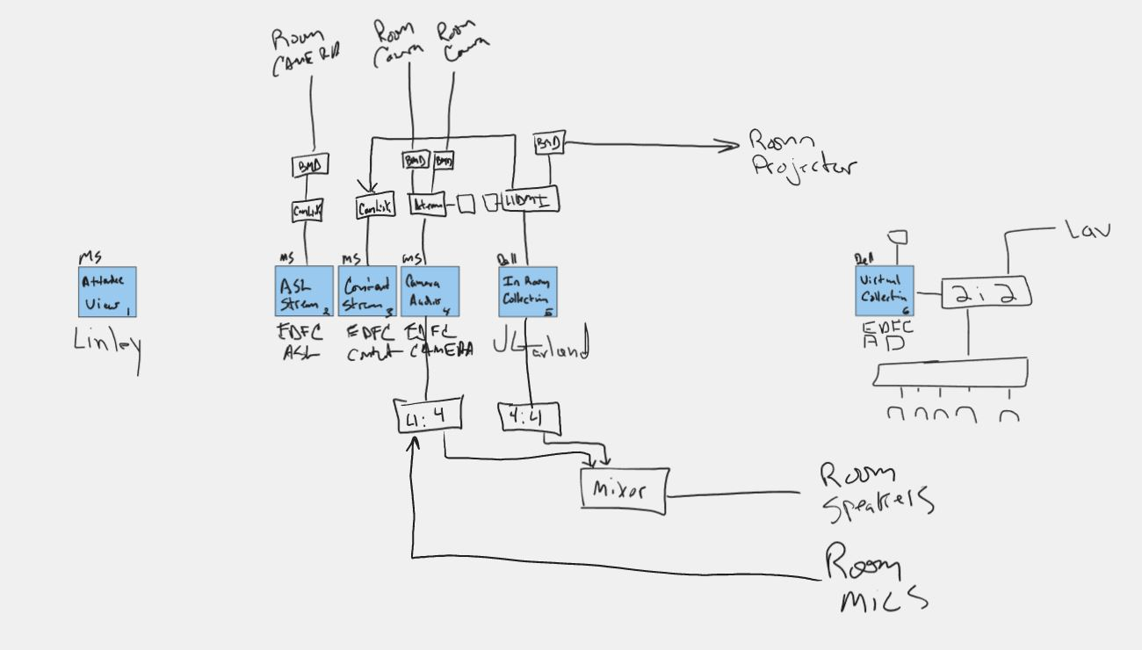

Slide 31
EDFC 2025 – Onsite Option 1
Jim’s Components List
5 Laptops
3 BMD – SDI to HDMI
1 BMD – HDMI to SDI
4 Elgato Capture Cards
6 Ethernet Adapters (MAC Addresses)
Audio
1 4i4
1 2i2
Accessory List
6 x HDMI Short (3 foot)
4 x HDMI Medium (6 foot)
2 x XLR Cables (3 foot)
1 Set Earbuds
1 HDMI Splitter
Accounts
Jim Garland - Microsoft
Camera One - JCG
Camera Two - JCG
Camera Three - JCG
Camera Four - JCG
Camera 1
Camera 2
Camera 3
AJA Converter
SDI
Room Projector
HDMI/SDI
HDMI/SDI
HDMI/SDI
BMD
BMD
BMD
HDMI Splitter
Pre-Recoded Content / NDI Audio
HDMI
HDMI
HDMI
Elgato
Room Speakers
4i4
vMix Audio Master
Elgato
Elgato
Elgato
USB
USB
USB
HDMI
Room Mics
4i4
vMix In-Room Mic Source
Virtual ASL
Camera One
Camera Two
Camera Three
Camera Four
In-Room Prod PC
In-Room Mic / Pre-Recoded Content / NDI Audio
2i2
NDI
vMix Audio A
Production Teams Meeting
Presenter Teams Meeting
In-Room Mic Only During Two-Way Dialog
vMix Audio B
In-Room Mic / Pre-Recoded Content / NDI Audio (Master - Except During Two-Way Dialog)
NDI
Blended Audio (Master - During Two-Way Dialog)
Virtual Camera
Pre-Recoded Content / In-Room Mic Except During Two-Way Dialog
Virtual Prod PC
NDI
Virtual Listener
vMix Audio Master
vMix Audio A
RTMP
Pre-Recoded Content / In-Room Mic Except During Two-Way Dialog
Audio Sync Issues During Two-Way Dialog:
Presenters Meeting – Video from Virtual Prod PC and Audio from In-Room Prod PC
Virtual Production – Video from EDFC Stage from Production Meeting but Audio from Presenters Meeting
Teams Town hall &
YouTube
Green Box = Computer

Slide 32
Experience Attendee Connection Through Teams Hybrid Events!

Slide 33
Thank you!
Next session…
11/5/25 – NDA Roadmap for events in Microsoft Teams*
*This session will NOT be recorded or available on demand - so please join us live!

Slide 34

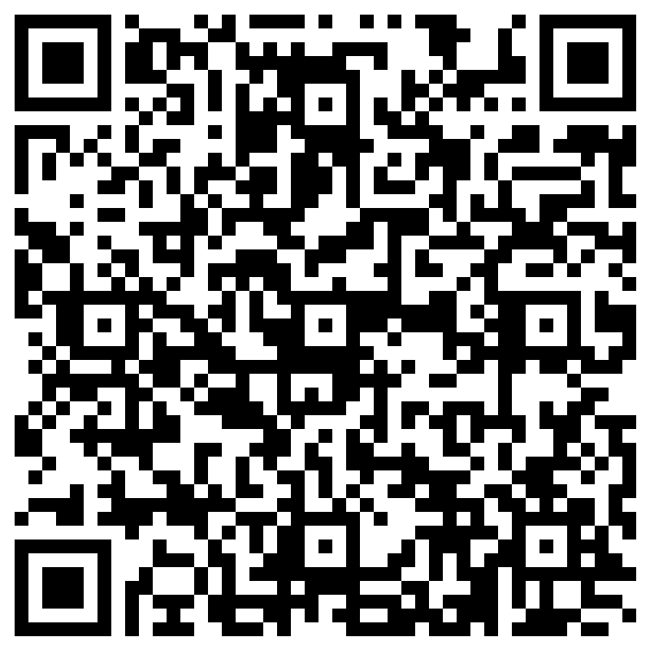
THANK YOU – Your feedback is critical
Scan with your mobile device camera
-OR-
We’re committed to making your Customer Hub experience the best it can be – and your feedback is a critical component to that.
Before you scoot, please take a moment to provide some feedback.
Visit
Customer Hub Survey
aka.ms/CustomerHubSurvey
Select Frontline Friday Series

Slide 35
Visit Customer Hub website for upcoming sessions, updates, and on demand contents!
https://aka.ms/CustomerHubSessions​

Slide 36
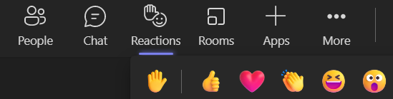
Q&A
1
Please raise your hand and unmute when called on
2

Slide 37
A/V Team Evaluation Checklist for Hybrid Events
This checklist guides the evaluation of Audio/Video teams for complex live events by covering key inquiries such as experience with similar productions, detailed AV quotes, backup plans, project management, venue-specific setup, support for scripted segments and live show calling, live streaming capabilities, use of creative technologies, coordination with other vendors, provision of references, and understanding of mix-minus audio routing to ensure seamless, high-quality event execution.

Slide 38
A/V Team Evaluation Checklist for Hybrid Events
☐ 1. What’s your experience with events of this size and complexity? Can you provide references and a portfolio of past work?
Ask for examples of similar high-stakes productions, including hybrid formats, live streaming, and multi-camera setups.
☐ 2. Can you walk me through your AV quote line by line?
Ensure transparency and clarity on every item—equipment, labor, contingency, and creative services. ☐ 3. What’s your backup plan if equipment fails or something goes wrong?
Confirm they have redundancy for critical gear (e.g., mics, switchers, power, internet, cables, etc.) and a documented contingency workflow.
☐ 4. Who will be my project manager, and can I meet them before signing?
You need a dedicated point of contact who understands your goals and can coordinate across teams.

Slide 39
A/V Team Evaluation Checklist for Hybrid Events
☐ 5. How do you plan the AV setup around the venue’s layout and limitations?
Ask if they’ve worked in similar venues and whether they’ll conduct a site visit to assess rigging points, acoustics, and lighting.
☐ 6. Can you support teleprompters, cue-to-cue scripting, speaker timer, and live show calling?
For high-stakes events, precision matters. Confirm they can handle scripted segments, transitions, and talent support.
☐ 7. What are your hybrid capabilities for live streaming and hybrid audience engagement?
Ask about RTMP/SRT support, Teams integration, and audience mic mixing. Confirm they’ve done stream tests and rehearsals.

Slide 40
A/V Team Evaluation Checklist for Hybrid Events
☐ 8. Do you understand and implement mix-minus audio routing?
Ask them to explain how they configure mix-minus setups, especially for remote participants, IFB, or live broadcast. This prevents audio feedback loops and ensures clean communication.
☐ 9. What creative technologies do you offer—LED walls, projection mapping, AR/VR?
If you want to elevate the experience, ask about cutting-edge tech and how it fits your budget.
☐ 10. How do you coordinate with other vendors (staging, decor, catering)?
AV teams must collaborate seamlessly with other event partners. Ask about their process for vendor syncs and shared timelines.

