Slide 1
Analyst Deep Dive
Overview Use Cases & Scenarios Prompt Guidance

Slide 2
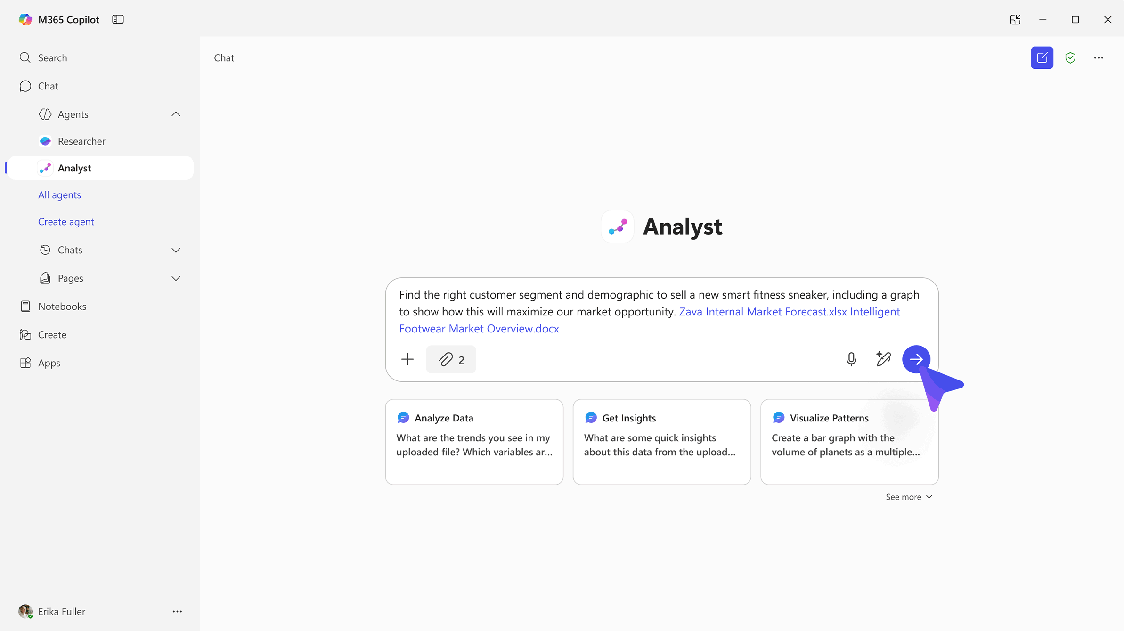
Analyst
is an advanced reasoning agent that uses iterative chain-of-thought reasoning for advanced data analysis–turning raw data to insights in minutes with the power of OpenAI’s O3-mini model.
Notes:
Introducing Analyst Agent
Now, let’s talk about Analyst, another deep reasoning agent designed to help with data analysis tasks.
Analyst is built to perform the kind of work you’d expect from a data analyst or data scientist—someone who works with Excel, Python, or SQL to analyze data, uncover insights, and create visualizations.
This agent is powered by OpenAI’s 03 mini model, which Microsoft has specifically optimized for advanced data analysis. The engineering team has post-trained the model using real-world data analysis tasks and expertise from Excel and other Microsoft tools.
Analyst is not just about answering quick questions. It takes your prompt, reasons through it, constructs a plan, and shares its thought process along the way. You’ll see how it understands your data, finds connections, and explains its approach step by step.
The goal is to help knowledge workers—regardless of their technical skill level—get quick, actionable insights from their data, even if they’re not experts in Python or advanced analytics.
Analyst can work across multiple data sources and formats, making connections between structured data (like Excel sheets) and unstructured data (like PDF reports or Word documents).
In summary, Analyst is designed to mirror human analytical thinking, helping you solve complex data problems and make informed decisions more efficiently.

Slide 3





Challenges in data analysis
Data overload: Organizations are inundated with structured and unstructured data from countless sources— spreadsheets, databases, CRM systems, and more. This volume of data can overwhelm teams and make it difficult to extract timely, actionable insights.
Skill gaps: Extracting value from complex data often requires technical expertise—SQL, Python, BI tools— that many knowledge workers lack. This creates bottlenecks and reliance on specialized data analysis roles.
Time-consuming workflows: Disproportionate time is often spent cleaning, formatting, and stitching together messy data. This manual effort delays insights and increases the risk of missed opportunities.
Fragmented tools and silos: Data lives in disconnected systems—Excel files, reporting systems, internal dashboards—making it hard to get a unified view. We often must jump between tools, losing context and efficiency.
Inaccessible insights: Even when insights are generated, they’re often buried in complex dashboards or static reports, making it difficult to interpret results or ask follow-up questions.
Notes:
Data Analysis Challenges and Analyst’s Solution
Let’s discuss some of the challenges organizations face with data analysis, and how the Analyst agent is designed to help.
In today’s workplace, there’s an overwhelming amount of data—ranging from simple Excel sheets to complex Power BI dashboards, CRM systems, and resource planning tools.
While data-driven decision-making is crucial, the sheer volume of information can make it hard to find quick, actionable insights. Many knowledge workers spend hours just organizing and understanding their data before they can even begin analysis.
Another challenge is the varying skill levels among employees. Not everyone is an expert in Python or advanced analytics, so they often rely on colleagues in data science or analysis teams for help.
Analyst aims to reduce these bottlenecks by making it easier for anyone—regardless of technical skill—to get meaningful insights from their data.
Analyst can work across multiple data sources and formats, connecting structured data (like tables in Excel) with unstructured data (like PDF or Word reports). This helps break down silos and enables more comprehensive analysis.
The goal is to help you answer business questions, uncover insights, and make informed decisions faster and more efficiently.

Slide 4

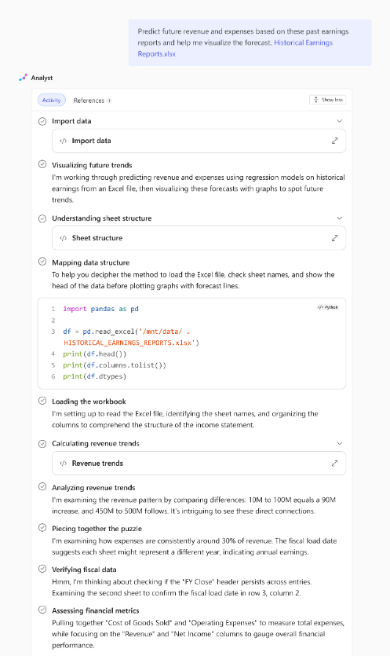
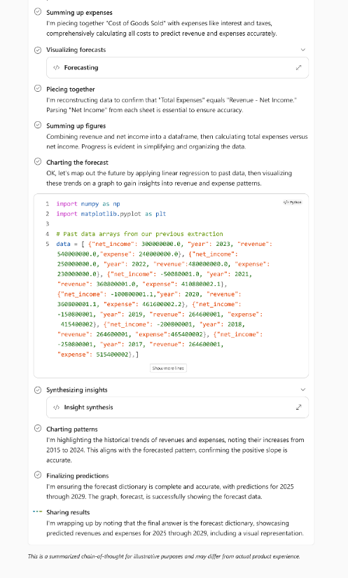
How does Analyst work?
Unlike traditional large language models that jump too quickly from problem to proposed solution while often failing to adjust to new complexities or gracefully recover from mistakes, Analyst:
Implements a reasoning-driven, chain-of-thought (CoT) architecture derived from OpenAI’s O3-mini.
Progresses through problems iteratively by hypothesizing, testing, refining, and adapting.
With the capability to generate and execute code at every step within its reasoning trajectory, this model excels at incremental information gathering, constructing hypotheses, course correction, and automatic recovery from errors.
Notes:
How Analyst Works—Step-by-Step Reasoning
Let’s look at how the Analyst agent actually works and what makes it different from traditional large language models.
Unlike models that jump straight from your question to a quick answer, Analyst takes a more thoughtful approach. It starts by understanding your question, then creates a plan for how to tackle it.
Analyst will often share its reasoning process with you. For example, it will explain how it’s interpreting your data, what connections it’s finding, and what steps it plans to take to answer your problem.
As Analyst executes tasks—like running Python code for visualizations or advanced analysis—you can follow its “chain of thought” and see how it arrives at its conclusions.
Analyst adapts to the complexity of your data and your question, taking as many steps as needed to provide a thorough answer. This mirrors how a human data scientist would approach a problem: by sharing their process and reasoning along the way.
The result is a more transparent, step-by-step solution that helps you understand not just the answer, but how Analyst got there.

Slide 5
How to use Analyst
How to use Analyst
Find the file(s) with the raw data you need help analyzing and add it to your prompt in Copilot Chat, either by uploading directly or selecting from your M365 files.
Analyst currently supports up to 5 files at once across multiple formats including documents (Word, PPT, PDF) and datasets (Excel, CSV, JSON).
Ask Analyst to provide the insights you’re looking for, including specifying the type of visualization or graph.
Analyst will then work to understand the data, construct a plan, and execute Python code to reason over your prompt.
This process may take a few minutes and you can follow along with chain-of-thought reasoning to check its work.
Where can you use Analyst
Analyst is accessible as an agent in Copilot Chat in the Microsoft 365 Copilot app, Teams, and Outlook.
Turning on Analyst
The agent will appear in the Agent Store under ‘Built by Microsoft’ located within the ‘All agents’ and ‘Get agents’ landing page.
For users with a Microsoft 365 Copilot license, Researcher and Analyst agents will be pre-pinned for all eligible users.
Notes:
Tips for Using Analyst Effectively
Let’s go over some practical tips for getting the most out of the Analyst agent.
To use Analyst, simply provide the files you want it to analyze along with a clear prompt. You can upload files directly from your device or select them from your M365 files, such as those stored in OneDrive.
Analyst currently supports analyzing up to five files at once, and these can be in different formats—Excel, CSV, JSON, Word documents, PowerPoint decks, PDFs, and more.
The agent will show you how it understands the content of each file and use that information to answer your question. This means you can combine structured data (like spreadsheets) with unstructured data (like reports) for a more comprehensive analysis.
When you ask Analyst for insights, be specific about what you want. For example, if you need a particular type of visualization or output—such as a table or a graph—mention that in your prompt. The more details you provide, the better the results will be.
Analyst will typically give you a summary of its findings and, if requested, include additional outputs like charts or tables. You can also review its reasoning process, including any Python code it executes, to understand how it arrived at its conclusions.
Keep in mind that, because Analyst is a reasoning model, the process may take a few minutes depending on the complexity of your data and your question. This is intentional, as it allows for deeper analysis and more accurate results.
For quick answers, Copilot chat may be sufficient, but for advanced data analysis and multi-file reasoning, Analyst is the best choice.

Slide 6



When to use Analyst
When to use Analyst
Consulting multiple data sources: Gathers and integrates data from different file types for comprehensive analysis.
Step-by-step problem solving: Progresses through challenges by hypothesizing, testing, and adapting responses, making it useful for iterative decision-making.
Visualizations: creates key visualizations for data analysis and presentation.
Example use cases
Financial performance analysis and forecasting
Customer segmentation analysis
Sentiment analysis over survey or feedback data
Data storytelling with visualizations
Best practices for using Analyst
Upload both structured (Excel, CSV, JSON, etc.) and unstructured (PDF, Word, PowerPoint etc.) data files, up to 5 files at once
Ask complex, multi-variable questions that require advanced data analysis
Specify the type of insight or visualization needed
Review chain-of-thought and Python generated insights for accuracy
Notes:
When to Use Analyst
Let’s talk about the best scenarios for using the Analyst agent.
Analyst is especially powerful when you need to reason across multiple data sources and file types, not just a single spreadsheet or report.
It excels at step-by-step problem solving, making it ideal for advanced questions that go beyond simply retrieving a single data point.
Analyst is great for statistical analysis and can execute Python code for advanced visualizations, so it’s well-suited for tasks like forecasting, segmentation, and trend analysis.
For example, use Analyst for financial analysis, customer segmentation, sentiment analysis, or when you want to tell a story with your data using visualizations.
If your question requires connecting information from different files, performing calculations, or generating charts and graphs, Analyst is the right tool for the job.
For quick, simple answers, Copilot chat may be enough. But for deeper, multi-step analysis, Analyst is your go-to agent.

Slide 7
Analyst in Action
Notes:
Reviewing Analyst’s Reasoning and Output
Let’s talk about how you can review and understand the reasoning process and outputs provided by the Analyst agent.
Analyst will always share its thought process as it works through your prompt. You’ll see how it understands your data, constructs a plan, and executes steps to arrive at its conclusions.
If you want to see the details, you can expand and review the Python code Analyst runs for advanced analysis and visualizations. This transparency helps you understand exactly how the agent arrived at its results.
All of Analyst’s reasoning and outputs are saved in your chat and conversation history, so you can revisit them anytime for reference or further analysis.
Keep in mind, because Analyst is a reasoning model, the process may take a few minutes depending on the complexity of your data and question. This intentional design allows for deeper analysis and more accurate results.
In summary, Analyst not only provides answers but also shows you the steps it took, making its insights more trustworthy and actionable.

Slide 8
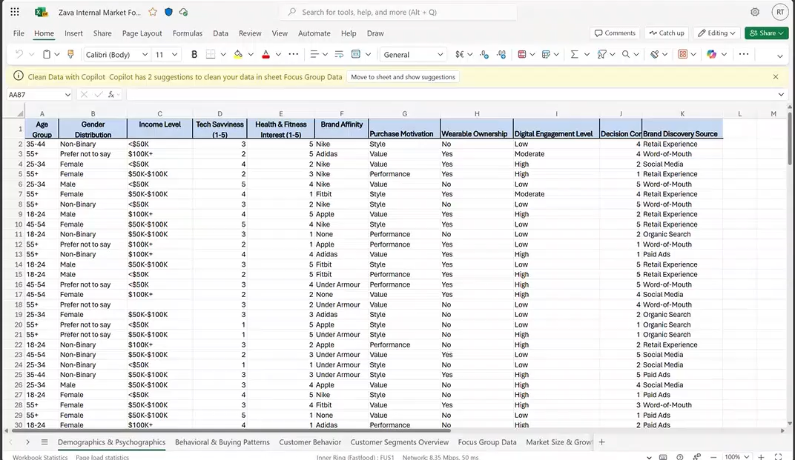
Analyst demo video
Notes:
Demo – use the audio in the video or turn it off and use this description
We used a scenario for working at a fitness company and we’re looking to launch a smart sneaker. We have this messy data set and we’re not sure what segment to target – what demographic, their buying patterns, we have so much of this data available in multiple tabs. You can see focus group data and even market size assumptions. Often times this would take me quite a bit of time to analyze and determine the best segment to target.
Start at 0:38
You can also see we have a second Word document here with more information on the intelligent footware market. There’s information on market size assumptions, growth assumptions, breakdown of regions, some market drivers, and where the best opportunities may sit. It’s likely that between these two data sets it will help me determine the answer to what customer segment we should start with. Typically it may take a few hours and I may need help from the team, so let’s see how Analyst can help me here.
Start at 1:12
So we’re going to head over to the Copilot app, access the Analyst agent and insert the prompt that is to help me decide the right customer segment and demographic to target with a new smart sneaker to maximize our market opportunity including a graph to visualize why. We’re going to point it to the two documents we showed previously, the Excel spreadsheet and the Word document – then we’ll let Analyst go off and do it’s job.
You can see Analyst is starting to think through the process, it starts to understand the data and what’s in the file and then starts to answer the question. You can see it’s sharing it’s chain-of-thought and reasoning along the way. It’s breaking down the steps, analyzing customer segments and you can follow along the entire process.
Start at 2:25
As it takes a few minutes and given time, we previously ran this prompt, so let’s show you the output here. You can see it did a similar chain-of-thought reasoning and gave it very useful answer on the specific market to target, the age group and key metrics on why this segment.
It gave a really nice visualization across the segments where the opportunity might lie and across those key metrics. Now we can take this data and share it with my team and we can move forward with a decision to make progress.

Slide 9





Try it!
 | Customer Service | Sales | Finance | Marketing | HR
Pain point | Lack of visibility into customer service trends and feedback | Lack understanding of pipeline health and probability of meeting quarterly or year-end close targets | Strategic decisions require complex modeling across multiple business drivers | Limited understanding of campaign insights | Managers need to generate and modify team strategies while quickly assessing project performance for clarity and continuous improvement
Scenario | Gain visibility into larger trends and patterns of customer feedback | Gain real-time visibility into pipeline trends and sales performance | Analyze P&L, market growth, and cost structure data to evaluate the financial impact of launching a new product line | Gain insights into efficacy and outcomes of marketing levers and investments | Co-create and draft team strategy based on team goals and expected outcomes and use lessons learned to feed a continuous improvement loop
How Analyst can help | Use Analyst to understand sentiment across customer reviews and comments | Use Analyst to analyze data to determine sales targeting opportunities | Use Analyst to simulate financial outcomes, compare scenarios, and generate decision-ready insights for leadership. | Use Analyst to understand marketing results data (e.g. SEO, web traffic, conversion rates, etc.) to determine investments | Use Analyst to assess project outcomes for effectiveness, timeliness, and other metrics
Notes:
Analyst’s Versatility Across Functions
You just saw an example of how marketing teams may use this to determine the best area to invest in to drive growth for the company. And often times it’s easy to think oh data analysis sits with the data teams and with roles in Finance, but the reality is data analysis is happening across a company, across so many different teams and roles, and so we’ve helped identify where there are opportunities to help across various scenarios and the business value that Analyst can deliver.
Analyst is designed to help with any scenario that requires data analysis, even in areas you might not expect, like HR, sales, or operations.
For example, HR teams can use Analyst to review effectiveness metrics, improvement loops, and other data to share insights with their teams.
Sales professionals can quickly analyze sales data, identify the best opportunities, and determine which customers to target for maximum impact.
Analyst’s ability to work across different file types and connect information from multiple sources means it can help uncover missed insights and support better decision-making in any department.
As organizations become more data-driven, Analyst empowers everyone—not just technical experts—to make sense of complex information and act on it quickly.

Slide 10
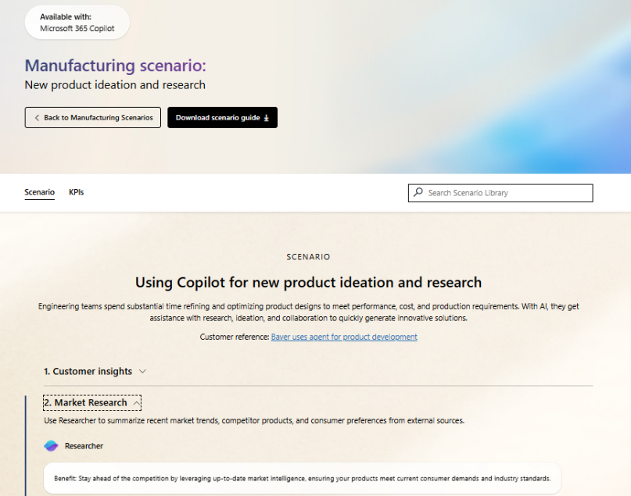
Scenario Library
Get ideas on how to integrate Analyst into your business processes.
Improve merchandising decisions – Use Analyst to help define sales targets based on historical data, market trends, and business goals.
Implement adaptive pricing – Use Analyst to identify sales trends and compare pricing options.
Data strategy and insights – Use Analyst to gain insights into data streams.
Intelligent sales forecasting – Use Analyst to analyze sales and market data to create forecasts.
Financial insights – Use Analyst to gain deeper insights into sources of revenues and costs.
Deliver insights to managers – Use Analyst to produce reports on manager strengths and development opportunities.
Notes:
Analyst in the Scenario Library
As we wrap up, I want to highlight some valuable resources to help you get the most out of the Analyst agent and other Copilot features.
Microsoft provides a scenario library at adoption.microsoft.com, which walks through specific use cases for different functions and industries. You’ll find examples tailored to finance, HR, sales, operations, and more.
These resources include KPIs you might be tracking and show where Analyst and Copilot can help you solve real business problems and drive adoption in your organization.

Slide 11
Resources
Read the announcement blog and view the demos: Blog: Researcher and Analyst are now generally available
Video: Explore Researcher and Analyst agents and the Agent Store
Check out the Agents in Microsoft 365 adoption page
Learn more from our engineering team:
Researcher agent in Microsoft 365 Copilot | Microsoft Community Hub
Analyst agent in Microsoft 365 Copilot | Microsoft Community Hub
Notes:
Finally, we have some great resources available to help you learn more, get started and start to realize how Analyst can play a meaningful role in data analysis across your business. We encourage you to check these resources out and know that we’re continuing to innovate, as you try out these agents, we welcome your feedback and look forward to hearing how you’re leveraging them across your organization.

Slide 12
Next Steps and Call to Action

Slide 13


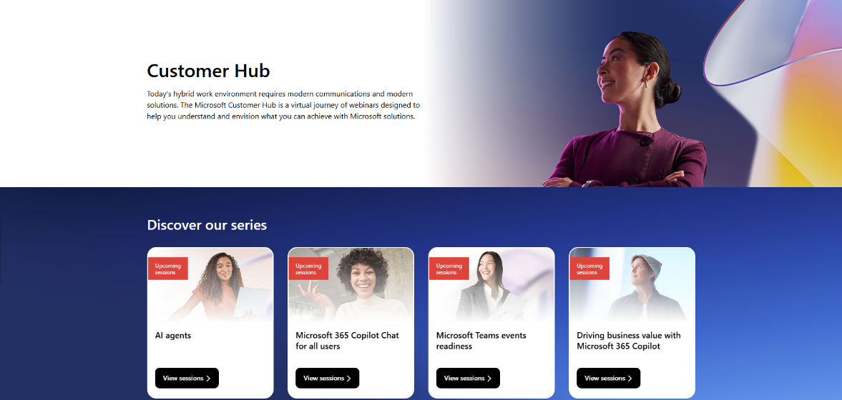
Customer Hub
Visit Customer Hub website for upcoming sessions, updates, and on demand contents!
https://aka.ms/CustomerHubSessions​
Notes:
Customer Hub
Introduction
“As we wrap up, I want to highlight some resources that can help you and your organization get even more value from Copilot Chat.”
Key Points to Cover
Customer Hub
“Get the latest information from Microsoft experts with extensive demos.”
“If you want to deliver the full version of the course you can access is on Customer Hub”
“Next, we’ll look at where to get the content you need for adoption.”

Slide 14
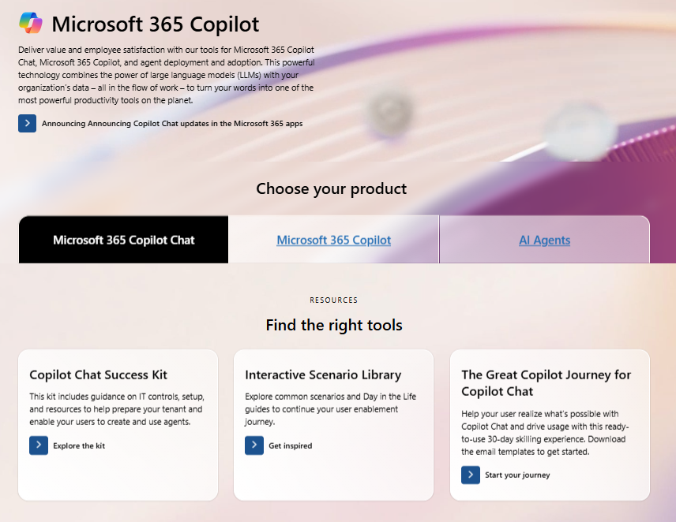

Copilot Chat Adoption Hub
adoption.microsoft.com/copilot-chat/
Notes:
Copilot Chat Success Kit & Support Resources
Introduction
“The Adoption Hub has content organized by role and adoption stage to make it easy to find what you need.”
Key Points to Cover
Copilot Chat Success Kit:
“There’s a Copilot Chat Success Kit available, which is a great resource for organizations looking to deploy Copilot Chat. It includes helpful materials like IT controls guides, user onboarding email templates, a trainer kit, user training guides, handouts, and links to other useful resources.”
“We also have great programs like the Great Copilot Journey to help your users make Copilot a habit and the Scenario Library to learn how to improve your key business processes with Copilot.”
“Next, we’ll look at how to access Copilot Chat on your mobile device and wrap up with final tips.”

Slide 15
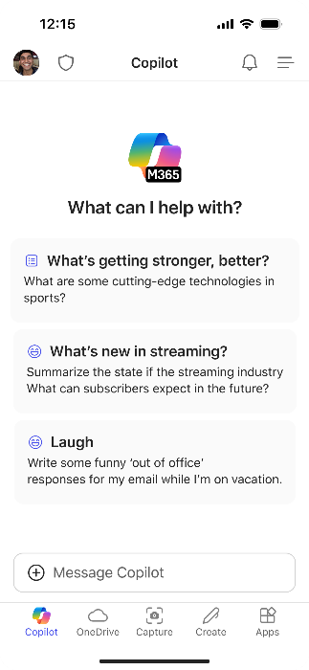

Use Copilot Chat on the go
Download the Microsoft 365 Copilot mobile app and sign in with your work or school account to access Copilot Chat
Notes:
Speaker Notes: Copilot Chat on Mobile Devices
Introduction
“Before we finish, let’s talk about how you can use Copilot Chat on your mobile device.”
Key Points to Cover
Mobile Access:
“Copilot Chat isn’t just for your desktop or laptop—it’s also available on mobile devices.”
“You can download the Copilot Chat app using the QR code provided on this slide.”
“Having Copilot Chat on your phone means you can get quick answers, summaries, and support wherever you are—even outside the office.”
Practical Benefits:
“This is great for staying productive on the go, resolving questions in meetings, or even settling debates at a restaurant!”
“You’ll have the same secure, enterprise-grade experience as on your desktop, with all your data protected.”
Encourage Experimentation:
“If you haven’t tried Copilot Chat on mobile yet, I encourage you to download it and explore its features.”
“It’s a handy way to keep Copilot close at hand for work and personal use.”
Wrap-Up
“That brings us to the end of our session. Thank you for participating and exploring Copilot Chat with me today.”

Slide 16
Thank-you

