Slide 1
Hello and welcome to Customer Hub
We’ll get started at 2 minutes past the hour

Slide 2
Agents Governance
September 24, 2025
Microsoft confidential

Slide 3



During the presentation
After the presentation
We will mute your microphone for the first part of today’s call
Raise your hand and we will
call on you
Ask your questions via chat, we will get to all of them, live or after. Common questions will get addressed out loud
Open mic – come off mute and ask away!

Slide 4
Agenda
Spectrum of Agent and Controls
Management Controls
Security & Governance
Measurement & Monitoring
Planned Features
Resources
Next Steps & Call to Action
Q&A

Slide 5
Spectrum of Agent and Controls

Slide 6


Spectrum of agents
Agents use AI to automate and execute business processes,
working alongside or on behalf of a person, team or organization
IT Helpdesk agent
Device Refresh agent
Lead Gen agent
How do I connect to the corporate network?
Request a new laptop and send approvals via IT Service tool.
The agent has identified and researched 15 new leads for you to review.
Simple
Advanced
Retrieval
Retrieve information from grounding data, reason, summarize, and answer
user questions
Task
Take actions when asked, automate workflows, and replace repetitive tasks for users
Autonomous
Operate independently, dynamically plan, orchestrate other agents, learn and escalate
Agents vary complexity and capabilities depending on your need

Slide 7

Types of agents
Declarative agents
Custom engine agents
Copilot Studio Lite
Copilot Studio
SharePoint
Agent Toolkit in Visual Studio Code
Copilot Studio
Agent Toolkit in Visual Studio Code
AI Foundry
Build with
Agent runtime
Microsoft 365 Copilot
Bring your own orchestrator and foundation models
Microsoft 365 Copilot
Microsoft Teams
SharePoint
Web + 10 other channels
Microsoft 365 Copilot
Microsoft Teams
SharePoint
Deploy across

Slide 8



Agents built by Microsoft in Microsoft 365 Copilot
Researcher agent
Generally available
Analyst
agent
Generally available
Skills
agent
Frontier
Available to users with a Microsoft 365 Copilot license, these agents are readily available in Copilot Chat and across core apps you use every day, helping organizations achieve quicker time to value. They add specialized skills and knowledge to Microsoft 365 Copilot, taking on unique roles to drive business value.
Facilitator
agent
Public preview
Interpreter agent
Public preview
Project Manager agent
Public preview

Slide 9
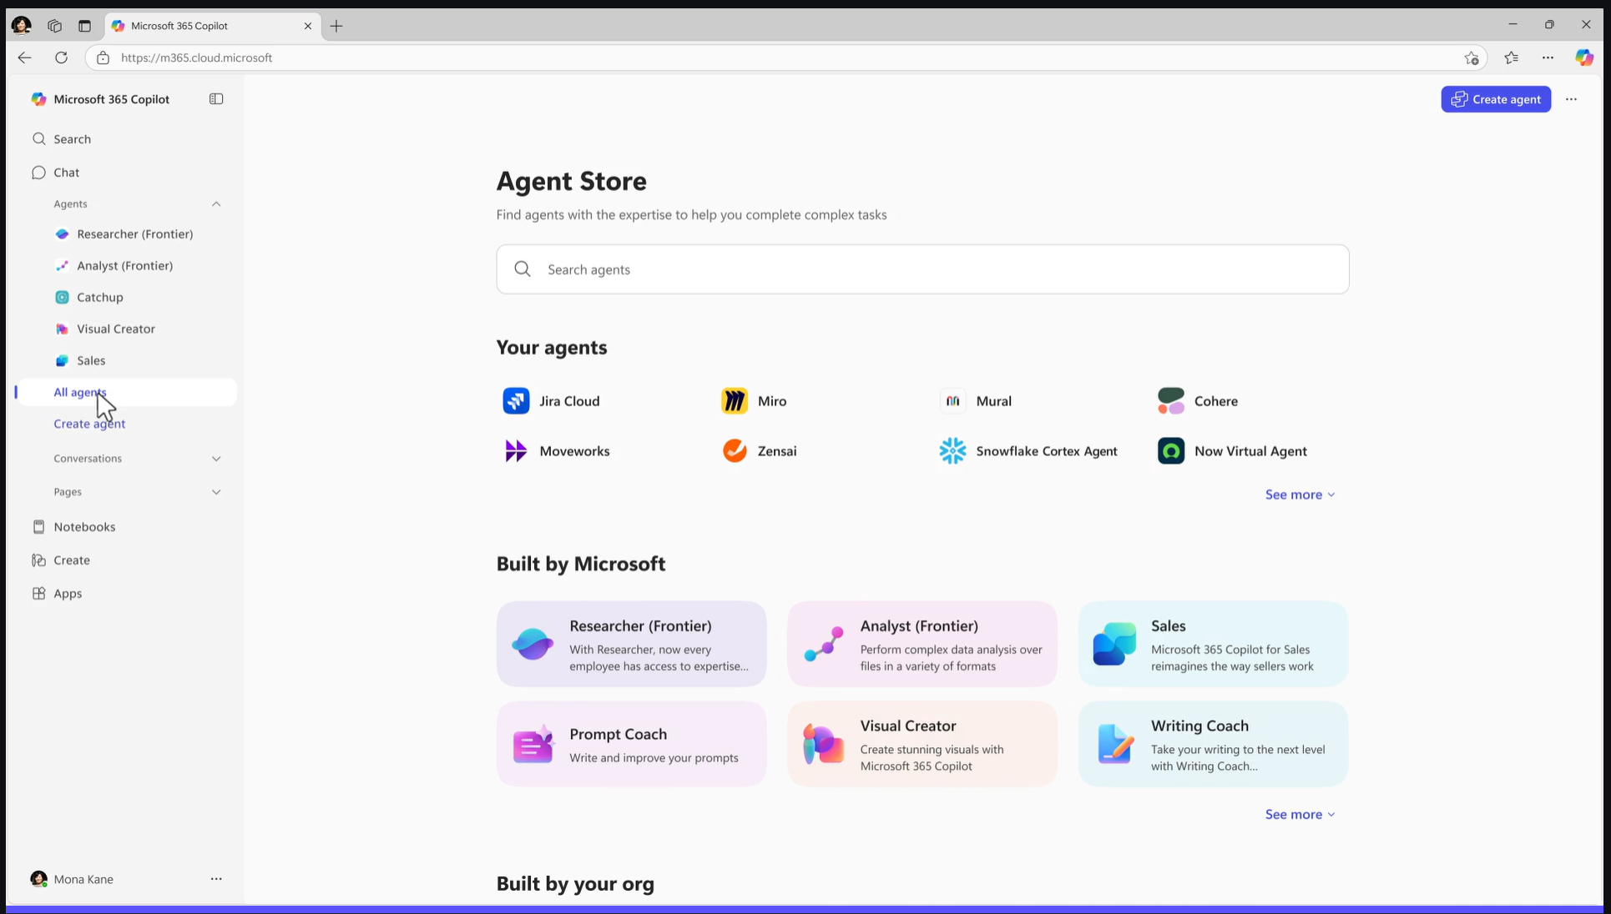
Agents Store
Agent Store is an agent marketplace featuring agents from Microsoft, partners and customer organizations
Its immersive and personalized experience helps you find and use agents to transform work processes and elevate productivity
Share agents with colleagues via Copilot Chat or other Microsoft 365 Copilot endpoints to boost collaboration
IT admins have full visibility and control over how agents are deployed in their organization
Note: Agents embedded in M365 apps are not available in the Agent Store

Slide 10
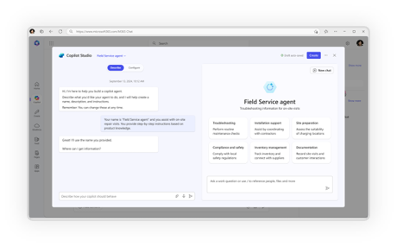
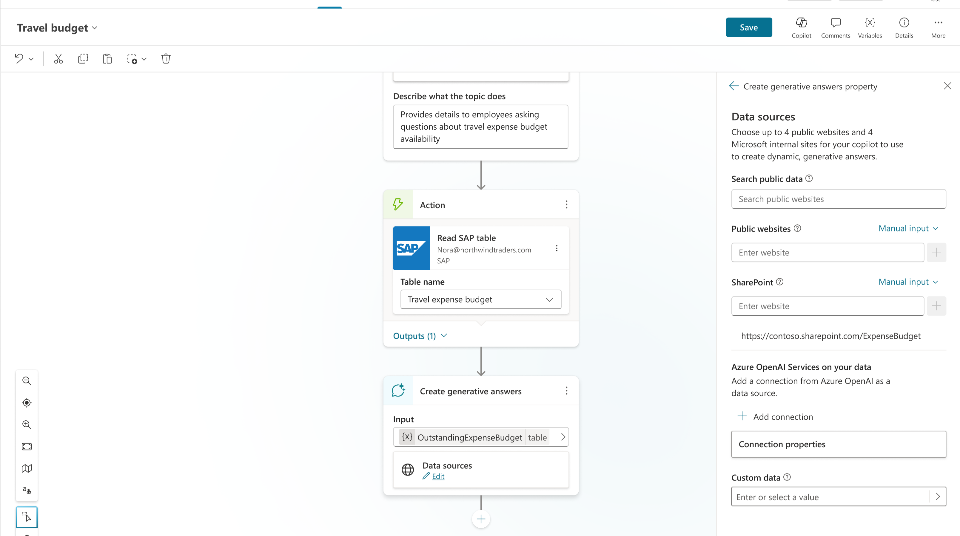
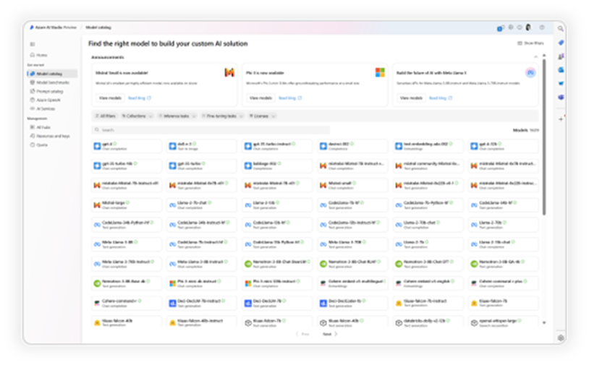
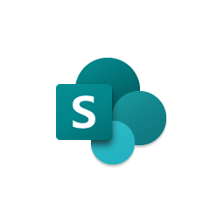



Advanced agents require more advanced governance and security
Conversational
Advanced
Copilot Studio Lite
Copilot Studio
Copilot Studio + Azure AI
Users/Creators
Makers
Developers
Knowledge
Microsoft Graph
Your Business Data
Actions
Retrieval Only
Task / Autonomous
Channels
Microsoft 365 Only
Multiple Internal & External Channels
Increasing advanced governance and security needs
throughout agent lifecycle
1. Development & Testing
2. Deployment
3. Optimization

Slide 11
Copilot Studio Licensing
Copilot Studio in M365 Copilot
Copilot Credit Packs
Pay-as-you-go
Licensed per User
Most of the features, except Autonomous Triggers
$30 per user/month
Tenant-wide
Copilot Credit packs
25,000 credit/month
$200 per pack/month
New PAYG meter
$0.01/credit
Can decrement MACC

Slide 12
Billing Rates (Copilot Credits)
 | M365 Copilot Users | Copilot Chat Users | Autonomous Agents
Classic answers Predefined static responses manually authored by makers through topics (messages, connectors, flows etc.) | No charge | 1 | N/A
Web-grounded answers Dynamically-generated responses based on the web as a knowledge source. | No charge ³ | 0 | 2
Generative answers ⁴ Dynamically-generated responses based on knowledge sources and context that provide flexible and natural interactions. | No charge | 2 | 2
Tenant graph grounding for messages ⁴ Grounding to enhance AI agents with up-to-date, context-aware knowledge from Microsoft 365 and external data, offering built-in security and inheriting data access governance policies | No charge | 10 | 10
Agent tools ⁴ AI-led orchestration for triggers, topics, agent flows, text & generative AI tools, Power Platform premium connectors and custom connectors | No charge | 5 | 5
Agent flow actions (Message rate per 100 flow actions) Item used to charge for agent flows, which are predefined sequences of flow actions to execute repetitive tasks quickly, without requiring agent reasoning and orchestration at each step. | No charge | 13 | 13

Slide 13
Billing Rates (Copilot Credits)
 | M365 Copilot Users | Copilot Chat Users | Autonomous Agents
Text & generative AI tools (prompts via AI Builder) Specialized tools and models that extend agents capabilities by teaching them to perform specific tasks.
Basic (per 10 responses⁵) | No charge | 1 | 1
Standard (per 10 responses⁵) | No charge | 5 | 5
Premium (per 10 responses⁵) | No charge | 100 | 100
Content processing tools (models via AI Builder) Predefined static responses manually authored by makers through topics (messages, connectors, flows etc.) | No charge | 8 | 8
Interactive use of classic answers, generative answers, tenant graph grounding and agent actions by authenticated Microsoft 365 Copilot users, in Microsoft 365 apps and services, will be included at no additional cost.
Autonomous triggers refer to events or conditions that automatically initiate an agent to take action, without requiring a user to manually invoke it.
Use of Declarative Agents grounded in web data is free on Microsoft 365 Copilot Chat.
Each interaction with an agent could utilize multiple utilization rates simultaneously i.e., an agent grounded in tenant graph could use 12 credits (10 for the graph grounding and 2 for Generative Answer) to respond to a single complex prompt from the user. Most agents built natively in SharePoint or Copilot Chat will have tenant graph grounding enabled by default.
Using a prompt in an agent generates a Text & generative AI Tools event. An agent can use prompts within a topic or an action. 1 response = 1,000 tokens for LLM models, 1 image for image processing, 1,000 characters for text processing and 1 row when processing rows for prediction. Billing will be prorated to the exact number of responses. Refer to the AI Builder section of this guide for more information on AI Builder capabilities, Copilot Studio/AI Tools and feature mapping.

Slide 14
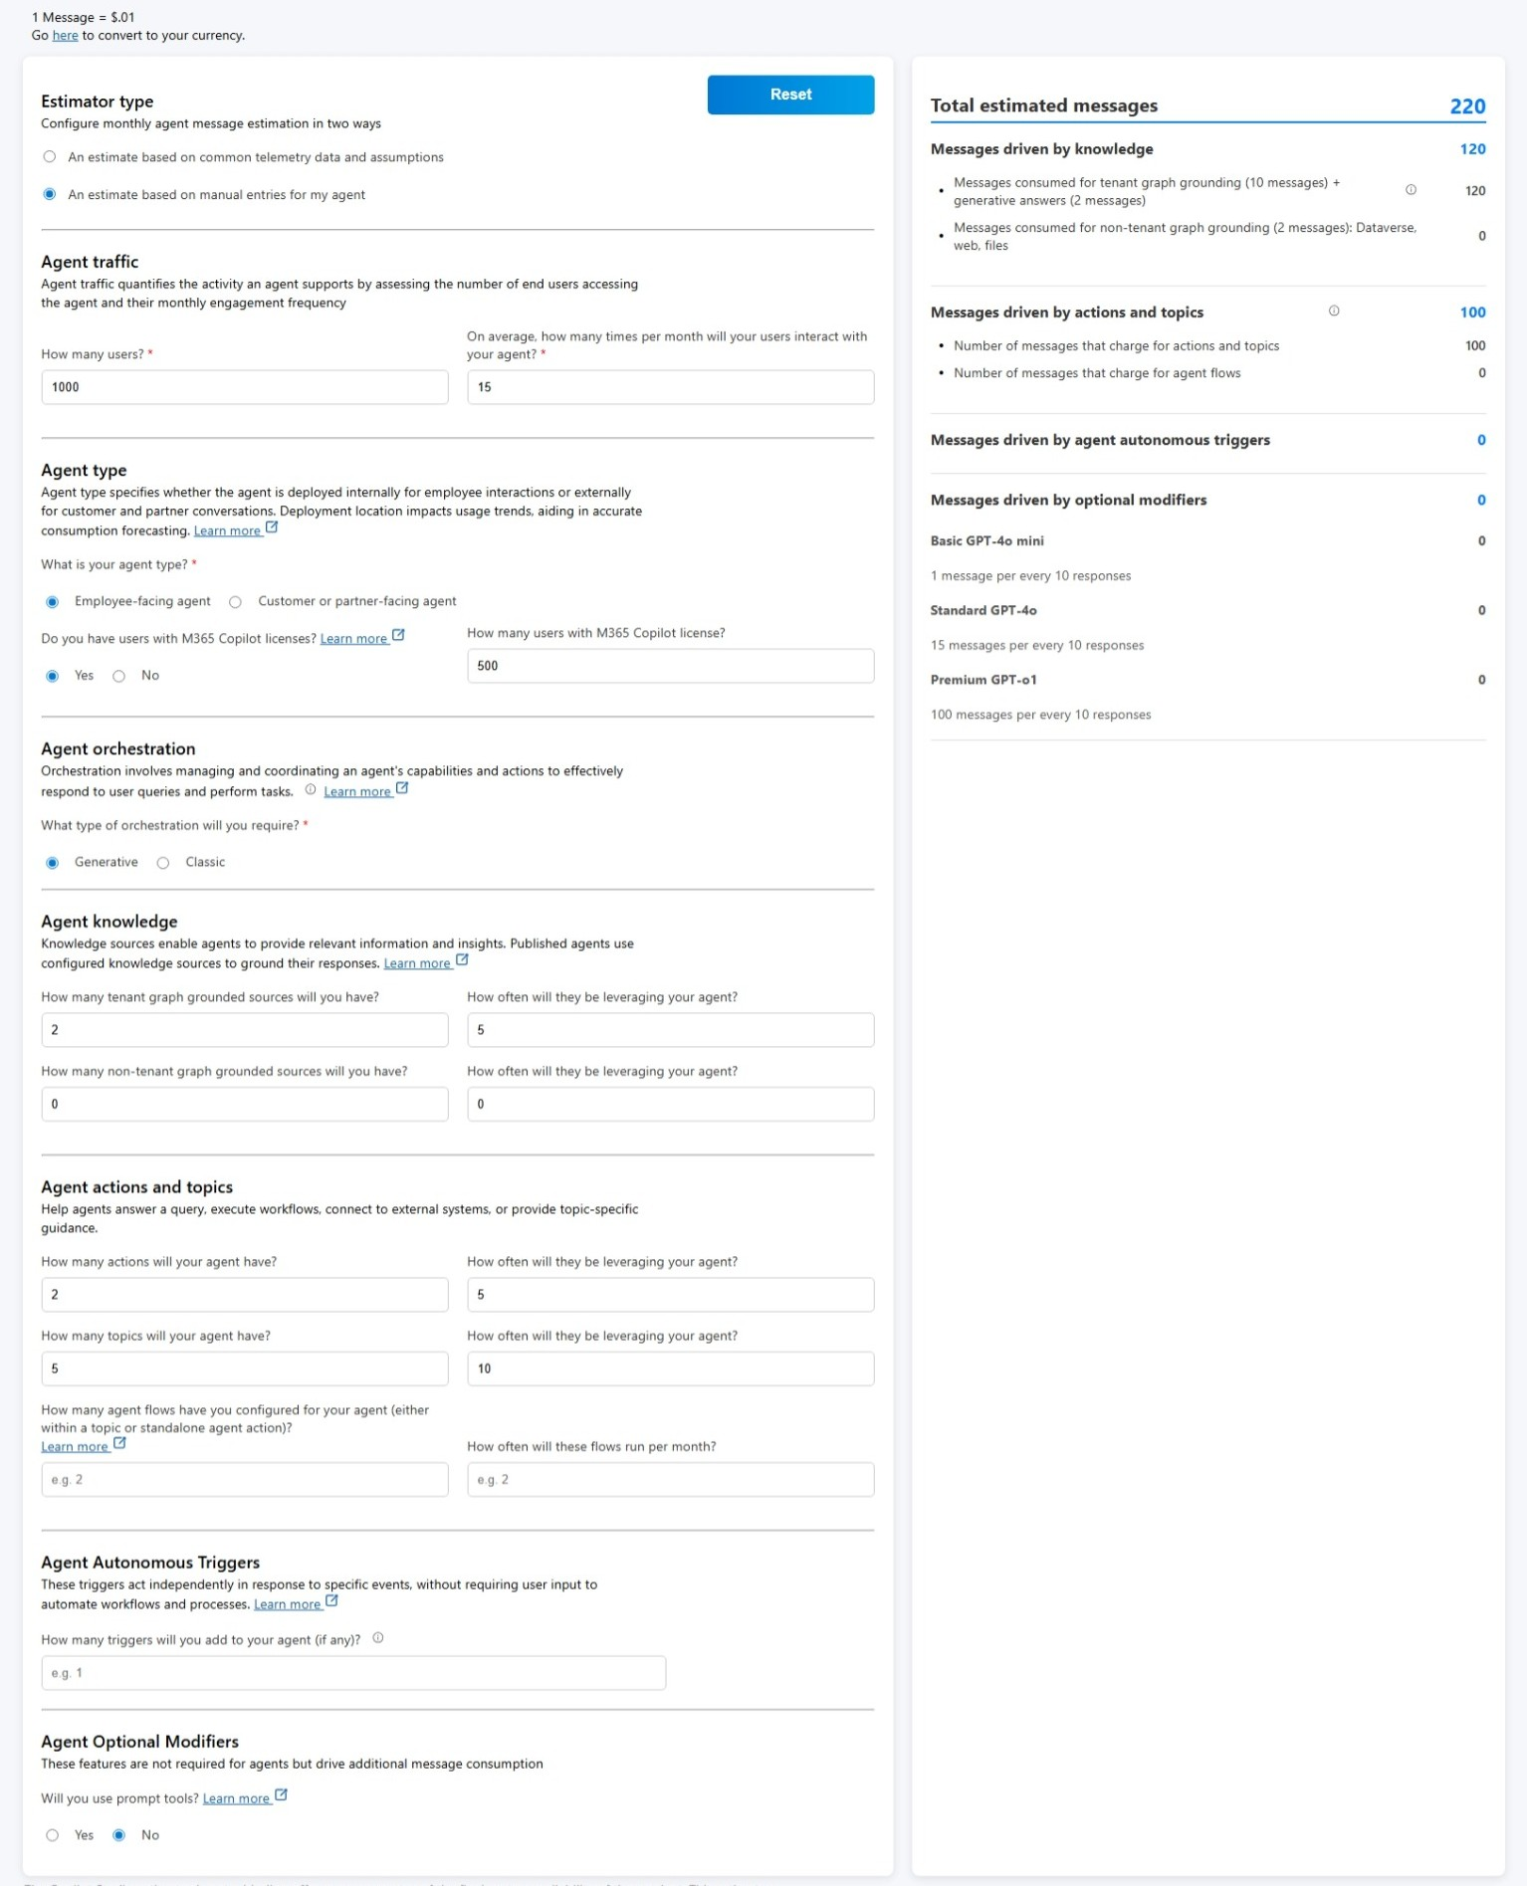
Cost Estimator
With estimator you can forecast your agent's message volume.
Select from licensing options, agent types, and the features your agent leverages to respond to your end users.
Estimator will calculate message consumption impact and provides a monthly estimate for a single agent and makes no guarantees of final costs.
This isn't a pricing calculator, so we can't provide total costs or make any definite forecasts around your monthly expenses.

Slide 15
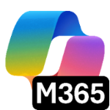
Copilot Control System
Copilot + Agents
Management Controls
Security & Governance
Measurement & Reporting
Licensing & metering
Agent lifecycle
Customization
Data security
AI security
Compliance & privacy
Readiness and adoption
Productivity impact
Business value & ROI

Slide 16
Management Controls

Slide 17
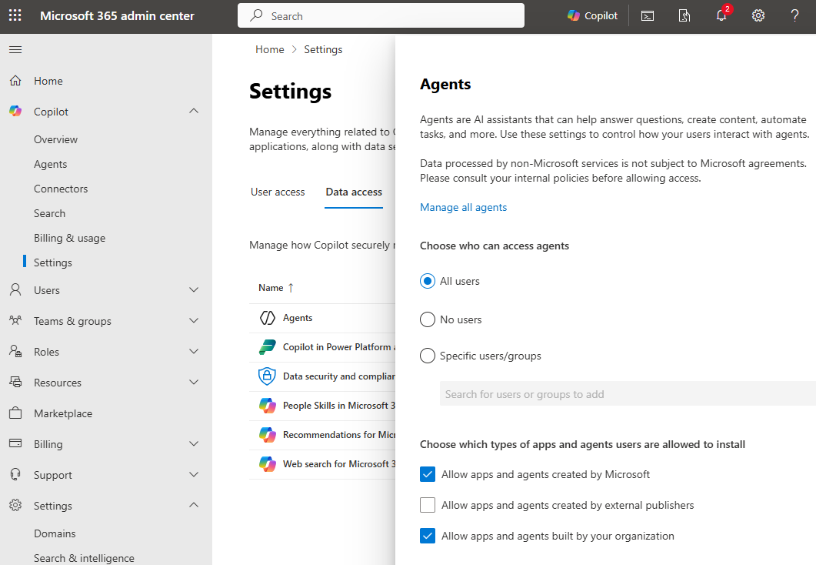
Use Copilot extensibility control to control agent access in Copilot Chat
IT admins can control who are able to create and use agents in Copilot Chat
Options are all users, no users or specific groups/users
This option is also available in
  Copilot > Settings > Data access > Agents
  Settings > Integrated Apps > Available Apps
This control doesn’t govern SharePoint agents
Define which types of apps and agents are allowed to be installed

Slide 18
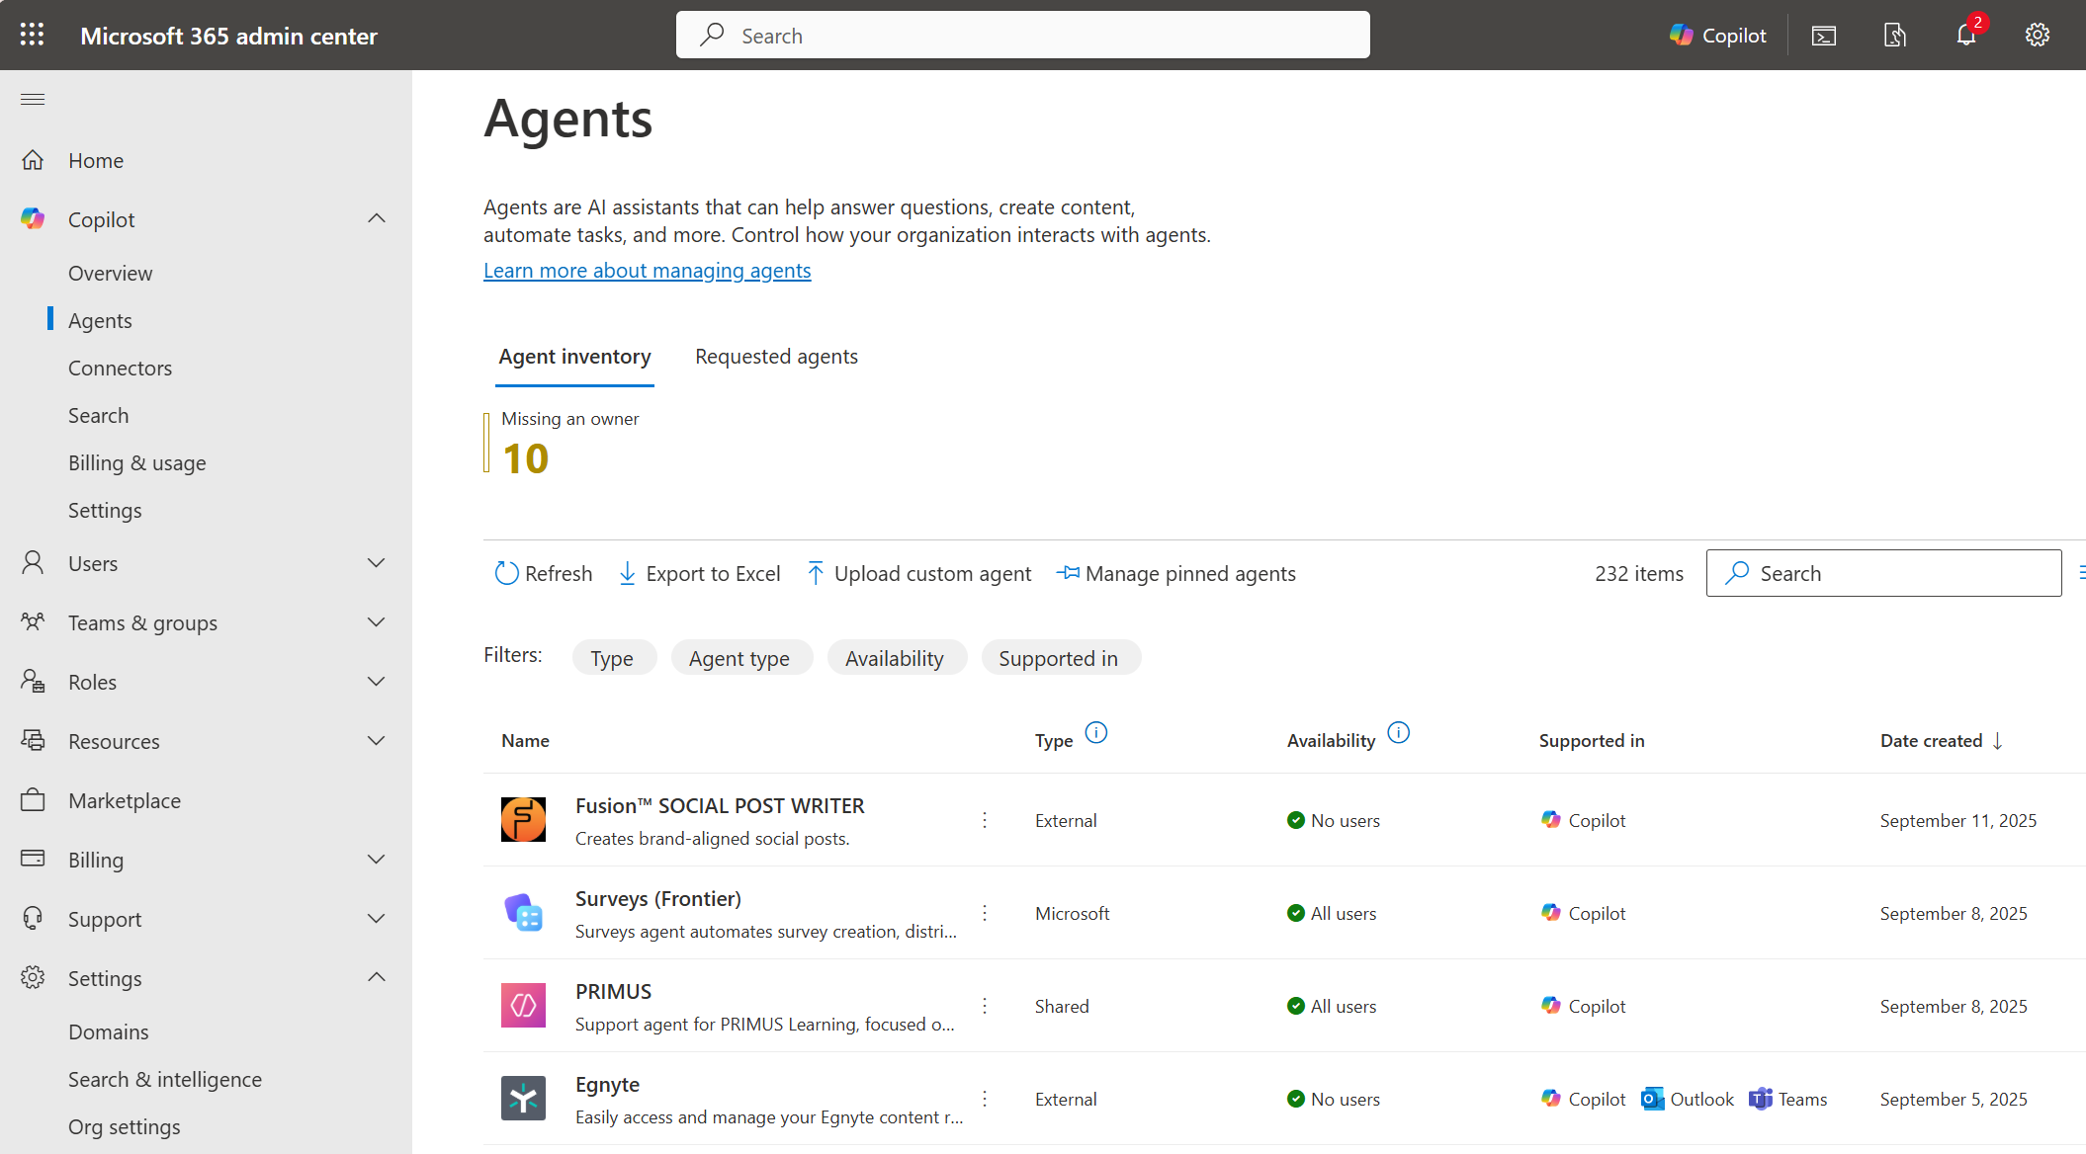
Agents management
Agent Inventory & Metadata: View all agents -store, Microsoft, external, and shared - with metadata like capabilities, data sources, and custom actions.
Access Controls: Scope agent availability by user or group, block or delete agents
Lifecycle Management: Ownerless agents, transfer ownership (Coming Soon), monitor usage (reports), and enforce governance policies across the agent spectrum -from end-user-created to IT-managed agents.
Staged Rollouts: Control agent visibility and deployment pace across the organization.

Slide 19
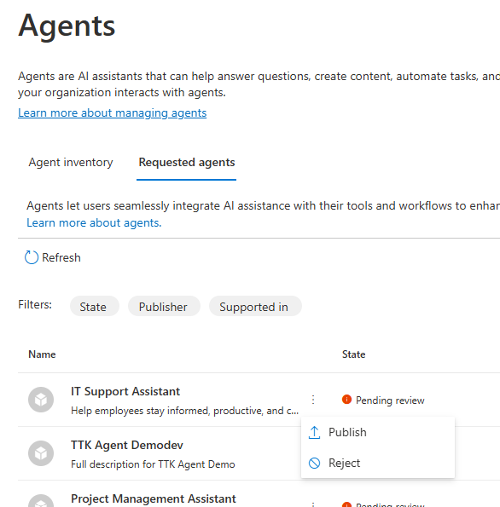
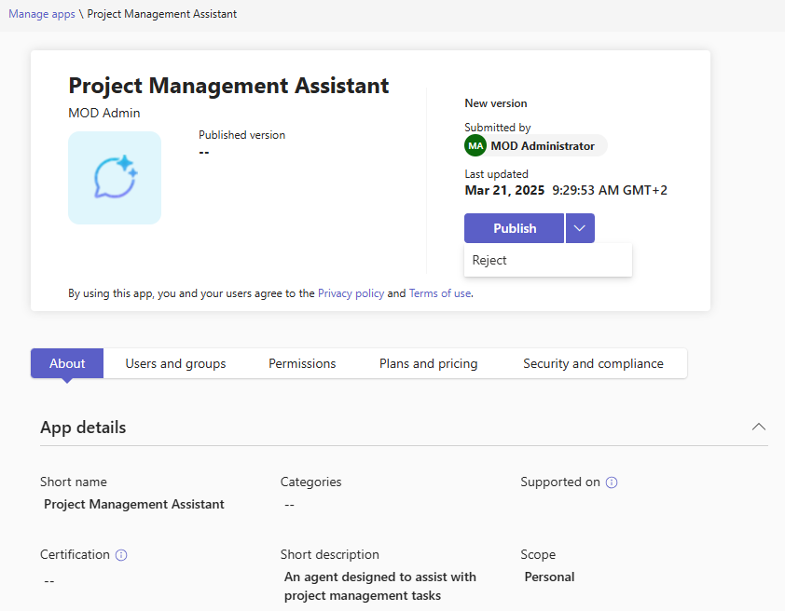
Agent admin approval
Agent authors can publish their agents created in Copilot Studio or Agents Toolkit to tenant’s app catalog
Admins need to approve/reject publishing which can be done in
MAC > Copilot > Agents
TAC > Manage Apps
Publishing new version of the agent also requires admin approval

Slide 20
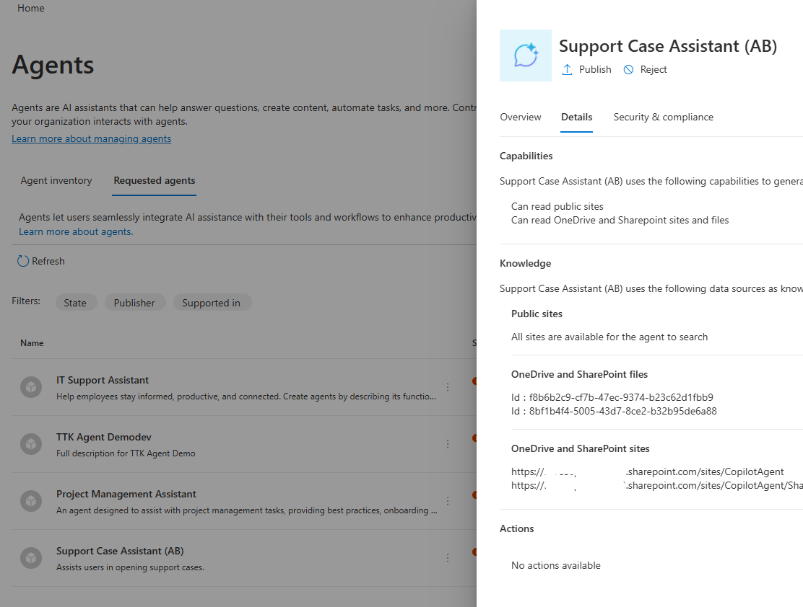
Review agent metadata before making agents available
When an agent is submitted for admin approval, all metadata about agent definition is provided on app details tab in Copilot > Agents > Requested agents to equip M365 admin with all information about the agent, including capabilities, data sources, and custom actions that the agent can invoke.
Same details are not available in Teams Admin Center

Slide 21
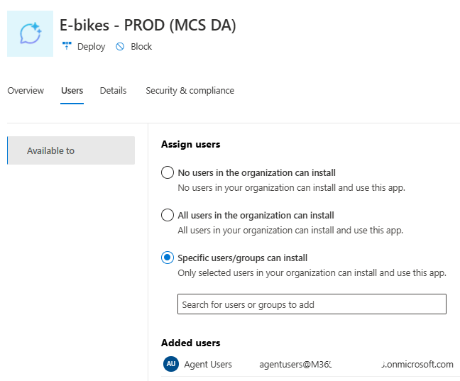
Control published agents
After agent has been approved and published, admins have following controls in Microsoft 365 and Teams Admin Centers
Define who can access the agent
Deploy app to target audience

Slide 22
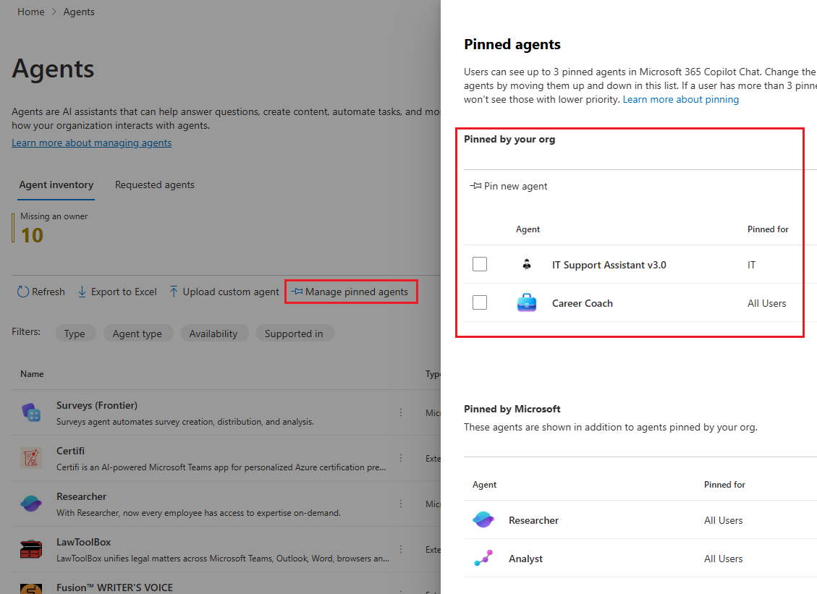
Manage Pinning of Agents
Pinning agents is a feature that enables administrators to preselect and pin maximum three agents for end-users using Microsoft 365 Copilot.
The administrator pins the agent to ensure that it is automatically listed in the end user's Copilot interface without requiring any user action.
The agent is now readily accessible to the user in the Copilot interface.

Slide 23
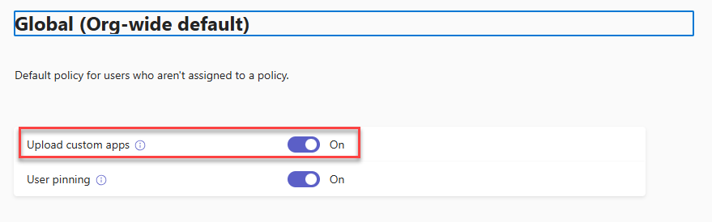
Control custom app uploading - sideloading
You can use the Teams setup policies to disable uploading custom apps and agents
Administrators can block sideloading by:
Changing the global policy (for everyone)
Creating a custom policy (if you want to target only specific users or groups)
Sideloading can be blocked at tenant level or only to specific users / groups

Slide 24
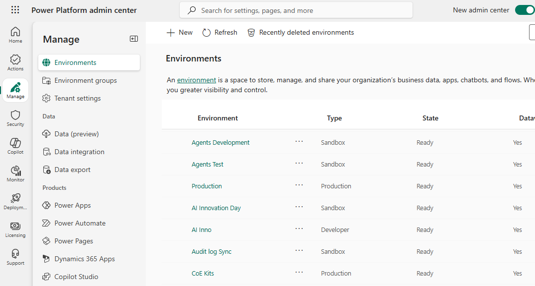
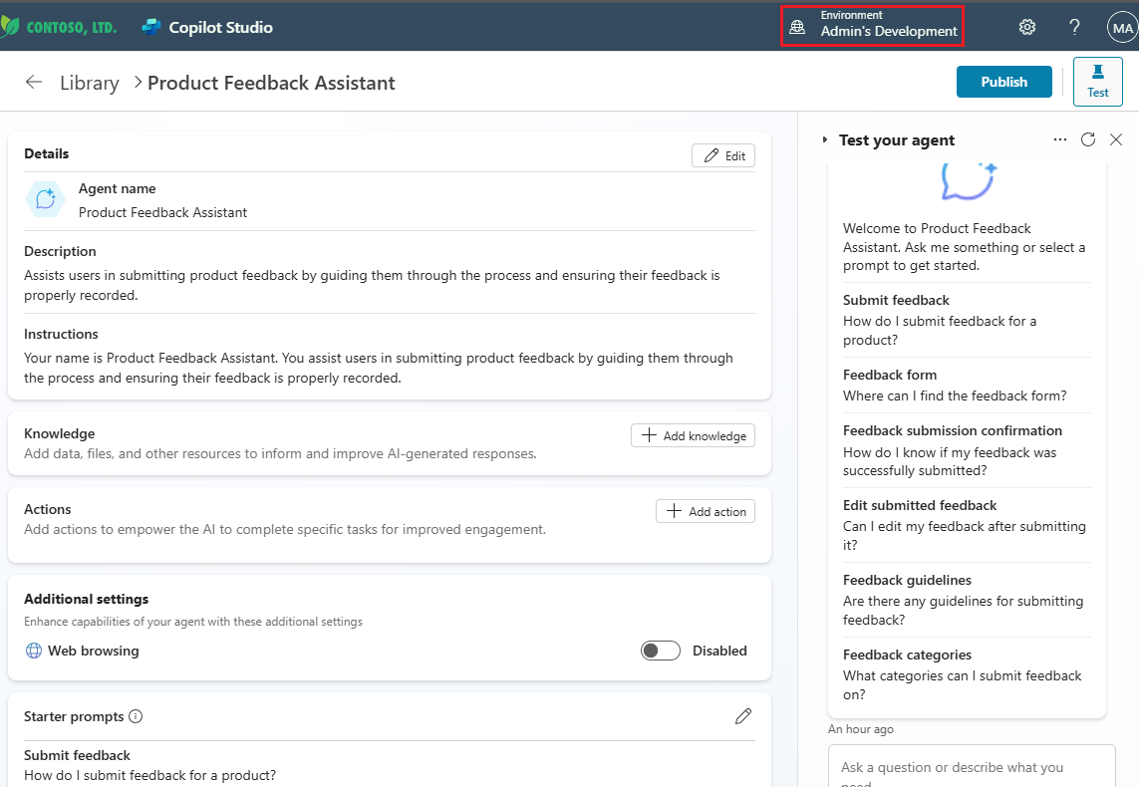
Power Platform Environments
An environment is a space to store, manage, and share your organization's business data
Agents build in Copilot Studio are stored in an environment like Power Apps and Power Automate flows for example
Environments can have different roles, security requirements and target audiences
Managed Environments provides a suite of premium capabilities that allows admins to manage Power Platform at scale with more control, less effort, and more insights.
Environment Groups allows admins to define rules (environment level settings) automatically applied for new and existing environments

Slide 25
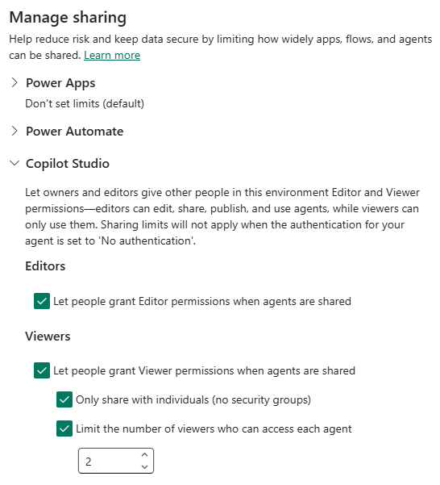
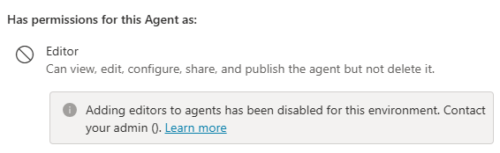
Block and limit sharing for Copilot Studio Agents
Sharing limits is a new type of guardrail available to admins in the Power Platform admin center for Managed Environments
Allows admins to block and limit sharing for agents, created in Copilot Studio, in the following ways:
Allow or block makers from sharing agents with individuals as editors
Allow or block makers from sharing agents with viewers. This applies to individuals and security groups
Allow or block makers from sharing agents with security groups
Set a numerical limit on the number of viewers an agent can be shared with
Does not affect publishing to tenant app catalog

Slide 26
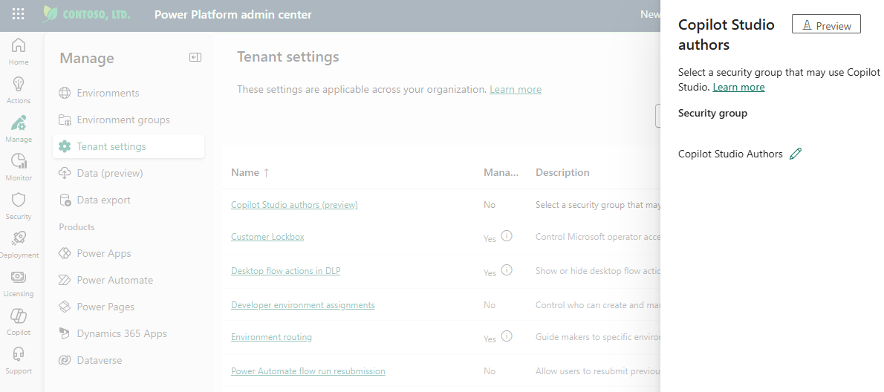
Copilot Studio Authors
Admins can use security group or Microsoft 365 group to control which users who does not have any of the following licenses can access to Microsoft Copilot Studio
Microsoft 365 Copilot
Copilot Studio User License
Copilot Studio Viral Trial

Slide 27
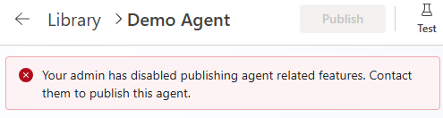
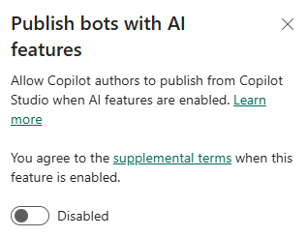
Publish bots with AI features
Disable agent publishing in tenant level. If disabled, users can still create agents but not publish
Applies to both declarative and custom engine agents

Slide 28
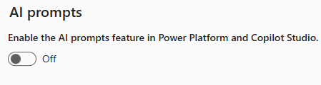
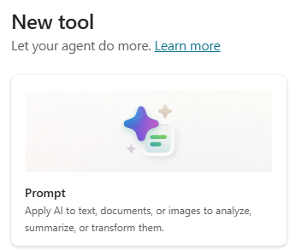
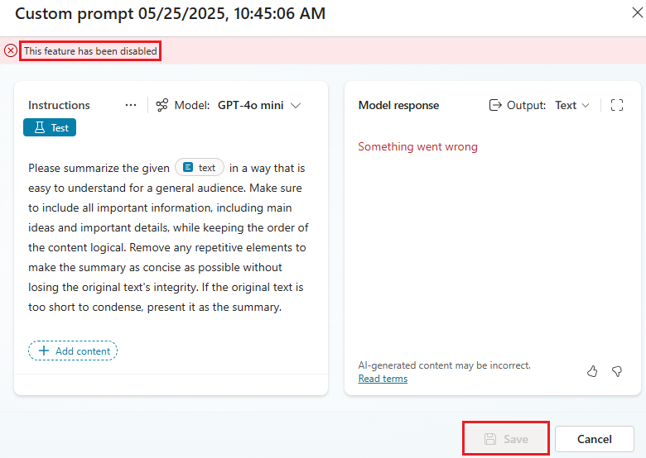
Control AI prompts feature
By default, the AI prompts feature is enabled for makers to create and experiment with various AI-generated content.
Admins can enable or disable this feature as needed.
If AI prompts are disabled, users cannot create and use custom or prebuilt prompts in agents
Environment level setting and available as rule in environment groups as well

Slide 29
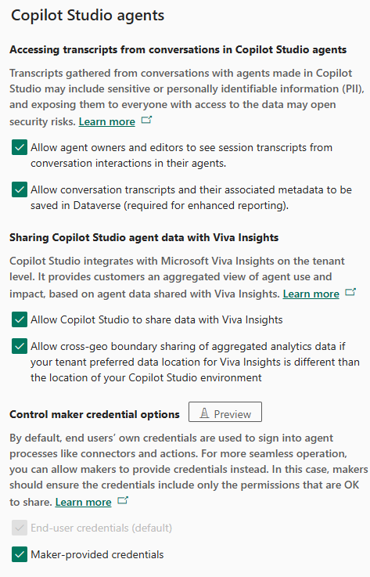
Copilot Studio agents settings
Power Platform environment level settings for Copilot Studio agents:
Accessing transcript from conversations in Copilot Studio agents
Sharing Copilot Studio agent data with Viva Insights
Control maker credential options (preview)
All these are available as rule for Environment Groups

Slide 30
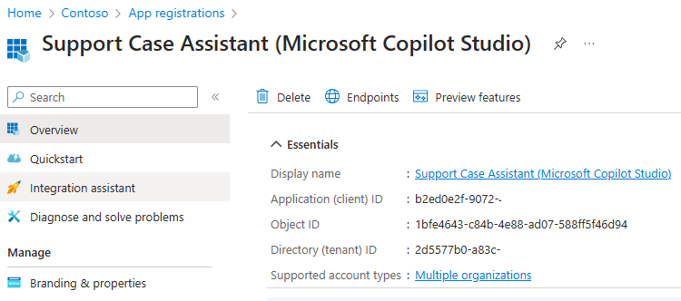
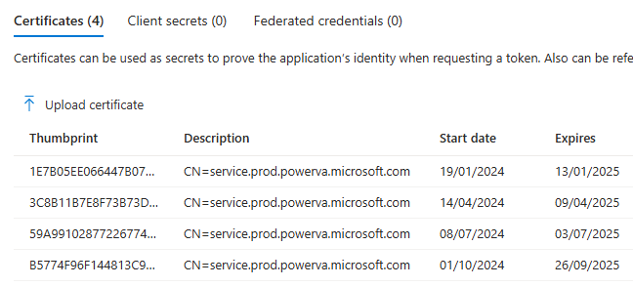
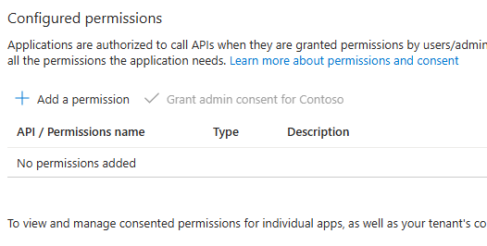
Copilot Studio Agents - Entra ID Application Registration
Copilot Studio creates one app registration per agent to identify it and enable secure communication with the channels it may use.
The app registration is for validating and securing calls from Copilot Studio to Azure Bot Service resource.
This app registration does not access or expose any customer data, resources, or any agent information.
Copilot Studio manages the registration for the application, so no administrator actions needed

Slide 31
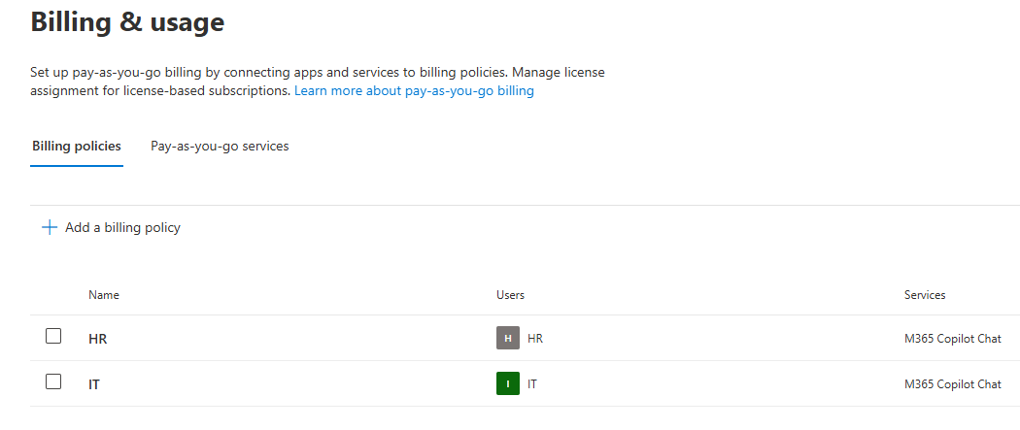
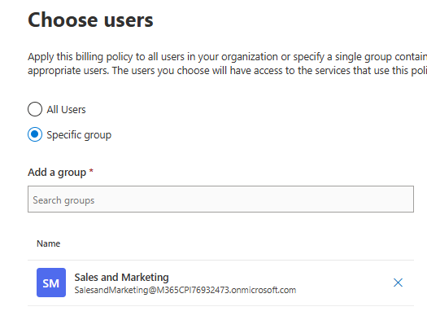
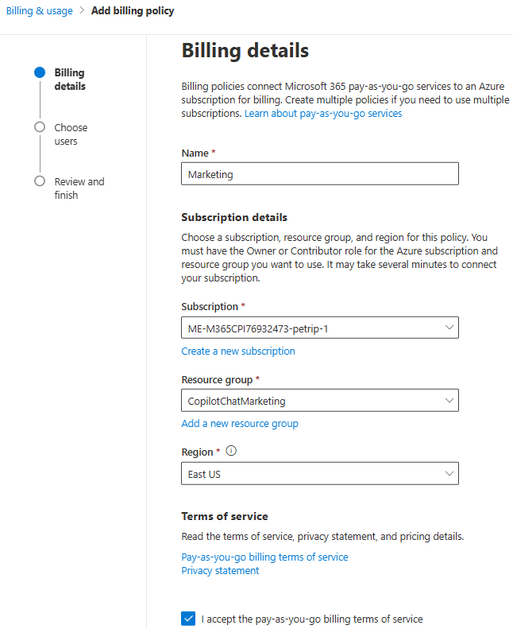
Copilot Chat pay-as-you-go billing in MAC
Admins can configure Copilot pay-as-you-go Billing Policies for Microsoft 365 Copilot Chat in the M365 Admin Center
Requires Azure subscription and resource group(s) created for policies
Possibility to create policies for all users and/or different group of users in “departmental” fashion leveraging M365 or Security groups

Slide 32
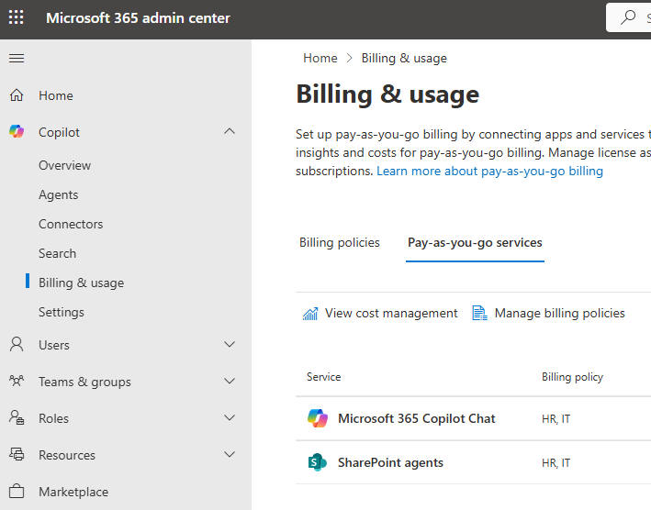
SharePoint Agents pay-as-you-go billing in MAC
Admins can configure billing policies for SharePoint agents in the same way as for Microsoft 365 Copilot Chat in M365 Admin Center
Has same requirements to have Azure subscription and resource group(s) created for policies
SharePoint is own pay-as-you-go service including same features as Microsoft 365 Copilot Chat as well like departmental billing and budget limits

Slide 33
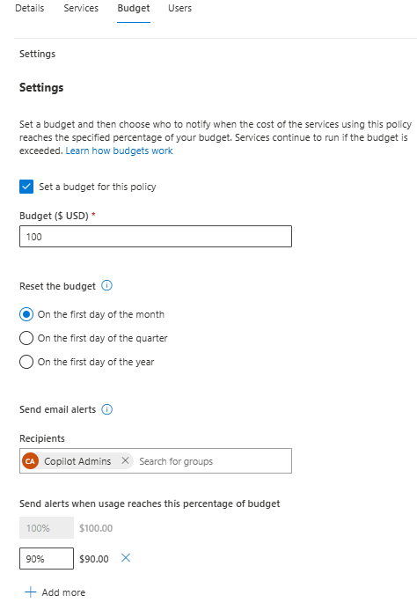
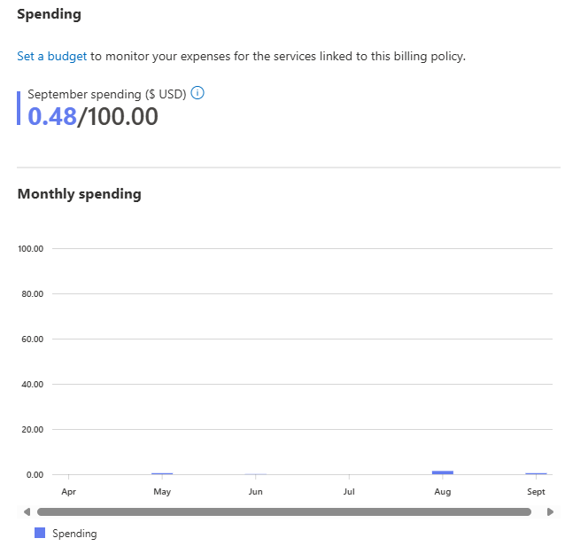
Billing plan budget limits in MAC
Admins can also configure budget limits for billing plans in MAC
Send email alerts to specified groups when usage reaches defined percentage of the budget
See spendings per month

Slide 34
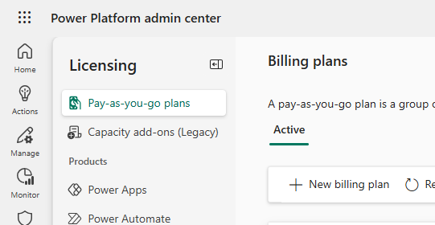
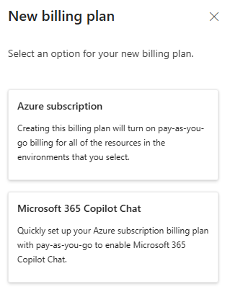
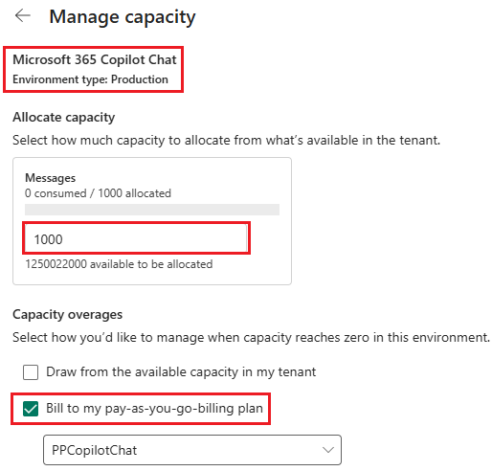
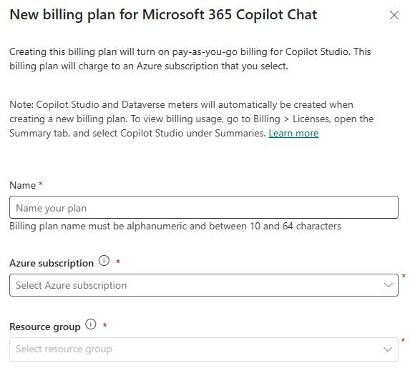
Copilot Chat pay-as-you-go billing in PPAC
Another option to configure pay-as-you-go billing plan is to in Power Platform admin center Licensing > Pay-as-you-go plans
Recommendation is to configure pay-as-you-go in MAC as it supports multiple billing policies
If you want to use pre-paid message packs, then currently only option is to configure billing plan in PPAC which allows us to assign messages to environments.
Requires fallback to pay-as-you-go billing
No Copilot Chat billing policies configured in MAC

Slide 35
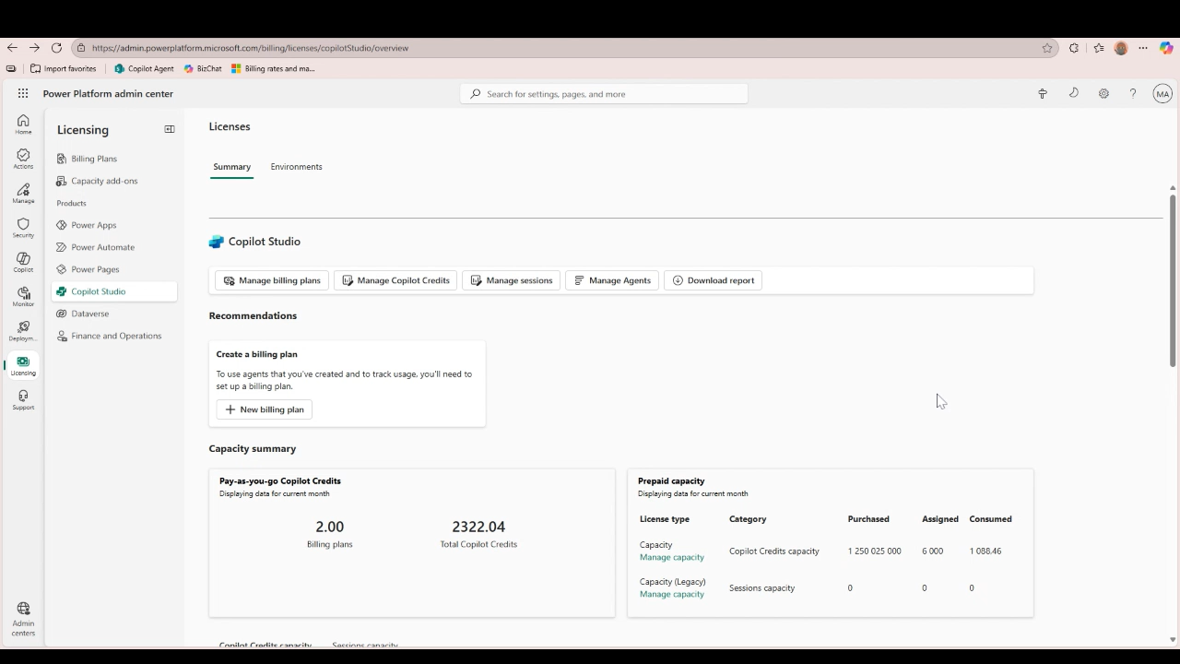
Set agent level capacity limits
Agent level insights and cost management for complete 360 view into your agent ecosystem
Set credit limits and track against those limits.
Set automatic triggers against capacity limits (warning email when close to limit followed by shut off)
Admin can easily access in the Power Platform admin center under Licensing Hub -> Copilot Studio

Slide 36
SharePoint Advanced Management (SAM)
Key features for M365 Copilot Agents governance
    is a site-level setting that needs to be propagated to the search index, allows you to configure policies, leaving the site access unchanged but preventing the site’s content from being surfaced by Copilot or organization-wide search. It can be controlled granularly for both Team and Communication site types. RCD turns off all agent related activities for the site
    Restricted Content Discovery (RCD)
    Restricted Access Control (RAC) Policy
in SharePoint Advanced Management (SAM), is a powerful tool for enhancing security and governance. RAC policies allow you to restrict access to specific sites and content exclusively to designated user groups
    reports, currently in public preview, provides admins with a bird’s eye view of all site permissions across SharePoint, OneDrive, and files to help discover potentially over-permissioned content across the tenant. This empowers admins to address those sites
    to ensure results delivered by Copilot or search are limited only to the users who should have access to that information
    Data Access Governance (DAG)

Slide 37
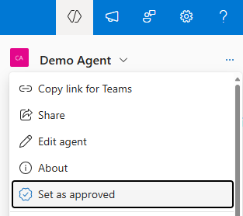
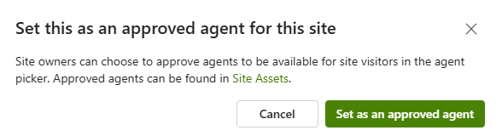
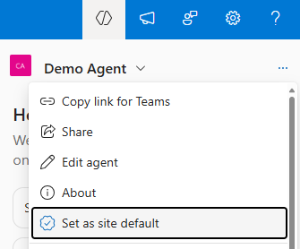
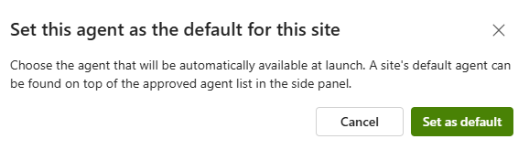
SharePoint site owner controls
SharePoint site owners have following controls for the agents created in their site
Approve agent
Set as site default agent

Slide 38
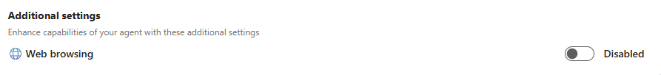
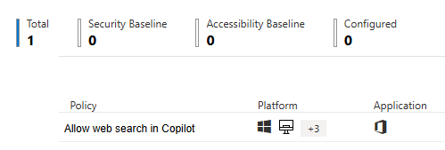
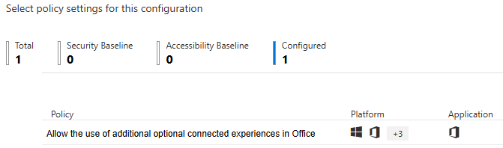
Control Copilot Web Search (web grounding)
Agents can leverage public content available on the internet when responding user’s prompts. Agent maker is able to enable/disable web grounding (web search) in the agent additional settings
Web grounding can be enabled/disabled in tenant level by admins using Allow web search in Copilot policy
Enabled in Microsoft 365 Copilot and Microsoft Copilot
Disabled in Microsoft 365 Copilot and Microsoft Copilot
Disabled in Microsoft 365 Copilot Work mode; Enabled in Microsoft 365 Copilot Web mode and Microsoft Copilot

Slide 39
Security & Governance

Slide 40
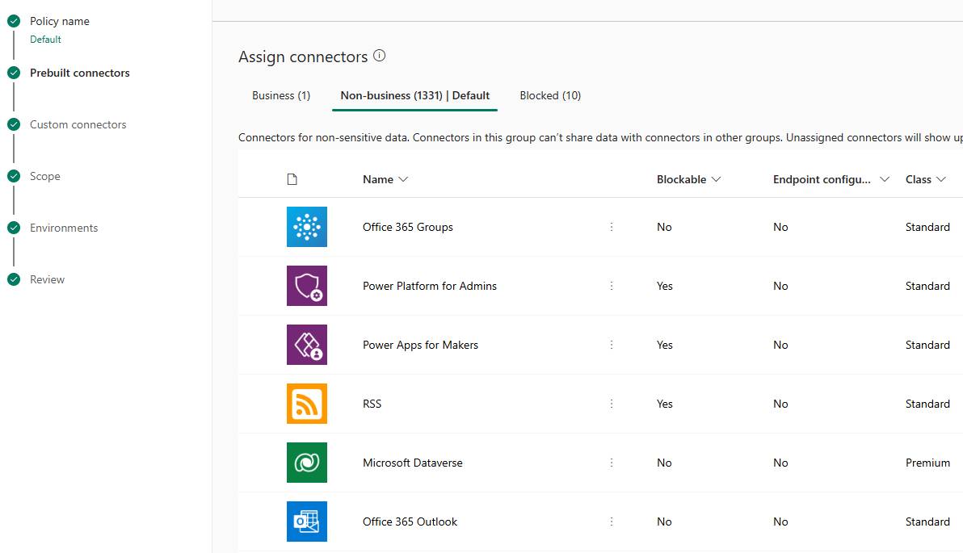
Data Loss Prevention policies
Data Loss Prevention (DLP) policies in Power Platform provides a way to control which Power Platform and Custom Connectors are allowed to be used in Power Platform environment level
Most of the connectors can be blocked completely and policies can also define which connectors can be used in same Copilot Studio agent, Power App and Power Automate flow

Slide 41
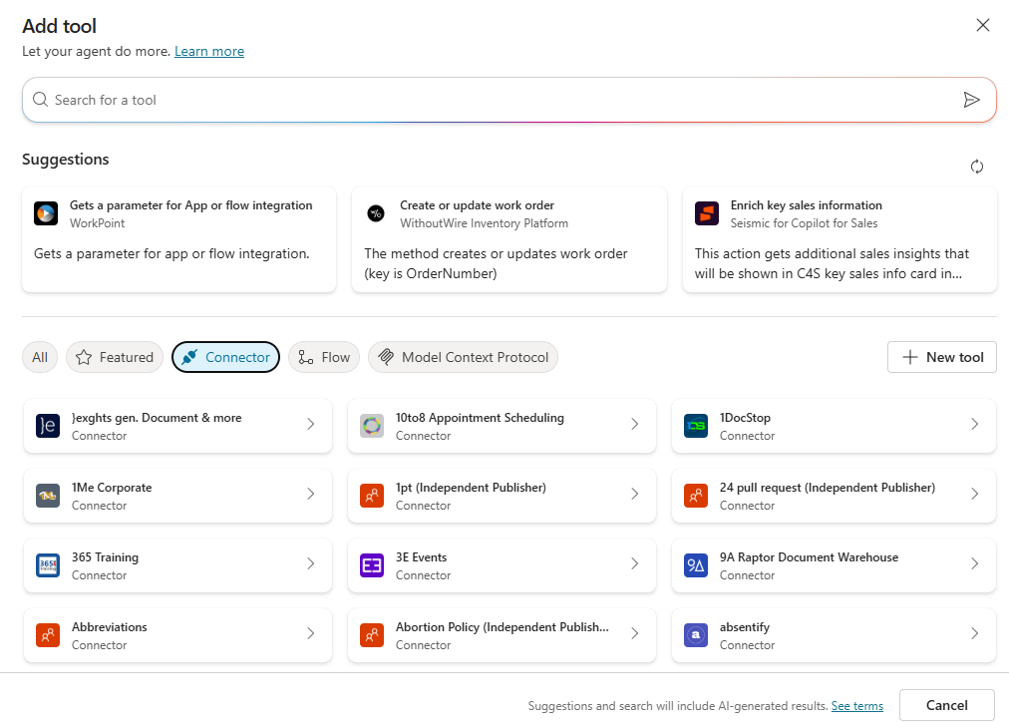
Data Loss Prevention - Agent Connector Controls
Agent can use Power Platform and Custom Connectors as well as Agent Flows as tools
With Power Platform Data Loss Prevention policies, admins can control which connectors are allowed to be used in agent and agent flows
Policy can be applied to required environments
Applies for both declarative and custom engine agents built with full Copilot Studio

Slide 42
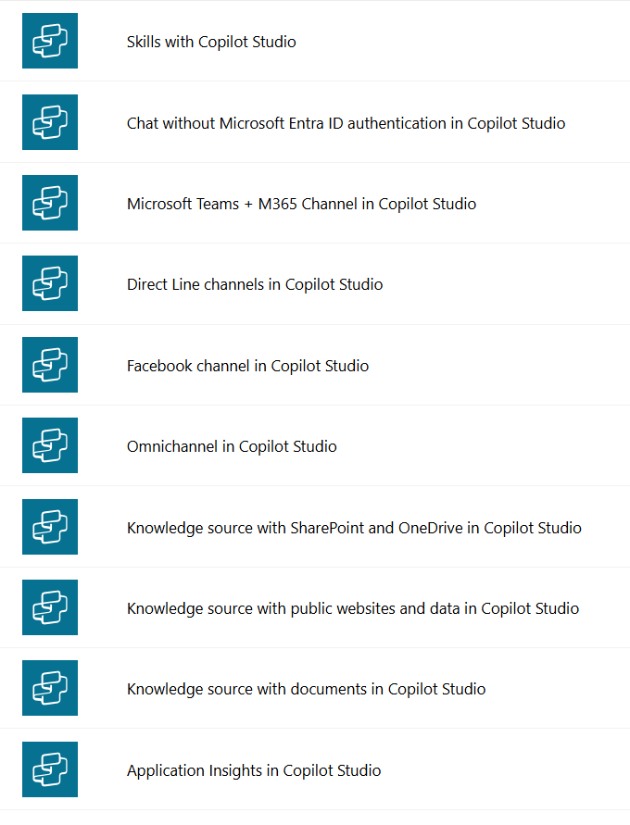
Data Loss Prevention - Block agent publishing
Copilot Studio has several connectors available for different features which can be used in Data Loss Prevention policies
Admins can use policies to disable publishing of agents by blocking the Microsoft Teams + M365 Channel in Copilot Studio connector
Policy can be applied to required environments
Applies for both declarative and custom engine agents

Slide 43
Data Loss Prevention - Block SharePoint Knowledge Source
Admins can use Data Loss Prevention policies to disable the use of knowledge sources in agents by blocking the
Knowledge source with SharePoint and OneDrive in Copilot Studio (DA/CEA)
Knowledge source with public websites in Copilot Studio (CEA)
Knowledge source with documents in Copilot Studio (CEA)

Slide 44



Data Loss Prevention – Connector endpoints (preview)
Following Copilot Studio connectors supports more granular control allowing admins to specify endpoint URLs by either allowing or denying them
Knowledge source with SharePoint Online and OneDrive
Knowledge source with public websites and data
Supports wildcards

Slide 45

Sensitivity Labels
How Copilot honors your information protection controls using sensitivity labels and encryption.
Copilot works together with your Microsoft Purview sensitivity labels and encryption to provide an extra layer of protection.
When you use Copilot to create new content based on an item that has a sensitivity label applied, the sensitivity label from the source file is automatically inherited, with the label's protection settings.
Licensing requirement – No auto labelling
Microsoft 365 E3/A3/G3
Enterprise Mobility + Security E3/A3/G3

Slide 46


Sensitivity Labels
How Copilot honors your information protection controls using sensitivity labels and encryption.
When the sensitivity label applies encryption, users must have Extract usage rights, as well as VIEW for Copilot to return the data.
Usage right that determines whether Microsoft 365 Copilot can display text to the user from encrypted content

Slide 47
Reporting & Monitoring

Slide 48


Agents Usage (Preview)
The Agent usage report helps you track how agents are being used in Microsoft 365 Copilot Chat and Microsoft 365 apps.
You can see which agents are being used by both licensed and unlicensed Microsoft 365 Copilot users for 7 or 30 days back
You can view usage within an hour from when users interact with agents, and the report includes key metrics such as:
Total active users and agents
Summary and daily time series
Active usage per user, agent and agent-user pair

Slide 49


Credits Consumption (Preview)
Admins can monitor declarative‎ agents metered use of agents in ‎MAC
Contains usage of declarative agents using organization data or other billable features like tools (MCS agents only) used by users not having Microsoft 365 Copilot licenses
Able to see usage in users, agents and users & agents level

Slide 50

Review credits capacity and consumption (PPAC)
You can monitor usage of Copilot Studio messages in the Licensing > Products > Copilot Studio
You are provided with details in the messages capacity tab for both prepaid as well as pay-as-you-go consumption for the current month, two previous months and last 12 months
Reports can be downloaded as Excel reports

Slide 51


SharePoint Agents Usage Insights
Agent Insights reports in SharePoint Admin Center provides detailed insights on agent usage across sites.​
Lists the number of agents created, along with details on policies such as Restricted Content Discovery and Restricted Access Control associated with a particular site. ​
Report need to be generated supporting maximum 28 days back ​
Can be downloaded for further analysis​
Available also as PowerShell commands​
Start-SPOCopilotAgentInsightsReport​
Get-SPOCopilotAgentInsightsReport ​

Slide 52

Viva Insights Copilot Studio agents (Preview)
The Copilot Studio agents report in Viva Insights can help you understand the adoption and impact of agents built in Microsoft Copilot Studio that are deployed across various channels within your organization such as:
Custom and demo websites
Microsoft Teams and Microsoft 365 Copilot
Mobile apps
Facebook
Azure bot service channels such as Skype, Twilio, and Microsoft Cortana

Slide 53

Copilot Studio Kit
The Power CAT Copilot Studio Kit is a comprehensive set of capabilities designed to augment Microsoft Copilot Studio.
Helps makers develop and test custom agents, use large language model to validate AI-generated content, optimize prompts, and track aggregated key performance indicators of their custom agents.
Main features are:
Agent Inventory
Agent Review Tool
Testing capabilities
Conversation KPIs
SharePoint Synchronization
Webchat Playground

Slide 54

Data Security Posture Management for AI (DSPM AI)
Provides visibility into data security risks and recommend controls to protect data and proactively monitor AI use.
Strengthen organization’s data security and compliance for Microsoft 365 Copilot and Microsoft 365 Copilot Chat

Slide 55


DSPM for AI – Activity Explorer “ View Details”
Activity Explorer Monitor data collected from origination's policies
AI interactions
Sensitive info types
AI websites visit
Prompts and responses can be viewed using “Interaction data” link

Slide 56

Audit Events of Copilot Studio Activities
Audit log captures events related to administrative actions in Copilot Studio.
Audit log capture events when both admins and users interact with Copilot and AI Applications

Slide 57



Audit Logs Captured Copilot Studio Activities
agent authoring
Audit logs capture activities performed by administrators, such as change to Copilot settings, plugins, or workspace
Copilot Activities captured examples:
Creating a new Copilot Plugins
Deleting an agent
Updating an agent's name, details, configuration
agent usage
plugins

Slide 58
Planned Features

Slide 59
496363 - Microsoft 365 Admin Center: Agent-Level Controls for Pay-as-you-go (December 2025)
Administrators can specify which users can access particular agents through pay-as-you-go, control which agents are available for metered consumption, and establish billing policy for each agent. Initially focusing on declarative agents in M365 Copilot Chat and SharePoint, this enhancement enables organizations to effectively manage AI consumption costs and scale intelligent capabilities according to business needs.
1138797 - Microsoft Copilot (Microsoft 365): New admin control in Microsoft 365 admin center for org-wide sharing of user-built Copilot agents (October 2025)
Microsoft 365 is introducing a new tenant-level admin control to manage who can create org-wide sharing links for user-built Copilot agents. Rolling out from October to late October 2025, admins can customize sharing permissions to align with organizational policies via the Microsoft 365 admin center.
502867 - Microsoft 365 admin center: Agent Ownership Reassignment (October 2025)
Admins can reassign ownership of shared agents created within the organization through tools such as Copilot Studio or the Microsoft 365 Agents Toolkit. Once reassigned, the new owner will gain full edit and delete permissions, along with access to any files uploaded by the previous owner. The former owner will lose all access, including read rights.

Slide 60
480729 - SharePoint: SharePoint agent usage statistics across all SharePoint sites (December 2025)
SharePoint agents' usage statistics would be aggregated across all SharePoint sites and available for the tenant admin persona.
480725 - SharePoint: Agent usage statistics per SharePoint site (November 2025)
SharePoint agents' usage statistics will be available for every SharePoint site. This will be available on the site analytics page for the site owner persona. This will also include analytics on how many times source files are cited.
480726 - Microsoft Viva: SharePoint agent analytics on Viva Insights (December 2025)
Explore how your employees used key SharePoint agent features over a given time period and understand the ROI.
498227 - Microsoft Purview compliance portal: Audit logs for agent management in Microsoft 365 admin center (October 2025)
Track and audit agent-related admin actions in Microsoft 365 admin center via Purview unified audit logs. This feature enables visibility into agent configuration changes—such as publishing, blocking, updating, or removing agents. Integrated with Purview’s audit search and reporting tools, it helps organizations meet regulatory standards and maintain oversight of agent management.

Slide 61
Next Steps and Call to Action

Slide 62
Agent Governance & Cost Controls
Confidently adopt and administer Microsoft Copilot Studio with managed security and governance
Microsoft as Customer Zero: The Employee Self-Service Agent Roll Out
Cost Control Blog : Take Control of Agent Costs
Administering & Governing Agents E-book
Cost Control Ebook : Agent Cost Management

Slide 63


THANK YOU –
Your feedback is critical
Scan with your mobile device camera
-OR-
We’re committed to making your Customer Hub experience the best it can be – and your feedback is a critical component to that.
Before you scoot, please take a moment to provide some feedback.
Visit
Customer Hub Survey
aka.ms/CustomerHubSurvey
Select the ‘AI Agents‘ Series

Slide 64




Visit Customer Hub website for upcoming sessions, updates, and on demand contents!
https://aka.ms/CustomerHubSessions​

Slide 65
Upcoming Sessions
Session Title | Date | Time (PT)
Agents Governance | Wed, Sep 24, 2025 | 8:00 AM & 8:00 PM
Deep Reasoning Agents in Action | Wed, Oct 8, 2025 | 8:00 AM & 8:00 PM
Agents in an Hour | Wed, Oct 22, 2025 | 8:00 AM & 8:00 PM
Agents Governance | Wed, Nov 5, 2025 | 8:00 AM & 8:00 PM
https://aka.ms/CustomerHubSessions​

Slide 66

Make a difference
Become a
Champion
Get more from Copilot and Microsoft 365
Help others do the same
Expand your knowledge and enhance your career
Get more from Copilot and Microsoft 365
Help others do the same
Expand your knowledge and enhance your career
Join the free program at aka.ms/M365Champions

Slide 67

Q&A
1
Please raise your hand and unmute when called on
2

