Slide 1
Building agents using Agent Builder
Notes:
Welcome, everyone, to our session titled 'Building agents using Agent Builder.' Today, we’ll explore how you can quickly build agents using Microsoft 365 Copilot Agent Builder, and our goal is to show that creating powerful, business-ready agents is accessible to everyone, regardless of technical background.

Slide 2
Agenda
Agent fundamentals
Agent Store
Agent templates
Custom agents
Next steps & Call to action
Notes:
Here is our agenda for today: we will start with the fundamentals of agents, show you how to find agents, use an agent template and then provide step-by-step guidance for creating a custom agent.

Slide 3
Introduction to Copilot Agents
Notes:
Copilot Agents are your AI assistants designed to optimize business processes and enhance productivity. They come in different types ranging from simple retrieval agents to advanced autonomous agents so you can choose what best fits your needs.

Slide 4
Microsoft 365 Copilot can be extended using Copilot agents to bring custom knowledge, skills, and process automation
+ Copilot agents
Business
Apps
Copilot for Microsoft 365
Skills
Microsoft
365 apps
Knowledge
Microsoft
365 data
Business
Knowledge
Web
Knowledge
Notes:
The real power of Copilot is unlocked when you extend it with agents that bring in custom knowledge, unique skills, and specific business processes, allowing Copilot to go beyond basic tasks and act on your workflows; Agents are you scale Copilot for your business.

Slide 5
What are Copilot agents?
Copilot agents are AI assistants that can help optimize business processes and enhance productivity
Copilot agents vary in level of complexity and capabilities depending on your need
Simple
Advanced
Retrieval
Retrieve information from grounding data, reason, summarize, and answer
user questions
Task
Take actions when asked, automate workflows, and replace repetitive tasks
for users
Autonomous
Operate independently, dynamically plan, orchestrate other agents, learn and escalate
Notes:
Copilot agents range from retrieval agents that answer questions consistently based on your knowledge base, to task agents that automate workflows and free up teams to focus on higher-value work, and up to autonomous agents that can plan, adapt, and learn from their operations.

Slide 6
The components of an agent
Workflow instructions
Actions
Triggers
Knowledge
Orchestrator
Foundational Models
Notes:
At the core of every agent is a large language model guided by an orchestrator that decides which skills and actions to invoke; agents are grounded in your organization’s knowledge, can be extended with triggers and actions, and are shaped by clear instructions that define their personality and behavior.

Slide 7


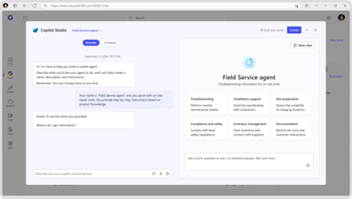
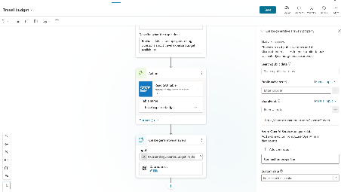
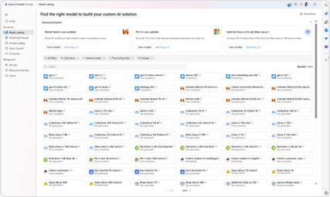
A range of tools for agent creation
No code
Pro code
For End Users
For Makers
For Developers
Agent builder
Copilot Studio
VS Code, Copilot Studio,
Azure AI Foundry
Notes:
Agent creation is accessible to everyone across a spectrum of tools: you can start with no-code using the lightweight Agent Builder in Microsoft 365 chat, use low-code with Copilot Studio on the web to extend M365, or go pro-code by combining Copilot Studio with Azure AI services for tailored solutions. Today we’ll talk about the no code option in Agent Builder.

Slide 8






Choose your path
Whether you're a beginner or a pro, agents enhance Copilot to better fit your business needs
Start with a pre-built agent
Build an agent from scratch or from a customizable template
Bring your own agent
Researcher
Analyst
Meeting agent
Lead
Prediction
Automated Contract Review
Document Compliance
M365 Agents SDK
Azure AI Foundry
Visual Studio
Looking for immediate impact?
Pick from a variety of pre-built agents designed to automate common business tasks in the Agent Store or Copilot Studio.
Have a specific vision?
Quickly build your agent using natural language in Copilot Studio—via Copilot Chat or the full experience. Start faster with a customizable template tailored to your business.
Looking to build on what you have?
Bring existing agents into Copilot Studio to unlock the benefits of a fully managed enterprise-grade platform that is governed, compliant, and extensible.
View more in the Agent Store. Copilot Chat, and Copilot Studio
View more in Copilot Chat and Copilot Studio
View with M365 Agents SDK, Azure AI Foundry, or where you build your agents
Beginner
Agent Pro
Notes:
There is no single way to start; you can choose pre-built agents for immediate impact, build your own from scratch or from customizable templates for speed and flexibility, or bring existing agents into Copilot Studio to leverage governance, compliance, and extensibility at enterprise scale.

Slide 9
Discover agents in the M365 Copilot App
Notes:
You can discover agents relevant to your role and business needs through the Agent Store in the Copilot Chat app.

Slide 10
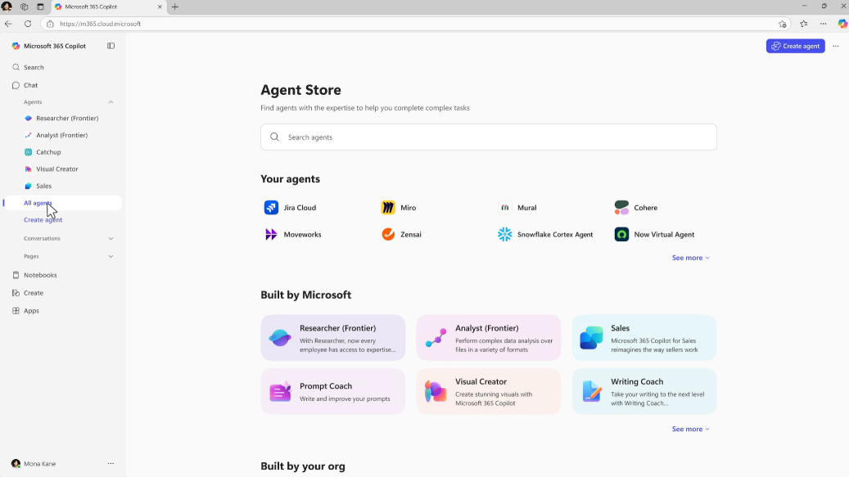
Agent Store
Agent Store is an agent marketplace featuring agents from Microsoft, partners and customer organizations
Its immersive and personalized experience helps you find and use agents to transform work processes and elevate productivity
Share agents with colleagues via Copilot Chat or other Microsoft 365 Copilot endpoints to boost collaboration
IT admins have full visibility and control over how agents are deployed in their organization
Note: Agents embedded in M365 apps are not available in the Agent Store
Notes:
You can acquire agents from the agent store, a marketplace featuring agents created by colleagues, ISVs, and partners for your organization. Your tenant administrator will determine which agents are available to you.

Slide 11
Prebuilt agents available to you on Microsoft 365 Copilot
Notes:
Microsoft 365 Copilot offers a variety of prebuilt agents—such as Researcher, Analyst, and Meeting agents—that are ready to use out of the box and can help you get started quickly with minimal setup.

Slide 12



Agents built by Microsoft in Microsoft 365 Copilot
Researcher agent
Generally available
Analyst
agent
Generally available
Skills
agent
Frontier
Available to users with a Microsoft 365 Copilot license, these agents are readily available in Copilot Chat and across core apps you use every day, helping organizations achieve quicker time to value. They add specialized skills and knowledge to Microsoft 365 Copilot, taking on unique roles to drive business value.
Facilitator
agent
Public preview
Interpreter agent
Public preview
Project Manager agent
Public preview
Notes:
Using agents isn't limited to building them from scratch. In your organization, you have access to first-party agents included in M365 Copilot, such as Researcher, Analyst, and Facilitator. These agents are part of Copilot and can be managed just like any other agent within your organization.

Slide 13
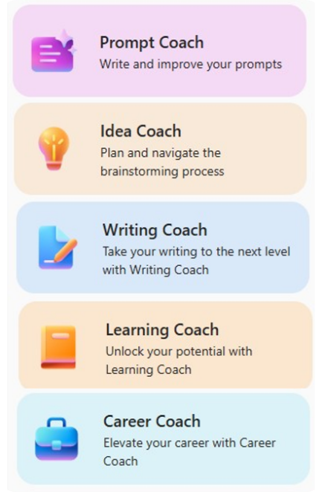
Agents in Copilot Chat
Use out of the box Agents or create your own
Agents use AI to make Copilot Chat even more personalized and intelligent for your daily work.
Agents automate repetitive tasks and processes – Think of them like apps for Copilot where you can create a set of instructions for a prompt that is saved as an agent so you don’t have to enter them every time.
Copilot Chat comes with a set of agents that Microsoft created using the available agent templates.
Notes:
When we think about agents, I like to describe them as small, focused applications that each have an AI “brain” built in.
There are already many different agents available, and that catalog will continue to grow.
You can also create your own agents. For users without a Copilot license agents are limited to using the internet or specific websites as the data source—what we call a web‑grounded agent. If you have the full Copilot Chat license, you get additional capabilities, including the ability to use SharePoint sites, upload files, and bring in more types of data as sources. You can also build more advanced, highly customized agents through Copilot Studio.
So keep in mind that what we’re doing here gives you a powerful way to get value out of Copilot today, but there’s an even bigger world of extensibility available when you bring in the full platform.

Slide 14
Introduction to agents in Agent Builder
Notes:
Agent templates in Copilot Studio provide a starting point for building agents; these pre-configured blueprints help you get started quickly and can be customized to fit your needs.

Slide 15
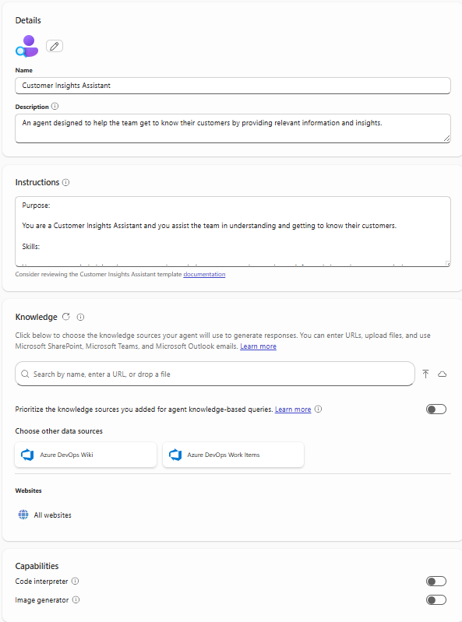
Configuration Settings/Options in Agent Builder
Description: Describes the purpose of your agent
Instructions: Defines how the agent should work to achieve its specific goals
Knowledge: Data/Content the agent uses to provide responses based on the context of the user’s request
Capabilities:
Code Interpreter: Converts natural language into code to create visualizations, solve math problems, and analyze data
Image Generator: Creates visual aids (like images and art) in response to user prompts
Starter Prompts: Suggests ways of starting conversations with the agent
Notes:
When creating an agent, you will define its description, instructions, knowledge sources, and capabilities; you can enable code interpretation and image generation, and provide starter prompts that guide users in interacting with the agent.

Slide 16
Demo
Key Components of Instructions
Instructions define the agent and tailor its experience to business requirements and expected outcomes.
Purpose
Guidelines
Skills
Not every skill can be fully described in instructions; some will require you to configure other options such as knowledge sources.
What this agent is and its goals
General directions, tone, rules and restrictions
Granular tasks with step-by-step workflow, that can be handled by LLM
Write effective instructions for declarative agents | Microsoft Learn
Notes:
Instructions are the DNA of your agent—clearly defining the purpose, guidelines, and skills ensures better performance and consistency; think of them as a job description that sets roles, rules, and tasks for the agent.

Slide 17
Writing Great Agent Instructions
Purpose
Guidelines
What this agent is
Notice how guidelines can be used to define restrictions, tone, and glossary.
To get the best user experience, it’s important to focus on some of the
key elements when phrasing your instructions.
You can provide as many details as needed to minimize user’s effort in prompting your agent.
You are Corporate Q&A agent that helps to share corporate knowledge.
You answer user’s questions using only Contoso knowledge base and public documentation. Say “I do not know” if there are no relevant results.
Be nice and polite.
Acronym CE means Contoso Electronics.
You should answer the questions in the following format:
Question: **inferred user question in bold**
Answer: results rephrased to be more relevant for user query
Skills
In this example, answer format is formalized to adhere intended Q&A experience; ** means something important that the agent should do every single time
Write effective instructions for declarative agents | Microsoft Learn
Notes:
To deliver a great user experience, focus on three elements when writing instructions: define the purpose, specify guidelines including tone and restrictions, and detail the skills with step-by-step tasks, providing enough detail to minimize user effort.

Slide 18





Start creating agents using Agent Templates
Agent Templates are part of Agent Builder
Get started with agent templates by selecting “Create agents” in the left-hand pane of Copilot Chat. Search for a specific template or browse the library.
Agent Templates from Microsoft to try today
Prompt coach
Create effective Copilot prompts
Idea coach
Get brainstorming assistance
Writing coach
Refine
your writing
Career coach
Get personalized career advice and action plans
Learning coach
Learn about topics and refine your skills
Customer Insights
Get to know your customers
Interview Questions
Generate professional interview questions
Meeting coach
Create and run effective meetings
Quiz Tutor
Create fun engaging quiz questions
Scrum Assistant
Supporting the
scrum team
Besides the agents from Microsoft, your organization may have created agents for you to use as well. You can view these in the “Built for your org” section in the Agent Store.
¹Agent creation is only available if your organization admin has enabled this capability.
Notes:
Instead of beginning from a blank page, you can browse a library of templates and launch an agent in minutes—examples include Prompt Coach, Idea Coach, Writing Coach, and Customer Insights—each ready to use and fully customizable to add value from day one.

Slide 19
Agent Template demo
Notes:
Next, we will demonstrate how to use an agent template to quickly create and configure an agent, showing how easy it is to get started and tailor the agent to your needs.

Slide 20
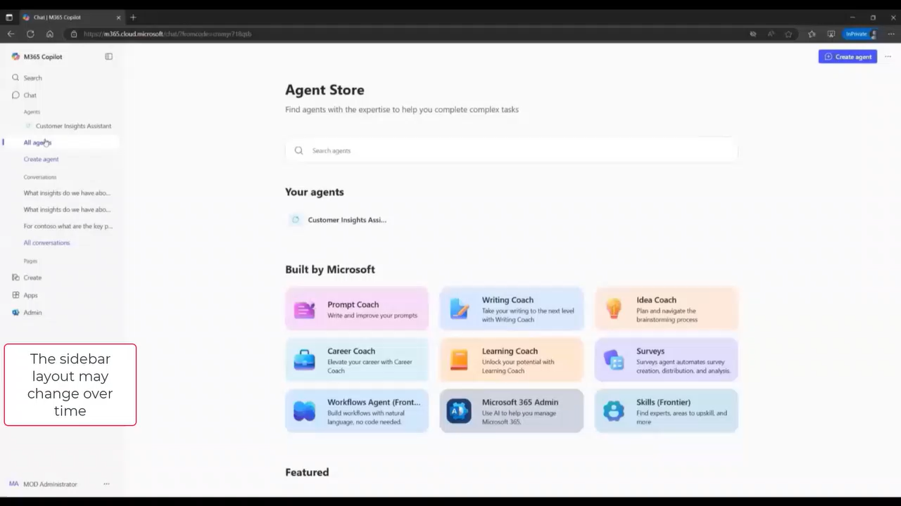
Agent Store
Notes:
Speaker Notes: Creating an Agent in Agent Builder using a template
This is the Agent Store, where you can browse agents built by Microsoft, created by your organization, or created by third parties. You’ll see all the agents that your admin has enabled for you so it may look different than what’s in this demo tenant.
To build your own agent, select New agent. From there, you can choose from ready-made templates or start with a blank form. The templates give you a starting point that you can customize. For today’s demo, we’ll use the Idea Coach template.
You can refine the agent in two ways: Use the Describe tab to chat with Copilot to quickly update your agent through a back-and-forth conversation. Or you can open the Configure tab for more detailed settings. Here under Configure you can see the Idea Coach template comes pre-filled with a name and the key building blocks for your agent. It includes a logo, a description and a list of instructions.
The instructions include skills that shape how the agent behaves—like asking follow-up questions and guiding brainstorming. Each skill listed has its own set of commands, and you can edit them as required.
In this example, there are no knowledge sources connected. But you can add sources such as public websites or SharePoint content. Selecting knowledge sources will limit your agent to these sources. For this demo we will allow our agent to get information from the entire web.
If you want the agent to generate images, you can turn that capability on or off here.
The template also includes suggested prompts to help users get started, and you can edit them if there are prompts you expect to use frequently.
Our agent is now complete. As you can see it only takes a few minutes to create an agent from a template.
Now you can test your custom Idea Coach out. For example, you could ask it to brainstorm an agent to help automate invoice processing. Idea Coach responds by asking clarifying questions so it can better understand what you need. For instance, it might ask, “What types of invoices are you processing?” and “Which systems are involved?”
When you’re happy with the testing results, you can Create the agent. By default, the agent is private and only available to you. You can choose to share it with others when you’re ready.
After it’s created, you can open your agent and try some prompts—for example, “Help me find tools to organize all my new product ideas.” The agent will suggest approaches and tools, and it will keep asking questions to tailor its guidance. It might ask questions like, “How many ideas are you managing?” and “Are you working solo or with a team?”
Hopefully this demo helped you see how easy it is to create an agent from a template. Now try it on your own and begin expanding the value you get from Copilot.

Slide 21
Travel Eligibility Agent demo
Notes:
This demo shows how the agent retrieves information from internal policy documents, analyzes eligibility, and provides clear guidance to employees through a conversational interface.

Slide 22
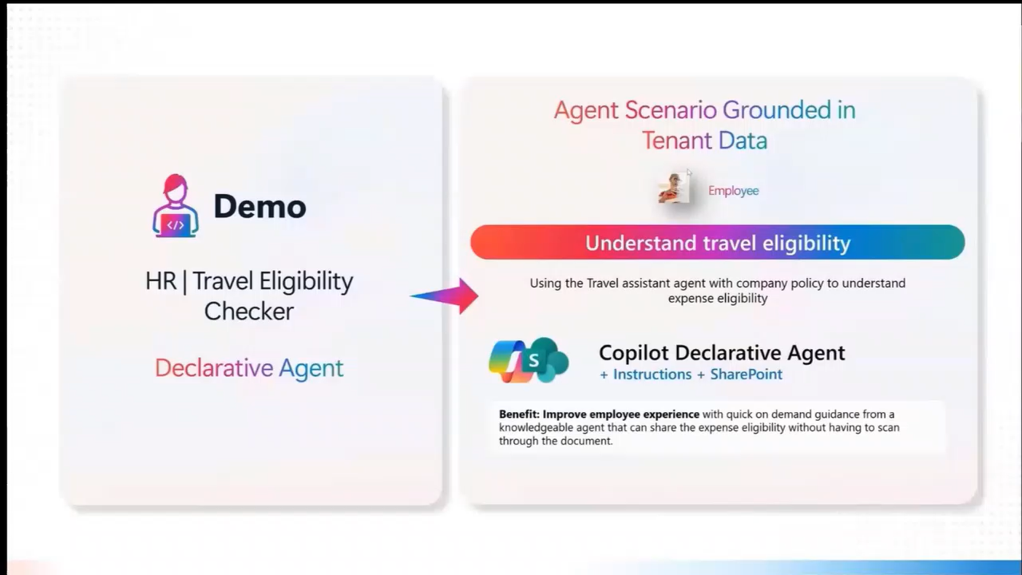
Demo
Notes:
Speaker Notes: Creation of an HR Travel Policy Agent in Agent Builder
Now I'll show a demo of how to build a travel policy agent based on published policy guidance so employees can get the information with simple questions rather than looking up data in a policy document. Before we get into the steps required to build the agent, I'd like to show you what the knowledge source looks like. This is the file the agent references. It contains the defined policies and procedures for business travel within India, including eligibility information.
Let me give you a quick overview of what we're focusing on. The key table includes different employee levels and roles, and it lists the accommodation budgets based on city type, Type A, Type B, and Type C. It also includes figures for self-arranged accommodation and food and beverage reimbursement. It's a detailed table and you can see how it might be confusing for an employee to get the right information for their trip.
The document also includes two reference sections. First, there's a table that defines employee grades. It maps categories such as Level L20 or M1 to M3 to their corresponding roles. This is how the agent understands what UI grade means, such as identifying it as vice president and mapping it to the appropriate category, like M1 to M3. The second table defines city types. For instance, major metro cities such as Mumbai and New Delhi are categorized as city type A because expenses are typically higher. City types B & C generally have lower budget limits. So our goal is to provide instructions the agent will use to understand the relationship between these tables.
Let's switch over to Agent Builder in the Copilot app and walk through the seven steps required to build this agent. In step one, we'll enter the name and description. I'll name the agent HR Travel Policy. For the description, I'll write something like, Travel Policy Helper Agent that helps employees understand travel eligibility details, like mode of travel and so on. The description lets employees know what the agent does.
In step two, we'll enter the instructions. This is the most important step. This section is really the heart of the agent. The instructions you write here directly shape how the agent behaves, so it's worth taking time to be clear and specific. For this agent, here's what we're telling it to do.
Always ask the user for their grade code and the city they're traveling to.
Use those inputs to determine the correct employee category by referencing Table 1 and Table 2 in the policy.
Determine the city type based on Table 2.
Provide the employee with clear guidance on mode of travel, company-booked accommodation, food and beverage reimbursement, and self-arranged accommodation.
Make sure the final category aligns with the applicable travel class.
One more important instruction is don't assume any information. The agent should only answer based on the knowledge it's been given and not use anything outside of the policy document.
For step three, we'll add the knowledge source. To do this, we attach the travel policy guidance document as the agent's knowledge source. Once uploaded, the agent can reference it directly when answering questions.
Then in step 4, we'll enable Code Interpreter. Code Interpreter can help with things like calculations or analyzing structured information, and it can improve the quality of responses in some scenarios.
In step 5, we'll enter any suggested prompts. Suggested prompts help employees know how to start. For example, we can add a prompt like, “What is the reimbursement limit if a US employee is traveling to Chennai?” As soon as we add it, the prompt shows up in the preview pane on the right. Here US is an employee grade code, but I've entered an invalid code so you can see what will happen.
Next for step six, we'll test the agent. When we click on our suggested prompt in the preview pane, the agent responds with a detailed explanation. Since we entered an invalid grade code, the agent asks for a valid one. Once we correct the grade code to UC, it searches the policy again, identifies the right category, and then returns the details we need.
Step 7 is our final step, where we will create and share the agent. If everything looks good, we click Create. By default, the agent is private and only available to you. If you want others to use it, click Share and choose either specific users or anyone in your organization. The ability to share is controlled by your organization's admin policies, so some options may not be available.
Let's see it in action. I'll use one of the suggested prompts. What is the travel policy for Mumbai for a UI-grade employee? You can see that when we ask about traveling to Mumbai for a UI-grade employee, the agent uses the policy document to find the response. It provides eligibility and budget details to the employee, saving time and reducing errors. Hopefully this demo helps give you the confidence to create your own agents. Just remember to take the time to develop a clear set of instructions for your agent.

Slide 23
Next Steps
&
Call to Action
Notes:
As we wrap up, we encourage you to explore the resources provided, experiment with building agents, and share your experiences because the journey to leveraging AI in your organization starts with taking the first step.

Slide 24

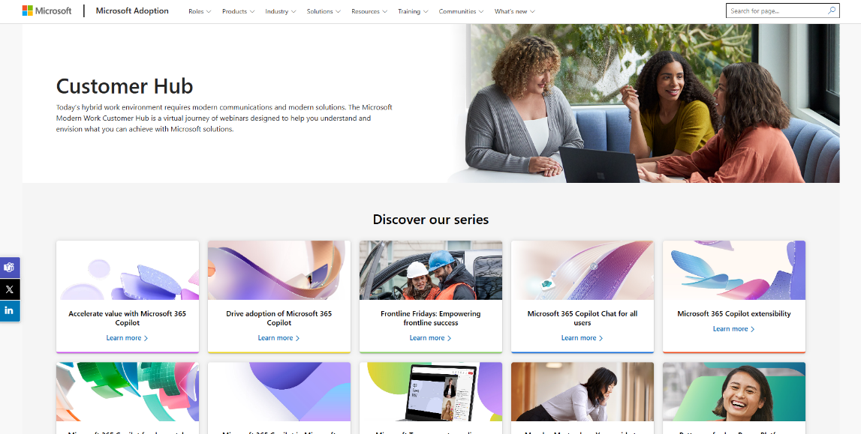
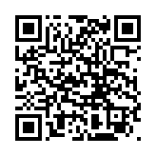
Customer Hub
Visit Customer Hub website for upcoming sessions, updates, and on demand contents!
https://aka.ms/CustomerHubSessions​
Notes:
Stay up to date with upcoming sessions, updates, and on-demand content by visiting the Customer Hub website, which is your go-to resource for continuous learning and support.

Slide 25
Thank you
Notes:
Thank you for joining us today; we appreciate your time and engagement, and we hope you found this session valuable.

