Slide 1
Secure Copilot and agents Practical steps for addressing oversharing concerns utilizing SAM and Purview
Dave Minasyan, SharePoint
Sophie Ke, Purview

Slide 2
Copilot Control System
Copilot + Agents
Security & Governance
Management Controls
Measurement & Reporting
Data security
AI security
Compliance & privacy
Licensing & metering
Agent lifecycle
Customization
Readiness and adoption
Productivity impact
Business value & ROI
Notes:
The Copilot Control System is a set of tools designed for IT professionals to better understand and manage AI within their organization. It is comprised of three main pillars:
First, security and governance. Your data is secure within the Microsoft Security Trust Boundary, ensuring compliance and protection at every level.
Second, management controls. Technology empowers people to create what they need at work. We’ve built powerful controls to help you manage AI sprawl within your company, ensuring the right people have access to the right tools and are using them as intended.
Third, measurement and reporting. This helps you understand and track usage, adoption, and the business impact of Copilot and agents within your organization. We call this Copilot Analytics.

Slide 3
Copilot Control System
Copilot + Agents
Security & Governance
Management Controls
Measurement & Reporting
Data security
AI security
Compliance & privacy
Licensing & metering
Agent lifecycle
Customization
Readiness and adoption
Productivity impact
Business value & ROI
Notes:
The security and governance pillar of CCS helps to address security challenges with multiple foundational¹ controls for M365 Copilot and agents. Optimized² controls, including integrations with Microsoft Purview, Defender for Cloud Apps and Entra provide additional layers of capability for a better-together, comprehensive solution for security and governance.

Slide 4
Agenda
Introductions
What is oversharing?
Oversharing blueprint
SharePoint Advanced Management Demo
Purview Demo
Resources, Q&A

Slide 5
Opportunity summary
Microsoft 365 Copilot’s ability to leverage information available to users has raised concerns for organizations about overshared permissions
If oversharing risks aren’t addressed, they could lead to
Access to information beyond what the user needs for their role
Inappropriate sharing of content
Out of date or irrelevant responses
By addressing these risks, organizations can ensure that information is shared appropriately and securely

Slide 6
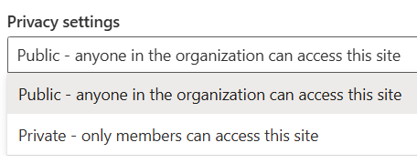
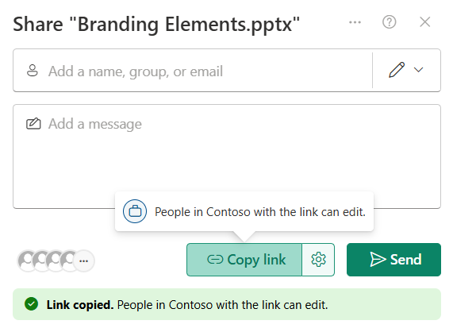
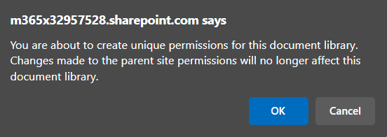
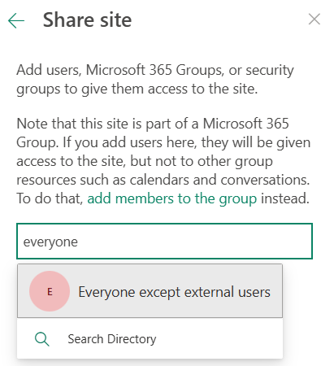
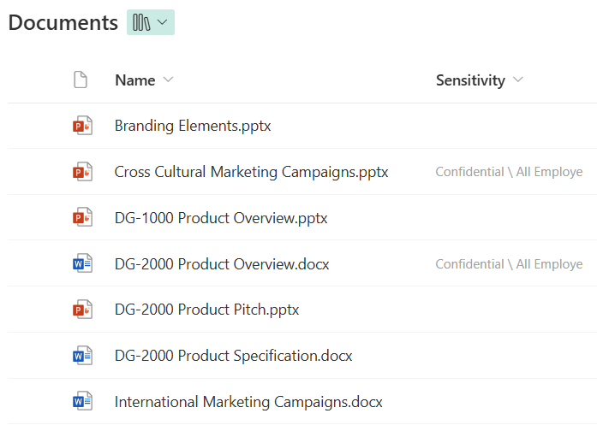
Common causes of oversharing
Site privacy set to public
Default sharing option is everyone
Broken permission inheritance
Use of “everyone except external users” domain group
Sites and files without sensitivity labels

Slide 7
Internal oversharing: Too much access and too few controls
1
2
Over-permissioning
too much internal access
Under-enforcement
too few internal controls
Bias towards overly broad access for permissions and links
Content looks the same without labeling and content-aware policies to follow its use
Implications
Risk of exposure in search and AI tools
Hard to get started with AI and solve without the right tools
Notes:
Too much content available to too many people, with too few controls.
Challenges around content governance – Alex and Liz
Remake this to align with 3 pillars
SAM: content Sprawl, oversharing, Lifecycle,

Slide 8
Two powerful tools to address oversharing
SharePoint Advanced Management
Microsoft Purview
Provides SharePoint site management and content governance capabilities
Provides security, compliance, and governance across data and files
Notes:
Same pattern – identify oversharing and lock it down. One at the site level and one at the file level.

Slide 9
Introducing built-in content governance with Copilot
Provided by SharePoint Advanced Management ¹²
Reduce content sprawl
Control content oversharing
Manage site lifecycle
Identify patterns and potential issues with reporting and receive actionable recommendations
View reports that identify sites that contain potentially overshared or sensitive content
Review and monitor changes you've made to a SharePoint site's properties
Run automated, rule-based policies to manage and retire inactive sites and their content
Enforce stringent access conditions when users access SharePoint sites with access policies
Use broad reports to review changes to SharePoint site properties
Create and leverage AI-powered policies and reports to govern content at scale
Prevent sites and content from being discovered with restricted content discovery control
Leverage policies to ensure proper content ownership and manage unused content across the organization
¹ Does not include capabilities which require Microsoft Purview (Extended SharePoint Permissions or Default Sensitivity Label for a SharePoint Document Library)
² SharePoint Advanced Management is available as a standalone offer (3 PUPM) for customers without a Copilot license
Notes:
Get details on sites that are permissioned for greater than a certain number of users to include files and folders that broke inheritance from site permission.

Slide 10
Secure and govern Copilot data with Microsoft Purview
with
Security
Compliance
Privacy
Responsible AI
Discover
AI risks
Protect
sensitive data
Govern
Copilot usage
Prevent Data Oversharing | Data Leaks | Non-Compliant Usage
Notes:
As mentioned earlier in the slides, Copilot is built with foundational security in mind, with Microsoft's comprehensive approach to security, compliance, privacy and responsible AI. On top of that, you can layer on additional security capabilities to discover AI risks, protect sensitive data, and govern Copilot usage.
Discover AI risks: First, security and IT teams must assess the data risks associated with user activities in Copilot. For instance, they should identify the types of sensitive data shared within Copilot prompts and understand the user risk context during these interactions. Organizations can leverage our pre-built classifiers to detect sensitive information such as credit card numbers, passport details, and custom SITs. Additionally, all user interactions in Copilot are logged, enabling organizations to review activities and identify potential risks. Lastly, organizations can proactively identify instances of overshared content within SharePoint sites by reviewing the site permissions.
Protect sensitive data: After understanding the risks, organizations can implement controls to safeguard data. They can establish labeling and Data Loss Prevention (DLP) policies to mitigate the risks of oversharing and data leakage. Additionally, leveraging conditional access policies ensures that Copilot usage occurs through secure and governed identities and devices, reducing potential security threats. Lastly, organizations can implement SharePoint site-wide access controls to eliminate idle or excessive access to sensitive data.
Govern Copilot usage: To ensure compliant usage of Copilot, organizations can establish retention policies for Copilot interactions and utilize our pre-built classifiers (such as gifts & entertainment, unauthorized disclosure, and stock manipulation) to detect non-compliant activities. In the event of a potential security or compliance incident, organizations will have access to logs and interaction details for investigation. Additionally, to minimize obsolete insights, organizations can apply retention labels to inactive files, automatically removing outdated data.
Microsoft Security can help you discover, protect and govern Copilot usage to enable secure and responsible adoption of Copilot.

Slide 11
Framework introduction
Aka.ms/copilot/oversharing
Notes:
This section is 5 mins

Slide 12
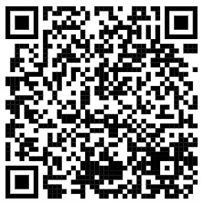
Customers with E5
Optimized
aka.ms/Copilot/Oversharing
Address internal oversharing concerns for M365 Copilot deployment
Pilot (Optional)
Deploy
Operate
Identify most popular sites & assess oversharing with SAM DAG and Purview DSPM for AI Data risk assessment
Grant Copilot access to popular, low risk sites with RSS
Turn on proactive audit and protection with Purview audit and DLP for SharePoint
Discover oversharing risks with SAM DAG and Purview DSPM for AI Data risk assessment
Restrict sensitive info from Copilot access and/or processing with SAM RCD and Purview DLP for Copilot
Increase site privacy with Purview sensitivity labels
Further reduce risk and simplify oversight at scale with SAM site lifecycle management policies and Purview DSPM for AI Data risk assessment
Further secure sensitive data with Purview sensitivity labels
Improve Copilot responses with SAM Inactive site policy and Purview DLM by removing inactive site and content
Activities
Outcomes
Deploy copilot to sub-set of users with up to 100 sites
Copilot fully deployed in your organization
Continuous improvement of data security practices
Technical implementation Effort*
2–4 days
2–4 weeks
More than one month
*Suggested efforts should be reviewed into timelines based on your tenant size and organizational complexity
Last updated April 14, 2025

Slide 13
SAM demo

Slide 14
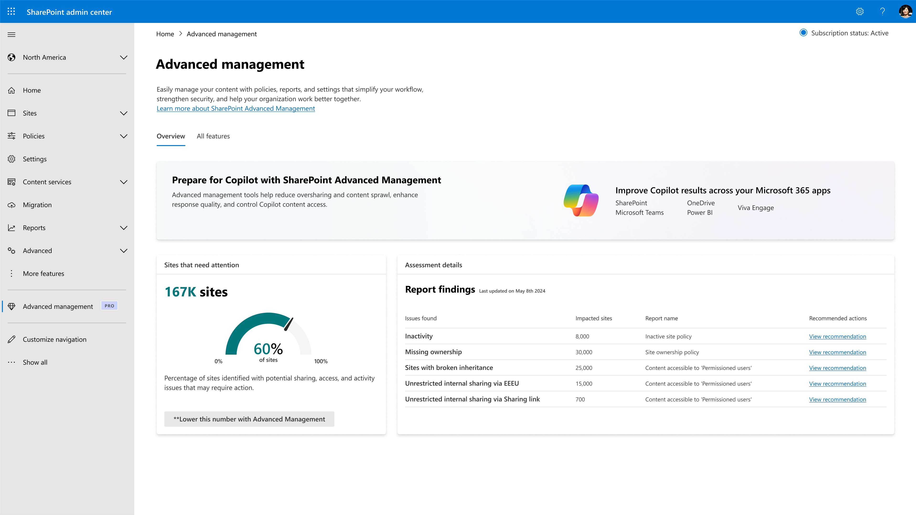
Content Management Assessment
Check your SharePoint and OneDrive state
What does it do?
A built-in tool to evaluate and improve content management within SharePoint.
Helps identify content risks, ensure compliance, and maintain data integrity.
Benefits:
Comprehensive Tenantwide Insights Provides a detailed report on governance state.
Actionable Solutions Links problem areas to SAM features for quick resolution.
Boost Efficiency Reduces manual assessments and expert involvement.
Helps Define Copilot Readiness Establishes a clear governance roadmap for Copilot success.
Private Preview in H1

Slide 15
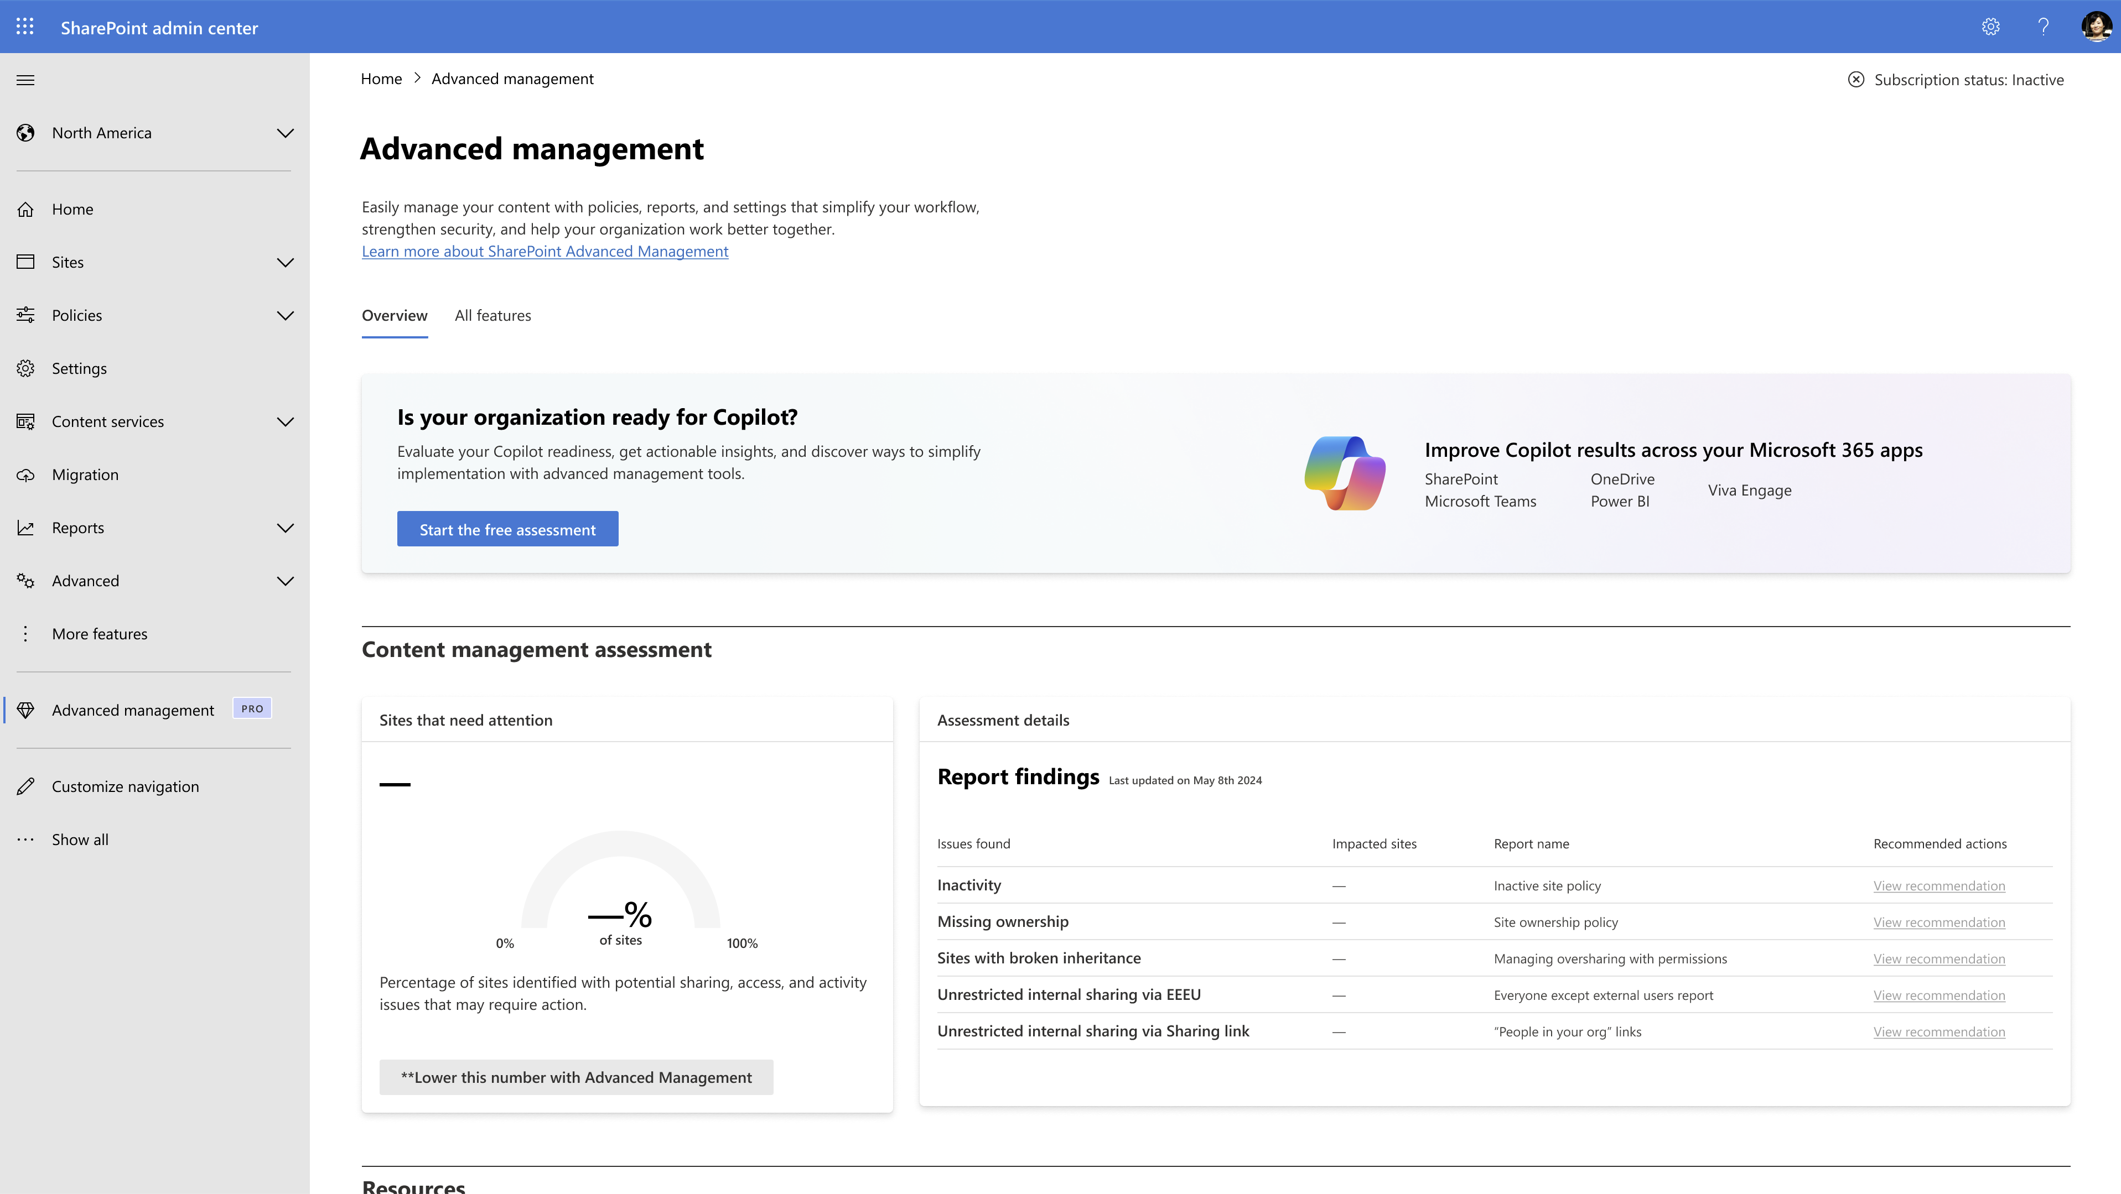

Slide 16
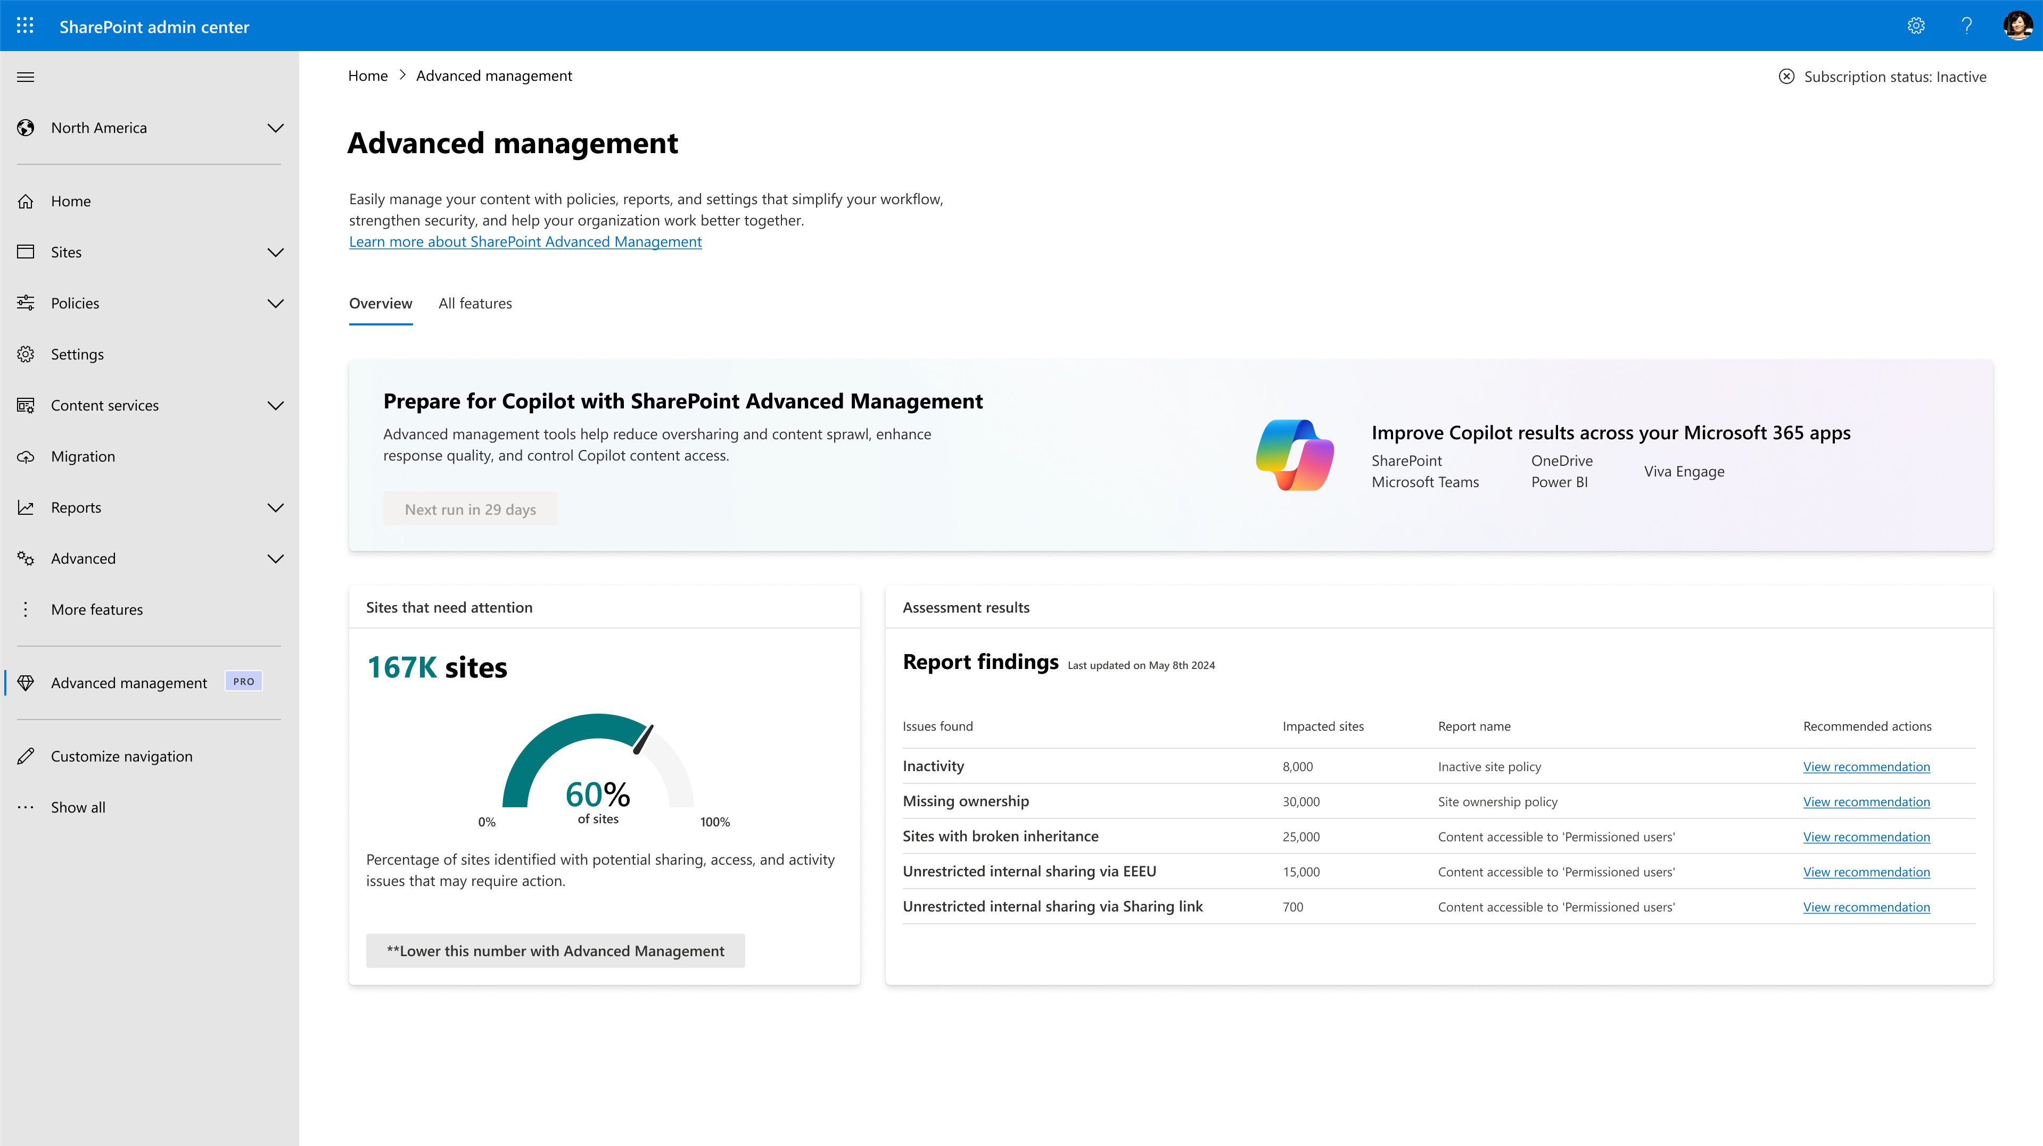

Slide 17
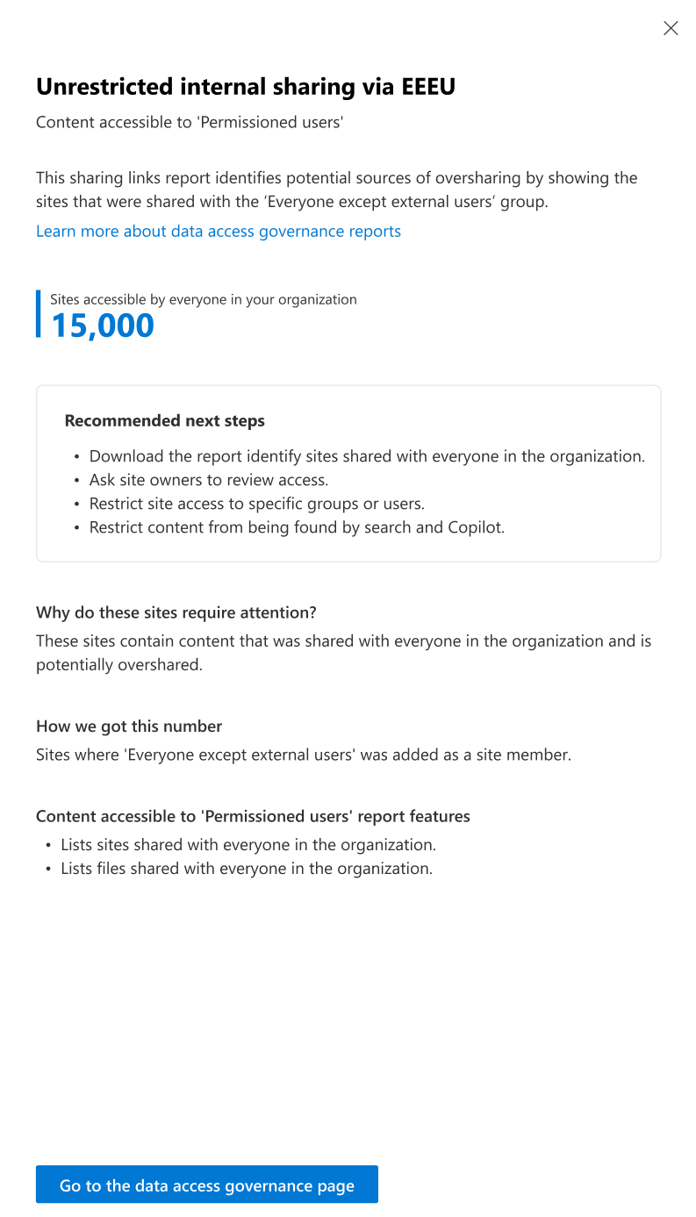
MS20 - Secure AI - Ke.pptx

Slide 18
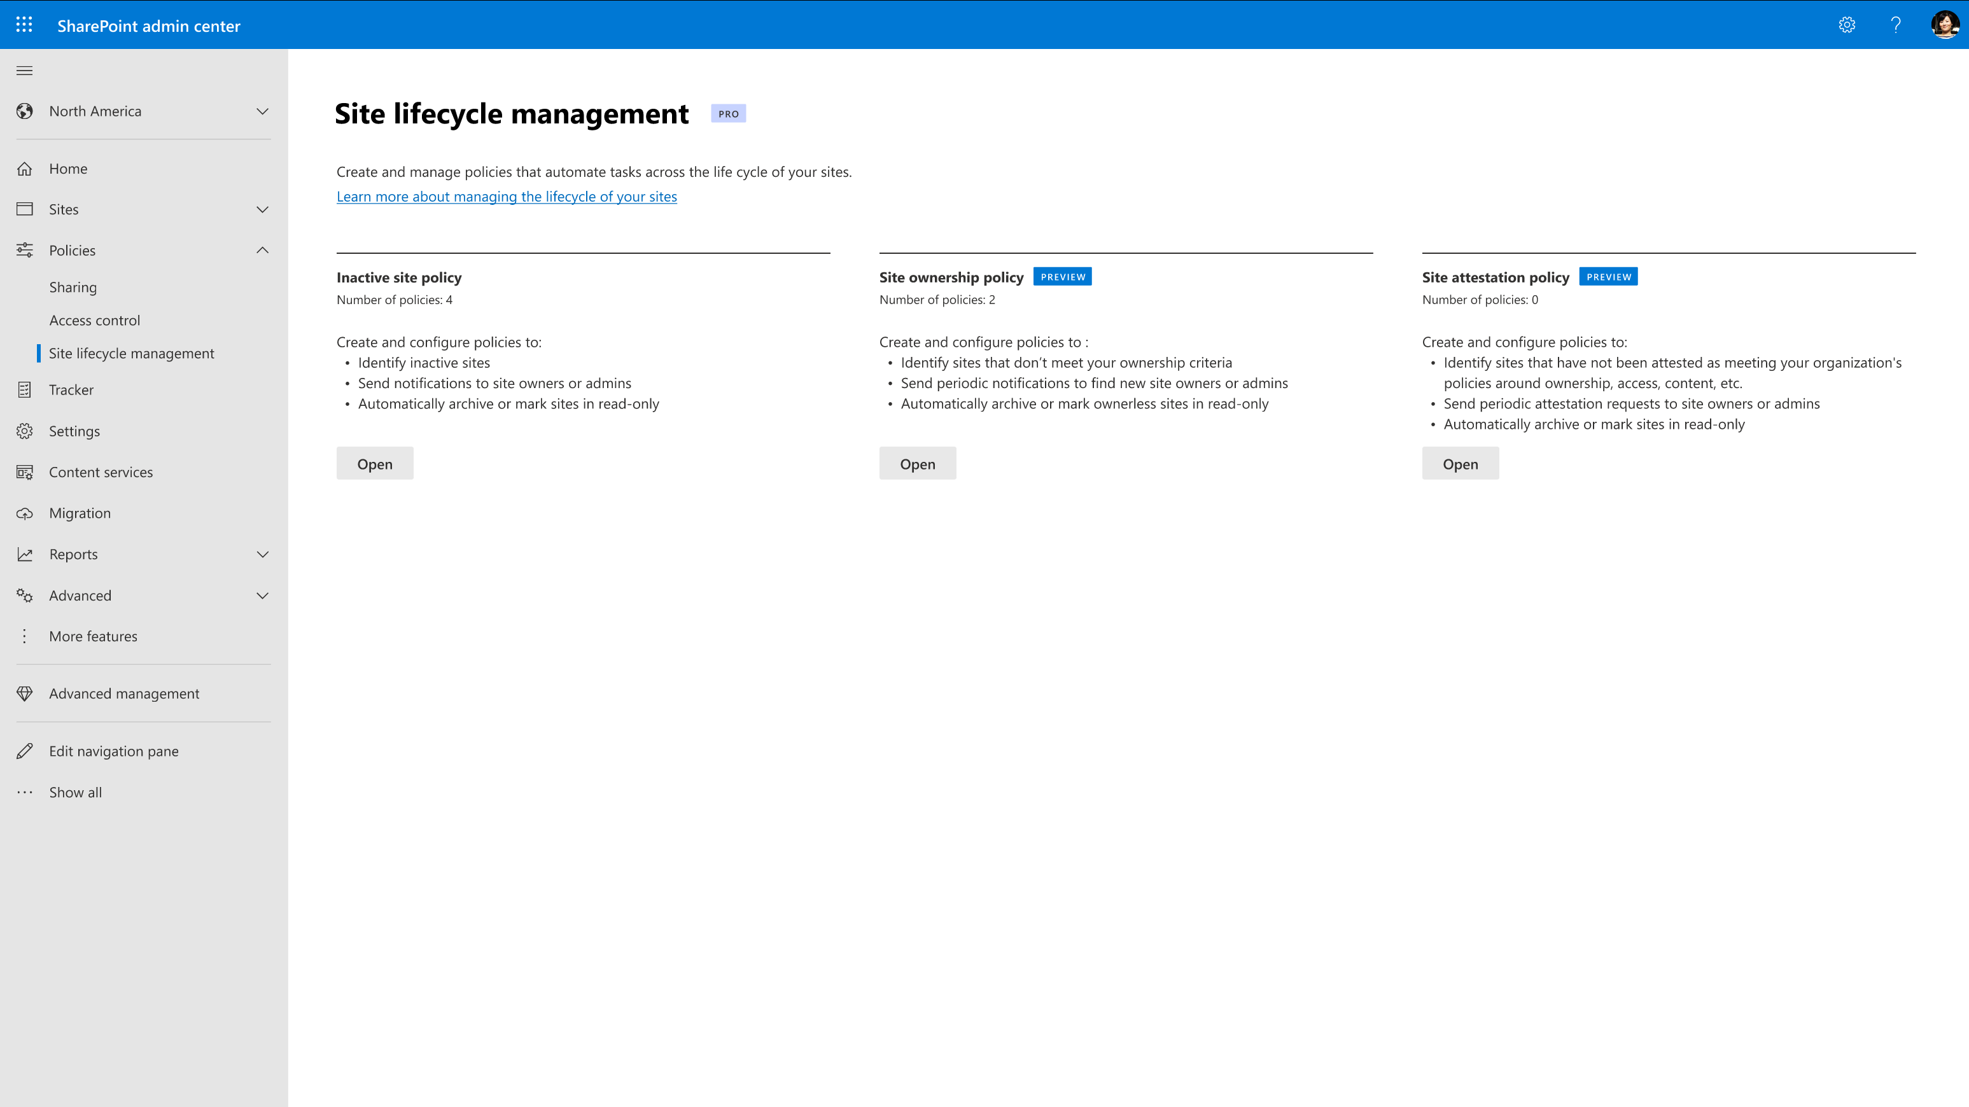
Content Lifecycle Management
Governance of content at scale
Inactive Site Policy
Automatically identify inactive sites to improve Copilot response quality.
Take scalable actions like certify, archive or mark content as read only.
Site Ownership Policy
Automatically identify sites that don't meet your ownership criteria, find new owners, and take actions on ownerless sites.
Site Attestation Policy
Automatically empowers site owners to maintain access to their site content
Generally available and coming soon

Slide 19
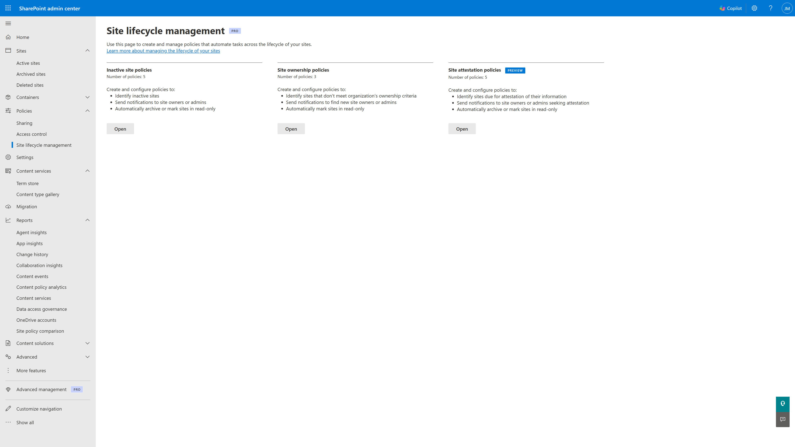

Slide 20
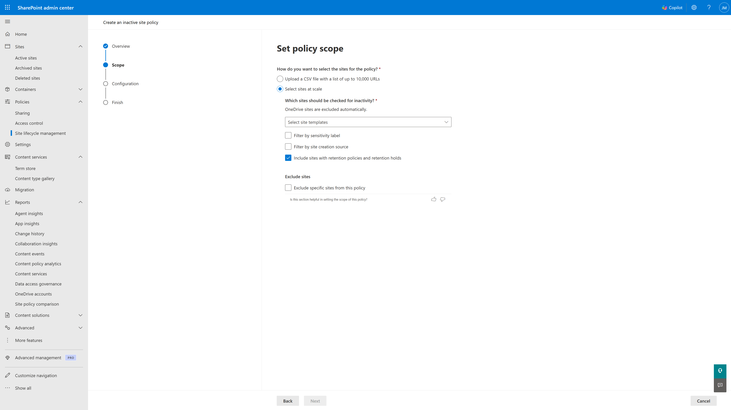

Slide 21
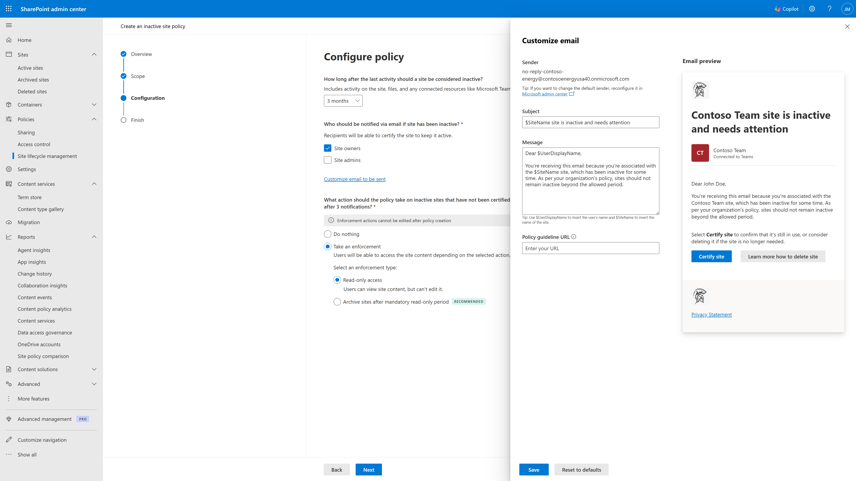

Slide 22
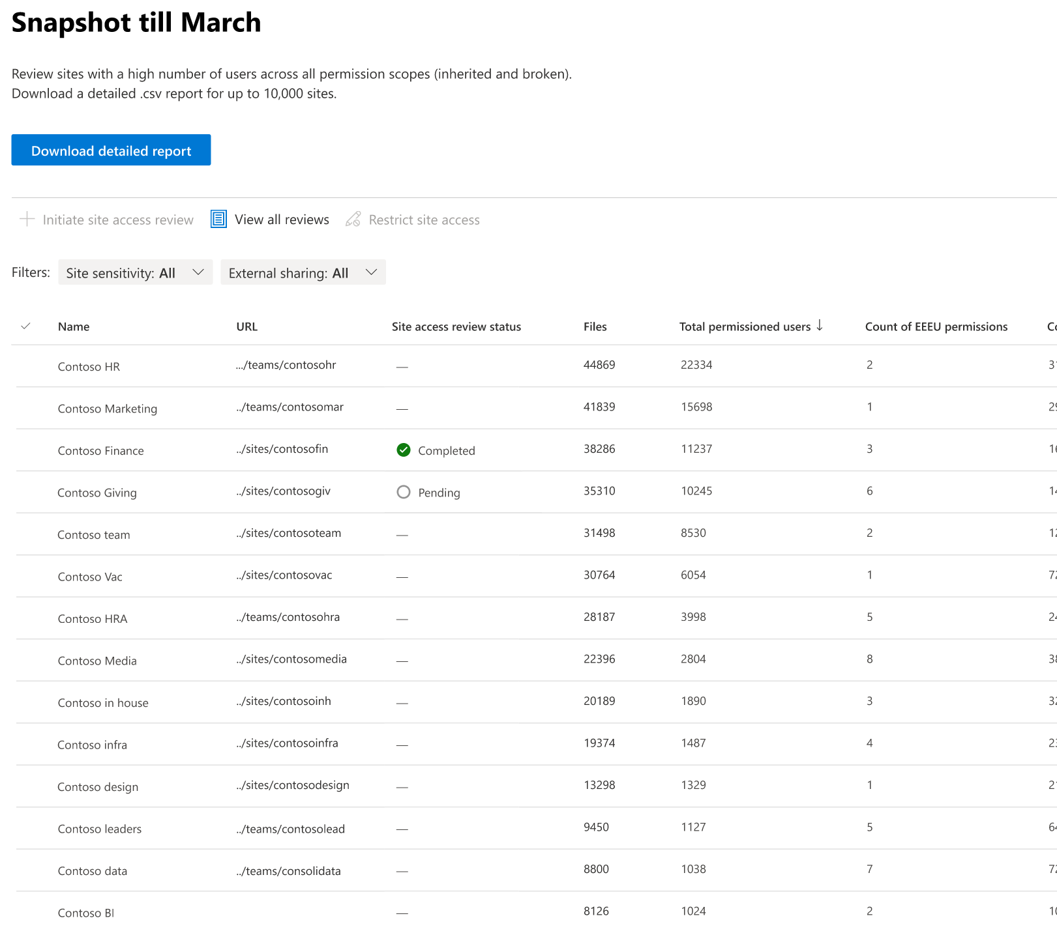
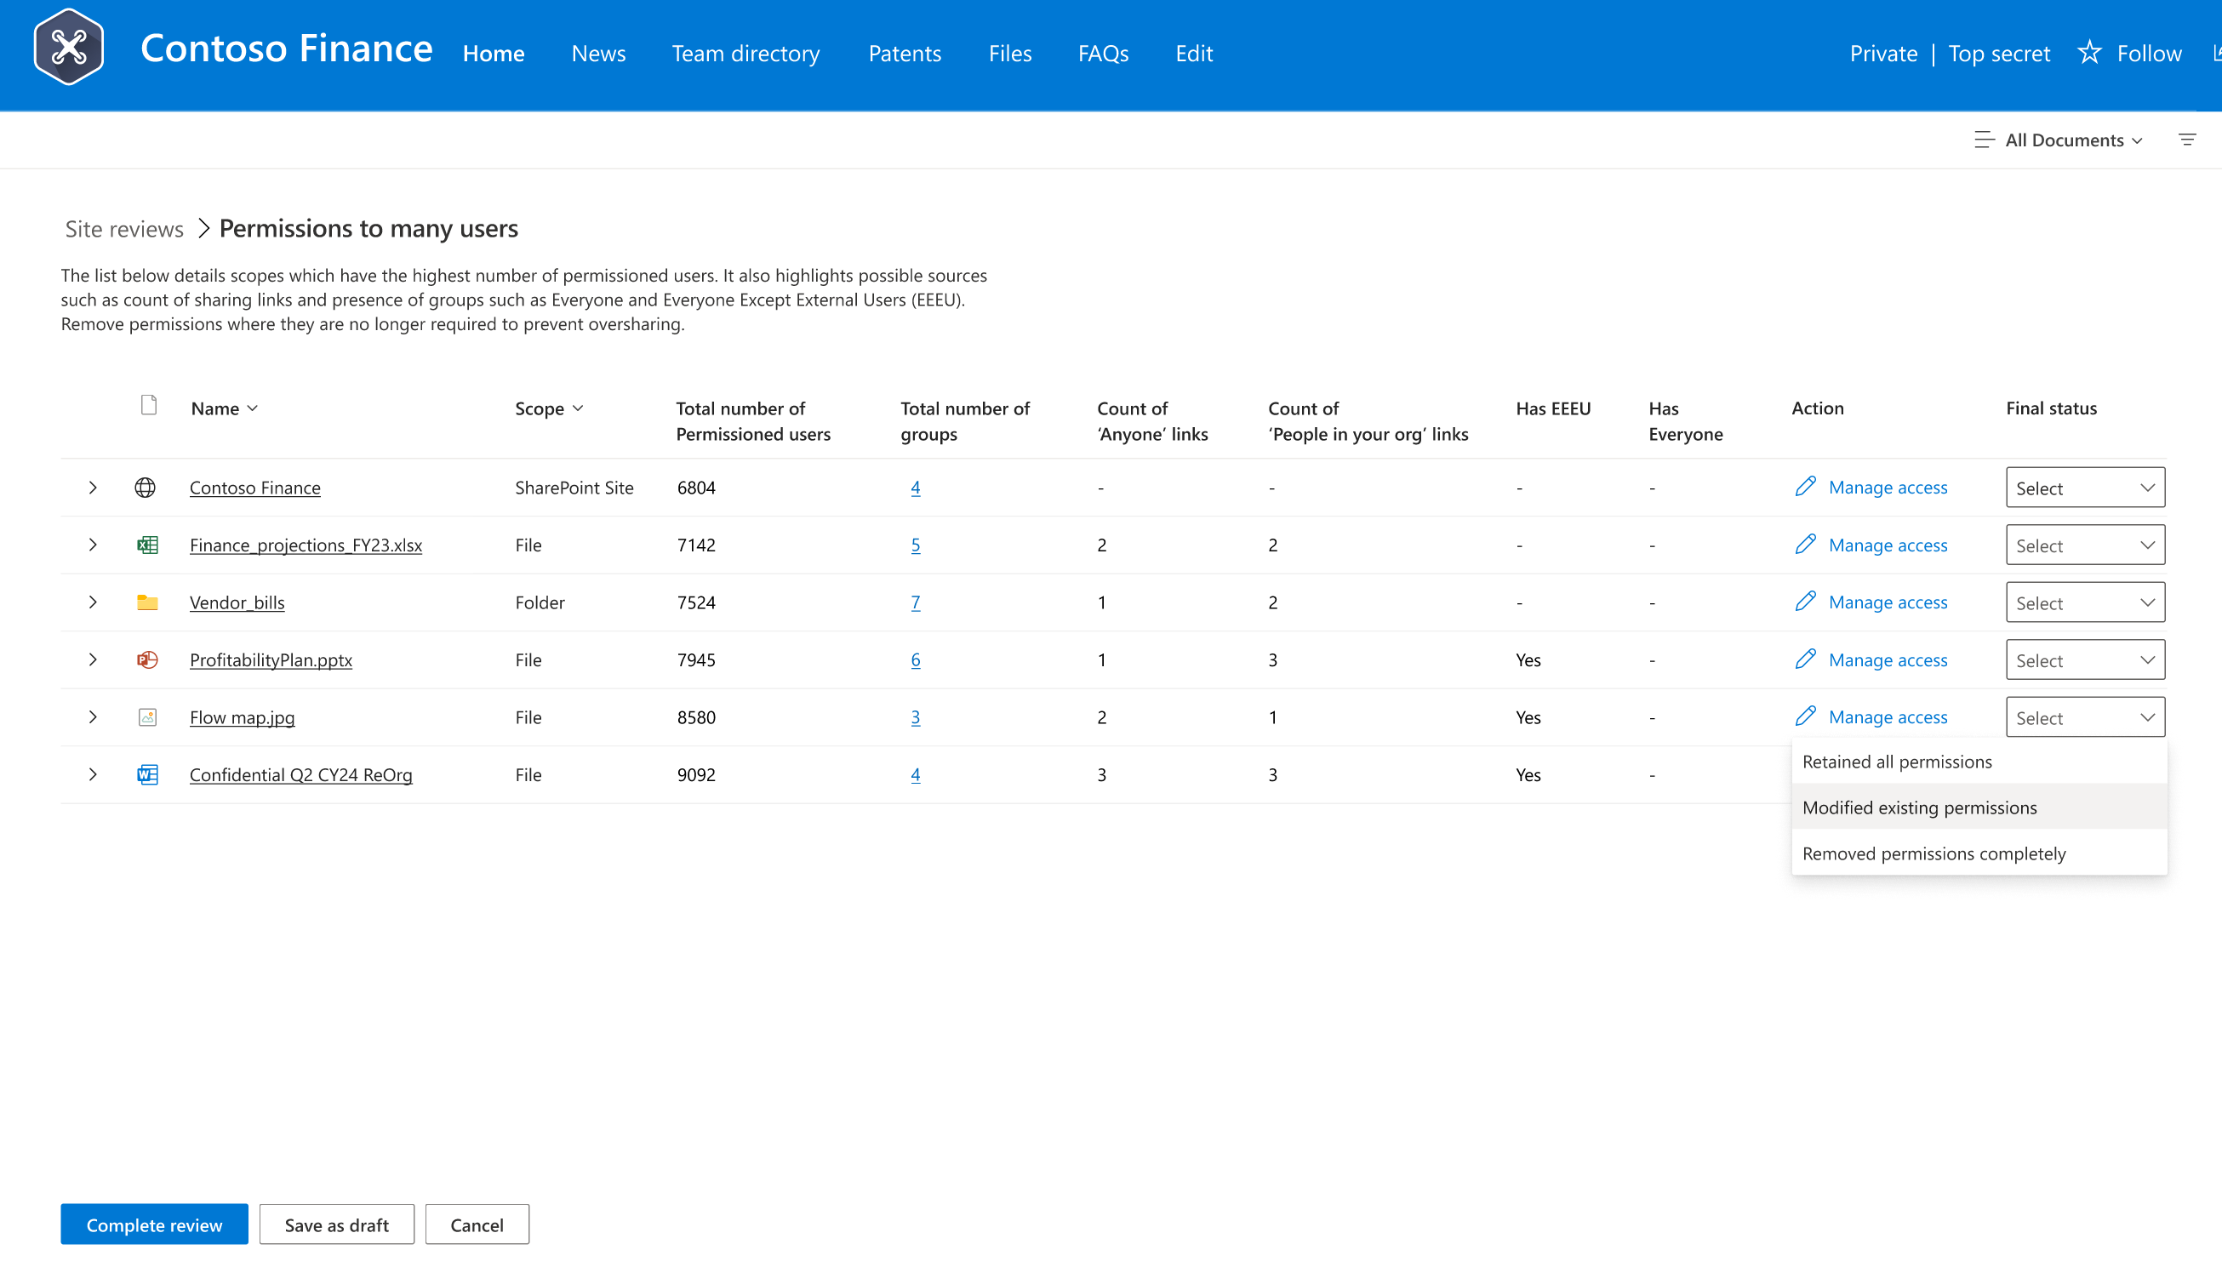
Oversharing control: Permission State Report with Actions
Gain Control Over Site Permissions and Overshared Content
Identify Overshared content:
Customizable and comprehensive permission reports across all sites
Detect root causes of oversharing (broken inheritance, sharing links, EEEUs, site privacy and more)
Focus on critical permissions by user count and extended groups
Integrates with sensitivity labels for enhanced security
Downloadable, with insights from AI analytics
Scalable Actions:
Site Access Review with site owner file review dashboard
Restricted Access Control – limit access to high-risk areas
Restricted Content Discovery – lock down content from Copilot
Broken inheritance, Sharing links, EEEU domain group
Generally available

Slide 23
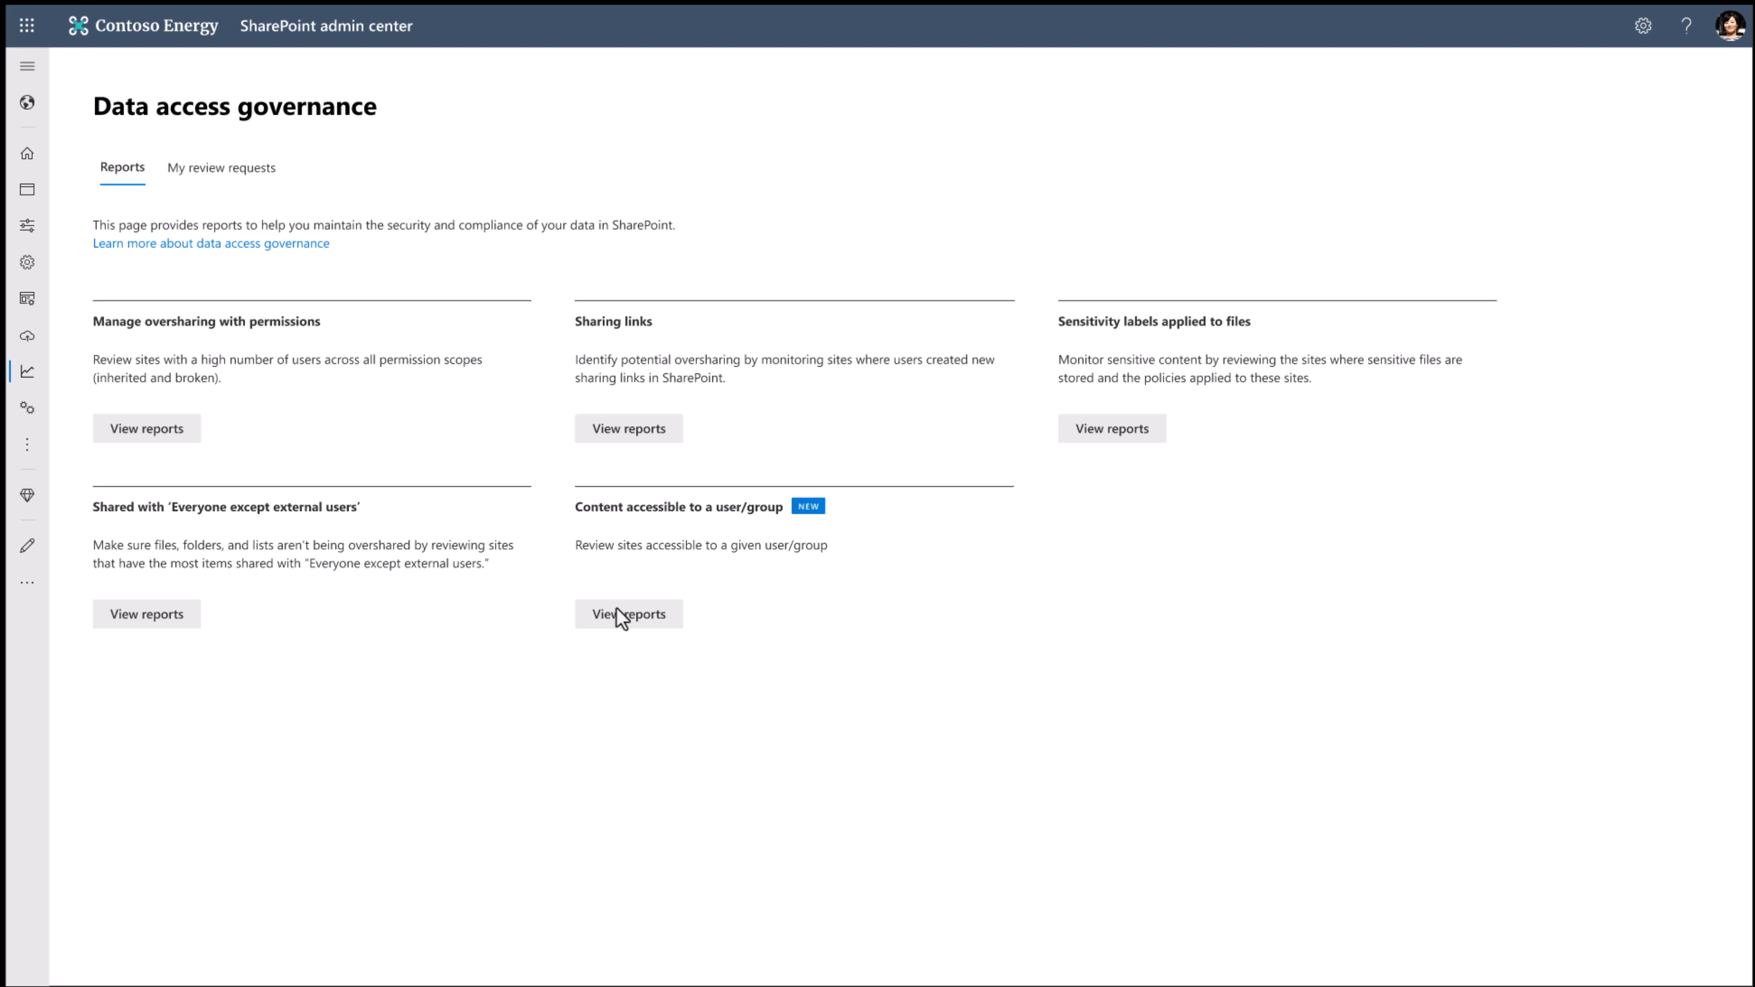

Slide 24
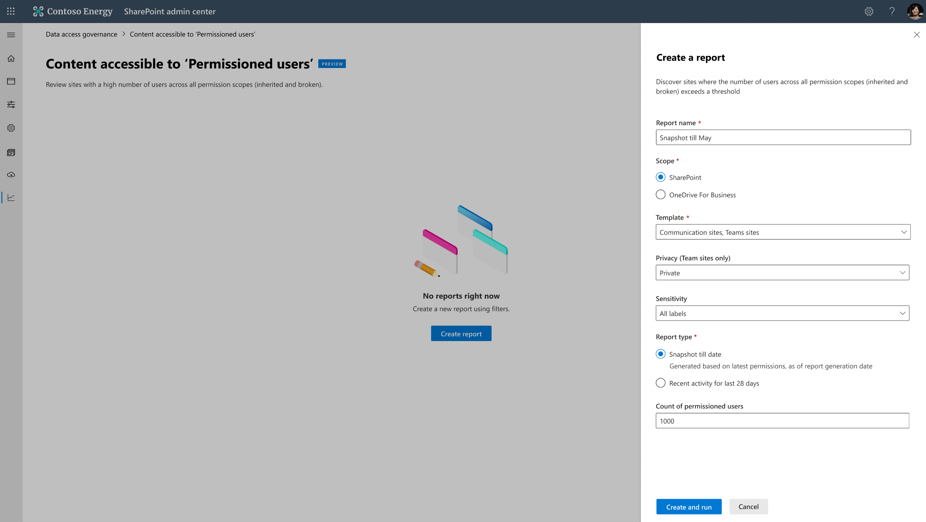
Notes:
Snapshot report; covers the entire tenant; rather than just specific sites.
Can target to private or public sites. Can target based on label or SIT.

Slide 25
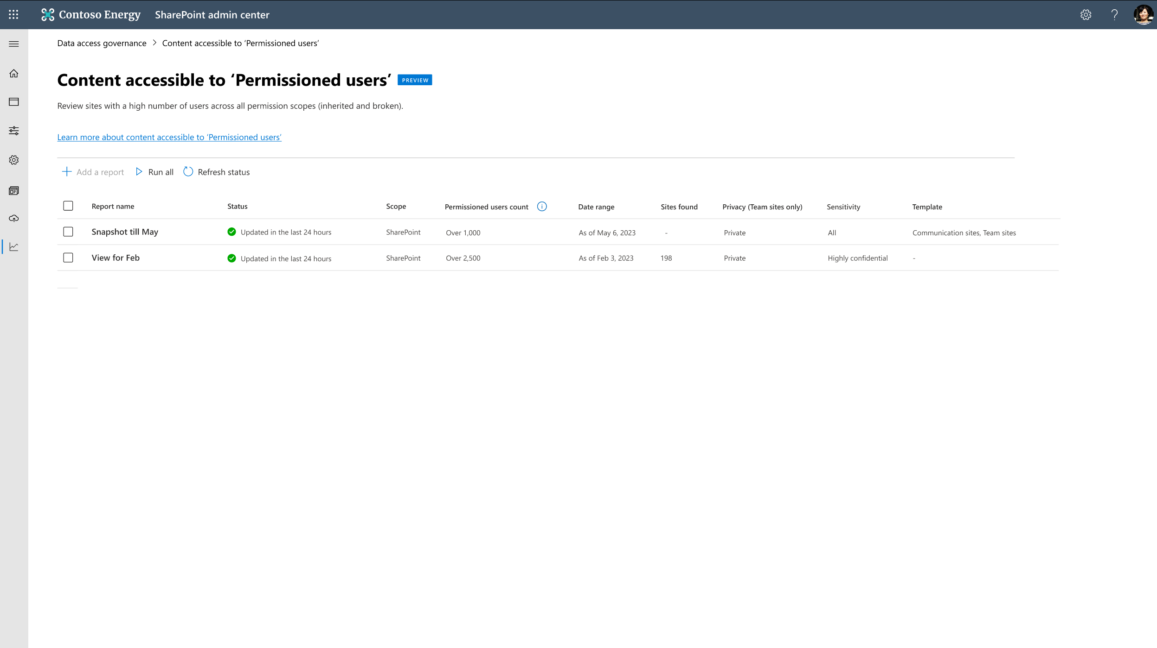
Notes:
Report takes 24-72 hours to run depending on size.

Slide 26
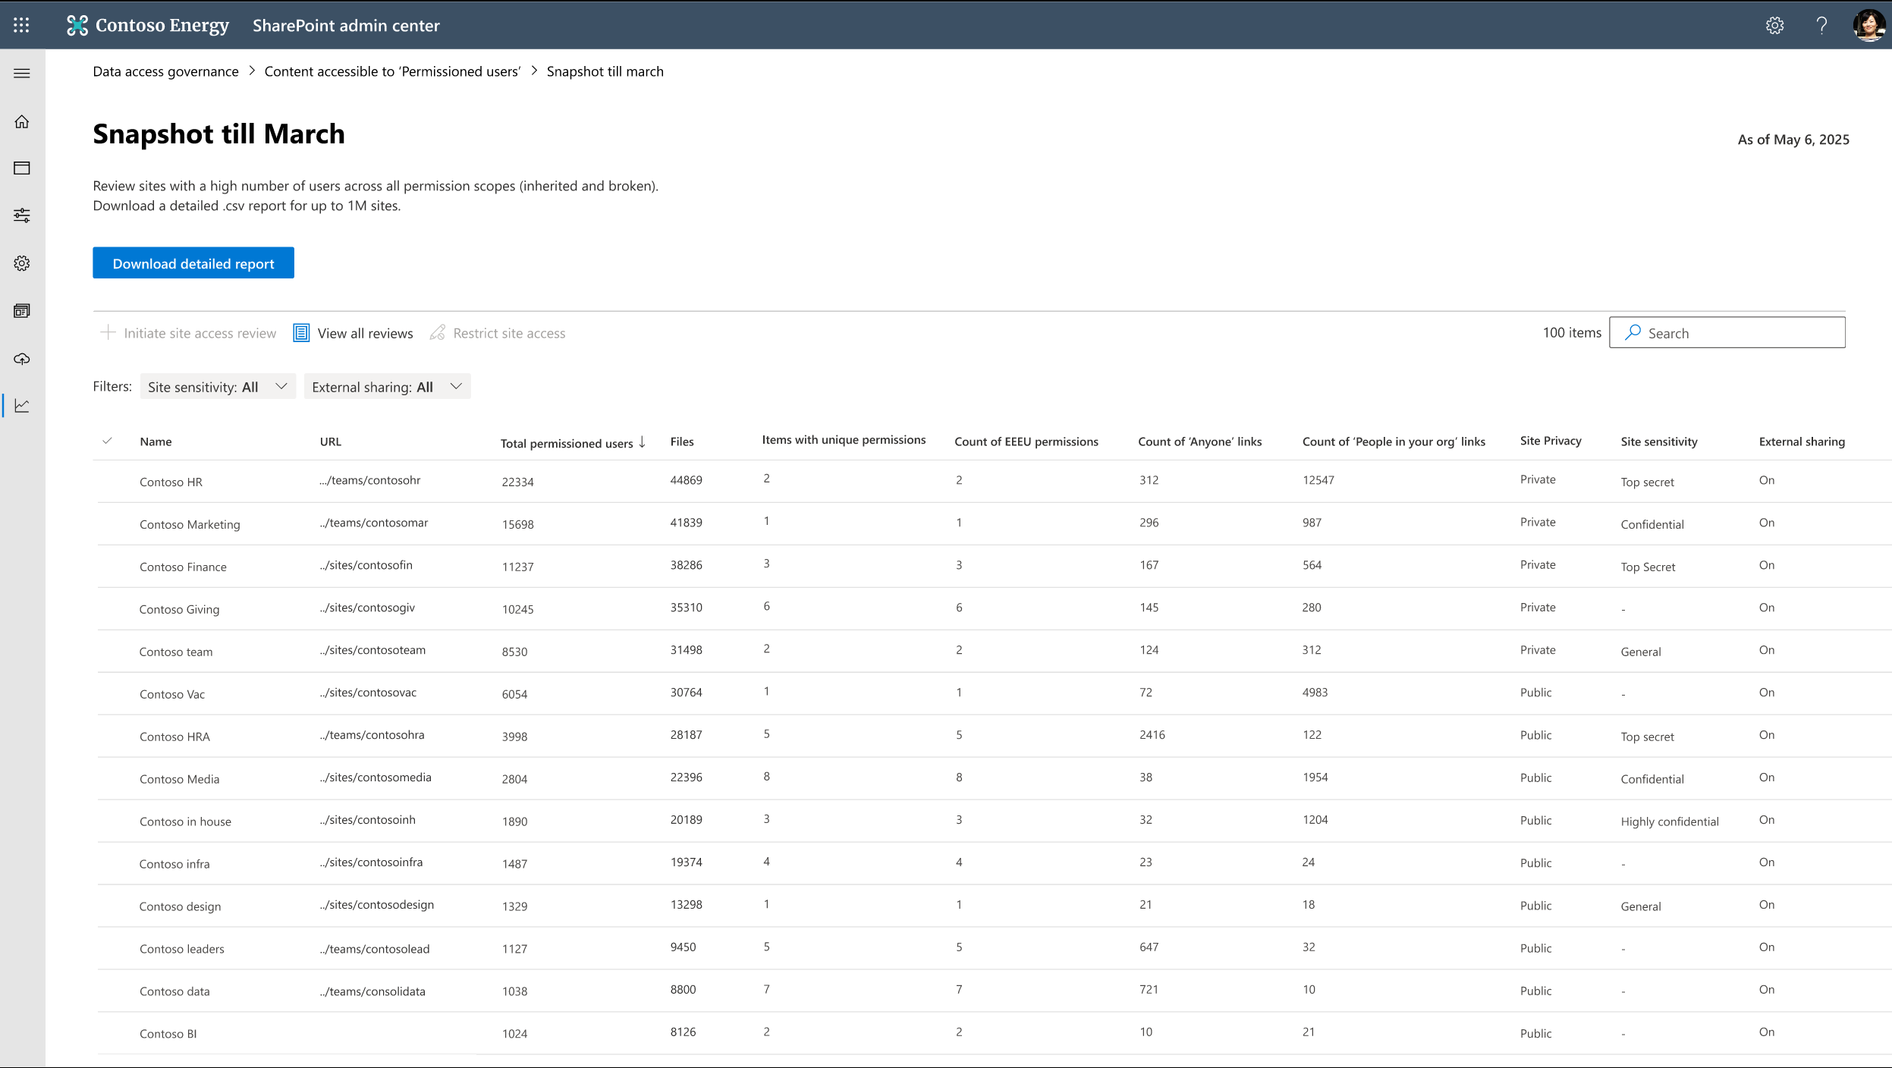
Notes:
Drill in slide. How many minutes?
Total permissioned users.

Slide 27
Broken permission inheritance
Use of “everyone except external users” domain group
Default sharing option
is everyone
Site privacy set to public
Sites and files without sensitivity labels
Notes:
Drill in slide. How many minutes?
Total permissioned users.

Slide 28
Notes:
Drill in slide. How many minutes?
Total permissioned users.

Slide 29
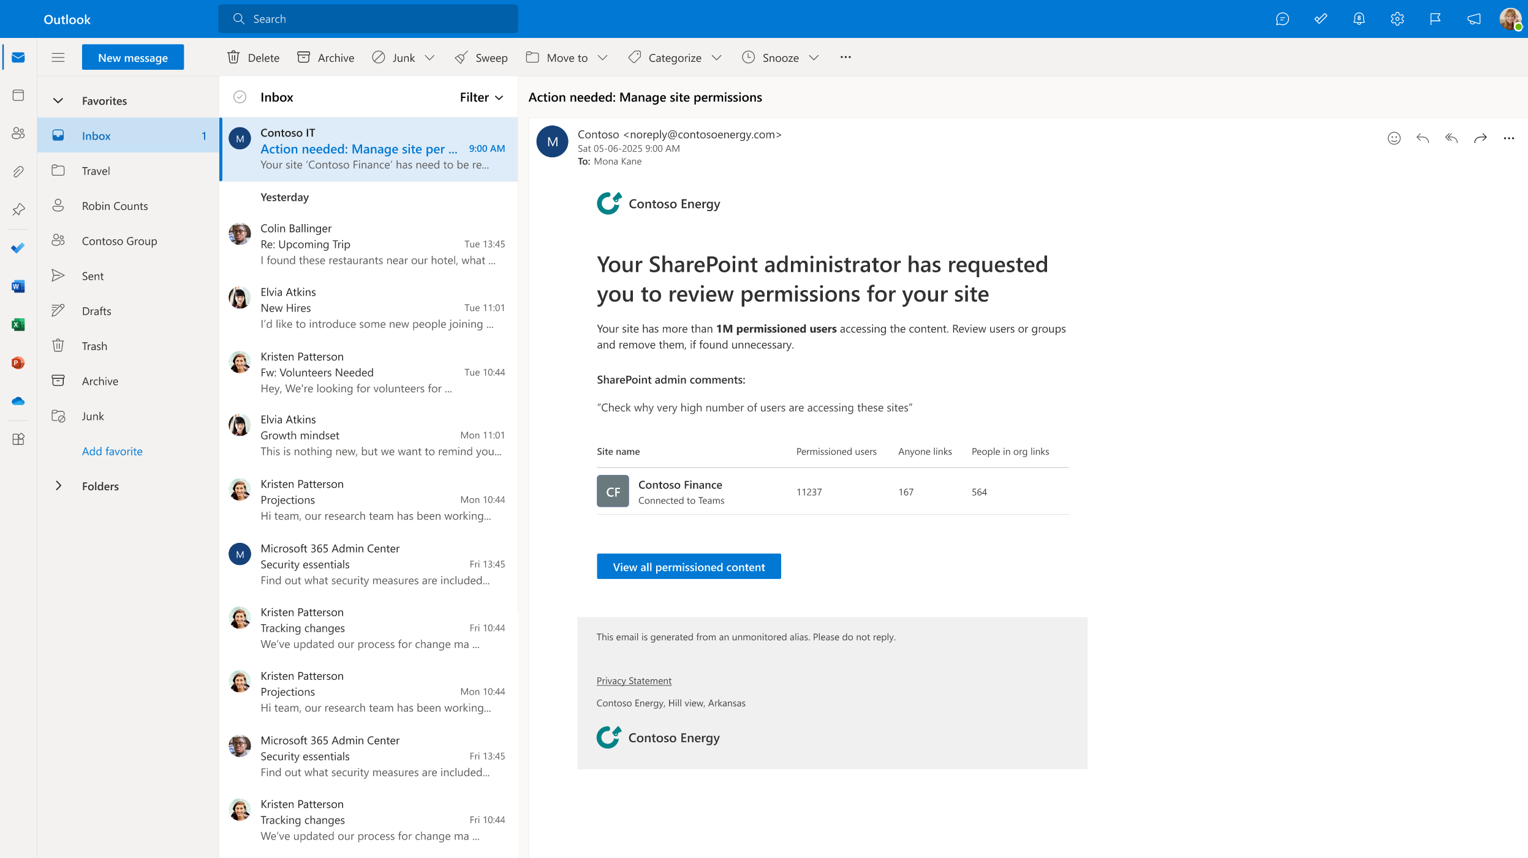
Notes:
Site review view for site owner. S

Slide 30
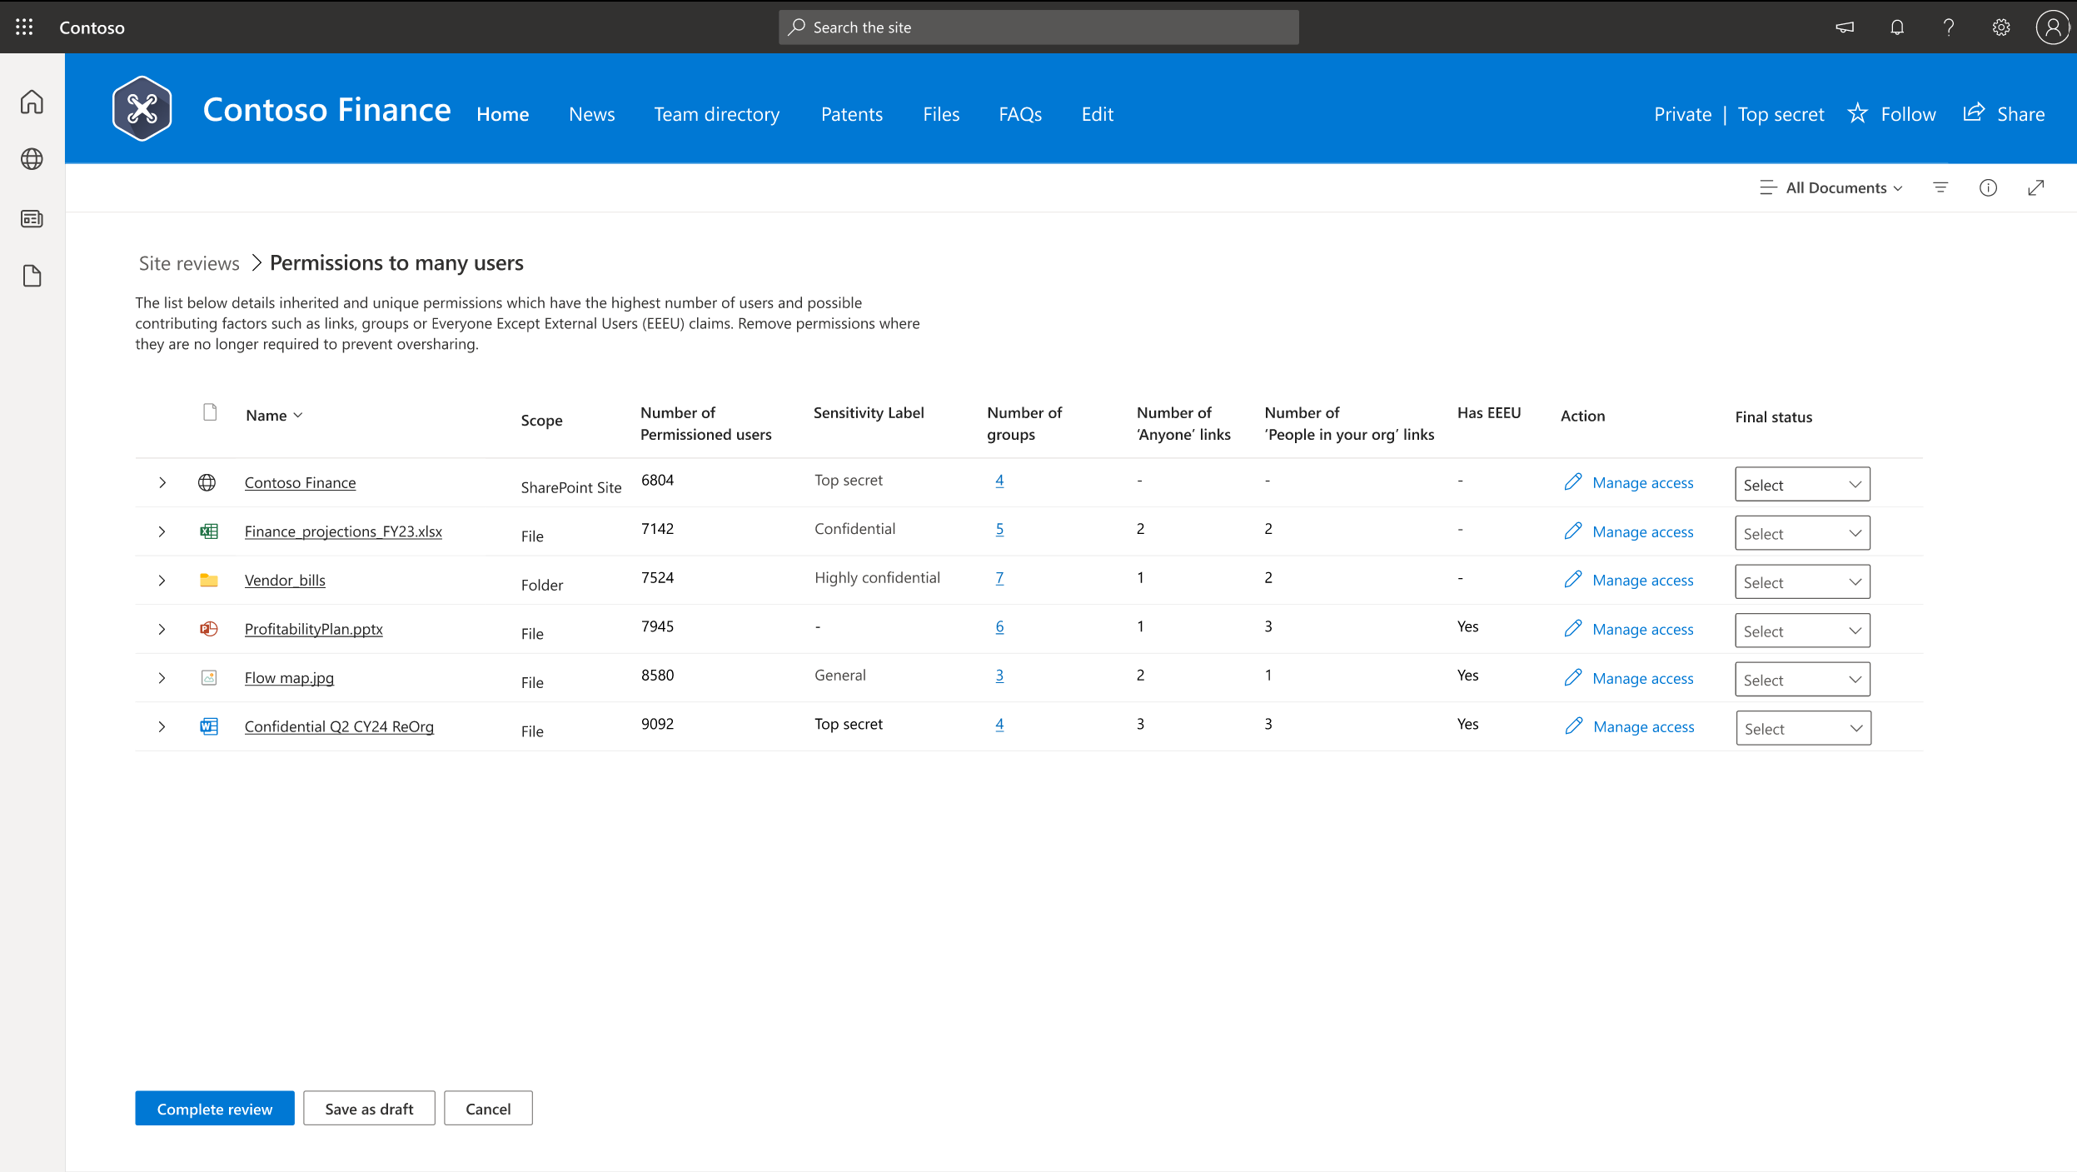
Notes:
Site review view for site owner. S

Slide 31
Default sharing option is everyone
Site privacy set to public
Broken permission inheritance
Sensitivity Label
Use of “everyone except external users” domain group
Notes:
Site review view for site owner. S

Slide 32
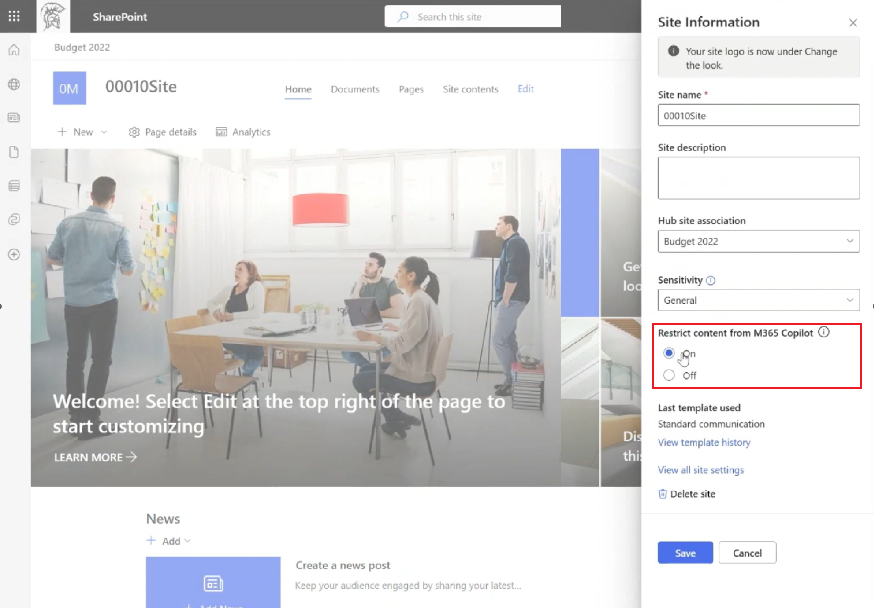
Restricted Content Discovery (RCD) + Delegation
Advanced discoverability control to exclude sites from Copilot and Agents
What does it do? Limit SharePoint sites to be discoverable by Copilot and Agents.
What’s New
Restricted Content Discovery for SPO admins (v1).
SPO admins can delegate RCD management to Site Admins! *
V1 Generally available
*Enhancements Private Preview

Slide 33
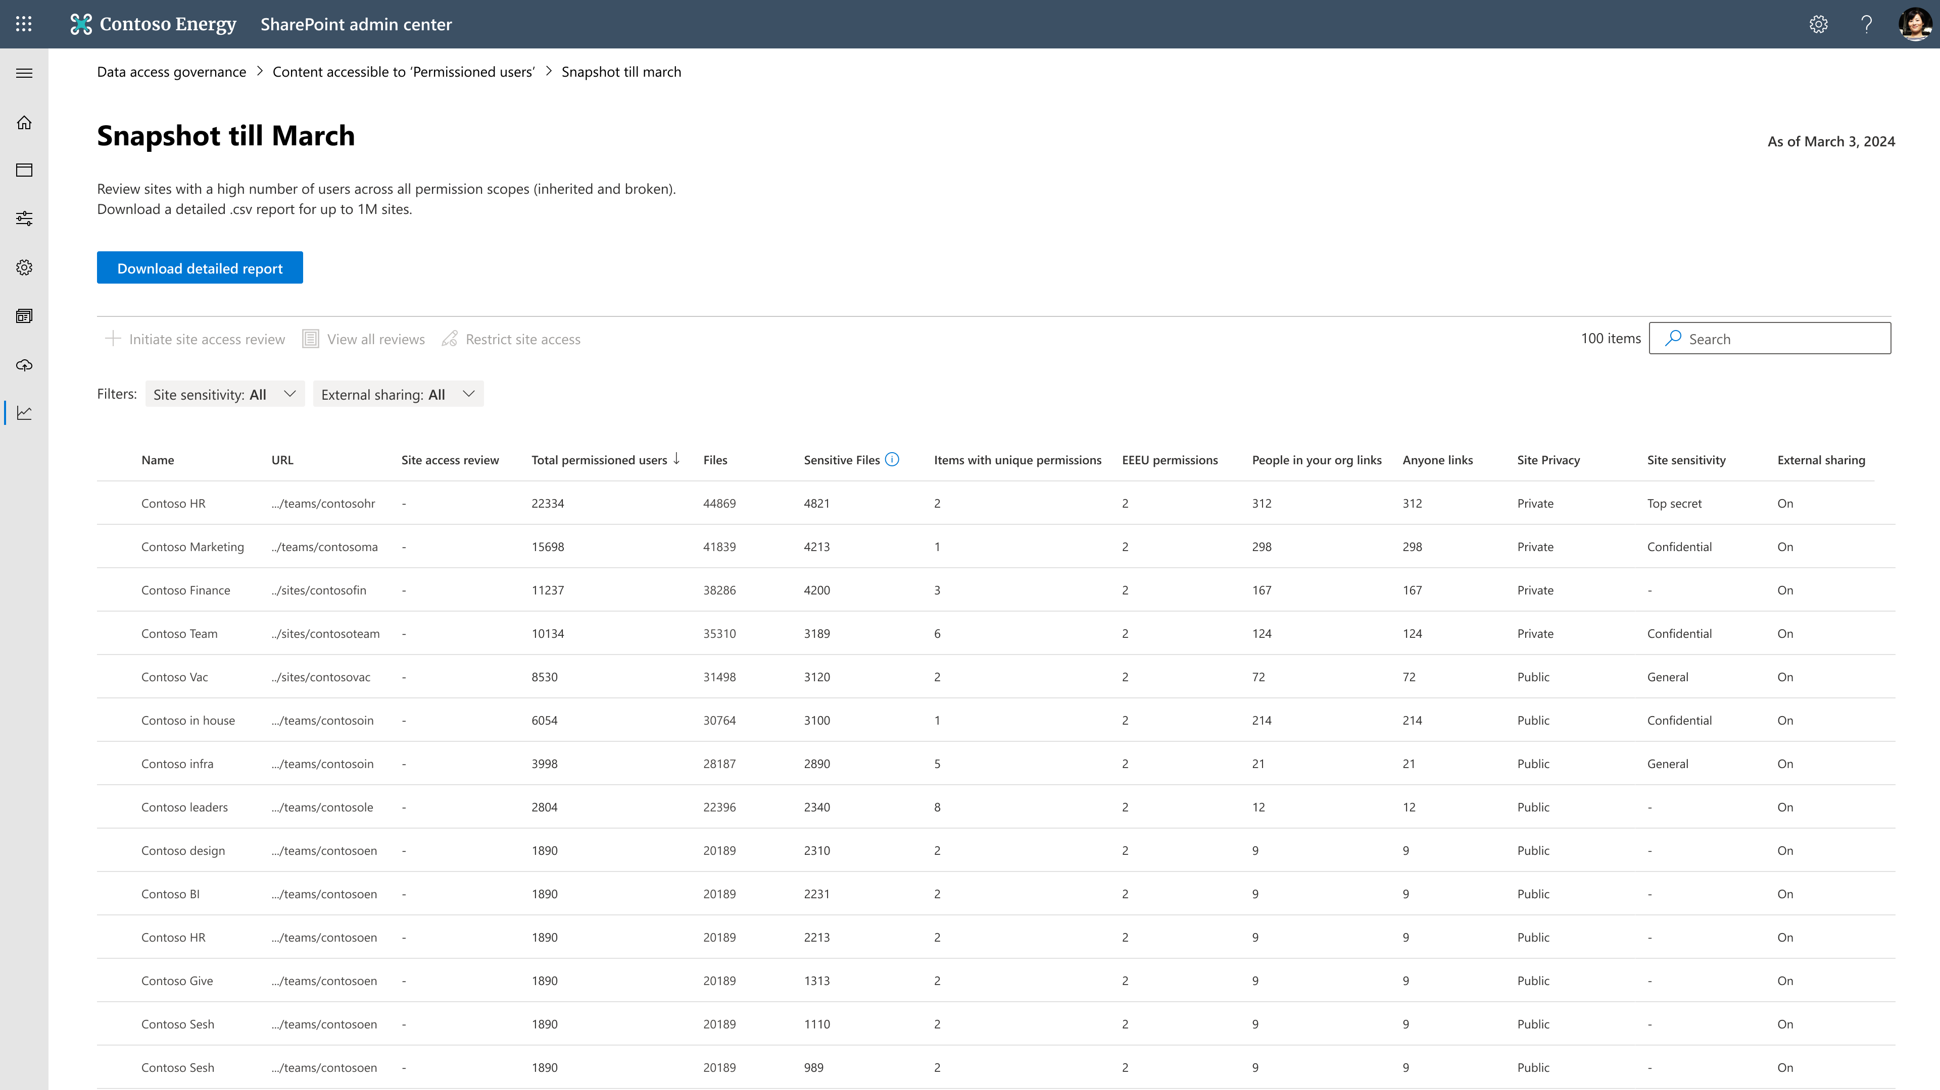
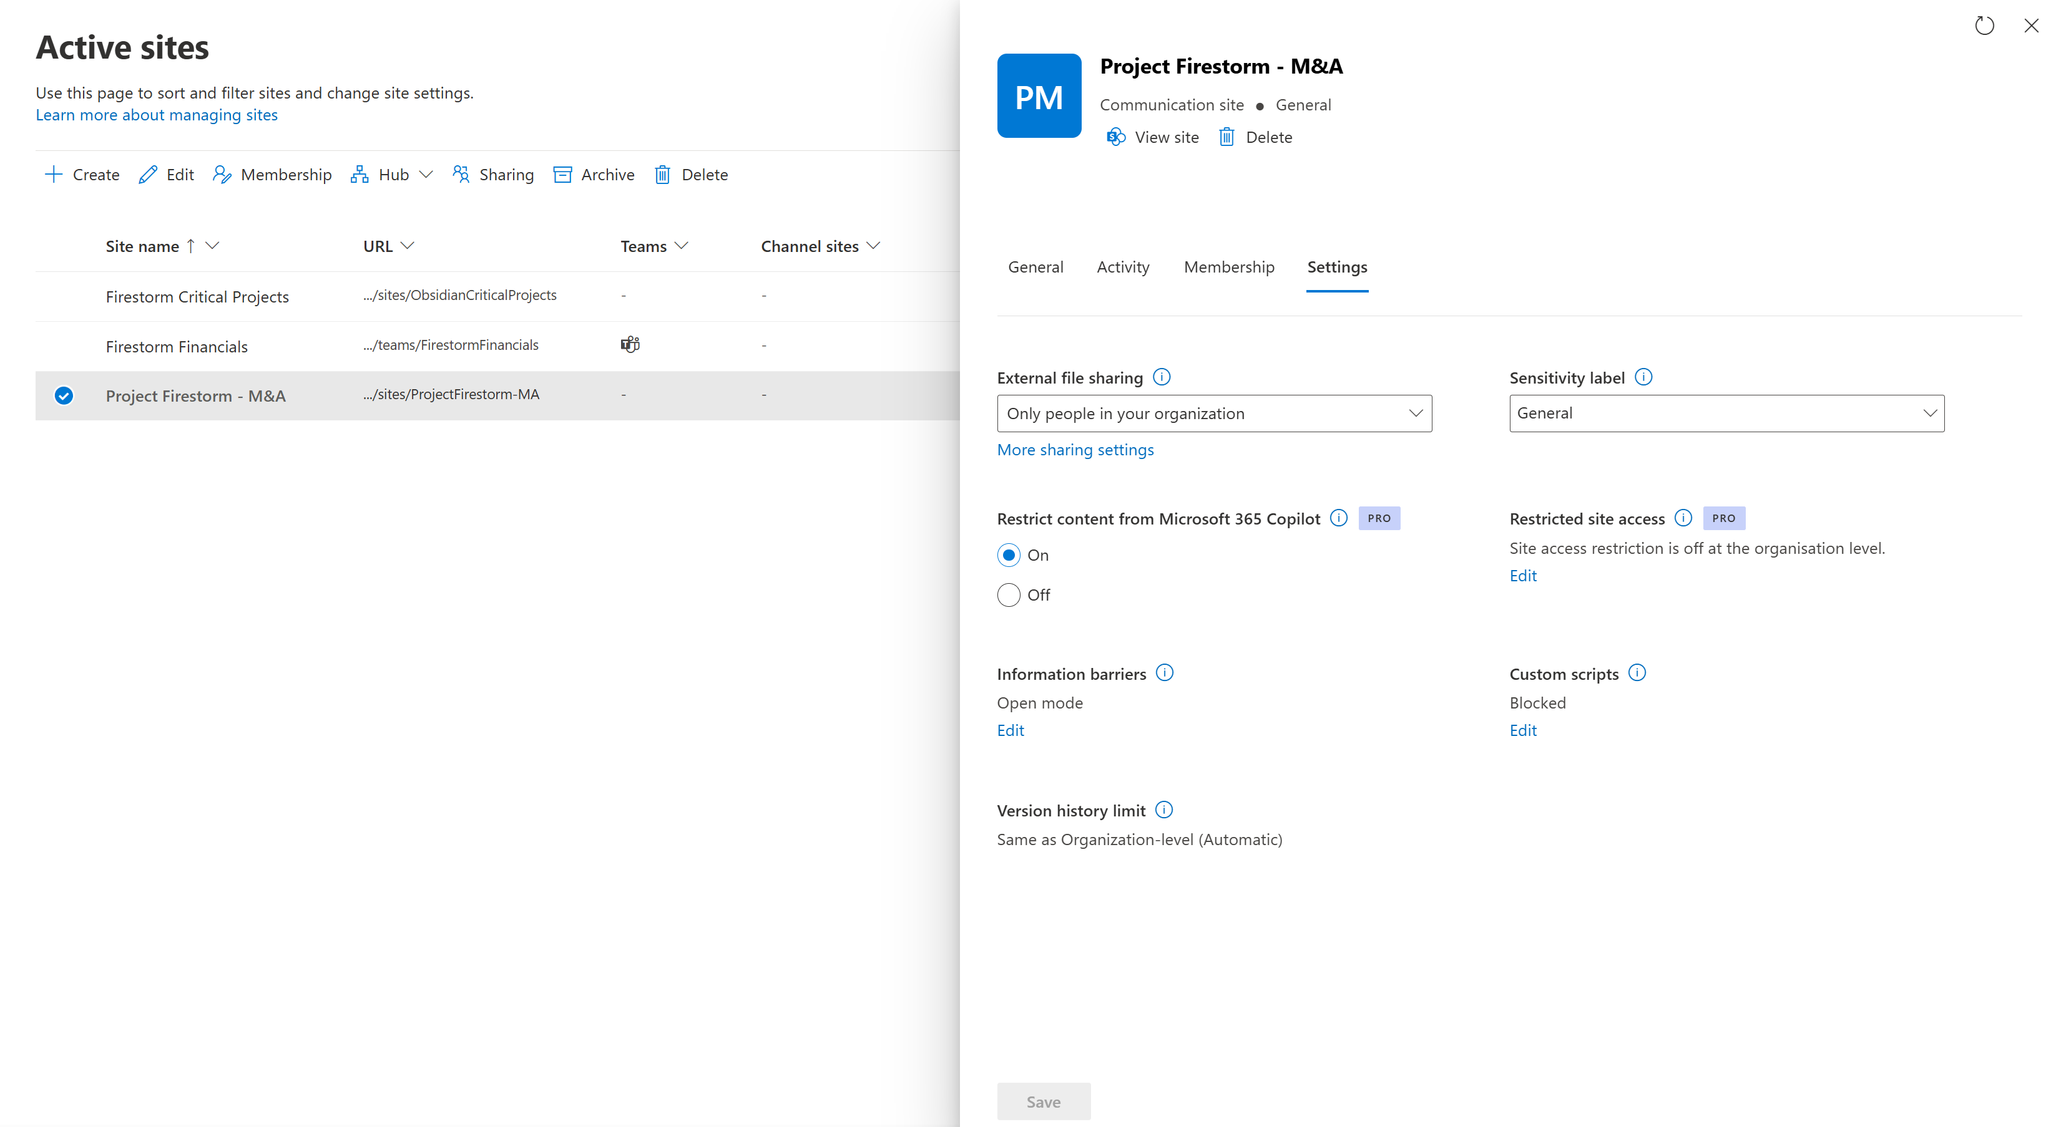
Notes:
Drill in slide. How many minutes?
Total permissioned users.

Slide 34
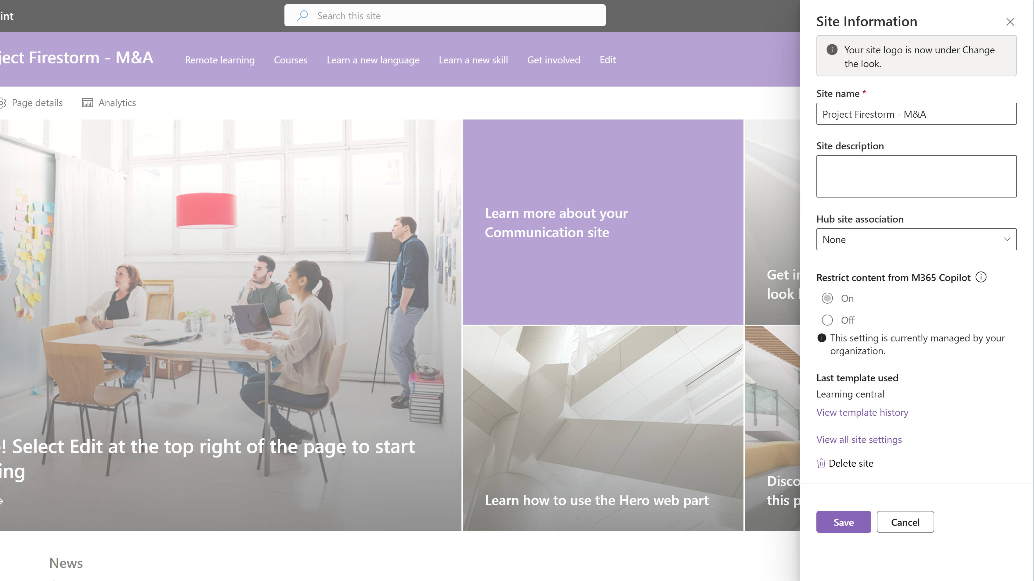
Notes:
Drill in slide. How many minutes?
Total permissioned users.

Slide 35
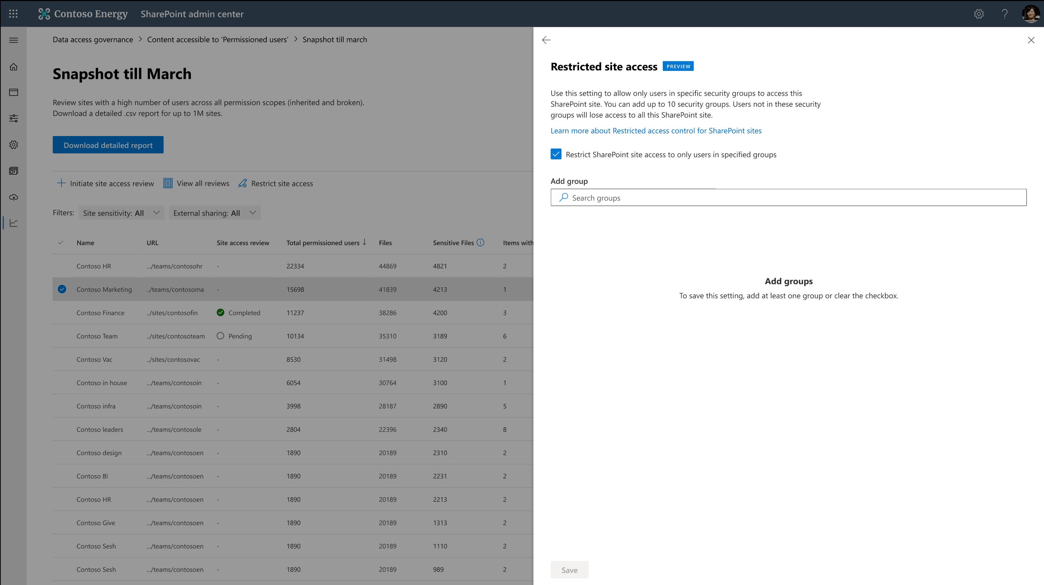
Restricted Access Control (RAC)
for SharePoint & OneDrive
RAC (Restricted access control) policy can be set at the site level. Even if individual files/folders have broken inheritance and over-shared, only RAC allowed users can access
Copilot honors RAC policy!
Microsoft 365 group-connected sites, Non-group SharePoint sites, Teams sites, Shared channel sites, OneDrive sites
Generally available
Notes:
RAC serves this purpose of locking down the site while the site is being reviewed. Only the people you explicitly provide access to the site while the review is taking place

Slide 36
Notes:
RAC initiated

Slide 38
Purview demo
DSPM for AI Data Risk Assessment

Slide 39
Microsoft Purview DSPM for AI
Data security and compliance for the era of AI
Notes:
Introducing DSPM for AI, a centralized place where you can discover, protect, and then govern the interactions with AI apps.

Slide 40
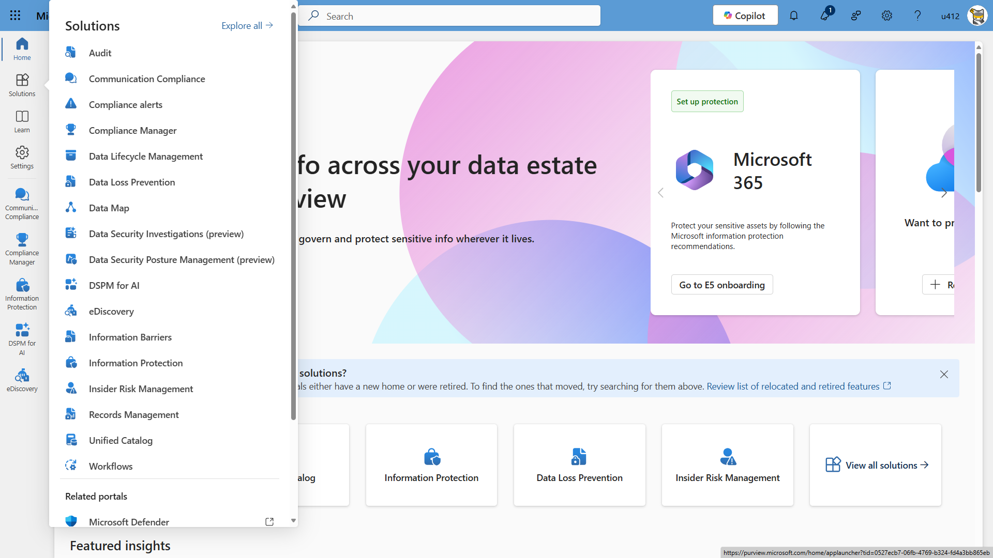

Slide 41
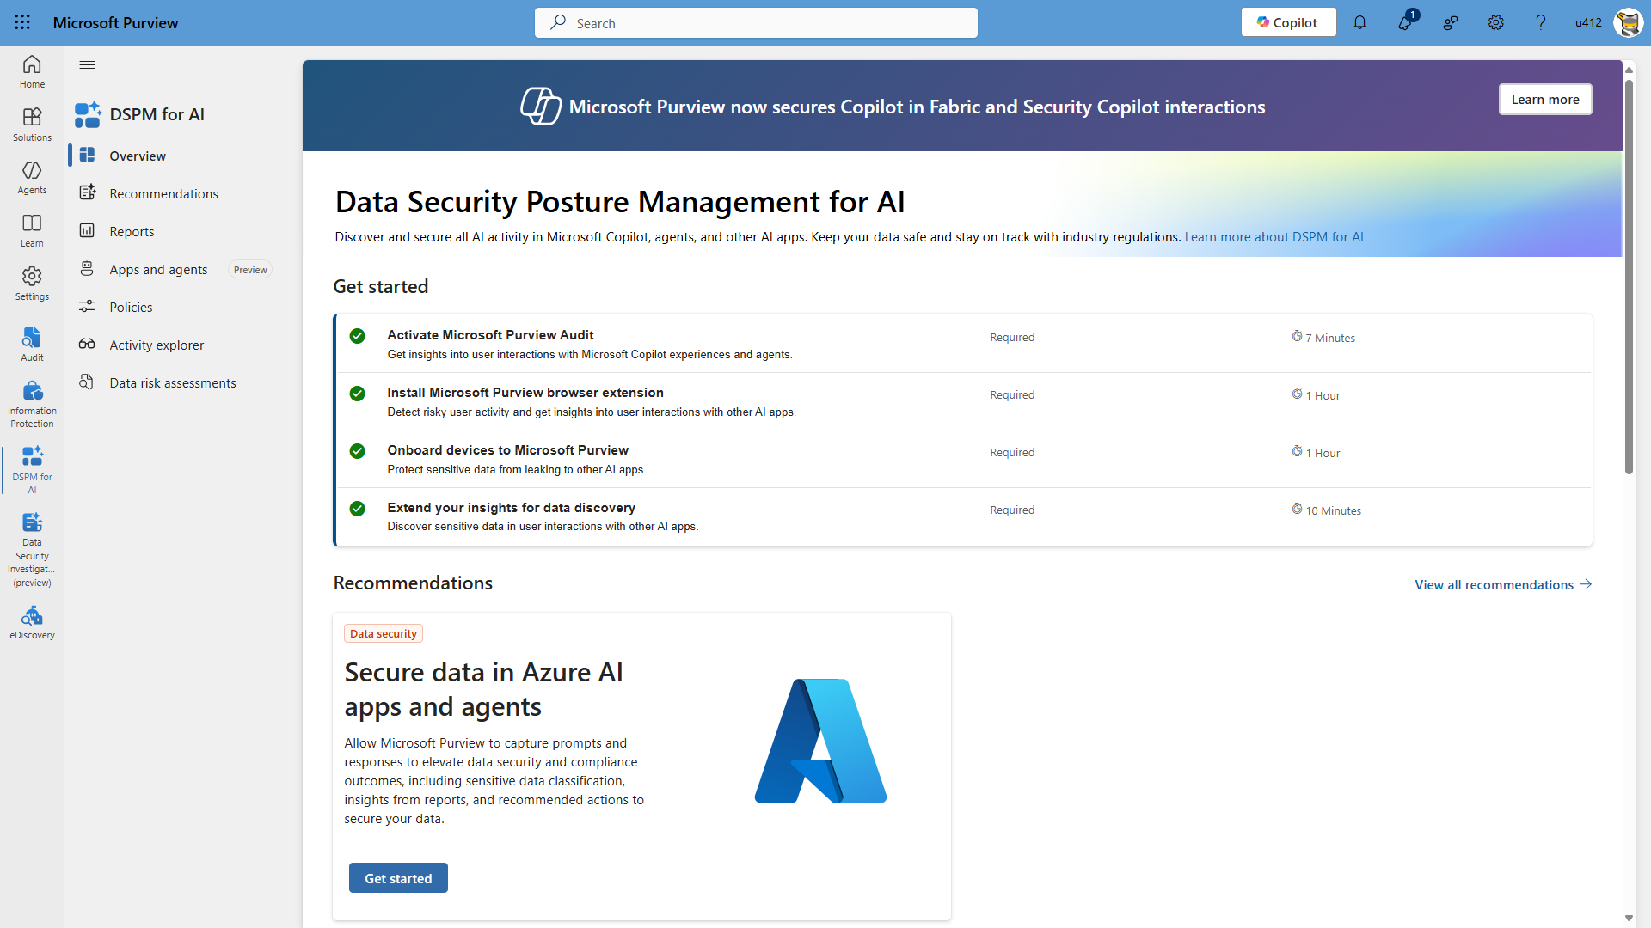

Slide 42
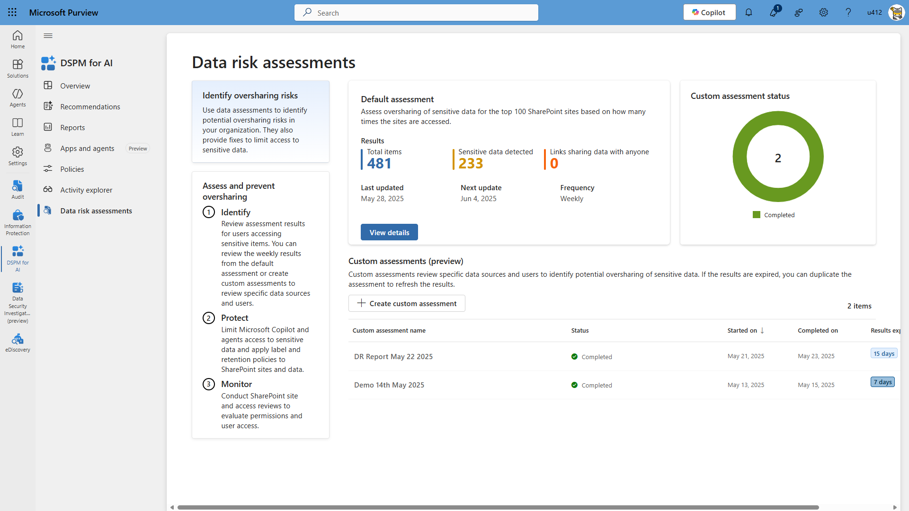

Slide 43
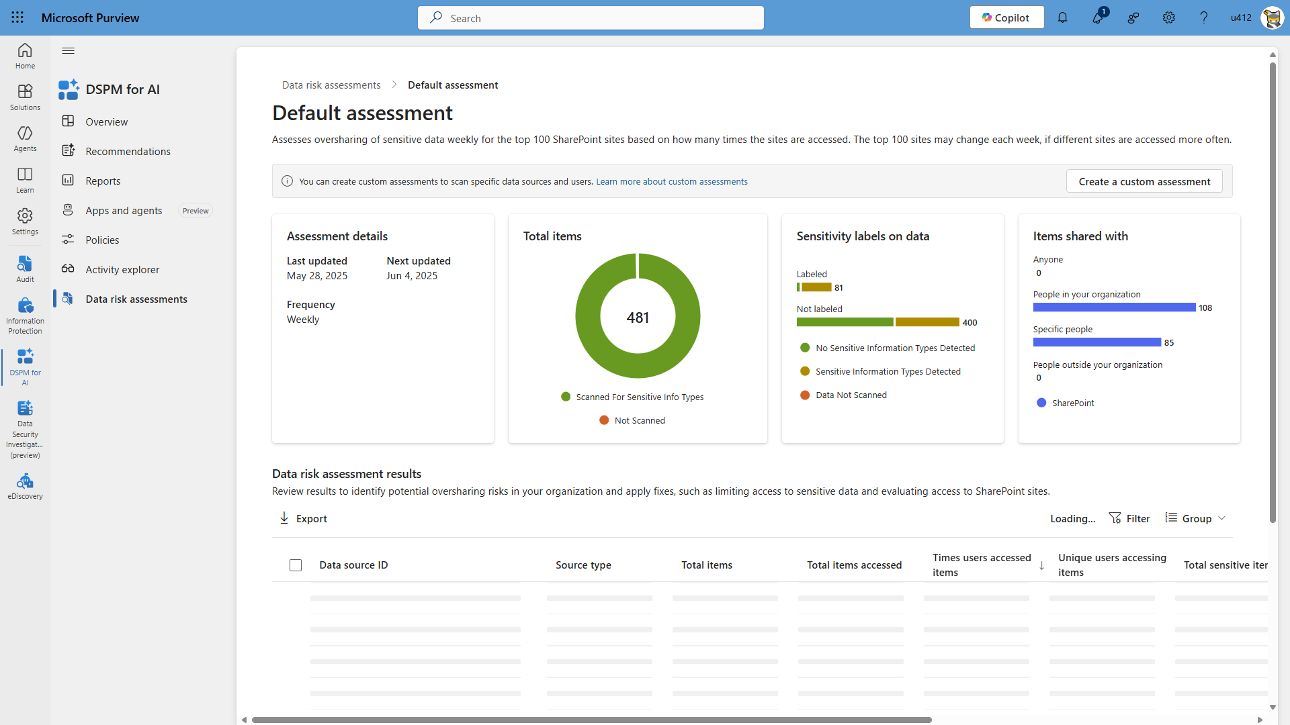

Slide 44
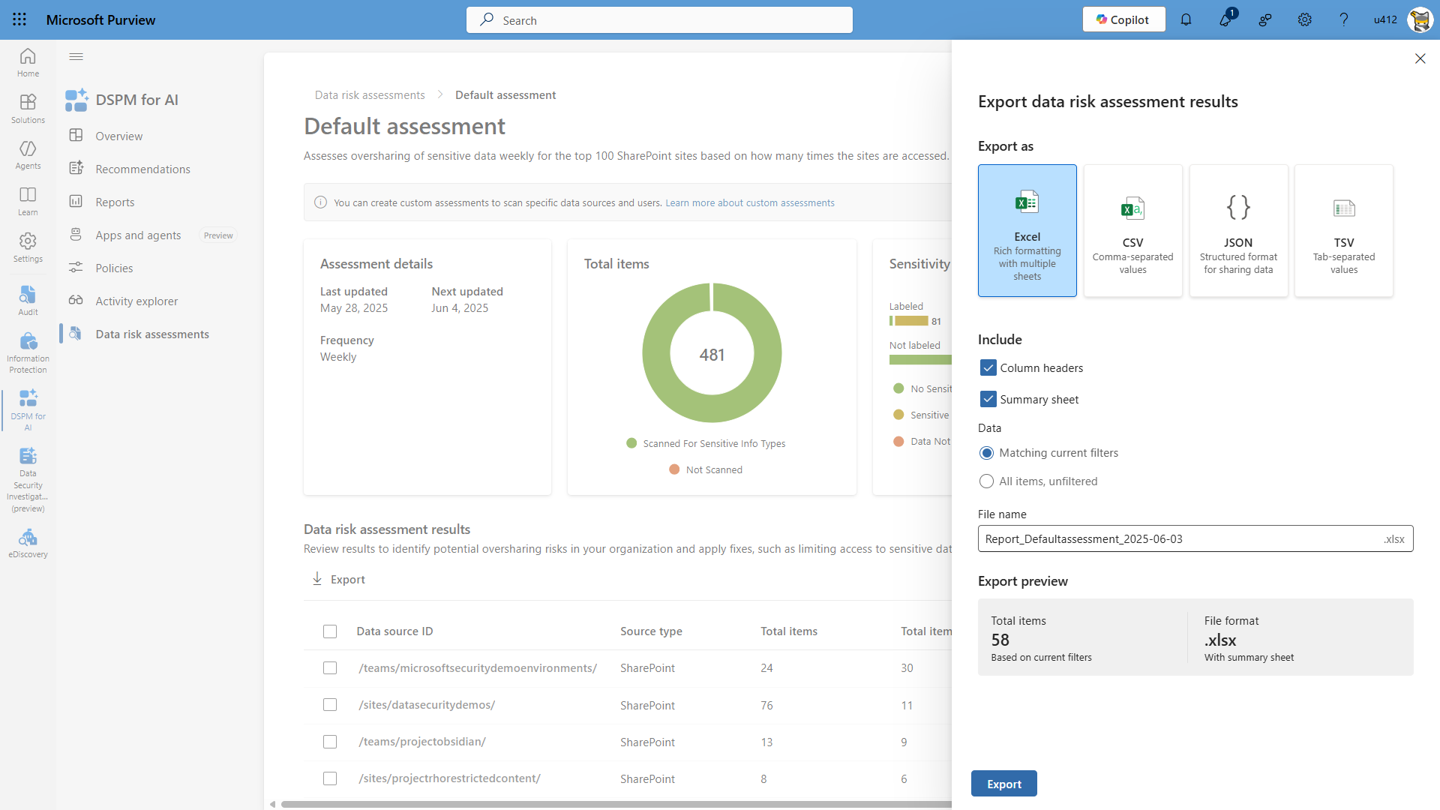

Slide 45
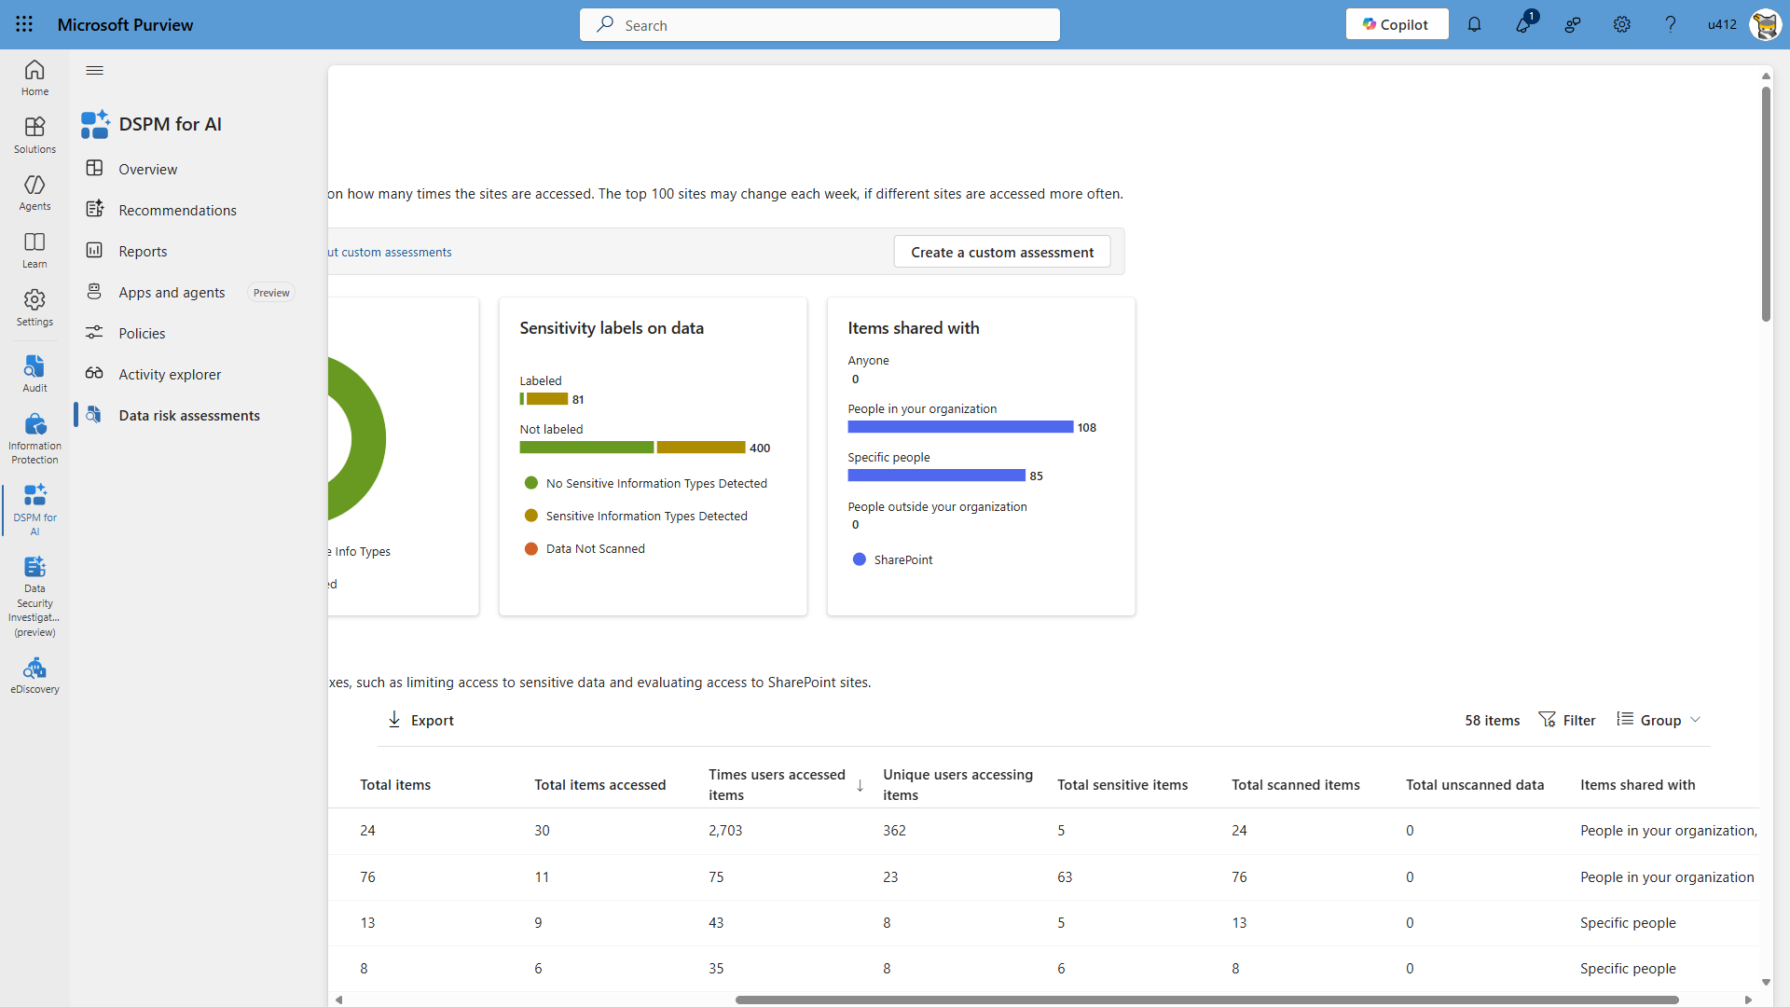

Slide 46
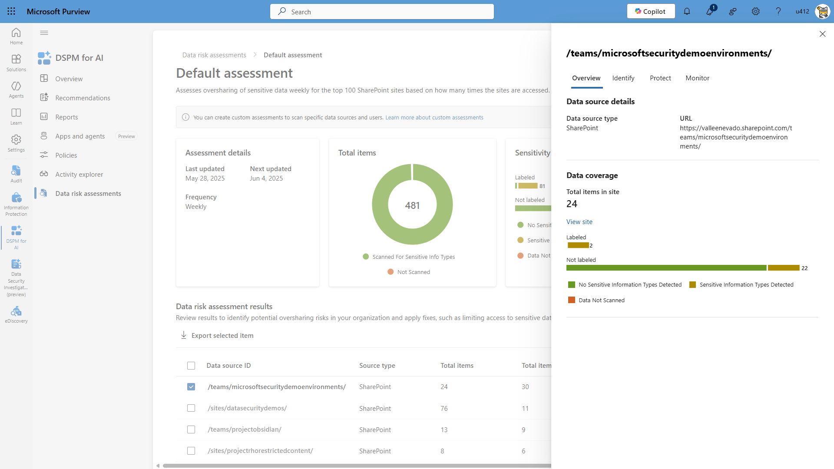

Slide 47
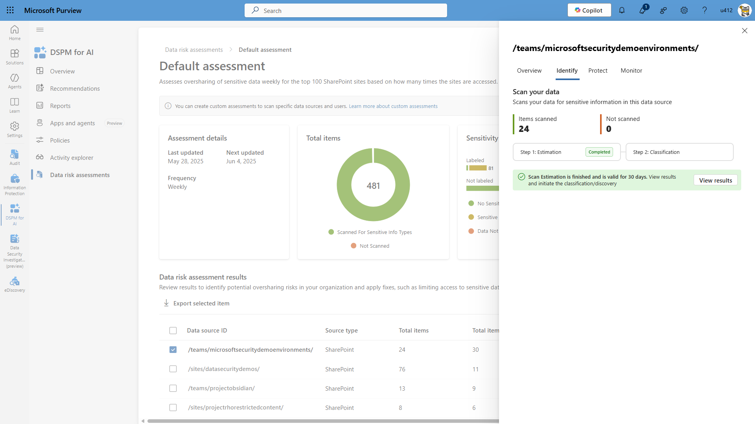

Slide 49
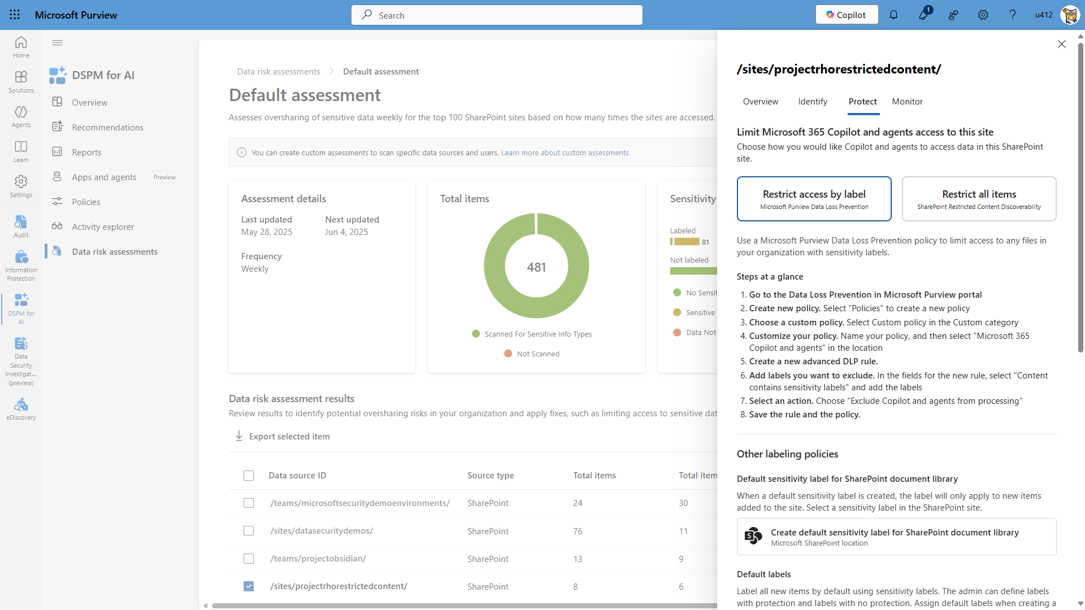

Slide 50
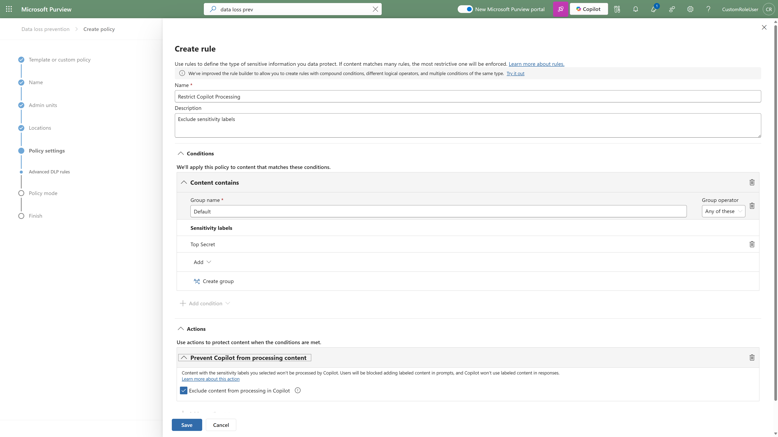
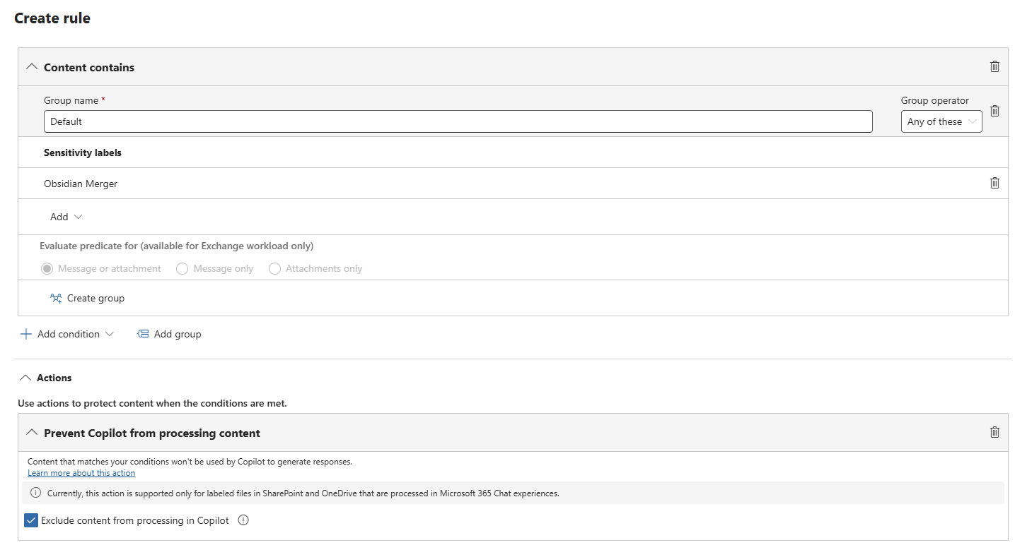
Prevent Copilot from processing content
Obsidian Merger
Purview DLP for Microsoft 365 Copilot policy can prevent Copilot from using sensitive data to generate responses.
Notes:
For enterprise-grade AI applications, such as Microsoft 365 Copilot, data security teams have more sophisticated and comprehensive controls to implement. For example, data security admins can create DLP policies for M365 Copilot to exclude documents with specified sensitivity labels from being summarized or used in responses in Microsoft 365 Copilot Business Chat. This capability, which currently works with Office files and PDFs in SharePoint, helps ensure that potentially sensitive content within a labeled document is not readily available to users to copy and paste into other applications.

Slide 51
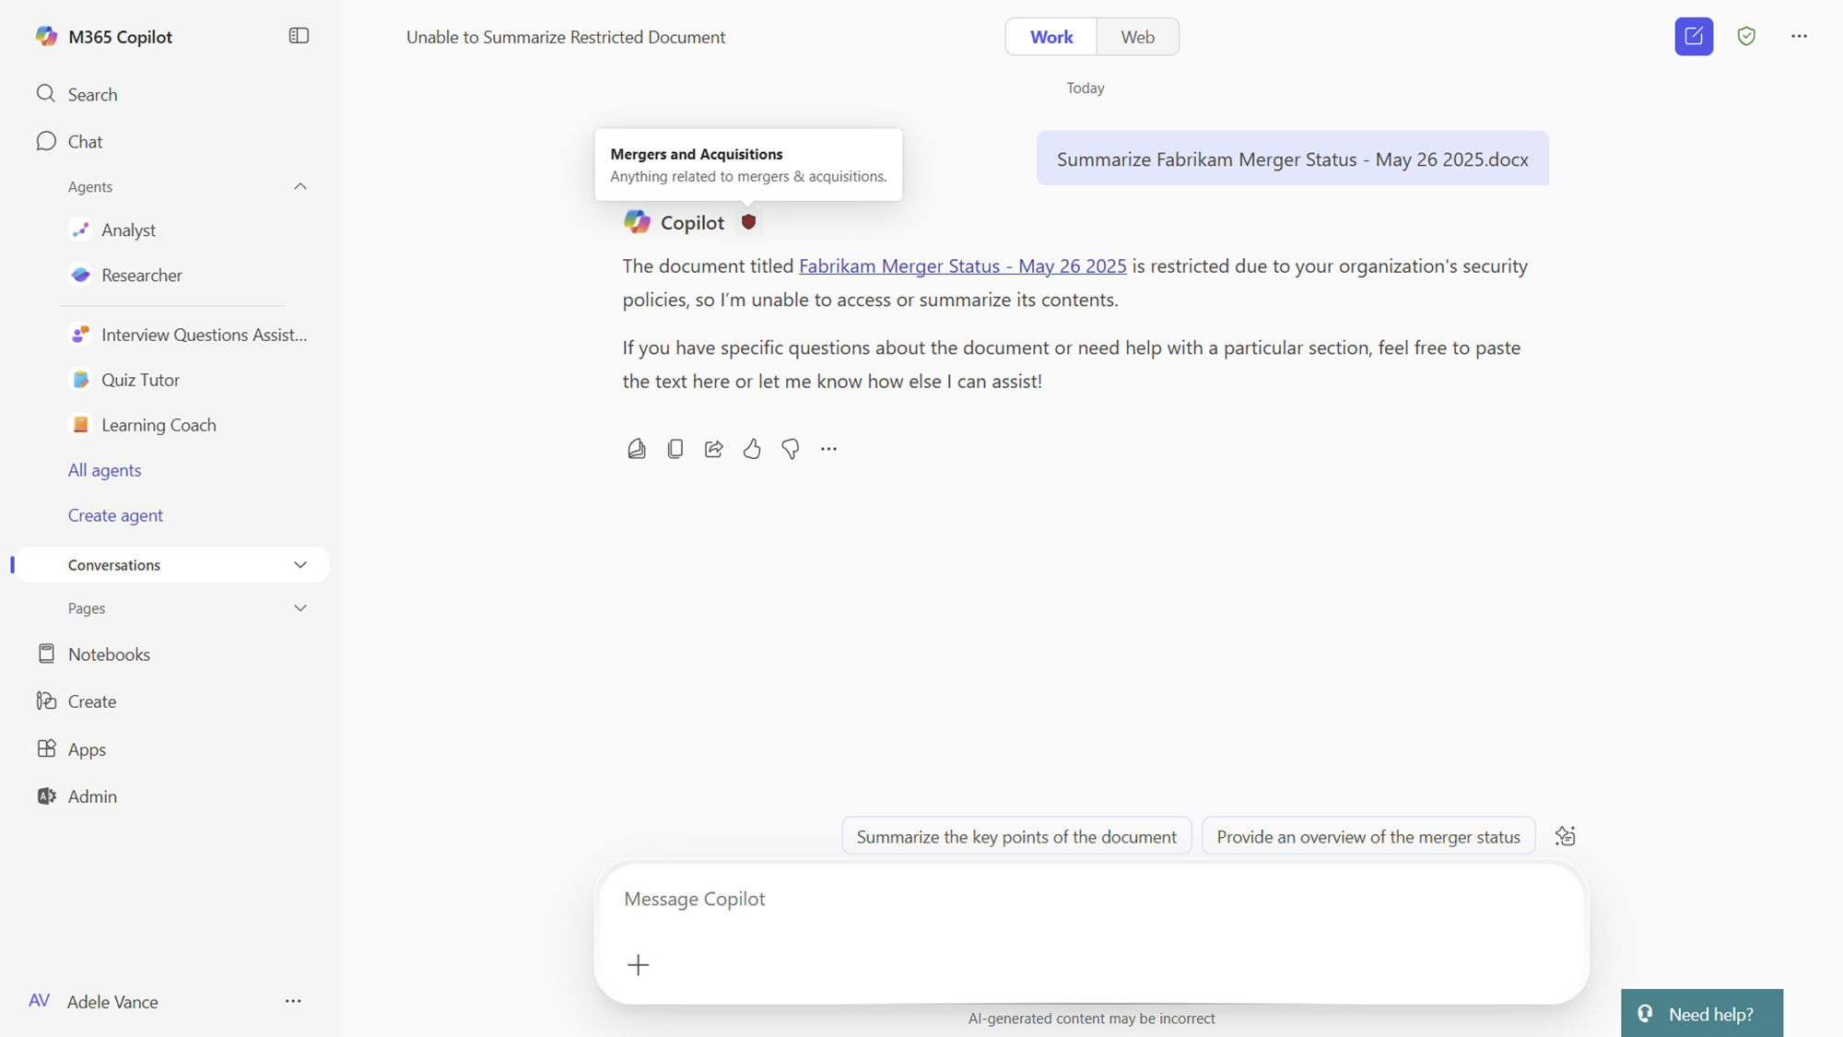
Prevent Copilot from using sensitive content
Purview DLP for Microsoft 365 Copilot policy can prevent Copilot from using sensitive data to generate responses.
Notes:
For example, after Contoso security team configure a DLP policy for M365 Copilot for Project Obsidian, Copilot would not summarize the project in its response to employees.

Slide 52
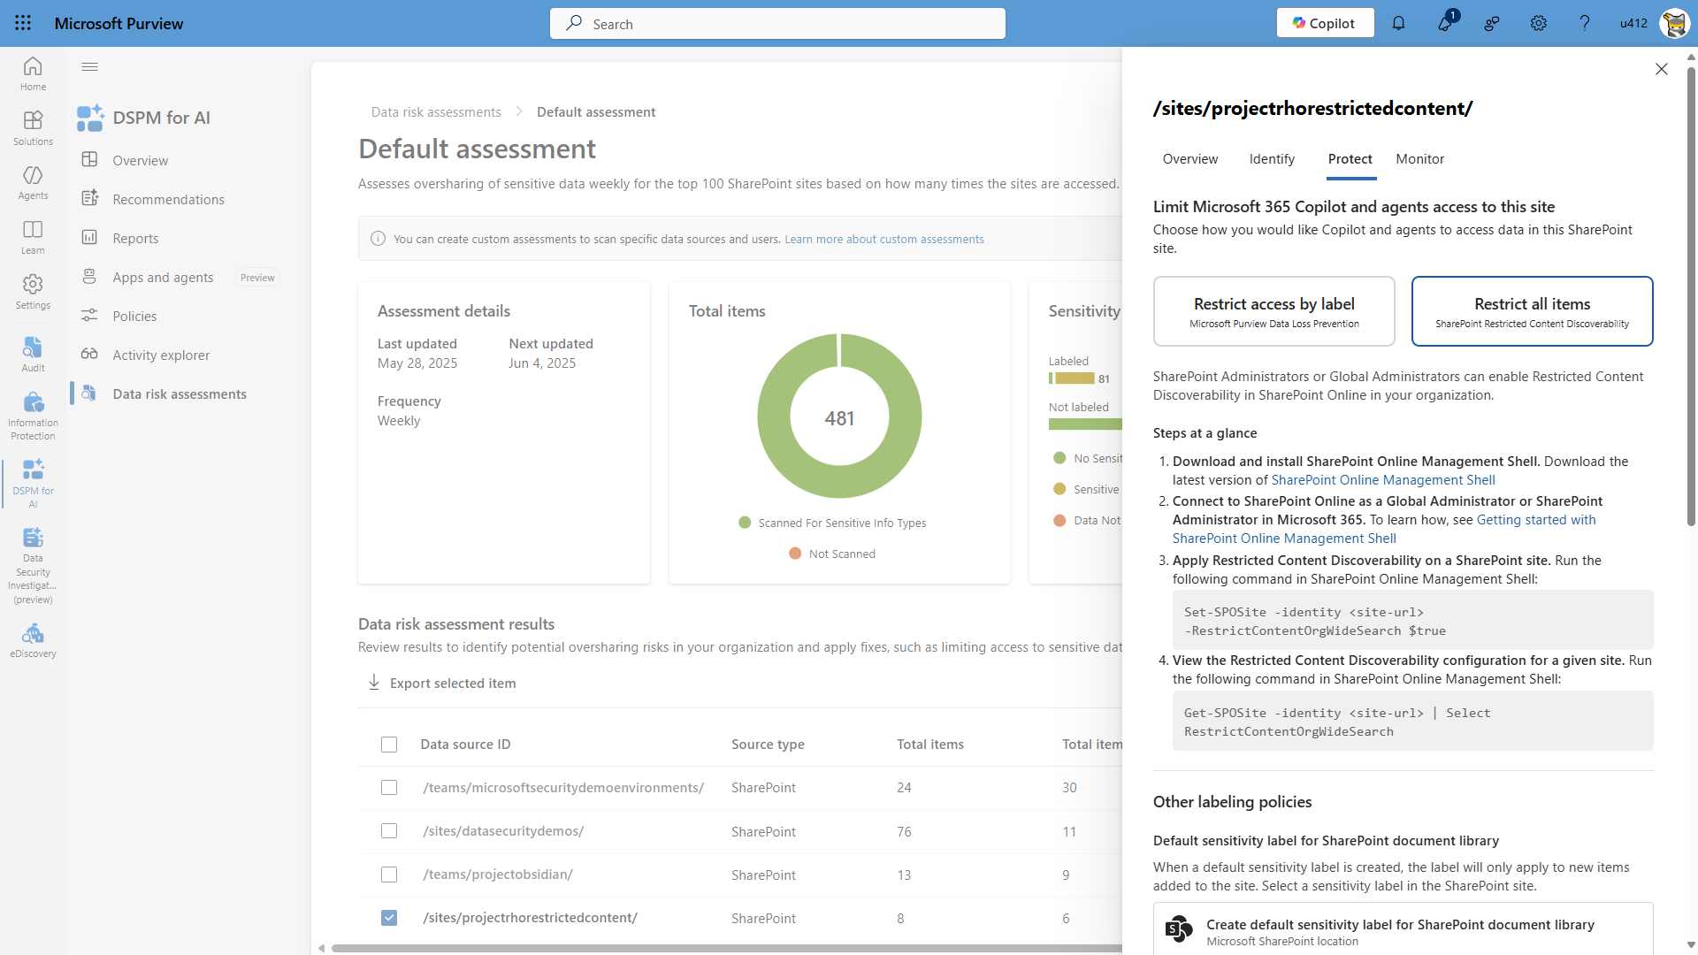

Slide 53
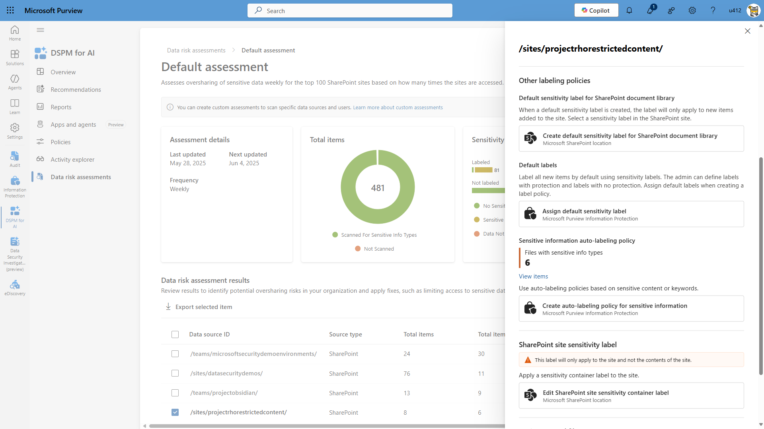

Slide 54
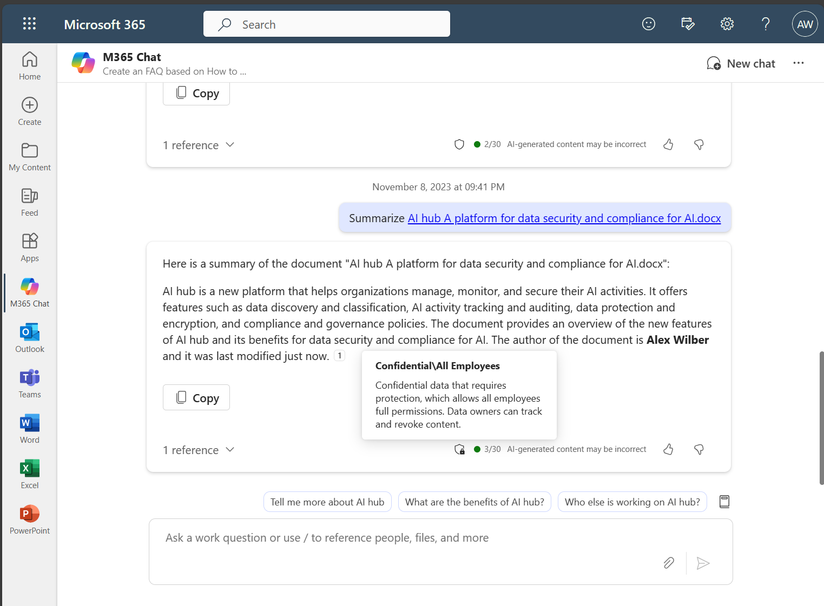
Copilot conversation inherits the sensitivity label of referenced file
A sensitivity label applies to the entire conversation.
Conversations inherit the most restrictive sensitivity labels from the references used to formulate a response.
GA
Notes:
Talking points:
The next cool thing that Copilot can do it around label inheritance.
When users reference a labeled document in a Copilot conversation the entire conversation inherits the same sensitive label as the reference document.

Slide 55
Honoring access control restrictions on labeled content
Only content from references where the user has appropriate permission will be included in responses.
If a user lacks the right permissions, Copilot will inform the user and provide a link but will not include the content for generating responses.
Copilot will not include information from referenced files where the user does not have appropriate access rights.
Notes:
Talking points:
This demo auto plays to highlight the summary from reference information the user has extract permissions
Then information about relevant references where the user does not have extract permissions

Slide 56
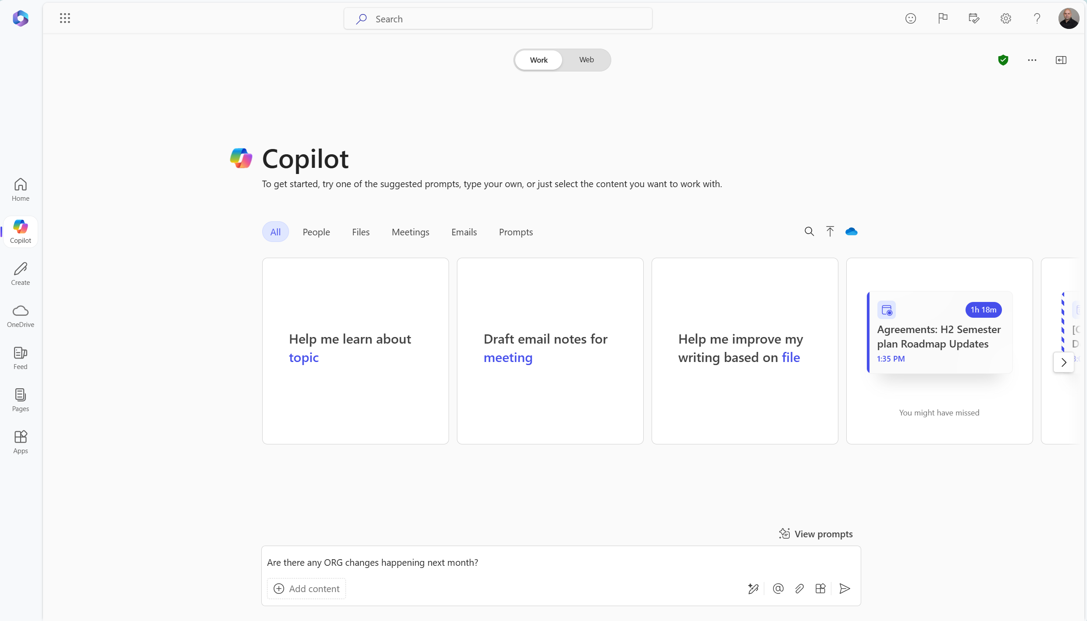

Slide 58
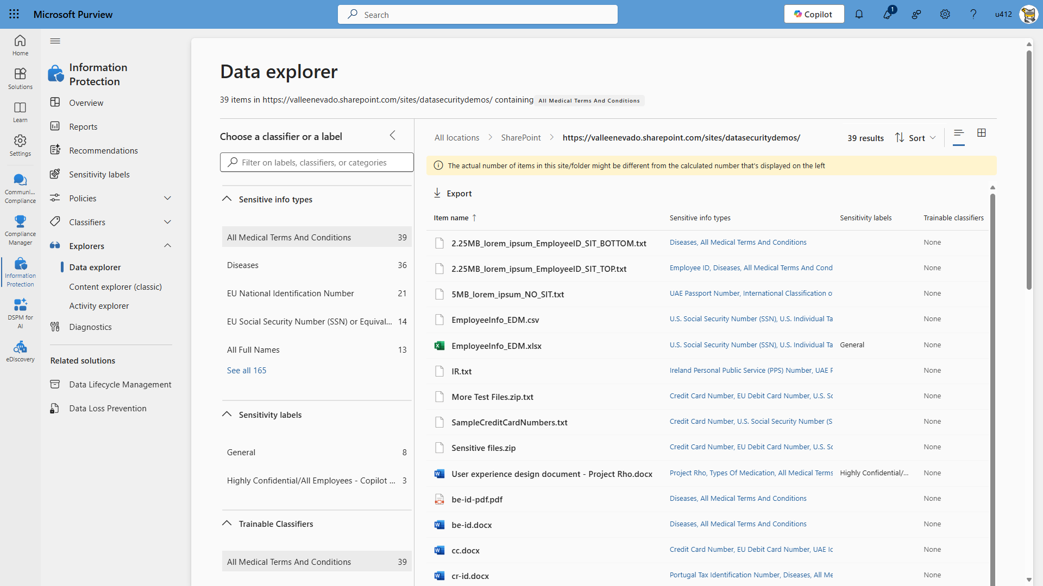

Slide 59
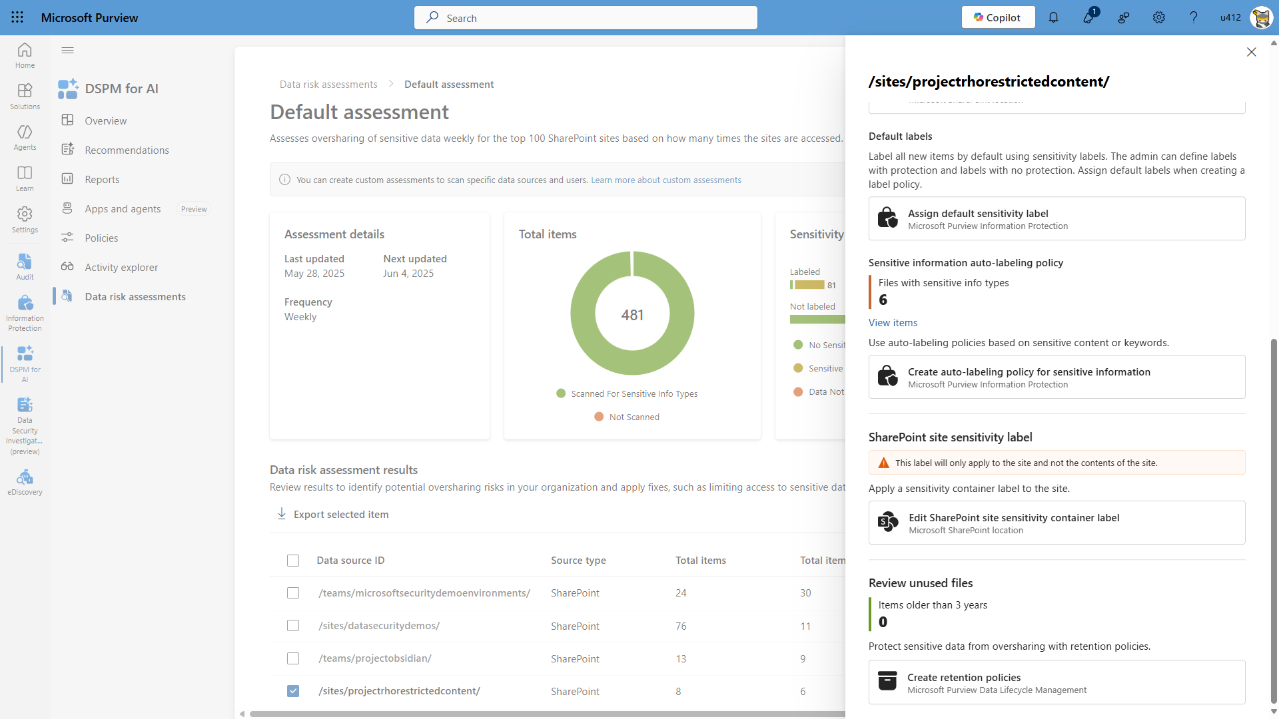

Slide 60
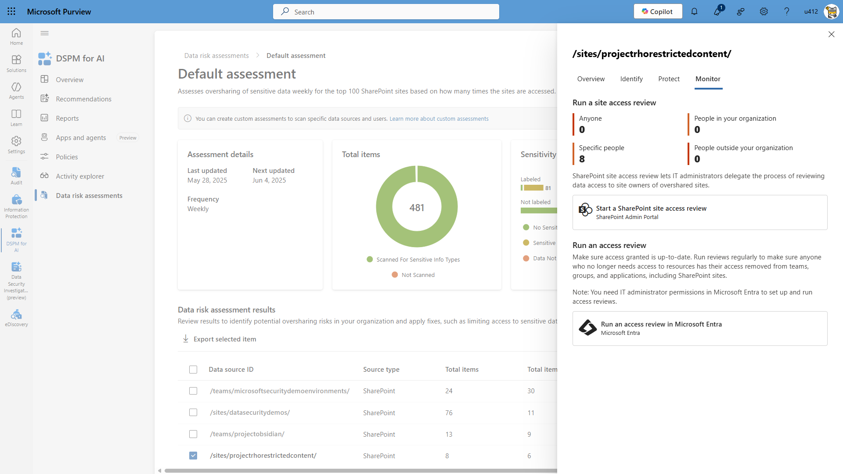

Slide 61
Customers with E5
Optimized
aka.ms/Copilot/Oversharing
Address internal oversharing concerns for M365 Copilot deployment
Pilot (Optional)
Deploy
Operate
Identify most popular sites & assess oversharing with SAM DAG and Purview DSPM for AI Data risk assessment
Grant Copilot access to popular, low risk sites with RSS
Turn on proactive audit and protection with Purview audit and DLP for SharePoint
Discover oversharing risks with SAM DAG and Purview DSPM for AI Data risk assessment
Restrict sensitive info from Copilot access and/or processing with SAM RCD and Purview DLP for Copilot
Increase site privacy with Purview sensitivity labels
Further reduce risk and simplify oversight at scale with SAM site lifecycle management policies and Purview DSPM for AI Data risk assessment
Further secure sensitive data with Purview sensitivity labels
Improve Copilot responses with SAM Inactive site policy and Purview DLM by removing inactive site and content
Activities
Outcomes
Deploy copilot to sub-set of users with up to 100 sites
Copilot fully deployed in your organization
Continuous improvement of data security practices
Technical implementation Effort*
2–4 days
2–4 weeks
More than one month
*Suggested efforts should be reviewed into timelines based on your tenant size and organizational complexity
Last updated April 14, 2025

Slide 62
Deployment Blueprint
Address internal oversharing for Microsoft 365 Copilot
aka.ms/Copilot/Oversharing
Notes:
And here are some great links to keep learning.

Slide 63
SAM Additional resources
SharePoint Advanced Management Preview Program: aka.ms/SAMPreviewProgramSignUp
Get ready for Microsoft 365 Copilot with SharePoint Advanced Management: https://learn.microsoft.com/en-us/sharepoint/get-ready-copilot-sharepoint-advanced-management
Notes:
And here are some great links to keep learning.

Slide 64
Purview Additional resources
Join our Microsoft customer connection program: aka.ms/JoinCommunity
Deployment guides DSPM for AI: aka.ms/DSPMforAI/deploy Data Risk Assessment: aka.ms/DSPMforAI/oversharing
Accelerate your Information Protection and Data Loss Prevention deployment: aka.ms/PurviewDeploymentModels
Notes:
And here are some great links to keep learning.

Slide 65
Questions?

