Slide 1
Practical guidance for AI and collaboration adoption
Karuana Gatimu, Director of Customer Advocacy – AI & Collaboration

Slide 2
The journey to becoming AI powered
You are here
Leadership
Human change
Technical readiness
Develop leadership capabilities to leverage AI for business outcomes
Manage the human transformation with robust user enablement programs
Build and iterate technical skills to deliver on business results
Executive sponsorship
Align AI to business strategy
Providing clarity and prioritization
Best practice: AI Council
User enablement program
Communications and community
Skilling and training
Best practice: Community of Practice and Copilot Dashboard
Secure your data infrastructure
Policy review
Extend to new high value line of business scenarios
Best practice: Optimization Assessment
Responsible AI principles

Slide 3
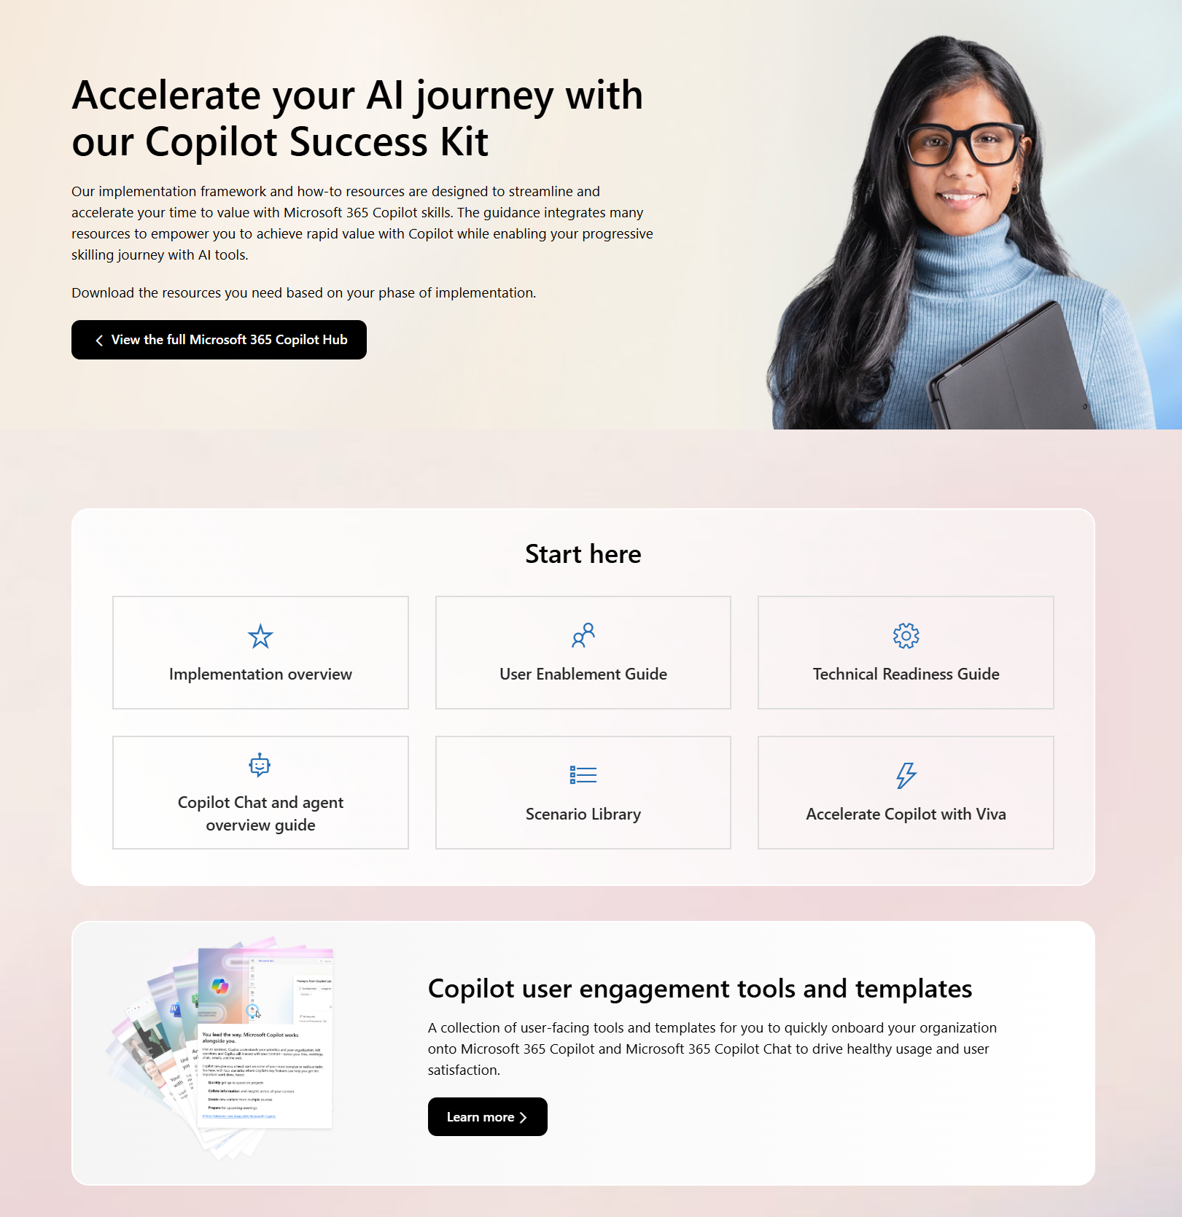
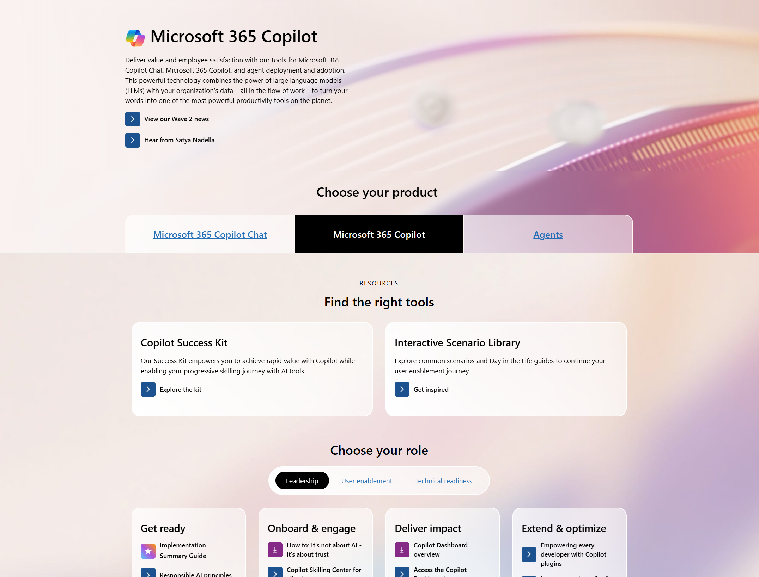

Copilot resources on Microsoft Adoption
One site for all your Copilot needs
https://adoption.microsoft.com/copilot
Resources by role
Interactive Scenario Library
Product announcements and news
Links to all other Microsoft sites
Extended links for Small/Medium business, Copilot in Sales, Microsoft Viva, and more
Take the Class!
Earn your User Enablement badge & validate your skills with MS-4007 available today!

Slide 4
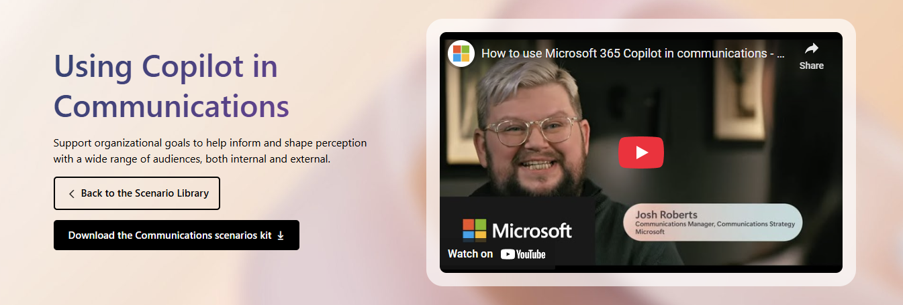
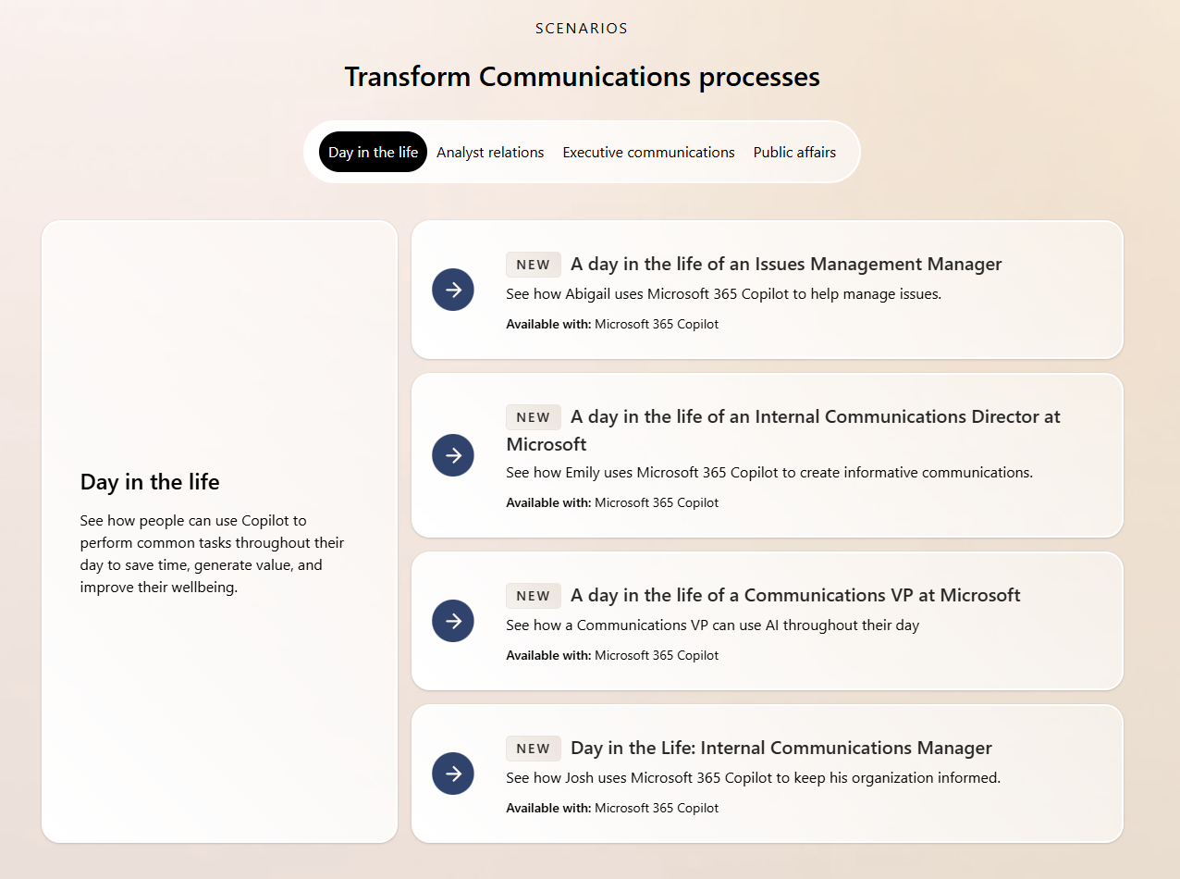
Delivering Value
aka.ms/Copilot/ScenarioLibrary
Start with our content to get new ideas
Use as discussion tool with business users
Experiment with new ideas and processes
1

Slide 5

Microsoft 365 Copilot implementation
Human change
Prepare organization and employees for the AI transformation journey through user enablement programs
Copilot
readiness checklist
You are here
Workstreams support each other for maximum value and ROI
Copilot implementation
Sponsor
Scenarios
Security
Get ready > Onboard & engage > Deliver impact > Extend & optimize
Technical readiness
Address technical deployment and optimization, including governance, security, compliance, and management
Leadership journey

Slide 6



Extended view: Designing scenarios using the
Modern Collaboration Architecture (MOCA) Framework
adopt attention-harnessing
contains essential
supported by
Person
Focus areas
Capability/needs
Microsoft 365 apps
Behaviors
Values
Essential elements that enable people to get work done. Performing the capability/needs enables people to accomplish their individual, team, community and organizational tasks.
Organizational
Cultural Values
#PeopleFirst
Foundation focus areas provide an essential foundation for people to develop strong collaboration practices.
To address the specific capability/needs of people when they operate as individuals, teams, community, and organizational focus areas, specific Microsoft 365 applications can be used to accomplish the required tasks.
Behaviors that enable attention to be harnessed to create focus and flow for people to get work done. If attention-harnessing behaviors are not intentionally created, attention-distracting behaviors get adopted, resulting in a drop in people’s effectiveness and a negative impact on collaboration across the team, and the wider organization.
An organization’s culture is comprised of the behaviors of groups of people. When we help individuals adopt attention-harnessing behaviors, that in return contributes to the positive culture of an organization.
It’s all about people.
A person’s effectiveness can be increased by getting them to adopt the right ‘attention-harnessing’ behaviors.
Extended focus areas enable improvement of business improvement and differentiation to focus on developing a culture of continual improvement.
work within
are enabled by
contribute to the wider organizational

Slide 7
Essentials for Copilot user enablement success
Nominate and activate your Copilot executive sponsors, in partnership with your AI Council
Accelerate your business impact by defining highest value scenarios
Define your path to secure your data for compliance and peace of mind

Slide 8

Implementation overview
Microsoft 365 Copilot
You are here
Get ready
Onboard & engage
Deliver impact
Extend & optimize
User Enablement Workstream
Complete User Enablement Strategy training
Define user experience and feedback strategy
Design and deploy training and engagement community (Community of Practice/Champion Platform)
Launch employee communications and Champion program
Onboard executives and user cohorts
Deliver user Champions and support staff training
Review success measures and user survey results
Conduct feedback and reporting analysis
Deliver extended training and adoption support
Identify additional optimization scenarios
Iterate user experience strategy
Gather and amplify success stories
Extend to new high value scenarios
Deliver business process transformation with Copilot Studio, plugins, and connectors
Drive group and cross-organizational productivity and innovation
Understand custom line of business opportunities
Secure exec sponsorship, create AI Council, and define RAI principles
Identify success owners, Champions, and early adopter cohorts
Detail high value scenarios and personas
Be intentional with assignment and concentrate seats
Define success criteria, KPIs, and success measurement plan
User
Enablement
Technical Readiness Workstream
Ensure appropriate Data Security controls are in place
Prepare your organization for Microsoft 365 Copilot with setup guide: deploy Microsoft 365 apps, if needed; assign licenses
Assign permissions by role to provide access to the Microsoft 365 Copilot usage report
Establish service management plan
Analyze Microsoft 365 Copilot usage reports and the Microsoft Copilot Dashboard to observe user adoption, retention, and engagement
Design, build, and publish plugins to deliver unique experiences
Build your own custom agents
Perform the Microsoft 365 Copilot Optimization Assessment
Address data security, governance, and data access questions
Build shared Microsoft 365 Copilot implementation plan with User Enablement team
Technical Readiness

Slide 9
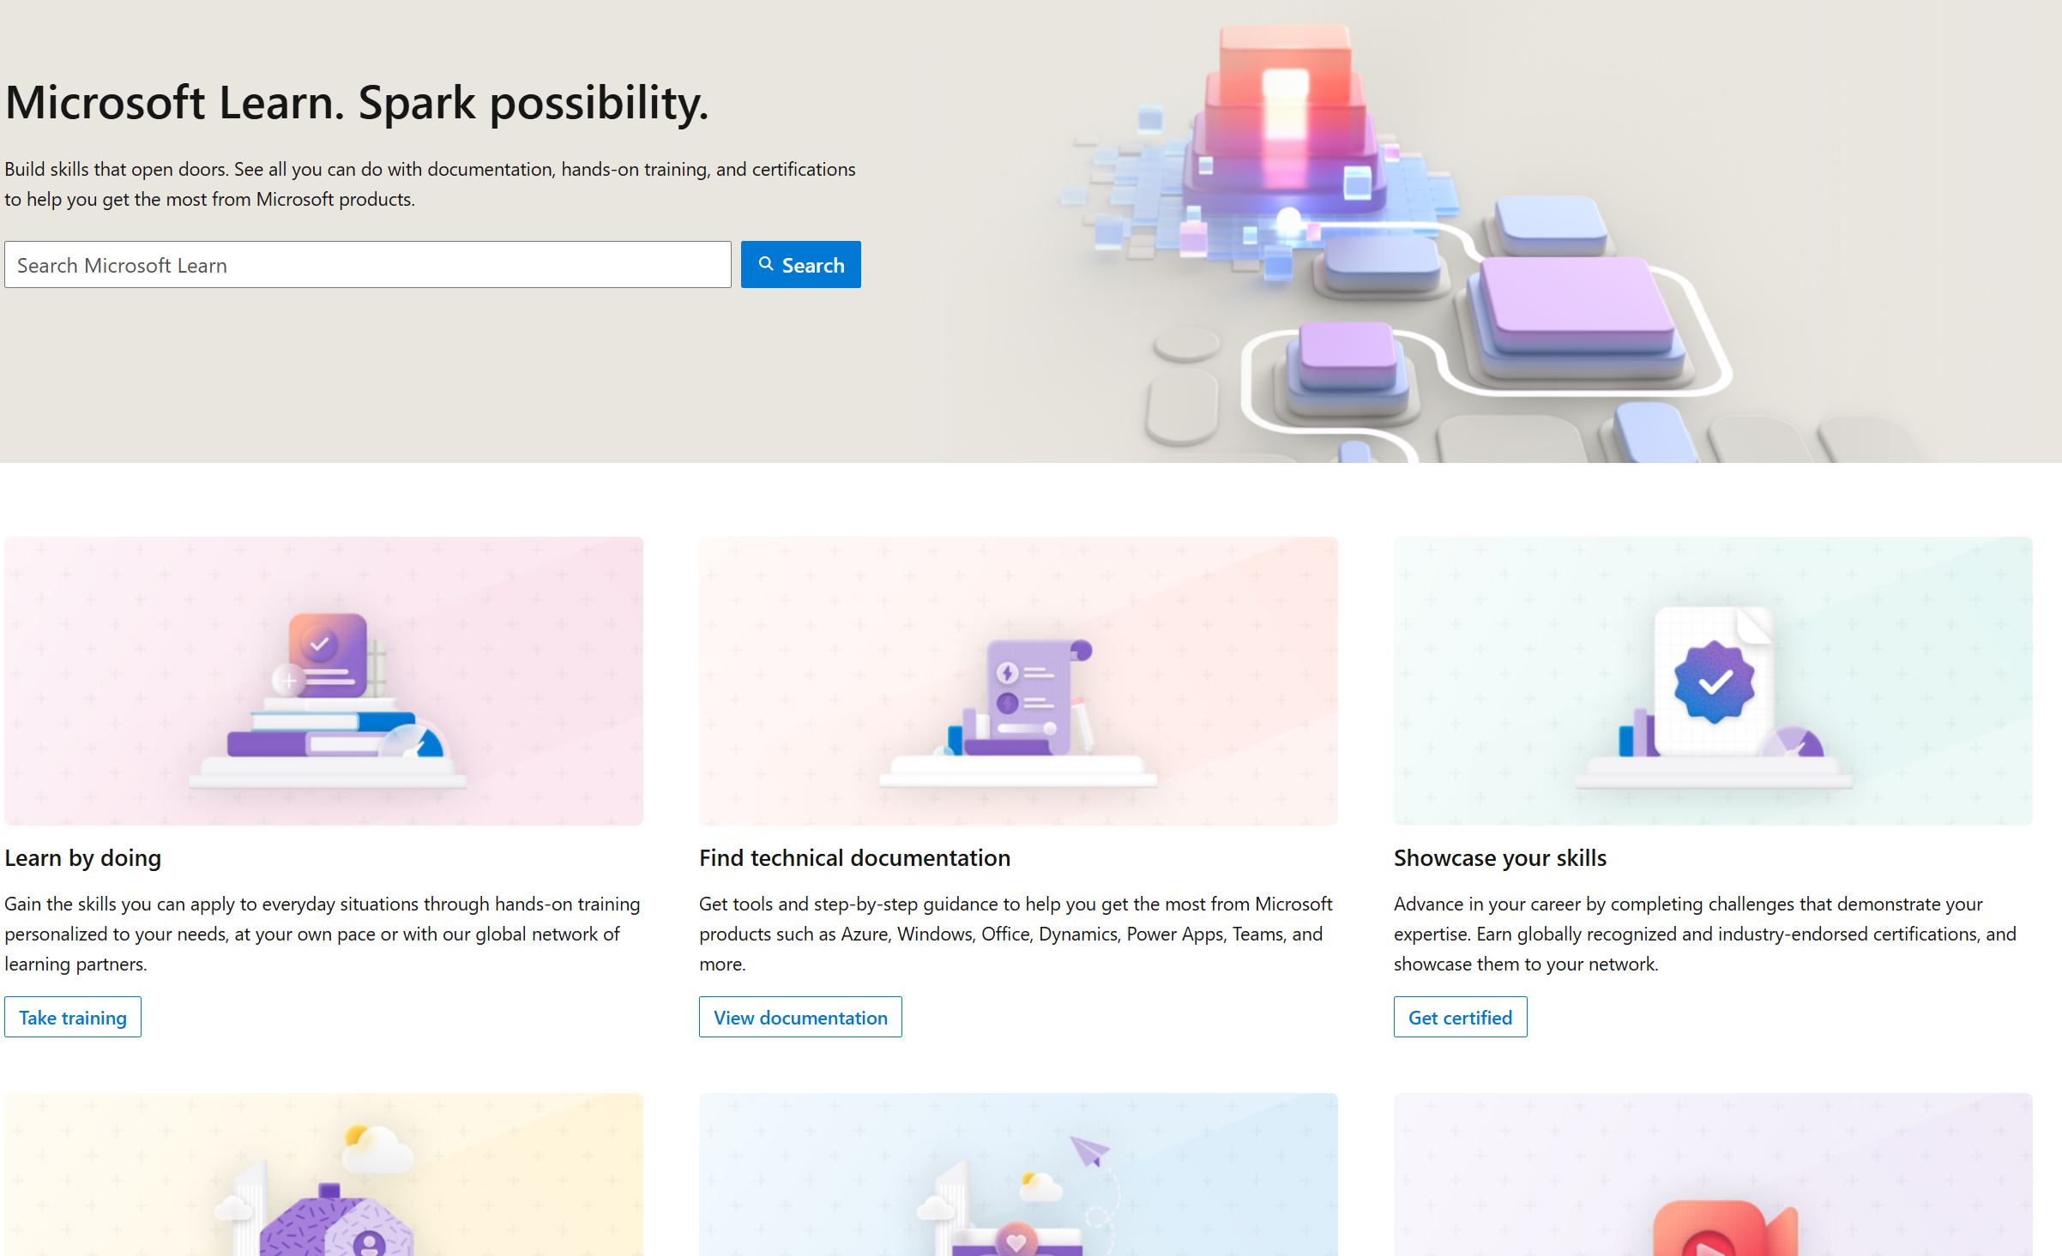
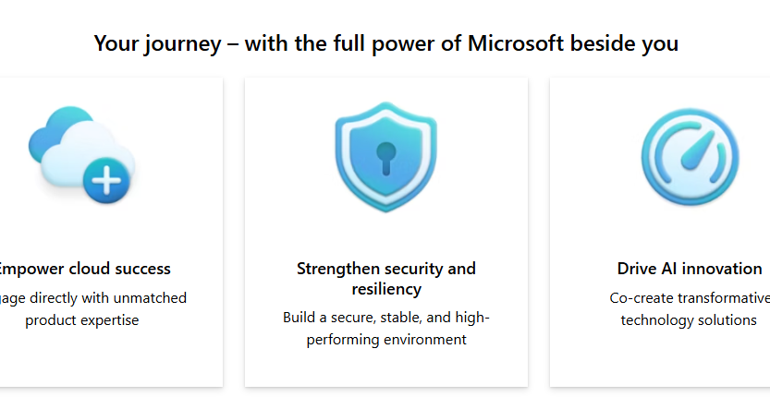
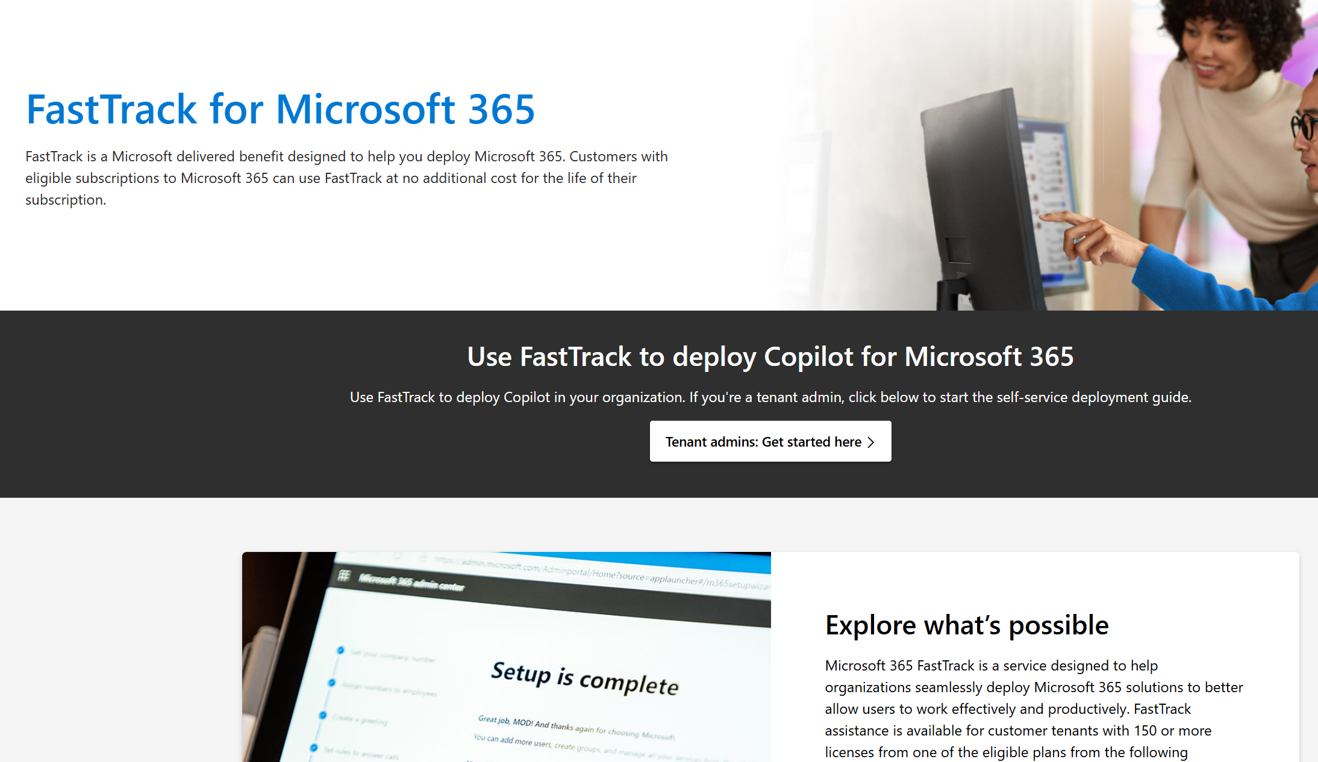
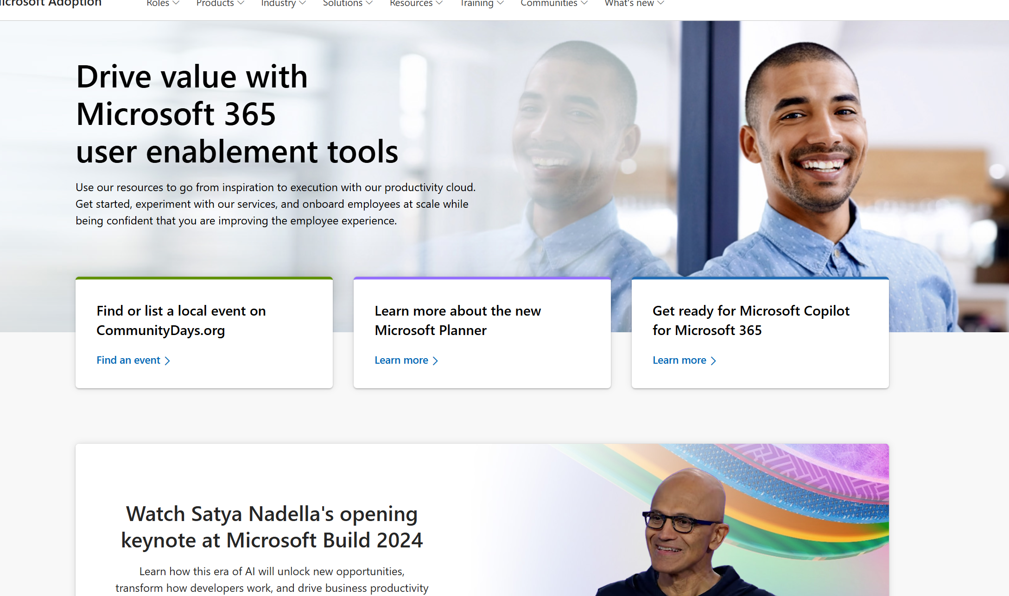
Copilot for Microsoft 365
Readiness checklist and key resources
Get ready
Onboard & engage
Deliver impact
Extend & optimize
Secure exec sponsorship, create AI Council, and define RAI principles
Identify success owners, Champions, and early adopter cohorts
Detail high value scenarios and personas
Be intentional with assignment and concentrate seats
Define success criteria, KPIs, and success measurement plan
Complete User Enablement Strategy training
Define user experience and feedback strategy
Design and deploy training and engagement community (Center of Excellence/Champion Platform)
Launch employee communications and Champion program
Onboard executives and user cohorts
Deliver user Champions and support staff training
Review success measures and user survey results
Conduct feedback and reporting analysis
Deliver extended training and adoption support
Identify additional optimization scenarios
Iterate user experience strategy
Gather and amplify success stories
Extend to new high value scenarios
Deliver business process transformation with Copilot Studio, plugins and connectors
Drive group and cross-organizational productivity and innovation
Understand custom line of business opportunities
User Enablement
Support continuous learning and optimization
Microsoft Learn
Build your skills across Microsoft products and services with industry leading online training and certification programs.
Microsoft Unified
Unified unlocks the greatest value from your investment.
Microsoft FastTrack
FastTrack is a Microsoft delivered benefit designed to help you deploy Microsoft 365.
Microsoft resources
Microsoft Adoption
Resources to ensure you are delivering employee satisfaction and business value. Accelerate human change management with on-line resources, training and communities to make the most of your investment, all included with your subscription.

Slide 10
Evaluate your user enablement capabilities
Invest in a healthy champions team, who will provide peer learning and support during the AI journey
Leverage in-product experiences to create a culture of continuous learning and deliver training in the flow
of work
Ensure a vibrant community of practice for ongoing user engagement and skill building

Slide 11
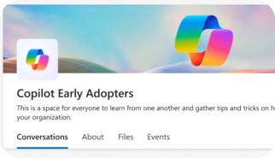
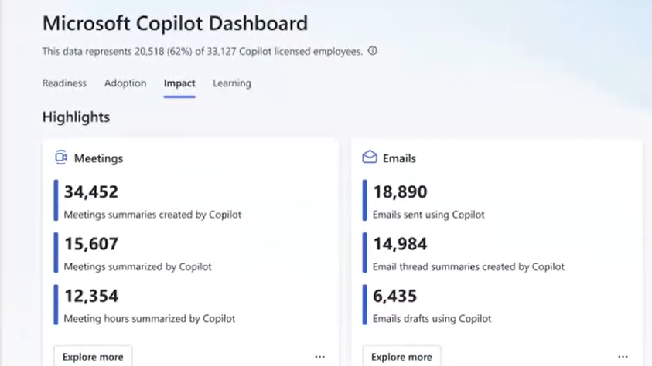
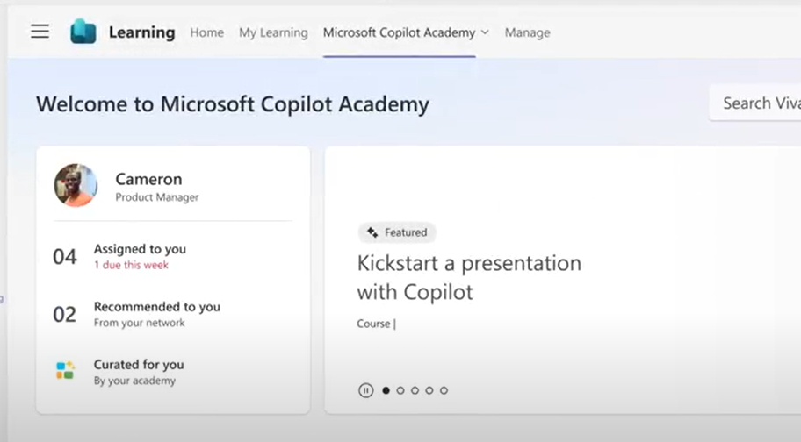

Accelerate your AI workforce transformation
Communications
Measurement
Skilling
Copilot Communities to facilitate user enablement
Share best practices
Access company announcements
Seek support from peers and IT
Copilot Analytics for ROI and impact assessment
Copilot Dashboard for leaders
Viva Insights for customizable analysis
Copilot business impact reports
Copilot Academy for user skill development
Curated learning paths
Hands-on prompt guidance
Content created by Microsoft experts
aka.ms/CopilotCommunities
aka.ms/CopilotAnalytics
aka.ms/CopilotDashboard
aka.ms/CopilotAcademy
Powered by Microsoft Viva

Slide 12

Get ready
Shared activity
Foundational tasks
Copilot specific tactics
Build the right team
Identify scenarios
Review Microsoft provided materials
Onboard supporting resources
(as needed)
Identify communication channels
and initial rhythm
Build relationships with technical leaders
Understand Microsoft 365 Copilot capabilities
Review Responsible AI principles
Identify early adopters and scale onboarding cohorts
Target AI-ready scenarios
Build prompt and natural language skills
Embrace rapid feedback cycles

Slide 13
Secure exec sponsorship
  Ensure they understand the ABCs:
  Executive Sponsors should:
Executive Sponsors may:
Help the project team identify and prioritize their top business needs.
Encourage shared planning between user enablement and technical teams.
Play a role in communicating the vision to leaders across the organization.
Actively participate in and use Copilot to help drive and reinforce enablement.
Promote the enablement program. Studies show engaged employees are 2.6x¹ more likely to fully support a successful AI transformation.
Lead or participate in the organizational AI Council.
Have purchasing authority for licenses or services from supporting suppliers.
Be directly accountable for Microsoft 365 or broader digital workplace initiatives.
A
Active, visible, and consistent participation
B
Build a coalition with their executive peers
C
Communicate directly with employees to support landing the change
¹The state of AI change readiness eBook, Microsoft Viva People Science

Slide 14
Shared planning with Technical Readiness Team
Shared activity
Guidance
Your User Enablement (UE) Team is a component of the overall Copilot Implementation Team and includes a variety of roles. Your model may appear different based on the existing structure of your organization.
Assemble your team
Below are characteristics of successful UE Teams, which should be considered as you recruit the UE Lead and additional resources:
Understanding of organizational change management practices
Technical skills across Microsoft 365 collaboration tools
Advanced program management skills
Relevant business acumen and visibility to overall AI vision
Strong written and verbal communications skills
Ability to model desired leadership skills

Slide 15
A cross-functional and multidisciplinary body
It is essential for organizations to establish a governance framework that ensures the responsible and ethical use of AI across their operations and stakeholders.
AI Council
One way to achieve this is to create an AI Council, a cross-functional and multidisciplinary body that oversees and guides the development, deployment, and evaluation of AI solutions within the organization. An AI Council can help to align the organization's AI strategy with its vision, values, and goals, as well as to identify and mitigate potential risks and harms of AI. An AI Council can also foster a culture of trust, collaboration, and innovation among the AI practitioners, users, and beneficiaries within and outside the organization.
that oversees and guides the development, deployment and evaluation of AI capabilities.
Get started today
aka.ms/copilot/AICouncilSetupGuide

Slide 16

Rules
Responsible AI Standard
Records
our practice of Responsible AI by Design – the proactive ways in which we guide the design, build, and testing of AI systems
Establishes
a durable framework for the maturing practice of responsible AI and evolving regulatory requirements
Reflects
our deeper exploration of what our six AI principles mean and the steps we must taken to uphold them

Slide 17
Onboard & engage
Shared activity
Foundational tasks
Copilot specific tactics
Complete User Enablement
Strategy training and template
Define user experience
and feedback strategy
Launch employee communications
and Champion program
Onboard executives and user cohorts
Deliver user Champions and support staff training
Review Microsoft provided training and engagement content
Design and deploy training
and engagement community
(Center of Excellence/Champion Platform)
Leverage Microsoft Viva for Copilot Enablement (if available)
Review overall plans with
AI Council and stakeholders

Slide 18
Craft a user experience strategy
A user experience strategy will enable you to quantify the value received from implementing Microsoft 365 Copilot.
Your technology enablement team is central to the success of your project and your employees with your technology investments.
Your user experience strategy gives them a vision and roadmap for success.
Use Microsoft 365 Copilot to create the initial draft.
1
Identify target user personas
2
Quantify pain points and potential productivity gains
3
Define engagement touch points
4
Prioritize user feedback methods and issue resolution
#ProTip
5
Define success measures and use cases
Driving enablement is an ongoing user and stakeholder engagement process. It is a lifecycle activity not a moment in time.

Slide 19






Understanding the user journey
Getting to “Aha!”
Feel
When can
I use it?
How can
I get help?
Why should
I care?
How will
WE use it?
How does this change my experience?
How can I do more?
What’s
next?
How will
I use it?
Act
Think
The Think-Act-Feel framework is grounded in decades of research showing a whole human understanding – including feelings – is critical to business outcomes.
Building on this framework we understand that delivering accelerated change is based on trust.
How can I share
my success?
How can I enhance my profession
with this?
An aha moment is defined as “a moment of sudden insight or discovery”.
Notes:
As mentioned before, Copilot is a bit different than the experiences we have driven enablement in the past. Many of us have launched large and small technology projects but we all have a failed technology project where the technology didn’t deliver what was promised, and that’s where the trust gets eroded. We have an opportunity now with Copilot to rebuild trust yet again. This means that we can rebuild the trust that the user has in that the system will help them to get the most of what’s been put in front of them. Our job is creating that trust and enthusiasm at scale and helping people get to what we refer to “aha” moments. This is the moment where an individual gets it, where they understand how the technology can help them.
This slide documents and charts, based on decades of research done at Microsoft and the collective 100 years of experiences of user enablement people around the world, the unarticulated questions that most users are asking when faced with new technology or change. We can talk about the benefits and value of new technology, but until someone has that personal experience that understands why it matters for them, frankly it’s all talk. They really want to know why should they care.
The interactive Copilot Scenario Library (https://aka.ms/Copilot/ScenarioLibrary) is critical to the user journey because you can use it to answer the “why should I care” question, to show users specific examples of how this new technology can help them be more productive in their role.

Slide 20
Keys to user enablement success
Research results below support suggested approach for building
your adoption plan.
Top reported activities for driving successful product adoption*:
% of respondents that rated activity as having above average importance
1
Define a vision and identify how target product will be used
2
Obtain proactive support from key roles to accelerate use of Copilot including senior leadership, legal, ITDMs, and key BDMs
3
Enable Champions and provide business relevant, snackable,
and on-demand training for business users
4
Raised awareness through launch event and omni-channel communications planning
*Results of a related Microsoft research study survey
Notes:
If we take a moment to reflect back on the previous slides, we start to understand the important of the user journey in driving a successful change program. Highlighted on this slide are the top four categories or areas that should be considered as important for the business to consider as part of their deployment. Defining the vision and identifying how the target product in this scenario copilot gives users a clear understanding of how copilot can and will be used effectively within the organization. We have talked previously about the importance of key stakeholders to reinforce the commitment from the business to not only introduce Copilot but supporting its rapid deployment. Points one and two are both seen as adding significant value. The introduction of change champions, in alignment with relevant training material and a great communication strategy are also both again seen as crucial for a successful implementation.

Slide 21
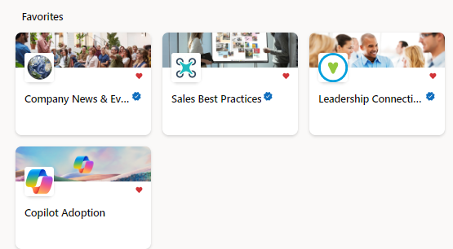
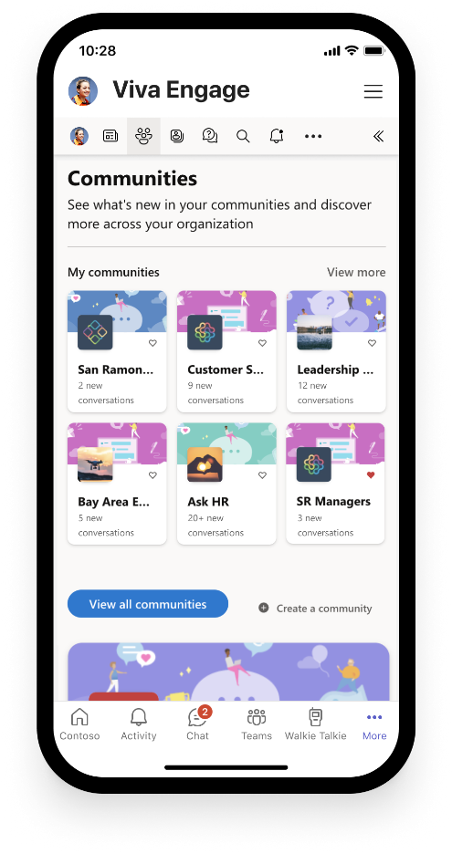
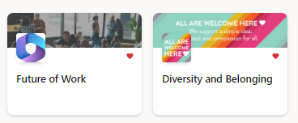
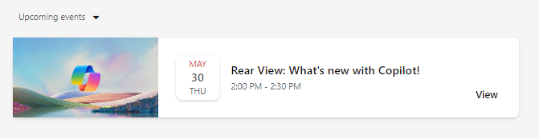

Build your Community of Practice with Viva Engage
Connect and empower employees
Create a community in Viva Engage to generate excitement, share learning, and support Copilot Champions and experts.
Give employees a place to:
Share best practices, such as prompts
Share success stories of Copilot saving time and driving productivity
Access company announcements on AI usage, direction, and mission
Facilitate peer to peer learning and Champion engagement
Get ready
Onboard & engage
Deliver impact
Extend & optimize
Notes:
NOTE: Viva Engage is recommended for enterprise customers already utilizing Viva Engage in their environment. Small/medium businesses may opt to hold this essential employee engagement in Microsoft Teams or other community chat tools.

Slide 22

Identifying user cohorts
Shared activity
Selecting the right participants for the Early Adopter Program
is key to gain valuable insights and inform the organization-wide launch. For success, a much larger group of employees should be selected for Copilot onboarding than in other service enablement plans. This allows for organic knowledge sharing,
rapid feedback, and success at scale*.
The list below describes the types of employees to include in your program:
  Users primarily from the same lines of business or departments, preferably those who work together on a project or business process.
  Likely Champions or leaders who will become advocates during the broad launch to the entire organization.
  IT and help desk team members who will support users
  during launch.
  Important: Executive onboarding is a distinct category of business user with different needs and requirements. Plan for dedicated learning time and feedback cycles from these users.
  *Based on observation and research from early Copilot customer implementations.
Notes:
We have talked a lot around user personas, business value, and realizing the benefits of copilot. It is key that you gain valuable insights ahead of an organizational launch or deployment, and it’s best practise to identify users as part of an early adopter program. These are typically groups of users who will be given early access to copilot to gain valuable feedback and help inform key decisions around deployment approach and methodology. Typically these would be groups of users rather than individuals as what we are trying to identify ultimately is where copilots is not only supporting users on an individual basis but is able to drive maximum efficiencies across a functional area within the organisation.
Other early adopters could be seen as change champions or senior leaders who will be actively reinforcing positive messaging during redeployment.
It is important that members of the IT and help desk are also given access as they are likely to be supporting users during the launch.
Particularly with Copilot, the business executive team are always very keen to be early adopters, but they can be a very complex user. In many circumstances, they will be aligned to an executive assistant or colleague. It is therefore important that they are considered as their own user type or persona and will likely require dedicated support and training. It is important that you insure there is allocated resource and time to support them.

Slide 23
Create or extend your Champion program
Peer to peer learning is a powerful tool for user enablement. Leverage this skill in your organization by creating or extending an internal Champion program.
Champions will supplement your help desk and support systems, acting as trusted advisors to their peers. They will also provide valuable feedback on your enablement.
Use our step-by-step guide to empower your Champions today.
Microsoft 365 Copilot capabilities will inspire you to transform existing business processes and drive innovation across employee experiences.
Notes:
Having an internal Champion program can help accelerate your time to value with any new technology, and that is especially true of Copilot. Follow our guide to create your own program. Join the worldwide Microsoft 365 Champion program’s monthly community calls to gain further insights, content, ready to use assets, and access to Microsoft subject matter experts: https://aka.ms/M365Champions.

Slide 24
Build a sustainable
Champions community
  Champions:
1
  Should be formally trained to increase their depth and breadth of knowledge.
  Champions help build, grow, and sustain your Copilot implementation by gathering feedback, supporting the human change lifecycle, and providing peer to peer guidance.
2
  Should be encouraged and empowered to guide, teach, and train their peers.
3
  Need consistent positive reinforcement that affirms the impact of their efforts.
4
  Need a clear plan upon which to execute.
Notes:
Building a change champion community comprises of four key areas to consider.
It is important that Champions should be formally trained, usually by the project or program team, and ideally as a community of Champions. That way not only do they feel empowered as individuals, but they also become a community within themselves that promotes collaboration and a sense of togetherness. Often it is the case when working within a Champion community they will be sharing ideas and best practices with other colleagues which can only prove to be beneficial.
As part of their training, Champions should be encouraged and empowered to be supporting their colleagues and identifying business challenges and scenarios from within their functional areas.
When a Champion either volunteers or is nominated from within their department, the positive impact that they will have needs to be recognized formally. You must make it clear that these individuals will need dedicated time away from their day-to-day activities to undertake training and to support their colleagues during the launch.
This is why you need to make sure there is a structured plan and clarity around the role, the time implications, and a clearly defined set of activities that they will need to undertake.

Slide 25

Five steps to developing a Champions community
1
  Set the context.
2
  Align the Champions community to organizational objectives and vision for your Copilot implementation.
3
  Identify Champions and get buy-in.
4
  Build a plan with Champions. Skill them first and often.
5
  Execute and share Champion feedback with leaders and through Service Health Reviews.
Notes:
There are five steps to developing your champions community.
Set the context, be clear on the project objectives on the role that the change champions will play in the launch.
Make sure that the Champions are aligned to the business objectives and outcomes the key success criteria and the business objectives for your copilot deployment.
When identifying your champions, a a great way to do this is to contact your HR department and ask them to identify all the functional areas that exist within your business. In an ideal world it would be great to have representation as a change champion from each of those functional areas. This will ensure that you are gaining real world insight and true representation from the business as a whole. Ideally you are looking to recruit champions who are keen to be involved rather than an individual who has just been nominated but is not necessarily eager to be a part of the project.
We cannot emphasise enough the importance of Champions in helping you to be successful, so it is crucial that you are building a plan and taking on board their feedback. Make sure that they are upskilled before other colleagues, and they are receiving regular training as the technology develops. It is key that they are seen and respected by colleagues As true ambassadors.
Their feedback is critical as this will be coming directly from the business and ensure it is taken into consideration and fed back to senior leaders and sponsors. In some circumstances this might lead to adopting a new approach during the deployment, but if you are taking feedback directly from the business and acting upon it, this can only serve to be a positive outcome.

Slide 26
The Champions program checklist
  Find enthusiastic Champions who can commit time and effort.
  Design a program to engage and recognize their effort, such as providing privileged access to relevant events or speaking engagements.
  Build a Viva Engage or Microsoft Teams Group
  for Champions to share updates and successes.
  (See our Build Your Experience and Microsoft Viva for Copilot Enablement guides).
  Communicate to individuals about the Champions role and where they can be found – remember, they are not an IT support function but business representatives.
  Provide materials ready to support their work on the group with teams and individuals (e.g., lunch and learn sessions).
  Incorporate Microsoft 365 training resources into your own internal training site.
  Ensure a regular rhythm for discussions with the Champions on what’s working and what’s not.
  Create a contest (e.g., scavenger hunts and giveaways) between departments to encourage people to interact with Microsoft 365.
Notes:
The Champions checklist provides a starting list of actions and activities for when you start setting up your Champion program.

Slide 27

Make a difference
Become a Champion
Get more from Copilot and Microsoft 365
Help others do the same
Expand your knowledge and enhance your career
Join the free program at aka.ms/M365Champions
Notes:
Once your Champions have been identified, make sure they join the worldwide Microsoft 365 Champion program so that they can get continuously get skilled up and gain access to Microsoft subject matter experts and resources. Join here: https://aka.ms/M365Champions.

Slide 28
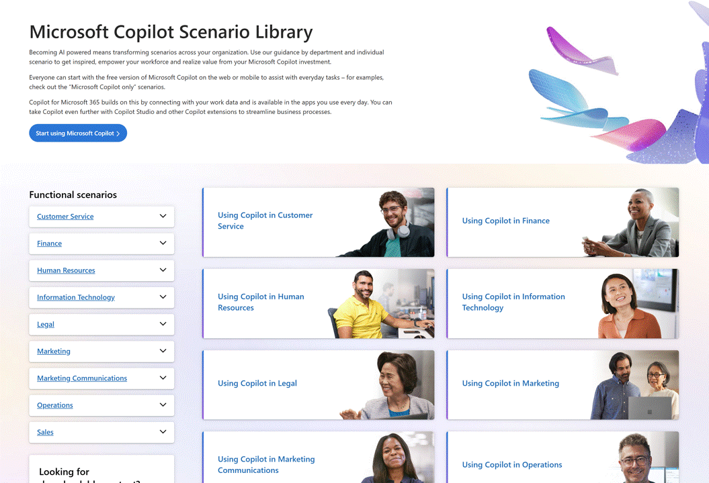
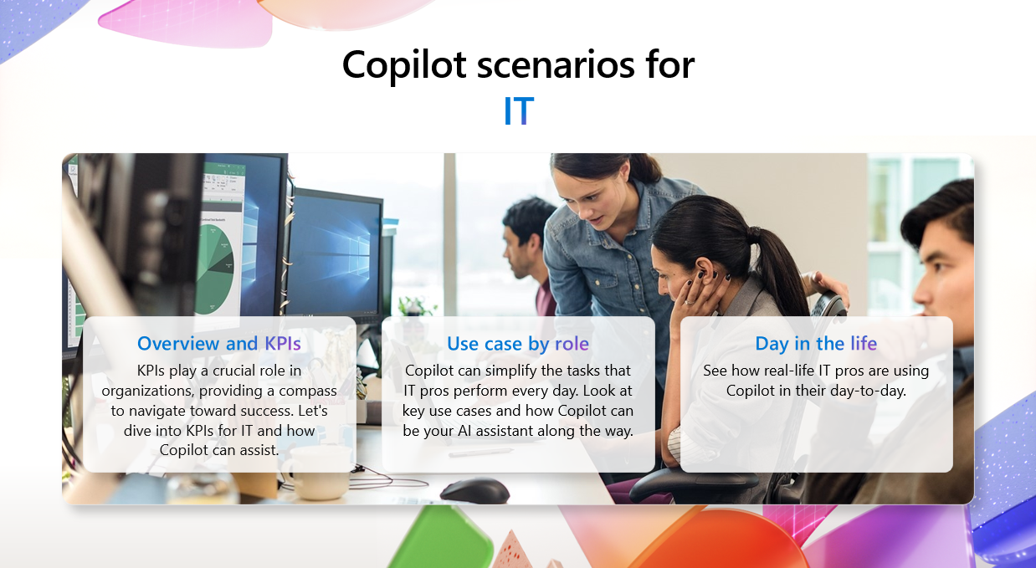
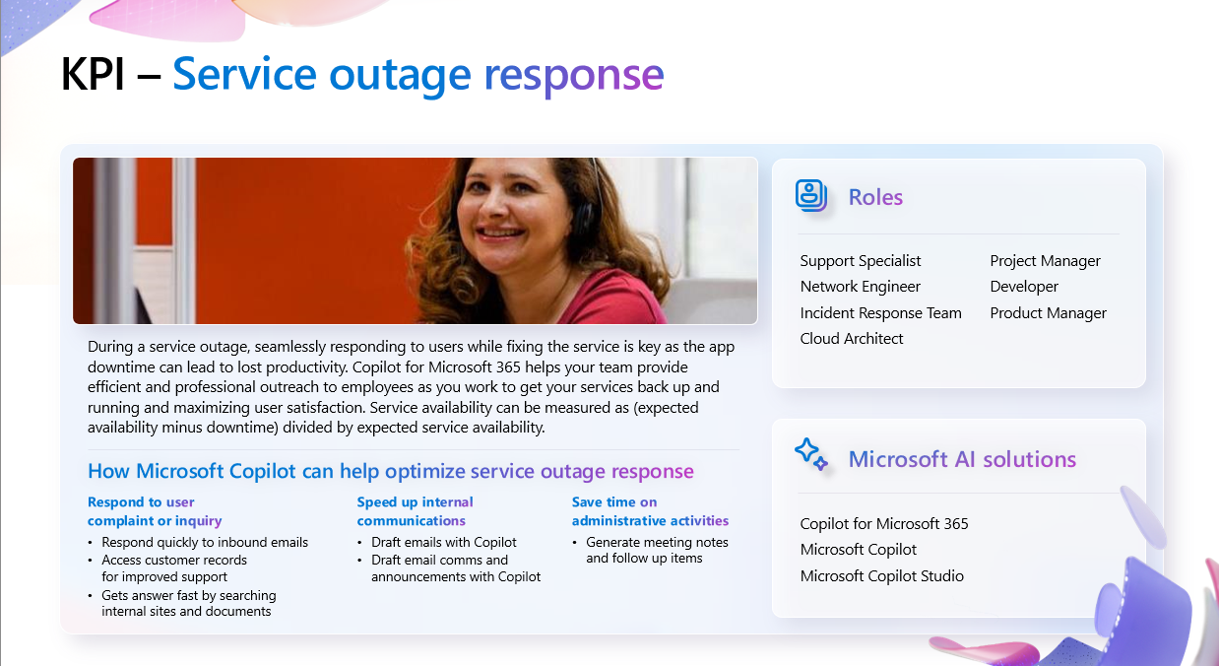
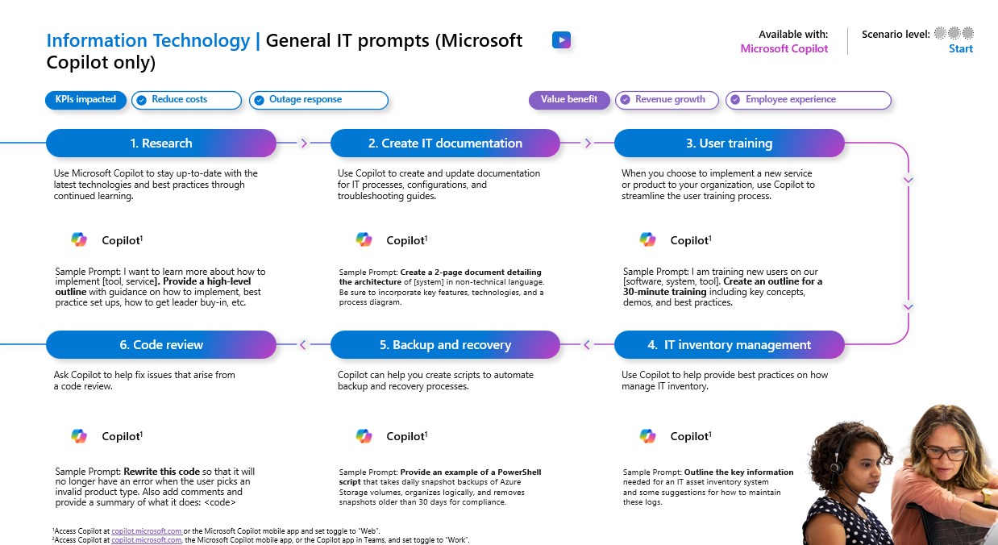
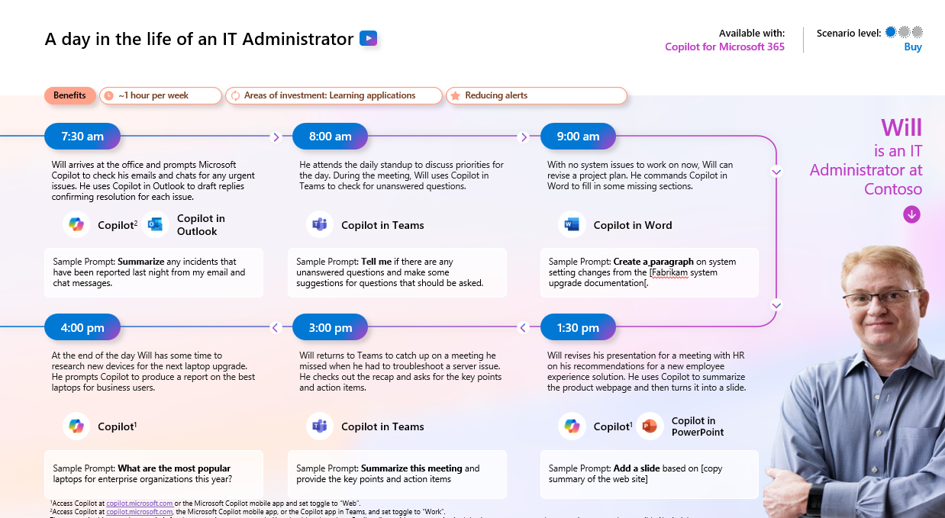
Functional scenario guidance
Utilize our interactive scenario library to start the conversation with business users about their pain points, opportunities, and ideas: aka.ms/Copilot/ScenarioLibrary.
  Interactive library
  Downloadable guidance
Notes:
Leverage the interactive Copilot Scenario Library to help find and define specific user scenarios for your early adopters and organization.

Slide 29
Build your communications plan
Shared activity
Before building your engagement plan, take time to understand who needs to be informed, key messages to convey, and preferences for communication channels.
Notes:
Now that you’ve created your Champions program and defined business scenarios and are ready to enable users, let’s discuss a communications plan.
First step is to take time to understand who needs to be informed, what the key messages you want to convey, and the organization’s preferences for communication channels. It would be good at this stage to align with the company communications team if you have one.

Slide 30




Objective:
Build daily AI habits and employee satisfaction
Shared activity
Awareness
Engagement
Measurement
Management
  Land AI transformation vision
  Tailor content by audience, scenario, persona, and usage journey
  Copilot Champions launch
  Internal testing for some
  Deliver strategic engagements by
  org and role
  Ongoing partner and employee education
  Showcase successes
  via #CopilotStories
  Conduct ongoing feedback surveys
  Usage, support, and health metrics inform baseline for enablement journey
  Drive listening systems engagement
  Improve employee guidance
  Identify additional scenarios for AI transformation
  Improve the experience from employee feedback
  Deliver integrated service roadmaps
  Iterate messages and tactics bi-monthly
  Provide employee insights signals in
  Service Health Review
Land the message
Support the change
Analyze and adjust
Improve the experience
Notes:
Landing and expanding awareness and the AI vision can be broken down into these four pillars:
Awareness – landing the message. Consider your vision, your audiences, and the scenarios aligned to each. Launching with Copilot Champions first is key to ensuring that your program is a success. Make sure your Champions understand that they are not a support function but are truly representative of the wider business.
Engagement – understand the importance of supporting the change internally. Strategic onboarding and user enablement, ongoing education (either internally or with a partner), success stories, and feedback surveys are all ways leadership can support the change.
Measurement – analyze the data and metrics in the Copilot Dashboard and survey results to adjust their strategy as needed. This gives a baseline allowing organizations to listen, engage, improve guidance, and identify additional scenarios for AI transformation.
Finally, there’s Management – the opportunity to improve the user experience based on learnings and feedback. You will also want to deliver integrated service roadmaps and continue iterating communication and providing employee insights in their Service Health reviews.

Slide 31
Themes for Success
1
2
3
Change
Needs
Makers
Moments
That
Matter
Get
Stuff
Done
Plan Your Impact

Slide 32
Get Stuff Done campaign
5
We all need to “get stuff done” (GSD) amidst busy work days.
The GSD video campaign focuses on short 1-3 minute videos that highlight task completion using Microsoft tools. The goal is to humanize technology, diversify voices, and drive engagement by landing a message everyone can relate to: getting stuff done!
Visit aka.ms/TeamGSD to:
Watch 1-3 minute videos on Modern Work and Security
Join #TeamGSD
by submitting your own videos
#TeamGSD #GetStuffDone

Slide 33
Onboard & engage
Lay the foundation for continuous learning and an intelligent progression of AI skills
3
Advanced
skills
Generate synergies across departments with extensibility
Streamline and automate cross-business process flows
Org value
Start
here
2
Departmental skills
Departmental value
Use role-specific and multi-step prompts
Extend usage to role-based processes
1
Foundational
skills
Inspire quick wins to reach value tipping point
Master basic prompts (e.g., summarization, revision)
Individual value
1
Start with top 10 generic skills from Copilot Prompt Gallery that deliver immediate success (e.g., summarize a meeting, email thread)​.
2
Use the Copilot Scenario Library
to train users on new departmental use cases and process improvement to impact departmental KPIs.
3
Extend to line of business systems to streamline and automate for organizational level impacts on revenue and costs.
Prioritize peer-to-peer learning through community engagement and knowledge sharing.
Notes:
It’s important to set the right foundation for driving value and setting expectations because customers are going to quickly want to understand, “What is the impact? What is the ROI?”
We all start with Copilot value at this first level – what we call individual value or foundational skills. These are the skills, such as summarizing your meetings, revising your Word drafts, etcetera – things that help all users, regardless of what their job or function is.
Once users get pretty good at that, they move to the next level and start digging into departmental or job-specific prompts, such as multi-step or multi-turn. This is where users start to feel like they're really getting high value out of Copilot.
Finally, there's the org value or these advanced skills where folks start to streamline and automate some of those business flows. There are significant gains here and by the time you are achieving this, the ROI becomes very apparent, and you should be seeing the value and gains, which will help you build support for your deployment and opens opportunities for additional growth
You’ll want to make sure that you're setting the right expectations for this journey of intelligent progression of AI skills.

Slide 34
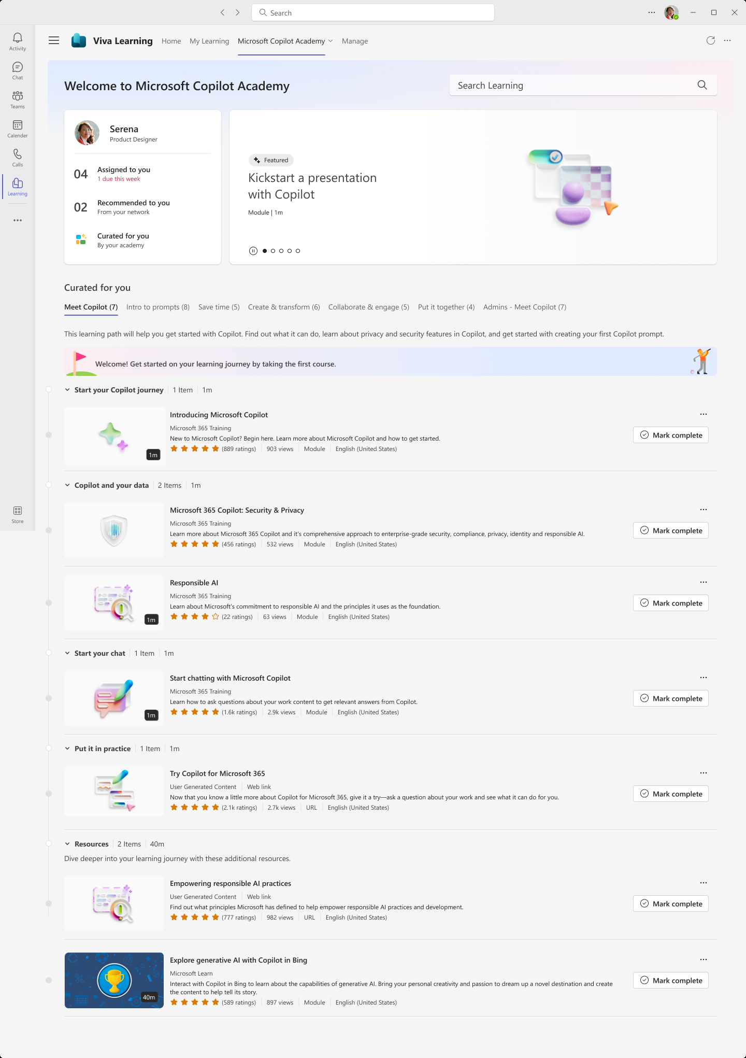
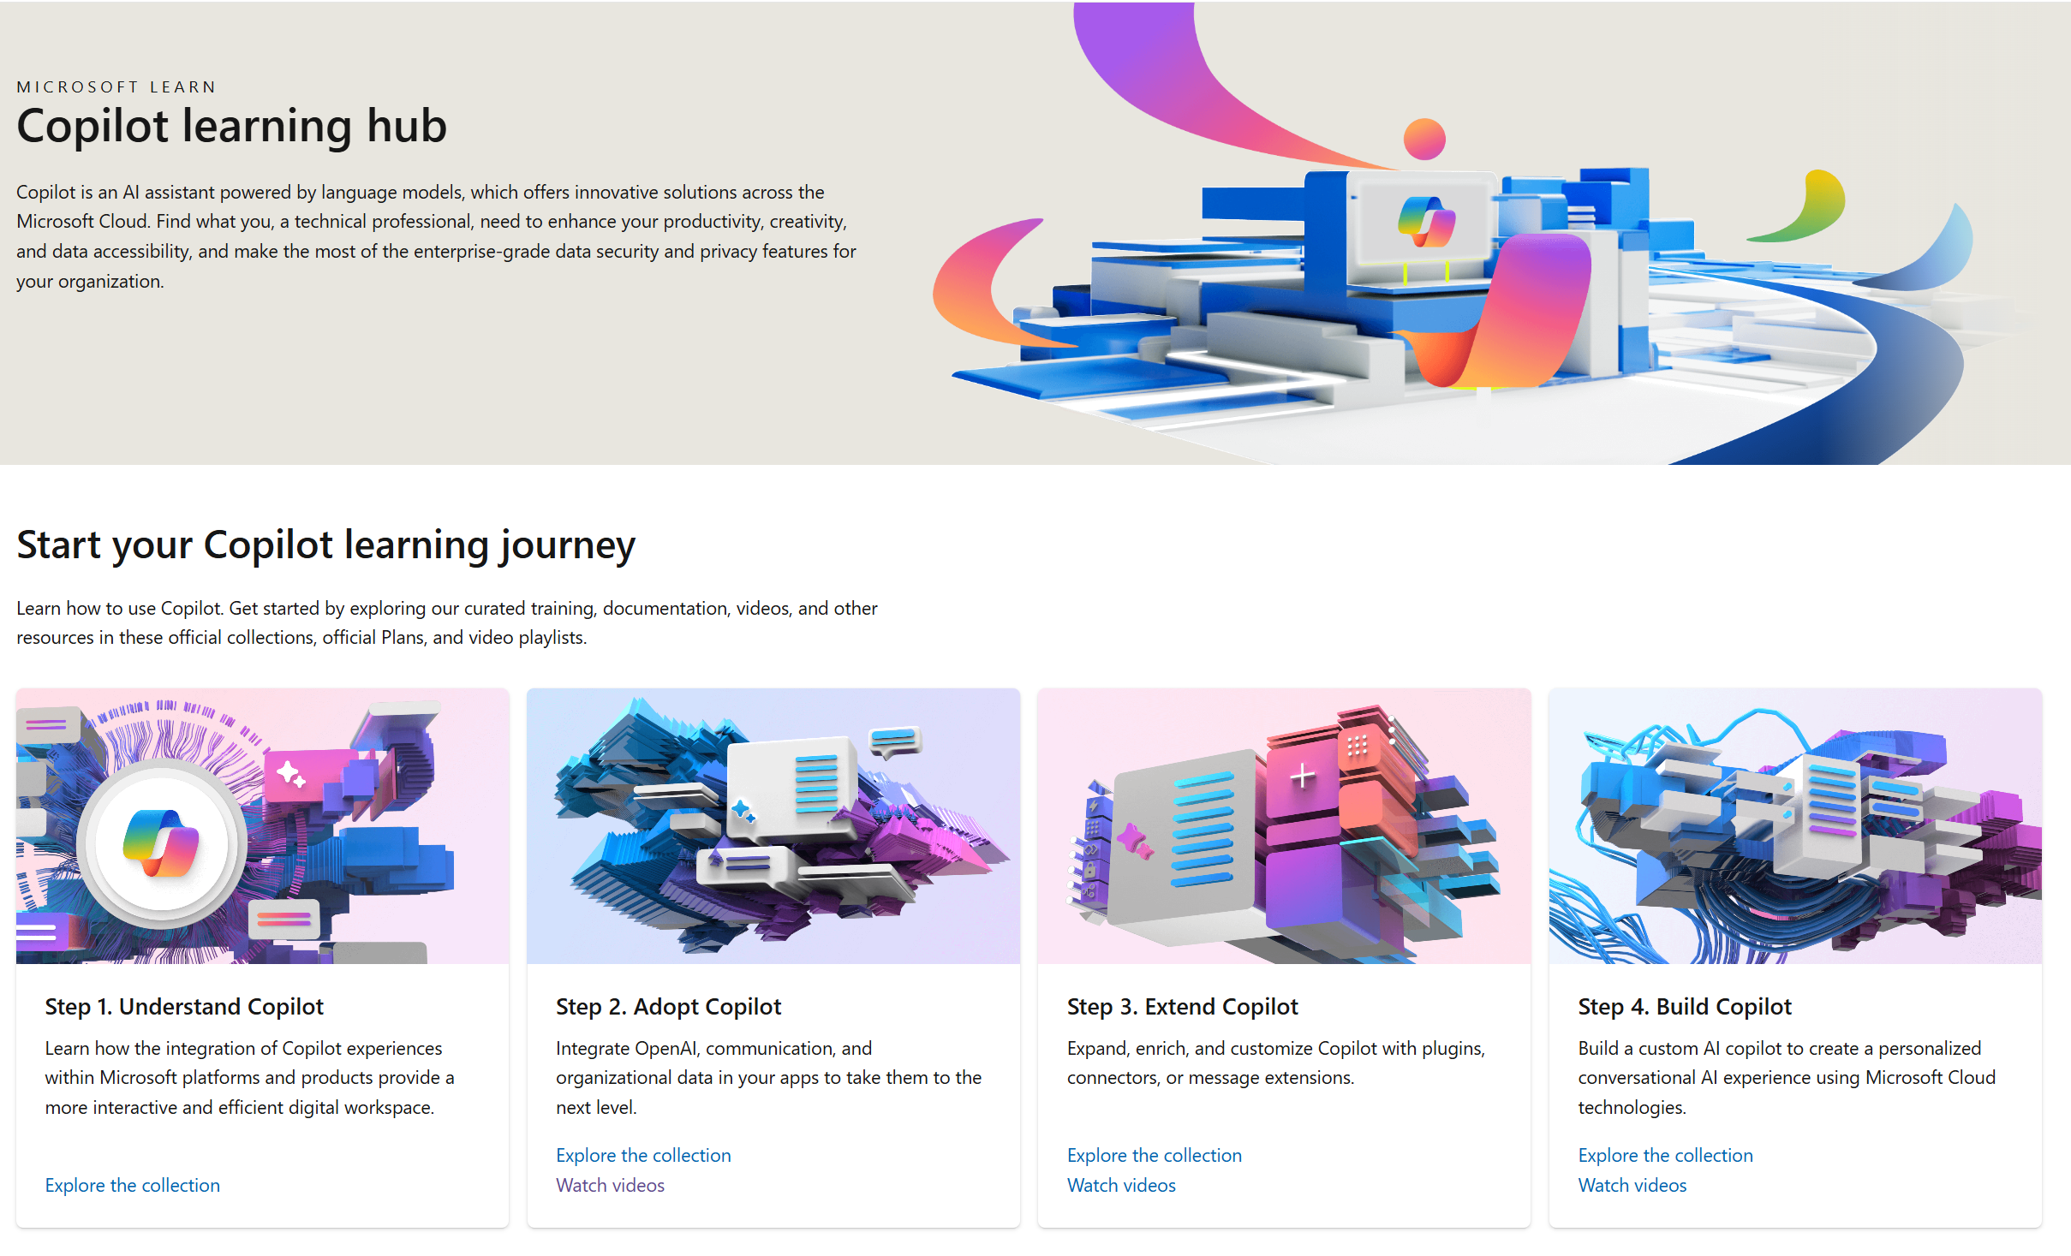
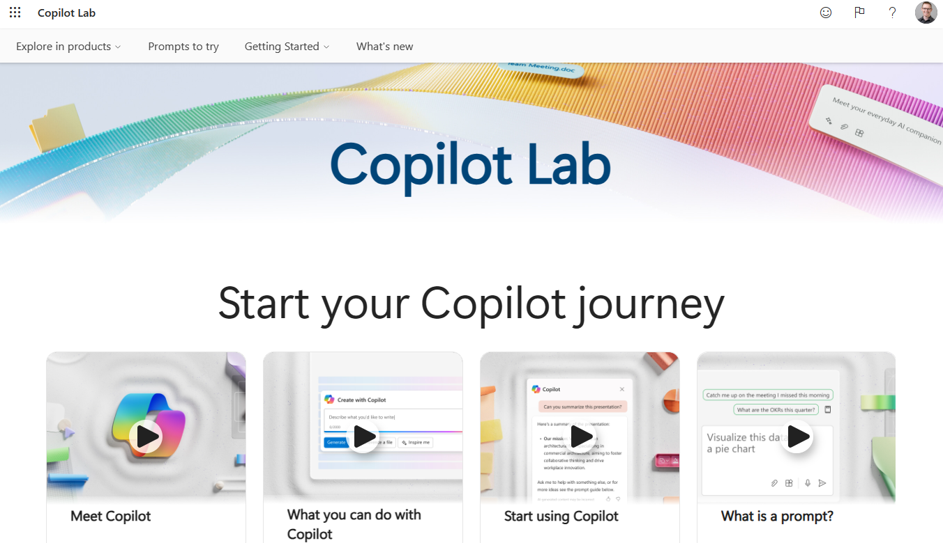
Skilling experiences
Microsoft 365 Copilot
Microsoft
Copilot Academy
Available to all Microsoft 365 Copilot customers
Centralized location to help with the basics of Copilot learning and upskilling, pulling the best content from available free Microsoft sources
Structured content in easily consumable learning paths curated
by Microsoft experts
Develop your AI interaction skills from your Viva Learning app
in Teams or webapp
Microsoft Learn
Free, on-demand training content
for skill development
Step-by-step exercises guiding learners through common Copilot prompts and use cases
Copilot Prompt Gallery
Free location to meet, learn about,
and test the capabilities of Copilot
Improve your prompt engineering skills in an interactive hands-on environment
Downloadable assets for customization available at adoption.microsoft.com/copilot
Notes:
This slide shows the top skilling experiences for Microsoft 365 Copilot:
Copilot Academy is a free training tool built on Viva Learning and available directly within your flow of work for all types of users. It is a centralized location which pulls in the best Copilot learning content into structured, consumable learning paths curated by Microsoft experts.
Microsoft Learn is another free web resource for self-paced, on-demand training content and step-by-step exercises for users. The training content here is skewed towards more technical audiences.
Finally, there’s Copilot Prompt Gallery, a free library learn about and test out Copilot prompts and capabilities. This is an interactive environment great for users who learn by doing.

Slide 35
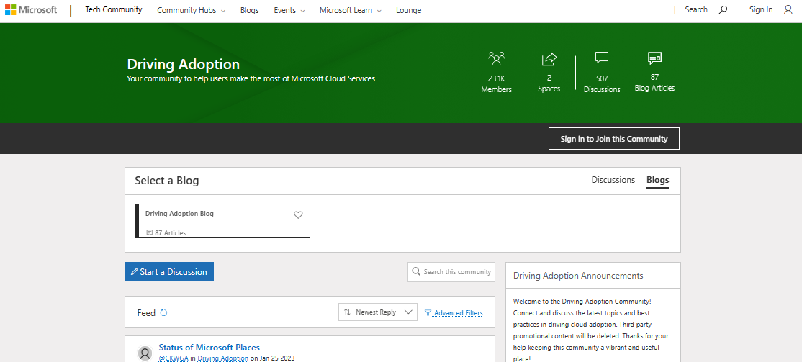
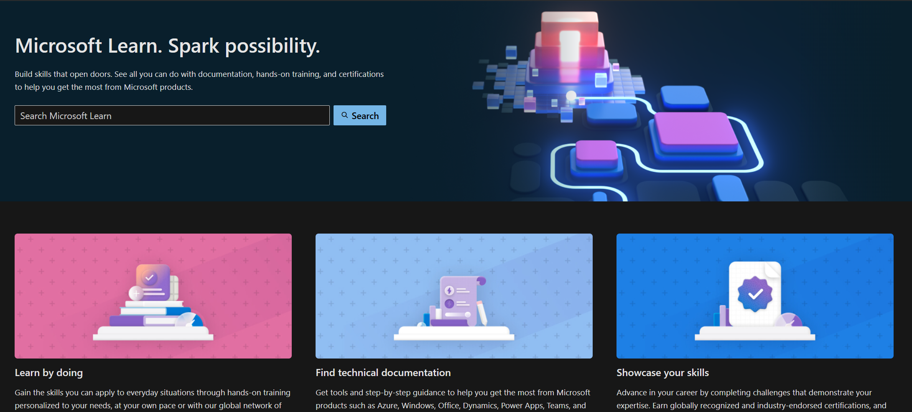
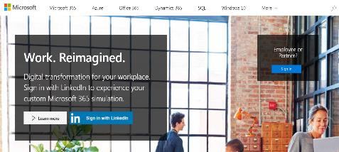
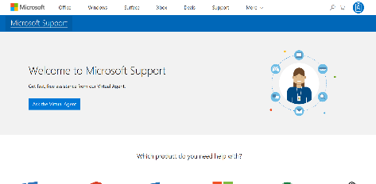
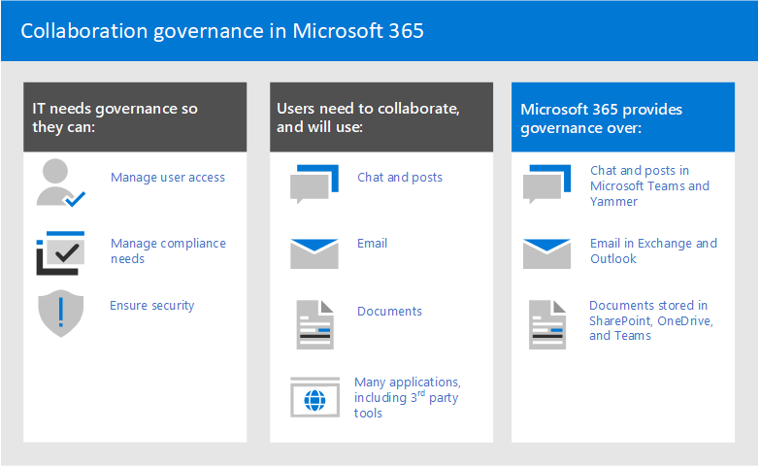
Bookmark Microsoft enablement resources
Join Driving Adoption Tech Community
Microsoft Learn
Microsoft Adoption Hub
https://aka.ms/DriveAdoption
Collaborate, share, and learn from experts
https://learn.microsoft.com
Technical documentation for developers
and IT professionals
https://adoption.microsoft.com
Resources to help you drive adoption
of Microsoft services
Microsoft Support
Teamwork governance
Join our communities
Utilize our resources
Achieve your goals
http://support.microsoft.com/copilot
Access FAQs and user help and learning
https://aka.ms/TeamworkGovernance
Collaboration governance guidance
for Microsoft 365
Notes:
Bookmark these helpful links to enablement resources and communities to help you achieve your goals.
Join the Driving Adoption Tech Community to collaborate and learn from other experts.
On the Microsoft Support page, you’ll find FAQs and self-driven user help.
Teamwork governance is where you can find collaboration governance guidance for Microsoft 365.
And as we’ve already discussed our Microsoft Learn site and Adoption Hub are great resources for developers, IT professionals, and driving adoption.

Slide 36
Deliver Impact
Shared activity
Foundational tasks
Copilot specific tactics
Review success measures and user survey results
Conduct feedback and reporting analysis
Deliver extended training and adoption support
Iterate user experience strategy
Gather and amplify success stories
Measure Copilot impact
Ensure progressive AI skilling with training tools
Identify additional optimization scenarios
Expand Microsoft Viva for Copilot Enablement tactics (if available)
Review feedback with
AI Council and stakeholders
Notes:
Delivering impact is without doubt one of the most important aspects of change management on the implementation of copilot.
This section discusses foundational tasks such as customer success criteria, feedback and reporting, training and adoption support, as well as iterating the user experience strategy and success stories.

Slide 37
Share with technical team and stakeholders
Identify common themes
Identify opportunities for expansion
and extension
Validate support scenarios and guidance
Identify success stories
Conduct success/challenge analysis
Categorize issues: technical, enablement, strategy or communications, other
Analyze feedback
Notes:
When analyzing feedback with your technical team and your stakeholders, make sure that you're identifying common themes, opportunities for expansion, and success stories, and validating support scenarios and guidance as well as conducting success and challenge analysis.
Categorize your issues in buckets like technical, enablement, strategy, or communications. This will make it easier to decide who will take what feedback and run with it.

Slide 38
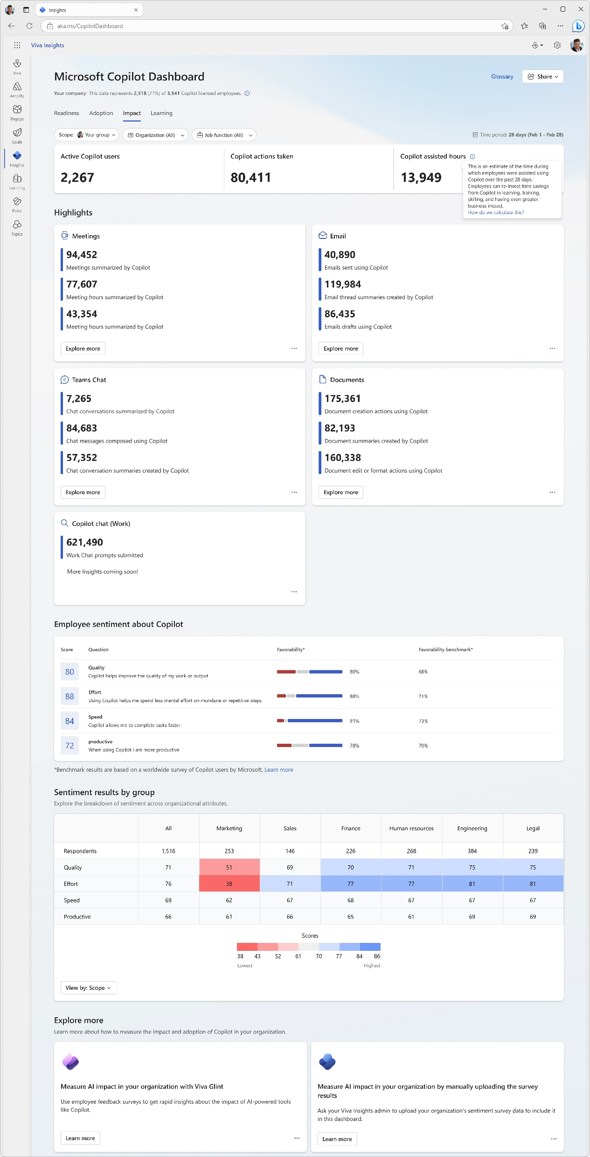
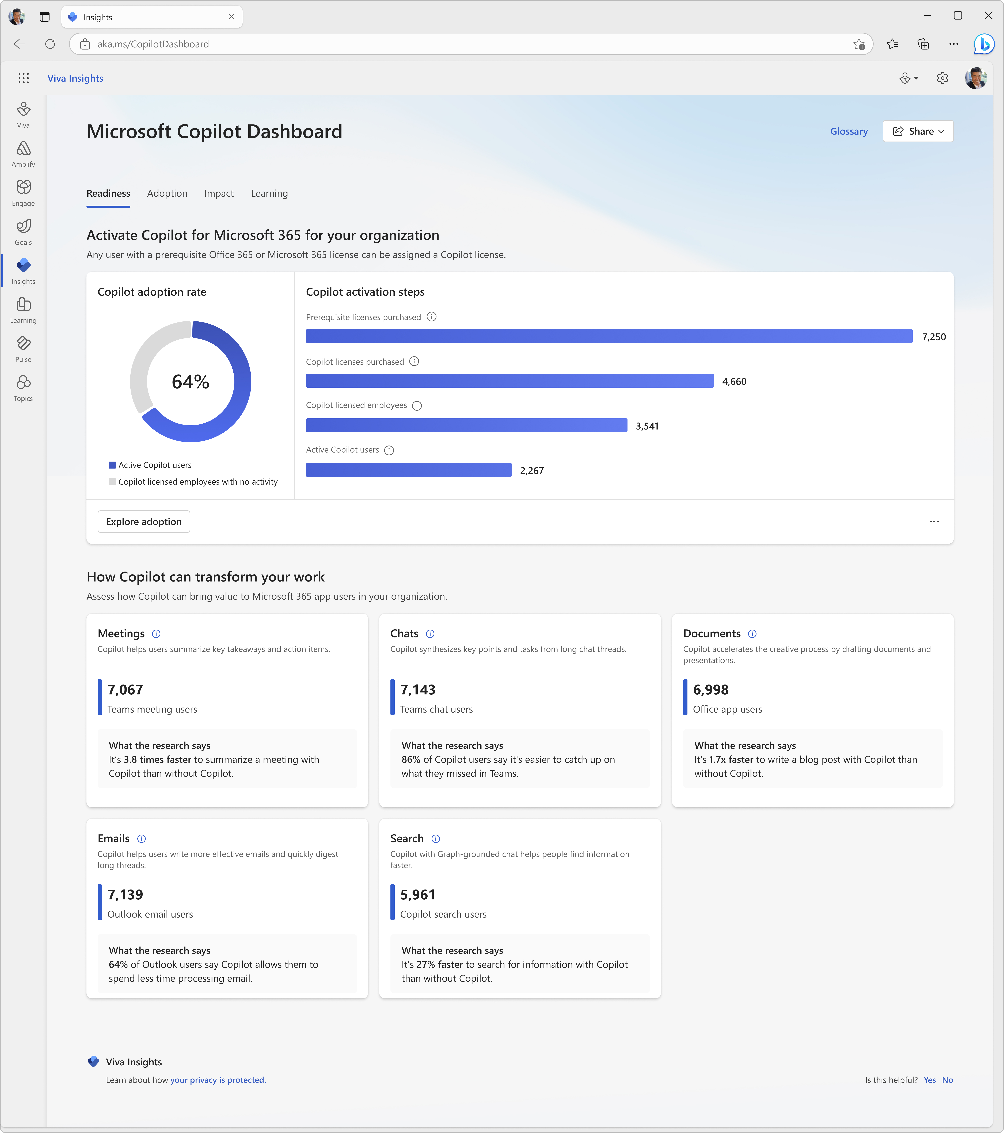

Copilot Dashboard
Measurement
Measure Copilot adoption and impact
Pre-built dashboard for business leaders to prepare for their Copilot rollout, understand and drive usage and adoption, and measure the impact of their investments.
Access directly at aka.ms/CopilotDashboard
Readiness tab to see licensing and copilot activation status across the tenant
Adoption tab to see Copilot trends and usage down to the app feature level, with filters to drill down by group, organization, and job function.
Impact tab to view Copilot actions by productivity categories, Copilot assisted hours and related value calculator and how Copilot usage is correlated with behavioral patterns in your business. Sentiment data from uploaded survey results is also available.
Learning tab for research and best practices to inform your AI journey
Use the Copilot Dashboard metrics eBook to help understand and interpret the data
Notes:
Use the Copilot Dashboard, powered by Viva Insights, to access usage reports and analyze data to understand trends and measure impact.

Slide 39
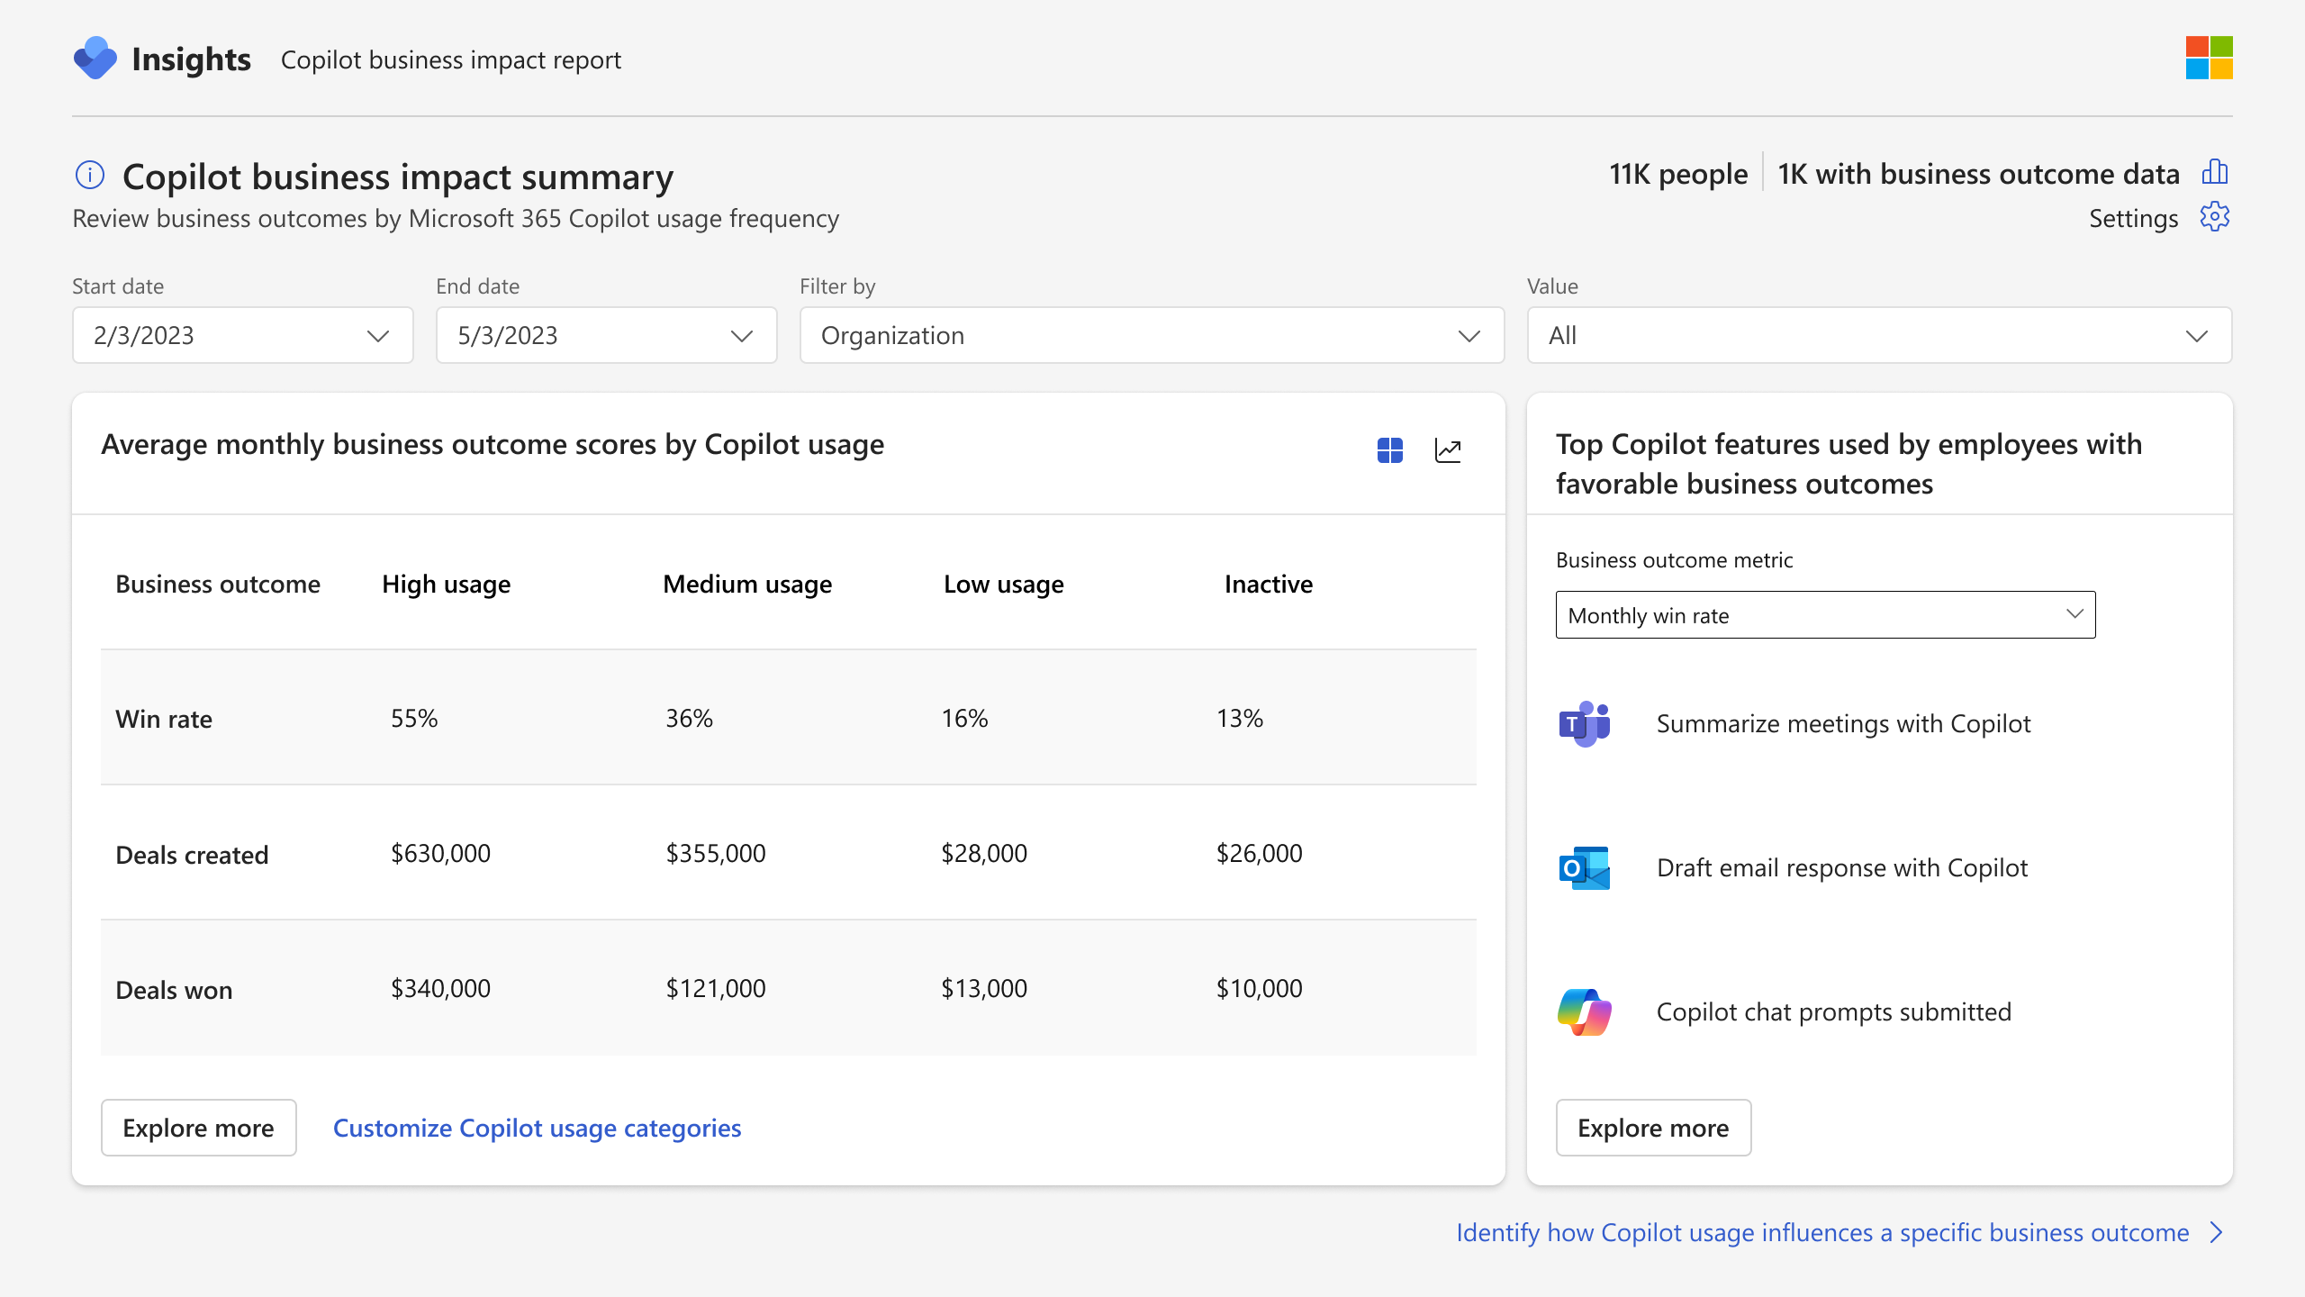
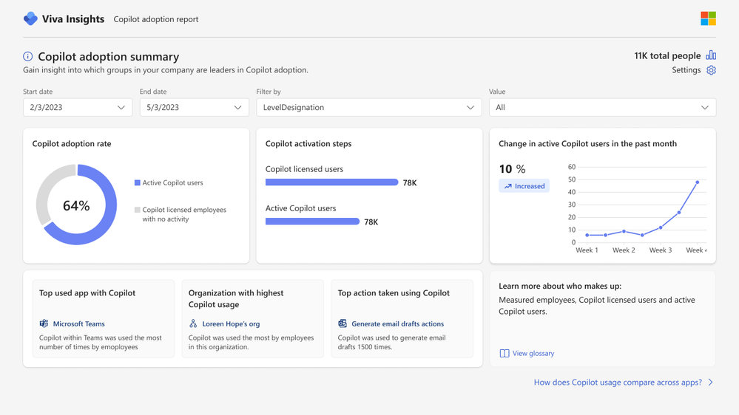
Viva Insights advanced impact reports
Measurement
  Included with Microsoft 365 Copilot
  Copilot business impact reports
Measure the value of Microsoft 365 Copilot with your key business metrics.
See setup details
  Advanced adoption and impact reports
Get a deeper look into Microsoft 365 Copilot adoption and impact trends with a customizable, prebuilt report.
Notes:
Viva Insights now comes included with your Microsoft 365 Copilot license.
Business impact reports:
Understand how Copilot usage relates to business outcomes in a Power BI report template
Customize your analysis for any function with your KPIs from your business data
Identify best practices based on what Copilot activities lead to successful business outcomes
Pinpoint opportunities to improve low Copilot usage to improve adoption and impact
Advanced M365 Copilot adoption report:
Understand how Copilot usage is trending across groups, apps and more.
Includes a dynamic date slicer, advanced filters and groups, trendlines, ability to customize active usage definitions and highlight section that calls out top Copilot actions.
Pull usage data older than 28 days with dynamic time ranges.
Advanced M365 Copilot impact report:
Tailor your Copilot impact report with advanced capabilities to get a deeper look into impact areas.
Compare collaboration patterns across groups or before and after Copilot usage.
Includes dynamic date slicer, Copilot assisted hours and value calculator, group comparisons, and the ability to customize active usage definitions.
Pull usage data older than 28 days with dynamic time ranges.

Slide 40

Copilot business impact report overview
Included with Copilot for Microsoft 365
Measure the value of Microsoft 365 Copilot with your key business metrics
Understand how Copilot usage relates to business outcomes in a PBI report template
Customize your analysis for any function with your metrics from your business data
Identify best practices based on what Copilot activities lead to successful business outcomes
Pinpoint opportunities to improve low Copilot usage to improve adoption and impact
Product images subject to change
Notes:
Understand how M365 Copilot usage impacts your key business metrics for any function using your business data.
This prebuilt report powered by Viva Insights can be customized for metrics in Sales, Customer Service, Finance, IT and more.
Customers identify and upload their KPIs for a function and run the report to see how Copilot usage impacts those KPIs.
See how different levels of Copilot usage relate to business performance, understand what Copilot actions employees are doing to drive performance and measure how usage differs across groups.

Slide 41
We have an exciting future ahead.
Make it Yours.

Slide 42





Microsoft 365 Copilot
Training and documentation by phase
Get ready
Onboard & engage
Deliver impact
Extend & optimize
Copilot Experiences Explained
(11 mins)
Leading in the Era of AI:
Creating an AI Council
Discover how to drive enablement of Microsoft 365 Copilot in your organization (2.5 hrs)
User Experience Strategy template
Copilot Prompt Gallery
(including app specific guidance)
Leading in the Era of AI:
It’s about Trust
Learn about Copilot prompts
Empower your workforce with Microsoft 365 Copilot Use Cases
(7 business group use cases)
Craft effective prompts for Microsoft 365 Copilot (2 hrs)
Get better results with
Copilot Prompts
Edit a Copilot prompt to
make it your own
Share your best prompts
Modern Collaboration Architecture people-centric scenario guidance
Video
Docs
Course
Docs
User Enablement
Article
Tool
Course
Course
Article
Article
Article
Article
Article
Prepare your organization for Microsoft 365 Copilot (1.5 hrs)
How Microsoft 365 Copilot works (11 mins)
How to get ready for Microsoft
365 Copilot (9 mins)
Data, Privacy, and security for Microsoft 365 Copilot
Microsoft 365 Copilot requirements
Get started with Microsoft 365 Copilot (2 hrs)
Admin steps to get ready for Microsoft 365 Copilot (46 secs)
Apply principles of Zero Trust to Microsoft 365 Copilot
Enable users for Microsoft 365 Copilot
Microsoft 365 Copilot Documentation
Copilot Dashboard implementation
Extend Microsoft 365 Copilot
Create copilots with Microsoft Copilot Studio (4 hrs)
Optimize and extend Microsoft 365 Copilot (1 hr)
Extend and manage Microsoft Copilot Studio copilots (2 hrs)
Build connectors and plugins for Microsoft 365 Copilot (3 hrs)
Course
Course
Docs
Docs
Video
Video
Docs
Technical Readiness
Course
Video
Docs
Course
Docs
Docs
Course
Docs
Course
Notes:
This is an appendix slide with hot links to the relevant training and documentation by implementation phase.

