Slide 1
CMO guide to get started with
Microsoft 365 Copilot
Practical examples and how-tos to launch Copilot in your organization
March 2026

Slide 2

Here’s what you’ll learn in this deck:
Getting started with Copilot
Specific prompts you can use
Suggested use cases for your team
How to inspire your team
How to measure success

Slide 3
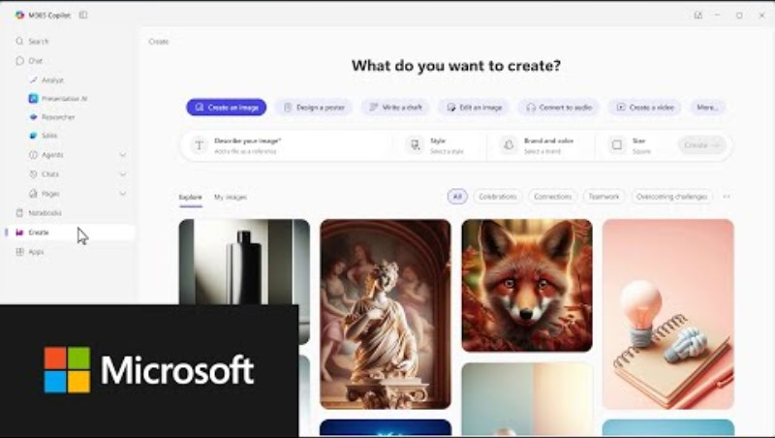
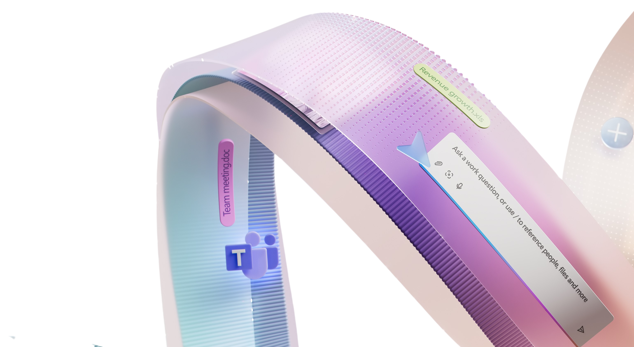

Getting started with Copilot
  Copilot can help you just as much as your team so we recommend you spend a
  few minutes building your own AI habits.
Watch the video.
If you want more depth, you can try out the Copilot training for executives.

Slide 4

Specific scenarios and prompts you can use
See some ways Copilot can help your team before we dive into the use case examples and KPIs.
Summarize data
Upgrade your writing:
Simplify reporting
Ensure clear communications
Categorize your data and identify patterns.
Use Copilot to rewrite content more clearly.
Simplify complex documents and articles.
Get assistance with writing employee communications.
In an Excel file try
the prompt:
Analyze this campaign performance data for [time period]. Identify what’s driving results by channel, audience, and campaign. Call out top performers, underperformers, and unexpected patterns.
In Word try the prompt:
Refine this draft into an executive‑ready annual marketing plan suitable for board review. Tighten the language and highlight strategic tradeoffs and ROI.”
In PowerPoint try the prompt:
Summarize this marketing report for an executive audience. Focus on impact, results, risks, and decisions required. Rewrite it in concise, outcome focused language suitable for senior leadership, and limit the output to one page.
In Outlook try the prompt:
Draft a clear, confident message explaining this marketing initiative to [sales leaders / field teams / executives]. Anticipate questions or concerns, include key talking points, and keep the tone aligned to our brand voice and priorities.

Slide 5
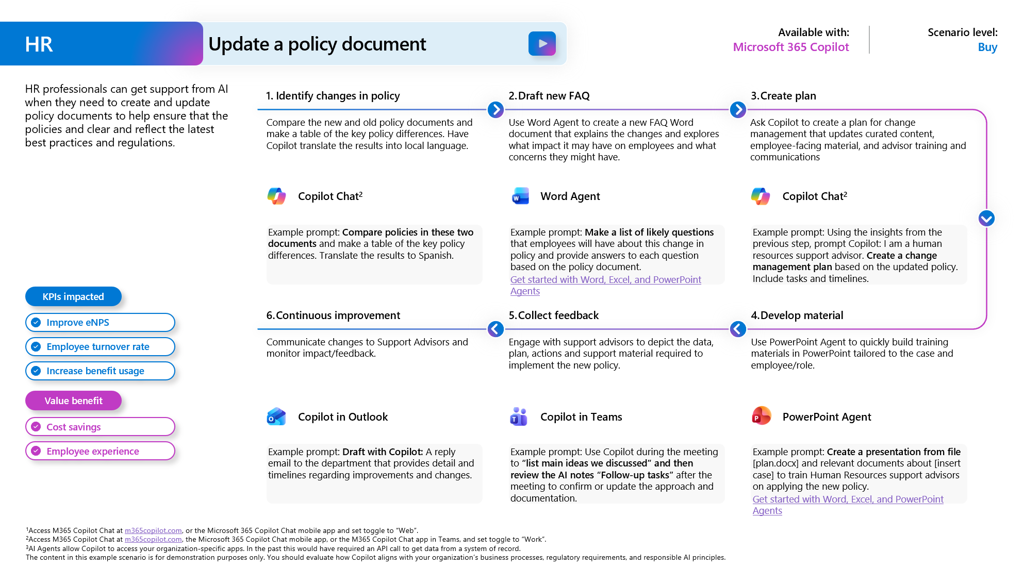
Suggested use cases for your team
The Scenario Library for Marketing offers detailed examples of use cases.
Example use cases for Marketing:
Create a Bill of Materials
Streamline market research
Create a new offering
Campaign performance tracking

Slide 6
Inspire your team
Subject: Using Copilot to help Marketing move faster and smarter
Team,
Marketing has never moved faster—or carried higher expectations. We are asked to deliver differentiated stories, personalized experiences, and measurable impact, often at greater scale and speed than ever before. To meet that bar, we must continually evolve how we work.
That’s why I want Microsoft Copilot to become a core part of our day‑to‑day marketing workflow. Copilot is not about replacing creativity or judgment—those remain central to our craft. It is about removing friction: helping us move from idea to execution faster, improving consistency and quality, and freeing up more time for insight, strategy, and impact.
Copilot can help us:
Accelerate development of campaign messaging, briefs, and content
Create strong first drafts of emails, presentations, social content, and FAQs
Quickly summarize research, performance data, and campaign results
Build clearer narratives and storytelling for internal and executive audiences
Organize, refine, and pressure‑test ideas—more efficiently
What I expect
Over the coming weeks, I expect everyone across Marketing to begin using Copilot in meaningful ways on real work. That includes:
Integrating Copilot into daily workflows in Word, PowerPoint, Outlook, Excel, and Teams
Applying it to active campaigns, content creation, performance analysis, and internal communications
Sharing learnings—what’s working, where it adds the most value, and where it needs improvement
This is not about perfection or using Copilot for everything. It is about building fluency, developing good habits, and collectively learning how AI can best support how we market.
How we’ll support you
To help you get there, we’ll provide:
Marketing‑specific examples and high‑value prompts
Clear guidance on responsible, brand‑safe use
Opportunities to learn from peers who are already seeing impact
Marketing is strongest when we pair creativity with smart execution. Copilot is another capability that helps us raise the bar on both—while moving faster together.
Thank you for continuing to lead with creativity, curiosity, and a willingness to evolve how we work.
Best regards,
[CMO Name]
Chief Marketing Officer

Slide 7
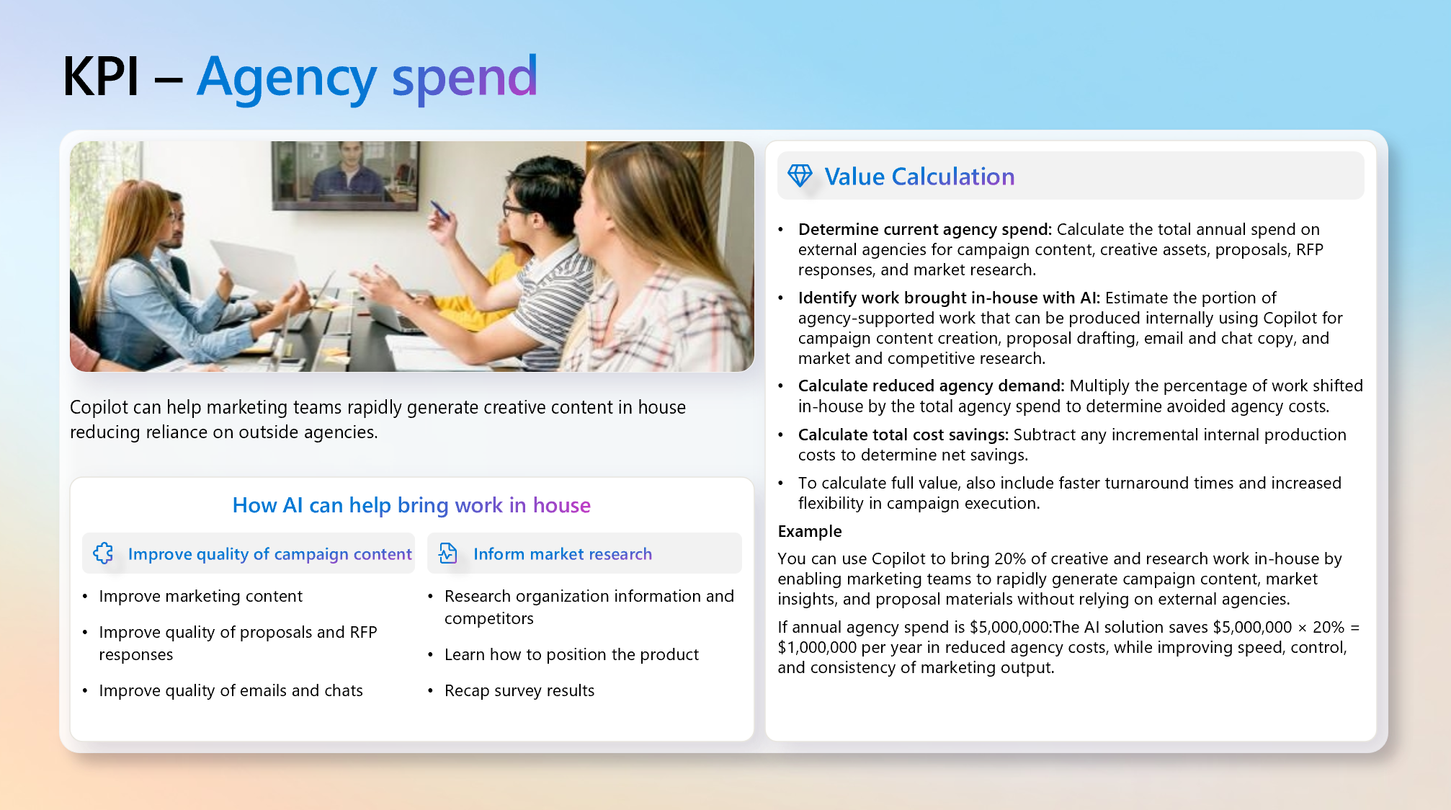
Measure success
You’ll need to set the criteria for success within your organization. Seer this guide to Defining business value for more information. The Scenario Library for Marketing suggests many KPIs that could be used to
measure success.
Example KPIs for Marketing:
Reduce agency spend
Leads generated
Brand value
Cost per lead

