Slide 1
CHRO guide to get started with
Microsoft 365 Copilot
Practical examples and how-tos to launch Copilot in your organization
March 2026

Slide 2

Here’s what you’ll learn in this deck:
Getting started with Copilot
Specific prompts you can use
Suggested use cases for your team
How to inspire your team
How to measure success

Slide 3
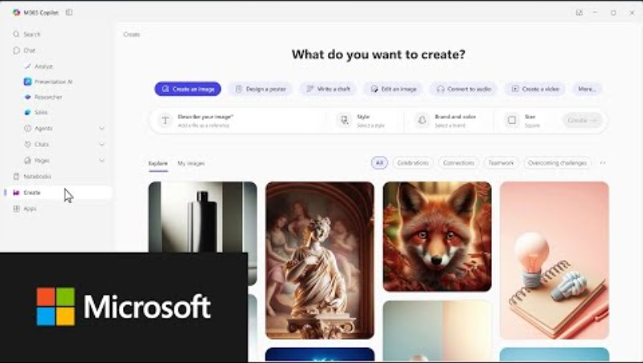
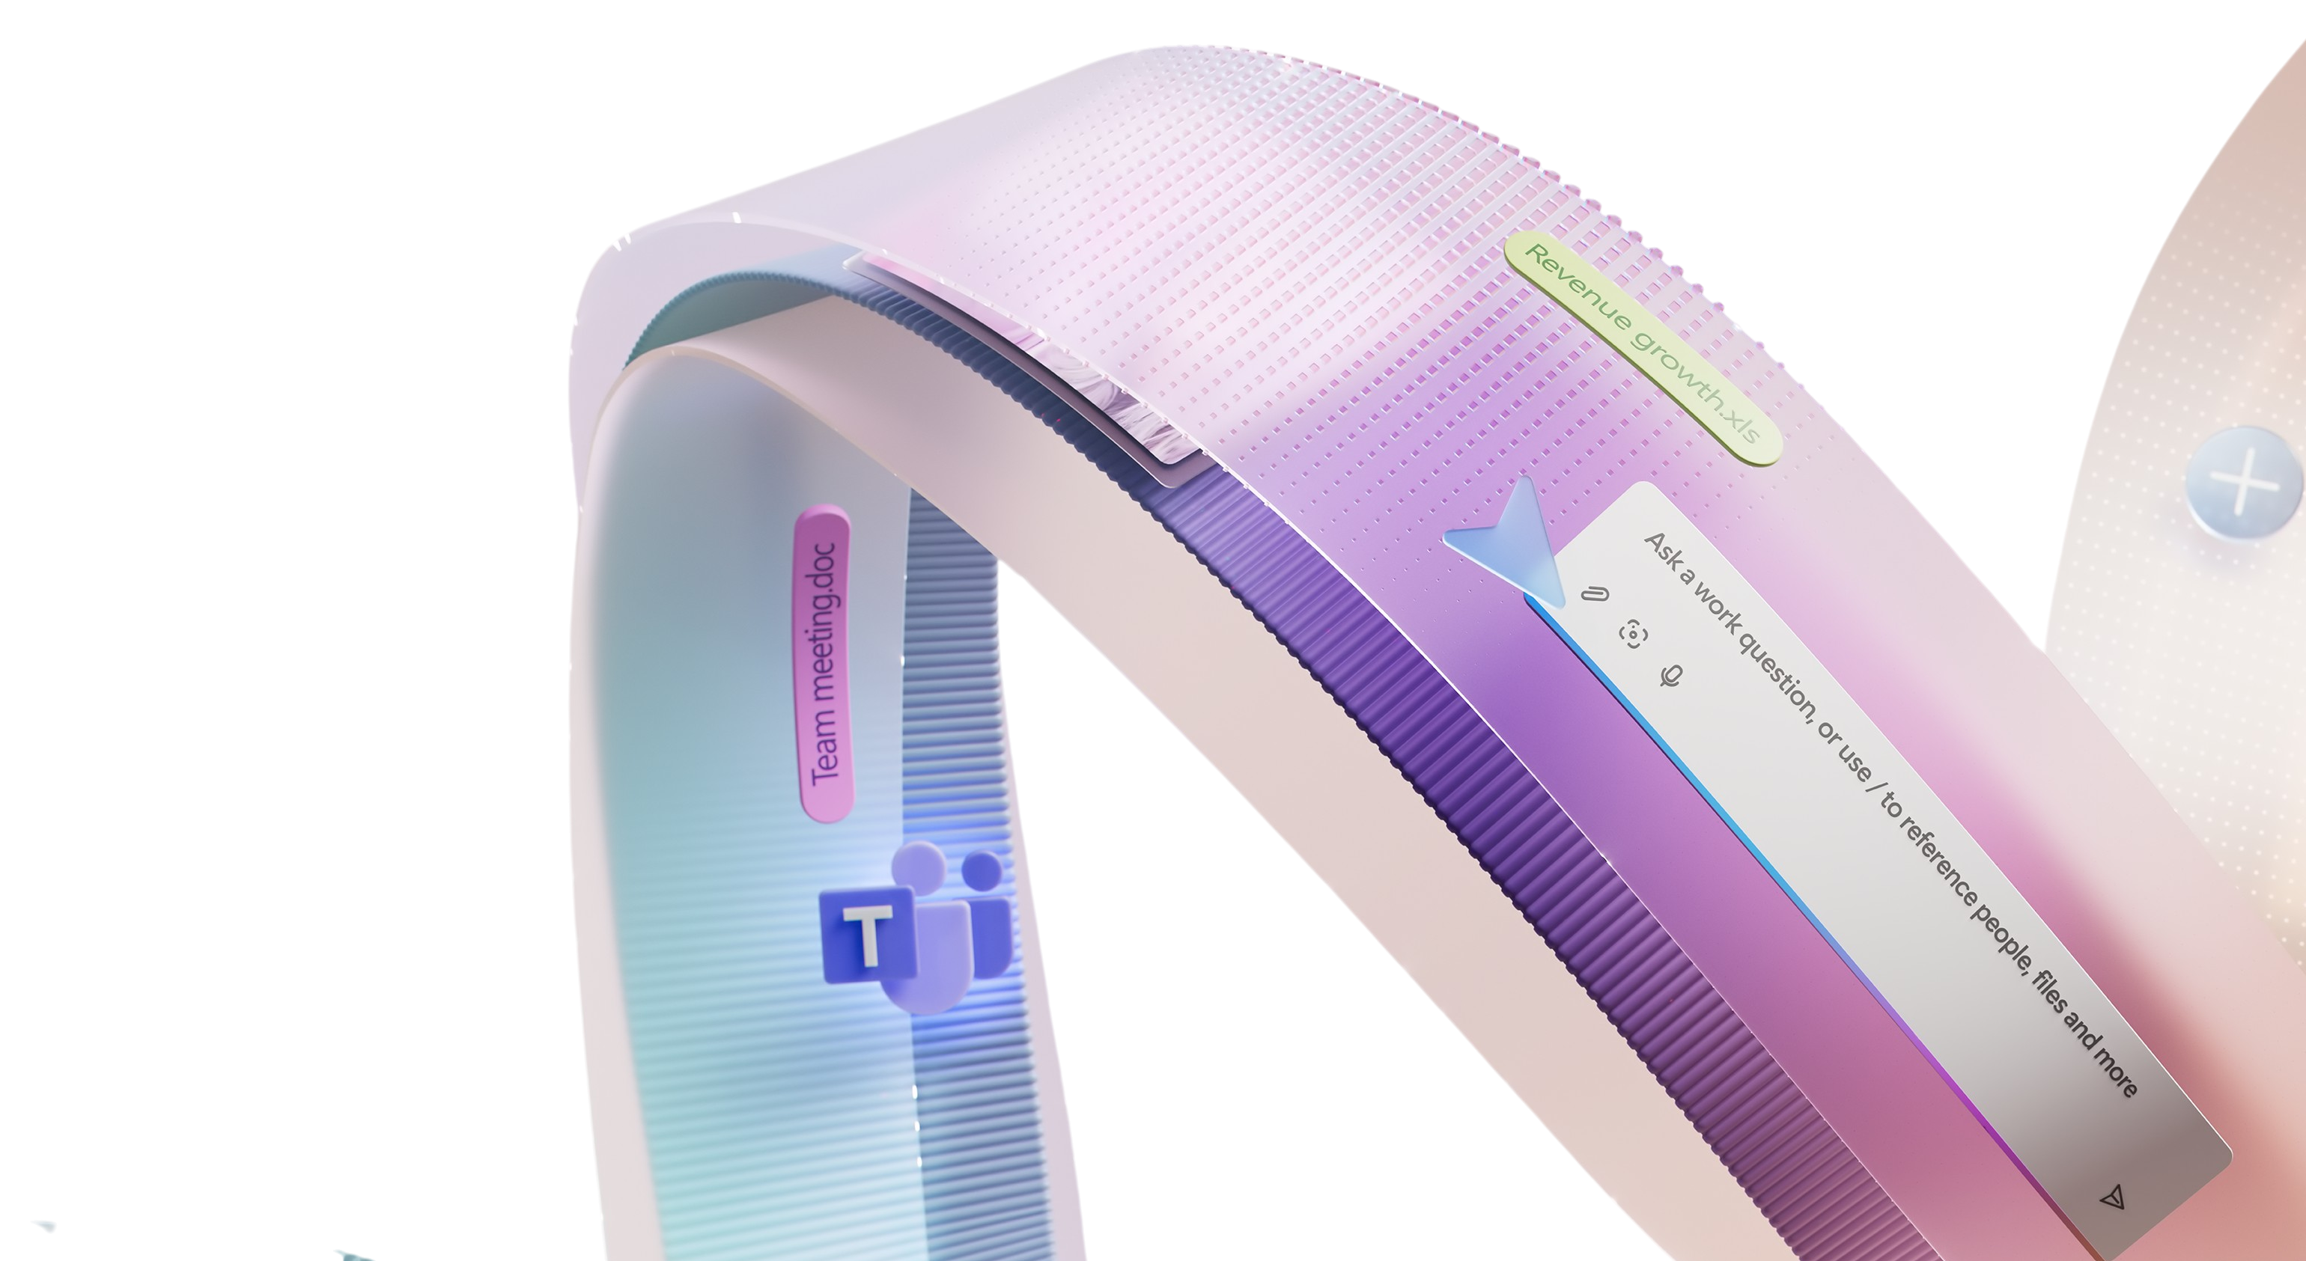

Getting started with Copilot
  Copilot can help you just as much as your team so we recommend you spend a
  few minutes building your own AI habits.
Watch the video below.
If you want more depth, you can try out the Copilot training for executives.

Slide 4

Specific scenarios and prompts you can use
See some ways Copilot can help you before we dive into the use case examples and KPIs.
Summarize data
Upgrade your writing
Simplify reporting
Ensure clear communications
Create summaries and lists of key points, variances, and risks in a flash.
Use Copilot to rewrite content more clearly.
Simplify complex documents and articles.
Get assistance with writing employee communications.
In an Excel file try
the prompt:
Using this workforce dataset, analyze attrition trends over the last [6–12 months] by Department, Role, Location, and Tenure. Identify key drivers, emerging risk areas, and any statistically
unusual patterns.
In Word try the prompt:
Refine this content into a board‑ready workforce strategy summary, focused on risk, capacity, and long‑term capability.
In PowerPoint try the prompt:
Summarize this HR report for an executive audience. Focus on key insights, risks, and decisions needed. Rewrite it in clear, concise language suitable for senior leadership, and limit the output
to one page.
In Outlook try the prompt:
Draft a clear, empathetic message to managers explaining [topic]. Anticipate questions or resistance, suggest talking points, and keep the tone supportive, consistent, and action oriented.

Slide 5
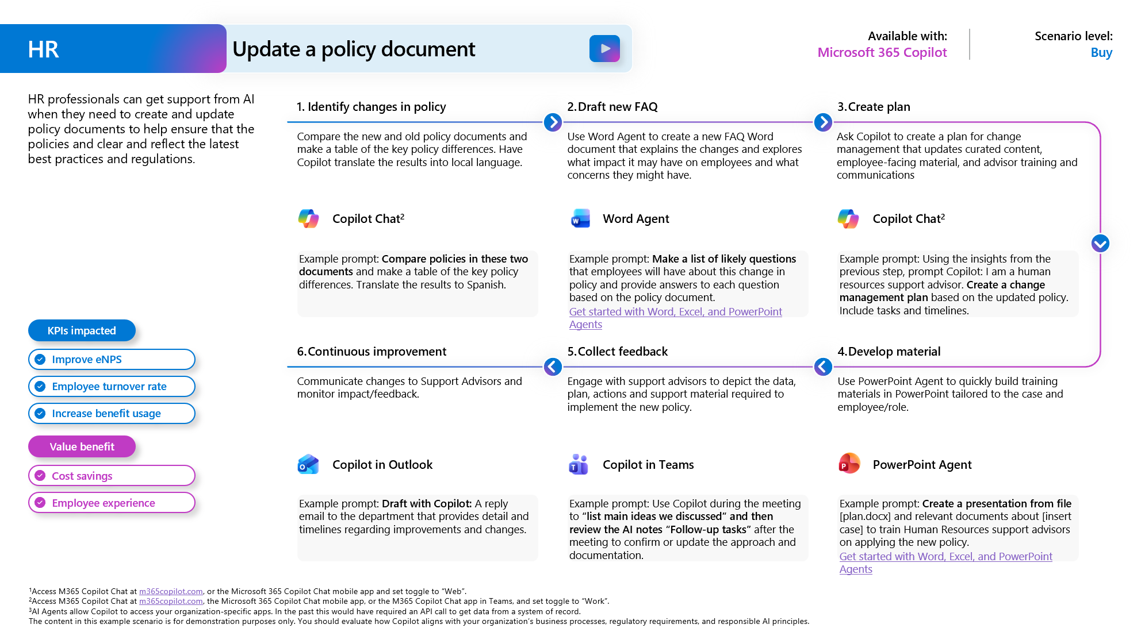
Suggested use cases for your team
The Scenario Library for HR offers detailed examples of use cases:
Update a policy document
Improve onboarding and development
Resolving employee issues
Employee self-service

Slide 6
Inspire your team
Subject: Strengthening how HR supports our people with Microsoft 365 Copilot
Team,
At the core of Human Resources is our responsibility to support our people, our leaders, and the culture that defines our organization. As the scope, pace, and complexity of our work continue to grow, it’s increasingly important that we use tools that allow us to focus less on manual effort and more on thoughtful, people‑centered impact.
To that end, I’m asking everyone across HR to actively incorporate Microsoft 365 Copilot into your day‑to‑day work.
Copilot is designed to help streamline common HR activities and bring greater consistency and efficiency to how we operate. In practical terms, it can support us in:
Drafting, refining, and tailoring communications, policies, and employee guidance
Summarizing meetings, interviews, and feedback while preserving key themes and intent
Analyzing workforce, hiring, and attrition data to surface trends and insights
Preparing presentations and materials for leaders and employees
Structuring plans related to talent development, performance, and engagement
Copilot is a tool to support our expertise—not replace it. Human judgment, empathy, discretion, and trust remain central to everything we do. Copilot helps reduce friction and free up time so we can focus on those responsibilities even more deeply.
What I’m asking of you
Over the coming weeks, I expect each of you to:
  Incorporate Copilot into your regular HR workflows across Word, Excel, PowerPoint, Outlook, and Teams
  Apply it to real HR work, such as workforce planning, policy drafting, talent reviews, and leader communications
  Share feedback and best practices, so we can learn together what works well and where we need guardrails
There is no expectation to use Copilot for everything or to be perfect from the start. This is about building comfort, confidence, and sound judgment over time.
How we’ll support you
We’ll be sharing:
  HR‑specific examples and prompts aligned to our work
  Clear guidance on responsible and appropriate use
  Opportunities to learn from peers who are finding effective and innovative ways to apply Copilot
  HR plays a critical role in enabling our organization’s success. Thoughtful adoption of tools like Copilot is one way we can continue to evolve how we operate while staying grounded in our values.
Thank you for your commitment to our people and for your openness to new ways of working.
Best regards,
[CHRO Name]
Chief Human Resources Officer

Slide 7
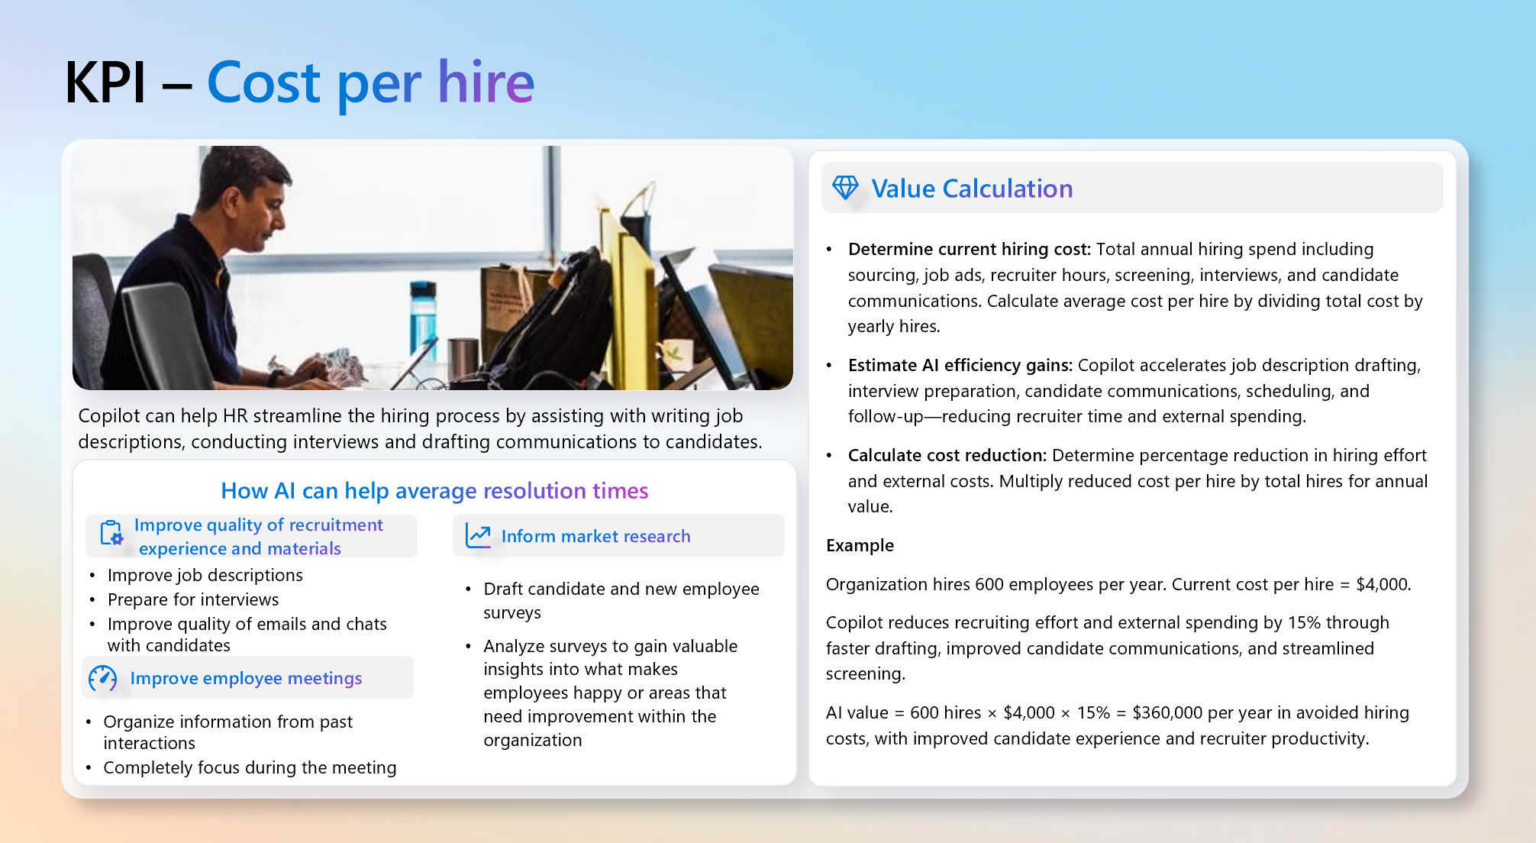
Measure success
You’ll need to set the criteria for success within your organization. See this guide to Defining business value for more information. The Scenario Library for HR suggests many KPIs that can be used to measure success.
Example KPIs for HR:
Employee onboarding time
Employee retention
Calls handled by agents
Cost per hire
Benefit usage
Employee NPS

