Slide 1
CFO guide to get started with
Microsoft 365 Copilot
Practical examples and how-tos to launch Copilot in your organization
March 2026

Slide 2

Here’s what you’ll learn in this deck:
Getting started with Copilot
Specific prompts you can use
Suggested use cases for your team
How to inspire your team
How to measure success

Slide 3
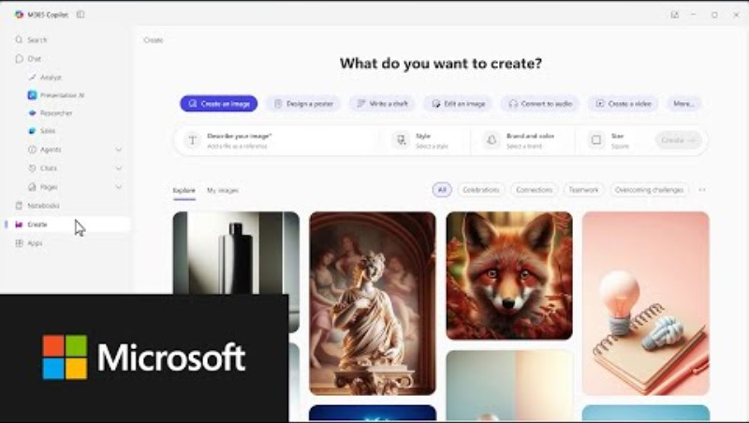


Getting started with Copilot
  Copilot can help you just as much as your team so we recommend you spend a
  few minutes building your own AI habits.
Watch the video below.
If you want more depth, you can try out the Copilot training for executives.

Slide 4

Specific scenarios and prompts you can use
See some ways Copilot can help your team before we dive into the use case examples and KPIs.
Summarize data
Enhance compliance
Simplify reporting
Ensure clear communications
Create summaries and lists of key points, variances, and risks
in a flash.
Use Copilot to help understand regulations and apply them to your processes.
Simplify complex documents and articles.
Get assistance with writing employee communications.
In an Excel file
try the prompt:
Summarize our YTD financial performance vs plan, calling out key variances, drivers,
and risks.
In Word
try the prompt:
Identify potential compliance gaps in this process documentation.
In PowerPoint
try the prompt:
Turn this financial report into executive level talking points for a board meeting.
In Outlook
try the prompt:
Summarize these documents into a short email briefing for the executive team ahead of our financial review meeting.

Slide 5
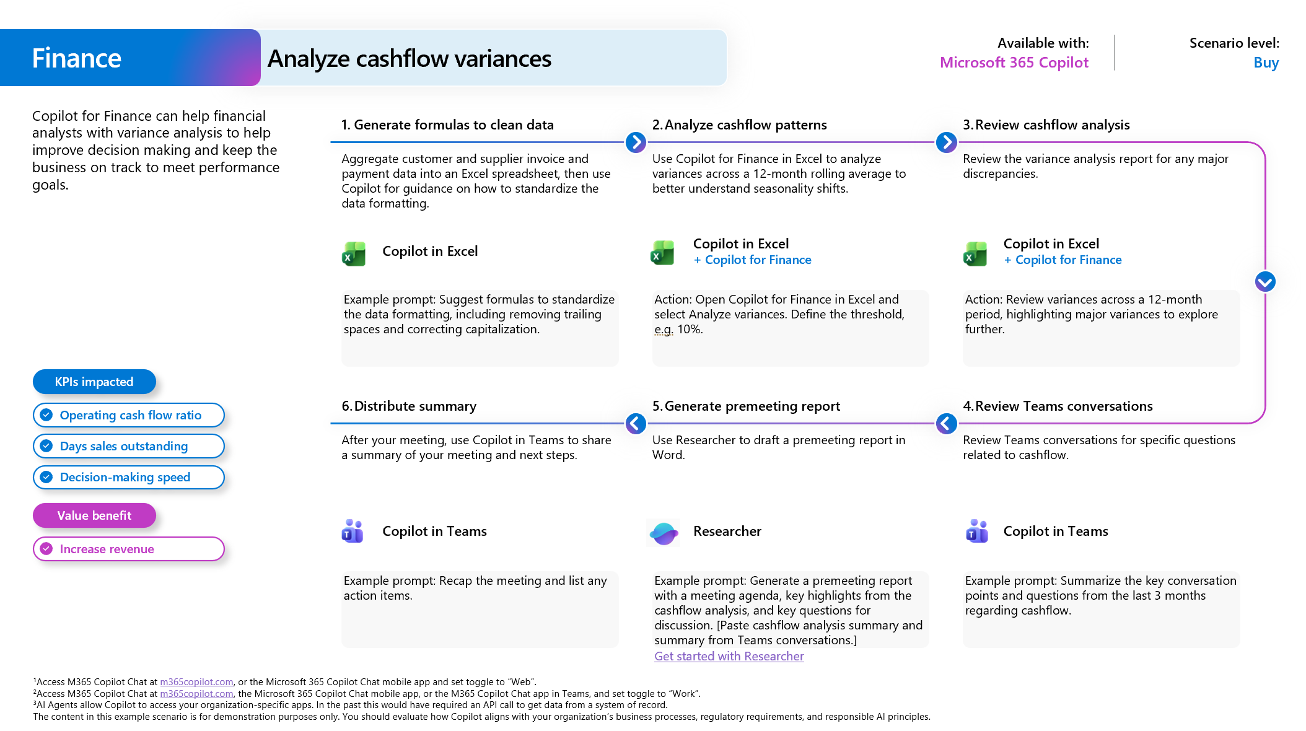
Suggested use cases for your team
The Scenario Library for Finance offers detailed examples of
use cases.
Analyze business performance
Analyze cashflow variance
Intelligent sales forecasting
Contract analysis
Build a business case

Slide 6
Inspire your team
Subject: Using Copilot to work smarter across Finance
Team,
As our organization continues to scale and operate in an increasingly complex environment, Finance must consistently focus its time and expertise on what drives the most value—clear insight, sound judgment, and informed decision‑making. Reducing time spent on manual, repetitive work is essential to that goal.
To support this, I’m asking everyone across Finance to actively incorporate Microsoft 365 Copilot into your day‑to‑day workflow.
Copilot will accelerate the mechanics of our work so we can spend more time where it matters most. In practical terms, this includes helping us:
Analyze financial data to surface key drivers, trends, and variances
Draft executive‑ready summaries, reports, and presentations
Build, review, and stress‑test forecasts, scenarios, and assumptions
Summarize meetings, emails, and action items efficiently
Understand, audit, and construct complex Excel models more effectively
Copilot does not replace our judgment, accountability, or professional standards. Those remain squarely with us. What it does is streamline the underlying work so we can deliver faster, sharper, and more impactful insights to the business.
What I’m asking of you
Over the coming weeks, I expect each of you to:
  Start using Copilot regularly in Excel, Word, PowerPoint, Outlook, and Teams
  Apply it to real finance activities—monthly close, forecasting, variance analysis, reporting, and communication
  Share what’s working, where it adds value, and where it falls short so we can improve collectively
No one is expected to become an expert overnight. Like any tool, the value grows with use and practice.
How we’ll support you
To help you get there, we’ll provide:
  Practical finance‑specific examples and prompts
  Best practices from across the team
  Training resources and guidance on responsible use
Our expectation is not perfection—it’s measurable progress.
Finance has always been at its best when we combine strong fundamentals with thoughtful innovation. Copilot is another way we can raise the bar on how we operate and how we support the business.
Thank you for your continued focus, professionalism, and openness to new ways of working.
Best regards,
[CFO Name]
Chief Financial Officer

Slide 7
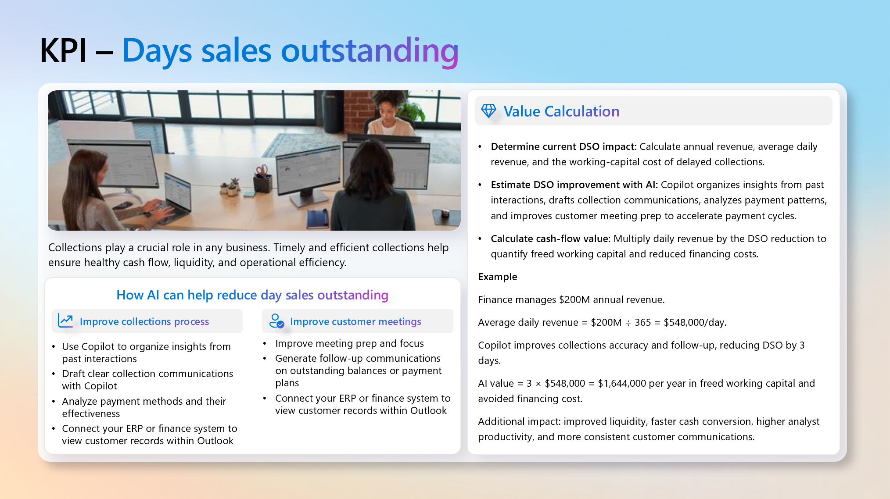
Measure success
You’ll need to set the criteria for success within your organization. See this guide to Defining business value for more information. The Scenario
Library for Finance suggests
many KPIs that can be used to measure success.
Cost per analysis request
Days sales outstanding
Outsourcing spend
Spend on financial systems

