Slide 1


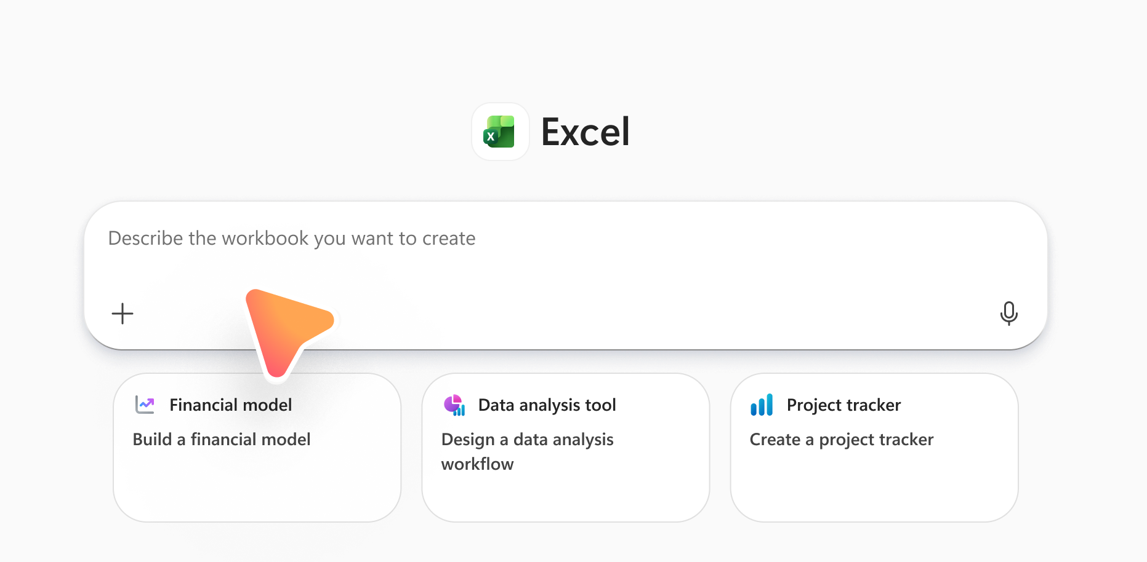
New Word, Excel,
and PowerPoint Agents
now available in the Microsoft 365 Copilot app
Microsoft 365 Copilot helps you get work done faster by turning your ideas into drafts you can build on. Copilot already supports everyday productivity and creativity, and now we’re introducing new capabilities that make it even easier to get started.
You can now create new files from a prompt!
Use the Word, Excel, and PowerPoint Agents in the Microsoft 365 Copilot app to create a new file by describing what you need. Whether you’re working on a work project or personal task, these agents help you generate drafts, organize information, and build files, grounded on information from the web and any information or files you include in your prompt.
These agents are available to Copilot Chat users without a Microsoft 365 Copilot license. They are also available with additional functionality and access to Work IQ for users with a Microsoft 365 Copilot license.
How to create a file: In the Microsoft 365 Copilot app, go to the Agents menu, and choose the Word, Excel, or PowerPoint Agent, or type “@[app name]” in the prompt box of Copilot Chat. Enter your prompt describing the file you want to create.
✨Excel Agent
Pulls together web data and explicitly chosen files and turns them into charts, summaries, and insights using built-in formulas and logic. Ideal for financial forecasts, project plans, and decision-making tools.
✨Word Agent
Organizes complex information into clear, well-written documents. Great for strategic plans, policy write-ups, and technical papers.
✨PowerPoint Agent
Builds polished presentations with strong storytelling and visual structure. Perfect for executive decks, strategic updates, and market overviews.
Start by prompting: “Create a project tracking workbook with tasks, owners, due dates, and status, plus a summary sheet.”
Start by prompting: “Create a 2-page project proposal with an introduction, problem statement, solution overview, and timeline.”
Start by prompting: “Create a 6-slide executive update on our go to market plan, including progress, risks, and next steps based on [GTM plan.doc].”
Learn more
• Get started with Word, Excel, and PowerPoint Agents in Microsoft 365 Copilot

