Slide 1
Word, Excel, and PowerPoint agents in the Microsoft 365 Copilot app
Experience for users without a Microsoft 365 Copilot license

Slide 2
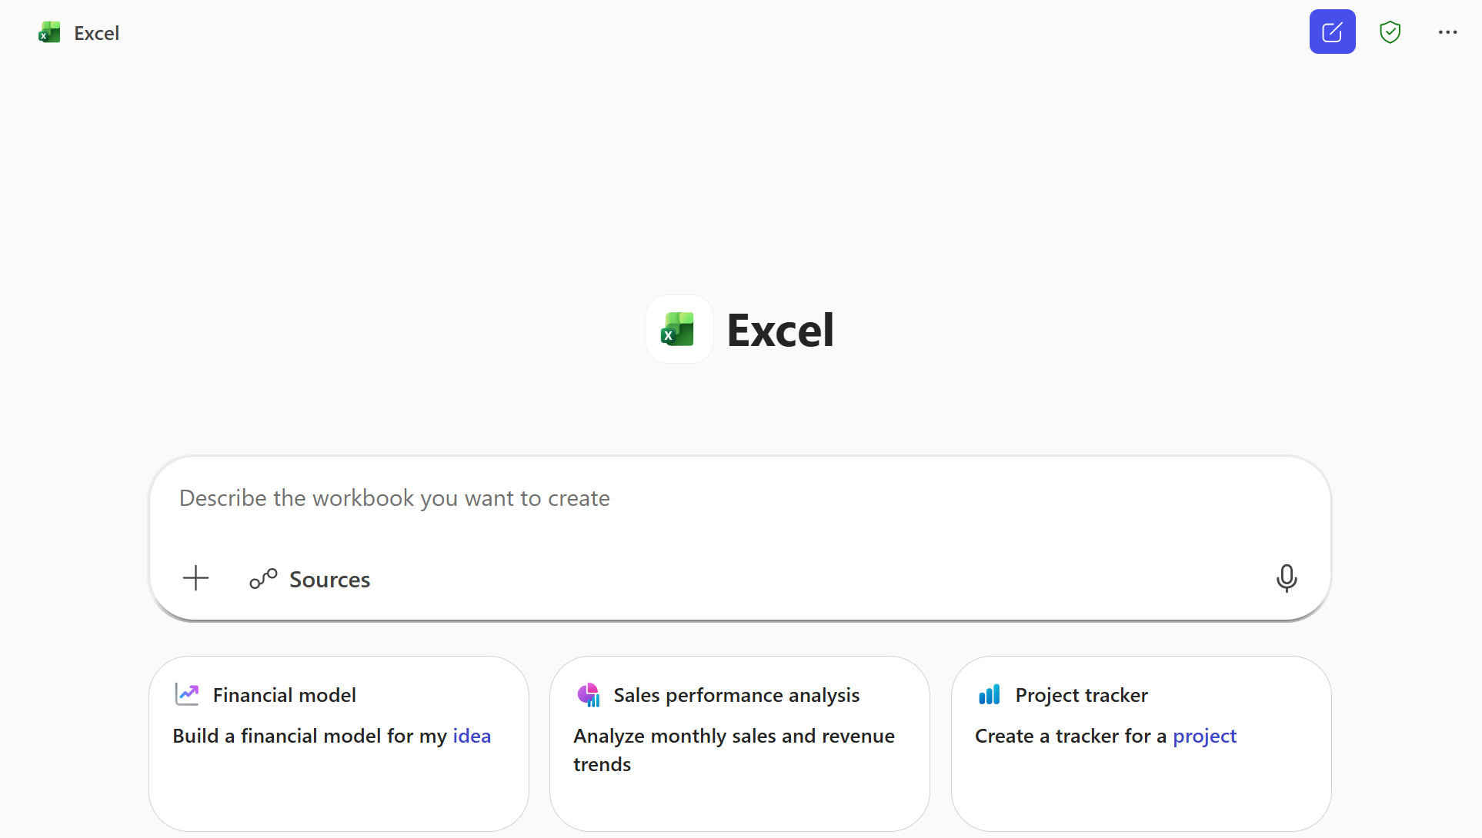
Cheat sheet: When to use the Word, Excel, and PowerPoint agents for creation
App | What you can do | Example prompts to demo
Excel | Build and iterate on spreadsheets Create structured workbooks | Create (in chat): “Create a project tracking workbook with tasks, owners, due dates, and status, plus a summary sheet based on [Project Nano Launch Workback.xlsx]”
Word | Create and refine real documents Draft net‑new content | Create (in chat): “Create a 2‑page customer brief explaining our Q3 product strategy, including goals, key initiatives, and success metrics based on [Q3 product strategy.doc].”
PowerPoint | Create and transform presentations Generate a first‑draft deck | Create (in chat): “Create a 6‑slide executive update on our go‑to‑market plan, including progress, risks, and next steps based on [GTM plan for Q4.doc].”
 | Word, Excel & PowerPoint Agents (in Chat)
Where you access | Microsoft 365 Copilot app (Agents store or @mention)
How it works | Copilot creates an artifact using web content or files you include in your prompt, then you can refine via chat
Key value | Turn ideas into polished files through conversational prompts directly from chat
How this helps | Handles research, formatting, and layout for you—refine in chat or app

Slide 3

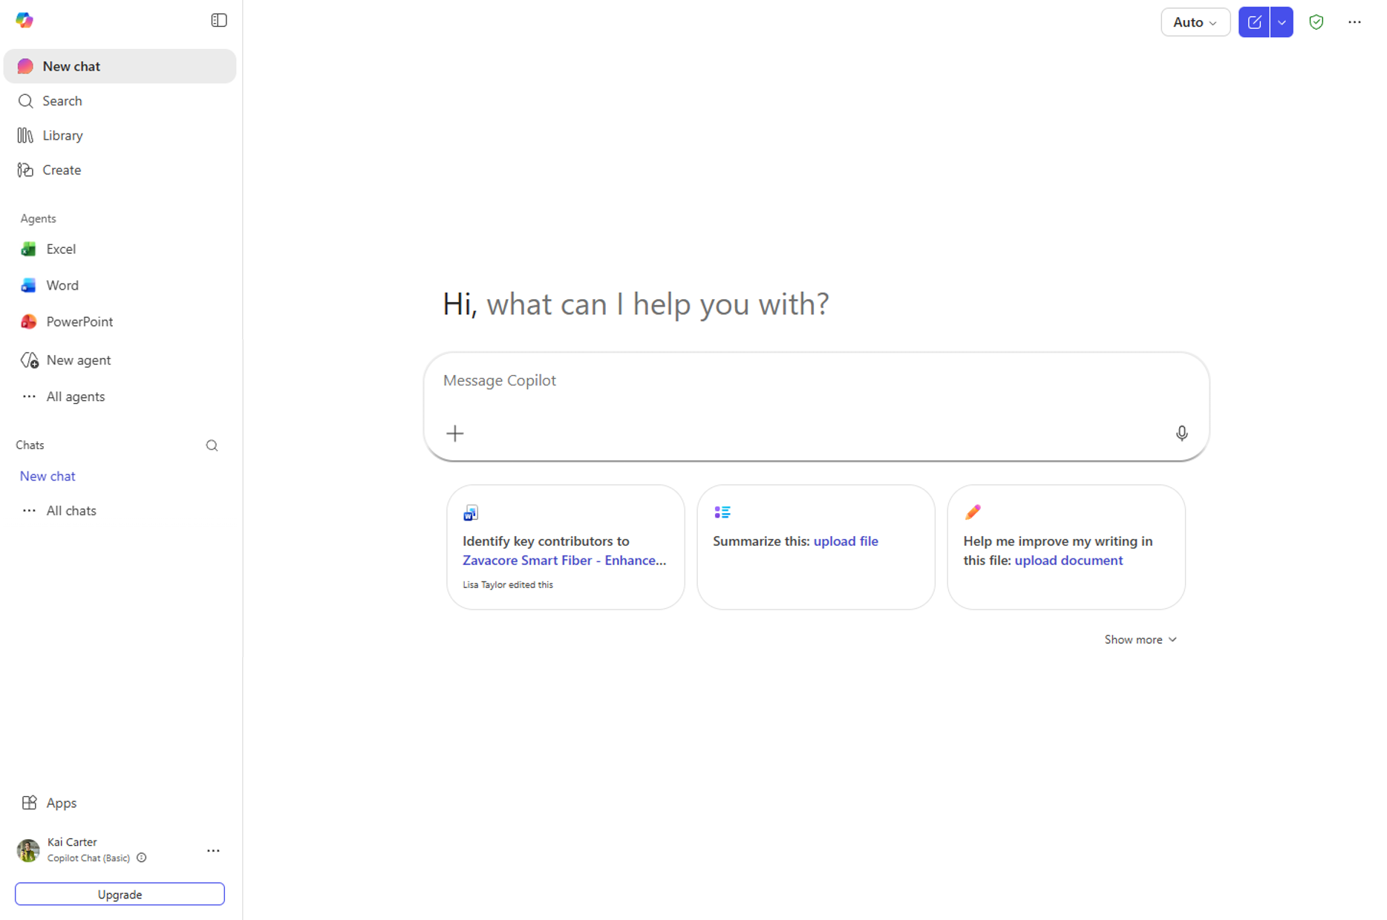
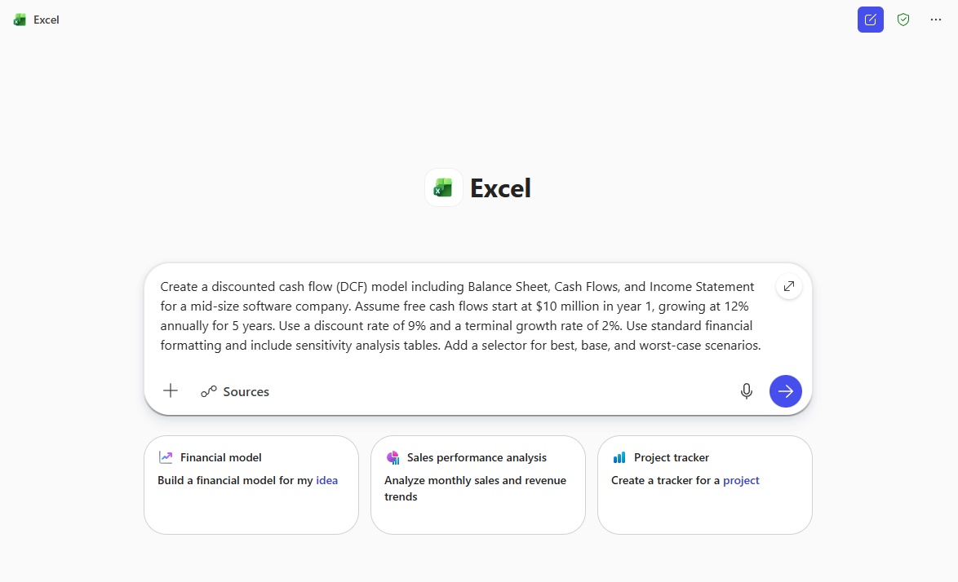
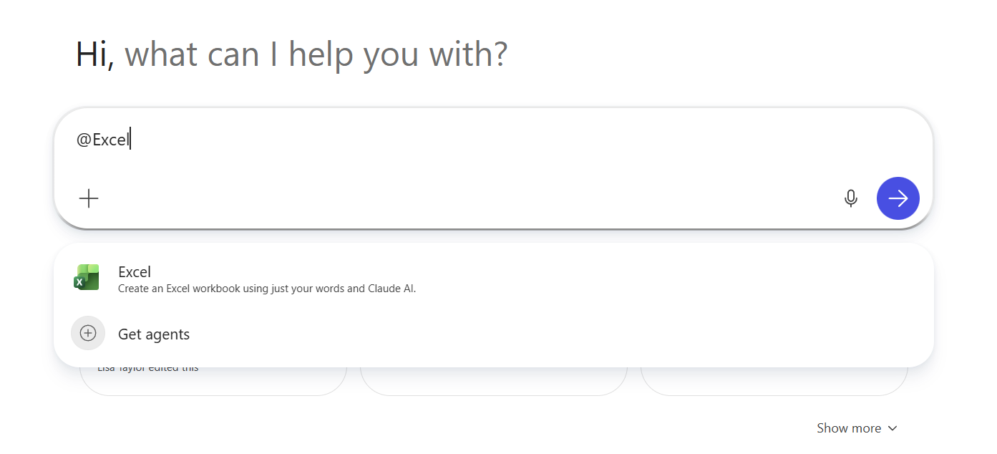
Excel agent: How to find and use
Step 1: Select the agent
Step 2: Input your prompt
Select “All agents” to find Excel in the agent store. Then select the Excel agent from Agents or type “@Excel” in the prompt box and select the agent.
Type in your prompt and run it using the Excel agent. The Excel agent is
grounded on web sources and specific files that you upload or select from available sources.

Slide 4
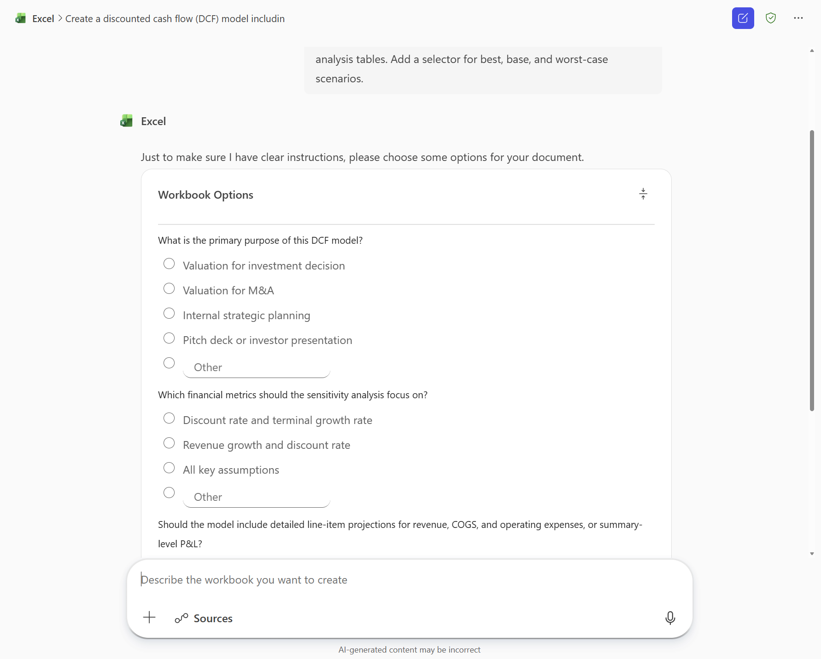
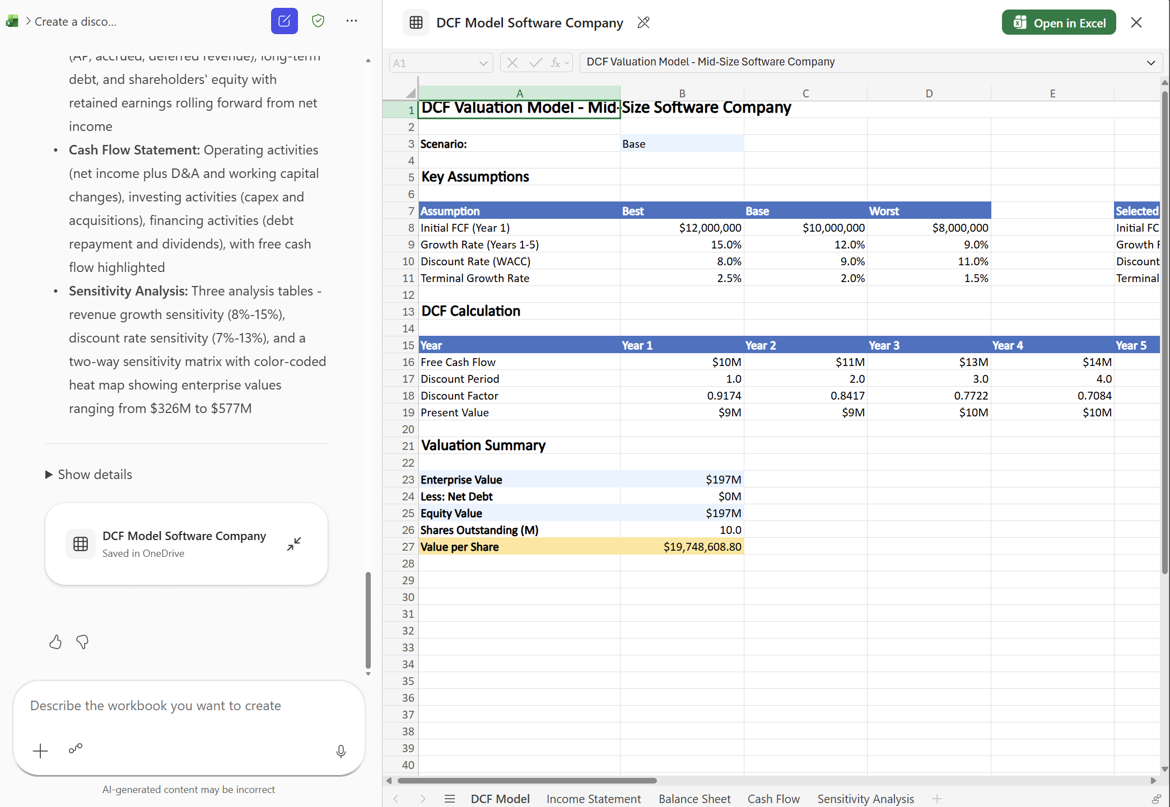
Excel agent: How to find and use (cont.)
Step 3: Answer a few validation questions
Step 4: View your output & adjust using chat
Copilot will ask you a few questions to help guide its output. You can choose from preselected options or write in your own answers. Select “Let’s go” to begin generating the spreadsheet.
Copilot produces the file, saves it to your OneDrive, and shows it side-by-side with chat. You can use chat to refine the file further or open it in Excel.

Slide 5
Create from scratch with Excel agent
Financial model (web search)
Project tracking (file upload)
Create a discounted cash flow (DCF) model including Balance Sheet, Cash Flows, and Income Statement for a mid-size software company. Assume free cash flows start at $10 million in year 1, growing at 12% annually for 5 years. Use a discount rate of 9% and a terminal growth rate of 2%. Use standard financial formatting and include sensitivity analysis tables. Add a selector for best, base, and worst-case scenarios.
Create a full project tracking system that includes tasks, owners, milestones, budgets, and risk ratings grounded in recent workback plans, sprint notes, and budget files using [upload files]. Generate a Gantt‑style timeline, conditional formatting for at‑risk or overdue tasks, and a dashboard with burndown charts, budget tracking, and a risk heatmap. Provide a status‑ready summary section that can be exported for leadership updates.
Scenario modeling (file upload)
Market forecast (web search)
Build a multi‑year model using historical revenue, cost, pipeline, renewal, and pricing guidance data in [upload file]. Include full P&L, cash flow, and balance sheet views with linked assumptions, driver‑based forecasting, and base/upside/downside scenarios. Incorporate sensitivity analysis on key variables such as price, win rate, and churn. Produce error checks, a dashboard of charts, and a one‑page executive summary of the model.
Build a US market forecast for smart fitness apparel from 2026-2030. Use the latest data on the activewear market segment and growth rates. Build a model with adjustable assumptions and a chart showing revenue by segment.
Follow up: Add a sheet with region-specific breakdowns including charts.

Slide 6

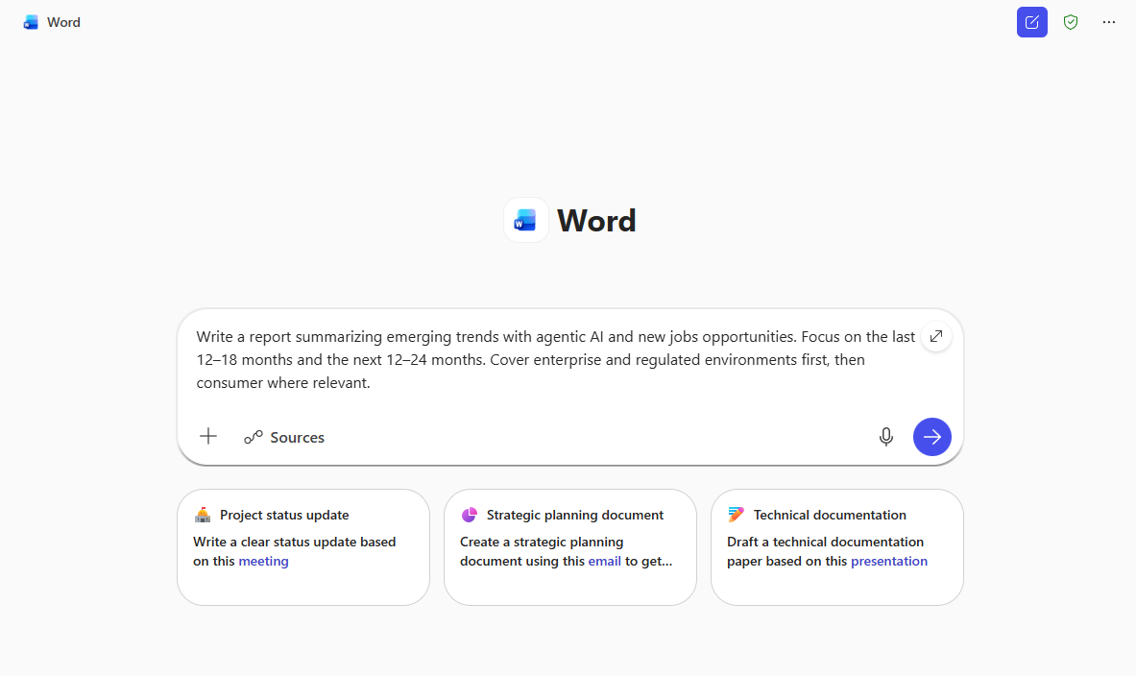
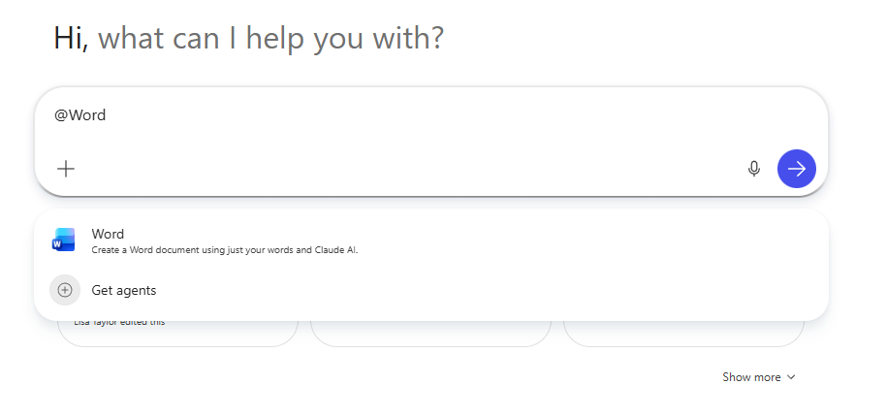
Word agent: How to find and use
Step 1: Select the agent
Step 2: Input your prompt
Select “All agents” to find Word in the agent store. Then select the Word agent from Agents or type “@Word” in the prompt box and select the agent.
Type in your prompt and run it using the Word agent. The Word agent is
grounded on web sources and specific files that you upload or select from available sources.

Slide 7
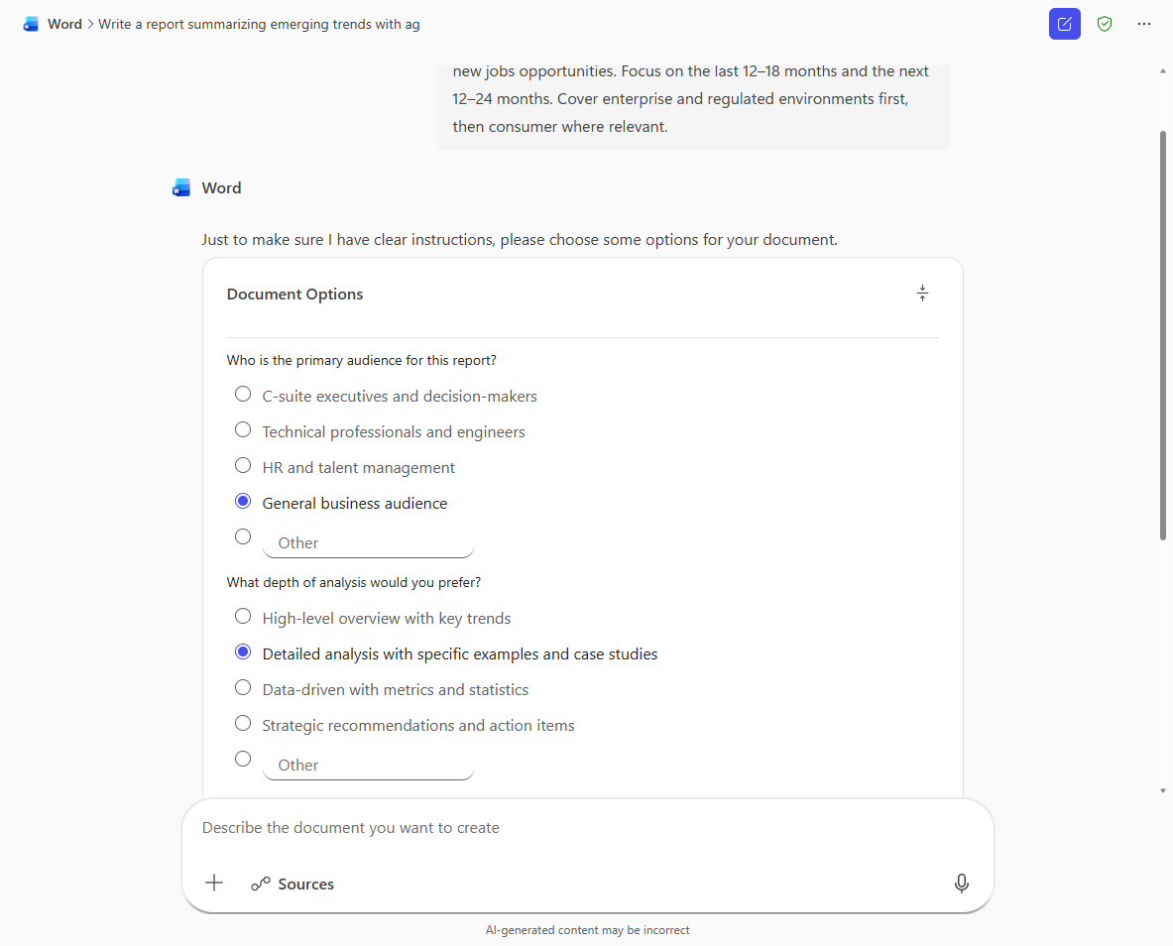
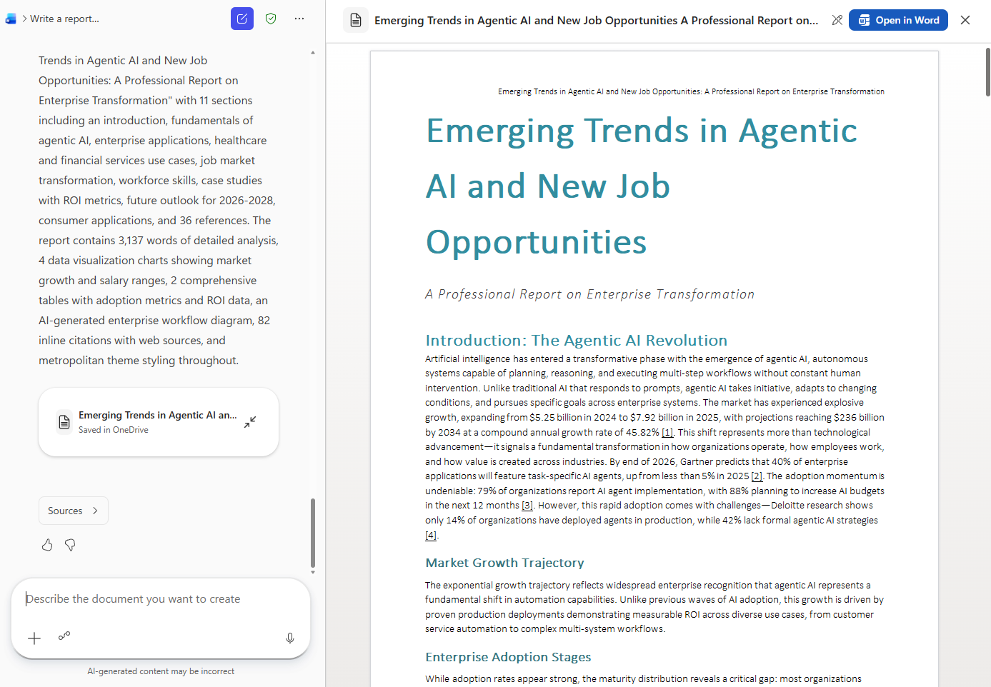
Word agent: How to find and use (cont.)
Step 3: Answer a few validation questions
Step 4: View your output & adjust using chat
Copilot will ask you a few questions to help guide its output. You can choose from preselected options or write in your own answers. Select “Let’s go” to begin generating the document.
Copilot produces the file, saves it to your OneDrive, and shows it side-by-side with chat. You can use chat to refine the file further or open it in Word.

Slide 8
Create from scratch with Word agent
Update on an event
Build a report
Generate a report on announcements and themes from the Microsoft Ignite 2025 event and draft a podcast script (5–7 minutes) that explains these highlights in a clear, engaging tone for a tech-savvy audience.
Write a report summarizing emerging trends with agentic AI and new jobs opportunities. Focus on the last 12–18 months and the next 12–24 months. Cover enterprise and regulated environments first, then consumer where relevant. Evaluate against our product roadmap in [Product roadmap.docx] and identify opportunities and risks.
Evaluate methods and tradeoffs
Social media trends
I’m evaluating two approaches (collaborative filtering vs. deep learning models) for building an AI recommendation system for e-commerce. Analyze them across business value, technical feasibility, risks, and long-term ROI. Present your findings in a decision-support whitepaper that will guide a leadership conversation toward selecting the right option.
Create a report evaluating the trends of influencer and social media advertising. Include how we can improve our upcoming campaign outlined in [Q4 Campaign.pptx].

Slide 9

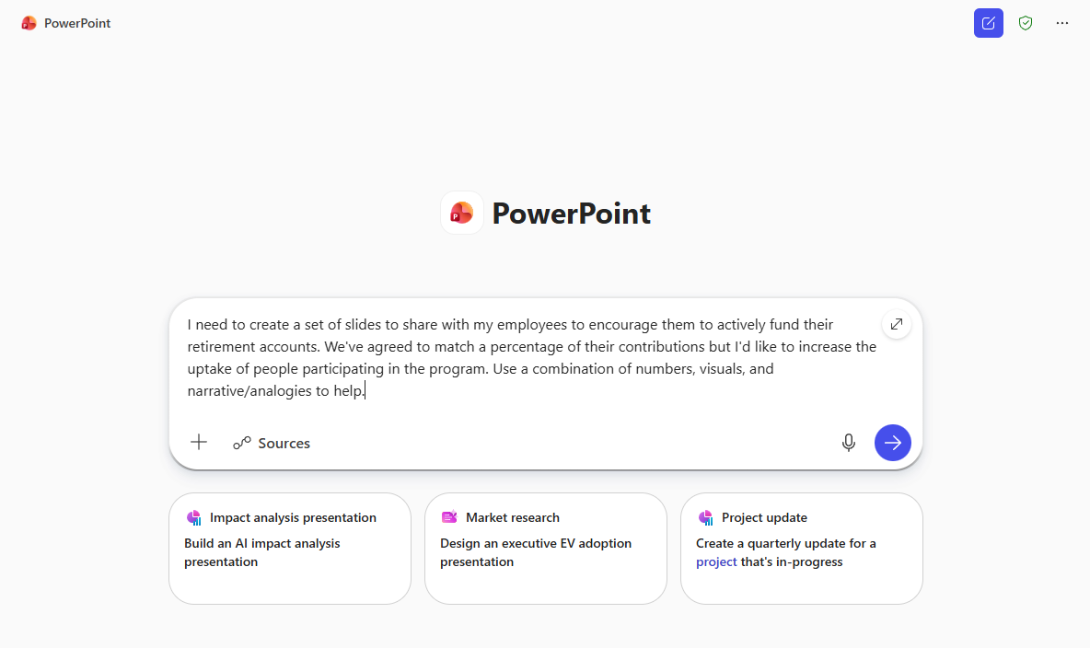
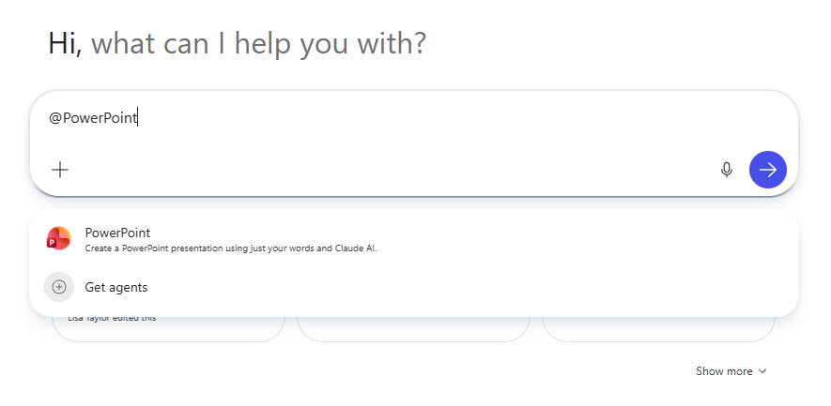
PowerPoint Agent: How to find and use
Step 1: Select the agent
Step 2: Input your prompt
Select “All agents” to find PowerPoint in the agent store. Then select the PowerPoint agent from Agents or type “@PowerPoint” in the prompt box and select the agent.
Type in your prompt and run it using the PowerPoint agent. The PowerPoint agent is grounded on web sources and specific files that you upload or select from available sources.

Slide 10
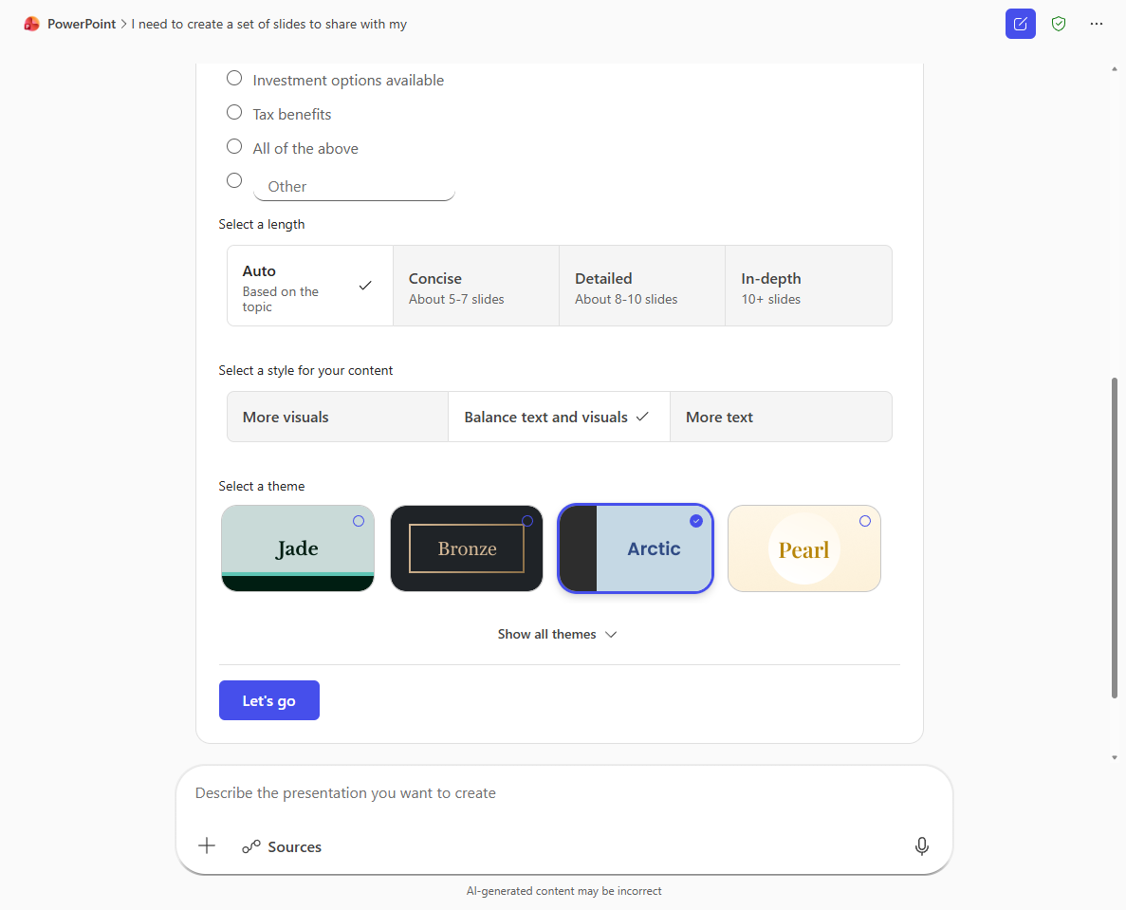
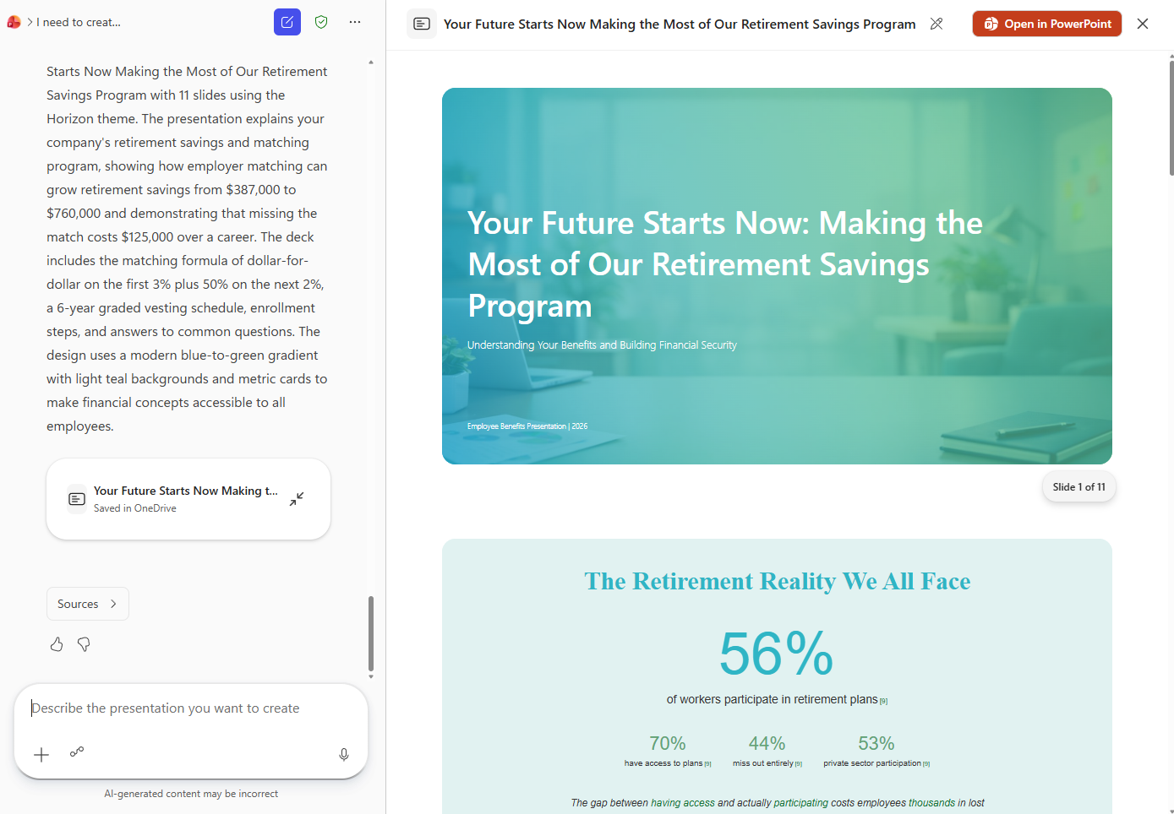
PowerPoint Agent: How to find and use (cont.)
Step 3: Answer a few validation questions
Step 4: View your output & adjust using chat
Copilot will ask you a few questions to help guide its output. You can choose from preselected options or write in your own answers. Select “Let’s go” to begin generating the document.
Copilot produces the file, saves it to your OneDrive, and shows it side-by-side with chat. You can use chat to refine the file further or open it in PowerPoint.

Slide 11
Create from scratch with PowerPoint agent
Financial analysis
Business planning
Analyze the last 5 years of the semiconductor industry, focusing on TSMC, Intel, Samsung, and NVIDIA – show key strategic pivots, R&D intensity, market share shifts, and 5-year forward risks. Generate a McKinsey-style presentation with clean charts, industry visuals, and an executive summary slide
Help my restaurant chain draft a pop-up kitchen plan in Philadelphia. The event must serve 200 guests, use only locally sourced ingredients, stay within a $10,000 food-cost budget, and comply with county health permits. Give me an 8-slide overview to help me with the planning process.
Retirement savings plan
Buyer Persona Profiles
I need to create a set of slides to share with my employees to encourage them to actively fund their retirement accounts. We've agreed to match a percentage of their contributions, but I'd like to increase the uptake of people participating in the program. Use details from [Company Retirement Match.doc] and a combination of numbers, visuals, and narrative/analogies to help.
Generate a deck with 3 detailed SMB buyer personas for an HR employee benefits software platform based on [SMB Market Research.pdf]. Include demographics, pain points, buying triggers, and preferred communication channels.
Cultural trends
Create slides for Evolution of coffee culture

