Slide 1


Slide 2

Agenda
What is Microsoft Baseline Security Mode
Overview
Setting breakdown
Demo

Slide 3
Microsoft Baseline Security Mode (MBSM)
Ability to apply a unified security baseline to Microsoft’s Office, SharePoint, Exchange, Teams, Entra and other 1P workloads effectively closing known vulnerabilities, reducing risk from attackers.
What
V1 - GA announced at Ignite’25 V2 - In development - includes Intune, Purview, Dynamics 365 – Preview at the M365 Conf, April ’26
When
Key capabilities
Tailored baseline recommendations.
Apply low impact settings in bulk.
Single entry point in the M365 Admin Center
Understand impact before rollout.
Apply exclusions where needed.
Value
Rely on Microsoft’s baseline to reduce risk quickly
Immediately make your tenant immune to known vulnerabilities in Microsoft 365
Safely adopt protections with built-in change management

Slide 4
Overview
Files
Open ancient legacy formats in Protected View and disallow Editing
Open old Legacy formats in Protected View and allow Editing
Block ActiveX controls (WXPV) *
Block OLE Graph and OrgChart objects
Dynamic data Exchange (DDE) server launch is blocked in Excel
Office & ODSP
Block FTP, HTTP, FPRPC
Block Basic Auth
ODSP Auth Protocols – Block RPS / IDCRL
ODSP Web Security - Block new scripts injection, Disable access to the SP store UX.
Substrate – EWS deprecation
Entra\ Admin – Phishing resistant Auth *
Entra\ User – Block legacy Auth *
Entra\ apps – block use of passwords and limit end user consent to M365 certified and single tenant apps *
Authentication
Room Devices
Only allow endpoint managed, compliant devices to sign in
Block resource account sign in to M365 clients
Remove resource account access to M365 assets post meeting/collaboration
*Settings that allow exclusion, 10% allowed
Notes:
https://learn.microsoft.com/en-us/microsoft-365/baseline-security-mode/open-ancient-legacy-formats-protected-view-disallow-editing?view=o365-worldwide
Ancient legacy formats:
Word 2 and earlier binary documents
Word 6.0 binary documents
Word 95 binary documents
Excel 2, 3, 4 Macrosheets and add-in files
Excel 2, 3, 4 worksheets
Excel 4 workbooks
Old legacy formats:
Word 2007 and later Binary Documents and Templates
Word 2003 Binary Documents and Templates
Word 2003 and Plain XML Documents
Word XP Binary Documents and Templates
Word 2000 Binary Documents and Templates
Word 97 Binary Documents and Templates
Legacy Converters for Word
PowerPoint 97-2003 Presentations, Shows, Templates, and Add-in Files
Legacy Converters for PowerPoint
Excel 97-2003 Add-in Files
Excel 97-2003 Workbooks and Templates
Excel 95-97 Workbooks and Templates
Excel 95 Workbooks
Legacy Converters for Excel

Slide 5
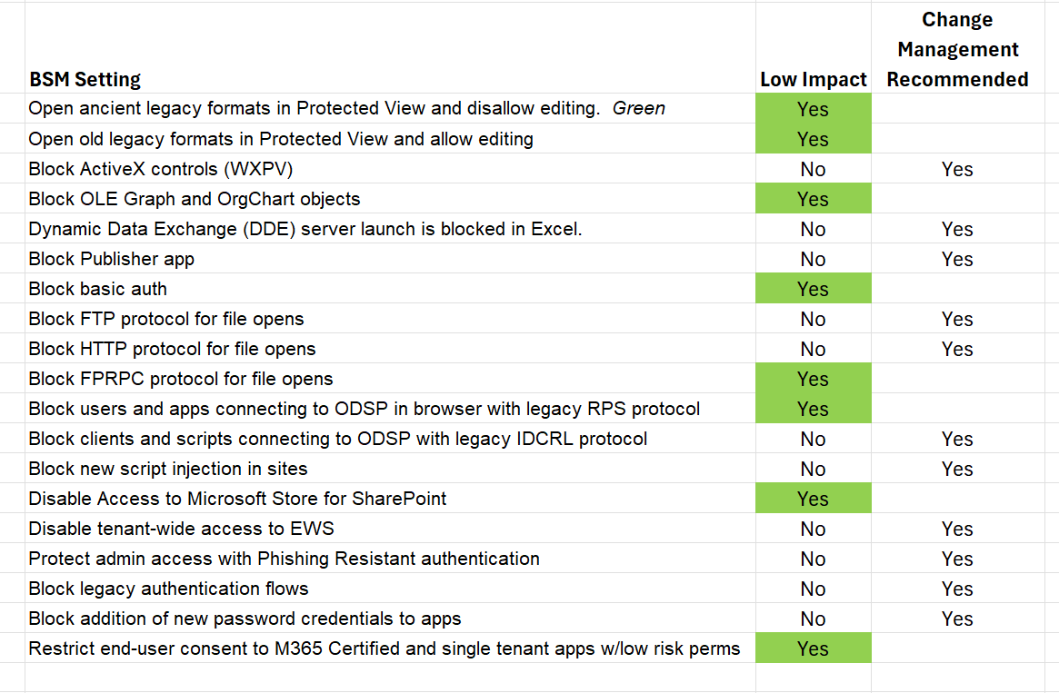

Slide 6

Demo

Slide 7
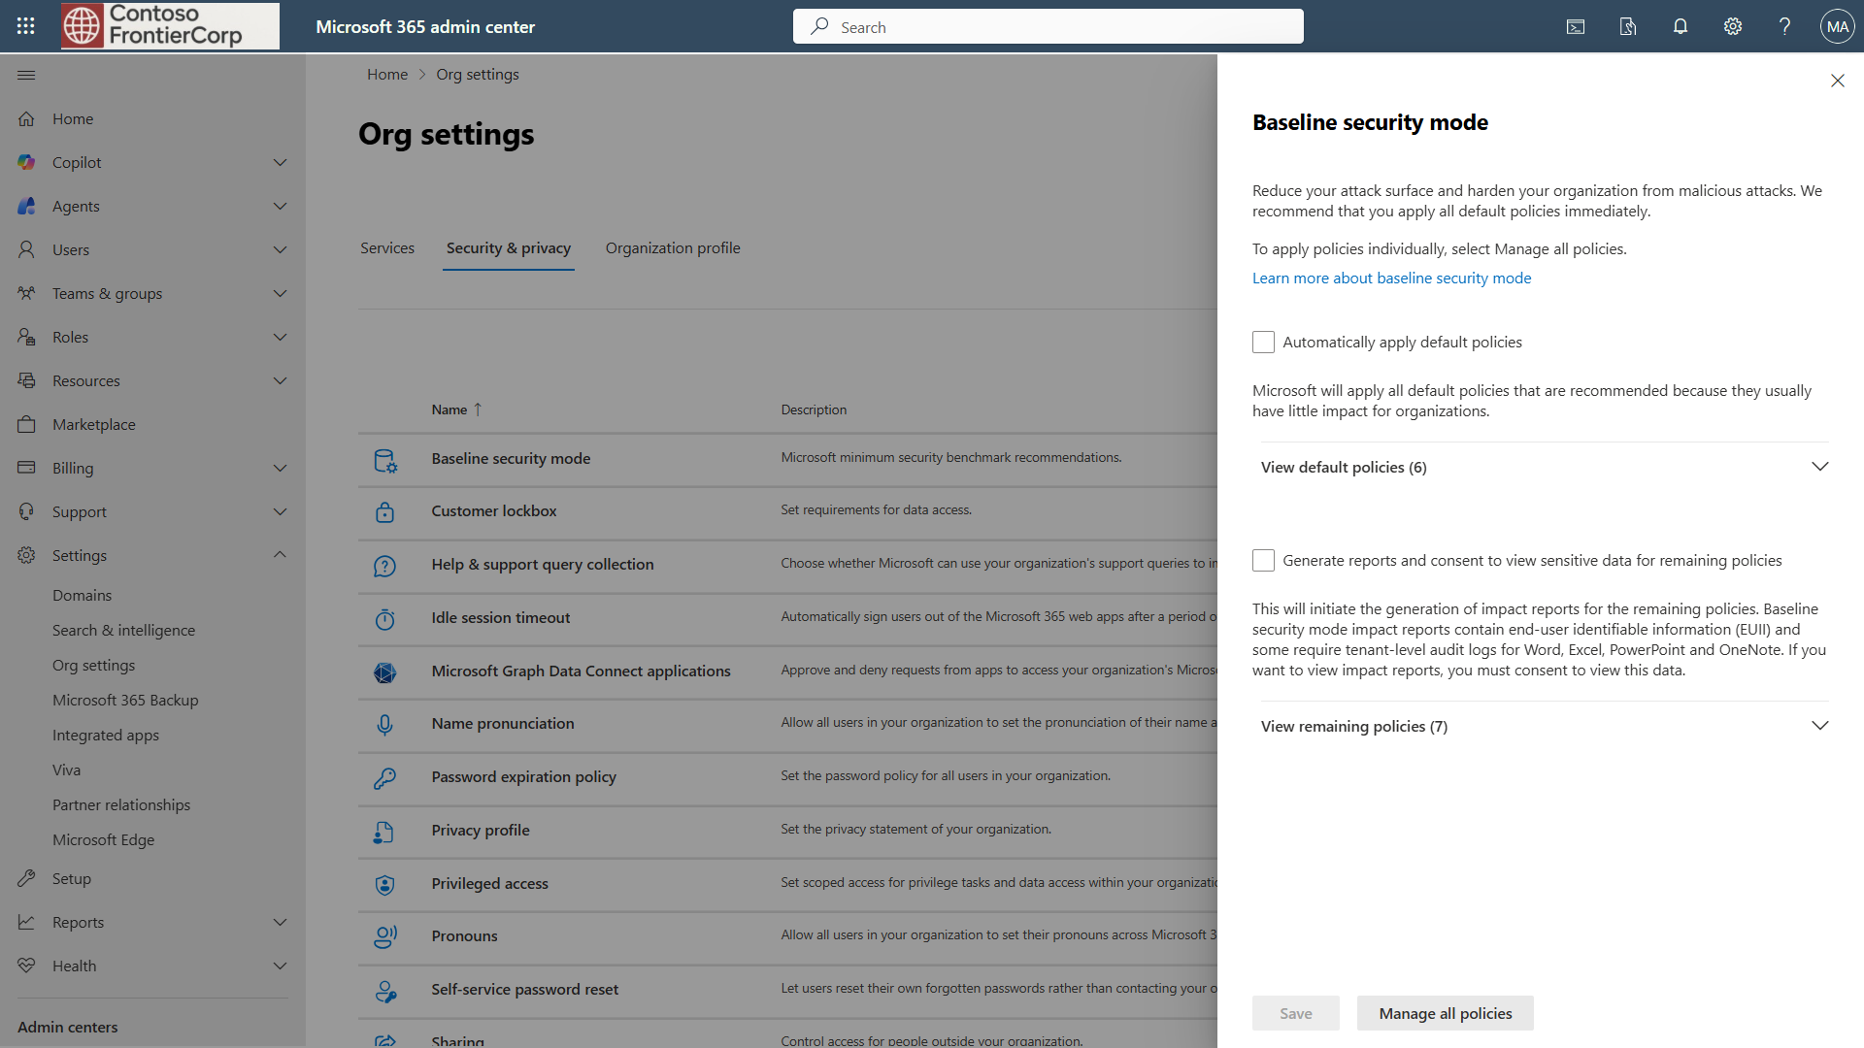

Slide 8
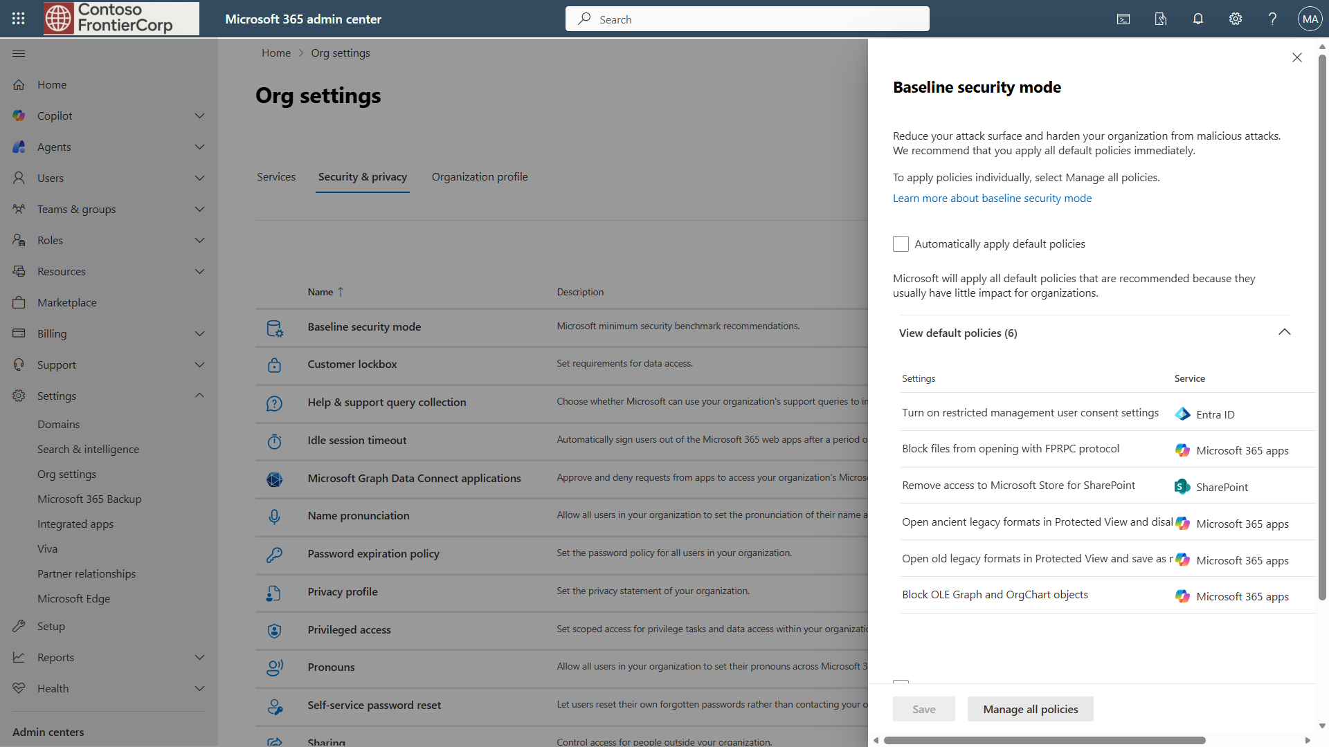

Slide 9
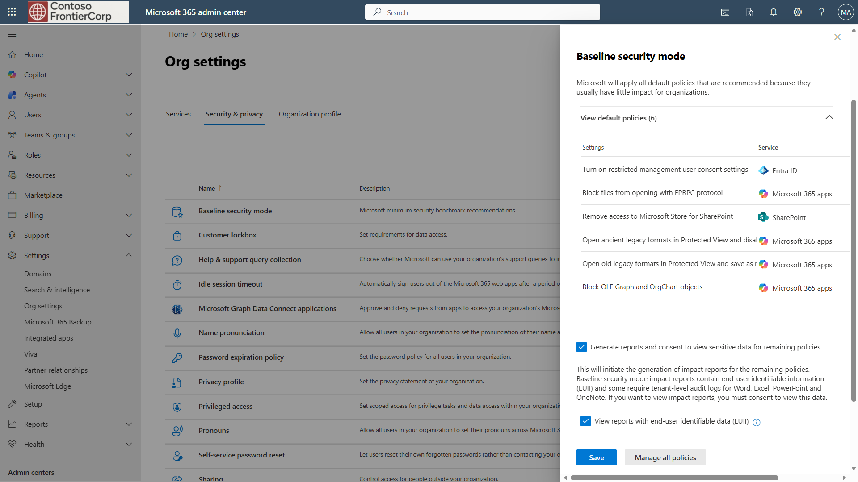

Slide 10
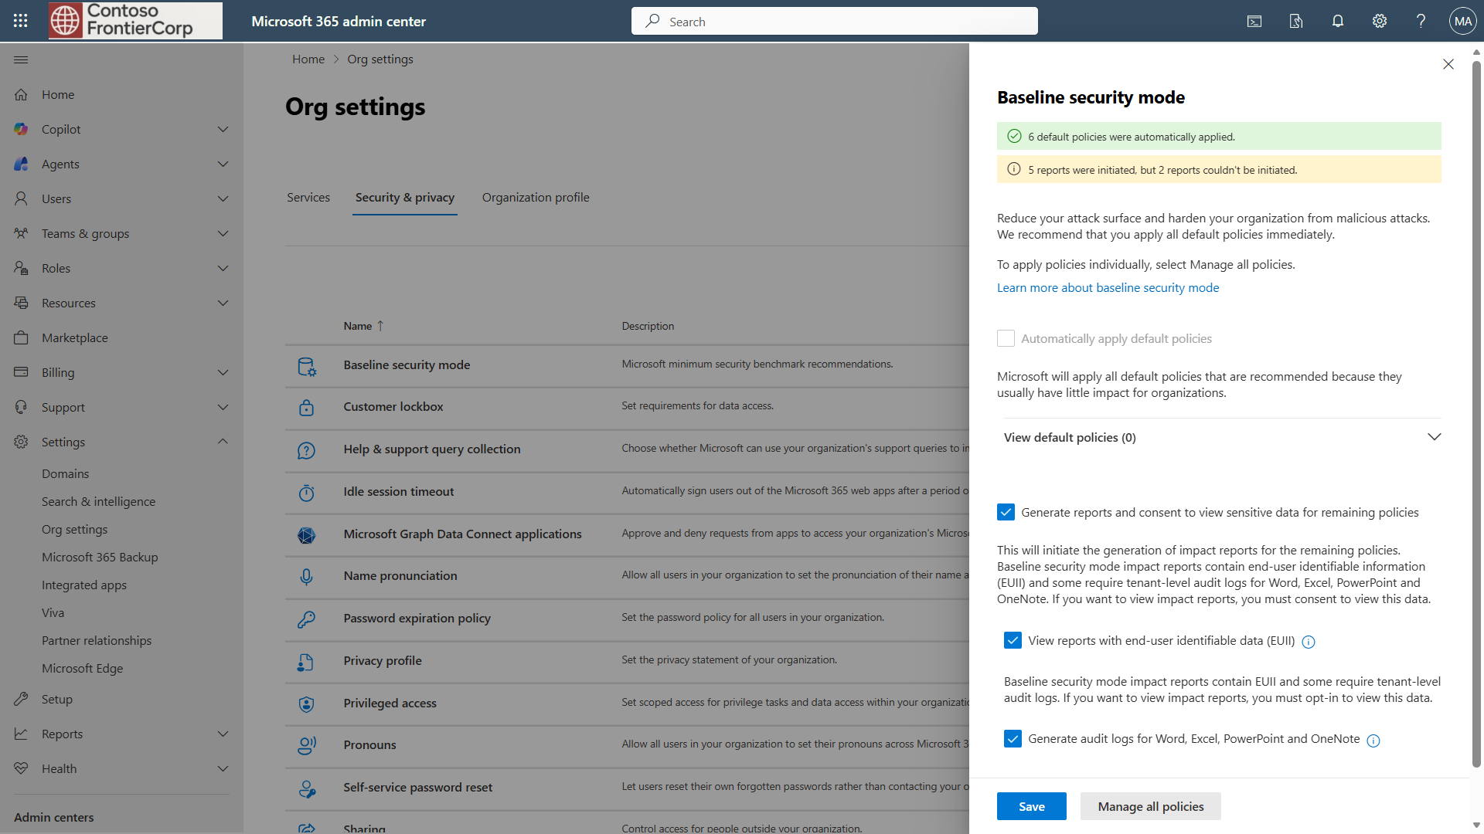

Slide 11
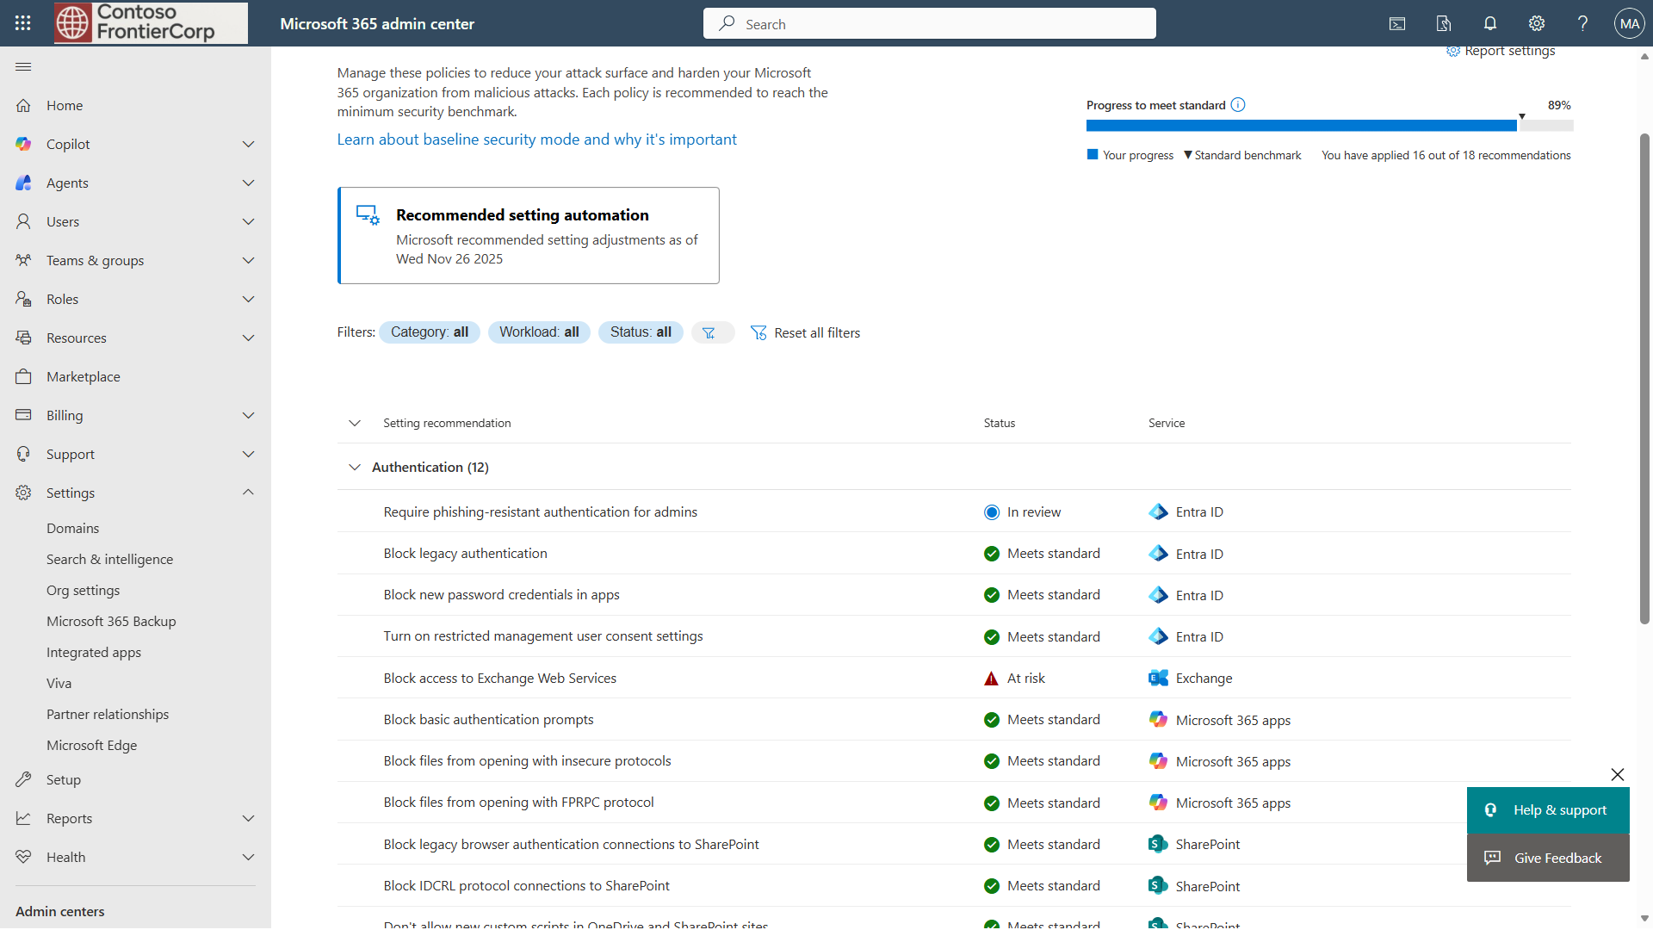

Slide 12


Slide 13
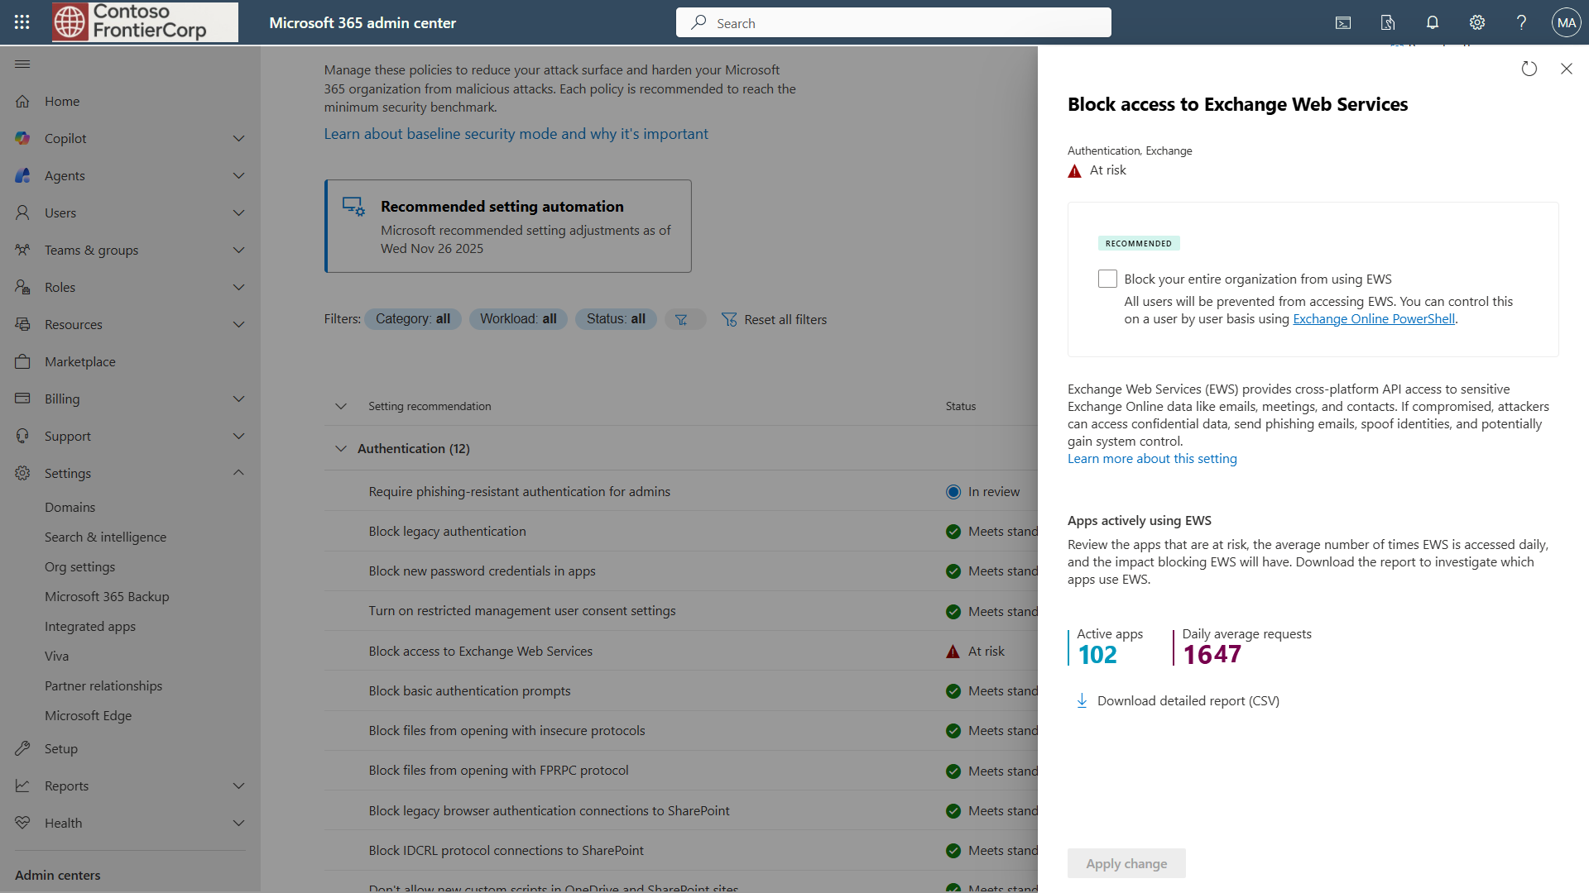


Slide 14
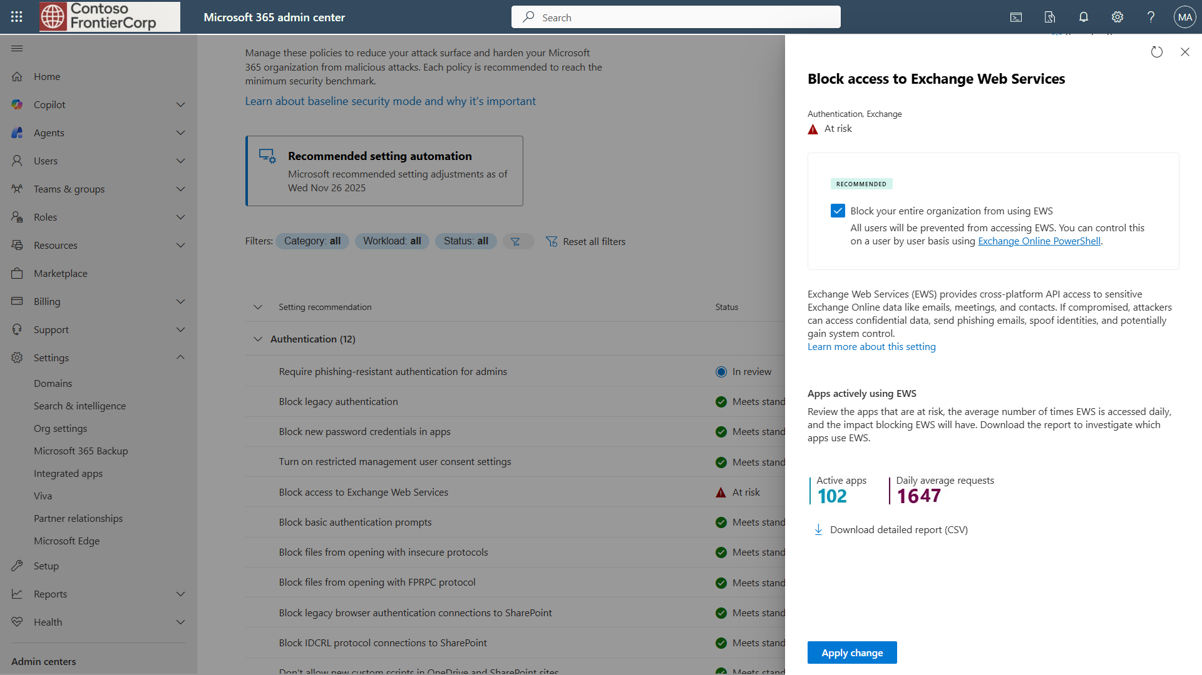

Slide 15
