Slide 1




IT management and security in the AI era
Secure Microsoft 365 Copilot and Agents against data loss
Erica Toelle
Sophie Ke

Slide 2


What is Data loss?
DLP for Copilot prompt
Agenda
Demos
Resources

Slide 3
Protect against data loss
What is data loss?
What causes data loss?
Data loss may occur without Copilot use. The productivity benefits of these tools create opportunities for these risks to happen with less effort
Copilot creates documents that aren’t protected by default, because the inputs weren’t protected
Data loss is when unsafe or inappropriate sharing, transfer, or use of sensitive content occurs
Using Copilot to access or summarize sensitive data in a way that violates usage guidelines

Slide 4

Prevent data loss and insider risks: how Purview helps today
Get alerts and reports of risky behavior and AI use
Govern how Copilot can interact with sensitive data
Dynamically apply security policies based on risky actions
Data Security Posture Management
View reports and insights about sensitive data use in Copilot
See the text of Copilot prompts, responses, search queries, and data referenced
DLP for M365 Copilot
Prevent Copilot from processing sensitive files
Insider Risk Management
Identify patterns of risky behavior using AI
Automatically add users to stricter security policies until investigated
Microsoft Purview
Have control over how Copilot interacts with your sensitive data
Notes:
So how can organizations get ahead of their data security challenges.
They need to understand hidden risks to their data – this starts with getting visibility into what data you have, where it is located, how your users are interacting with that data, what activities are happening in your organization. Without this visibility, you will not be able to effectively protect the data.
Once you have that visibility into data risks, you can implement multiple layers of controls – you need to combine that data context with the user context so that you can create effective data loss prevention policies across the digital landscape. Remember – there is no one size fits all – and that applies to your DLP policies as well. We hear from customers that they scope their DLP policies to most users and therefore only run them in audit mode, since they do not want to impede user productivity. Such a strategy, prevents the organization from being proactive and keeps in the reactionary stage.
And finally, if and when a data security incident happens, you need to be able to quickly investigate and remediate the incident and put policies in place to prevent similar incidents from happening in the future.

Slide 5


Data Loss Prevention for Microsoft 365 Copilot + Agents
Blocked
A file or email referenced in the prompt has a sensitivity label blocked by a DLP for Copilot policy
Microsoft Graph grounding
M365 Copilot or Chat response
Prompt sent to M365 Copilot or Copilot Chat
Displays “this request cannot be processed due to company policies” message
Bing web grounding

Slide 6
What we heard from you
1
2
3
Concerns that sensitive data may be sent to Bing for web grounding
When sensitive information is typed into a prompt, Copilot should detect it and not generate a response or proceed with any grounding
When any admin defined keywords are typed into a prompt, Copilot should detect it and not generate a response or proceed with any grounding

Slide 7
Microsoft Purview Data Loss Prevention for Microsoft 365 Copilot to safeguard prompts
Included for all users of Microsoft 365 Copilot and Copilot Chat
Now in Public preview

Slide 8
DLP for M365 Copilot prompts data flow
Blocked
Copilot Safety Check:
If contains a Purview sensitive information type = Yes
Microsoft Graph grounding
M365 Copilot or Chat response
Process stops
Prompt sent to M365 Copilot or Copilot Chat
Displays “this request cannot be processed due to company policies” message
Bing web grounding

Slide 9
Demo in the Microsoft 365 Admin Center
Notes:
Now let’s see a demo of what it’s like to turn on Purview DLP for Copilot prompt as an IT/AI Admin.

Slide 10
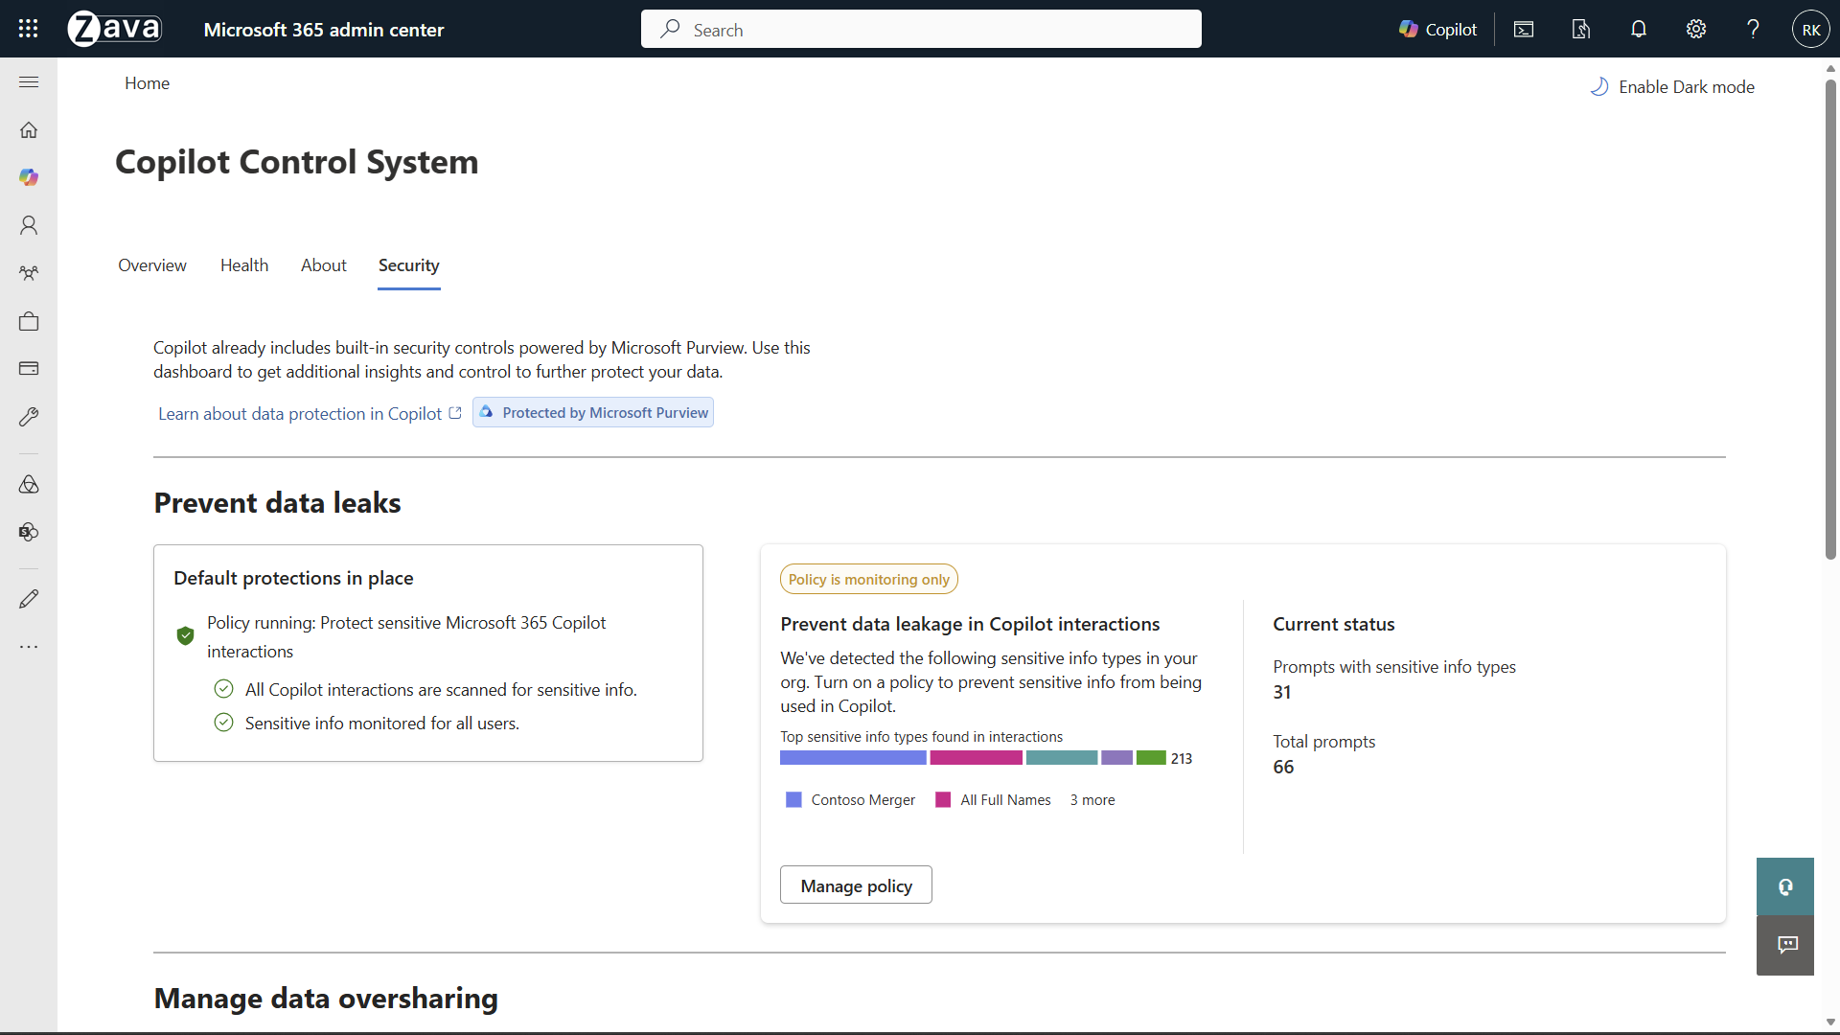

Title slide6
Notes:
As an IT admin, I can now access a brand new Security tab in the Microsoft 365 admin center under Copilot. You can use this dashboard to get additional insights and control to protect your data.
The first item is to help you prevent data leaks, I can see a default policy already in place to protect sensitive Copilot prompts, and that there is a policy to prevent data leak in monitoring only, where it found out of 66 total prompts, 31 contained sensitive information types.
You can go ahead and click Manage policy to learn more.

Slide 11
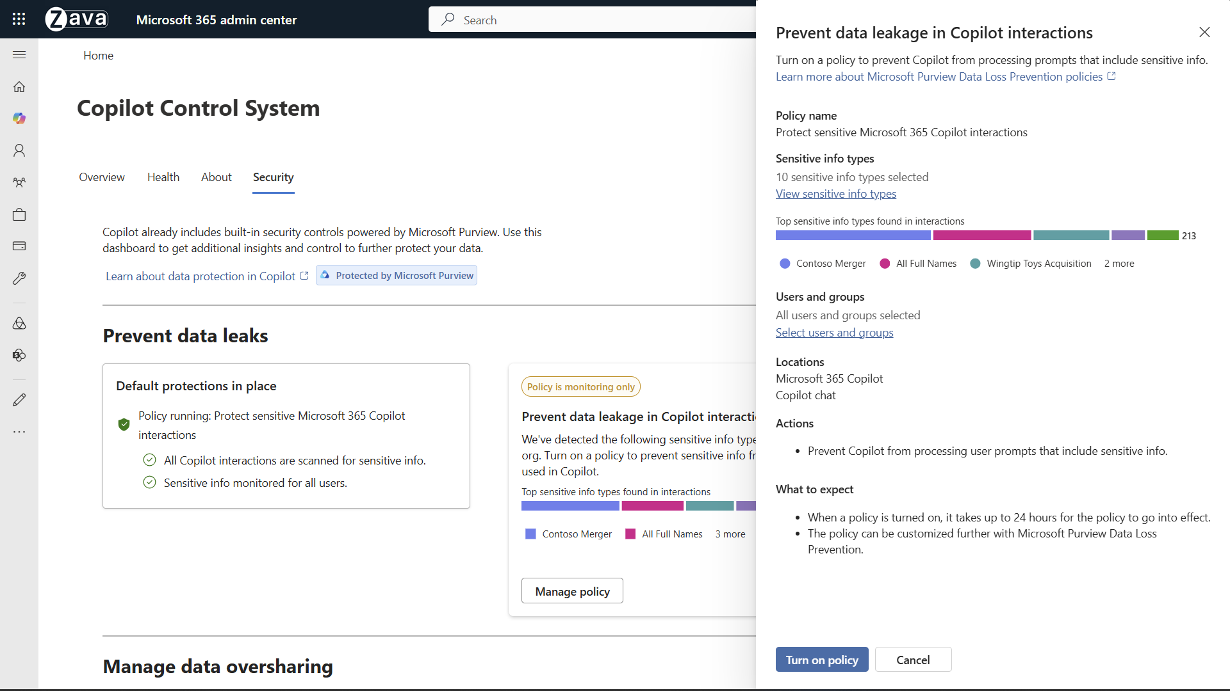
Title slide7
Notes:
A side panel will pop up and show you information about the Purview DLP for Copilot prompt policy, including:
They types of SITs selected.
You can click on view sensitive info types to see them

Slide 12
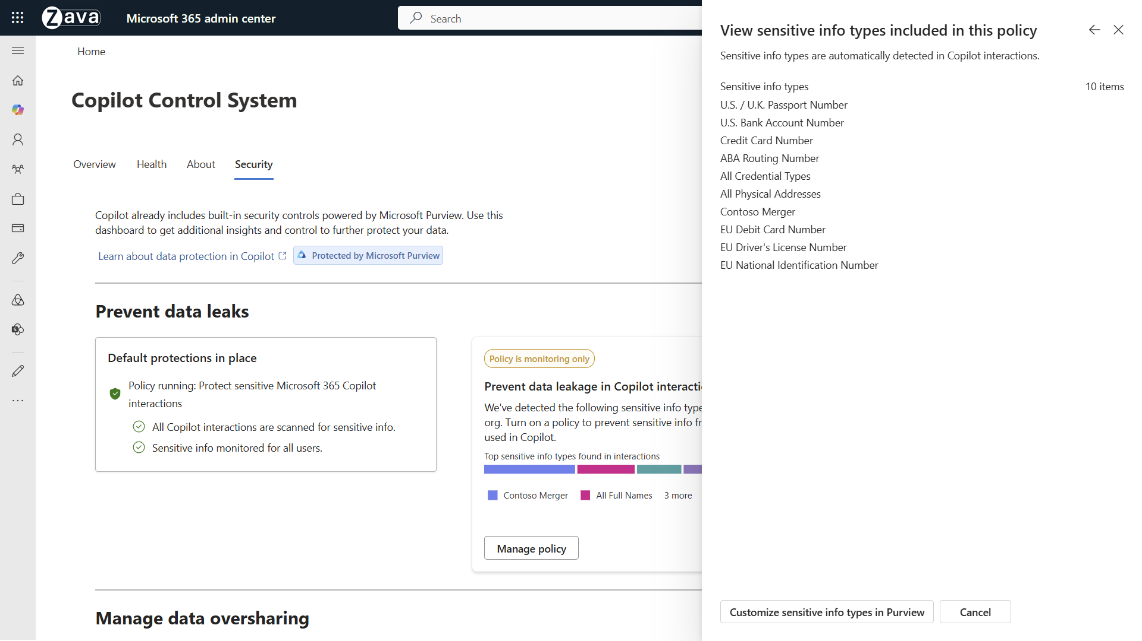
Title slide9
Notes:
Now click back.

Slide 13
Title slide7
Notes:
You can also scope the policy to users and groups by clicking Select users and groups

Slide 14
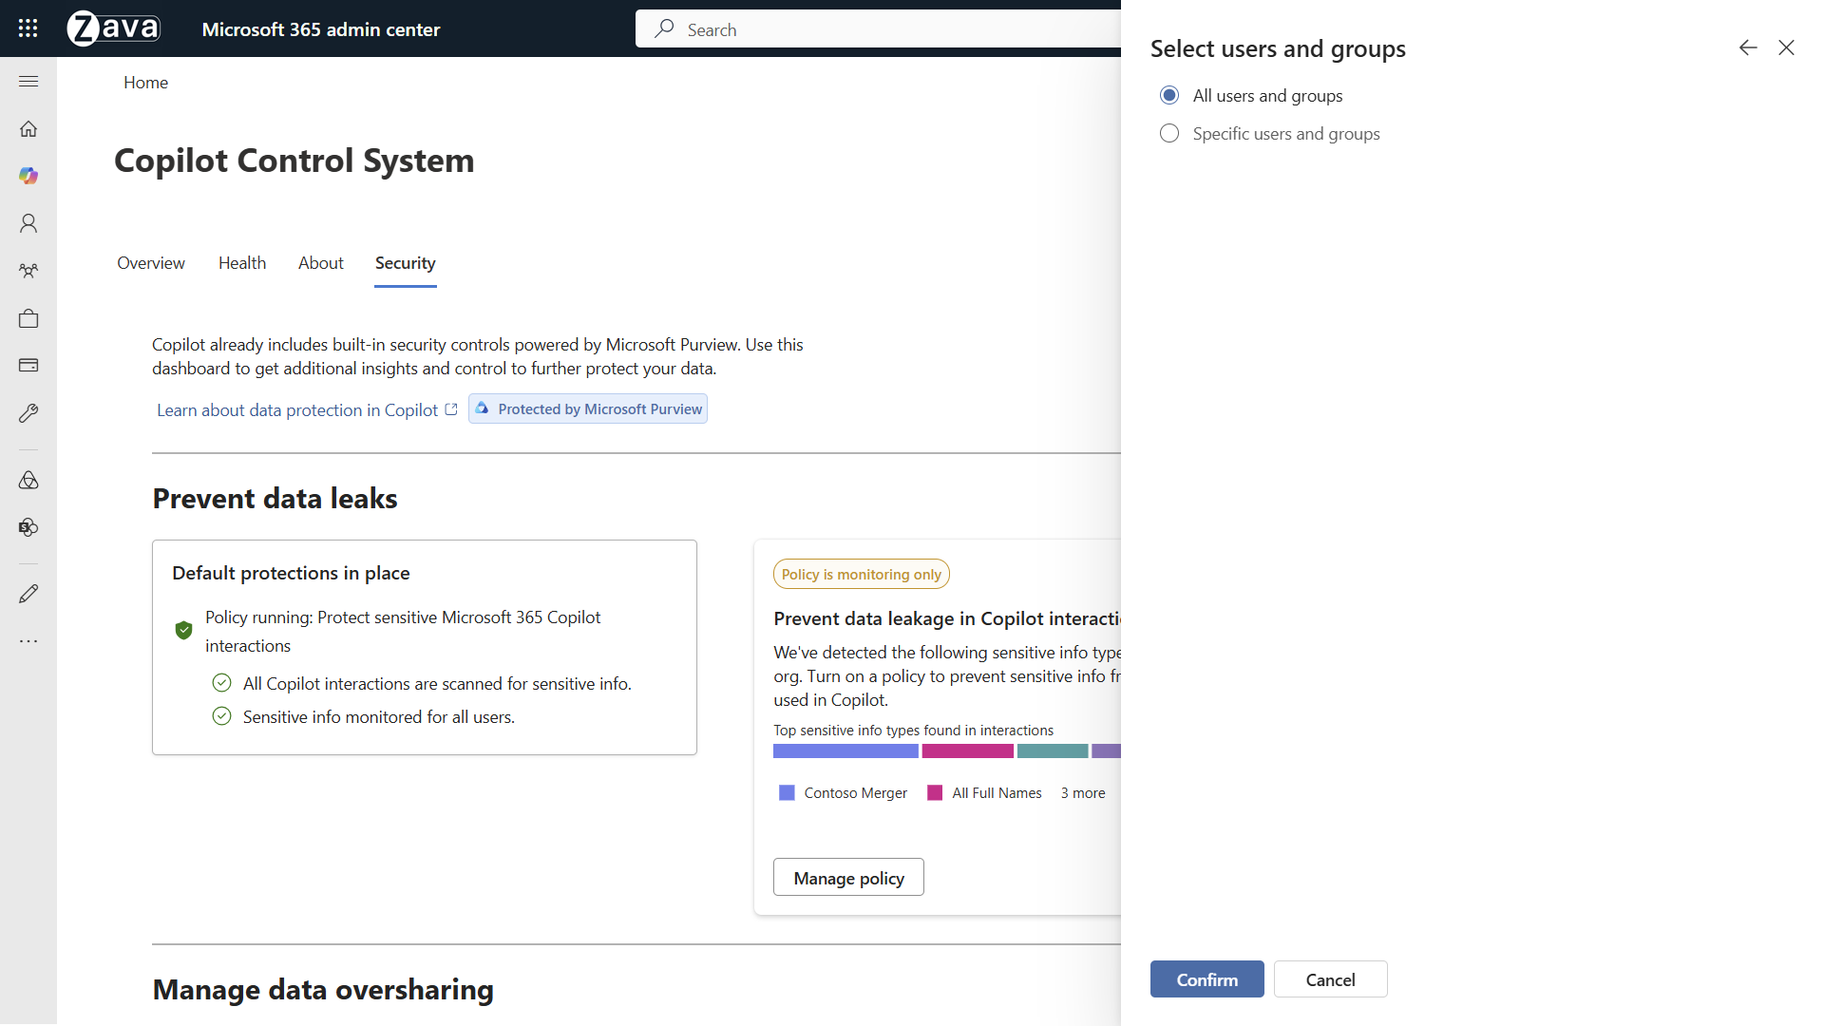
Title
Notes:
Here you can choose all users and groups of specific ones.
Click on confirm when you are done

Slide 15
Title slide7
Notes:
Now you can turn the policy on and start preventing Copilot from responding to prompts containing the specific sensitive info types you selected.

Slide 16
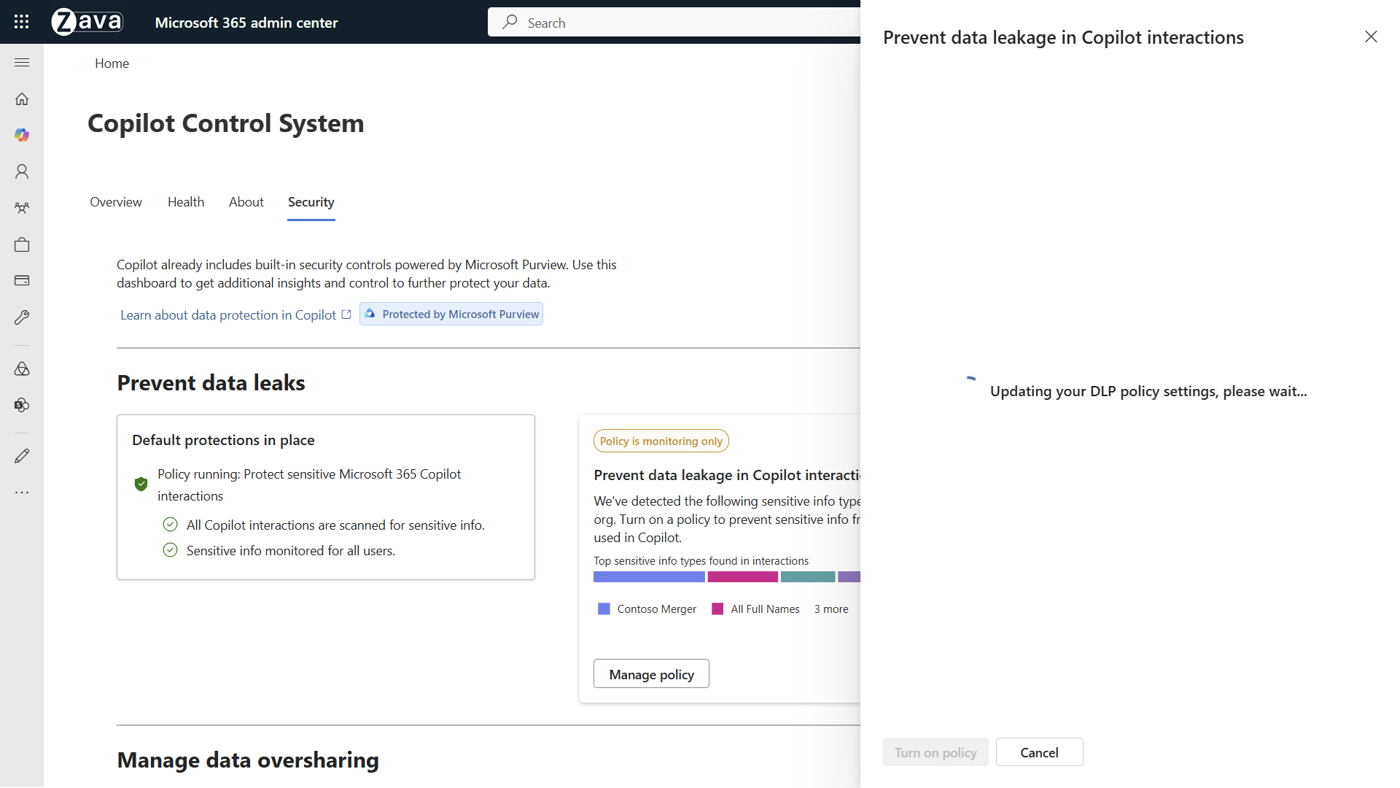
Title

Slide 17
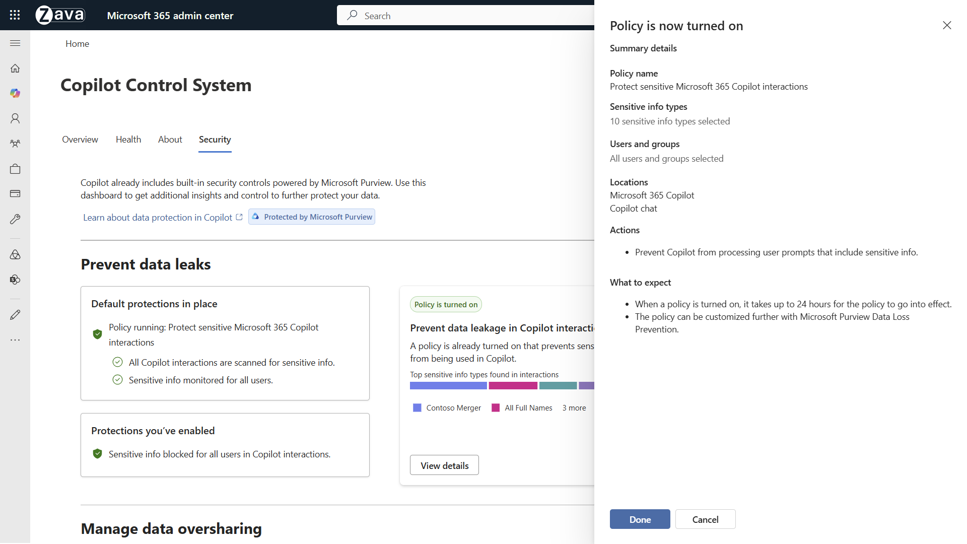
Title slide10
Notes:
Review the summary and click on done

Slide 18
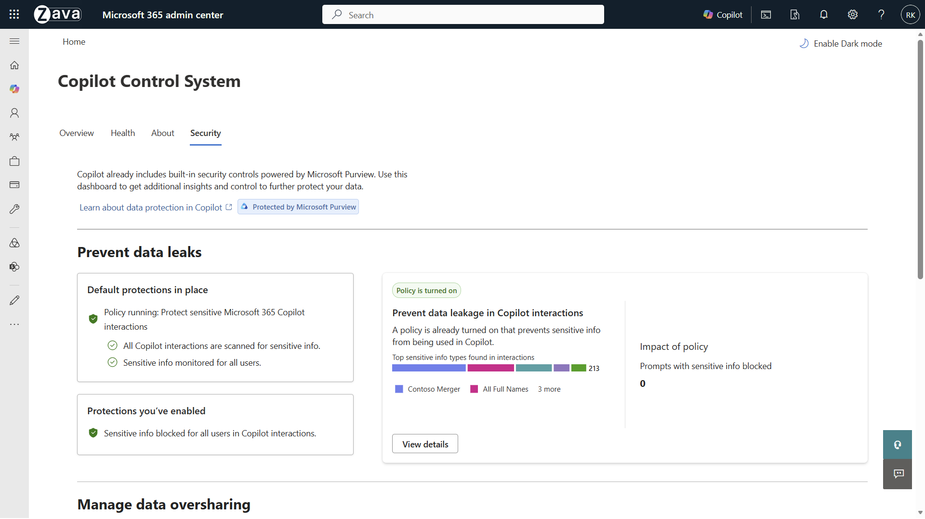
Title
Notes:
Now you will be able to see how many prompts with sensitive info have been blocked.
With that, I will turn it over to Erica to show you the end user experience.

Slide 19
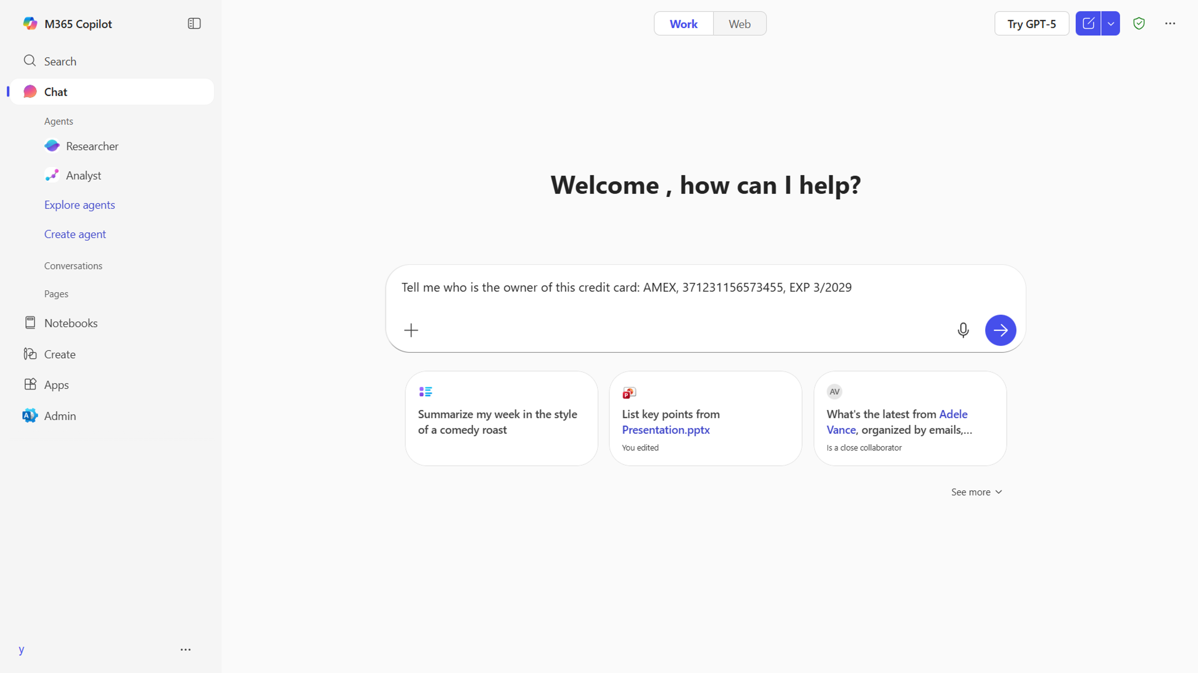
Title

Slide 20
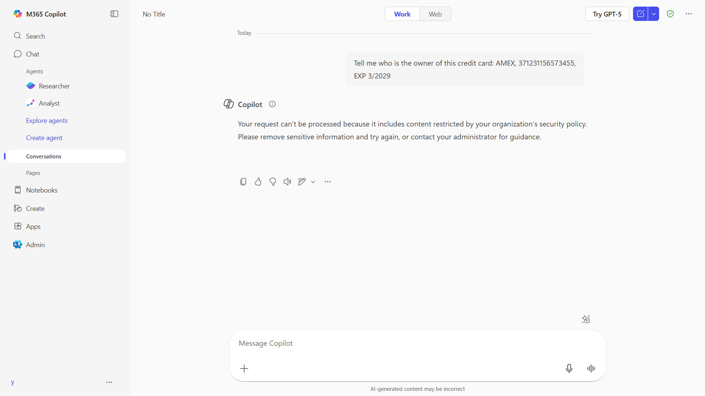
Title

Slide 21
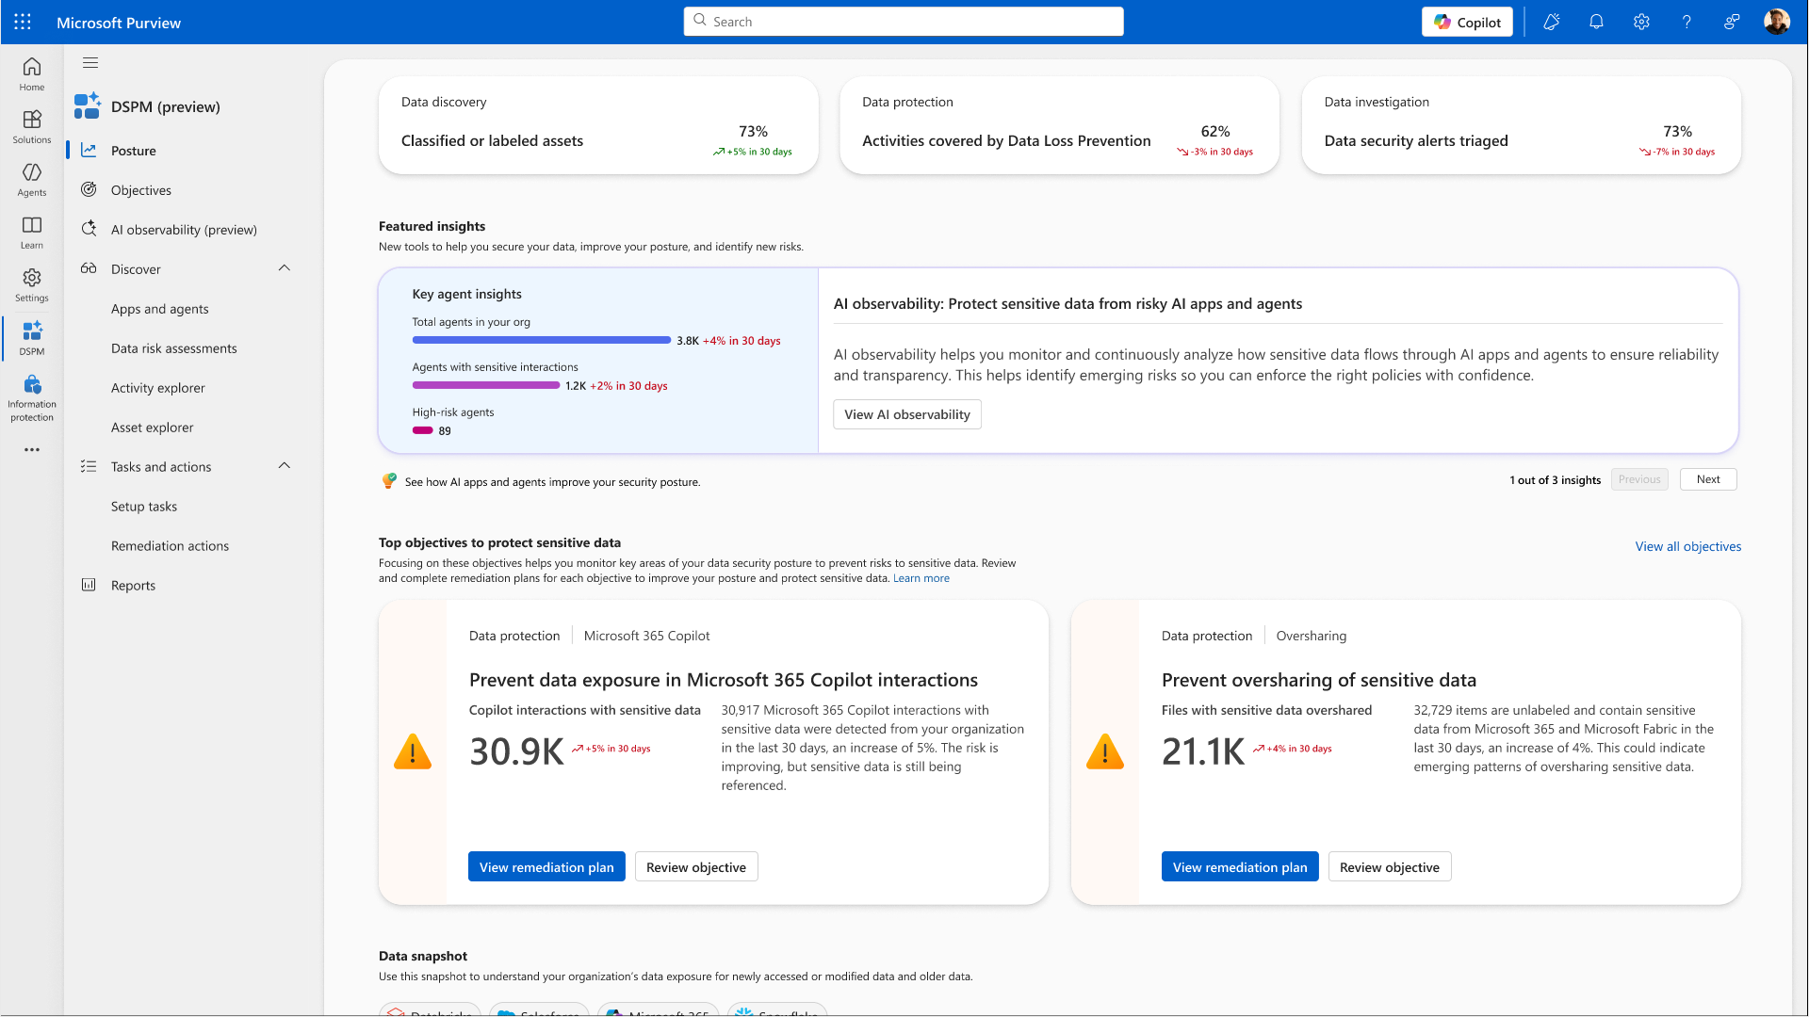
Title

Slide 22
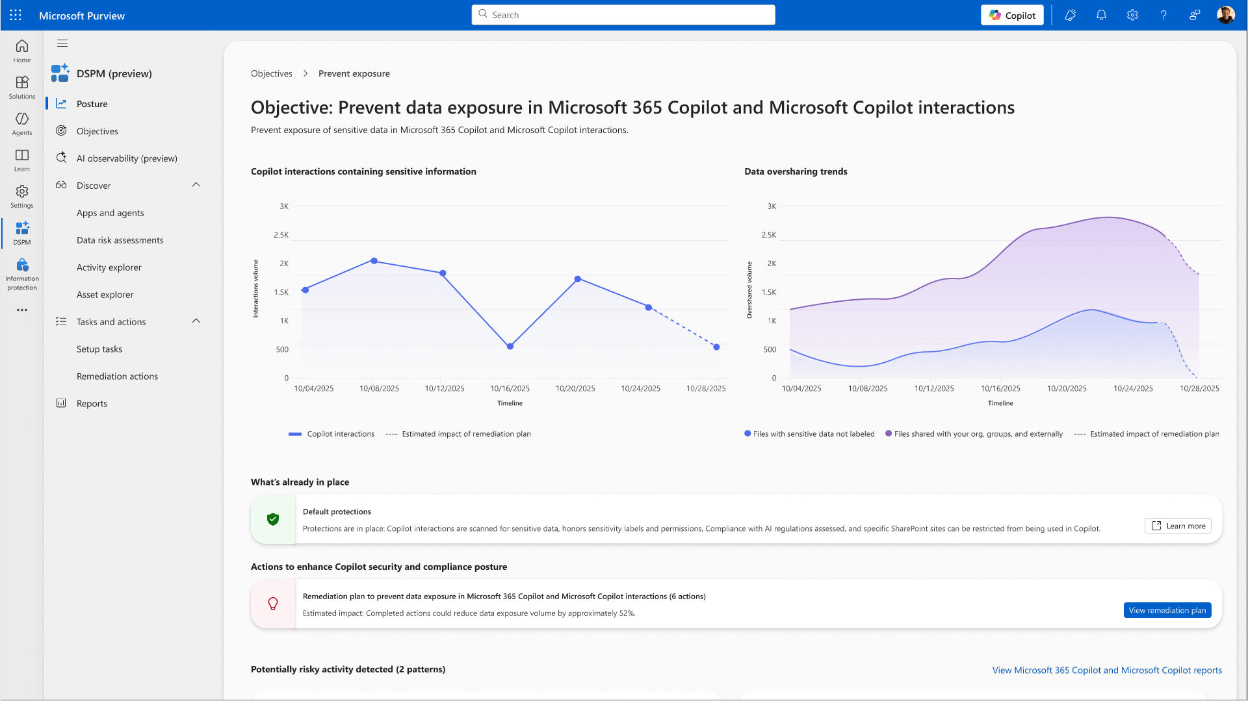
Title

Slide 23
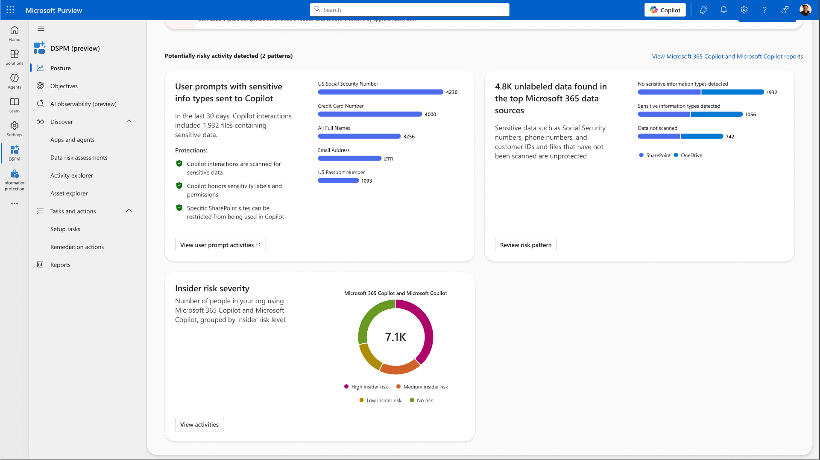
Title

Slide 24
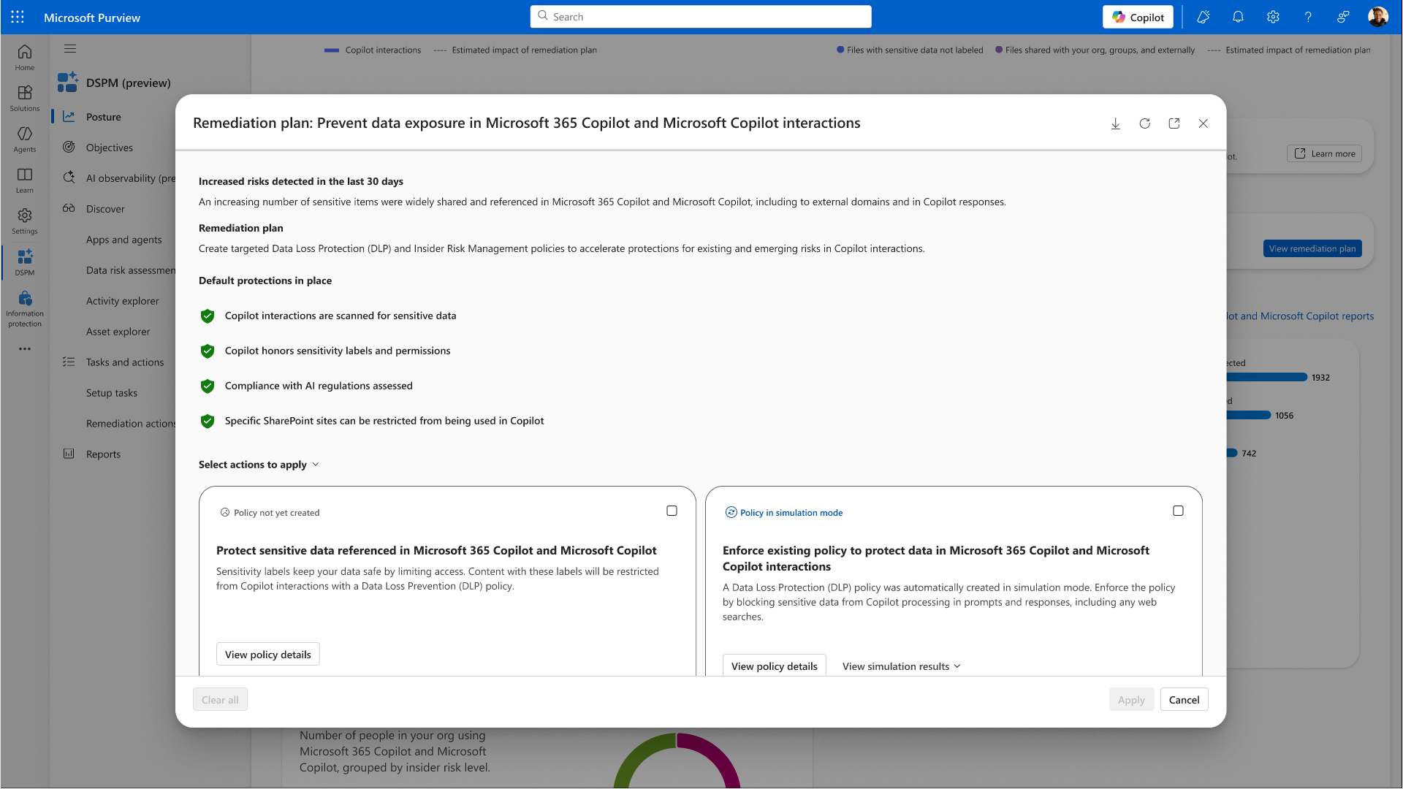
Title

Slide 25
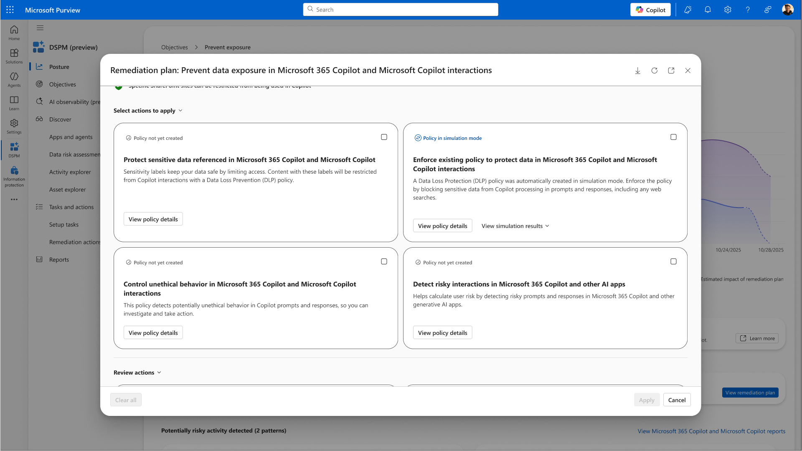
Title

Slide 26
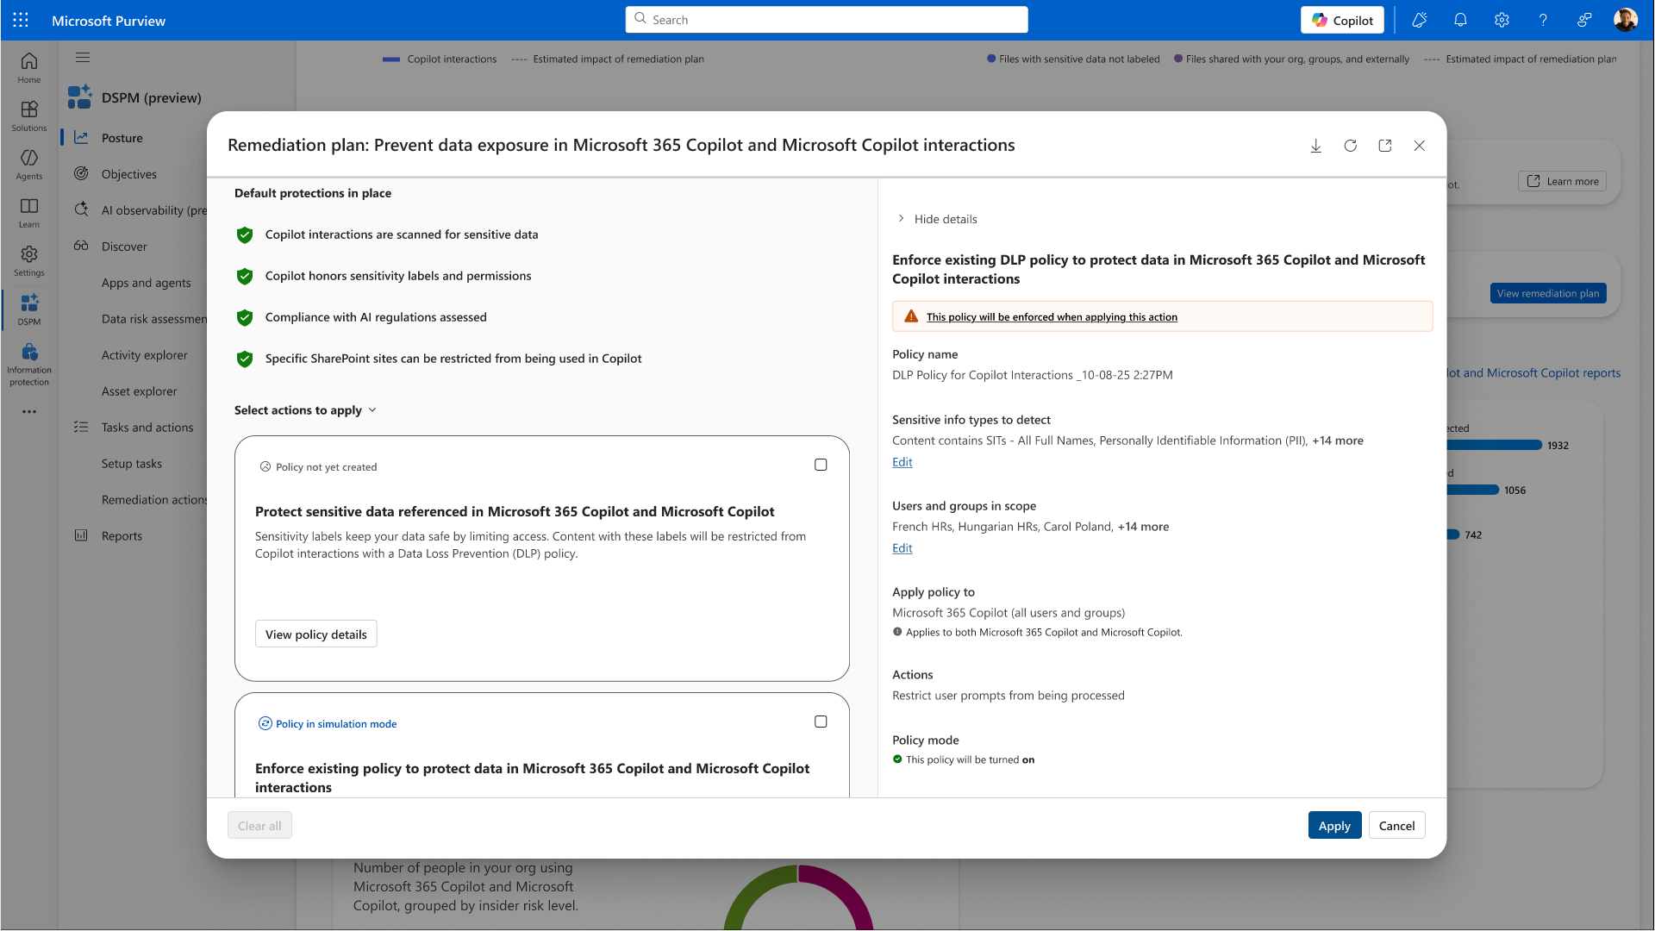
Title

Slide 27
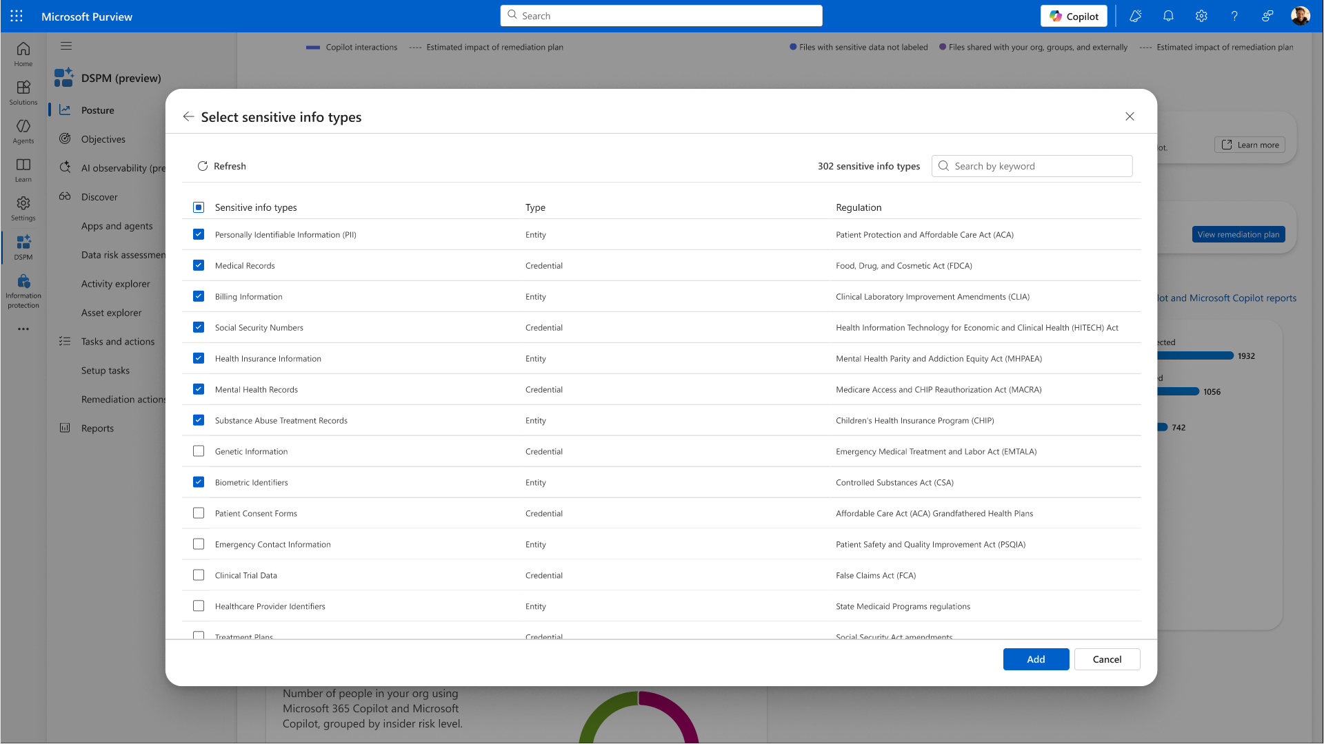
Title

Slide 28
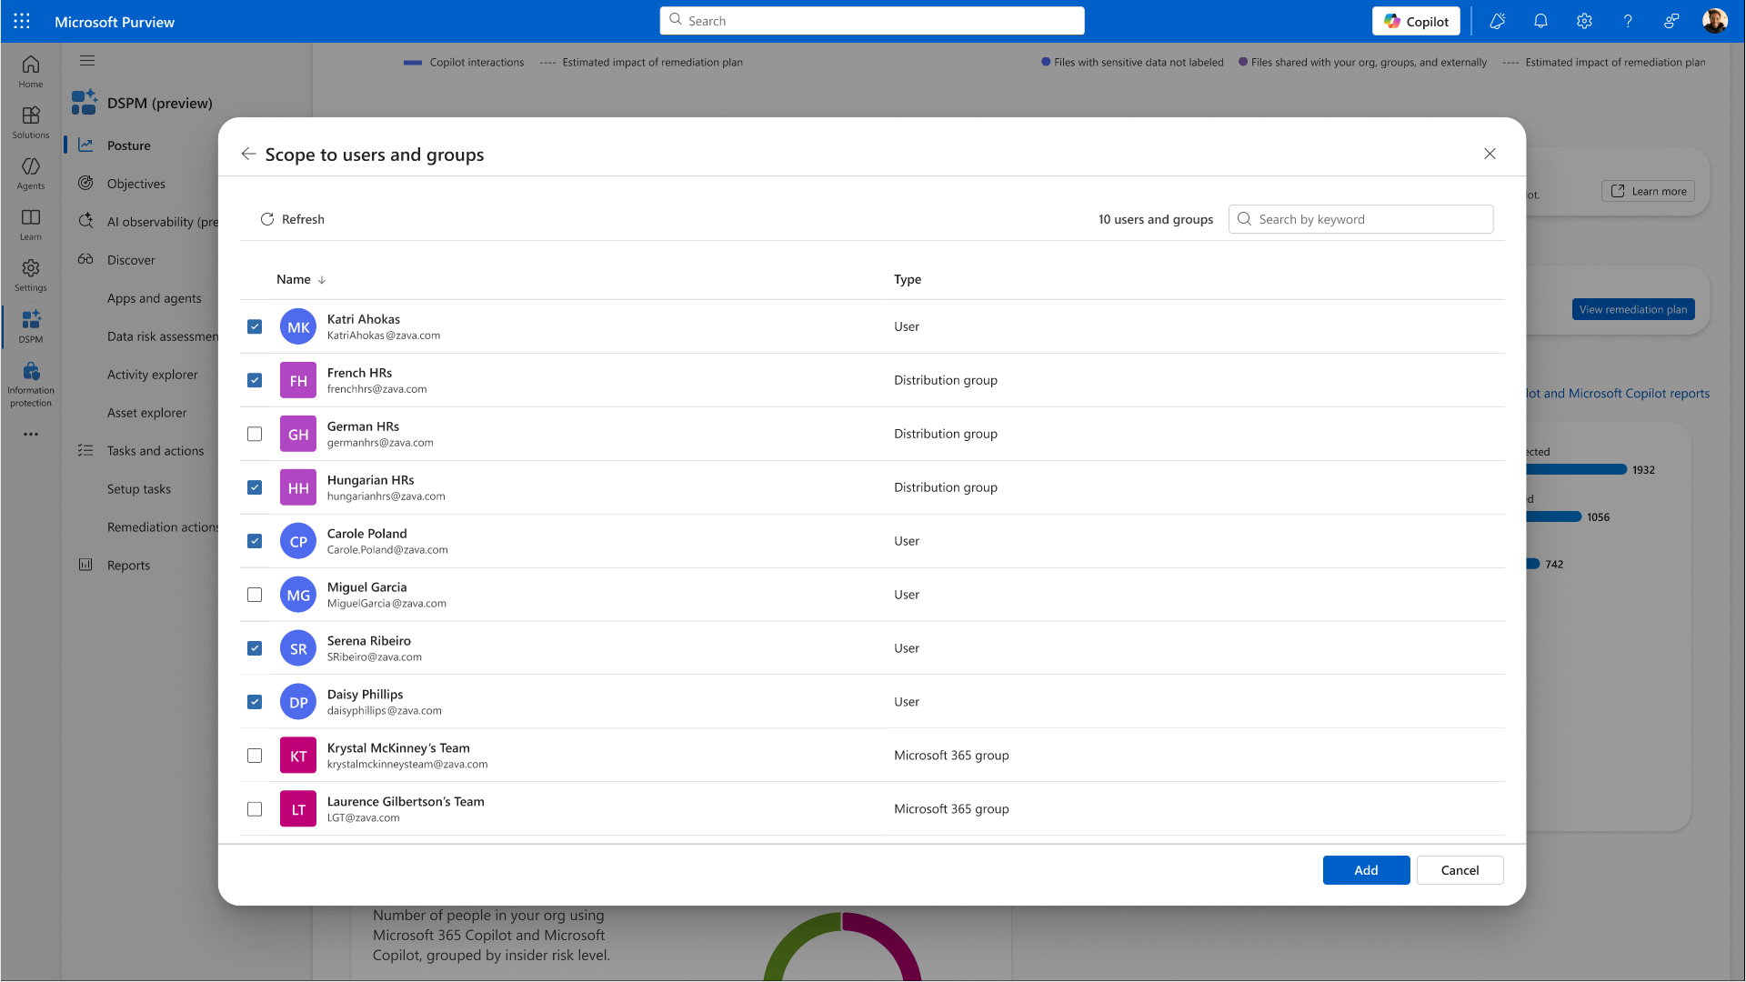
Title

Slide 29
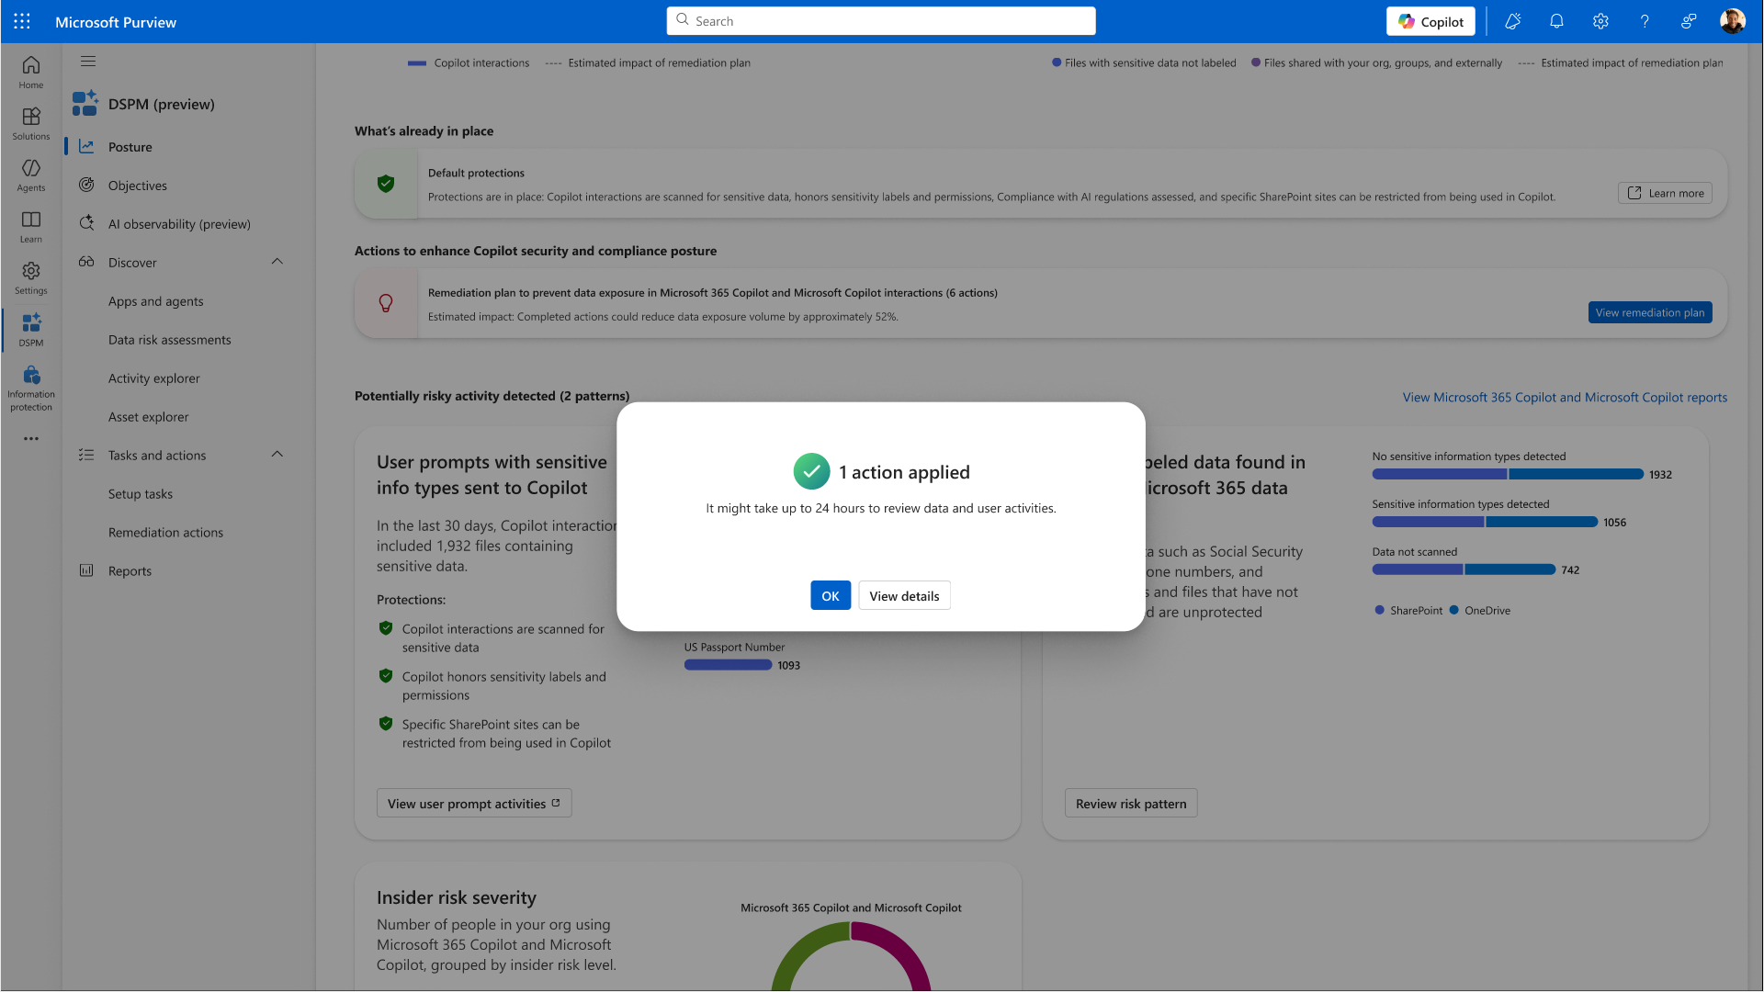
Title

Slide 30
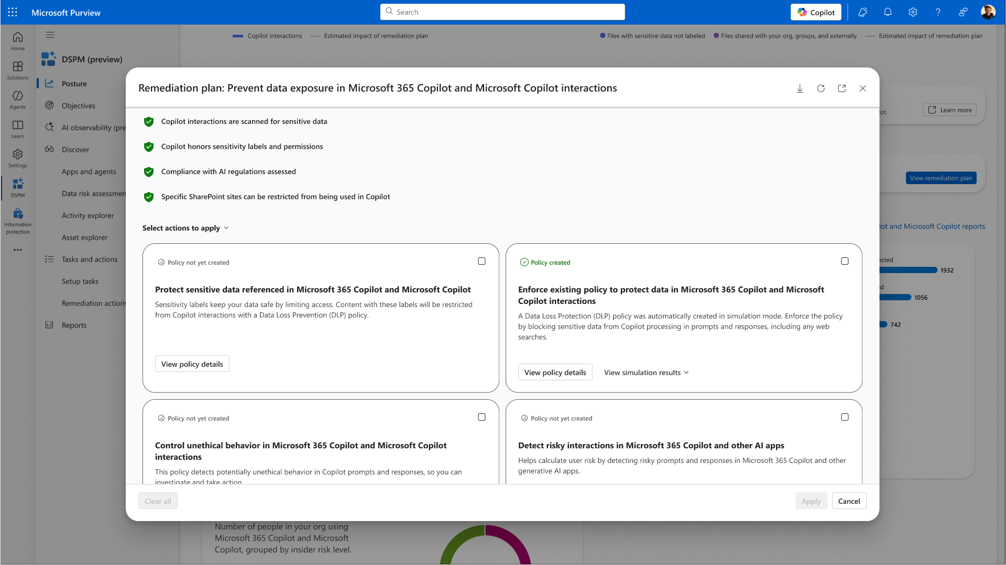
Title

Slide 31
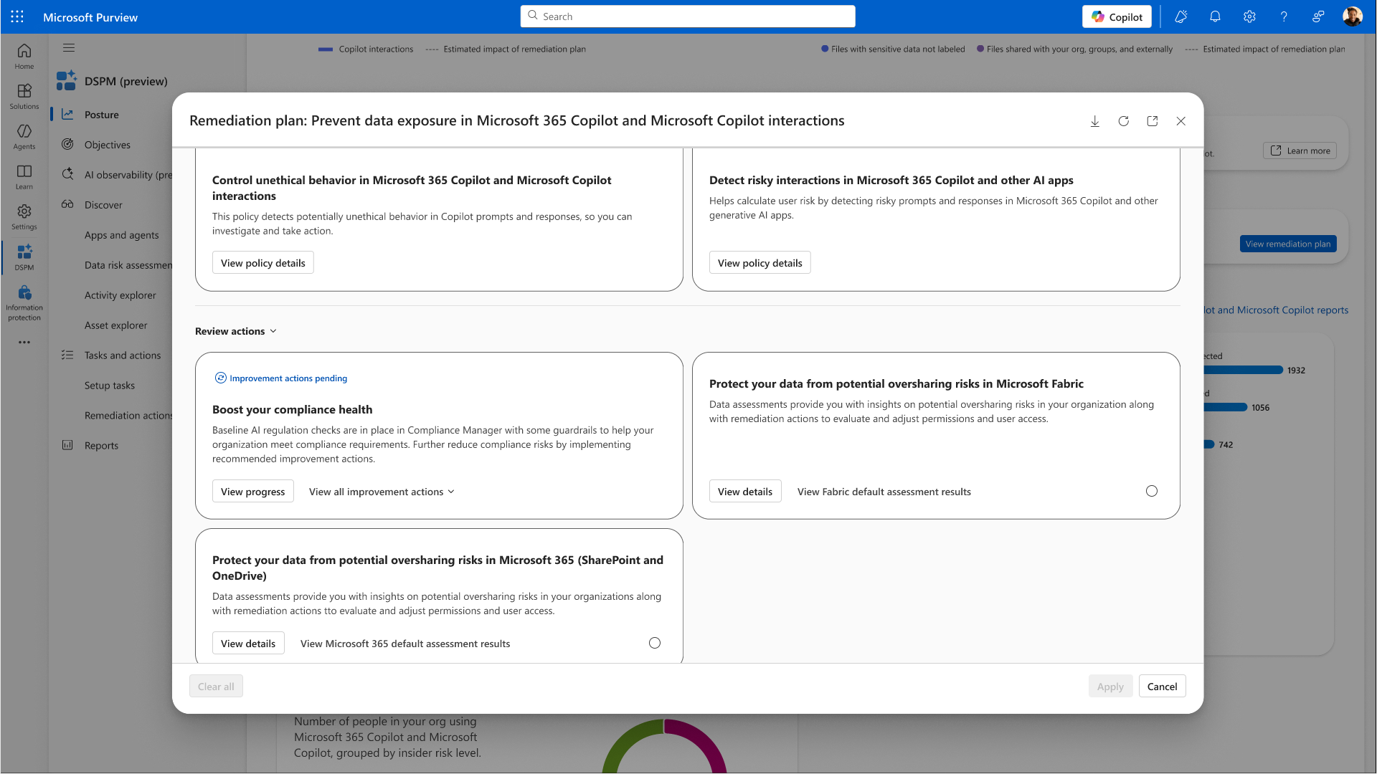
Title

Slide 32
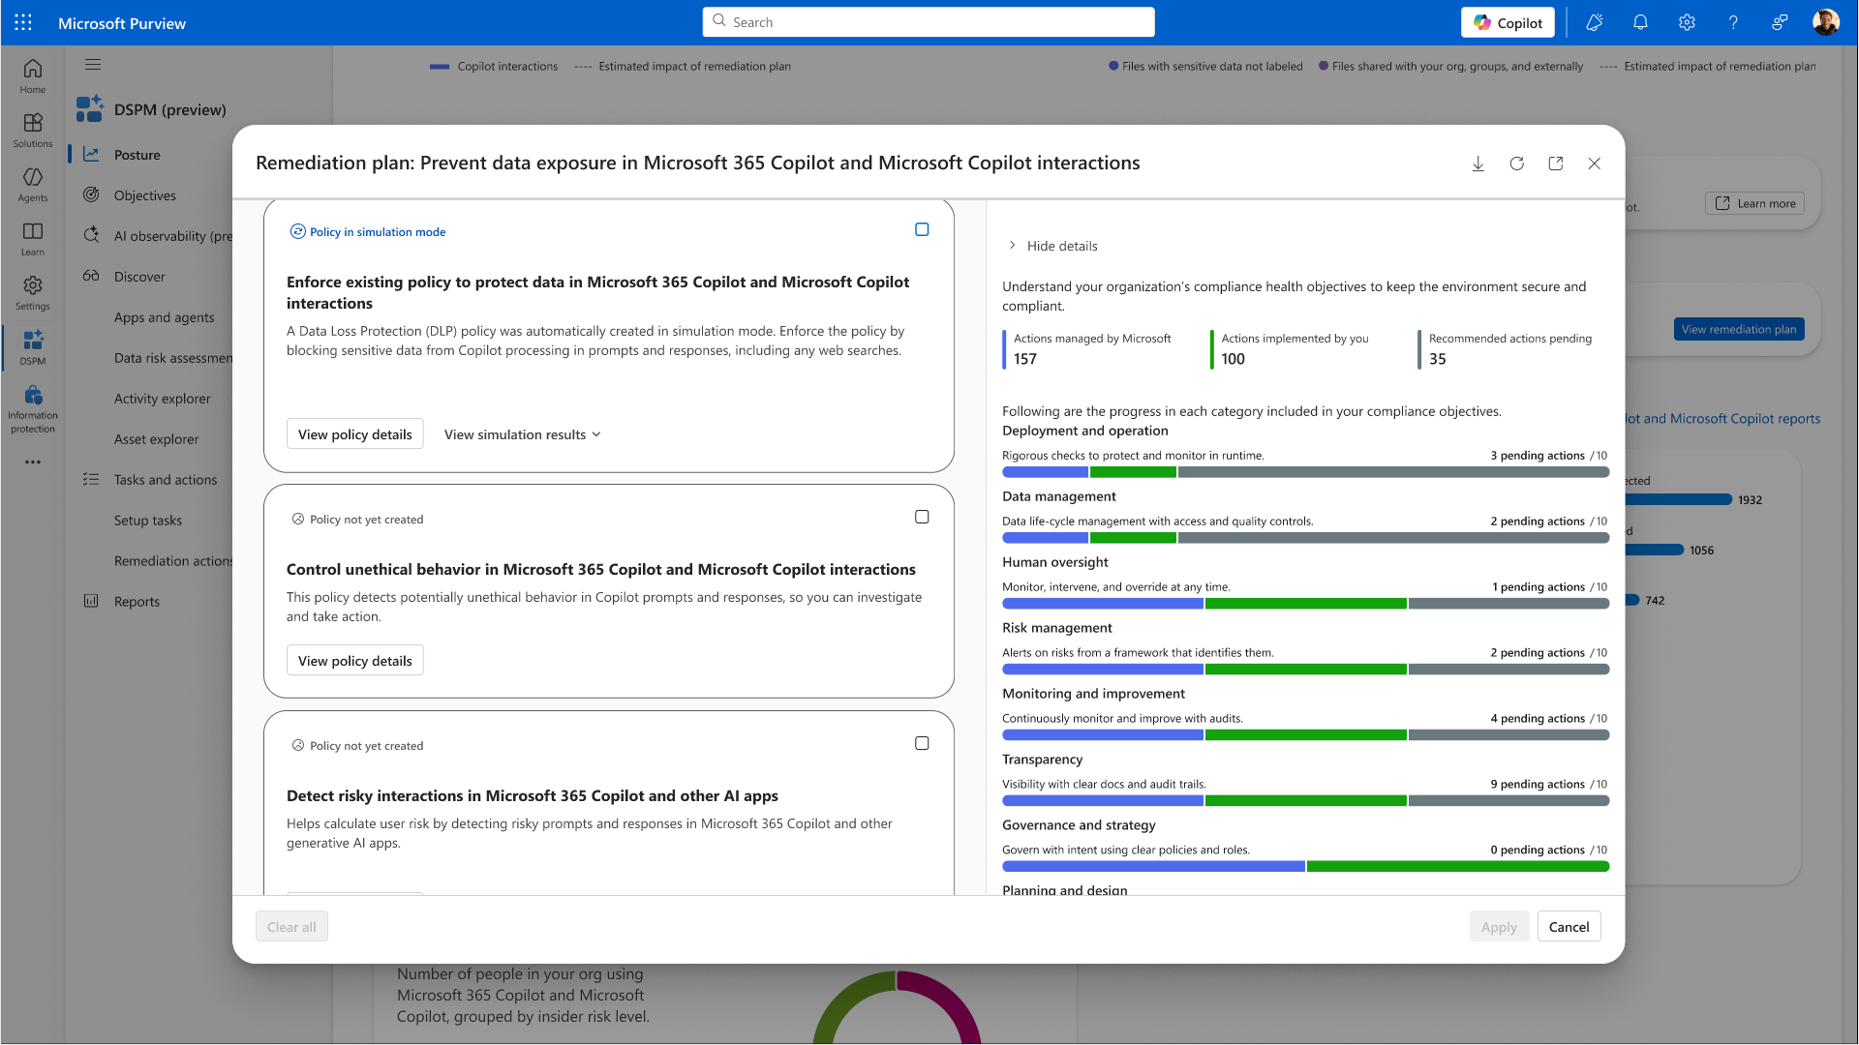
Title

Slide 33
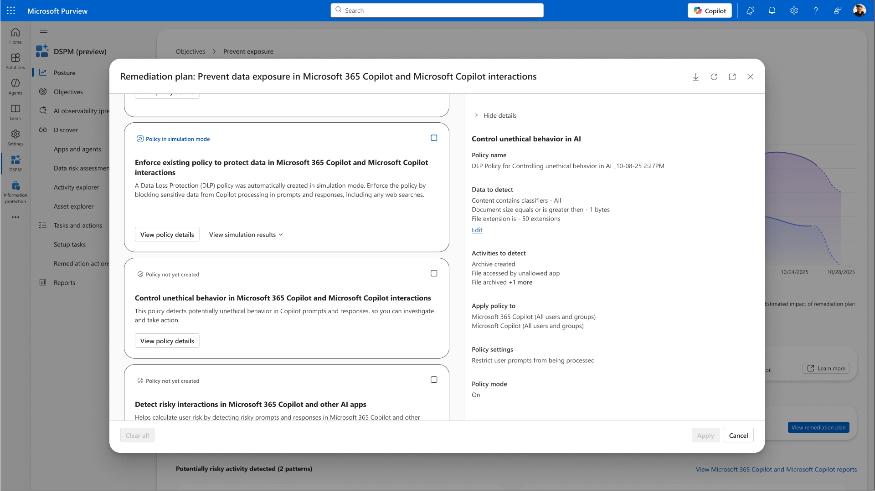
Title

Slide 34
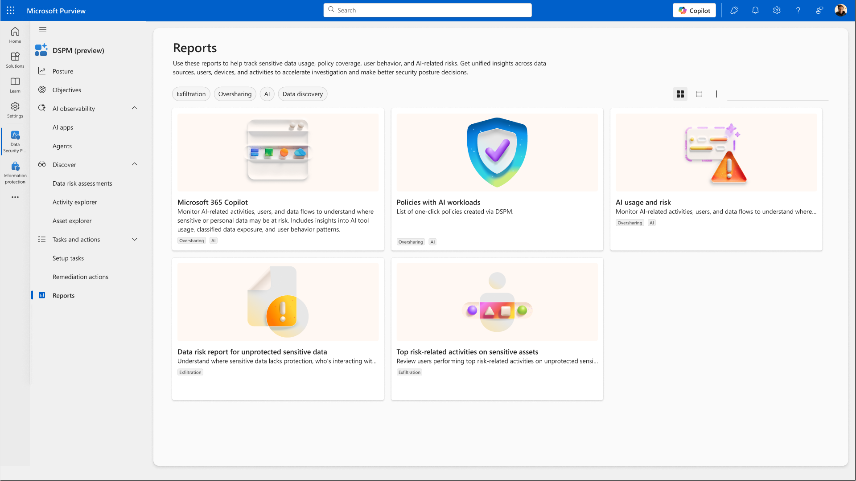
Title

Slide 35
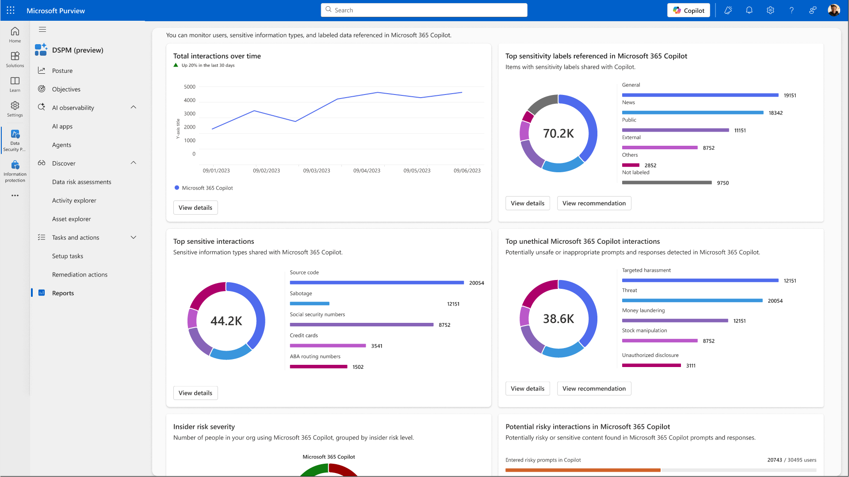
Title

Slide 36
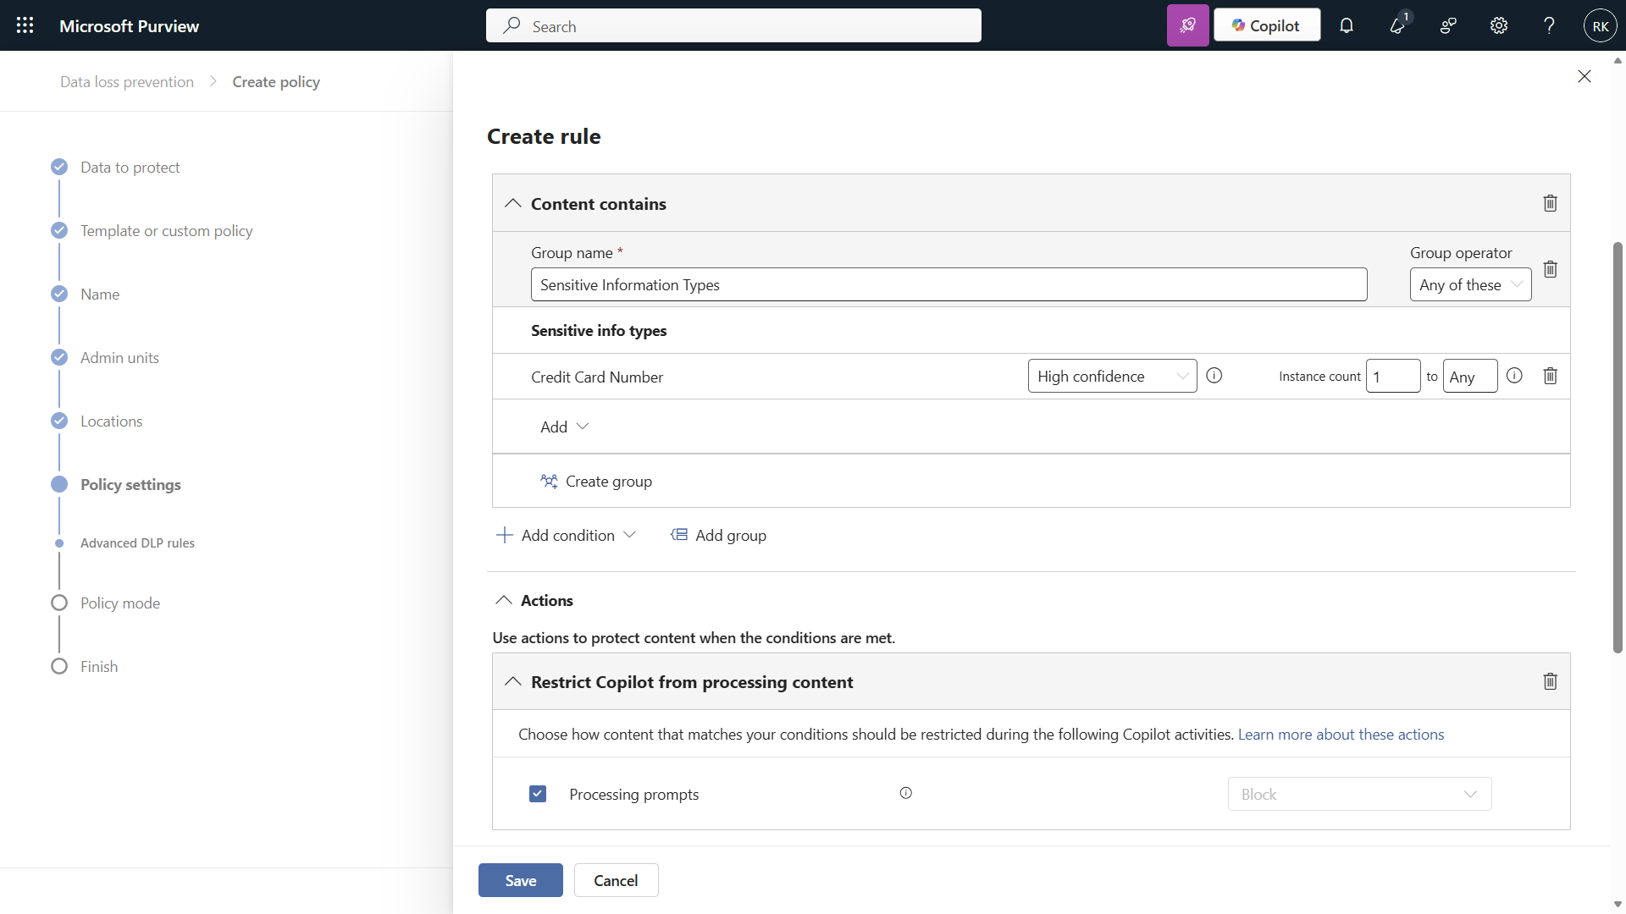
Title

Slide 37
Microsoft Purview Data Loss Prevention for Microsoft 365 Copilot to safeguard prompts
Included for all users of Microsoft 365 Copilot and Copilot Chat
Try it today!
Notes:
We are very excited for Purview DLP for Copilot prompt to be in public preview, and included for all users of Microsoft 365 Copilot and Copilot Chat.
Whether you are an IT admin or Data security admin, be sure secure and protect Microsoft 365 Copilot and agent against data loss with Purview DLP for copilot prompt today.

Slide 38
Resources
aka.ms/Purview/DLPforCopilotDocs
aka.ms/S4AI_IgniteNews2025
aka.ms/DataSecurityIgnite2025
aka.ms/SecurityBlog_Ignite2025
Notes:
To help you learn more, here are some resources to get you started.

