Slide 1
Getting Started with Custom Analysis
Microsoft 365 Copilot Analytics:
© 2025 Microsoft Corporation. All rights reserved. This document is provided "as-is." Information and views expressed in this document, including URL and other Internet Web site references, may change without notice. You bear the risk of using it. Examples herein are for illustration only and are fictitious. No real association is intended or inferred.
This document does not provide you with any legal rights to any intellectual property in any Microsoft product. You may copy and use this document for your internal, reference purposes.

Slide 2
Introduction: Measuring the Impact of AI Transformation
Is our AI transformation successful?
This guide covers:
Measuring AI transformation can feel like a daunting and complex job.
Before even considering how to measure success, there are numerous preliminary questions to address. For example,
Where should we deploy licenses in our organization, and
what are the current obstacles to Copilot adoption?
Additionally, it’s crucial to consider the strategic question of: how do we define success? This requires a deep understanding of your organization’s goals, priorities, and context. In other words, why are we choosing to adopting AI in the first place?
There are also practical considerations regarding the actual measurement process.
Where will the data come from, and how do we set everything up?
How should surveys come into play?
AI transformation initiatives involve many moving parts, and without a clear roadmap, it’s easy to lose sight of what matters. To assist you on your journey, this guide provides practical steps for building and executing a comprehensive measurement plan.
By the end of this guide, you’ll have a clear, actionable approach to measuring AI transformation in a way that is both meaningful and aligned with your organization’s strategic objectives.
How to leverage the Microsoft Copilot Analytics suite to support your measurement efforts, including:
Designing a measurement strategy and timeline that aligns with your organization’s goals and the typical deployment journey
Setting up Microsoft Viva Insights to understand Copilot usage patterns and digital collaboration behaviors.
Surfacing insights with analysis tools in Viva Insights (incl. Copilot Dashboard, Power BI reports, and the R / Python libraries) to drive informed decisions and continuous improvement.
Notes:
To ensure that your measurement strategy aligns with these goals, it’s essential to engage stakeholders early through structured workshops. These sessions help clarify priorities, uncover potential barriers, and ensure that your approach is tailored to the realities of your organization.

Slide 3
Overview
Who is this document for?
Design your measurement strategy
Define goals and success metrics for Copilot adoption.
Identify business outcomes to track.
Plan and sequence interventions (e.g., training, nudges).
Set up your measurement tools
Configure Viva Insights to track Copilot usage and collaboration patterns.
Link sentiment and adoption surveys with Viva Insights (via organizational data upload).
Prepare and upload organizational data.
Enable analysis and reporting
Assign Analyst and Administrator roles in Viva Insights.
Run queries and generate insights using Power BI templates.
Use R or Python libraries for advanced custom analysis.
This document is for stakeholders in AI strategy and business value measurement looking for a practical guide on how to measure Copilot adoption and impact within their organization.
This guide will walk through how to:
What will this document cover?
This resource provides practical guidance on how to set up a measurement program for AI transformation within their organization, specifically using the capabilities available within Copilot Analytics.

Slide 4
Planning a measurement program

Slide 5
Checklist before embarking on a measurement program
Planning a measurement program
Before launching your custom analysis journey, ensure the following are in place to effectively measure business value:
Strategy and alignment
Governance and implementation
Measurement and execution
These steps ensure clarity of purpose and stakeholder alignment before diving into execution.
This phase sets up the operational foundation for the program.
These steps focus on implementation, tracking, and communication.
Define the goals of the measurement program
Clarify what success looks like and how it aligns with your AI transformation objectives.
Establish a governance model
Define roles, responsibilities, and decision-making processes for managing the measurement program.
Define success metrics and KPIs
Document how success will be measured based on the aligned goals.
Prepare for change management and communication
Address potential barriers by ensuring awareness of program benefits through clear communication plans.
Identify key stakeholders
Include business leaders, data owners, IT, and transformation leads to ensure alignment across functions.
Plan for data availability and integration
Ensure access to relevant data sources, integrate securely, and employ feedback sources.
Select the business use case and target population
Focus on high-impact scenarios and groups where Copilot can drive meaningful outcomes.
Select the right tools for insight generation
Confirm fit with Viva Insights, Viva Glint, or Power BI for deeper insights into metrics that matter most.
Design a timeline for interventions and measurement
Align training interventions and reporting intervals with your business needs.
Assess budget and scope
Determine available budget (time, personnel, tools) and the program's scope to ensure alignment with goals.

Slide 6
Example 1 – extensive AI transformation project plan
Planning a measurement program
This project plan outlines a structured approach to implementing and measuring AI transformation within an organization. It is designed to align Copilot deployment with business goals, ensure stakeholder engagement, and track progress through meaningful metrics.
Strategy and alignment: Foundational workshops with key stakeholders to identify high-impact use cases, assess readiness, and define a roadmap for AI integration.
Governance and implementation: A phased rollout of Copilot licenses, supported by targeted interventions to drive adoption and maximize value.
Measurement and execution: A comprehensive measurement strategy using surveys, focus groups, and analytics tools to assess readiness, monitor adoption, and evaluate the effectiveness of interventions.
The plan is divided into three key phases:
This timeline provides a practical framework for organizations to manage change, surface insights, and demonstrate the business value of AI transformation.
Month 1
Month 2
Month 3
Month 4
Month 5
Month 6+
AI transformation workshop – Initial set up
Identify key populations – typically based on business need
Identify business outcomes to measure success of implementation (What does success look like?)
Identify requirements and feasibility of implementing surveys.
AI transformation
workshop – Interim review
Evaluate progress of adoption
Determine interventions.
AI transformation
workshop – Final review
Strategy and alignment
Governance and implementation
Acquire and assign M365 Copilot licenses.
Implement intervention program, e.g., training (optional).
Set up Viva Insights, e.g., assign roles, upload organizational data and outcomes
Design and launch Copilot readiness survey.
Design and launch Copilot adoption survey.
Design and launch Copilot impact survey (allow 12 weeks from license assigned).
Measure effectiveness of interventions (allow 12 weeks from implementation of intervention).
Review of adoption & readiness surveys.
Evaluate Copilot usage & impact
Microsoft Admin Center
Microsoft Copilot Dashboard
Copilot Adoption report, Copilot Impact report, Copilot business impact report
Review of readiness survey.
Measurement and execution
Notes:
Validation with Product Analytics:
Month 3 – Evaluation time makes sense
8 weeks – Purchase to High Adoption (65% active) – makes sense to run Month 2 for adoption reports
High Adoption can take up to 5 months

Slide 7
Example 2 – agile AI transformation project plan (8 – 12 weeks)
Planning a measurement program
This agile project plan is ideal for organizations with limited timeframes and resources to demonstrate value.
Where possible, weekly check-ins and review of the dashboard and Copilot reports support tracking progress, identifying early wins, and quickly addressing any challenges or roadblocks.
This iterative approach helps keep the project aligned with business goals and ensures value is delivered throughout each phase of the transformation.
It is important to select a project plan that fits your organization’s needs. For organizations piloting with larger populations or engaging a broader set of stakeholders, a more extensive project plan may be more appropriate.
This timeline provides a practical framework for organizations to manage change, surface insights, and demonstrate the business value of AI transformation.
Week 1
Week 2-3
Week 3-4
Week 4-8
Week 8+
Initial set up meeting
Identify key populations – typically based on business need.
Check-in
Explore hypotheses on what is driving adoption.
Design initiatives, e.g., training.
Gain stakeholder buy-in.
Propose KPIs and tracking measures.
Check-in
Iterate measurement strategy with ongoing organizational needs.
Strategy and alignment
Assign Copilot licenses to pilot population.
Set up Viva Insights, e.g., assign roles, prepare and upload organizational data and outcomes.
Roll out interventions and build custom Copilot Analytics to support.
Review progress with stakeholders.
Governance and implementation
Evaluate early adoption with the Microsoft Admin Center and the Microsoft Copilot Dashboard.
Identify which populations are adopting fastest and which apps / use cases are gaining momentum.
Evaluate Copilot usage & impact
Copilot Adoption report,
Copilot Impact report,
Copilot business impact report
Roll out surveys on adoption.
Continuous evaluation with Copilot Analytics (custom analysis tools) and surveys to track progress.
Update interventions where necessary.
Measurement and execution
Notes:
Validation with Product Analytics:
Month 3 – Evaluation time makes sense
8 weeks – Purchase to High Adoption (65% active) – makes sense to run Month 2 for adoption reports
High Adoption can take up to 5 months

Slide 8
Planning for Copilot Rollout & Measurement
Planning a measurement program
A 3-workshop framework for leaders
Workshop 1: Initial setup
(Month 1)
Workshop 2: Interim review
(Month ~4)
Workshop 3: Final review
(Month 6+)
Purpose
Lay the foundation for a successful Copilot rollout
Evaluate progress and course-correct
Evaluate rollout success and identify next steps for program
Business Unit Leaders
IT & Data Governance
HR / Learning & Development
Change Management Leads
Copilot Champions / Early Adopters
Same as Workshop 1, plus:
Selected end users for feedback
Analytics team
Executive Sponsors
Business Strategy Leads
AI/Innovation Office (if applicable)
Who to Invite
Which teams or roles will benefit most from Copilot?
What business outcomes (KPIs) define success?
What data is available to measure impact?
Can we implement sentiment surveys or training programs?
What’s the current adoption rate?
What are users’ pain points or blockers?
Are interventions (e.g., training, nudges) needed?
Are we on track to meet KPIs?
Did we achieve the intended business outcomes?
What lessons were learned?
How do we scale Copilot or expand AI transformation?
Key Questions
Prioritized rollout populations
Defined success metrics (e.g., productivity, satisfaction)
Feasibility plan for additional components (e.g., surveys, interventions)
Updated adoption metrics
Identified barriers and enablers
Action plan for mid-course interventions
Final evaluation of success metrics
Recommendations for broader AI adoption
Strategic roadmap for next phase
Expected Outcomes

Slide 9
Measurement: defining tools for each stage of your AI journey
Planning a measurement program
The following lists tools within Copilot Analytics that enables the measurement of Copilot usage and adoption.
Tool | Platform | Purpose | Key Features |  | When to Use | Coverage
Readiness and Adoption Report | Microsoft 365 admin center | Helps plan Copilot license deployment and monitor adoption readiness | Reports on: Readiness Usage Chat AI Adoption score | Agents Message consumption | Before or during rollout planning | 180 days
Copilot Dashboard | Copilot Dashboard | Provides post-deployment insights and organizational impact metrics | Usage metrics across Microsoft 365 Estimated financial savings Learning resources |  | After Copilot deployment | 28 days
Advanced Reporting | Viva Insights Analyst portal | Enables deep analysis and custom reporting on Copilot usage and impact | 100+ customizable metrics Pre-built and custom Power BI reports Business impact measurement Accompanying R and Python libraries for advanced analysis |  | For detailed, customizable analytics | 13 months
Measure Copilot sentiment | Viva Glint | Captures employee sentiment to understand motivations and barriers to AI adoption | Pulse and lifecycle surveys Sentiment analysis AI-driven insights Integration with Viva suite |  | During and after rollout to monitor sentiment | Variable
↓ Focus of this playbook ↓
For more details, see https://learn.microsoft.com/en-us/viva/insights/copilot-analytics-introduction
Notes:
Comparison table or flow chart for when to use MAC, Copilot Dashboard, Copilot reports (PBI), and custom analysis in Viva Insights

Slide 10
Setting up Viva Insights for Copilot Analytics
Notes:
TALK TRACK:
Now that we have covered how to design a Copilot measurement program, we will look at how to set up Viva Insights to measure Copilot usage and collaboration metrics.

Slide 11

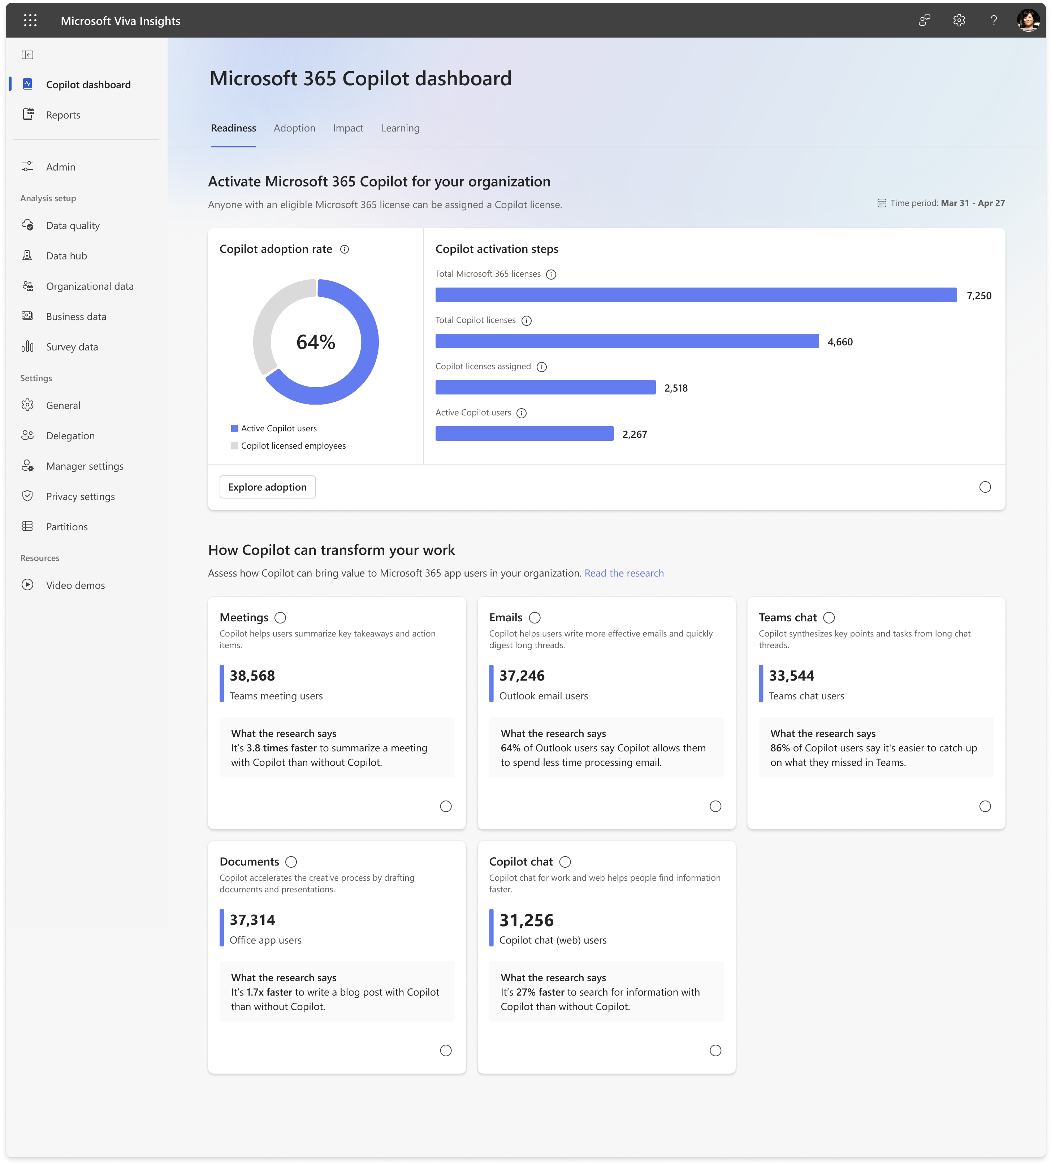
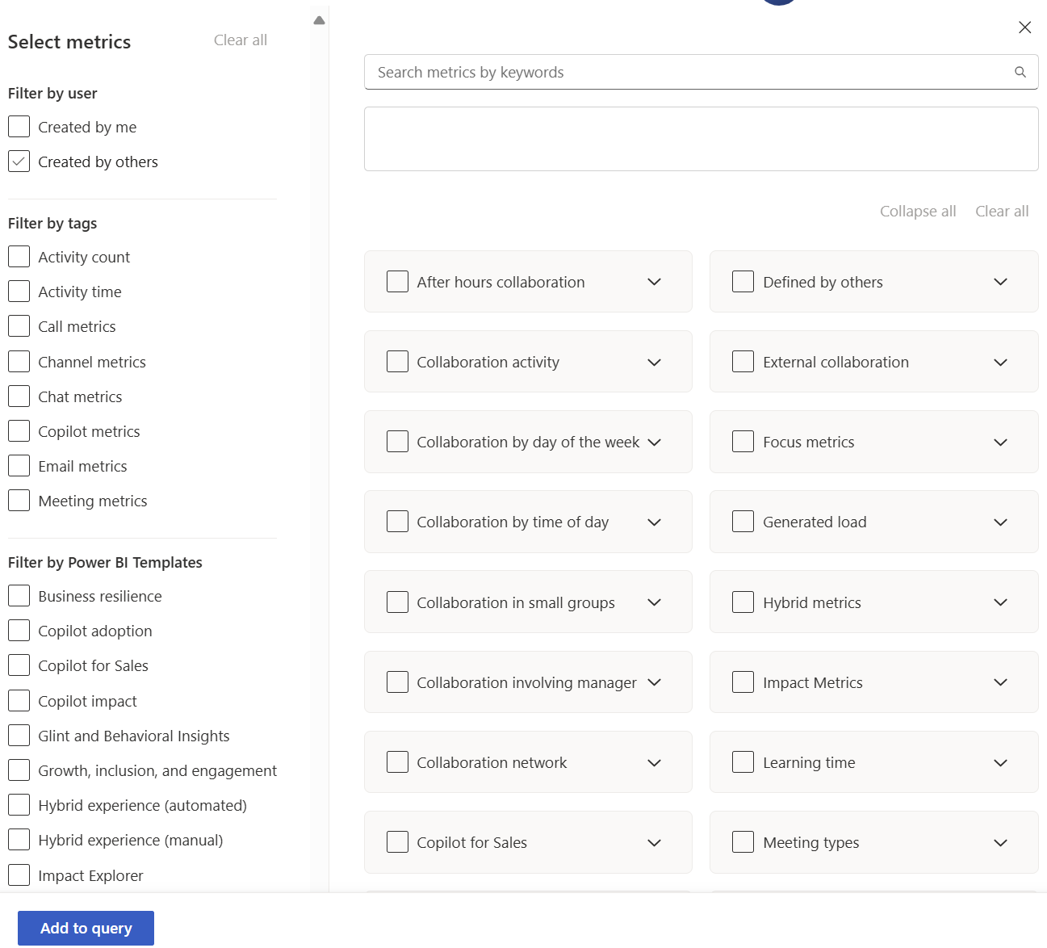

Viva Insights is a key part of the Viva toolkit for accelerating Copilot adoption and measurement – and is part of the measurement pillar of the Copilot Control System (CCS) - providing 200+ metrics for enhancing employee wellbeing and productivity
Setting up Viva Insights
Microsoft Viva
Accelerate Copilot adoption and measurement
Communications
Skilling
Measurement
Viva Insights offers data-driven insights and recommendations to enhance productivity and wellbeing in the workplace
Viva Insights has multiple surfaces for different levels of users…
Personal insights – individual employees
Teams insights - managers
Organizational insights – leaders, delegates
Advanced insights – business leaders, analysts
Copilot Dashboard – leaders driving AI transformation for their org
…and an expansive set of metrics that feed into these surfaces
Collaboration activity (emails, chats, meetings, etc.)
After-hours collaboration
Collaboration involving manager
Collaboration network
Focus time
Generated load
Copilot
…and more
Part of Microsoft Viva’s Measurement pillar (together with Glint, Pulse) for accelerating Copilot adoption and measurement.
Combines collaboration data from M365 (Exchange, Teams) and organizational data to offer metrics that help measure organizational wellbeing and productivity.
Privacy-protected and supports data compliance.
Notes:
TALK TRACK:
Before we delve deeper into the set up process – what is Viva Insights?
Microsoft Viva is an employee experience platform, with many familiar names that you will recognize: Glint, Engage, Pulse, Learning, Goals
Viva Insights is part of its ‘Measurement’ pillar, positioned to help customers to accelerate Copilot measurement.
We combine with M365 data and behavioural data to produce metrics that (initially) serve more of an HR and Operational Strategy audience, but have since expanded.

Slide 12
The Viva Insights Analyst portal allows you to run queries for custom analysis
Setting up Viva Insights
The Viva Insights Analyst portal enables:
Creation of custom metrics
Export of raw csv data files
Access to 15+ prebuilt Power BI report templates (including the Copilot adoption and impact reports).
The Analyst portal is only accessible to those assigned with the Viva Insights Analyst role.
https://analysis.insights.viva.office.com/

Slide 13



Setting up Viva Insights for custom analysis – a simplified flow
Setting up Viva Insights
To configure Viva Insights for custom analysis, there are three key steps which are discussed in greater detail in the subsequent sections of this playbook.
License and role assignment
Set-up and plan analysis
Analysis and surface insights
Power BI reports
Analyst sets up Power BI templates to surface initial hypotheses.
R / Python
Analyst runs scripts or notebooks to validate hypotheses or deep dive into specific areas.
Copilot licenses launched and assigned.
Roles assigned to Insights Administrator and Insights Analyst.
Viva Insights organization data prepared and uploaded.
Analyst confirms questions and hypotheses to test*.
Analyst runs custom query on Viva Insights.
Custom query accessible via Power BI Connector, or raw CSV file.
Analyst is set up on Power BI and Python/R, installing the relevant packages*.
* For R and Python users, it is recommended to install and load the R library and Python library respectively.

Slide 14
Overview: Viva Insights from setup to impact
Setting up Viva Insights
Recommended activities in 5 phases
Step 1
Step 2
Step 3
Step 4
Step 5
Objective Setting
Preparatory Work
Deployment
Value Creation
Impact Evaluation
Design an impactful project by addressing a core business challenge.
Complete key foundational work before tool deployment.
Activate Viva Insights and manage access rights.
Obtain relevant insights and drive decision-making.
Quantify impact and assess future opportunities.
Copilot measurement initiation workshop
Define Viva Insights components to be activated
Acquire and assign licences
Gather insights from pre-built dashboards
Track KPIs and measure impact
Conduct privacy assessment
Assign access rights (roles)
Complete additional analysis
Identify additional opportunities
Communicate project to target population
Intervention planning and execution
Prepare organizational data
Notes:
Introduction to assigning licenses for Workplace Analytics users - Workplace Intelligence | Microsoft Docs
https://docs.microsoft.com/en-us/workplace-analytics/setup/assign-licenses-to-population / https://learn.microsoft.com/en-us/viva/insights/advanced/setup-maint/assign-licenses
https://docs.microsoft.com/en-us/workplace-analytics/setup/assign-roles-to-wpa-admins / https://learn.microsoft.com/en-us/viva/insights/advanced/setup-maint/user-roles
https://docs.microsoft.com/en-us/workplace-analytics/setup/prepare-organizational-data / https://learn.microsoft.com/en-us/viva/insights/advanced/admin/prepare-org-data
Workplace Analytics setup - Workplace Intelligence | Microsoft Docs / https://learn.microsoft.com/en-us/viva/insights/advanced/introduction-to-advanced-insights
Upload you first organizational data file into Workplace Analytics - Workplace Intelligence | Microsoft Docs
https://docs.microsoft.com/en-us/workplace-analytics/tutorials/power-bi-intro
Microsoft Viva Insights about my organization - Workplace Intelligence | Microsoft Docs

Slide 15
Assigning roles in Viva Insights
Notes:
TALK TRACK:

Slide 16
Key Skills and Roles Required
Roles in Viva Insights
Resources recommended for a Project execution
Viva Insights Analyst
Project Sponsor
Project Lead
M365 Admin
Define objective, resources and drive interactions across business units
Complete key foundational work and support insights generation
Assign Viva Insights access and deployment
Use Insights platform, conduct data analysis and gather insights
Insights role: Insights Administrator
Insights role: Insights Analyst
Full access to all product features, except Admin.
This role is used for the analyst who requires the most complete access to the data. They will develop the more custom and advanced use cases.
Access to Admin and Data Sources features. This role is used for the administrator to set system defaults, privacy settings, upload and verify organizational data.
NOTE: Microsoft 365 Admin does not have access to Viva Insights.
See https://learn.microsoft.com/en-us/viva/microsoft-viva-admin-roles#viva-insights

Slide 17
Overview: Viva Insights from setup to impact
Roles in Viva Insights
Project Sponsor
M365 Admin
Project Lead
Viva Insights Analyst
Recommended activities in 5 phases
Step 1
Step 2
Step 3
Step 4
Step 5
Objective Setting
Preparatory Work
Deployment
Value Creation
Impact Evaluation
Design an impactful project by addressing a core business challenge.
Complete key foundational work before tool deployment.
Activate Viva Insights and manage access rights.
Obtain relevant insights and drive decision-making.
Quantify impact and assess future opportunities.
Engage with key internal stakeholders
Define Viva Insights components to be activated
Acquire and assign licences
Gather insights from pre-built dashboards
Track KPIs and measure impact
Understand business priorities
Conduct privacy assessment
Assign access rights (roles)
Complete additional analysis
Identify additional opportunities
Define pilot objective and population
Communicate project to target population
Complete tool onboarding
Intervention planning and execution
Define timeline and resources
Prepare organizational data
Notes:
Introduction to assigning licenses for Workplace Analytics users - Workplace Intelligence | Microsoft Docs
https://docs.microsoft.com/en-us/workplace-analytics/setup/assign-licenses-to-population / https://learn.microsoft.com/en-us/viva/insights/advanced/setup-maint/assign-licenses
https://docs.microsoft.com/en-us/workplace-analytics/setup/assign-roles-to-wpa-admins / https://learn.microsoft.com/en-us/viva/insights/advanced/setup-maint/user-roles
https://docs.microsoft.com/en-us/workplace-analytics/setup/prepare-organizational-data / https://learn.microsoft.com/en-us/viva/insights/advanced/admin/prepare-org-data
Workplace Analytics setup - Workplace Intelligence | Microsoft Docs / https://learn.microsoft.com/en-us/viva/insights/advanced/introduction-to-advanced-insights
Upload you first organizational data file into Workplace Analytics - Workplace Intelligence | Microsoft Docs
https://docs.microsoft.com/en-us/workplace-analytics/tutorials/power-bi-intro
Microsoft Viva Insights about my organization - Workplace Intelligence | Microsoft Docs

Slide 18
Organizational data in Viva Insights
Notes:
TALK TRACK:

Slide 19
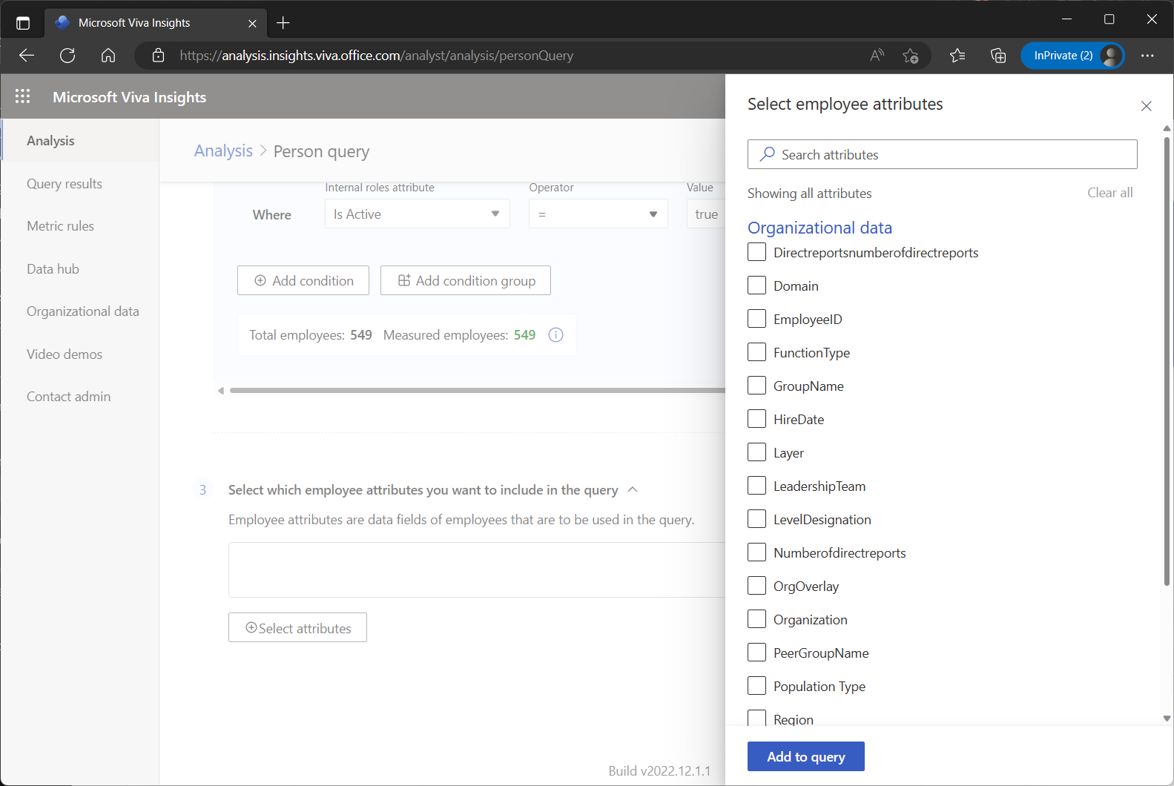
What is organizational data, and why is it important?
Organizational data
In the context of Viva Insights, organizational data refers to structured information about employees and their roles within the company – such as reporting lines, job titles, departments, and other HR-related attributes. This data is foundational for enabling meaningful analysis of collaboration patterns, productivity, and wellbeing across teams and hierarchies.
Organizational data is essential for several reasons:
Contextualizing collaboration patterns: It allows Viva Insights to analyse how employees interact across teams, levels, and reporting lines. For example, it can detect whether meetings involve redundant layers of management or if cross-functional collaboration is strong.
Enabling segmentation and benchmarking: The workforce can be segmented by role, department, or seniority to compare usage and outcomes.
Integrate survey and business outcomes with behavioural insights: Survey results and business outcomes can be included as organizational data within Viva Insights to facilitate an integrated measurement.
For more details, see https://learn.microsoft.com/en-us/viva/insights/advanced/admin/org-data-overview
Notes:
Need a 1-slider that explains
Why is organizational data important?
Sources of organizational data – needs to mention Microsoft Entra ID in additional to organizational data.

Slide 20
This section will cover
For whom do we need to provide organizational data for?
Options for providing organizational data to Viva Insights
Required data attributes
Additional data attributes
Effective dating
Best practices
Additional resources

Slide 21
For whom do we need to provide organizational data for?
Organizational data
The best practice is to include all employees in the broader company (even unlicensed employees). This enables you to measure how licensed employees worked with other teams.
Example: I only licensed employees in the United States, but I want to understand how my U.S. employees invested their time with teams across the globe.
Including organizational data for all employees enables granular filtering and break down, even for a partially licensed organization:
Organizational data only for licensed employees
Organizational data for all employees
Including all licensed employees
It's the admin's responsibility to maintain
up-to-date and complete organizational data.
In this task, "complete" means two things: data that includes the right people and includes the right attributes for those people.
The reason for including all employees in the organization is that, if their organizational data is missing, analysts can't filter by that data when they build a query on the Analysis page. So, employees whose data is missing will be excluded from the analyses that analysts perform.
U.S. employees allocated their time to:
U.S. employees allocated their time to:

Slide 22
There are several ways of providing organizational data to Viva Insights. Currently, the two primary methods are Entra ID and .csv upload.
Organizational data
Updated as of July 2025.
1. Microsoft Entra ID*
2. Manual – via .csv upload
3. Organizational data in M365
Mandatory
attributes
API-based import
Azure blob import
PersonId
ManagerId
Organization
EffectiveDate**
(These are auto-populated in Entra ID if csv upload is not available)
Workday connector
SAP connector
Attributes:
Domain (from primary SMTP address)
TimeZone (from Outlook/ Exchange settings)
… other optional attributes, including:
LevelDesignation
FunctionType
HireDate
HourlyRate
Layer
SupervisorIndicator
OnsiteDays
Location
(The above methods are in preview as of July 2025)
Optional attributes provide flexibility to ensure the organizational data is adequate for supporting the analysis.
“Parallel" data ingestion method ensures that critical data such as the ManagerId and Organization attributes can be retrieved from Entra, while additional data fields can be fetched from .csv files or automated connectors.
* This will be replaced by Microsoft 365 Profile in the near future. Microsoft 365 Profile is a data repository from multiple sources and will include Entra ID.
** EffectiveDate attribute should be used to indicate when the change has taken place. If not provided, the upload date will be used instead.

Slide 23
Introducing required data attributes (1/2)
Organizational data
PersonId
EffectiveDate
ManagerId
Organization
Once data is uploaded, the Person ID will be hashed and deidentified. It must reflect the employee’s primary SMTP email address.
The Effective Date helps define the impact that changes such as promotions, relocations, changes in management, etc. have on employee collaboration patterns. It must be in mm/dd/yyyy format.
Each row in your org file has a specific Effective Date and represents a defined point-in-time snapshot of that individual person’s status.
For example, in May, Ann was a senior individual contributor. In July, she was promoted to managerial level (and her line manager changed as well).
PersonId | EffectiveDate | ManagerId | Organization | LevelDesignation
ann@contoso.com​ | 5/1/2018 (May) | jered@contoso.com | Marketing​ | Senior IC​
ann@contoso.com​ | 6/1/2018 | jered@contoso.com | Marketing​ | Senior IC​
ann@contoso.com​ | 7/1/2018 (July) | carolina@contoso.com | Marketing​ | Manager​

Slide 24
Introducing required data attributes (2/2)
Organizational data
PersonId
EffectiveDate
ManagerId
Organization
Viva Insights uses the Manager ID column to measure how much time an employee spends with their direct manager, skip-level manager interactions etc. It should reflect the direct manager’s email address.
Organization is used to calculate the metric Network outside organization and internal collaboration and communication patterns.
Network outside organization is a count of the distinct internal organization units where I’ve had a reciprocal interaction with in the past month.
Broadly defined organizations will result in fewer cross-org interactions and smaller network breadth.
Narrowly defined organizations will result in more cross-org interactions and larger network breadth.
Notes:
We want to like the Organization as much as possible- for 2000 employees have ~50 organizations max. Otherwise this will result in too few people in a group 8-10 people min per group

Slide 25
You can include up to 100 additional organizational data attributes to enrich your analysis
Organizational data
This enables survey items and business outcomes to be combined with the analysis of Copilot usage
Description
Attribute Examples
Employee type, status and job history, frequently used to scope an analysis.
Hourly Wage
Employee Type (Regular, Contingent, Intern)
Exempt/Non-Exempt
Background
Describes where the employee sits geographically.
Region, Country, City
Campus
Building
Location
Describes the employee’s position within the organizational reporting structure.
Business Unit
Division
Department
Cost Center
Organization
Describes the employee’s skills, function, and responsibilities.
Functions, Title
Manager Flag
Career Level
Level Designation
Role
Includes measures that are driven by how an employee works, and that contribute to overall business results.
Performance Rating
Engagement Survey Score
Sales Quota Attainment
Manager Effectiveness Score
Customer Satisfaction
Match key (for joining other data sources)
Surveys / Outcomes

Slide 26
Viva Insights relies on effective dating for its accuracy and to allow you to monitor long-term change.
Organizational data
Sentiment, performance, efficiency all shift
over time.
New joiners establish their networks, supervisors are promoted, leaders change roles, departments restructure, companies merge.
Aligning Viva Insights to these trends allows decision makers to accurately review the impact of change and determine success and areas to further improve.
Notes:
Effective dating by month (only for employees that had changes in this sample)

Slide 27
Collaboration data is mapped to the most recent organizational snapshot that precedes the dates of the collaboration activity
Organizational data
Jan
Feb
Mar
Apr
May
Jun
Jul
Aug
Sept
Oct
Nov
Dec
Jan
Organizational data
Weekly collaboration data
Jan
Feb
Mar
Apr
May
Jun
Jul
Aug
Sept
Oct
Nov
Dec
Jan
Data Accuracy
The more snapshots included, the more
accurately organizational data will be mapped to collaboration data, providing a clearer picture of changes over time.
Monthly Snapshots
Include 13 monthly snapshots of historical data in the initial organizational data upload to ensure accurate mapping of organizational data to collaboration data. Upload monthly going forward.

Slide 28
It may sometimes be an appropriate strategy to overwrite an earlier effective date when only a single historical snapshot is available
Organizational data
Sept
Organizational data
Sept
Jan
Organizational data
Overwrite the real Effective Date with a date at least 13 months earlier.
Weekly collaboration data
Jan
Feb
Mar
Apr
May
Jun
Jul
Aug
Sept
Oct
Nov
Dec
Jan
Effective Date Assignment
If only one historical snapshot is available, it is important to assign the right effective date to that snapshot.
Overwriting Effective Dates
To map a recent organizational snapshot to all historical collaboration data, the effective date can be overwritten to precede the earliest measured collaboration, ensuring accurate data mapping.

Slide 29
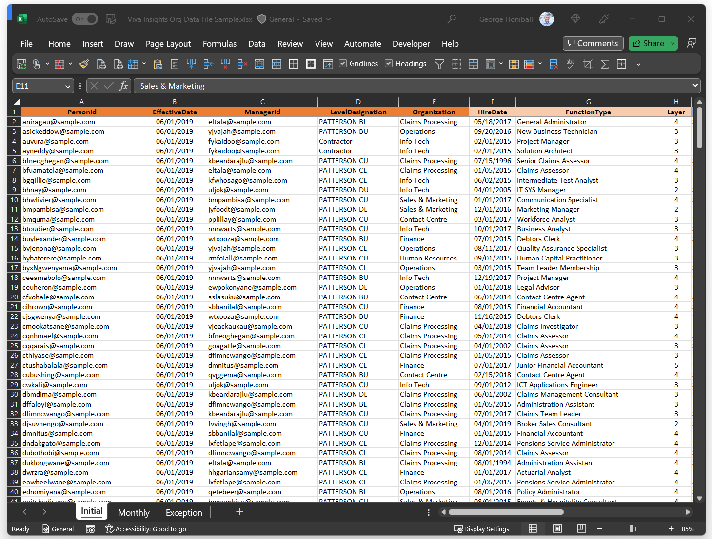

Reference the sample organizational data resource as a guide for preparation
Organizational data
Please refer to the sample organizational data file provided.
The Initial tab provides a sample of data used to perform the initial data upload for a company.
The Monthly tab provides a sample of data used to update Viva Insights of any changes. There are slight changes every month (promotions, new joiners…).
The Exception tab provides a sample of data that has changed for each month. Only changes for each month are reflected.
Notes:
Use the Excel sample file for reference purposes

Slide 30
Best practices: naming field headers
Organizational data
The field values in data rows should comply with the following formatting rules:
All field header or column names should:
Begin with a letter (not a number).
Only contain alphanumeric characters (letters and numbers, for example Date1).
Have at least one lower-case letter (Hrbp); all uppercase won't work (HRBP) .
Have no leading or trailing blank spaces or special characters (non-alphanumeric, such as @, #, %, &); if spaces or special characters are included, which will be removed from the name.
(Recommended) Match exactly as listed for the Required and Reserved optional attributes, including for case sensitivity, such as Personld and HireDate
The required EffectiveDate and HireDate field values should be in the MM/DD/YYYY format.
The required Personld and Managerld field values must be a valid email address (for example, gc@contoso.com).
The Layer field values must contain numbers only.
The HourlyRate field values must contain numbers only (which the app assumes are in US dollars for calculations and data analysis).

Slide 31
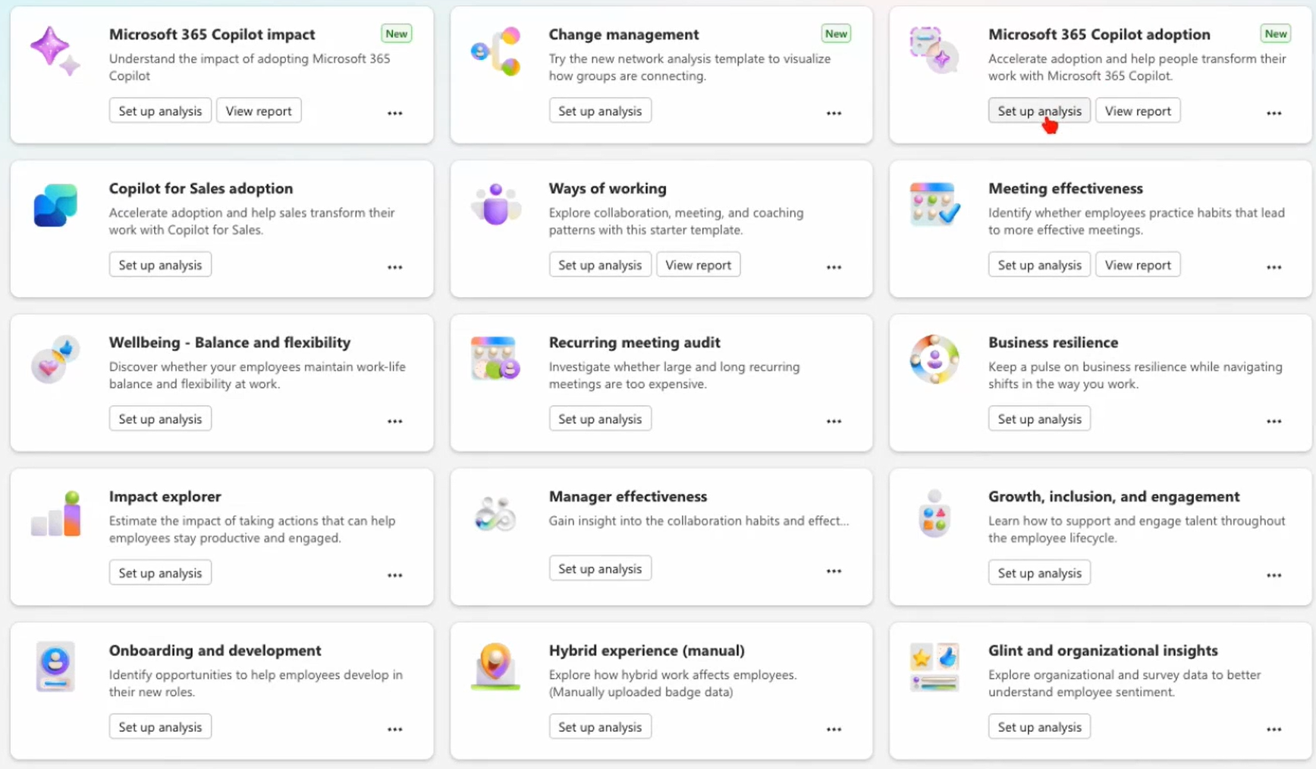
Best practices: reserved optional attributes
Organizational data
Power BI templates
Organizational data power a wide array of Power BI templates in Viva Insights:
Reserved optional attributes
The following attributes are reserved column headers for attributes that are currently used to calculate, filter, and group data.
LevelDesignation
FunctionType
HireDate
HourlyRate
Layer
SupervisorIndicator
WeeklyBadgeOnsiteDays
Location
CountryOrRegion
Reserved optional attributes are predefined data fields that are not mandatory for system operation but are recognised by the platform and can be mapped during data ingestion.
Used in Power BI templates

Slide 32
Best practices: creating and refreshing data
Organizational data
Best practices
Initial organizational file should include one snapshot for each of the past 13 months to map to initial historical collaboration data load.
Include descriptive organizational data for all employees in the company, even if they are not part of the licensed population, to enrich custom collaboration metrics for the licensed group.
Scope
Include one snapshot for each month historically and going forward to capture changes to employee attributes.
Upload files including “net new” employees, effective dates, and columns using “Append” option.
Avoid renaming columns.
Updates
Avoid columns with:
Many missing values.
Too broad or detailed for useful grouping and filtering (e.g., Company code, Job title).
Redundant attributes (e.g., Department name and Department code).
Dirty data (e.g., multiple spellings of one value: “Marketing” vs. “Mktg”, etc.).
Quality
Privacy
To help ensure privacy, do not include employee names or ID/SS numbers in the file.

Slide 33
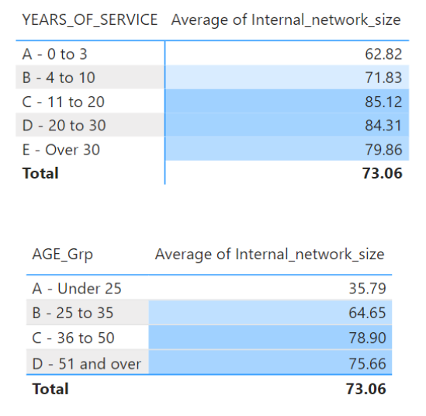
Best practices: meaningful grouping of information
Organizational data
`HireDate` example
As a field, the Hire Date is not immediately practical for your ad-hoc reporting.
But you can generate a value (actual Years of Service) that can be used for further analysis.
You can also place employees into meaningful groups (Hint: Check your company annual report for grouping).
Use this for other Attributes as well (for example, age groups, generational splits, performance grouping etc.).

Slide 34

Best practices: Ensure that your organizational data is meticulously prepared
Organizational data
The results (or outcomes) generated by Viva Insights can only be as good as the information that is fed into the system.
Typical challenges when consolidating information
Many different departments, teams and levels need to work together to consolidate the information into a single file.
Some of the information may be highly sensitive and confidential (e.g., HIPOs, Successors).
The data required comes from multiple, diverse sources (Payroll, CRM, ERP, Site Security etc.).
Unique identifiers are not always available across different datasets (Payroll ID, Employee number, Email address).
Formatting may be incorrect in certain fields (especially dates and with some languages).
Ensuring information is 100% accurate is tedious and time consuming (e.g., Reporting lines, Layers, Job titles etc.).
The time taken to prepare the data is usually much longer than the upload and subsequent analysis process

Slide 35

Best practices: Ensure that your organizational data is carefully maintained
Organizational data
The results (or outcomes) generated by Viva Insights can only be as good as the information that is fed into the system.
Typical challenges when maintaining information
Some information is current, but some may be outdated (importance of effective dating).
Some scores may not be categorized or grouped effectively (for example Performance scores, Engagement measures, Age groups, Tenure/Years of Service etc.).
The person responsible for uploading the information does not always understand the value of the process or do any analysis of the final results.
It is important to check the accuracy of the outputs (compared to initial upload) to see if any people or groups are missing.
Adding new attributes can make the process more complicated (e.g., Time and Attendance, Sales performance).
Spaces and case sensitivity can impact grouping and reporting (e.g., Sales Department vs Sales department etc.).

Slide 36
Preview: send organizational data from HCM source system to Viva Insights via API based import*
API-based import
For more information, visit https://learn.microsoft.com/en-us/viva/insights/advanced/admin/import-org-data-first
M365 Global Admin
M365 Global Admin
HR source
system Admin
HR source
system Admin
HR source
system Admin
Viva Insights Admin
Leader, Manager Analyst
Create single tenant app in Entra admin center and share App ID with VI Admin.
Share Entra Tenant Id + App ID with HR source system admin.
Configure code to send data from HR source system to Insights API, using App ID + tenant ID provided by M365 admin (sample code and ADF template provided).
Create security certificate and share public key with M365 admin to upload it to Entra admin center. This will be used
for authorization.
Send .csv/Zip file to Insights API containing organizational data .csv data file + optional Json mapping file.
Scheduled full and incremental refreshes are supported.
Enter App ID in Viva Insights to enable HR source system to send data to VI.
Data import is successful and powers Leader, Manager and Analyst insights.
Microsoft admin center (MAC)/
Entra admin center
HR source system
Viva Insights
This features is in preview as of July 2025.

Slide 37
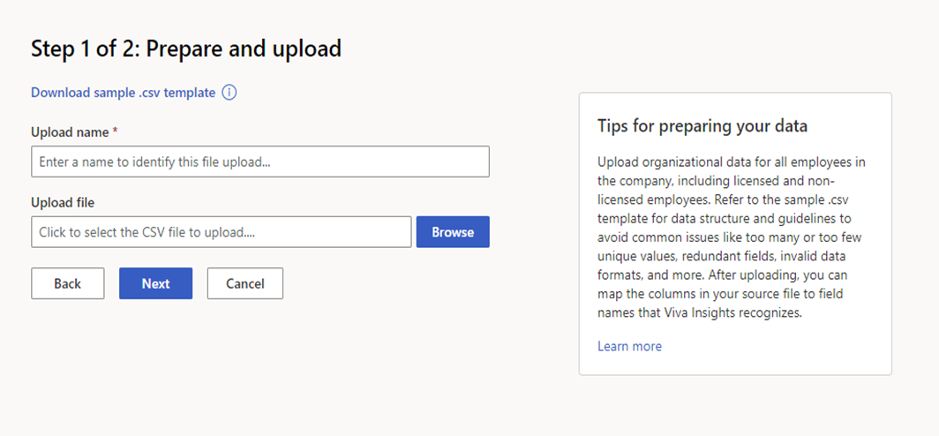
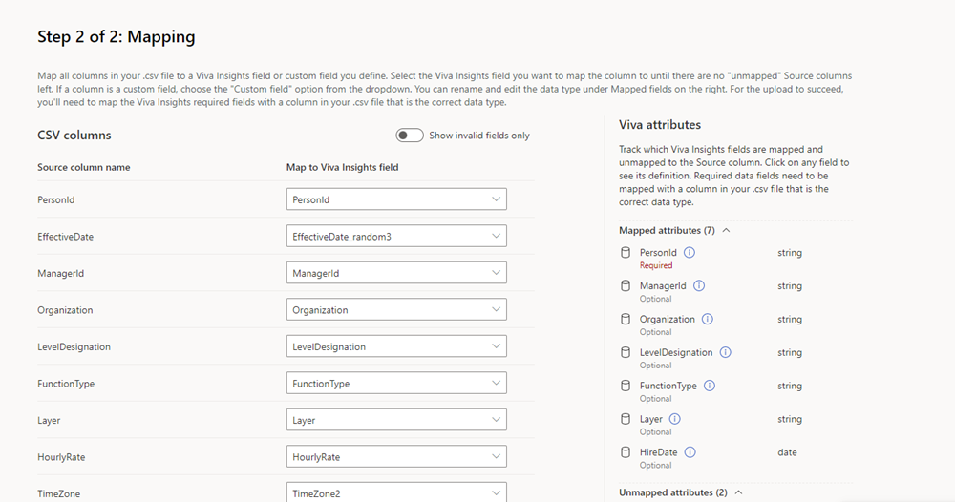
Additional resources
Organizational data
Below are some resources which can be helpful as you go through the organizational data setup process:
Glossary of advanced insights terms.
How to prepare your initial upload file (Administrator).
How to update or replace your data (Administrator).
Reviewing your organizational data quality (Analyst).
Migration to upload via Microsoft Admin Center (MAC)
Notes:
Feel free to follow these online resources during the presentation

Slide 38
Queries

Slide 39
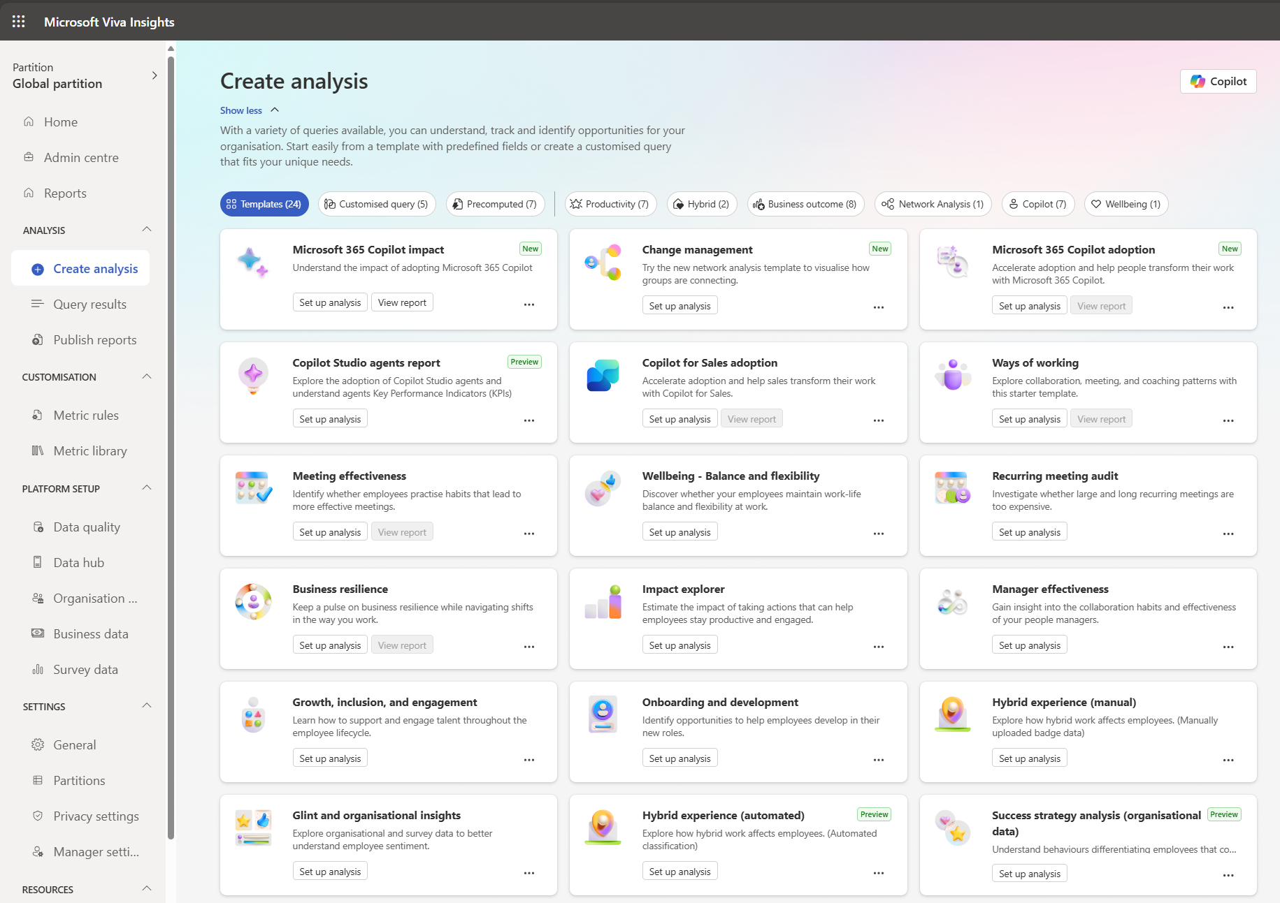
There are over 20 query templates on the Viva Insights analyst portal (… and growing!)
Viva Insights queries
You have the option to:
run a template query which exports directly to a Power BI,
Or run a custom query which you can download as a .csv or export to Azure through the Microsoft Graph Data Connect service
We recommend using a template query and running the analysis in Power BI if you are new to Viva Insights and are unsure of what to look for.
On the other hand, a custom query can offer great flexibility for more experienced or advanced analysts. With a custom query, you can choose to mix and match the required Viva Insights metrics to build an analysis that suits your needs.

Slide 40
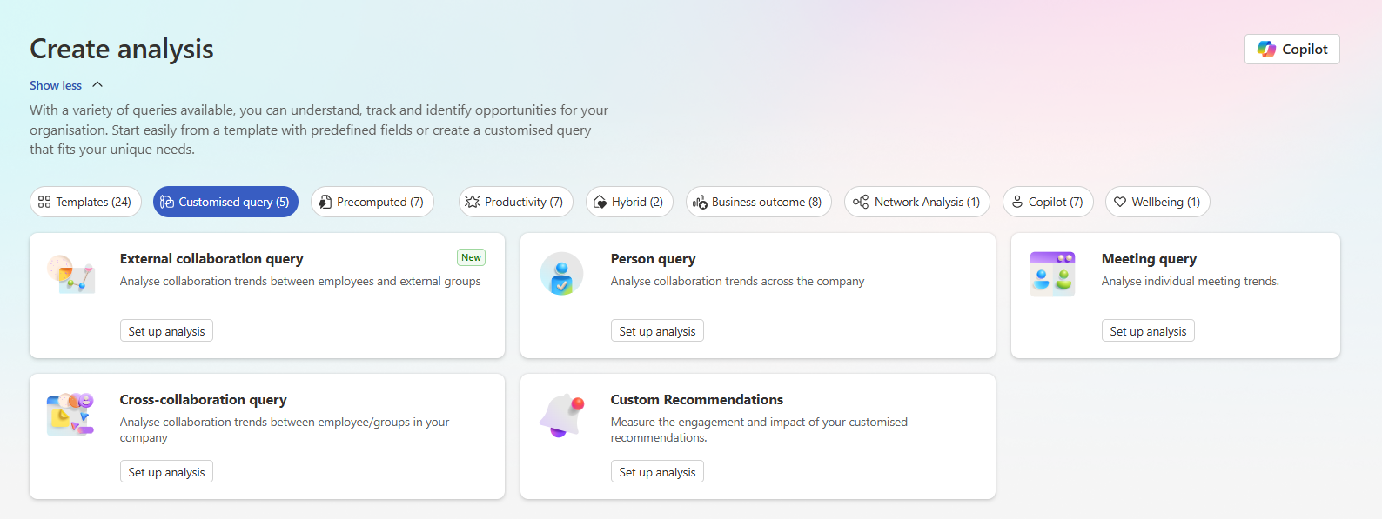
For custom analysis, there are 5 base templates:
Viva Insights queries

Slide 41
The Person query is the main query to use for custom analysis, as it is currently the only query that contains Copilot metrics. The other queries can support additional deep dives on collaboration and networks
Viva Insights queries
Query type | Type | Each row uniquely identifies… | Key columns
Person query | Person-week | Person-week (options to aggregate instead as day or month) | PersonId MetricDate Total Copilot actions taken Organization
Meeting query | Meeting | Meeting item (not repeated across attendees) | ActivityId Attendee meeting hours Number of attendees Number of attendees multitasking
Cross-collaboration query (Group-to-group) | Edge list | An edge / link between two groups as identified by organizational attribute (e.g. Organization, Level) | PrimaryCollaborator_Organization SecondaryCollaborator_Organization MetricDate Group Meeting Time Invested
Cross-collaboration query (Person-to-person) |  | An edge / link between two persons if a reciprocal tie exists between them | PrimaryCollaborator_PersonId SecondaryCollaborator_PersonId MetricDate Diverse tie score Strong tie score
Cross-collaboration query (Person-to-group) |  | An edge / link between a person and a group | PrimaryCollaborator_PersonId SecondaryCollaborator_FunctionType MetricDate Meeting Count
External collaboration query |  | An edge / link between an internal person and an external contact (as identified by domain address) | PrimaryCollaborator_PersonId PrimaryCollaborator_Organization SecondaryCollaborator_Email MetricDate Meeting Hours with External Collaborators Mails Sent to External Collaborator

Slide 42
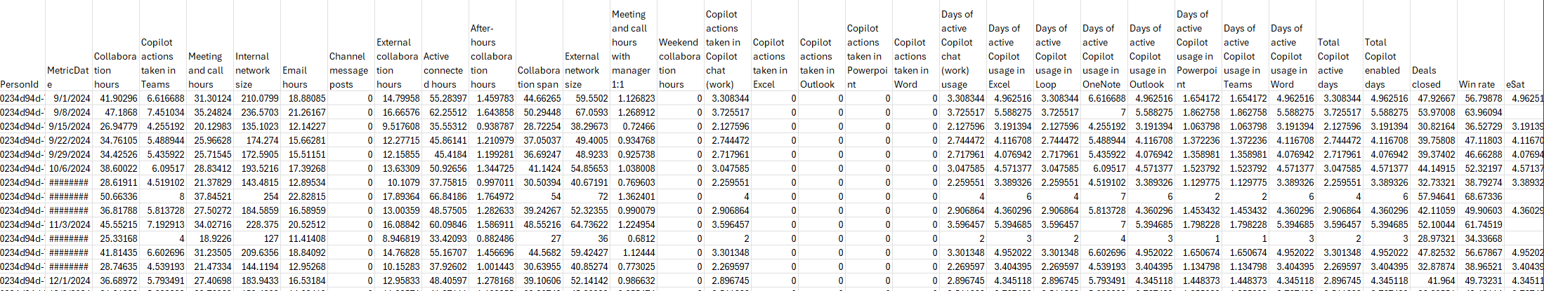
Example view of a Person Query
Viva Insights queries
Based on simulated data – values may not be realistic
Key column groups in a Person Query
PersonId
MetricDate
Collaboration metrics
Copilot metrics
Organizational
attributes
Business outcomes
Survey responses
Identifier for each person – a hash ID providing pseudonym
Date variable indicating week (always a Sunday)
Metrics measuring collaboration, e.g. email hours, meeting hours, internal network size
Metrics measuring M365 Copilot usage, e.g. number of prompts submitted via [app]
Organization, Function, Level, Supervisor Indicator, Area, Country, Tenure, etc.
Deal size, Deals closed, Win rate, NPS, Tickets closed, etc.
Columns representing survey items uploaded, e.g. Q5_Copilot_SAT
Synthetic metrics
These are additional metrics that can be created from the above, such as segments, custom KPIs or ratios
Viva Insights metric descriptions

Slide 43
What happens after I download my query?
Viva Insights queries
Set up and run query
After running and downloading a person query in .csv, the next step is to import the data into your analysis software of choice.
We recommend either R or Python as these are mature, powerful, and flexible programming languages used by many for data analysis and data science. We also have designated libraries which cater for users of these two languages (see next section), making things easier as users will not have to write analysis code from scratch.
Before diving straight into the analysis, we always recommend analysts to do two things as a best practice:
Run a data validation exercise to understand the context of the data.
Create an analysis plan to ensure that the analysis is targeted to address the core business questions.
CSV downloaded
Adjustments if necessary
Load in R/Python
Data validation
Analysis
Analysis plan

Slide 44
Validating your data
Viva Insights queries
Data validation is a process of observing your data for issues, such as missing values in your organizational data and outliers in Insights metrics. These issues may be normal or require correction, depending on the cause.
For instance, organizational data can have unintended blanks or “NA” values which may require populating, or spelling errors could result in the same value appearing as multiple values.
Another example is licenses assigned to non-information workers or extended time-off could result in unusually low collaboration or Copilot metrics, which will indicate that a filter should be applied in the analysis.
The next section covers some data validation functions that come in our R and Python libraries.
Common data validations:
Observation | Possible reason(s) | Action(s) required
Blanks or “NA”s in organizational data. | Omission or gaps in organizational data upload. | Refresh upload required.
Similar values in organizational data, e.g. “Customer service”, and “CS”. | Inconsistent naming conventions in the organizational data. | Correction and refresh upload required.
Very low outliers in collaboration or Copilot metrics. | User is non-information worker or is on leave. | The individual or the specific person-weeks should be filtered out, depending on the scenario.
After-hours collaboration is unusually high for some groups. | This may be due to odd Outlook settings being set for the individuals. | Data to be imputed or filtered depending on the situation.

Slide 45
Putting together an analysis plan
Viva Insights queries
When working with Viva Insights data, creating a targeted analysis plan is essential to ensure your findings are relevant, actionable, and aligned with organizational goals. Viva Insights provides rich behavioral and collaboration metrics, so a structured approach helps you extract meaningful insights while avoiding common pitfalls.
Here are the key steps:
Begin by identifying the specific business challenge or opportunity you're addressing. Viva Insights is most powerful when used to support scenarios like improving focus time, reducing burnout risk, or enhancing cross-functional collaboration.
Example: “Assess how meeting overload affects focus time for frontline managers in Sales.”
Clarify the business scenario
Map metrics to business questions
Select Viva Insights metrics that directly relate to your scenario. For example, use Meeting hours, Focus hours, or After-hours collaboration to explore productivity and wellbeing.
Consider combining metrics to create derived indicators (e.g., ratio of focus time to collaboration time).
Decide which organizational attributes (e.g., function, level, region) are relevant for your analysis. This helps uncover patterns that may be masked in aggregate data.
Example: Compare collaboration patterns between high-performing and low-performing teams.
Segment the population
Apply filters based on context
Use filters to exclude records that may distort the analysis, such as employees on extended leave, contractors, or those without active licenses. This ensures your insights reflect typical working patterns.
Plan for longitudinal or comparative analysis
Determine whether your analysis will look at trends over time, compare groups, or evaluate the impact of an intervention. Viva Insights supports time-based analysis, which is useful for tracking changes post-policy or initiative.
Define success criteria and outputs
Establish what a successful analysis looks like — whether it's identifying a risk area, validating a hypothesis, or generating recommendations. Also decide on the format of outputs (e.g., dashboards, reports, presentations).
Document assumptions and limitations
Note any assumptions (e.g., completeness of organizational data) and limitations (e.g., lack of sentiment data or external context) to ensure transparency and guide interpretation.

Slide 46
Example analysis plan – Copilot adoption
Viva Insights queries
For detailed guidance on creating an analysis plan, see our advanced analysis playbook
Category | Page | Business question | Chart title | Visual | Vertical Axis | Horizontal Axis | Population (filter) | Logic
Overview | 1 | How many people are using Copilot? | Number of Copilot enabled users | Box | / | / | Total
 | 1 | How many people are using Copilot? | Number of Copilot active users | Box | / | / | Total
 | 1 | How many people are using Copilot? | % of Active Users over Enabled Users | Box | / | / | Total
 | 1 | How many people are using Copilot? | Total population | Box | / | / | Total
 | 1 | How many people are using Copilot? | Number of Enabled and Active by [Attribute 1] | Horizontal stacked bar plot | [Attribute 1] | n - Enabled Users, Active Users, Non-Users | Total | distinct count of PersonId
 | 1 | What groups am I looking at? | [Attribute 1] (n) | Horizontal bar plot | [Attribute 1] | n | Total | count distinct PersonId
 | 1 | What does collaboration look like overall? | Collaboration hours by time | Line plot | Collaboration hours | MetricDate | Total | mean
Collaboration | 2 | What does the baseline look like for collaboration? | Collaboration hours by [Attribute 1] | Horizontal bar plot | [Attribute 1] | Average collaboration hours | Total | mean
 | 2 | What does the baseline look like for collaboration? | After hours collaboration hours by [Attribute 1] | Horizontal bar plot | [Attribute 1] | Average after hours collaboration hours | Total | mean
 | 3 | What does the baseline look like for collaboration? | Key metrics by [Attribute 1] | Heatmap | [Attribute 1] | Average of key collaboration metrics (see definition) | Total | mean
Wellbeing | 4 | Are people at risk of collaboration overload? | Weekend collaboration hours by [Attribute 1] | Horizontal bar plot | [Attribute 1] | Average weekend collaboration hours | Total | mean
 | 4 | Are people at risk of collaboration overload? | After hours collaboration hours by [Attribute 1] | Horizontal bar plot | [Attribute 1] | Average after hours collaboration hours | Total | mean
Meeting quality | 5 | Are people having good quality collaboration? | Key meeting quality metrics by [Attribute 1] | Heatmap | [Attribute 1] | Average of key meeting quality metrics (see definition) | Total | mean
Overview - Copilot | 6 | How does Copilot usage look like overall? | Average Copilot actions by [Attribute 1] | Horizontal bar plot | [Attribute 1] | Average Total Copilot actions | Total | mean
 | 6 | How does Copilot usage look like overall? | Average Copilot actions over time | Line plot | Total Copilot actions | MetricDate | Total | mean
 | 7 | How does Copilot usage look like overall? | Average Copilot actions across apps | Heatmap | App surfaces | [Attribute 1] | Total | mean Total Copilot actions
Copilot Segments | 8 | How does Copilot usage vary? | Copilot Usage Segments (n) | Horizontal bar plot | Copilot Usage Segments | n | Total | count distinct PersonId
 | 8 | How does Copilot usage vary across users? | Activities by Copilot Usage Segments | Table | Copilot actions | Copilot Usage Segments | Total | mean

Slide 47
R and Python for Copilot Analytics

Slide 48

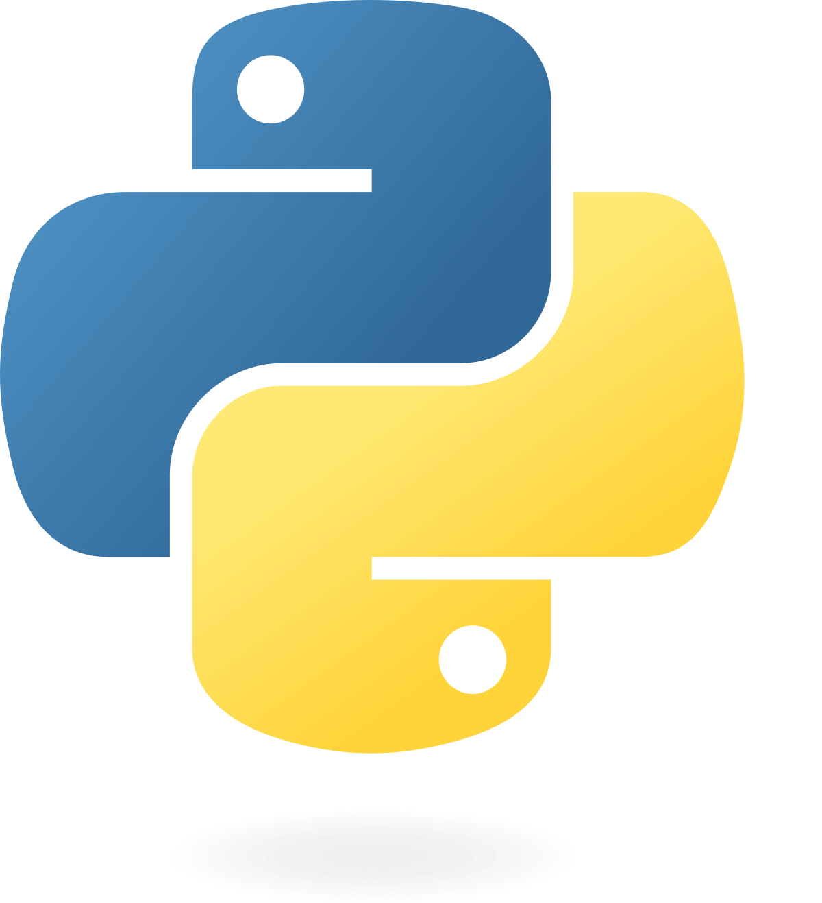



Extending the power of Copilot Analytics with R and Python
R and Python
Viva Insights integration
Why R and Python?
Advanced Analytics & Modeling
Run machine learning, causal inference, and predictive models.
Viva Insights
Automated Workflows
Build repeatable pipelines for reporting and analysis.
Data export capability
Viva Insights allows export of Copilot metrics as .csv via the Analyst Portal.
Organizational Network Analysis (ONA)
Perform deep ONA using graph-based libraries.
Powerful Visualization
Create custom dashboards and interactive plots.
Flexible tooling
Analysts can load data into R or Python, depending on preference.
Scalability & Performance
Handle large datasets efficiently.
Seamless workflow integration
Ideal for embedding into existing data science pipelines
Tailored Libraries: vivainsights
Available in both R and Python. Includes functions for:
Data validation
Exploratory analysis
ONA
Visualization

Slide 49


Open-source tools for Viva Insights
R and Python
vivainsights R library
aka.ms/VivaInsightsR
vivainsights Python library
aka.ms/VivaInsightsPy
Install from CRAN
Install from Python Package Index (PyPI)
install.packages("vivainsights")
pip install vivainsights
Notes:
TALK TRACK:
Here, we would like to introduce the open-source tools for Viva Insights.
They are a set of packages, written in R and Python respectively, that will help you:
Achieve the Analyst needs mentioned previously
Get more out of Viva Insights
Delivering better analysis and insights, faster
Here are the links on the documentation for each library, and the code to install them.

Slide 50

Open-source tools for Viva Insights
R and Python
Essentials
Advanced
Data Import / Export
Network analysis
Import CSV from flexible queries and export plots and output analysis in a wide range of formats.
Network visualization based on group / person collaboration.
Data Validation
Text mining
Automated data validation report for Viva Insights data.
Text mining meeting subject lines.
Community Detection
Plotting / Data Viz
Understand structure of your organization.
60+ pre-built visuals.
Quickstart Reports
Information Value
Automated reports to establish baselines quickly.
Calculate feature importance with employee sentiment data.
Notes:
TALK TRACK:
Earlier, we introduced a hierarchy of Analyst needs, composing of Essential needs and Advanced needs.
The R and Python packages contain features to address both.
On the LHS with the Essentials features, we have…
On the RHS with the Advanced features, we have…
NOTE:
The network analysis features are experimental features that we have, to test the efficacy of the upcoming ONA experiences in the main product. If R and Python is part of your analysis toolkit, as a customer you can use these to experiment with ONA capabilities.

Slide 51
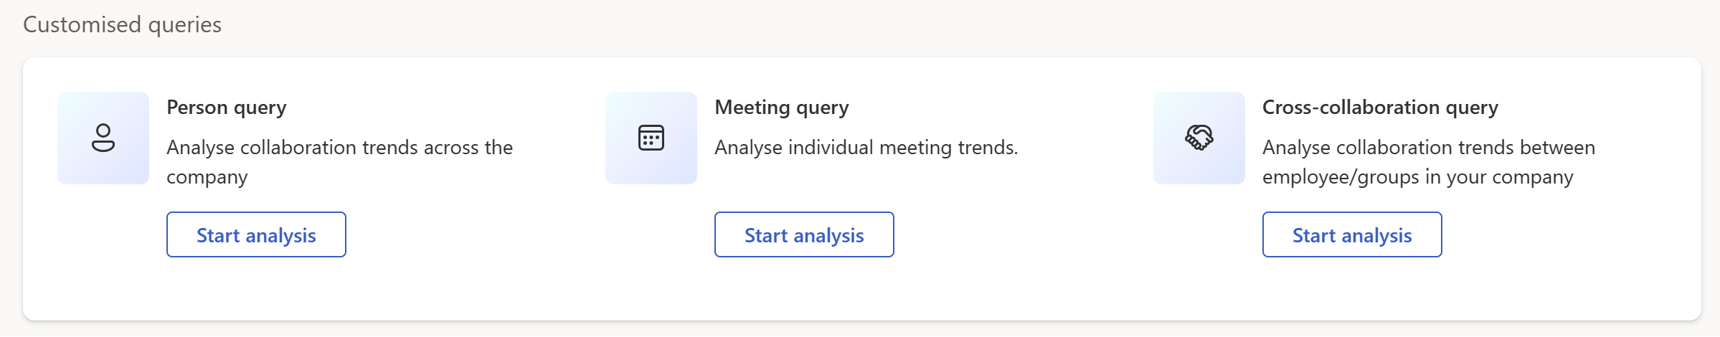
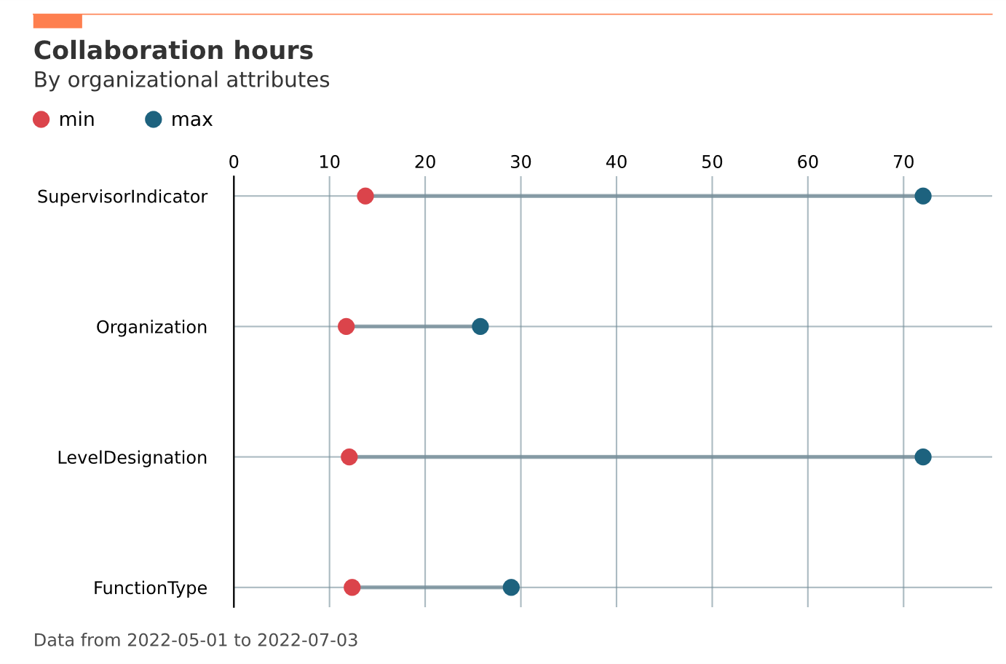
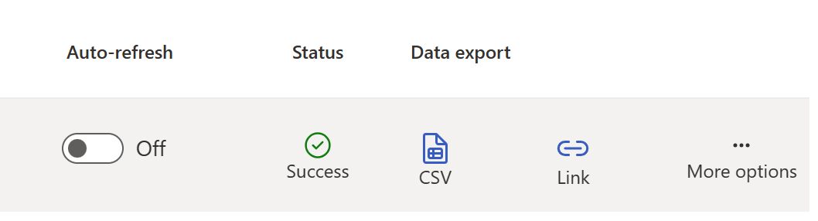
How does it work?
R and Python
Generating analysis with the R/Python libraries is a simple three-step process.
1
2
3
Run query in Analyst Experience and export data as CSV.
Load data into R or Python, using the vivainsights package.
Run code and generate analyses/ visualization.
library(vivainsights)
pq_df <- import_query(“pq.csv”)
import vivainsights as vi
pq_df = import_query(“pq.csv”)
Notes:
TALK TRACK:
So how does it work?

Slide 52


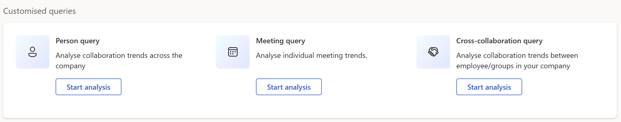
Guide: From Queries to Use Cases
R and Python
Query type
Analysis options
Use cases
Data validation
Exploratory data analysis
General data visualization
Survey correlations
Time-series analysis
Identify and address wellbeing challenges
Drive productive behaviour
Improve focus and innovation
Understand drivers of churn and engagement
Improve collaboration practices… and more
Data validation
Text mining
Improve meeting effectiveness
Enhance operational effectiveness
Organization Network Analysis
Community detection
Network viz
Centrality calculations
Improve manager effectiveness
Identify silos
Improve information flow
Optimize initiative rollout with influencers
Workspace planning
Notes:
TALK TRACK:

Slide 53
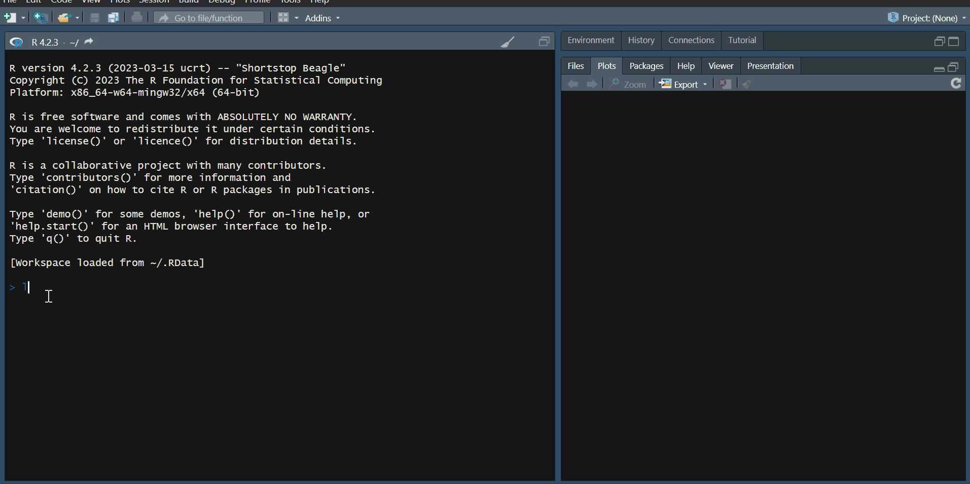
Example of generating a network visualization using the R library – RStudio
R and Python
Notes:
TALK TRACK:
Here is an example of the experience in the R library, and how you can generate a network visualization with just a few lines of code.

Slide 54
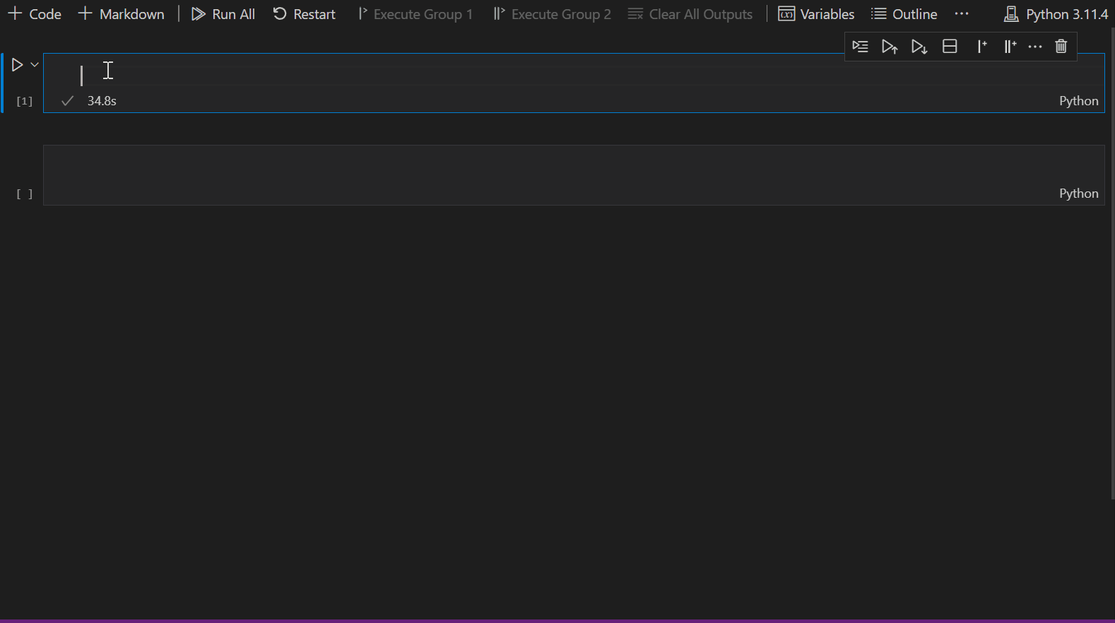
Example of generating a visualization using the Python library – Visual Studio Code
R and Python
Notes:
TALK TRACK:
And you can do the same with the Python library, run on a Jupyter notebook.
This time the example here shows a people-averaged bar chart of Emails sent across organizations.

Slide 55
Use cases
Data validation
Exploratory data analysis
Usage segments
Notes:
TALK TRACK:
Let’s now talk through a few use cases on what you can do with the R and Python libraries.

Slide 56


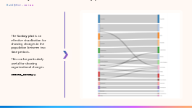
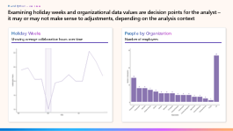
Data Validation
R and Python – use cases
Starting a piece of analysis by gaining a good understanding of the structure and the nature of the data is critical. Data validation helps analysts avoid blindspots and making errors in inferring conclusions from the data.
Scenario
Example code
Example outputs
There may be scenarios where the data can be inconsistent with the analysis goal. For instance,
Inactive individuals, public holidays, or non-knowledge workers.
Outliers in collaboration behavior.
Organizational data may be overly granular (small groups) or static (same over time).
identify_outlier(data, group_var = "MetricDate", metric = "Collaboration_hours")
R
library(vivainsights)
identify_outlier(
data = pq_data,
group_var = "MetricDate",
metric = "Collaboration_hours“
)
Function examples
`identify_holidayweeks()`
`identify_inactiveweeks()`
`identify_nkw()`
`identify_outlier()`
`identify_tenure()`
`validation_report()`
Python
import vivainsights as vi
vi.identify_outlier(
data = pq_data,
group_var = "MetricDate",
metric = "Collaboration_hours“
)
Notes:
TALK TRACK:
Why might you want to perform data validation?
When I am working with customer, before we start any analysis I always suggest doing some data checks and validation
There are several reasons why you might want to do this…
Inactive individuals or public holidays may skew collaboration activity
Outliers may occur naturally, but should be excluded as they do not represent the general org
Organizational data may be overly granular (small groups) or static (same over time), resulting in lower interpretability or reliability

Slide 57
Data Validation Report
R and Python – use cases
Self-serve report providing guidance and recommendations to the user by leveraging 15+ data validation functions.
1
2
3
Review settings
Assess Organizational Data Quality
Assess M365 Data Quality
Review distribution of Outlook Settings and impact on after-hours calculation.
Review meeting exclusion rules and identify if common exclusion terms remain in the data.
Review attributes available, excess of unique values and missing values.
Identify groups under privacy threshold/required to be excluded from reports.
Explore distribution of employees in key org. attributes.
Check if the organization data has been updated during the period of analysis.
Review quality of hire date/
tenure data.
Review measured population over time.
Identify possible non-knowledge workers (persistent low collaboration activity).
Identify company wide holiday weeks (global fall in collaboration activity).
Identify individual inactive weeks (individual fall in collaboration activity).
Review extreme values for key metrics (high collaboration outliers).
Demo link: Data Validation Report (microsoft.github.io)
|
Note: currently only available in the R package
Notes:
TALK TRACK:
To make it easier to run all the data validation tests in one go, we have created a Data Validation Report that performs all these tests on a Person Query.

Slide 58
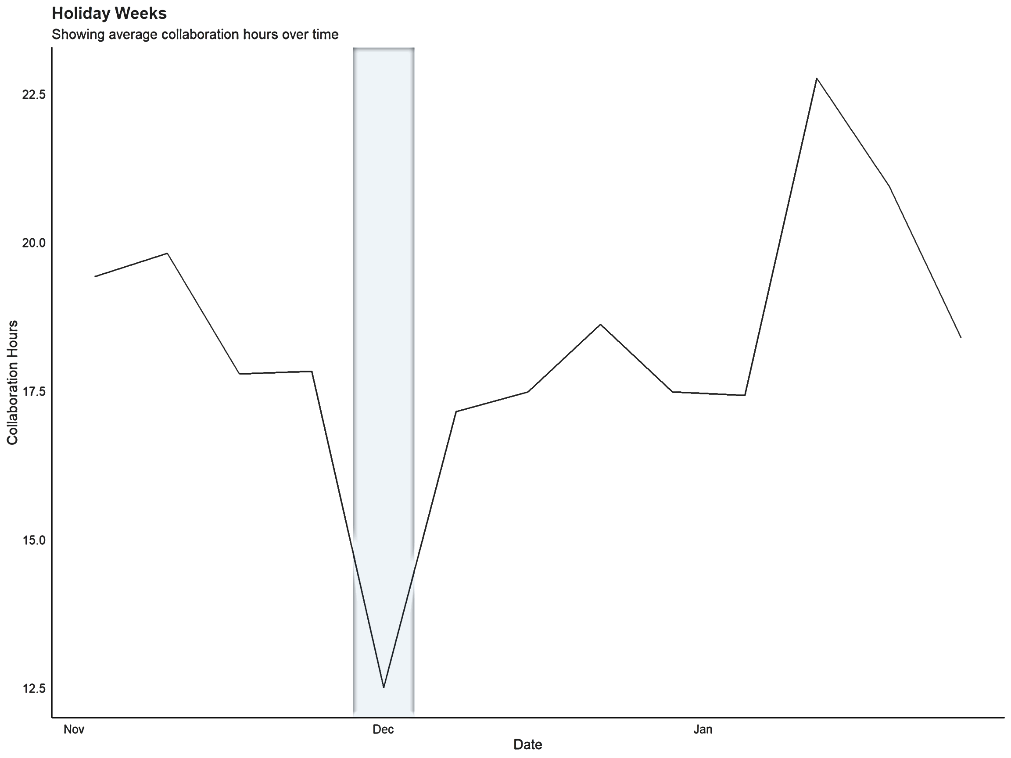
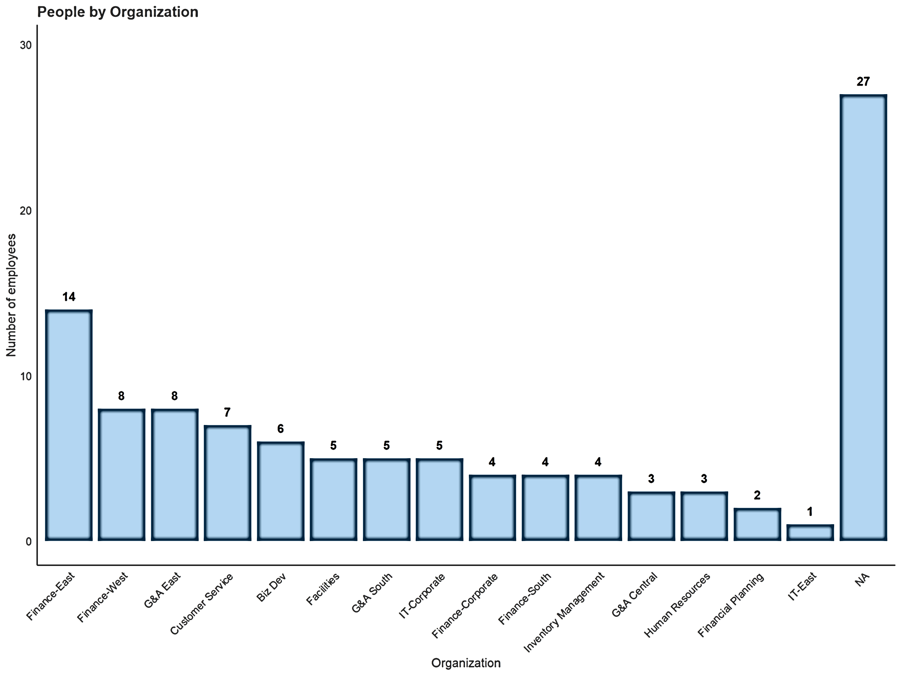
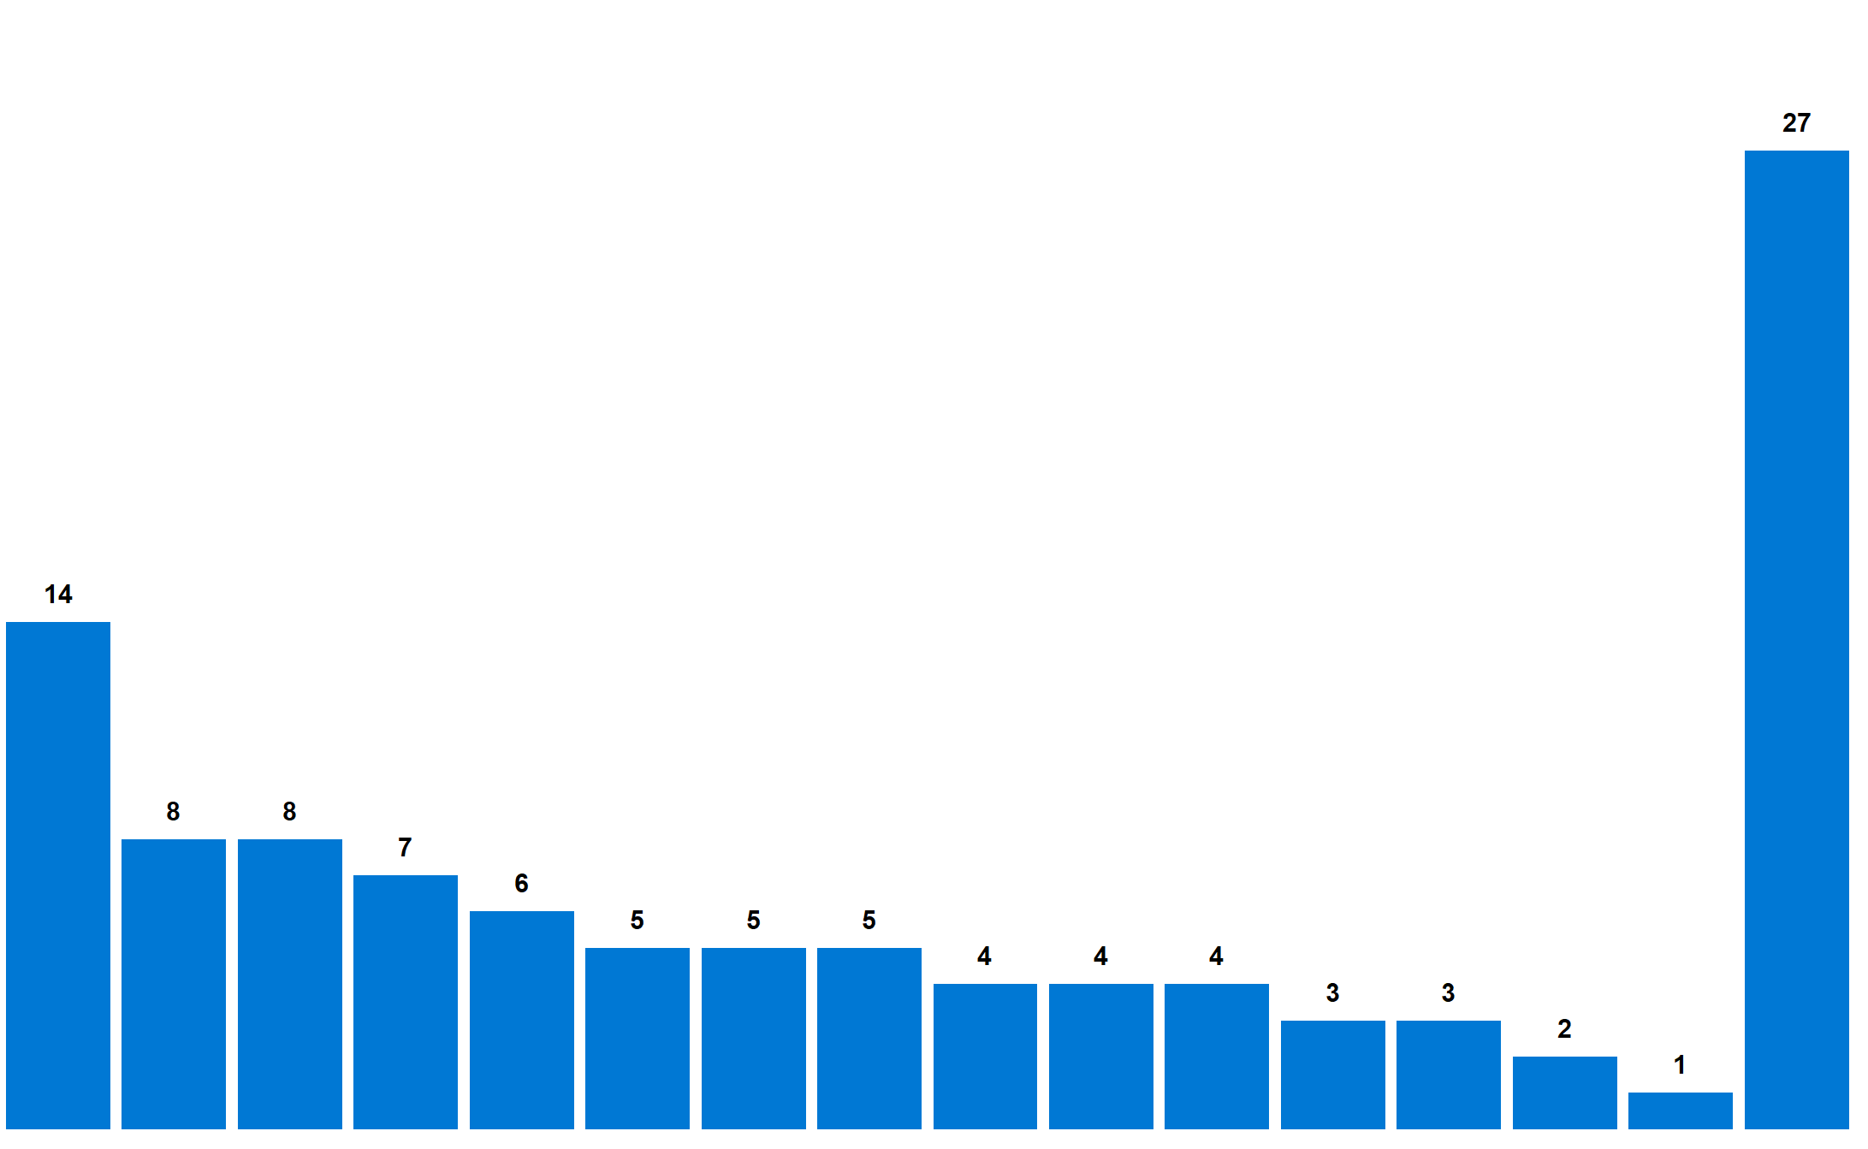
Examining holiday weeks and organizational data values are decision points for the analyst – it may or may not make sense to adjustments, depending on the analysis context
R and Python – use cases
Holiday Weeks
People by Organization
Showing average collaboration hours over time
Number of employees
Notes:
TALK TRACK:

Slide 59
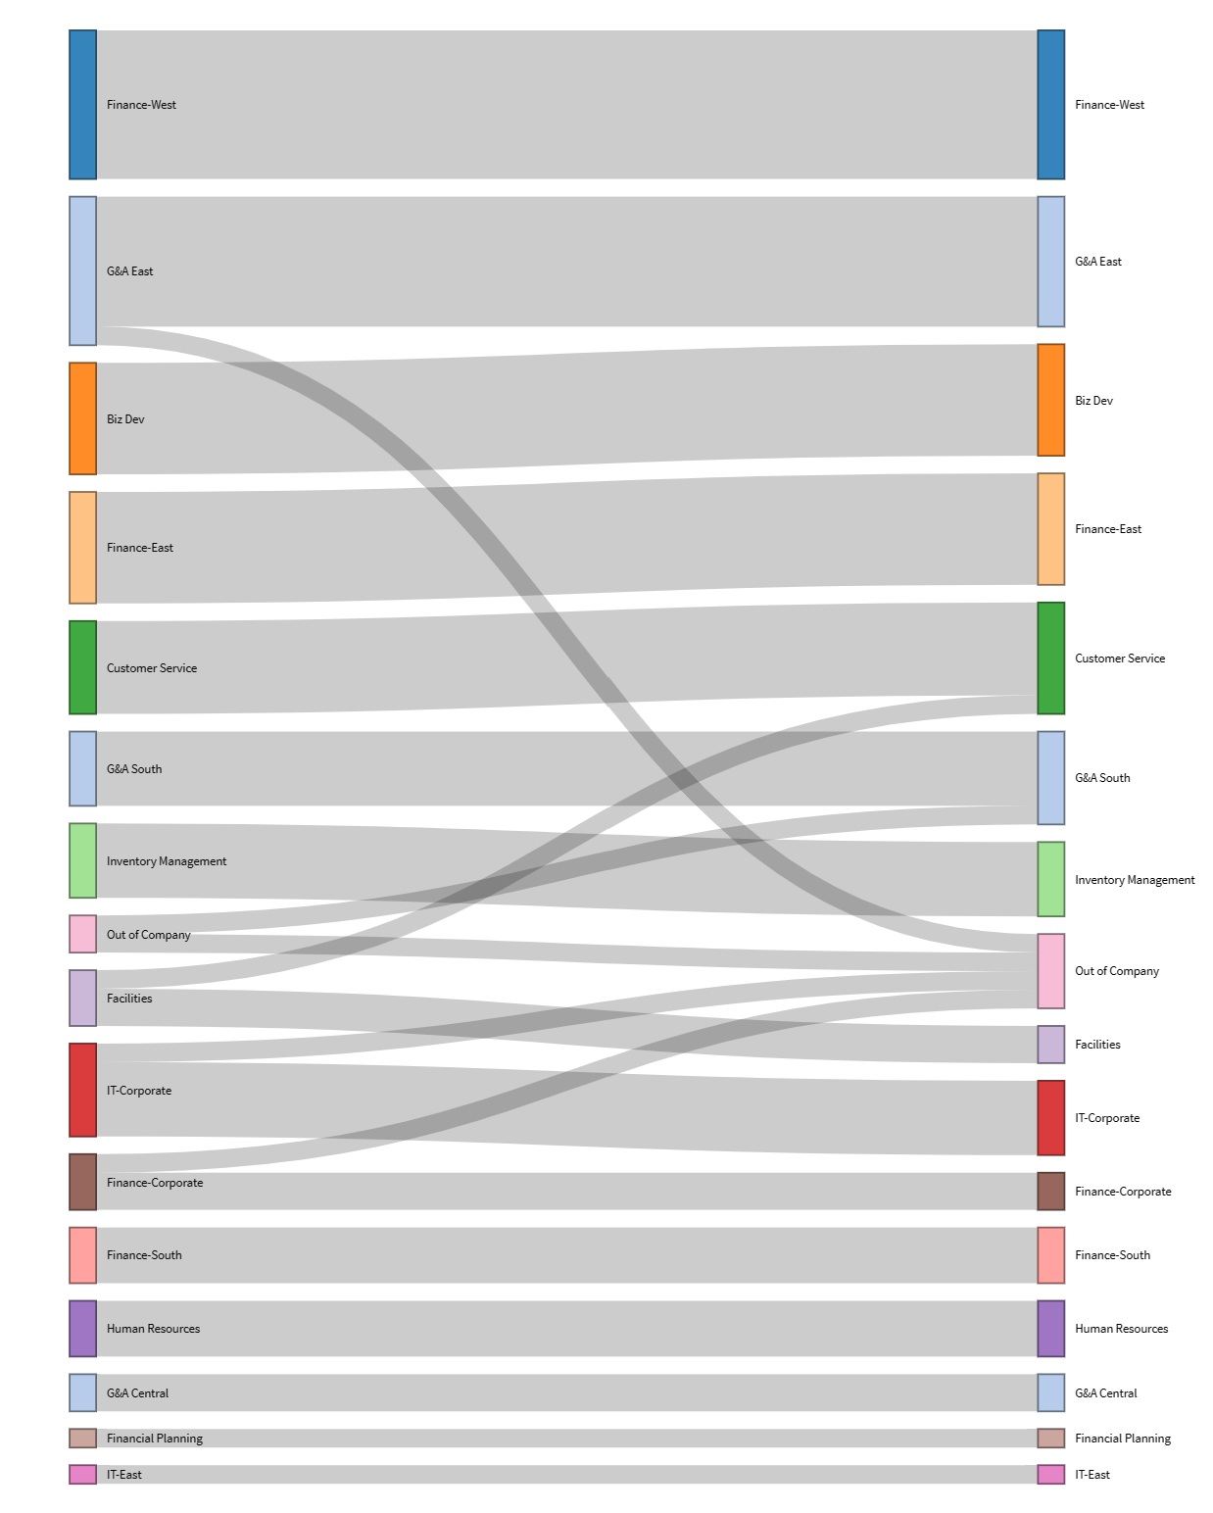
R and Python – use cases – Sankey plot
R and Python – use cases
The Sankey plot is an effective visualization for showing changes in the population between two time periods.
This can be particularly useful for showing organizational changes.
create_sankey()
Notes:
TALK TRACK:

Slide 60
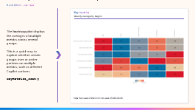
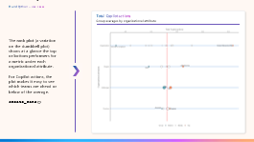
Exploratory Data Analysis
R and Python – use cases
Exploratory analysis helps analysts surface the initial hypotheses around Copilot adoption and impact. This helps save time as it helps analysts to identify the key relevant hypotheses to test when addressing business questions.
Scenario
Example code
Example outputs
Exploring the query, the population, or an organizational attribute for the first time.
Evaluating a segmentation or classification (e.g., top performers, Power Users of Copilot, top engagement).
create_rank()
R
library(vivainsights)
create_rank(
data = pq_data,
hrvar = c("FunctionType", "LevelDesignation"),
metric = "Total_Copilot_actions_taken",
return = "table"
)
Function examples
Python
`create_rank()` – rank all possible groups in the dataset by their averages of a VI metric.
`keymetrics_scan()` – view averages of the key VI metric across an org attribute dimension.
import vivainsights as vi
vi.create_rank(
data = pq_data,
hrvar = ["FunctionType", "LevelDesignation"],
metric = "Total_Copilot_actions_taken",
return_type = "table"
)
Notes:
TALK TRACK:
Exploratory data analysis is another key use case, where the goal is to surface initial hypotheses around a dataset.
Useful when you don’t know what you don’t know!
Scenarios:
Understand your summary statistics, what are the most frequent meeting durations, whats the average collaboration hours, and understanding the variations between the different organizational attributes available such as location, organization or level designation. You can also use it to setting you internal benchmarks on different metrics. Many of my customers leverage exploratory data analysis or the different functions that we have available in these open source tools to measures the impact of different initiatives by looking at the before and after averages of the relevant viva insights metrics. So for example if you are creating an initiative around improving employee wellbeing you might want to have a look at the overall collaboration hours and after hours, their collaboration span, or the working patterns, are employees taking breaks throughout the day, do they have focus time to get things done, etc.

Slide 61
Automatic exploratory analysis accelerates hypothesis generation and reduces blind spots when seeking to target an organizational challenge
R and Python – use cases
Pinpointing the challenge
`create_rank()`
is an automatic exploratory function loops through the different combinations of HR attributes in your data and ranks them from top to bottom for a given metric.
In a complex organization with multiple ways of delineating groups, it is not often easy to pinpoint the source of an organizational challenge.
A challenge could be:
High collaboration overload.
Inefficient meeting practices.
Low network connections.
Analysts have to confirm whether the challenge is localized to:
Organizations.
Regions.
Job roles.
…. or a mixture of the above.
Example output
Delineation | Group | Total Copilot actions taken | n
Organization | APAC | 17.8 | 91
FunctionType | Communications | 11.2 | 62
LevelDesignation | L2 | 9.8 | 119
LevelDesignation | L1 | 9.0 | 290
Organization | Finance | 8.6 | 87
...
Organization | Finance | 2.7 | 204
Organization | Marketing | 2.3 | 150
FunctionType | Operations | 2.2 | 99
Organization | Product Development | 2.2 | 113
FunctionType | Supply Chain | 1.5 | 83
Top 5 affected groups
Bottom 5 affected groups
Notes:
TALK TRACK:

Slide 62
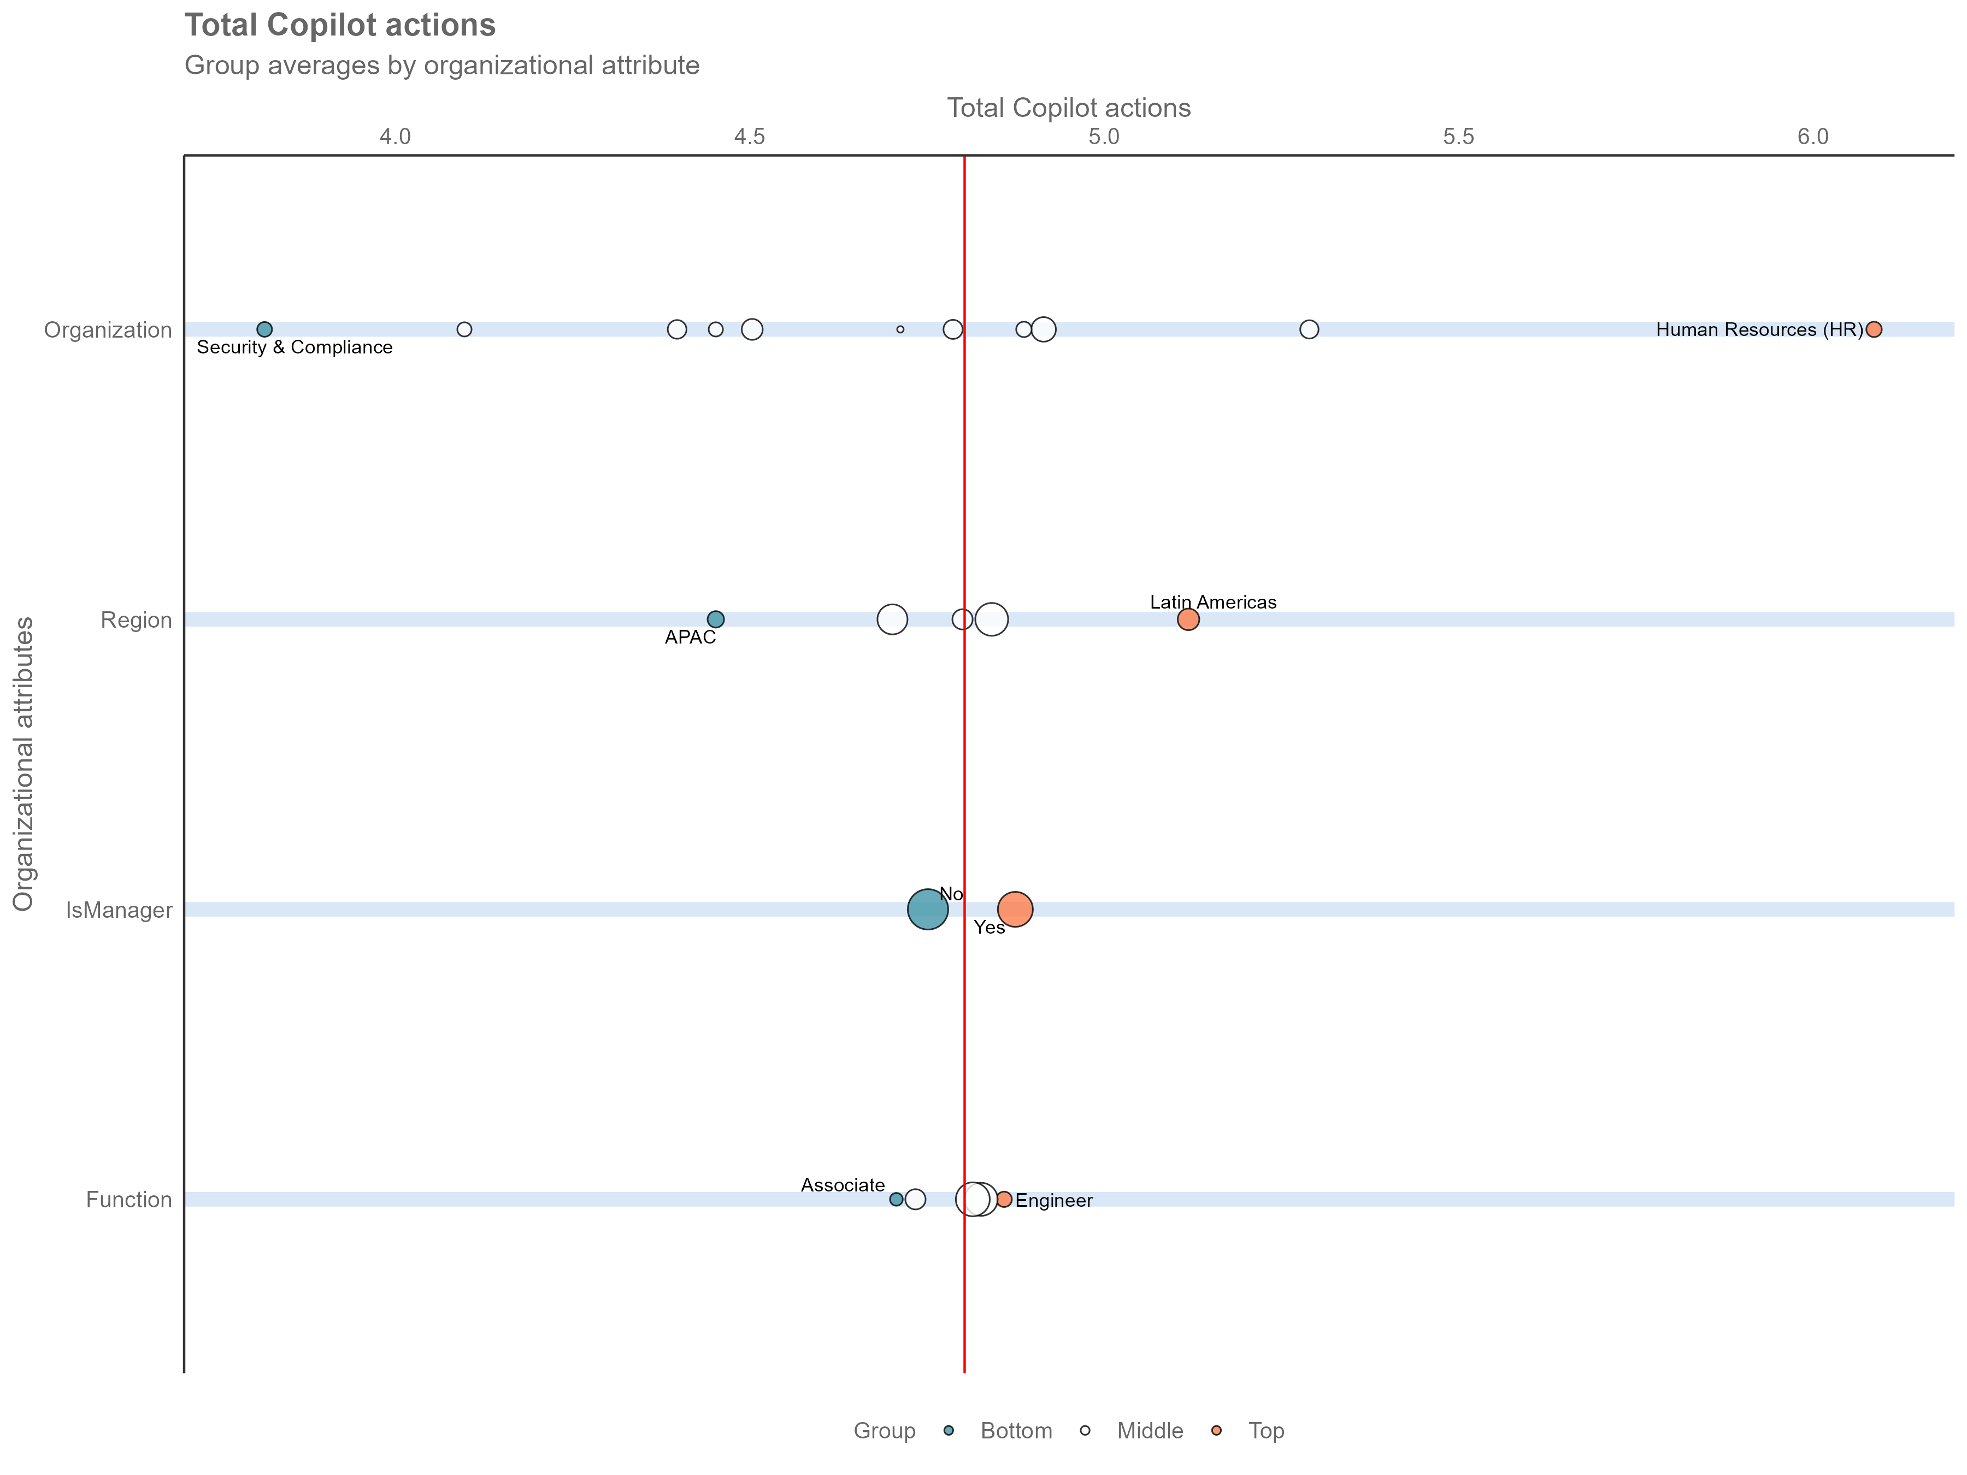
R and Python – use cases – Rank Plot
R and Python – use cases
Total Copilot actions
Group averages by organizational attribute
The rank plot (a variation on the dumbbell plot) shows at a glance the top or bottom performers for a metric under each organizational attribute.
For Copilot actions, the plot makes it easy to see which teams are ahead or below of the average.
create_rank()

Slide 63
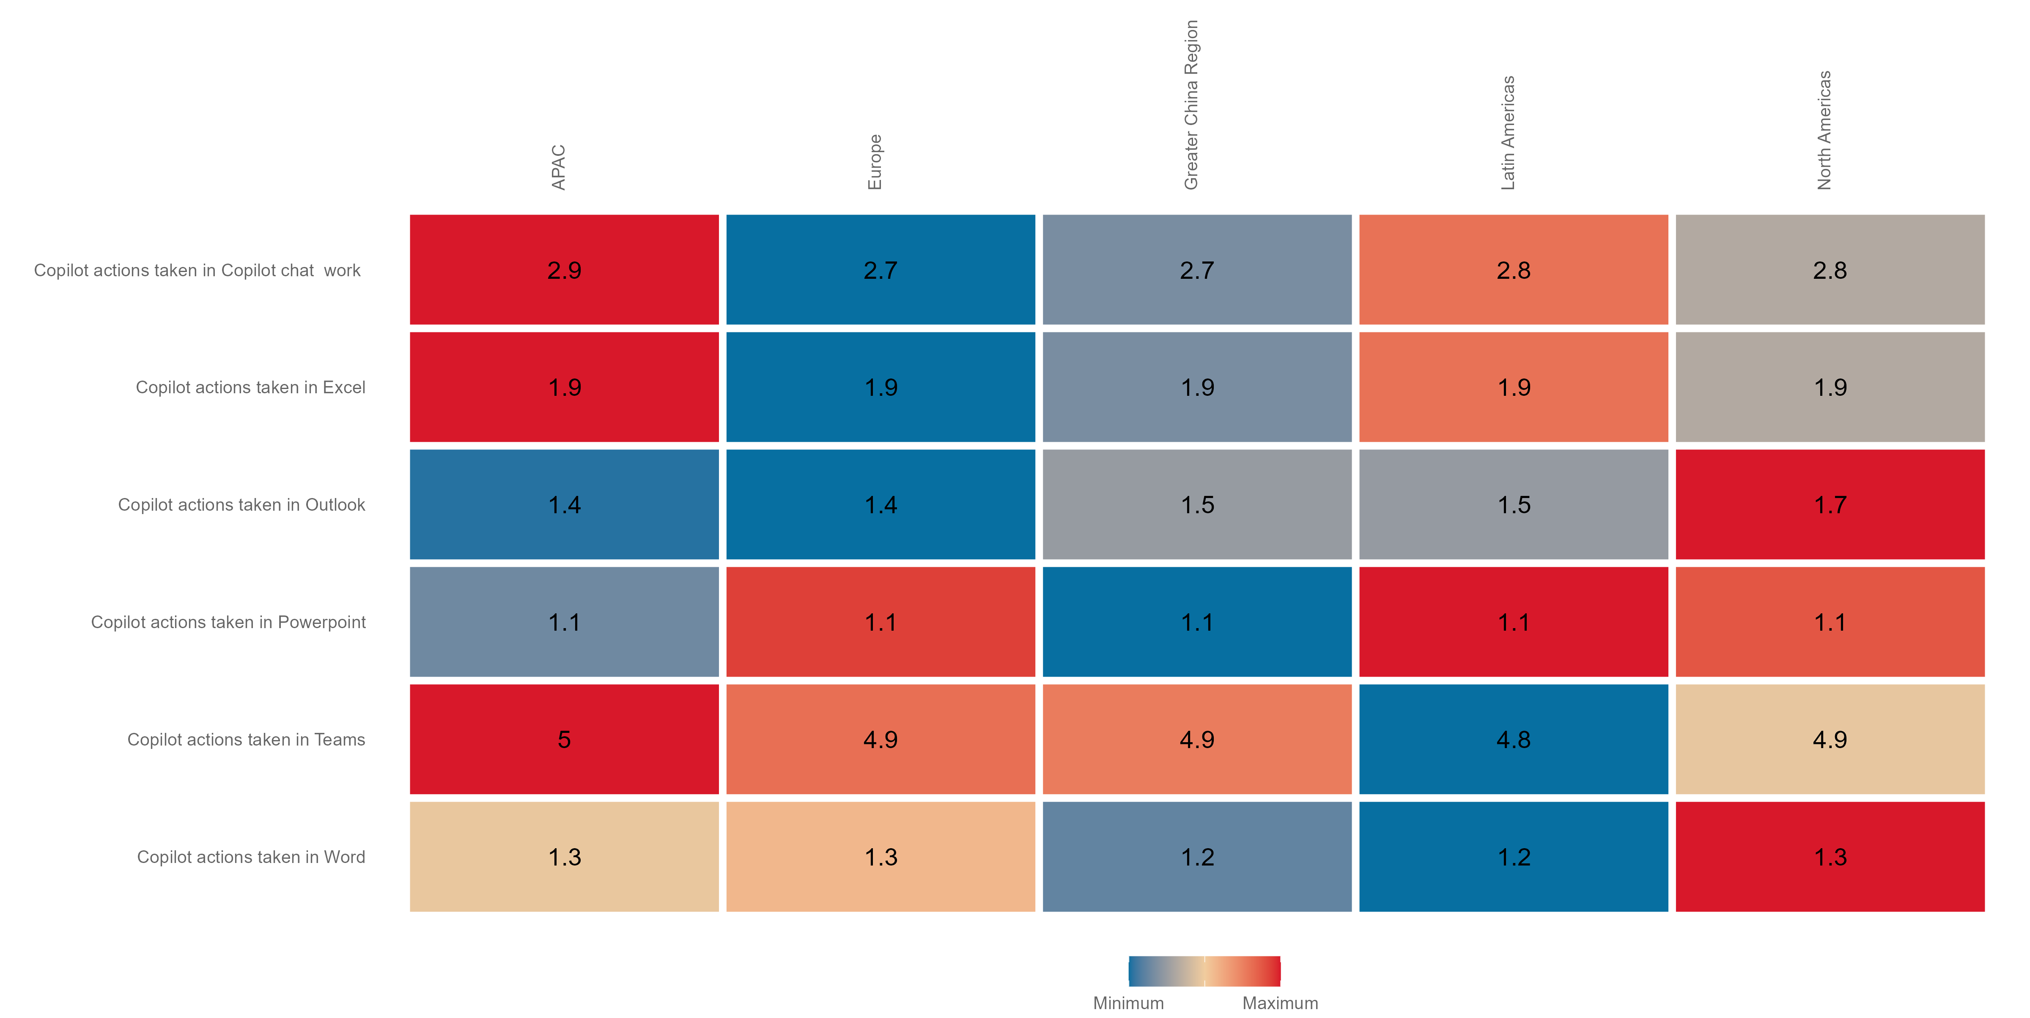
R and Python – use cases – Heatmap Plot
R and Python – use cases
Key metrics
Weekly average by Region
The heatmap plot displays the averages of multiple metrics across several groups.
This is a quick way to explore whether certain groups over or under perform on multiple metrics, such as different Copilot surfaces.
keymetrics_scan()
Data from week of 2023-10-15 to week of 2025-06-08
Notes:
TALK TRACK:

Slide 64
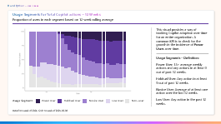
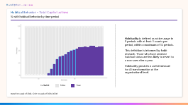
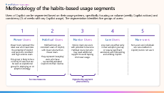
Copilot Usage Segments
R and Python – use cases
An actionable segmentation framework identifying groups that have achieved consistent adoption of Copilot (Power Users, Habitual Users) as well as segments like Novice Users which indicate an opportunity to target interventions.
Scenario
Example code
Example outputs
Measure and benchmark the progress of Copilot adoption.
Going beyond average usage volume to understand how different users are adopting Copilot, as the adoption distribution can be very skewed.
create_rank()
R
library(vivainsights)
identify_usage_segments(
data = pq_data,
metric = “Total_Copilot_actions_taken",
return = “plot"
)
Python
Function examples
import vivainsights as vi
vi.identify_usage_segments(
data = pq_data,
metric = “Total_Copilot_actions_taken",
return_type = “data"
)
`identify_habit()` - identifies whether a user has formed a habit over a given interval of time.
`identify_usage_segments()` - classifies segments based on a given metric – Total Copilot actions taken.

Slide 65
Methodology of the habits-based usage segments
R and Python – use cases
Users of Copilot can be segmented based on their usage patterns, specifically focusing on volume (weekly Copilot actions) and consistency (% of weeks with any Copilot usage). The segmentation identifies five groups of users:
1
2
3
4
5
Power Users
Habitual Users
Novice Users
Low Users
Non-users
Power Users represent the ideal user who maximizes the potential of Copilot and are both consistent and high-volume users.
This group is likely to be a minority of users but can be seen as aspirational group for deploying an AI adoption strategy.
Habitual Users are consistent users of Copilot, with lower volume than Power Users.
They represent ‘everyday’ users who have successfully adopted Copilot into their routine.
Novice Users are users with potential to become Habitual Users, but who may need additional support to avoid lapsing into lower usage.
Low Users are either early in their adoption journey or require significant assistance with onboarding and utilizing Copilot.
Non-users are individuals who are enabled on Copilot, but do not use it.
Success measures
Opportunity segment
(intervention)

Slide 66
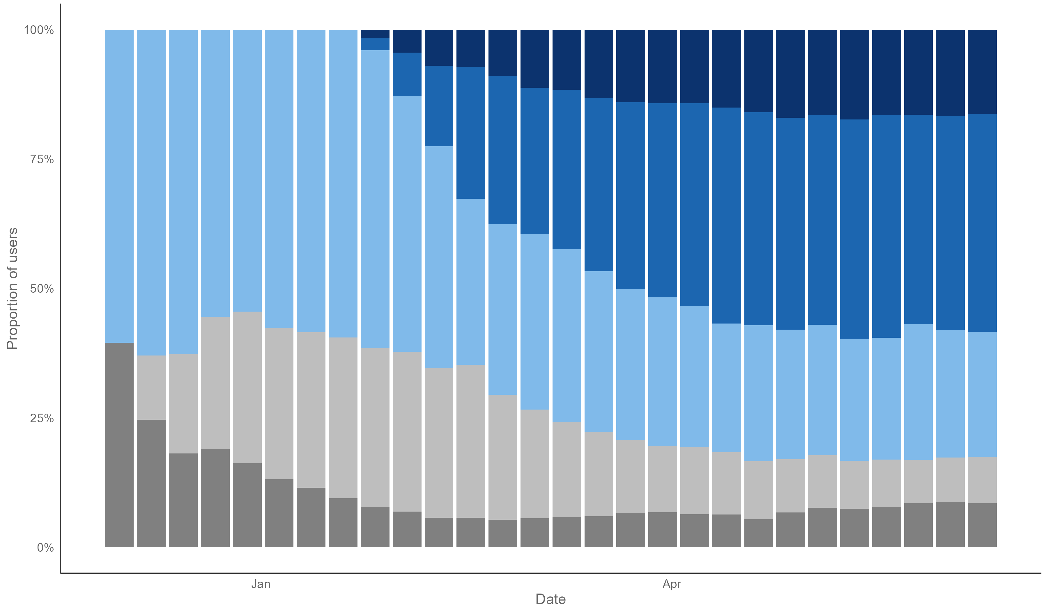
Usage Segments for Total Copilot actions – 12 Weeks
R and Python – use cases
Proportion of users in each segment based on 12-week rolling average
This visual provides a way of tracking Copilot adoption over time for an entire organization. A common KPI is to check for the growth in the incidence of Power Users over time.
Usage Segments – Definition:
Power User: 15+ average weekly actions and any actions in at least 9 out of past 12 weeks.
Habitual User: Any action in at least 9 out of past 12 weeks.
Novice User: Average of at least one action over the last 12 weeks.
Low User: Any action in the past 12 weeks.
Usage Segment:
Power User
Habitual User
Novice User
Low User
Non−user
Data from week of 2024-12-01 to week of 2025-06-08
Notes:
TALK TRACK:

Slide 67
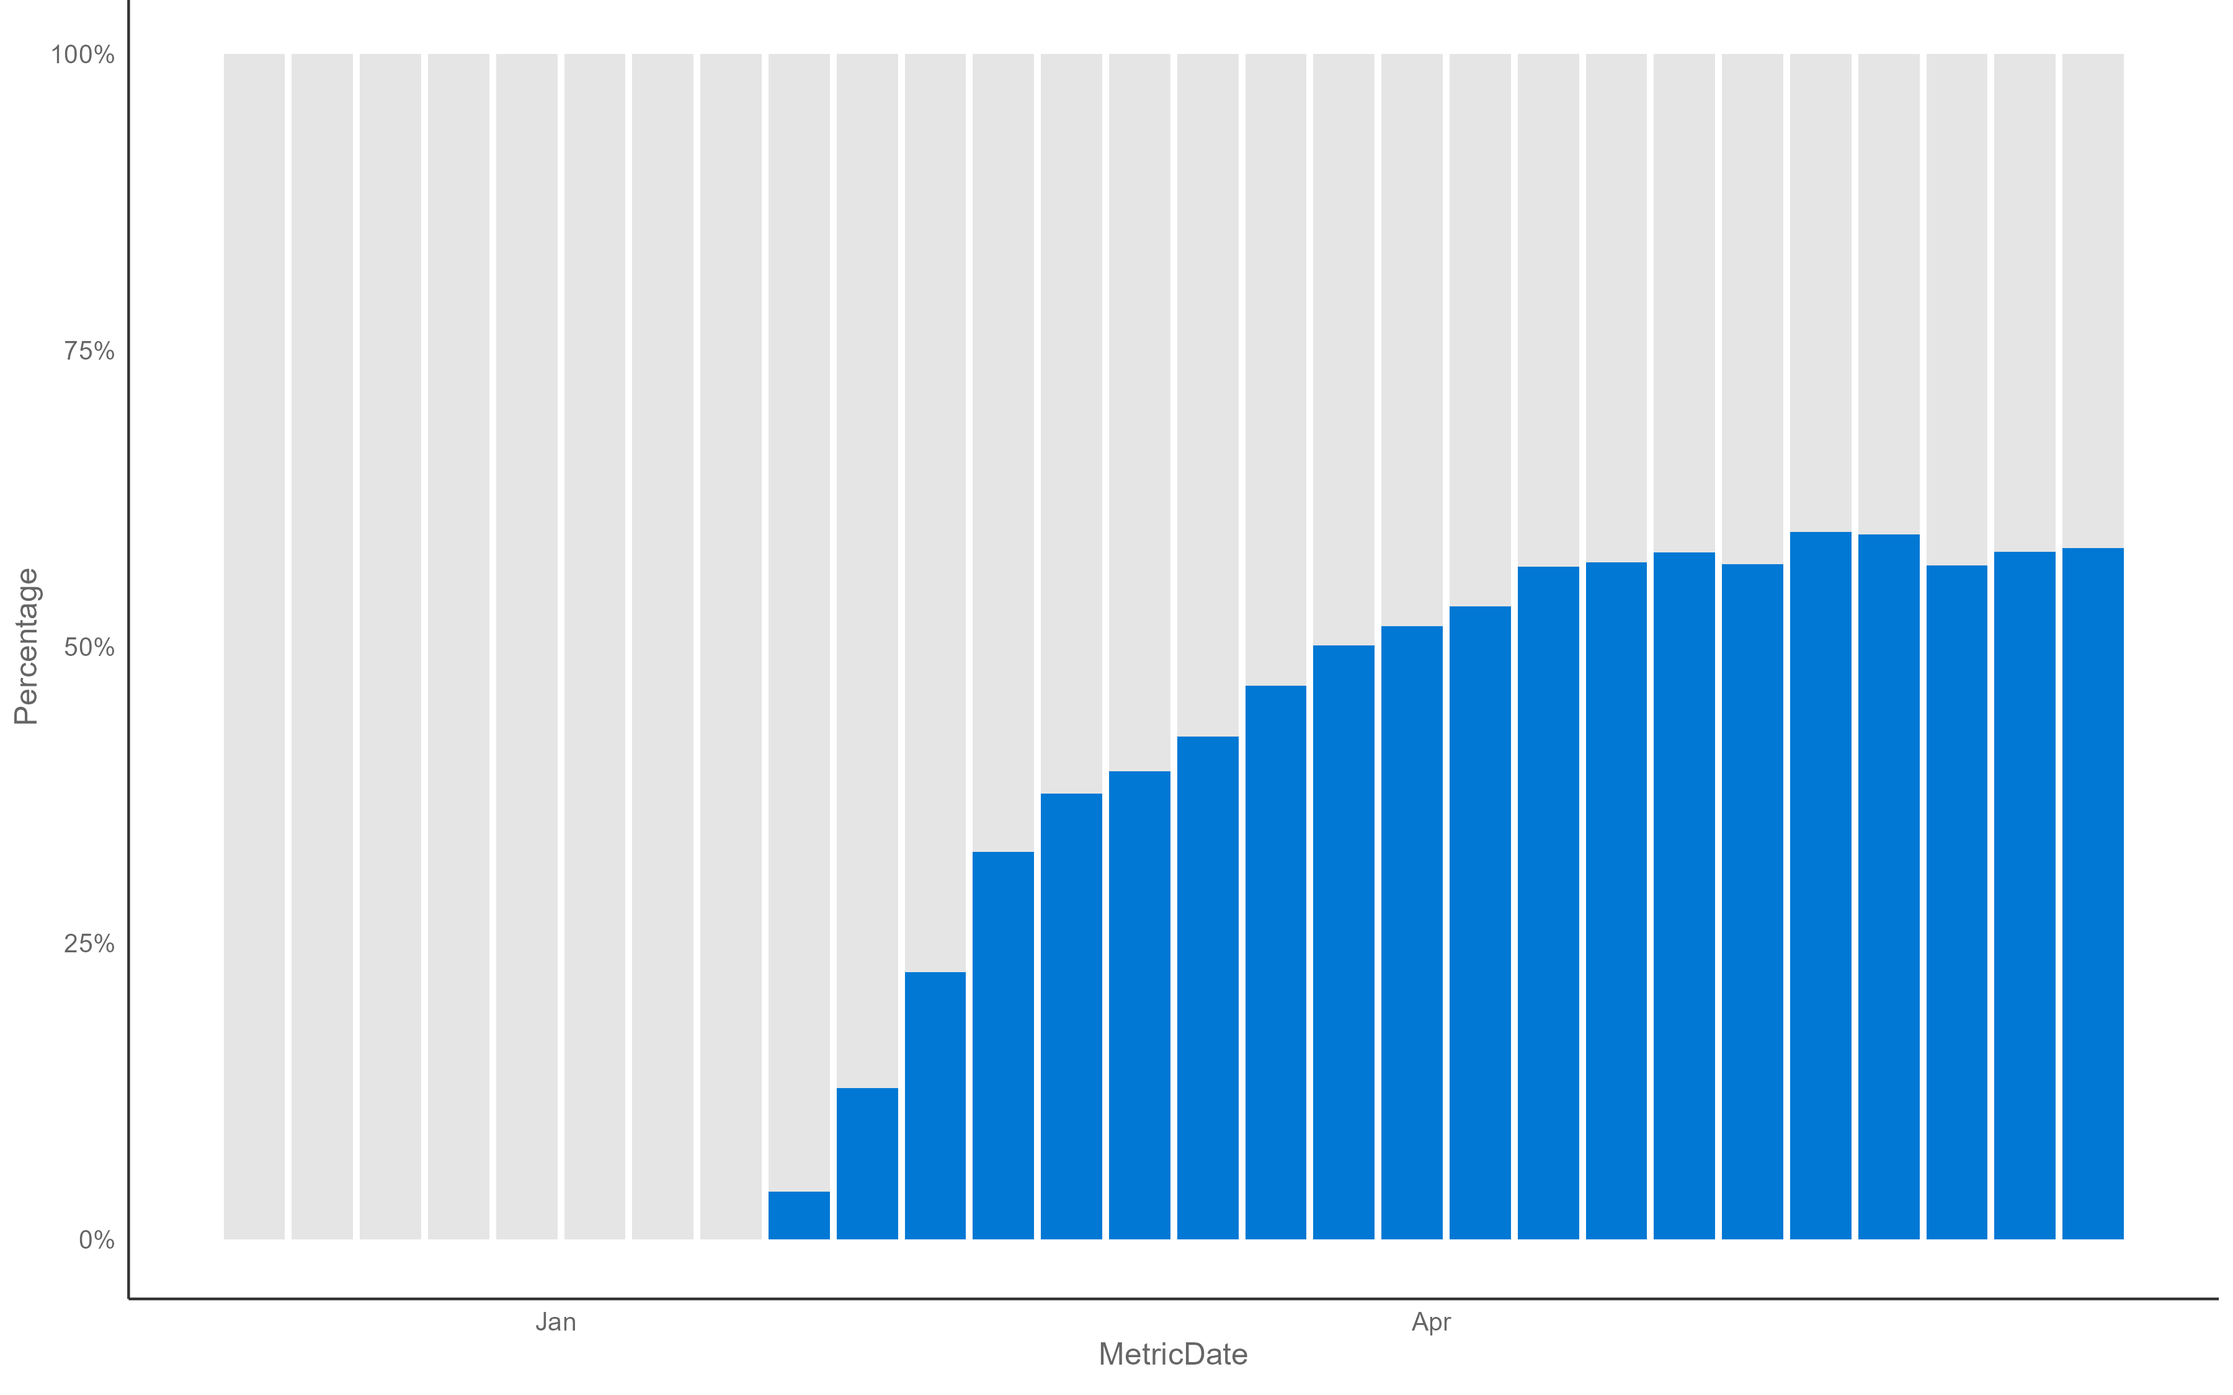
Habitual Behavior – Total Copilot actions
R and Python – use cases
% with habitual behavior by time period
Habituality is defined as active usage in 9 periods with at least 1 counts per period, within a maximum of 12 periods.
This definition is informed by habit research. Those who have attained habitual status are less likely to revert to a non-user after a year.
Habituality provides a useful measure for AI transformation at the organizational level.
Is Habit:
False
True
Data from week of 2024-12-01 to week of 2025-06-08
Notes:
TALK TRACK:

Slide 68
Get involved in our Viva Insights open-source community!
Submit feature requests
or bug reports.
Contribute sample
code snippets.
Contribute an
article.
https://github.com/microsoft/vivainsights/issues/
https://github.com/microsoft/vivainsights-py/issues/
https://github.com/microsoft/viva-insights-sample-code/
Email: martin.chan@microsoft.com
Request a demo for your
Analyst Team.
Fork and submit a pull request.
Get in touch!
Aka.ms/VivaInsightsR
Aka.ms/VivaInsightsPy
Email: martin.chan@microsoft.com
Notes:
TALK TRACK:
And that covers are use cases and most of what we wanted to cover with you in this call. But there are different ways that you can get involved in the our Viva Insights open source community. You can submit any feature requests of report any bugs in the links shown to you on the screen. You can also contribute with sample code snippets, link for that on screen as well and if you want to request a demo or contribute to an article feel free to reach out.

Slide 69

Thank you for reading!
In this playbook, you should have learnt how to:
Plan a Copilot Analytics measurement program.
Choose amongst the out-of-the-box tools before setting up a custom measurement program.
Set up Viva Insights to access custom analysis capabilities for Copilot Analytics, including steps such as assigning roles and preparing organizational data (including survey and business outcome data).
Run queries.
Putting together an analysis plan and analyzing them in R or Python.
If you have further questions, you can find more from our MS Learn documentation.
In the next several pages, you will find links to more resources to help you on your journey of Copilot adoption.

Slide 70
Link to other resources
Copilot Analytics – official documentation.
Recommendations on creating an analysis plan - Advanced analysis playbook.
R library companion for Viva Insights: vivainsights.
Python library companion for Viva Insights: vivainsights.
Understanding Copilot ‘Super Users’: aka.ms/decodingsuperusage

Slide 71
Get started on your AI measurement journey today
Next steps
Available Microsoft services
Get started with the
Copilot Success Kit.
Find Partners to help with Microsoft 365 Copilot Analytics.
Microsoft 365 Copilot Partner Directory
Eligible customers can request technical
and deployment assistance.
Microsoft FastTrack
Get started on your Copilot journey
with expert-led services.
Microsoft
Unified
Define your Copilot rollout strategy.
Identify key business metrics for measurement.
Connect with your Microsoft representative for more information.
Notes:
Take the next steps to get started on your AI measurement journey today.
Our Copilot Success Kit

Slide 72
AI Measurement Resources, continued
Webinars: Accelerate value with Microsoft 365 Copilot
Learn articles:
Copilot Analytics
Copilot Dashboard
Copilot Business Impact Report
Viva Insights
Copilot Scenario Library

