Slide 1
Get started with
Microsoft 365 Copilot Chat in Word
Practical examples and how-tos for users without a Microsoft 365 Copilot license
September 2025

Slide 2
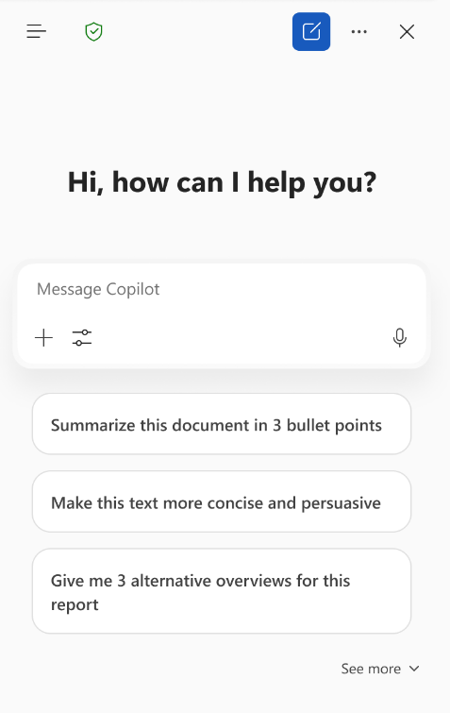
Copilot Chat in Word
With Copilot Chat in Word, you can create, edit, summarize and find information quickly and easily. Interact with your document to quickly find information or clarify details.
Copilot Chat also allows you to summarize or rewrite content quickly, helping you to work efficiently and share your ideas more clearly or in a tone that fits your audience.
Here are some ways that you can use Copilot Chat in Word
“Write a compelling intro paragraph for this document.”
“What are some questions a reader might have when going through this document?”
“Write a summary with the top 5 key points as a draft email that I can send to my team.​​​​​”

Slide 3

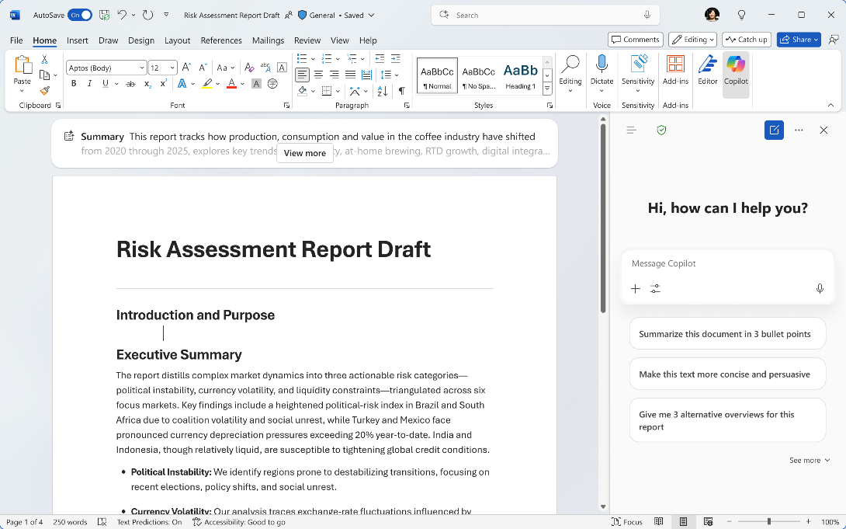


Starting a chat in Word
Enterprise data protection
shield – Indicates your data is protected
Navigation panel
Access agents and conversation history
Copilot
Open Copilot Chat from the ribbon
Start a new chat
More options – feedback and controls options
Close Copilot Chat
Prompt Box
Start your chat here
Add content
Add files and images to the prompt
Sample prompts
Suggested prompts that are tailored to your document with option to expand and see more
Access tools
Access agents in your chat
Start dictation
Interact with Copilot using your voice
Notes:
Open Copilot Chat from the ribbon—look for the Copilot icon.
Once you have the Chat window open you’ll see there are a lot of options packed into a small space. But luckily the UI is consistent across all of your apps so you’ll only need to learn it once.
The navigation panel lets you access agents and your conversation history. If you want to continue an old chat or reference information Copilot previously provided you can find that here. When you access an agent you will leave Copilot Chat and interact with that agent. You’ll need to go back to the Navigation panel if you want to use Copilot Chat again.
The enterprise data protection shield means your data is secure. You can start a new chat, access more options (like feedback and controls), and close the chat when done. When you start a new chat you have the option to start a temporary chat that won’t be saved in your conversation history.
The prompt box is where you start your conversation—add content, files, or images to enrich your chat. You can also access specialized agents like Designer and use voice dictation.
Sample prompts are tailored to your document, with options to expand and see more.

Slide 4
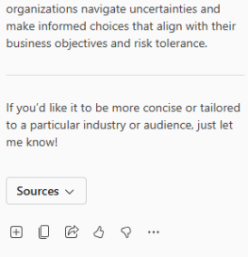

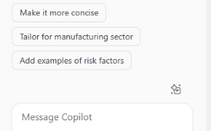
Copilot Chat in Word response
Add to doc
Insert the response into your document
Copy response
Copy the response to the clipboard to paste in another location
Share prompt and copy with response
Create a link for the prompt in Copilot Chat. Copies the prompt and response with the link to provide context
I like something
Provide positive feedback to your admin and Microsoft
Prompt response
See the response here. Click on Sources to find references to files or web sites used
I don’t like something
Provide positive feedback to your admin and Microsoft
Multi-turn suggestions
Continue the conversation with these suggestions to enhance your response or click on View Prompts to go to the Prompt Gallery
More options
Options to copy the response to a new document, have the response read aloud, or schedule the prompt for later
Prompt Box
Continue your chat here
Notes:
When you ask a question, Copilot will create a detailed response with references to files or websites used.
You can ask follow-up questions in the prompt box.
Insert responses directly into your document, copy them to the clipboard, or share them with others.
Use the feedback buttons to let Microsoft know what works well or what could be improved.

Slide 5


My Chat pane doesn’t look like the picture
We are squeezing a lot of capabilities into a small space so you may notice the chat pane is highly dynamic depending on its width. Here is what you may experience
Navigation panel
Chat title
New chat with temporary option
More options
Full width
Enterprise data protection shield
Close chat
Remove chat title
Move the Enterprise Data Protection shield next to Navigation panel icon
Move temporary chat option to more options
Min width
Notes:
With more space there is an opportunity to include more information in the Chat options bar. This slide will help make it clear when and where items appear so that you can always find the UI elements you need.
Note that the chat title will only appear if you have already entered a prompt in the chat session.
The other main change is that the way to create a temporary chat changes from a dropdown on the new chat button to a selection under More Options.

Slide 6
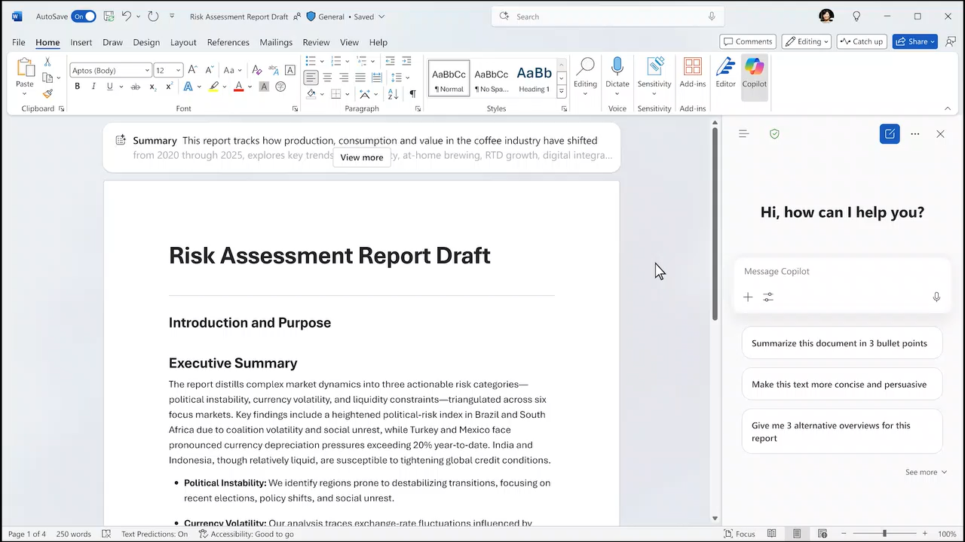
Copilot Chat in Word demo open file reference
Notes:
Here is a short 15 second demo of Copilot Chat in action. You can ask Copilot about the information in your Word file to create a summary or write new content.

Slide 7
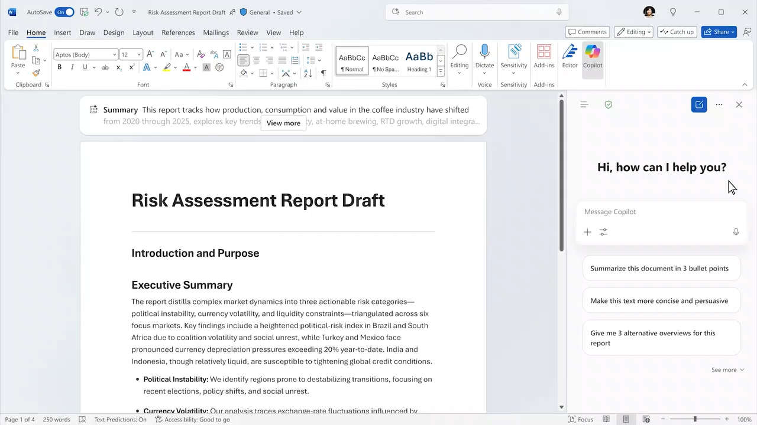
Copilot Chat in Word demo additional file reference
Notes:
In this second video you’ll see that you can still reference other files just as you would using chat in the Copilot app. So, if the information you need is in another file or on the web you don’t have to leave Word to find it. Copilot brings the answers you need right to your file and then you can insert the response into the file with one click.

Slide 8
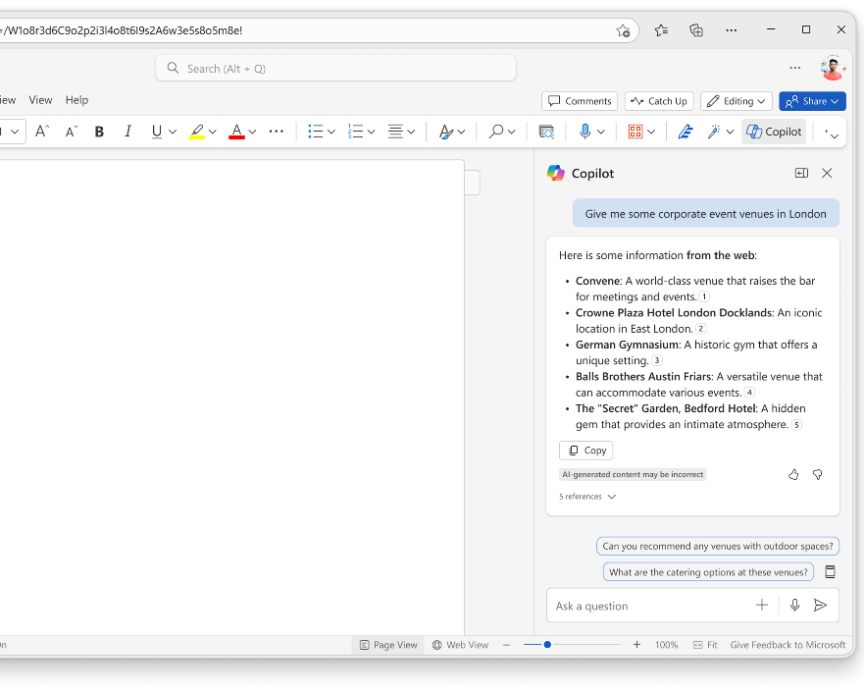
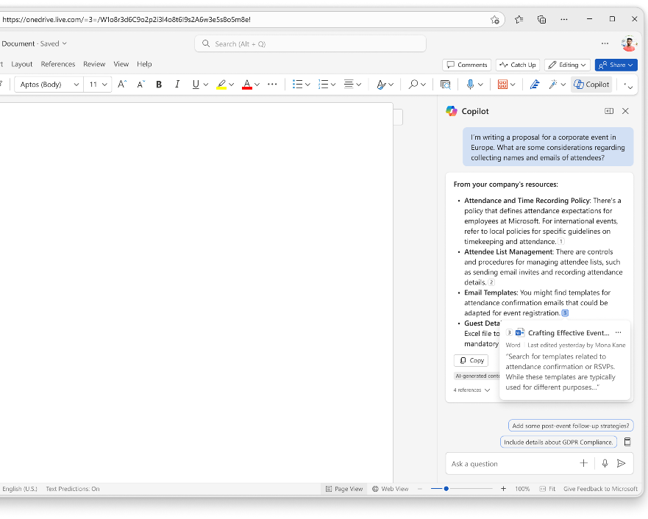
Ask open-ended questions and reference the web and work content
Notes:
In the Copilot Chat pane, you can also use Copilot to retrieve information from the web that is relevant to a general question you ask. Copilot Chat delivers quick, relevant, and current information in a conversational format, so you don’t have to sift through multiple search results or know exactly where to find the source information you’re looking for to support a general request. Ask about specific files, messages, or general information.
Copilot Chat also looks at search results across the web to offer you a summarized response and links to its sources.

Slide 9
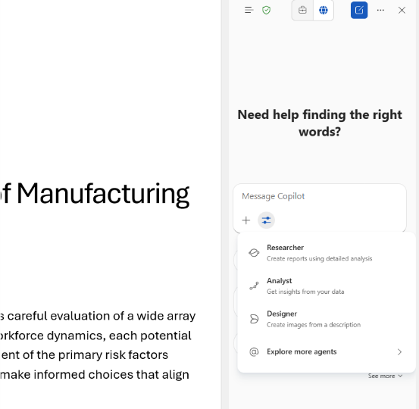
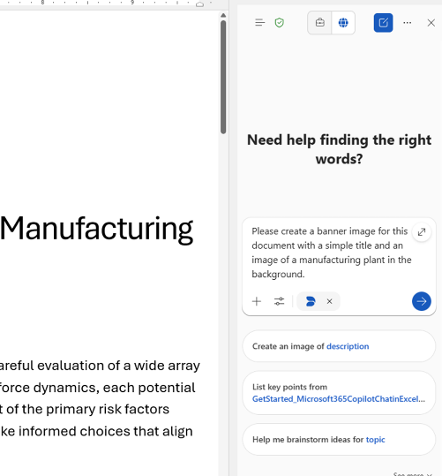
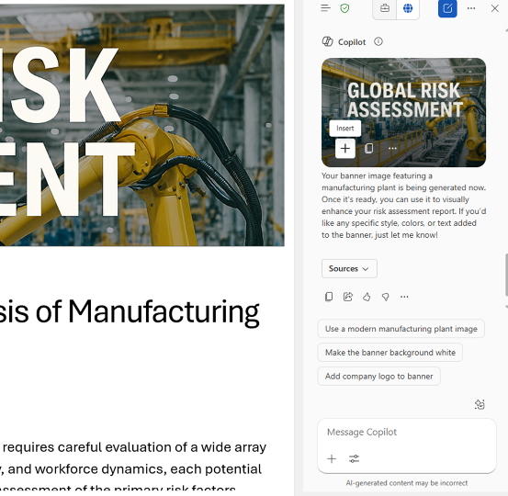
Polish your document with Designer-generated banners and images
Use the Tools icon to access Designer to create images and banners.
Once Designer is selected you will see new prompt suggestions or you can enter a description of what you want to create.
You can ask Copilot to modify the image or insert it into your document.
Notes:
In the Chat pane, Designer integration with Copilot Chat allows you to request banners for your documents, and Designer will generate custom banner visuals tailored to your document content that you can insert into the document.

