Slide 1
Get started with
Microsoft 365 Copilot Chat in Excel
Practical examples and how-tos for users without a Microsoft 365 Copilot license
September 2025
Notes:
Welcome everyone! Today, we’ll explore how Microsoft 365 Copilot Chat can supercharge your workflow in Excel. Excel is packed with features, but it can be overwhelming to know where to start. Copilot adds even more capabilities, making it easier to get answers, automate tasks, and save time. This session will show practical examples and how-tos, so you can use Copilot to work smarter and more efficiently.

Slide 2
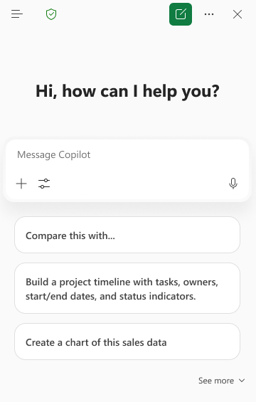
Copilot Chat in Excel
With Copilot Chat in Excel, you gain a range of capabilities that make working with spreadsheets faster with more impact.
Ask questions about your Excel file or get knowledge from the web
Use suggested prompts.
Copy responses into your document or into new files.
Here are some ways that you can use Copilot Chat in Excel
“Share the top insights and trends of this data and create a visualization”
"Analyze these customer reviews in this sheet and share the top customer insights.”
"Compare our financial metrics with the latest earnings data from our top competitor"
Notes:
Copilot Chat in Excel lets you ask questions about your workbook and even pull in knowledge from the web. You can use suggested prompts to get started, or type your own questions. Responses can be copied directly into your document or into new files, making it easy to integrate Copilot’s insights into your workflow. Highlight that Copilot Chat is designed to be interactive and flexible, supporting a wide range of Excel tasks.

Slide 3

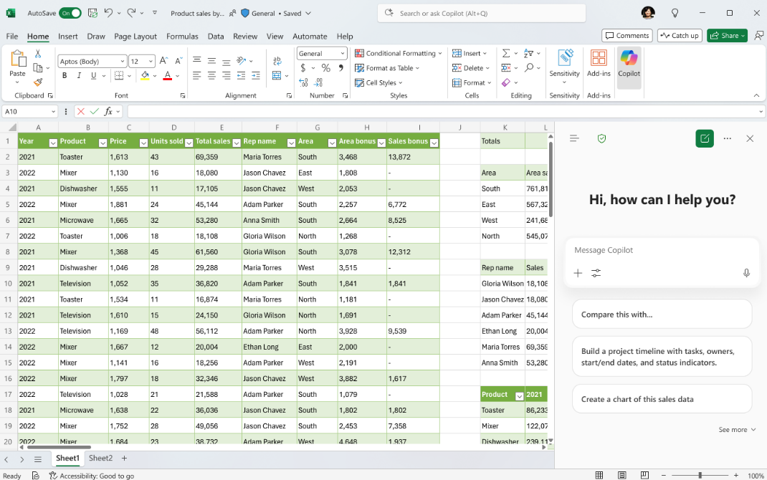


Starting a Copilot Chat in Excel
Enterprise data protection
shield – indicates your data is protected
Navigation panel
Access agents and conversation history
Copilot
Open Copilot Chat from the ribbon
Start a new chat
AutoSave
Excel files must be in the cloud to use Copilot Chat
More options – feedback and controls options
Close Copilot Chat
Prompt Box
Start your chat here
Add content
Add files and images to the chat
Sample prompts
Suggested prompts that are tailored to your document with option to expand and see more
Access tools
Access agents in your chat
Start dictation
Interact with Copilot using your voice
Notes:
To use Copilot Chat, your Excel file must be saved in the cloud (OneDrive or SharePoint) with AutoSave turned on. Open Copilot Chat from the ribbon—look for the Copilot icon.
Once you have the Chat window open you’ll see there are a lot of options packed into a small space. But luckily the UI is consistent across all of your apps so you’ll only need to learn it once.
The navigation panel lets you access agents and your conversation history. If you want to continue an old chat or reference information Copilot previously provided you can find that here. When you access an agent you will leave Copilot Chat and interact with that agent. You’ll need to go back to the Navigation panel if you want to use Copilot Chat again.
The enterprise data protection shield means your data is secure. You can start a new chat, access more options (like feedback and controls), and close the chat when done. When you start a new chat you have the option to start a temporary chat that won’t be saved in your conversation history.
The prompt box is where you start your conversation—add content, files, or images to enrich your chat. You can also access specialized agents like Designer and use voice dictation.
Sample prompts are tailored to your document, with options to expand and see more.

Slide 4
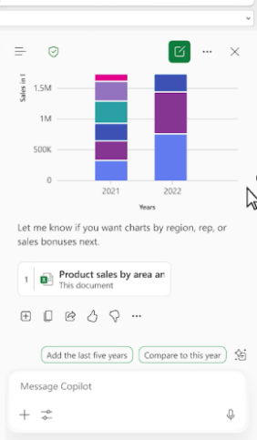
Copilot Chat in Excel response
Add to doc
Insert the response into your document
Copy response
Copy the response to the clipboard to paste in another location
Share prompt and copy with response
Create a link for the prompt in Copilot Chat. Copies the prompt and response with the link to provide context
I like something
Provide positive feedback to your admin and Microsoft
Prompt response
See the response here with references to files or web sites used
I don’t like something
Provide positive feedback to your admin and Microsoft
Multi-turn suggestions
Continue the conversation with these suggestions to enhance your response or use the Prompt Box to ask a follow up question.
More options
Options to copy the response to a new document, have the response read aloud, or schedule the prompt for later
Prompt Box
Continue your chat here
Notes:
When you ask a question, Copilot will create a detailed response with references to files or websites used.
You can continue the conversation with multi-turn suggestions or ask follow-up questions in the prompt box.
Insert responses directly into your document, copy them to the clipboard, or share them with others.
Use the feedback buttons to let Microsoft know what works well or what could be improved.

Slide 5


My Chat pane doesn’t look like the picture
We are squeezing a lot of capabilities into a small space so you may notice the chat pane is highly dynamic depending on its width. Here is what you may experience
Navigation panel
Chat title
New chat with temporary option
More options
Full width
Enterprise data protection shield
Close chat
Remove chat title
Move the Enterprise Data Protection shield next to Navigation panel icon
Move temporary chat option to more options
Min width
Notes:
With more space there is an opportunity to include more information in the Chat options bar. This slide will help make it clear when and where items appear so that you can always find the UI elements you need.
Note that the chat title will only appear if you have already entered a prompt in the chat session.
The other main change is that the way to create a temporary chat changes from a dropdown on the new chat button to a selection under More Options.

Slide 6
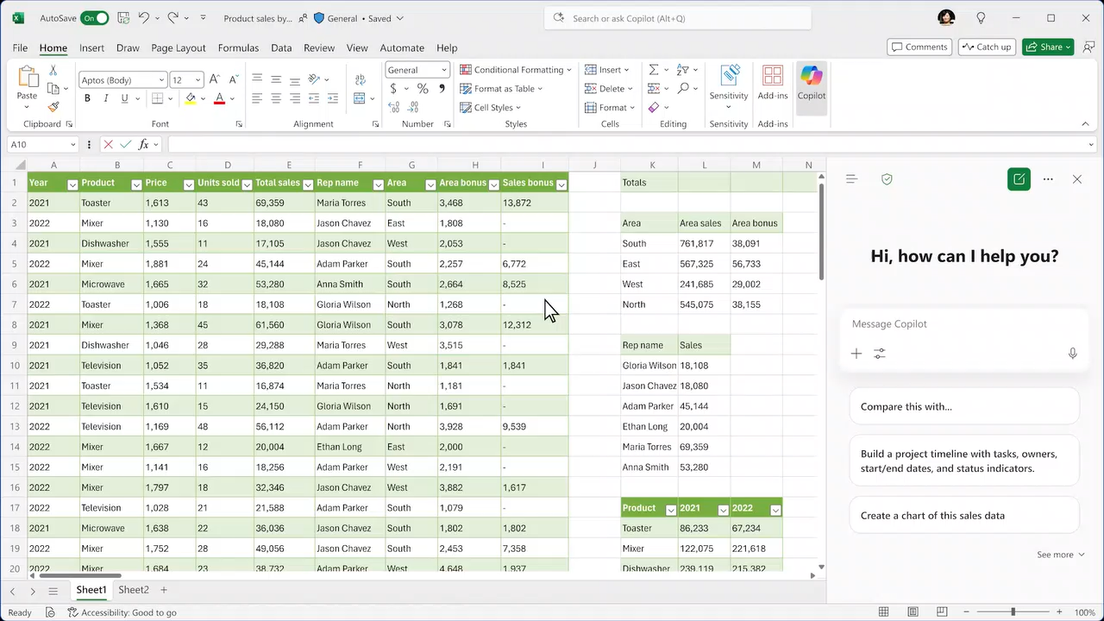
Copilot Chat in Excel demo open file reference
Notes:
Here is a short 15 second demo of Copilot Chat in action. You can ask Copilot about the data in your Excel file and have it create charts for you right within Excel.

Slide 7
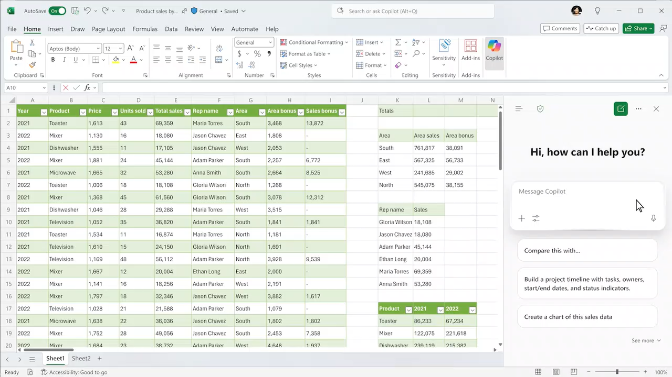
Copilot Chat in Excel demo additional file access
Notes:
In this second video you’ll see that you can still reference other files just as you would using chat in the Copilot app. So, if the information you need is in another file or on the web you don’t have to leave Excel to find it. Copilot brings the answers you need right to your file and then you can insert the response into the file with one click.

Slide 8
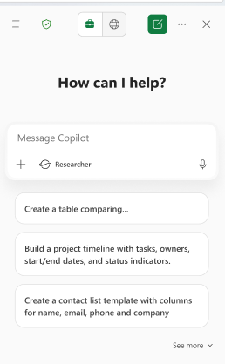
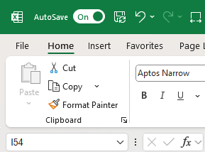
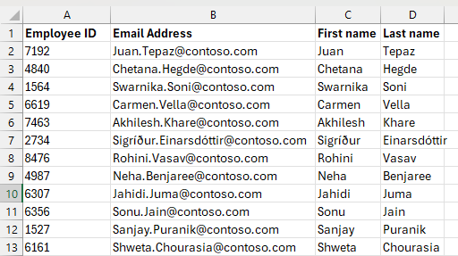
Getting started
Autosave on
“Table-less” Copilot
Open the chat pane
The file must be saved to OneDrive or SharePoint, with Autosave turned on.
Copilot works with data that’s either in an Excel Table (Insert | Table) format, or in a “Table-Like Range” with column headers.
Click on the Copilot button on the ribbon
and try one of the starting prompts or write
your own.
Notes:
A few things to know up front before you get started:
#1: Copilot in Excel only works if the file is saved to OneDrive or SharePoint, with Autosave turned on.
#2: Copilot works best with structured data – that includes data that’s in an Excel Table format (from Insert | Table), or in what are called “Table-Like Ranges” with headers for each column and no blank rows, such as the example on this slide.
#3: Then, just click on the Copilot icon on the Home tab of the Ribbon to get started – try one of the starting prompts that show up or write your own.
This slide shows a few specific examples of some of those use cases as an introduction – later slides have more examples that also show the sample data used.

Slide 9
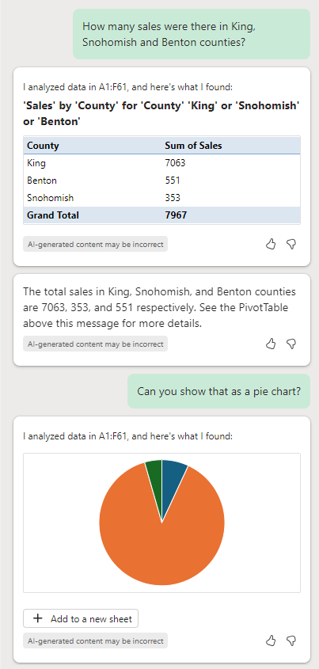
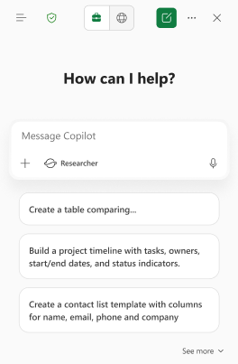
Tip: use multi-turn
Use multi-turn to add clarification or request changes.
If you don’t get what you want the first time, try saying “actually can you do XYZ instead” – that helps the model learn what you want.
Note that previous prompts/responses have informed Copilot’s latest response – create a new chat thread to start fresh.
Notes:
Here are some tips and tricks to get the most out of Copilot in Excel:
“Multi-Turn” refers to the idea of having a conversation with Copilot in the chat pane – which is quite a different experience from clicking menus and buttons!
For example, if you don’t get the answer you wanted in your first prompt, try following up with more clarification or request changes – see the left-hand screenshot here for an example, where the first prompt was about sales volume for a specific filter, and after Copilot returned the response, the user asked for that information to be shown as a pie chart. Copilot keeps track of your conversation and knows what the word “that” meant in “Can you show that as a pie chart”.
Conversations are also helpful for helping the Large Language Model that powers Copilot learn what you want – if you don’t like Copilot’s first response, try saying “Actually instead of that, can you do <this> instead”.
Also be aware that previous prompts you wrote plus Copilot’s responses to those prompts have all informed Copilot’s most recent response – sometimes, that may not be what you want, in which case just start a new chat thread to start fresh. Click on the “New chat” to start a new conversation with Copilot.

Slide 10
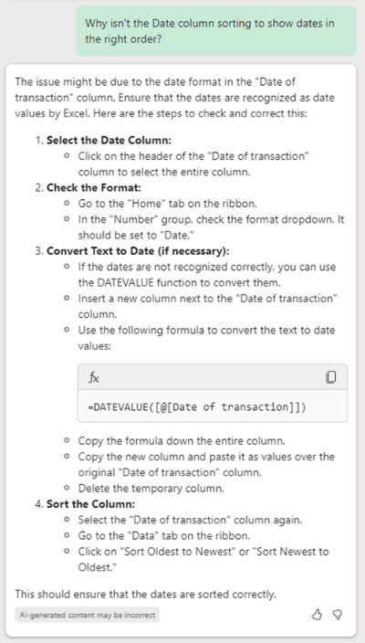
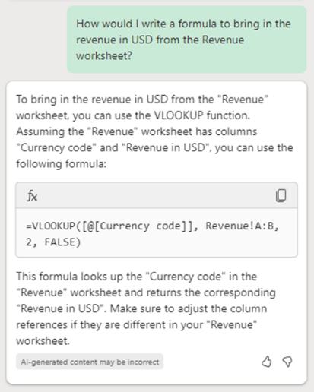
Tip: Ask “why” and “how” questions
Try asking Copilot why something isn’t working or how to do the task in Excel, instead of asking it to do it for you.
If Copilot doesn’t seem to understand what you want, try rephrasing your prompt with different words.
Please use the thumbs up and down to let us know your experience!
The Excel team spends a lot of time reviewing these – and include a screenshot if possible, that context is very helpful.
Notes:
Another tip for using Copilot if it’s not doing what you want – try asking Copilot “WHY” or “HOW” questions about your task, instead of asking Copilot to do the task for you.
Rephrasing your prompt with different words can also be helpful if it doesn’t seem to be understanding what you want. Although it may seem counter-intuitive, sometimes adding *more* detail and words helps Copilot better understand what you’re looking for.

Slide 11
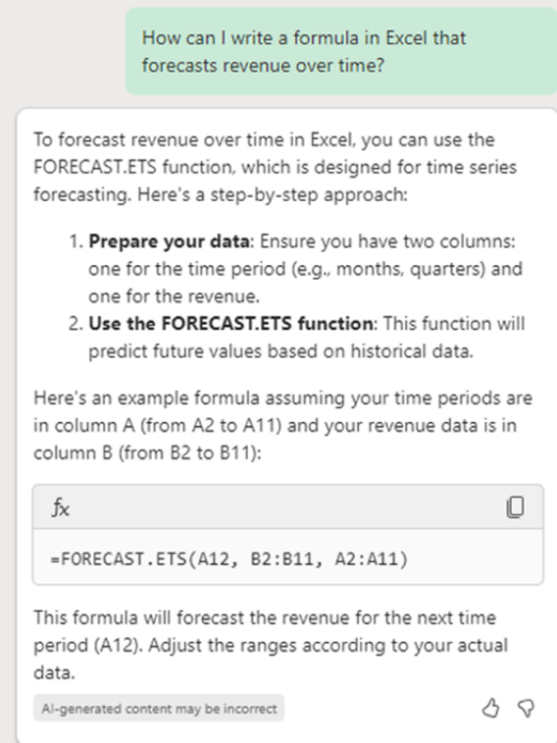
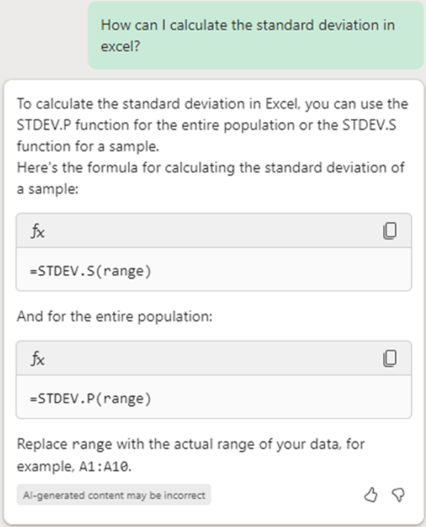
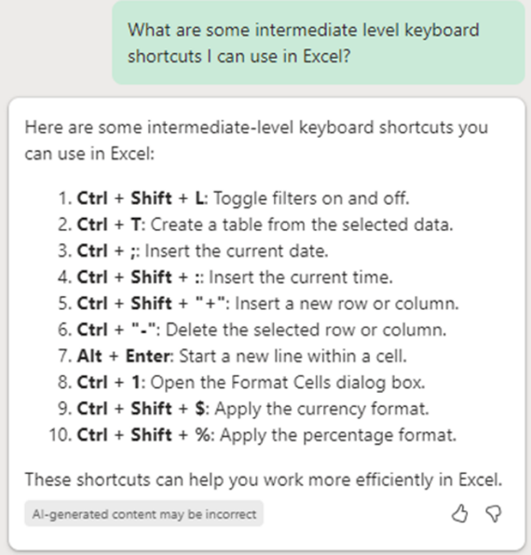
Ask questions about Excel
Notes:
Think of Copilot like having an Excel encyclopedia in your pocket.
If you can’t remember how to do something in Excel or if you want to learn how to do something in Excel, just ask Copilot!
Like in these examples: asking Copilot how to write a formula that forecasts revenue over time, or how to calculate the standard deviation, or about keyboard shortcuts.

Slide 12
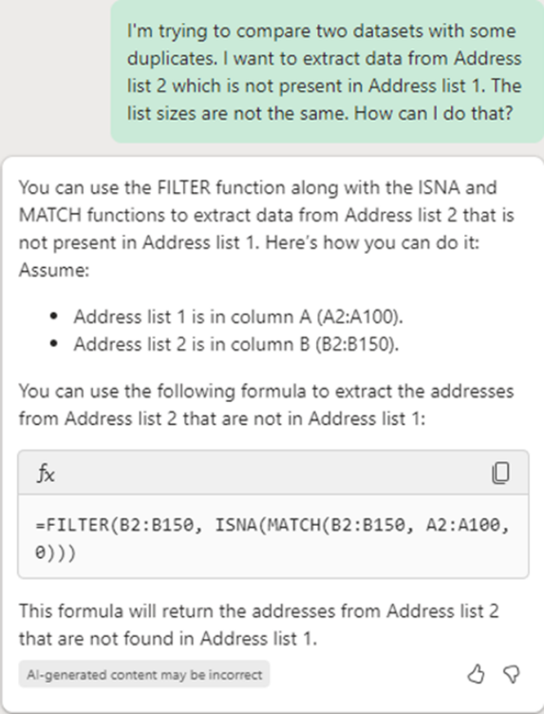
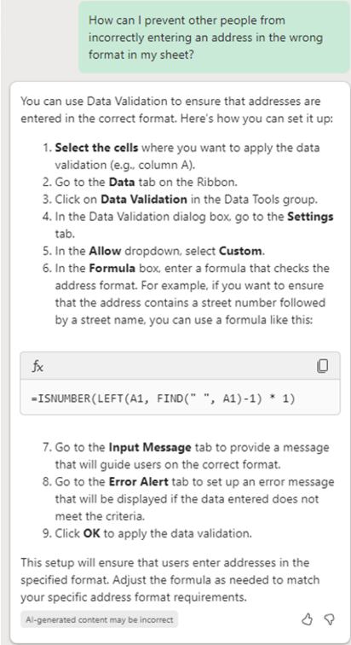
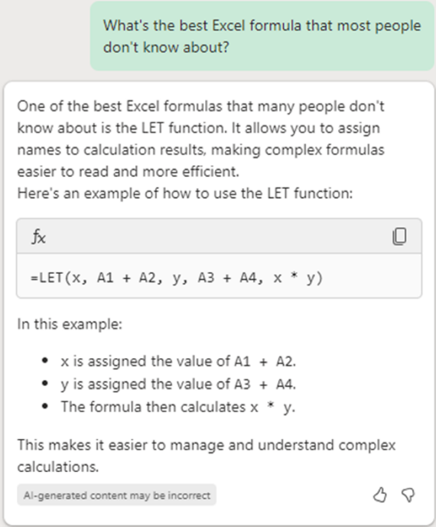
Ask questions about Excel (continued)
Notes:
And lastly, a few more examples:
The left-most screenshot shows an example of a user explaining to Copilot what they’re trying to achieve and asking for help on how to do it. Copilot both explains how to structure the data and then provides a formula to work against that data.
Or in the middle screenshot, Copilot explains how to navigate the Excel user experience to access certain functionality in order to answer that user’s question.
Or in the right-most screenshot, think creatively about questions to ask Copilot around Excel – for heavy Excel users and enthusiasts, Copilot can be a really great way to get new ideas of how to get value out of Excel.

Slide 13
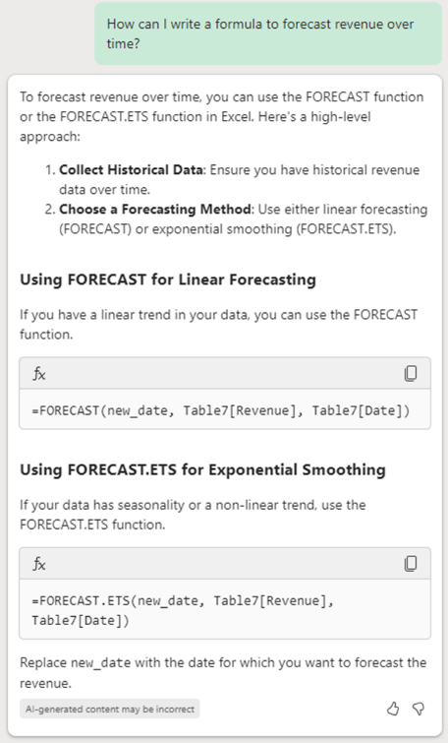
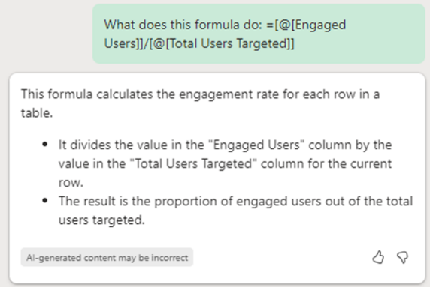
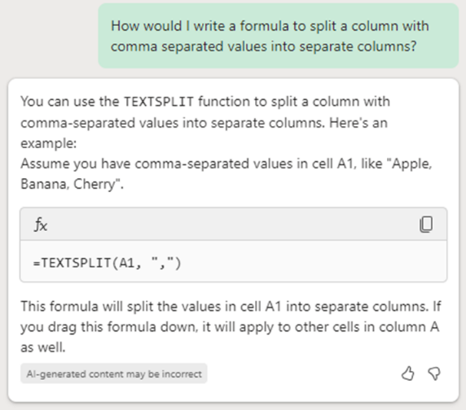
Formulas: Writing, explaining, and asking questions
Notes:
One of the parts of Excel that Copilot can help you with is with formulas – writing them, explaining them, troubleshooting errors, and so on.
This slide shows a few specific examples of some of those use cases as an introduction – later slides have more examples that also show the sample data used.

Slide 14
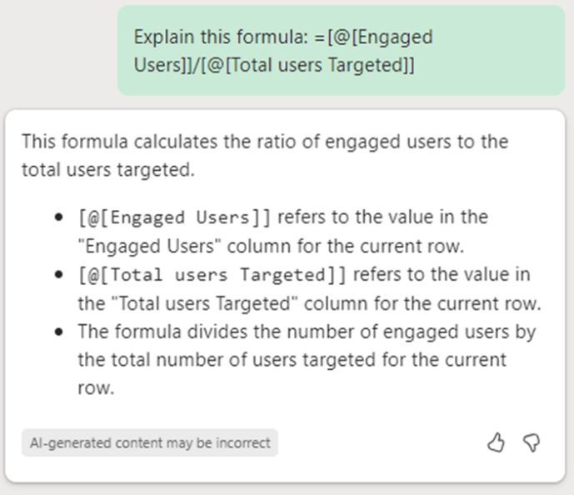
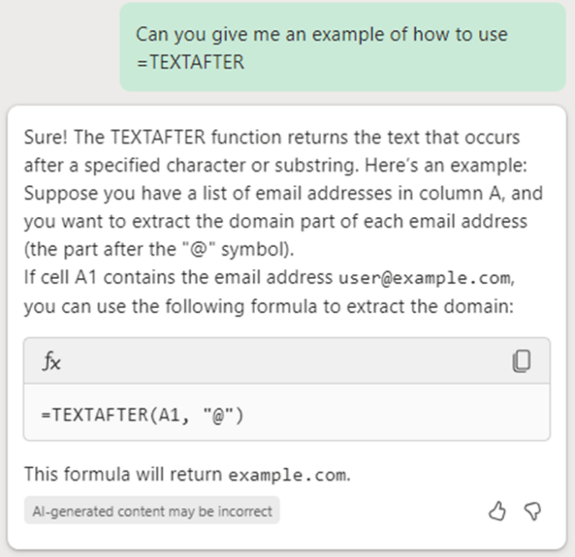
Formula help (continued)
Prompt 1:
Explain this formula: <example of an Excel formula>.
Explain a specific formula.
Ask for an example of how to use a specific formula.
Prompt 2:
Can you give me an
example of how to use =FORMULANAME in Excel.
Notes:
Another way to take advantage of Copilot in Excel is with explaining a formula in an existing workbook, or asking for examples of how to use specific Excel formulas.
You can also give Copilot additional details in the prompt to explain exactly what you mean – for example if you want to know how to use a particular formula in more detail, try explaining the conditions you want the formula to handle, such as referencing a cell two columns to the left.

Slide 15
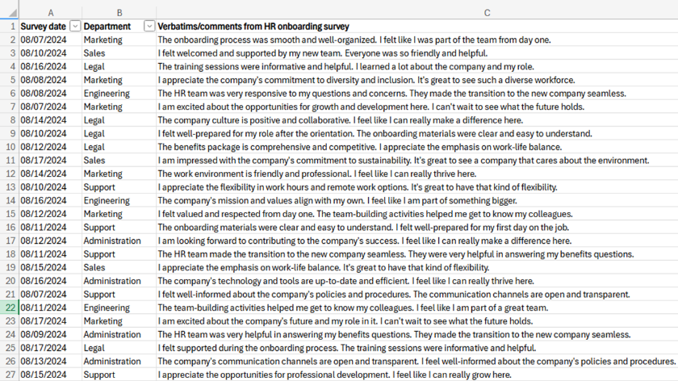
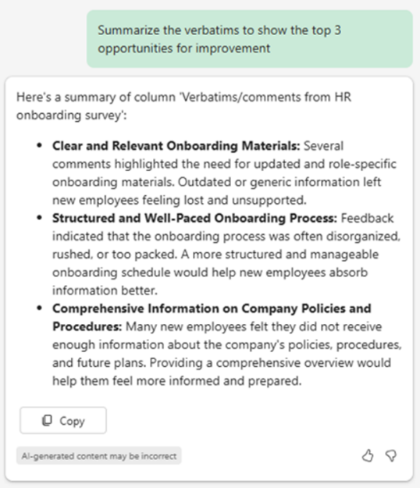
Summarize a column of text
Source
Any dataset with a text-heavy column, such as survey responses.
Prompt 1
Summarize <column> to show the top 3 opportunities for improvement.
Notes:
One common scenario for Excel is managing results from surveys, which often include text verbatims and comments.
With Copilot in Excel, you can now ask for summaries of text-heavy columns such as in this example, where there were verbatims from an HR onboarding survey for newly hired employees, and the user asked Copilot to summarize those verbatims to show the top 3 opportunities for improvement.
Also note that in this particular example, Copilot in Excel was used to generate the verbatims in this screenshot! ☺ To test that out yourself, ask Copilot to generate sample reviews for a particular product or business. Add details to describe the product or business, how long you want the reviews to be, how many you want to be positive vs negative, and give it guidance about including spelling errors.

