Slide 1
Data readiness blueprint for Small & Medium sized Businesses
Microsoft 365 Copilot

Slide 2
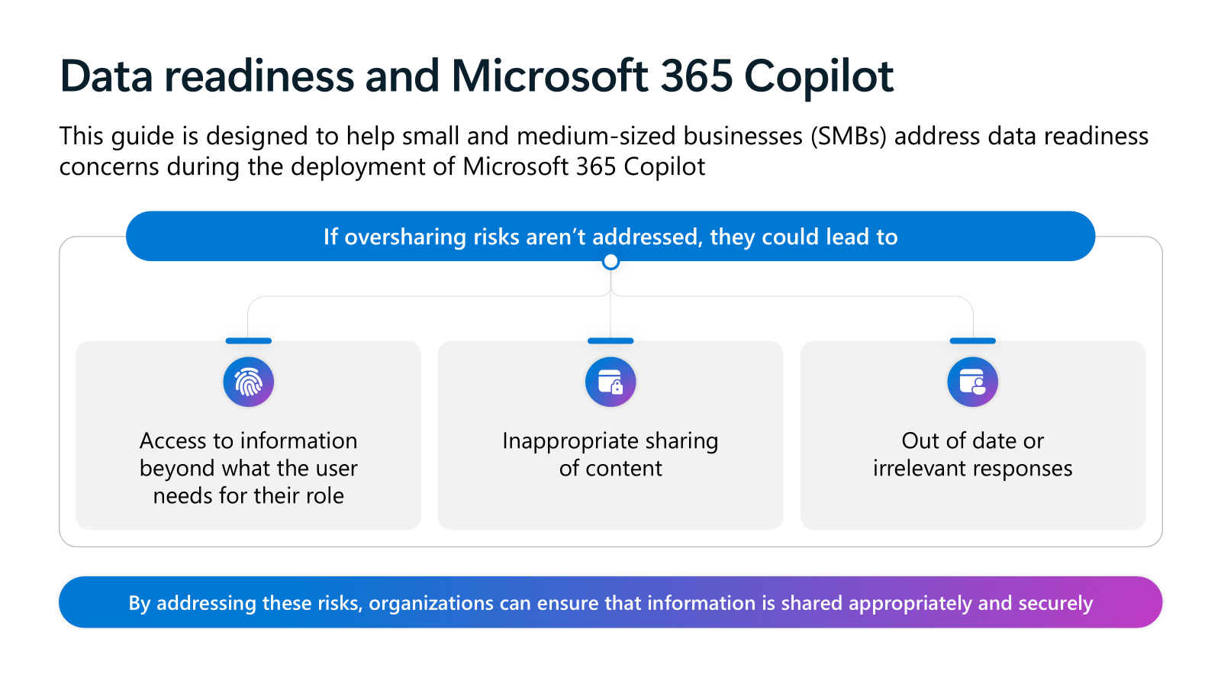
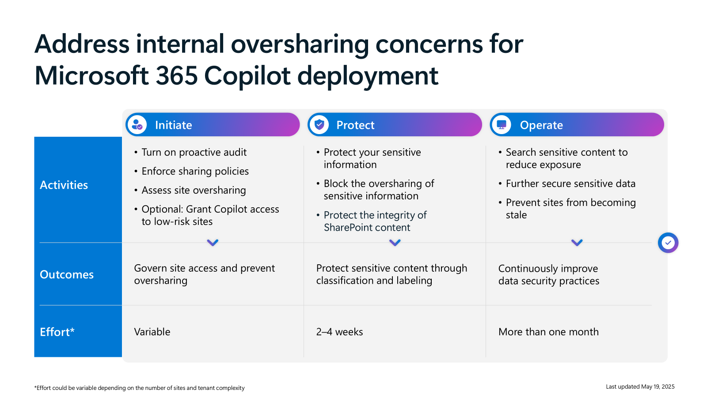
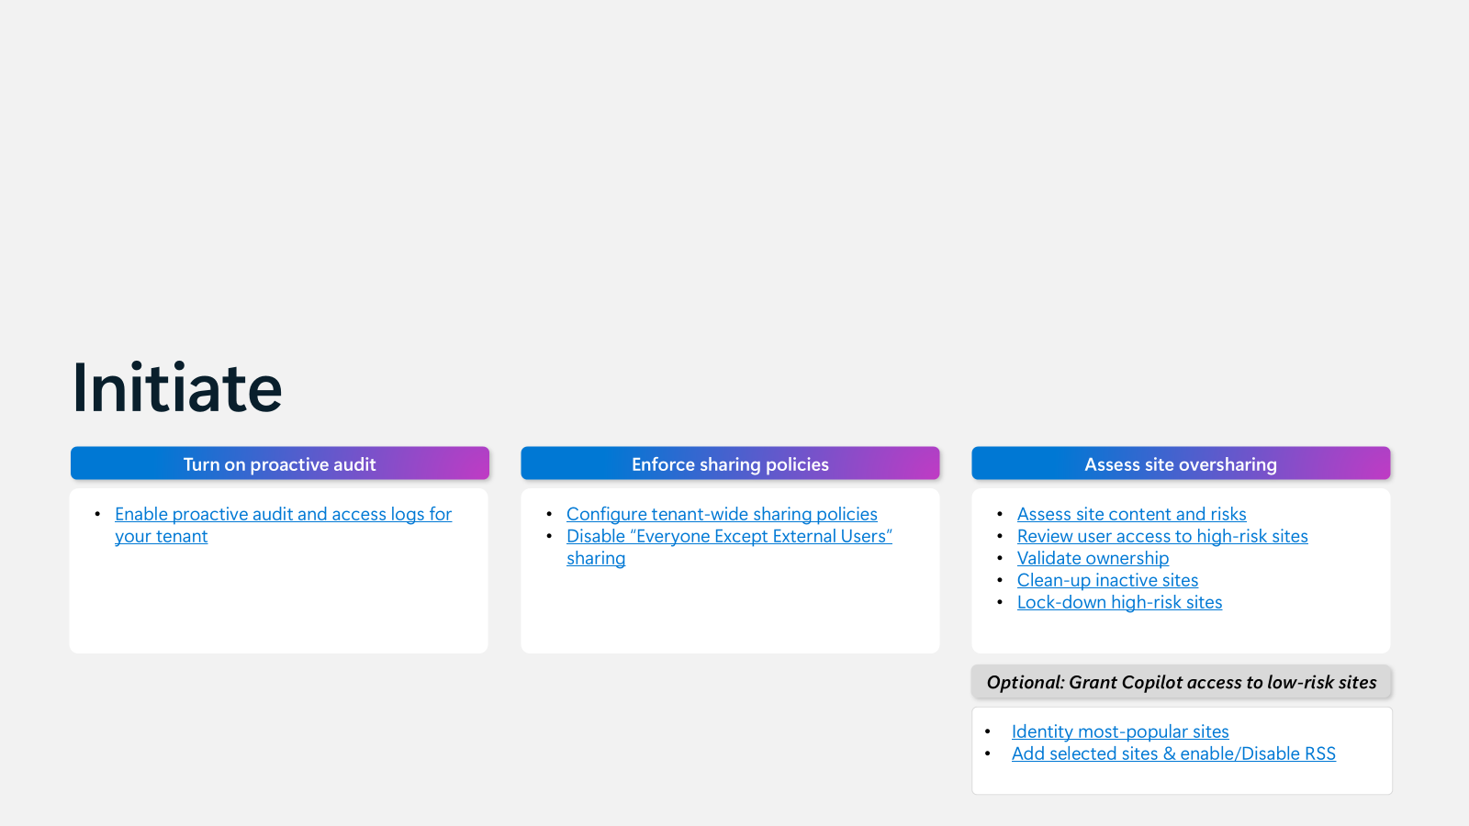
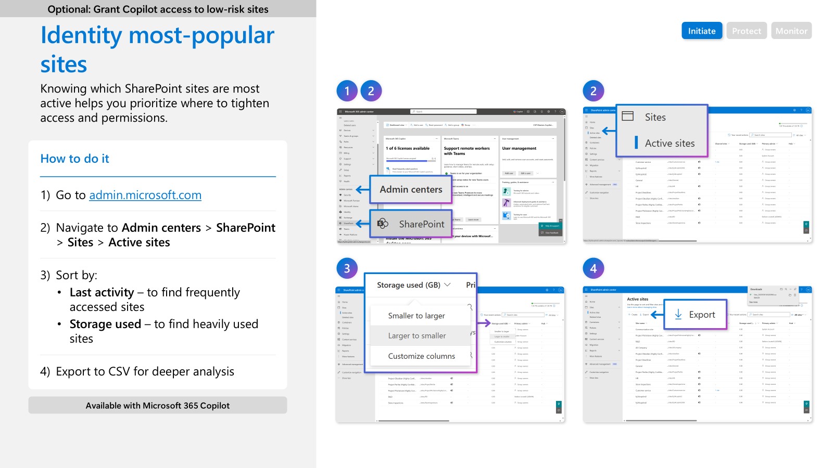
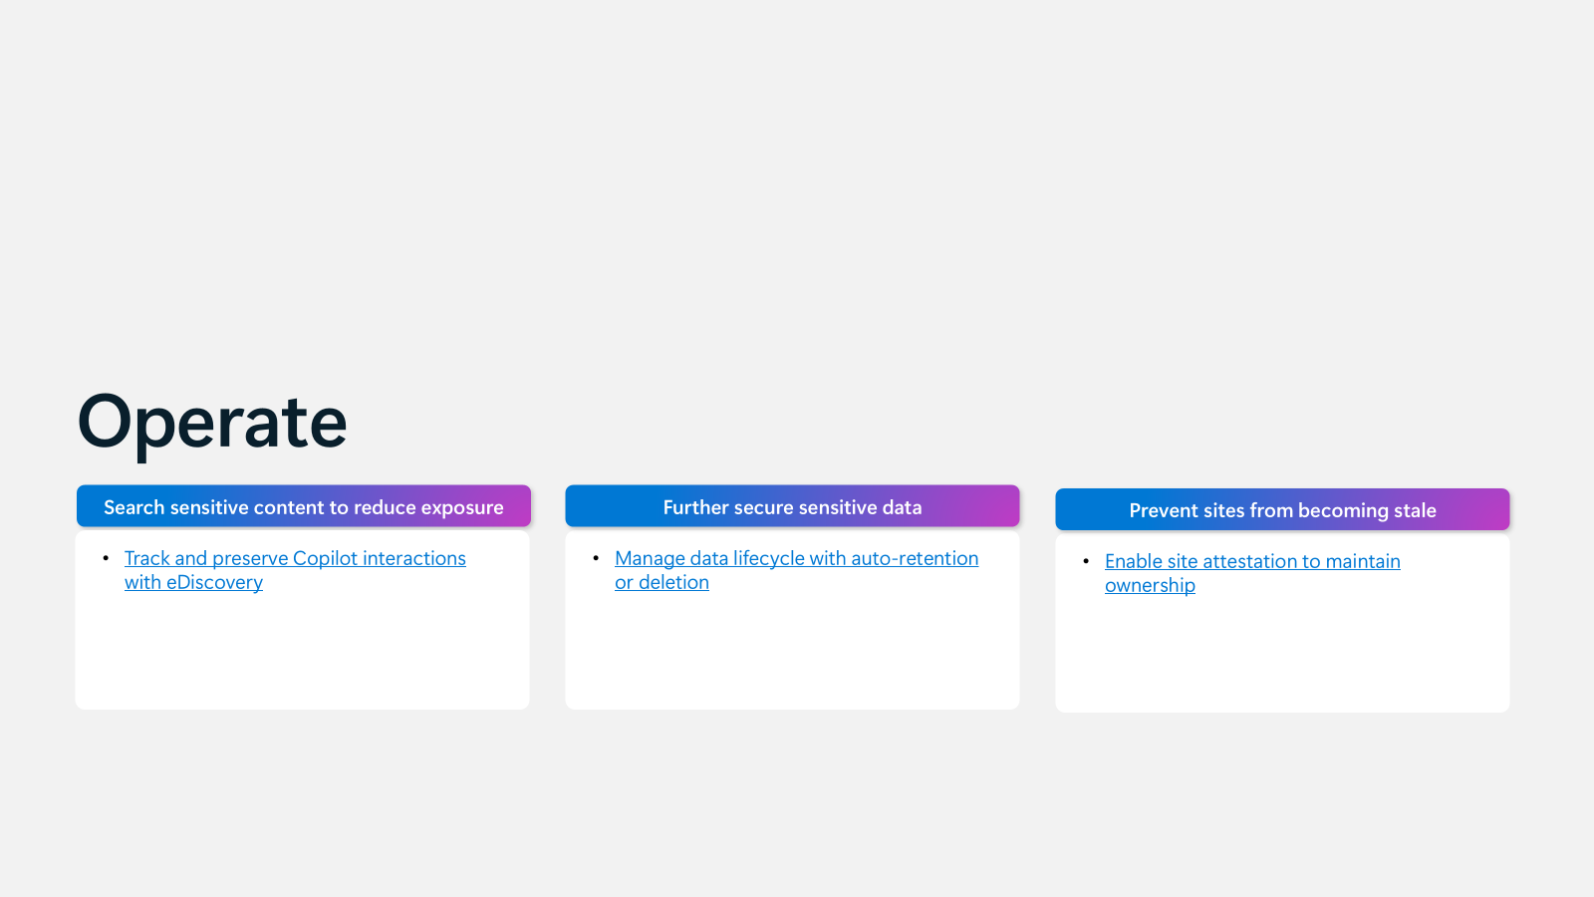
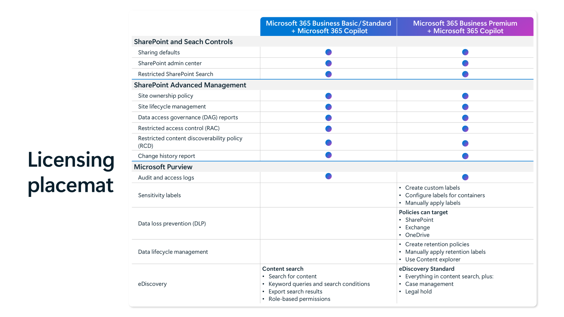
Storyboard
Introduction and guidance
Guide introduction | Data oversharing: What it is and common causes | Oversharing blueprint: Initiate, Protect, Operate
Detailed step by step guide
Data oversharing blueprint: Initiate (9 slides) | Initiate: Optional controls (2 slides) | Data oversharing blueprint: Protect (7 slides) | Data oversharing blueprint: Operate (4 slides)
Appendix slides
Data oversharing blueprint: Summary of capabilities | Licensing placemat

Slide 3
About this guide
Oversharing in Microsoft 365 often results from default or overly broad sharing settings. This isn’t a Microsoft 365 Copilot issue—it’s a common challenge that can be addressed by reviewing access controls.
Copilot follows existing permissions; it may surface content that’s already been shared too widely. The key is to review and adjust permissions to ensure the right people have access.
This guide provides clear, screenshot-based steps to help SMBs review and refine their Microsoft 365 sharing practices ahead of Copilot deployment.
Audience: IT admins or partners supporting SMB customers using Microsoft 365 Business (Basic, Standard, or Premium) and Copilot licenses.
Note: Steps may vary slightly as Microsoft updates the interface and features.

Slide 4
Data readiness and Microsoft 365 Copilot
This guide is designed to help small and medium-sized businesses (SMBs) address data readiness concerns during the deployment of Microsoft 365 Copilot
If oversharing risks aren’t addressed, they could lead to
Access to information beyond what the user needs for their role
Inappropriate sharing of content
Out of date or irrelevant responses
By addressing these risks, organizations can ensure that information is shared appropriately and securely

Slide 5
Prepare data for Copilot by ensuring correct access to files
What is oversharing?
Oversharing happens when an employee has access to information beyond what is necessary to do their jobs​
Copilot only accesses data that an individual user is authorized to access
What causes oversharing?
Accidentally saving a file to a location with broad access permissions
A user sharing content with someone who should not have access
Files do not have access protections

Slide 6
Address internal oversharing concerns for Microsoft 365 Copilot deployment
Initiate
Protect
Operate
Turn on proactive audit
Enforce sharing policies
Assess site oversharing
Optional: Grant Copilot access to low-risk sites
Protect your sensitive information
Block the oversharing of sensitive information
Protect the integrity of SharePoint content
Search sensitive content to reduce exposure
Further secure sensitive data
Prevent sites from becoming stale
Activities
Outcomes
Govern site access and prevent oversharing
Protect sensitive content through classification and labeling
Continuously improve data security practices
Effort*
Variable
2–4 weeks
More than one month
*Effort could be variable depending on the number of sites and tenant complexity
Last updated May 19, 2025

Slide 7
Initiate
Turn on proactive audit
Enforce sharing policies
Assess site oversharing
Enable proactive audit and access logs for your tenant
Configure tenant-wide sharing policies
Disable “Everyone Except External Users” sharing
Assess site content and risks
Review user access to high-risk sites
Validate ownership
Clean-up inactive sites
Lock-down high-risk sites
Optional: Grant Copilot access to low-risk sites
Identity most-popular sites
Add selected sites & enable/Disable RSS

Slide 8
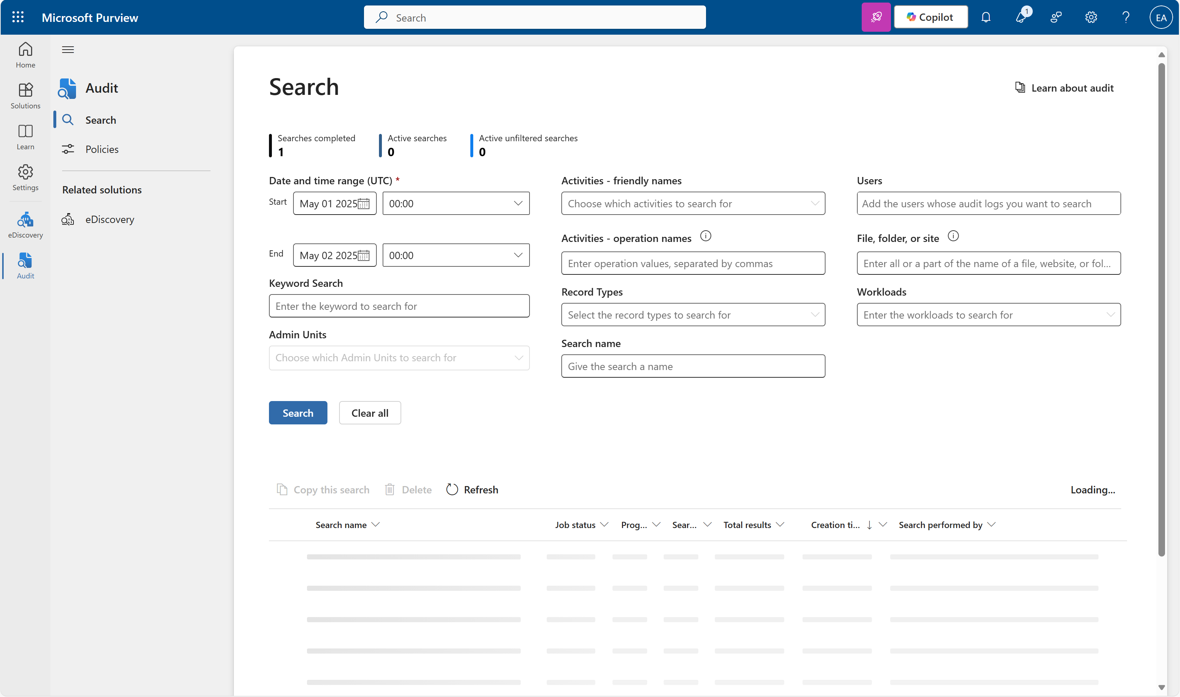
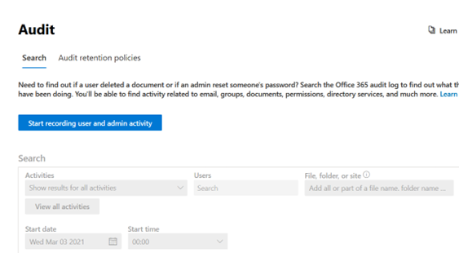
Enable proactive audit and access logs
1. Turn on proactive audit
Initiate
Protect
Operate
Audit logs track user and admin activity, including Copilot interactions, helping detect oversharing. Even though auditing is usually turned on by default, confirming it's active ensures no gap in visibility.
1
2
3
Available with M365 Business Basic, Standard, and Premium
How to do it
Go to purview.microsoft.com
In the left-hand navigation, select Solutions
4
5
6
In the Solutions catalog, click Audit
If audit logging is already enabled, you will see the Search interface
If it’s not enabled, click Start recording user and admin activity at the top of the page
Wait up to 60 minutes for auditing to activate
Learn more on our “Turn auditing on or off ” page. You must be assigned the Audit Logs role in Exchange Online to turn auditing on or off.

Slide 9
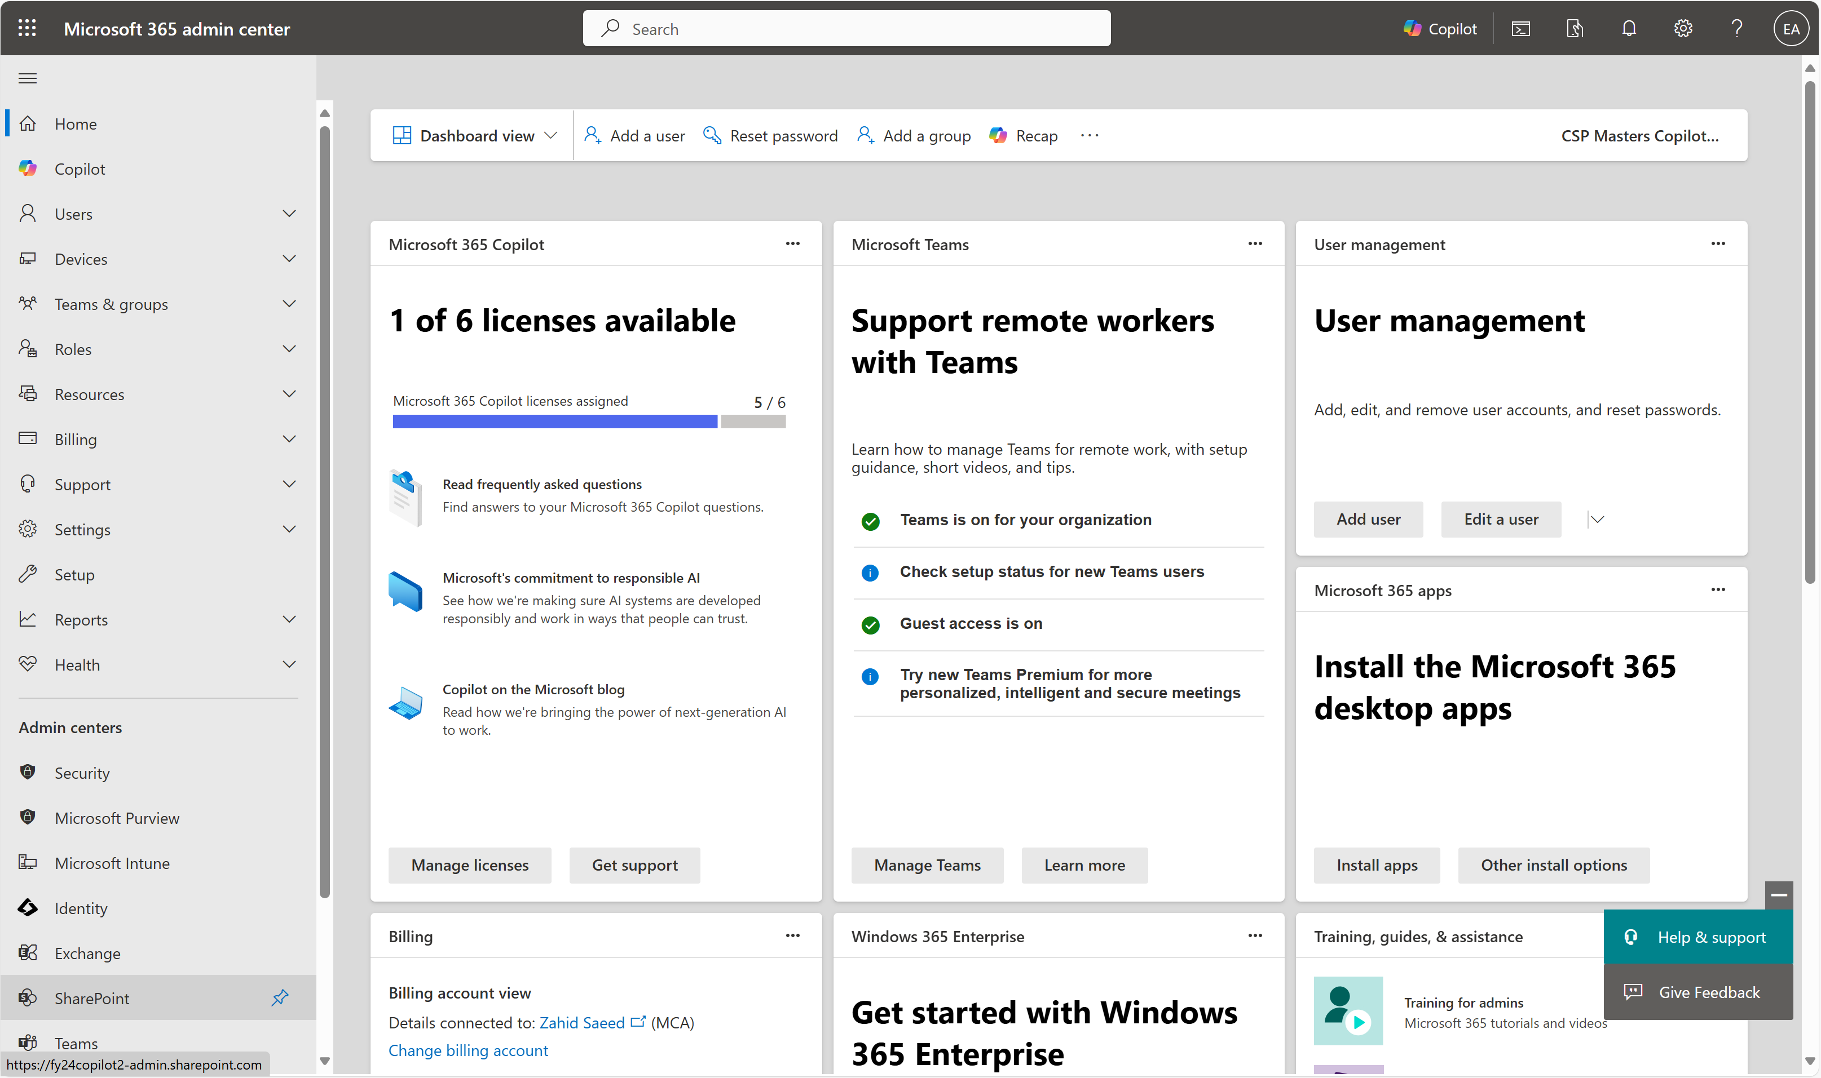
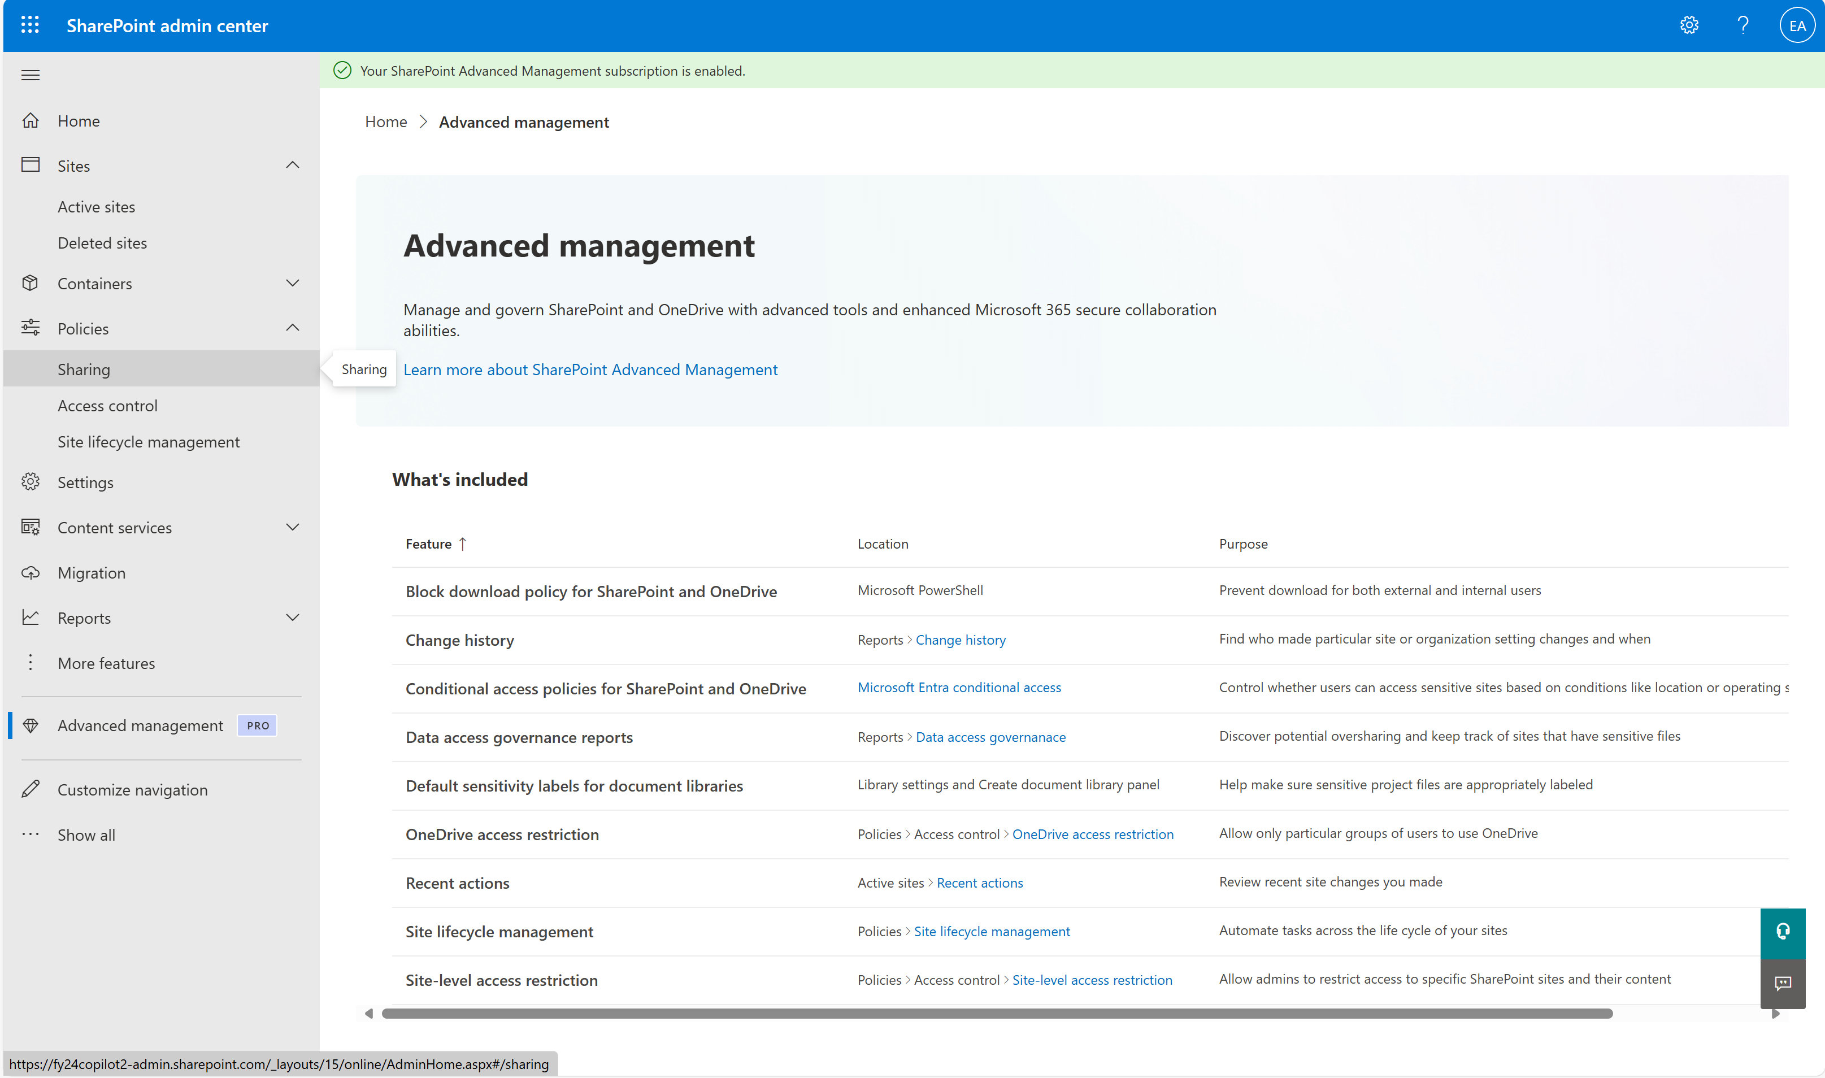
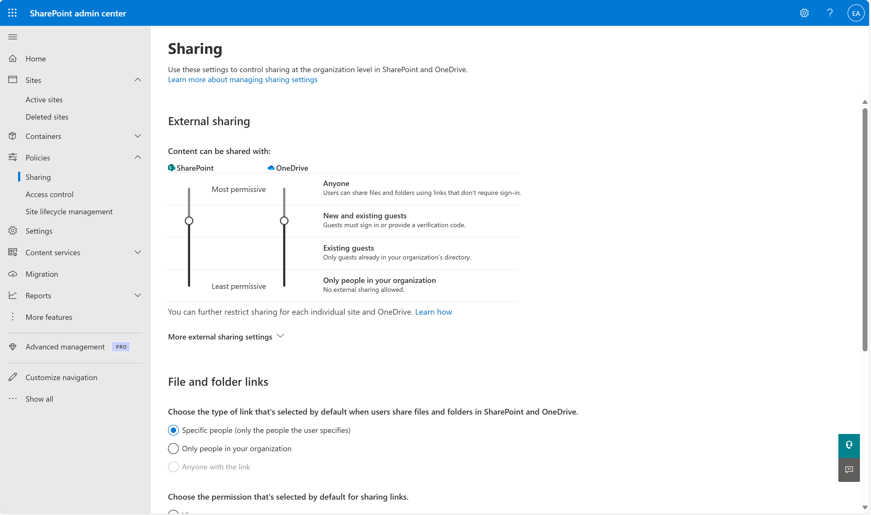
Configure tenant-wide sharing policies
2. Enforce sharing policies
Initiate
Protect
Operate
1
2
Overly permissive sharing settings are one of the top causes of data oversharing in SMB environments. Microsoft 365 Copilot can surface any content a user has access to. Setting strong sharing defaults reduces the risk of exposing sensitive information unintentionally.
Available with M365 Business Basic, Standard, and Premium
How to do it
Go to admin.microsoft.com
2
3
4
Navigate to Admin centers > SharePoint > Policies > Sharing
Adjust external sharing for SharePoint and OneDrive
Recommended: “New and existing guests” or more restrictive
Adjust File and folder links
Recommended: “Only people in your organization”
Learn more on our “Manage sharing settings for SharePoint and OneDrive” page

Slide 10
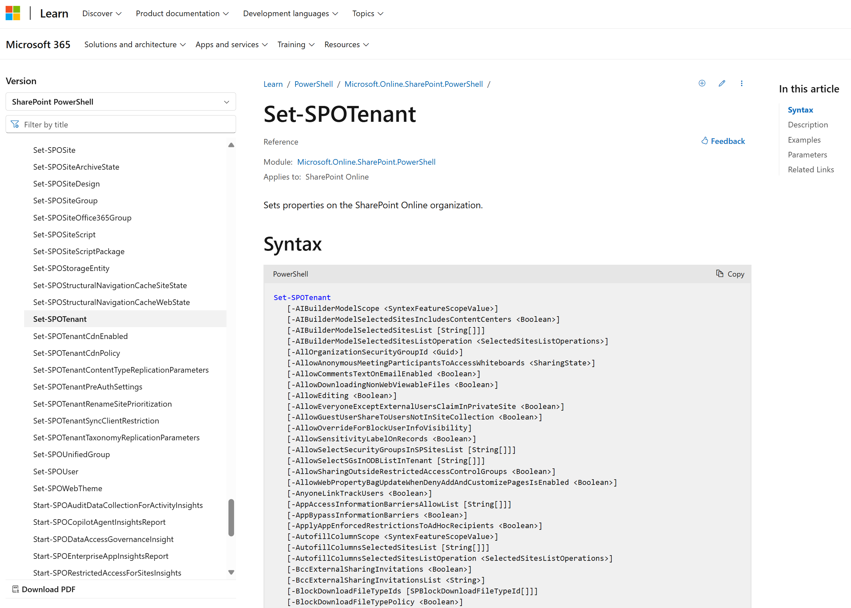
Disable “Everyone Except External Users” sharing
2. Enforce sharing policies
Initiate
Protect
Operate
Disabling “Everyone Except External Users" EEEU at the tenant level will prevent users from sharing files and folders within private SharePoint sites with everyone in the organization except external users.
Available with M365 Business Basic, Standard, and Premium
How to do it
This setting can only be controlled by setting the following parameter to false using PowerShell: AllowEveryoneExceptExternalUsersClaimInPrivateSite
Use the Set-SPOTenant cmdlet to adjust your tenant-wide sharing settings
Follow the official Microsoft documentation, “Turn off EEEU at the tenant level,” for the latest instructions and syntax

Slide 11
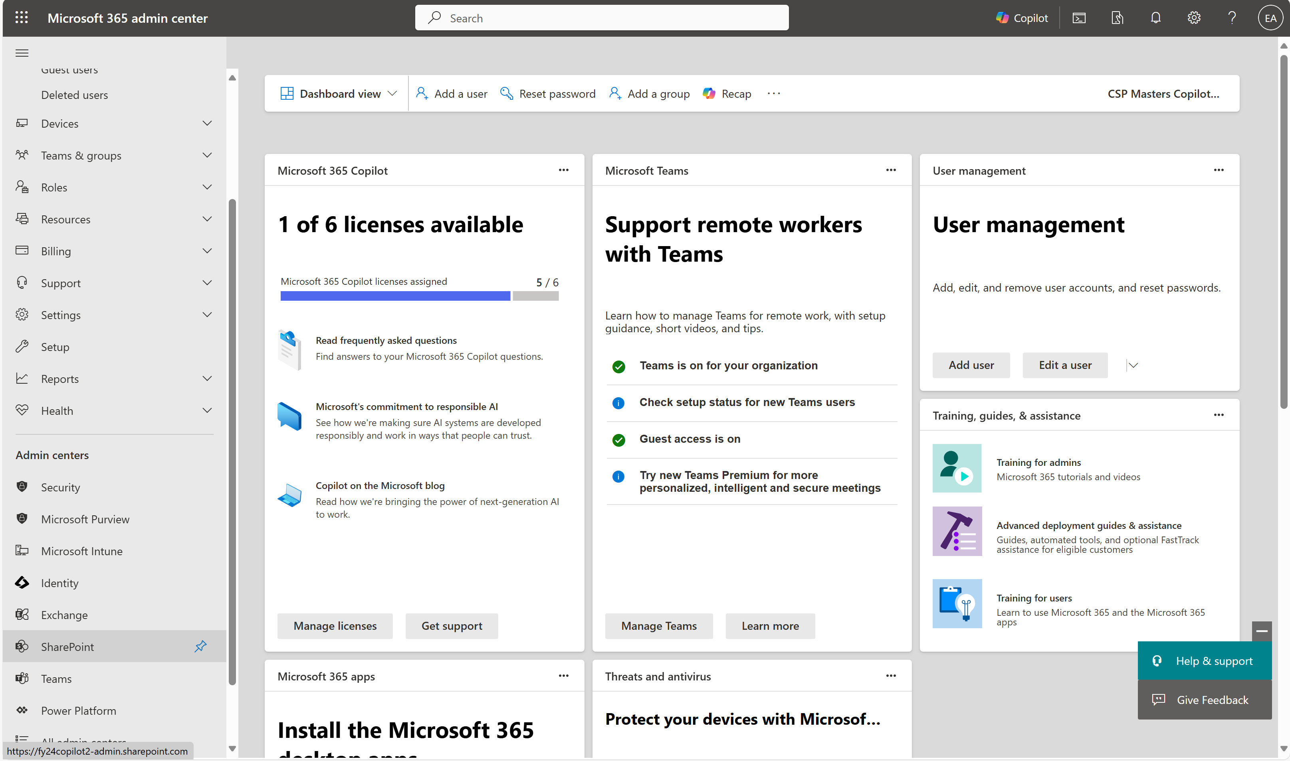
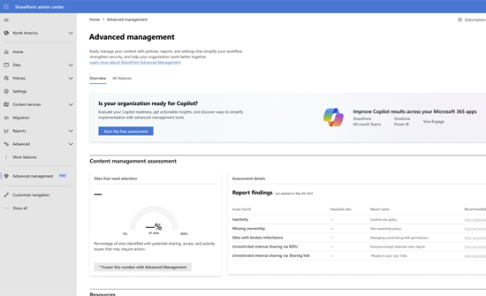
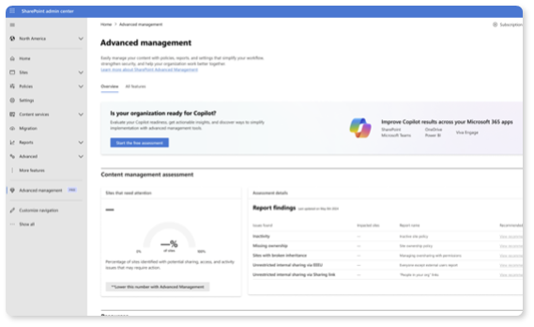
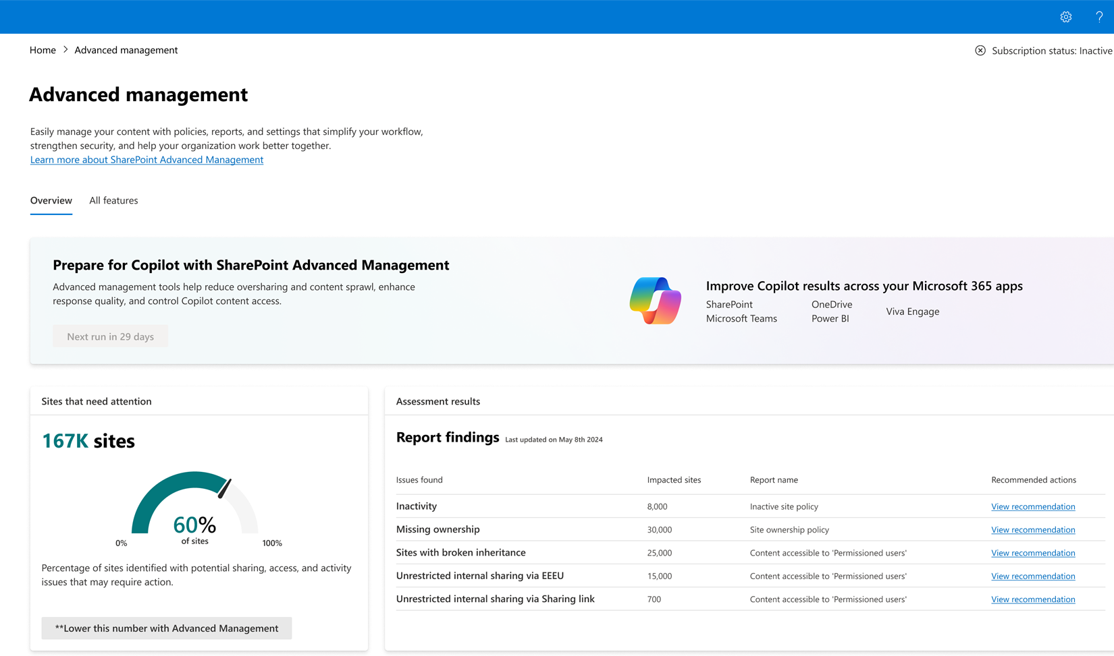
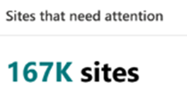
Assess site content and risks
3. Assess site oversharing
Initiate
Protect
Operate
Running a Content Management Assessment in the SharePoint Admin Center will automatically scan your tenant for governance issues like overshared, inactive, or ownerless sites and provide step-by-step guidance to resolve them using SAM features.
1
2
Available with Microsoft 365 Copilot
How to do it
Navigate to the SharePoint admin center from admin.microsoft.com
3
4
Navigate to the Advanced Management section
Click Start Assessment to begin tenant scanning
Review the results and follow the fixes with built-in guidance
Learn more on our “Restrict SharePoint site access” page

Slide 12
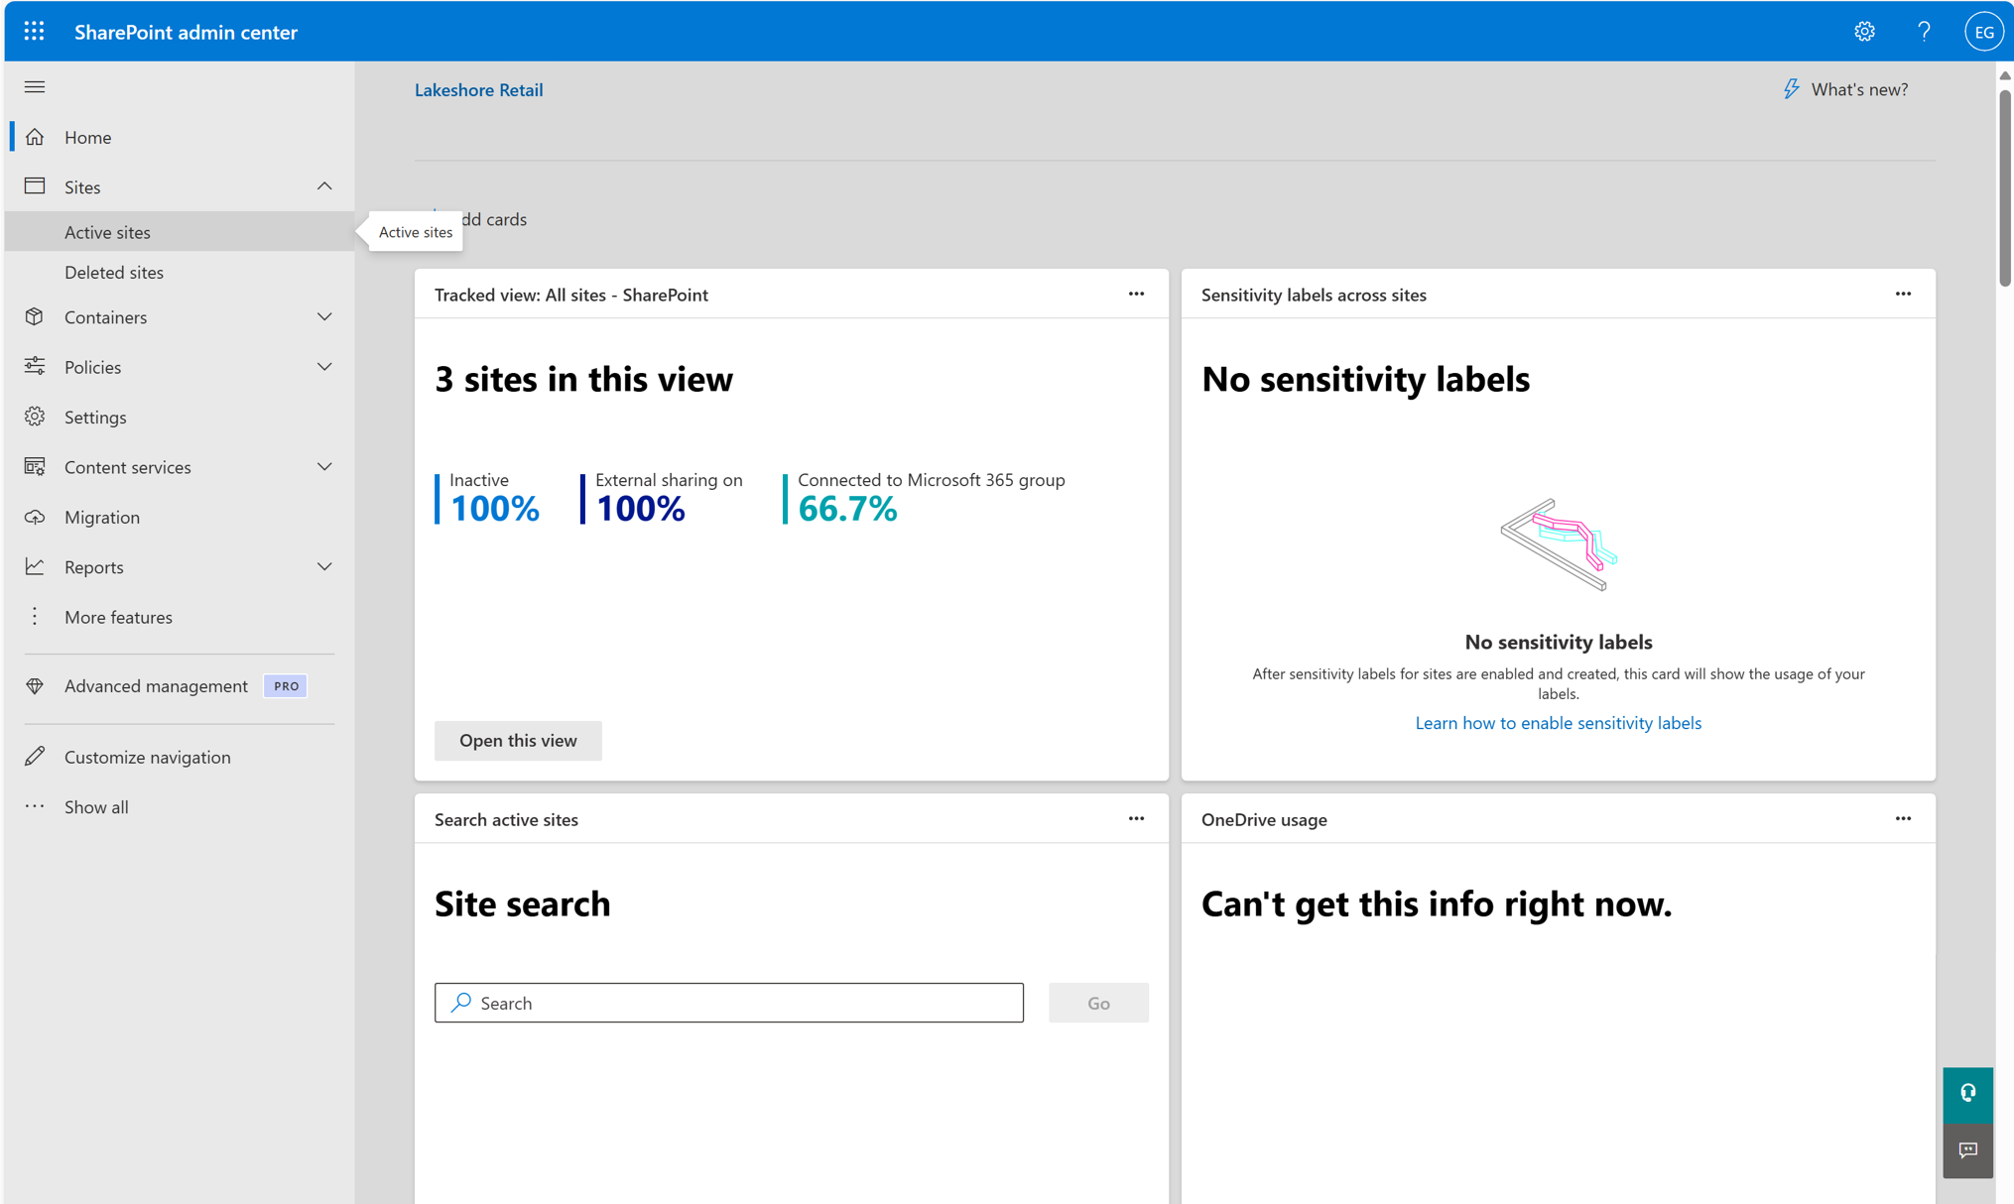
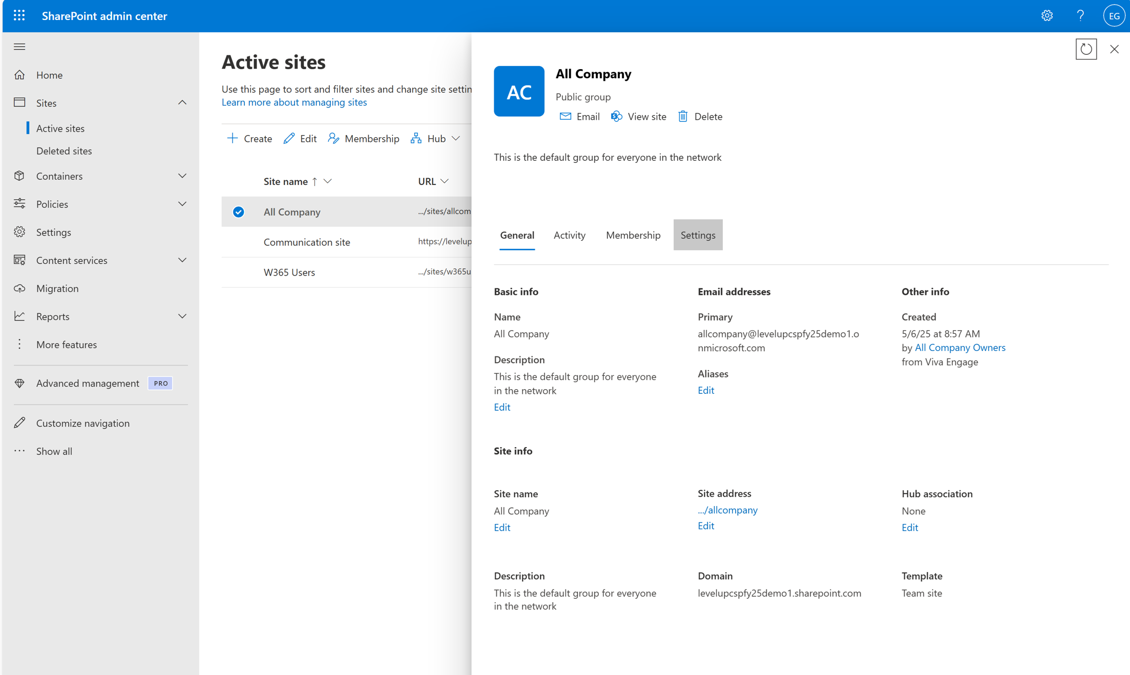
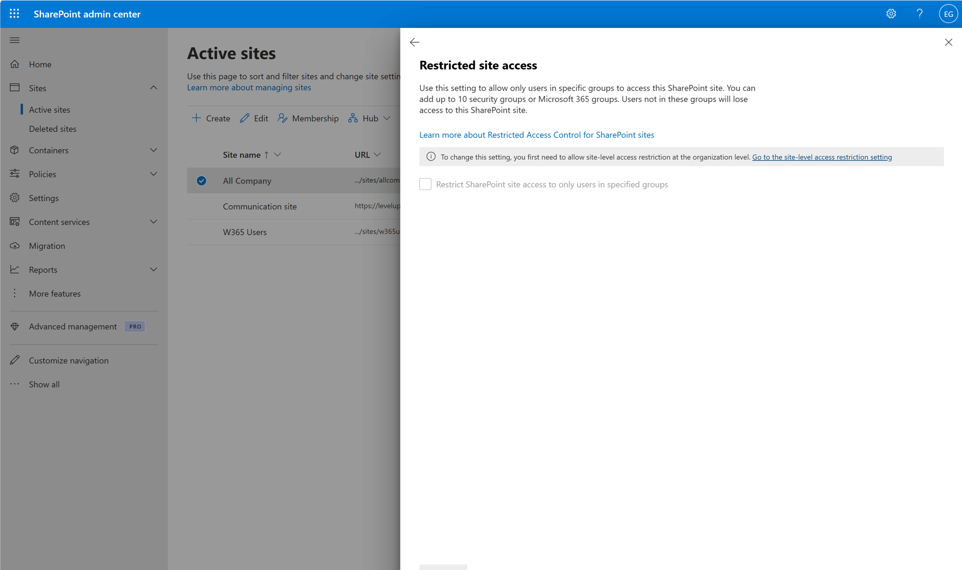
Review user access to high-risk sites
3. Assess site oversharing
Initiate
Protect
Operate
Restricted site access control lets you prevent oversharing by designating access of SharePoint sites and its content to users in a specific group. Users not in the specified group can't access the site or its content, even if they had prior permissions or a shared link.
1
2
Available with Microsoft 365 Copilot
How to do it
Navigate to the SharePoint admin center from admin.microsoft.com
3
4
Navigate to Sites > Active sites
Select the site you want to manage > Settings
Review user permissions and remove any unnecessary or high-risk access
Learn more on our “Restrict SharePoint site access” page

Slide 13
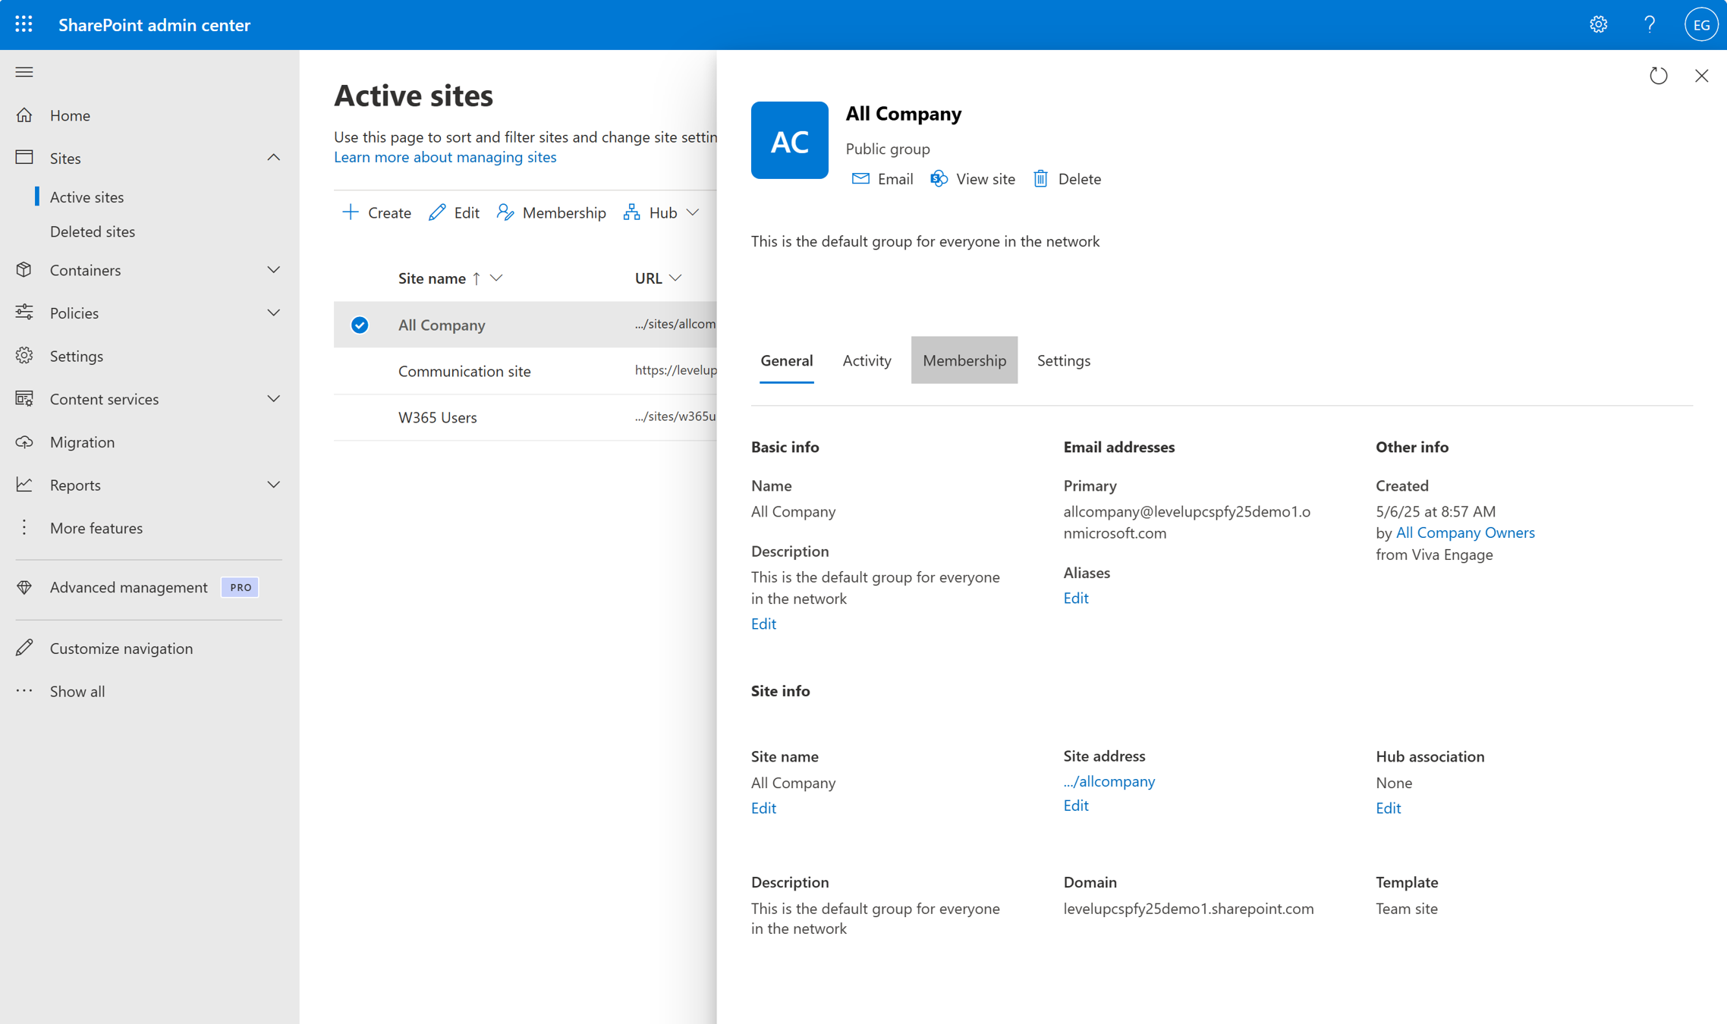
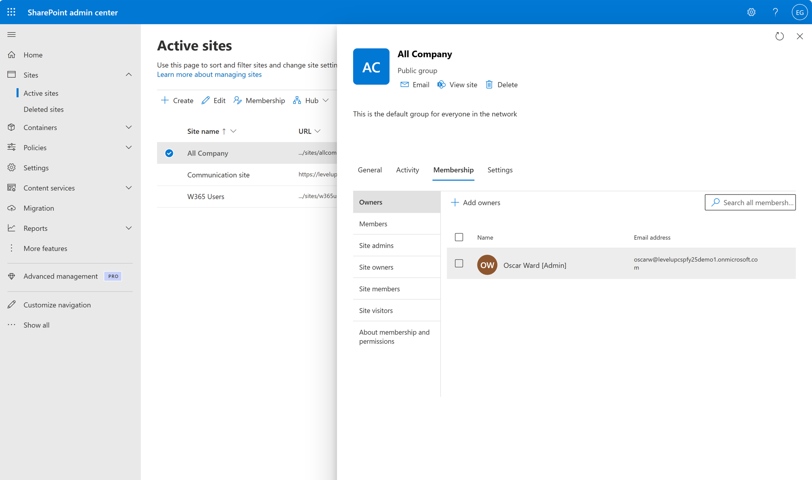
Validate site ownership
3. Assess site oversharing
Initiate
Protect
Operate
Site ownership policies help manage ownership of SharePoint sites. Ensuring that each site has owners that are responsible and accountable for its content, access, and other aspects of collaboration is important to keep your organization secure and compliant.
1
2
3
Available with Microsoft 365 Copilot
How to do it
Go to admin.microsoft.com
4
4
Open Admin centers > SharePoint
In the left panel, go to Sites > Active sites
Review and assign owners for flagged “ownerless” sites
Learn more on our “Create SharePoint site ownership policy” pages

Slide 14
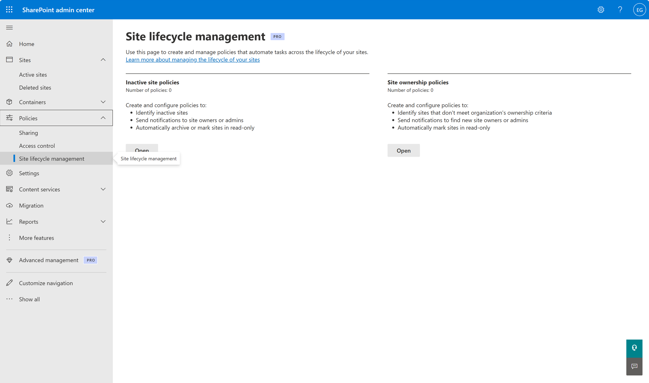
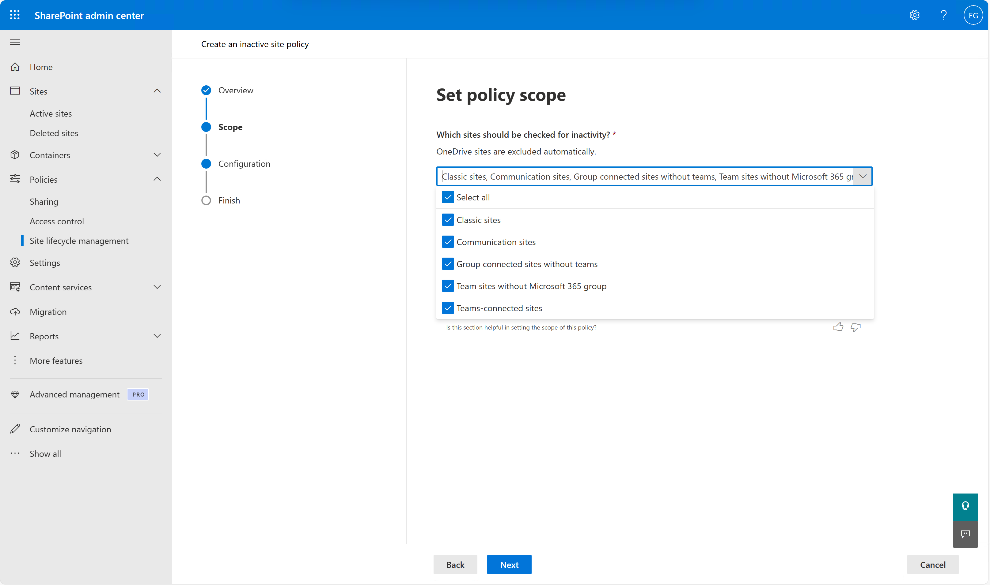
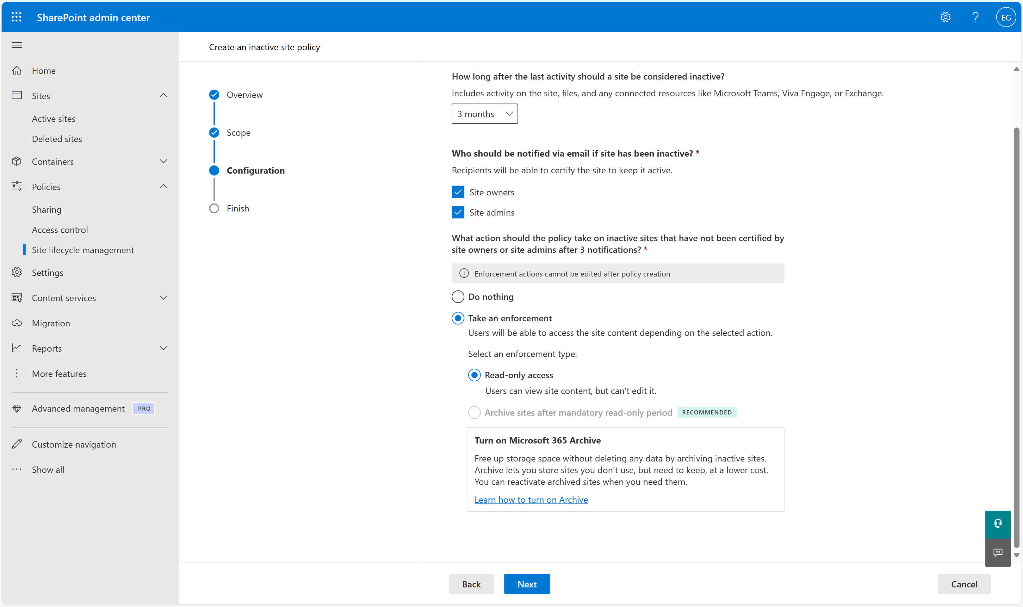
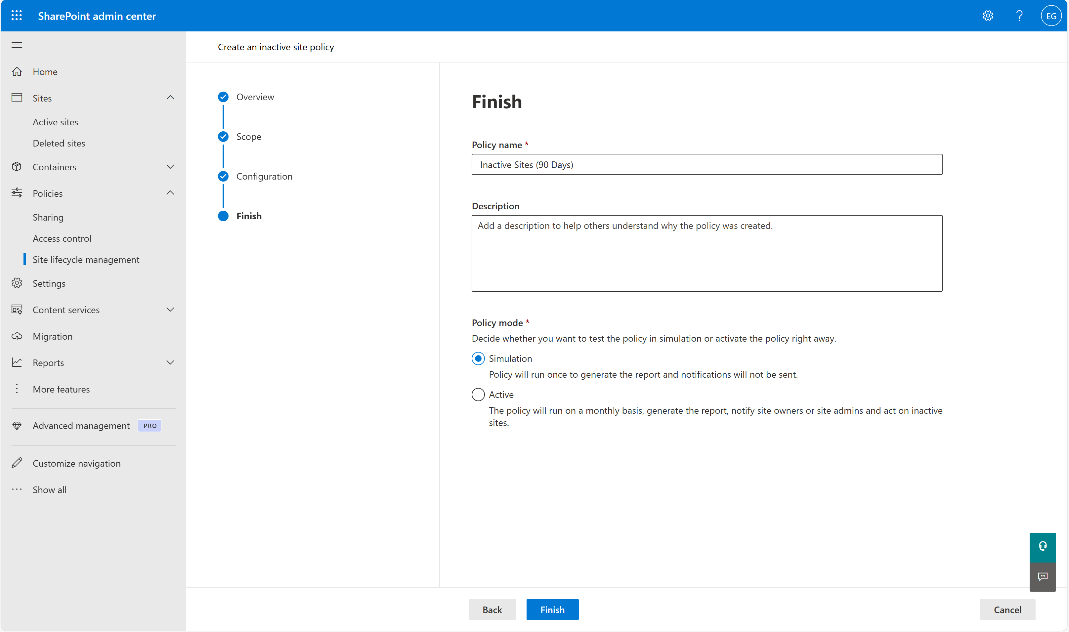
Clean-up inactive sites
3. Assess site oversharing
Initiate
Protect
Operate
An inactive site policy keeps SharePoint organized, reduces clutter, and ensures security by archiving or removing unused sites. It helps manage storage, compliance, and governance efficiently.
1
2
Available with Microsoft 365 Copilot
How to do it
In the SharePoint admin center, go to Policies > Site lifecycle management
Create a new policy and set the policy scope for ownerless inactive sites
3
4
Then, choose what happens after the inactivity threshold (e.g., 3 months) is met, such as:
Archive the site or set it to read-only access (restrict edits)
Start in Simulation mode to test the policy, then switch to Active mode once validated
Learn more on our “Manage inactive sites using Site lifecycle management” pages

Slide 15
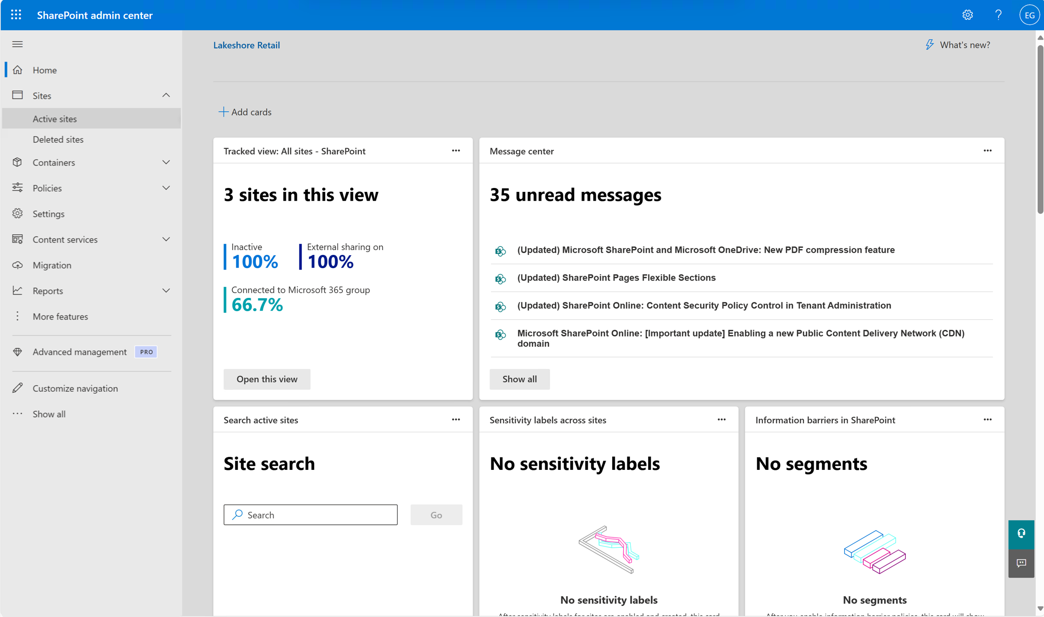
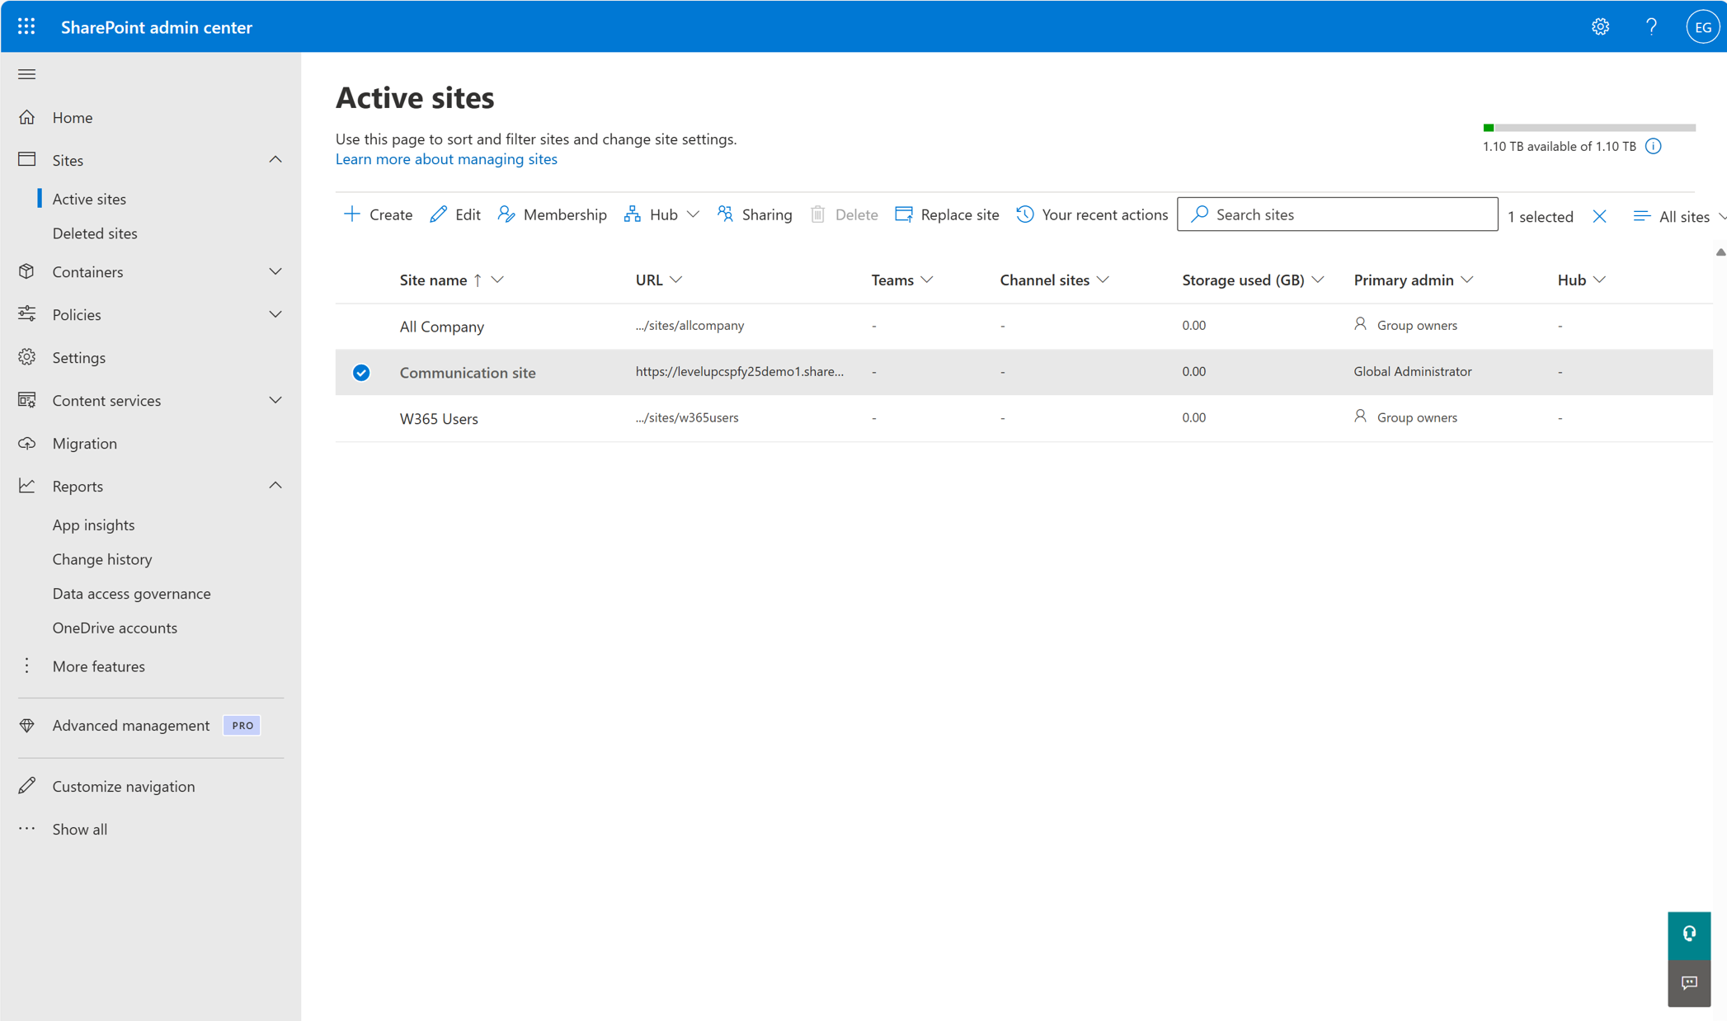
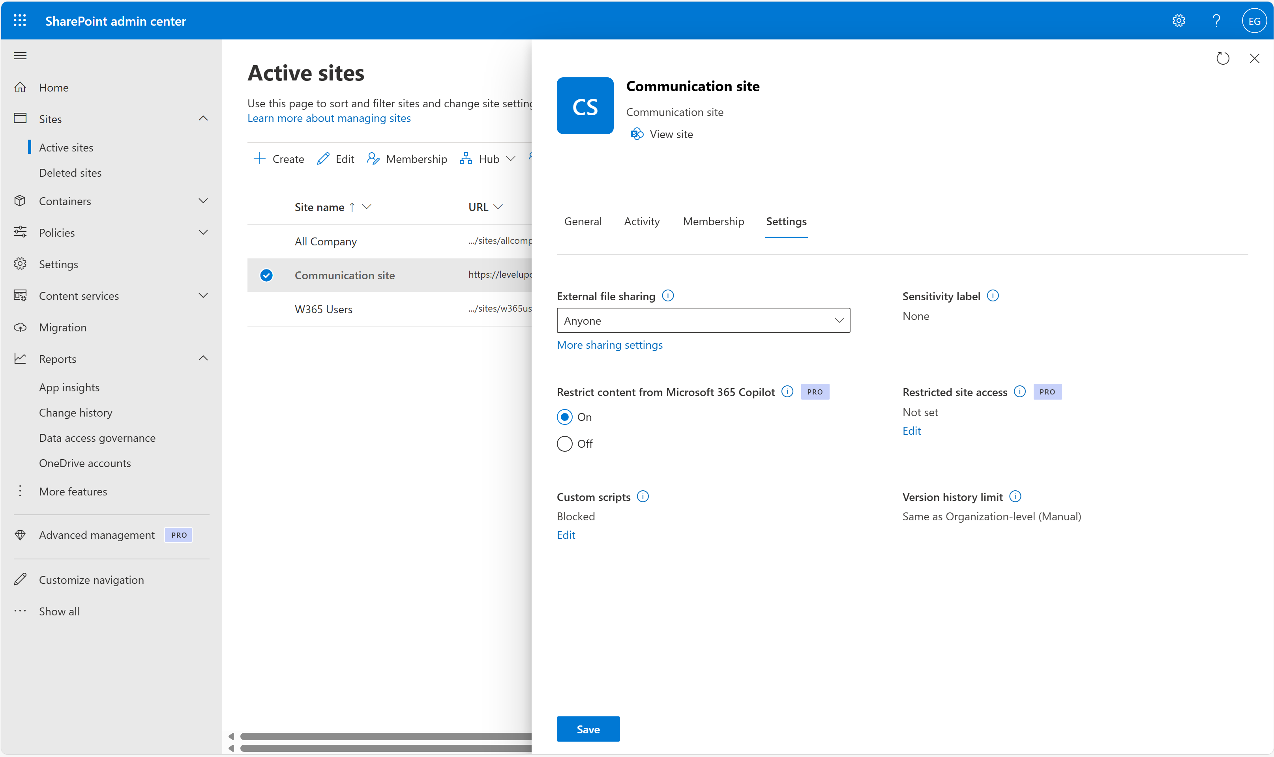
Lock down high-risk sites
3. Assess site oversharing
Initiate
Protect
Operate
High-risk sites can be excluded from Copilot access using Restricted Content Discovery (RDC) policies. RCD for high-risk sites prevents these sites from surfacing in organization-wide search and Microsoft 365 Copilot Chat.
1
2
Available with Microsoft 365 Copilot
How to do it
In the SharePoint admin center, go to Sites > Active sites
3
Select the high-risk/regulatory-sensitive sites (as applicable to your org) to exclude
Navigate to Settings > select “On” for Restrict Content from Microsoft 365 Copilot
Learn more on our “Restrict discovery of SharePoint sites and content” page

Slide 16
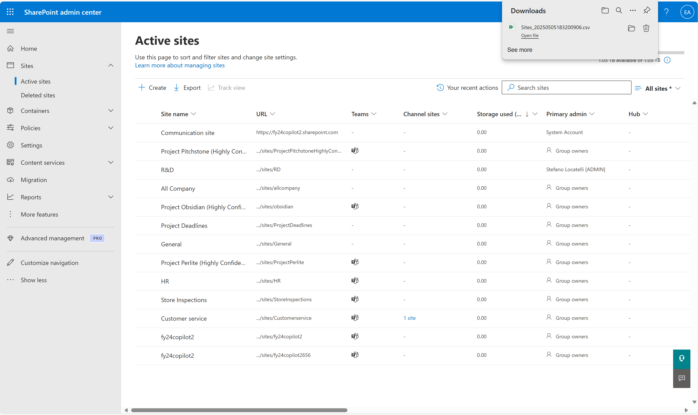
Identity most-popular sites
Optional: Grant Copilot access to low-risk sites
Initiate
Protect
Operate
Knowing which SharePoint sites are most active helps you prioritize where to tighten access and permissions.
1
2
2
Available with M365 Business Basic, Standard, and Premium
How to do it
Go to admin.microsoft.com
Navigate to Admin centers > SharePoint > Sites > Active sites
3
4
Sort by:
Last activity – to find frequently accessed sites (you may have to click on customize columns)
Storage used – to find heavily used sites
Export to CSV for deeper analysis

Slide 17
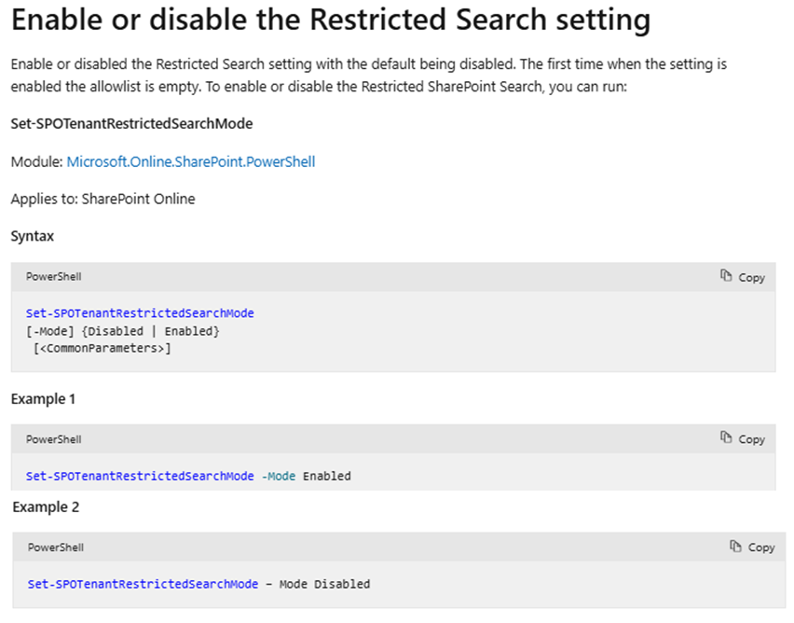
Manage Copilot site access with RSS
Optional: Grant Copilot access to low-risk sites
Initiate
Protect
Operate
By default, Copilot can search across all SharePoint and OneDrive content the user has access to. RSS helps you narrow the search scope to only business-critical or secure sites (up to 100 sites), reducing the risk of Copilot surfacing unintended or sensitive content.
Available with Microsoft 365 Copilot
How to do it
Open PowerShell as Administrator
Connect to SharePoint Online:
Connect-SPOService –Url https://<yourtenant>-admin.sharepoint.com
Add specific sites you want Copilot to search:
Add-SPOTenantRestrictedSearchAllowedList
Enable RSS at the tenant level:
Set-SPOTenantRestrictedSearchMode [-Enabled]
To disable RSS in the future:
Set-SPOTenantRestrictedSearchMode [-Disabled]
Learn more on our “Restricted SharePoint Search” page

Slide 18
Protect
Protect your sensitive information
Block the oversharing of sensitive information
Protect the integrity of SharePoint content
Create Sensitivity Labels
Publish Sensitivity labels
Enable OneDrive and SharePoint labels
Educate users
Create and deploy DLP policies across:
Exchange
SharePoint
OneDrive
Track app risks with App Insights reports

Slide 19
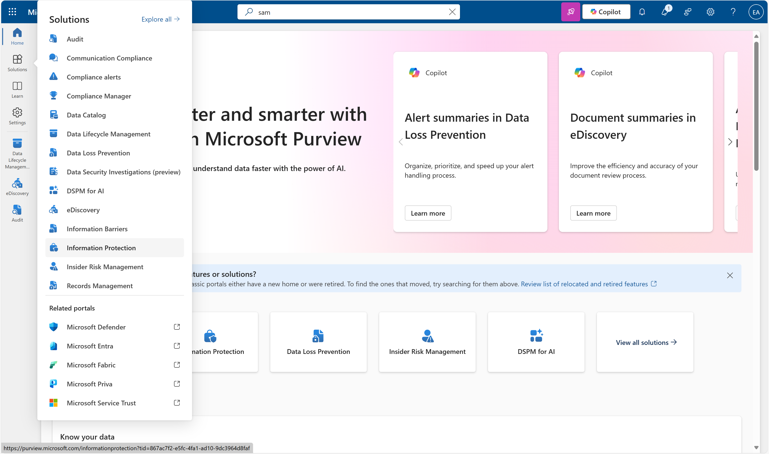
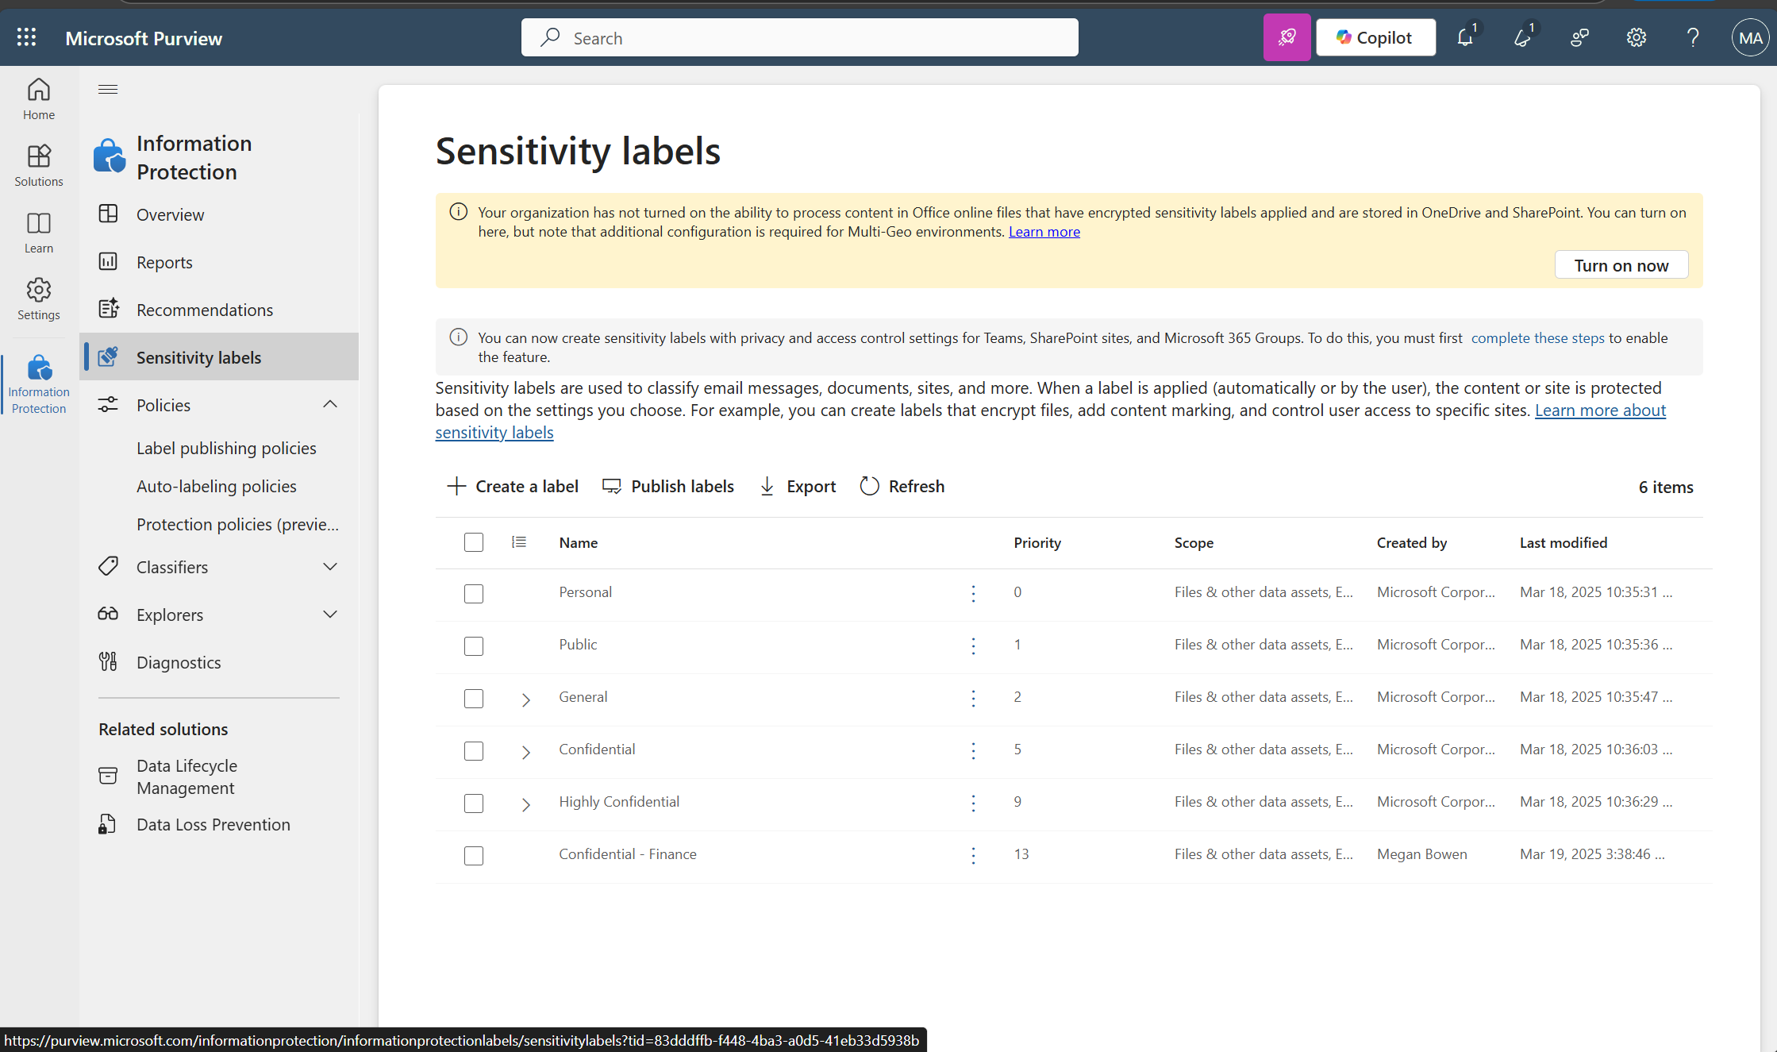
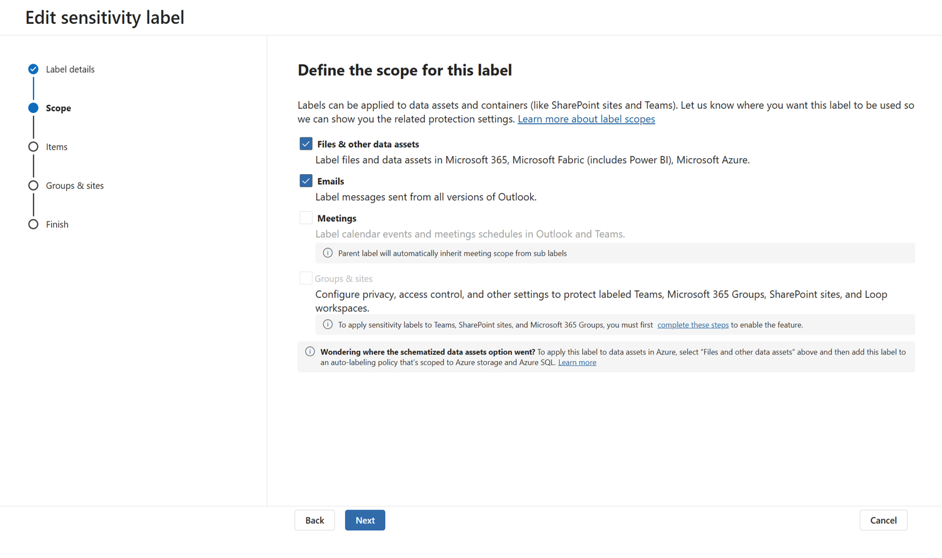
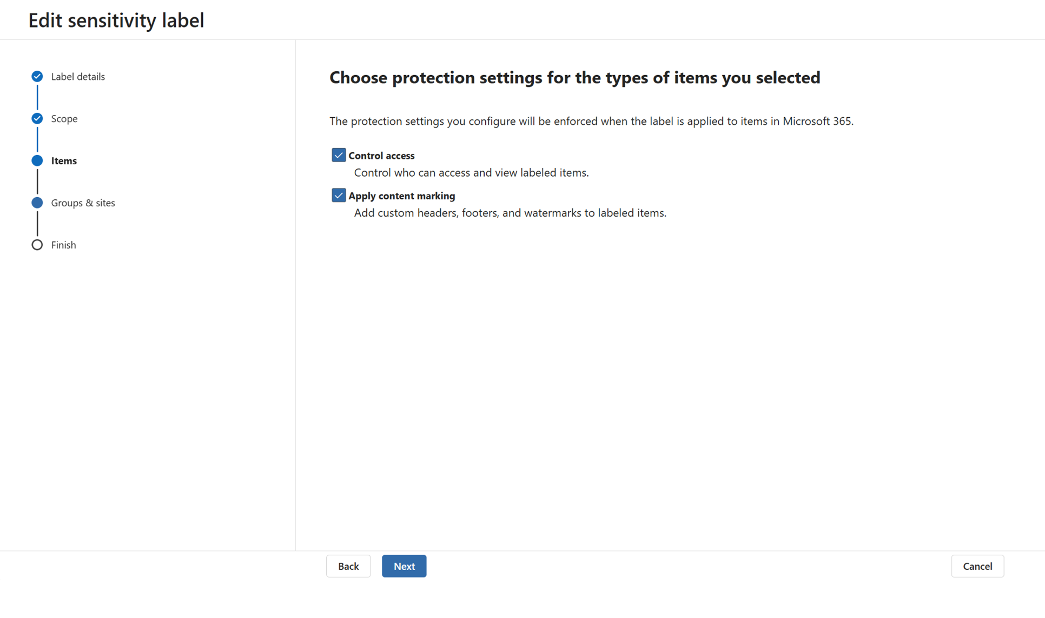
Create Sensitivity Labels
1. Protect your sensitive information
Initiate
Protect
Operate
Sensitivity labels help protect business data by classifying content, restricting access, and optionally applying encryption. This is essential before enabling Copilot, which can access labeled content based on user permissions.
1
2
3
Available with Business Premium
How to do it
Go to purview.microsoft.com
4
4
Go to Solutions > Information protection
Select Sensitivity labels > Create a label
Define:
Name and description
Scope (e.g., files, emails, containers)
Encryption and content marking options
Learn more on our “Create and configure sensitivity labels and their policies” page

Slide 20
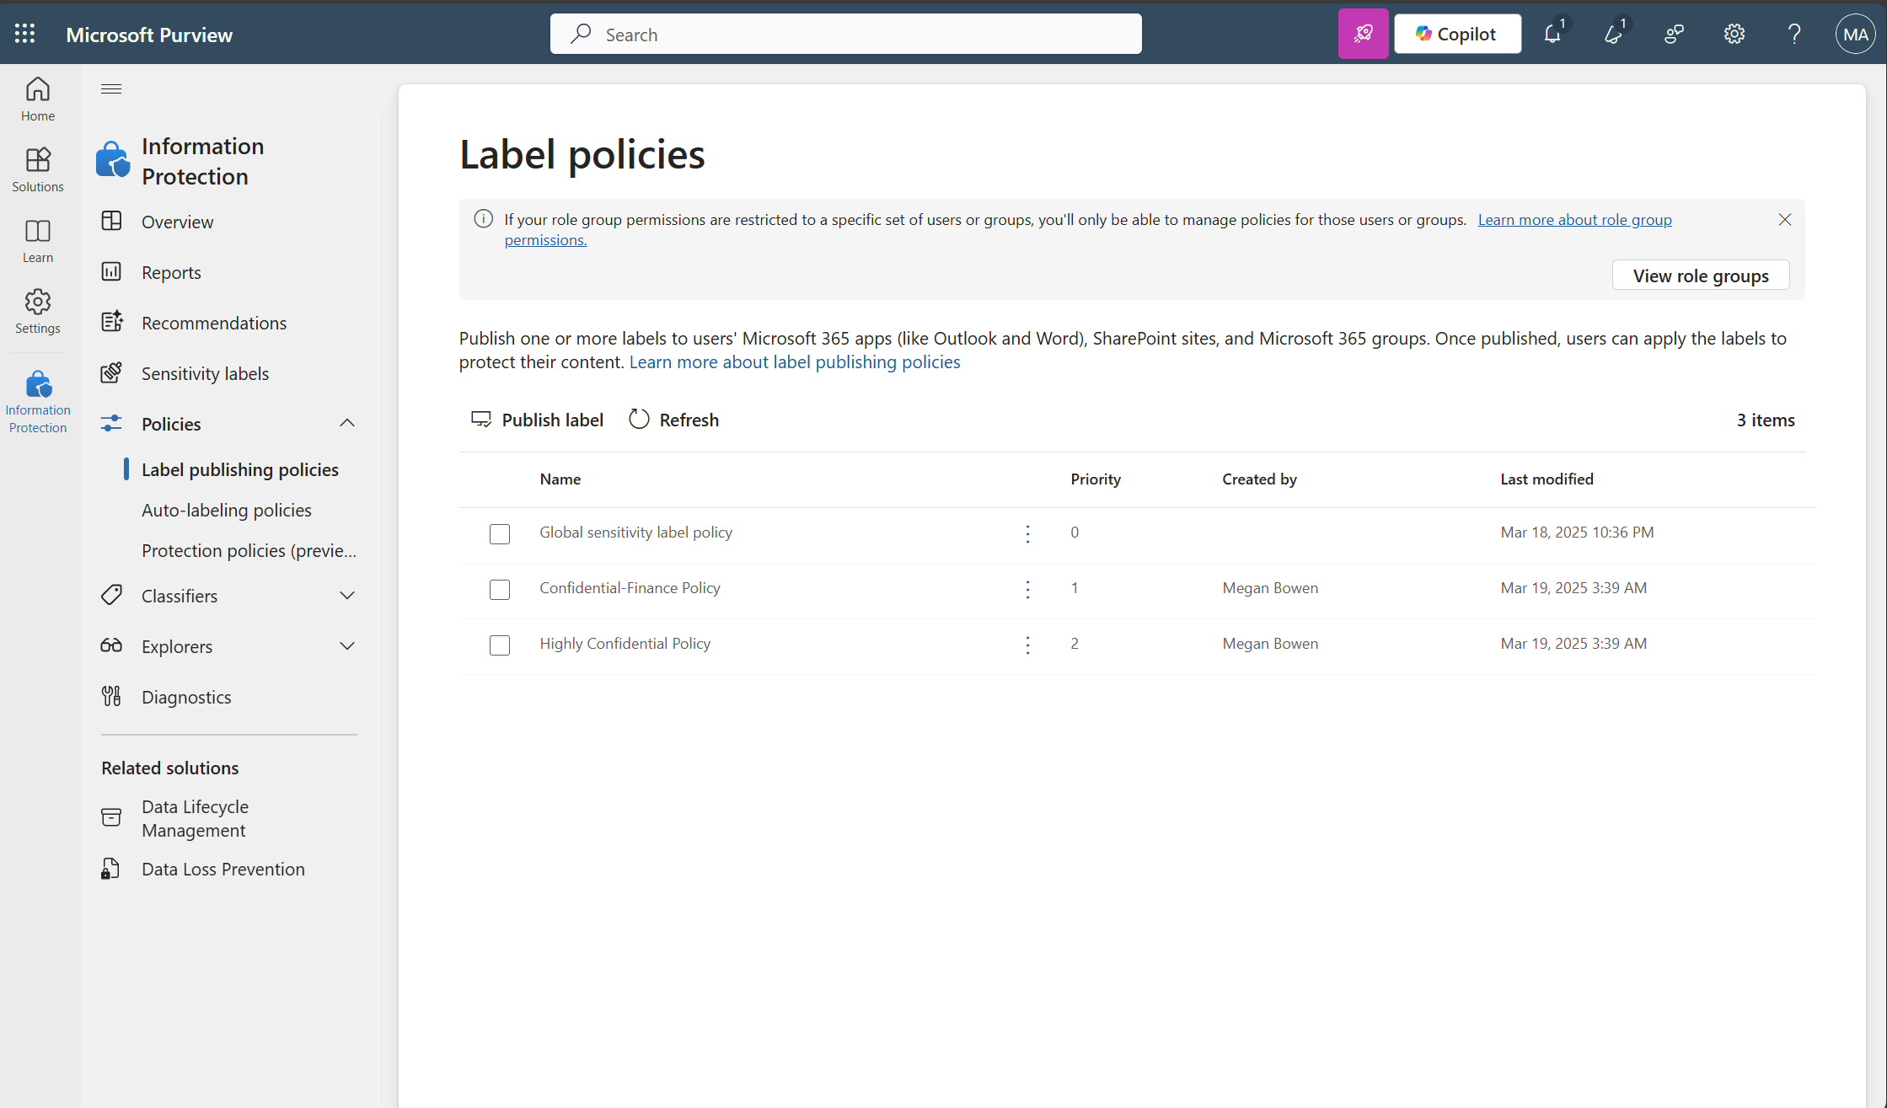
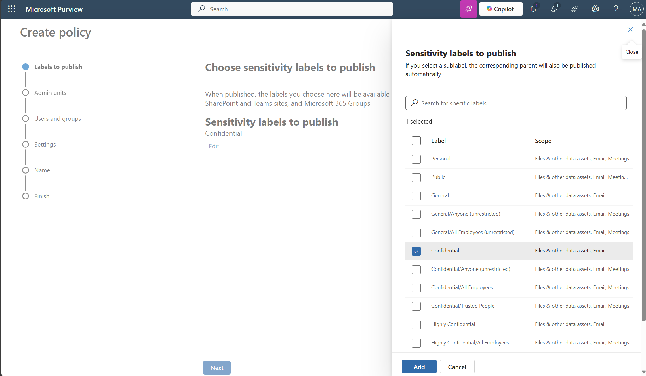
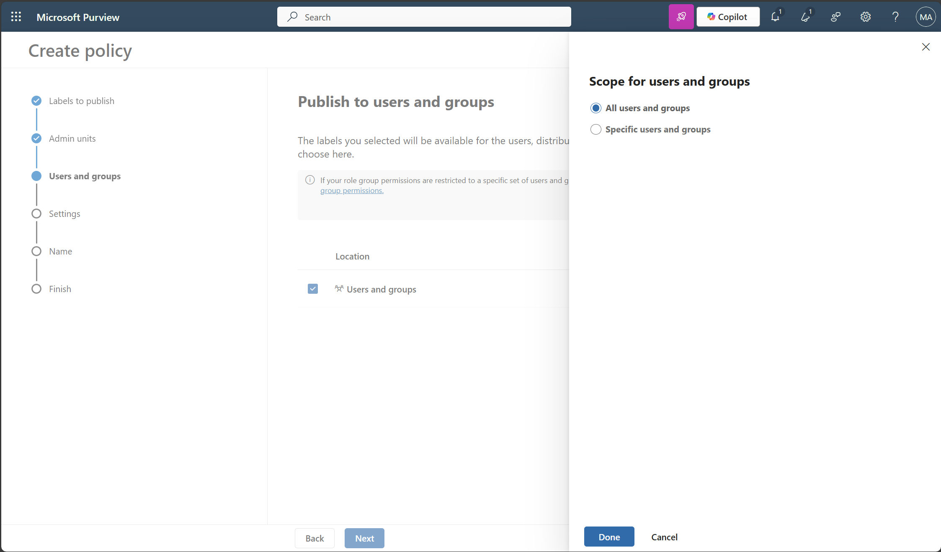
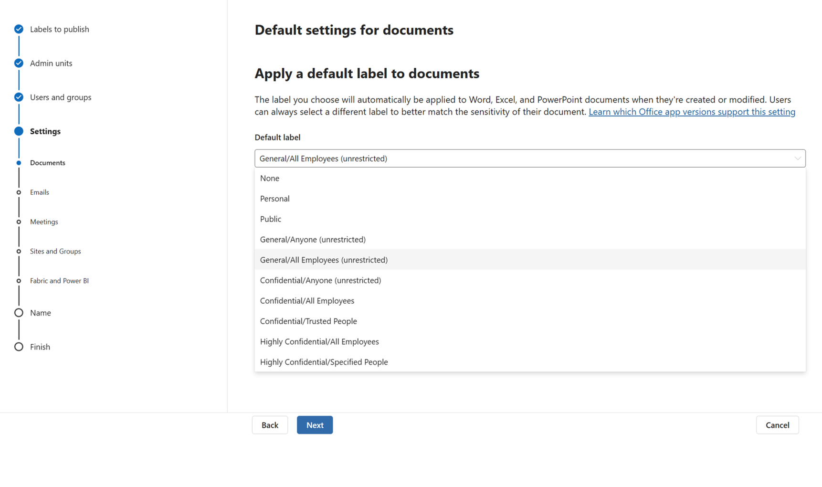
Publish Sensitivity labels
1. Protect your sensitive information
Initiate
Protect
Operate
Publishing your labels ensures users can see and use them. Automatically applying labels helps scale protection across Teams, SharePoint, and OneDrive.
1
2
Available with Business Premium
How to do it
In Information protection > Policies > Label publishing policies > Publish labels
3
3
Choose a label type
Assign to specific users or groups
Set default labels
Learn more on our “Create and configure sensitivity labels and their policies” page

Slide 21
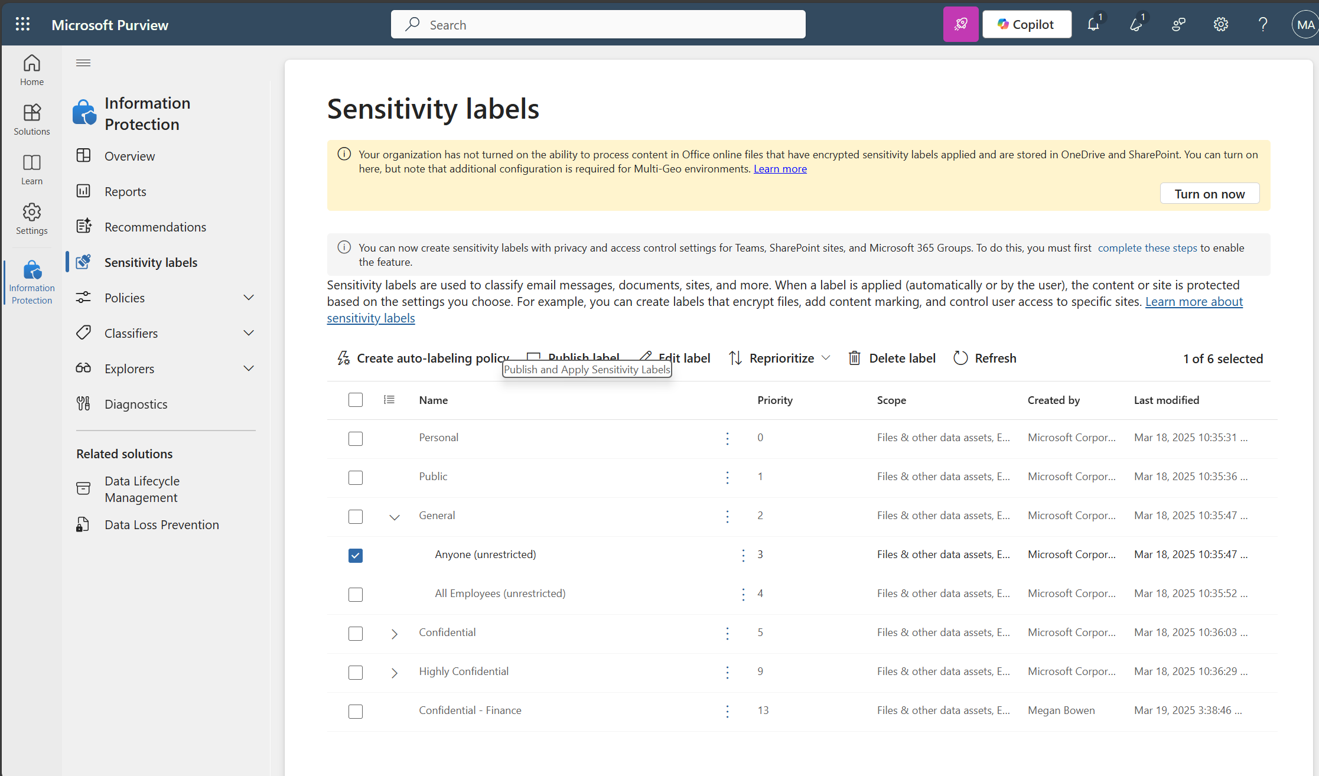
Enable OneDrive and SharePoint labels
1. Protect your sensitive information
Initiate
Protect
Operate
Publishing your labels ensures users can see and use them. Applying labels helps scale protection across Teams, SharePoint, and OneDrive.
Available with Business Premium
How to do it
Select Information Protection > Sensitivity labels > select ”Turn on now” if you see the following message:
“Your organization has not turned on the ability to process content in Office online files that have encrypted sensitivity labels applied and are stored in OneDrive and SharePoint. You can turn on here, but note that additional configuration is required for Multi-Geo environments.”
This allows documents to inherit labels from libraries.
Learn more on our “Create and configure sensitivity labels and their policies” page

Slide 22
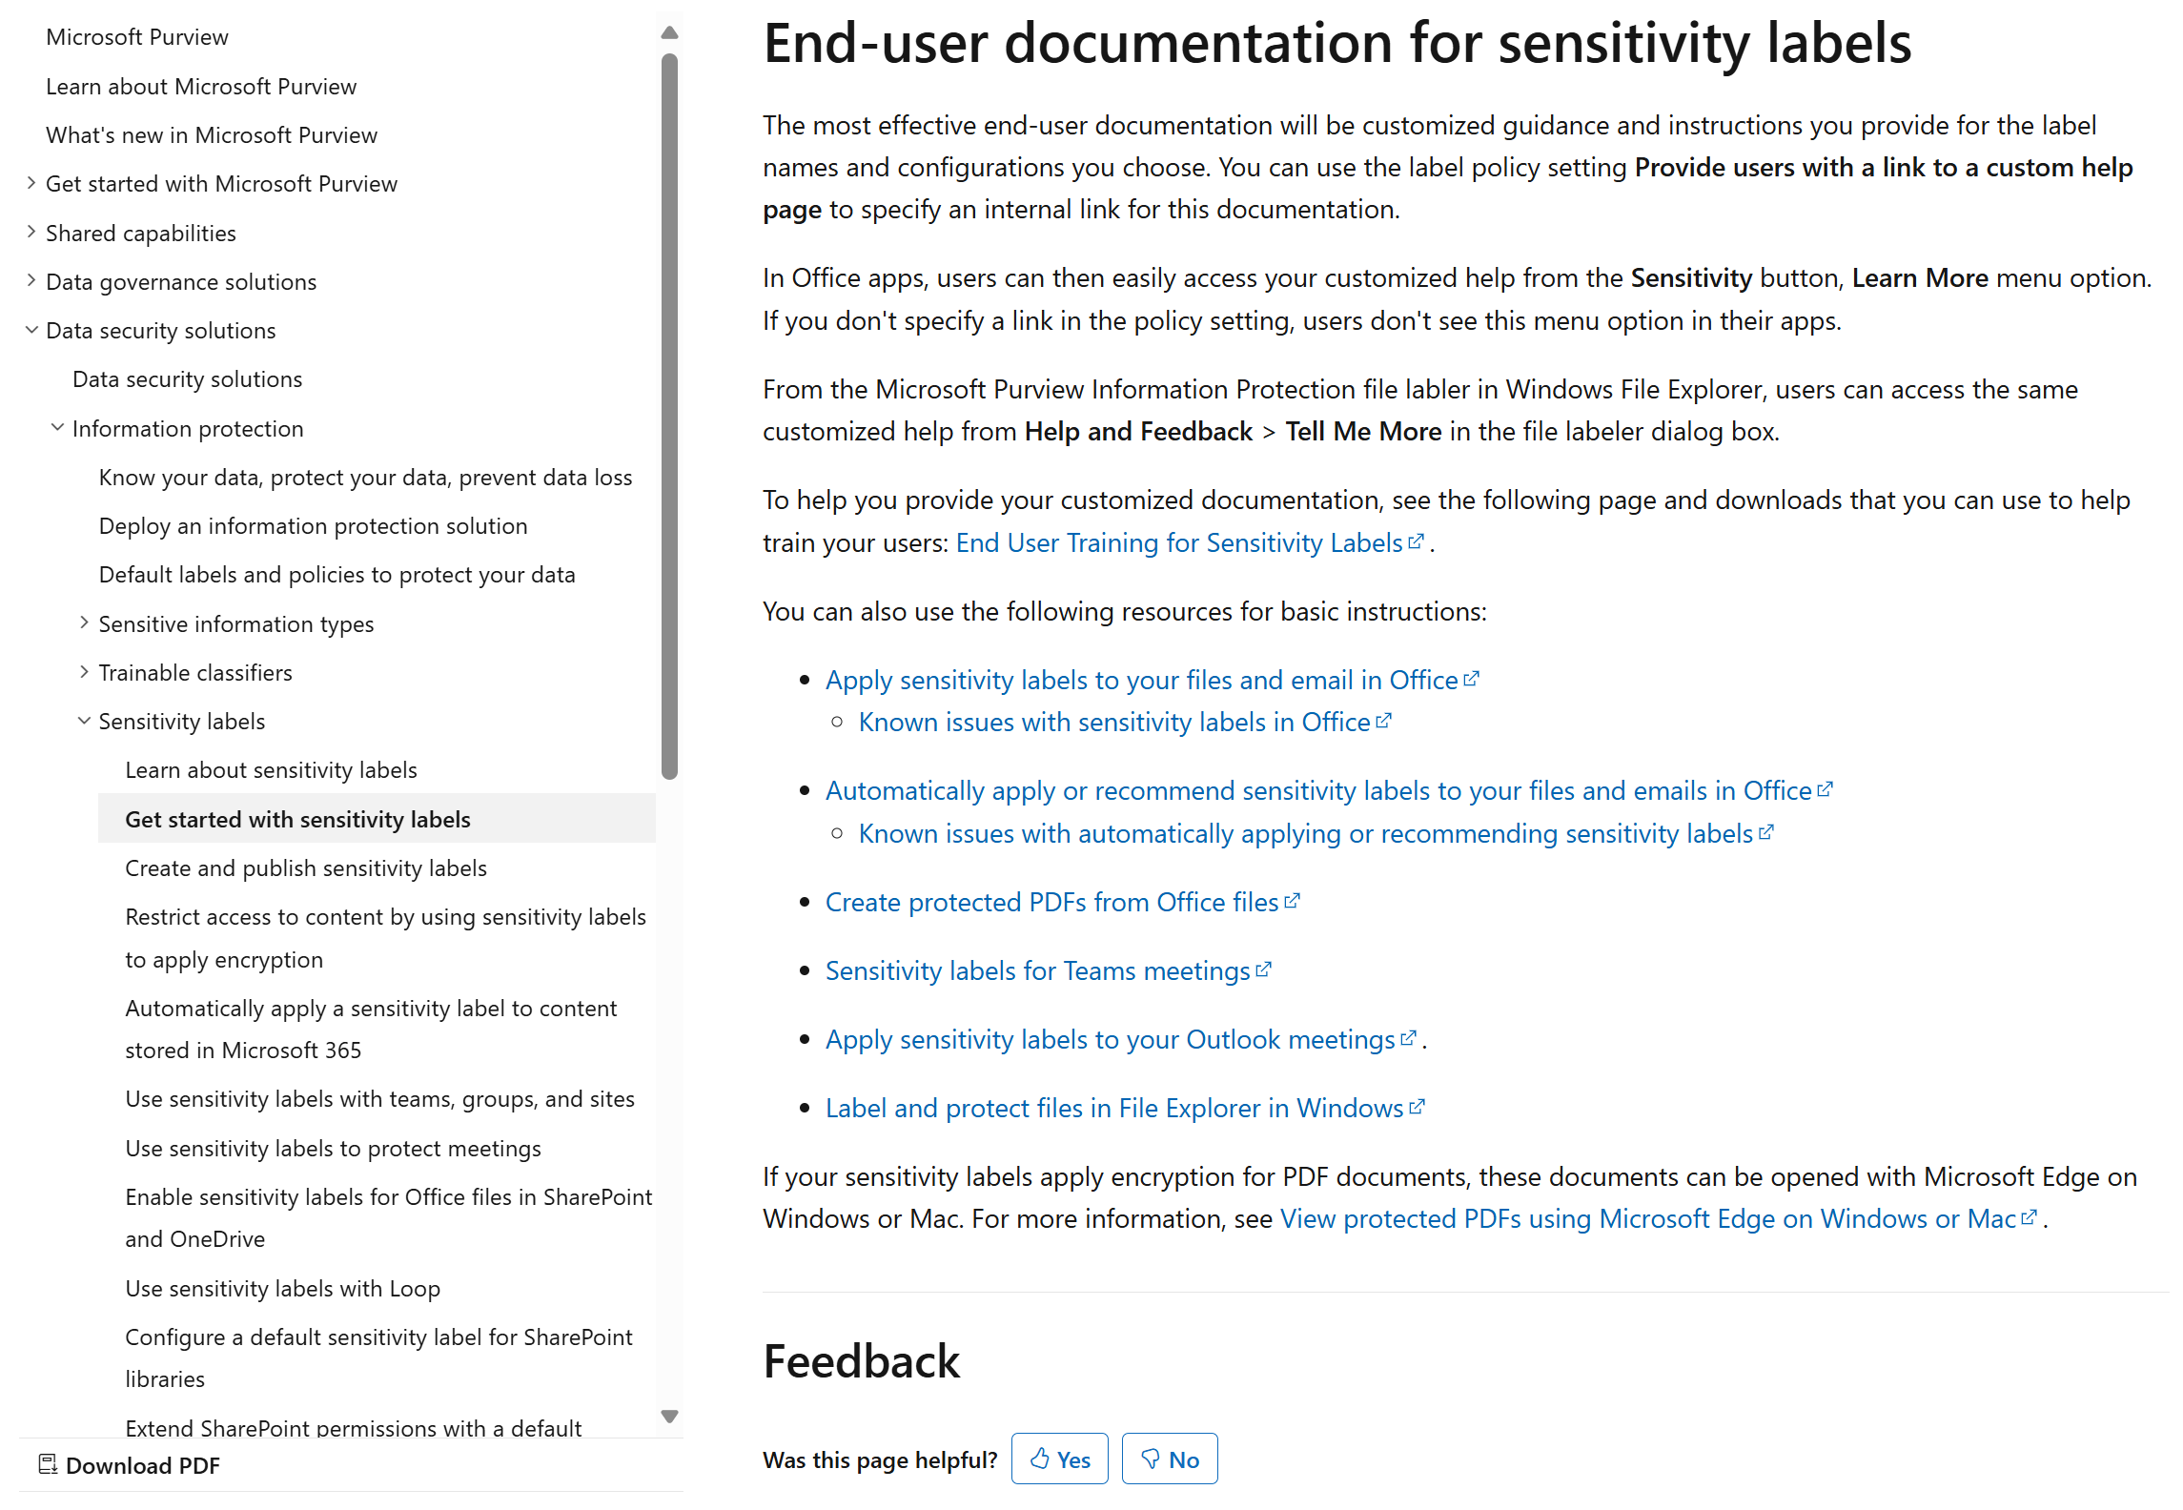
Educate users
1. Protect your sensitive information
Initiate
Protect
Operate
Publishing your labels ensures users can see and use them. Applying labels helps scale protection across Teams, SharePoint, and OneDrive.
Available with Business Premium
How to do it
Provide guidance on when to apply the correct sensitivity label. To help you with this step, read our ”End-user documentation for sensitivity labels” page
Learn more on our “Create and configure sensitivity labels and their policies” page

Slide 23
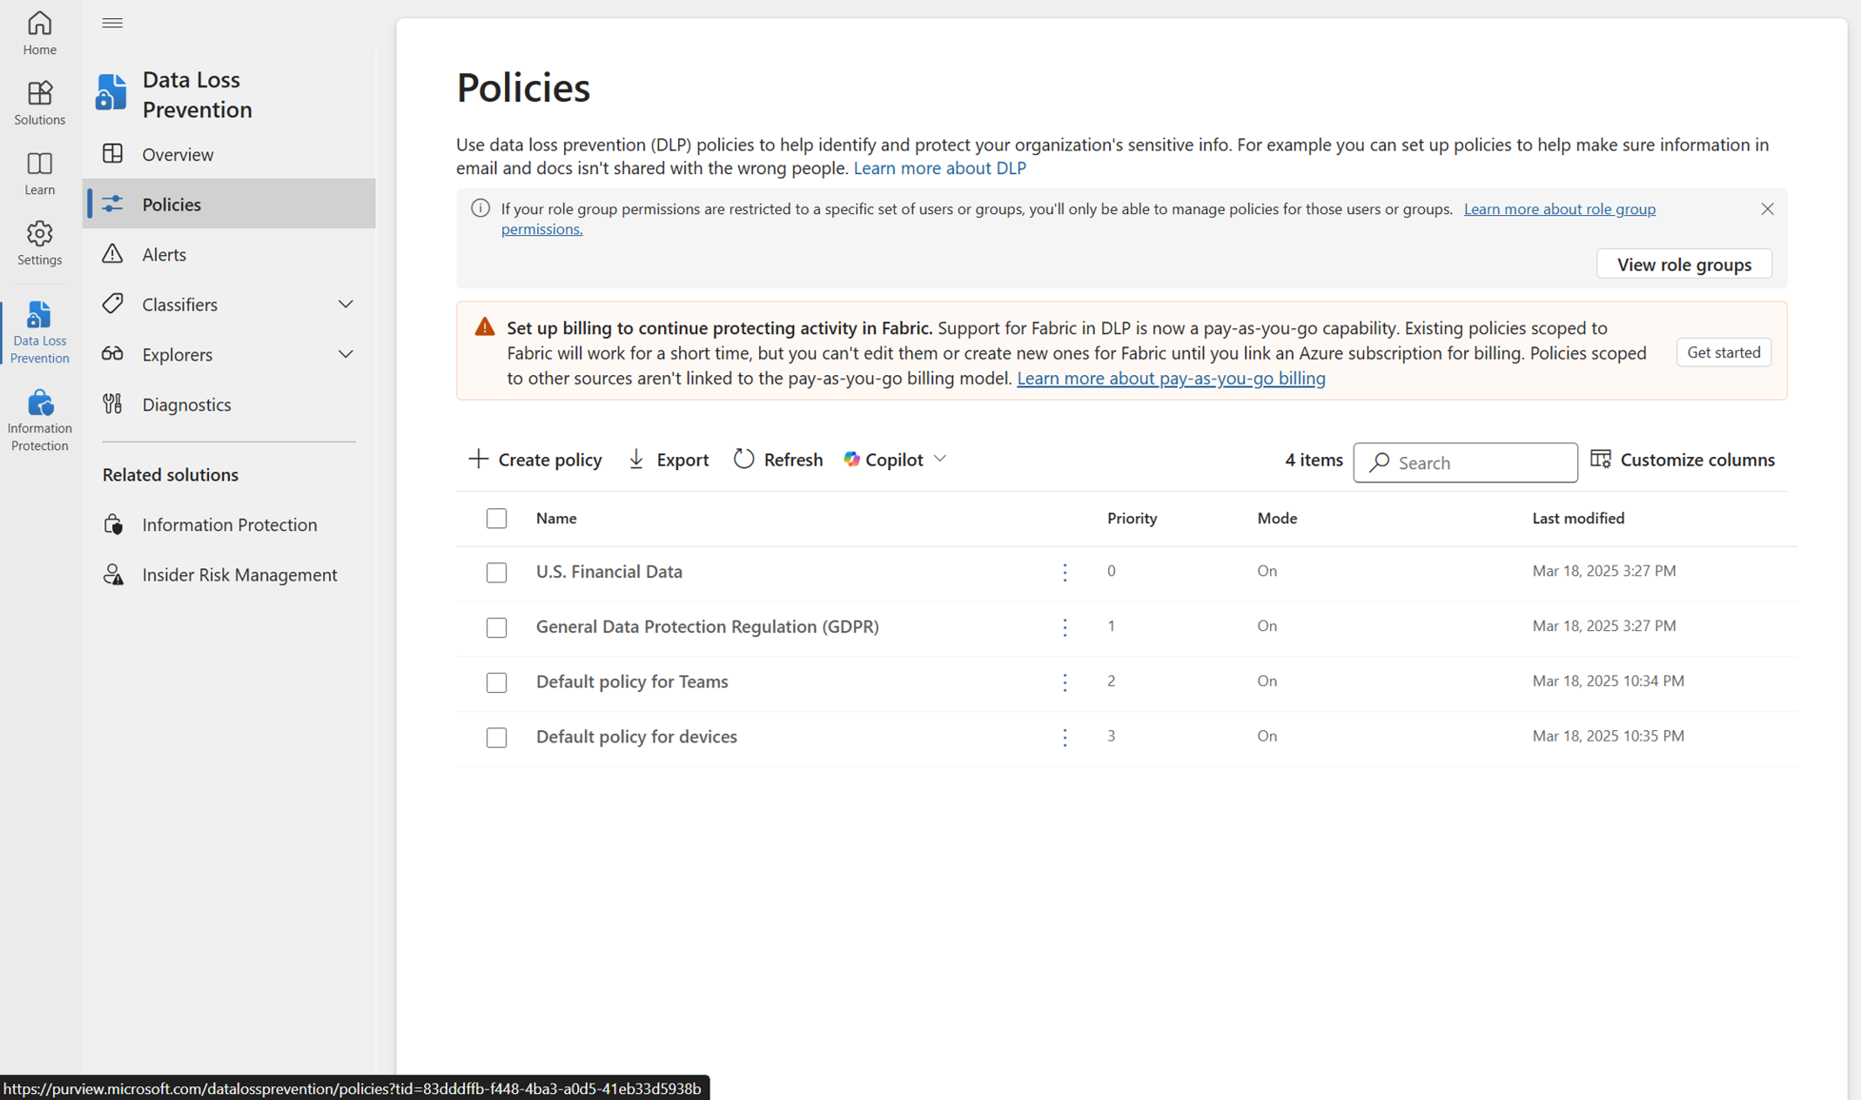
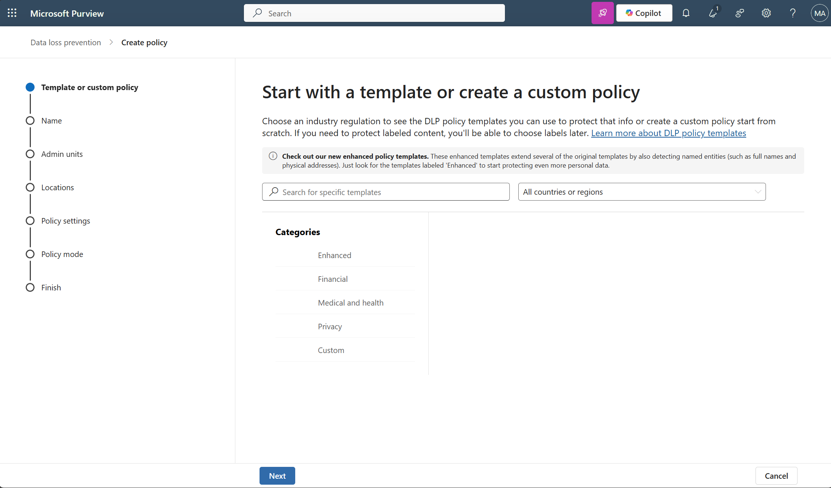
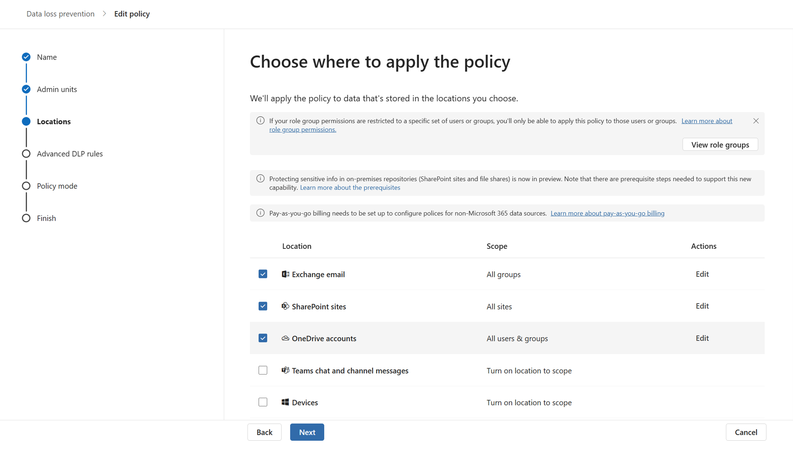
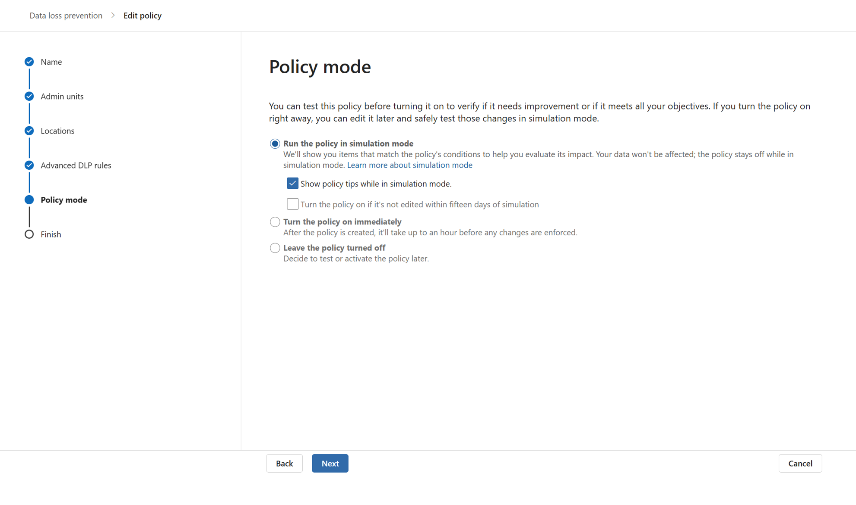
Create and deploy DLP policies
2. Block the oversharing of sensitive information
Initiate
Protect
Operate
DLP (Data Loss Prevention) helps prevent sensitive data in Exchange, SharePoint, and OneDrive from being shared with unauthorized users—reducing the risk of exposure through Copilot and supporting secure information access in Microsoft 365.
1
2
Available with Business Premium
How to create a DLP policy
Go to purview.microsoft.com > in the left nav, select Data Loss Prevention > then Policies > + Create policy
3
4
Following the wizard, choose a template (e.g., “U.S. Financial Data” or “Custom policy”)
Select locations:
Exchange Online (EXO)
SharePoint Online (SPO)
OneDrive for Business (OBD)
​Turn it on or test it in simulation mode
Simulation mode allows you to see the effect of an individual policy without enforcing the policy
Operate your policies with alerts and built-in reports
Learn more on our “Design a data loss prevention policy” and “Create and Deploy data loss prevention policies” pages

Slide 24
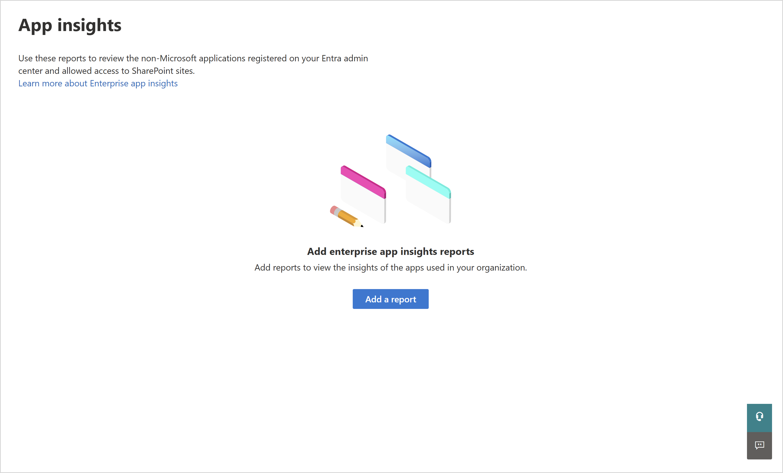
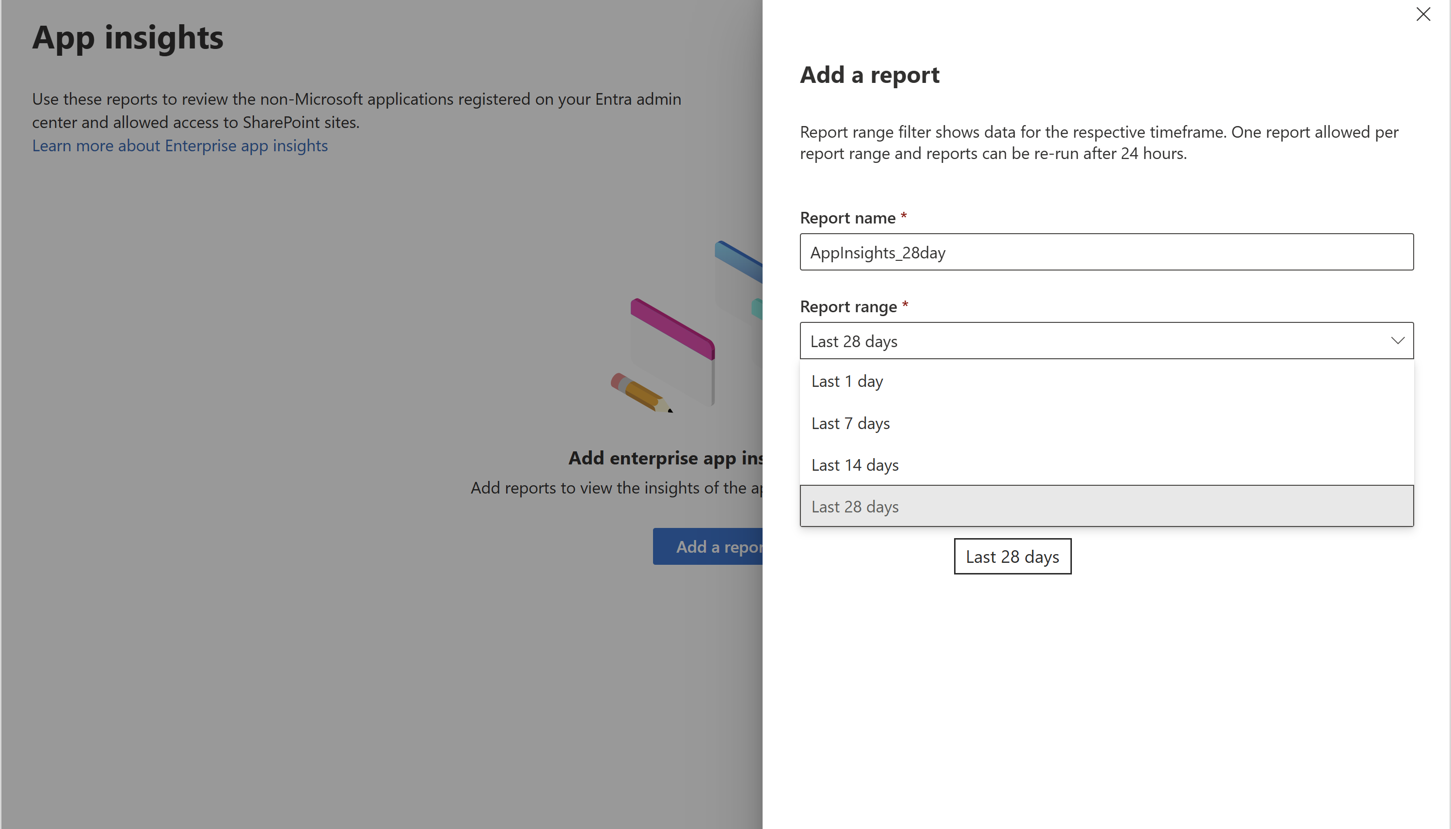
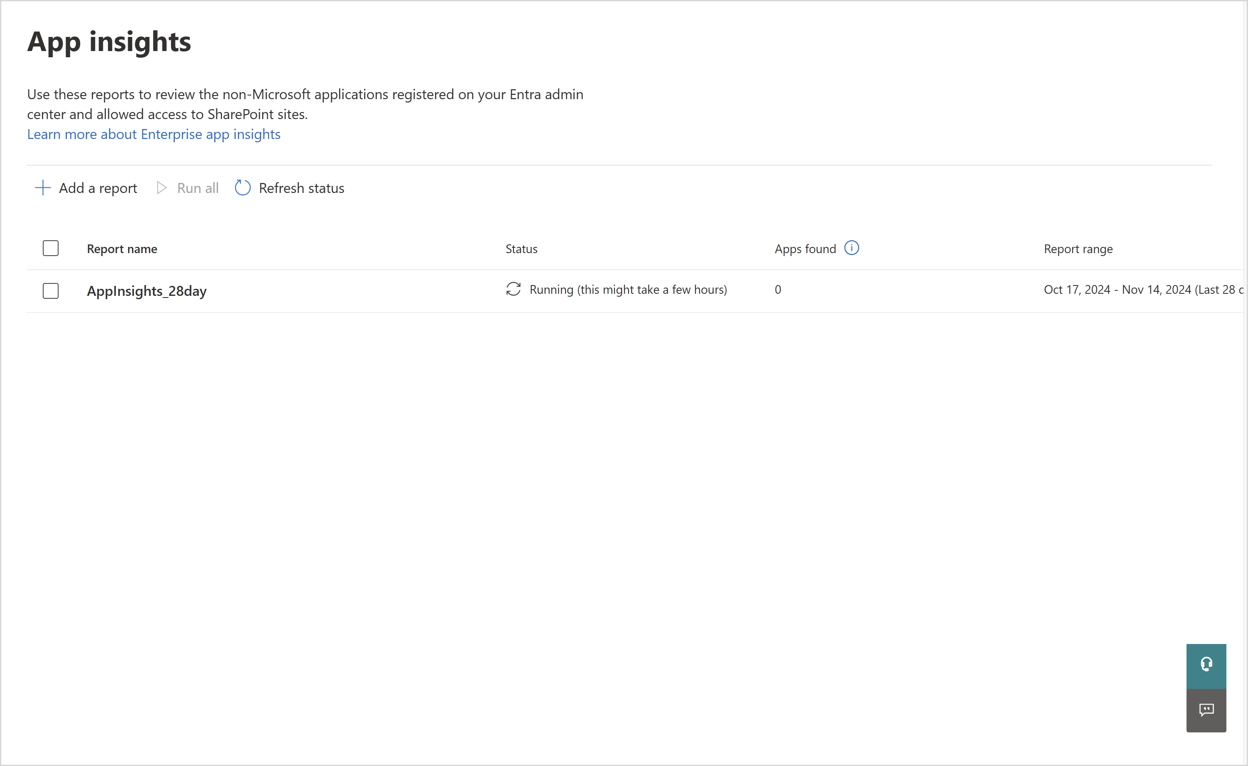
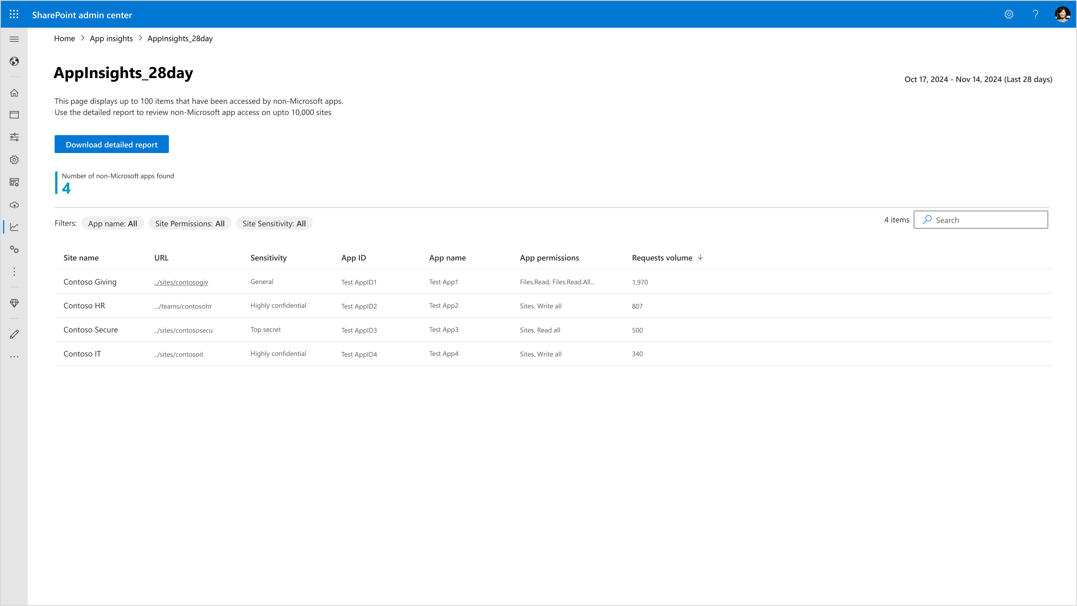
Track app risks with App Insights reports
3. Protect the integrity of SharePoint content
Initiate
Protect
Operate
Turning on Enterprise App Insights in the SharePoint Admin Center enables visibility into how third-party and custom apps interact with SharePoint and OneDrive, helping admins detect risky behavior and strengthen app governance.
1
2
3
Available with Microsoft 365 Copilot
How to do it
In SharePoint Admin Center > Reports > App Insights, select Add a report
4
4
Choose a time frame to filter the data you want to analyze
Use the Status column to see when the report is ready or last updated.
Explore the top 100 apps by request volume and filter by app name, permissions, or site sensitivity.
Learn more on our “Generate App insights reports” page

Slide 25
Operate
Search sensitive content to reduce exposure
Further secure sensitive data
Prevent sites from becoming stale
Track and preserve Copilot interactions with eDiscovery
Manage data lifecycle with auto-retention or deletion
Enable site attestation to maintain ownership

Slide 26
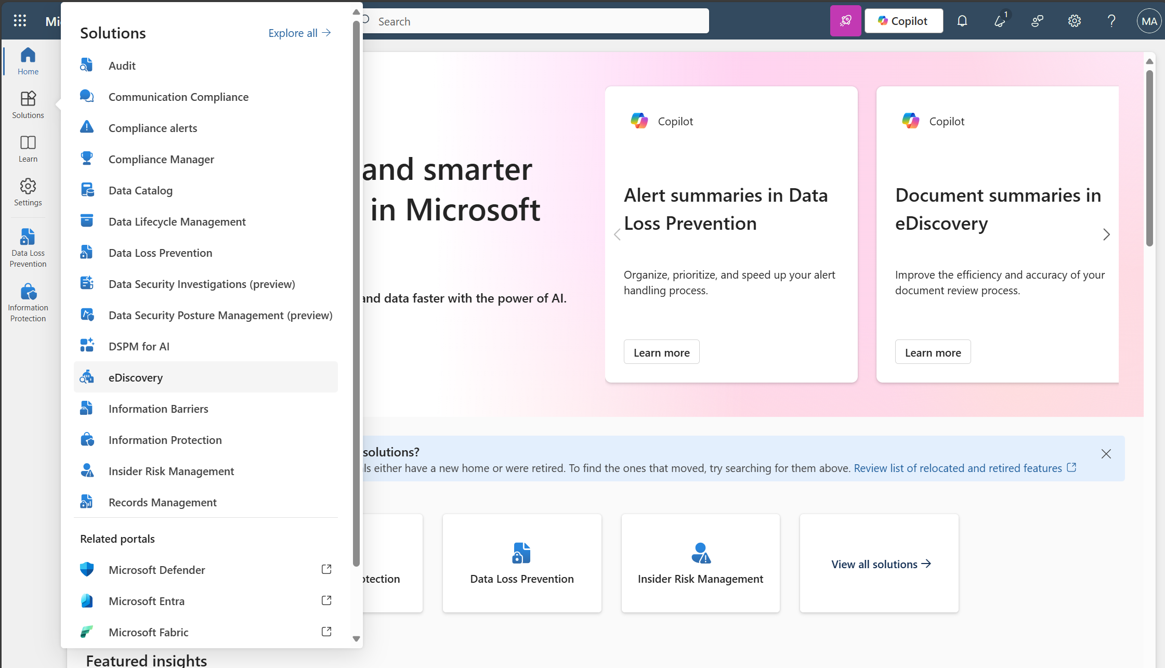
Collect and preserve Copilot interactions with eDiscovery
1. Search sensitive content to reduce exposure
Initiate
Protect
Operate
1
2
To support audits, compliance, or internal investigations, you may need to search for Copilot-generated content and interactions. Microsoft Purview eDiscovery lets you search, preserve, and export this data by keyword, user, or content type.
Available with Business Premium
How to do it
3
Go to purview.microsoft.com > in the left nav, select eDiscovery > Standard
To apply a legal hold (optional):
Go to the Hold policies tab within your case
Add users or content locations to preserve related data
Create a new case (or open an existing one)
​Search for Copilot-related content
Under Cases, select the Searches tab
Use keywords like “Copilot,” “CopilotQueryInitiated,” or other relevant terms
Apply filters like location (SharePoint, Exchange, Teams), users (e.g., departments enabled for Copilot), and date ranges
To export search results:
After search completes, click Export results
Choose export settings and download the file from the Export tab
Learn more on our “Design a data loss prevention policy” and “Create and Deploy data loss prevention policies” pages

Slide 27
Manage data lifecycle with auto-retention or deletion
2. Further secure sensitive data
Initiate
Protect
Operate
1
2
2
Inactive, outdated, or unnecessary content increases risk when Copilot is enabled. It can surface data that no longer serves a business purpose. Use Data Lifecycle Management (DLM) to reduce clutter, protect sensitive data, and control what stays accessible.
Available with Business Premium
How to do it
3
To set up Data Lifecycle Policies, go to purview.microsoft.com > in the left nav, select Data lifecycle management > choose Retention policies under Policies (broad rules) or Retention labels (optional)
To use Retention Labels (Granular Control): Use retention labels only if you need an exception to a retention policy
Go to Data lifecycle management > Labels
Create a new label (e.g., “Keep for 1 year”)
Define retention settings (retain/delete logic)
Publish the label to user groups or content types
If you applied retention labels, Operate them to see how they're being used
​To create a Retention Policy, select + New retention policy > name your policy > apply to SharePoint, OneDrive, Exchange, or Teams
​Choose to retain for a period, delete, or retain and then delete > review and Publish
Learn more on our “Learn about retention policies & labels to retain” pages

Slide 28
Enable site attestation to maintain ownership
3. Prevent sites from becoming stale
Initiate
Protect
Operate
Enabling a Site Attestation Policy in the SharePoint Admin Center will prompt site owners to regularly confirm site activity and ownership, helping ensure your sites are secure and compliant by reducing the risk of unmanaged sites.
1
2
Available with Microsoft 365 Copilot
How to do it
From the SharePoint admin center from admin.microsoft.com
3
4
Policies > Site lifecycle management > Site attestation policy
Set site scope, and select site owners as responsible for attesting a site
Exclude specific owners/admins (if needed) > enforce action > activate
Learn more on our “Restrict SharePoint site access” page

Slide 29
Appendix

Slide 30
Address internal oversharing concerns for Microsoft 365 Copilot deployment (detailed)
Initiate
Protect
Operate
Turn on proactive audit
Enable proactive audit and access logs for your tenant
Enforce sharing policies
Configure tenant-wide sharing policies
Disable “Everyone Except External Users” sharing
Assess site oversharing
Assess site content and risks
Review user access to high-risk sites
Validate ownership
Clean-up inactive sites
Lock-down high-risk sites
Optional: Grant Copilot access to low-risk sites with RSS
Protect your sensitive information
Create Sensitivity Labels
Publish Sensitivity labels
Enable OneDrive and SharePoint labels
Educate users
Block the oversharing of sensitive information
Create and deploy DLP policies across: Exchange, SharePoint & OneDrive
Protect the integrity of SharePoint content
Track app risks with App Insights reports
Search sensitive content to reduce exposure
Track and preserve Copilot interactions with eDiscovery
Further secure sensitive data
Manage data lifecycle with auto-retention or deletion
Prevent sites from becoming stale
Enable site attestation to maintain ownership
Activities

Slide 31
Licensing placemat
 | Microsoft 365 Business Basic / Standard + Microsoft 365 Copilot | Microsoft 365 Business Premium + Microsoft 365 Copilot
SharePoint and Seach Controls
Sharing defaults | ● | ●
SharePoint admin center | ● | ●
Restricted SharePoint Search | ● | ●
SharePoint Advanced Management
Site ownership policy | ● | ●
Site lifecycle management | ● | ●
Data access governance (DAG) reports | ● | ●
Restricted access control (RAC) | ● | ●
Restricted content discoverability policy (RCD) | ● | ●
Change history report | ● | ●
Microsoft Purview
Audit and access logs | ● | ●
Sensitivity labels |  | Create custom labels Configure labels for containers Manually apply labels
Data loss prevention (DLP) |  | Policies can target SharePoint Exchange OneDrive
Data lifecycle management |  | Create retention policies Manually apply retention labels Use Content explorer
eDiscovery | Content search Search for content Keyword queries and search conditions Export search results Role-based permissions | eDiscovery Standard Everything in content search, plus: Case management Legal hold

