Slide 1
Copilot Chat Administration
What every Administrator should know

Slide 2
Agenda
1
Spectrum of Agents and Controls
2
Management Controls
3
Security & Governance
4
Measurement & Monitoring
5
Planned Features
6
Resources
7
Next Steps & Call to Action
Notes:
Hello everyone. Today we'll discuss how to control, manage, and govern agents in Microsoft Copilot. We'll begin with an introduction to agents and Copilot's capabilities, then cover management, control, security, governance, measurement, and monitoring features. Finally, we'll review upcoming features, resources, and actionable next steps.

Slide 3

Copilot is the UI for AI
Copilot
Agents
Notes:
Let me give you a quick overview of Copilot, just as a reminder of what this app is all about. Copilot is designed to be the user interface for artificial intelligence—think of it as the UI for AI. It sits alongside all the familiar Microsoft tools, like Outlook and Word, and even newer ones like Microsoft Loop and Teams. The idea is that Copilot works with these tools in context, helping you as you go about your work.
Feel free to use this anecdote or choose you own
I always compare Copilot to spell check. Back in the day, I had a dictionary sitting on my desk to look up words I didn’t know how to spell. Then, spell check came along—first in Word, then Outlook, and eventually everywhere. Now, it’s just part of how I work, and I don’t even think about it. AI is becoming the same way: Copilot sits right next to you, ready to help out whenever you need it.
Under the hood, it’s powered by a large language model—today that’s GPT‑5 through our partnership with OpenAI. When you ask a question or give Copilot an instruction, the AI processes that request and returns a response. What makes Copilot unique is that we’ve architected it so it can also make API calls and interact directly with Microsoft 365 apps. In the full, paid version of Copilot, that means it can do things like edit documents, insert rows in Excel, or reason across all your work data. For example, you can ask an open‑ended question like, “What’s my most important meeting this week?” and Copilot can look across your calendar, files, Teams chats, SharePoint sites, emails, and more to determine the answer.
The version of Copilot included with your Microsoft 365 license doesn’t have all of that deep integration, but it shows up in the same place and looks the same—our goal is to provide a lightweight, secure interface that sits right alongside your Microsoft 365 tools so AI can become part of your everyday workflow.
If you need to do something more complex, like a business process with lots of steps, you can use agents. Agents let you structure multi-step tasks and work autonomously, all within your workflow.

Slide 4
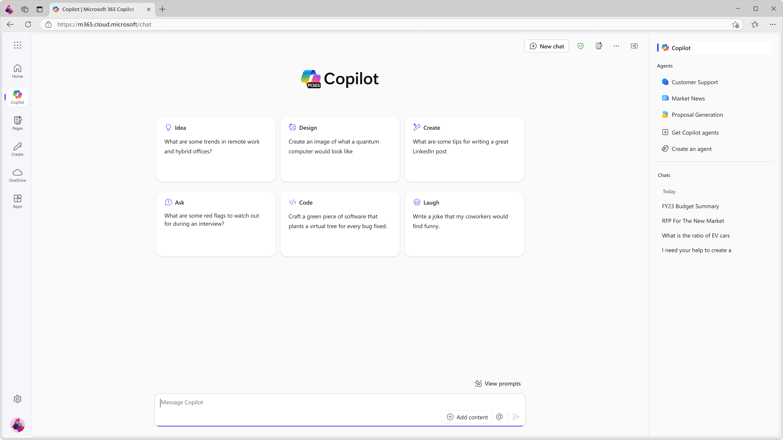
M365 Copilot Chat: A Secure AI chat tool
Microsoft 365 Copilot Chat is an AI chat tool built specifically for work. It uses the latest AI models and data from the web to answer your questions, generate content and ideas, and find information. It also protects your data so information from your chat conversation does not get exposed to the public.
In addition, with Copilot Chat you can:
Upload files to get responses based on information from your work documents, presentations, etc¹.
Generate images¹ and data visualizations.
Refine and collaborate on chat responses.
Connect Copilot Chat to your organization data like team documents and internal SharePoint sites².
Get started by going to M365Copilot.com
¹ Image generation and file upload limits apply.
²Connecting Copilot Chat to your organization data is only available if your organization admin has enabled this capability.
Notes:
One of the big benefits of Copilot Chat is that it gives me creative access to the content in my work without requiring me to move files into another tool. For example, I can ask it to summarize a document, suggest improvements, or offer ideas directly alongside the Microsoft 365 apps I’m already using. IT and compliance teams really appreciate this model because it keeps all AI activity inside the Microsoft 365 substrate—nothing leaves the organization’s data boundary. This prevents the types of “shadow IT” behavior we used to see years ago, like employees uploading confidential documents to external services just to work around limitations. Our goal with Copilot Chat is to avoid that entirely by giving every user a secure way to get AI assistance with their work files.
And because it’s included with Microsoft 365, organizations can use it to introduce AI broadly, learn where it provides value, run small pilots, and then decide which users need the full Copilot license. From there, teams can collaborate more effectively, share AI‑generated insights, and start building toward a mature, secure AI transformation strategy.
Copilot also improves productivity because it helps people get their work done a little faster and keeps teams aligned. In a moment, I’ll show you some examples in Copilot Pages that demonstrate how teams can collaborate around AI‑generated content in a shared space.
And as I mentioned earlier, bringing secure AI into the enterprise is a critical part of our strategy. The included version of Copilot Chat gives organizations a safe, structured way to start introducing AI broadly, helping users build familiarity while keeping all activity within Microsoft 365’s compliance and security boundaries.

Slide 5

Let us help you get started with Secure AI
Kickstart Copilot Chat Adoption in your organization.
NEW: Copilot Chat and Agent Starter Kit – Agent overview guide, IT set up and controls guide, Copilot Chat Scenarios, Copilot Chat user training guide
User Engagement Tools and Templates – Copilot Chat user onboarding email templates, Agents in Copilot Chat handout
Learn about how Microsoft 365 solutions can help you elevating security for Copilot.
M365 E3 tools to help implementing Zero trust principles for AI companions
Getting your data ready for Copilot with M365 E3
Notes:
We also have a library of resources to help you get started. These are just a few of the areas we can support you throughout your entire journey.

Slide 6


Tools to secure and govern your Copilot use
Address oversharing concerns
Gain visibility into overshared content
Remediate excessive permissions
Prevent Copilot from processing sensitive files
Protect against data loss and insider risks
Get alerts and reports of risky behavior and AI use
Protect sensitive files and Copilot interactions
Dynamically apply security policies based on risky actions
Govern AI use to meet regulations & policies
Inspect interaction content and audit logs
Investigate for compliance and ethical violations
Enforce lifecycle policies and legal holds
Secure
Govern
Notes:
Microsoft provides tools that you can use to secure and govern your use of Microsoft 365 Copilot.
Assess oversharing risks by getting visibility into overshared content. We have recently published a blueprint on how to address oversharing. https://aka.ms/Copilot/OversharingBlueprintLearn It will walk you through how to get started, deploy, and continue to operate securely. Some of the key things that you can do:
Use reports and dashboards to identify content that may have been shared too broadly.
Fix excessive permissions using policy recommendations from the oversharing report.
Optionally, prevent Copilot from processing or referencing sensitive files.
Protect against data loss and insider risks.
Review how users interact with Microsoft 365 Copilot and get alerts if risky behavior occurs, such as unethical usage, copyright violations, or attempts to access a large volume of sensitive content.
Protect sensitive files wherever they live or travel. Copilot responses and Copilot created files will inherit protections from the source file.
Dynamically apply security policies based on risky actions. For example, if a user performs a series of Copilot actions that indicate a high level of risk we can automatically add them to more strict security policy.
Govern AI use to meet regulations and policies.
Visibility into copilot interaction text and linked files, and audit log entries for these copilot interactions.
Copilot interactions are included in admin search results, such as investigations for compliance purposes, potential ethical violations, or for litigation or legal reasons.
Manage the lifecycle of Copilot prompts and responses alongside all of your Microsoft 365 data. You can also put Copilot prompts and responses on a legal hold.

Slide 7
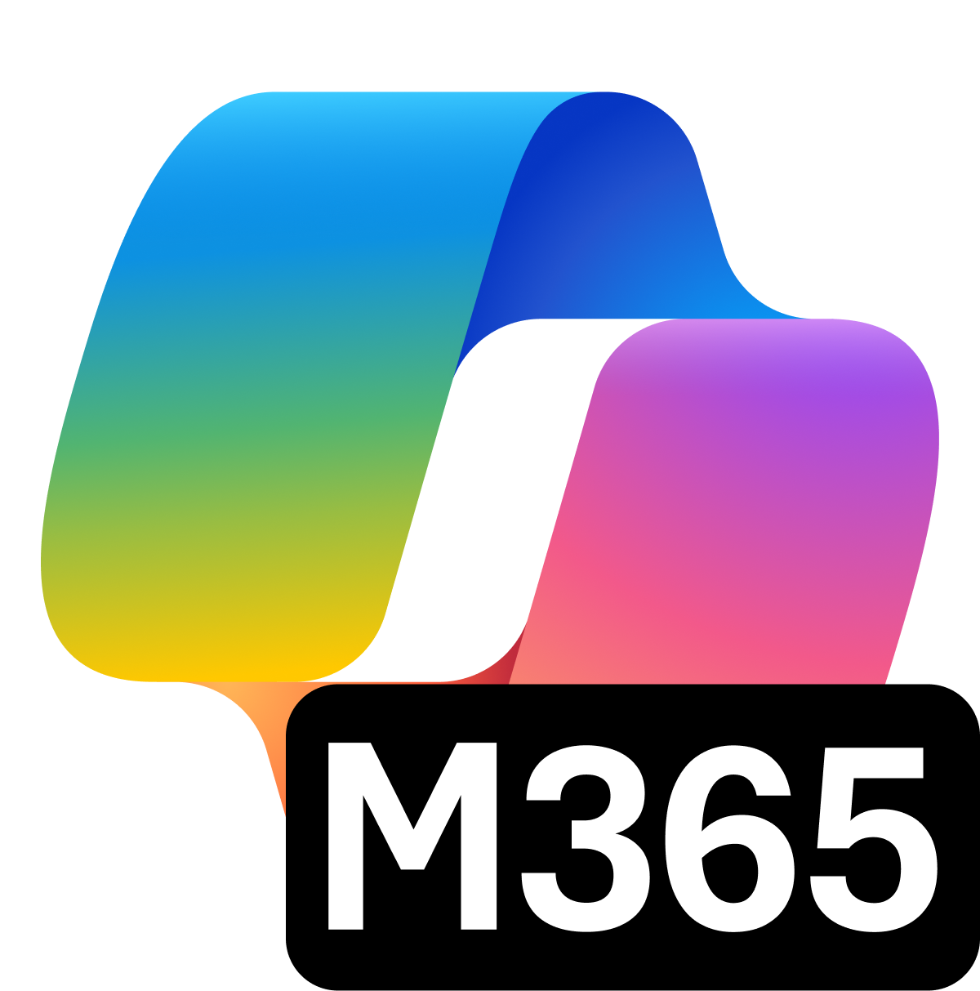
Foundational AI Commitments
Microsoft commitments and controls
We secure your data at rest and in transit
You control your data
Microsoft 365 Copilot is built on trust
Your data is not used to train or enrich foundation models
You’re protected against AI security and copyright risks¹
¹ Learn more about the Customer Copyright Commitment
Notes:
Customers trust Microsoft 365 with their sensitive data because of the foundation of trust we have built through the commitments to protect customer and the controls we make available directly to customers. These same commitments and controls apply to prompts and responses in M365 Copilot and Copilot Chat.
When it comes to commitments,
We secure your data at rest and in transit. We help protect your data with encryption, at rest and in transit, rigorous physical security controls, and data isolation between tenants.
You control your data. Our time-tested approach to data privacy is grounded in our commitment to give you control over the data you put in the cloud. In other words, you control your data. Microsoft guarantees this with the contractual commitments we make to you.
Your data is not used to train or enrich foundation models. Prompts, responses, and web search queries in Copilot aren’t used to train foundation models.
You’re protected against AI security and copyright risks. We help safeguard against AI-focused risks such as harmful content and prompt injections. For content copyright concerns, we provide protected material detection and our Customer Copyright Commitment.

Slide 8
Enterprise Data Protection
Notes:
Let’s kick things off by talking about enterprise data protection and what it really means.
A few years back, this feature wasn’t available, and it was one of the most requested additions. When enterprise data protection finally rolled out for unlicensed users, it was a big deal—people had been waiting for it.

Slide 9
What is enterprise data protection for prompts and responses?
Enterprise data protection
We secure your data: Encryption at rest and in transit, rigorous physical security controls, and data isolation between tenants.
Your data is private: We won’t use your data except as you instruct. Privacy commitments include support for GDPR, ISO/IEC 27018³, and Data Protection Addendum.
Your access controls and policies apply to Copilot: Copilot respects your identity model, permissions, sensitivity labels, retention policies, audit log, and follows administrative settings. The specific controls and policies will vary depending on the underlying subscription plan.
You are protected against AI security and copyright risks: We help safeguard against AI-focused risks such as harmful content and prompt injections. For content copyright concerns, we provide protected material detection, and our Customer Copyright Commitment.
Your data isn’t used to train foundation models: Prompts, responses, and data accessed through Microsoft Graph aren’t used to train foundation models.
Enterprise data protection (EDP) for prompts and responses offers the same enterprise terms¹ available in our Microsoft 365 commercial offerings.
EDP refers to controls² and commitments, under the Data Protection Addendum (DPA) and Product Terms, that apply to customer data for users of Microsoft 365 Copilot and Microsoft 365 Copilot Chat.
With EDP, prompts and responses are protected by the same contractual terms and commitments widely trusted by our customers for their emails in Exchange and files in SharePoint.
Microsoft 365 Service Boundary
¹ Microsoft 365 Copilot supports HIPAA compliance for properly configured implementations. Microsoft 365 Copilot Chat is under review and does not support HIPAA compliance at this time.
² The specific controls will vary depending on the underlying subscription plan.
³ Microsoft 365 Copilot runs on the ISO 27018 certified Microsoft 365 platform
Notes:
EDP refers to controls and commitments, under the Data Protection Addendum (DPA) and Product Terms, that apply to customer data for users of Microsoft 365 Copilot and Microsoft 365 Copilot Chat.
The use of the term EDP is not meant to limit the benefits offered under the DPA and Product Terms.

Slide 10
Prompts and responses vs web search queries
Use of Microsoft 365 Copilot Chat and Microsoft 365 Copilot involves prompts (entered by users) and responses (content generated by Copilot). In both Microsoft 365 Copilot Chat and Microsoft 365 Copilot prompts and responses are protected by EDP.
Enterprise data protection
Bing Search Service
We secure your data: Encryption at rest and in transit, rigorous physical security controls, and data isolation between tenants.
Your data is private: We won’t use your data except as you instruct. Privacy commitments include support for GDPR, ISO/IEC 27018², and Data Protection Addendum.
Your access controls and policies apply to Copilot: Copilot respects your identity model, permissions, sensitivity labels, retention policies, audit log, and follows administrative settings. The specific controls and policies will vary depending on the underlying subscription plan.
You are protected against AI security and copyright risks: We help safeguard against AI-focused risks such as harmful content and prompt injections. For content copyright concerns, we provide protected material detection, and our Customer Copyright Commitment.
Your data isn’t used to train foundation models: Prompts, responses, and data accessed through Microsoft Graph aren’t used to train foundation models.
Web search queries: Short, few word web query derived from user prompt. Full prompt not sent to Bing.
Security: Sent via a secure connection with user and tenant identifiers removed.
Handling: Not shared with advertisers. No impact on search rankings, answers, rich captions, social features. Not used to train foundation models.
Web search policy: Allows direct management of web search in Copilot with options for same or separate access to web search for work vs. web.
User toggle: Microsoft 365 Copilot users have toggle for web search queries.
Prompt
Web search query²
Web grounding must be turned on to send web search queries out from the M365 service boundary
Response
Relevant web data
Microsoft 365 Service Boundary
¹ Microsoft 365 Copilot runs on the ISO 27018 certified Microsoft 365 platform
² Web search queries are different from Microsoft Graph queries
Notes:
Enterprise data protection means your data is secure—there’s encryption both at rest and in transit, plus strong physical security controls. Your data stays private; it’s only used as instructed. Copilot respects your organization’s access controls, permissions, sensitivity labels, retention policies, and audit logs.
You’re also protected against AI security and copyright risks, and your data isn’t used to train AI models. For example, when you prompt Copilot, only what’s needed is used—your data isn’t just floating around.

Slide 11
Web query handling in Microsoft 365 Copilot Chat and Microsoft 365 Copilot
Web queries sent to the Bing search service are handled identically by both Microsoft 365 Copilot Chat and Microsoft 365 Copilot
Web queries are generated from the prompt don’t include the entire prompt (unless very short, e.g., one word)
Web queries are sent via a secure connection with user and tenant identifiers removed
Web queries are not shared with advertisers. They don’t impact search ranking, answers, rich captions, and social features (like auto suggest, trending, zero input).
How Copilot uses queries when web grounding
Entity | Text
Prompt (written by the user) | We're considering a possible acquisition of Fabrikam. Help me put together a 200-word summary report of publicly available financial information on the company, including their business strategy.
Web queries (generated by Copilot and sent to the Bing search service) | Fabrikam strategy Fabrikam financials
Response (generated by Copilot) | Fabrikam is a CPG startup that offers healthier food alternatives but with the same familiar taste as traditional brands. The company gathered $4.5 million in seed funding in 2019 and raised $31.5 million in a series B funding round in 2022. As of January 2023, Fabrikam raised a total of $83.4 million in funding and is on target to more than double its sales this year. As the pandemic hit, Fabrikam faced the challenge of pivoting from brick-and-mortar stores to online sales, and that’s where their influencer marketing strategy came into play. Instead of relying on in-store events and promotions, Fabrikam turned to social media and influencer partnerships to build brand awareness and reach a wider audience. The company also approached innovation from a genuine angle, balancing traditional consumption drivers with better-for-you offerings and having a holistic, robust distribution strategy. In summary, Fabrikam has raised over $55 million in funding and has a strong influencer marketing strategy that has helped them pivot to online sales during the pandemic.
The prompt is written by the user.
The Copilot LLM generates web queries that are sent to the Bing search API:
Documents and files are not sent to Bing search service; only search key words are sent.
Queries sent to Bing by Copilot are disassociated from the user ID or tenant ID.
Web search queries generally don’t contain all the words from a user's prompt (unless very short). They're generally based off a few terms used to find relevant information on the web. However, they may still include some confidential data, depending on what the user included in the prompt.
The response is generated by the Copilot LLM.
Notes:
When you start a prompt in Copilot Chat, the system generates queries that might reach out to Bing, but not everything you type is sent. Only specific keywords or parts of your prompt are shared with Bing to get the best response. The size of your prompt matters, but generally, not the whole thing is sent out—just what’s needed.

Slide 12



Mitigate Security concerns
What are some risks?
Organization
BYOAI
Employees are excited to try Generative AI apps due to productivity benefits. Sometimes, they will use apps that are not sanctioned nor managed by IT
Left unchecked, sensitive data (e.g. PII, Intellectual Property) might be shared with “Shadow AI” apps, creating risk of leakage, malicious use, or use to train 3rd party algorithms
Monitoring Shadow AI can help uncover use in the business and manage security, privacy, and compliance risks
How you can Mitigate
Gaining visibility on Shadow AI apps on the corporate environment (endpoints, network)
Understand the security & compliance risks of the specific cloud AI apps against a common benchmark (GDPR, SOC reports, etc)
Audit & create policies around the use of Shadow AI apps, while managing relevant apps with IT security
Enhance protection on managed apps by applying data classification best practices
Notes:
Organizations looking at boosting productivity with A.I. face the challenge of protecting their data while managing multiple productivity tools and complex hybrid environments.
Employees see the productivity boost brought by AI and want to experiment it.
The work trend index research from 2024 shows that Use of generative AI has nearly doubled in the last six months, with 75% of global knowledge workers using it. And from that 78% are bringing their own AI to work.
(Ref: https://www.microsoft.com/en-us/worklab/work-trend-index/ai-at-work-is-here-now-comes-the-hard-part)
We call this phenomenon “Shadow AI”, when employees use Gen AI apps that are not managed by the organization for work. Left unchecked, sensitive data such as PII (personal identifiable information) or Intellectual Property might be shared through the AI apps without proper due diligence on sensitivity level.
This might lead to malicious use, or to train 3rd party algorithms – in summary – it might lead to data leakage.
Monitoring Shadow AI can help uncover AI use and equip IT to assess the risks and take the best decision on managing such apps and taking steps to reduce the risks.
How to discover Shadow AI use?
The first step is to gain visibility on current use in the organization, employee endpoints and network. Once apps are discovered, IT should be able to assess the risk of those apps based on information available about the developer and security / compliance frameworks.
Having readily available information about the apps is a great help – as searching for it might consume precious time.
Upon finalizing analysis, a decision is made on audit, block, or allow the app use with proper monitoring for example. Risks are reduced or controlled, and IT becomes an enabler of AI transformation while reducing risks.

Slide 13




Discover and manage apps in your environment with ME3,ME5
Discover cloud apps and services
Assess risk levels
Approve apps and apply policy
Should employees use it?
No way!
Tag as unsanctioned
Block unsanctioned apps and guide usage to approved apps
Of course!
Tag as sanctioned
Should it be managed by IT?
Onboard app to Entra ID for conditional access
Plan to integrate into app management as needed (e.g., Intune, Defender for Cloud apps)
Not sure
Assign for further review
Yes
Notes:
Organizations can’t apply access policies to apps they don’t know are being used. Discovery of the cloud apps and services being used in your organization allows you to assess those cloud resources for risk and decide whether to approve and apply policy or block and guide usage towards other approved apps and resources.
So, how do we recommend managing newly discovered applications?
Ask yourself, should my employees use this app? In terms of both their productivity point of view and this app's Security and compliance implications.
Should they?
If there is no way users should use the app – Unsanction the app for use – this will be propagated directly to your endpoints blocking any access to this web apps
If yes, first sanction this app for use – then – ask yourself if this app’s usage should be audited and managed by IT.
If not – you are all set.
If yes – apply controls – Connect to Defender for Cloud Apps to get deep visibility, threat protection and DLP capabilities or onboard to AAD to manage identities and control logins via SSO and then apply conditional access and session controls for this application – blocking any risky activity in real-time
But, what about when the app’s risk is in the grey area? Or, when there are many people relying on it for productivity – in that case this app is not recommended, but users should still be able to access it. You can monitor the app – providing a Warning message on access but allowing your user to bypass and continue to use the app until the organization provides them with an alternative.

Slide 14

Protect against non-approved AI tools using Microsoft Defender for Cloud
Govern
Secure
App Catalogue
General Guidance about different categories of Generative AI Apps
Risk Assessment
Cloud Discovery
Upload Firewall / Network Equipment logs to generate reports in dashboard
Remediation
Configure Defender for Endpoint P1 with an indicator to block / warn
Notes:
Use Microsoft Defender for Cloud to discover and Monitor AI Applications
Cloud App Discovery Defender for Cloud Apps uses traffic logs and integrations with Microsoft Defender for Endpoint to identify AI apps being used in your environment—even those not officially approved (Shadow IT).
The Cloud App Catalog includes a Generative AI category with over 1,000 AI apps profiled against 90+ risk attributes (security, compliance, privacy).
This enables security teams to see which AI tools employees are using and assess their risk level.
Risk Assessment and Governance
Risk Scoring Each AI app is evaluated for compliance (e.g., GDPR, HIPAA), security controls (MFA, encryption), and privacy practices. Apps receive a 0–10 risk score to guide decisions on sanctioning or blocking.
Sanction or Block Apps
Mark apps as Sanctioned (approved), Monitored, or Unsanctioned (blocked).
When an app is marked Unsanctioned, Defender for Endpoint enforces blocking across managed devices.
Alternatively, configure Warn mode to educate users and optionally redirect them to a corporate guidance page.
Custom Policies Create discovery policies to automatically flag or block apps based on conditions like category = Generative AI and tag = Unsanctioned.

Slide 15
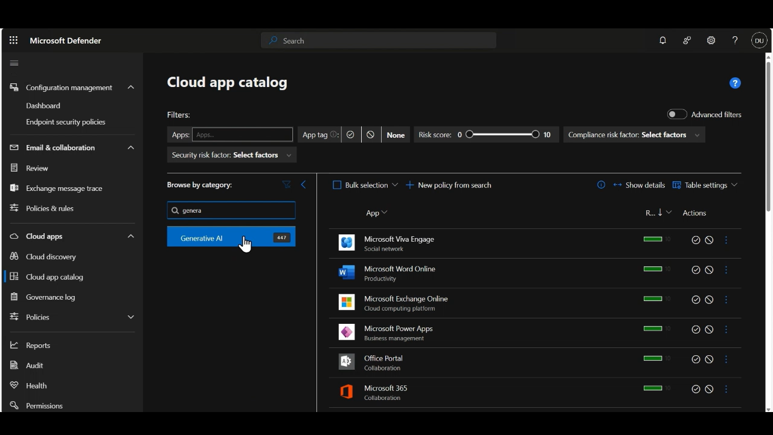
Cloud app catalog & Risk Assessment Information
Notes:
The Cloud App Catalog in the Microsoft Defender admin center (specifically under Microsoft Defender for Cloud Apps) is a key feature for managing and securing SaaS applications across your organization.
It provides a list of over 31,000 discoverable cloud apps that Defender for Cloud Apps can identify and monitor. This catalog is the foundation for Cloud Discovery, which analyzes your organization’s traffic logs to detect apps being used—helping you uncover Shadow IT and unauthorized services.
Each app in the catalog is scored based on 90+ risk factors, including:
Security: Encryption, MFA support, data classification.
Compliance: Certifications like HIPAA, ISO 27001, SOC 2, PCI-DSS.
Legal and Privacy: Data retention policies, DMCA compliance. These scores help you evaluate whether an app meets your organization’s security and compliance requirements.

Slide 16

Cloud discovery | Continuous Reports from Automatic Log Upload
Notes:
Cloud Discovery analyzes your organization’s network traffic logs and integrates with Microsoft Defender for Endpoint to identify all cloud apps being used—both sanctioned and unsanctioned. This helps uncover Shadow IT and provides insights into app usage patterns across devices and users.

Slide 17
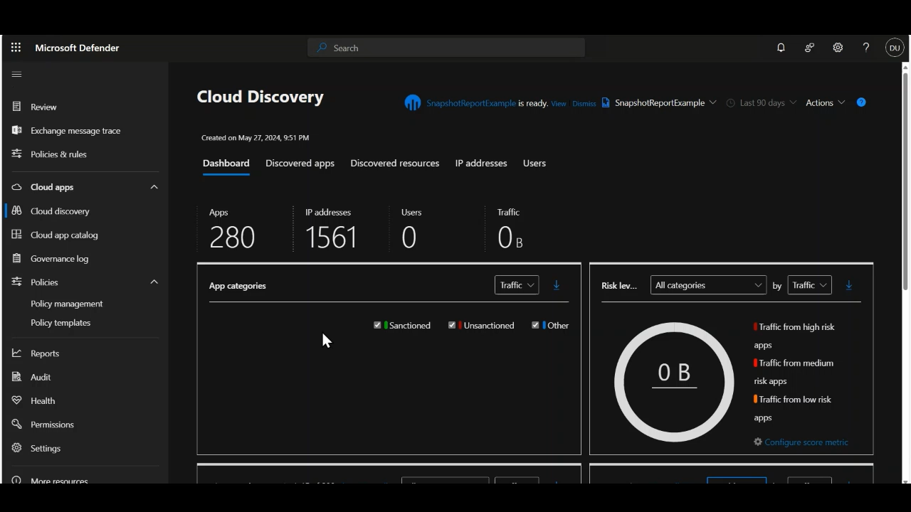
Cloud Discovery Dashboard | Check discovered apps (ME3)
Notes:
The Cloud Discovery dashboard gives an at-a-glance view of:
Types of apps in use and their categories.
Risk levels and open alerts.
Top users and source IP addresses.
Geographic distribution of app headquarters.
You can filter data to focus on sanctioned apps, high-risk apps, or specific categories.

Slide 18
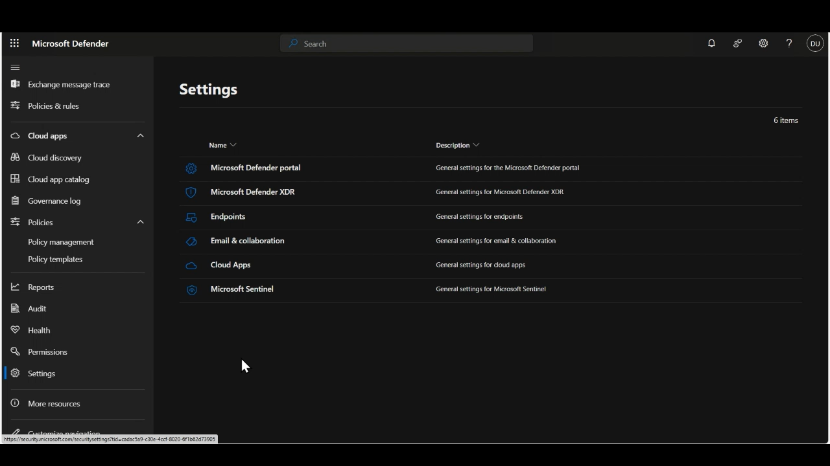
Remediation-Indicator Rule to block/warn/redirect
Notes:
Custom Policies Create discovery policies to automatically flag or block apps based on conditions like category = Generative AI and tag = Unsanctioned.

Slide 19
Enable Copilot Chat
Notes:
Let’s talk about how to enable and manage Copilot Chat in your organization.

Slide 20
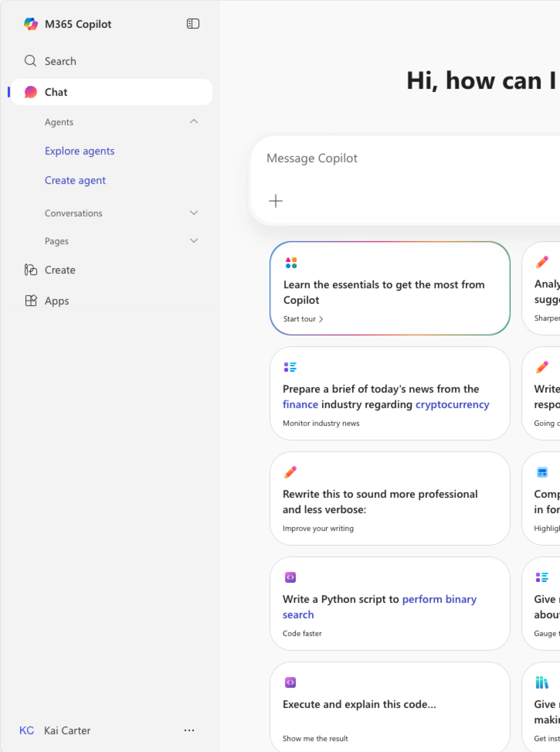
Licenses
Every Entra account user with one of the following licenses can use Microsoft Copilot Chat:
Microsoft 365 A1/A3/A5*
Microsoft 365 Business Basic/Business Standard/ Business Premium
Microsoft 365 E3/E5
Microsoft 365 F1/F3
Microsoft Teams/Teams Enterprise/ Teams Essentials/ Teams Rooms
Office 365 A1/A1 Plus/A3/A5
Office 365 E1/E1 Plus/E3/E5
Office 365 F3
Microsoft 365 Copilot Chat eligibility
*(including MA3/MA5 for students, MA3/MA5 for faculty, and MA3/MA5 student-use benefit)
Notes:
Copilot Chat is available across multiple license types, so most of your users will likely have access. There’s a full list of supported licenses—keep that handy so you know exactly who can use Copilot Chat.

Slide 21
Configuration checklist
✓
Pin Microsoft 365 Copilot Chat
Make sure every user enjoys seamless and direct access to Microsoft 365 Copilot Chat by pinning Copilot Chat.
✓
Manage Copilot Chat in 365 apps, M365 Copilot app and Web
Admins can control through the Integrated Apps portal if Copilot Chat is available in the Microsoft 365 apps.
✓
Manage web search in Copilot Chat
Manage if Copilot Chat should base its responses on the latest web search results or leverage its existing knowledge.
✓
Manage Copilot Chat in Teams
Admins can leverage the app centric management and the app setup policy to control Copilot Chat in Teams.
✓
Network requirements
Make sure all necessary network endpoints are allowed in your organization to guarantee seamless access to Copilot Chat.
✓
Validate Proxy configuration
Admins should verify the local proxy configuration to ensure users can seamlessly access the necessary endpoint for Copilot Chat:
M365copilot.com
Copilot.cloud.microsoft
microsoft365.com
office.com
m365.cloud.microsoft
Note: Additional endpoints are required and mentioned here:
Network requirements
✓
Copilot Chat usage reporting
Implement a process to regularly review the usage of Copilot Chat, gaining valuable insights into how users are interacting with the product.
✓
Manage Copilot Chat in Edge
Admins can control if and how use can access and use Copilot Chat in Microsoft Edge.
✓
Manage Copilot Chat on mobile devices
Admins can maintain the same security, privacy and compliance standards for their mobile users for Copilot Chat.
Notes:
Speaker Notes: Configuration Checklist for Copilot Chat
Today, I want to walk you through the configuration checklist for Copilot Chat. Turning on Copilot Chat isn’t just a technical step—it’s about making sure you set it up the right way for your organization.
Let’s begin with accessibility. It’s really important to pin Copilot Chat so users can easily find and use it. With the latest updates, you can pin Copilot Chat across different Microsoft 365 apps. This isn’t just a convenience—it’s essential to make sure everyone has access to Copilot Chat from the Windows navigation bar and inside Office apps.
Next, let’s talk about data protection and web search. You need to decide if Copilot should be allowed to use web search. What does that mean? If you enable it, Copilot can go beyond its built-in knowledge and pull in the latest information from the web, which gives users even better results. Administrators have full control over this setting, and I’ll show you what options are available and how to manage them.
Now, let’s cover network requirements. Copilot Chat is a cloud service, just like other Microsoft 365 tools. Your organization needs to make sure users have seamless access to all the necessary endpoints for Copilot Chat to work. If you use a proxy service, it’s important to validate your proxy configuration and make sure the right URLs are allowed. This step is critical for providing full access to Copilot Chat. You’ll find all the technical details in the link at the bottom of the slide.
Reporting is another key area. Once Copilot is in use, it’s important to track adoption and engagement. Understanding how users interact with Copilot helps drive adoption and provides insights into product usage. Copilot Chat is integrated into the Microsoft 365 portal, so you can review usage reports and see how Copilot Chat is being used across your organization.
Let’s not forget about Edge. Copilot is available in Microsoft Edge, which allows users to reason over the current web context. Managing this experience is part of the overall Copilot Chat configuration.
Mobile device management is also important. Applying a zero trust approach ensures that only people inside your organization can access Copilot Chat, in line with your security, privacy, and compliance standards.
Managing the Copilot Chat experience means making sure integrated apps are available to users. You can control whether the Copilot app appears in the taskbar through pinning. For Teams, things work a bit differently. You can specifically manage whether the Copilot app appears in the left navigation rail for Teams users. App-centric management and app setup policies let you control how and where Copilot is pinned in Teams.

Slide 22

Managing Microsoft 365 Copilot Chat
The following administrative management options are available
Manage access to Microsoft 365 Copilot Chat
Manage web search queries in Microsoft 365 Copilot Chat
Manage Copilot Edge settings and behavior
Manage Microsoft 365 Copilot Chat in Microsoft 365 mobile apps
Administrators have multiple options to manage the Microsoft 365 Copilot Chat experience for their users.
Manage Microsoft 365 Copilot Chat
Notes:
The most useful resource I recommend is the "Manage Microsoft 365 Copilot Chat" link at the bottom left, which summarizes all key management features for Microsoft 365 Copilot Chat.
This helps you manage and govern Copilot Chat as needed for your organization. It covers accessing Copilot Chat, web search controls, managing Edge and side card behavior, and app access on various platforms, including mobile devices.

Slide 23
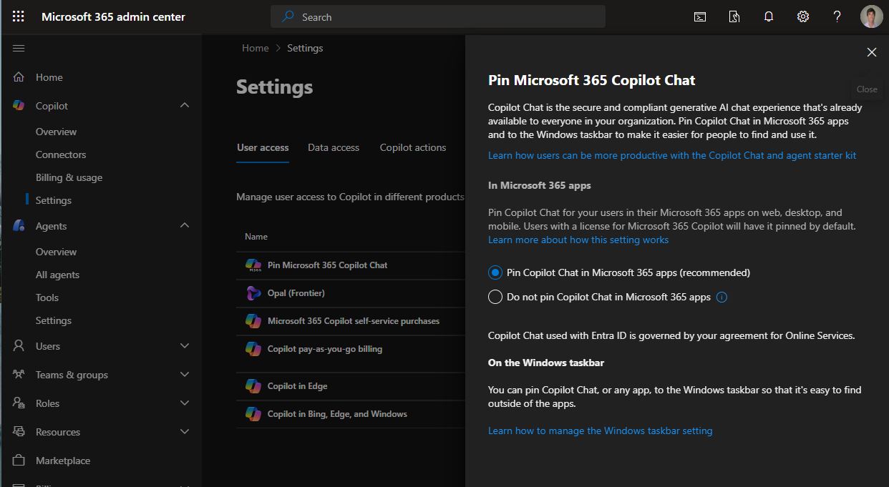

Pin Microsoft 365 Copilot Chat in the Microsoft 365 Apps
Administrators can encourage users to use Microsoft 365 Chat by pinning Microsoft 365 Copilot Chat in the Microsoft 365 apps across web, desktop, and mobile and the Windows navigation bar.
Pin Microsoft 365 Copilot Chat
Notes:
If you go to Copilot>Settings>User Access in the Microsoft 365 Admin Center, you can pin Copilot Chat in the Microsoft 365 Apps for users. This makes Copilot is available to your users where they are working and enables them to take advantage of Copilot to work on their open documents.

Slide 24
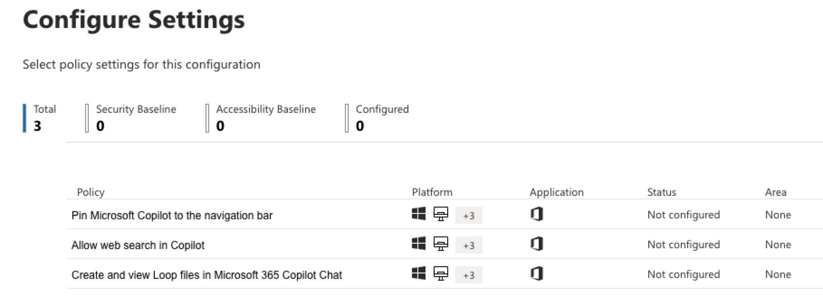
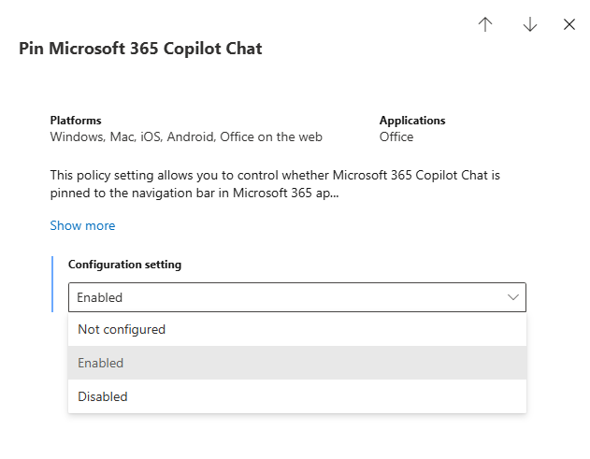
Pin Microsoft 365 Copilot Chat to the Windows taskbar
The policy offers 3 options:
Not Configured
Enabled
Disabled
Pinning the Microsoft 365 App with Office policy
Notes:
Additionally, you have the capability to manage the Windows taskbar. If Copilot Chat is accessible from your users' Windows taskbar, it can be integrated with the Microsoft 365 Copilot application.
In summary, it is advisable to pin the Copilot Chat interface for users, thereby ensuring that Copilot Chat remains available within Microsoft 365 applications.

Slide 25
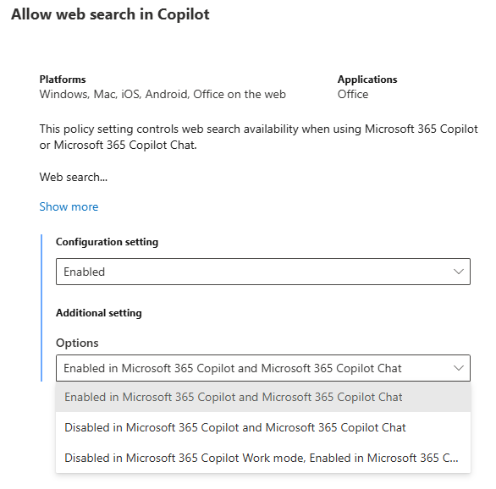
Control web search for Copilot Chat
This policy configuration manages only the availability of web search while utilizing Microsoft 365 Copilot or Microsoft 365 Copilot Chat. The data from web searches is governed by Bing's consumer terms, which are distinct from the terms related to the handling and processing of Microsoft 365 data.
The policy offers 3 options:
Enabled in Microsoft 365 Copilot and Microsoft 365 Copilot Chat
Disabled in Microsoft 365 Copilot and Microsoft 365 Copilot Chat
Disabled in Microsoft 365 Copilot Work mode; Enabled in Microsoft 365 Copilot Web mode and Microsoft 365 Copilot Chat
Controls available to manage web search
Notes:
Let's discuss managing web search, which is similar to pinning in terms of control.
Cloud policy allows admins to enable or disable web search for users, with options that vary between free and paid versions. Admins can choose how much access Copilot and Copilot Chat have to web information. These controls also apply to pinning the Copilot Chat experience, which can be assigned more precisely using cloud policies, such as by security groups.

Slide 26

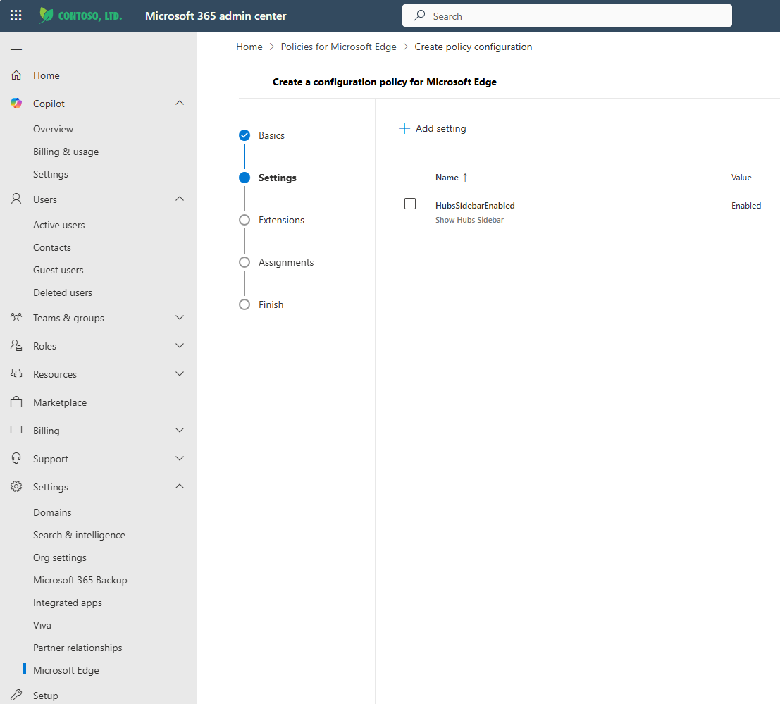
Copilot in Edge controls
+
Administrators can use configuration profiles in the Microsoft 365 Admin Center to manage the settings and integrations available in Microsoft Edge for Microsoft 365 Copilot Chat.
Microsoft Edge management service | Microsoft Learn
Prerequisites:
Microsoft Edge 115.0.1901.7 or greater
Microsoft Edge Administrator to access the experience in Microsoft 365 Admin Center
Windows 10/11 or Windows Server 2016 or later
Notes:
Managing Copilot chat in Edge can be done through the Microsoft 365 Admin Center, where administrators set up configuration profiles to control user experiences. To access these features, you must be a Microsoft Edge administrator and use a specified Edge version or newer. These settings apply only to Windows 10, 11, and Windows Server.

Slide 27
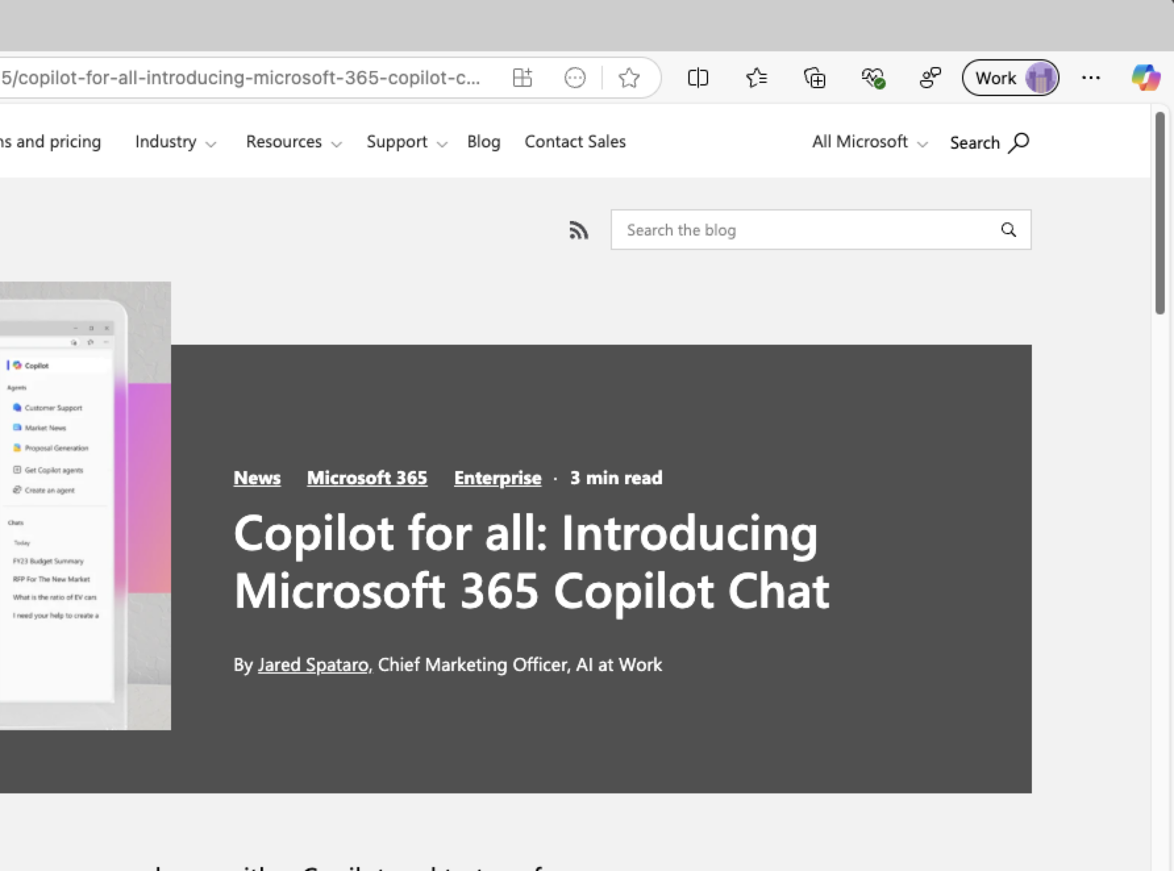
Admin Controls for Microsoft Edge (Windows)
Microsoft365CopilotChatIconEnabled
This policy controls whether the Microsoft 365 Copilot Chat icon will be shown in the Microsoft Edge for Business toolbar for Microsoft 365 Copilot licensed and unlicensed users. Microsoft365CopilotChatIconEnabled
Admins can use group policy settings to manage the behavior of the Copilot in Edge sidebar.
EdgeEntraCopilotPageContext
+
This policy controls access to page contents for Microsoft 365 Copilot Chat with enterprise data protection (EDP) in the Microsoft Edge sidebar for the web tab only. This policy controls whether Microsoft 365 Copilot Chat can perform page summarization and similar contextual queries.
CopilotPageContext
To allow or block Copilot in Edge from using browsing context when users are signed in with their personal MSA Bing account while in the Edge work profile, use the CopilotPageContext policy. This policy prevents the personal Copilot version without enterprise data protection from using webpage or PDF content when it formulates responses to prompts.
Notes:
You can use Microsoft365CopilotChatIconEnabled to control if Copilot Chat is available to users in Edge.
EdgeEntraCopilotPageContext determines whether a user signed in with an Entra ID can use Copilot Chat to interact with content shown in the Edge browser—such as open PDF documents or other items. You can enable or disable this feature using the control.
CopilotPageContext has the same functionality but is meant for MSA accounts. For users logged into Edge with their personal account, you can use this setting to manage their access to Copilot page context features.

Slide 28
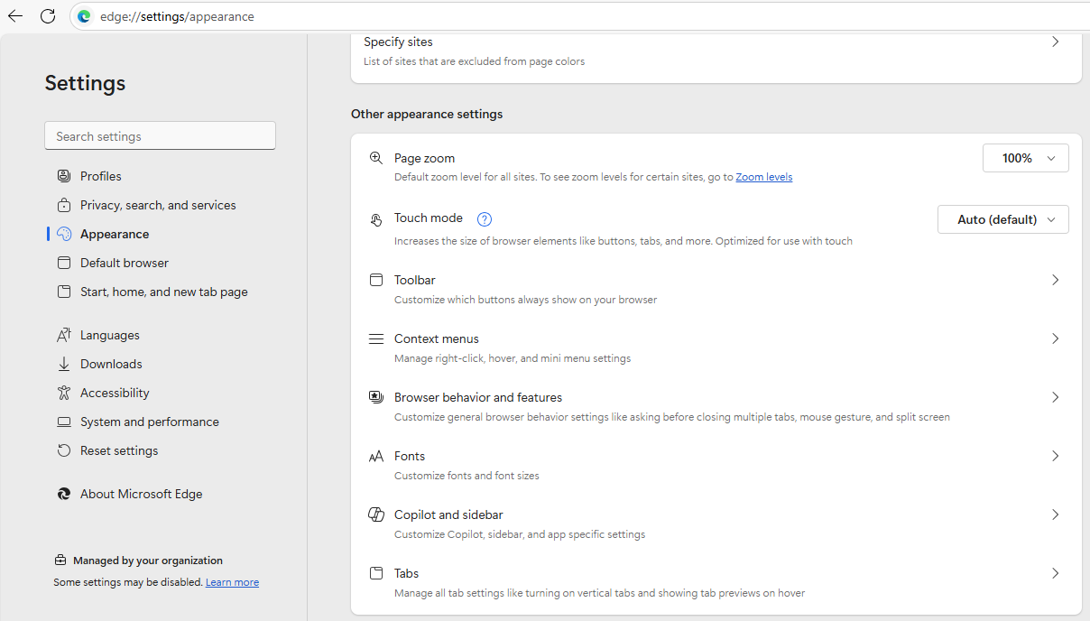
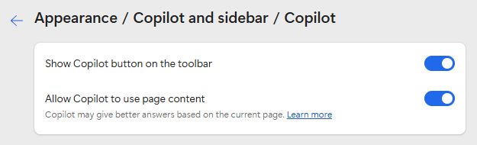
User Control in Microsoft Edge
User have full control over their Copilot experience within Microsoft Edge
Within the Microsoft Edge settings, under the Appearance > Copilot and sidebar section, users can manage the availability and behavior of Copilot in their browser experience.
Notes:
We also want users to remain in control of their experience when using the Edge browser. Within Edge, under the Experiences section—specifically Copilot and sidebar—users can easily choose whether to include Copilot chat in their browsing by toggling it on or off. They can also decide if Copilot has access to the context of the current page.

Slide 29
Govern Copilot Chat
Notes:
Let’s talk about governance. Governing Copilot Chat is critical for securing AI.

Slide 30
Retention of Copilot Chats
Retention period
SubstrateHolds folder
1–7 days
Permanent deletion
Minimum 1 day
X
In a Copilot interaction, users can upload local files, which are automatically stored in the Microsoft Copilot Chat Files folder in the user's OneDrive.
Copilot chats are stored in a user's mailbox (hidden folder)
How long the Copilot Data (and Teams Chats) will be stored depends on you retention settings for Copilot Chats
1
Message removed from Copilot
Copilot message
2
Message remain in Copilot
1–7 days
SubstrateHolds folder
1–7 days
Permanent deletion
Minimum 1 day
X
For retention policies that support automatic retention and deletion, user prompts and responses are identified and included in the Microsoft Copilot Experiences policy location.
Learn about retention for Copilot & AI apps | Separate existing 'Teams chats and Copilot interactions' policy
Notes:
One key aspect is retention: when users upload files in Copilot Chat, those files are stored in a hidden folder in their mailbox and are retained according to your organization’s policies. The data stays within your tenant, leveraging OneDrive, and follows your retention rules.

Slide 31
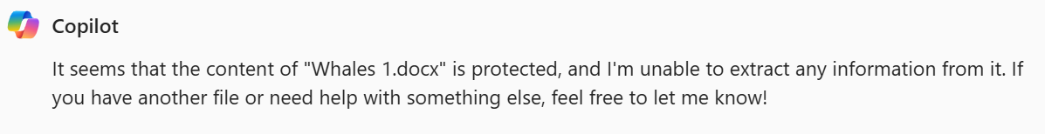
Copilot Chats and Sensitivity Labels
The sensitivity labels that you use to protect your organization's data are recognized and used by Microsoft 365 Copilot Chat to provide an extra layer of protection.
If the labels applied encryption from Microsoft Purview Information Protection, Copilot checks the usage rights for the user.
Only if the user is granted permissions to copy (the EXTRACT usage right) from an item, is data from that item returned by Copilot.
Sensitivity labels for Microsoft 365 Copilot and Microsoft 365 Copilot Chat
Notes:
Sensitivity labels help protect your data. If a document uploaded to Copilot Chat has a sensitivity label from Microsoft Purview, Copilot will check the user’s rights and respect those labels. Copilot won’t surface information from labeled documents unless the user has the right permissions.

Slide 32
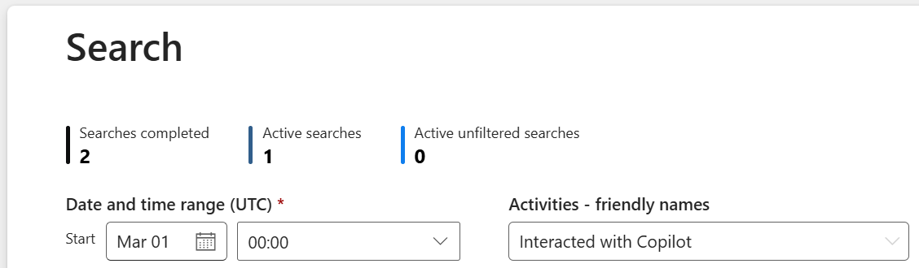
Auditing Copilot Chats interactions
Every interaction with Copilot generates an audit log entry in the same way as user actions in SharePoint, OneDrive, or Teams do today, searchable by the audit activity named Interacted with Copilot.
Review end-user activity with Copilot Chat through the Edge browser's Copilot sidebar, and Microsoft 365 Apps
Audit logs for Copilot and AI activities
Notes:
Every interaction with Copilot generates an audit log entry, just like actions in SharePoint or OneDrive. You can search these logs to see who used Copilot, from which system, and more. There’s an “interacted with Copilot” activity you can look for in the logs.

Slide 33
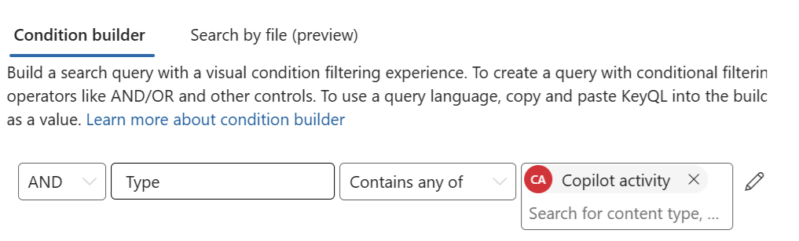
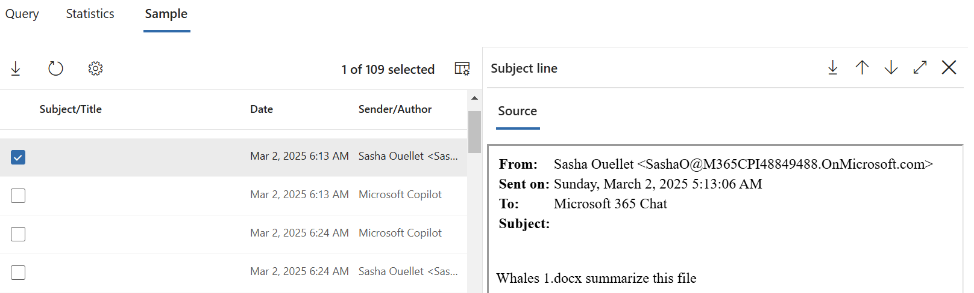
Searching Copilot Chats interactions
As Microsoft 365 Copilot Chat interactions are stored in the same manner as chat messages from Microsoft Teams, the same Content Search and eDiscovery features are available to customers to access them.
Microsoft 365 Copilot Chat interactions are searchable with Content Search and eDiscovery administrator tools.
Search for and delete Copilot data
Administrators can search and preview the prompts that end-users send to Microsoft 365 Copilot Chat.
Notes:
Copilot Chat interactions are stored like Teams chat messages, so you can use content search and eDiscovery to access them. Admins can search and preview prompts used in Copilot Chat, which is a powerful feature for compliance and oversight.

Slide 34
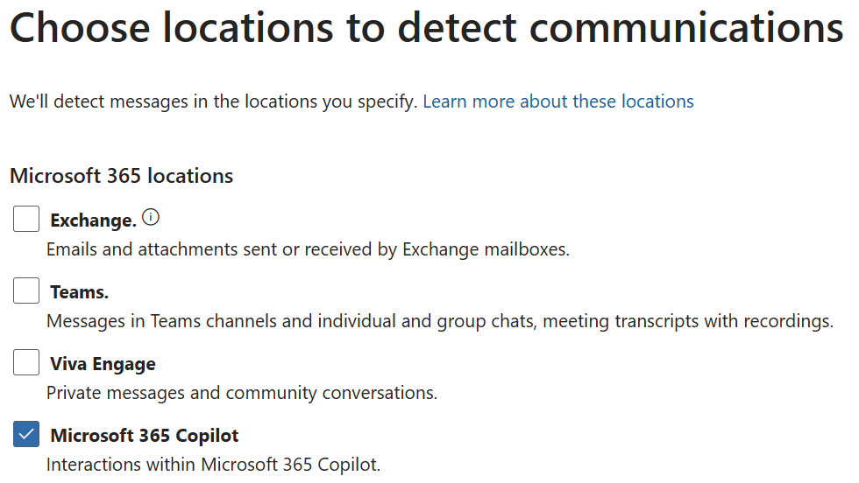
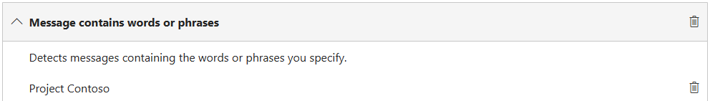
Searching Copilot Chats interactions
Communication compliance policies can analyze Microsoft 365 Copilot Chat prompts and responses to detect for inappropriate or risky interactions or sharing of confidential information entered interactions that include sensitive information.
Copilot and Communication Compliance
Notes:
Communication compliance policies can analyze Copilot Chat prompts and responses to detect inappropriate or risky interactions. This is especially important for organizations concerned about confidential information being shared. You can search for Copilot Chat interactions using these compliance tools.

Slide 35
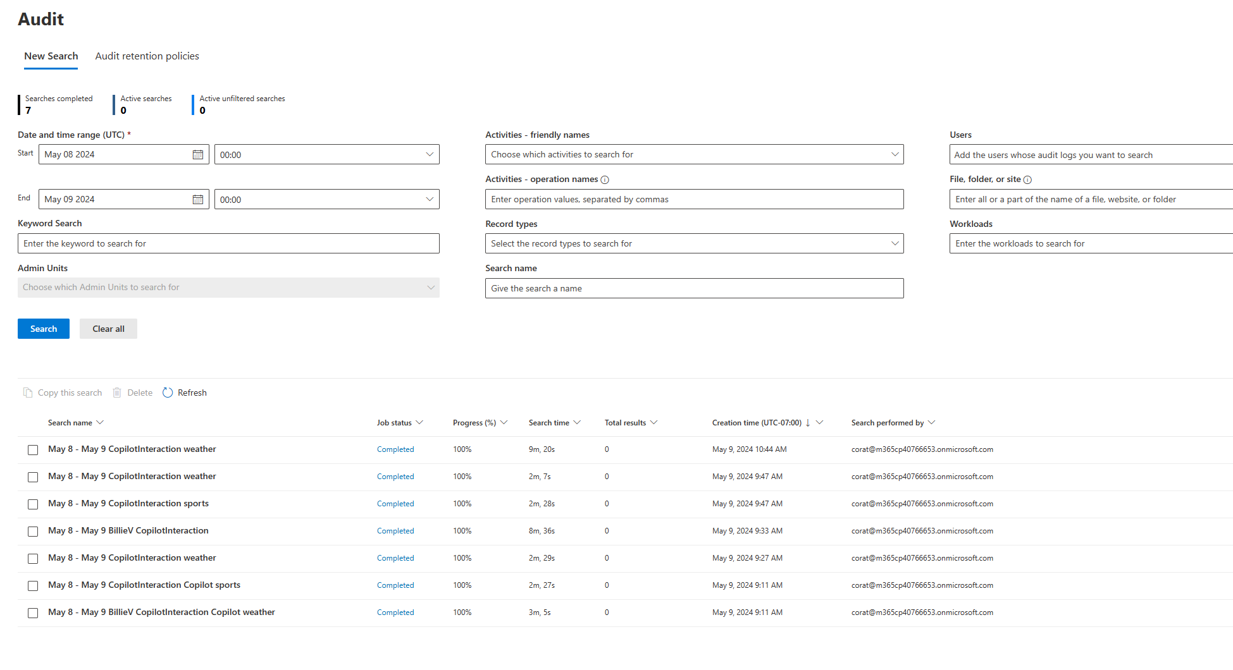
Copilot web search query logging
Enables admins to perform audit, search, and eDiscovery on the exact web search queries Copilot derived from the user's prompt when enhancing responses with the latest data from the web.
Admins can use the same tools they use today for audit, search, and eDiscovery of prompts and responses in Microsoft 365 Copilot.
(Applies to both Microsoft 365 Copilot Chat, Microsoft 365 Copilot)
Available now
Notes:
Microsoft 365 Copilot provides both admins and users with transparency into web queries when Copilot grounds responses in the latest information from Bing Search (Applies to Microsoft Copilot for M365, Microsoft Copilot).
With Copilot web search query logging, admins will be able to perform audit, search, and eDiscovery on the exact web search queries Copilot derived from the user's prompt when enhancing responses with the latest data from the web. Admins can use the same tools they use today for audit, search, and eDiscovery of prompts and responses in Microsoft 365 Copilot.
Copilot web search query citations for users lets users of either Microsoft 365 Copilot or Copilot see the exact web search queries derived from their prompt in the linked citation section of the Copilot response. Paired with the sites searched (already available), this will give users greater understanding of what search queries were used to enhance the response and enhance their control over the process.

Slide 36
Usage Reporting
Notes:
Another area we explored regarding Copilot chat, based on customer feedback, is the desire to understand its reporting features.
People are interested in learning how Copilot chat is being used.
Therefore, let's take a closer look at the available usage reporting for Copilot chat.

Slide 37
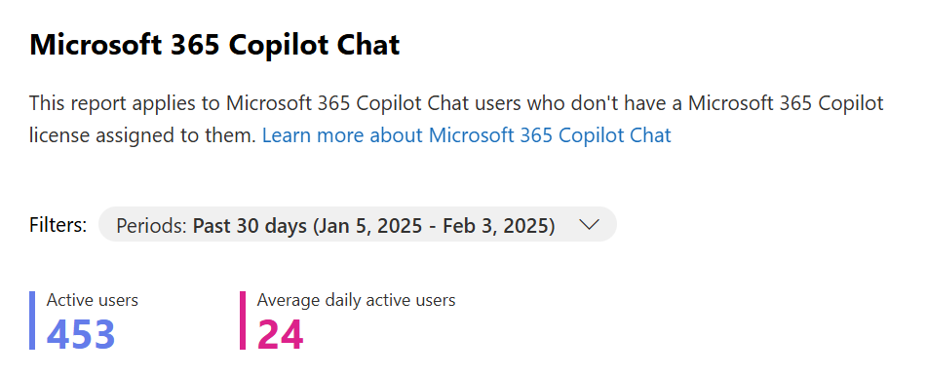
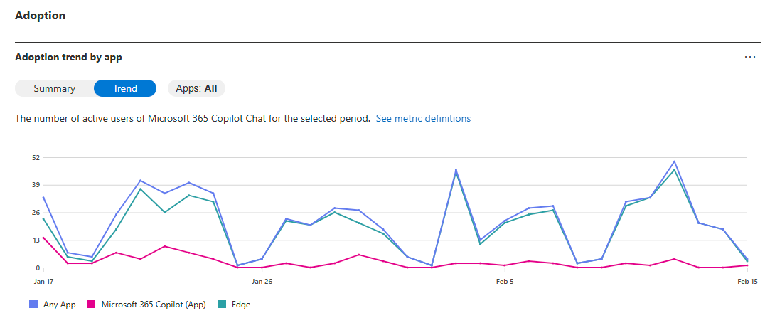
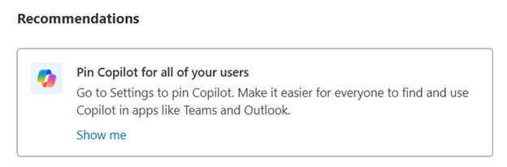
Copilot Chat Usage Report
The Microsoft 365 Copilot Chat usage report provide insights into usage of Microsoft 365 Copilot Chat in your organization.
Active Users (overall and daily)
Reports are available for the past 7, 30, 90 and 180 days
Recommendations to improve the adoption
Adoption trends by app (Copilot Chat and Edge)
Detailed last activity table
Microsoft 365 Copilot Chat Usage Report
Notes:
Copilot Chat usage reports give you insights into how Copilot Chat is being used in your organization. You can see trends, active users, and adoption by app, with reports available for different timeframes. These reports are updated frequently, so check back often for the latest info and recommendations on improving adoption.

Slide 38
Next Steps and Call to Action
Notes:
Next steps and call to action.

Slide 39
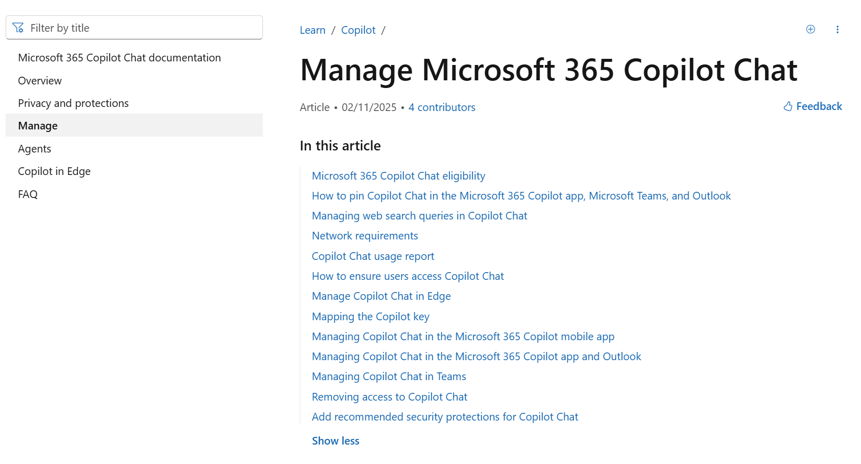
Deploying Copilot Chat
Microsoft 365 Copilot Chat eligibility
How to pin Copilot Chat in the Microsoft 365 Copilot app, Microsoft Teams, and Outlook
Managing web search queries in Copilot Chat
Network requirements
Copilot Chat usage report
How to ensure users access Copilot Chat
Manage Copilot Chat in Edge
Mapping the Copilot key
Managing Copilot Chat in the Microsoft 365 Copilot mobile app
Managing Copilot Chat in the Microsoft 365 Copilot app and Outlook
Managing Copilot Chat in Teams
Removing access to Copilot Chat
Add recommended security protections for Copilot Chat
Manage Microsoft 365 Copilot Chat | Microsoft Learn
Notes:
And in fact, employees are not waiting. On the Work Trend Index research in 2024, we learned that 75% of knowledge workers around the globe were already using generative AI at work.
Employees want to see how AI can help them do daily tasks more quickly, save time and get ahead in their jobs. And the ROI further proves out the potential for AI.
According to a recent IDC study for every $1 a company invests in generative AI, they have an ROI of $3.7x. They are realizing value within 13 months and, no surprise, but AI users also report that productivity use cases are providing the greatest ROI.

Slide 40

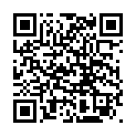
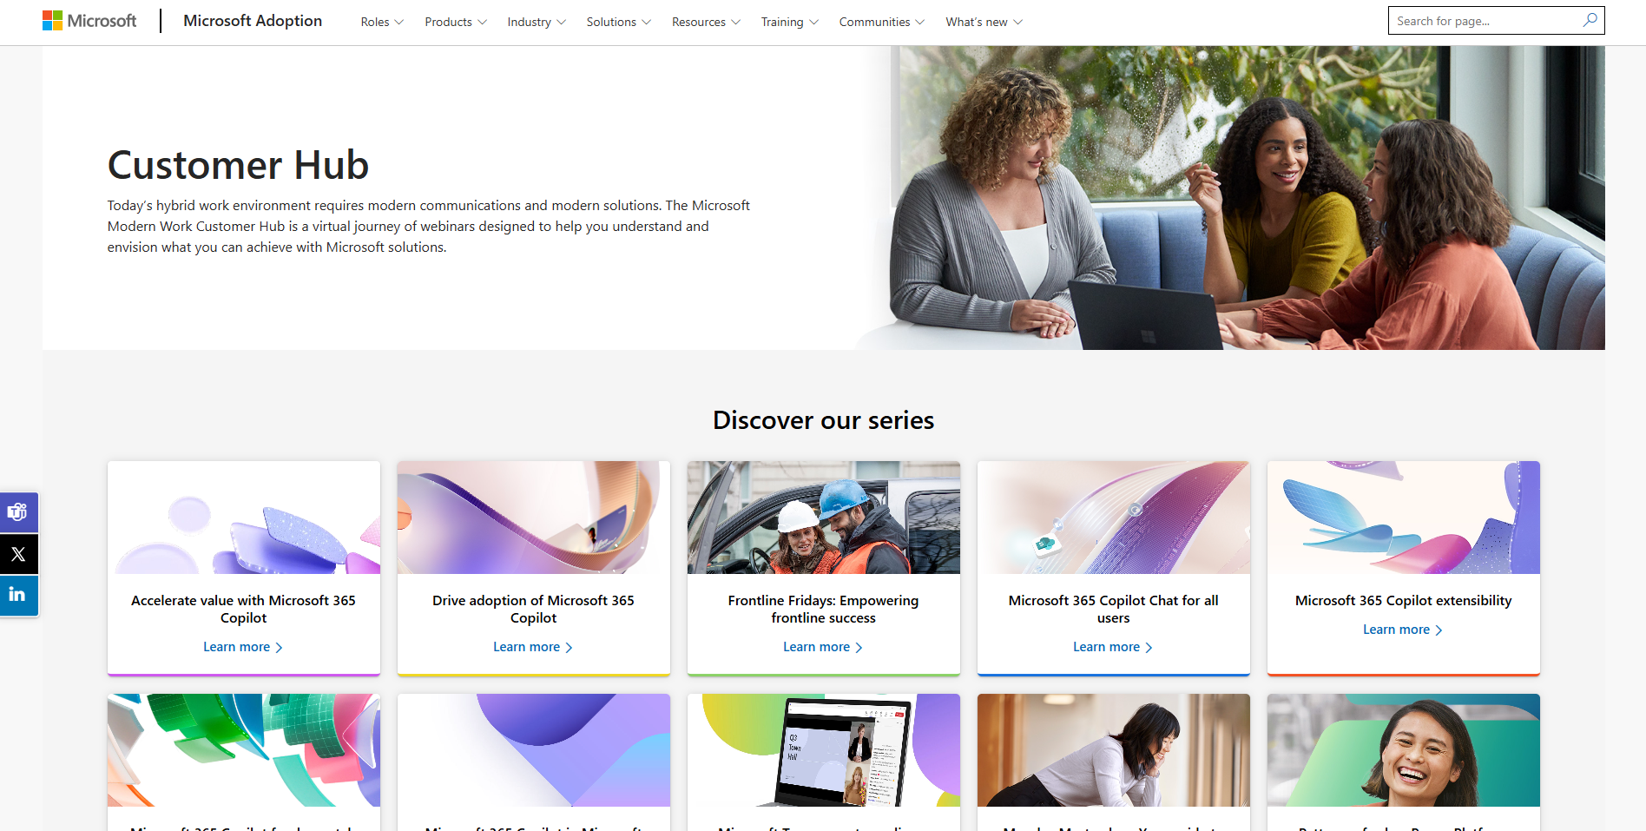
Customer hub
Visit Customer Hub website for upcoming sessions, updates, and on demand contents!
https://aka.ms/CustomerHubSessions​
Notes:
Additionally, upcoming customer hub sessions are available at the designated Customer Hub Sessions page.

Slide 41
Thank You!

