Slide 1
Get started with Microsoft 365 Copilot Chat
Practical examples and how-tos for users without a Microsoft 365 Copilot license
September 2025
Notes:
Welcome everyone! Today, we’ll explore how Microsoft 365 Copilot Chat can supercharge your workflow in Excel. Excel is packed with features, but it can be overwhelming to know where to start. Copilot adds even more capabilities, making it easier to get answers, automate tasks, and save time. This session will show practical examples and how-tos, so you can use Copilot to work smarter and more efficiently.

Slide 2

Here’s what you’ll learn in this deck:
What Copilot Chat is and how it’s different from other AI chat tools
How to use Copilot Chat
What agents are in Copilot Chat and how to use them
Example Copilot Chat prompts

Slide 3
What is Copilot Chat?

Slide 4
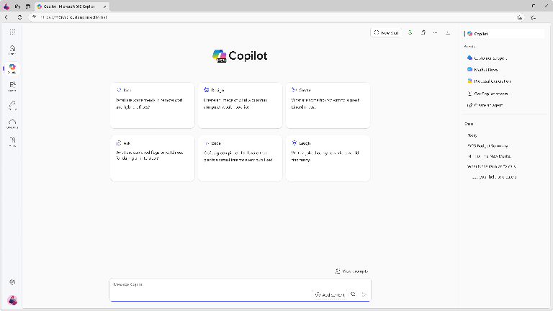
Our approved AI chat tool
Microsoft 365 Copilot Chat is an AI chat tool built specifically for work. It uses the latest AI models and data from the web to answer your questions, generate content and ideas, and find information. It also protects your data so information from your chat conversation does not get exposed to the public.
In addition, with Copilot Chat you can:
Upload files to get responses based on information from your work documents, presentations, etc¹.
Generate images¹ and data visualizations.
Refine and collaborate on chat responses.
Connect Copilot Chat to your organization data like team documents and internal SharePoint sites².
Get started by going to M365Copilot.com
¹Image generation and file upload limits apply.
²Connecting Copilot Chat to your organization data is only available if your organization admin has enabled this capability.

Slide 5

Copilot Chat introduction video

Slide 6
Get started with Copilot Chat

Slide 7
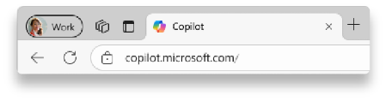
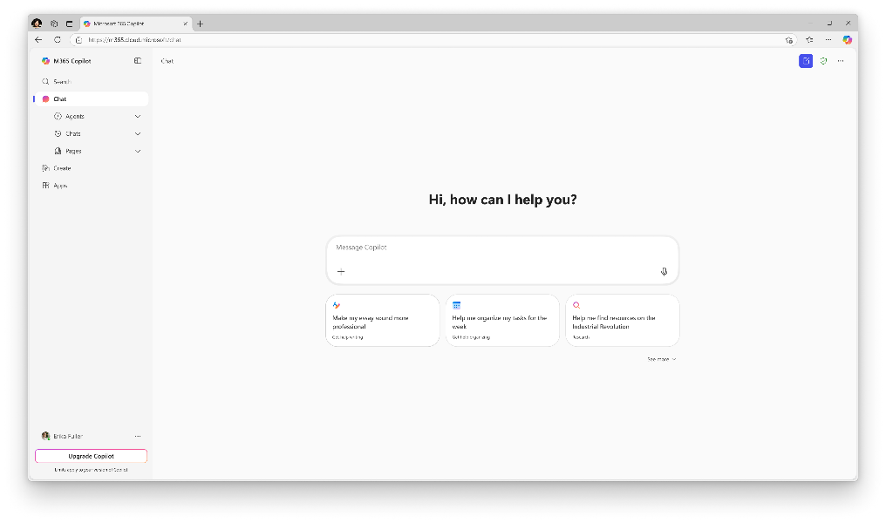


Sign in with your work account
1
2
1
Navigate to M365Copilot.com on your preferred browser on your device to get to Copilot Chat.
https://M365Copilot.com
2
Ensure you’re signed in with your work or school account.
You will know you are successfully signed in to Copilot Chat when you see the green shield icon next to “New chat”
If you are not signed in with your work or school account, enterprise data protection does not apply.

Slide 8
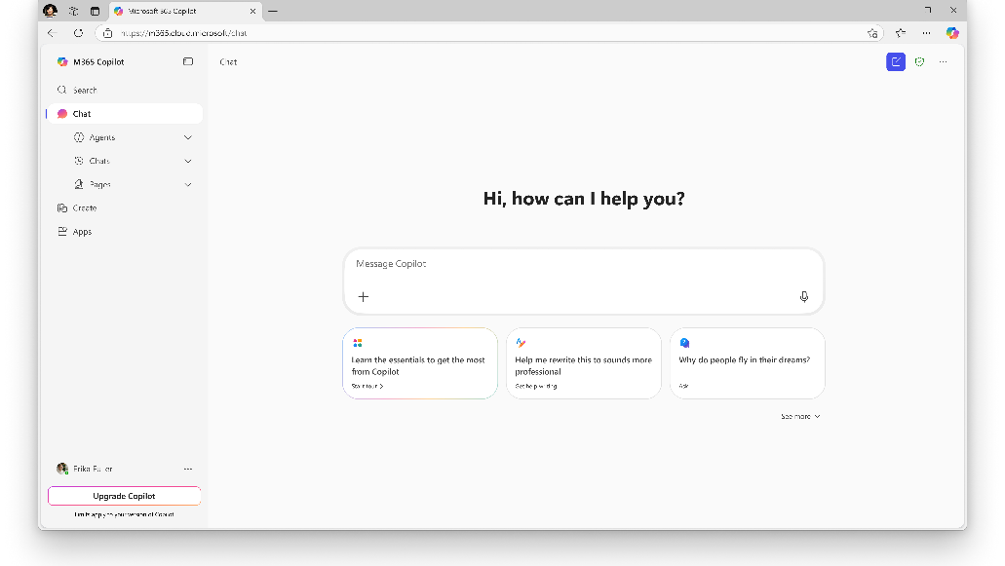
Get to know Copilot Chat
Start a new chat button
Clear your past chat and start a new conversation.
Agents
Use existing agents or create new ones¹. Learn more about agents in slide 17
Prompt box
Start your conversation here
Chat history
View your past conversations
Dictation
Use dictation if you prefer to speak rather than type when you’re chatting with Copilot (coming soon)
Add content and agents
Expand to upload files, images or add an agent to chat
Suggested prompts
Get started with prompt suggestions
Copilot Prompt Gallery
Expand the suggested prompts to view the full Copilot Prompt Gallery, including saved prompts and prompts from your team
¹Agent creation is only available if your organization admin has enabled this capability.

Slide 9





How to chat in 3 steps
1. Enter your prompt
2. Check sources
3. Continue the conversation
Enter your detailed prompt in the text box at the bottom. If you would like Copilot to source information from any reference files, you can upload them in your prompt by selecting the “Add content” button.
Copilot Chat is transparent about the sources of its information. See these sources listed underneath the answer.
Vet these sources and validate your answers.
You can ask follow-up questions as you would in a conversation. You can refine the answer too.
For example, try “Write a shorter answer" or "Give me more detail." You can also select suggested prompts.

Slide 10

What is a “prompt?“
Prompts are how you have a conversation with Copilot
Use plain but clear language and provide context like you would with an assistant.
Enter your first prompt in the text box at the bottom of your screen, like “Draft a cold call email to a customer.”
Get started by entering your prompt in the text box

Slide 11
Writing an effective prompt
Include the right prompt ingredients
Context
Goal
Expectations
Context
Goal
Source
Expectations
To get the best response, it’s important to focus on some of the key elements when phrasing your Copilot prompts.
Source
Why do you need it and who is involved?
What responses do you want from Copilot?
Which information sources or samples should Copilot use?
How should Copilot respond
to best meet your expectations?

Slide 12
Writing an effective prompt part 2
Context
Goal
To get the best response, it’s important to focus on some of the key elements when phrasing your Copilot prompts.
Why do you need it and who is involved?
What response do you want from Copilot?
I work in marketing and focus on competitor research. Give me a concise summary of recent news about [company name]. Focus on web articles from the last 2 months. Provide the answer in two to three paragraphs and use a business tone.
Which information sources or samples should Copilot use?
How should Copilot respond
to best meet your expectations?
Source
Expectations

Slide 13
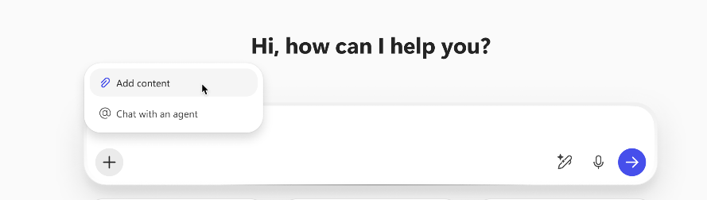
Upload a file to your prompt
Want Copilot to respond using information from a Word document, PowerPoint deck, or other file? Select the “Add content” button in the Copilot Chat prompt box to upload a file.
Example prompt: Summarize this document in 5 bullet points. <attach file>
Note: Copilot Chat supports uploads of Word documents, PowerPoint decks, Excel spreadsheets, images, and PDFs.

Slide 14
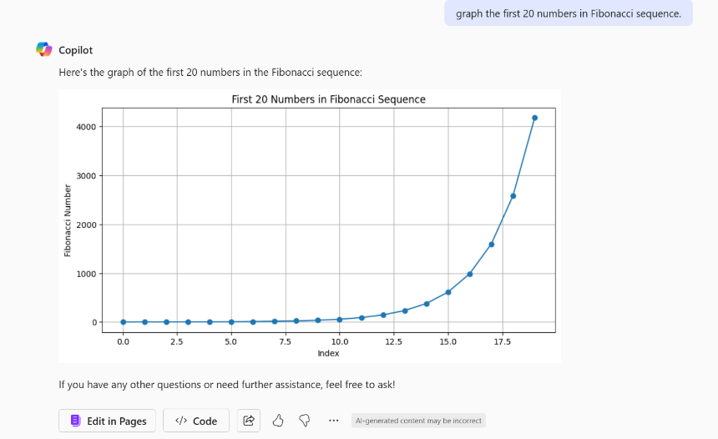
Use Copilot Chat to visualize data
Copilot Chat has built-in capabilities to graph and visualize data as it’s relevant to your prompt.
For example, use the prompt: “Graph the first 20 numbers in Fibonacci sequence”.

Slide 15
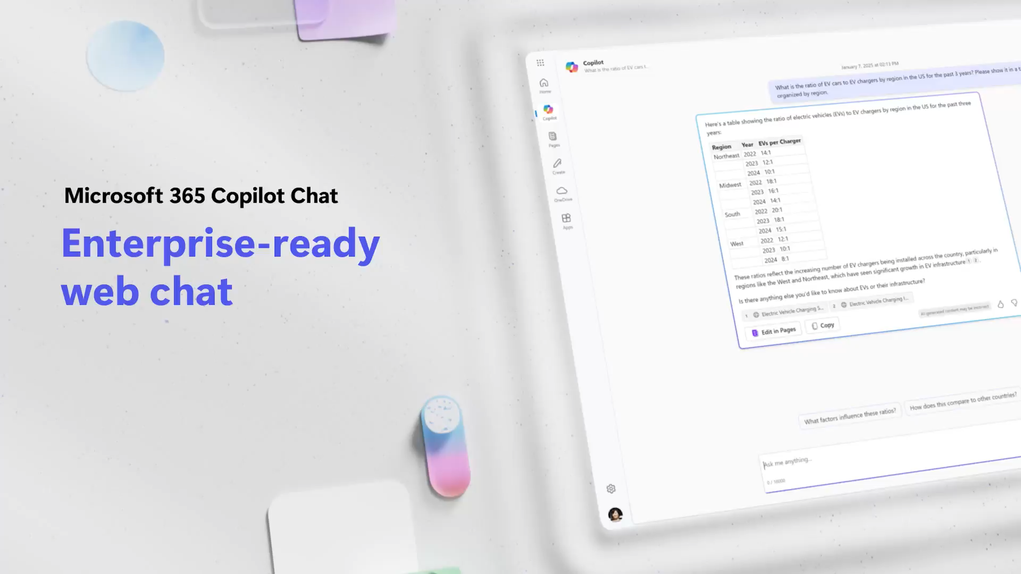
Video: Copilot Chat

Slide 16
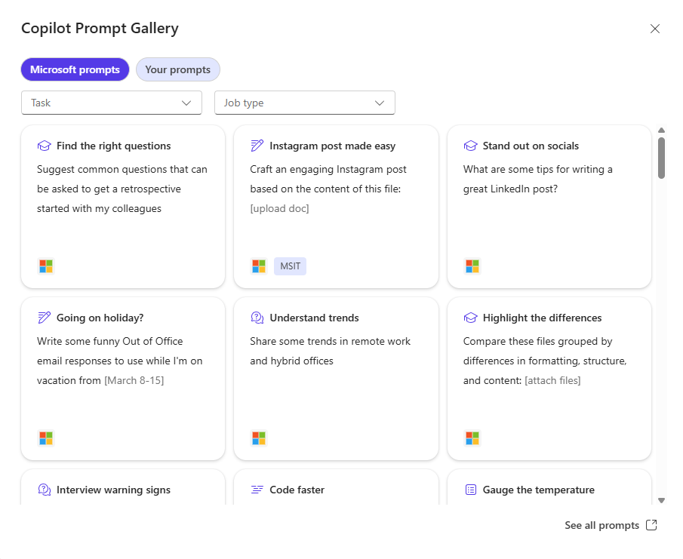
Discover and share Copilot prompts
Copilot Prompt Gallery helps you find prompting inspiration so you can take greater advantage of Copilot in your daily work.
Explore the curated selection of Copilot prompts
Save your favorite prompts
Share your favorite prompts with colleagues
Find prompting inspiration from others
Access the Prompt Gallery in Copilot Chat by selecting “See more” under the initial prompt suggestions and selecting the Prompt Gallery button at the bottom of the list. Here, you’ll see more Copilot prompts and your saved prompts.
Watch the video to see it in action

Slide 17
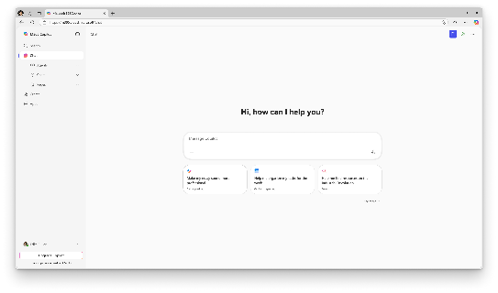
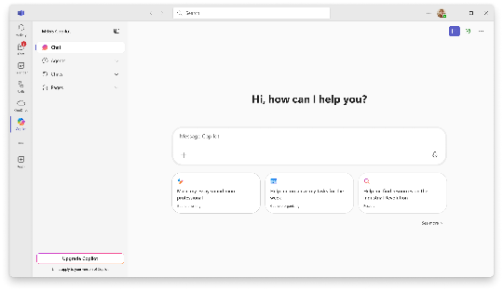
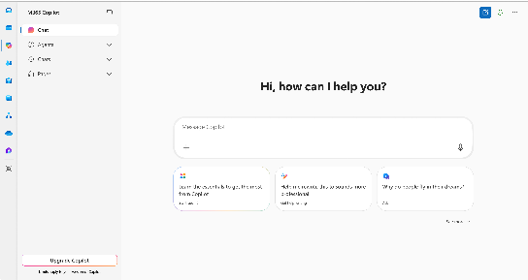
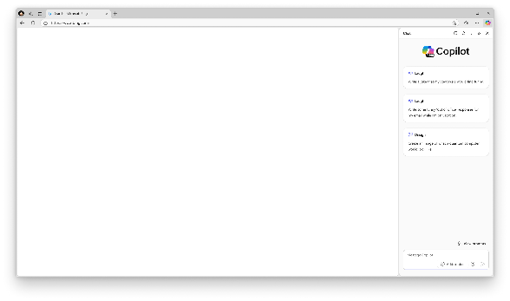
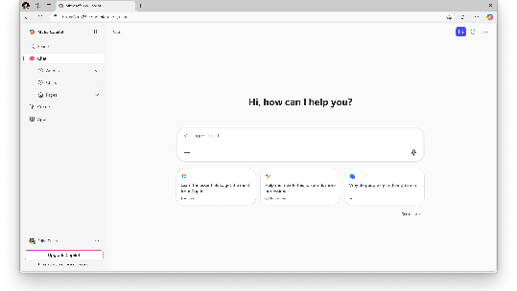
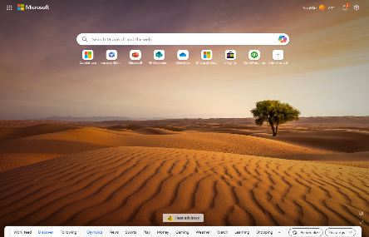
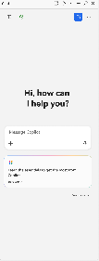

Access Copilot Chat from where you’re working
Admin note: The Microsoft 365, Outlook, and Teams app Copilot experiences will only available if Copilot is pinned by the user or admin. Instructions on how to pin Copilot for your organization can be found here.
M365Copilot.com
Teams app*
Outlook app*
Microsoft 365 Copilot app*
Edge browser sidebar
Microsoft 365 Copilot mobile app
*Ensure Copilot is pinned to your left navigation across Teams, Outlook, and the Microsoft 365 Copilot app.

Slide 18
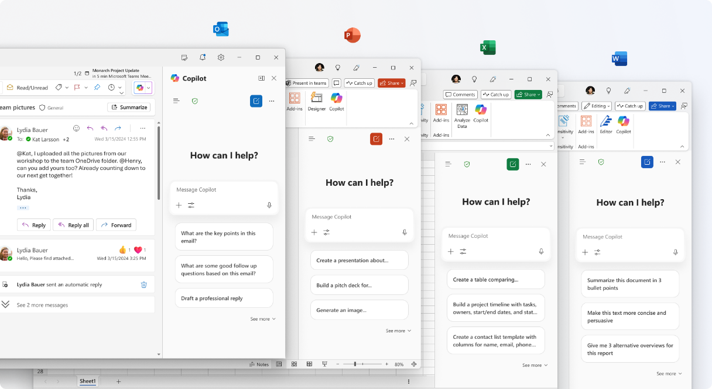
Access Copilot Chat from your apps
When using Copilot Chat within an app you can reference the open document in your queries.

Slide 19
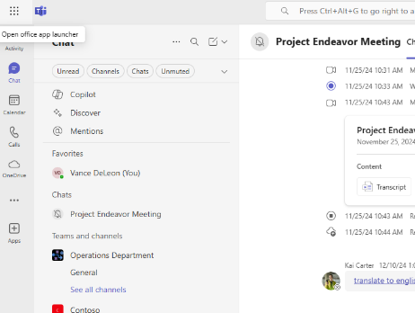
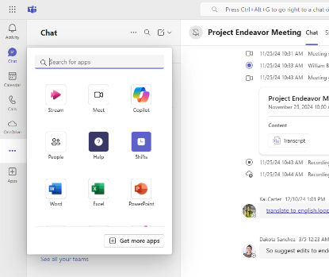
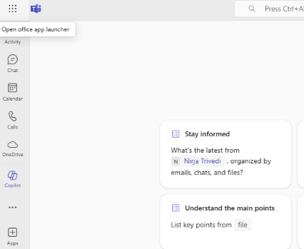
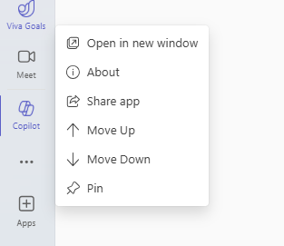
Pin Copilot Chat in your Teams app
1. Select the ellipses in the left sidebar in the Teams app to open the app library.
2. Select Copilot to open Copilot Chat.
3. Right click on Copilot in the left sidebar in the Teams app.
4. Select “Pin” to pin Copilot Chat to the sidebar for easy access.

Slide 20

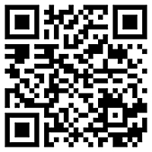
Use Microsoft 365 Copilot on the go
Download the Microsoft 365 Copilot mobile app and sign in with your work or school account to access Copilot Chat
Download Microsoft 365 Copilot App | Microsoft 365

Slide 21
Copilot Chat prompt examples

Slide 22
Get the answers you need to move forward
Get hiring tips
Retrieve buried info
How can I evaluate an interview candidate’s soft skills?
What are the deadlines mentioned in this file? <attach file>?
Summarize a file
Boost your knowledge
Summarize this document in 5 bullet points. <attach file>
Help me learn about [topic]. Provide 2 analogies & files to dig in.
Start your research
Highlight the differences
How have world literacy rates changed in the past 30 years?
Compare these two paragraphs grouped by differences in formatting, structure, and content: [paste content]
Calculate the answer quickly
Monitor your PR
At $X per unit, how many units to break even if costs are $Y
Give me a concise summary of recent news about [company]
Reach a broader audience
Stay on top of tech advances
How do you say [thank you for your time] in Japanese?
Summarize the main points of the latest research on AI
Discover synonyms
Make informed decisions
What are some other words for [exciting]?
Create a table that compares top-selling office printers
Understand trends
Make your code better
Share some trends in remote work and hybrid offices
Optimize and fix this code: [insert code]

Slide 23
Brainstorm and draft content quickly
Co-create with Copilot
Start a conversation
Ask me 3 questions to help me draft an email about [OKRs]
Suggest ways to break the ice with my new colleague.
Going on holiday?
Jump-start a draft
Write some funny Out of Office email responses.
Create an FAQ based on this file <attach file>
Make it stand out
Draft an introduction
Suggest a few email subjects for the following email: [body]
Write a compelling intro paragraph for this speech <attach file>
Generate ideas
Make it better
List ideas for a fun remote team building event
Improve my writing in: <attach file>
Put info in a table
Disagree gracefully
Organize the world’s most valuable companies into a table
Provide a convincing counterargument to the following: [paste content]
Visualize the data
Rally the team
Create an image of a bar chart demonstrating growth
Draft an exciting email … using <attach files>
Track changes over time
Get started on a plan
Create a line chart showing the relationship between…
Draft a business plan based on [idea]

Slide 24

Microsoft 365 Copilot Chat
Congratulations!
We want you to grow your skills in AI. We encourage you to keep exploring Copilot Chat with the resources below:
Check out the Copilot Help & Learning site for short videos and articles on getting started.
Join the Microsoft 365 Copilot Community on LinkedIn to get more Copilot Chat tips and product updates and engage with other users.

