Slide 1
Researcher & Analyst Adoption

Slide 2
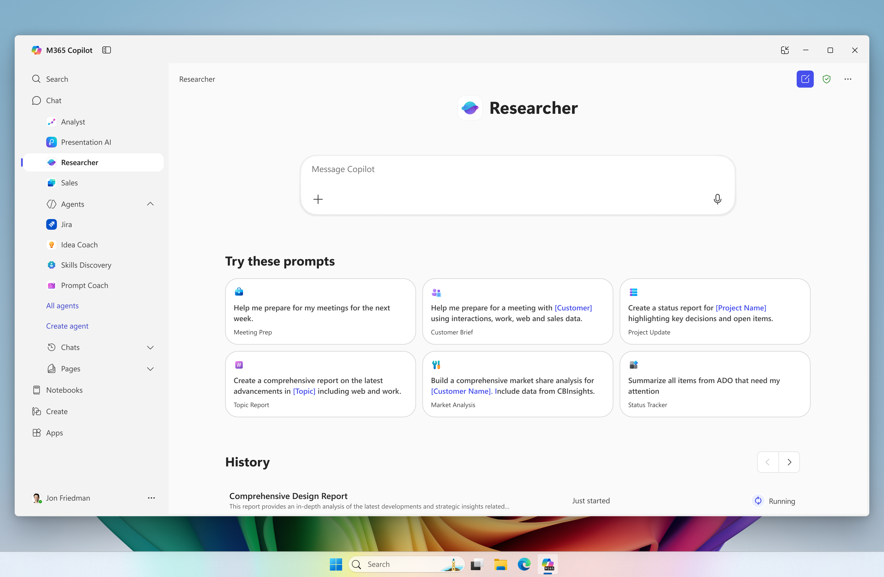
Researcher agent
The Researcher Agent gives organizations the capability they would expect from a highly paid strategist or researcher.
By combining the most advanced deep reasoning models with web and work-grounding from Copilot Chat, this agent provides well-reasoned responses to complex prompts with the most relevant data.
Users gain a thought partner that can perform advanced reasoning grounded in their unique context.
Notes:
Researcher agent combines the most advanced reasoning models with Copilot Chat's web and work-grounding capabilities, as well as other agents, to do in-depth reporting for organizations.
More specifically, it combines OpenAI’s deep research model with Microsoft 365 Copilot’s advanced orchestration and deep search capabilities to help users tackle complex, multi-step research at work.
Why does this matter? It helps organizations deliver insights with greater quality and accuracy than ever before.

Slide 3
Turning data into value is only limited by the intelligence applied to it
The data: Organizations and users have access to more data than ever, from companywide SharePoint sites to the last chat or email you sent.
Transforming data into value: One of the superpowers of humans has been to internalize large amounts of this highly unstructured data, apply intelligence to it, and turn it into organizational value.
Transforming data into value with GenAI: Generative AI tools like Copilot Chat transformed how we brought digital tools into the workplace, by bringing an organization’s data to the models capable of applying complex reasoning to it.
Addressing the most complex questions and challenges with Researcher: But for the most complex, most strategic questions, it’s not simply a matter of finding information and running it through an AI model; instead, what’s needed is to first create an execution plan, then internalize as much information as needed to “understand” the problem. Then iteratively work with as much internal and web-based data as needed to create a detailed, comprehensive, high-value report.
For situations that require in-depth research using complex and/or many sources and the ability to apply advanced reasoning skills to all that data, Researcher is a new tool that supports everything from board-level strategies to complex project management. It not only accelerates work but allows individuals to do the work they’d previously rely on experts to perform.

Slide 4
Connecting the data that matters most with the most capable models
Knowledge workers rely on two types of data:
Copilot Chat relies on the latest large language models to quickly search work and web data sets and provide rapid quick, concise answers.
Researcher builds on Copilot Chat with a new class of models – advanced reasoning models – to create a research plan, execute it, and build more comprehensive, complex, and exec-ready reports.
Work Data
The proprietary data that a user has access to, from emails and call transcripts to SharePoint sites and databases.
Retrieval Augmented Generation
Copilot Chat uses a tool called Retrieval Augmented Generation to search across all of a user’s data – and the web – to extract the items most relevant to the question asked.
Chain of Thought
In response to a prompt, Researcher uses recursive reasoning to understand a task, perform research, and create a report.
Web Data
Publicly available data that helps define the current state of the world.
Research
Researcher is built on a model that’s been taught to think like a professional researcher.

Slide 5
How to use Researcher
Where can you use Researcher
Researcher is accessible as an agent in Copilot Chat in the Microsoft 365 Copilot app, Teams, and Outlook.
Start from Copilot | Microsoft 365 Copilot
View the left navigation pane
Click on Researcher
Start a new report
You can begin by typing in a research topic or question into Researcher’s prompt box. For example, you might ask: “Give me a research report on the impacts of AI in healthcare.” You can also use any suggested prompts or templates provided on the Researcher home screen. These suggestions can help inspire what to ask.
Answer clarifying questions
Once you submit your query, Researcher will ask you a set of clarifying questions. You can choose to answer these questions or just type “Go ahead.”
Wait for the report to compile
Researcher will work through each step, fetching information and analyzing it. This may take some time depending on how complex the query is. You can watch the progress in real-time, or you can go do other work. Researcher will show all the steps it's taking as it creates your report.
View the results
Once complete, you will see a structured report with the findings. The report might have sections that summarize different aspects of the topic and often includes context like where information came from (for example, referencing a specific document or stating the source of a statistic). This context helps you trust and verify the information.
Take action on the report
Finally, you can utilize the follow-up actions. For example, if you need to edit the report, click ”Edit in Pages” and the report is shown in a side-by-side view. Once opened in Pages, the report gets saved automatically.
Turning on Researcher
The agent will appear in the Agent Store under ‘Built by Microsoft’ located within the ‘All agents’ and ‘Get agents’ landing page.
For users with a Microsoft 365 Copilot license, Researcher and Analyst agents are pre-pinned for all eligible users.

Slide 6
Researcher demo video

Slide 7
Example use cases for Researcher agent

Slide 8
Try it! Researcher Agent
Sample Query
Sample Output
Project Status
“Give me a detailed history and current status update on Project Alpine and identify all key decisions and open questions. Focus on [meetings / files /etc.]”
Researcher will gather emails, meeting notes, documents, and any SharePoint pages about that project and summarize the timeline and current state.
Client Prep
“Prepare a report for my upcoming meeting with Fabrikam Co. My goals for this meeting are…”
Researcher will pull the last interactions with Fabrikam, recent news about them, and relevant product info
Industry Research
“What are the latest trends in cybersecurity and how might they impact our business? Focus on [product / project / etc.]”
It will consult internal reports in your organization’s knowledge base as well as external articles to produce a trend report.
Competition
Analysis
“Brief me on Company X’s recent announcements and our internal insights on them.”
Combining web/news data about Company X with any internal analysis or emails that discuss Company X
Personal
Productivity
““Help me prepare for my week. I want to…”
A report that outlines your upcoming meetings, deadlines, and pulls in any materials you should review for each, essentially a personalized weekly game plan.

Slide 9
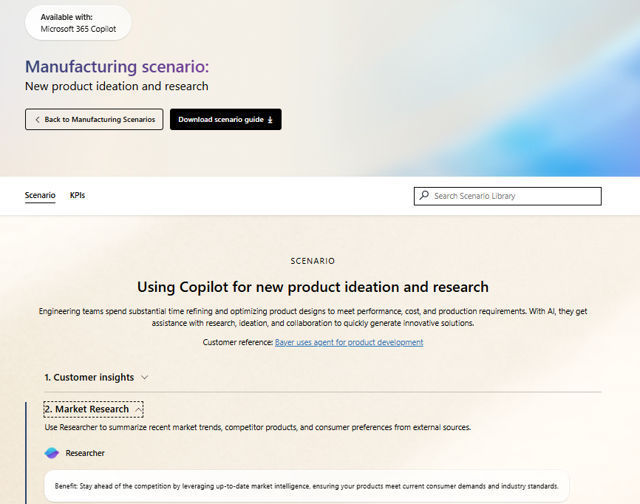
Scenario Library
Get ideas on how to integrate Researcher into your business processes.
New product ideation and research – use Researcher to create a report on market trends, competitor products, and consumer sentiment. Then combine market research, project information, and meeting notes into a report on new product ideas.
Streamline market research and strategy – use Researcher to create a market research report from internal and external sources.
Data strategy and insights – use Researcher to propose a strategy for how to monetize data streams.
Create an unsolicited proposal – use Researcher to better understand a customer’s business challenges and strategies before proposing new services. Then use Researcher to create a strategy for using your solution to improve the customer’s business.
Draft a product strategy document – use Researcher to create a proposal for a new IT solution.

Slide 10
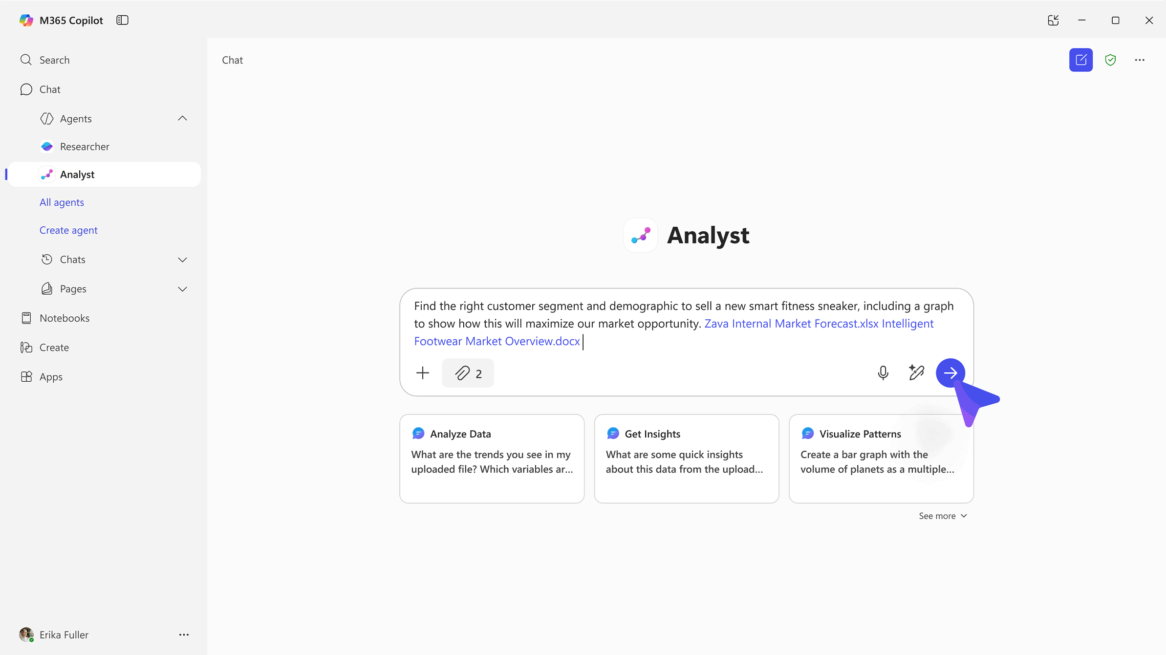
Analyst agent
is an advanced reasoning agent that uses iterative chain-of-thought reasoning for advanced data analysis – turning raw data to insights in minutes with the power of OpenAI’s o3-mini model.
Notes:
Analyst agent is another first-of-its-kind reasoning agent for work that can help companies tackle complex data queries.
Analyst works to analyze raw data and deliver results, so you can go from raw data to insights quickly.
Built on OpenAI’s o3-mini reasoning model and optimized to do advanced data analysis at work

Slide 11
Challenges in data analysis
Data overload: Organizations are inundated with structured and unstructured data from countless sources—spreadsheets, databases, CRM systems, and more. This volume of data can overwhelm teams and make it difficult to extract timely, actionable insights.
Skill gaps: Extracting value from complex data often requires technical expertise—SQL, Python, BI tools—that many knowledge workers lack. This creates bottlenecks and reliance on specialized data analysis roles.
Time-consuming workflows: Disproportionate time is often spent cleaning, formatting, and stitching together messy data. This manual effort delays insights and increases the risk of missed opportunities.
Fragmented tools and silos: Data lives in disconnected systems—Excel files, reporting systems, internal dashboards—making it hard to get a unified view. We often must jump between tools, losing context and efficiency.
Inaccessible insights: Even when insights are generated, they’re often buried in complex dashboards or static reports, making it difficult to interpret results or ask follow-up questions.
Notes:
Modern organizations are awash in structured data – from Excel sheets and CSV exports to database records and BI reports – but extracting meaningful insights from this data often requires technical skills or significant time. Many knowledge workers find themselves spending hours wrestling with messy spreadsheets or disparate data sources, trying to answer business questions and often missing key insights due to the labor-intensive process

Slide 12
How does Analyst work?
Unlike traditional large language models that jump too quickly from problem to proposed solution while often failing to adjust to new complexities or gracefully recover from mistakes, Analyst:
Implements a reasoning-driven, chain-of-thought (CoT) architecture derived from OpenAI’s o3-mini.
Progresses through problems iteratively by hypothesizing, testing, refining, and adapting. Analyst takes as many steps as necessary, adjusts to each complexity it encounters, and mirrors human analytical thinking.
With the capability to generate and execute code at every step within its reasoning trajectory, this model excels at incremental information gathering, constructing hypotheses, course correction, and automatic recovery from errors.
Notes:
Powered by an advanced reasoning model that Microsoft has optimized for more in-depth data analysis, it gathers information and reasons through the data, using Python to generate a response.
Analyst uses chain-of-thought reasoning to progress through problems iteratively, taking as many steps as necessary to refine its reasoning and provide a high-quality answer.
It can run Python to tackle your most complex data queries—and you can view the code it's running in real time to check its work.

Slide 13
How to use Analyst
How to use Analyst
Find the file(s) with the raw data you need help analyzing and add it to your prompt in Copilot Chat, either by uploading directly or selecting from your M365 files.
Analyst currently supports up to 5 files at once across multiple formats including documents (Word, PPT, PDF) and datasets (Excel, CSV, JSON).
Ask Analyst to provide the insights you’re looking for, including specifying the type of visualization or graph.
Analyst will then work to understand the data, construct a plan, and execute Python code to reason over your prompt.
This process may take a few minutes and you can follow along with chain-of-thought reasoning to check its work.
Where can you use Analyst
Analyst is accessible as an agent in Copilot Chat in the Microsoft 365 Copilot app, Teams, and Outlook.
Turning on Analyst
The agent will appear in the Agent Store under ‘Built by Microsoft’ located within the ‘All agents’ and ‘Get agents’ landing page.
For users with a Microsoft 365 Copilot license, Researcher and Analyst agents will be pre-pinned for all eligible users.

Slide 14
Analyst demo video

Slide 15
Example use cases for Analyst agent

Slide 16
When to use Analyst
When to use Analyst
Consulting multiple data sources: Gathers and integrates data from different file types for comprehensive analysis.
Step-by-step problem solving: Progresses through challenges by hypothesizing, testing, and adapting responses, making it useful for iterative decision-making.
Visualizations: creates key visualizations for data analysis and presentation.
Example use cases
Financial performance analysis and forecasting
Customer segmentation analysis
Sentiment analysis over survey or feedback data
Data storytelling with visualizations
Best practices for using Analyst
Upload both structured (Excel, CSV, JSON, etc.) and unstructured (PDF, Word, PowerPoint etc.) data files, up to 5 files at once
Ask complex, multi-variable questions that require advanced data analysis
Specify the type of insight or visualization needed
Review chain-of-thought and Python generated insights for accuracy

Slide 17
Try it!
The Analyst agent was designed and tested using various methods to ensure its effectiveness and reliability:
 | Customer Service | Sales | Finance | Marketing | HR
Pain point | Lack of visibility into customer service trends and feedback | Lack understanding of pipeline health and probability of meeting quarterly or year-end close targets | Strategic decisions require complex modeling across multiple business drivers | Limited understanding of campaign insights | Managers need to generate and modify team strategies while quickly assessing project performance for clarity and continuous improvement
Scenario | Gain visibility into larger trends and patterns of customer feedback | Gain real-time visibility into pipeline trends and sales performance | Analyze P&L, market growth, and cost structure data to evaluate the financial impact of launching a new product line | Gain insights into efficacy and outcomes of marketing levers and investments | Co-create and draft team strategy based on team goals and expected outcomes and use lessons learned to feed a continuous improvement loop
How Analyst can help | Use Analyst to understand sentiment across customer reviews and comments | Use Analyst to analyze data to determine sales targeting opportunities | Use Analyst to simulate financial outcomes, compare scenarios, and generate decision-ready insights for leadership. | Use Analyst to understand marketing results data (e.g. SEO, web traffic, conversion rates, etc.) to determine investments | Use Analyst to assess project outcomes for effectiveness, timeliness, and other metrics

Slide 18
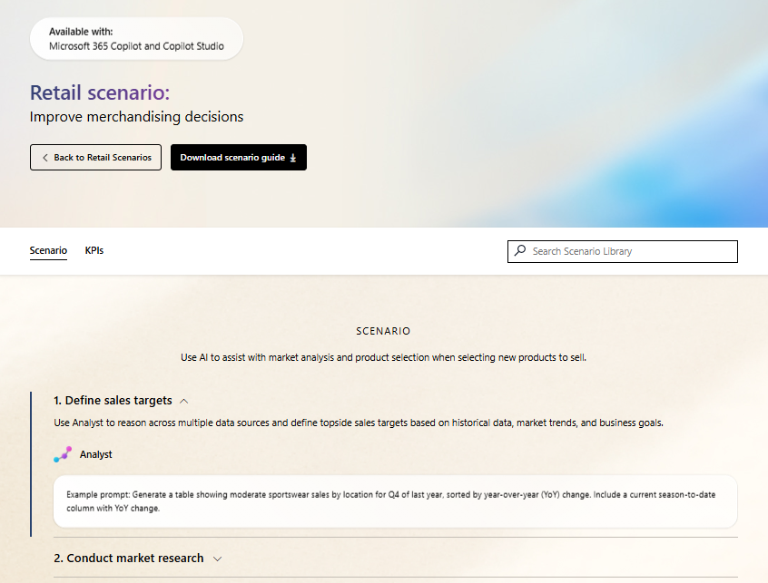
Scenario Library
Get ideas on how to integrate Analyst into your business processes.
Improve merchandising decisions – use Analyst to help define sales targets based on historical data, market trends, and business goals.
Implement adaptive pricing – use Analyst to identify sales trends and compare pricing options.
Data strategy and insights – use Analyst to gain insights into data streams.
Intelligent sales forecasting – use Analyst to analyze sales and market data to create forecasts.
Financial insights – use Analyst to gain deeper insights into sources of revenues and costs.
Deliver insights to managers – use Analyst to produce reports on manager strengths and development opportunities.

Slide 19
Resources
Read the announcement blog and view the demos: Blog: Researcher and Analyst are now generally available
Video: Explore Researcher and Analyst agents and the Agent Store
Check out the Agents in Microsoft 365 adoption page
Learn more from our engineering team:
Researcher agent in Microsoft 365 Copilot | Microsoft Community Hub
Analyst agent in Microsoft 365 Copilot | Microsoft Community Hub

