Slide 1
Speaker notes
    Purpose:
    The goal of this guide is to help customers understand how they can rapidly deploy Microsoft 365 Copilot and specific steps they should take to optimize their data security environment based on their current licensing profile and security posture. The guide is divided in four phases:
    In the Get ready phase, complete the Microsoft 365 Copilot Optimization Assessment to understand your current environment and what data security controls are implemented today, address any specific Generative AI questions, and proceed with developing an implementation plan based on the outcome of the assessment and the initial scenario discovery.
    In the Onboard & Engage phase, we recommend focusing on addressing any content management questions, fulfilling required prerequisites, assigning licenses, and deploying Microsoft 365 Copilot. In this phase, if needed, we provide recommendations on how to reduce the risk of oversharing by enabling Restricted SharePoint Search, then guide you down one of two paths: Core and Best-in-Class. These two paths have been developed to meet you where you are and guide you on how to address specific data security concerns that may exist.
    The Deliver impact phase is focused on understanding how users are adopting and engaging with Microsoft 365 Copilot by analyzing Microsoft 365 Copilot readiness and usage reports.
    In the Extend & optimize phase, we expand on how you might want to enhance Microsoft 365 Copilot experiences and start designing, building, and deploying your own AI plugins to fulfill specific business requirements.
    This Technical Readiness Guide goes hand in hand with the User Enablement Guide which prepares organizations and employees for the AI transformation journey. The link to the User Enablement guide can be found here: https://aka.ms/Copilot/UserEnablementGuide.
    Target audience: Technical delivery managers, Microsoft 365 Architects and Consultants, IT Professionals.
    What this asset is NOT: Detailed technical product documentation.

Slide 2
Microsoft 365 Copilot
Technical Readiness Guide
Creating the AI-powered organization
January 2025

Slide 3
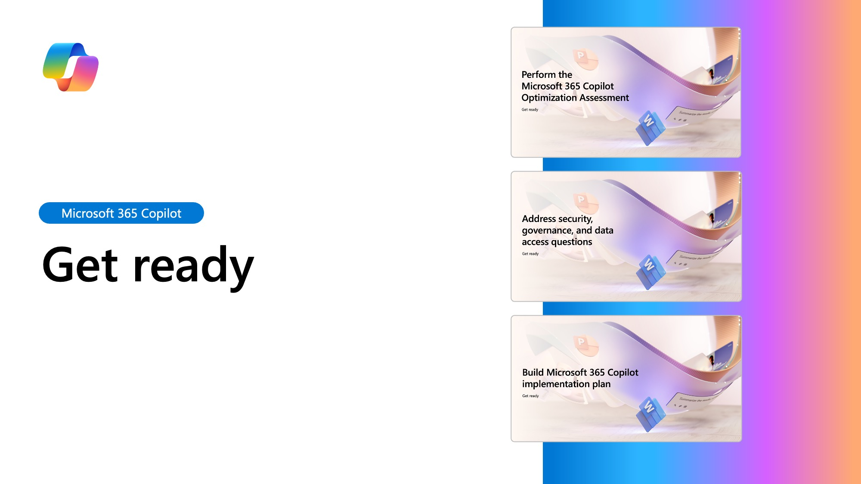
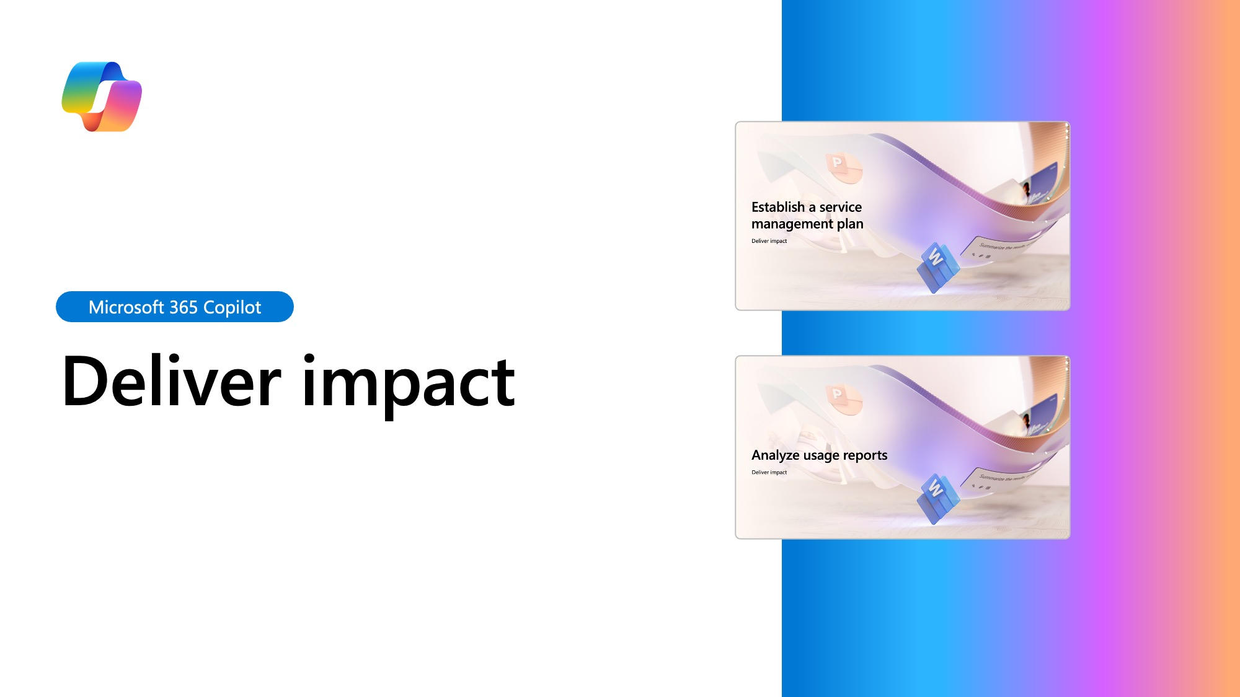
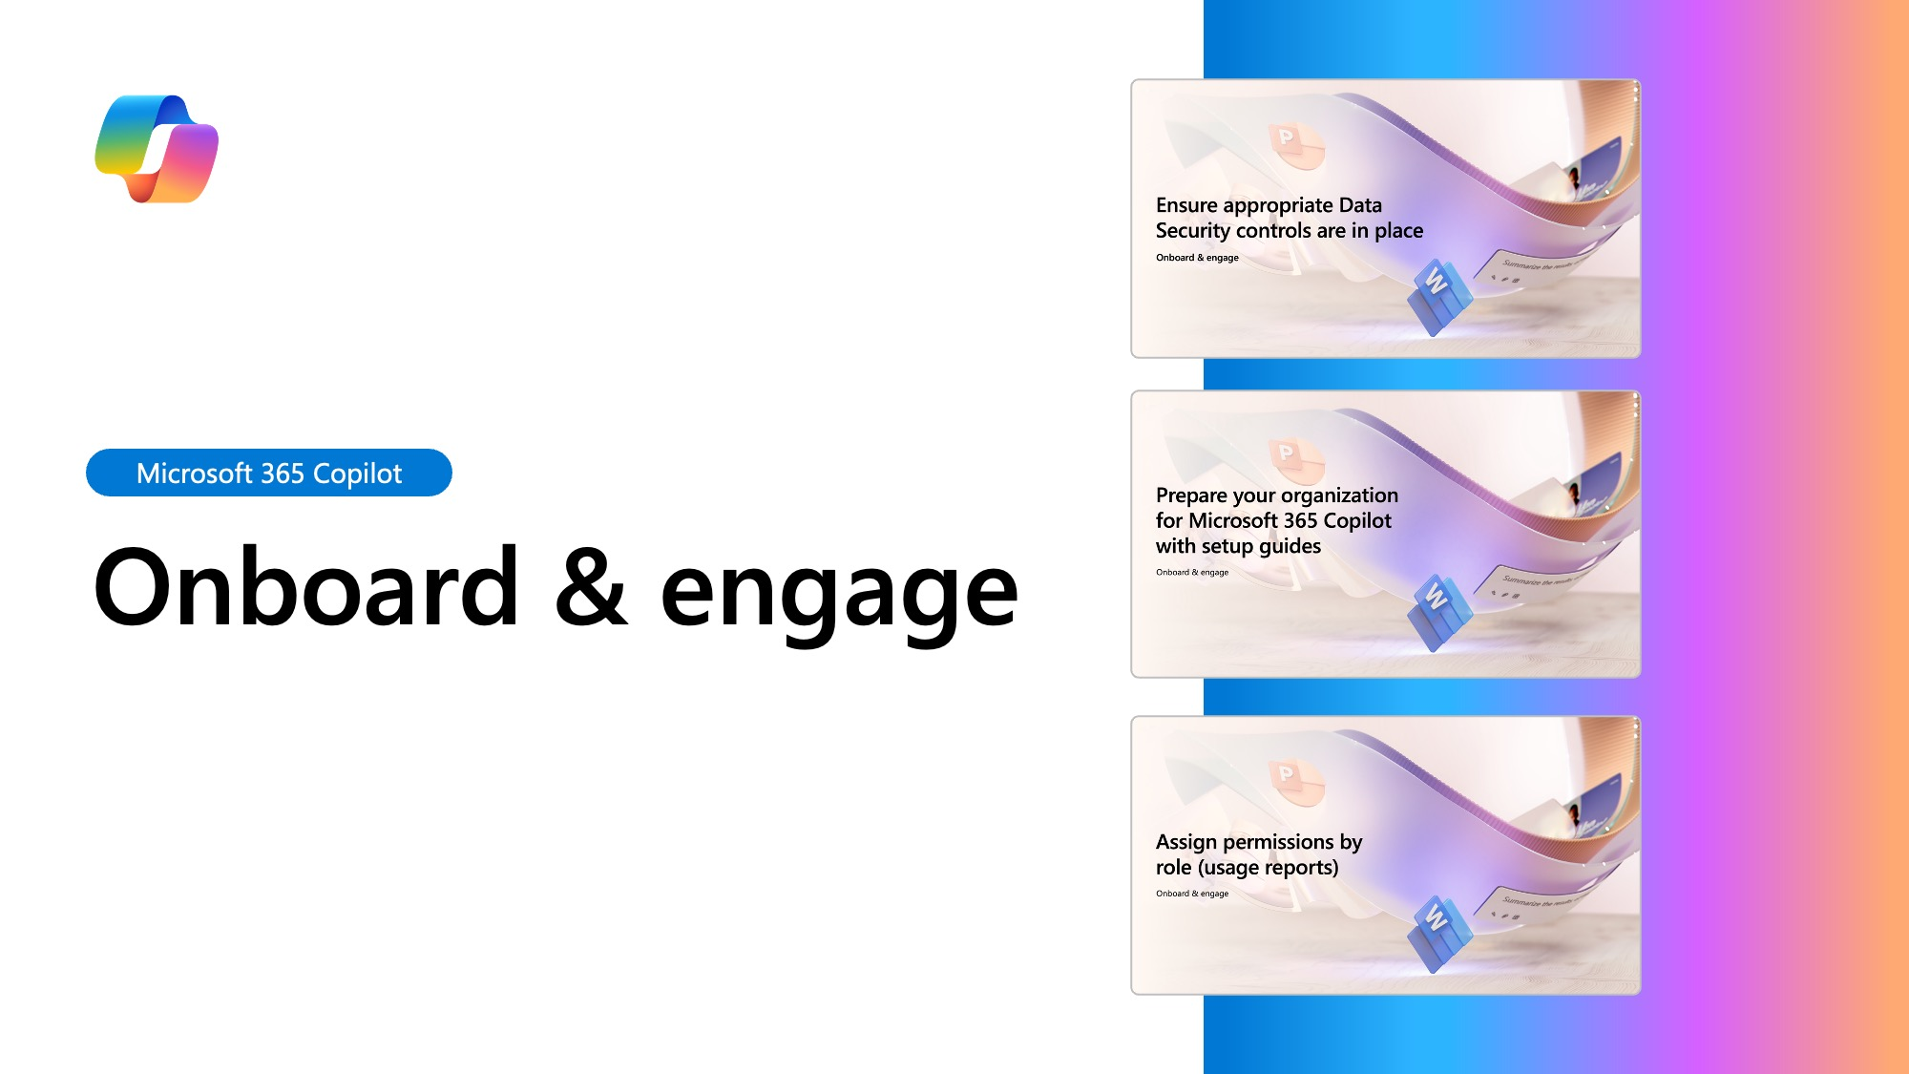
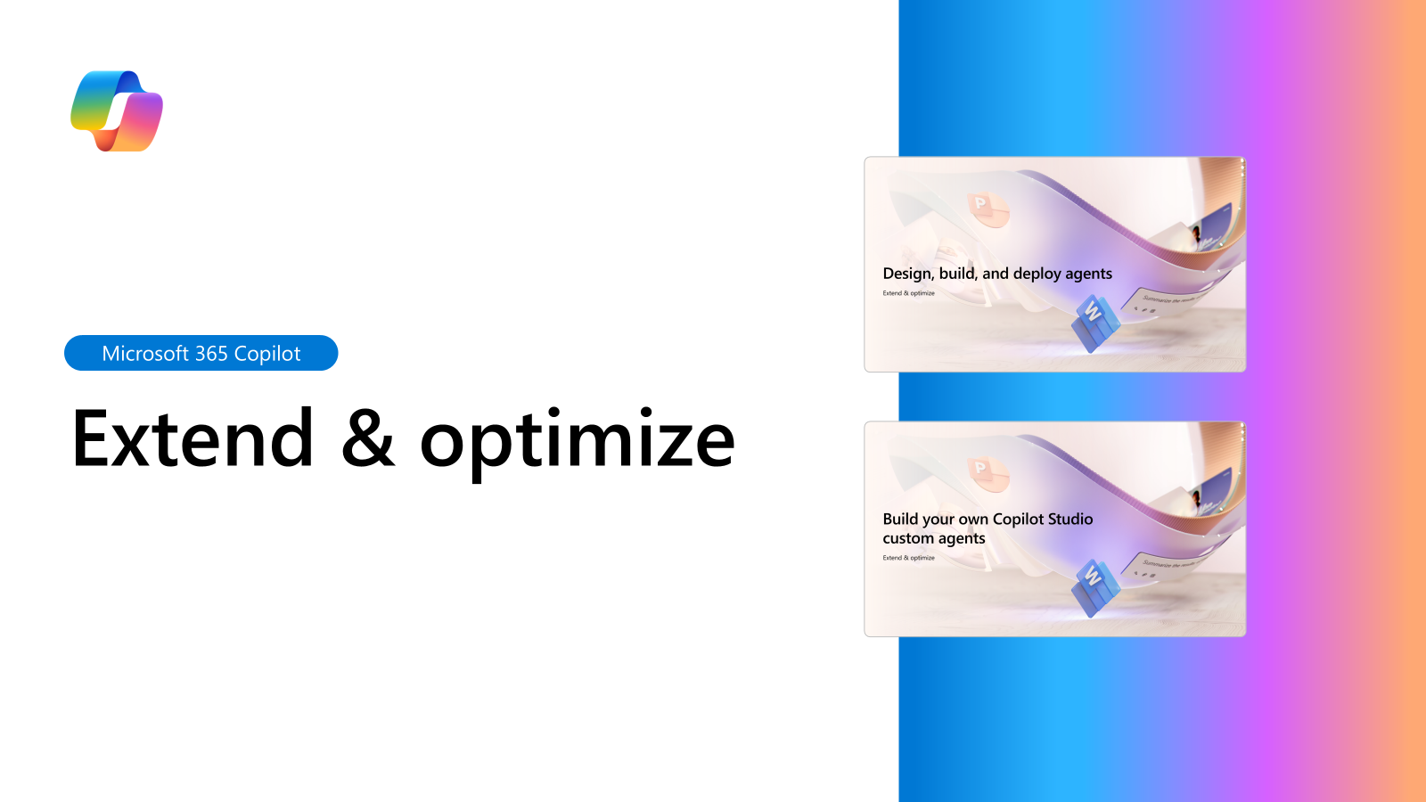
Table of contents

Slide 4
The journey to becoming AI powered
You are here
Leadership
Human change
Technical skills
Develop leadership capabilities to leverage AI for business outcomes
Manage the human transformation through robust user enablement programs
Build and iterate technical skills to deliver on business results
Foundational learning
Business strategy
AI Council creation
Providing clarity and prioritization
Provide access to training and experts
Manage and mitigate risk
Improve service management process
Invest in the employee experience
Improve the culture
Authentically integrate feedback
Responsible AI principles

Slide 5

Microsoft 365 Copilot implementation
Human change
Prepare organization and employees for the AI transformation journey through user enablement programs
Copilot
readiness checklist
You are here
Workstreams support each other for maximum value and ROI
Copilot implementation
Sponsor
Scenarios
Security
Get ready > Onboard & engage > Deliver impact > Extend & optimize
Technical readiness
Address technical deployment and optimization, including governance, security, compliance, and management
Leadership journey

Slide 6
Essentials for Copilot success
Nominate and activate your Copilot executive sponsors, in partnership with your AI Council
Accelerate your business impact by defining highest value scenarios
Define your path to secure your data for compliance and peace of mind

Slide 7

Implementation overview
Microsoft 365 Copilot
Get ready
Onboard & engage
Deliver impact
Extend & optimize
User Enablement Workstream
Complete User Enablement Strategy training
Define user experience and feedback strategy
Design and deploy training and engagement community (Center of Excellence/Champion Platform)
Launch employee communications and Champion program
Onboard executives and user cohorts
Deliver user Champions and support staff training
Review success measures and user survey results
Conduct feedback and reporting analysis
Deliver extended training and adoption support
Identify additional optimization scenarios
Iterate user experience strategy
Gather and amplify success stories
Extend to new high value scenarios
Deliver business process transformation with Copilot Studio, plugins, and connectors
Drive group and cross-organizational productivity and innovation
Understand custom line of business opportunities
Secure exec sponsorship, create AI Council, and define RAI principles
Identify success owners, Champions, and early adopter cohorts
Detail high value scenarios and personas
Be intentional with assignment and concentrate seats
Define success criteria, KPIs, and success measurement plan
Human Change
Technical Readiness Workstream
Ensure appropriate Data Security controls are in place
Prepare your organization for Microsoft 365 Copilot with setup guide: deploy Microsoft 365 apps, if needed; assign licenses
Assign permissions by role to provide access to the Microsoft 365 Copilot usage report
Establish service management plan
Analyze Microsoft 365 Copilot usage reports and the Microsoft Copilot Dashboard to observe user adoption, retention, and engagement
Design, build, and publish Copilot agents to deliver unique experiences
Build your own custom agents
Perform the Microsoft 365 Copilot Optimization Assessment
Address data security, governance, and data access questions
Build shared Microsoft 365 Copilot implementation plan with User Enablement team
Technical Readiness
You are here

Slide 8
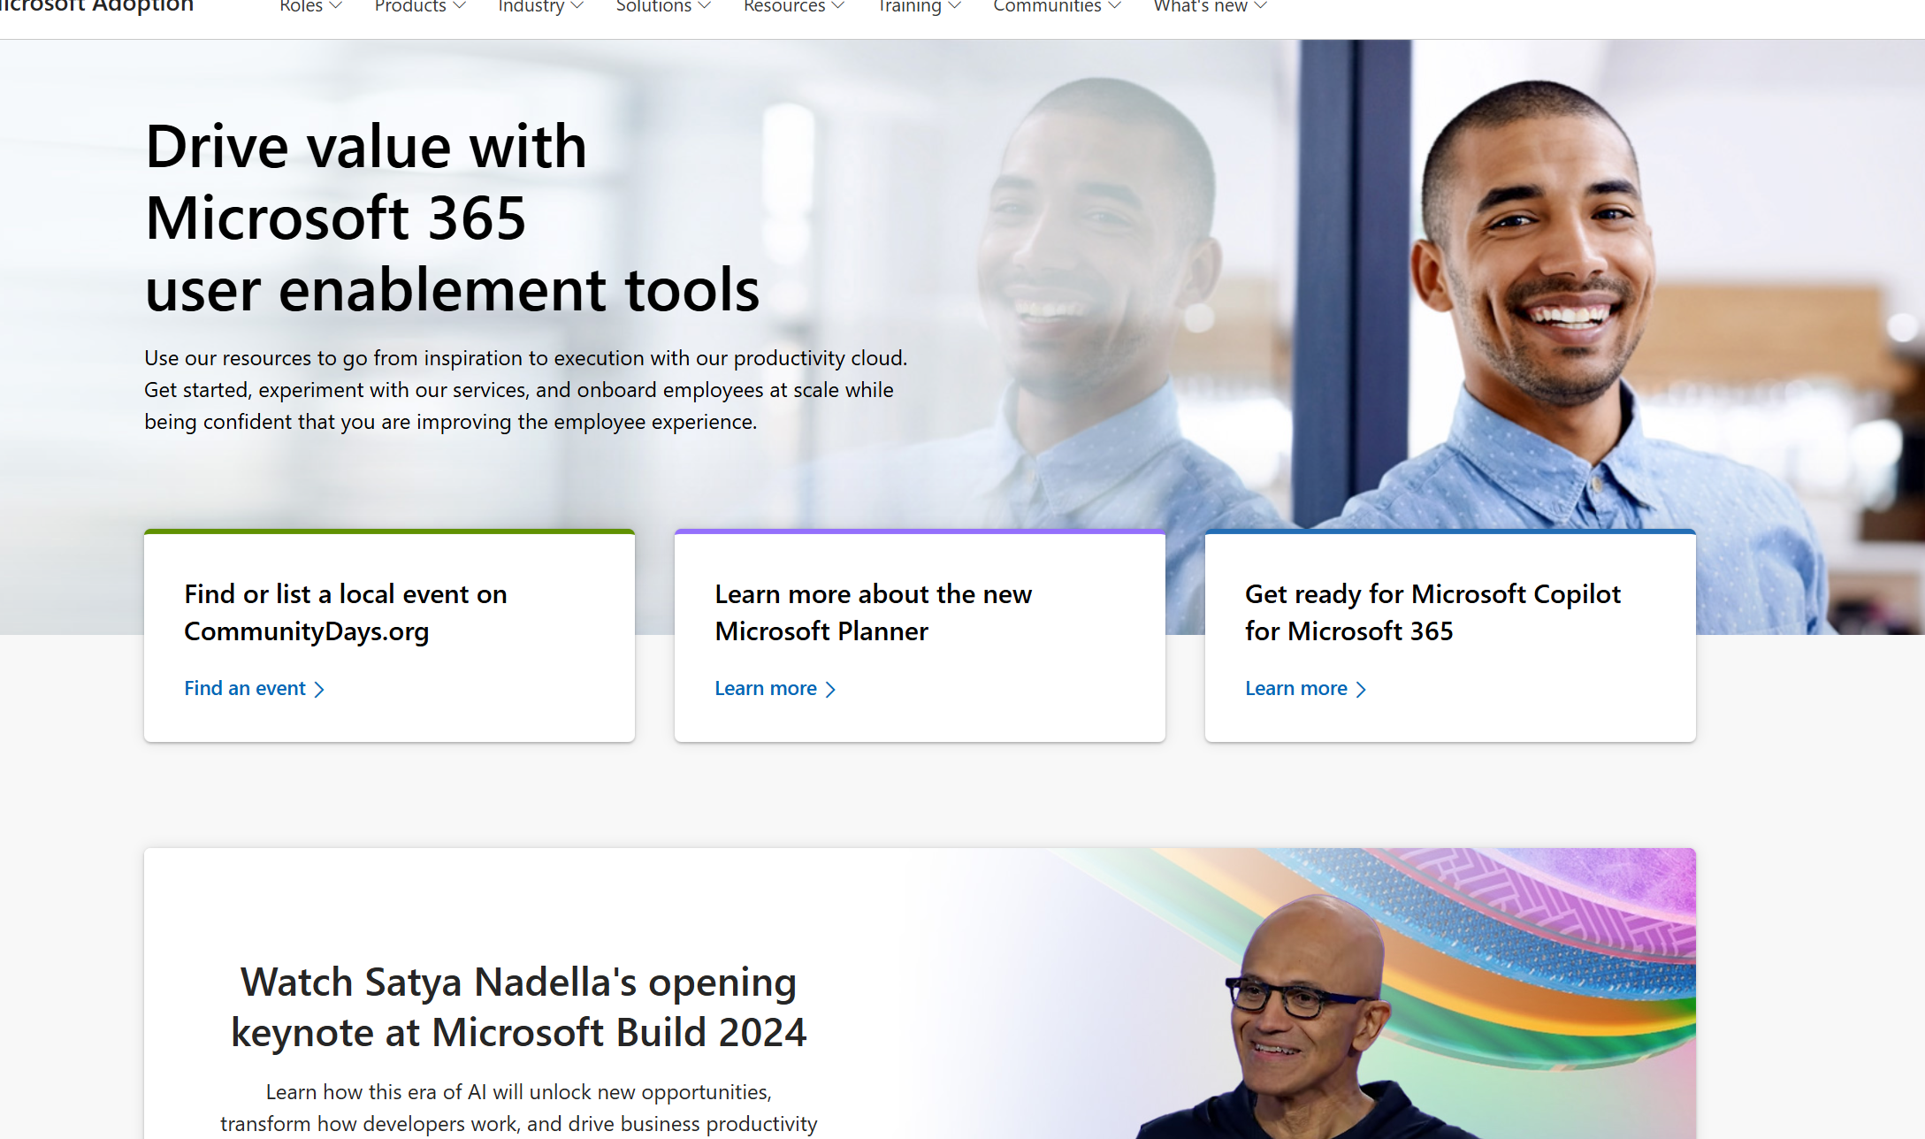
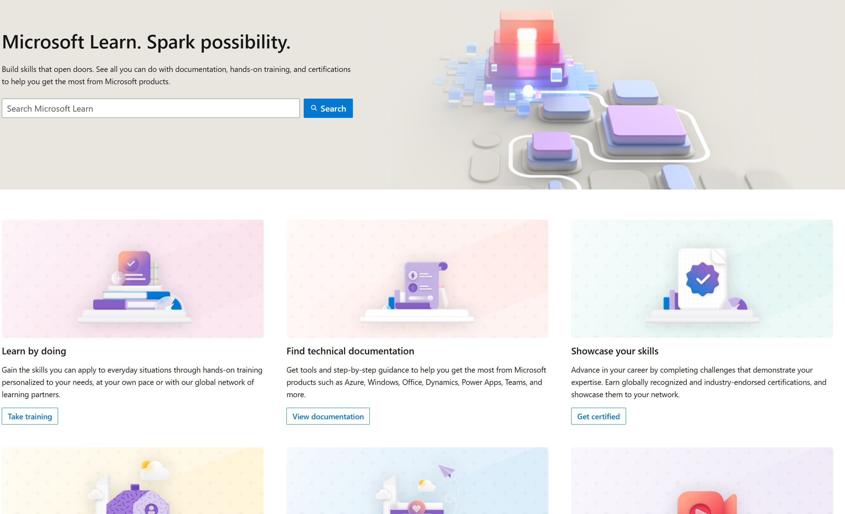
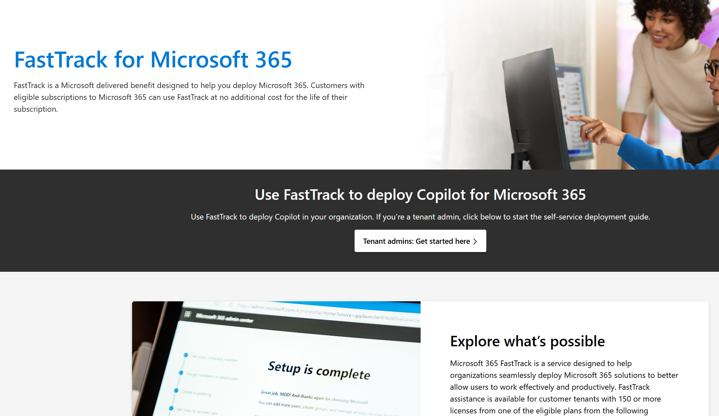
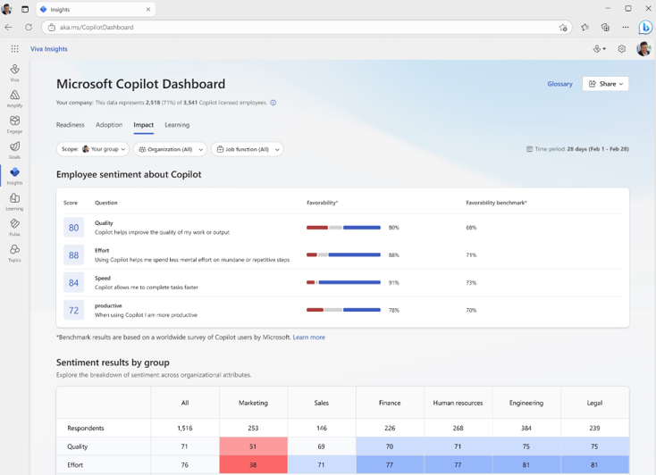
Microsoft 365 Copilot
Readiness checklist and key resources
Get ready
Onboard & engage
Deliver impact
Extend & optimize
Perform the Microsoft 365 Copilot Optimization Assessment
Address data security, governance, and data access questions
Build shared Microsoft 365 Copilot implementation plan with User Enablement team
Apply appropriate data security and governance controls
Prepare your organization for Microsoft 365 Copilot with setup guide: deploy Microsoft 365 apps, if needed; assign licenses
Assign permissions by role to provide access to the Microsoft 365 Copilot usage report
Establish service management plan
Analyze Microsoft 365 Copilot usage reports and the Microsoft Copilot Dashboard to observe user adoption, retention, and engagement
Design, build, and publish Copilot agents to deliver unique experiences
Build your own custom agents
TECHNICAL READINESS
Support continuous learning and optimization
Microsoft Adoption
Resources to ensure you are delivering employee satisfaction and business value.
Copilot learning hub
Build your skills across Microsoft Copilot with industry leading online training and certification programs.
Microsoft resources
Microsoft FastTrack
FastTrack is a Microsoft delivered benefit designed to help you deploy Microsoft 365.
Copilot Dashboard
Measure the impact of your Copilot investment with the Copilot Dashboard.

Slide 9
Implementation project summary
First 30 days
30-60 days
Shared milestone view
Recurring tasks
Complete foundational learning
Assemble team
Share prioritized scenarios
Select and validate initial cohort
Helpdesk onboarding
Review community management plan
Launch training content and
office hours
Purchase decision
Triage of daily feedback
Review shared support process
Launch progressive skilling content
Prepare for and conduct Service Health Review
Summarize scenario and user recommendations
Launch extensibility skilling content
Weeks
00
01
02
03
04
05
06
07
08
09
10
11
12
Stakeholder alignment
Define comms ROB and tools
Share Optimization Assessment results
Deliver shared implementation plan
Ensure data security
controls are in place
Install apps, assign licenses
Ensure reporting roles assigned
Update support systems
Enhance Center of Excellence
Analyze usage reports and Dashboard data
Summarize risk, issues, and opportunities
Prepare AI Council insights

Slide 10
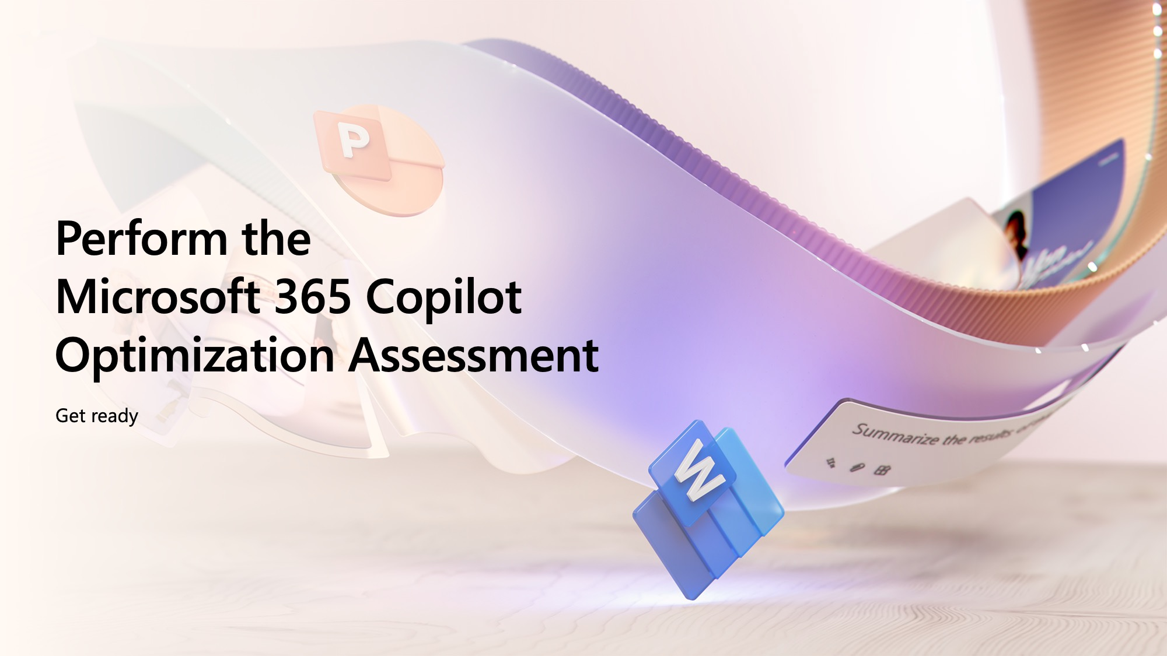


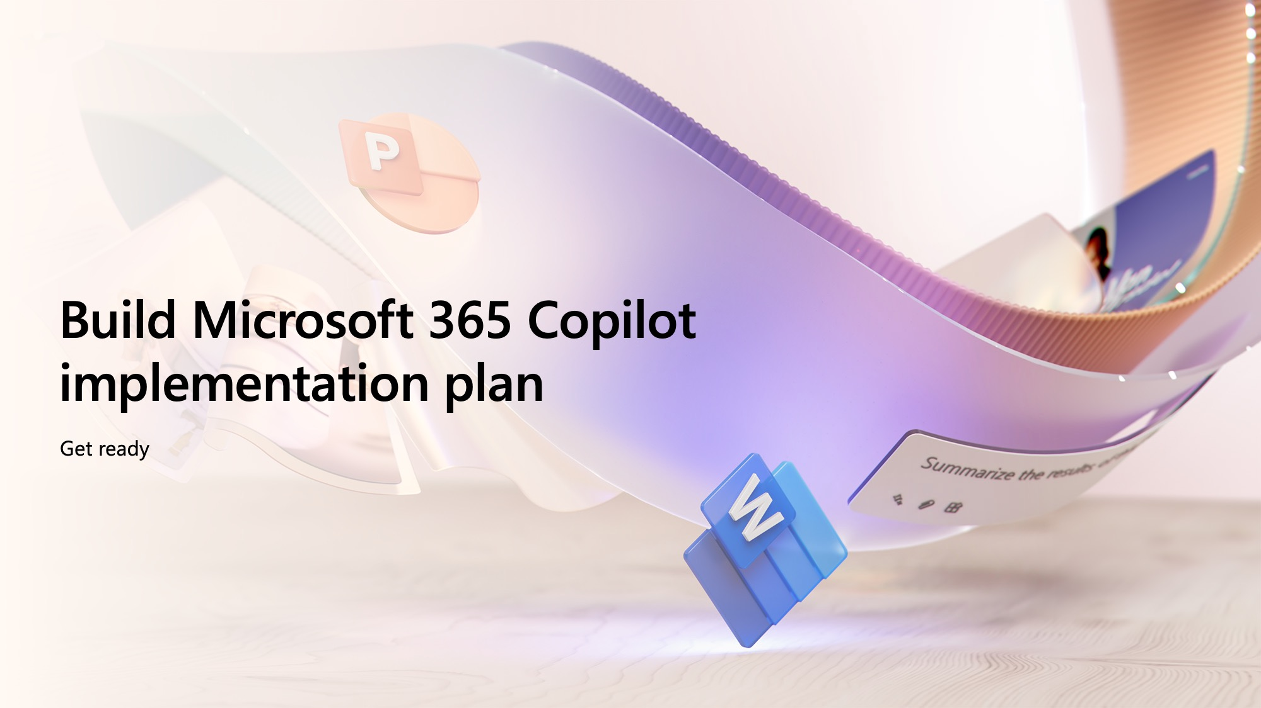
Get ready
Microsoft 365 Copilot

Slide 11
Perform the
Microsoft 365 Copilot Optimization Assessment
Get ready

Slide 12
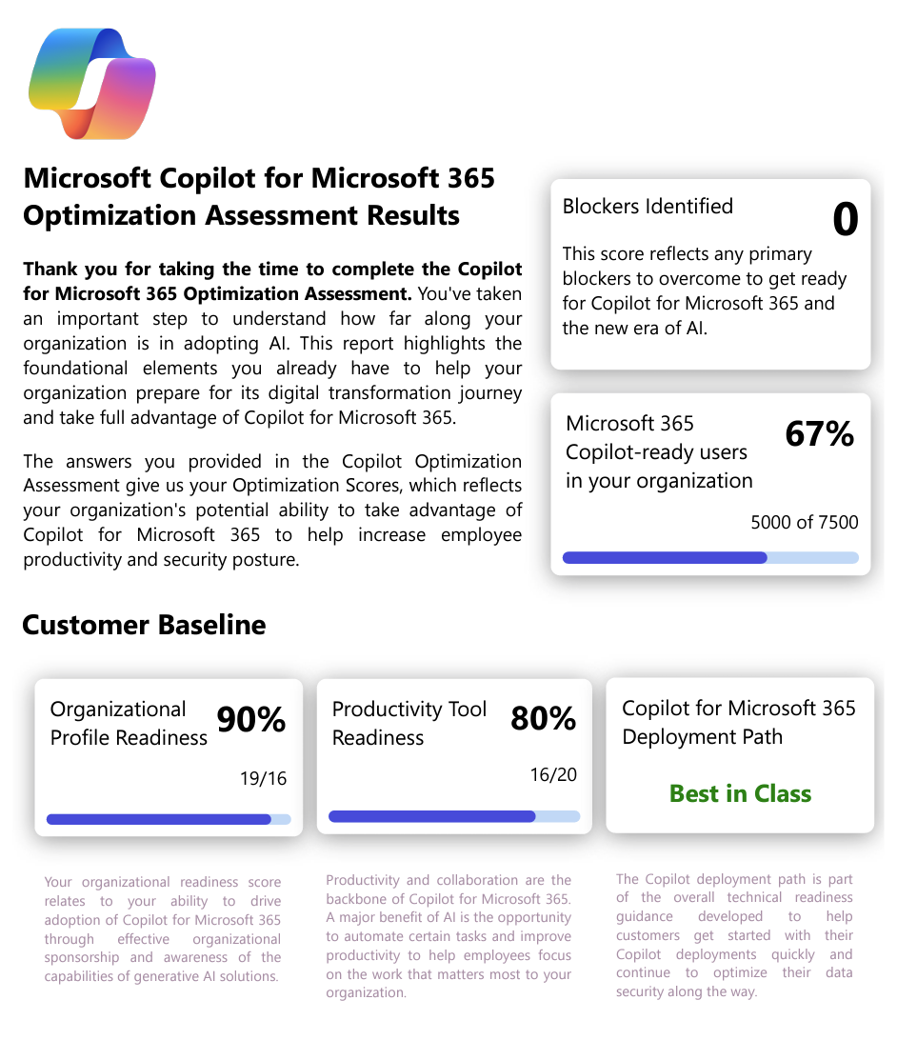
Perform the Microsoft 365 Copilot Optimization Assessment
Get ready
Optimization Assessment
      The assessment is designed to understand your current licensing profile, your collaboration tools, sensitive data handling, and security controls implemented today in your organization, helping you identify a clear path to deploying Microsoft 365 Copilot. The assessment consists of 26 questions and takes about 30 minutes to complete.
  Complete the Microsoft Microsoft 365 Copilot Optimization Assessment
  Understand current licensing
  Understand identity management
  Understand current collaboration tools
  Understand current data locations
  Uncover opportunities to implement data security measures and improve data security posture to optimize user experience with Microsoft 365 Copilot

Slide 13
Address security, governance, and data access questions
Get ready

Slide 14

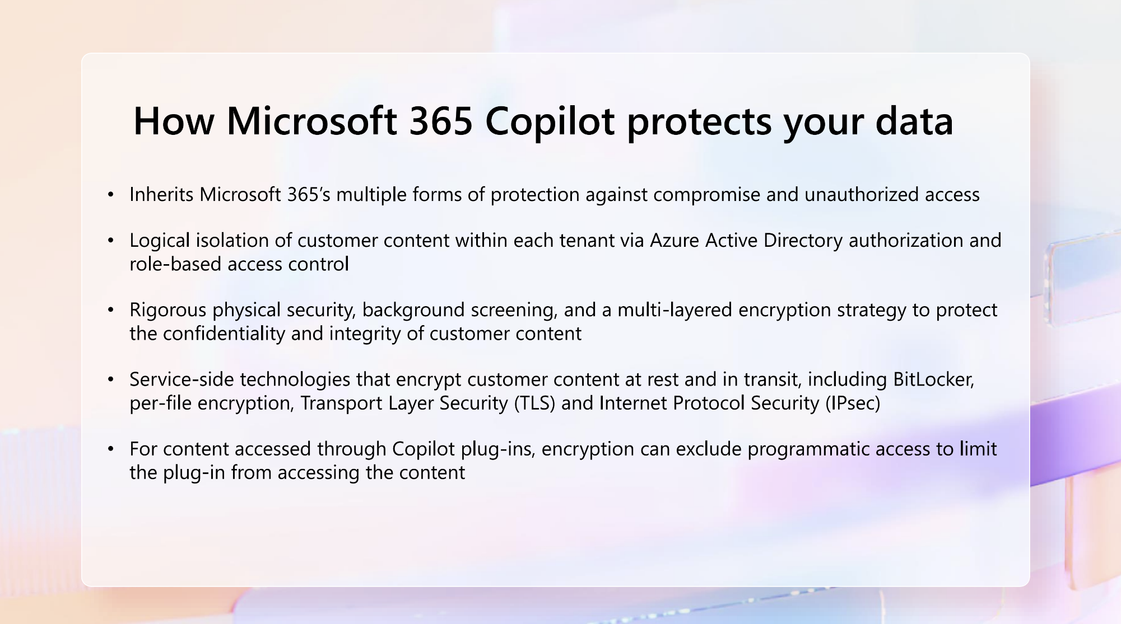
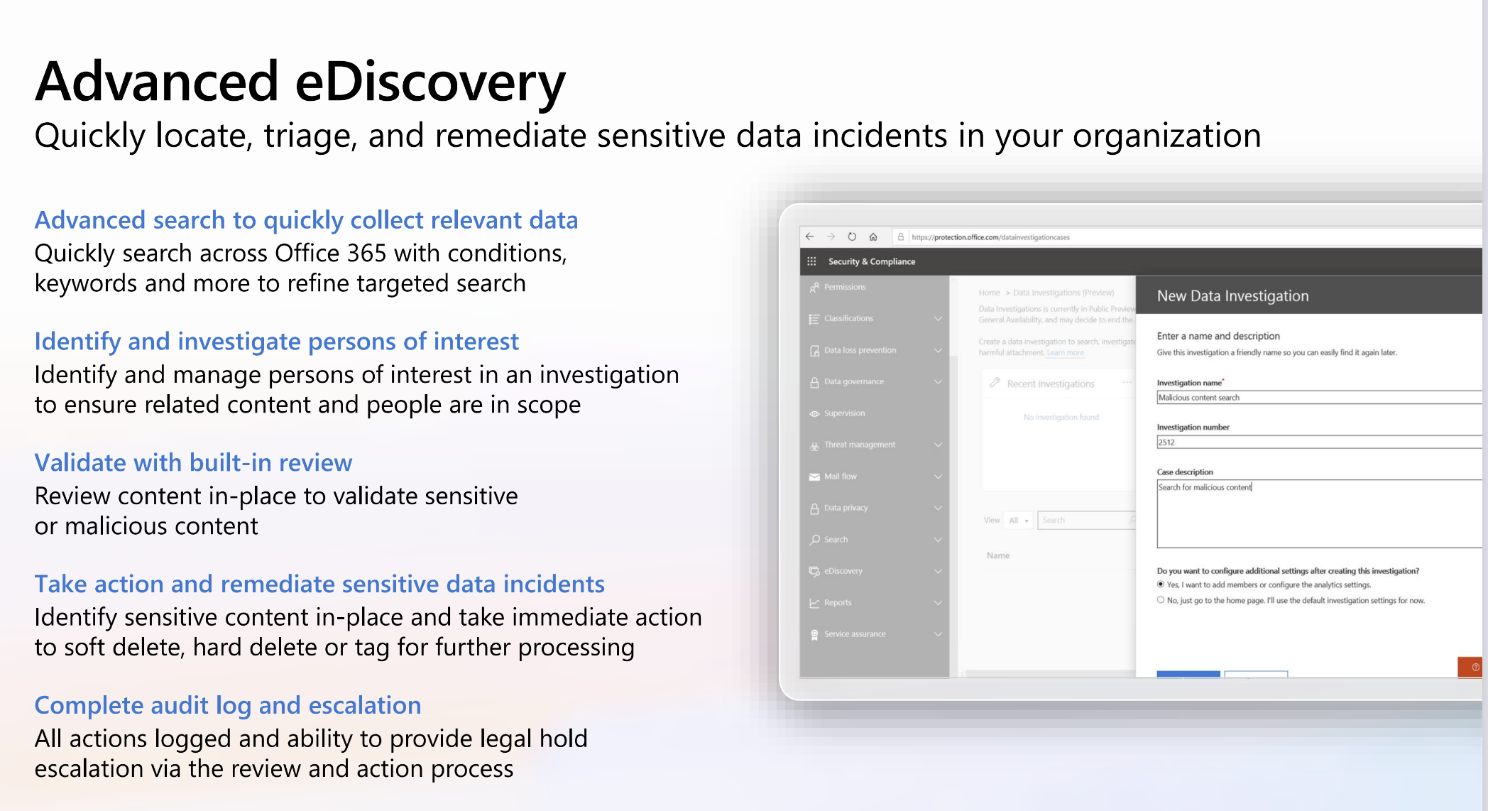
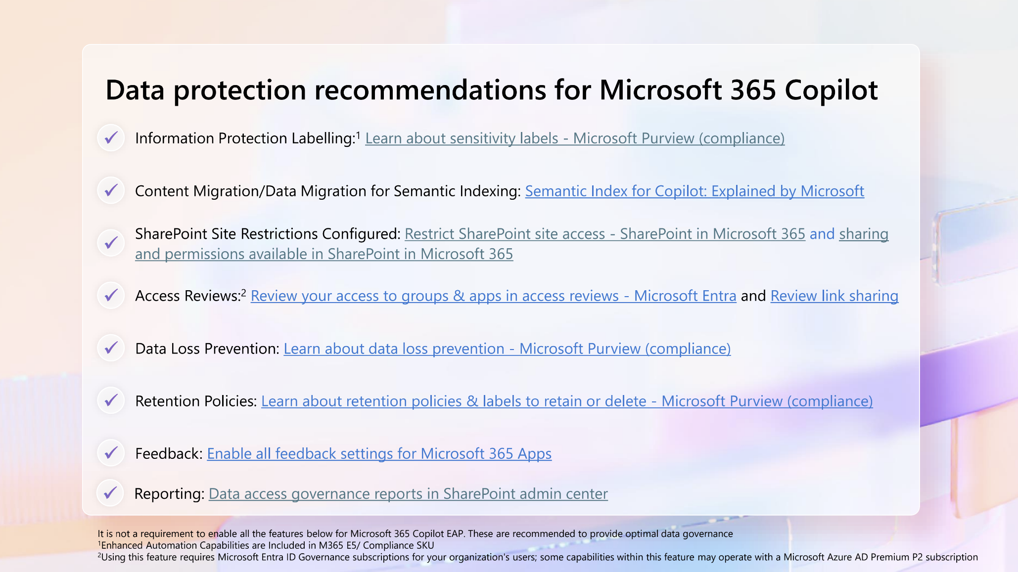
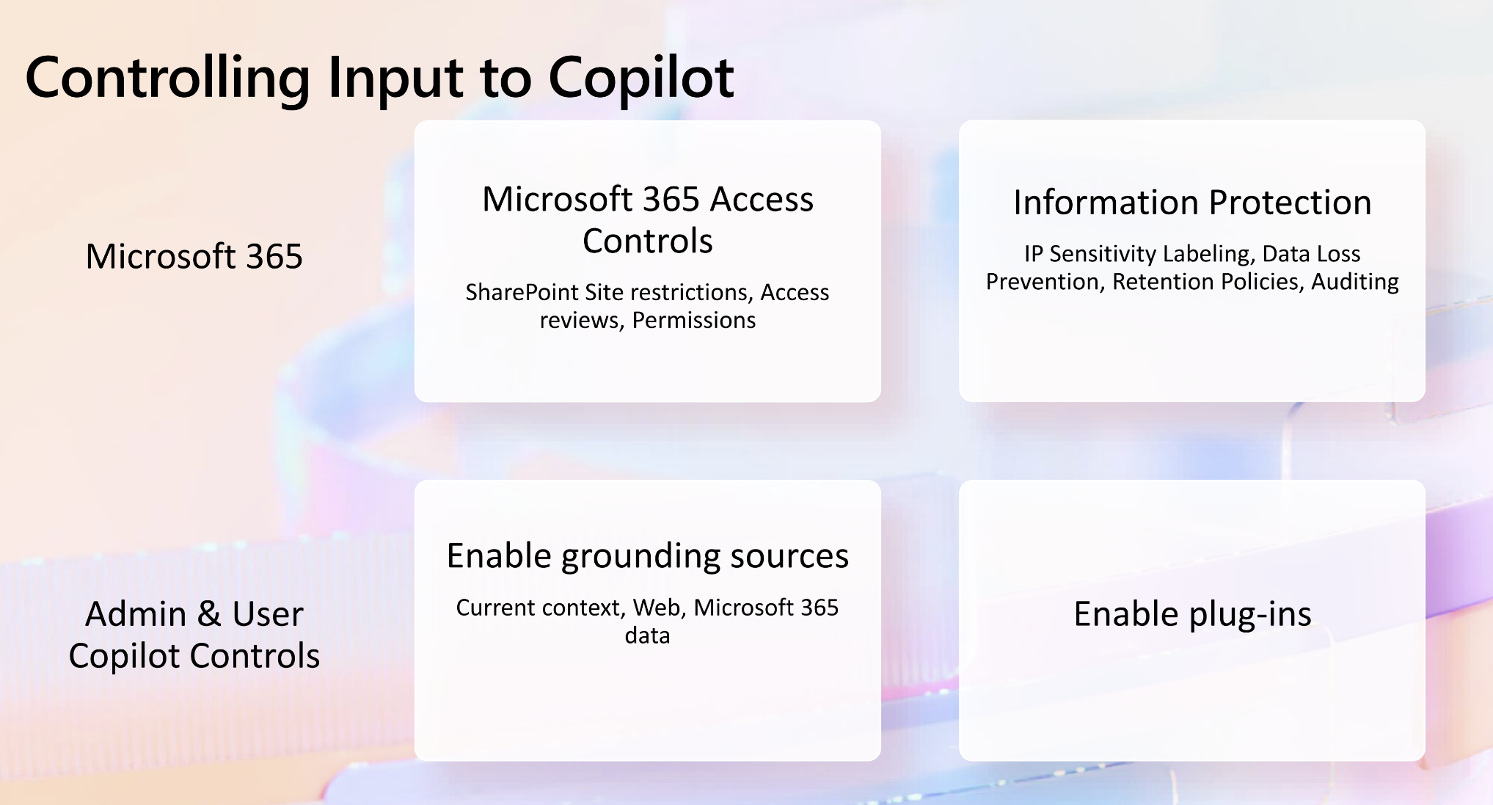
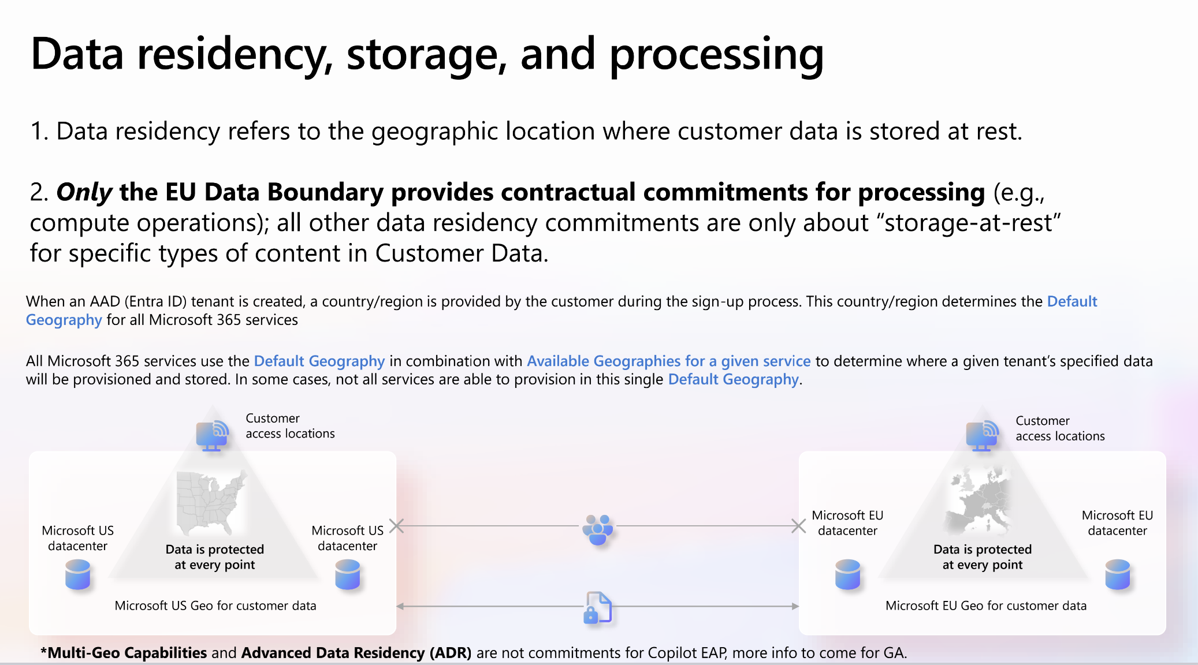
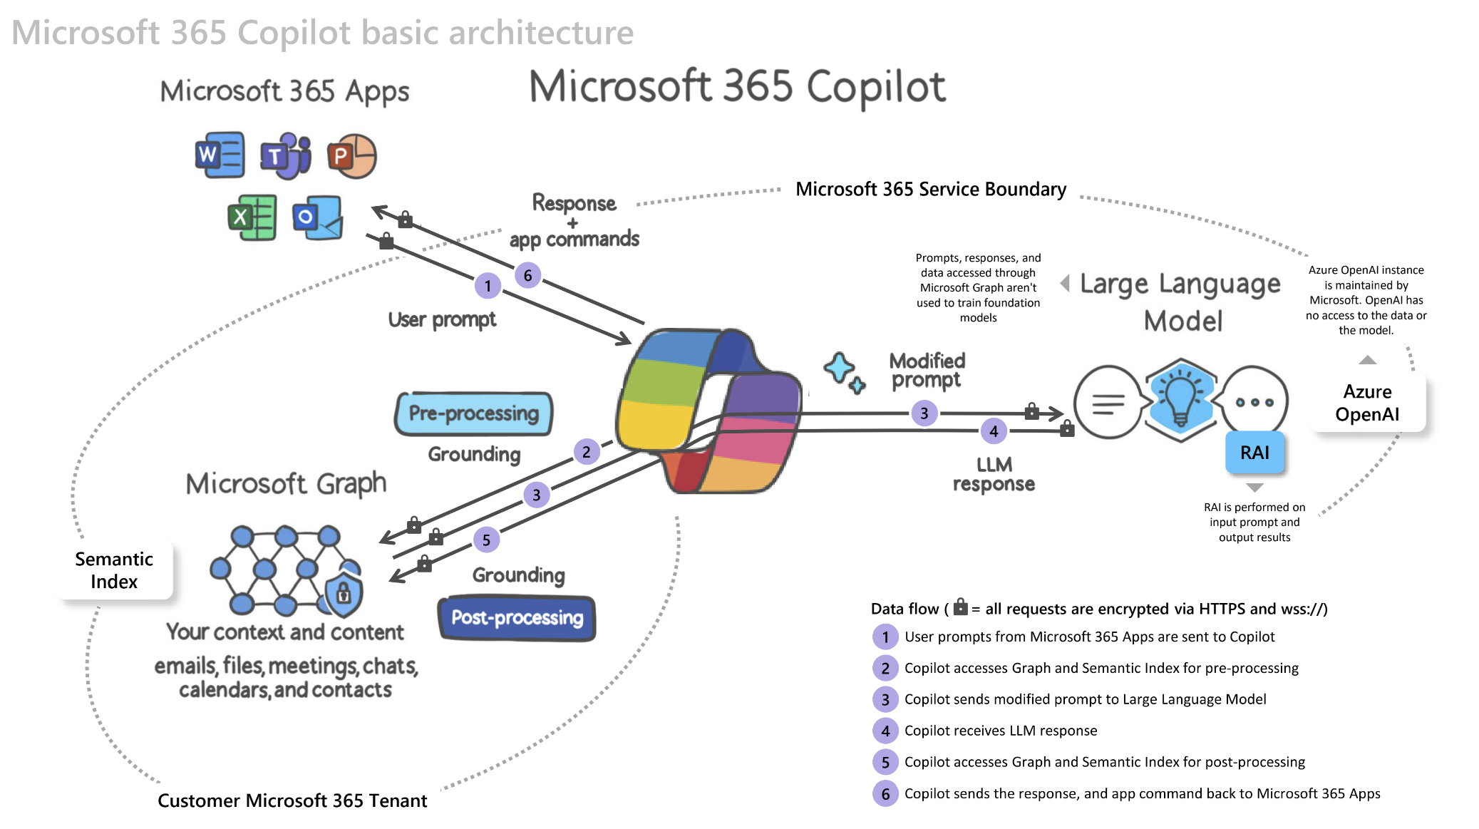
Address security, governance, and data access questions
Shared activity
      Access the IT Professional admin resources for additional documentation and to help address deeper questions you may have about Microsoft 365 Copilot, such as:
  How does Microsoft 365 Copilot Chat, AI-powered chat for the web, work? How is it different from Microsoft 365 Copilot?
  Is this AI-powered chat available for eligible Entra ID users at no additional charge?
  How does Microsoft 365 Copilot work?
  How is my data indexed?
  How should I prepare my data by adjusting permissions and policies?
  Where does my data go?
  How do Copilot agents work?
  What is Microsoft’s responsible AI commitment?
  AND MORE….
Note: For more information on AI Council and RAI, visit User Enablement Guide.

Slide 15
Build Microsoft 365 Copilot implementation plan
Get ready

Slide 16
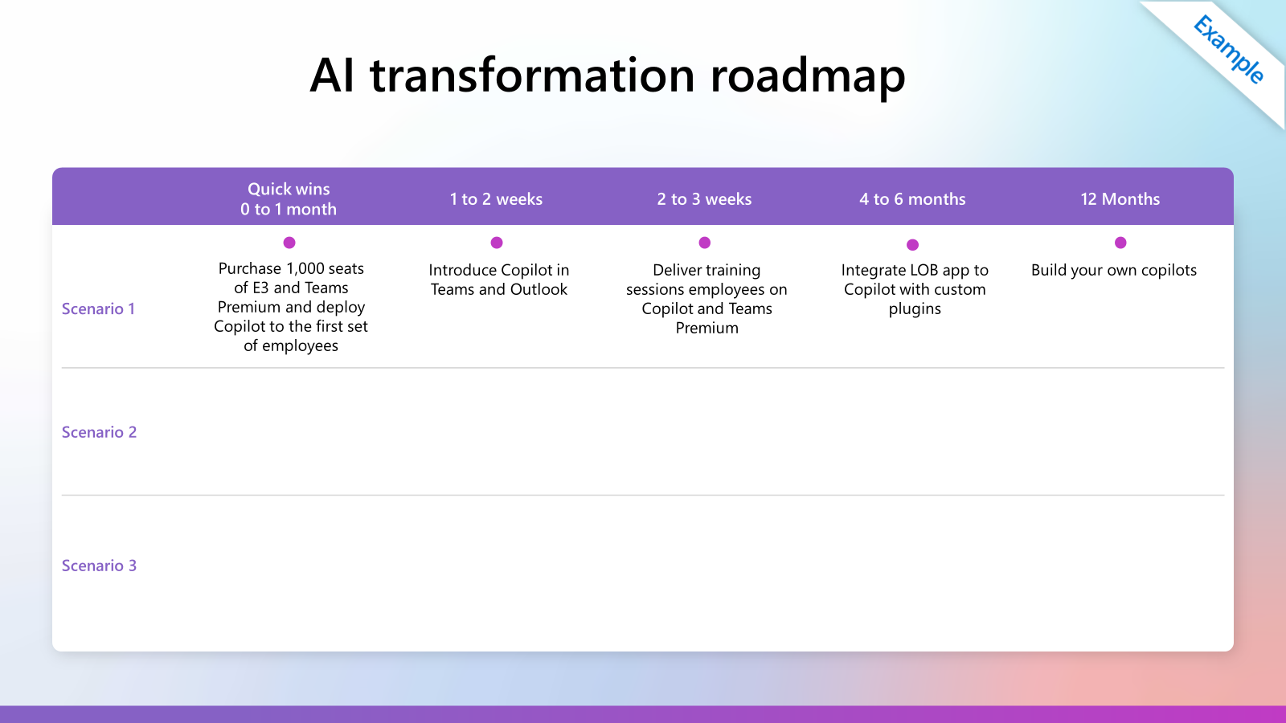
Build an implementation plan
Shared activity
      Use the results of the Optimization Assessment and
      scenario discovery to develop a plan for implementation of Microsoft 365 Copilot.
        Questions to help develop the plan:
  Are all the gaps in the optimization assessment listed in the plan?
  Have you identified the first set of employees that would get Microsoft 365 Copilot?
  How many licenses would you need to purchase?
  Are there any data security questions that you need to address?
  Do all items have owners and due dates?
  Have you identified key adoption steps for the first set of prioritized scenarios?

Slide 17
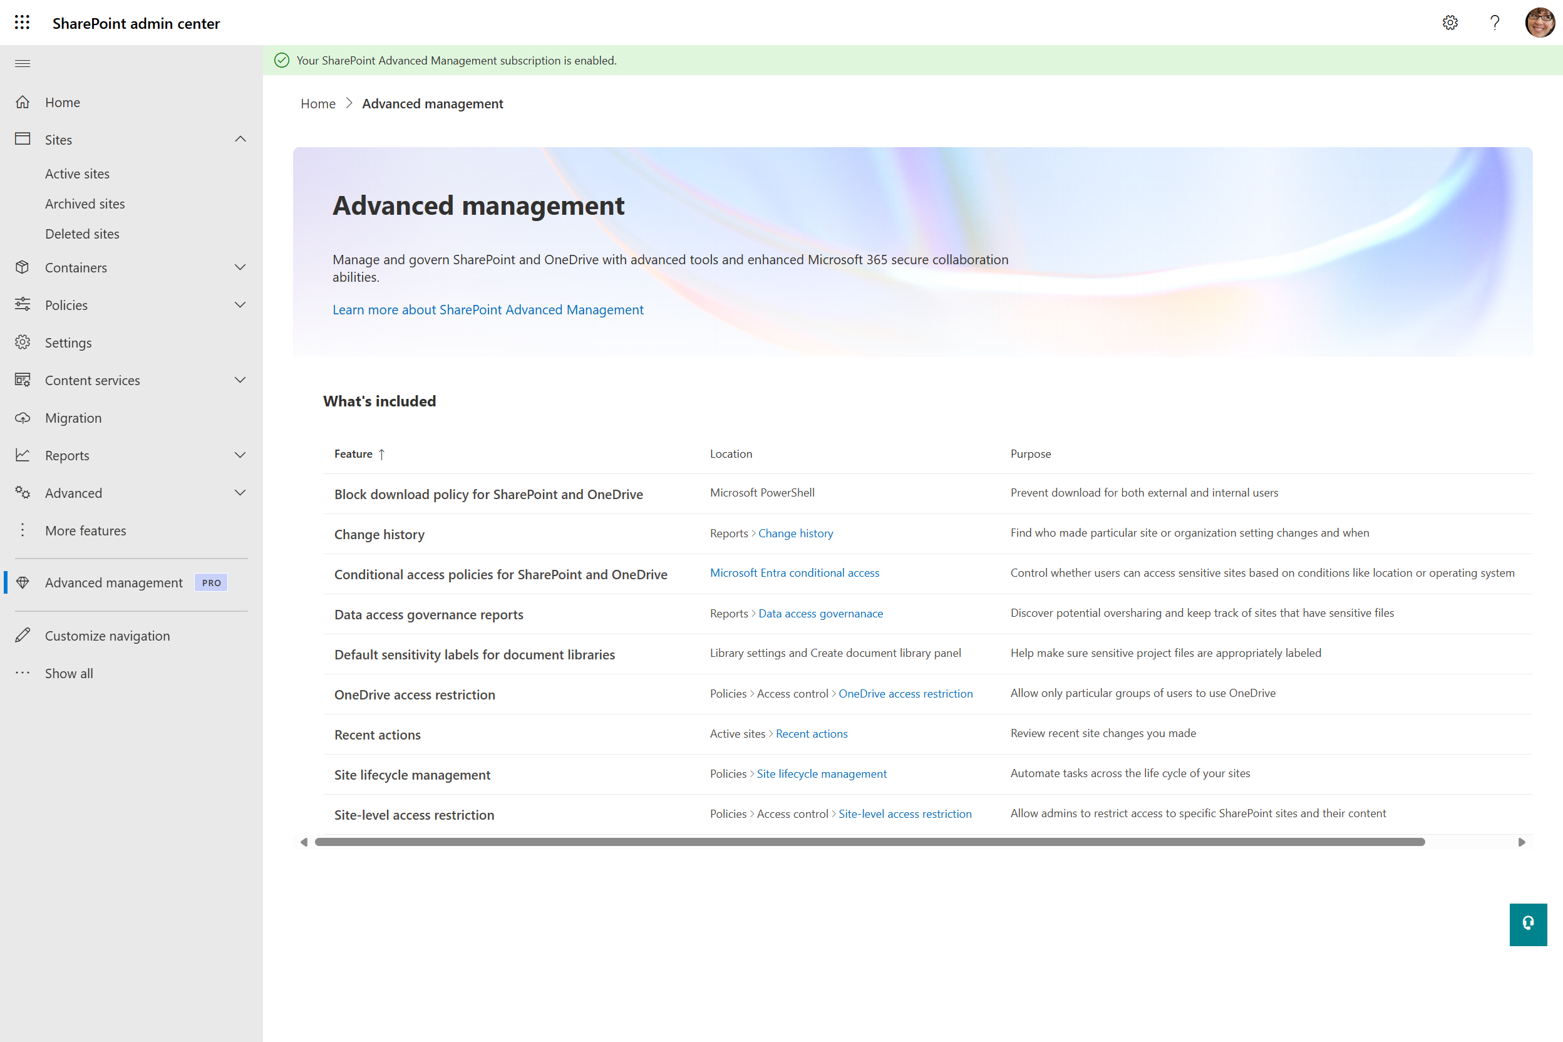
Use SharePoint Advanced Management to get your organization ready for Copilot
Technical readiness
Get ready
Accelerate Site Governance
      Use SharePoint Advanced Management to reduce accidental oversharing, minimize your content governance footprint, improve Copilot response quality, control content access by Copilot, and ensure data safety specifically for business-critical sites.
  Reduce accidental oversharing with SharePoint sharing settings
  Ensure all sites have valid owners
  Clean up unused sites
  Identify sites with potentially overshared content
  Control access to content
  Take proactive measures on business-critical sites
Notes:
To ensure assistance provided by Copilot is appropriate, accurate, and compliant, as your organization’s SharePoint admin, it's crucial for you to ensure that your organization’s data in SharePoint is appropriately governed from the following three aspects:
Manage content sprawl: Reduce content duplication and ensure well-planned content creation. Ensure all sites and content are well managed governed by site owners.
Prevent content oversharing and control content access: Use tools available to SharePoint admins and site owners to prevent users from oversharing content. Limit content access by Copilot with user group settings, and other tools.
Manage content lifecycle: Remove inactive and outdated content and sites. Make sure the information Copilot access is accurate and up to date.
Get ready for Microsoft 365 Copilot with SharePoint Advanced Management - SharePoint in Microsoft 365 | Microsoft Learn

Slide 18
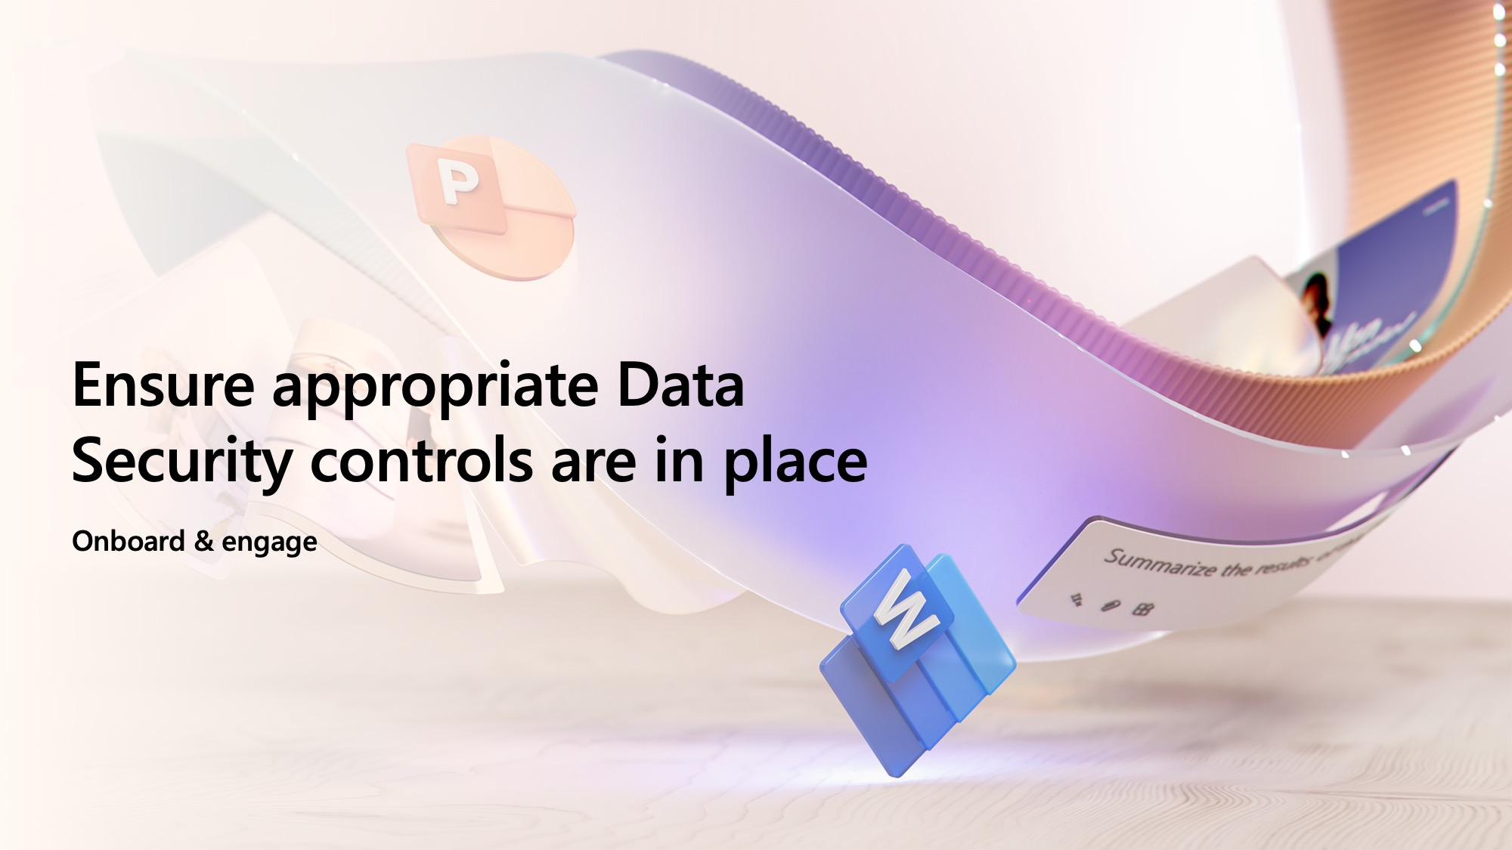
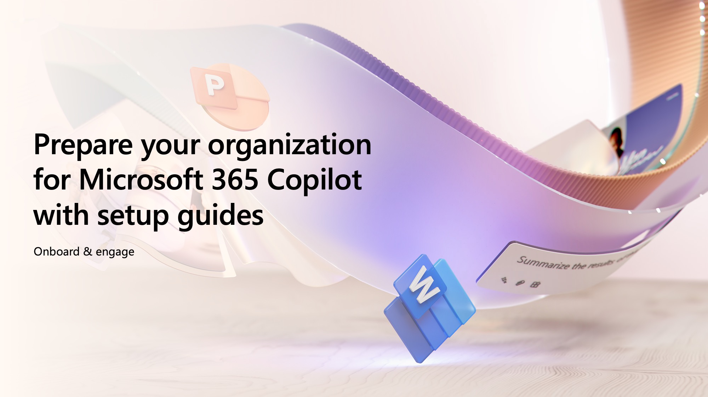
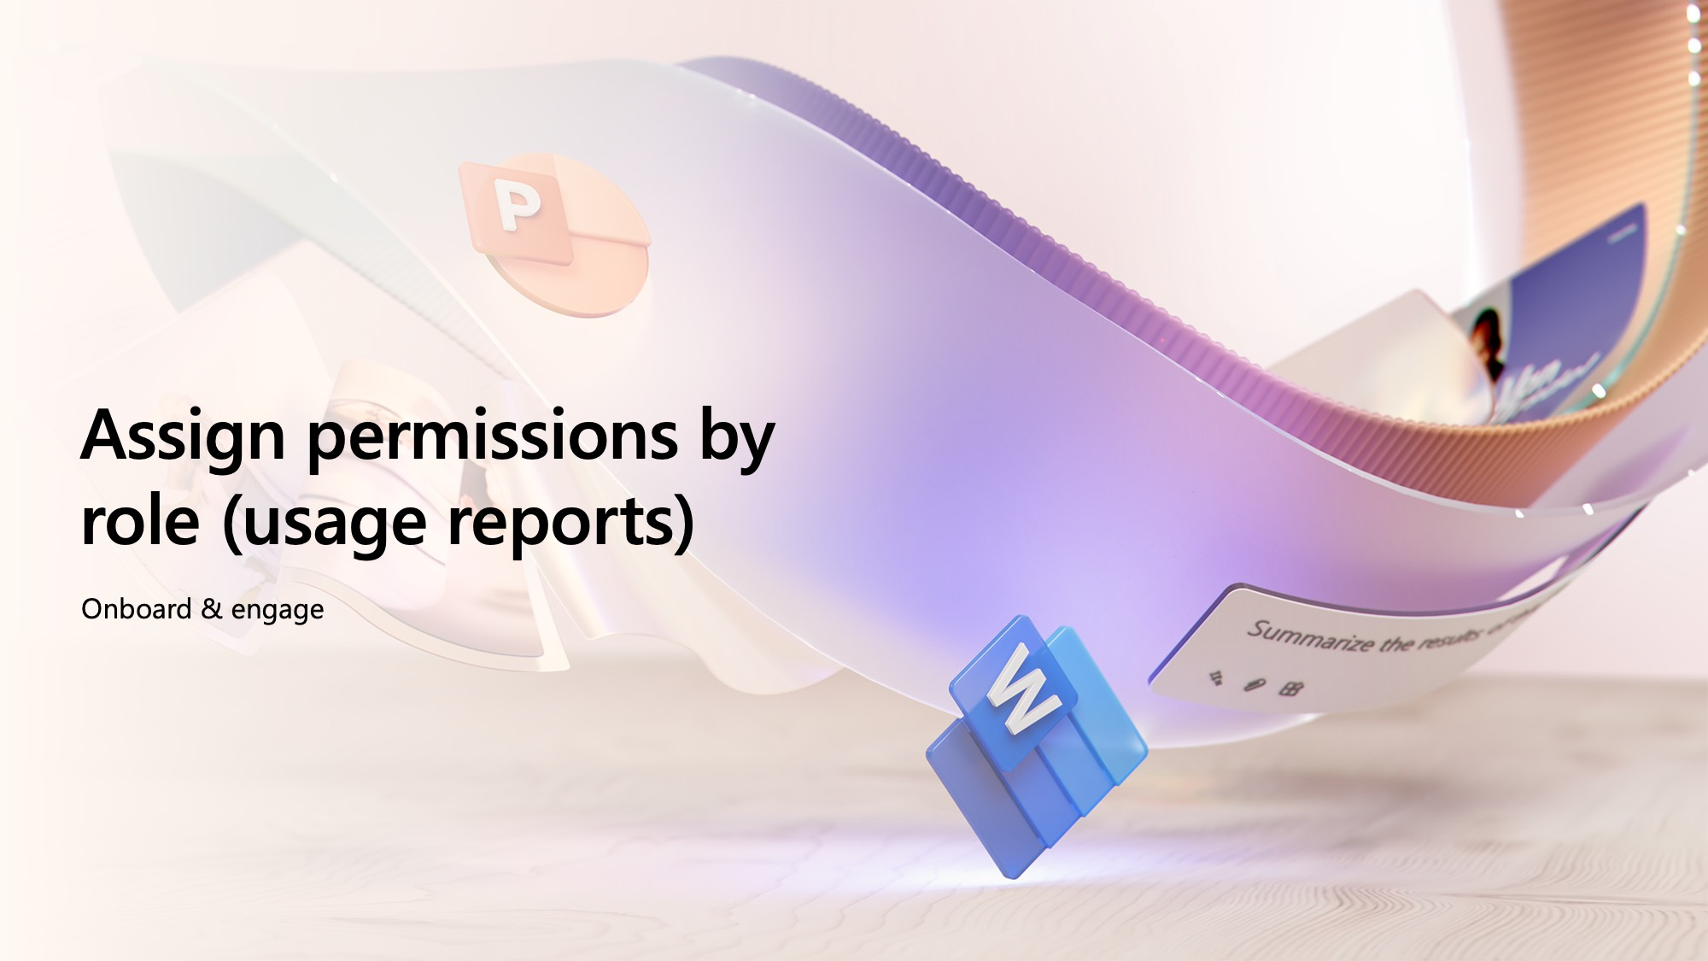
Onboard & engage
Microsoft 365 Copilot

Slide 19
Ensure appropriate Data Security controls are in place
    Onboard & engage

Slide 20



Securing and governing
Microsoft 365 Copilot
Baseline
Core
Best-in-class
Microsoft 365 Copilot
+ Office 365 E3
Microsoft 365 Copilot
+ Microsoft 365 E3
+ SharePoint Advanced Management
Microsoft 365 Copilot
+ Microsoft 365 E5
+ SharePoint Advanced Management
Multi-factor authentication
Audit logging
Conditional Access
Manual sensitivity labels
Data loss prevention policies
Advanced SharePoint sitewide access controls and reporting
Unified endpoint management
Conditional Access based on identity risk
Automatically apply sensitivity labels
Automatically remove inactive content
Prevent data leak on endpoint devices
Detect non-compliant usage

Slide 21
Get started with Microsoft 365 Copilot
Required licenses:
Office 365 E3 or higher
Baseline
  Follow the recommended baseline activities to proceed with Microsoft 365 Copilot deployment.
Product | Deployment outcomes | Get started activities
Microsoft 365 Copilot | Evaluate data governance maturity and data security controls | Complete Microsoft 365 Copilot Optimization Assessment Based on the outcomes of the assessment determine your path forward
 | Deploy Microsoft 365 Copilot | Follow the Microsoft 365 Microsoft Copilot setup guide to proceed with the deployment steps If there are any concerns about your data security, enable Restricted SharePoint Search If enabled, update Restricted SharePoint Search allow list: configure up to 100 sites to be on the allow list of sites. Start with sites containing highly used unrestricted content. FastTrack for Microsoft 365 can help you get started*
Copilot with commercial data protection | Enable commercial data protection in Copilot for all users in your organization | Log into Copilot on copilot.microsoft.com and flip the Work/Web toggle to Web. See if commercial data protection is enabled (look for green Protected pill by the user profile) Review the Copilot with commercial data protection documentation to ensure that commercial data protection is available for your users
*Note: Eligible customers can request technical and deployment assistance from Microsoft FastTrack.

Slide 22
Continue to the Core path as needed
Required licenses:
Office 365 E3, Microsoft 365 Business Standard/Premium, or higher; and SPP-SharePoint Advanced Management
Core
  Follow the recommended activities for the Core path to further optimize data security controls.
Product | Deployment outcomes | Core activities
Microsoft 365 Copilot | If enabled, update Restricted SharePoint Search allow list | Configure up to 100 sites to be on the allow list of sites. Extend to sites containing highly used, low risk content
Microsoft SharePoint* | Evaluate sharing controls that govern who can share and how broadly | At the tenant level: Update sharing link defaults from organization-wide sharing to specific people links. Consider hiding "Everyone Except External Users" in the People Picker control to reduce risks around accidental misuse. Consider educating site admins on the site-level controls they can use to restrict sharing: Set the default sharing link type on specific sites Set sharing link expiration on anyone links Set site owner sharing approval on sensitive sites Ask OneDrive for Business (ODB) owners to run sharing reports in their ODB and correct as needed Ask site owners to manually review SharePoint site permissions and correct as needed
Microsoft SharePoint Advanced Management | Clean up unused sites | Implement Inactive Site Policy in Simulation mode Then Activate to take actions like: Site Owner attestation, make read-only, move to Microsoft 365 Archive
 | Identify sites with potentially overshared content, then take action to control access to that content | Run Data Access Governance (DAG) reports Apply Restricted Access Control on sites based on DAG reports Initiate Site Access Reviews for sites with potentially overshared content
 | Take proactive measures on business-critical sites | Apply Restricted Access Control policy to proactively protect against oversharing Apply a BlockDownloadPolicy on sensitive sites or for Teams Meeting Recordings
Microsoft Purview | Gain visibility into how users are interacting with data in the organization and with Microsoft 365 Copilot | Confirm that Microsoft Purview Audit is enabled, if not enable it
 | Enable citations and protections for sensitive data access by Microsoft 365 Copilot | Manually Label emails and documents with out-of-the-box sensitivity labels using one-click or previously created policies
 | Protect sensitive information from being shared beyond its intended audience and reduce the risk of oversharing | Create and deploy Data Loss Prevention (DLP) policies for SharePoint, Exchange, and OneDrive for Business
 | Retain the data you need to keep and remove data that no longer has business value to reduce data surface for oversharing | Create and Configure retention policies to archive or delete content exceeding data retention guidelines or maximum retention date
 | Gain additional understanding of content used and shared in Copilot interactions | Use Microsoft Purview eDiscovery Content search to find email in search for in email, documents, and instant messaging conversations
*Note: Customers using Microsoft 365 Business Standard/Premium may choose to evaluate their environment with manual controls in lieu of implementing SharePoint Advanced Management capabilities

Slide 23
Continue to the Best-in-Class path as needed
Best-in-class
Required licenses:
Microsoft 365 E5; and SPP-SharePoint Advanced Management
  Follow the recommended activities for the Best-in-Class path to achieve top-tier security posture.
Product | Deployment outcomes | Best-in-Class activities
Microsoft 365 Copilot | If enabled, update Restricted SharePoint Search allow list | Configure up to 100 sites to be on the allow list of sites. Extend to sites containing restricted content, after validating permissions are set correctly
 | Disable Restricted SharePoint Search to allow full Copilot experience | Once all the data security concerns are addressed, disable Restricted SharePoint Search
Microsoft SharePoint Advanced Management | Perform periodic reviews of oversharing reports, initiating Site Access Reviews and restricting access as appropriate | Run DAG reports on a periodic basis. Apply RAC policies and initiate Site Access Reviews for sites that contain potentially overshared content.
 | Perform periodic reviews of inactive sites, and take action | Apply inactive sites policy with optional actions configured.
 | Perform periodic reviews of Change History reports to discover when oversharing occurs | Run the change history report and investigate changes to sharing in sites.
Microsoft Purview | Apply a baseline protection to documents and containers (Microsoft 365 Groups, Microsoft Teams Sites) without the need for content inspection or manual labeling | Set a default sensitivity label on SharePoint Online document libraries to protect documents without content inspection Use Sensitivity labels to protect content in Teams, Groups and SharePoint sites
 | Dynamically protect sensitive information from being shared beyond its intended audience and reduce the risk of oversharing on across instant messages and user endpoints. | Create, deploy, and regularly evaluate Teams DLP Policies Create, deploy, and regularly evaluate Endpoint DLP Policies Create Adaptative Protection policies to automatically assign DLP policies based on the users identified risk level
 | Automatically protect sensitive data access by Microsoft 365 Copilot for based on recommended conditions. | Automatically apply sensitivity labels to content in SharePoint, OneDrive, and Exchange Automatically apply sensitivity labels to content within Office apps
 | Automatically retain or dispose of documents based on their content | Automatically apply retention labels to content that match specific conditions
 | Detect sensitive data and non-compliant content in Copilot interactions | Create Communication Compliance policies to regularly evaluate interactions with Microsoft 365 Copilot
 | Preserve, collect, review, analyze, and export Copilot interactions | Use eDiscovery Premium to search for and optionally delete Copilot interactions

Slide 24




Apply appropriate controls to address oversharing
  Get started quickly and continue to optimize along the way
  Pilot (Optional)
  Deploy
  Operate
Identify most popular sites & assess oversharing
Grant Copilot access to popular, low risk sites
Turn on proactive audit and protection
Discover oversharing risks
Restrict sensitive info from Copilot access and/or processing
Increase site privacy
Further reduce risk and simplify oversight
Further secure sensitive data
Improve Copilot responses
Activities
Outcomes
Deploy copilot to sub-set of users with up to 100 sites
Copilot fully deployed in your organization
Continuous improvement of data security practices
Effort*
2–4 days
2–4 weeks
More than one month
*Suggested efforts should be reviewed into timelines based on your tenant size and organizational complexity
Last updated December 10, 2024

Slide 25
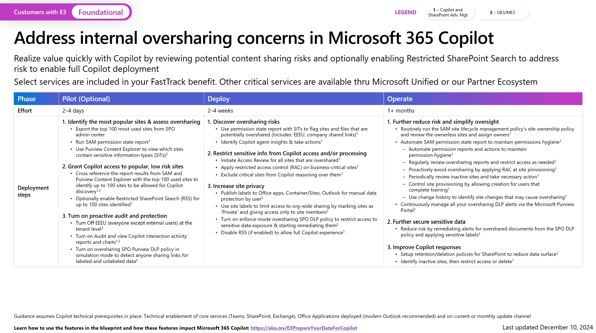
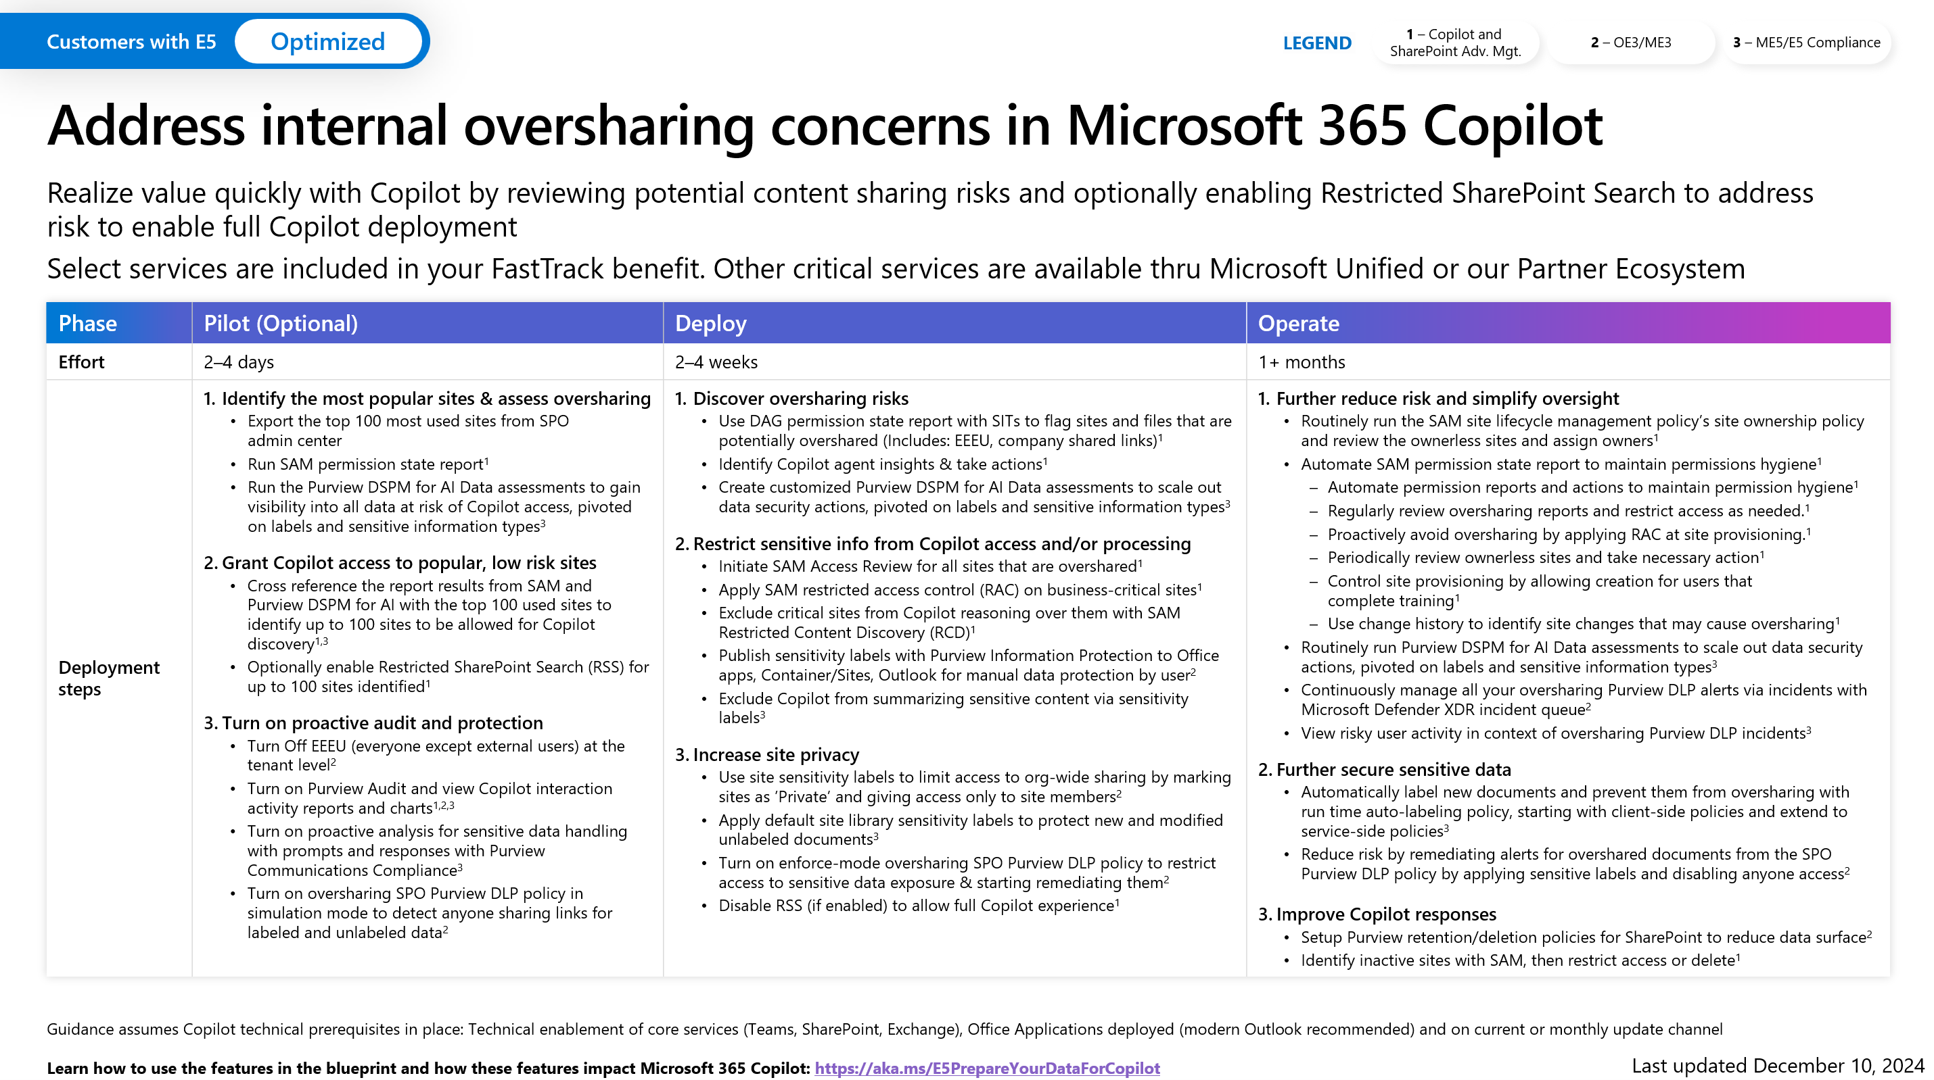
Microsoft deployment blueprint to implement internal oversharing protections for Microsoft 365 Copilot
Get the blueprint:
https://aka.ms/Copilot/OversharingBlueprintLearn
Notes:
Blueprint designed for E3 and E5
Contains details on all the steps covered by these slides.
Get it today.

Slide 26



Options to secure and govern Microsoft 365 Copilot
Foundational
Optimized
Microsoft 365 Copilot* + Microsoft 365 E3
Microsoft 365 Copilot*+ Microsoft 365 E5
Everything in foundational, plus:
Foundational security through site governance tools to discover, manage, and restrict site access, and streamline site lifecycle management
Microsoft Purview
Advanced protections, including automations, real-time alerts, and endpoint protection
Microsoft Purview
Foundational data security, data compliance, and data governance capabilities that provide layered protections for Microsoft 365 Copilot
*with SharePoint Advanced Management

Slide 27

Apply appropriate Data Security controls
  Get started quickly and continue to optimize along the way
Core
Restrict data oversharing and data leaks with manual labeling and policies
Get started
1
2a
3
Required licenses:
Office 365 E3, Microsoft 365 Business Standard/Premium, or higher; and
SPP-SharePoint Advanced Management
5
Microsoft 365 Copilot
Optimization Assessment
Ready to deploy?
Yes
If used,
disable Restricted
SharePoint Search
4
Deploy Microsoft 365 Copilot
Optimize further as needed
Determine path
(26 questions; 30 minutes)
NO
Best-In-Class
Prevent data oversharing, data leaks, and detect non-compliant usage at scale with auto labeling and policies
2b
Enable
Restricted SharePoint Search*
Required licenses:
Microsoft 365 E5; and
SPP-SharePoint Advanced Management
*Restricted SharePoint Search will limit Microsoft 365 Copilot experiences and organization-wide search. It is a temporary option which gives you time to address oversharing concerns while getting started on your Copilot journey.

Slide 28
Restricted SharePoint Search
This is intended as a temporary solution to give you time to review and audit site permissions, while implementing robust data security solutions from Microsoft Purview and content management with SharePoint Advanced Management.
  IMPACT
  Restricted SharePoint Search disables organization-wide search, while allowing you to select sites that you trust. This means users in your organization can use Copilot to reason over:
  An allowed list of curated SharePoint sites set up by admins (up to 100 SharePoint sites), honoring existing permissions on a site
  Users’ OneDrive for Business, chats they are part of, emails they send and receive, calendars to which they have access, etc.
  Files that are shared with, and accessed by users
  Content from users’ frequently visited sites
  Turning on Restricted SharePoint Search does not affect the site’s index or associated DLP and labeling policies.
  Access this blog for more info.
  Restricted SharePoint Search is designed for organizations particularly concerned about unintentional oversharing of content
  When enabled, Copilot experiences and organization-wide search are limited to a select set of SharePoint sites, as well as the individual user’s files and content
  PREREQUISITES
  Available to tenants with Microsoft 365 Copilot subscriptions
  Activation requires Global/Tenant/SharePoint admin rights

Slide 29
Prepare your organization for Microsoft 365 Copilot with setup guides
Onboard & engage

Slide 30
Readout to the shared team
Shared activity
Deliver a readout on the prioritized activities for data security controls based on the selected deployment path
Validate user cohorts prior to assignment of licenses

Slide 31
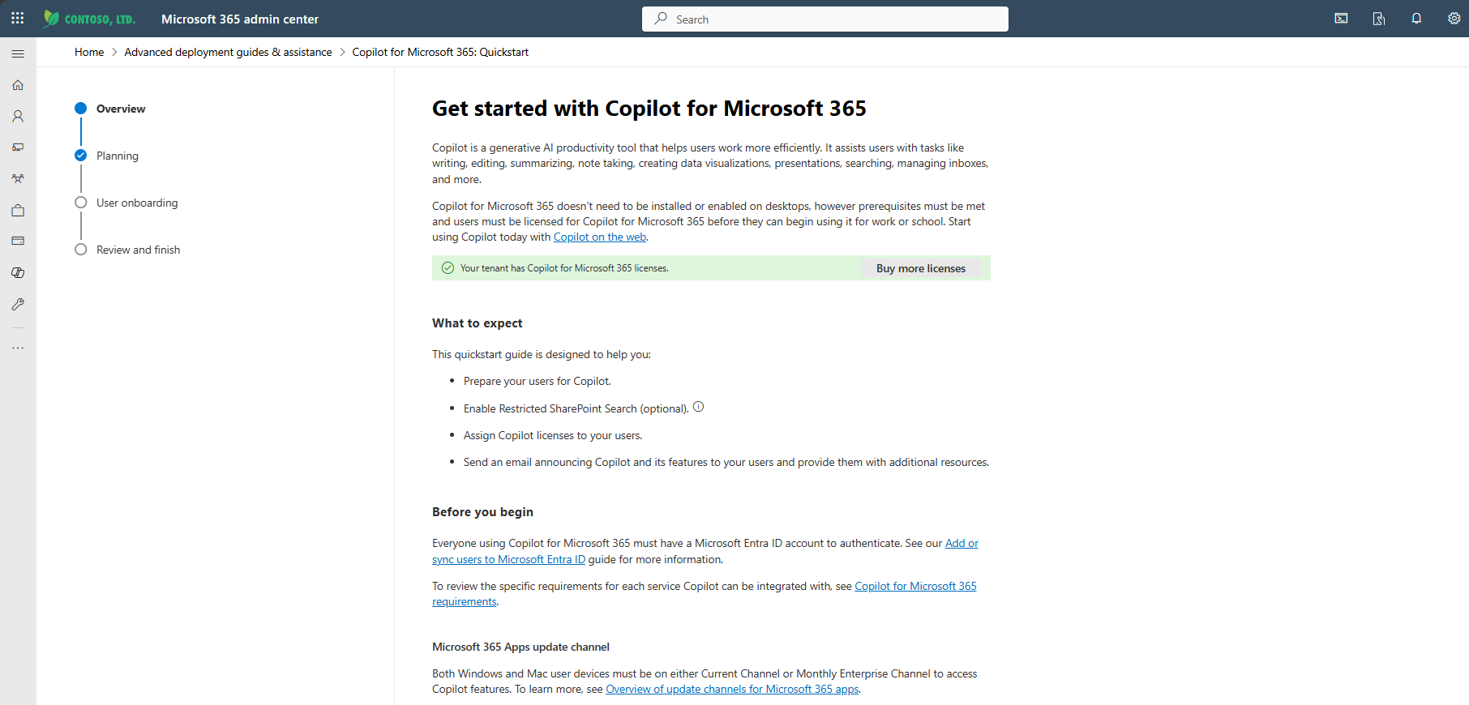
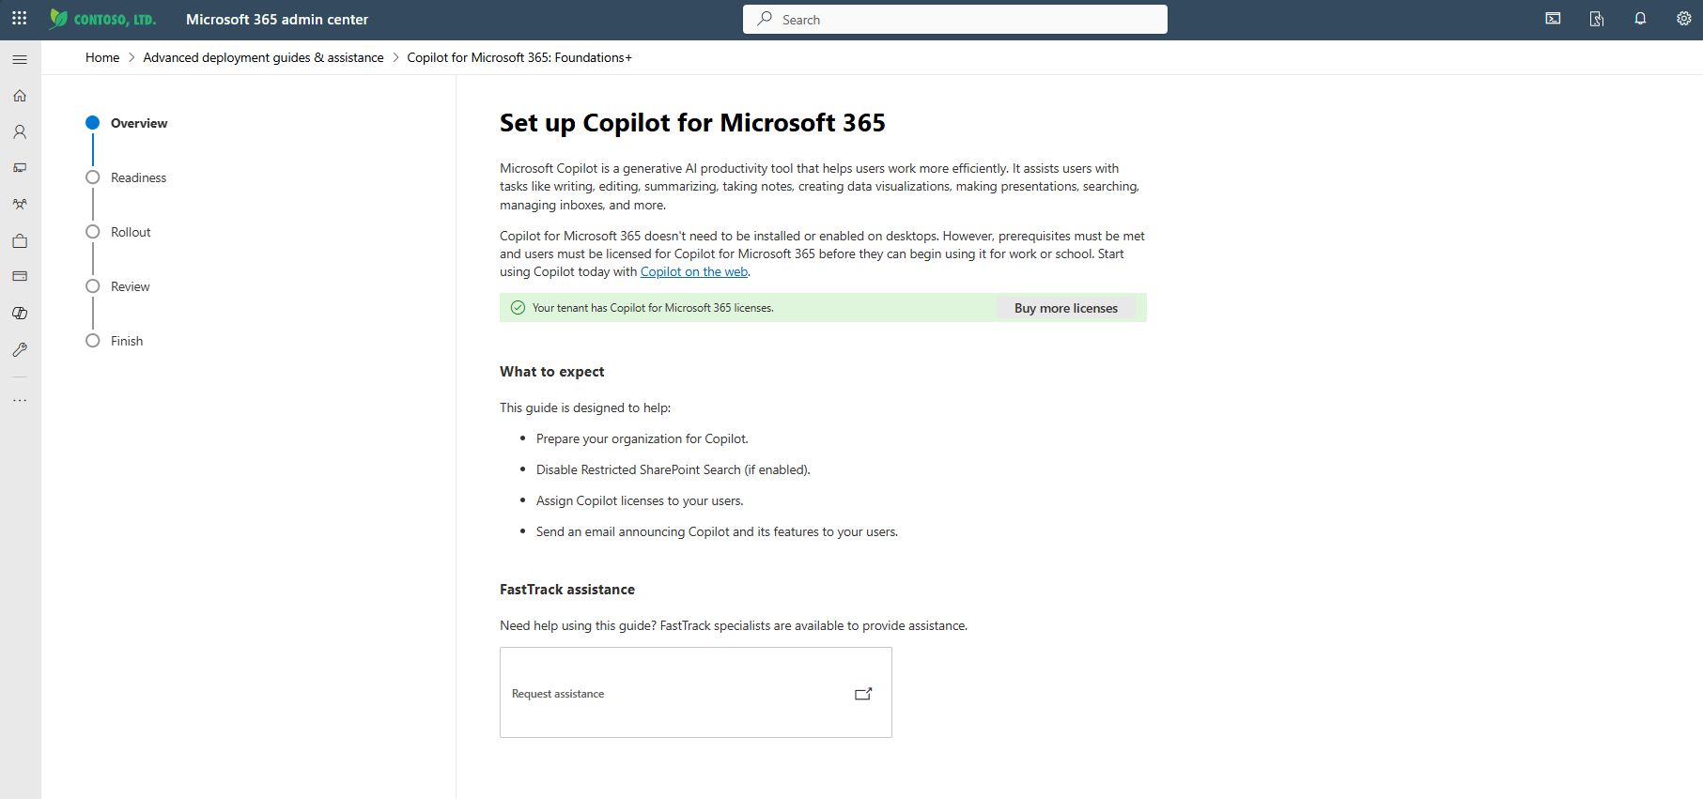
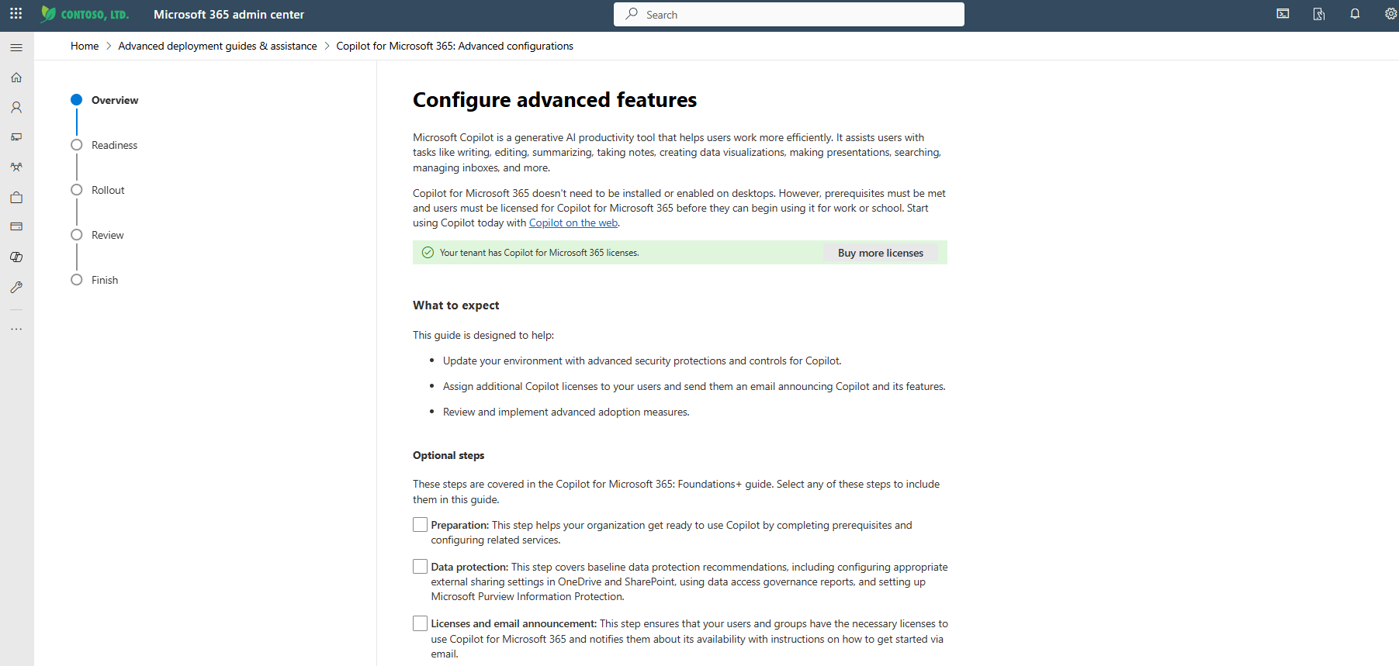
Onboard & engage: Setup guides
  Set up Microsoft 365 Copilot
Quick start – this guide helps you accelerate Microsoft 365 Copilot for onboarding, with step-by-step guidance to fulfill the core requirements for Microsoft 365 Copilot. New features include Restricted SharePoint Search (RSS).
Foundations+ – this guide is the next step in your customer’s Copilot onboarding process and includes core recommendations to support Copilot readiness and full-scale adoption.
Advanced Configurations – advanced configurations provide best in class security, privacy, and data protection recommendations for Microsoft 365 E5.
‌These guides may be completed individually or in sequence, so administrators can choose the path that best suits their organization’s needs.

Slide 32
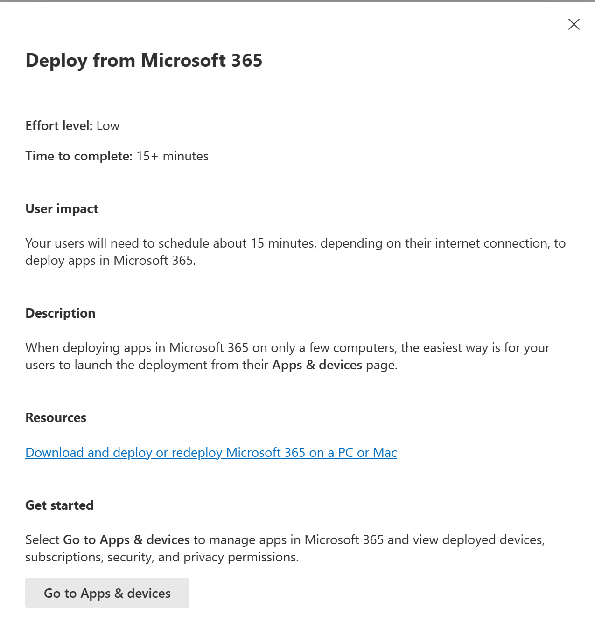
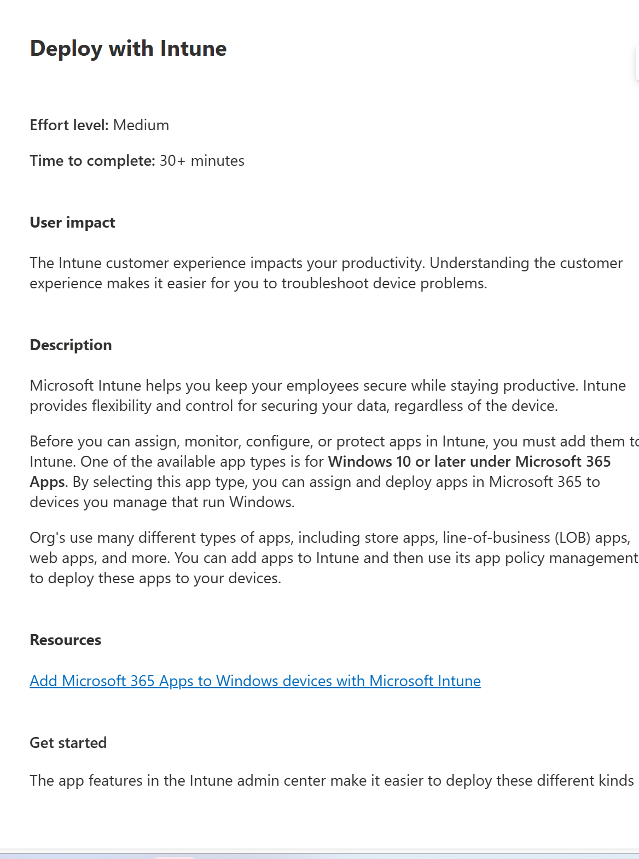
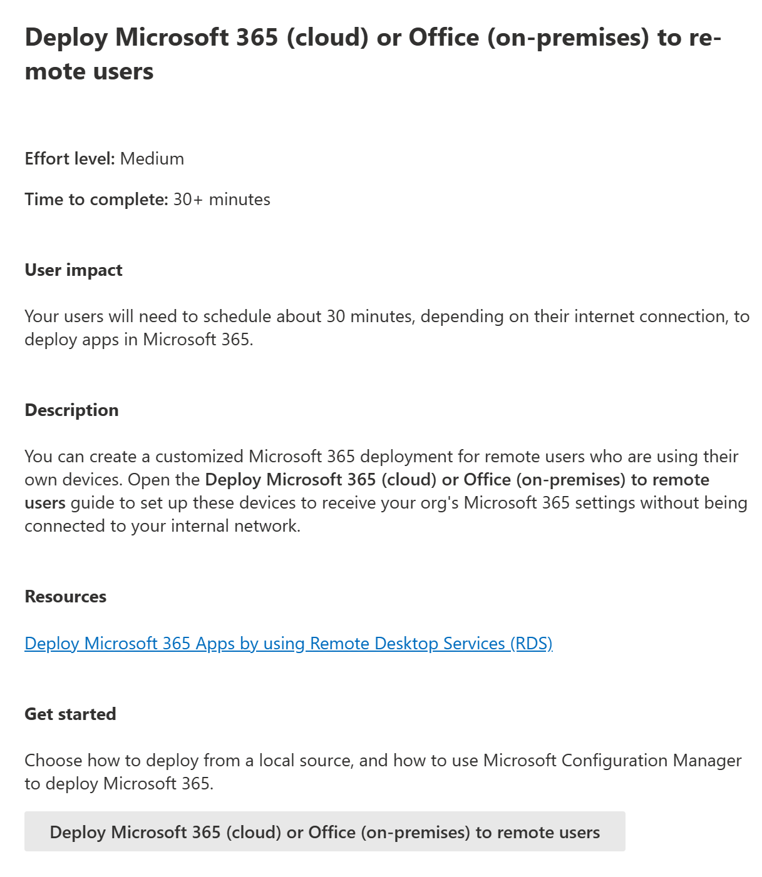
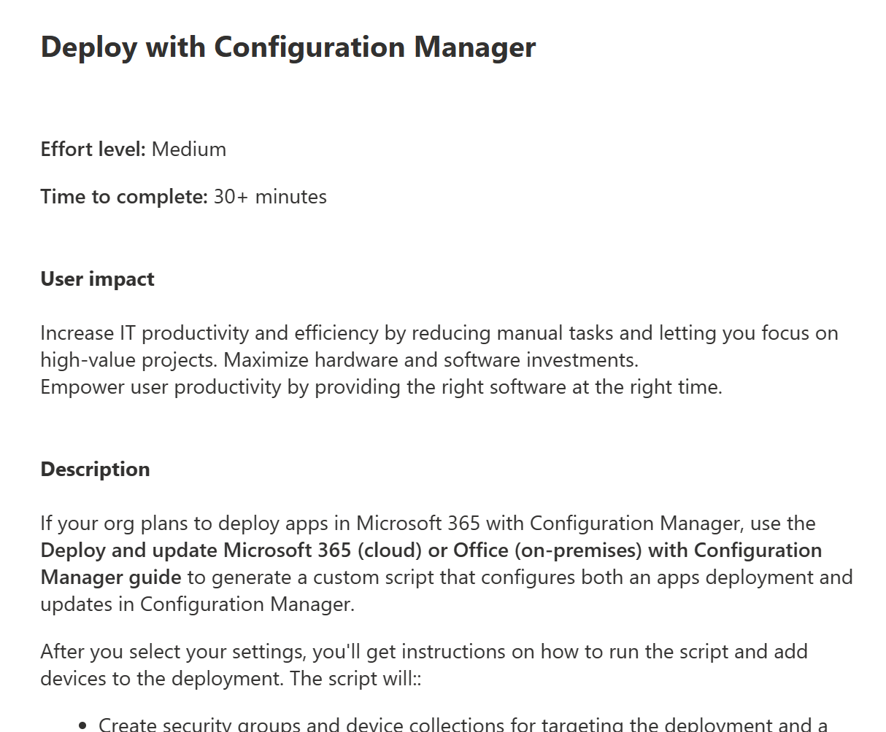
Onboard & engage: Deploy apps/configure channel
  Deploy Microsoft 365 apps to Business Users
  Deploy required apps
  To seamlessly integrate with Microsoft 365 Copilot, you are required to deploy the following applications for your users:
  Word, Excel, PowerPoint, new Outlook for Windows
  Microsoft Teams, OneDrive, SharePoint, Exchange
  Configure Channel
  To use Microsoft 365 Copilot, Microsoft 365 apps must run on Current Channel or Monthly Enterprise Channel. Follow this guidance to configure the default update channel. Support options are available to help you make the most of Microsoft 365 Copilot*!
  Develop a list of users who will receive apps
  Map the users to the apps
  Deploy apps using the built-in tool in admin center or customer’s preferred method. For additional information, watch these videos on how to deploy Microsoft 365 apps
  For more information on the implementation process, please see Deployment guide for Microsoft 365 apps
*Note: Engage your Microsoft Account Technical Specialist (ATS) or Customer Success Account Manager (CSAM) to discuss the support options available to you.

Slide 33



Microsoft 365 Apps: Leverage App Assure if you encounter in application compatibility issue moving to a monthly update channel!
Microsoft 365 Copilot application compatibility promise
Microsoft is committed to ensuring your apps work when moving to Monthly Enterprise Channel to take advantage of Microsoft 365 Copilot. If you encounter any issues, App Assure will help you remediate them!
Help customers troubleshoot root cause and resolve app compatibility issues
Included as part of your license, this service is at no additional cost
Customers get a direct line of communication to Microsoft product engineering teams
Questions? Email: achelp@microsoft.com | Submit a Request for Assistance | For more information visit aka.ms/AppAssure

Slide 34
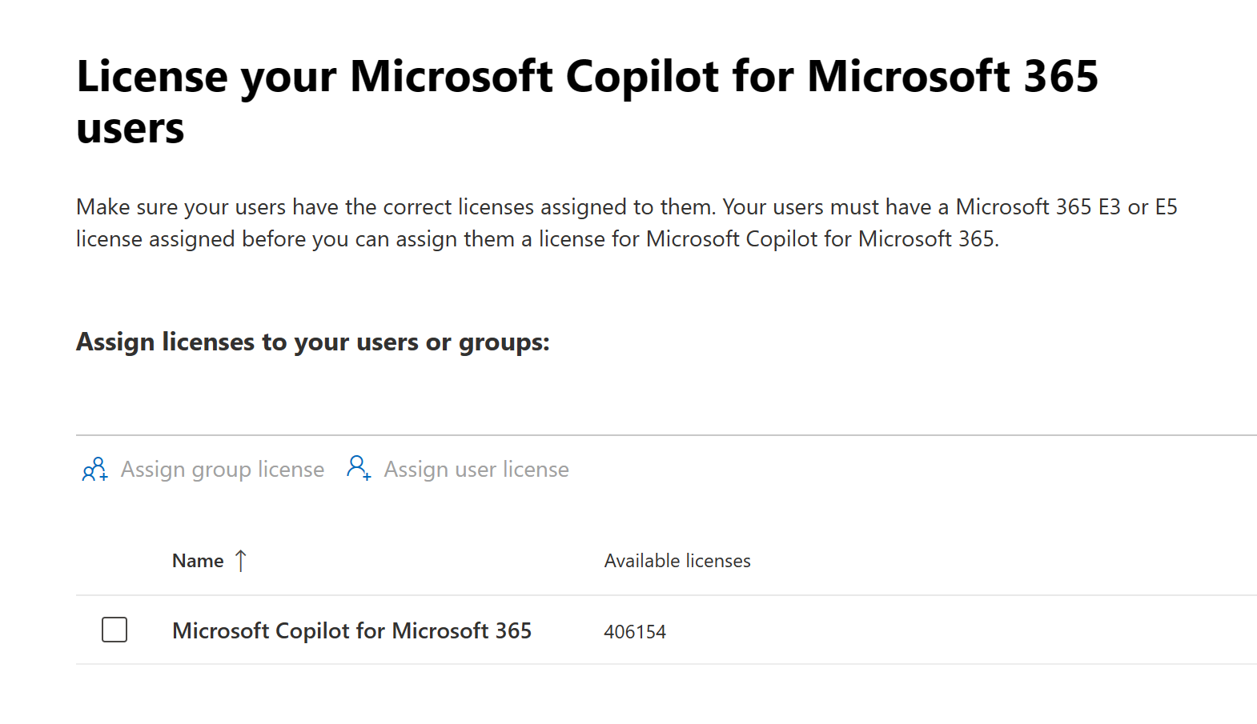
Onboard & engage: Assign licenses
  License your Business Users
  Assign licenses
  Based on the results of the Optimization Assessment and scenario discovery, the appropriate licenses need to be assigned to the select set of end users.
  Based on the adoption plan, develop a list of users who will
  receive the licenses first. A few data points to keep in mind:
  Analyze departments with the highest Microsoft 365 usage data, and based on that analysis start enabling entire teams within Marketing, Sales, or HR
  Use the Scenario Library to identify top use cases and the key metrics you would like to improve in your functional area
  Use the setup guide to assign required licenses to users or customer’s preferred method. You can assign and unassign licenses for users on the Licenses page under the Active users page.

Slide 35
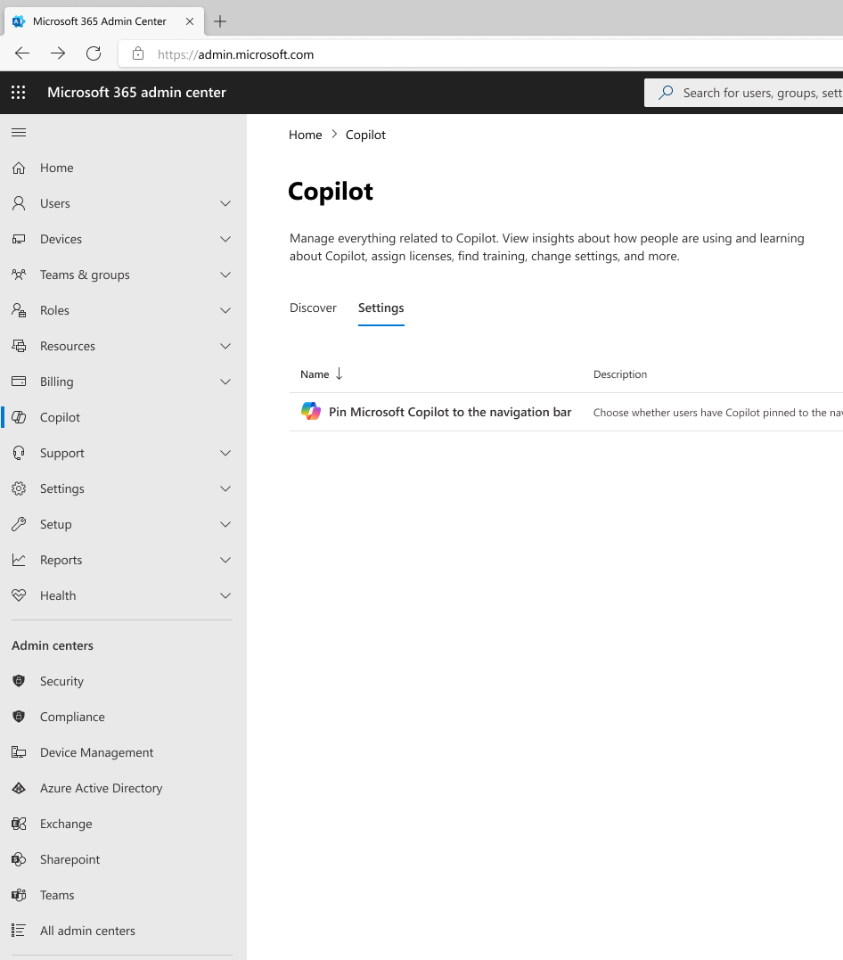
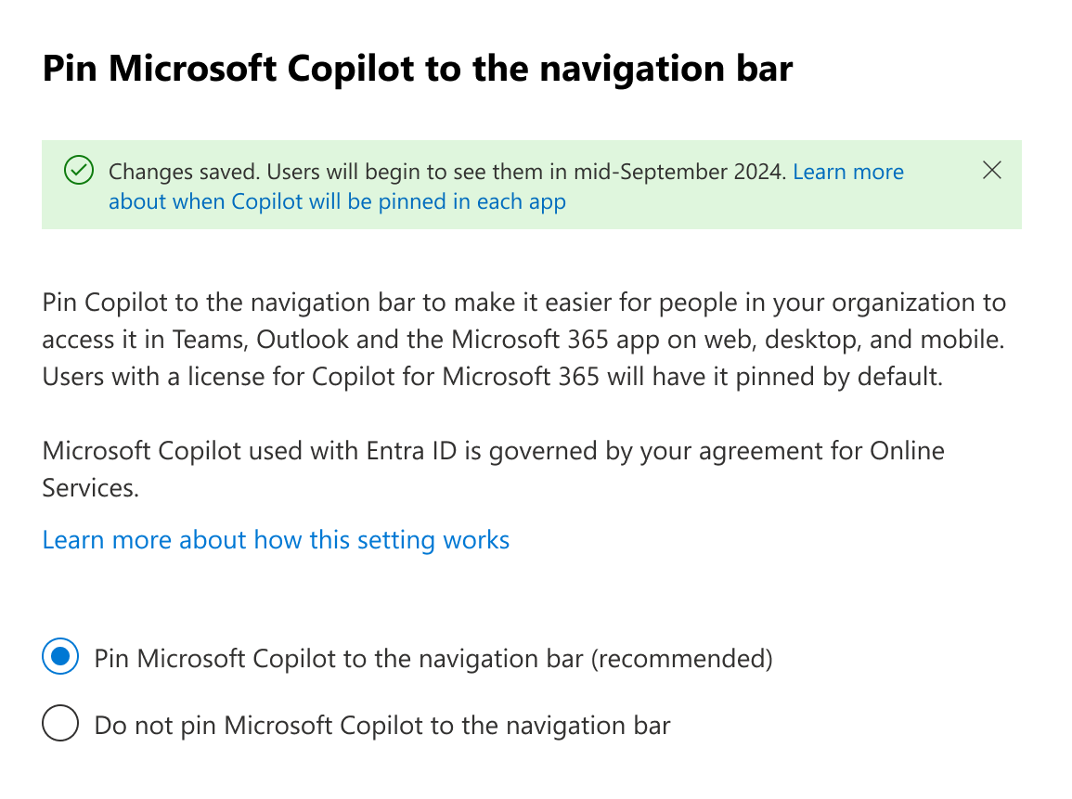
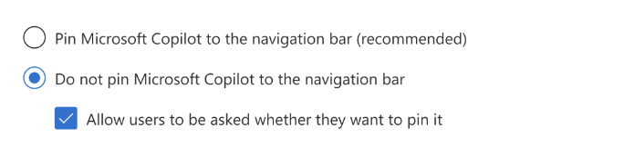
Pinning Microsoft Copilot
Encourage your organization to use Copilot by pinning it to the navigation bar of the Microsoft 365 apps.
By default, Copilot is not pinned to the navigation bar. Users will be asked if they want to pin Copilot.
Administrators can change this behavior by selecting an option for pinning Microsoft Copilot to the navigation bar:
Learn more about pinning Copilot

Slide 36
Assign permissions by role (usage reports)
Onboard & engage

Slide 37
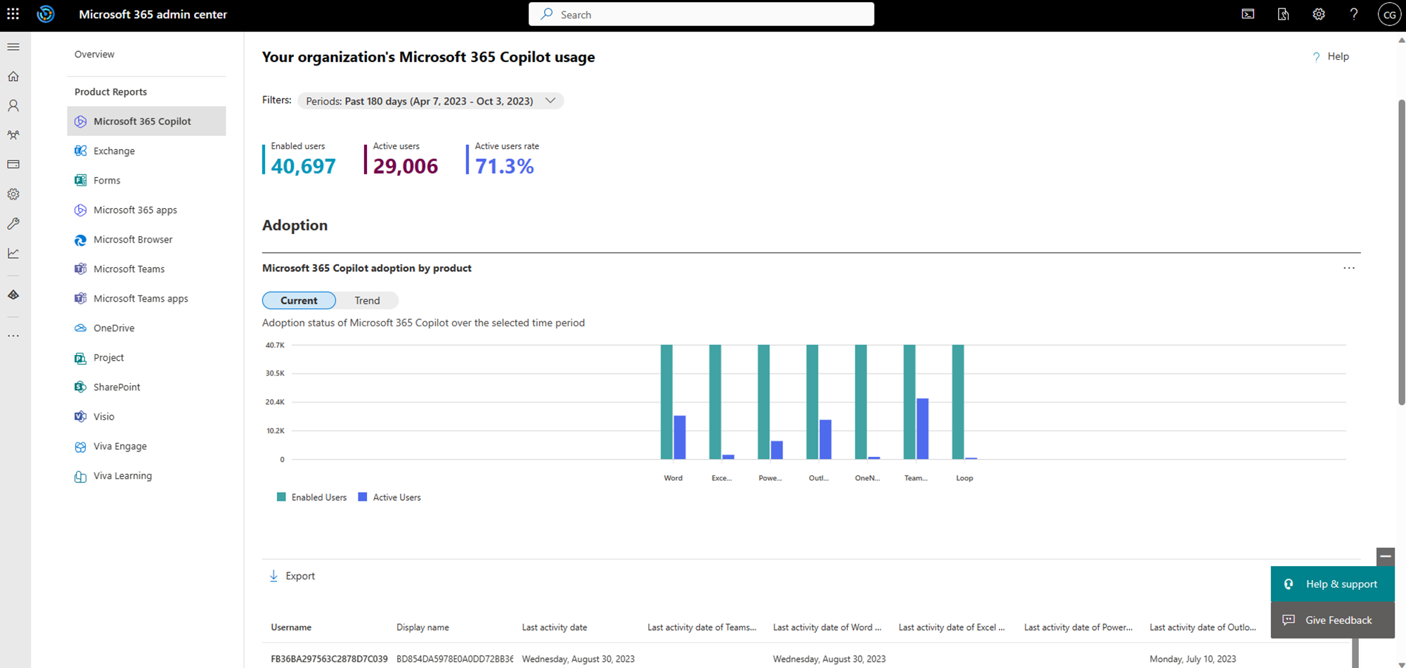
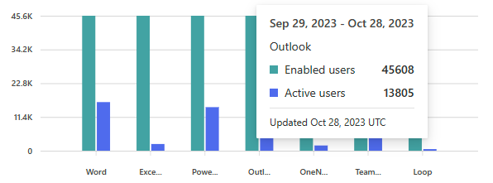
Onboard & engage: Assign permissions by role
  Assign usage report permissions
  The Microsoft Copilot 365 usage report allows you to interpret how ready your organization is to adopt Microsoft 365 Copilot.
  The following roles can see the report: Global admins, Exchange admins, SharePoint admins, Reports reader, Teams admins, User Experience Success Manager. For more details, read our documentation here.
  Develop a list of users who will have permissions to read the Microsoft 365 Copilot usage report
  Assign permissions to the identified users

Slide 38
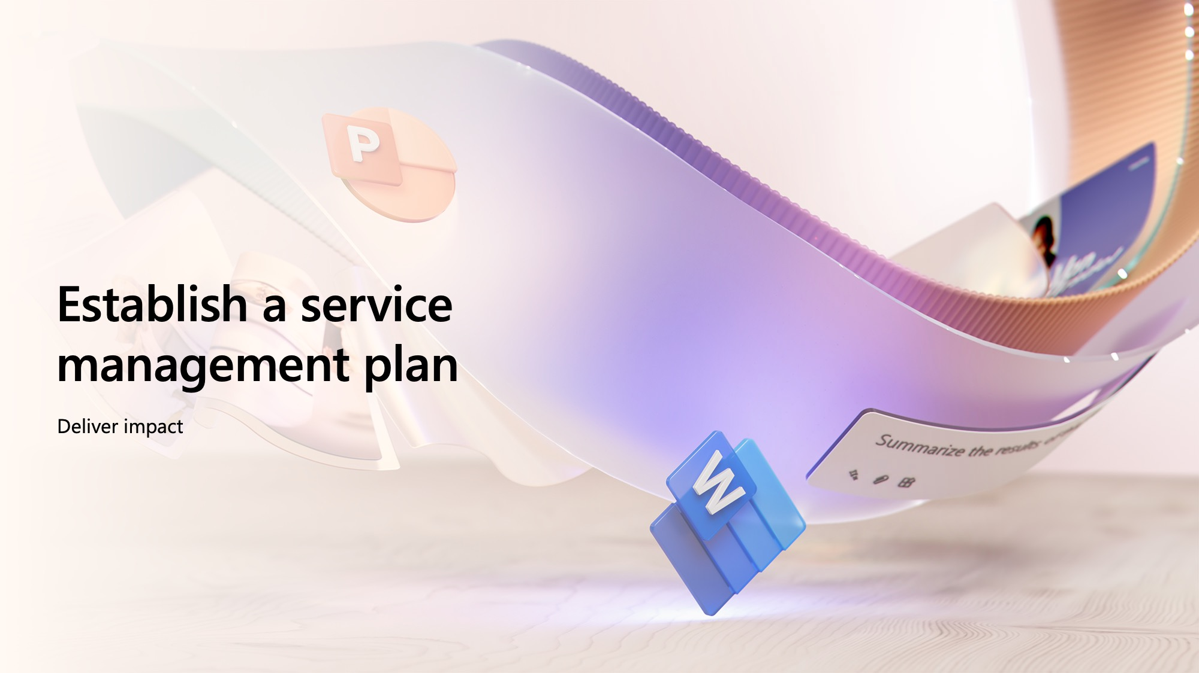
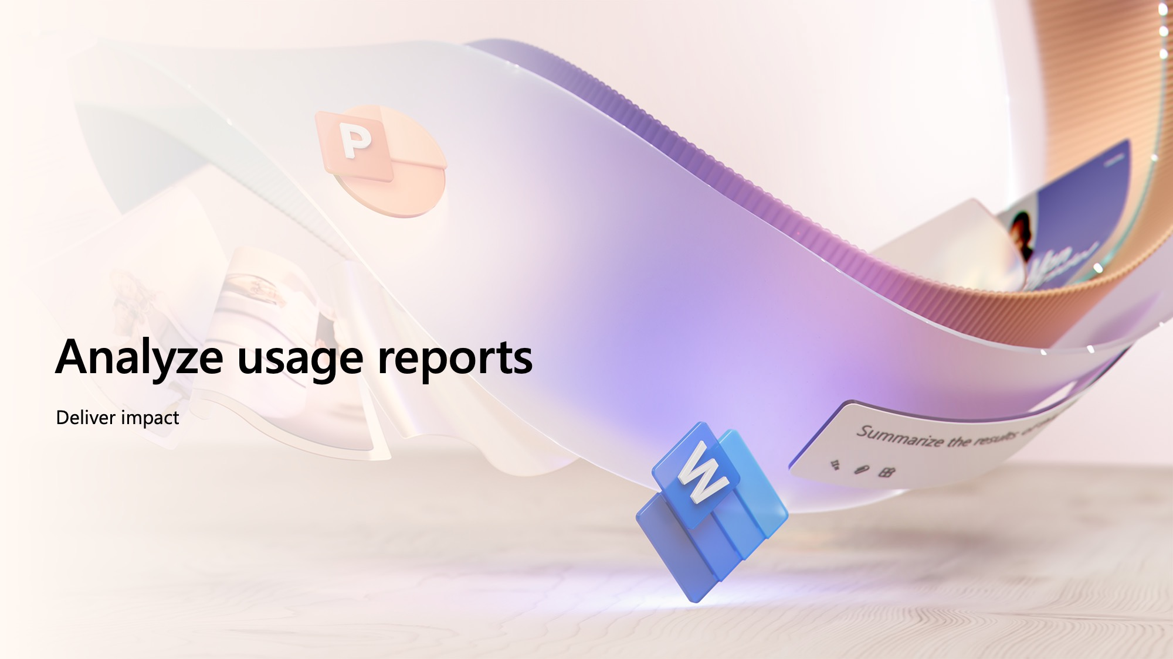
Deliver impact
Microsoft 365 Copilot

Slide 39
Establish a service management plan
Deliver impact

Slide 40
Deliver impact: Establish service management plan
  Establish forum for continuous service improvement
Performance
Establishing a service management plan empowers
IT and User Enablement teams to:
Periodically review health and business value of the AI transformation journey
Conduct periodic assessments of governance, security, and user enablement practices
Identify opportunities for expansion and further optimization of key Microsoft 365 Copilot user experiences
Risk mitigation
Feedback analysis
Service Health Reviews components
Roadmap planning
Incident review
  Access the admin documentation for the latest technical
  requirements, policies and reporting
  Join the Copilot community to connect with experts and community members
  Participate in Copilot Ask Microsoft Anything events
Success stories

Slide 41
Shared deliverable: Service Health Reviews
Shared activity
Performance
Feedback
analysis
A Service Health Review (SHR) is a systematic process of evaluating the current state and future needs of IT services in an organization.
The purpose of an SHR is to identify the strengths and weaknesses of IT services (in this case Copilot implementation), as well as the opportunities and threats that may affect their delivery and value.
An SHR provides recommendations for improving IT service management, governance, user enablement, and alignment with business goals.
SHRs foster a transparent and collaborative partnership between business leaders, user enablement specialists, and IT professionals.
Recommended practices include:
SHR Chair is the Copilot Success Owner
Conducted monthly, moving to quarterly, once onboarding cohorts are complete
Includes service feedback and top issues from User Enablement staff
Core focus on data-driven fact finding, scenario identification, learning,
and improvement in a blame-free environment
SHRs are opportunities for leadership skill building
SHRs provide data for AI Council review
Incident
review
Success
stories
Roadmap planning
Risk
mitigation

Slide 42
Analyze usage reports
Deliver impact

Slide 43

Deliver impact: Access usage reports
Shared activity
  Interpret the Microsoft 365 Admin Center Usage Report
  The Microsoft 365 Copilot usage report includes two sections: Readiness and Usage.
  In the Readiness section, you can review technical eligibility, license assignment, and users who are in a strong position to get value from Microsoft 365 Copilot.
  In the Usage section, you can view a summary of Microsoft 365 Copilot adoption with visibility into users’ last Microsoft 365 Copilot activity.
  Interpret the Readiness section by analyzing assigned and
  available Copilot licenses, how many users are technically eligible,
  and how many are in a strong position to get value from Microsoft 365 Copilot.
  If needed, you can export the report data into an Excel .csv file by selecting the Export link. This exports the Microsoft 365 Copilot last activity data of all users and enables your identified report readers to do simple sorting, filtering, and searching for further analysis.

Slide 44
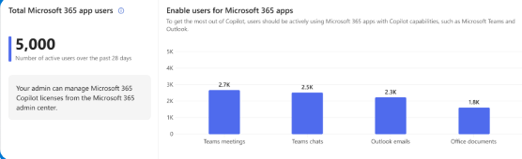
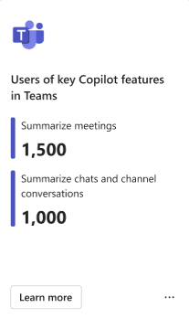
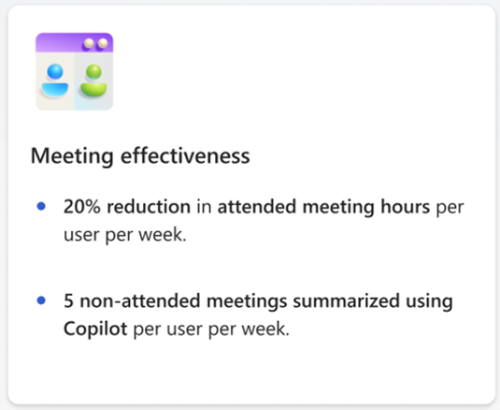
Deliver impact: Analyze usage reports
Shared activity
  Interpret the Microsoft Copilot Dashboard data
  In the Readiness tab, you assess your organization’s overall readiness for Copilot rollout based on technical eligibility requirements and overall Microsoft 365 app usage.
  In the Adoption tab, you track user adoption trends per Microsoft 365 app and understand how employees are using Copilot features.
  In the Impact tab, you gain visibility into total Copilot assisted hours, time savings and behavioral changes between active Copilot users and non-Copilot users.
  The Learning tab provides information research around the impacts of AI on workplace productivity.
Readiness
  Instruct users to access the Copilot Dashboard in Teams or web app
  to analyze the tabs
  Analyze Readiness, Adoption, and Impact tabs
  Follow the instructions on the Impact tab under Sentiment section to deliver a survey to users
  Upload the survey results through the Microsoft 365 admin center to have them displayed in the Microsoft Copilot Dashboard
  Analyze insights on how users feel about the AI assistance they receive from Copilot
Adoption
Impact

Slide 45
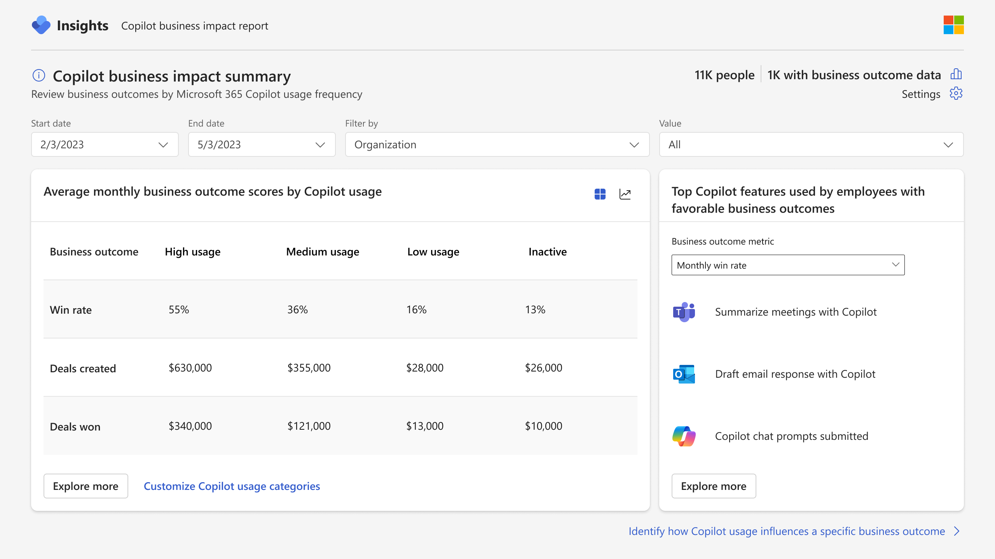
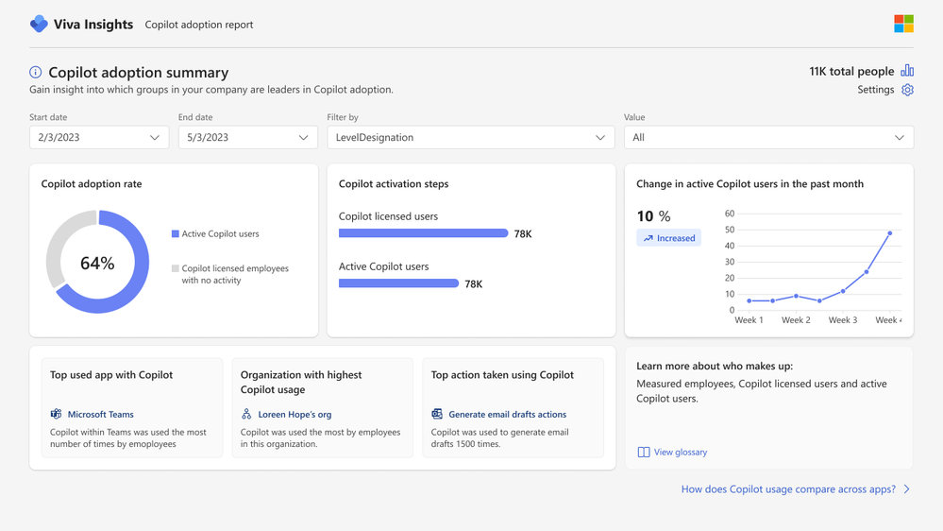
Viva Insights advanced impact reports
  Included with Microsoft 365 Copilot
  Copilot business impact reports
Measure the value of Microsoft 365 Copilot with your key business metrics.
  Advanced adoption and impact reports
Get a deeper look into Microsoft 365 Copilot adoption and impact trends with a customizable, prebuilt report.
Notes:
Viva Insights now comes included with your Microsoft 365 Copilot license.
Business impact reports:
Understand how Copilot usage relates to business outcomes in a Power BI report template
Customize your analysis for any function with your KPIs from your business data
Identify best practices based on what Copilot activities lead to successful business outcomes
Pinpoint opportunities to improve low Copilot usage to improve adoption and impact
Advanced Microsoft 365 Copilot adoption report:
Understand how Copilot usage is trending across groups, apps and more.
Includes a dynamic date slicer, advanced filters and groups, trendlines, ability to customize active usage definitions and highlight section that calls out top Copilot actions.
Pull usage data older than 28 days with dynamic time ranges.
Advanced Microsoft 365 Copilot impact report:
Tailor your Copilot impact report with advanced capabilities to get a deeper look into impact areas.
Compare collaboration patterns across groups or before and after Copilot usage.
Includes dynamic date slicer, Copilot assisted hours and value calculator, group comparisons, and the ability to customize active usage definitions.
Pull usage data older than 28 days with dynamic time ranges.

Slide 46
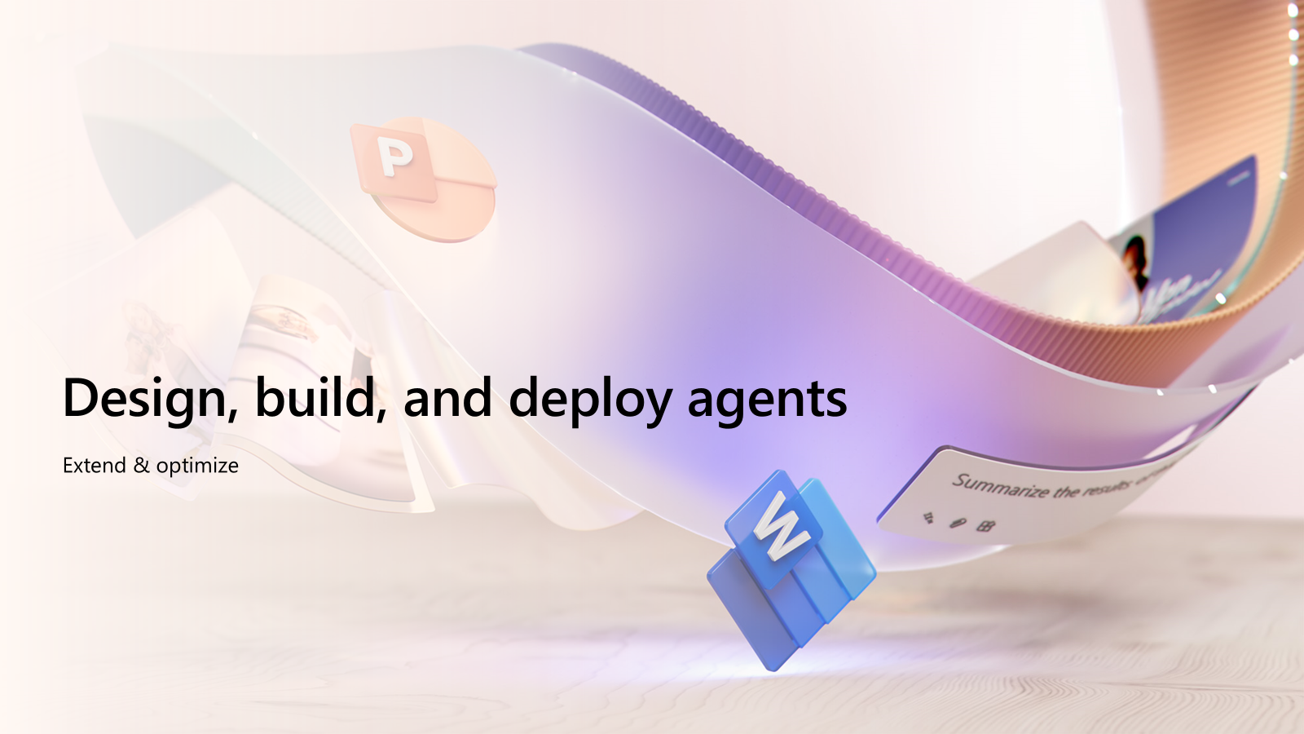
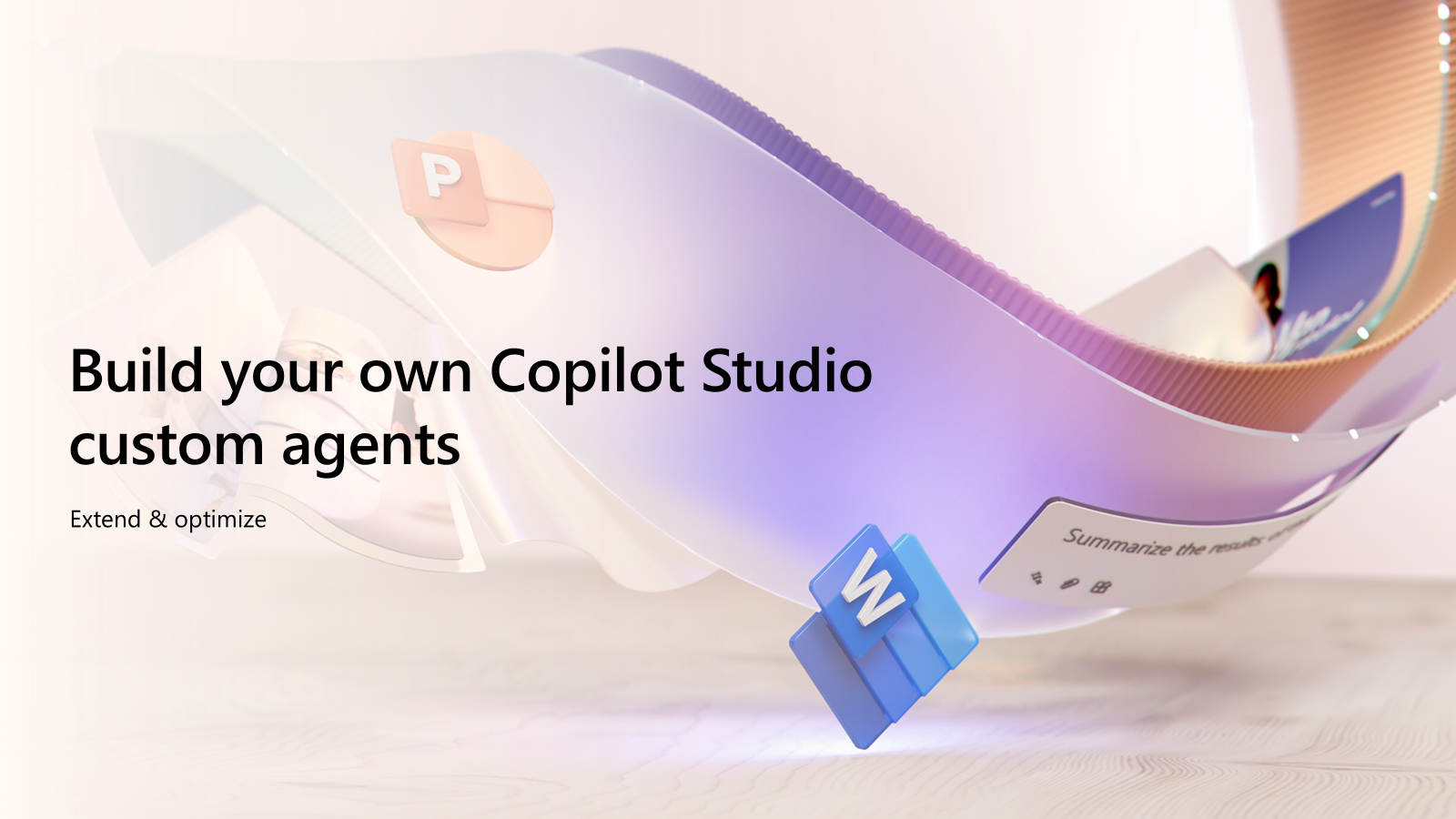
Extend & optimize
Microsoft 365 Copilot

Slide 47
Design, build, and deploy agents
Extend & optimize

Slide 48
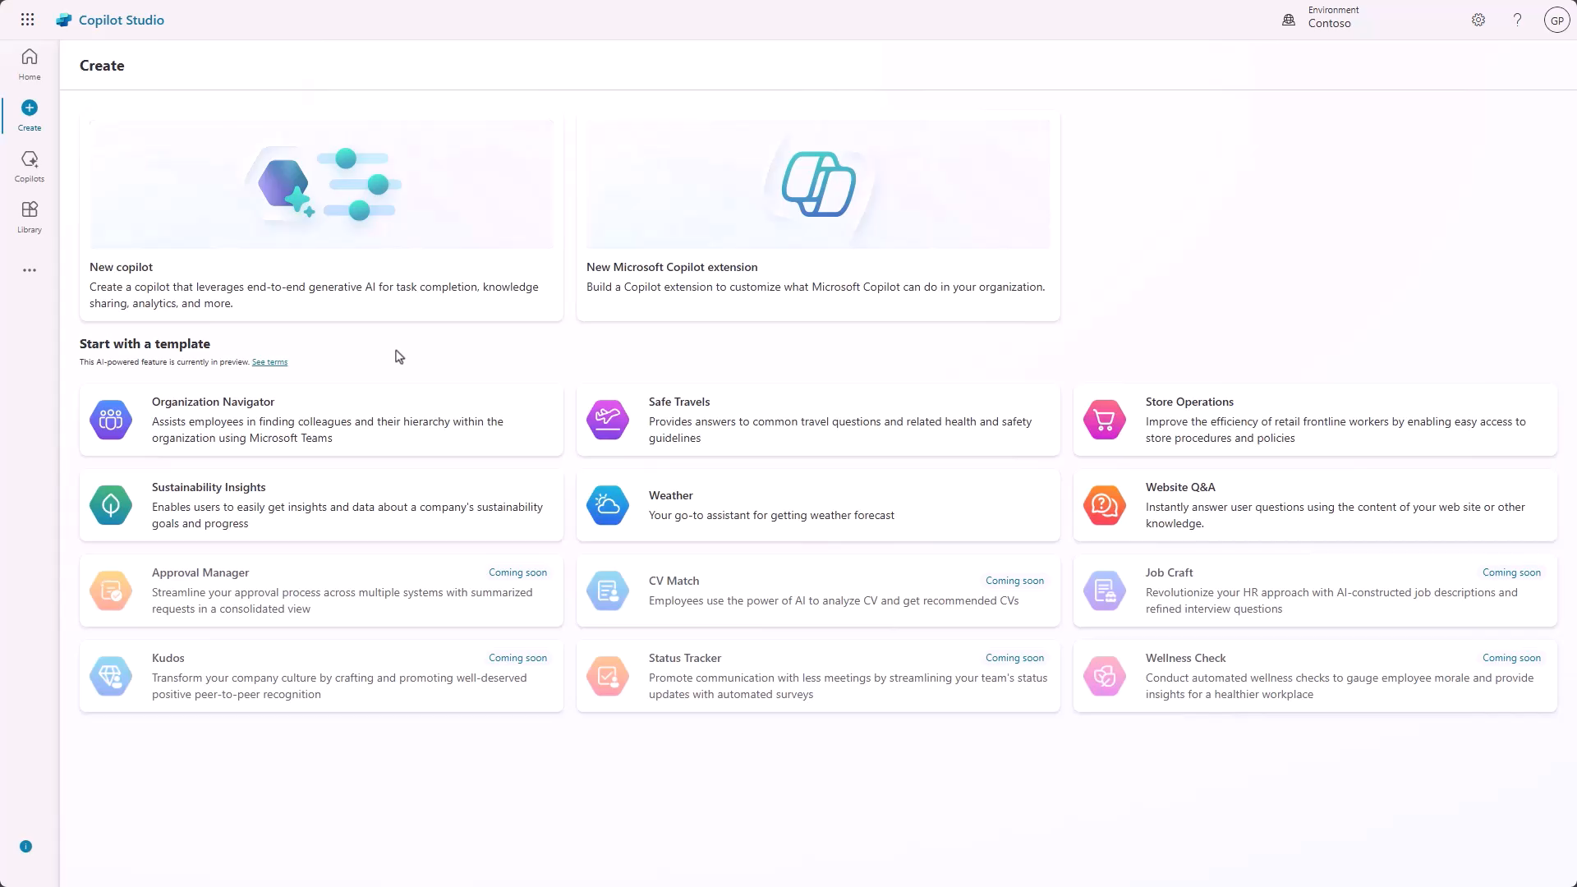
Extend & optimize: Design, build, and deploy agents
Shared activity
  Building Copilot agents with Copilot Studio
  Copilot Studio is the platform to build Copilot agents that extend Microsoft 365 Copilot or operate standalone:
  End users can build in the Copilot Studio agent builder, available in Microsoft 365 Copilot BizChat and SharePoint.
  IT and developers can build in Copilot Studio, the full featured graphical authoring environment.
  There are countless ways to optimize and reinvent your business processes with Copilot agents:
Copilot agents can handle highly variable situations in real time, using judgment to plan their steps and perform specialized tasks required to complete the job.
Agents can collaborate with multiple users and other agents to accomplish tasks that span disconnected systems, and organizational boundaries.
Using natural language, agents can enable any employee to design and operate custom tailored agents for their workflows.
  Determine the path forward for extensibility with our decision guide
  Try Teams toolkit with Teams AI Library at aka.ms/TryTeamsToolkit
  To learn more, go to Extend Microsoft Microsoft 365 Copilot | Microsoft Learn
Notes:
We recognize that agents has been an industry term used over the years. In 2024, it is mostly associated with the right side of autonomy. We believe everything is an agent and that they live on a spectrum of capability.
Retrieval: Designed with specific instructions on how to behave, their personality, and their overall objectives. They follow predefined rules and guidelines set by the creators.
Task: connected to specific workflows or processes. They operate based on knowledge, skills, and rules based automation. Their primary purpose is to automate repetitive tasks.
Autonomous: Operate independently, dynamically planning and learning from the processes. They adapt to changing conditions and make decisions without constant human intervention.

Slide 49
Build your own Copilot Studio custom agents
Extend & optimize

Slide 50
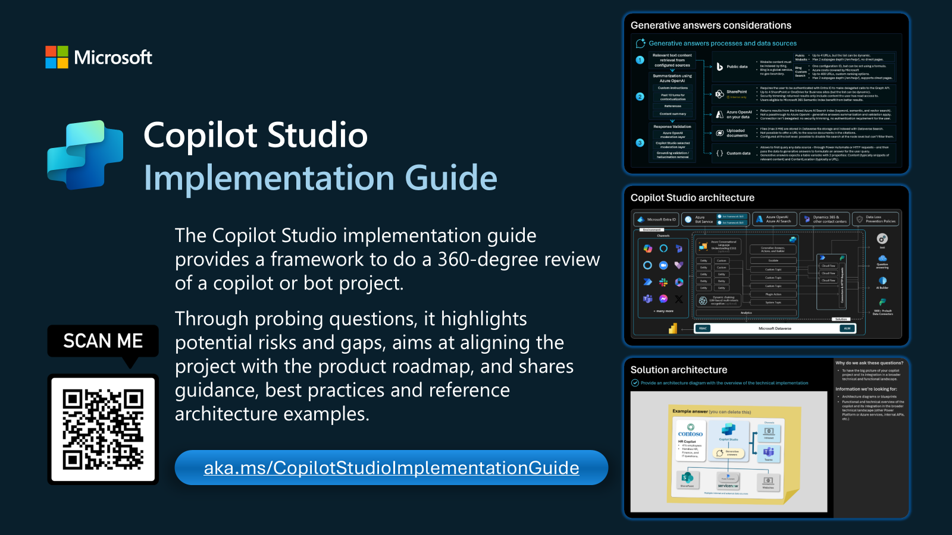
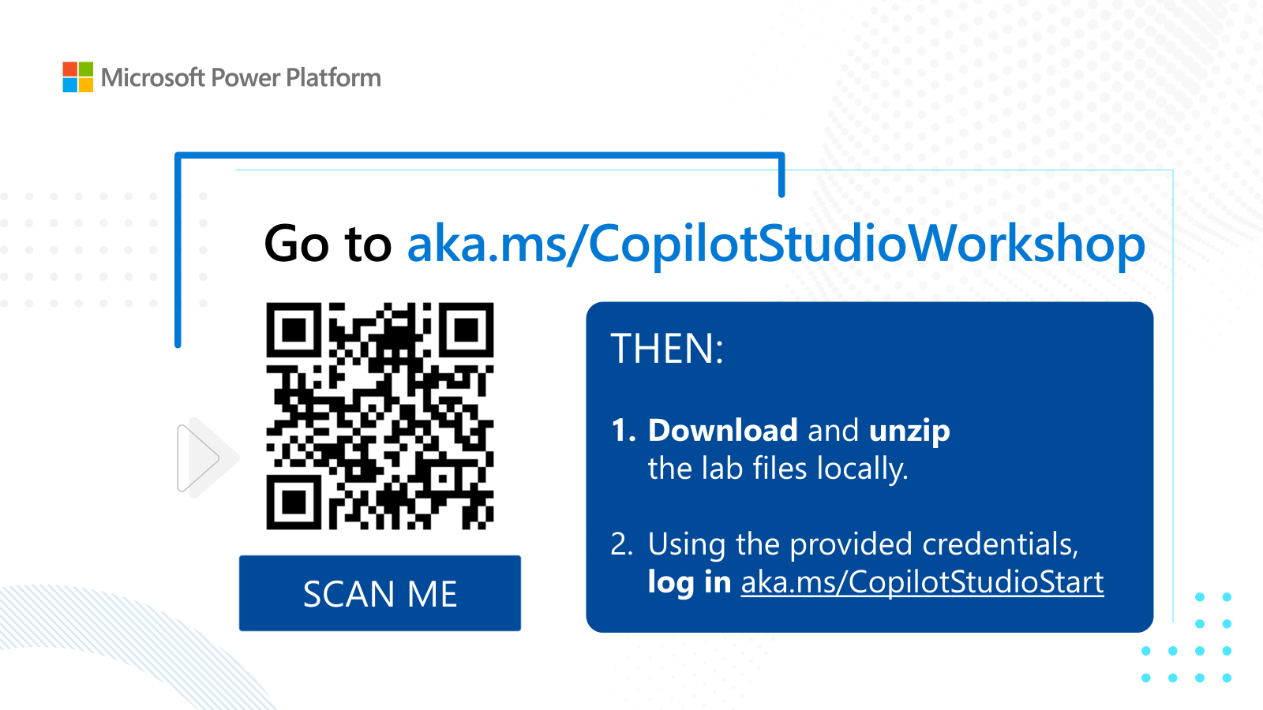
Extend & optimize: Build your own custom agents
  Microsoft 365 Copilot Studio
  Copilot Studio in a Day
  ½ day to 1 (one)-day hands-on workshop for subject matter experts and business users, covering the breadth of Microsoft Copilot Studio.
  The goal is for customers to:
  Have enough experience with the product to be able to understand the value and features currently in preview and how they could begin to use it
  Understand how Copilot Studio differentiates from the competition and become Copilot Studio advocates in their organization
  Know what the next steps are to learn more about Copilot Studio and become part of the community
  To develop your own custom agents for high-value scenarios
  The latest workshop materials are published on GitHub at aka.ms/CopilotStudioWorkshop
  Access the learning path at aka.ms/CopilotStudioTraining
  Sign up and attend Copilot Studio in a day events at aka.ms/CopilotStudioInADay
  Check for latest content on Microsoft Power Platform Partner Hub

Slide 51
Next steps & resources
Learn more about the requirements for Microsoft 365 Copilot
Follow the blog series on What’s new in Copilot to keep up to date on the latest news
Learn more about the benefits of using Monthly Enterprise Channel in this Forrester study
Read the change update channels guide for directions on managing update channels across multiple technologies
Learn more about the Microsoft 365 Apps admin center and the features available with Cloud Update
Follow our guide for Cloud Update to get started
Watch these short tutorial videos about the latest features in Cloud Update
Check out our other deployment and servicing videos for Microsoft 365 Apps
Work with App Assure to unblock your app compatibility issues

Slide 52
Microsoft investments to accelerate your time to value
Customers that buy more than 150 Copilot
seats are eligible for Microsoft co-investment in partner deployment and adoption services through eligible Microsoft Partners.
Eligible customers can request technical and deployment assistance from Microsoft FastTrack.
Get started on your Copilot journey with
expert-led services through Microsoft Unified.

Slide 53
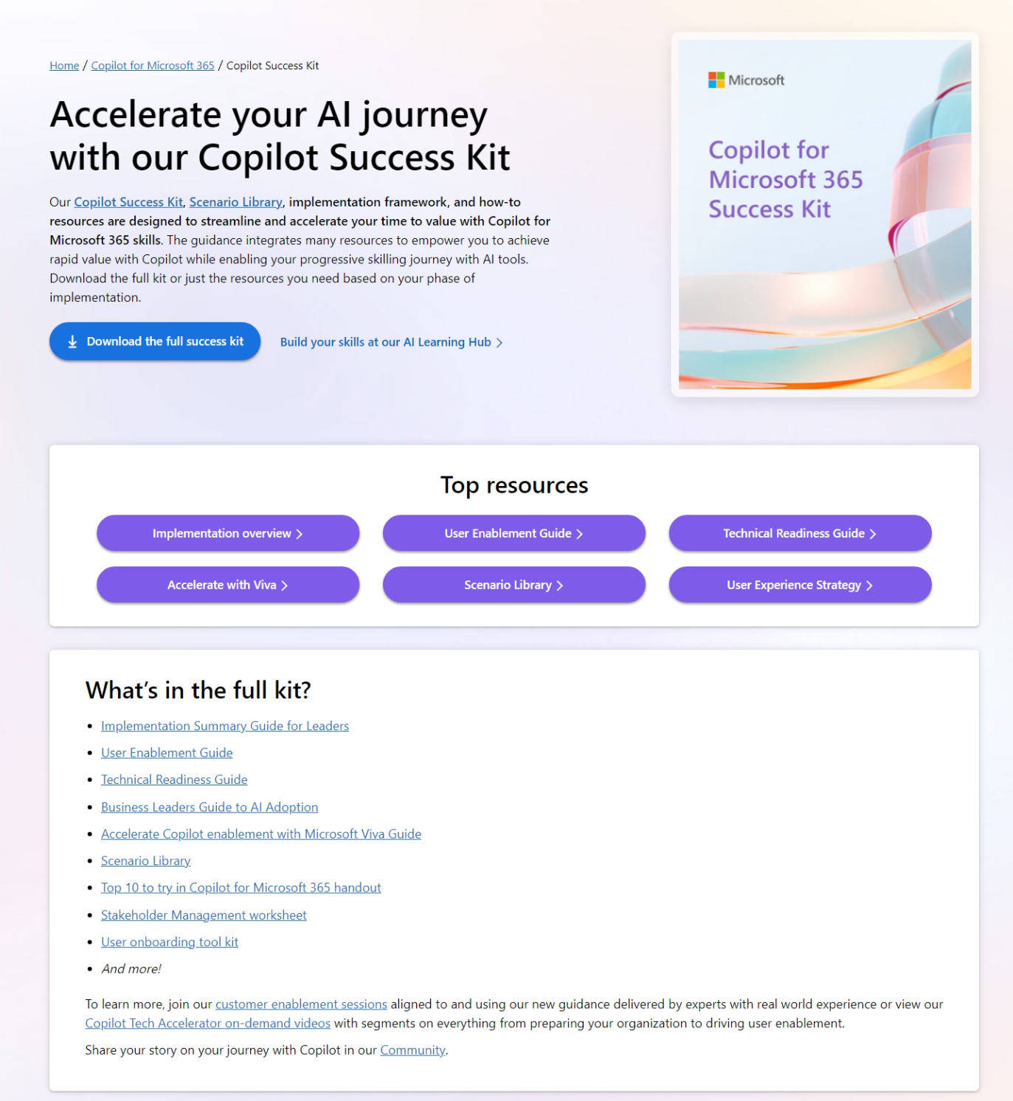


Copilot resources on Microsoft Adoption
One site for all your Copilot needs
https://adoption.microsoft.com/copilot
Resources by role
Interactive Scenario Library
Product announcements and news
Links to all other Microsoft sites
Extended links for Small/Medium business, Copilot in Sales, Microsoft Viva, and more
Take the Class!
Earn your User Enablement badge & validate your skills with MS-4007 available today!
Notes:
Provides resources by role/area, such as leader, user enablement, and technical readiness, to help deploy, use, and scale Copilot.
Showcases what’s new in Copilot, such as Copilot for SMB, Copilot for Sales, Microsoft 365 Copilot, and more.
Invites users to explore what’s possible with Copilot, such as building prompt skills, creating content, joining the community, and using Copilot in different apps.
Offers links to other Copilot experiences, such as Copilot for Sales, Copilot Studio, and Microsoft Copilot.

Slide 54



Skilling experiences
Microsoft 365 Copilot
Microsoft
Copilot Academy
Available to all Microsoft 365 Copilot customers
Centralized location to help with the basics of Copilot learning and upskilling, pulling the best content from available free Microsoft sources
Structured content in easily consumable learning paths curated
by Microsoft experts
Develop your AI interaction skills from your Viva Learning app
in Teams or webapp
Microsoft Learn
Free, on-demand training content
for skill development
Step-by-step exercises guiding learners through common Copilot prompts and use cases
Copilot Prompt Gallery
Free location to meet, learn about,
and test the capabilities of Copilot
Improve your prompt engineering skills in an interactive hands-on environment
Downloadable assets for customization available at adoption.microsoft.com/copilot
Notes:
Slide Objective – There are many ways to develop your Copilot skills.
Copilot Academy provides a centralized location to help with the basics of Copilot at work and structured content in easily consumable learning paths curated by Microsoft experts. Develop your AI interaction skills from your Viva Learning app in Teams or webapp

Slide 55


Copilot Scenario Library
Leadership
Copilot brings AI value across lines of business
Use the Scenario Library to identify top use cases and business metrics you would like to improve in that functional area.
Library PPT deck: https://aka.ms/CopilotScenarioLibrarySlides
All roles & execs
HR
Marketing
Operations
IT
Sales
Finance
Improve meetings
Content creation
Manage daily agenda
Cost per hire
Employee turnover
Compliance risk reduction
Leads created
Brand value
Cost per lead
Customer retention
Product time to market
Supply chain efficiencies
Outstanding support tickets
Application downtime
Departmental spending
Number of opportunities
Close rate
Revenue per sale
Accelerate cash flow
Spend on ERP system
Risk reduction
https://aka.ms/Copilot/ScenarioLibrary
Notes:
As I mentioned earlier…the Copilot scenario library offers examples of the top use cases by functions and metrics to help you measure areas you'd like to improve.
It maps the scenarios to Copilot product capabilities which provide a blueprint for each function
Some examples of the functions available in the scenario library include HR, Marketing, Operations, Sales and more.

Slide 56





Training and documentation by phase
Microsoft 365 Copilot
Get ready
Onboard & engage
Deliver impact
Extend & optimize
Copilot Experiences Explained
(11 mins)
Leading in the Era of AI:
Creating an AI Council
Discover how to drive enablement of Microsoft 365 Copilot in your organization (2.5 hrs)
User Experience Strategy template
Copilot Prompt Gallery
(including app specific guidance)
Leading in the Era of AI:
It’s about Trust
Learn about Copilot prompts
Empower your workforce with Microsoft 365 Copilot Use Cases
(7 business group use cases)
Craft effective prompts for Microsoft 365 Copilot (2 hrs)
Get better results with
Copilot Prompts
Edit a Copilot prompt to
make it your own
Share your best prompts
Modern Collaboration Architecture people-centric scenario guidance
Video
Docs
Course
Docs
Article
Tool
Course
User Enablement
Course
Article
Article
Article
Article
Prepare your organization for Microsoft 365 Copilot (1.5 hrs)
How Microsoft 365 Copilot works
(11 mins)
How to get ready for Microsoft
365 Copilot (9 mins)
Data, Privacy, and security for Microsoft 365 Copilot
Microsoft 365 Copilot requirements
Microsoft deployment blueprint to implement internal oversharing protections for Microsoft 365 Copilot
Course
Article
Video
Get started with Microsoft 365 Copilot (2 hrs)
Admin steps to get ready for Microsoft 365 Copilot (46 secs)
Apply principles of Zero Trust to Microsoft 365 Copilot
Enable users for Microsoft 365 Copilot
Get Ready for Microsoft 365 Copilot with SharePoint Adv Management
Microsoft 365 Copilot Documentation
Copilot Dashboard implementation
Extend Microsoft 365 Copilot
Create agents with Microsoft Copilot Studio (4 hrs)
Optimize and extend Microsoft 365 Copilot (1 hr)
Extend and manage Microsoft Copilot Studio agents (2 hrs)
Build connectors and plugins for Microsoft 365 Copilot (3 hrs)
Course
Docs
Docs
Video
Video
Docs
Technical Readiness
Course
Docs
Docs
Course
Docs
Docs
Course
Docs
Article
Course

Slide 57
Links to learn more (1 of 2)
Copilot Readiness Hub
What is Copilot?
Introducing Microsoft 365 Copilot
The Copilot System
ChatGPT vs. Microsoft 365 Copilot: What's the difference?
How Copilot works
How Microsoft 365 Copilot works: Microsoft Mechanics video
Semantic Index for Copilot
Microsoft Graph
Microsoft Graph connectors
Additional copilot experiences across the Microsoft Cloud
  Microsoft Dynamics 365 Copilot
  Copilot in Power Platform
  Microsoft Security Copilot
  GitHub Copilot
  Copilot in Microsoft Stream
Privacy
Microsoft’s privacy policy
Microsoft Privacy Statement
Trust Center data protection and privacy
Data, privacy, and security for Microsoft 365 Copilot
Data, privacy, and security for Azure OpenAI Service
Role-based access control
User permissions and permission levels in SharePoint Server
Customer Lockbox requests
Microsoft 365 isolation controls
Data Protection Addendum

Slide 58
Links to learn more (2 of 2)
Data residency and storage
EU Data Boundary
  Website
  Blog
  Documentation
Compliance
Microsoft Compliance
Service Trust Portal
Compliance offering definitions
General Data Protection Regulation (GDPR)
  Full summary
  Short summary
Security
Configure usage rights for Azure Information Protection (AIP)
Universal Licensing Terms for Online Services
Data Protection Addendum
Isolation and Access Control in Microsoft 365
How to prepare for Microsoft 365 Copilot
Learn about Microsoft feedback for your organization
Manage Microsoft feedback for your organization
How to manage Microsoft Search
Microsoft 365 Product Terms
Content management and security in SharePoint, OneDrive, and Teams
Transcription Management in Microsoft 365 Copilot
Get Ready for Microsoft 365 Copilot with SharePoint Advanced Management
Microsoft deployment blueprint to implement internal oversharing protections for Microsoft 365 Copilot
Responsible AI
Responsible AI core principles
  Videos
  Documentation
Microsoft Responsible AI Standard
Governing AI: A Blueprint for the Future

Slide 59
MICROSOFT 365 COPILOT TECHNICAL READINESS
Modern Management of Microsoft 365 Apps
The importance of monthly update channels

Slide 60



Microsoft 365 Apps | update channels
Choosing the right update channel that best fits the needs of your organization
More than 75% of commercial devices are using a monthly update channel today!
Copilot ready!
Recommended for Enterprise
Current Channel (CC)
Monthly Enterprise Channel (MEC)
Semi-Annual Enterprise Channel (SAEC)
General-purpose devices, any type and size organization
General-purpose apps, large enterprises
Non-human devices, specialized and business-critical workloads
No Copilot!
Most current Office features, latest security value, and performance improvements as soon as they are ready
The latest features on a predictable monthly cadence, additional tools and controls
All new features, security value, and performance improvements shipped once a month
For select devices in an org where end-users are not present to conduct specialized & automation tasks
Overview of update channels for Microsoft 365 Apps | Microsoft Learn
Channels explained | YouTube
Notes:
We recommend Current Channel, because it provides your users with the newest Office features as soon as they're ready.
Current Channel usually receives new features at least once a month, but there's no set schedule for when those updates are released.
In some cases, a new feature is made available only to a subset of users as the feature is gradually rolled out in Current Channel.
We recommend Monthly Enterprise Channel if you want to provide your users with new Office features each month, but only want to receive one update per month on a predictable release schedule.
Updates to MEC are released on the second Tuesday of the month. This monthly update can include feature, security, and non-security updates.
We recommend Semi-Annual Enterprise Channel only for those select devices in your organization where extensive testing is needed before rolling out new Office features.
Non-human devices
User productivity is not top priority
Updates to SAEC are released on the second Tuesday of the month. In January and July, the monthly update can include feature, security, and non-security updates.
In other months, the update can include security and non-security updates.

Slide 61
Modern management: Monthly Enterprise Channel
Drivers
Benefits
Ensures great fundamentals across performance, reliability, compliance, and accessibility
The most secure experiences
Minimize incidents and disruptions
Modern tools to empower end-users to do their best work
The best modern, connected, and collaborative experiences
Alignment with industry best practices for agility
70% of helpdesk claims eliminated
Increased quality – 6+ months faster fixes
Better diagnostics for supportability
Performance increases (~15% vs SAEC*, ~50% vs Office 2019)
Security features 6+ months faster
Higher end user satisfaction (NPS +~3%)
Modern Management: Safety nets + Insights (Rollback, Pause, Exclusion Dates, Servicing Profiles, Apps Health, Inventory, …)
For more information on the benefits of the Monthly Enterprise Channel, review the Forrester Total Economic Impact (TEI) paper:
https://aka.ms/M365AppsTEIStudy
Notes:
MEC is recommended for ALL Enterprises and Government customers – it was specifically built with these customers in mind. SAEC as the highest quality, most conservative, bits is a myth. SAEC is simply slower by time (larger changes less often vs smaller changes monthly).
MEC isn’t about “new office features faster” – it is about big improvements to the basics: Security, Performance, Reliability, Quality fixes, and less cost for IT. New features faster is a side benefit.
*Performance benefit – on average 15%-20% faster vs SAEC that is 12 months old (note perf on monthly is almost always faster than SAEC – small changes each month, but large deltas show the older SAEC gets)
Not all fixes go to SAEC in patching – many fixes are held for next SAEC, but Monthly customers get them quickly
Better diagnostics is due to engineers instrumenting new quality checks as bugs and issues are found – so if a customer calls support, usually step one is to update some machine to a newer build so we can see enhanced telemetry – Monthly customers get these benefits quickly and ‘for free’
Modern Management – Monthly Enterprise Channel is currently the only channel that supports our best management tools: Servicing Profiles to automate rollout of builds – allows IT to define waves to roll out monthly bits too saving IT a ton of time and keeping environments up to date automatically. It comes with Safety Net controls though if something does go wrong – ability to pause a rollout, rollback to the last version, wait until the next version, set exclusion dates (e.g. pause rollouts for Retail industry around the holidays, or around Tax season, etc.). It also has Insights to give confidence environment is good and lets admins see if there’s a problem – the Apps Health dashboard, or Inventory to get a near real time look at all the machines in the environment running office

Slide 62
Myths vs reality: semi-annual enterprise channel
Microsoft 365 Apps is a cloud service. It is recommended that you stay up to date with the latest features like other productivity apps (Teams, OneDrive, Edge). Semi-annual is intended for non-human devices and is unique to the Windows client apps. Web, mobile, and macOS all run on monthly.
Copilot will be available for SAEC
There are no plans to ship Copilot with SAEC (Link 1, Link 2, Link 3)
The speed at which Copilot evolves makes it ineligible for SAEC
SAEC is more reliable
Non-blocking issues can stay unfixed for 6-12 months on SAEC
Issues are detected and fixed up to 5 months faster on monthly channels
Monthly update channels are less secure
All channels have the same exposure to known vulnerabilities
Monthly update channels benefit from having access to the latest security features sooner
SAEC only needs to update once every 6 months
Regardless of channel, staying current requires updating at least once a month
The difference is not when an update installs, but what is included in the update (e.g., security, quality, and features)
Users cannot absorb monthly feature updates
Higher end user satisfaction on MEC (NPS +~3%)
SAEC delivers lump-sum feature releases, CC and MEC are incremental
Update Under Lock minimizes user disruption
Monthly channel updates will kill my network
Leverage Delivery Optimization for Microsoft 365 Apps to minimize WAN usage
Monthly updates are small and incremental, see update size
SAEC is recommended for Enterprise
It was in the past, before we worked with customers to design MEC
MEC is recommended for Enterprise, SAEC is designed for non-human devices
CC and MEC are the leading update channels for Enterprise customers
Notes:
7-step animation
Switch from a green button approach to a red button approach
Green button = test everything, move slowly, miss out, not a good experience for cloud services due to the velocity of change
Red button = go fast, stay current, use data insights, have safety nets in place and the ability to pause and rollback if needed
NPS = Net Promoter Score
https://learn.microsoft.com/microsoft-365/admin/manage/manage-feedback-product-insights?view=o365-worldwide
Copilot is not coming to SAEC:
"The speed at which Microsoft 365 Copilot evolves to bring the latest and greatest to your users’ fingertips makes it ineligible for users running Semi-Annual Enterprise Channel.“
https://techcommunity.microsoft.com/t5/microsoft-365-blog/microsoft-365-admin-monthly-digest-feb-2024/ba-p/4067971
"Your users will need to be on the Current Channel or Monthly Enterprise Channel for Microsoft 365 apps to have access to Copilot in desktop clients.“
https://techcommunity.microsoft.com/t5/copilot-for-microsoft-365/how-to-prepare-for-microsoft-365-copilot/ba-p/3851566
"Microsoft Microsoft 365 Copilot will follow the standard practice of deployment and updates for Microsoft 365 Apps, being available in all update channels, except for Semi-Annual Enterprise Channel.“
https://learn.microsoft.com/copilot/microsoft-365/microsoft-365-copilot-requirements#update-channels
For customers with a significant number of devices on Apple Mac, being on a monthly on the Windows side is the only way to get all the desktop on the same cadence. On Mac, there is only one delivery option which is monthly, and very similar in essence to the Monthly Enterprise Channel (MEC): Only version per month on (or close to) Patch Tuesday.
On most customers we see devices mainly on PC and when there is a small number of Mac, it’s usually for Exec. By moving to MEC you could have updates on the Windows side on the same cadence as your Exec, and also on the same cadence as all other platforms in addition to Mac (Mobile)

Slide 63
Making the move to monthly

Slide 64
Best practices: moving to monthly
No need to reinvent the wheel, leverage tried and true update methodologies
Beta Channel
Unscheduled; released weekly
Unsupported insider channel
Use to validate new features in active development
Define your user personas and leverage faster update channels to validate new features and changes before broad deployment
Insiders
Changes added based on feedback and quality
Beta or
CC (Preview)
Current Channel
MEC
SAEC
Pioneers
Early adopters
Broad userbase
Non-human devices
Current Channel (Preview)
Unscheduled; multiple releases every month
Supported until the next version is released
Use to preview new features that are about to ship
For broad deployment, implement custom rollout waves, controlling which users go first, while giving sufficient time to pause and rollback if the need arises
Changes added based on feedback and quality
Current Channel
Unscheduled; multiple releases every month
Supported until the next version is released
Recommended for users that want the latest on release
Wave 1 (UV)
Wave 2
Wave 3
Wave 4
1-10% representation
10-15% of users
10-15% of users
All remaining devices
Production
Changes added in 4-8 weeks
7 days
1-5 days
1-5 days
Confidently move to a monthly update channel to take advantage of Microsoft 365 Copilot apps while knowing App Assure will help remediate any app compatibility issues: http://aka.ms/AppAssure
Monthly Enterprise Channel
Scheduled; release on Patch Tuesday
Supported for 60 days
Recommended for enterprise customers
Notes:
4-step animation
There are multiple monthly update channels available to accommodate different user personas.
Insider channels offer early access to new features and fixes, with up to 12+ weeks of validation time
Define user personas and optimize the use of update channels
Leverage custom rollout waves and update validation to ensure a consistent experience with time to adjust if needed
Utilize App Assure for app compatibility issues

Slide 65

Confidently use Microsoft 365 Copilot with App Assure
Confidently move to Monthly Enterprise Channel or Current Channel to take advantage of Microsoft 365 Copilot while knowing your apps will just work. Microsoft is committed to ensuring your apps work with the latest versions of our software. If you encounter any app compatibility issues, App Assure will help remediate them at no additional cost!
App Assure helps customers troubleshoot, root cause and resolve app compatibility issues
Included as part of your license, this service is at no additional cost
Customers get a direct line of communication to Microsoft product engineering teams
Questions? Email: achelp@microsoft.com | Submit a Request for assistance | For more information visit aka.ms/AppAssure
Notes:
Bottom Line:
Microsoft takes responsibility for application compatibility with App Assure, so you can feel confident migrating to the Current Channel or Monthly Enterprise channel to get the full value from Microsoft 365 Copilot.
Gain the full value of Copilot
- Microsoft 365 Copilot is an AI tool whose value is based upon leveraging the most up-to-date information and features available. It is constantly evolving from new data sources, user feedback, and research advancements. To stay current, your organization needs to be on the latest release of Copilot, done by migrating to the Current Channel or Monthly Enterprise Channel.
Migrate with confidence
- Microsoft Apps on the Current or Monthly Enterprise Channels receive regular updates to the latest versions. Your can migrate with confidence with the knowledge that Microsoft promises application compatibility with the latest versions of our software. App Assure was created for this purpose.
App Assure services
- App Assure is Microsoft's commitment to ensuring your apps work on the latest versions of our software. App Assure will help remediate app compatibility issues at no additional cost. We help identify the root cause and provide guidance to fix app compatibility issues. (we've got examples we can provide!) This service is delivered by Microsoft engineers and provides a direct line of communication to our product engineering team in the event that an issue with one of our first party products is found. On your behalf we also coordinate with software providers on third party apps that need updates to stay efficient and effective for your team.

Slide 66



Management tools for Microsoft 365 Apps
Planning your update management strategy
There are multiple tools available for managing Microsoft 365 Apps
Microsoft recommends Cloud Update for managing Microsoft 365 Apps across your organization
Planning | Group Policy | Microsoft Intune | Windows Autopatch | Configuration Manager | Cloud Update
TCO | Medium | Medium | Low | High | Low
Enterprise controls | Lightweight | Lightweight | Lightweight | Extensive | Enterprise Ready
Supported enclaves | Commercial | Commercial, GCC, GCC-H | Commercial | Commercial, GCC, GCC-H, DoD, AG | Commercial
The benefits
of Cloud Update
27% more
Less than 1%
More than 6hrs
apps updated at the end of the month
install errors detected using automation
saved per week troubleshooting updates
Notes:
1-step animation
Our quality has improved and is the strategic direction of Microsoft.
We have added customer controlled and more engineering responsive rollbacks if something goes wrong.
Customer can flexibly manage users that may be in "lockdown". Don't update my tax preparers for 3 months.
Rich data insights, cloud policies, servicing, scheduling, waves, rollback, and channel management.

Slide 67
The benefits of cloud update
Microsoft 365 Apps admin center (config.office.com)
Rich data insights that keep you informed about the Microsoft 365 Apps across your organization
Automatic updates that keep your apps up to date with the least amount of effort
Channel management simplifies the task of changing update channels and prevents configuration drift
Custom waves enable you to customize your rollout and define which users goes first
Update validation enables you to validate the latest build before you reach broad deployment
Pause your deployments at any time, for as long as you need
Exclusion windows enable you to schedule updates around critical freeze periods
Rollback offers a safety net, enabling you to rollback to the previous build with flexible targeting
Notes:
8-step animated slide
* Least privileged role is Office Apps Admin then Security Admin and finally Global Admin

