Slide 1
Copilot Scenario Library
Discover industry and role-based scenarios

Slide 2
Copilot value journey
Grow value from a base of solid usage and individual productivity and then extend through agents to impact organizational KPIs.
Org Value
Role-based agents
Copilot Studio
Microsoft 365 Copilot industry scenarios
Extend
Functional Value
Copilot Studio agent builder
Microsoft 365 Copilot functional scenarios
Buy
Individual Value
Microsoft 365 Copilot universal prompts (Meeting Recap, Summarize an email, etc.)

Slide 3
Top 10 to "Try First"
with Microsoft 365 Copilot Foundational skills for new users
1
2
3
4
5
Recap a meeting – let Copilot keep track of key topics and action items so you can stay focused during the meeting and avoid listening to the recording after.
Summarize an email thread
– get quickly caught up to a long, complex email thread.
Draft email
– personalize the tone and length.
Summarize a document
– get right down to business by summarizing long documents and focusing on the relevant sections.
Tell me about a topic/project
– provide insights and analysis from across multiple sources to get up to speed quickly.
Draft an email to [name] that informs them that Project X is delayed two weeks. Make it short and casual in tone.
Draft an email with notes and action items from meeting
Click on the Summarize icon
Give me a bulleted list of key points from file
Tell me what's new about topic organized by emails, chats, and files?
6
7
8
9
10
Give me some ideas for …
– boost your creativity with ideas for your work such as agendas, product names, social media posts, etc.
Help me write …
– jumpstart creativity and write and edit like a pro by getting a first draft in seconds.
What did they say …
– when you vaguely remember someone mentioning a topic, have Copilot do the research.
How do I …
– let Copilot help you build or fix formulas in Excel.
Translate a message
– with business becoming increasingly international, it’s important to be able to read or write messages in other languages.
Suggest 10 compelling taglines based on file
Generate three ways to say [x]
What did person say about topic
How do I sum values that are greater than 0?
Translate the following text into French:
For more prompts, visit Copilot Lab at: aka.ms/promtps

Slide 4
”Effort” level for each scenario
Start
Buy
Extend
1
2
3
Your first step into generative AI
Unlock productivity out of the box
Tailor your data, systems and workflows via Copilot agents
Microsoft Copilot
Microsoft 365 Copilot
Security Copilot
Role-based Copilot agents
Copilot Studio
Azure AI Studio

Slide 5
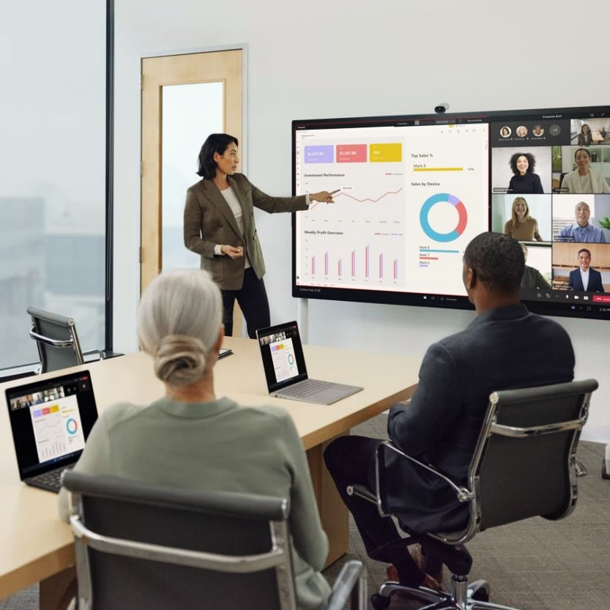
Copilot scenarios for Accessibility

Slide 6
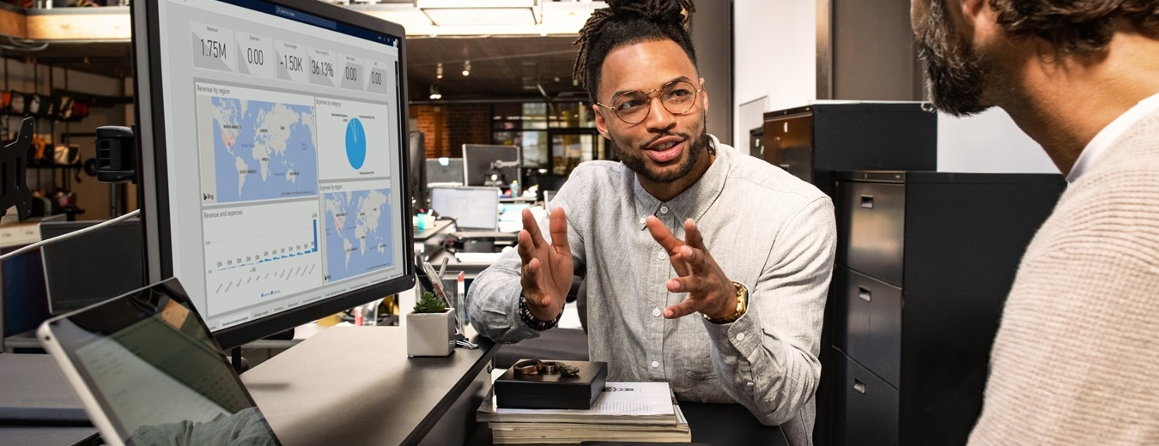
Copilot Accessibility scenarios
Overview and KPIs
Use cases
Day in the life
KPIs play a crucial role in measuring progress. Let's dive into KPIs for Accessibility and how Copilot can assist.
Copilot can simplify the tasks required to change processes and measure success. Look at key use cases and how Copilot can be your AI assistant along the way.
See how real-life Accessibility pros are using Copilot in their day-to-day.

Slide 7
Using Copilot to support Accessibility
Copilot helps organizations achieve their strategic goals for accessibility and disability inclusion, transforming everyday work practices. By simplifying tasks and taking inputs from a variety of sources, Copilot enhances digital accessibility. It empowers employees with disabilities to independently create professional documents and presentations and to consume content efficiently by summarizing lengthy documents, pages, or videos.
Goals and challenges
Accessibility roles
Chief Diversity Officer
IT Manager
HR Specialist
Accessibility Program Manager
Microsoft Copilot opportunity to impact key functional KPIs
Enhanced productivity and innovation
Integrate accessible technology to empower all employees, including those with disabilities, to work efficiently. This boosts productivity and drives innovation by embracing diverse perspectives.
Generate drafts quickly by using prompts to create initial content, refine style, and add images with alt text (text descriptions of images that help blind/low vision users.).
Seamlessly transform content from one format to another.
Summarize lengthy documents, emails, and reports into concise overviews with key points that users with learning disabilities can leverage.
Efficiently prioritize emails, identify key chats, prepare for meetings, and search for information across all sources - a great tool for users with mobility disabilities.
Transcribe, summarize, and generate action items from meetings –features deaf/hard of hearing users love for Teams calls.
Analyze and format data in complex spreadsheets with ease.
Expand market reach
Utilize the lived experiences of disabled and neurodivergent employees in product design to appeal to a wider audience, fostering greater customer loyalty and expanding market share.
Copilot can assist with...
Compliance and risk management
Learn about accessibility standards to address legal compliance, minimize the risk of lawsuits and penalties, and strengthen your reputation as a socially responsible organization.
Employee engagement and retention
Foster an inclusive workplace where all employees feel valued and supported, driving higher engagement, improved retention, and the ability to attract top talent.
Revenue growth
Cost savings and avoidance
Improve employee experience

Slide 8
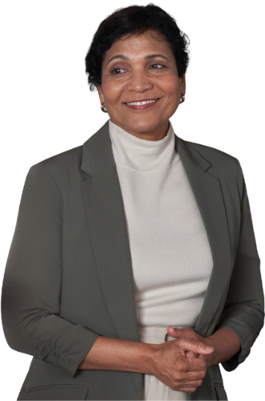
Improve quality of Accessibility initiatives
Key Processes
Before AI
Using AI
Generate drafts quickly by using prompts to create initial content, refine style, and add images with alt text (text descriptions of images that help blind/low vision users.).
Seamlessly transform content from one format to another.
Summarize lengthy documents, emails, and reports into concise overviews with key points that users with learning disabilities can leverage.
Create content
Manually creating presentations and documents by gathering information, structuring content, and formatting is time-consuming and repetitive.
Efficiently prioritize emails, identify key chats, prepare for meetings, and search for information across all sources - a great tool for users with mobility disabilities.
Transcribe, summarize, and generate action items from meetings –features deaf/hard of hearing users love for Teams calls.
Analyze and format data in complex spreadsheets with ease.
Reading through extensive documents, emails, and reports to extract relevant information is time-consuming and overwhelming.
Consume content

Slide 9
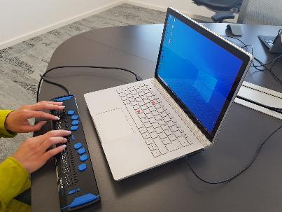
A day in the life of a person who is blind
Microsoft 365 Copilot
Buy
Benefits
Areas of investment: Content creation
Meeting preparation
8:30 am
9:00 am
9:30 am
Lena starts working from her home-office and asks Copilot to summarize her emails and chats for any customer requests.
She receives a Word document that is inaccessible with her screen reader. She asks Copilot in Word to summarize the document resulting in an accessible summary.
Lena has an upcoming meeting in the afternoon and needs to get prepared. She uses Copilot to get prepared.
Lena uses a screen reader and braille keyboard to consume and create content.
Business Chat²
Copilot in Word
Business Chat²
Sample Prompt: Summarize questions from customers sent yesterday from my email and chat messages and prioritize my top 3 action items for today.
Sample Prompt: Summarize this document.
Sample Prompt: Help me prepare for [Review Meeting]
4:00 pm
2:00 pm
10:30 am
Lena receives an email which includes an image that does not have any alternative text. She asks Copilot what the image shows.
She attends a large meeting which takes place every week. She needs to find a message from the chat from last month. To save a lot of clicks, she uses Copilot in Teams.
Lena needs to prepare a slide deck for the upcoming meeting. She already has her notes created in Word. She asks Copilot to create a presentation from that document, which she can do without sighted assistance.
Business Chat¹
Copilot in Teams
Copilot in PowerPoint
Sample Prompt: Please describe this image?
Sample Prompt: What did /Anna ask in last week`s meeting?
Sample Prompt: Create a presentation from /[file]
¹Access Copilot at copilot.microsoft.com or the Microsoft Copilot mobile app and set toggle to “Web”.
²Access Business Chat at copilot.microsoft.com, the Microsoft Copilot mobile app, or the Copilot app in Teams, and set toggle to “Work”.
³Copilot agents allow Microsoft 365 Copilot to access your organization-specific apps. In the past this would have required an API call to get data from a system of record.
The content in this example scenario is for demonstration purposes only. You should evaluate how Copilot aligns with your organization’s business processes, regulatory requirements, and responsible AI principles.

Slide 10
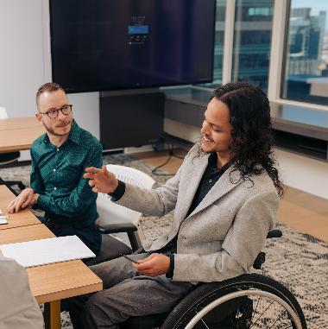
A day in the life of a person with a mobility disability
Microsoft 365 Copilot
Buy
Benefits
Areas of investment: Reduced keystrokes
Team collaboration
8:30 am
9:00 am
9:30 am
In preparation for a customer meeting, Jordan uses Copilot to find all emails, teams chats, documents, and presentations related to that customer, significantly reducing keystrokes.
Jordan joins the Teams call with his customer but is not able to type meetings notes during the call, so he leverages Teams Meeting Recap to capture meeting notes and action items.
Following the meeting, Jordan needs to send a message to the customer with a summary of the meetings and next steps using Copilot in Outlook.
Jordan uses his voice to navigate his computer and create content.
Business Chat²
Copilot in Teams
Copilot in Outlook
Sample Prompt: Find all my conversations about [customer].
Sample Prompt: Following the meeting, Jordan selects View Recap to review meeting notes and follow-up tasks.
Sample Prompt: Draft email to [customer] summarizing the meeting with next steps and request a date for the next meeting.
4:00 pm
2:00 pm
10:30 am
Jordan needs to create an account plan for a new customer. He uses Copilot to research his new customer.
After refining the outline, Jordan now needs to create a PowerPoint file.
Jordan needs to create a presentation for his customer about the benefits of an inclusive environment for employees with disabilities. He leverages prompts to reduce the amount of dictation required.
Business Chat¹
Copilot in PowerPoint
Copilot in Word
Sample Prompt: Provide a one paragraph commercial summary about [customer].
Sample Prompt: Create a presentation from /[file].
Sample Prompt: Draft an outline about the benefits of an inclusive environment for employees with disabilities.
¹Access Copilot at copilot.microsoft.com or the Microsoft Copilot mobile app and set toggle to “Web”.
²Access Business Chat at copilot.microsoft.com, the Microsoft Copilot mobile app, or the Copilot app in Teams, and set toggle to “Work”.
³Copilot agents allow Microsoft 365 Copilot to access your organization-specific apps. In the past this would have required an API call to get data from a system of record.
The content in this example scenario is for demonstration purposes only. You should evaluate how Copilot aligns with your organization’s business processes, regulatory requirements, and responsible AI principles.

Slide 11
A day in the life of a person who is dyslexic (neurodivergent)
Microsoft 365 Copilot
Buy
Benefits
Areas of investment: Reading comprehension
Improve writing
9:00 am
9:15 am
10:00 am
To prepare for her day, Ana asks Copilot to summarize all emails and chat over the past day.
She received a lengthy document with complex language from a customer. She asks Copilot in Word to summarize the document and simplify the language.
Ana also received a long video in Stream. She uses Copilot in Stream to get the main points of the video while reducing cognitive load.
Ana uses technology to create and consume content.
Business Chat²
Copilot in Word
Copilot in Stream
Sample Prompt: Summarize all my emails and Teams chats in the past day.
Sample Prompt: Summarize this document and simplify the language.
Sample Prompt: Summarize the video.
4:00 pm
3:00 pm
1:00 pm
Ana has missed a few chats during the day. She sees that her team has been discussing a new product launch and asks Copilot to summarize the conversation.
Next, Ana is going to write a blog about a grant recipient for her organization website. She creates a first draft using Copilot in Word, then refines the content for the target audience.
She needs to send an email back to her customer but struggles to get started from a blank email. She uses Draft with Copilot to create the first draft without worrying about grammar and spelling, then she can refine and send.
Copilot in Teams
Copilot in Word
Copilot in Outlook
Sample Prompt: Summarize this chat and include the key points and who made them.
Sample Prompt: Create a draft about [grantee] including [grantee] overview, project description, and project results.
Revise the tone for an external corporate blog.
Sample Prompt: Create draft to [customer] outlining our last meeting and provide suggested next steps.
¹Access Copilot at copilot.microsoft.com or the Microsoft Copilot mobile app and set toggle to “Web”.
²Access Business Chat at copilot.microsoft.com, the Microsoft Copilot mobile app, or the Copilot app in Teams, and set toggle to “Work”.
³Copilot agents allow Microsoft 365 Copilot to access your organization-specific apps. In the past this would have required an API call to get data from a system of record.
The content in this example scenario is for demonstration purposes only. You should evaluate how Copilot aligns with your organization’s business processes, regulatory requirements, and responsible AI principles.

Slide 12
A day in the life of a person who is autistic (neurodivergent)
Microsoft 365 Copilot
Buy
Benefits
Areas of investment: Better understand tone
Asking additional questions
8:00 am
8:15 am
9:00 am
Ricardo starts his day by asking Copilot to summarize his emails from the day and prioritize them.
Ricardo joins a call with several attendees, all actively participating in the conversation. He uses Copilot in Teams to assess the tone of the meeting.
As the meeting continues, Ricardo asks Copilot to list the questions asked during the call to ensure they are all answered.
Business Chat²
Copilot in Teams
Copilot in Teams
Sample Prompt: Summarize all my emails and Teams chats in the past day and help me prioritize.
Sample Prompt: What is the tone of this meeting?
How does [meeting participant} feel about this topic?
Sample Prompt: What questions were asked during the meeting that have not been answered?
Ricardo uses Copilot in meetings and communications.
4:00 pm
2:00 pm
11:00 pm
At the end of his day, Ricardo drafts an email in Copilot in Outlook, then uses Coaching by Copilot to assess and adjust the tone.
As Ricardo prepares for a team meeting, he asks Copilot what questions he should raise to quickly create an agenda.
Switching gears, Ricardo received the latest financial numbers from his business planning lead. He uses Copilot in Excel to analyze the complex data quickly.
Copilot in Outlook
Business Chat²
Copilot in Excel
Sample Prompt: Coaching by Copilot
Sample Prompt: What questions should I ask about [project]?
Sample Prompt: What is the percentage of [total revenue from each region]?
Are there any trends in my data?
¹Access Copilot at copilot.microsoft.com or the Microsoft Copilot mobile app and set toggle to “Web”.
²Access Business Chat at copilot.microsoft.com, the Microsoft Copilot mobile app, or the Copilot app in Teams, and set toggle to “Work”.
³Copilot agents allow Microsoft 365 Copilot to access your organization-specific apps. In the past this would have required an API call to get data from a system of record.
The content in this example scenario is for demonstration purposes only. You should evaluate how Copilot aligns with your organization’s business processes, regulatory requirements, and responsible AI principles.

Slide 13
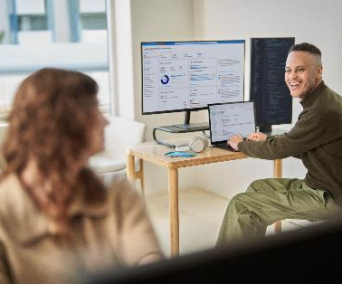
A day in the life of a person focusing on mental well-being
Microsoft 365 Copilot
Buy
Benefits
Areas of investment: Focus on important tasks
Clear communications
8:00 am
8:15 am
9:00 am
Kyle starts his day with a team meeting with many attendees. He uses Copilot in Teams to recap what each person says, focus on key information, and gain a feeling of being informed instead of lost.
Kyle needs to create a draft project proposal and refine it leveraging Copilot in Word to get him 70% along the way and use Inspire Me to alleviate writer’s block and stay in flow.
Kyle needs to write an email to his leadership team about the project and refine the email to ensure he is clear and understood.
Kyle
leverages technology to create clear communications and create work/life balance.
Copilot in Teams
Copilot in Word
Copilot in Outlook
Sample Prompt: Recap the meeting and summarize what each person said.
Sample Prompt: Draft a proposal for [project] including project goals, timeline, and budget.
Use Inspire me to create the next paragraph.
Sample Prompt: Draft an email with an overview of [project]. Use Coaching with Copilot to assess tone and improve clarity.
4:00 pm
2:00 pm
11:00 pm
Kyle is working on a stretch project to develop his coding skills. He uses GitHub Copilot to complete the simple tasks that give him more time/space to focus on the important code.
After reading feedback from his colleagues, Kyle needs to do additional research to continue building out a project plan. He uses Copilot to research which supports his way of thinking and writing better than other tools.
Kyle receives feedback from the team on the project. He uses Copilot to summarize conversations on [project] to surface emails that he missed or needs to revisit.
GitHub Copilot
Business Chat²
Business Chat²
Sample Prompt: Refactor this function to improve its readability and performance.
Sample Prompt: Give me a concise summary of recent news about [project topic].
Sample Prompt: Summarize all my conversations about [project].
¹Access Copilot at copilot.microsoft.com or the Microsoft Copilot mobile app and set toggle to “Web”.
²Access Business Chat at copilot.microsoft.com, the Microsoft Copilot mobile app, or the Copilot app in Teams, and set toggle to “Work”.
³Copilot agents allow Microsoft 365 Copilot to access your organization-specific apps. In the past this would have required an API call to get data from a system of record.
The content in this example scenario is for demonstration purposes only. You should evaluate how Copilot aligns with your organization’s business processes, regulatory requirements, and responsible AI principles.

Slide 14
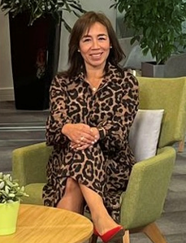
A day in the life of a non-native English speaker
Microsoft 365 Copilot
Buy
Copilot in Outlook
Benefits
Reduce cognitive load
Clear communications
8:00 am
8:15 am
9:00 am
Elena starts her day by checking her Teams messages on her mobile. She sees a message mentioning that Johnny is "being laid back." Unsure how to interpret this, she uses Copilot to interpret the message and understand the Intention.
Elena joins a call with several attendees, all actively participating in the conversation. Due to different accents, she uses Copilot in Teams to verify that she is correctly following the content of the meeting.
Elena finds following the meeting and the chat conversation simultaneously stressful and is distracted by the chat. She uses Copilot in Teams to get a summary of the chat and the meeting in separate sections at the end of the call..
Elena
Is a non-native English speaker and uses M365 Copilot as her personal translator
Business Chat²
Copilot in Teams
Copilot in Teams
Sample Prompt: What does “being laid back” mean? Is it positive or negative?
Sample Prompt: Summarize what was said about our new metrics.
Sample Prompt: Summarize the chat in the meeting in separate sections.
4:00 pm
2:00 pm
11:00 pm
Elena is struggling to find the right words for an email she needs to send to her customer. She uses Copilot in Outlook to draft an email and Coaching by Copilot to ensure her communication is clear, professional, and not misunderstood.
Elena uses the narrative builder in PowerPoint to help her structure her monthly review based on the insights she got from Excel. This reduces her cognitive load, helps her recharge, and boosts her confidence.
Switching gears, Elena receives her FY25 adoption targets and her customer’s portfolio. There is a lot of new data , so she uses Copilot in Excel to summarise it using pivot tables to quickly identify key metrics and trends.
Copilot in Outlook
Copilot in PowerPoint
Copilot in Excel
Sample Prompt:. Draft an email with current project status.. Use Coaching to verify clarity.
Sample Prompt: Help me structure my PowerPoint presentation based on [Excel file].
Sample Prompt: Summarize this data using pivot tables.
¹Access Copilot at copilot.microsoft.com or the Microsoft Copilot mobile app and set toggle to “Web”.
²Access Business Chat at copilot.microsoft.com, the Microsoft Copilot mobile app, or the Copilot app in Teams, and set toggle to “Work”.
³Copilot agents allow Microsoft 365 Copilot to access your organization-specific apps. In the past this would have required an API call to get data from a system of record.
The content in this example scenario is for demonstration purposes only. You should evaluate how Copilot aligns with your organization’s business processes, regulatory requirements, and responsible AI principles.

