Slide 1





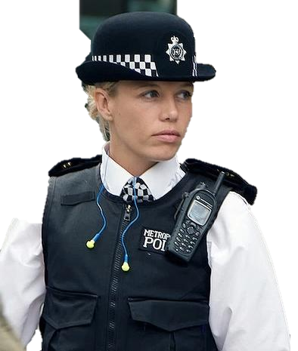

A day in the life of a Police Officer
Microsoft 365 Copilot
Benefits
~30 minutes per day
Areas of investment: Investigation efficiency
Analysis techniques
7:00 am
8:30 am
10:00 am
Begin the day by asking Copilot sort through all emails – prioritize and identify action items and priority information regarding the assigned patrol area.
Ask Copilot to review the Crime Analysts’ reports and provide a detailed summary along with recommended patrol action items to address emerging crime trends in their assigned patrol area.
Officers, investigators, and analysts from the assigned patrol area share information on recent crimes, arrests, intelligence and assignments.
Erin
is a Police Officer.
Copilot Chat²
Copilot Chat²
Copilot in Teams
Prompt: Summarize emails from the last 24 hours, identify tasks and priorities.
Prompt: Generate recommended patrol tasks and assignments from previous shift intelligence report.
Prompt: Summarize the meeting and provide a list of crimes, arrests, intelligence and assignments from this transcript for patrol area X.
4:15 pm
2:30 pm
11:00 pm
End of the day compilation and summarization of the day’s activities and training goals achieved and areas in need of improvement.
Use Live Translation feature during a call with a non-English-speaking individual to understand their concern. The officer then shares recommended actions, translated into the individual's language, using the summary feature.
Utilizing rough notes and an outline the officer quickly generates a comprehensive incident report. After Officer review, the report is checked to ensure all agency required report elements are present.
Copilot in Word
Copilot in Teams
Copilot in Word
Prompt: Summarize training report and identify tasks completed and tasks that need improvement.
Prompt: Summarize recommended actions and translate to [language of individual] Spanish.
Prompt: Compare this report to the standard report requirements and identify any inconsistencies or errors.

