Slide 1




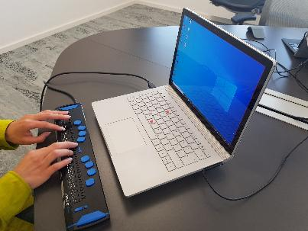


A day in the life of a person who is blind
Microsoft 365 Copilot
Buy
Benefits
Areas of investment: Content creation
Meeting preparation
8:30 am
9:00 am
9:30 am
Lena starts working from her home-office and asks Copilot to summarize her emails and chats for any customer requests.
She receives a Word document that is inaccessible with her screen reader. She asks Copilot in Word to summarize the document resulting in an accessible summary.
Lena has an upcoming meeting in the afternoon and needs to get prepared. She uses Copilot to get prepared.
Lena
uses a screen reader and braille keyboard to consume and create content.
Business Chat²
Copilot in Word
Business Chat²
Sample Prompt: Summarize questions from customers sent yesterday from my email and chat messages and prioritize my top 3 action items for today.
Sample Prompt: Summarize this document.
Sample Prompt: Help me prepare for [Review Meeting]
4:00 pm
2:00 pm
10:30 am
Lena receives an email which includes an image that does not have any alternative text. She asks Copilot what the image shows.
She attends a large meeting which takes place every week. She needs to find a message from the chat from last month. To save a lot of clicks, she uses Copilot in Teams.
Lena needs to prepare a slide deck for the upcoming meeting. She already has her notes created in Word. She asks Copilot to create a presentation from that document, which she can do without sighted assistance.
Business Chat¹
Copilot in Teams
Copilot in PowerPoint
Sample Prompt: Please describe this image?
Sample Prompt: What did /Anna ask in last week`s meeting?
Sample Prompt: Create a presentation from /[file]
¹Access Copilot at copilot.microsoft.com or the Microsoft Copilot mobile app and set toggle to “Web”.
²Access Business Chat at copilot.microsoft.com, the Microsoft Copilot mobile app, or the Copilot app in Teams, and set toggle to “Work”.
³Copilot agents allow Microsoft 365 Copilot to access your organization-specific apps. In the past this would have required an API call to get data from a system of record.
The content in this example scenario is for demonstration purposes only. You should evaluate how Copilot aligns with your organization’s business processes, regulatory requirements, and responsible AI principles.

