Slide 1





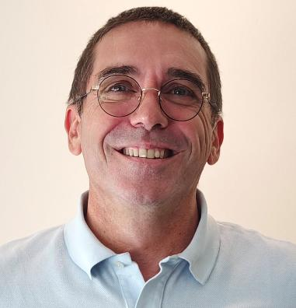

A day in the life of a person who has loss of hearing
Microsoft 365 Copilot
Buy
Benefits
Reduce cognitive fatigue
Clear understanding
9:00 am – Meeting captions
10:15 am – Summarize meeting
11:00 am – Get action items
Christophe joins a team meeting with attendees from various countries. He uses captions to follow along and asks Copilot in Teams to summarize the call to avoid any misunderstandings.
Christophe is responsible for summarizing Town Hall recordings. Rather than listening and summarizing, he uses Copilot in Stream to collect the main points, reducing cognitive load and fatigue.
Christophe watches an internal video in Stream in a very noisy environment and needs to prepare a high-level presentation on the main elements of the video. He uses Copilot in Stream to extract the main points.
Christophe
leverages technology to avoid fatigue and ease understanding
Copilot in Teams
Copilot in Stream
Copilot in Stream
Sample Prompt: Recap the meeting and summarize what each person said.
Sample Prompt: Summarize the video.
Sample Prompt: Extract the main points of the video.
3:00 pm – Recap a meeting
2:00 pm – Learn ASL
1:30 pm – Create presentation
That is the last call of the day, but Christophe’s tinnitus is acute. He decides to drop from the call and relies on Copilot in Teams for a summary.
Christophe will soon be attending a global event and wants to learn a few ASL signs to meet with other deaf peers.
Having gathered the main points into a file, Christophe then uses Office Agent to create a PowerPoint presentation covering those main points.
Copilot in Teams
Copilot Chat¹
Office Agent with PowerPoint
Sample Prompt: Summarize the discussion and identify next steps for me.
Sample Prompt: How can I sign ‘hello, my name is Christophe’ in ASL?
Sample Prompt: Create a presentation from /[file].
Get started with Office Agent

