Slide 1
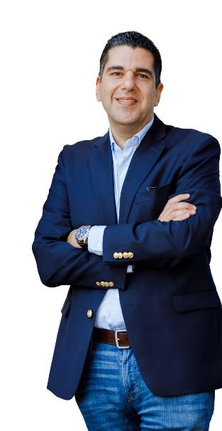
A day in the life of a Customs Agent
Microsoft 365 Copilot
Benefits
~1 hour per day
Areas of investment: Investigation efficiency
Analysis techniques
Matt
is a Customs Agent who aims to improve the customs clearance and collection efficiency.
8:00 am
9:30 am
10:00 am
Begin the day by analyzing the latest batch of declarations filings to identify any discrepancies or cases of non-compliance.
Discuss strategies for dealing with delinquent trader accounts and the implementation of new customs processes with the management and clearance team.
Focus on in-depth analysis of accounts that have been flagged for potential issues to determine the necessary course of action.
Copilot in Excel
Copilot in Teams
Copilot Chat²
Prompt: Sort the data by clearing status and then filter out the high-priority cases.
Prompt: Summarize the meeting and ensure all new processes are captured and distributed to relevant teams.
Prompt: Summarize the information on accounts due for investigations and create an action plan.
4:00 pm
2:00 pm
11:00 pm
Revise the collection forecasts based on recent in-person investigations and their projected impact on revenue.
Catch up on correspondence to resolve outstanding queries and ensure clearance.
Prepare to brief the investigation team on upcoming actions and ensure that all team members are informed of their specific roles.
Copilot in Excel
Copilot in Teams
Copilot in PowerPoint
Prompt: Assess the impact of new investigations on collection targets.
Prompt: Summarize this thread identifying outstanding issues and actionable items.
Prompt: Create a presentation from the investigation action report for the team.

