Slide 1
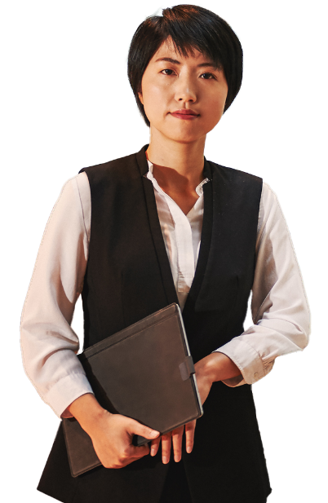
A day in the life of a Clerk of Courts
Microsoft 365 Copilot
Buy
Benefits
~45 minutes per day
Areas of investment: Communication
Research
7:00 am
8:00 am
10:30 am
Esther
is a Clerk of Court.
Arrive at the courthouse and use Copilot to organize emails and review schedule and tasks.
As court sessions commence, Copilot promptly transcribes the events, producing a preliminary transcript that is searchable within minutes, enabling concentration on the ongoing court proceedings.
During a break in proceedings, use Copilot to draft and send updates to other court staff members and summarize new emails to identify new action items.
Copilot Chat²
Copilot in Teams
Copilot in Outlook
Prompt: Review my last 24 hours of email, identify tasks and create list of priorities; review schedule and create reminders for 30 minutes ahead of each meeting.
Prompt: Find where person mentioned [phone call to defendant].
Prompt: Summarize this email thread.
5:00 pm
3:00 pm
2:00 pm
At the end of the day, use Copilot in Excel to analyze outstanding payments.
The Clerk performs in-depth legal research at the request of the Judge, using Copilot to find legal precedents, statutes, and case law. Present these findings and insights to the Judge in a concise manner, along with relevant references in a Word document.
Using the automated transcript from the morning session, use Copilot to create a summary of the court orders and payment arrangements outlined by the Judges for each case, ensuring that all necessary information was accurately documented.
Copilot in Excel
Copilot Chat²
Copilot Chat²
Prompt: Sort this list of outstanding payments from largest to smallest.
Prompt: Find and summarize relevant documents, statutes, presidents and case law on [subject of case]
Prompt: Summarize this transcript and provide a summary of court orders and payment arrangements

