Slide 1
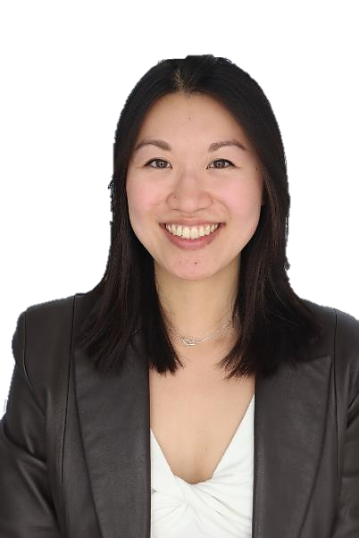
A day in the life of a Product Marketing Manager at Microsoft
Microsoft 365 Copilot
Buy
Benefits
~90 minutes per week
Areas of investment: Creative solutions
Job satisfaction and output
8:00 am
8:15 am
9:00 am
Andrea is a Sr. Product Marketing Manager
Andrea uses Copilot to catch up on unread email and chat messages. Copilot surfaces an ask from her communications lead for her to draft an announcement blog for the upcoming event.
Andrea receives the latest product planning deck from her engineering colleague. She opens the deck and uses Copilot in PowerPoint to summarize key points.
Now that she’s digested the technical details, Andrea opens Word and uses Copilot in Word to draft an announcement blog, using the product planning deck as a source file.
Copilot Chat²
Copilot in PowerPoint
Copilot in Word
Example prompt: Catch up on email and Teams chats from the past day, highlighting the primary asks and open items.
Example prompt: Summarize this presentation, highlighting upcoming product changes in the next few months.
Example prompt: Draft an announcement blog with an introduction explaining the product, middle explaining new features, and conclusion based on [Q3CopilotPlanning].
4:00 am
2:00 pm
11:00 am
With the announcement blog in good shape, Andrea uses Copilot in Outlook to draft an email to her product, communications, and marketing stakeholders to review the announcement blog.
Switching over to Teams, Andrea takes her 1:1 meeting with her manager. Copilot in Teams helps her take meeting notes and record action items so she can focus on her conversation.
Andrea wants to add some background information to the blog intro. She prompts Copilot for relevant industry articles from analysts. Copilot summarizes each article and provides links to the sources.
Copilot in Outlook
Copilot in Teams
Copilot Chat¹
Example prompt: Draft an email to my colleagues asking for them to review my draft of the blog for the upcoming event by June 5.
Example prompt: What were the action items from the meeting?
Example prompt: What are some recent trends on generative AI for work from well known industry analysts and influencers?

