Slide 1
Outreach Personalization Agent
SALES FUNCTION
Analyze communication patterns, generate personalized messaging, and streamline email and meeting invite creation
Outreach to customers is repetitive, manual, and lacks personalization and customer context
Current Workflow Challenges
Significant seller bandwidth spent on repetitive tasks like writing emails and creating meeting invites which are generic and lack customer context
Low response/ conversion rates from customers due to lack of personalization
Limited seller capacity to focus and build relationships with customers
Key Features
Business Impact
From
Ingests customer/contact info and opportunity data
Sales Lifecycle → expedited process for a seller to make a sale
Response Rates → percentage increase in email and meeting invite responses
Analyzes previous communication patterns
Lead Conversion Rates → percentage increase in conversions (ex: scheduled meetings, follow-ups, closed deals)
Tailored outreach to customers with AI-Agents automates data analysis and content structuring to tailor communication to the unique needs and preferences of individual prospects or customers
To
Suggests email content structure and call-to-action
Key User(s)
AI Agent drives real-time intent identification, intelligent routing, and hyper-personalized recommendations
Sellers
Drafts personalized outreach email and/or meeting invites

Slide 2
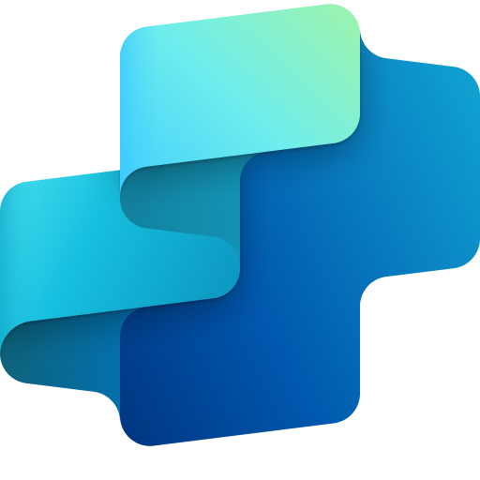
Sales
Outreach Personalization Agent
Available with:
Copilot Studio
Scenario level:
Extend
Ingest Data
Analyze Previous Patterns
Personalize Outreach Strategy
Agent retrieves CRM records, contact history, and opportunity details.
Evaluates past communication trends across channels to identify patterns that drive engagement.
Identifies customer preferences, roles, and potential intent to tailor the tone and content of outreach.
Automatically analyze customer communication patterns to craft personalized messaging and streamline email and meeting invite creation for more effective sales management.
KPIs impacted
Value benefit
AI Agent
Connection to CRM (Dynamics)
AI Agent
Connection to Outlook
Connection to MS Teams
AI Agent
Connection to CRM (Dynamics)
Benefit: Pulls in contact history and opportunity details to set the foundation for targeted outreach.
Benefit: Reveals what communication styles and channels have worked best in the past.
Benefit: Customizes messaging based on customer roles, preferences, and behavior signals.
Sales Lifecycle
Response Rates
Draft Outreach
Generate Email Structure
Identify Customer Information
Lead Conversion Rates
Agent writes first drafts of emails or meeting invites customized to client context. Agent allows manual final touches before sending.
Agent generates a personalized draft outline aligned to customer profile and deal stage.
Identifies customer preferences, roles, and likely intent to shape outreach tone and content
Cost Saving
AI Agent
Connection to Communication Channel (Outlook)
AI Agent
Connection to CRM (Dynamics)
Connection to Communication Channel (Outlook)
AI Agent
Connection to CRM (Dynamics)
Employee Experience
Benefit: Speeds up engagement with editable, AI-generated emails or invites that feel personal.
Benefit: Creates context-aware email drafts aligned with buyer journey and persona.
Benefit: Surfaces key details to help tailor tone, timing, and content strategy.

Slide 3

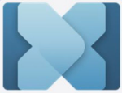
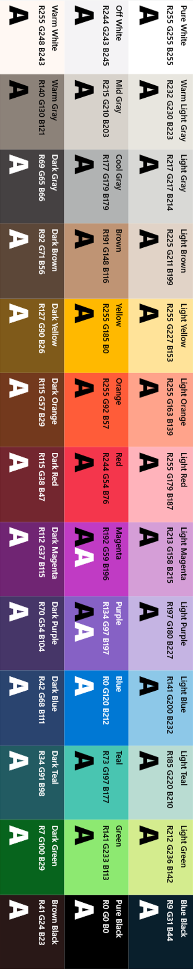
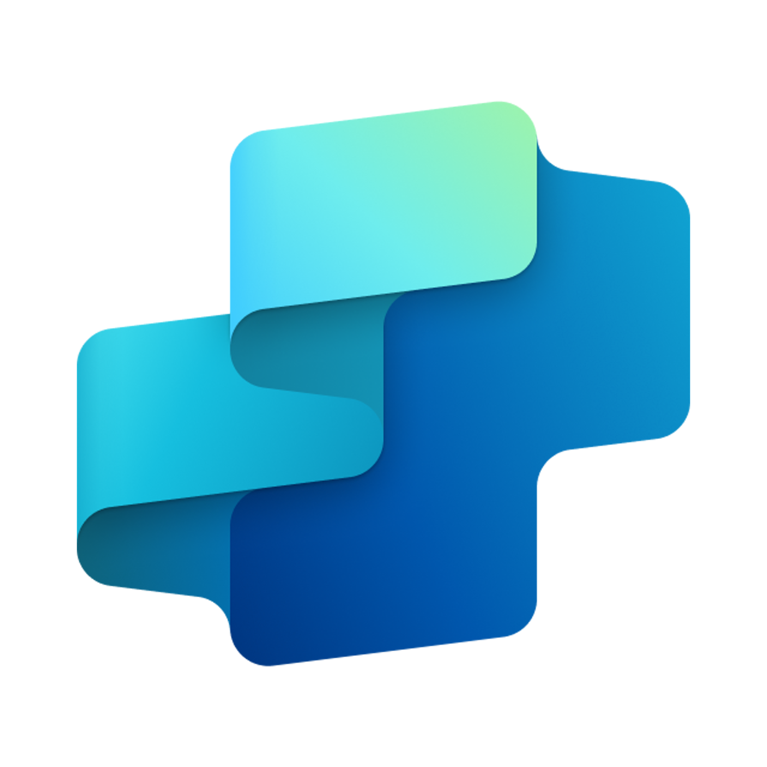


Outreach Personalization Agent
SALES FUNCTION
Analyze communication patterns, generate personalized messaging, and streamline email and meeting invite creation
Key Considerations to Address
Email context and metadata (sender/recipient, prior threads) must be accessible
PII / Sensitive info: LLMs should operate in-memory or ensure sensitive data is secure (e.g., customer name, purchase history, etc.) communication history, etc.)
Optional: CRM, Outlook, and calendar APIs for automatic email/invite creation
Inputs needed
Core integrations for CRM (Dynamics), Email Systems (Outlook)
CRM records and opportunity metadata (JSON/CSV)
Prior email communications (.msg, .txt)
Optional - sales engagement playbooks / branding guidelines (DOC, HTML)
Sales and Marketing Team
7. Response
1. User Query
Knowledge
Power Platform
Connectors
No
SharePoint, Dynamics 365, Salesforce, ServiceNow, Public URLs and other integrated platforms
Power Platform Connection Identity
User Intent(Prompt) to (SQL,API Call)
Backend system search – based on connector implementation
2. Fetch
information
Microsoft Graph
Semantic Index/
Advanced search features
Context and Content
(emails, files,
meetings, chats,
calendars and contacts)
Orchestrator
3. Tenant Graph Grounding
End-User Identity
User Intent (Prompt) to MSFT Graph query
Keyword(Lexical) Search
User Feedback
Customer Analyzer
(Analyzes customer / contact information)
Communication Pattern Analyzer
(Analyzes previous communication patterns)
Yes
4. One or more actions/topics/ knowledge matched
Skills
Content Structure
(Suggests email content structure and call-to-action)
Trigger, Actions, Workflows (Perform data grounding)
5. A plan is generated using
actions / knowledge / topics
Autonomy
Planning, Self-Learning (using feedback)
*Reference Architecture Assumptions
Integrated CRM and email systems with access to prior communications and contact metadata
Defined customer engagement playbooks, branding standards, and approved outreach templates
Insights
Data Handling and security
6. Monitor Management
Logs, Telemetry data for analysis and Monitoring
Workflow Development
Data Source Integration
Base Pre-trained OpenAI Models available in Copilot Studio

