Slide 1
Lead Prediction Agent
SALES FUNCTION
Leverage behavioral and CRM data to score leads, predict conversion probabilities, and optimize follow-up prioritization
Lead scoring and prioritization is manual and limited in actionable insights
Current Workflow Challenges
Manual lead prediction and prioritization processes
Individual predictions are often based on incomprehensive analysis, due to significant volume
Key Features
Business Impact
From
Scores leads using behavioral, CRM, and external data
Sales Pipeline Efficiency → increase in the effectiveness and speed with which leads are converted
Lead Conversion Rates → percentage increase in leads that are most likely to convert to customers
Enhanced conversion predictions using historic patterns allowing businesses to focus their efforts on high-potential leads, increasing the overall conversion rate
Increased Efficiency and ROI: → prioritization process reduces the effort required from sales teams, allowing them to focus on closing deals
Agent automates the scoring and prioritization of leads while offering predictive insights on conversion probabilities, enhancing the sales lifecycle and delivering valuable follow-up information
To
Recommends optimized follow-up prioritization by continuously monitoring and re-evaluating leads based on new data, ensuring that follow-up actions are timely and relevant
Key User(s)
AI Agent drives real-time intent identification, intelligent routing, and hyper-personalized recommendations
Sellers
Suggests optimal routing path like assigning a senior sales rep who is an SME on a niche skill that will be required for the lead

Slide 2
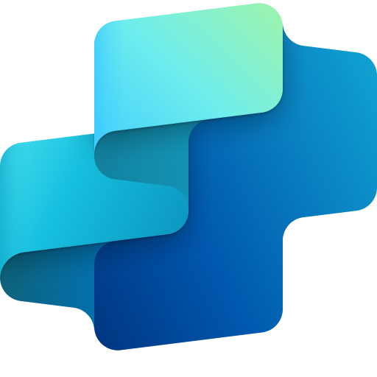
Sales
Lead Prediction Agent
Available with:
Copilot Studio
Scenario level:
Extend
Lead Scoring with Data Insights
Improved Conversion Forecasting
Continuous Lead Monitoring
Scores leads using behavioral, CRM, and external data
Enhanced conversion predictions using historic patterns allowing businesses to focus their efforts on high-potential leads, increasing the overall conversion rate
Monitors and updates lead data in real-time, capturing new information to keep the lead profiles accurate and up-to-date.
Leverage behavioral and CRM data to score leads, predict conversion probabilities, and optimize follow-up prioritization
KPIs impacted
Value benefit
AI Agent
Connection to CRM tool
Connection to SharePoint
AI Agent
Connection to CRM tool
Connection to SharePoint
AI Agent
Connection to CRM tool
Connection to SharePoint
Connection to communications tool
Benefit: Ranks leads by likelihood to convert using behavioral, CRM, and external data.
Benefit: Boosts accuracy in predicting which leads are worth pursuing.
Benefit: Keeps lead profiles fresh and reliable with real-time updates.
Sales Pipeline Efficiency
Lead Conversion Rate
Provides Feedback & Recommendations
Dynamic Follow-Up Optimization
Increased Efficiency and ROI
Suggests optimal routing path like assigning a senior sales rep who is an SME on a niche skill that will be required for the lead
Reassesses lead priorities based on fresh data, ensuring follow-up actions are timely, relevant, and optimized for maximum engagement.
Cost Savings
AI Agent
Connection to CRM tool
Connection to SharePoint
Connection to communications tool
AI Agent
Connection to communications tool
Customer Experience
Benefit: Recommends the best-fit sales rep or next step based on lead context.
Benefit: Adjusts outreach timing and priorities to maximize engagement.

Slide 3


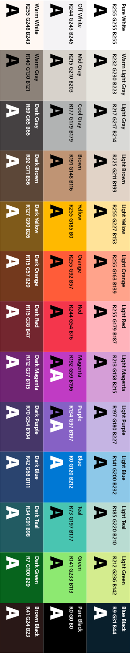
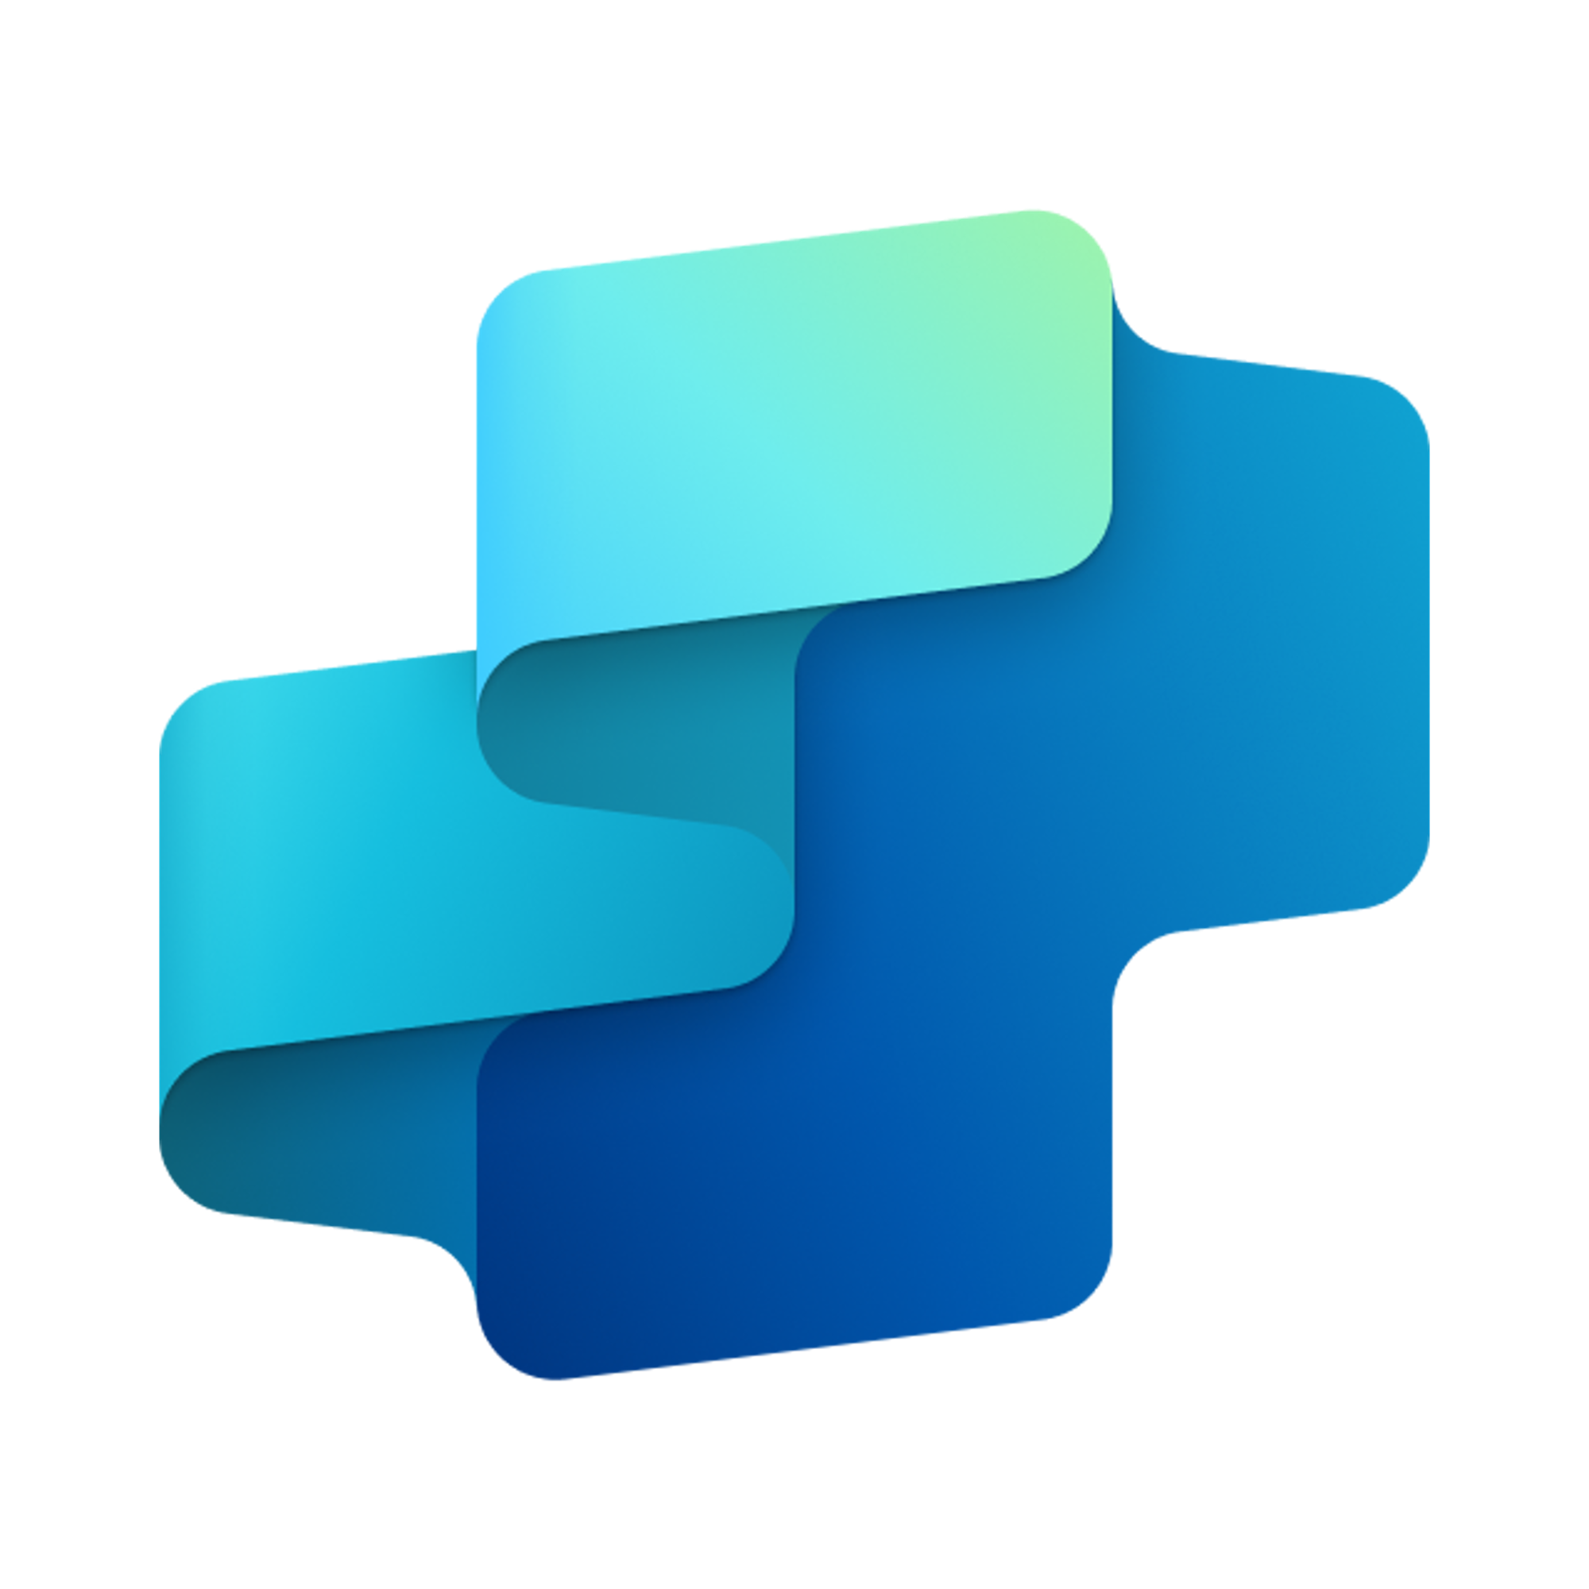


Lead Prediction Agent
SALES FUNCTION
Leverage behavioral and CRM data to score leads, predict conversion probabilities, and optimize follow-up prioritization
Key Considerations to Address
Must integrate data from CRM
AI/ML training using historical conversion data
Likely needs occasional retraining
Routing logic for segment, region, rep availability
Inputs needed
CRM pipeline data (CSV, JSON)
Historical conversion rate data (Excel)
Communication Data (.msg/.txt, Doc, HTML)
Knowledge content – optional (PDF, Doc, HTML)
Sales and Marketing Team
7. Response
1. User Query
Knowledge
Power Platform
Connectors
No
SharePoint, Dynamics 365, Salesforce, ServiceNow, Public URLs and other integrated platforms
Power Platform Connection Identity
User Intent(Prompt) to (SQL,API Call)
Backend system search – based on connector implementation
2. Fetch
information
Microsoft Graph
Semantic Index/
Advanced search features
Context and Content
(emails, files,
meetings, chats,
calendars and contacts)
Orchestrator
3. Tenant Graph Grounding
End-User Identity
User Intent (Prompt) to MSFT Graph query
Keyword(Lexical) Search
User Feedback
Customer Analyzer
(Analyzes customer / contact information)
Communication Pattern Analyzer
(Analyzes previous communication patterns)
Yes
4. One or more actions/topics/ knowledge matched
Skills
Training Strategy Generator
(Generate different training simulation based on the analysis report to train Sales Team)
Trigger, Actions, Workflows (Perform data grounding)
5. A plan is generated using
actions / knowledge / topics
Autonomy
Planning, Self-Learning (using feedback)
Insights
Data Handling and security
6. Monitor Management
Logs, Telemetry data for analysis and Monitoring
Workflow Development
Agent-to-Agent
Workflow
N/A
Data Source Integration
Base Pre-trained OpenAI Models available in Copilot Studio

