Slide 1
Conversation Simulation Training Tool
SALES FUNCTION
Enhance sales performance through AI-driven conversation training simulations for sales
Basic seller training does not prepare sellers for realistic customer conversations
Current Workflow Challenges
Training for sellers lacks a wide breadth of experiences / customer conversation types
Sellers do not feel prepared for initial customer conversations
Sellers have to learn on the job, hurting sales conversion rates
Key Features
Business Impact
From
Simulates customer conversations across different scenarios
Ramp Up Time for New Sellers → reduction in time to get new sellers to full productivity
Sales Readiness Scores → percentage increase in sellers’ proficiency scores
Adjusts tone, objections, and questions dynamically
Sales Conversion Rates → percentage increase in deal closures / successful customer engagements
AI-Agent driven conversational simulation seller training uses dynamic tone, objections, and feedback to improve seller performance
To
Evaluates seller responses in real-time
Key User(s)
AI Agent drives real-time intent identification, intelligent routing, and hyper-personalized recommendations
Sellers
Provides performance feedback and recommendations

Slide 2

Conversation Simulation Training Tool
Sales
Available with:
Copilot Studio
Scenario level:
Extend
Simulates Customer Conversations
Adjusts Tone and Objections
Evaluates Seller Responses
Agent creates conversations simulating real-life customer interactions, adjusting for factors such as customer role, product type, communication tone, and industry-specific nuances.
Agent role-plays as customers varying tone, objections, and complexity.
Assesses the effectiveness of the seller's responses during the conversation, providing immediate feedback on their approach, clarity, and ability to address customer needs.
Simulate AI-powered sales conversations that deliver interactive, real-time training—adapting tone, handling objections, and providing instant feedback.
KPIs impacted
Value benefit
AI Agent
Connection to Knowledge Base (SharePoint) for Product Docs, Industry FAQs
Connection to Communication Channel (MS Teams)
Connection to CRM (Dynamics, etc.)
AI Agent
Connection to Communication Channel (MS Teams)
AI Agent
Connection to Communication Channel (MS Teams)
Benefit: Builds real-world sales scenarios to train reps on tone, objections, and industry nuance.
Benefit: Adapts conversation challenges dynamically to mirror real customer behavior.
Benefit: Scores seller replies in real time, highlighting gaps in clarity, confidence, and effectiveness.
Ramp up Time for New Sellers
Sales Readiness Scores
Summarizes Feedback
Provides Feedback & Recommendations
Sales Conversion Rates
Compiles and summarizes feedback, providing clear insights and actionable recommendations to improve sales performance.
Offers actionable insights and suggestions for improvement, helping sales teams refine their communication strategies and enhance customer engagement in future interactions.
Employee Experience
AI Agent
Connection to Communication Channel (Teams)
AI Agent
Connection to Communication Channel (Teams)
Benefit: Packages insights into actionable takeaways to boost overall sales performance.
Benefit: Delivers targeted tips to improve sales techniques and customer engagement.

Slide 3


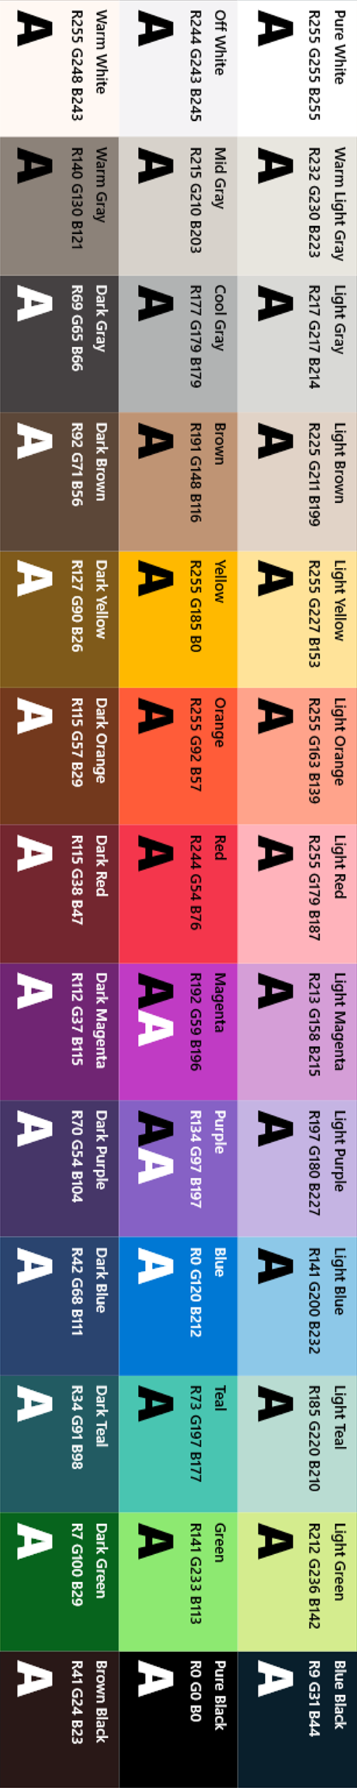
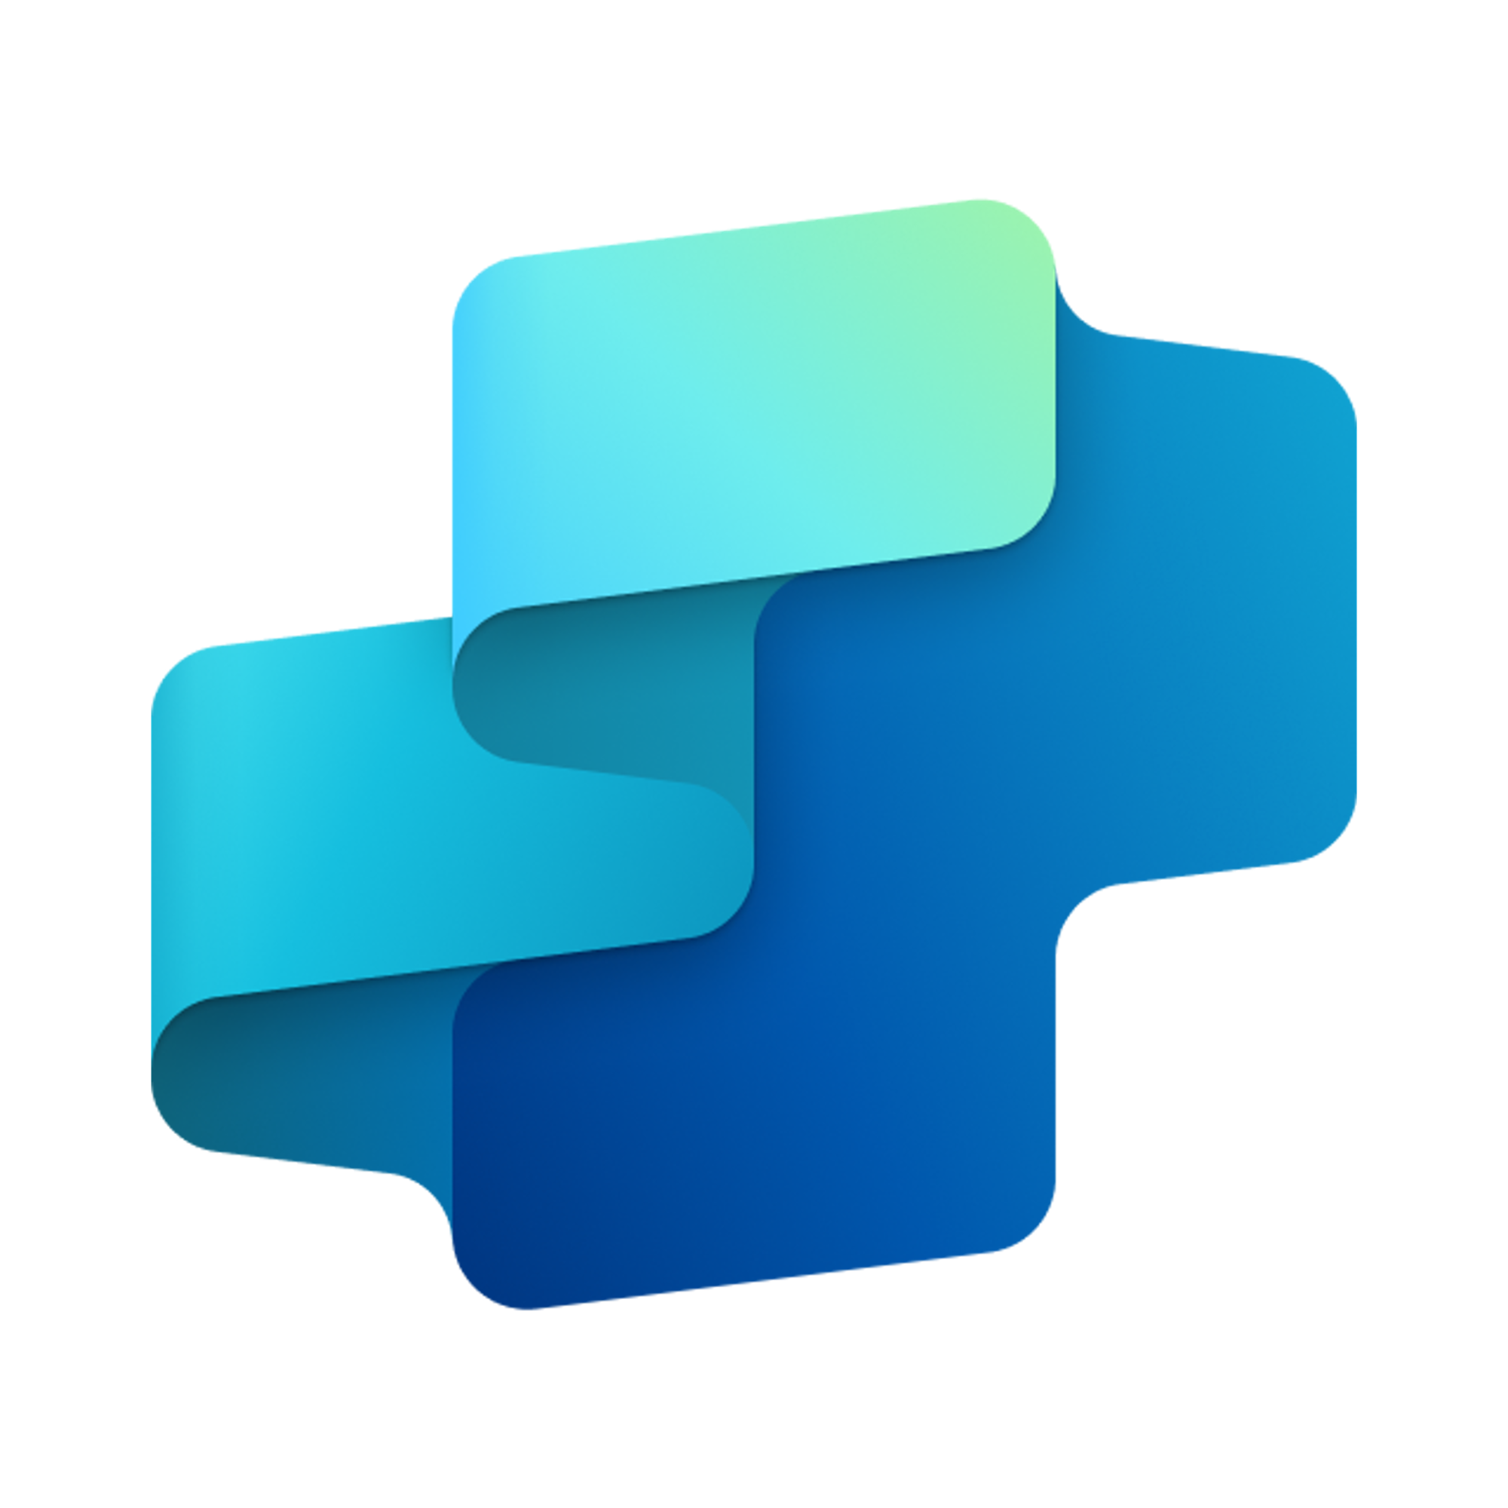


Conversation Simulation Training Tool
SALES FUNCTION
Enhance sales performance through AI-driven conversation training simulations for sales
Key Considerations to Address
Ingest customer communication data from email, chat logs, calls, call recordings transcripts, etc.
Omni channel interaction enablement (email, chat, call, shared documents)
PII required encryption from previous sales conversations (e.g., customer name, call recording transcripts, chat logs, emails etc.)
Inputs needed
Scenario libraries and training scripts (DOC, TXT)
Scoring framework or rubric (CSV, XLSX)
Communication Data (.msg/.txt, Doc, HTML)
CTI systems for Calls
Knowledge content – optional (PDF, Doc, HTML)
Previous training materials (PDF, Doc/HTML)
Sales and Marketing Team
7. Response
1. User Query
Knowledge
Power Platform
Connectors
No
SharePoint, Dynamics 365, Salesforce, ServiceNow, Public URLs and other integrated platforms
Power Platform Connection Identity
User Intent(Prompt) to (SQL,API Call)
Backend system search – based on connector implementation
2. Fetch
information
Microsoft Graph
Semantic Index/
Advanced search features
Context and Content
(emails, files,
meetings, chats,
calendars and contacts)
Orchestrator
3. Tenant Graph Grounding
End-User Identity
User Intent (Prompt) to MSFT Graph query
Keyword(Lexical) Search
User Feedback
Customer Analyzer
(Analyzes customer / contact information)
Communication Pattern Analyzer
(Analyzes previous communication patterns)
Yes
4. One or more actions/topics/ knowledge matched
Skills
Training Strategy Generator
(Generate different training simulation based on the analysis report to train Sales Team)
Trigger, Actions, Workflows (Perform data grounding)
5. A plan is generated using
actions / knowledge / topics
Autonomy
Agent-to-Agent
Workflow
Market Landscape Research Agent
Planning, Self-Learning (using feedback)
Insights
Data Handling and security
6. Monitor Management
Logs, Telemetry data for analysis and Monitoring
Workflow Development
Reference Architecture Assumptions
Access to historical omnichannel communication logs, training materials, and performance scoring frameworks
Defined learning and development workflows for simulation-based training and sales enablement
Data Source Integration
Base Pre-trained OpenAI Models available in Copilot Studio

