Slide 1
RETAIL INDUSTRY
Personalized Promotion Agent
Subfunction
Maturity
Delivers tailored promotions to customers based on behavior and past purchases
Customer Marketing & Data Monetization
Homerun
Promotions and marketing operations are often generic, one-size-fits-all approach which leads to low engagement, high costs and static sales
Current Workflow Challenges
Broad campaign strategy misses high-value segments
Limited use of behavioral or preference signals in targeting
High promotional spend with low ROI due to irrelevant offers
Manual segmentation and targeting is inefficient and takes lot of time
Difficult to measure the effectiveness of individual promotions
Missed opportunities for cross-sell or upsell based on customer behavior
Increases churn due to lack of relevant engagement
Difficult to A/B test offer variations and measure impact accurately
Key Features
Business Impact
From
Ingest customer behavioral, demographic, and purchase data from CRM
Promotion Engagement Rate → Higher open and click rates from personalized messaging
Conversion Rate → Improves performance through targeting based on customer preferences
Analyze past communication trends to identify patterns to drive engagement
Customer Acquisition Cost → Reduces spend from broad, inefficient campaigns to targeted marketing efforts
Revenue Uplift → Increases revenue though personalized offers, cross-sell and upsell promotions
Balances short-term promos with long-term value by targeting high-LTV segments and personalizing offers to boost ROI and loyalty
Segment customers based on their engagement preferences
To
Key User(s)
AI Agent drives real-time intent identification, intelligent routing, and hyper-personalized recommendations
Create tailored email messages/SMS, customized to the recipient’s needs
Marketing Team
CRM Managers
Deliver via email, app, or SMS with time-sensitive CTAs
Loyalty Program Leads

Slide 2
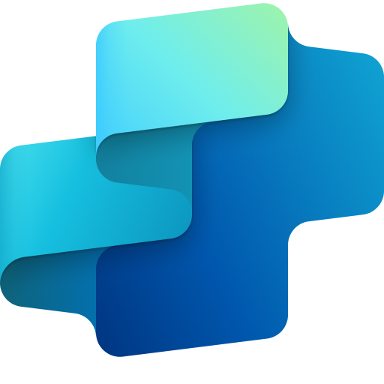
Retail
Personalized promotion agent
Available with:
Copilot Studio
Scenario level:
Extend
Email Structure & CTA Recommendation
Ingest data
Analyze previous patterns
Segment customer base
Ingests customer base with behavioral, demographic, and purchase data from CDP.
Analyzes past communication trends like each customer's preferred communication channel, optimal time of day, and preferred day of the week to drive engagement.
Leverages an ML model to segment customers based on their engagement preferences, campaign objectives and revenue goals.
Delivers tailored promotions to customers based on behavior and past purchases.
KPIs impacted
Value benefit
AI Agent
Connection to CDP (Dynamics 365) for customer data download
AI Agent
Connects to the CRM system (Dynamics 365) for customer engagement data analysis
Connection to Analyzing Tools (Excel) to analyze previous engagement data of customers
AI Agent
Connects to the CRM (Dynamics 365) for customer data, campaign objectives, available promotions etc.
Benefit: Helps streamline data intake from multiple sources to save time.
Benefit: Analyzes past communication trends, to help in more precise and timely targeting for improved engagement.
Benefit: Segments customer base, helps in effective customer targeting.
Increases Promotion Engagement Rate
5. Recommend CTA
4. Draft email/SMS structure
Improves Conversion rate
Delivers via email, app, or SMS with time-sensitive call to action.
Creates tailored email messages/SMS, customized to the recipient’s needs.
Decline in Customer Acquisition Cost
Customer Experience
AI Agent
Connection via API to cloud communication platforms for SMS/email delivery
AI Agent
Connection to CRM (Dynamics 365) for content generation that are tailored to the recipient
Revenue Growth
Benefit: Enables timely delivery of promotions via app, email or SMS to boost conversion rates.
Benefit: Creates tailored emails or SMS to enhance content quality and reduce manual effort.

Slide 3
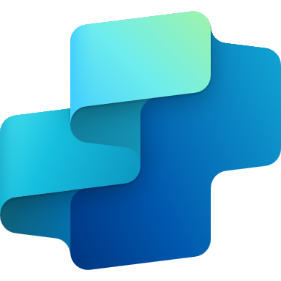
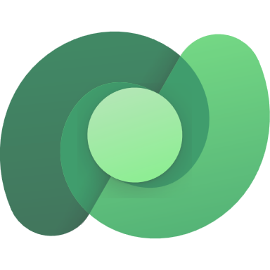
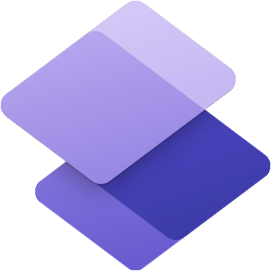
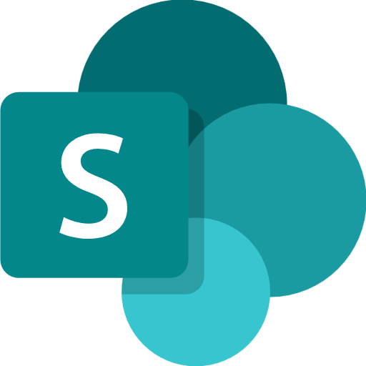
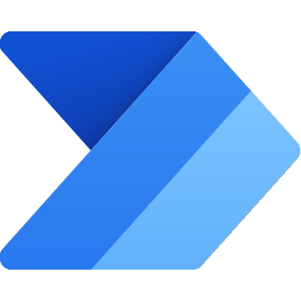
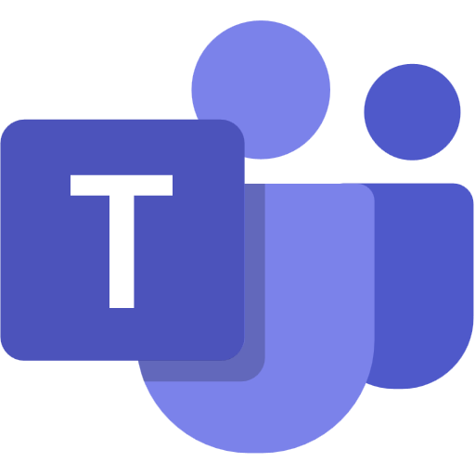
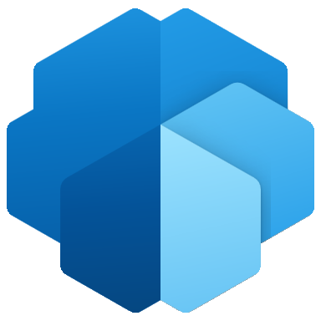
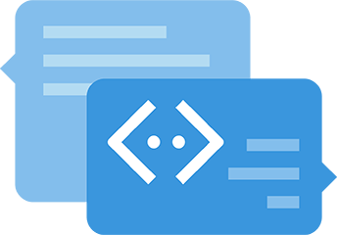
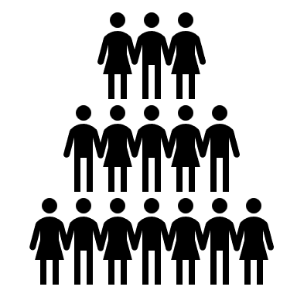
RETAIL INDUSTRY
Personalized Promotion Agent
Delivers tailored promotions to customers based on behavior and past purchases
Key Considerations to Address
Integrate with CDP (Dynamics 365) for customer engagement data in PDF, DOCX or image (JPEG, PNG) format for analyzing patterns in customer’s past engagement data
Integrate with CRM (Dynamics 365) to push campaign features, available promotions, product on offers etc. by CRM managers.
Integrate with AI Builder models for customer data segmentation
Integrate with Dataverse as knowledge to define promotion rule, SharePoint to share email templates
Integrate with APIs to cloud communication platforms to send SMS/email
PII includes customer data (name, contact information, customer service requests etc.)
1. Marketing Team and CRM managers launch new campaign with promotional offers
Licensed Users
Base Pre-trained OpenAI Models / custom Open AI models (preview)
Orchestrator
9b. Feedback – updates instructions and eligibility thresholds
Marketing Team
Low
Eligibility score
High
5. Invokes tools based on instructions
0
1
4. New promotion triggers workflow
5a. Categories promotions
5b. Evaluates customers
CRM Managers
3. New promotions/ offers pushed to Dataverse
Knowledge Base
Channels
7. Teams notification on review
Structured Records
5c. Derives eligibility score
Prompts
2. CRM already contains customer profile, past purchase and demographic data
Structured Records
Unstructured Documents (versioned)
Tools
Connector
LEGEND
5d. Pulls promotion templates
6b. eligibility_score <0.2, sends review message
Unlicensed Users
6-a-2. sends promotions
D365 Customer Portal
6-a-1. eligibility_score >0.8, sends promotional messages via SMS (Twillio) & emails
Customers
Dataverse
8. Agent logs are shown on Copilot Studio Kit
Agent-to-Agent
Workflow
SharePoint
Agent Ops (logging, audit, observability)
Customer Lifetime Value Prediction Agent
Conversation Transcript
Copilot Studio Agent
Reference Architecture Assumptions
Agent will be hosted on Teams channel with Microsoft authentication
Marketing team will be M365 license to access the agent
Customer will get communication from Agent, but no chat feature
WhatsApp channel is in preview now
Other dependent agents should be ready and discoverable to be associated with this agent
App Insights
9a. Agent logs are reviewed
Copilot Studio Kit - Extend
*Please Note: The WhatsApp channel uses Azure Communication Services (ACS) as the bridge between agents you create in Copilot Studio and your WhatsApp endpoint, the chat or group that the users of your agent will use to interact with the agent. It is in Preview now.
Flow / Connector
MS Teams

