Slide 1
Marketing Brief Creation Agent
MARKETING FUNCTION
Gather insights, tailor content, and ensure alignment across teams for effective strategy and execution
Marketing brief creation is manual, delayed, and inconsistent, resulting in team misalignment, delays, and inefficiencies
Current Workflow Challenges
Manual insights collection from multiple sources delays brief creation
Manual entry of data into briefing templates takes time and leads to errors
Difficulty in consolidating insights from diverse sources such as social media trends, audience insights, competitor data, and customer behavior
Misalignment between teams due to inconsistent briefing formats
Time-consuming collaboration and feedback cycles
Lack of customization for stakeholder-specific needs resulting in unclear communication
Key Features
Business Impact
From
Gathers insights from internal data (CRM, past campaigns) and external sources (social trends, competitor analysis) to inform marketing briefs
Faster Brief Creation → Reduces time required to create and refine marketing briefs
Improved Alignment Across Teams → Enhances collaboration by ensuring clear and consistent communication
Generates marketing briefs using both predefined and customizable templates to meet unique needs of various marketing teams
Higher Efficiency in Campaign and Project Execution → Faster execution through streamlined briefing process
AI-driven marketing brief creation streamlines data collection, customizes briefs for different stakeholders, and enables real-time collaboration to improve clarity, alignment, and campaign execution
To
Tailors briefs for marketing functions like creative, content, and campaign teams to align with their specific requirements
Key User(s)
AI Agent drives real-time intent identification, intelligent routing, and hyper-personalized recommendations
Project Managers
Campaign Strategists
Tracks feedback from stakeholders and recommends updates to briefs by identifying gaps and missing details, tailored to the specific needs of functional areas
Marketing Managers
Campaign Performance Measurement & Optimization team

Slide 2
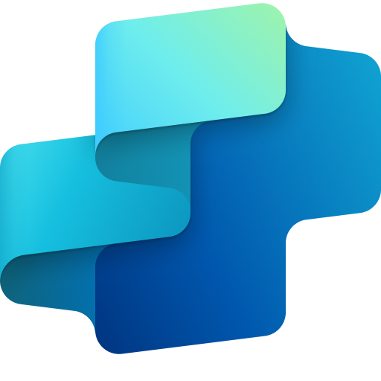
Marketing Brief Creation Agent
Marketing
Available with:
Copilot Studio
Scenario level:
Extend
Gather Internal Data Insights
Gather External Data Insights
Creates Marketing Briefs
Gathers insights from internal data (CRM, past campaigns).
Gathers insights from external sources (social trends, competitor analysis) to inform marketing briefs.
Generates marketing briefs using both predefined and customizable templates to meet unique needs of various marketing teams.
Streamline data collection of market insights, customize marketing briefs for different stakeholders, and enable real-time collaboration to improve clarity, alignment, and campaign execution.
KPIs impacted
Value benefit
AI Agent
Connection to CRM (Dynamics) for Marketing Analytics Data
AI Agent
Connections to External Data (Gartner, etc.)
AI Agent
Connection to Content SharePoint (Marketing Brief Templates)
Benefit: Pulls historical performance and CRM data to ground briefs in proven insights.
Benefit: Brings in social, competitive, and market trends to shape data-backed strategies.
Benefit: Auto-generates briefs using customizable templates to save time and ensure consistency.
Faster Brief Creation
Improved Alignment Across Teams
Optimized Recommendation
Stakeholder Feedback
Customizes Briefs for Marketing Functions
Higher Efficiency in Campaign & Project Execution
Recommends updates to briefs by identifying gaps and missing details, tailored to the specific needs of functional areas.
Feedback from the Stakeholders is tracked.
Tailors briefs for marketing functions like creative, content, and campaign teams to align with their specific requirements.
Cost Saving
AI Agent
Connection to Content Management System (SharePoint)
AI Agent
Connection to Power Automate
Connection to User Input (Routing Logic)
AI Agent
Connection to SharePoint (Marketing Brief Templates)
Employee Experience
Benefit: Identifies gaps and suggests tailored updates for more effective execution.
Benefit: Tracks and integrates feedback to keep briefs aligned and up to date.
Benefit: Adapts briefs to suit the specific goals of creative, content, and campaign teams.

Slide 3
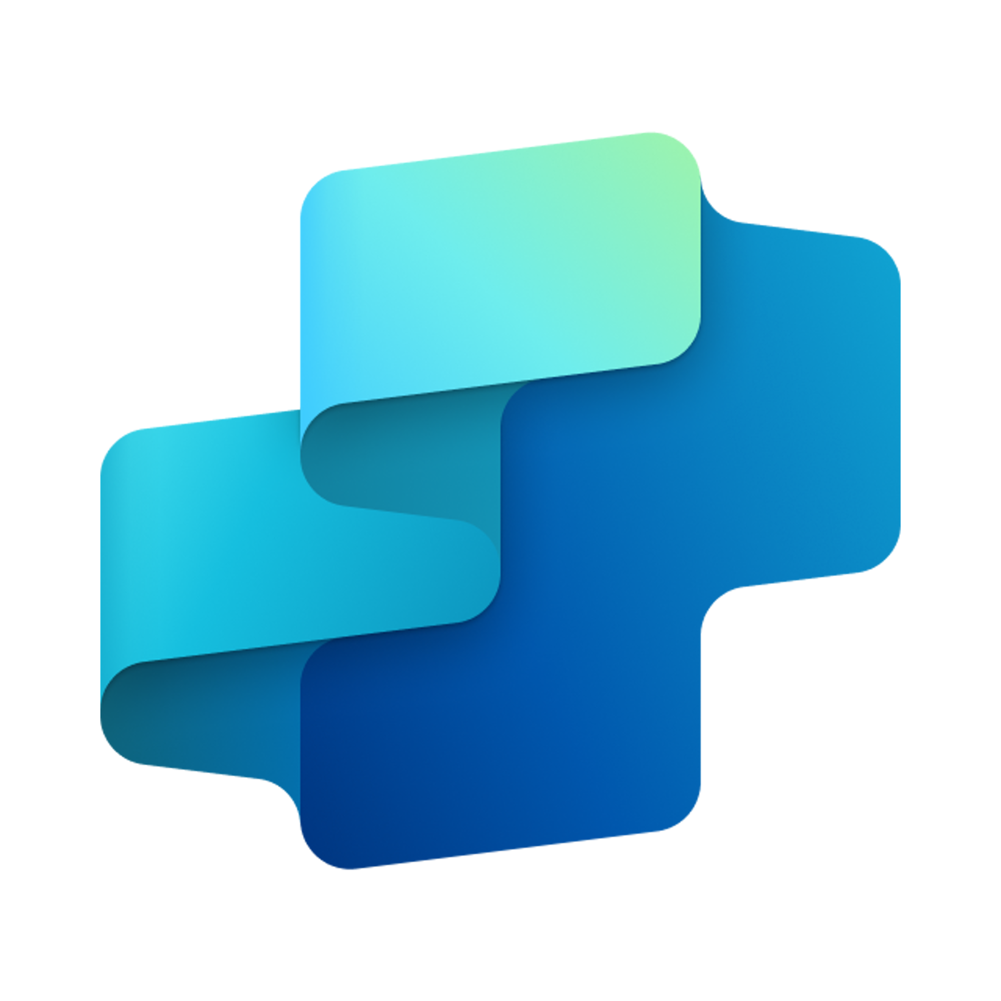
Marketing Brief Creation Agent
MARKETING FUNCTION
Gather insights, tailor content, and ensure alignment across teams for effective strategy and execution
Key Considerations to Address
Ensure brief aligns with brand guidelines, logos, and messaging
Requires access to historical brief repository
Optional - integration with external knowledge sources for industry/market insights (Gartner, etc.)
Optional - brand and messaging guidelines
Inputs needed
Training on Brand and legal compliance documents (Specific to brand and industry)
Ingestion of pre-defined brief template
Historical briefs and feedback (CMS) (DOC, PDF, HTML)
External knowledge sources (Gartner, etc.) (PDF, HTML, DOCX (depending on publisher)
Marketing Team, Compliance Team
7. Response
1. User Query
Knowledge
Power Platform
Connectors
No
SharePoint, Dynamics 365, Salesforce, ServiceNow, Public URLs and other integrated platforms
Power Platform Connection Identity
User Intent(Prompt) to (SQL,API Call)
Backend system search – based on connector implementation
2. Fetch
information
Microsoft Graph
Semantic Index/
Advanced search features
Context and Content
(emails, files,
meetings, chats,
calendars and contacts)
Orchestrator
3. Tenant Graph Grounding
End-User Identity
User Intent (Prompt) to MSFT Graph query
Keyword(Lexical) Search
User Feedback
Insight Collector
(Gather consolidated marketing trends report from marketing team and extract metadata)
Strategy Planner Analyzer
(Generate strategy according to trends, ensure to not violate compliance)
Yes
Content Generation Analyzer
(Generate content with strategic template)
4. One or more actions/topics/ knowledge matched
Skills
Trigger, Actions, Workflows (Perform data grounding)
5. A plan is generated using
actions / knowledge / topics
Autonomy
Communication Agent
(Execute)
Agent-to-Agent
Workflow
Integrated Creative Ideation & Content Creation Agent
Planning, Self-Learning (using feedback)
Insights
Data Handling and security
6. Monitor Management
Logs, Telemetry data for analysis and Monitoring
Workflow Development
*Reference Architecture Assumptions
Access to brand guidelines, legal compliance documents, and historical marketing briefs
Defined marketing content creation workflows with approval stages and templated brief structures
Data Source Integration
Base Pre-trained OpenAI Models available in Copilot Studio

