Slide 1
Compliance Check Agent
MARKETING FUNCTION
Automatically ensure marketing content aligns with brand guidelines and regulatory standards by proactively detecting inconsistencies and flagging compliance risks before publication
Manual, time-consuming content review processes lead to inconsistent brand messaging, regulatory violations, and potential legal risks
Current Workflow Challenges
Manual content review processes are slow, increasing time-to-market delays
Inconsistent checks result in missed brand inconsistencies and regulatory violations
High dependency on manual oversight increases the risk of human error
Difficulty in tracking and documenting compliance risks for audit purposes
Lack of proactive measures leads to costly post-publication corrections
Key Features
Business Impact
From
Scans marketing materials to ensure they adhere to established brand guidelines and regulatory standards
Increase in Brand Consistency → Ensures all marketing content aligns with brand guidelines.
Reduces chances of regulatory violations → By identifying content that does not adhere to company or legal policies
Proactively identifies content inconsistencies, potential legal risks, and regulatory violations before content goes live
Increases operational efficiency → Reduces manual review time
AI-driven content compliance check automates content reviews, ensures alignment with brand guidelines, and proactively detects compliance risks before content or campaign is published
To
Flags non-compliant content and suggests corrective recommendations for timely adjustments
Key User(s)
Compliance Teams
Legal Teams
Generates detailed compliance reports with recommended actions for improved brand governance
Marketing Managers
Content Review Specialists

Slide 2
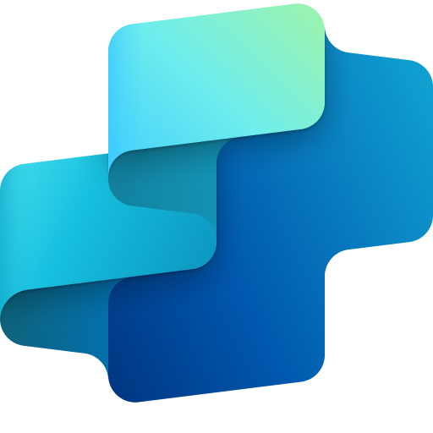
Compliance Check Agent
Marketing
Available with:
Copilot Studio
Scenario level:
Extend
Check Marketing Material Compliance
Identify Content Risks & Inconsistencies
Flag Non-Compliant Content
Scans marketing materials to ensure they adhere to established brand guidelines and regulatory standards.
Proactively identifies content inconsistencies, potential legal risks, and regulatory violations before content goes live.
Flags non-compliant content and suggests corrective recommendations for timely adjustments.
Automatically ensure marketing content aligns with brand guidelines and regulatory standards by proactively detecting inconsistencies and flagging compliance risks before publication.
KPIs impacted
Value benefit
AI Agent
Connection to Knowledge Base (SharePoint) for Brand & Compliance Rulebooks
Connection to Digital Asset Management System (SharePoint)
AI Agent
Connection to Knowledge Base (SharePoint) for regulatory guidelines, Historically Flagged Content
AI Agent
Connection to Communication Channel (Outlook, Teams)
Benefit: Ensures content meets brand and regulatory standards before publishing.
Benefit: Catches legal and branding issues early to prevent costly rework or violations.
Benefit: Notifies teams of risks and suggests quick corrective actions.
Increase in Brand Consistency
Increases operational efficiency
Generate Detailed Compliance Reports & Recommendations
Reduces chances of regulatory violations
Generates detailed compliance reports with recommended actions for improved brand governance.
Employee Experience
AI Agent
Connection to SharePoint
Cost Saving
Benefit: Delivers actionable reports to strengthen governance and streamline reviews.

Slide 3


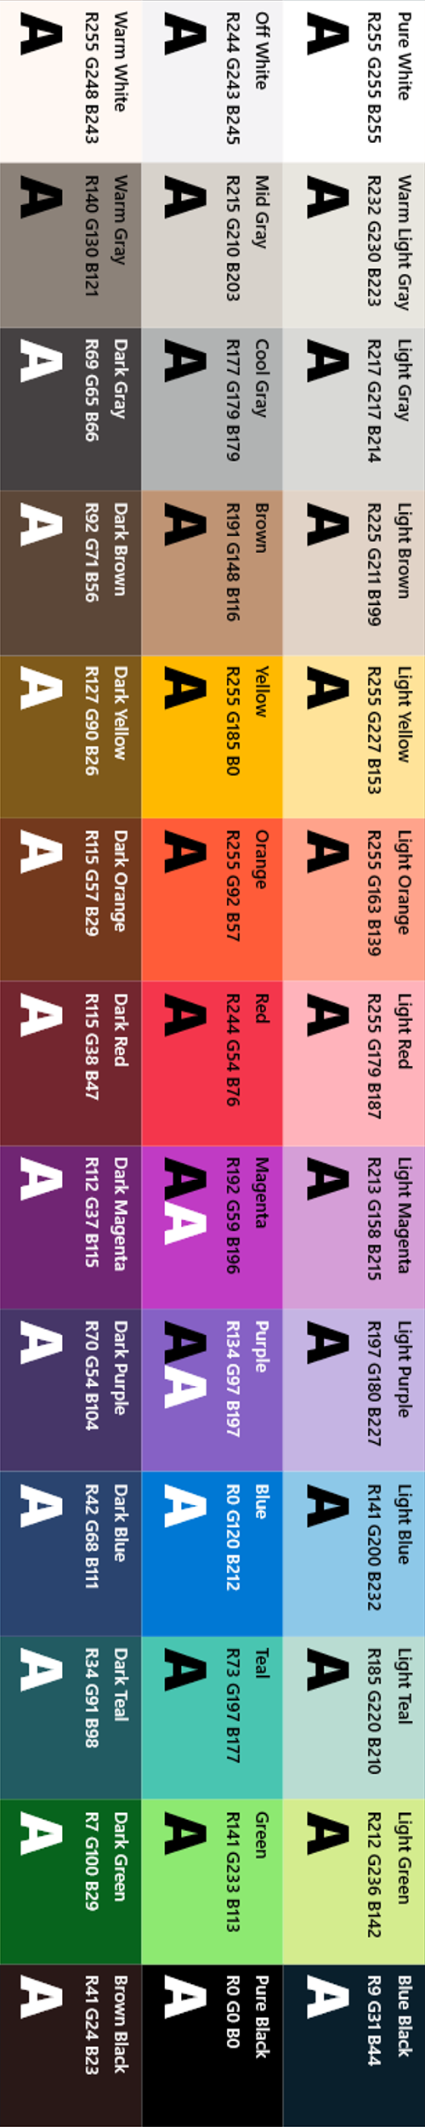
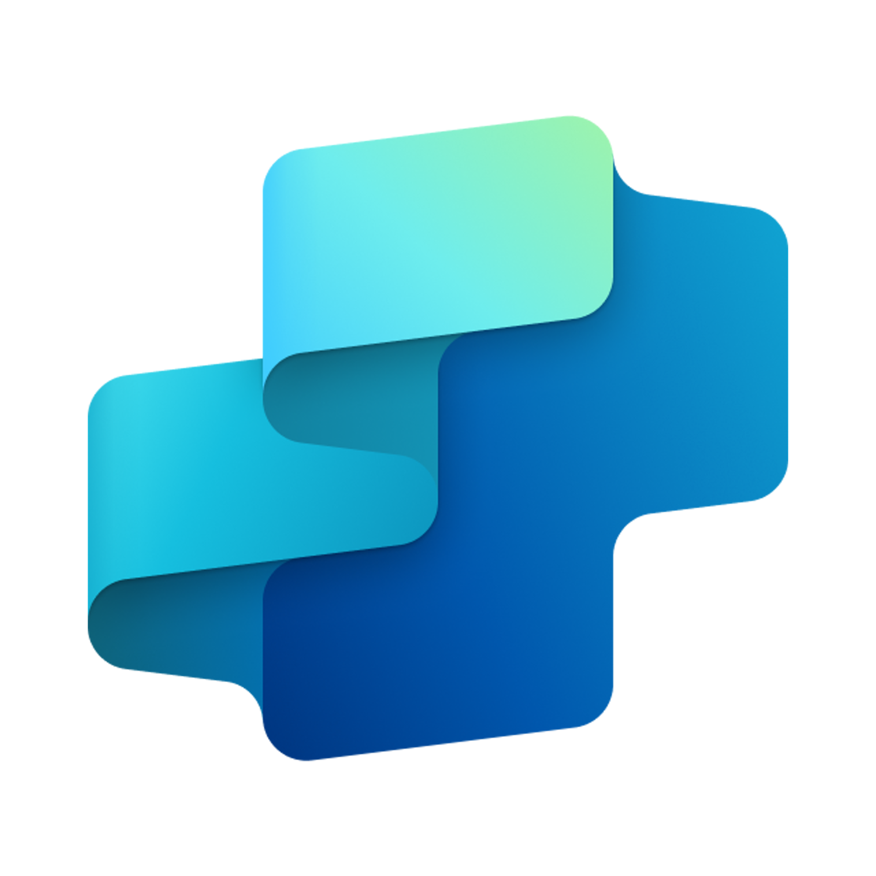


Compliance Check Agent
MARKETING FUNCTION
Automatically ensure marketing content aligns with brand guidelines and regulatory standards by proactively detecting inconsistencies and flagging compliance risks before publication
Key Considerations to Address
Needs integration with content repositories (DAM, CMS, SharePoint)
Needs access to brand guideline and legal compliance docs
Inputs needed
Creative Content Libraries (e.g., Microsoft ECM, Adobe, DAMs) ((HTML, DOC, PDF, PNG/JPG for OCR)
Brand and compliance rulebooks (DOCX, XLSX, YAML)
Marketing Team, Compliance Team
7. Response
1. User Query
Knowledge
Power Platform
Connectors
No
SharePoint, Dynamics 365, Salesforce, ServiceNow, Public URLs and other integrated platforms
Power Platform Connection Identity
User Intent(Prompt) to (SQL,API Call)
Backend system search – based on connector implementation
2. Fetch
information
Microsoft Graph
Semantic Index/
Advanced search features
Context and Content
(emails, files,
meetings, chats,
calendars and contacts)
Orchestrator
3. Tenant Graph Grounding
End-User Identity
User Intent (Prompt) to MSFT Graph query
Keyword(Lexical) Search
User Feedback
Data Collector
(gather guidelines and policy information)
Compliance Checker
(Compare and detect for inconsistences data)
Yes
Risk Reporter
(Collect inconsistent data and communicate with the team)
4. One or more actions/topics/ knowledge matched
Skills
Trigger, Actions, Workflows (Perform data grounding)
5. A plan is generated using
actions / knowledge / topics
Autonomy
Agent-to-Agent
Workflow
Integrated Creative Ideation
Content Creation Agent
Planning, Self-Learning (using feedback)
Data Handling and security
Insights
Workflow Development
6. Monitor Management
Logs, Telemetry data for analysis and Monitoring
Data Source Integration
*Reference Architecture Assumptions
Access to brand guidelines, legal policy documents, and creative content repositories
Established review workflows for pre-publication compliance checks and exception flagging
Base Pre-trained OpenAI Models available in Copilot Studio

