Slide 1
Campaign Performance Analysis & Insights Agent
MARKETING FUNCTION
Automate tracking and analysis of marketing campaigns to generate insights and optimization recommendations
Campaign performance tracking is fragmented and manual, resulting in delayed insights and minimal improvements for future campaigns
Current Workflow Challenges
Manual tracking of campaign performance leads to delays in identifying issues
Inconsistent data gathering prevents marketers from adapting strategies in real-time
Difficulty in analyzing historical campaign performance and predicting future trends
Lack of automated insights creates inefficiencies in campaign adjustments
Delayed reporting impacts speed-to-market and overall campaign effectiveness
Key Features
Business Impact
From
Continuously monitors campaigns across channels to assess performance metrics, audience engagement, and conversion trends
21-48% Increase in CTR → By delivering real-time insights and actionable adjustments
20-40% Lift in Conversion Rates → By optimizing campaign strategies
Flags underperforming campaigns and suggests data-driven adjustments to improve ROI
40% Increase in Speed to Marketing → By eliminating delays in campaign adjustments
Agent continuously tracks campaign performance, generates actionable insights, and recommends data-driven adjustments to improve marketing ROI and engagement
To
Recommends changes in channel mix, budget reallocation, and creative elements to optimize results
Key User(s)
Planning & Insights Team
Campaign Strategists
Provides automated performance reports with key insights and actionable recommendations for marketing teams
Marketing Managers
Product Managers

Slide 2
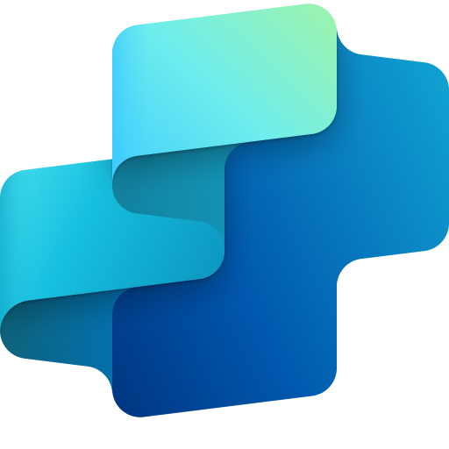
Campaign Performance Analysis & Insights Agent
Marketing
Available with:
Copilot Studio
Scenario level:
Extend
Identify & Improve Underperforming Campaigns
Monitor Ongoing Campaign Performance
Optimize Channel Mix and Budget
Continuously monitors campaigns across channels to assess performance metrics, audience engagement, and conversion trends.
Flags underperforming campaigns and suggests data-driven adjustments to improve ROI.
Recommends changes in channel mix, budget reallocation, and creative elements to optimize results.
Automate tracking and analysis of marketing campaigns to generate insights and optimization recommendations.
KPIs impacted
Value benefit
AI Agent
Connection to Campaign Management Platform (Dynamics)
Connection to CRM
AI Agent
Connection to Analytics Platform (Fabric)
Connection to Campaign Planning Tool (SharePoint)
AI Agent
Connection to CDP (Dynamics)
Benefit: Tracks performance across channels in real time to spot trends and bottlenecks early.
Benefit: Flags weak spots and suggests data-backed optimizations to boost ROI.
Benefit: Refines spend and channel strategy to maximize reach and efficiency.
21-48% Increase in CTR
20-40% Lift in Conversion Rates
Automate Performance Reports with Insights
40% Increase in Speed to Marketing
Provides automated performance reports with key insights and actionable recommendations for marketing teams.
Customer Experience
AI Agent
Connection to Analytics Platform (Fabric)
Connection to Campaign Planning Tool (SharePoint)
Cost Saving
Benefit: Saves time with automated reports that include actionable recommendations for campaign improvement.

Slide 3


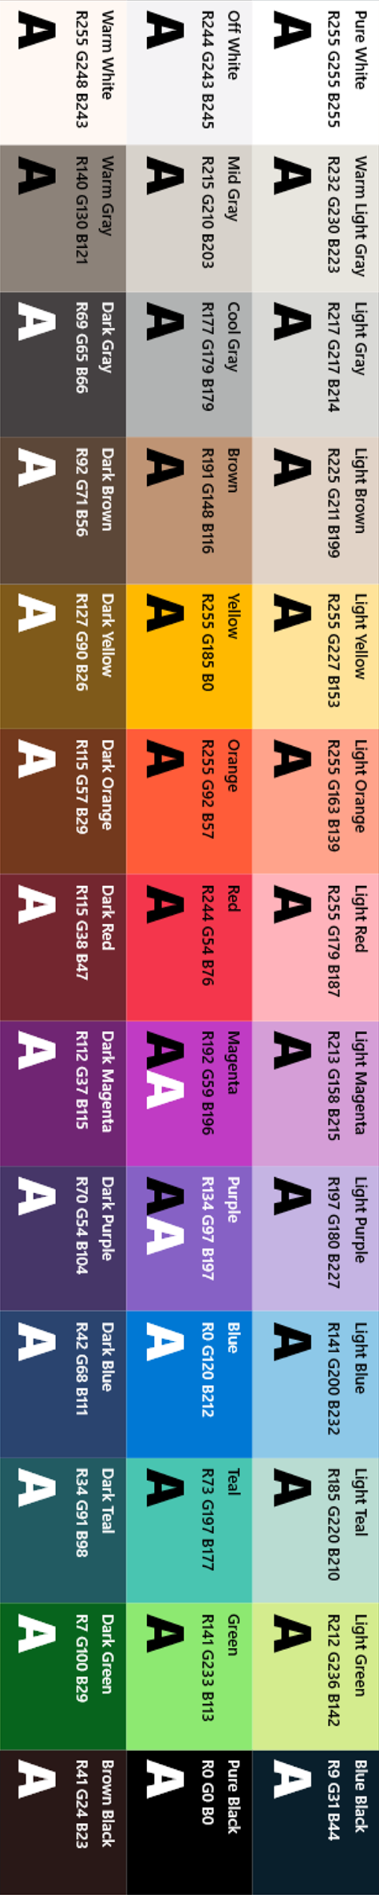
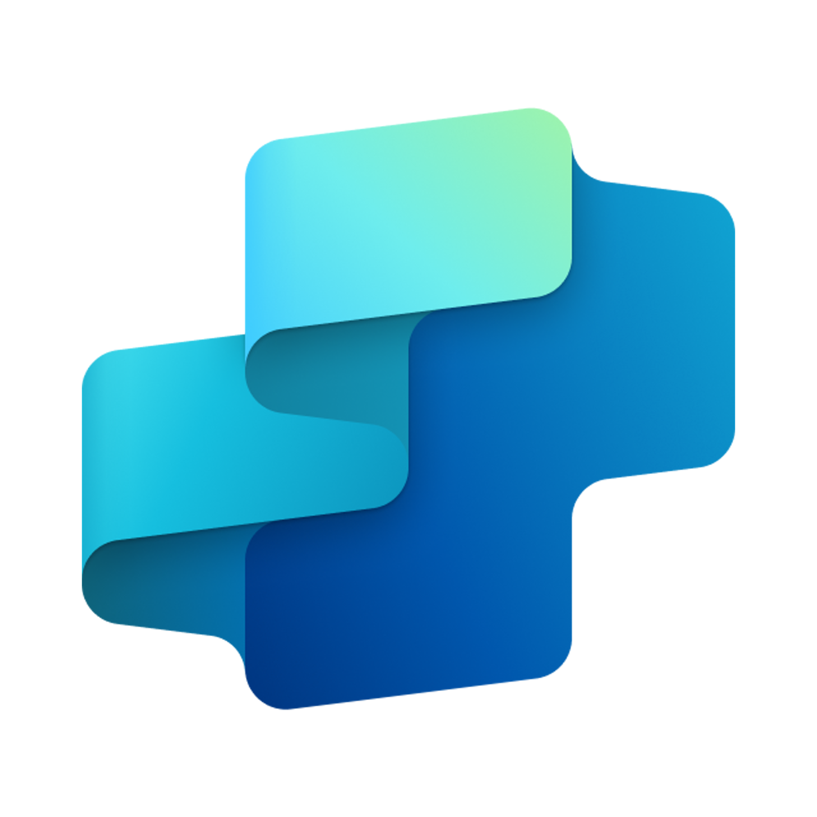


Campaign Performance Analysis & Insights Agent
MARKETING FUNCTION
Automate tracking and analysis of marketing campaigns to generate insights and optimization recommendations
Key Considerations to Address
Needs access to real-time campaign performance data
Integration with existing marketing tools (Microsoft Lists, Microsoft Viva, etc.)
Inputs needed
Campaign performance data (e.g. Microsoft Ads, etc.) (Excel)
Customer data platforms for audience insights (Microsoft dynamics) (API feed)
Analytics Tools (e.g. Power BI, etc.) (API fed)
Past campaign performance data reports for benchmarking (Extracted reports from ads platform) (Excel)
Marketing Team, Compliance Team
7. Response
1. User Query
Knowledge
Power Platform
Connectors
No
SharePoint, Dynamics 365, Salesforce, ServiceNow, Public URLs and other integrated platforms
Power Platform Connection Identity
User Intent(Prompt) to (SQL,API Call)
Backend system search – based on connector implementation
2. Fetch
information
Microsoft Graph
Semantic Index/
Advanced search features
Context and Content
(emails, files,
meetings, chats,
calendars and contacts)
Orchestrator
3. Tenant Graph Grounding
End-User Identity
User Intent (Prompt) to MSFT Graph query
Keyword(Lexical) Search
User Feedback
Campaigns Data Collector
(Gather consolidated marketing trends report from marketing team and extract metadata)
Insight Analyzer
(Analyze marketing campaigns data)
Yes
Optimizer
(Optimize the analyzed report based on the logic)
4. One or more actions/topics/ knowledge matched
Skills
Trigger, Actions, Workflows (Perform data grounding)
5. A plan is generated using
actions / knowledge / topics
Autonomy
Communicator
(Generate recommendation based on the report and communicate with the team)
Agent-to-Agent
Workflow
Marketing Intelligence Agent
Central Knowledge Repository
Planning, Self-Learning (using feedback)
Insights
Data Handling and security
6. Monitor Management
Logs, Telemetry data for analysis and Monitoring
Workflow Development
*Reference Architecture Assumptions
Access to brand guidelines, legal compliance documents, and historical marketing briefs
Defined marketing content creation workflows with approval stages and templated brief structures
Data Source Integration
Base Pre-trained OpenAI Models available in Copilot Studio

