Slide 1
MANUFACTURING
Production Schedule Optimizer Agent
Subfunction
Maturity
Continuously adapts production schedules to maximize throughput and reduce delays
Hi-Tech, Industrial
Homerun
Production planners manually update schedules using static forecasts and spreadsheets, reacting to equipment breakdowns, labor shortages, and rush orders after delays and disruptions occur
Current Workflow Challenges
Siloed systems delay visibility into real-time constraints (machine downtime, labor gaps)
Reliance on outdated forecasts and manual spreadsheet
Static schedules don’t adapt to changing production conditions
Manual reschedule takes hours and delays fulfillment
Missed constraints (e.g., labor or equipment clashes) cause bottlenecks and idle time
Key Features
Business Impact
From
Ingests production orders and schedules from ERP systems (e.g., SAP, Dynamics 365)
On-Time Fulfillment Rate → Optimized schedules improve on-time delivery and customer satisfaction
Pulls equipment condition (performance, health status, etc.) and availability from IoT sensors and MES
Production Downtime → Optimal schedules reduce unplanned downtimes
Incorporates workforce availability from HR systems and shift rosters
Stockout Rate → Smarter scheduling prevents production delays that lead to inventory shortfalls
Generate optimized schedules that account for machine status, workforce availability, and order priority
Inventory Carrying Cost → Smoother operations reduce overproduction and excess stock holding
To
Uses smart scheduling logic to create optimized production plans that respect capacity, material, and labor constraints
AI Agent drives real-time intent identification, intelligent routing, and hyper-personalized recommendations
Notifies production planners of potential schedule conflicts, schedule adjustments and delay alerts via email
Key User(s)
Production Planner
Factory Supervisor
Supply Chain Scheduler

Slide 2
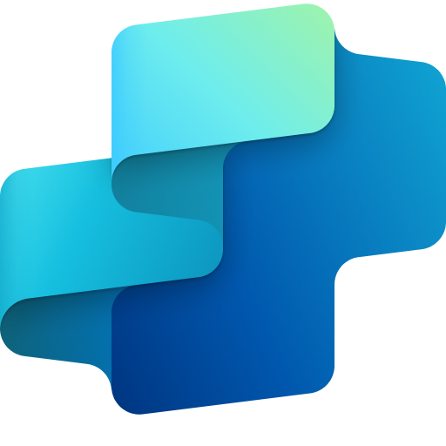
Manufacturing
Production schedule optimizer agent
Available with:
Copilot Studio
Scenario level:
Extend
Ingest production orders
Monitor equipment availability
Capture workforce availability
Retrieves production plans, bill of materials (BOM), and job orders from enterprise systems to establish baseline schedules.
Collects machine availability, performance, and health status (e.g., temperature, vibration) to detect downtimes or over-utilized assets.
Gathers shift rosters and personnel availability to ensure labor readiness in the updated plan.
Dynamically generates and updates factory production schedules by factoring in constraints and system data—ensuring that planners can minimize delays, avoid stockouts, and improve order fulfillment.
KPIs impacted
Value benefit
AI Agent
Connection to IoT sensors for real-time equipment status
Connection to stream processing services for handling and integrating IoT data
Connection to MES (e.g., Dynamics 365 Supply Chain) for machine logs and utilization
AI Agent
Connection to HR system (e.g., Workday) for shift data and absences
Connection to Collaboration Tools (e.g. Teams) for live status checks and supervisor input
AI Agent
Connection to ERP (e.g., Dynamics 365) for production orders (demand reports and historical orders) and schedules
Benefit: Centralizes all production-related information for accurate baseline.
Benefit: Incorporates machine-related data into scheduling.
Benefit: Collects shift rosters and personnel availability data to prevent resource conflicts.
Reduces Stockout Rate
Increases On-Time Fulfillment Rate
Notify planners of adjustments
Optimize schedule with constraints
Reduces Inventory Carrying Cost
Continuously updates production schedules to reduce delays, avoid bottlenecks, and make better use of resources.
Minimizes Production Downtime
Communicates updated schedules or potential delays through email, or alerts.
AI Agent
Connection to ERP (e.g., Dynamics 365) for BOM and routing constraints
Connection to MES (e.g., Dynamics 365 Supply Chain) for operational timelines
Connection to Analytics Platform (e.g., Microsoft Fabric) for schedule optimization insights and real-time disruption analysis
AI Agent
Connection to Email system (e.g., Outlook) for schedule alerts
Connection to Collaboration tools (e.g., Teams) for planning updates
Cost savings
Employee Experience
Revenue Growth
Benefit: Keeps planners informed and enables faster course corrections.
Benefit: Generates optimal schedules with minimal stockouts and improved throughput.

Slide 3
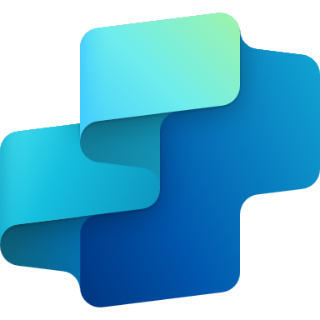
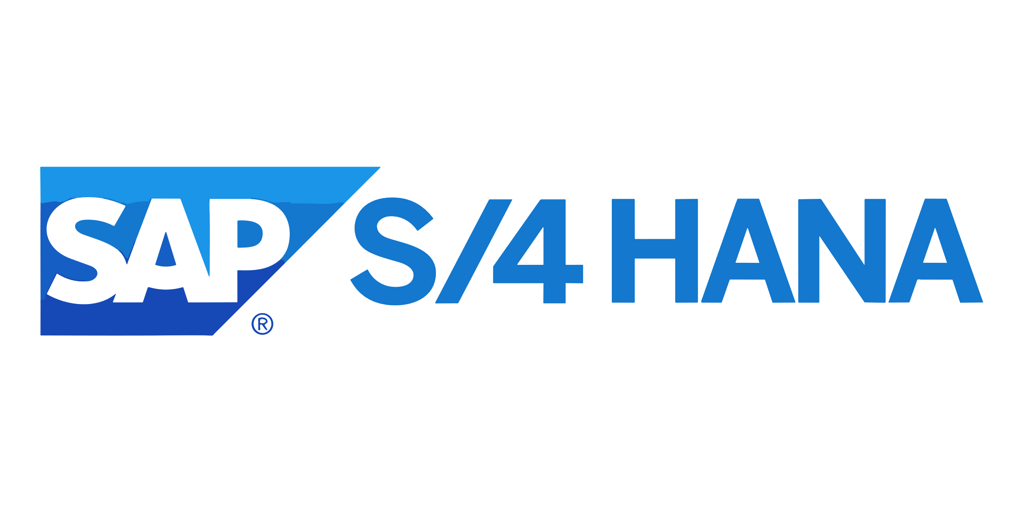
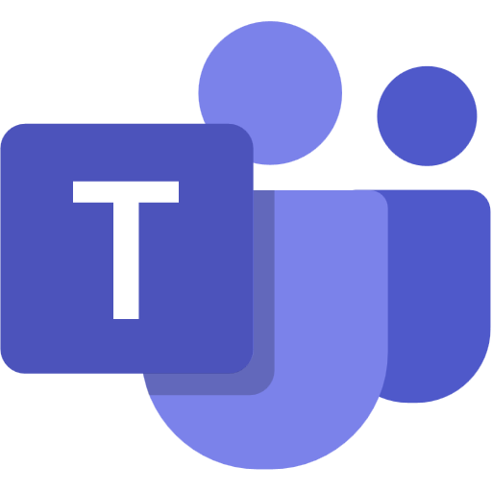
MANUFACTURING INDUSTRY
Production Schedule Optimizer Agent
Continuously adapts production schedules to maximize throughput and reduce delays
Key Considerations to Address
Pulls current, historical and planned schedules from ERP (e.g., Dynamics 365) to set baseline schedules
Streams equipment data from MES or IIOT to identify downtime events and trigger alerts based on predefined thresholds.
Fetches shift rosters and absence data from HR systems (e.g., Workday) to get labor shortfalls.
Applies inventory and order priority rules from ERP and WMS (e.g., Power Platform) to sequence production and prevent shortages
Applies constraint-based logic using ERP and MES data to identify delays, stockouts, underutilization and to escalate issues
PII includes employee names, shift assignments, and absence details
Base Pre-trained OpenAI Models / custom Open AI models (preview)
Orchestrator
Low Risk
schedule_confidence
High Risk
5a. Derives maintenance requirement and invokes action
8c. Updates the agent instruction and confidence threshold
Licensed Users
0
1
1a. Periodically syncs inventory details
4. Triggers topic
ERP System
1b. Periodically syncs workforce details
Tools
Production Planner
Knowledge Base
Channels
HR System
2. Inventory and Shifts are pushed
Rest API
Structured Records
5b. Generates rationale on schedule with properties
Prompts
Connector
Shifts
6. Pulls roster and inventory
Structured Records
Unstructured Document(versioned)
Factory Supervisor
IOT System
3. Anomalies (equipment performance, health status) logs create a summarization report
7a. Confidence >= 0.8, auto deploy schedule
1d. Sends anomalies
7. Generates smart scheduling
7b. Confidence <0.8, manual review by production planner
1c. IOT data is sent
Supply Chain Scheduler
8a. Agent logs are displayed
Azure Machine Learning Model
Conversation Transcript
Agent Ops (logging, audit, observability)
Shift Planning Agent
Manufacturing Inspector Agent
Maintenance Prediction Agent
Visual Work Instruction Agent
Agent-to-Agent
Workflow
8b. Agent logs are reviewed
LEGEND
Reference Architecture Assumptions
Agent will be hosted on Teams channel with Microsoft authentication
Planner, Supervisor, Scheduler will have M365 license to access the agent,
ERP, MES and HR systems would expose APIs or have connectors to fetch stocks, employee schedules
PDF, PPTX and DOCX are the supported knowledge in SharePoint. Dataverse knowledge can be max two with max 15 tables each.
Other dependent agents should be ready and discoverable to be associated with this agent
D365 Customer Portal
SharePoint
App Insights
Flow / Connector
Dataverse
Copilot Studio Agent
Copilot Studio Kit - Extend
MS Teams

