Slide 1
IP Creation Agent
LEGAL FUNCTION
Simplify intellectual property registration and lifecycle management with automated filings and monitoring
IP creation registration and lifecycle management are manual and time-consuming
Current Workflow Challenges
Researchers perform analysis by hand, file applications, and oversee the monitoring and management of intellectual property assets
The process of creating and managing these assets manually consumes significant time and resources for analysts
Errors or oversights can occasionally occur during the manual creation and management process
Key Features
Business Impact
From
Generates patent, trademark, copyright, and license documents and conducts intelligent search for preexisting IP conflicts
IP Application Processing Efficiency → increased speed and effectiveness of IP application processing
Renewal and Expiration Management Accuracy → increased precision with which renewals /expirations are managed
Submits applications to legal authorities and track status
Compliance and Risk Detection Rate→ percentage of risks correctly identified by the IP Creation Agent
Streamlined IP creation with AI-Agent automated filings, monitoring, and lifecycle management
Monitors IP asset expiration dates and renewal needs and identifies IP usage risks and enforce compliance
To
Key User(s)
AI Agent drives real-time intent identification, intelligent routing, and hyper-personalized recommendations
Manages licensing agreements lifecycle
Legal analysts

Slide 2

IP Creation Agent
Legal
Available with:
Copilot Studio
Scenario level:
Extend
IP Management
IP Research
Application Tracking
Generates patent, trademark, copyright, and license documents.
Conducts intelligent search for preexisting IP conflicts.
Submits applications to legal authorities and track status.
Simplify intellectual property registration and lifecycle management with automated filings and monitoring.
KPIs impacted
Value benefit
AI Agent
Connection to User Input (Patent/Trademark Templates)
AI Agent
Connection to USPTO/Trademark/Patent Databases via API
AI Agent
Connection to IP Submission Platform APIs (e.g., WIPO)
Benefit: Simplifies creation of IP documents to speed up filing processes.
Benefit: Reduces legal risk by checking for conflicting IP before submission.
Benefit: Provides real-time visibility into IP application status.
IP Application Processing Efficiency
Compliance and Risk Detection Rate
Agreement Lifecycle
Compliance
Asset Monitoring
Renewal & Expiration Management Accuracy
Manages licensing agreements lifecycle.
Identifies IP usage risks and enforce compliance.
Monitors IP asset expiration dates and renewal needs.
Cost Saving
AI Agent
Connection to SharePoint
AI Agent
Connection to Knowledge Base (SharePoint) for Internal Policy Rules, Licensing Terms
AI Agent
Connection to Communication Channel (Outlook, Teams)
Benefit: Streamlines license management to avoid renewal gaps or violations.
Benefit: Ensures IP use aligns with internal policy and legal standards.
Benefit: Prevents lapses by alerting teams ahead of IP expirations.

Slide 3


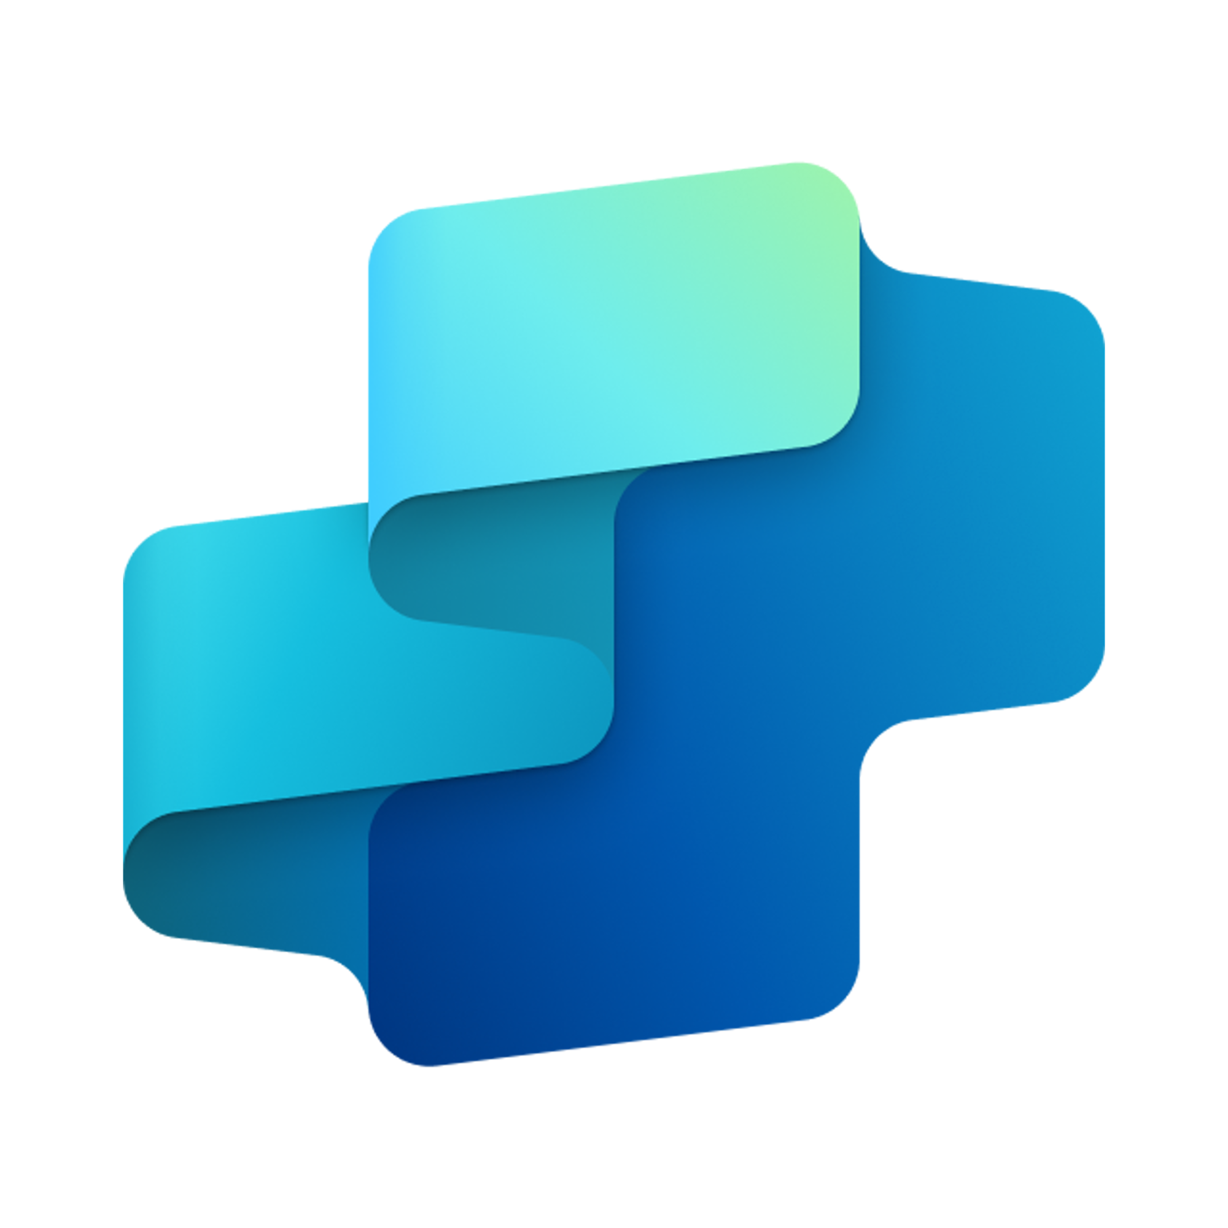


IP Creation Agent
LEGAL FUNCTION
Simplify intellectual property registration and lifecycle management with automated filings and monitoring
Key Considerations to Address
Needs data from varied internal and external sources (e.g., patents, trademarks, copyrights, and license documents
Needs data from IP applications (e.g., status, expiration dates, renewal needs) and integration with IP management tool or repository (e.g., SharePoint)
Needs integration with document generation tool (e.g., Word)
IP: confidential IP applications
Sensitive business information
Connects with IP office APIs (USPTO, EPO, etc.) for submission and tracking
Supports conflict checks via existing IP databases
Inputs needed
IP research reports (PDF, DOC)
Historic IP applications (PDF, DOC)
Draft IP filings (DOCX, XLSX)
IP metadata (asset types, jurisdictions, expiration dates)
Prior art/conflict documents (PDF, HTML, JSON)
IP Creator
7. Response
1. User Query
Knowledge
Power Platform
Connectors
No
SharePoint, Dynamics 365, Salesforce, ServiceNow, Public URLs and other integrated platforms
Power Platform Connection Identity
User Intent(Prompt) to (SQL,API Call)
Backend system search – based on connector implementation
2. Fetch
information
Microsoft Graph
Semantic Index/
Advanced search features
Context and Content
(emails, files,
meetings, chats,
calendars and contacts)
Orchestrator
3. Tenant Graph Grounding
End-User Identity
User Intent (Prompt) to MSFT Graph query
Keyword(Lexical) Search
User Feedback
Data Validator
(Gather data from legal sources and validate the same)
Filing Agent
(Submits application to local authorities)
Yes
IP Monitor
(Monitors IP assets and renewals, sends alerts for upcoming deadlines)
4. One or more actions/topics/ knowledge matched
Skills
Resource Holder
(Manages licensing agreements)
Trigger, Actions, Workflows (Perform data grounding)
5. A plan is generated using
actions / knowledge / topics
Autonomy
Conflict Tracker
(Fetch data from Monitor agent and supports conflict)
Planning, Self-Learning (using feedback)
*Reference Architecture Assumptions
Integration with IP repositories, government filing systems (e.g., USPTO, EPO), and legal metadata sources for end-to-end IP lifecycle support
Defined IP management workflows including submission, renewal monitoring, licensing, and conflict resolution
Insights
Data Handling and security
6. Monitor Management
Logs, Telemetry data for analysis and Monitoring
Workflow Development
Data Source Integration
Base Pre-trained OpenAI Models available in Copilot Studio

