Slide 1
Recruitment Assistant
HR FUNCTION
Identify and rank top candidates by analyzing job requirements, scanning talent databases, and refining search parameters based on recruiter feedback
Candidate sourcing is manual, fragmented, inconsistent, and has outdated matching criteria
Current Workflow Challenges
Scanning candidate profiles across multiple platforms is time-consuming
Uneven candidate quality and delayed decisions due to human judgement
Disparate systems and outdated criteria create a bottleneck in building a robust candidate pipeline
Hiring relies on inbound applications instead of proactive sourcing and historical data
Manual screening introduces bias, and job descriptions aren’t optimized based on actual candidate availability
No structured approach exists to anticipate renege risk, making workforce planning and backfilling reactive rather than proactive
Key Features
Business Impact
From
Evaluates job requirements, organization details, and predefined criteria
Time-To-Fill Positions → Drastically reduces time-to-hire by automating candidate discovery and screening
Searches internal databases and external job platforms to uncover top talent
Matching Accuracy → Improves candidate matching accuracy, leading to better hires and lower turnover
Operational Efficiency → Frees up recruiters from manual tasks, allowing them to focus on strategic decisions
Generates a candidate pipeline based on qualifications, experience, and predicted interest.
AI-Agent sources top candidates by analyzing job requirements, scouring both internal and external talent pools, intelligently ranking candidates, and refining its search based on real recruiter feedback
To
Key User(s)
Predict renege probability based on historical data and engagement patterns.
Recruitment teams
Hiring managers
Automate candidate communication with interview reminders and follow-ups
Talent acquisition specialists

Slide 2
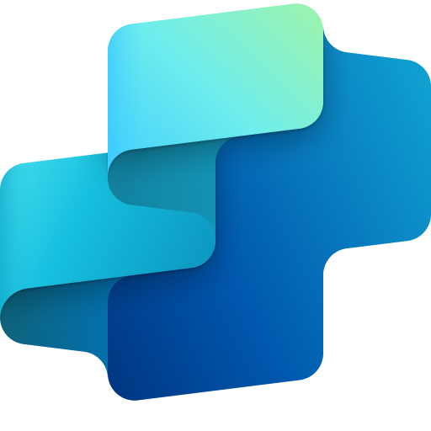
Recruitment Assistant
HR
Available with:
Copilot Studio
Scenario level:
Extend
Job Requirement Evaluation
Internal Talent Search
External Talent Search
Evaluates job requirements, organization details, and predefined criteria.
Searches internal databases to uncover top talent.
Searches external job platforms to uncover top talent.
Identify and rank top candidates by analyzing job requirements, scanning talent databases, and refining search parameters based on recruiter feedback.
KPIs impacted
Value benefit
AI Agent
Connection to Applicant Tracking System (ATS) or Human Resources Information System (HRIS)
AI Agent
Connection to Internal Talent Database
AI Agent
Connection to Online Job Board Platforms
Benefit: Analyzes role details to define ideal candidate profiles and streamline search.
Benefit: Surfaces qualified internal candidates to fill roles faster and promote retention.
Benefit: Scans external platforms to expand the talent pool and find top prospects.
Time-To-Fill Positions
Matching Accuracy
Automated Candidate Engagement
Renege Probability Prediction
Candidate Pipeline Generation
Operational Efficiency
Automate candidate communication with interview reminders and follow-ups.
Predict renege probability based on historical data and engagement patterns.
Generates a candidate pipeline based on qualifications, experience, and predicted interest.
Employee Experience
AI Agent
Connection to Communication Channel (Outlook, Teams)
AI Agent
Connection to Talent CRM (Historical Engagement Patterns)
AI Agent
Connection to SharePoint
Benefit: Sends timely follow-ups and interview reminders to keep candidates moving through the funnel.
Benefit: Flags candidates likely to back out so teams can adjust engagement early.
Benefit: Builds a curated list of candidates based on fit, interest, and availability.

Slide 3


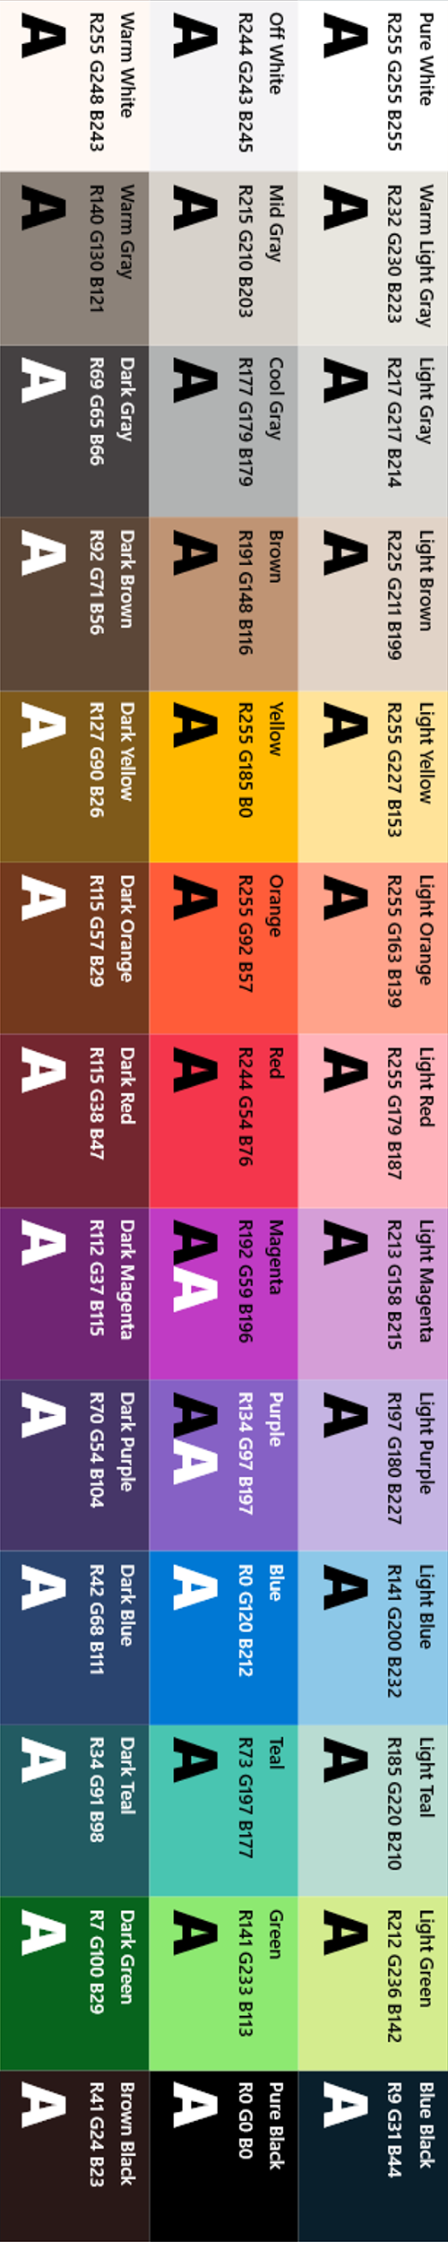
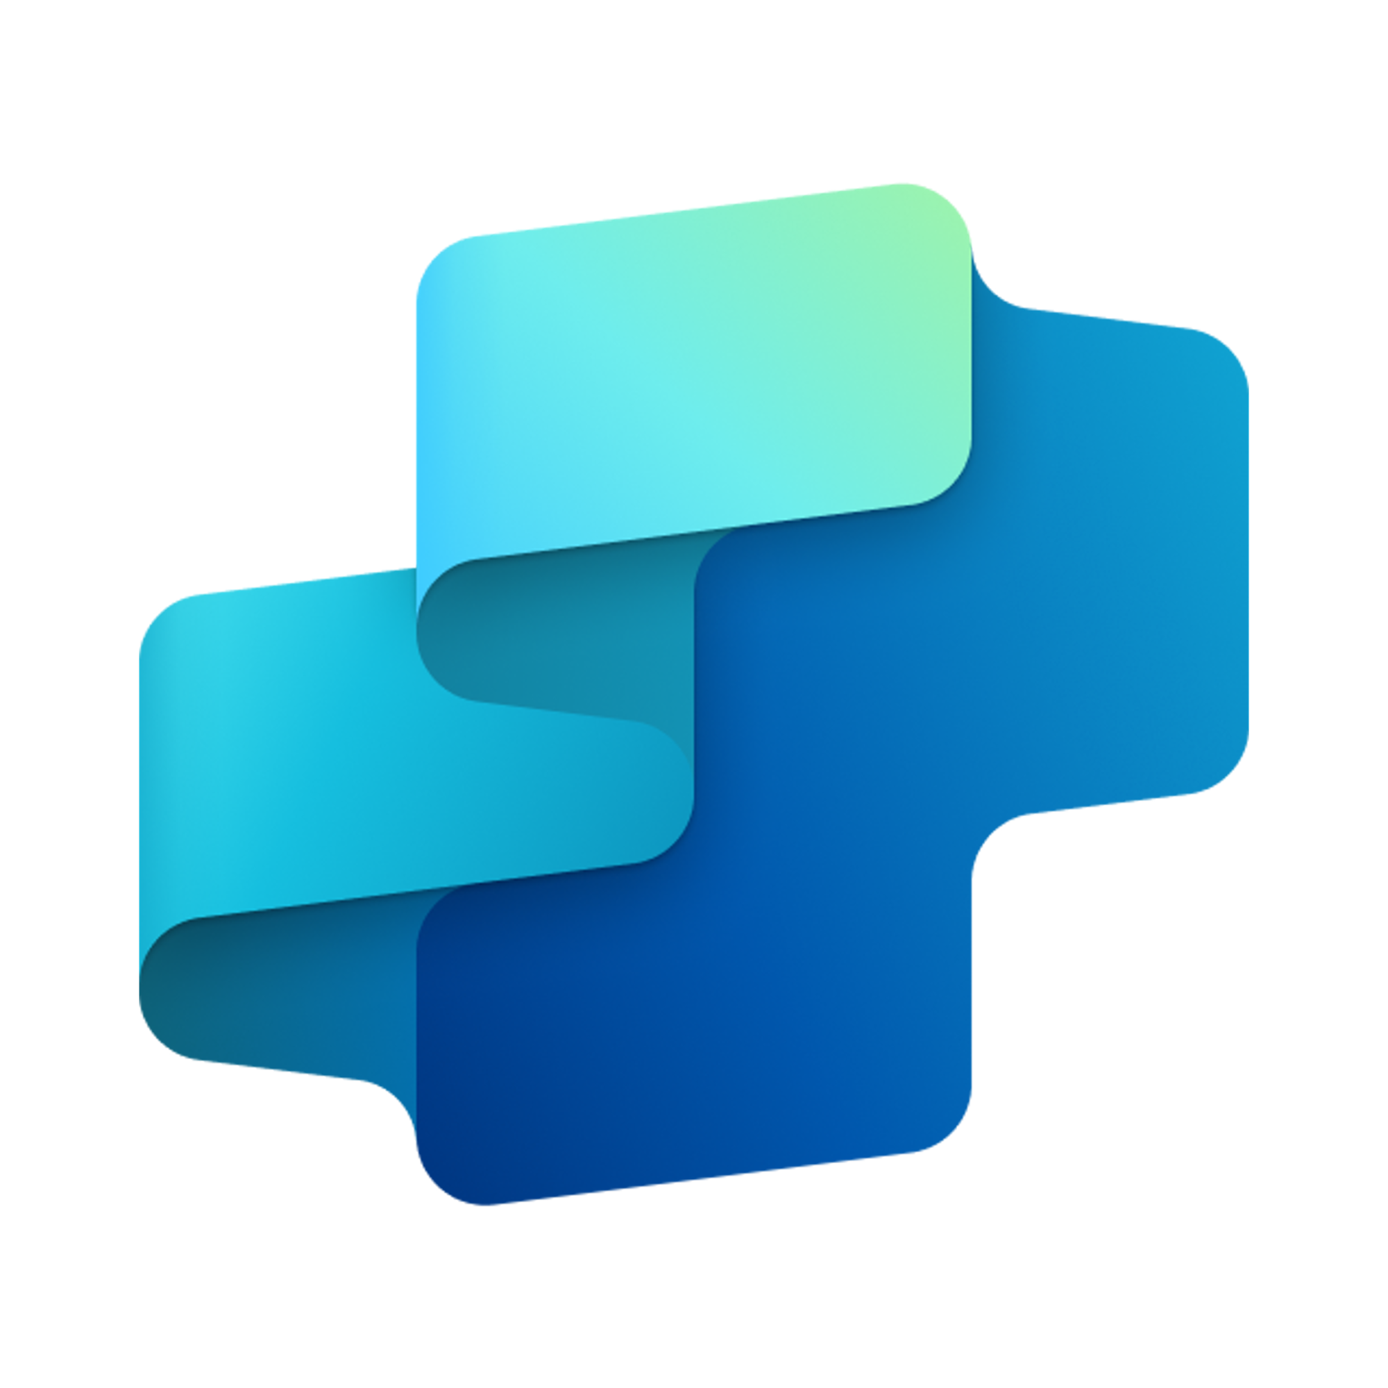


Recruitment Assistant
HR FUNCTION
Identify and rank top candidates by analyzing job requirements, scanning talent databases, and refining search parameters based on recruiter feedback
Key Considerations to Address
Needs integration with job platforms (e.g. LinkedIn, ATS, HRIS, and job platforms
Requires candidate data protection with secure storage and processing of PII
Non-complex unstructured data – recruiter feedback, external job platforms sources, screening test results (text)
Structured data – employee databases, job requirements, ATS records, screening test results
Inputs needed
Job requirements, like role, skills, experience, location, and predefined hiring criteria (PDF, DOC, HTML)
Talent sources, like Internal employee
Recruit feedback, such as inputs on candidate matches to refine future searches (CSV, JSON)
Candidate profiles/resumes (PDF, DOCX, LinkedIn APIs)
HR Recruitment Team, HR Hiring Manager, Talent Acquisition Specialists
7. Response
1. User Query
Knowledge
Power Platform
Connectors
No
SharePoint, Dynamics 365, Salesforce, ServiceNow, Public URLs and other integrated platforms
Power Platform Connection Identity
User Intent(Prompt) to (SQL,API Call)
Backend system search – based on connector implementation
2. Fetch
information
Microsoft Graph
Semantic Index/
Advanced search features
Context and Content
(emails, files,
meetings, chats,
calendars and contacts)
Orchestrator
3. Tenant Graph Grounding
End-User Identity
User Intent (Prompt) to MSFT Graph query
Keyword(Lexical) Search
User Feedback
Skill Validator
Identify right candidate according to Job Description)
Candidate Ranker
(Candidate ranking based on skill scale logic)
Yes
4. One or more actions/topics/ knowledge matched
Skills
Communicator
(Email notification, interview scheduling, Follow-ups)
Trigger, Actions, Workflows (Perform data grounding)
5. A plan is generated using
actions / knowledge / topics
Autonomy
Logic Refinement
(Skill matching parameters adjusted based on feedback & update to Orchestrator)
Agent-to-Agent
Workflow
Planning, Self-Learning (using feedback)
Behavioral Nudges and Adoption Enhancement Agent
Insights
6. Monitor Management
Logs, Telemetry data for analysis and Monitoring
Data Handling and security
*Reference Architecture Assumptions
Integration with ATS, HRIS, and external job platforms for structured and unstructured candidate data access
Defined talent acquisition workflows including job-matching logic, candidate scoring, and recruiter feedback incorporation
Workflow Development
Base Pre-trained OpenAI Models available in Copilot Studio
Data Source Integration

