Slide 1
PUBLIC SECTOR INDUSTRY
Upskilling Recommendation Agent
Subindustry
Maturity
Analyzes citizen’s skills to recommend targeted training and job opportunities
Education
Strategic Imperatives
Manual resume and training reviews rely on static course suggestions, with no outcome tracking
Current Workflow Challenges
Current one-size-fits-all advice fails to address specific skill gaps, hindering effective workforce development
Outdated content and inconsistent tagging hinder access to relevant training resources
Citizens navigate large role and training databases without guidance, leading to poor decisions
Counselors spend too much time manually compiling data, limiting personalized support
Key Features
Business Impact
From
Ingest resumes uploaded by Citizen
Number Of Skills Mastered → By providing personalized, targeted training pathways, it increases the number of relevant skills citizens acquire and effectively master
Compare skills on resume to skills for target roles selected by user
Learning Completion Rate → Tailored course recommendations and ongoing outcome monitoring motivate citizens, leading to a higher successful completion rate
Analyzes uploaded resumes and compares skills to live role requirements & Skill Gaps
Student Satisfaction Score → Enhances success in learning and career progression, while improving overall Upskilling journey
Agents identify and score citizens’ skill gaps against job requirements to recommend upskilling and roles matching current skills
To
Delivering personalized training and job alerts via Teams or email through no-code agent workflows
Key User(s)
AI Agent drives real-time intent identification, intelligent routing, and hyper-personalized recommendations
Career Counsellors
Job Coaches / Training Program Managers \ HRs
Automatically curates learning playlists aligned to target roles and tracks progress over time
Escalates edge cases (e.g., low alignment with any career paths) to human counselors with a summary of gaps and role-fit analysis

Slide 2
Public Sector
Upskilling recommendation agent
Available with:
Copilot Studio
Scenario level:
Extend
Ingest resumes uploaded
Map skills to target roles
Identify skill gaps
Collects resumes securely and extracts relevant skill details for analysis.
Maps extracted skills to target role requirements by cross-referencing the internal job catalog.
Analyzes uploaded resumes and compares skills to live role requirements & Skill Gaps.
Analyzes citizen’s skills to recommend targeted training and job opportunities.
KPIs impacted
Value benefit
AI Agent
Connection to content management system (SharePoint) for document storage and user uploads
Connection to CRM (Dynamics 365) if resumes are part of a citizen's profile within a CRM/case management system
AI Agent
Connection to Knowledge Base (SharePoint) for list of target roles and their skill requirements
Connection to CRM (Dynamics 365) where citizens select desired roles
AI Agent
Connection to Databases (Dataverse) to store the calculated skill gap scores and analysis results
Benefit: Collects resumes to automate extraction of relevant skills.
Benefit: Maps existing candidate skills from internal job catalog to target role’s required skills.
Benefit: Identifies gaps in current skills from uploaded resumes and provides recommendations for areas to upskill.
Increase in the number of skills mastered
6. Escalate edge cases to human counselors for review
Curate learning content
Recommend courses & resources
Increase in learning completion rate
Increase in student satisfaction score
Escalates edge cases (e.g., low alignment with any career paths) to human counselors with a summary of gaps and role-fit analysis.
Curates and consolidates videos, documents, and interactive modules from internal sources into a single, easy-to-navigate learning playlist.
Recommends personalized training and job opportunities via Teams or email, powered by no-code agent workflows.
AI Agent
Connection to Communication & Messaging (Teams) for sharing online lectures, collaborative activities, and virtual classrooms
Connection to content management system (SharePoint) for hosting course content, documents, and presentations
Employee Experience
AI Agent
Connection to Communication & Messaging (Outlook, Teams) push to human counselors with a summary of gaps and role-fit analysis
AI Agent
Connection to Content Management System (SharePoint) for course catalogs – course/training catalog and learning resources
Customer Experience
Benefit: Connects edge cases (e.g., low alignment with any career paths) via Teams or emails to human counselors for role-fit analysis.
Benefit: Consolidate videos, documents, and interactive modules to provide centralized access to all learning materials.
Benefit: Delivers personalized learning options via Teams and emails.

Slide 3
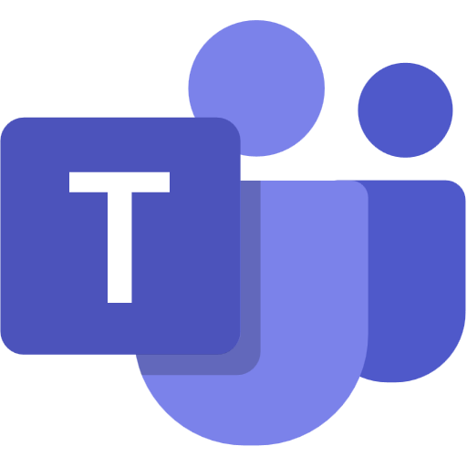
PUBLIC SECTOR INDUSTRY
Upskilling Recommendation Agent
Analyzes citizen’s skills to recommend targeted training and job opportunities
Key Considerations to Address
Access Content Management System (SharePoint) in PDF, DOCX, PPTX format to ingest resumes, course materials, role definitions, course/training catalog and learning resources.
Integrate with CRM (Dynamics 365) in format to pull citizen profile data, role selections and vacancy along with resume in format of PDF, DOCX and PPTX.
Connect to Databases (Dataverse) tables for skill-gap scores and analysis history
Messaging & Collaboration tools (Teams) in the form of chat, meetings, and email to route curated learning content, notifications and interview invites
Includes candidate PII data (name, contact, employment history, assessment data)
Base Pre-trained OpenAI Models / custom Open AI models (preview)
Orchestrator
Skill Gap Score
8c. Feedback – updates instructions and confidence threshold
Licensed Users
Low skill gap: 0 (more eligible)
High skill gap: 1 (less eligible)
1a. Citizen submits application
1b. resumes are uploaded
2. Applications get saved
Career Counselors
Knowledge Base
Citizens
(non licensed)
7c. Skill gap score <0.2, email sent on profile acceptance
Structured Records
Unstructured Documents (versioned)
6b. Sends the curated learning plan
4. Pulls and job descriptions
6c. skill gap core <0.2, copies resume to shortlisted folder
Channels
7b. Notifies counselors with interview details
Job Coaches / Training Program Managers
5b. Extraction fails, clarification sent via email
6a. skill gap score >0.2, curates learning plan
7a. Creates interview using graph API
LEGEND
3. Resumes are copied to SP temporary folder
D365 Customer Portal
5a. Extracts entities: skill, experience
6. Derives skill gap score
Prompts
Tools
Dataverse
SharePoint
8a. Logged details are shown to Dashboard
Agent Ops (logging, audit, observability)
Agent-to-Agent
Workflow
Document Processing & Routing Agent
Citizen Q&A Agent
Conversation Transcript
Copilot Studio Agent
*Reference Architecture Assumptions
PDF, PPTX and DOCx are the supported knowledge in SharePoint. Dataverse knowledge can be max two with max 15 tables each.
Career Counselors and Training program Managers will have M365 licenses
Citizen will use portal to upload resume and will be notified via email, won't have any chat feature.
Other dependent agents should be ready and discoverable to be associated with this agent
App Insights
8b. Logs are reviewed by counselors and coaches
Copilot Studio Kit - Extend
Flow / Connector

