Slide 1
FINANCIAL SERVICE INDUSTRY
Legal Contract Generation & Compliance Check Agent
Subfunction
Maturity
Creates and reviews contracts to ensure compliance with internal policy and regulation
Banking & Capital Markets
Homerun
Legal teams draft and proof contracts clause-by-clause which slows turnaround and increases the risk of errors
Current Workflow Challenges
Dense legal language and ever-changing rules demand meticulous review
Contract drafting and version redlining is manual and prone to human error, with occasional dependency on SME
Multiple review rounds inflate time-to-signature and client frustration
Missing or miswording clauses triggers compliance risks and leads to costly amendments
Key Features
Business Impact
From
Draft contracts from templates and deal data
Contract Compliance Rate → Ensures every clause meets policy and legal standards
Summarize action items and discussion history
Cycle Time → Faster drafting and fewer manual edits accelerate deal closure
Extract and analyze clauses using NLP and standardized clause libraries
Error Rate → Reduces human oversight gaps with automated checks
Automate contract assembly from previous templates, compliance checks red-lining, improvement suggestions and change summarization
Amendments Per Contract → Cleaner first drafts lead to fewer revision rounds
To
Check clause-level compliance to ensure institutional policy alignment
AI Agent drives real-time intent identification, intelligent routing, and hyper-personalized recommendations
Outsourcing Requirements → Internal Solution decreases dependency on third party service providers
Generate collaborative redlines on language, clause revisions, improvements and preserve earlier versions for audit tracking
Key User(s)
Generate summary and send for review
Legal & Compliance Team
Sales Team

Slide 2
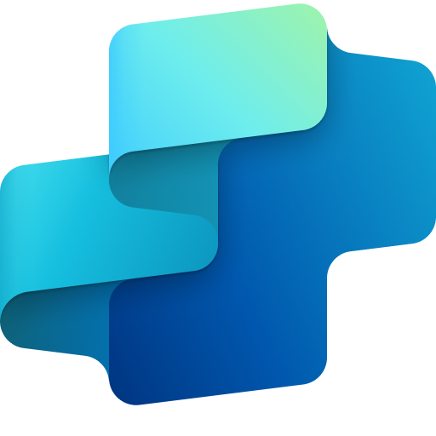
Financial Service
Legal contract generation & compliance check agent
Available with:
Copilot Studio
Scenario level:
Extend
Generate draft contract
Recap action items
Extract & analyze clauses
Uses templates and deal-specific data to auto-draft initial contracts.
Summarizes prior communications to inform contractual obligations.
Uses NLP to break down the contract into distinct, labeled clauses.
Simplifies contract creation and review by drafting documents, spotting compliance issues, and suggesting improvements to ensure legal accuracy and meet standards.
KPIs impacted
Value benefit
AI Agent
Connection to Document Generator (Word, SharePoint) for generating contracts from structured templates or historical contracts
Connection to CRM (Dynamics 365) for pulling deal-specific data such as client details and terms
Connection to Knowledge Base for storing and version-controlling contract drafts
AI Agent
Connects to a predefined taxonomy to segment contract text into structured, labeled clauses and extract contract structure and metadata
Connection to Knowledge Base for processing and storing intermediate analysis results
AI Agent
Connection to Communication Tool (Outlook, Teams) for extracting key points from recent email threads or summarizing meeting chat and call transcripts
Benefit: Uses templates and deal-specific data to accelerate drafting and ensures template consistency.
Benefit: Recaps action item to ensure contracts reflect actual agreements made.
Benefit: Extracts contract clause to enable precise review and easier compliance matching.
Increases Contract-Compliance Rate
Reduces Cycle Time
Generate review package
Redline & suggest revisions
Check compliance
Reduces Error Rate
Creates a final summary, redlines, and audit trail for legal or business approval.
Proposes edits for problematic language and unclear terms.
Evaluates each clause against internal legal rules and regulatory guidelines.
Reduces Amendments per Contract
Reduces Outsourcing Requirements
AI Agent
Connection to Document Editor (Word/PPT) for compiling change summaries and rationale
Connection to Communication Tool (Outlook/Teams) for distributing drafts to legal reviewers
Connection to Workflow Automation (Power Automate) for managing approval workflows and logging status
AI Agent
Connection to Document Editor (Word) for inserting tracked changes and legal redlines
Connection to Knowledge Base (SharePoint) for storing redlined versions with version control and proposing compliant language revisions
Connection to Communication Tools (Outlook, Teams) to create a draft and collaborative redlining
AI Agent
Connects to a compliance knowledge base or external compliance API to compare clauses against established compliance libraries
Connection to Knowledge Base (SharePoint) for accessing policies and legal guidance
Connects to notification channels (outlook) to alert and escalate non-compliant content, with access to defined escalation logic
Risk & Compliance Adherence
Customer Experience
Service Excellence
Benefit: Creates a final summary to speed up review cycles and enhances traceability.
Benefit: Redlines reduce rework and improves legal soundness.
Benefit: Flags non-compliant sections early in the process to be compliant.

Slide 3
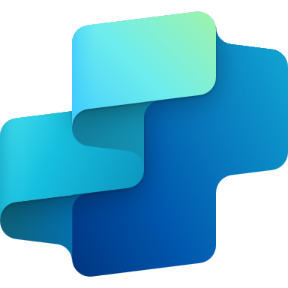
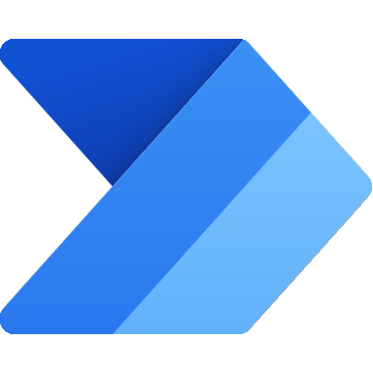
FINANCIAL SERVICE INDUSTRY
Legal Contract Generation & Compliance Check Agent
Creates and reviews contracts to ensure compliance with internal policy and regulation
Key Considerations to Address
Link CRM (Dynamics 365) to pull client and deal data for contract drafting
Knowledge Base (SharePoint) in DOC, PPT, PDF format is used to load standard contracts and store redline history
Refer to Knowledge Base (SharePoint) to extract clauses, compare terms, and flag non-compliance using predefined taxonomy for clause chunking
Use Communication Tool (Outlook, Teams) and Power Automate to manage legal reviews, approvals, and escalations
PII includes client name, client logos, deal terms, legal contacts, contract history
Base Pre-trained OpenAI Models / custom Open AI models (preview)
Orchestrator
LEGEND
3. Invokes tools
7c. Feedback – updates policy, templates and instructions
D365 Customer Portal
2. Forwards queries to Orchestrator
Dataverse
4a. Pulls template, institutional policies and earlier versions (if any)
Licensed Users
SharePoint
Knowledge Base
Tools
Channels
1. Request to generate contract
Copilot Studio Agent
Structured Records
All Bank Personnel
App Insights
4b. Generates clause by cluse steps
Structured Records
Unstructured Documents (versioned)
Prompts
Copilot Studio Kit - Extend
5. Saves draft contract in SharePoint
6. Generates summary/ draft and sends for review with document link
Flow / Connector
MS Teams
7a. Agent logs are displayed on Copilot Studio Kit
Agent-to-Agent
Workflow
Internal Policy Q&A Agent
Conversation Transcript
Agent Ops (logging, audit, observability)
Reference Architecture Assumptions
Agent will be hosted on Teams channel with Microsoft authentication for support agent
All Bank Personnel will be M365 license to access the agent
Policy document stored in SharePoint will be of PDF, PPT or DOC format
‘Internal Policy Q&A Agent’ has be ready and discoverable to be associated with this agent
7a. Agent logs are reviewed by admins

