Slide 1
Document Compliance Agent
CUSTOMER SERVICE FUNCTION
Monitor and analyze documents to prevent compliance violations and recommend process improvements
Document monitoring and compliance checking processes are manual, intermittent, time-consuming and prone to errors
Current Workflow Challenges
Customer service document compliance violations are identified manually, which is time-consuming and prone to errors
Documents are analyzed after interactions, leading to delayed confirmation to acceptance/rejection to customers
Traceability can be difficult and inefficient because violations are manual reported
Key Features
Business Impact
From
Continuously monitors customer service documents (ex: customer service scripts, dispute resolutions reports, etc.) for potential compliance violations against compliance benchmarks
Compliance Rate → Automated violation monitoring will reduce the likelihood of compliance oversights
Customer Satisfaction → Real-time recommendation on corrective action reduces TAT and thus increases CSAT
Alerts customer support reps and supervisors in real-time when compliance steps are missed
Manual compliance check time → Reduce average time taken to manually check compliance
Real-time compliance monitoring and alerts powered by AI agents help prevent violations and suggest process enhancements to maintain accuracy, consistency, and boost efficiency
To
Suggests compliant alternatives to documents based on company guidelines
Key User(s)
Customer Support Agent
Customer Service Supervisor
Stores compliance check history, suggested edits, user overrides, and approvals in an auditable log
All functional teams –
Sales, Marketing, Finance, HR, Legal and IT team

Slide 2

Document Compliance Agent
Customer Service
Available with:
Copilot Studio
Scenario level:
Extend
Compliance Monitoring
Alert Generation
Alternative Suggestions
Continuously monitors customer service documents (ex: customer service scripts, dispute resolutions reports, etc.) for potential compliance violations against compliance benchmarks.
Alerts customer support reps and supervisors in real-time when compliance steps are missed.
Suggests compliant alternatives to documents based on company guidelines.
Monitor and analyze documents to prevent compliance violations and recommend process improvements.
KPIs impacted
Value benefit
AI Agent
Connection to Knowledge Base (SharePoint) for Internal and External Compliance Requirements
Connection to Knowledge Base (SharePoint) for Service Articles
AI Agent
Connection to Communication Channel (Outlook, Teams)
AI Agent
Connection to Communication Channel (Outlook, Teams)
Benefit: Automatically flags potential compliance issues before they become violations.
Benefit: Notifies agents in real time when compliance protocols aren’t followed.
Benefit: Provides compliant alternatives instantly to help agents correct issues without delay.
Knowledge Retrieval Time
Manual Tagging Time
History Logging
Manual Compliance Check Time
Stores compliance check history, suggested edits, user overrides, and approvals in an auditable log.
Process Efficiency
AI Agent
Connection to Content Management System (SharePoint)
Benefit: Maintains a searchable audit trail for transparency, reviews, and accountability.

Slide 3


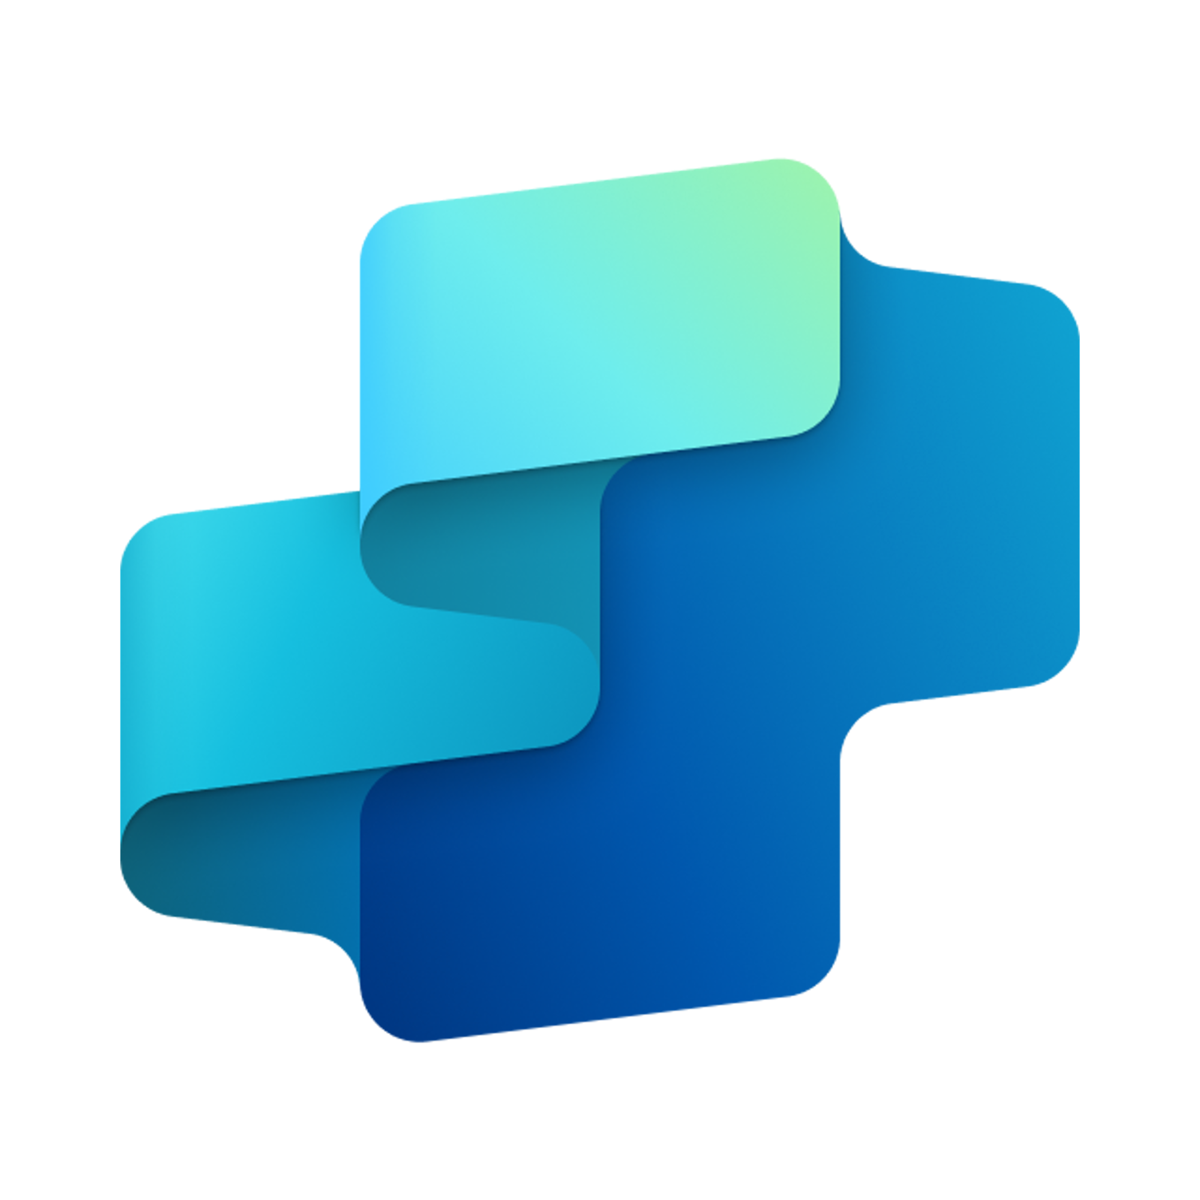


Document Compliance Agent
CUSTOMER SERVICE FUNCTION
Monitor and analyze documents to prevent compliance violations and recommend process improvements
Key Considerations to Address
Needs integration with content repositories (DAM, CMS, SharePoint)
Needs access to brand guideline and legal compliance docs
Needs access to customer service documents (ex: customer service scripts, dispute resolutions reports, etc.
Requires routing logic for when steps are missed
Integrates with document repositories (e.g., CLM, SharePoint, OneDrive)
Inputs needed
Creative Content Libraries (e.g., Microsoft ECM, Adobe, DAMs) ((HTML, DOC, PDF, PNG/JPG for OCR)
Brand and compliance rulebooks (DOCX, XLSX, YAML)
Knowledge content (PDF, Doc, HTML)
Support agent
7. Response
1. User Query
Knowledge
Power Platform
Connectors
No
SharePoint, Dynamics 365, Salesforce, ServiceNow, Public URLs and other integrated platforms
Power Platform Connection Identity
User Intent(Prompt) to (SQL,API Call)
Backend system search – based on connector implementation
2. Fetch
information
Microsoft Graph
Semantic Index/
Advanced search features
Context and Content
(emails, files,
meetings, chats,
calendars and contacts)
Orchestrator
3. Tenant Graph Grounding
End-User Identity
User Intent (Prompt) to MSFT Graph query
Keyword(Lexical) Search
User Feedback
Analyzer
(classify document base don category
and Analyze it)
Compliance Tracker
(Ensures documents follow regulations, flag it)
Yes
4. One or more actions/topics/ knowledge matched
Skills
Recommender
(To overcome compliance issue, Provide suggestion/recommendation to improve the process)
Trigger, Actions, Workflows (Perform data grounding)
5. A plan is generated using
actions / knowledge / topics
Autonomy
Agent-to-Agent
Workflow
Planning, Self-Learning (using feedback)
Knowledge Metadata Agent
Data Handling and security
Insights
Workflow Development
6. Monitor Management
Logs, Telemetry data for analysis and Monitoring
Data Source Integration
*Reference Architecture Assumptions
Document governance frameworks with defined compliance rules, approval flows, and audit trails
Access to structured repositories containing policies, brand standards, and legal documentation
Base Pre-trained OpenAI Models available in Copilot Studio

