Slide 1
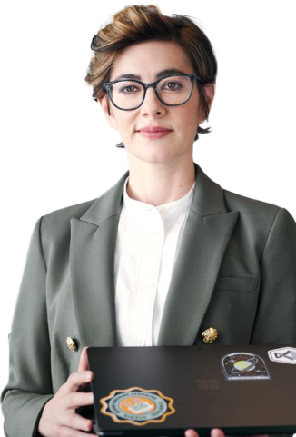
A day in the life of an Account Manager
8:00 am
8:15 am
9:00 am
Cassandra needs to prepare for her big pitch to Contoso so she summarizes the emails and chats from her main client.
Cassandra commands Copilot to create
a message to confirm the meeting.
Cassandra received the latest financial numbers from her business planning lead. She uses Copilot to create some amazing charts to showcase the value of the offer.
Cassandra is a sales lead at Contoso
Copilot
Copilot in Outlook
Copilot in Excel
Summarize all the emails and Teams chats in the past month from Contoso highlighting the primary asks and open items.
Draft an email to confirm the meeting this afternoon. Highlight how excited we are to present the latest product updates and new pricing. Use a formal tone and keep the email concise.
Show all data insights.
4:00 pm
2:00 pm
11:00 am
Cassandra has missed a few chats during the day. She sees that her team has been discussing a new product launch and commands Copilot to summarize the conversation to quickly catch up.
It's time for the pitch. Cassandra can focus on her presentation knowing Copilot is taking notes. She commands Copilot to list the questions asked so she can be sure everything gets answered during the call.
Cassandra puts the final touches on the pitch presentation by adding a slide based on the summary of the annual report she had Copilot draft.
Copilot in Teams
Copilot in Teams
Copilot in PowerPoint
Summarize this chat and make sure to include the key points and who made them.
What questions were asked during the meeting that have not been answered?
Add a slide based on [copy in annual report summary].

