Slide 1


We will begin the call at five minutes past the hour.
Microsoft 365 Champion Community Call
September 2026
Microsoft 365 Champion Community
Learn more. Do more. Achieve more, together.

Slide 2



Microsoft 365 Champion
community call
September 2026

Slide 3
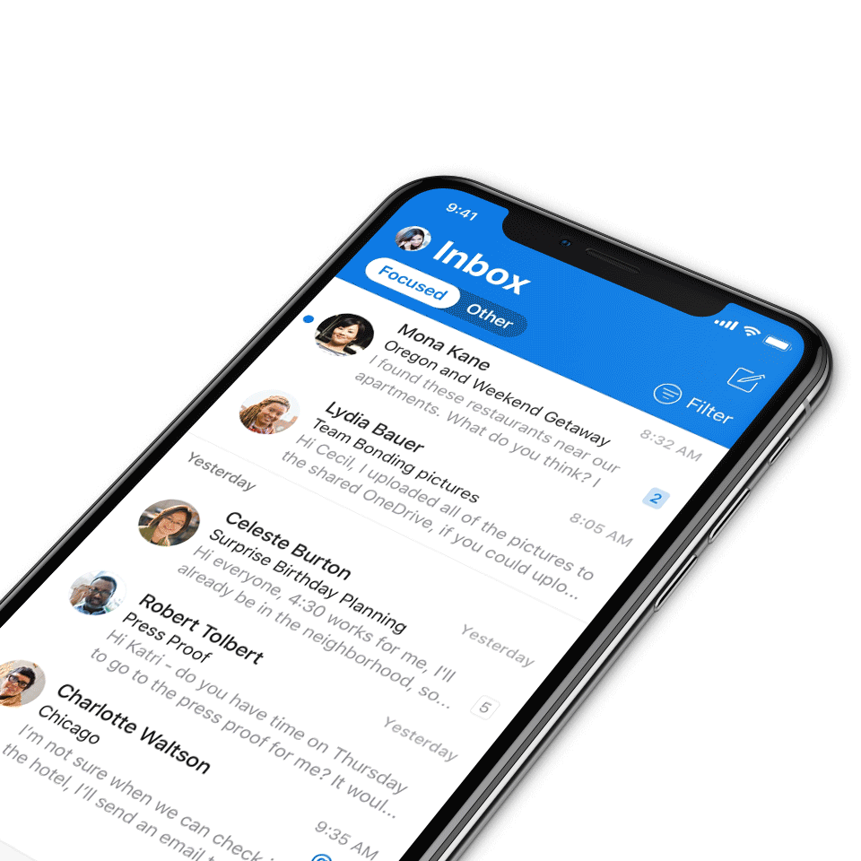
Digital Event Code of Conduct
Microsoft’s mission is to empower every person and every organization on the planet to achieve more. This includes all Microsoft events and gatherings, including on digital platforms, where we seek to create a respectful, friendly, fun and inclusive experience for all participants.​
We expect all digital event participants to uphold the principles of this Code of Conduct, which covers the main digital event and all related activities. We do not tolerate disruptive or disrespectful behavior, messages, images, or interactions by any party participant, in any form, at any aspect of the program including business and social activities, regardless of location.​
Microsoft will not tolerate harassment or discrimination based on age, ancestry, color, gender identity or expression, national origin, physical or mental disability, religion, sexual orientation, or any other characteristic protected by applicable local laws, regulations, and ordinances.​
We encourage everyone to assist in creating a welcoming and safe environment.
For more info, visit aka.ms/CodeofConduct.

Slide 4

Agenda
Announcements
OneDrive on mobile experience
Open discussion forum
Become a Champion today!
https://aka.ms/BecomeaChampion

Slide 5

Community announcements
Events
OneDrive + Copilot digital event
Your files are more than documents. They’re the ideas, projects, and moments that move work and life forward. Discover how OneDrive is evolving for the AI era, helping you move from files to outcomes with intelligence built into the experiences you use every day. Join us on October 20th at 9:00 AM PT for the free digital event where OneDrive and Microsoft Copilot come together to change how you work with your files.
Join us on October 20, 2026, at 9:00 AM PT for the free digital event where OneDrive and Microsoft Copilot come together to change how you work with your files at aka.ms/OneDriveEvent.

Slide 6

Star in a Champion story
Microsoft 365 Copilot Adoption · CHAMPION STORIES
Sign up to get your experience driving Microsoft 365 Copilot adoption professionally filmed and edited by our studio team – a story worth sharing far beyond this call.
▶
★
▲
♥
Studio-produced
Featured by Microsoft
Grow your brand
Inspire your peers
We film and edit it all – you share your story.
Published on Microsoft socials, web and blogs as a best practice.
Keep the polished video for your own network and portfolio.
Show peers what great Copilot adoption really looks like.
Sign up for a Champion Story →
Notes:
Champion call talking points — Champion Stories sign-up (M365 Copilot adoption):
The ask: We want to feature YOUR real experience driving M365 Copilot adoption. Sign up and our studio team films and fully edits a short story — you don't need any production skills.
What you get:
- Studio-produced: our team handles filming and editing end to end.
- Featured by Microsoft: your story is published across Microsoft Social, Web and Blogs as an adoption best practice.
- Yours to keep: you can post the polished, edited video on your own networks (e.g. LinkedIn) and add it to your professional portfolio.
- Community impact: help peers everywhere see what great Copilot adoption looks like.
OWNER TO DO before presenting: replace 'link in the chat' with the actual sign-up form URL and/or drop a QR code on the slide. Add the submission deadline if there is one.

Slide 7
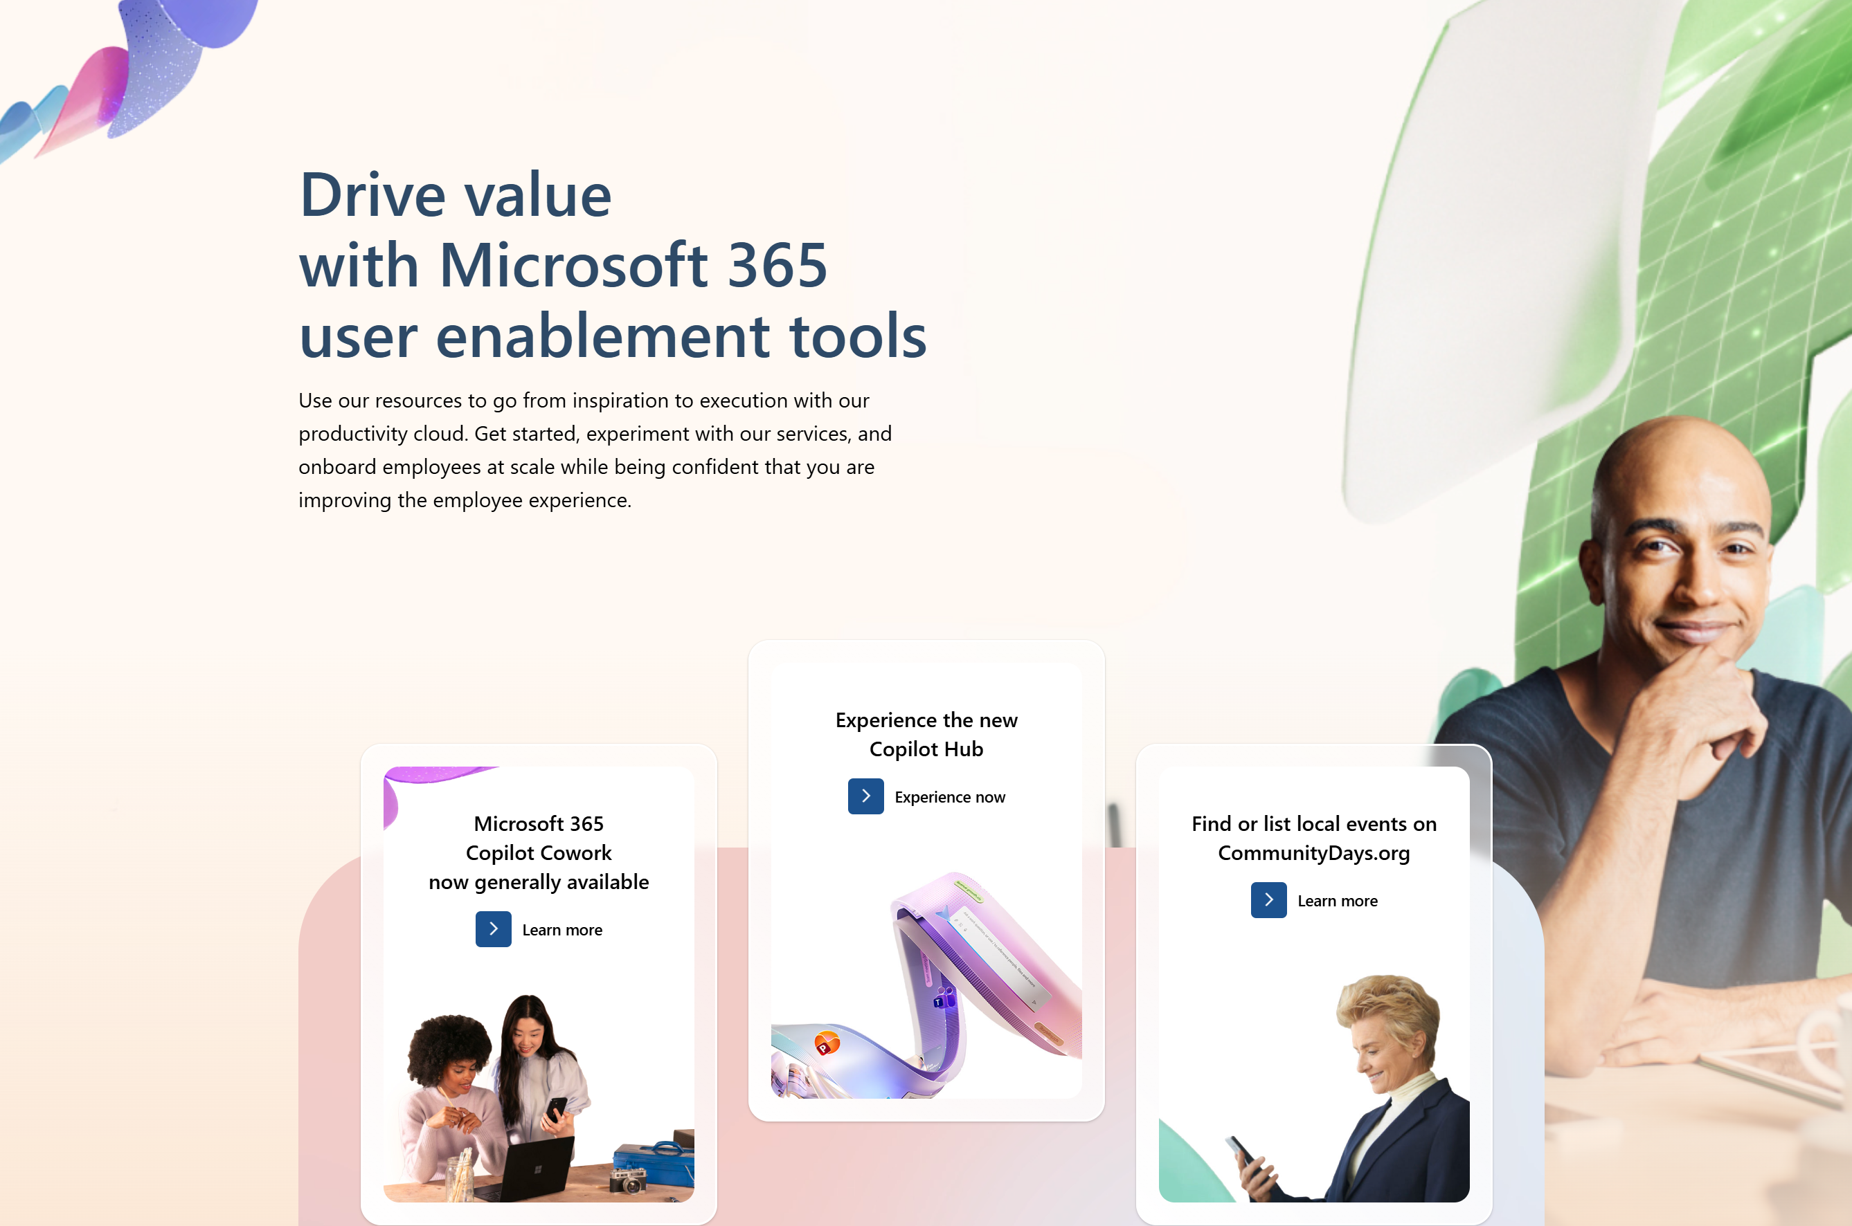
adoption.microsoft.com
Update highlights
New Teams and Viva Engage for Frontline Workers deployment guide
New Teams Platform page
New Comms Camp: a hands-on workshop for corporate communications teams and their IT partners
New Digital Accelerator: live, Microsoft-led skilling cohorts for Unified customers
Update to the Build your own Champion community guide
Added role-based resources to the Intune page
New sessions added to OneDrive Customer Office Hours
New stories added to Agent transformation stories
Read or subscribe to our release notes for more updates.

Slide 8
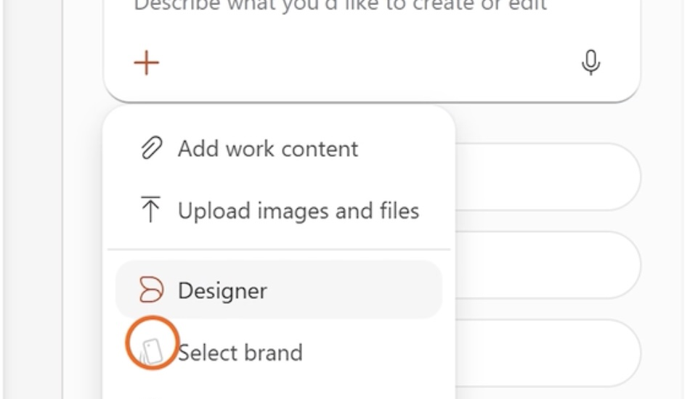
Top Microsoft 365 updates
Microsoft Copilot
Brand Kit and Skills in Copilot in PowerPoint
Brand Kit helps presentations to start with the appropriate look from your organization, while Skills make familiar workflows repeatable, so you can spend your time shaping the message.
How to try it:
When you create a presentation in PowerPoint, select an available Brand Kit and describe the presentation you want Copilot to create. You can also ask Copilot to use approved assets by your organization or bring an existing slide into alignment with the selected brand guidance.
Prompts to try after selecting Brand Kit:
Create a 10-slide deck for my marketing team based on our latest campaign
Add an executive summary slide to this deck based on my last monthly business review
Add an image for this product from my Brand Kit
Click here to learn more!
Notes:
Build reusable personal Skills
If users need flexibility beyond a prebuilt skills, they can also create personal skills for custom workflows such as improving a story, applying a preferred review framework, or creating follow-up material. Instead of rewriting and refining the same prompt every time, the workflow becomes a reusable skill that can be uploaded, accessed and managed directly within Copilot in PowerPoint so it’s ready the next time you need it.
How to try it
Open the Copilot chat pane in PowerPoint and choose a prebuilt Skill for a common task, or create a Custom Skill for a workflow you want to reuse. You can keep favorite Skills turned on and switch off the ones you use less often. Learn how to upload you own custom skill here

Slide 9
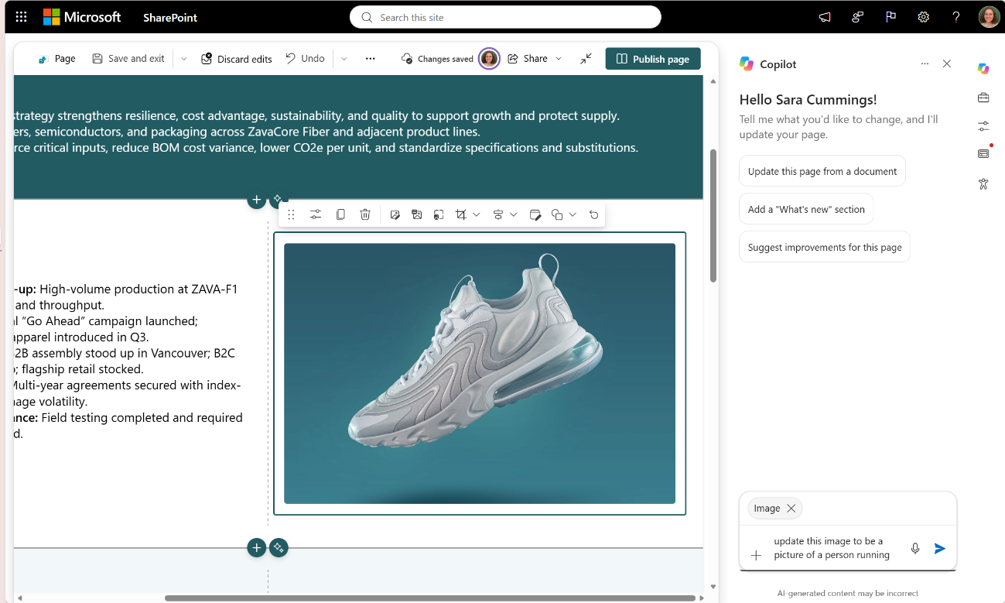
Top Microsoft 365 updates
Microsoft SharePoint
SharePoint AI page authoring: Select, describe, and refine
Creating and refining SharePoint pages is becoming more intuitive. Instead of describing where content lives on the page, authors can now simply select a section or web part and tell Copilot what they want to change.
Make focused edits. Select an image or another page element and ask Copilot to move or update it.
Restructure a section. Select the section and ask for a different column layout; Copilot can work across the components inside it.
Apply broader updates. Ask Copilot to update repeated content across a page, for example, changing a product or brand name in text and supported web-part content.
Review the result. Updated areas are visually indicated on the canvas so you can inspect the changes before publishing.
The feature is rolling out gradually. Availability may vary by tenant and release ring. Organizations must have Copilot in SharePoint enabled, and authors need permission to edit pages.
Click here to learn more!
Notes:
Previously, authors described both the content they wanted to change and where it was located on the page. With on-canvas selection, location becomes part of the context automatically. Simply select a web part or section and describe the outcome you want. The selected item appears in the Copilot experience, giving the request clear context.

Slide 10
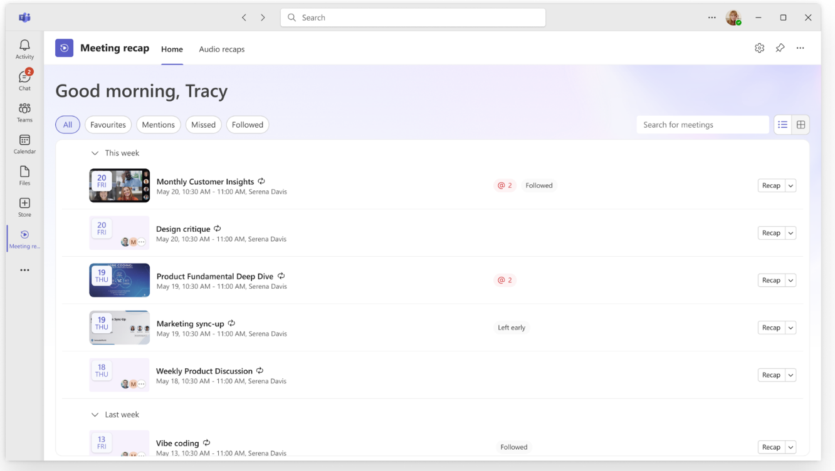
Top Microsoft 365 updates
Microsoft Teams
Teams Meeting Recaps app
Stop hunting through chats and calendars for the meeting notes you need. The Meeting Recaps app brings your intelligent recaps together in one convenient, pinned app in the Teams sidebar, making it easier to find and catch up across your meetings. Browse meetings with Recap from the past 30 days and use quick filters to instantly surface the meetings that matter most, like when you were mentioned in the discussion. You can also generate a podcast-style Audio Recap summary across multiple meetings so that you can conveniently catch up on the go.
Click here to learn more.
Notes:
Add the Meeting Recaps app
Add the app to Teams so your recaps are always available.
Select View more apps on the left side of Teams.
Search "Meeting recaps".
Select Meeting recaps in the search results.

Slide 11
Microsoft OneDrive on mobile experience
Lisa Miao – Principal Product Manager

Slide 12

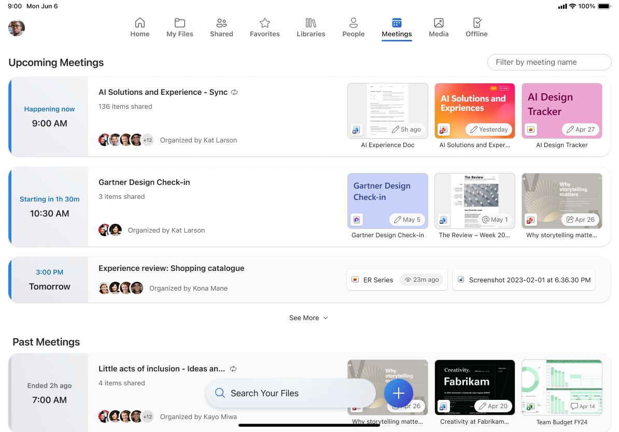
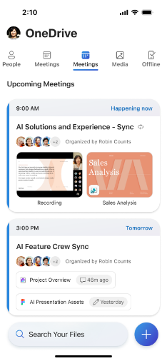
Why iPad
Who are iPad users?
Frontline and field teams – where portability matters the most
Senior leaders – execs who review decks on planes, mark up proposals between meetings, or catching up on budgets in transit
Hybrid workers – information workers using iPad as the “lean-back” device between meetings
iPad is the endpoint where productivity users on the go live
Mobile
(Tablet, phone)
Notes:
So here’s the thing — iPad or tablet has not been our strongest platform. If you line up the OneDrive experience across web, sync, and mobile, iPad has been the one lagging behind on browsing, organization, search... basically the file management fundamentals.
So why iPad, why now?
The answer is that more and more users are turning to iPad for their work. iPad is where your busiest users on the go live. Think about who’s iPad-first in your org — it’s usually two groups:
Your frontline and field teams. Signing contracts, checking on the status of a purchase order, or reviewing a specs document, these are the users that make iPad their primary device.
Your senior leaders. The execs who review board decks on a plane, mark up proposals between meetings, sign off on budgets from the back of a car. For them, iPad is the work device — the laptop stays closed.
And beyond those two, there’s the hybrid worker reaching for iPad as the lean-back device — on the couch, on a flight, between meetings. It’s where people read, review, and decide.

Slide 13
OneDrive mobile & tablet strategy
1
Bring mobile & tablet up to par with the rest of OneDrive productivity suite
Lean into “productivity on the go” scenarios
2
Notes:
Here’s what I want you to take away from today. We’re not just copying features over from web, our mobile strategy is two-fold.
Close the parity gap. The foundational file management capabilities you rely on across web and sync should just work on iPad. Browsing, search, permissions, library discovery — if you can do it on OneDrive.com, you should be able to do it on your tablet. But do it in a mobile-friendly way.
Lean into what mobile does best. Web or desktop will always be the better place to author a 40-slide deck. But mobile is uniquely positioned for *productivity on the go*. Audio playback so you can listen to a document on your commute. Offline access so you can actually work on that flight without Wi-Fi. Mobile-native previews that let you review confidential files easily when your CEO sends you that after hours "quick question".
We’ve already started down this strategy, and I’m excited to show you all the goodness we have already shipped and will ship soon.

Slide 14
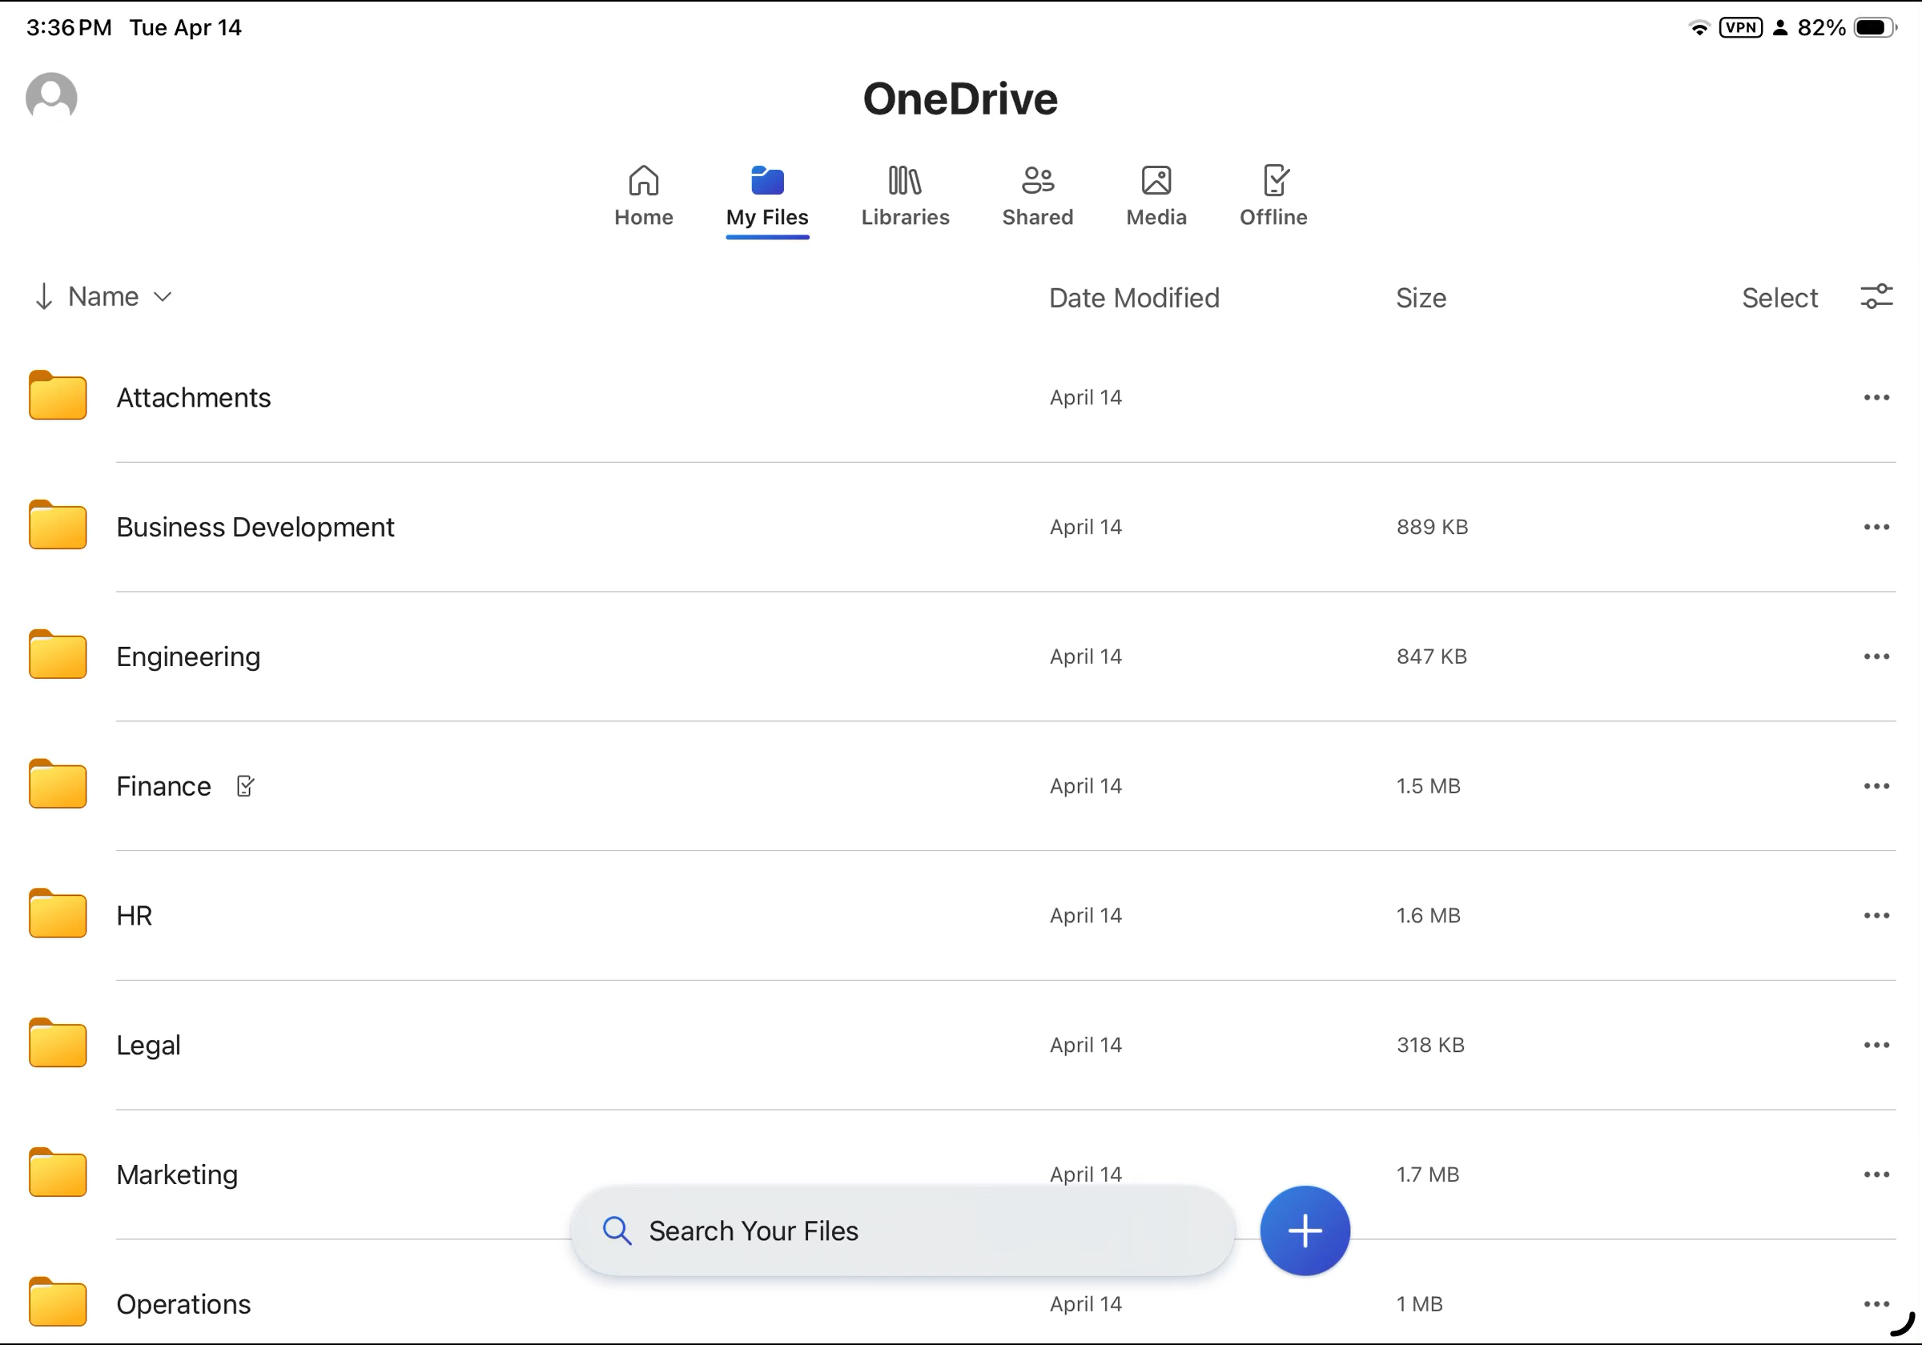
Offline Search
Launched!

Slide 15
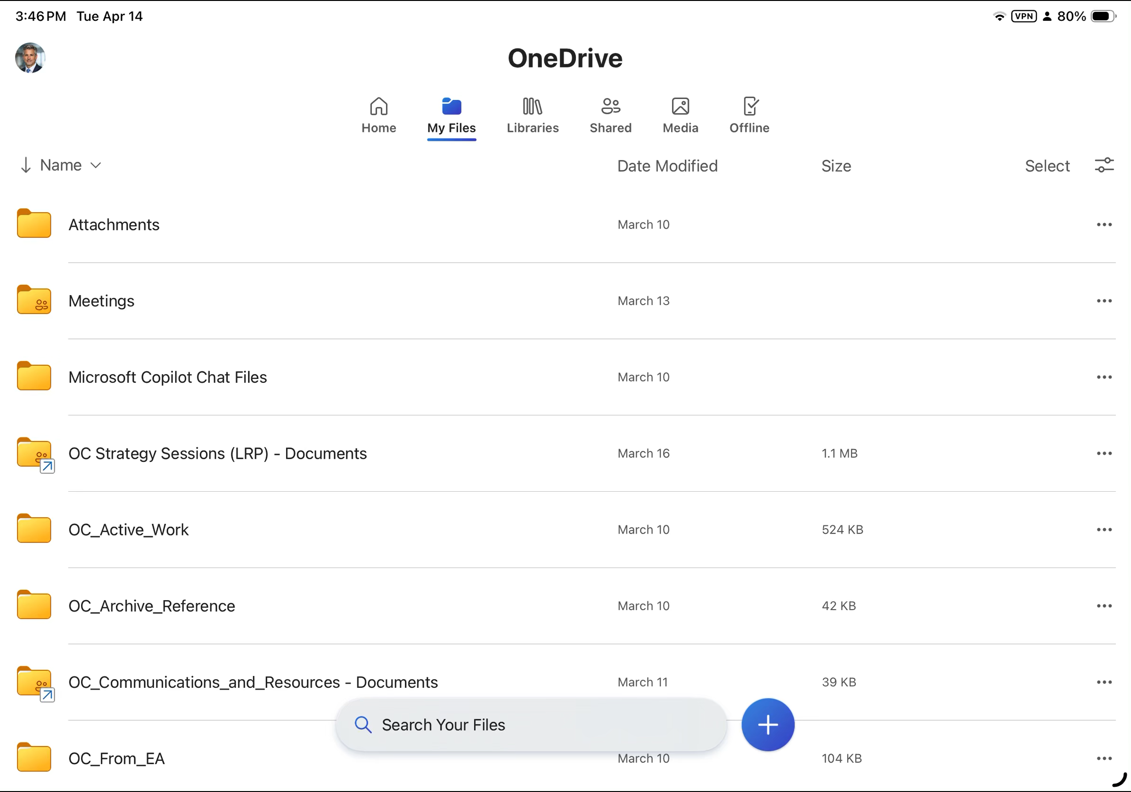
Previewing Confidential Files
Launched!

Slide 16
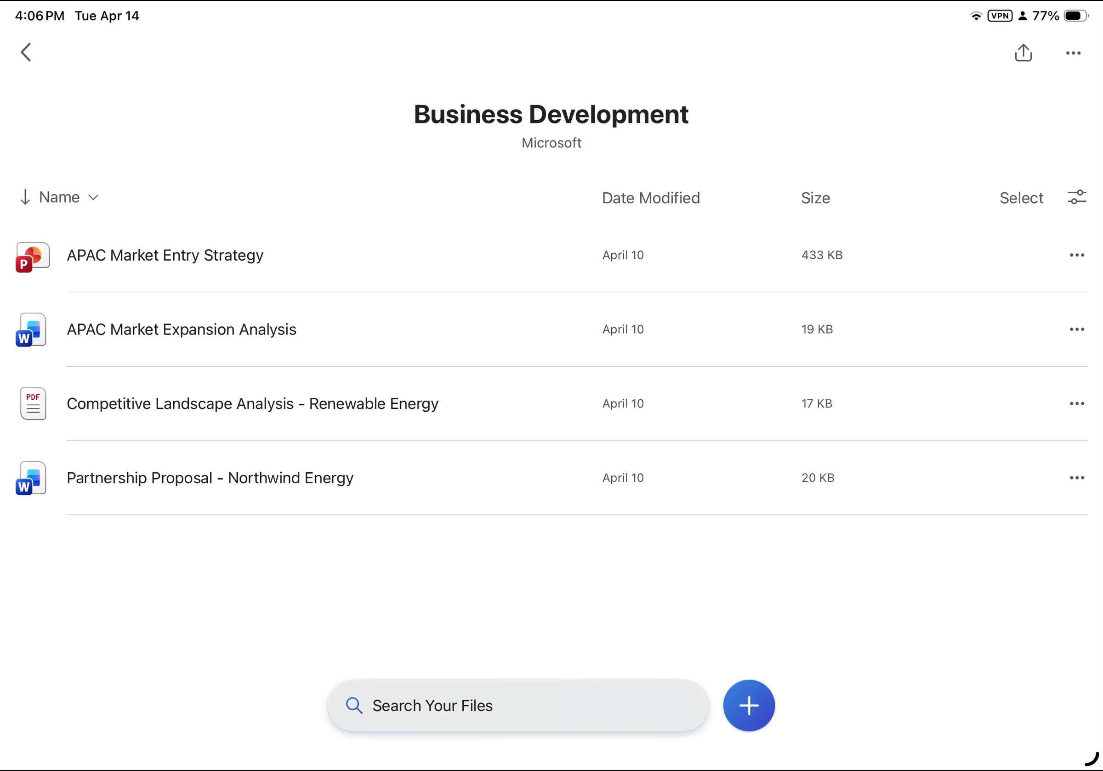
Copilot Summary on Mobile
Launched!

Slide 17
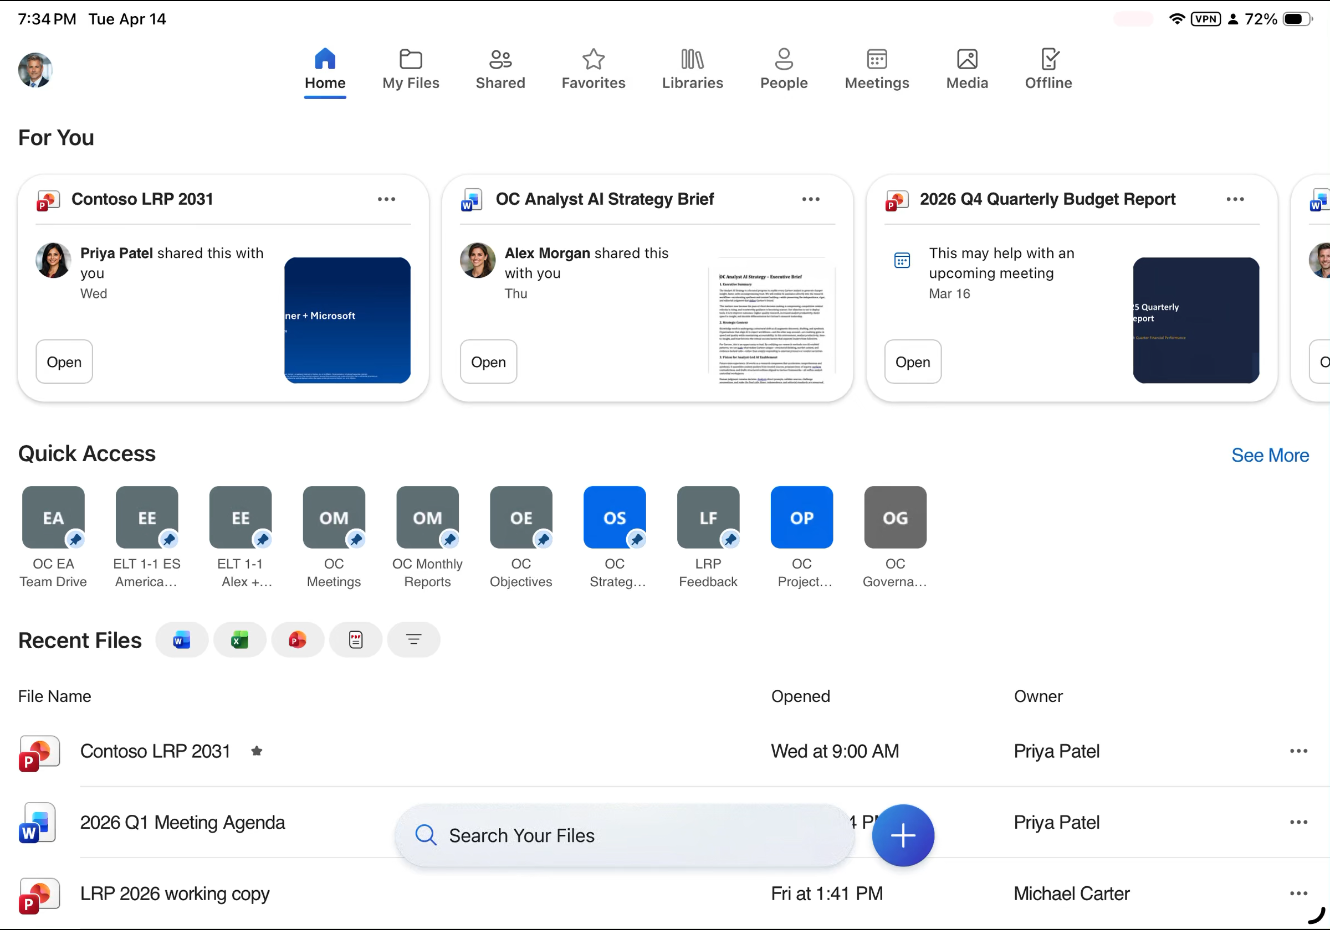
Improved iPhone & iPad UX
Launched!

Slide 18
Feature List
Theme | Feature | GA Timelines
Get to your content faster | File Filters, Dynamic Columns, and Breadcrumbs | Launched
 | Browsing & Searching for Libraries | Launched
 | Improved Online & Offline Search | Launched
 | Improved iPad UX to match OD Web: Home, Favorites, Shared pivot updates | Launched
 | People pivot | September
 | Meetings pivot | September
View your content seamlessly | Previewing Confidential Files | Launched
 | Previewing & Editing MD Files | September
 | Save Scanned Content Locally | September
Get answers faster | Copilot summarize | Launched
Notes:
This is a summary of all of the features we have launched or are launching soon for commercial OneDrive. You’ll notice that I didn’t have time to demo all of the features on this list but if you have any questions about these after the call, please feel free to reach out.

Slide 19
iPad Tips & Tricks
Enable background app refresh and preview office documents
Mark critical folders as offline before you travel
Use Scan for paper documents
To ensure your OneDrive app works seamlessly, make sure background app refresh and file preview are both turned on in your app settings. This is the single biggest lever on whether OneDrive mobile feels fast. With them off, the app cold-fetches every time you open it. With them on, your files are waiting for you the moment you tap in.
Before your next conference trip or flight, open the folder you’ll need and tap Make available offline. Combined with offline search, this means you can still find and open what you need at 35,000 feet — no Wi-Fi required. A minute of prep on the ground saves an hour of frustration in the air.
The built-in Scan tool auto-crops, corrects perspective documents, and saves it as a searchable PDF. Then, use our handy PDF markup editor to sign, correct, or add your personal flair. All your changes get saved to OneDrive for you to share with a collaborator, or polish it on your laptop when you’re back at your desk.
Notes:
Before I open it up for questions, three quick tips I’d love every person in this room to walk out with — simple things that unlock the best of OneDrive on iPad and mobile.
Tip 1: Enable background app refresh and preview office documents in your OS and OneDrive app settings
To ensure your OneDrive app works seamlessly, make sure background app refresh and preview office documents are turned on in your OS and OneDrive app settings. This is the single biggest lever on whether OneDrive mobile feels fast. With them off, the app cold-fetches every time you open it. With them on, your files are waiting for you the moment you tap in.
Tip 2: Mark critical folders as offline before you travel
Before your next conference trip or flight, open the folder you’ll need and tap Make available offline. Now that entire folder is made available offline. You never need to mark each file as offline individually. Combined with offline search, this means you can still find and open what you need at 35,000 feet — no Wi-Fi required. A minute of prep on the ground saves an hour of frustration in the air.
Tip 3: Use Scan for old school paper documents
The built-in Scan tool auto-crops, corrects prospective documents, and saves it as a searchable PDF. Then, use our handy PDF markup editor to sign, correct, or add your personal flair. All your changes get saved to OneDrive for you to share with a collaborator, or polish it on your laptop when you’re back at your desk.

Slide 20
Upcoming community events
Microsoft 365 Ottawa | September 25 | Ottawa, Canada
European Fabric + SQL Community Conference | September 28-October 1 | Barcelona, Spain
Community Days Montreal | October 7 | Montreal, Canada
TechCon 360 Dallas | November 2-6 | Dallas, TX
Microsoft Ignite 2026 | November 17-20 | San Francisco, CA
ESPC 26 | November 30-December 3 | Amsterdam, Netherlands
Explore other Microsoft events here and a full list of community-led events can be found at CommunityDays.org

Slide 21
Open discussion
If viewing on-demand, drop your questions in the Microsoft Tech Community – Driving Adoption event page to engage with us!
Share your feedback for this call by visiting https://aka.ms/Microsoft365ChampionCallFeedback

Slide 22



What’s next
Share your feedback
https://aka.ms/Microsoft365ChampionCallFeedback
Next call:
SharePoint – new updates to flexible sections
Join the Driving Adoption community
https://aka.ms/DrivingAdoption
Invite colleagues to become a Champion
https://aka.ms/M365Champions

