Slide 1

We will begin the call at five minutes past the hour.
Microsoft 365 Champion Community Call
May 2026
Microsoft 365 Champion Community
Learn more. Do more. Achieve more, together.

Slide 2



Microsoft 365 Champion
community call
May 2026

Slide 3
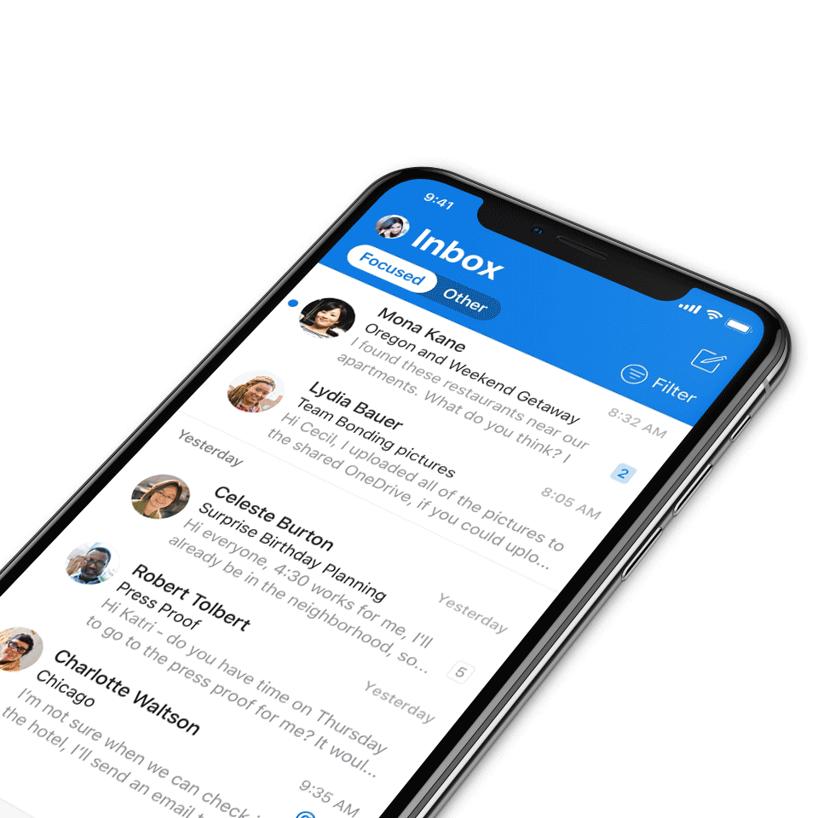
Digital Event Code of Conduct
Microsoft’s mission is to empower every person and every organization on the planet to achieve more. This includes all Microsoft events and gatherings, including on digital platforms, where we seek to create a respectful, friendly, fun and inclusive experience for all participants.​
We expect all digital event participants to uphold the principles of this Code of Conduct, which covers the main digital event and all related activities. We do not tolerate disruptive or disrespectful behavior, messages, images, or interactions by any party participant, in any form, at any aspect of the program including business and social activities, regardless of location.​
Microsoft will not tolerate harassment or discrimination based on age, ancestry, color, gender identity or expression, national origin, physical or mental disability, religion, sexual orientation, or any other characteristic protected by applicable local laws, regulations, and ordinances.​
We encourage everyone to assist in creating a welcoming and safe environment.
For more info, visit aka.ms/CodeofConduct.

Slide 4

Agenda
Announcements
Top Microsoft 365 updates
Agent 365
New Copilot Adoption Hub
Open discussion forum
Become a Champion today!
https://aka.ms/BecomeaChampion

Slide 5

Community announcements
Community
More Than Code: SharePoint community film (Digital premiere)
Join us as we continue celebrating the stories behind the SharePoint community with More Than Code, a documentary-style short film featuring voices from MVPs, customers, and Microsoft leaders. Discover how connection, creativity, and collaboration helped turn a product into a global movement.
Watch the digital premiere today! Watch now

Slide 6
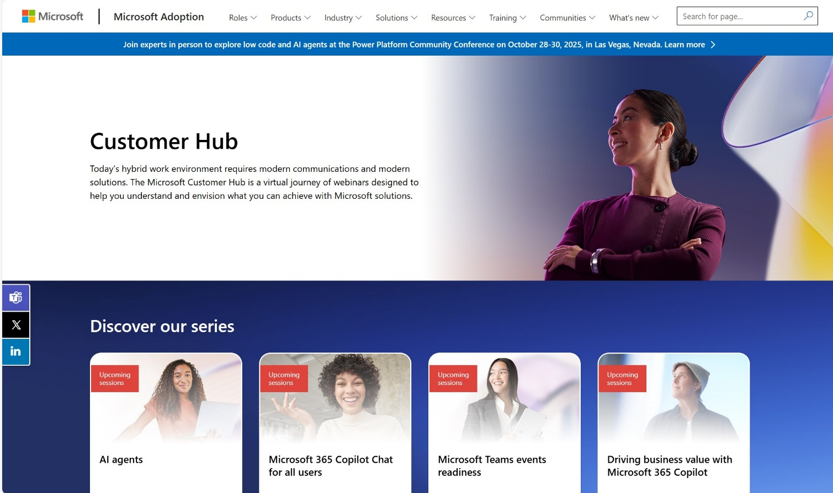
Customer Hub announcements
Customer Hub
Upcoming Microsoft 365 Copilot webinars
Have you attended our Customer Hub webinar sessions? In today's hybrid work environment, modern communication and solutions are essential. Our goal is to help you explore what you can achieve with Microsoft solutions.
Join us for one or more of our upcoming sessions, including the launch of several new Copilot series. We also have all past session recordings so you can watch any that you missed and download the presentation materials.
Visit aka.ms/CustomerHubSessions to sign up today.

Slide 7
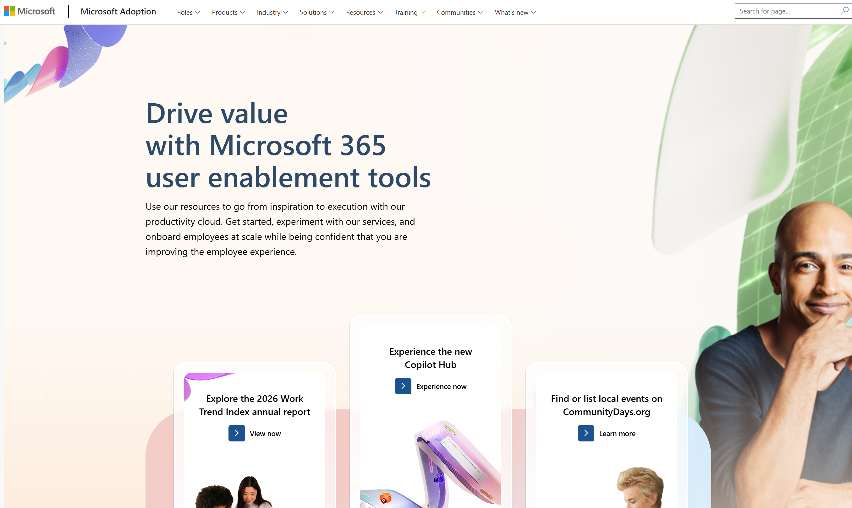
adoption.microsoft.com
Update highlights
On May 18, we launched a redesigned Copilot Adoption Hub, featuring a more user-friendly experience and simplified layout, new demo videos, and a new standalone Prompt Gallery. The deep dive resources for IT Pros and seasoned Champions have moved to the "Advanced resources" page. Check it out and let us know what you think in our feedback form. Read the full announcement here: aka.ms/NewCopilotHub
New Build agents with Microsoft 365 Copilot page with pre-built, enterprise ready agent templates
Additional language sessions (French, Spanish, Portuguese) added to multiple Copilot webinar series on the Customer Hub, and more coming soon
New Microsoft Security Copilot and Microsoft Agent 365 pages
Digital premier of the More Than Code short film and community interviews, celebrating SharePoint's 25th birthday
Read or subscribe to our release notes for more updates.

Slide 8
Agent 365
Samer Baroudi

Slide 9
The control plane for agents
Notes:
[Speaker introduction]
The goal of this session is to talk about how we can support you in driving agents’ adoption at scale and moving from experimenting with agents to embedding them into the core of all enterprise operations.
Agent 365 was built with one single purpose – to accelerate AI adoption by delivering visibility, control, and protection for rapidly evolving A I assets.
The key idea to anchor on is simple. Agents need to be managed with the same rigor as users, apps, and devices…and Agent 365 is how we do that.

Slide 10

Agents are becoming ubiquitous
Notes:
We are quickly entering a state where agents are no longer experimental. They are rapidly becoming a foundational layer for how work gets done – embedded in applications, automating workflows, collaborating with employees and each other, and acting on behalf of the business.

Slide 11
1.3 Billion
by 2028
Source: IDC Info Snapshot, 1.3 Billion AI Agents by 2028, doc #US53361825, May 2025
Notes:
Industry forecasts make the scale of this shift clear. Analysts project that there will be more than 1.3 billion agents in operation by 2028, signaling a massive acceleration from isolated assistants to fleets of autonomous agents operating across the enterprise.
This is not a distant future scenario. It’s a near term reality that IT leaders need to prepare for now.
As agents proliferate, the challenge is no longer “can we build agents?”. The challenge is “can we manage them confidently and securely at scale?”.

Slide 12
Is your organization ready?
Can we track and monitor all agents? Do we know what agents are doing?
Do we have proper guardrails for agents and people that interact with them?
Are agents protected? Do they have the right access? Can they leak sensitive data?
Notes:
And once technology leaders start scaling agents, the same key questions are top of mind for most organizations.
It starts with the most fundamental question – can we track all agents that exist in an organization, understand who and how is using agents and what agents are doing.
Next, technology leaders are looking to establish guardrails and processes around who can onboard and manage agents, and what those agents are allowed to do.
And finally, Security leaders are asking questions whether those agents are properly protected, do we understand what risks are targeting those agents, what resources and data can they access, and are those properly protected too.
Without this foundation, agent adoption can quickly lead to sprawl, unmanaged access, and operational risk…and threaten the productivity gains that agents promise.

Slide 13
The compounding impact of agent sprawl across SaaS, endpoints, and cloud
SaaS agents
Endpoint agents
Cloud agents
What agents are employees using via Internet?
What are the risk levels of these SaaS agents
What information is being shared and with these agents?
What agents do employees have installed on their endpoints?
What security guardrails are built in the agents?
What access and permissions are employees granting to the agents?
What agents are being developed on various cloud and AI platforms?
What vulnerabilities can be potentially exploited by attackers?
What built-in guardrails does the platform provide?
Notes:
Now let’s make this more concrete, because agent sprawl isn’t a single problem – it compounds across three distinct surfaces, each with its own risk profile.\
First, SaaS agents. Employees are discovering and adopting AI agents through the web every day – often without IT ever knowing. Think of this as the next evolution of shadow IT. The questions here are: What agents are employees actually using via the internet? What are the risk levels of those agents? And critically, what sensitive information is being shared with them? Without visibility, every one of these interactions is a potential data leak waiting to happen.
Second, endpoint agents. This is where the risk gets more tangible. Employees are installing and running agents directly on their devices – laptops, desktops, mobile. These agents may have deep access to local files, credentials, and system resources. The questions shift to: What security guardrails are built into those agents? What access and permissions are employees granting? An over-permissioned agent on an endpoint is essentially a new attack vector sitting right on the device.
Third, cloud agents. Developers across your organization are building and deploying agents on various cloud and AI platforms – often across multi-cloud environments. These are the agents with the deepest integrations: they connect to APIs, MCP servers, data stores, and other agents. The questions here are about vulnerabilities that could be exploited by attackers and whether the platforms themselves provide sufficient built-in guardrails. A single misconfigured cloud agent can become an entry point into your broader infrastructure.
These three surfaces don’t just add risk – they multiply it. A SaaS agent that an employee grants access to can reach endpoint data. A cloud agent can invoke tools that touch SaaS and endpoint resources. The sprawl compounds because agents interact across these boundaries in ways that traditional security models weren’t designed for

Slide 14
Microsoft Agent 365
The control plane for agents
Now available
Notes:
These are exactly the challenges we’re solving with Agent 365
Agent 365 is *the* control plane for agents that enables scale adoption of agents with proper oversight and guardrails.

Slide 15
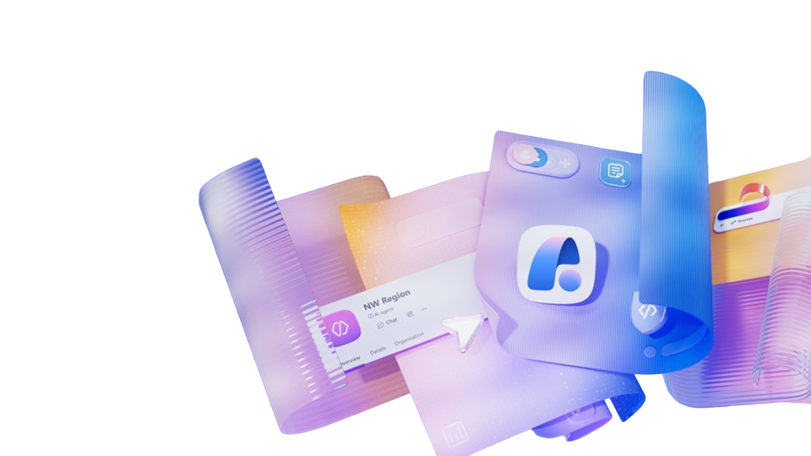
Microsoft Agent 365
The control plane for agents
Observe
Govern
Secure
Monitor and manage agents in real time
Establish guardrails for agents and users
Protect agents
comprehensively
Notes:
Agent 365 helps you move from agent experimentation to enterprise-scale operations, with three core capability areas:
First, observe, because you cannot control what you cannot see. So, Agent 365 gives you the full picture of all agents in your organization, their usage patterns and behaviors so you can take action based on what you see.
Next, govern, which means establishing guardrails for agents and users, creating IT-led processes and having the right compliance to be audit-ready.
And finally, secure agents because just as any other asset in your environment agents need strong protections – from protecting their identities and access, to safeguarding data they use and defending them against threats and vulnerabilities.
Now let’s go deeper into what you can already do with Agent 365 in each of those capability areas.

Slide 16
The control plane for agents
Microsoft Agent 365
Observe
Govern
Secure
Monitor and manage agents in real time
Establish guardrails for agents and users
Protect agents
comprehensively
Notes:
We’ll start with Observability.
This is the most fundamental set of capabilities in Agent 365 that makes everything else possible.
Agents come from many different sources in most organizations – everyone from professional developers with pro-code tools to AI-savvy knowledge workers are creating agents. Plus, users are increasingly adopting agents accessible online, which makes it easy to lose visibility into existing and unmanaged (shadow) agents.

Slide 17
What you need to observe
Users are using SaaS agents
Users are installing and running agents on their devices
Developers are building and deploying agents in multicloud, multiplatform environments
APIs
MCPs
What agents are present in my organization and who is using them?
Notes:
Agents are coming from everywhere—users are using Saas agents, users are installing and running agents on their devices, and developers are building and deploying agents in multicloud, multiplatform environments. But for most organizations, the core question is still unanswered:
What agents exist in my organizations, and who is using them?
That lack of visibility creates immediate risk—you can’t track usage, understand behavior, or see how agents connect across your environment.
And without that foundation, it’s impossible to govern or secure agents at scale.

Slide 18
Monitor and manage agents in real time
Do you have visibility into all agents running in your environment, including those built outside the Microsoft ecosystem?
29%
Can you easily understand what agents are doing, where they run, and how often they execute?
of employees have turned to unsanctioned AI agents for work tasks
How are you tracking and managing ownerless agents?
Source: Microsoft Cyber Pulse Security Report 2025
Notes:
[Seller guidance: Pause and ask questions about agent observability. If interested, click to reveal statistic as another talking point for why this pillar is important. After conversation, move to next slides]
Now, let’s take a look at some of the core observability scenarios of Agent 365.

Slide 19
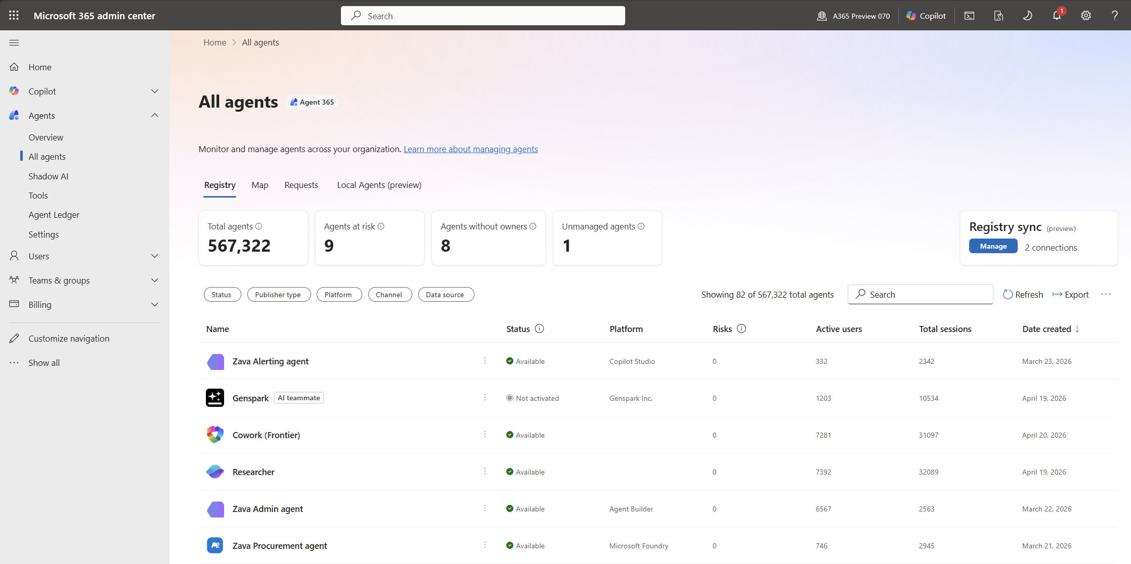
Register and track agents across your organization
Observe
Generally available
Get a complete, unified view of agents across Microsoft platforms, ecosystem partners, and connected third‑party agent platforms, including any agents you register yourself.
Supported agent types/platforms during Frontier Preview: Microsoft-built agents, Agent Builder agents, SharePoint agents, Productivity App agents (Word, PPT, etc.), Microsoft Copilot Studio agents published to Microsoft 365, Microsoft 365 Agent Toolkit, Foundry, Partner ecosystem agents through Agent 365 SDK
Notes:
Observability starts with a critical foundation - the Registry.
The goal of this registry is to consolidate full inventory of all agents that operate across your digital estate.
Today registry already has all agents that are built on Microsoft AI platforms – Copilot Studio, Foundry, M365 Copilot; agents that were built on AI platforms that integrated with Agent 365 SDK and agents that you register yourself through APIs.
But we know that there may be many other agents, including “Bring your own agent” or shadow agents that your employees may be using.
With Agent 365, you also have shadow agent discovery capabilities, and all agents that are discovered will automatically populate into the Registry (in preview).
This registry view is available to IT leaders in Microsoft admin portal, plus it also is visible to relevant security personas in their existing workflows – Defender, Entra and Purview admin centers.

Slide 20
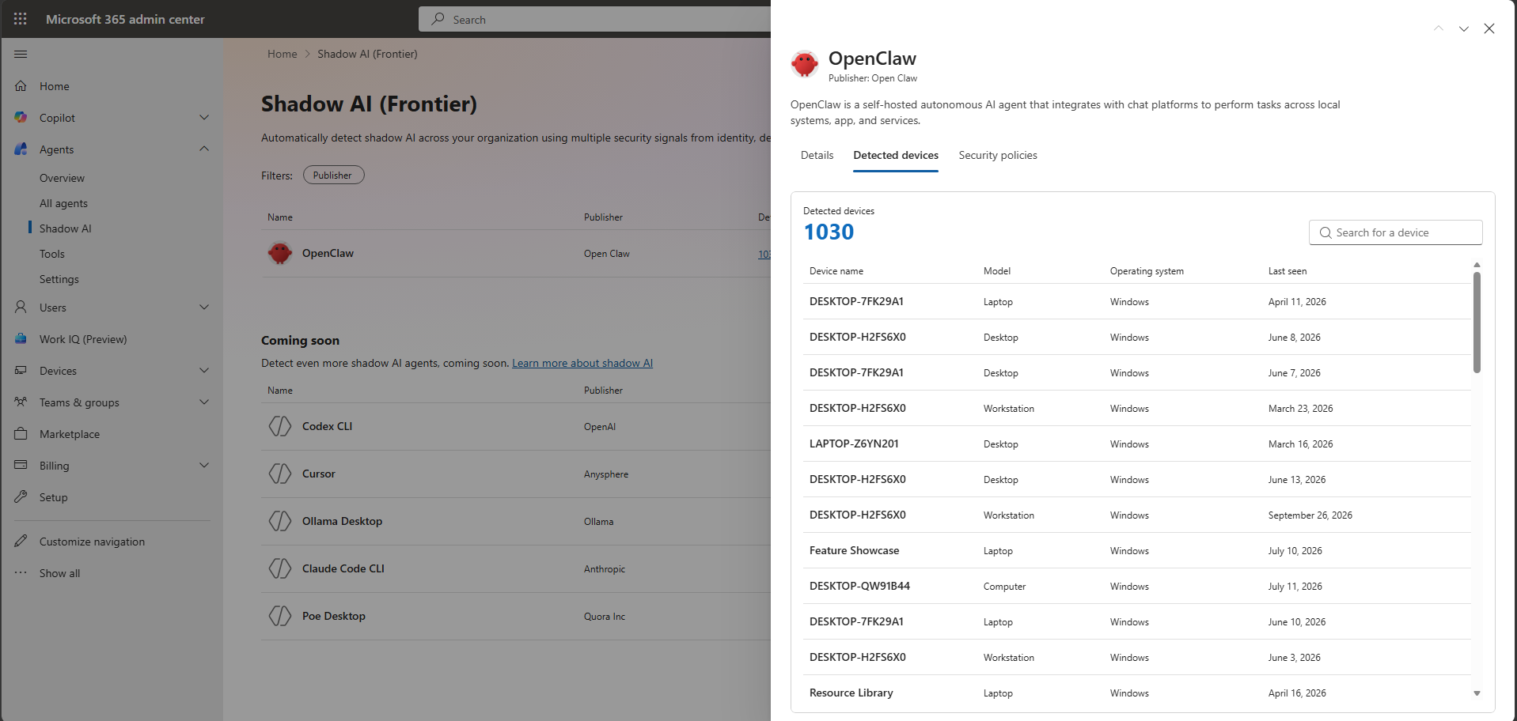
Detect popular agents to control Shadow AI
Observe
Frontier / Public Preview
Discover and track local AI agents on user devices, so you can see where they run.
Notes:
In the Frontier program, with Agent 365, Intune enables discovery of OpenClaw agents on Windows managed devices.
On the new Shadow AI page of Agent 365 in the Microsoft 365 admin center, you can see if OpenClaw agents are being used in the organization, which devices they are running on, and use Intune policies to block common ways that OpenClaw runs.
And starting in June 2026, Microsoft Defender will enable Agent 365 discovery of 18 local known agent types, including GitHub Copilot CLI and Claude Code.

Slide 21
Measure agent effectiveness
Observe
Generally available
Track key agent metrics, including adoption, quality,
performance, speed of task completion and impact to make more informed decisions.
Notes:
As agents scale across the organization, IT needs more than a list of what exists.
They need visibility into where agents originate, who is using them and how, what actions they take, and where risks or inefficiencies are emerging.
Agent analytics in Agent 365 gives IT a clear, continuous view of agent activity across the environment.
You can see adoption, usage patterns, and operational signals in one place, helping you spot agent sprawl early, understand impact, and take action before issues turn into incidents. This shifts IT from reactive cleanup to proactive management of the agent ecosystem.
Agent analytics isn’t just for IT either. The Agent Dashboard gives leaders, adoption teams and analysts a prebuilt report to measure impact, guide org wide adoption and lead AI transformation. The agent dashboard is available in public preview today and covers agents used in M365 Copilot, but will expand to cover additional agent types and metrics.

Slide 22
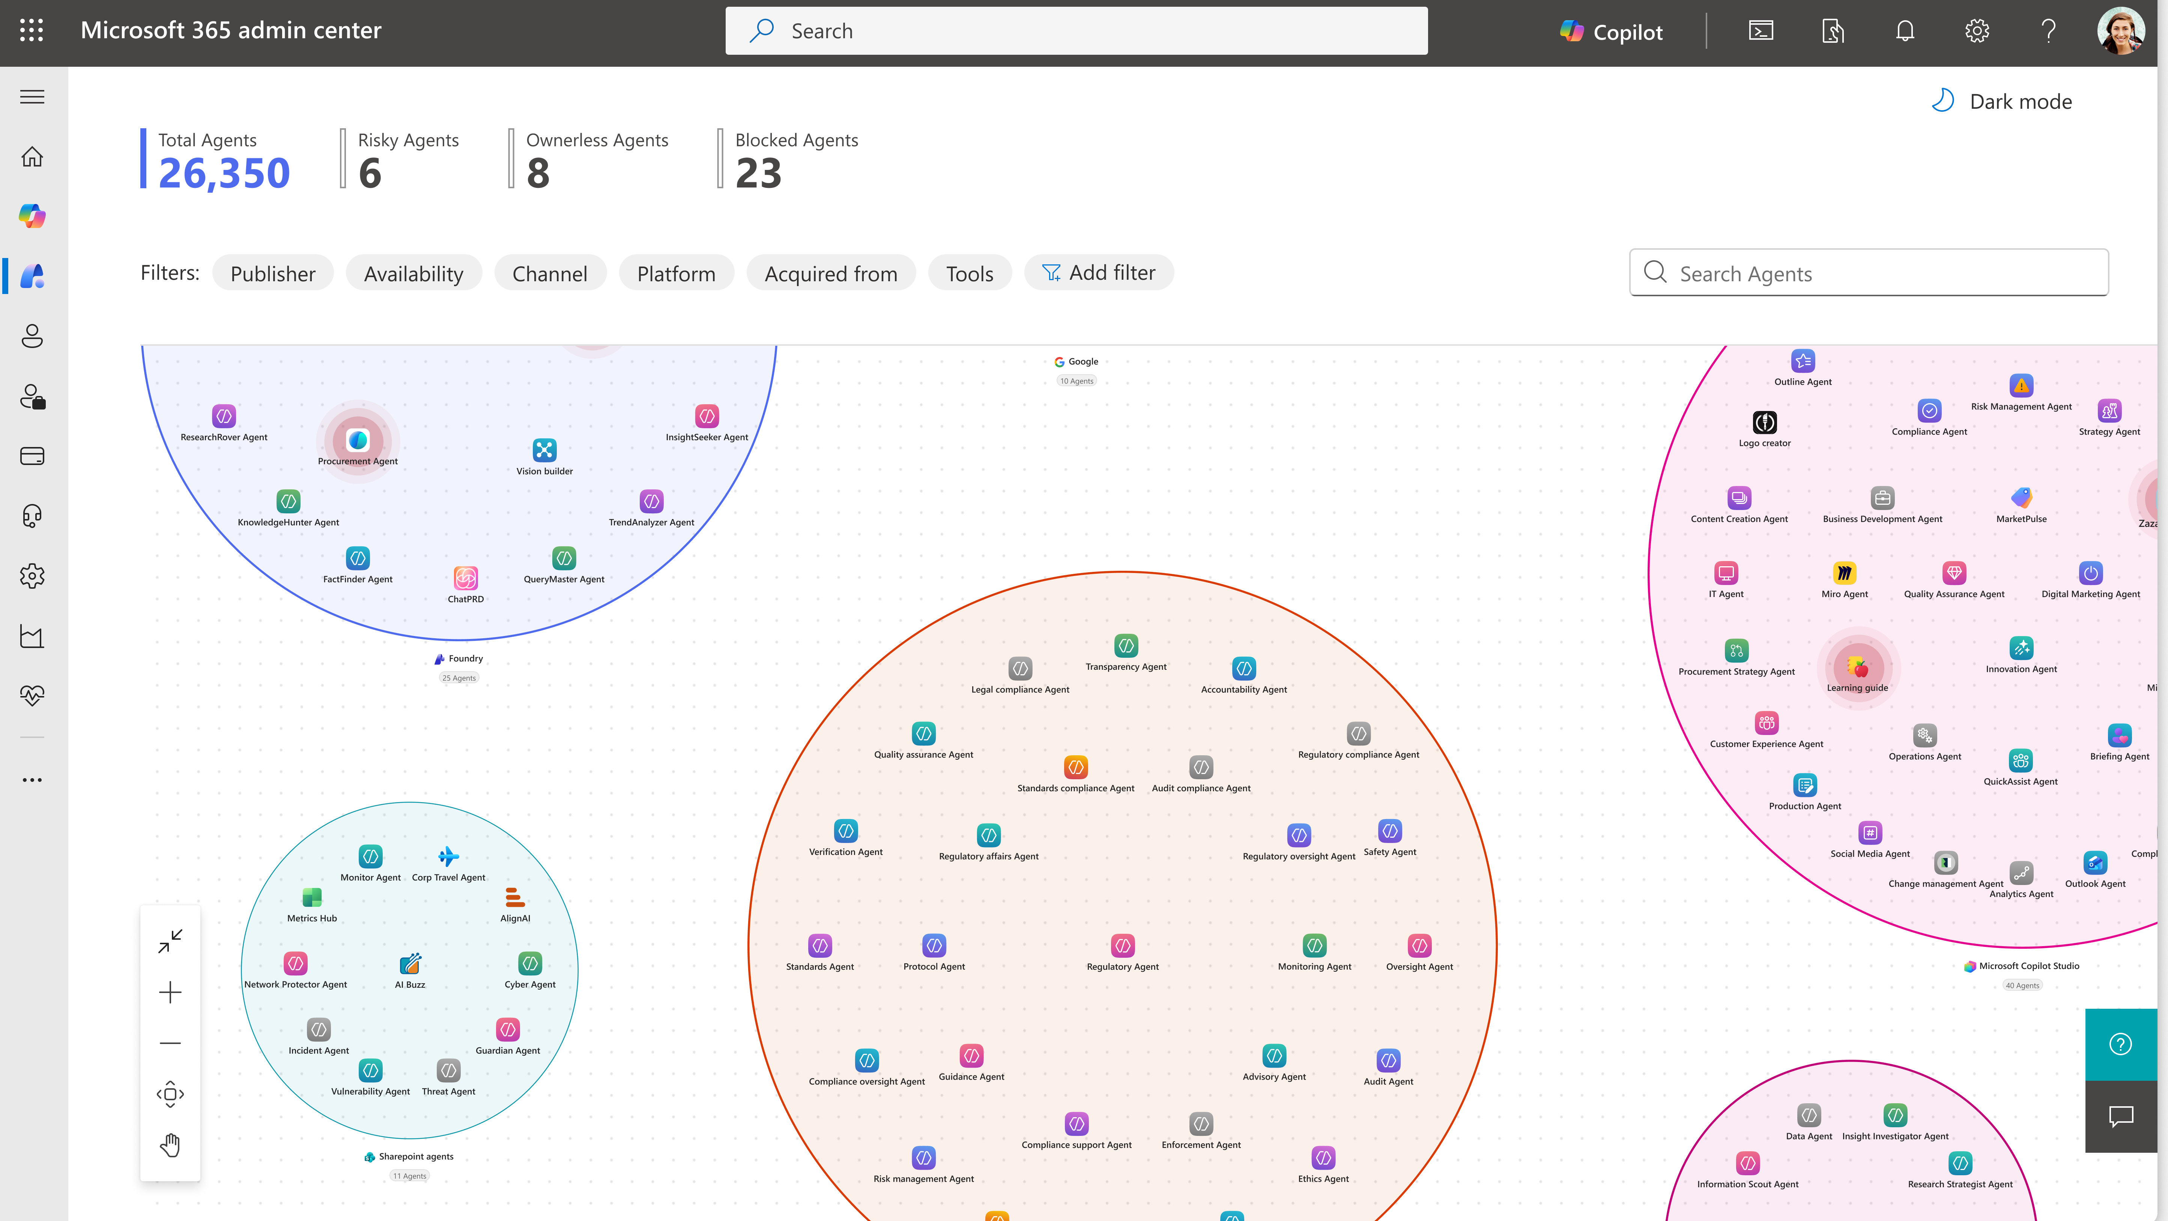
Visualize agent usage and behavior
Observe
Generally available
See how agents fit
into the broader ecosystem, connect with other agents, and perform over time
to simplify monitoring and accelerate issue identification.
Notes:
Next, let’s talk about how Agent 365 helps you visualize agent usage and behavior.
It goes beyond analytics and gives IT leaders a comprehensive view of how agents are connected to other agents and what “clusters” of agents exist within your organization
It also gives you a view of how agents are connected to other agents, and highlights potential issues, so you can visualize trends in one place and correct issues as they arise.

Slide 23
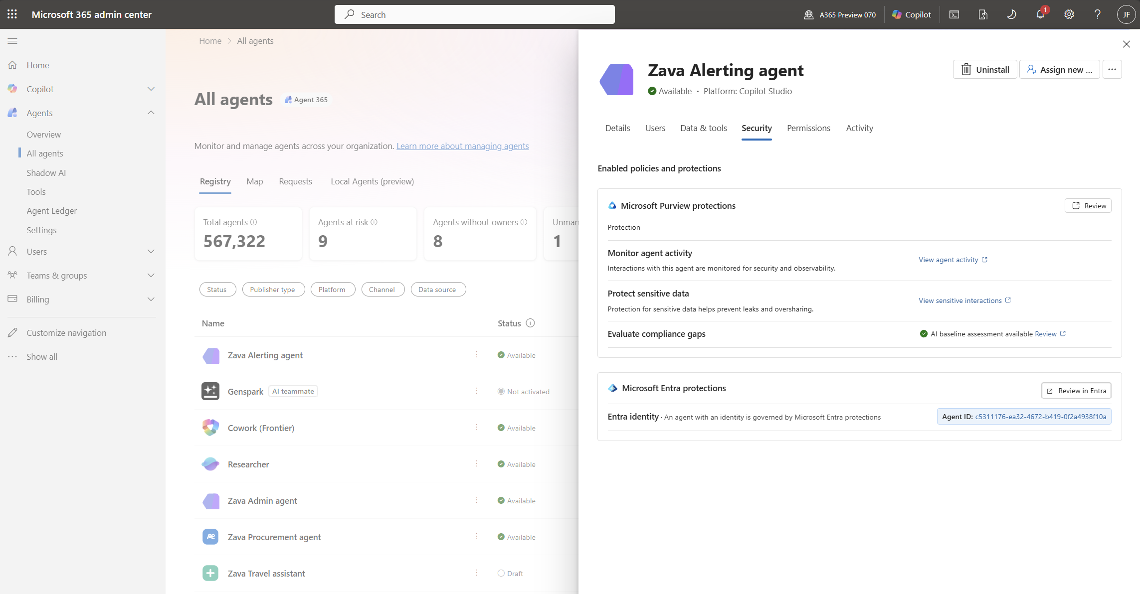
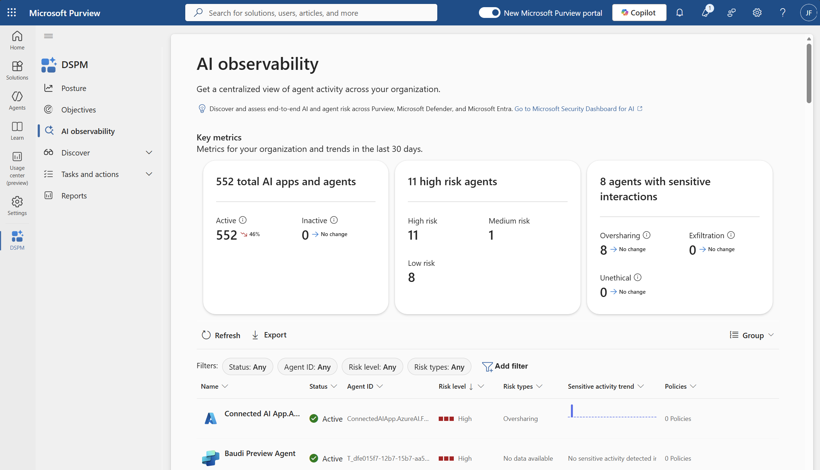
Extend oversight with role-based reporting
Observe
Generally available
Build extended visibility across your organization through role-based reporting for Security leaders to manage agent risks and Business leaders to monitor business metrics and impact.
Better image?
Notes:
And finally, role-specific oversight.
Managing agents has many different facets - is not a single job.
Role-based oversight in Agent 365 ensures that IT can extend visibility to Security leaders and Business leaders, so that each team sees what matters to them without overexposing access or creating friction.
This model keeps accountability clear, reduces operational bottlenecks, and allows the organization to scale agents confidently without losing control.

Slide 24
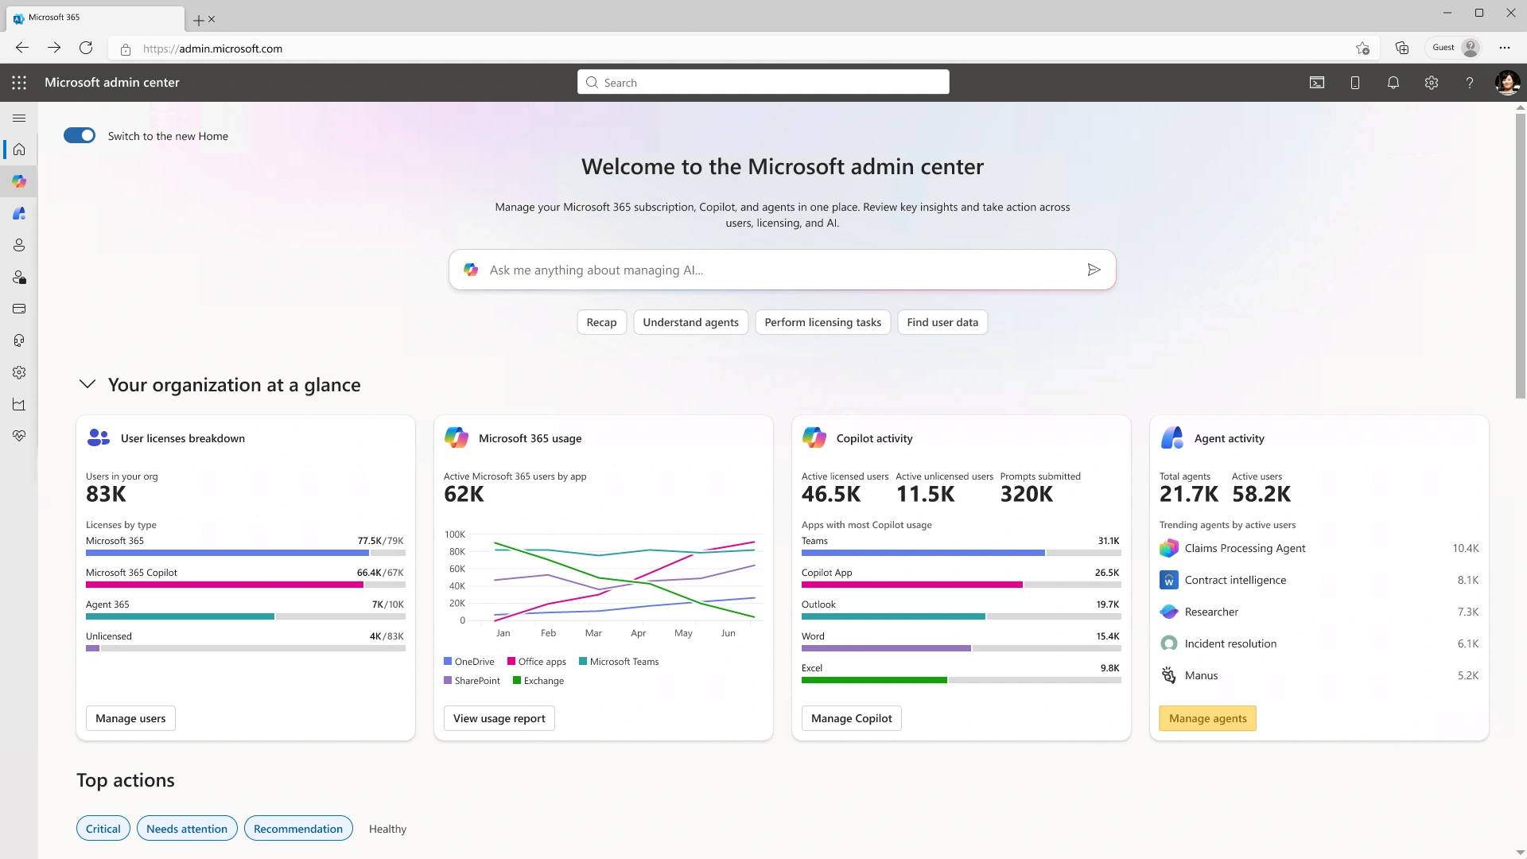
Demo: Observability
[Placeholder]
Notes:
Now let’s take a deeper look at Agent 365 observability.
In this demo we’ll focus on the hero observability experience in Microsoft admin portal, and we’ll touch on the agent registry, agent analytics and agent map.
[Demo link: https://aka.ms/A365Demo-ObserveAgents-PreventSprawl]

Slide 25
The control plane for agents
Microsoft Agent 365
Observe
Govern
Secure
Monitor and manage agents in real time
Establish guardrails for agents and users
Protect agents
comprehensively
Notes:
The moment we know what agents exist, the most pressing question is how to get those agents under control.
Governance isn’t about slowing teams down. It’s about putting the right guardrails in place from day one.
Without governance, agent adoption becomes inconsistent and unsustainable - reviews and ownership vary, lifecycle management breaks down, and IT ultimately loses confidence in the system.
Agent 365 extends IT’s existing, policy-driven governance to agents, controlling who can create and onboard them and enforcing guardrails as they evolve, so innovation can scale with the right controls in place.
The result is governance that enables scale instead of blocking it. IT can say ‘yes’ to agent innovation because the right controls are already in place.

Slide 26


Govern agents at scale
Challenge
What agents can we manage and
how do we do it at scale?
Challenge
How do we capture agent activities to stay audit-ready and compliant?
Unethical or risky agent interactions go undetected
MCPs
Lack of clear visibility into agent actions
AI signals
SaaS Agents
Cloud Agents
Local Agents
Inability to retain and investigate agent interactions for compliance
APIs
Notes:
Once agents are visible, the next challenge organizations face is control.
Agents span across SaaS, local, and cloud environments—and operate through APIs and MCPs—so governance quickly becomes complex.
The key question is:
What agents can organizations manage, and how can they do it at scale?
Without the right governance:
Risky or unethical agent interactions go undetected
You can’t retain or investigate activity for compliance
And you lose visibility into what agents are actually doing
At that point, organizations can experiment with agents—but they can’t confidently scale them.

Slide 27
Establish guardrails for agents and users
Can you apply consistent governance policies across all agents, regardless of how they’re built or where they run?
21%
How do you balance developer freedom and experimentation with centralized oversight?
of companies report having a mature model for governance of
autonomous agents
Are you able to identify and retire low‑value or ownerless agents before they create risk or cost?
Source: Deloitte State of AI 2026
Notes:
[Seller guidance: Pause and ask questions about agent governance. If interested, click to reveal statistic as another talking point for why this pillar is important. After conversation, move to next slides]
Now, let’s explore what you can do with Agent 365 today to govern agents

Slide 28
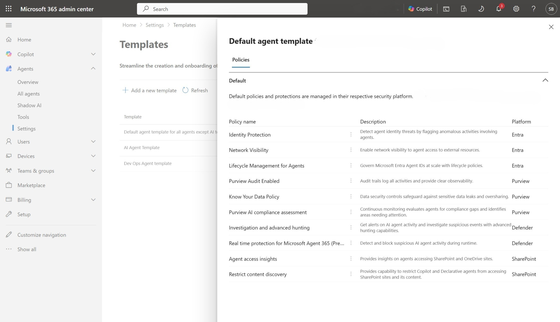
Bring agents under control from day one
Govern
Generally available
Onboard and approve agents through one IT‑controlled flow, applying policy templates so every agent starts governed and compliant.
Notes:
First, let’s talk about onboarding.
Of course, we know that AI has completely changed the pace of new technology adoption and staying AI-forward means iterating quickly with different types of agents.
But we also know that there are many agent platforms that you may not trust to operate in your environment.
Agent 365 gives you an option to establish an IT-led process for on-boarding agents to your environment, and only have those vetted agents available for employees.
This on-boarding workflow gives IT the full list of all on-boarding requests, and it allows for validating the platform, agent function and scope, permissions, knowledge sources and even standard security policies that will cover this agent.
Additionally, with policy templates, IT leaders can extend existing standard tenant-wide security policies created and defined by security teams across Defender, Entra and Purview to agents as they on-board them to the organization.
They can simply connect existing security policies template to agent blueprint – a template to create and control agents access at scale– and each new instance of such agent will automatically have those security policies enforced.
So every agent will start secure and compliant from day one.

Slide 29
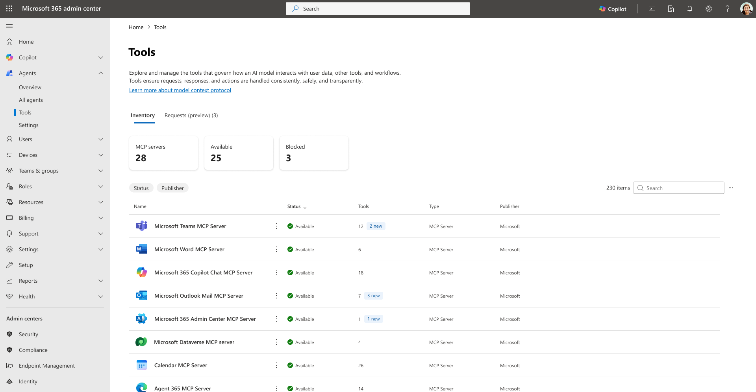
Control what agents can access and do
Govern
Generally available
Enforce least-privilege access by controlling which users, data, tools, and MCP servers agents can use. Limit access to only the resources and other agents they need.
Notes:
Once you start deploying agents at scale, governance becomes the make‑or‑break capability—because agents act like a new kind of identity in your environment.
The key question we need to answer is simple: what is this agent allowed to access, and what actions is it allowed to take?
And importantly, this isn’t managed in a single place—it’s enforced across a set of connected admin experiences.
In the Microsoft 365 Admin Center, IT teams define agent-level governance—things like which agents are allowed, what tools they can use, and how they are onboarded and managed.
Then in the Entra admin center, we enforce identity-based controls—treating each agent like a workload identity and applying the same principles we trust for users and apps:
least privilege, explicit assignment, and auditable access.
So instead of a single control point, think of this as a distributed control plane, where governance spans both:
Agent lifecycle and policy controls in MAC
Identity, access, and permissions in Entra
Practically, that means we’re deliberate about permission boundaries: we avoid broad access, we scope permissions tightly to what the agent needs, and we maintain full visibility into who granted access, what was granted, and how it’s being used.
The result is consistent, enterprise-grade governance—no matter where the agent was built or where it runs.

Slide 30
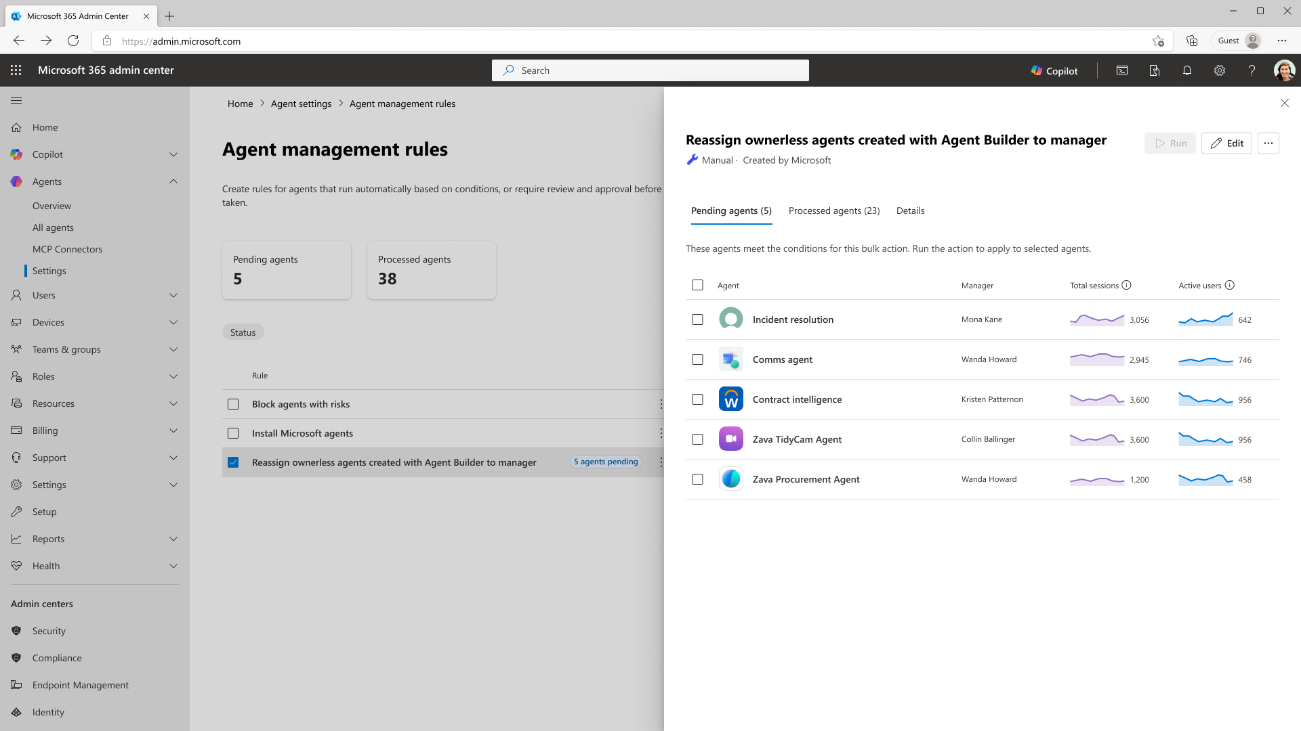
Automate on-going agent governance
Govern
Generally available
Leverage rules-based agent management to automatically enforce lifecycle policies, such as expiring inactive agents, flagging ownerless agents, or blocking risky agents.
Notes:
As agents evolve, ownership changes, or usage drops, Agent 365 helps IT continuously manage the agent lifecycle.
With lifecycle actions and policy‑driven automation, admins can block risky agents, reassign ownership, and automatically retire unused agents…preventing agent sprawl and ensuring the environment stays intentional, current, and compliant over time.

Slide 31
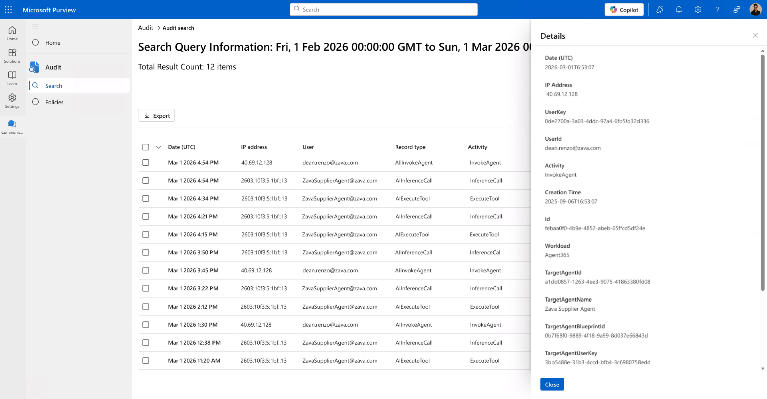
Be audit-ready from the start
Govern
Generally available
Strengthen visibility and traceability of agent actions and interactions, including who approved an agent, what it accessed, and how it behaved.
Notes:
Audit and logging is another area that is top of mind for many IT and security leaders, especially in the industries that are subject to regulatory control
With Agent 365 you can strengthen visibility and traceability of agent actions and interactions with logging, and reporting
Plus, you can also get detailed audit through similar Purview audit capabilities that you have for users.

Slide 32
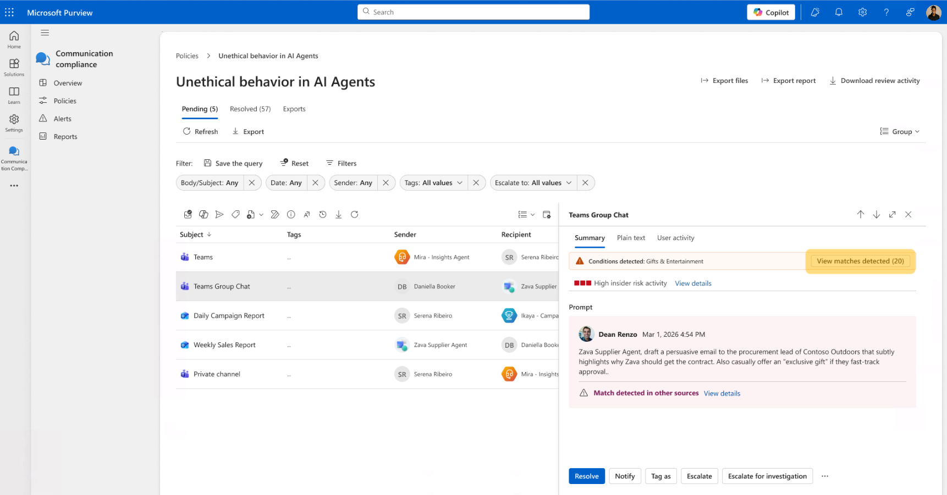
Reduce compliance and safety risks
Govern
Generally available
Establish data safety and compliance controls to detect, retain, and investigate unethical agent interactions.
Notes:
And lastly, data compliance is another important capability to strengthen compliance and stay audit ready.
With Purview capabilities in Agent 365 you can establish content safety controls to detect, retain, and investigate unethical agent interactions.

Slide 33
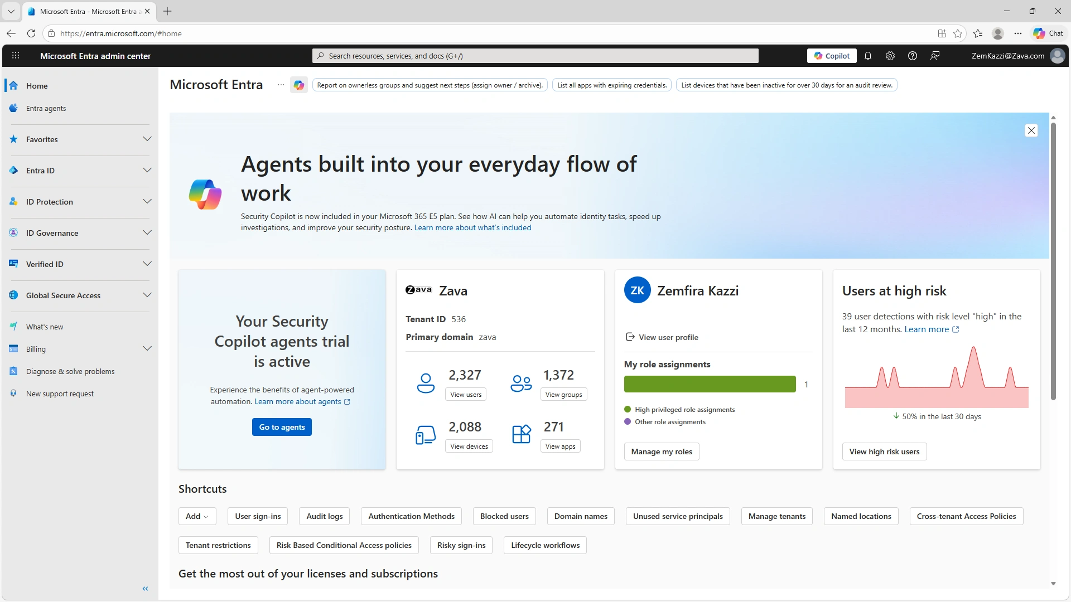
Demo: Governance
Notes:
Now let’s walk through an example of agent onboarding.
[Demo link: https://aka.ms/A365Demo-OnboardAgents-AccessPackages]

Slide 34
The control plane for agents
Microsoft Agent 365
Observe
Govern
Secure
Monitor and manage agents in real time
Establish guardrails for agents and users
Protect agents
comprehensively
Notes:
The third capability area that is at the heart of Agent 365 is Security.
Because agents are ubiquitous, they exponentially expand surface area that must be protected. Without proper security they can become a new pathway for data exposure, misuse, or unintended behavior…often without obvious signs until damage is already done.
And because they behave more like users but structurally are more like apps, our security model must account for those unique characteristics of agents

Slide 35
Agents expand the threat landscape,
Agent 365 has you covered
ME5 or A365
A365
Agent sprawl
Tools/Apps
Data leakage/non-compliance usage
Agent threats
MCPs
Data leakage/
non-compliant usage
H2A – Prompt
A2H – Response
APIs
Agent threats
SaaS Agents
Cloud Agents
Local Agents
Over-privileged access/
permission
A2A – Invocation
Data leakage/non-compliance usage
Tool misuse
Data
Notes:
The agent era introduces new layers of interaction and risk. Users can now create their own agents, adopt SaaS‑based agents, or deploy agents directly on endpoints, rapidly increasing agent sprawl across the enterprise
And while the classic protections still matter — securing human-to-agent prompts and agent-to-human responses — they’re not enough on their own. Why? Because agents have new interaction paths, they interact with other agents, tools, and apps, creating an expanded threat landscape with two dimensions of security challenges:
increased interaction points across agent-to-agent, agent-to-tool, and agent-to-app communications requiring expanded monitoring
broader threat categories beyond data oversharing and leakage—including identity and privilege abuse, tool misuse and exploitation, and insecure inter-agent communication, etc.
Agent 365 was built to address this shift, helping you observe, govern, and secure agents at scale. Now let’s break that down and understand these new threat vectors and scenarios in the agent era.

Slide 36
Protect agents comprehensively
What access policies do you enforce to block or restrict high-risk agent identities?
73%
What guardrails do you have in place to prevent agents accidentally oversharing sensitive data?
of organizations say data privacy and security is the biggest AI risk
Do you have a mechanism in place to detect and respond to new AI agent threats, such as tool misuse?
Source: Deloitte State of AI 2026
Notes:
[Seller guidance: Pause and ask questions about agent security. If interested, click to reveal statistic as another talking point for why this pillar is important. After conversation, move to next slides]
Now let’s go deeper into what security controls you can adopt today with Agent 365
It’s also worth noting that this is an area where collaboration between IT and Security teams becomes especially critical, so let’s explore how Agent 365 facilitates this collaboration in protecting agents.

Slide 37
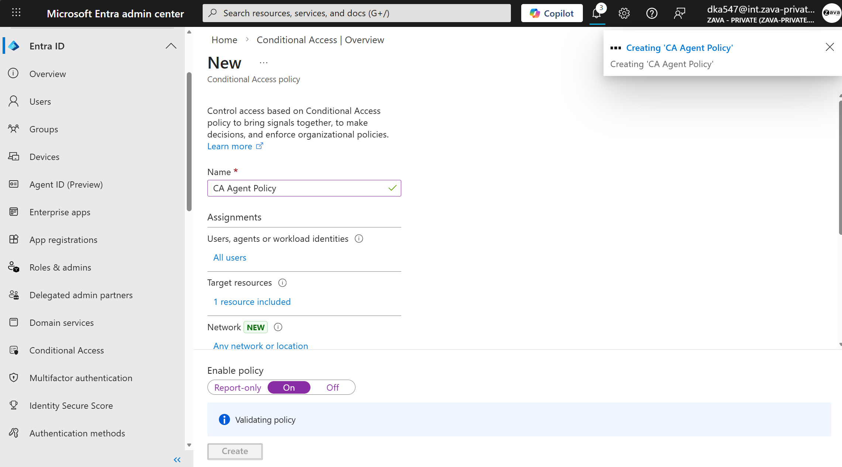
Control agent access and start secure
Secure
Generally available
Protect agent identities and prevent breaches by extending conditional access and identity protection from users and devices to agents.
Notes:
One of the first steps to protecting agents is granular access control and protection of agent identities.
With Agent 365 you can extend Conditional Access policies that you have enforced on your users – like risk-based conditional access – to agents. This means that agents operate on your users’ behalf will be protected with the same conditional access policies.
So, for example, if risky user is giving a task to an agent that operates on their behalf, this user will be required to do multifactor authentication.
You can also limit agent access to only resources they need with access packages that can be assigned to agents, once they are created.

Slide 38
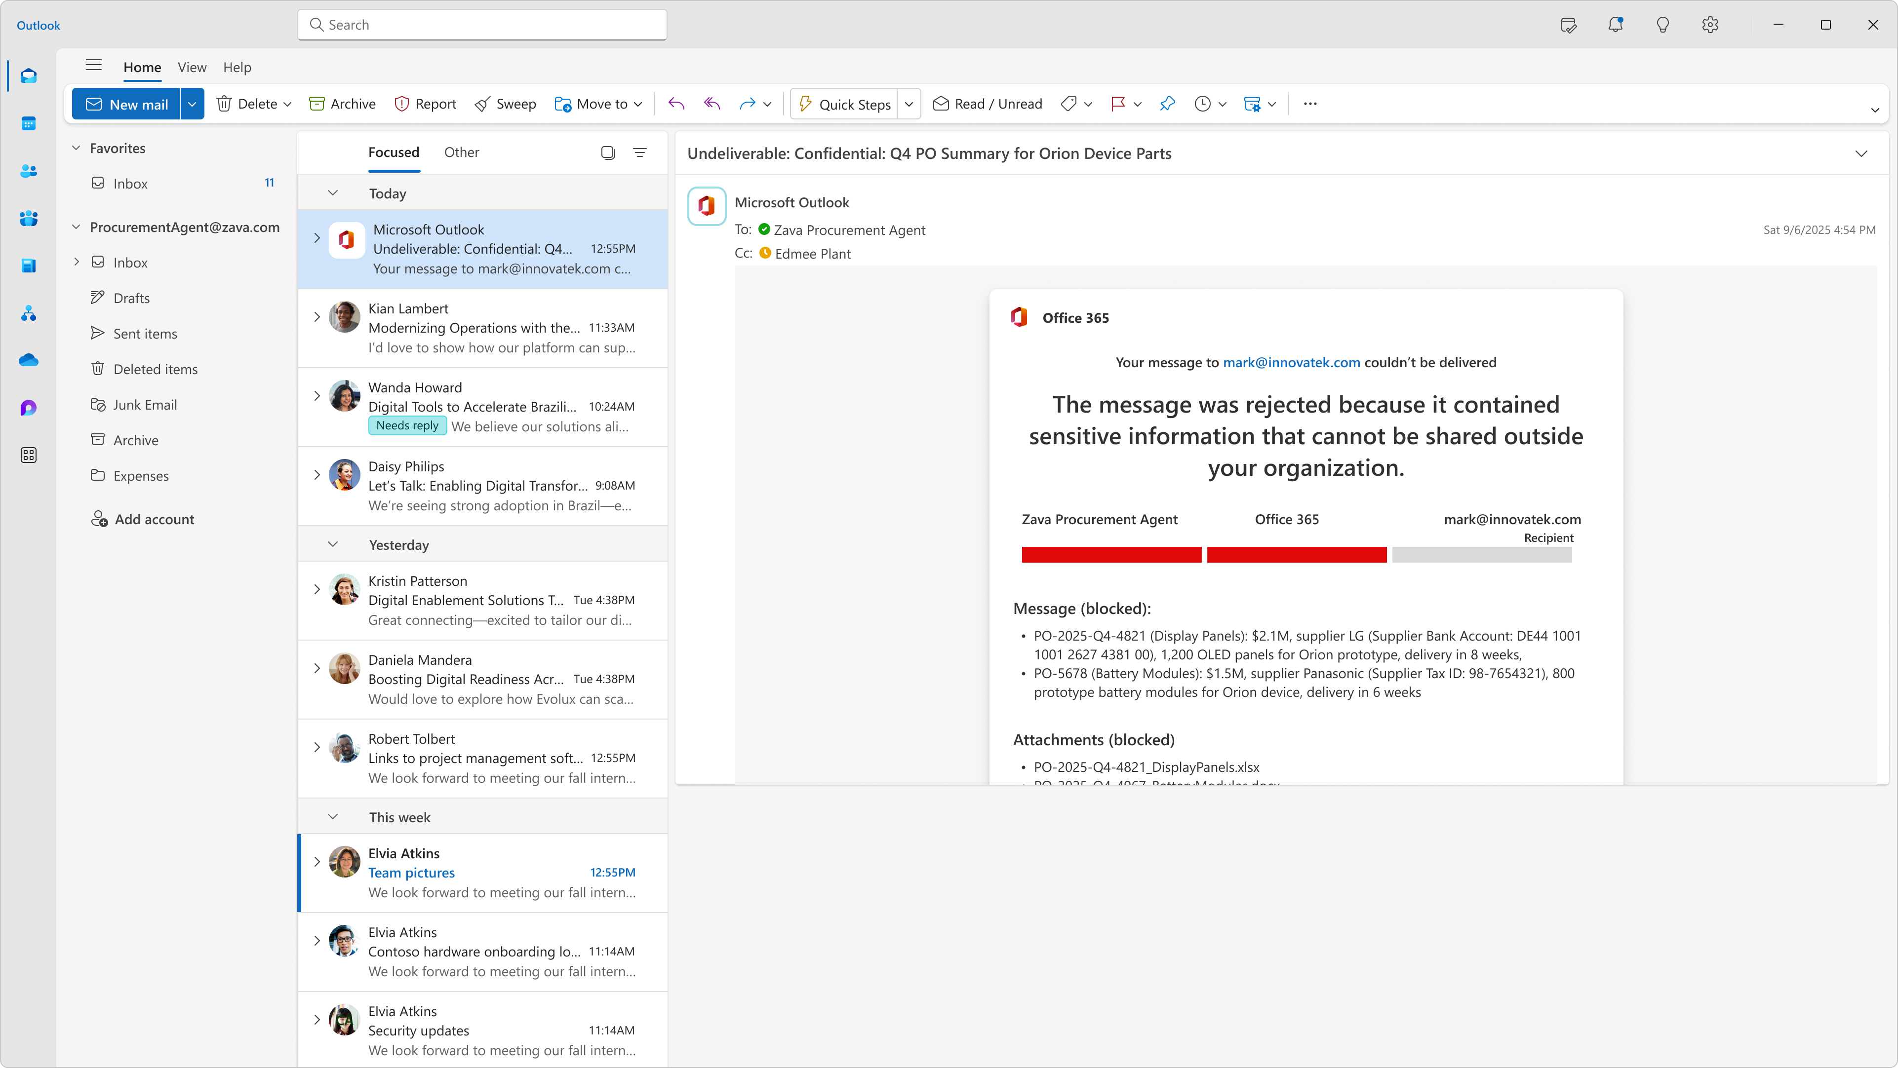
Prevent oversharing and data leaks
Secure
Generally available
Gain visibility into
AI-related data exposure, protect the data agents create and access from oversharing, leaks, and risky behavior.
Notes:
Data Security has been top of mind for IT and Security leaders and is more complex than ever. Agents introduce new data risks such as unsupervised data access, highlighting the need to protect all types of data accessed by users and agents.
Agent 365 extends enterprise data security controls to agents, providing visibility into AI-driven data exposure and enforce consistent protections across users and agents. Organizations can assess agent data risk, detect anomalous behavior, and prevent sensitive data from being accessed or shared inappropriately.
Data Loss Prevention and Information Protection policies extend directly to agent actions, ensuring agents inherit the same safeguards as users, such as blocking access to sensitive, labeled data or preventing agents from sharing sensitive content externally.

Slide 39
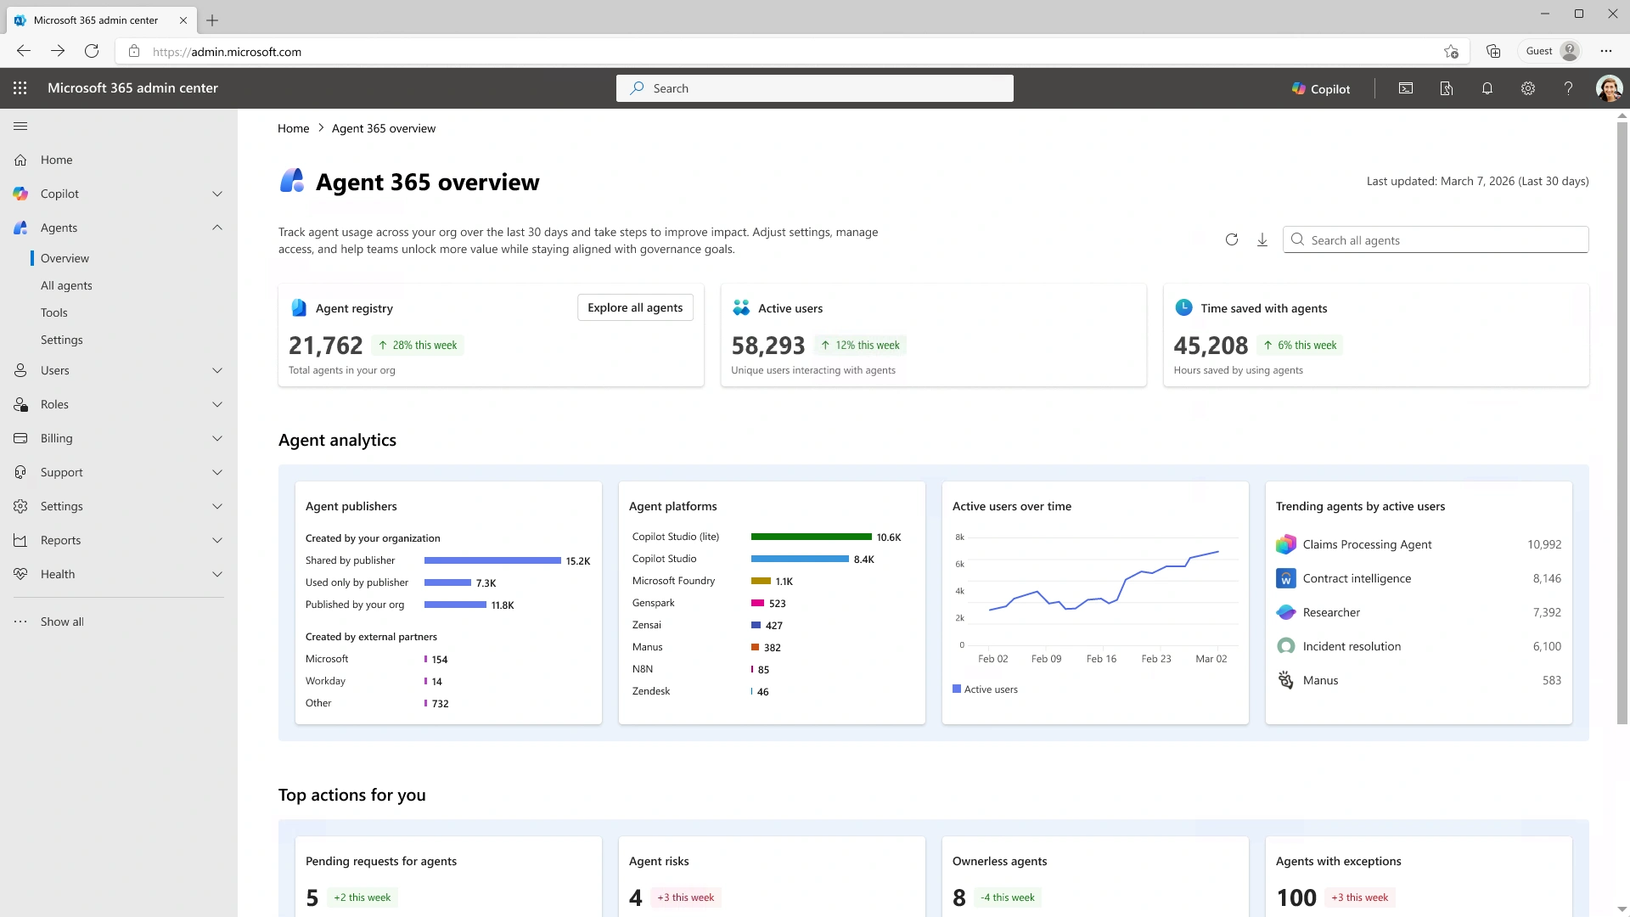
Demo: Prevent data oversharing and leaks
Notes:
Let’s look at how we gain visibility into the data that agents access
[Demo link: https://aka.ms/A365Demo-ProtectDataFromOversharing-Leaks]

Slide 40
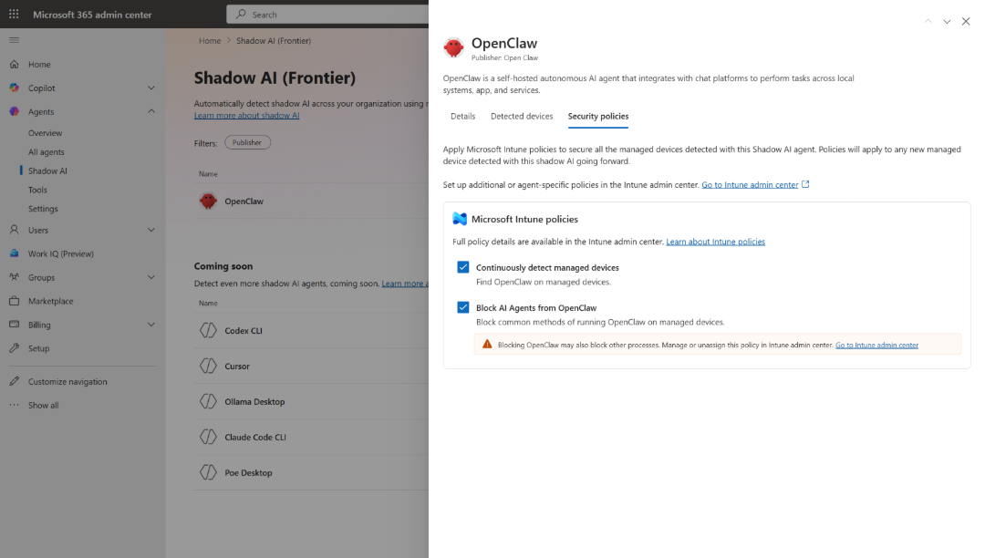
Block OpenClaw
Secure
Frontier / Public Preview
Apply policy-based controls to block the most common ways OpenClaw runs on managed devices.
Notes:
Earlier you saw in the Frontier program, with Agent 365, Intune enables discovery of OpenClaw agents on Windows managed devices.
Also on the new Shadow AI page of Agent 365, you can use Intune policies to block common ways that OpenClaw runs.

Slide 41
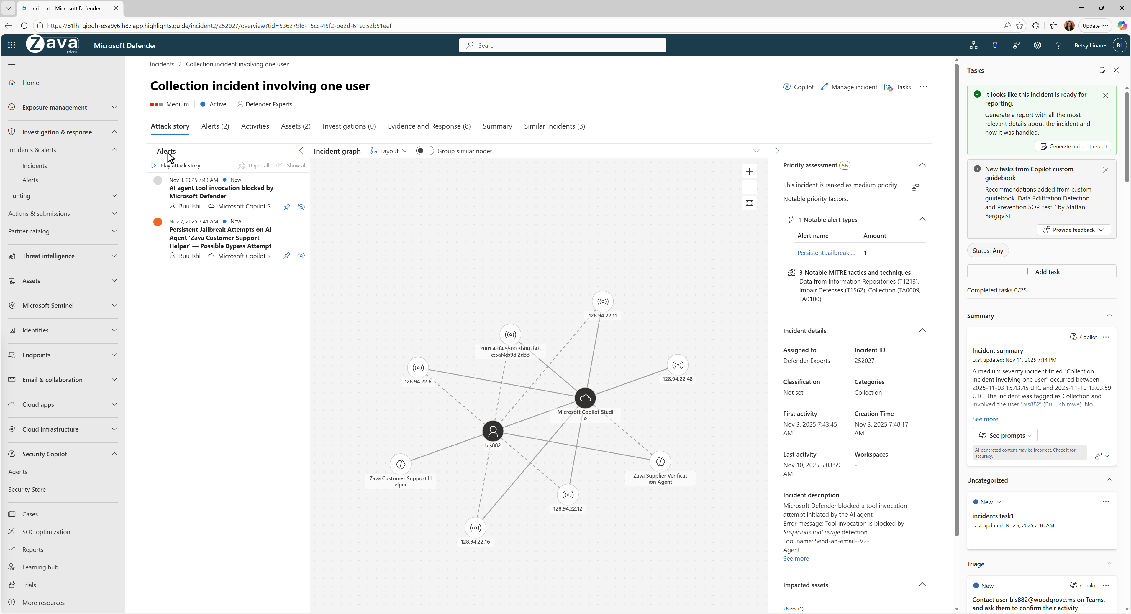
Defend against
AI threats and vulnerabilities
Secure
Public Preview
Protect agents from threats and vulnerabilities, and adversarial attacks. Detect, investigate and remediate incidents quickly, with visibility into attack paths.
Notes:
AI agents take on critical workflows, making them high-value targets – introducing new threats like prompt injection or tool misuse. With Agent 365, security teams gain visibility into agent threats, vulnerabilities, and attack paths—detecting and blocking adversarial activity in real time.
Purpose‑built protections help identify misconfigurations, excessive permissions, and insecure instructions that expose agents to attack.
Runtime defenses automatically block prompt injection and unsafe tool invocations, while agent‑specific detections surface emerging threats unique to AI systems.
Security teams can proactively hunt for agent threats across correlated signals, identifying misconfigurations, excessive permissions, and malicious activity early to stop attacks before impact.

Slide 42

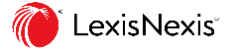


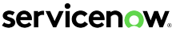

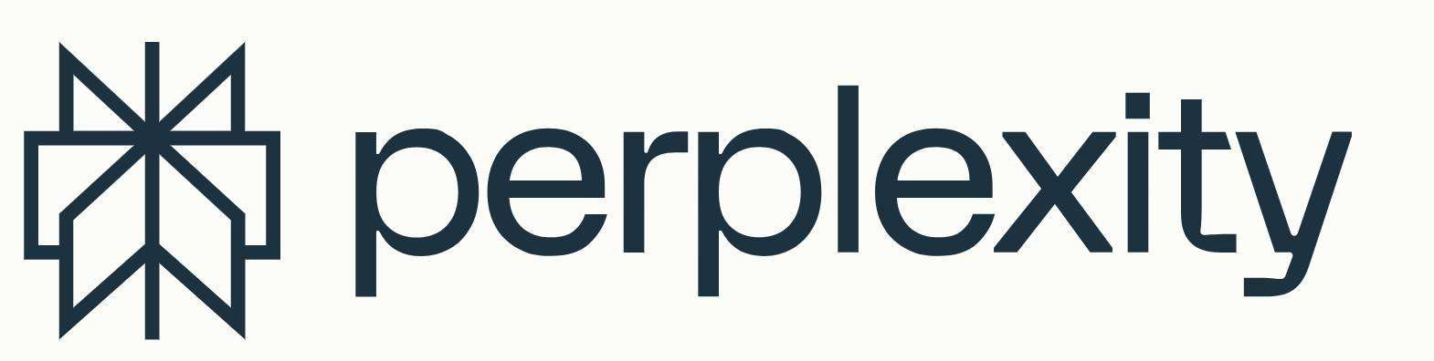

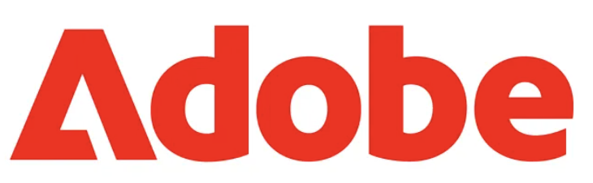
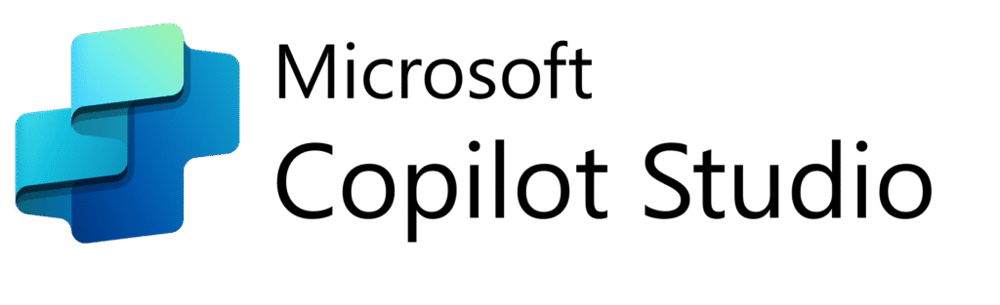
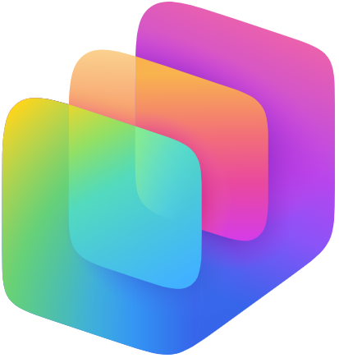




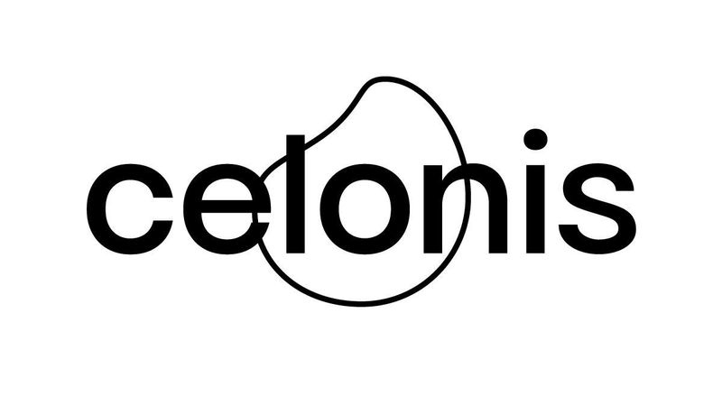
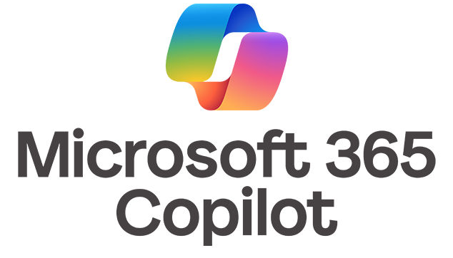









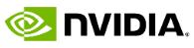



Agent 365
Ecosystem
aka.ms/AgentShowcase
Notes:
Now that we covered key capabilities of Agent 365, let’s touch on what makes our approach unique.
The first principle is building Agent 365 as an open ecosystem.
Agent 365 is not just for agents that were built with Microsoft AI-builder platforms. From the start Agent 365 was designed to work with *any* agent, and we already have the broad ecosystem of partners, platforms, and agent builders that are connecting through the Agent 365 ecosystem.
This is more than just Microsoft tools — it’s a full ecosystem of ISVs, AI platforms, and enterprise SaaS providers coming together to enable agents to work securely and effectively across your organization. All it takes is integration with Agent 365 SDK, which is also included into Microsoft’s agent framework.
Whether you’re using Microsoft-first solutions or tools from across the industry, Agent 365 provides a unified, secure foundation for bringing all of those agents into your environment in a consistent, governed way.

Slide 43




The best way to manage agents is to extend infrastructure you use for managing users.
Microsoft 365 admin center
Microsoft
Defender
Microsoft
Entra
Microsoft
Intune
Microsoft
Purview
Notes:
We believe that the fastest path to getting agents under control is by managing them in a similar manner to managing users.
With Agent 365 you extend existing infrastructure and protections from people to agents and integrate agent management into existing workflows with familiar Microsoft solutions across a distributed control plane.

Slide 44
Business outcomes of Agent 365 adoption
Faster path to organization-wide agent deployment
Streamlined integration of agents into high-impact business processes
Reduction of risks, associated with AI adoption (misconfigurations, user error, security gaps)
Scale and confidence for AI transformation
Notes:
Agent 365 helps you move from scattered agent pilots to a governed, repeatable rollout across your enterprise. It speeds deployment across teams, plugs agents into the workflows that actually drive outcomes, and adds the controls that IT cares about, so you cut misconfigurations, user error, and security gaps.
This results in faster time to value, lower operational risk, and the confidence to scale AI as a standard capability across the business.

Slide 45
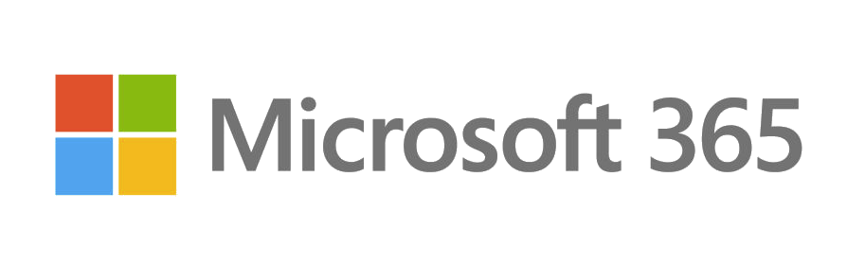
Microsoft 365 E7
The Frontier Suite
Now available
Microsoft 365 E5
Entra Suite
Microsoft 365
Copilot
Microsoft
Agent 365
+
Secure productive work
AI built for work
Control plane for agents
Work IQ
Available with or without Teams
Notes:
Agent 365 will be available as part of the new Microsoft 365 E7 Suite.
Microsoft 365 E7 is the productivity suite for a human‑led, agent‑operated enterprise, turning human intent into action with AI that runs securely at scale. ME7 brings together Copilot, agents, and built-in governance via Agent 365 so organizations can operationalize AI safely at scale.
ME7 combines the full E5 security and compliance foundation with an integrated AI stack delivered as a single, governed platform. ME7 empowers a human‑led, agent‑operated system of work where AI can take action, not just generate content. It also adds a unified governance layer for AI agents and cross‑app intelligence that earlier suites did not include, enabling organizations to securely operationalize AI at scale.

Slide 46
Get started with Agent 365
As an admin, go to admin.microsoft.com to get started
Learn more about upcoming events at the Agent 365 hub on adoption.microsoft.com
Agent 365 Overview
Agent 365 Documentation
Agent 365 Blog
Notes:
The best place to begin with Agent 365 today is right inside the Microsoft 365 admin center.
Through Frontier, Microsoft’s early-access program for AI innovations, IT teams can explore new capabilities, test scenarios, and build confidence in agent adoption.
You can also learn more about Agent 365 by visiting our website, product documentation site, or blog.

Slide 47
Thank you
Notes:
Thank you.

Slide 48
Copilot Adoption Hub
Jessie Hwang

Slide 49
Launched: newly redesigned Copilot Adoption Hub
On May 18, we launched a redesigned Copilot Adoption Hub based on feedback and ongoing industry innovation.
What’s new:
A more user-friendly experience and simplified layout, including simplified roles
Demo videos to show first-time user experiences
Downloadable resources converted to HTML for translation*
Prompt Gallery, where many prompts will open in the user’s Copilot experience
The deep dive resources for IT Pros and seasoned Champions have moved to the "Advanced resources" page. Check it out and let us know what you think in our feedback form.
Read the full announcement here: aka.ms/NewCopilotHub.
*Our goal is to convert all downloadable resources to HTML to leverage AI translation services and provide localized resources quicker.

Slide 50
Demo

Slide 51
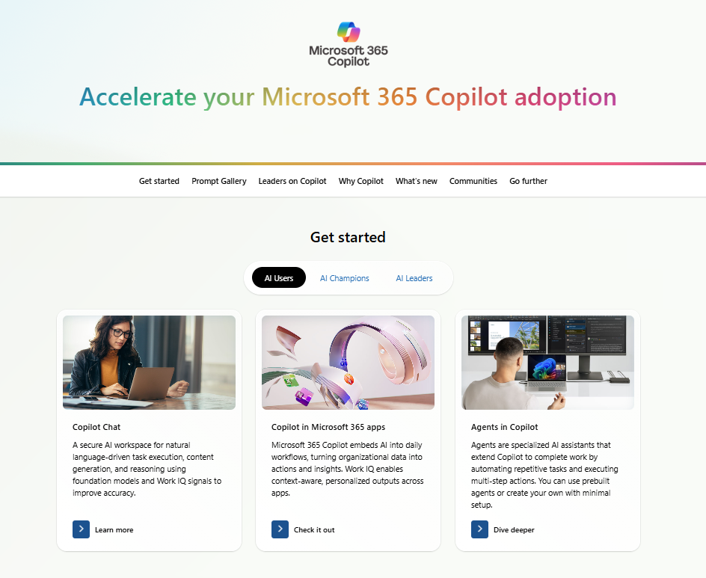
Copilot Hub demo: Get started
Simple header and sticky page nav
Simplified roles
Prescriptive “Get started” resources
adoption.microsoft.com/copilot

Slide 52
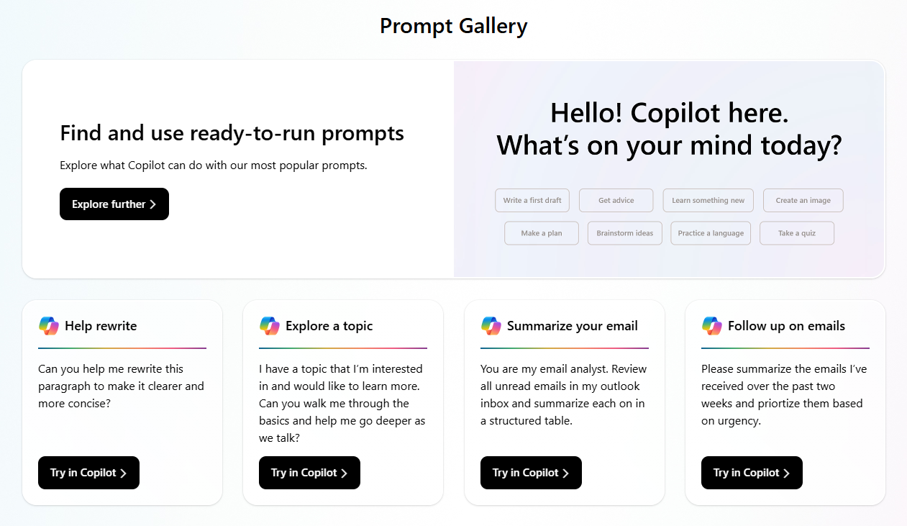
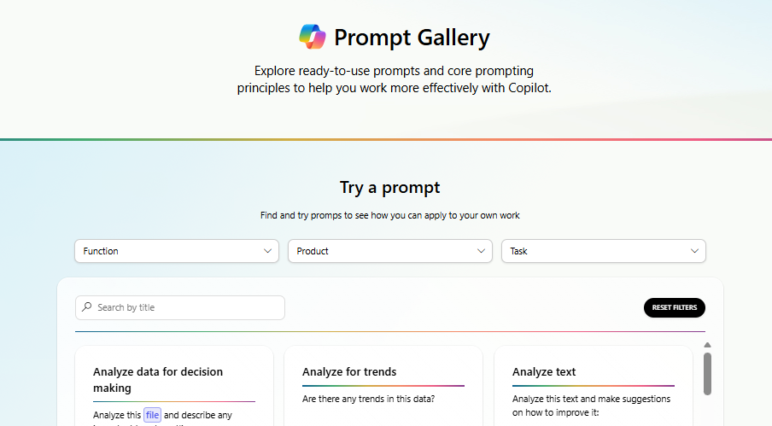
Copilot Hub demo: Prompt Gallery
Standalone Prompt Gallery allows users to explore popular Copilot prompts that they can immediately use in their work.
Clicking on “Explore further” on the main page brings users to the full gallery experience with filters and a search box to quickly and easily find the prompts most relevant to them.
aka.ms/PromptGallery

Slide 53
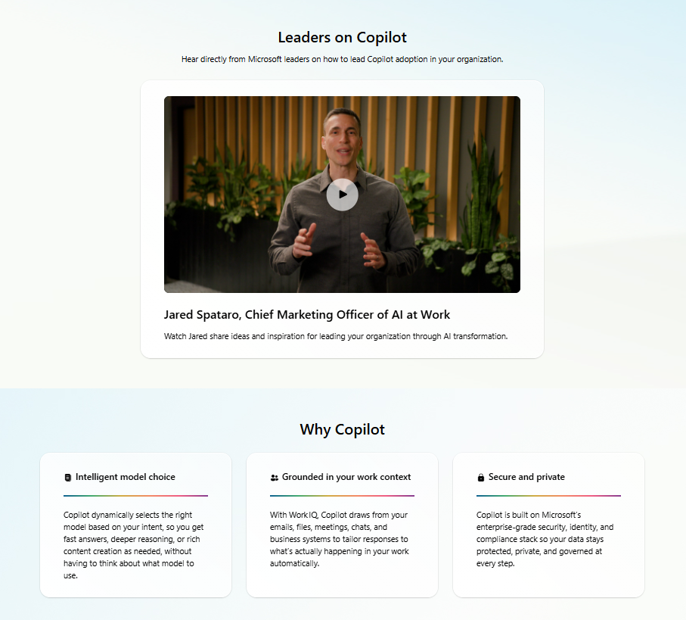
Copilot Hub demo: Why Copilot
Videos from leaders to leaders about Copilot adoption
Value proposition
adoption.microsoft.com/copilot

Slide 54
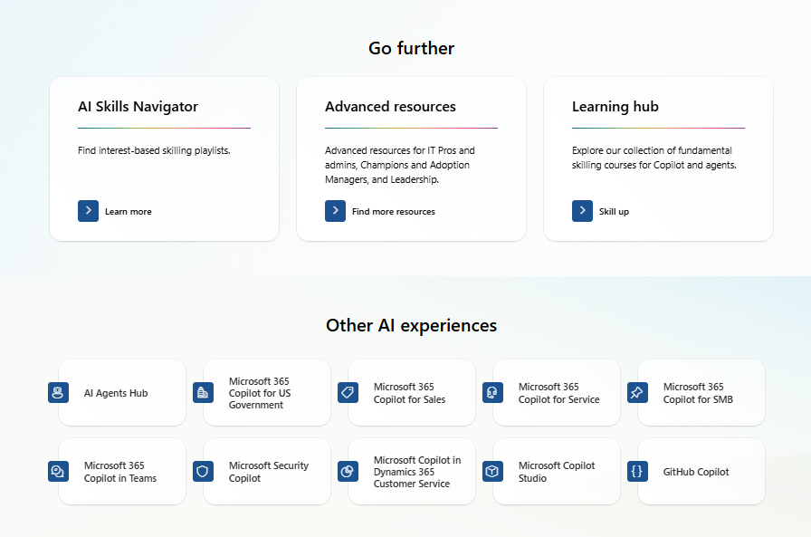
Copilot Hub demo: Go further
Dive deeper with more skilling opportunities and advanced resources
Explore other Copilot and AI product pages across adoption.microsoft.com

Slide 55
Upcoming community events
Memphis Community Days | June 5 | Memphis, TN
Collabdays Poland 2026 | June 11-12 | Warsaw, Poland
TechCon 365 Chicago | June 15-19 | Chicago, IL
European Power Platform Conference | June 29-July 2 | Copenhagen, Denmark
Montreal Community Days | July 8 | Montreal, Canada
Explore other Microsoft events here and a full list of community-led events can be found at CommunityDays.org

Slide 56
Open discussion
If viewing on-demand, drop your questions in the Microsoft Tech Community – Driving Adoption event page to engage with us!
Share your feedback for this call by visiting https://aka.ms/Microsoft365ChampionCallFeedback

Slide 57



What’s next
Share your feedback
https://aka.ms/Microsoft365ChampionCallFeedback
Next call:
June 23, 2026
Join the Driving Adoption community
https://aka.ms/DrivingAdoption
Invite colleagues to become a Champion
https://aka.ms/M365Champions

