Slide 1

We will begin the call at five minutes past the hour.
Microsoft 365 Champion Community Call
March 2026
Microsoft 365 Champion Community
Learn more. Do more. Achieve more, together.

Slide 2



Microsoft 365 Champion
community call
March 2026

Slide 3
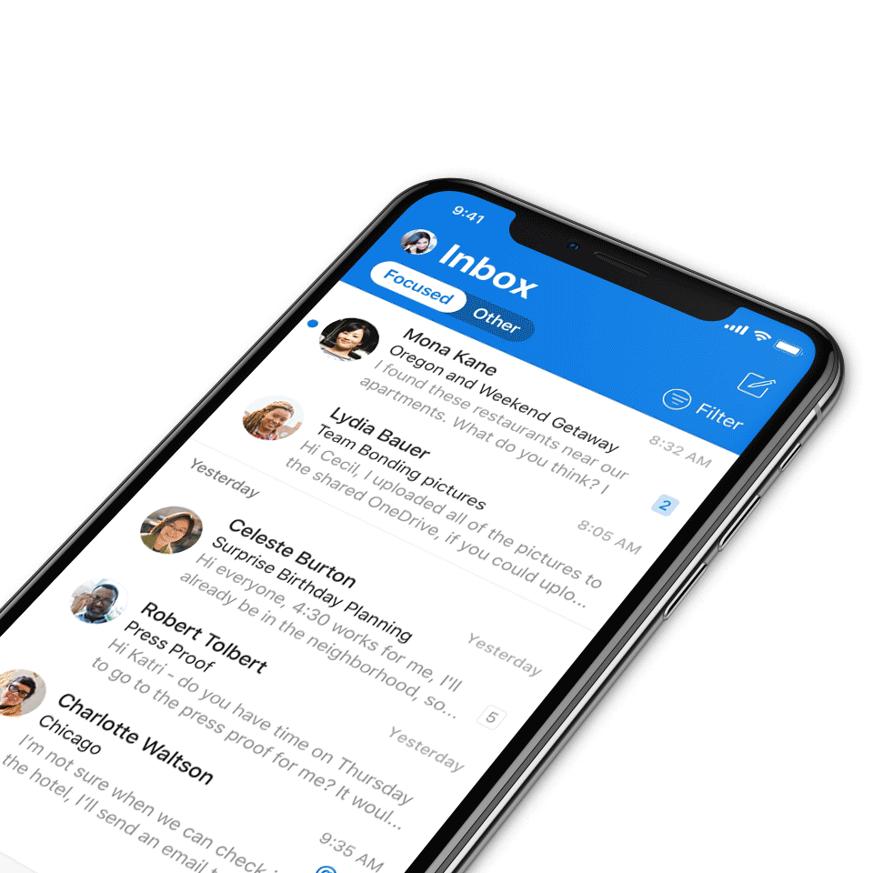
Digital Event Code of Conduct
Microsoft’s mission is to empower every person and every organization on the planet to achieve more. This includes all Microsoft events and gatherings, including on digital platforms, where we seek to create a respectful, friendly, fun and inclusive experience for all participants.​
We expect all digital event participants to uphold the principles of this Code of Conduct, which covers the main digital event and all related activities. We do not tolerate disruptive or disrespectful behavior, messages, images, or interactions by any party participant, in any form, at any aspect of the program including business and social activities, regardless of location.​
Microsoft will not tolerate harassment or discrimination based on age, ancestry, color, gender identity or expression, national origin, physical or mental disability, religion, sexual orientation, or any other characteristic protected by applicable local laws, regulations, and ordinances.​
We encourage everyone to assist in creating a welcoming and safe environment.
For more info, visit aka.ms/CodeofConduct.

Slide 4

Agenda
Announcements
Top Microsoft 365 updates
PowerPoint: Agent Mode and Brand Kit
Open discussion forum
Become a Champion today!
https://aka.ms/BecomeaChampion

Slide 5

Community Announcements
Community
The Microsoft 365 Community Conference: your front-row seat to the future of work
Join us in Orlando, Florida, on April 21-23, 2026, to discover how to harness the power of Microsoft technology to achieve more, together. From learning about the latest advancements in AI-driven tools and building skills you can use immediately, to connecting with Microsoft product-makers and executives, you’ll dive deep into big innovations and come home with actionable insights.
Click here to learn more and register today!

Slide 6
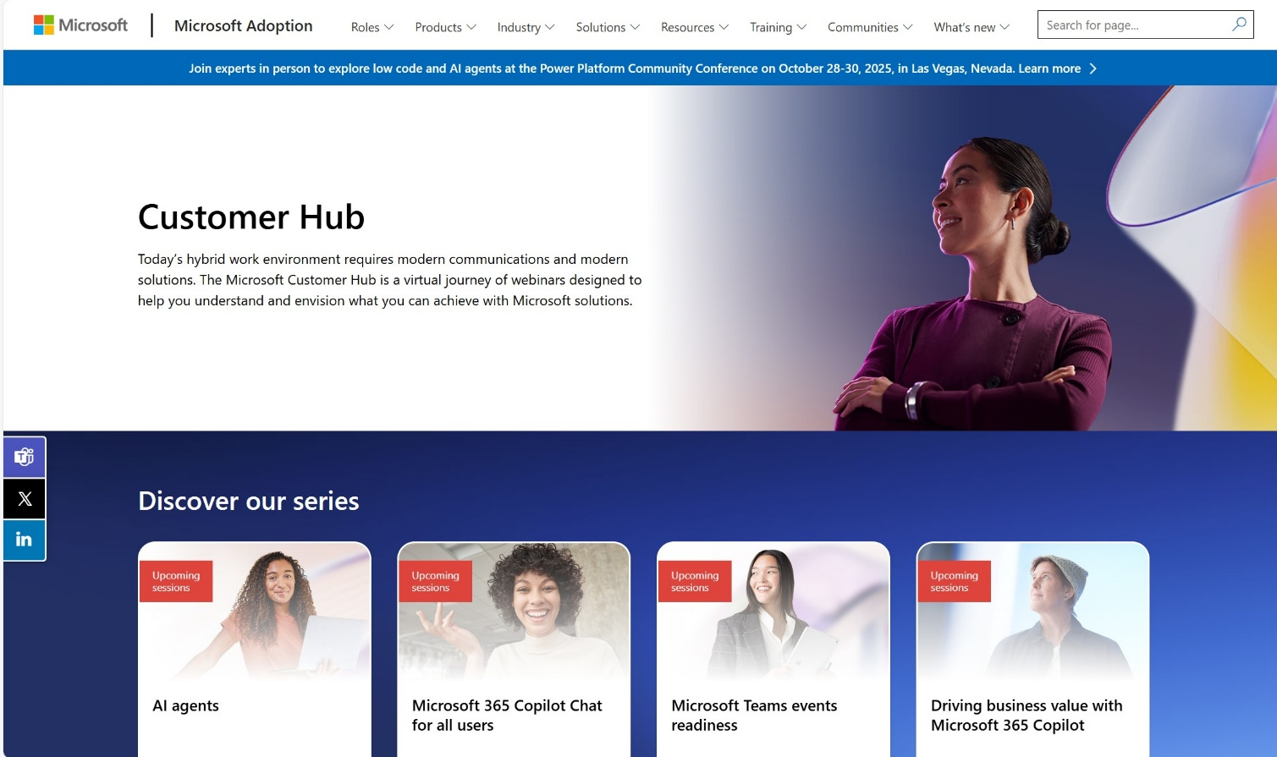
Customer Hub Announcements
Customer Hub
Upcoming Microsoft 365 Copilot webinars
Have you attended our Customer Hub webinar sessions? In today's hybrid work environment, modern communication and solutions are essential. Our goal is to help you explore what you can achieve with Microsoft solutions.
Join us for one or more of our upcoming sessions, including the launch of several new Copilot series. We also have all past session recordings so you can watch any that you missed and download the presentation materials.
Visit aka.ms/CustomerHubSessions to sign up today.

Slide 7
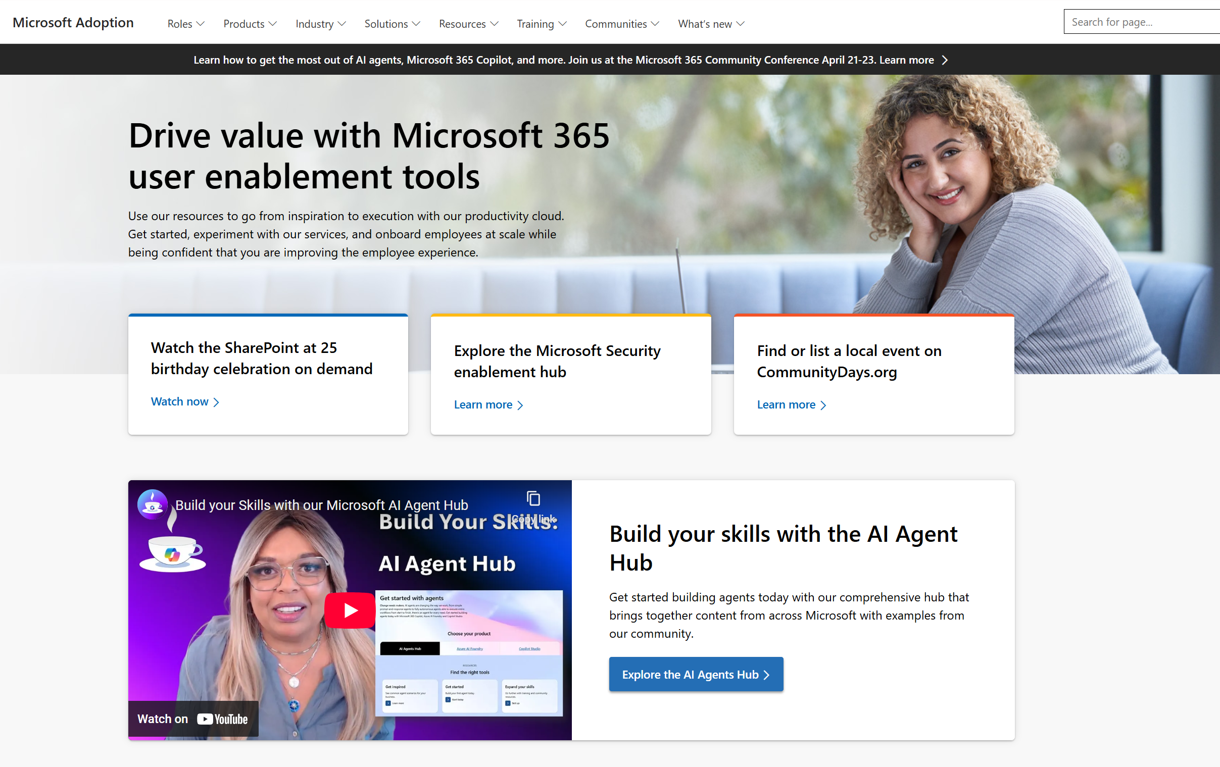
adoption.microsoft.com
Update highlights
Catch up on the SharePoint at 25 birthday celebration event
Launch of the Microsoft 365 Copilot app page
New Frontier program announcements and resources
Addition of Agent Factory resources and events on the Microsoft Copilot Studio page
Read or subscribe to our release notes for more updates.

Slide 8
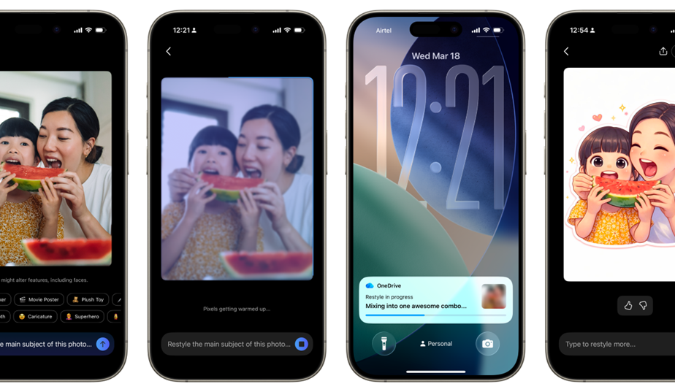
Microsoft OneDrive updates
Microsoft OneDrive
OneDrive photos restyle with AI – now rolling out on mobile and web
Photos capture real moments. With AI Restyle in OneDrive, you can reimagine those moments in expressive new styles-right where your photos already live.
With just a tap, transform everyday photos into cinematic posters, hand‑painted artwork, pencil sketches, anime‑inspired scenes, and more. Choose a style, watch a new version appear in seconds, and keep exploring until it feels just right.
Through it all, the people, places, and memories you care about stay unmistakably yours-just seen in a fresh new light.
Click here to learn more!
Notes:
AI Restyle is rolling out on OneDrive for iOS, Android, and web for customers with a Microsoft 365 Premium subscription. Availability may vary by region as rollout continues.
Create something beautiful instantly. Choose from a rotating set of one‑tap styles designed to match the content of your photo-so it’s easy to get a great result right away. New styles are added regularly, giving you fresh ways to reimagine your photos.
Add a personal touch when you want. Include an optional prompt to guide the look-no design skills required.
Explore until it feels right. Try multiple restyles, undo or redo changes, and keep experimenting until you find the look you love.
Share in just a few taps. Go from viewing to restyling to sharing with your favourite apps-without ever leaving OneDrive Photos.

Slide 9
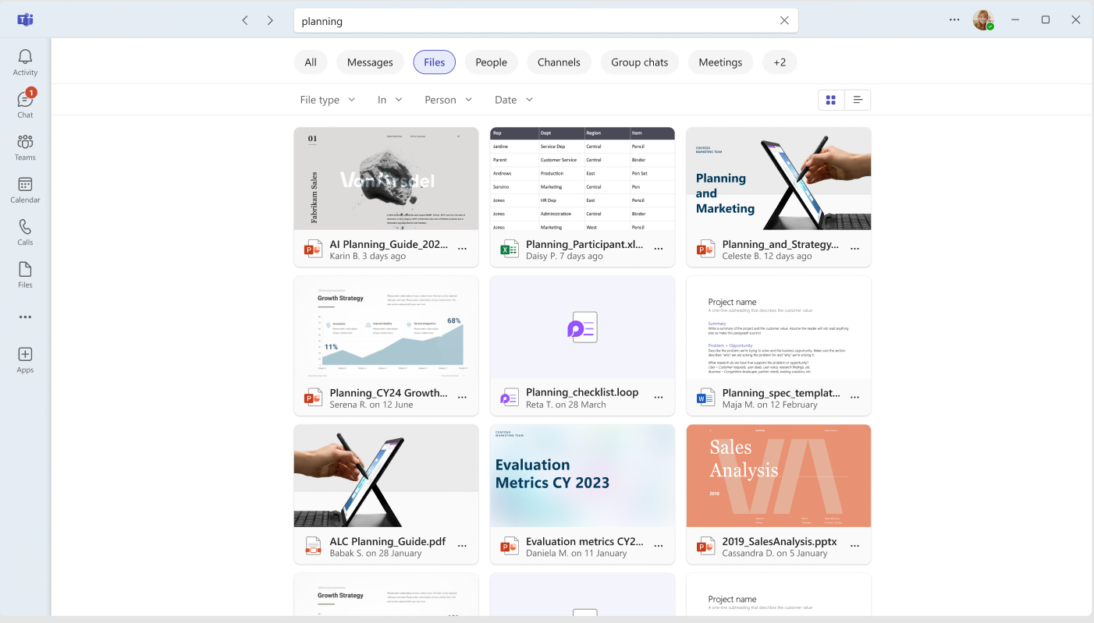
Microsoft Teams updates
Microsoft Teams
Grid view for files in Teams search results
Teams now has a preview‑based grid view for search results. This visual layout helps you differentiate files with similar names and more quickly identify the correct item, reducing the need to open files and interrupt the search flow. Simply go to the Files tab and toggle from the “list” to “grid view" icon.
Click here to learn more!

Slide 10
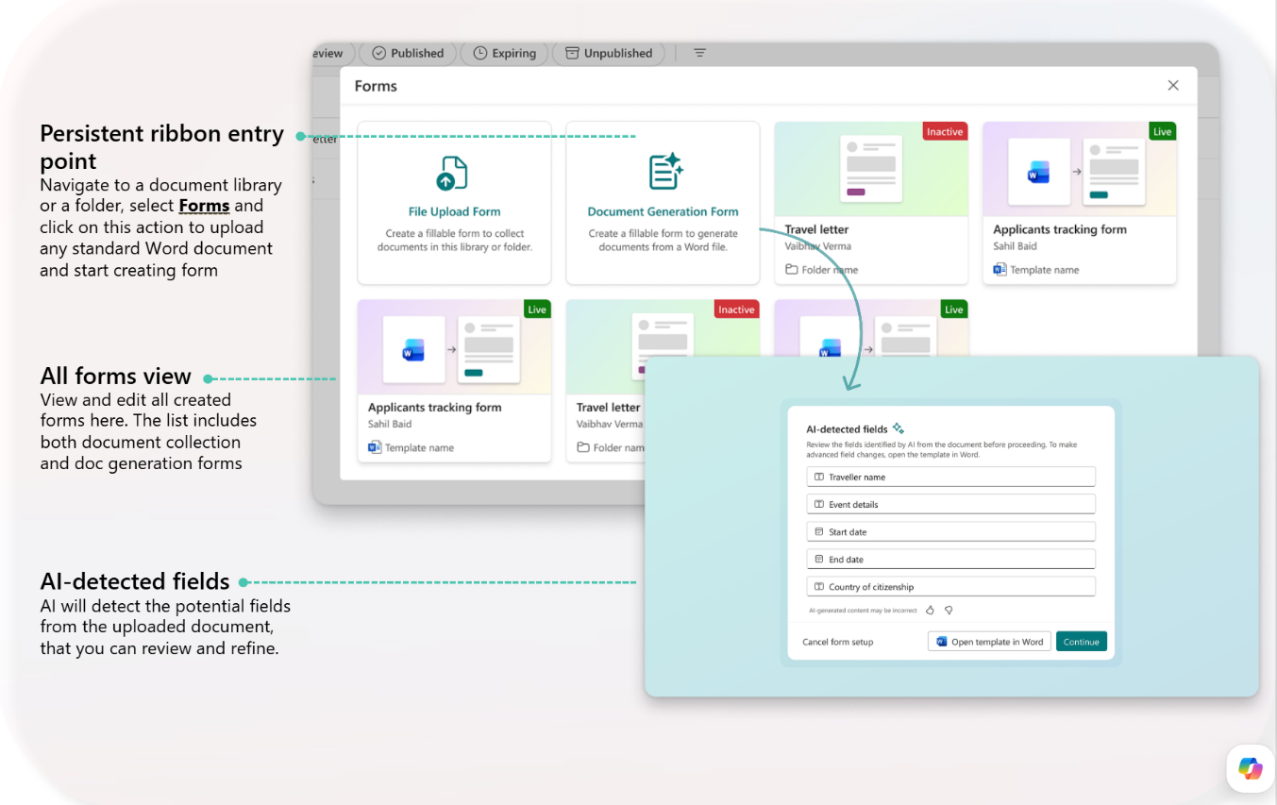
SharePoint updates
SharePoint
Structured document generation with forms now in preview
Features include:
Create AI-assisted document templates without code
Generate documents from structured form inputs
Share form links
Keep documents connected to structured data
Structured document generation with forms natively stores all content in SharePoint, allowing organizations to take advantage of existing document management, permissions, and lifecycle capabilities.
Note: A Microsoft 365 Copilot license is required to build the forms and workflows, but not to generate a document using the template.
Click here to learn more!
Notes:
Create AI-assisted document templates without code
Templates define the layout and structure of the generated document, making it easier to standardize outputs across teams and business processes. AI automatically detects fields in the document and creates reusables forms.
Generate documents from structured form inputs
Use forms to collect standardized information and automatically populate that data into a document template. This means documents are created with the right structure and fields every time.
Share form links
After a form is published, you can share the form link with users in your organization, enabling them to submit forms and generate documents. Each submission creates a new document that preserves the approved document’s layout and language — only the field values change.
Keep documents connected to structured data
Because documents are generated from a template, the output has consistent metadata, downstream workflows, and governance (including retention and sensitivity labels).

Slide 11
PowerPoint: Edit with Copilot, Brand Kit and Image Gen
Anubhav Nigam and Khaleel Amarshi

Slide 12

What’s new with
PowerPoint?
Mar 2026
Notes:
How many of you have seen or tried the new Edit with Copilot mode?
For those of you who are new to it, let me start with a demo video.

Slide 13
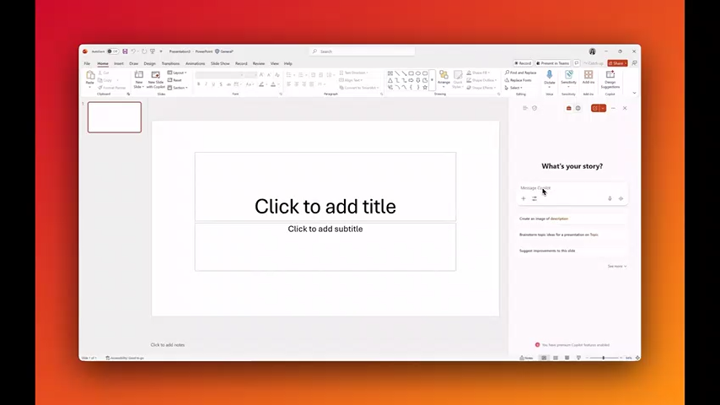
Video of how Edit with Copilot mode works
Notes:
Here’s an example on how Edit with Copilot mode (previously called Agent mode) can create and edit everyday presentations.
<Play video>
<After video is done:>
So as you can see, this covers the true power of Edit with Copilot in PowerPoint – from creating a presentation to editing images to pivoting the deck for time to checking the brand.
But the video went pretty fast so let’s break it down further…

Slide 14
How it works
Agent mode will take a task and break it down using natural language intent detection.
It has a full Agentic loop:
Three key characteristics
Complex planning: It supports complex planning and execution across many slides
Grounding: Gather information from within your business (WorkIQ), the web and the current presentation
Brand use: your brand assets and templates are autonomously used within the Agent using Copilot Brand kits
Plan > Execute > Review > Deliver
Notes:
Let starts with an overview of Edit with Copilot. (think of it as a brain and set of tools)
When you give a prompt to Agent, under the hood, we’re doing a series of steps:
1. We start by understanding your prompt - & creating a plan from your prompt, including deciding what tools we're going to use, what order, what tasks we’re going to perform?
2. Then we go ahead and execute our plan
3. And then we'll Review the outcome and see if we actually did accomplish what the prompt requested. And the reviewer may then say, "no, you need to make a new plan to fix these issues before going through."
And so we have a loop - what we call an agentic loop - that will go through until it's ready to deliver to the end user.
Thus, effectively, the Agent is self-correcting.
And this loop can take a few minutes to longer period of time depending on what you're doing, like making a longer deck
-----------------------
On the RHS of the slide, you'll see 3 Key Characteristics of Agent Mode on how it's working:
It is doing complex planning – rather than just simple 1-to-1 tasks like "bold this text", it can do more nuanced, complex tasks like generate a title slide that looks like a company’s brand or add a product into the image. You can also have a multi-layered prompts, and the Complex Planning capability will be able to handle that.
Next is Grounding – this is work, web and file grounding - these are all pieces that really helped you get the right content into the presentation with less effort. The agent can do the lift for you on translating document content and putting it on the slide.
The last one here is handling brand adherence - Brand owners and designers are often able to adhere to brand design very quickly, but this may be challenging for the average user. So, PPT Agent Mode takes your brand direction from your template. And if you use Brand Kit and provide assets there, we'll also leverage Brand Kit to further guide content creation.
Each of those steps is going to get better and better with every week - all the feedback you provide inform our evals which are run daily to improve Agent Mode.
-------------------
[Internal]
Backpocket note:
Slide intent: MSFT’s unique value - This outlines MSFT’s unique pipeline to really give you the best results we can. We're not just one-to-one plugging into a model and just telling it, give us the answer and then returning the answer to you. There's a series of specific things that we as Microsoft are doing along this plan, execute, review, and deliver pipeline to really give you the best results we can.
Between Templates and Brand Guidelines, the template gets the precedence if there are any conflicting rules."

Slide 15
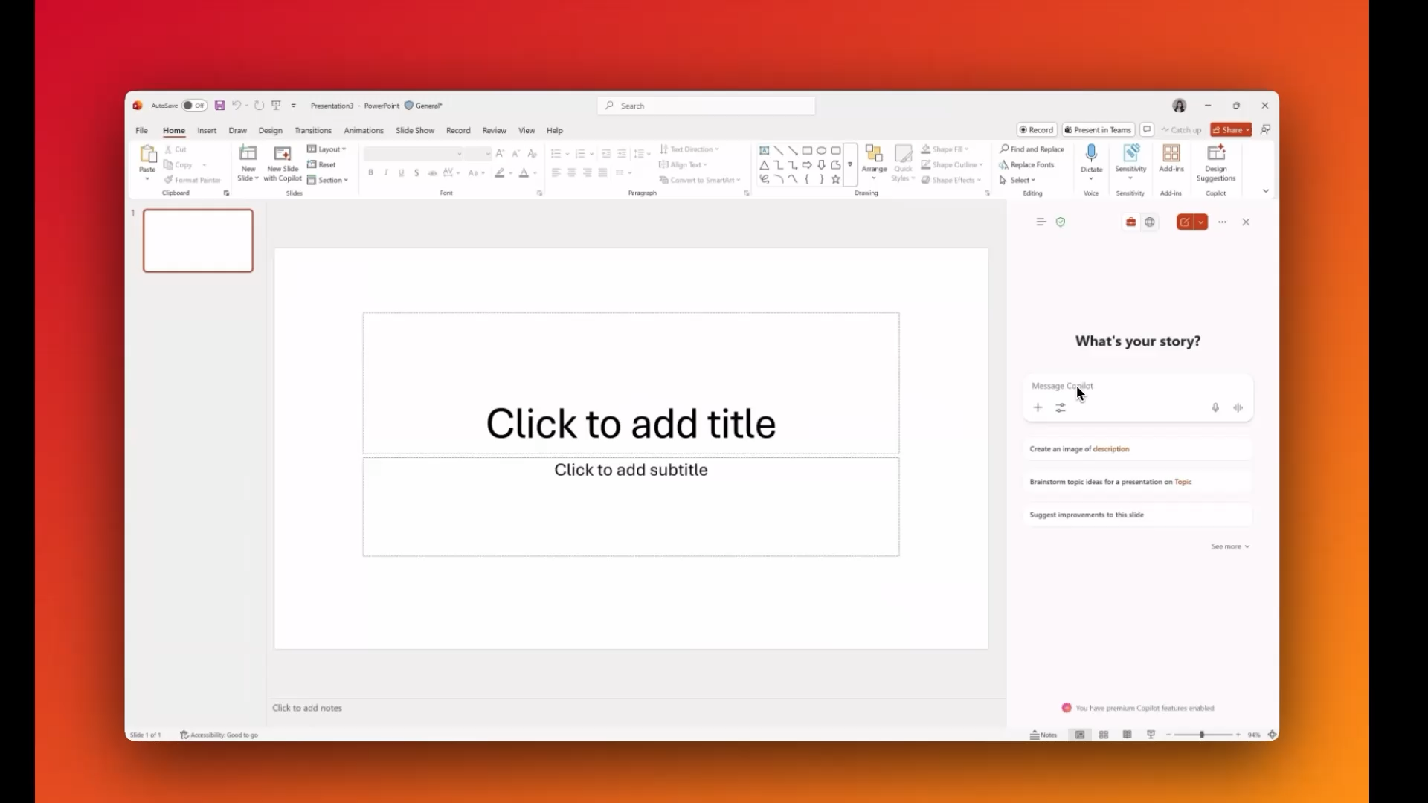
Visuals, charts, infographics
ZOOM IN
Notes:
Let’s zoom in further to the visuals, charts and infographics

Slide 16
Getting started…
Notes:
[Internal notes for presenter]
Backpocket note from 3/2/26:
Use this section if your audience would like to a tutorial on how to use Agent Mode in PPT – you can quickly go through the slides by reading off of them. Thus, this section does not have speaker notes.
These prompts can be used off a workbook set of slides that you can share with your audience after:

Slide 17
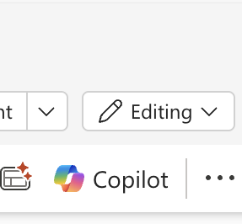
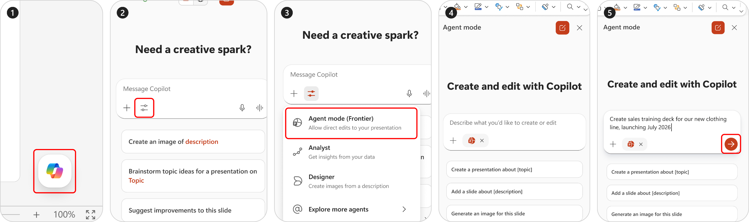

Here's how to launch agent mode...
1
2
3
4
Click on the Copilot icon in the far right of the home tab in the ribbon.
Click on the Tools button in input box within the Copilot chat pane.
Click on Agent Mode in the drop-down menu.
Once you see the orange PPT logo in your prompt box you are now in Agent mode!

Slide 18
Less clicks
More editing
Soon when you open Copilot pane in PowerPoint agent mode will already be enabled.
1
2
Click on the Copilot icon in the far right of the home tab in the ribbon.
Click on the Tools button in input box within the Copilot chat pane.

Slide 19
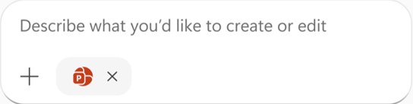
Make sure you see the PowerPoint icon in the corner

Slide 20
Things to try
Turn text into a diagram
Transform text into a chart
Edit images with your words
Rewrite text for clarity
Update data points in one go
Create a Presentation
Translate a slide or a presentation

Slide 21
Using your brands
Notes:
Now, let’s talk about Brand – One of the most common challenges we hear from customers is maintaining brand consistency.
And this is a high learning area of investment for us and we’d love your feedback so we can continue to iterate and improve results.

Slide 22


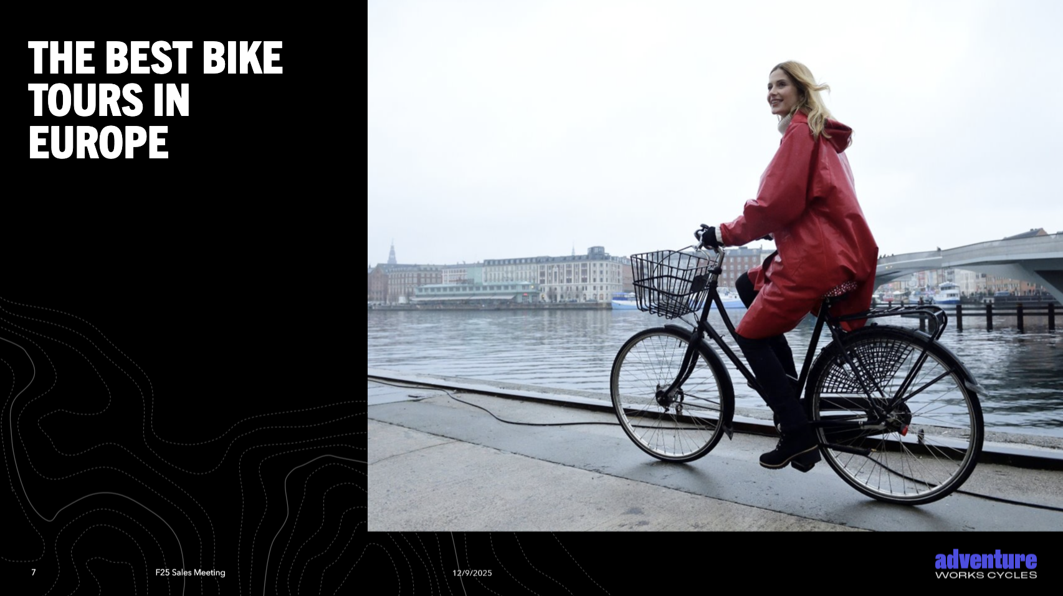
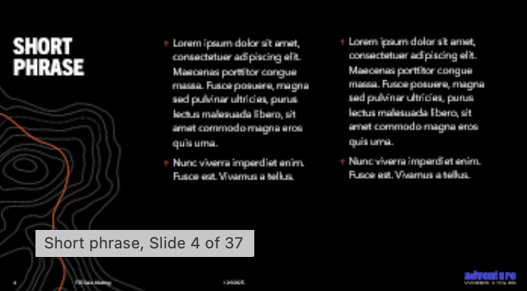
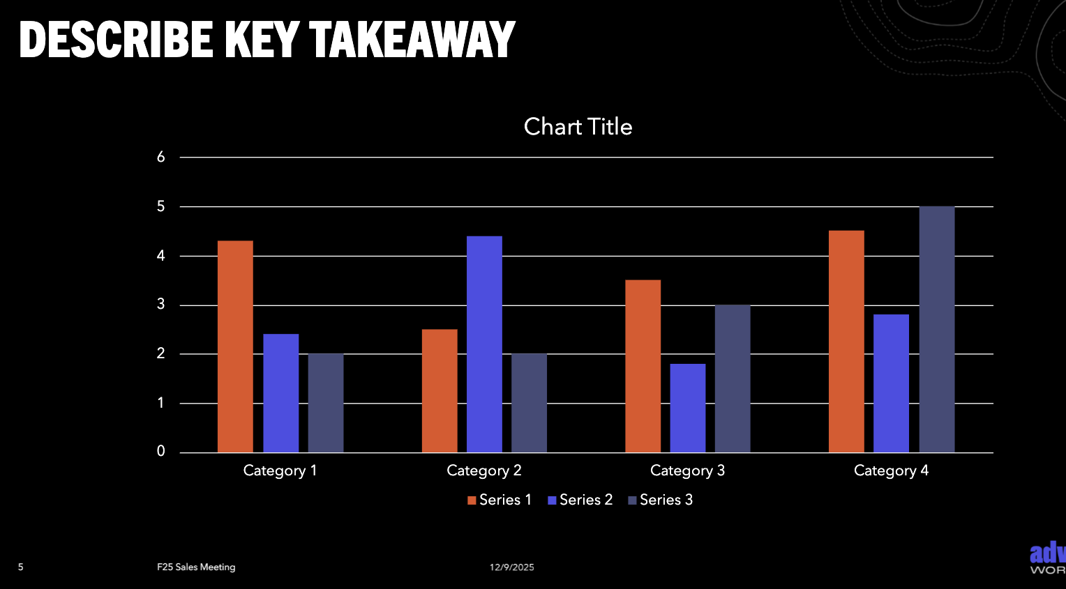
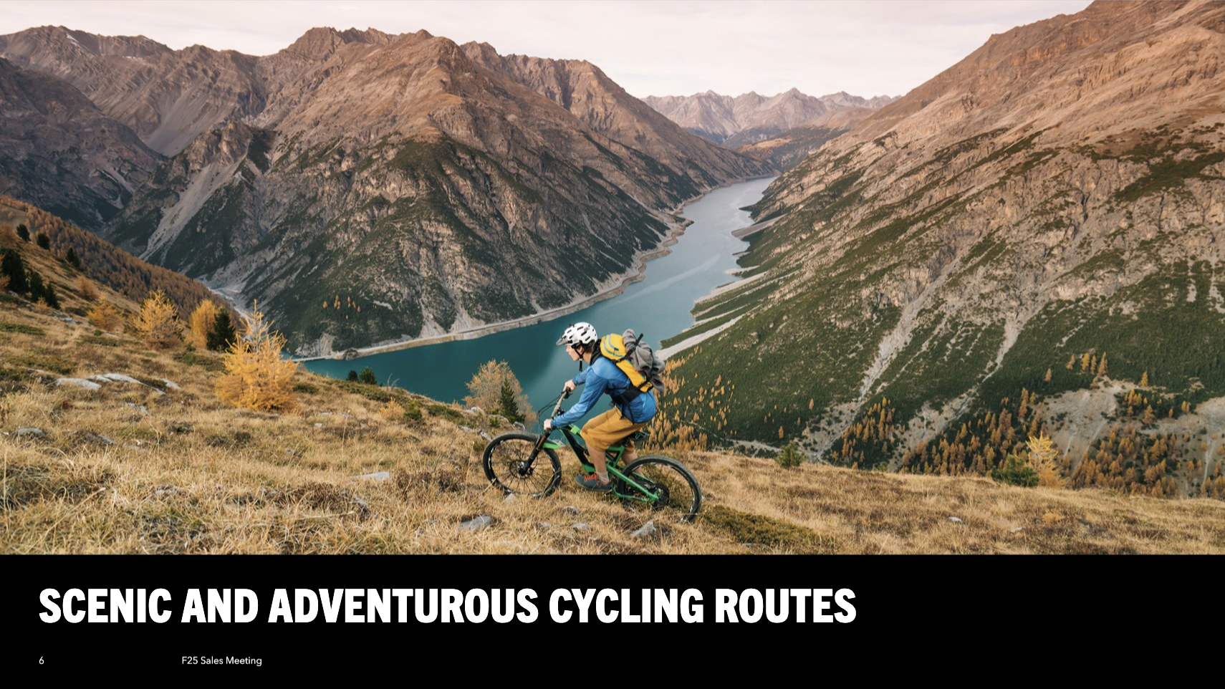

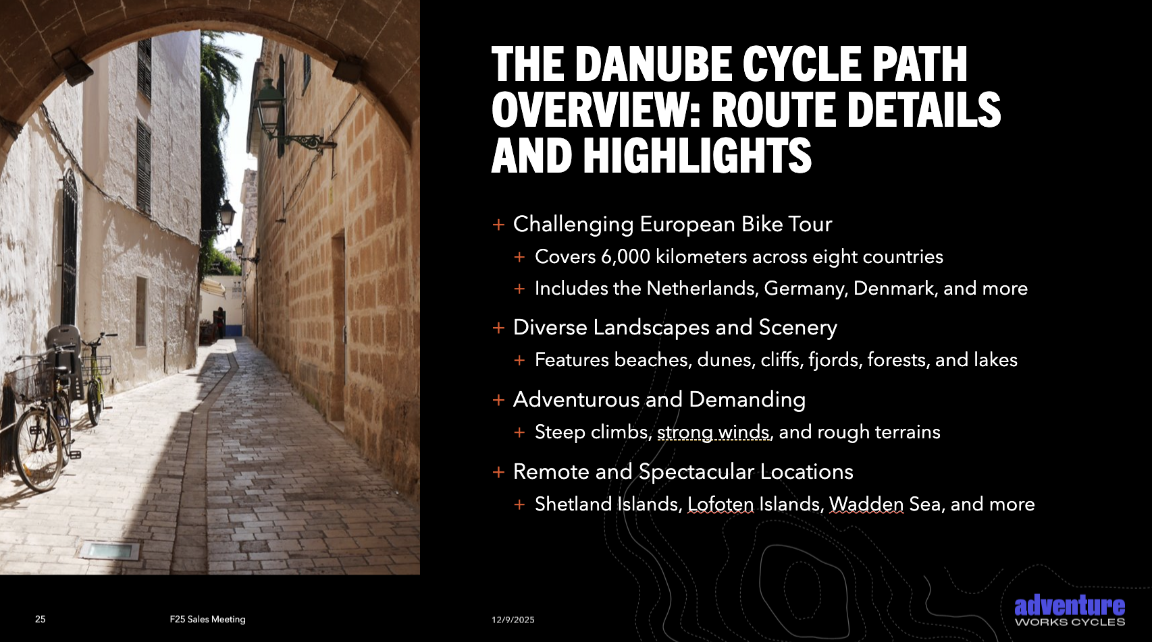
On brand by default
Templates first, Brand Kits make the agent smarter
In Agent Mode, PowerPoint uses existing organizational templates as the primary source of truth, then applies Brand Kit rules (image style, logo usage, brand voice, visual dos/don’ts) to drive stronger, more consistent AI‑generated slides than templates alone.
Notes:
The agent is on brand by default.
That means it respects your templates and then, if you light up brand kits, which we really encourage all of our enterprise customers, it'll just make the agent smarter.
You can upload your brand guidelines, icons, assets…all of these things then give the agent the ability to pull those in at the right time and inform things like infographics and other pieces of slide creation.
So think of it as a sort of a Crawl, Walk, Run:
having no template is going to be the least informed. The agent has the least information to get the right answer for brand
and a fully loaded brand kit gets you the best results

Slide 23


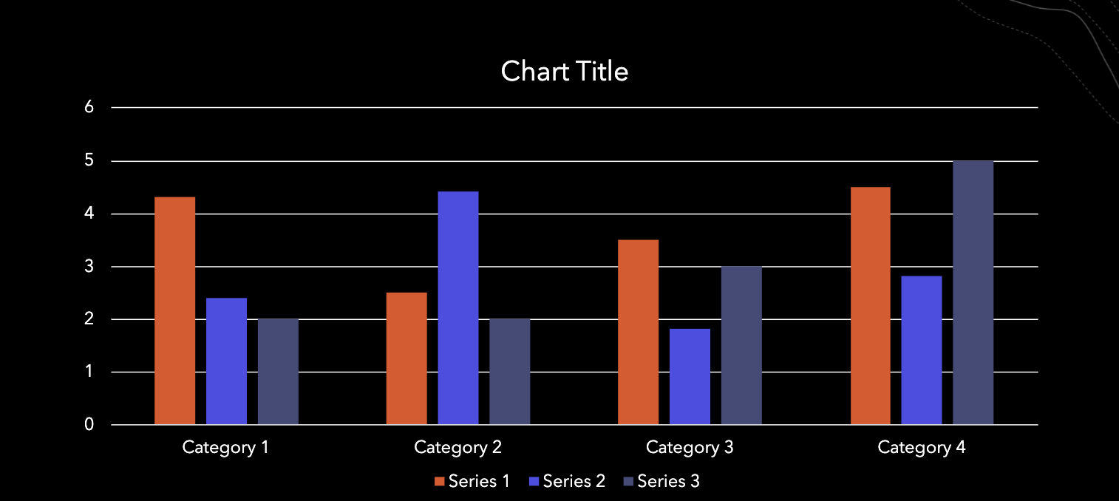

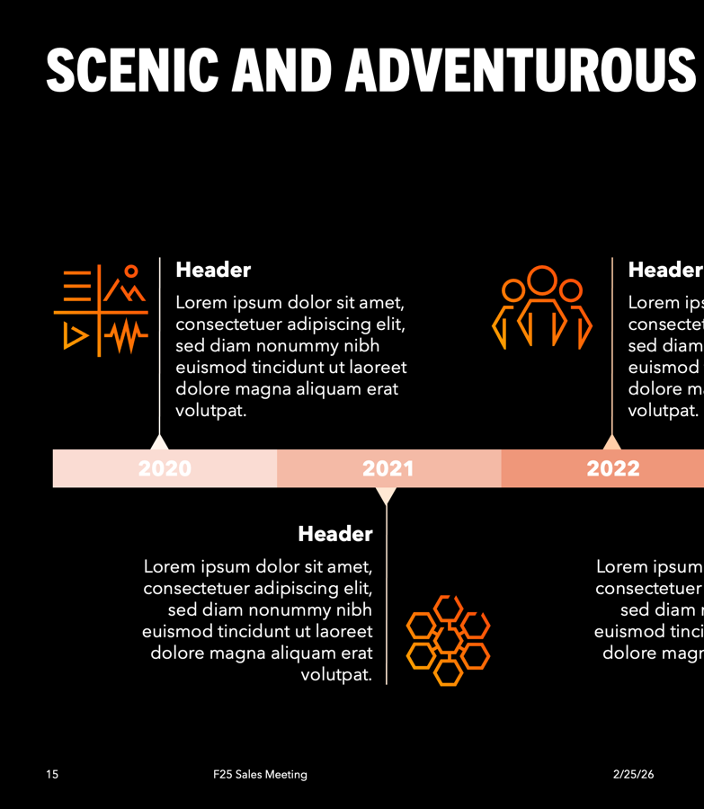
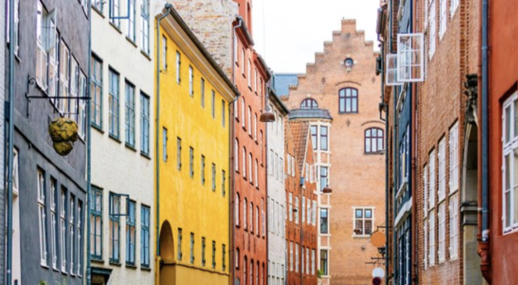

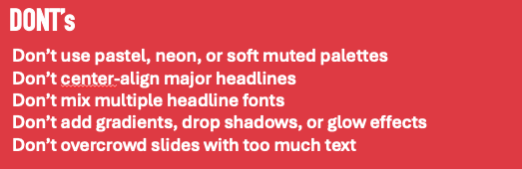
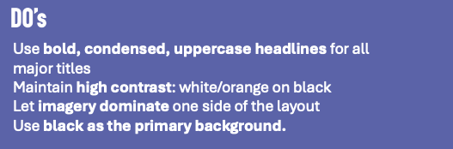

Brand kits
EXTRACTING SLIDE INFO
Brand kits give Agent Mode a first‑class understanding of a company’s brand—logos, colors, fonts, layouts, imagery rules, and brand voice—so AI‑generated decks start on‑brand instead of requiring cleanup after the fact.
Brand Kits are centrally managed by brand managers but automatically available to every employee. Agent Mode pulls approved, up‑to‑date assets directly from SharePoint, OneDrive, and organizational asset libraries.
Brand guidelines
Photography style
Infographics
Branding
Layouts
Do’s and Don’ts
Article: Create and manage official Brand Kits
Icons
Type / Color
Notes:
And with that, I wanted to talk little more about Brand kits
Brand kits is essentially a portal that you can upload all of these different aspects of your brand.
And then they'll be available to your full organization, or a select group of people, or just for yourself.
### 1. Official Brand Kits - allows for a brand manager or IT admin to set that up and then deploy that across the organization.
For brand managers in a security group members of a company
Brand Manager can publish brand kits to entire organization (so these are tenant-wide Official Brand Kits)
Companies can host multiple official brand kits for different brands
### 2. Shared Brand Kits
- Share a brand kit with specific group of people you're working with
- Enables collaboration within teams
### 3. Personal Brand Kits
Individual users can create their own brand kit
There's more information about that in the link in the lower left here about setting up your brand kit.

Slide 24
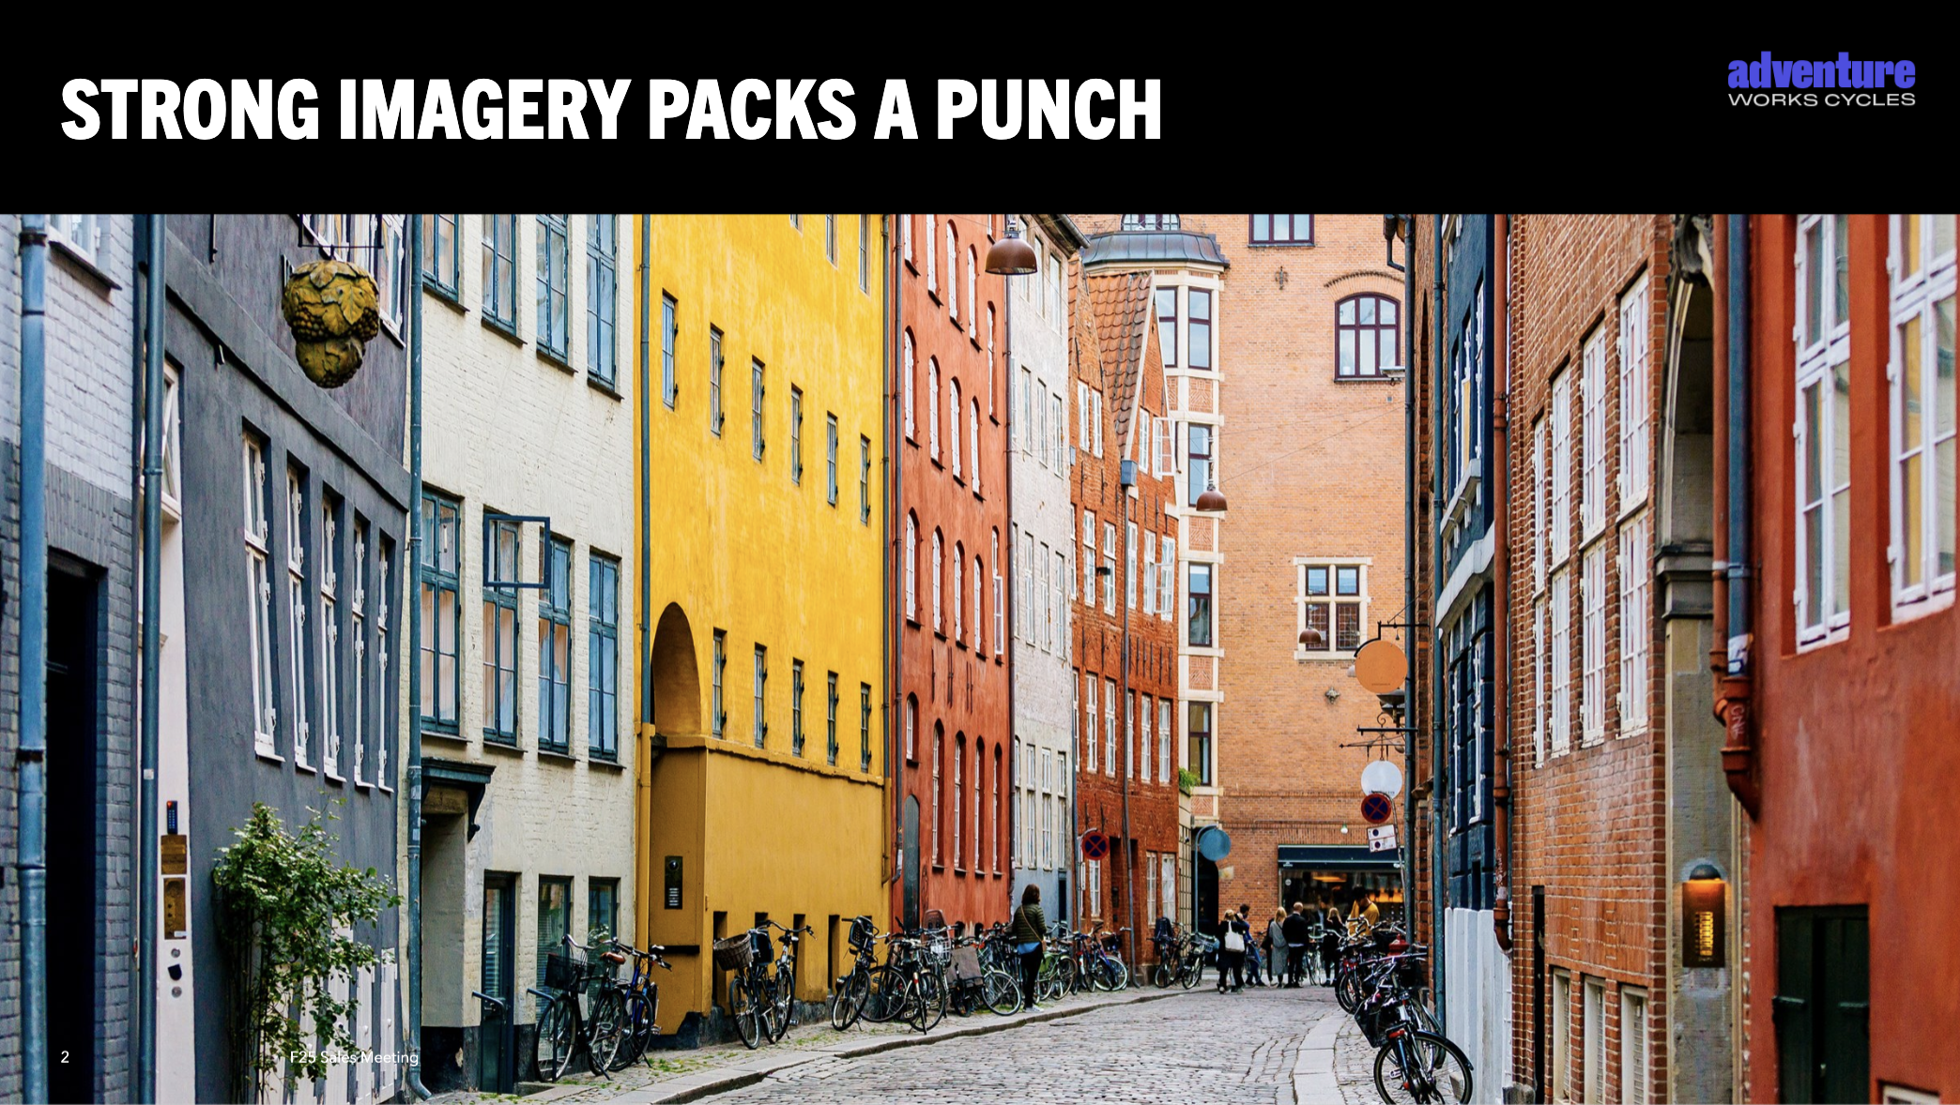
Brand Kits unpack the details
EXTRACTING SLIDE INFO
1
2
3
Layouts
1
Title Slide
4
Title and content
2
Title & Image
5
Tables
1
4
3
Section separator
6
Content and image
Objects
4
5
6
1
Slide Title
7
Graph
2
Text box
8
Data Visualization
2
3
Tiles
9
Table
7
4
Content Title
10
Insight/Quote
6
2
6
5
List
11
SmartArt
6
Highlight
12
Small print
5
Notes:
Brand kit is able to unpack the details of the templates and other assets that's being provided, and that really then allows Agent Mode to be even more intelligent as it starts creating slides.
Agent Mode can compose slides by teasing out the parts of existing slides and then reassemble them into various different slides and compositions.
------------
So, let's go through this together:
On the past slide, we showed a dummy brand we've created called Adventure Work Cycle, an enterprise travel sales company.
As you can see, its Brand Kit encompasses:
Brand guidelines
Layouts
Photography style
Do’s and Don’ts
Etc
And on this slide, we show how slides in your template are broken down semantically:​
what the slide types are present
the layouts of those slide types
and what objects are present
What we do is that we take all the information that you've supplied as part of the brand guidelines and example slides…
-------------------------
[Internal notes for presenter]
Backpocket note:
Brand center vs Create Brand kit: Brand center is limited to SharePoint Sites and Viva for site branding, while Create brand kits provide you solution for managing all brand information like logos, colors, fonts, styles, voice, guidelines, templates, images, and more that can be used for creating on-brand collateral (like images, posters, PPT) with Copilot. We are working with SharePoint team to have a unified experience in future.
Customers need to have a brand template and their brand kit loaded to get expected on-brand results. (anything else may not meet user expectation at this time in our development cycle – but always open to feedback!)
Also, the more example slides, the better Agent Mode is. It’s good at reproducing something it's seen before. It's really bad at reproducing something new and that’s something we’re working on.
Tune your message ("template vs any given deck") per the audience. If there is a Brand Manager or someone more focused on template in the audience, frame the talk track round template rules:
Slide Sense is not an external facing name – say “improved on-brand PPT creation and editing with Copilot” externally for now
"SlideSense will look to understand any rules set in your template, like what colors to use/not use.
Between Templates and Brand Guidelines, the template gets the precedence if there are any conflicting rules."

Slide 25
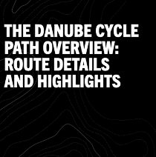
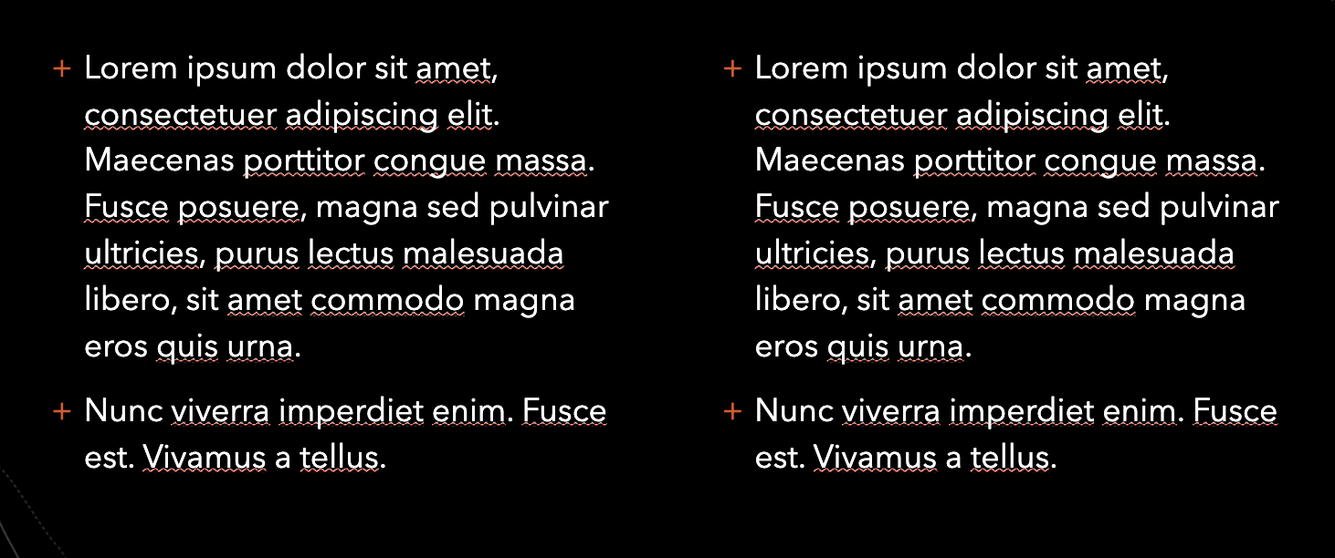
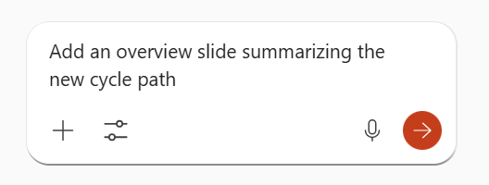
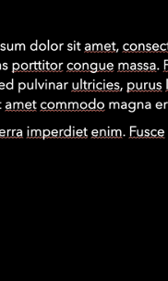

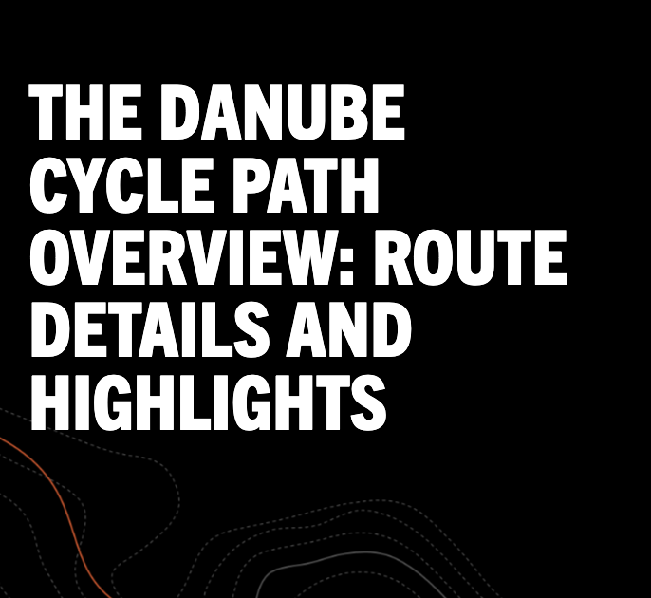
EXTRACTING SLIDE INFO
Your prompt
Template/Brand kit
On-brand creation
1
3
2
4
7
9
User types a prompt
Add a slide to the deck with specific info
Extracted info to create output
Layouts, Objects, Brand guidelines, Prompt and
Content supplied by user
User views the output
Slide is added to the deck with the required data
Notes:
And what we do is:
We take all that info in and when you prompt in PPT Agent Mode with, for example, “add an overview slide summarizing the new cycle path”, it will find the closest match of the representation of similar information and give you a slide which is coherent with the current deck.
To recap: effectively, what you're seeing is Agent Mode reasoning over layouts, objects, and structure to generate or edit slides that genuinely look like your organization created them.
And while Brand Kit is not a requirement, there are benefits to using it: the more you upload to and use BrandKit, the more you’ll see things light up within what Agent Mode creates for you.
--------------------------------
[Internal notes for presenter]
Backpocket note from 1/19/26: SlideSense will come out very soon. SlideSense is not an external facing name – call it “improved on-brand PPT creation and editing with Copilot.” for now.

Slide 26
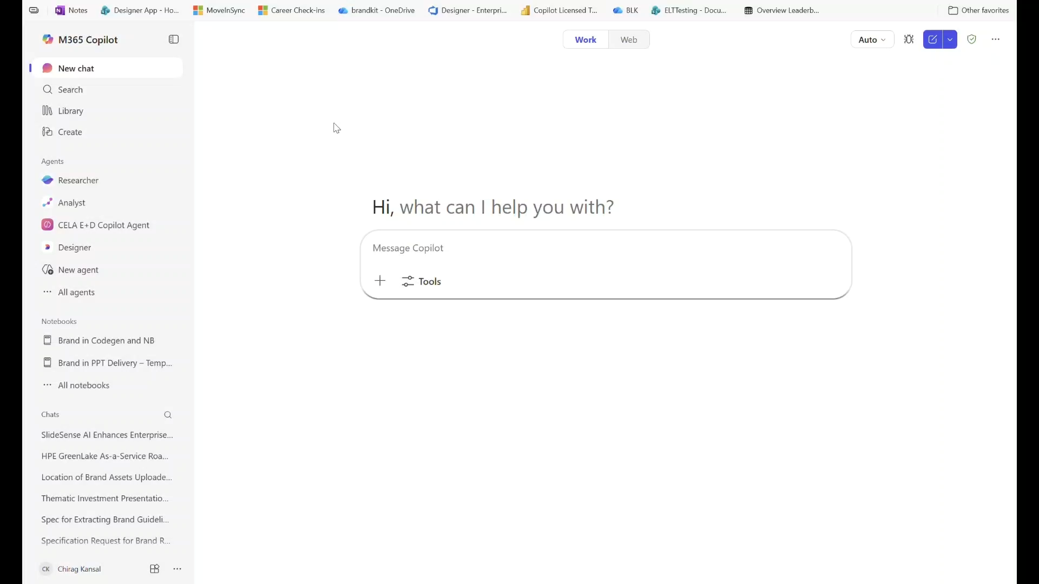
SETTING UP BRAND KITS
Brand kits
One place management of all brand assets (logos, color palettes, custom fonts, templates, styles, guidelines, voice)
Types of brand kits
💼 Official
Managed by brand managers only, accessible to everyone in tenant
🔗Shared
Available to a select group of people, access control at the time of sharing
✏️ Personal
Available only to the creator of the brand kit
Creating a personal kit
How to Create and Manage your Brand Kit – Support Doc
Notes:
## Three Types of Brand Kits (6:45)
- **Requirement:** Must have Copilot license
### 1. Official Brand Kits
For brand managers in a security group members of a company
Brand Manager can publish brand kits to entire organization (so these are tenant-wide Official Brand Kits)
Companies can host multiple official brand kits for different brands
### 2. Shared Brand Kits
- Share a brand kit with specific group of people you're working with
- Enables collaboration within teams
### 3. Personal Brand Kits
Individual users can create their own brand kit
## Creating a Brand Kit - <Play video>
We are starting to support of uploading brand guidelines pdf, from which we extract your brand assets like colors, brand voice, styles and also rules for all the asset types in brand kit like images. What we cannot get are your asset files which is your logos, custom fonts, templates, and images., which you will need to add to brand kits. Once extraction is complete you will have the option to review the guidelines and edit them as needed. These guidelines will be used by system to generate outputs that look like your brand
---------------
[internal]
**Future Plans (Internal Heads-Up):**
Planning to integrate with SharePoint brand kit system – but today, SharePoint is separate. You do not need to go to SharePoint to set this up.
**Note:** SharePoint brand kit currently only applies to SharePoint. This new system will unify everything.
- Will become M365-wide
- It’s will be a single backend storage, available across:
- PowerPoint
- Word
- Teams
- Outlook
- SharePoint

Slide 27
ImageGen in PowerPoint
Notes:
How many of you have seen or tried PowerPoint Agent Mode?
For those of you who are new to it, let me start with a demo video.

Slide 28
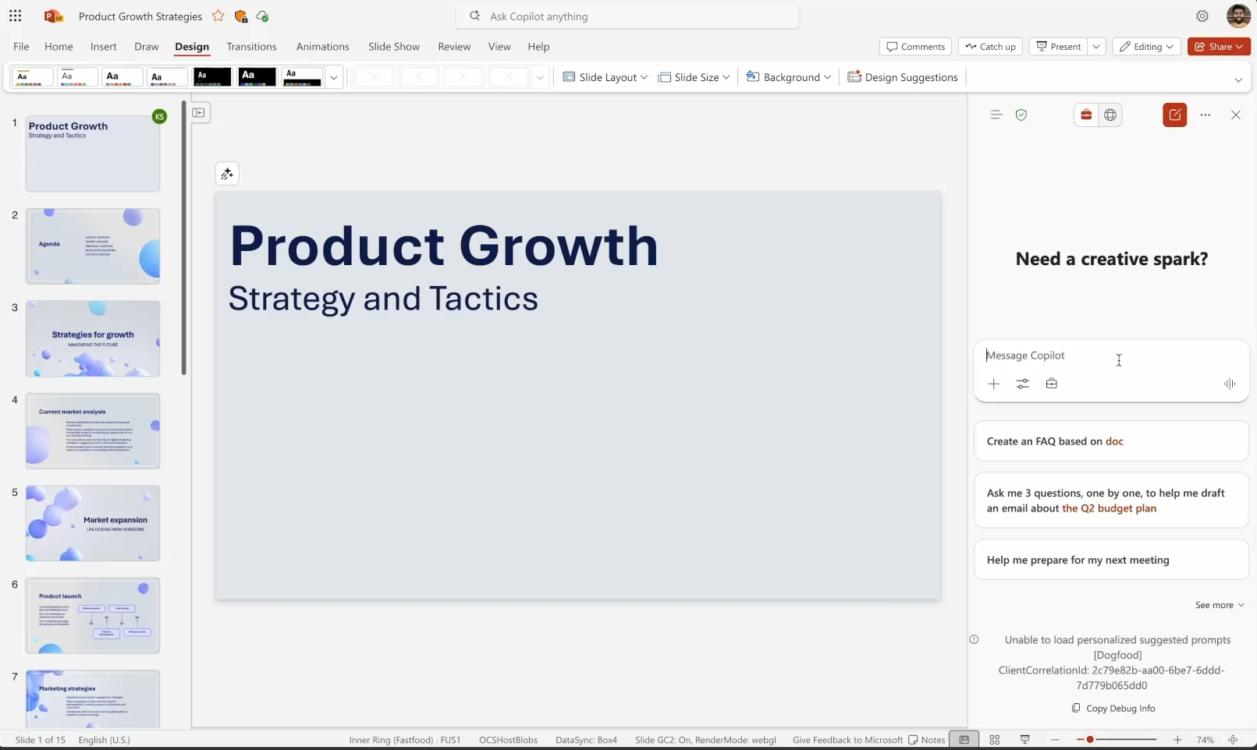
Create images contextually-aware of your presentation
Notes:
Images are a key ingredient to most presentations, so I thought I’d share recent improvements we made to image generation in chat – which is now contextually aware!
So when you generate an image in chat, not only is Copilot aware of what content you have on the slide, so it makes a relevant image for you, but it also understands the look and feel of your slide to create an image that perfectly fits. It will even make sure the image generated aligns with other graphics in your presentation to ensure your deck feels consistent throughout.
Now this next example is quite powerful. You can select text on slide, which will tailor the generation to what is selected. So in this example, maybe you might have 2 different icons in your stock library for travel or wellness, but Copilot can generate a tailor made icon in this situation that merges travel and wellness together! Now that’s probably not something you’ll find in a stock gallery anywhere, and I didn’t have to even bother a designer on my team for it!

Slide 29
Image Editing with AI in PowerPoint
Notes:
How many of you have seen or tried PowerPoint Agent Mode?
For those of you who are new to it, let me start with a demo video.

Slide 30
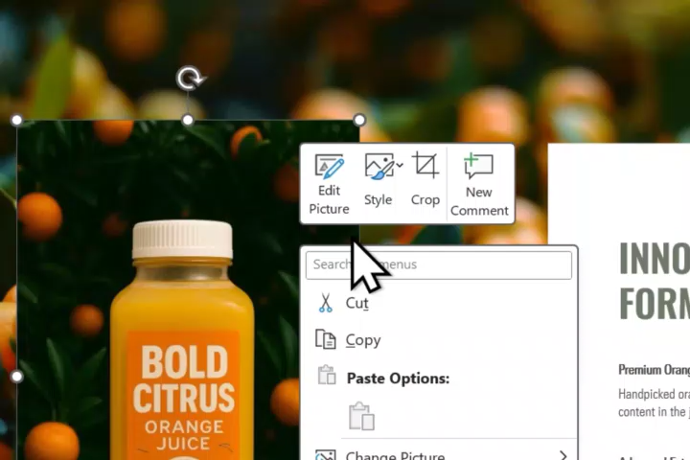
“Edit Picture” enables AI-powered image editing
Notes:
We're releasing a new AI-powered image editing feature
Rolling out on Desktop
Web and Mac to come soon
Play the video

Slide 31

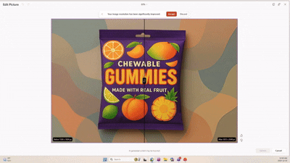
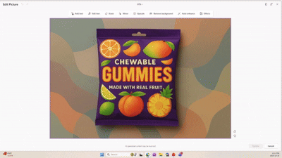
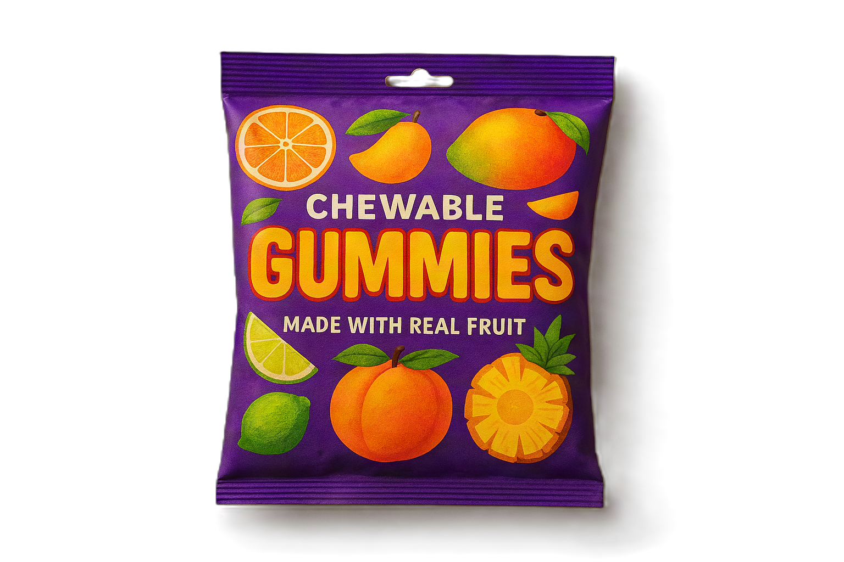
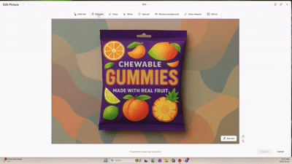


AI-powered image editing lets you craft high-quality visuals
Remove background
Upscale improving image resolution
Erase removing unwanted clutter
Extract, edit, and add text to the image
Move correcting image composition
Curated, customizable effects (e.g., glitch, glass)
Notes:
Initiate by a) right clicking on the image and select "Edit Picture) or b) choosing the option in the ribbon
It lets you:
Quickly remove background with one click
Improve the image resolution – particularly useful if you're copying in a scanned image or image downloaded from the web at low res
Select any object in the image – erase or move to remove clutter or change composition
"Edit Text" if you need to quickly edit the text that's part of the image or correct misspellings that we sometimes see in generated images
Curated set of image effects that you used to have to go to specilized tools like Adobe for, you can now quicly apply them with one click to add extra creative flair

Slide 32
Test and share your feedback

Slide 33

Join the Frontier program
We share our latest updates first in Frontier so you can give feedback early and test out our newest features.
General Frontier Set-up​
Frontier program – Microsoft Adoption​
Microsoft Frontier Program expands to individual Microsoft subscribers | Microsoft Community Hub

Slide 34
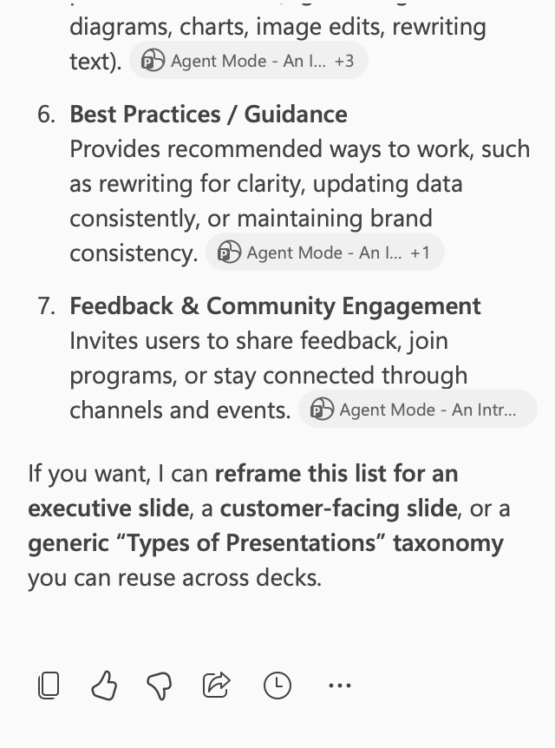
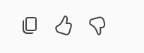
Share your feedback
We read 100% of the feedback that is coming in via thumbs. So please send your feedback and tell us what works and what needs to improve

Slide 35
Upcoming community events
M365 Community Days Quebec 2026 | April 1 | Quebec, Canada
AgentCon Seoul | April 16 | Seoul, South Korea
Microsoft 365 Community Conference | April 21-23 | Orlando, FL
M365 Community Day St. Louis | May 1 | Saint Louis, MO
European Collaboration Summit 2026 | May 5-7 | Cologne, Germany
TechCon 365 Chicago | June 15-19 | Chicago, IL
Explore other Microsoft events here and a full list of community-led events can be found at CommunityDays.org

Slide 36
Open discussion
If viewing on-demand, drop your questions in the Microsoft Tech Community – Driving Adoption event page to engage with us!
Share your feedback for this call by visiting https://aka.ms/Microsoft365ChampionCallFeedback

Slide 37



What’s next
Share your feedback
https://aka.ms/Microsoft365ChampionCallFeedback
Next call:
April 28, 2026
People Skills + Skills agent
Join the Driving Adoption community
https://aka.ms/DrivingAdoption
Invite colleagues to become a Champion
https://aka.ms/M365Champions

