Slide 1

We will begin the call at five minutes past the hour.
Microsoft 365 Champion Community Call
June 2026
Microsoft 365 Champion Community
Learn more. Do more. Achieve more, together.

Slide 2



Microsoft 365 Champion
community call
June 2026

Slide 3
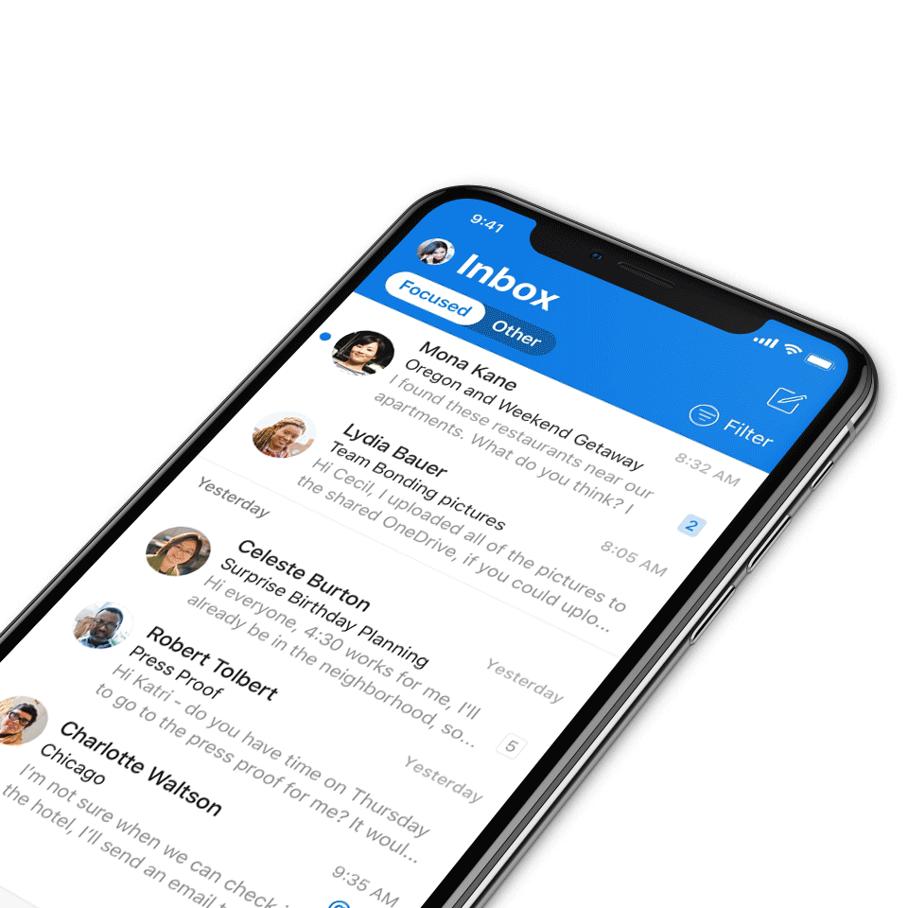
Digital Event Code of Conduct
Microsoft’s mission is to empower every person and every organization on the planet to achieve more. This includes all Microsoft events and gatherings, including on digital platforms, where we seek to create a respectful, friendly, fun and inclusive experience for all participants.​
We expect all digital event participants to uphold the principles of this Code of Conduct, which covers the main digital event and all related activities. We do not tolerate disruptive or disrespectful behavior, messages, images, or interactions by any party participant, in any form, at any aspect of the program including business and social activities, regardless of location.​
Microsoft will not tolerate harassment or discrimination based on age, ancestry, color, gender identity or expression, national origin, physical or mental disability, religion, sexual orientation, or any other characteristic protected by applicable local laws, regulations, and ordinances.​
We encourage everyone to assist in creating a welcoming and safe environment.
For more info, visit aka.ms/CodeofConduct.

Slide 4

Agenda
Announcements
Microsoft 365 Copilot Cowork
Open discussion forum
Become a Champion today!
https://aka.ms/BecomeaChampion

Slide 5
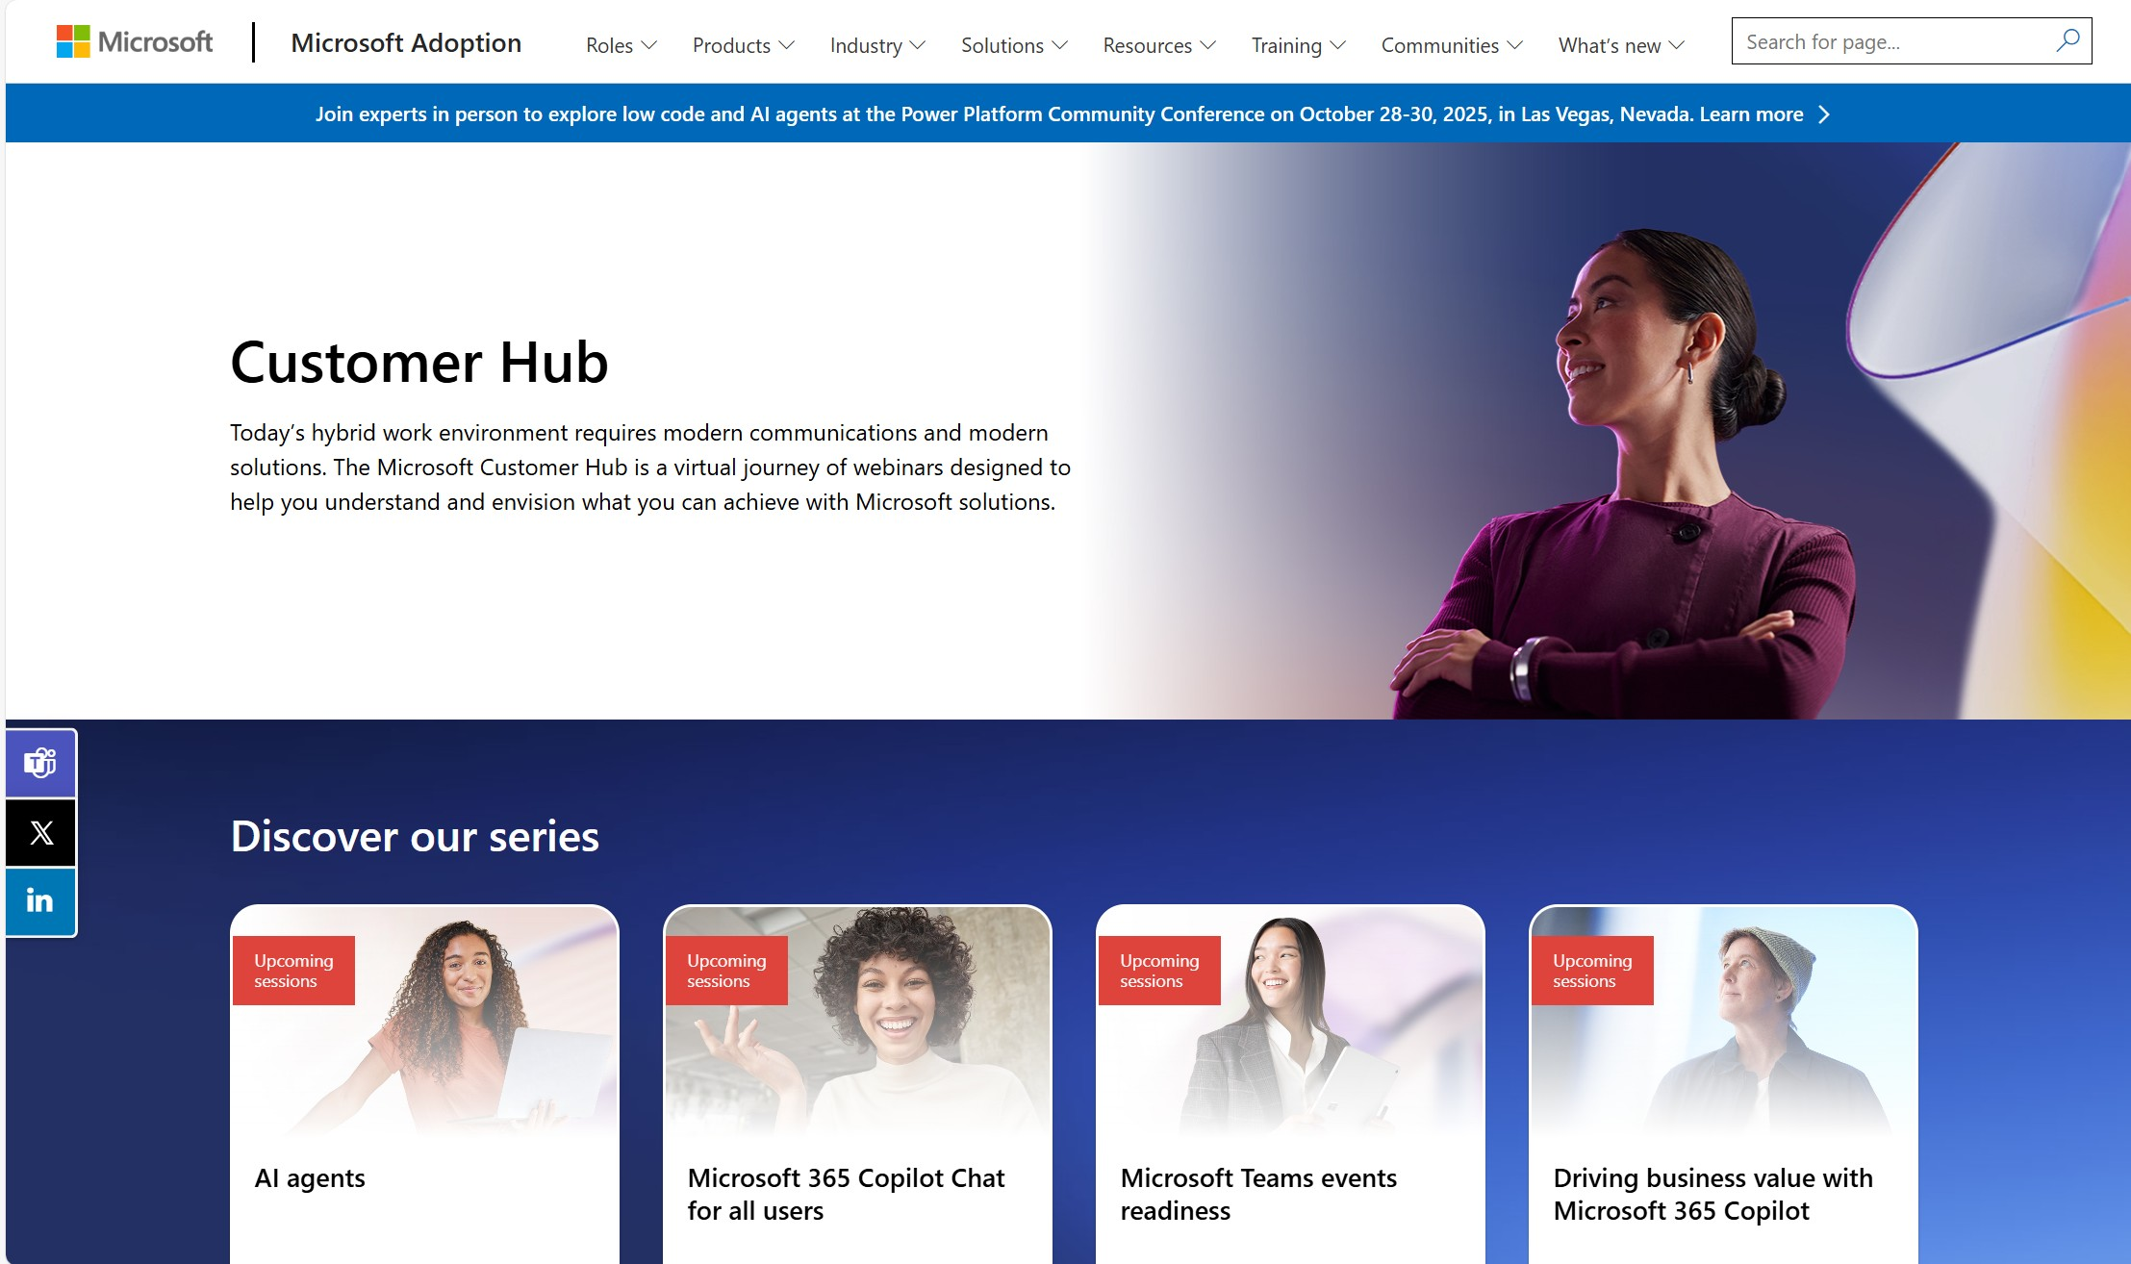
Customer Hub announcements
Customer Hub
Upcoming Microsoft 365 Copilot webinars
Have you attended our Customer Hub webinar sessions? In today's hybrid work environment, modern communication and solutions are essential. Our goal is to help you explore what you can achieve with Microsoft solutions.
Join us for one or more of our upcoming sessions, including the launch of several new Copilot series. We also have all past session recordings so you can watch any that you missed and download the presentation materials.
Visit aka.ms/CustomerHubSessions to sign up today.

Slide 6
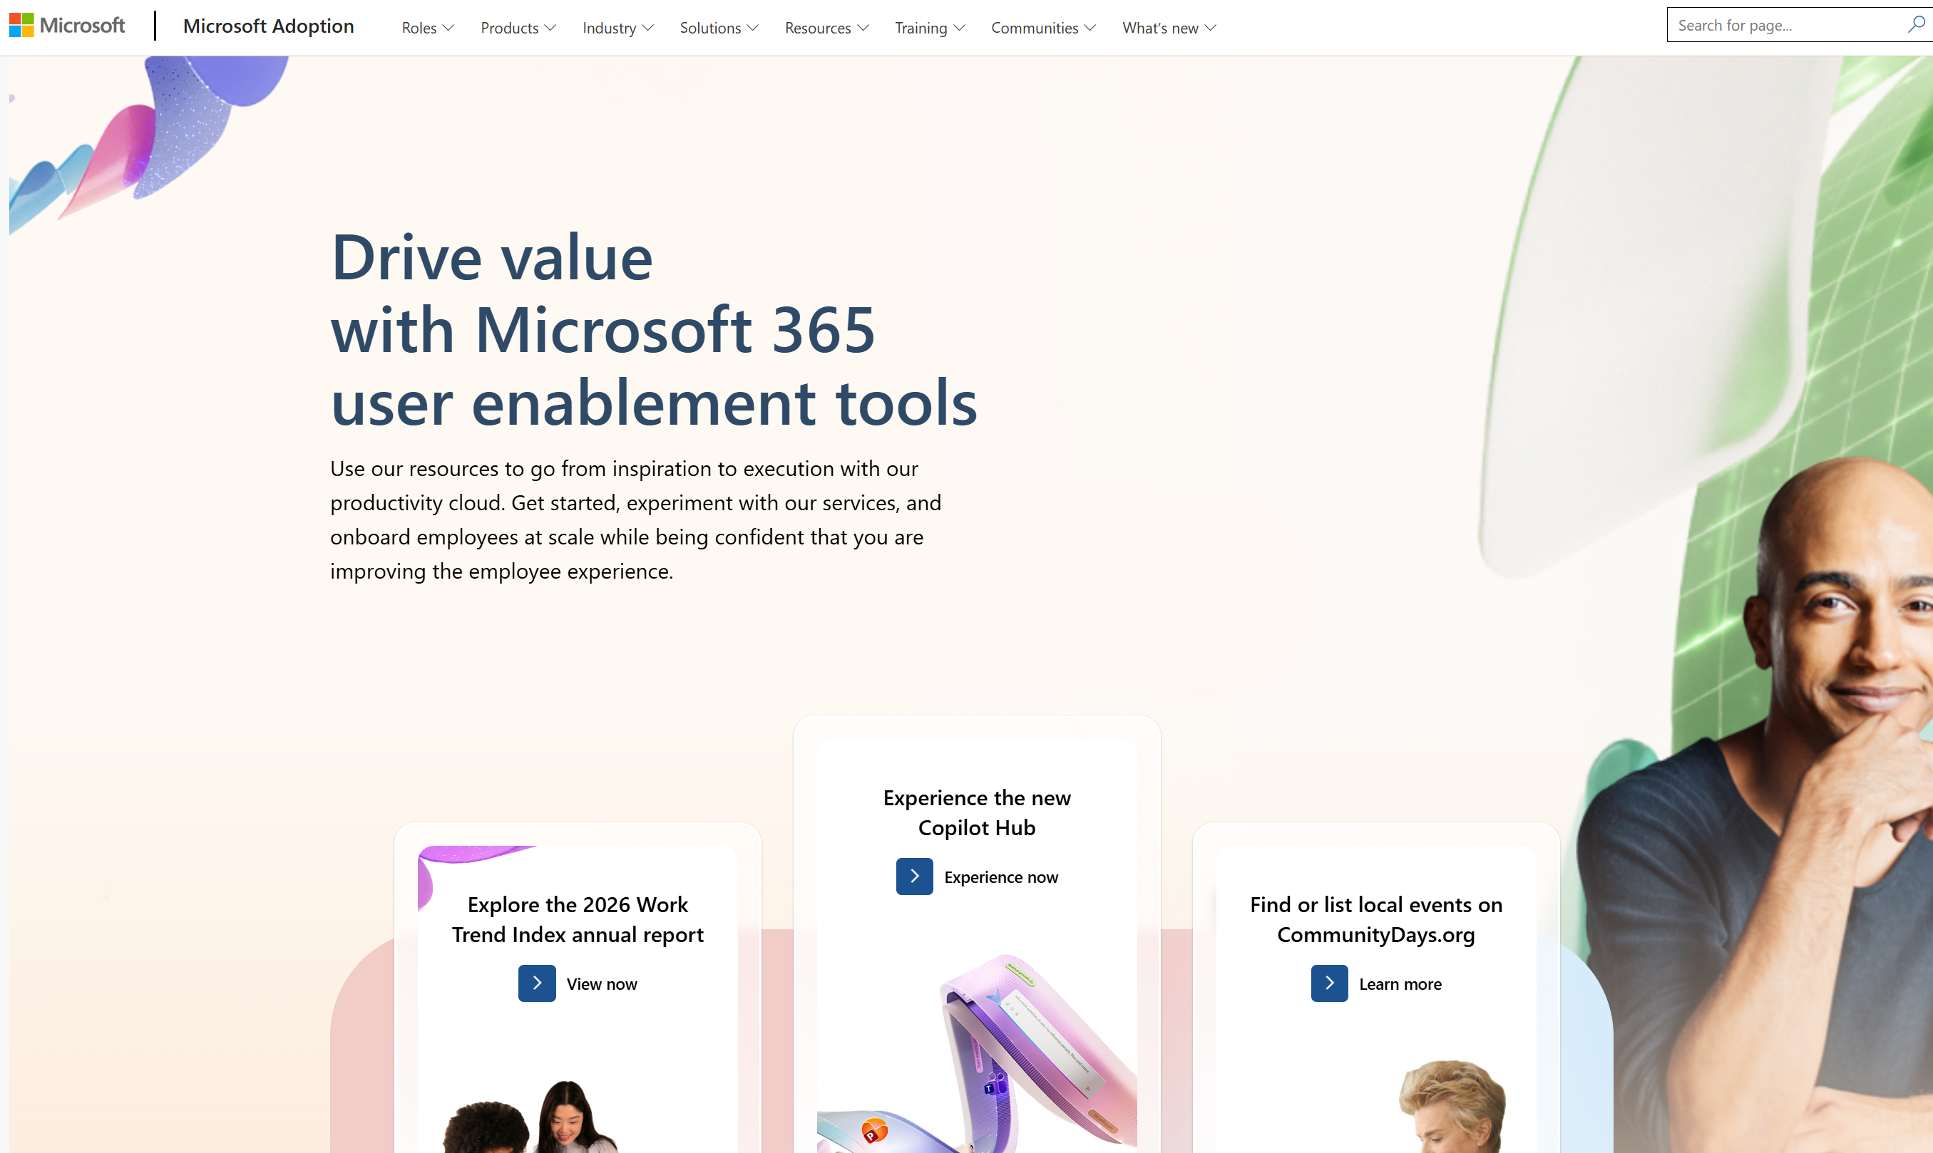
adoption.microsoft.com
Update highlights
New Microsoft 365 Copilot Cowork page
New Copilot in SharePoint page
New Microsoft Teams Rooms page
New Communities in Teams playbook on Viva Engage page
Session resources from the Microsoft 365 Community Conference 2026 now available
New Learning Agent demo and resources on the Agents in Microsoft 365 page
Read or subscribe to our release notes for more updates.

Slide 7
Microsoft 365 Copilot Cowork
Jessie Hwang
Brea Davenport
Shinhe Cho

Slide 8
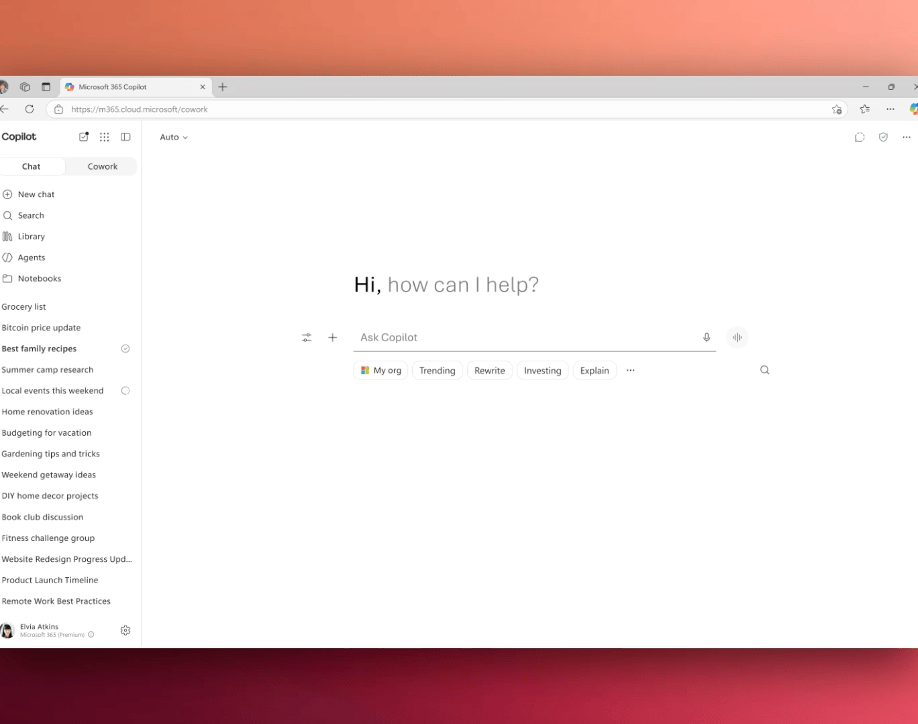
Cowork has launched!
On June 16, 2026, we announced the availability of Microsoft 365 Copilot Cowork.
What’s new:
Copilot Cowork plans, executes, and completes multi‑step work across your apps, files, and data
Users can assign a task, and Cowork carries it through, coordinating steps across tools and apps and going beyond just generating a response
Read the full announcement here: Copilot Cowork is now generally available.

Slide 9
5 things to know about Cowork
It runs inside the Microsoft ecosystem: Cowork operates within Microsoft 365, so it respects existing security, governance, and permissions. The right information goes to the right people at the right time.
Uses Work IQ to ground the work: Cowork pulls from your organization’s emails, files, meetings, and data and delivers context that is specific to your job.
Provides enterprise-grade security and visibility: Built-in security ensures safe usage. Leaders/owners can transparently observe how AI is being used across your organization.
Selects the right model for the work: Cowork uses multiple models within the Microsoft ecosystem. It dynamically applies the right model for the task, within your organization’s controls.
Runs work in the cloud, so you don’t have to stay with it: You can hand off a complex task and walk away! Cowork continues running in the background and completes the work.
Watch Karuana Gatimu tour Cowork on Coffee in the Cloud.
Notes:
Use the Microsoft 365 Implementation Framework to help drive Copilot and Cowork adoption in your org. Learn more about the framework here: https://adoption.microsoft.com/copilot/essential-guide/

Slide 10
What tool when: Chat vs Cowork vs agents
 | Chat | Cowork | Agents
Best for | Conversational AI for drafting, Q&A, and ideation | Delegate and execute long-running, multistep work across your apps | Ready-made agents for specialized or repeatable tasks
How you interact | A conversation: you steer each step from prompt → response | An assignment: you describe the goal, check in at key milestones | A workflow: you pick an agent built for a specific job
Typical work pattern | You’re in the loop: one prompt, one result, then you choose what’s next | You step away: Cowork plans, manages files and tasks across apps, and delivers completed work | You run it on demand: the agent handles the same scoped task each time

Slide 11
Core ways to drive Cowork adoption in your org
Confirm access
  Check whether Cowork is turned on in Copilot and if it isn’t, request access or loop in your IT admin
Differentiate from Chat
  Explain when to use Cowork vs Chat:
  Chat handles quick answers and drafts
  Cowork does multi-step work completed end-to-end
Start with real work
  Show where Cowork lives and guide one clear starting scenario.
Support and coach your team
Coach how to define:
  The right inputs
  What “done” looks like and ideal outcomes

Slide 12
Cowork adoption site demo
https://aka.ms/CoworkAdoption

Slide 13
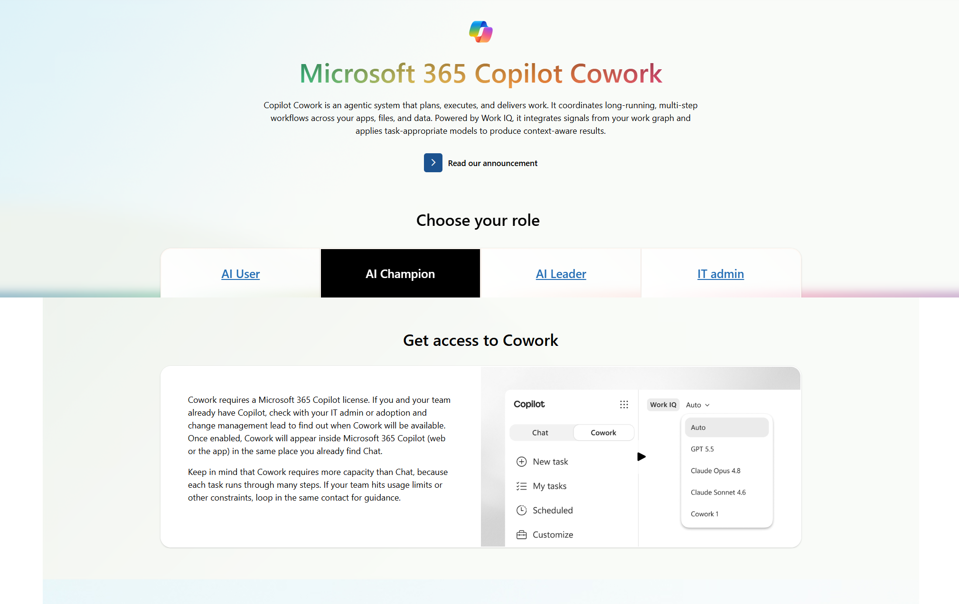
Copilot Hub | Cowork demo: AI Champions
Role based guidance
Details on access
Copilot Hub: Cowork for AI Champions

Slide 14
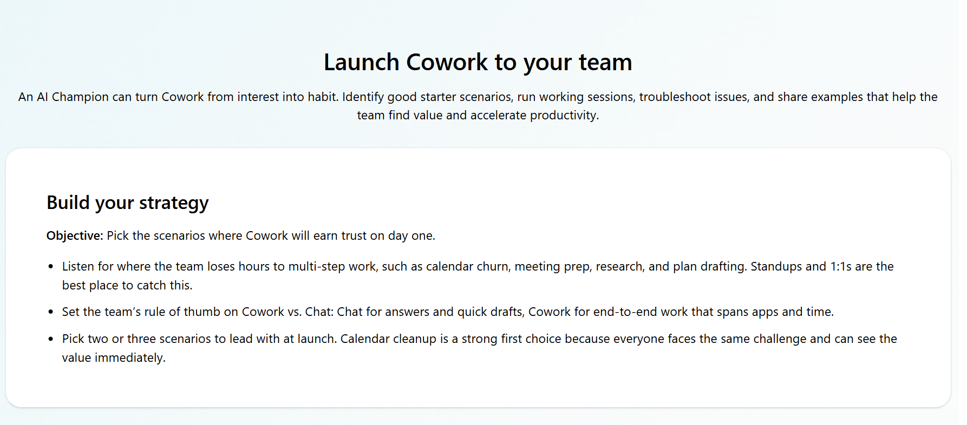
Copilot Hub | Cowork demo: AI Champions
Successful roll out tips
Support sections
Build your strategy
Roll out Cowork
Generate excitement
Share success and gather feedback
Join the Community

Slide 15
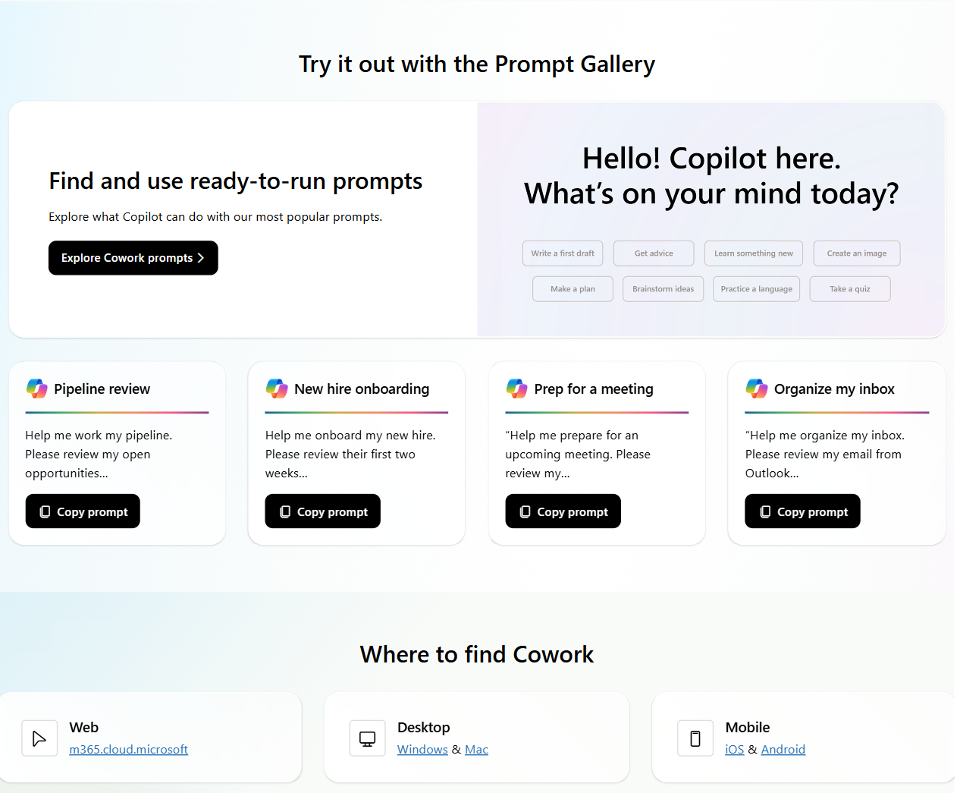
Copilot Hub | Cowork demo: AI Champions
“Explore more” link takes users directly to a filtered list of Cowork prompts in the Prompt Gallery
Where to find Cowork

Slide 16
Cowork adoption page + implementation framework
 | AI User | AI Champion | AI Leader | IT Admin
Plan | What Cowork can do Choose the right tool: Chat, Cowork, or agents Explore scenarios to spark ideas | Build your strategy | How Cowork is different from Copilot What you need to know about Cowork | Built on the Microsoft trust foundation Security and governance Model choice
Implement | Where to find Cowork Getting started with Cowork: what you’ll see | Get access to Cowork Launch Cowork to your team Roll out Cowork | Where you set direction Where to find Cowork | Get access and set up Cowork Where to do each step Rollout Cowork to the organization
Adopt | Effective prompting with Cowork Try it out with the Prompt Gallery | Generate excitement Coach the team on effective prompting Try it out with the Prompt Gallery | Your role as an AI Leader Watch how it works Try it out with the Prompt Gallery | Try it out with the Prompt Gallery
Manage | N/A | Share success and gather feedback | N/A | Where to find Cowork
Improve | Communities Go further | Join the Community | Communities Go further | Communities Go further
Notes:
Breakdown of the sections within the Cowork adoption page that fall within the phases in the Microsoft 365 Implementation Framework.

Slide 17
Key takeaways: using the Cowork page to guide your team
Use the Cowork page on the Copilot Hub as a starting point​
  Instead of starting from scratch, use the hub! It is here to help you across the adoption journey.
  Leverage our framework
  Use the phases to decide what is relevant right now, based on where you are in the adoption journey.
  Anchor on one real world scenario​
  Adoption builds when you consistently apply one scenario at a time.
  Helpful links
  Cowork adoption page
  Blog announcement
  Cowork product blog with full feature list
  Cowork Cost Estimator
  Copilot Credits guide
  Feedback: aka.ms/AMC/Feedback

Slide 18
Upcoming community events
CollabDays Hamburg 2026 | June 27 | Hamburg, Germany
European Power Platform Conference | June 29-July 2 | Copenhagen, Denmark
TechCon 365 Seattle | August 24-28 | Seattle, WA
The AI-Native Workplace Summit | September 16 | Virtual
CollabDays Bletchley Park 2026 | September 23 | Milton Keynes, UK
European Fabric + SQL Community Conference | September 28-October 1 | Barcelona, Spain
TechCon 365 Dallas | November 2-6 | Dallas, TX
Microsoft Ignite 2026 | November 17-20 | San Francisco, CA
Explore other Microsoft events here and a full list of community-led events can be found at CommunityDays.org

Slide 19
Open discussion
If viewing on-demand, drop your questions in the Microsoft Tech Community – Driving Adoption event page to engage with us!
Share your feedback for this call by visiting https://aka.ms/Microsoft365ChampionCallFeedback

Slide 20



What’s next
Share your feedback
https://aka.ms/Microsoft365ChampionCallFeedback
Next call:
July 28, 2026
Join the Driving Adoption community
https://aka.ms/DrivingAdoption
Invite colleagues to become a Champion
https://aka.ms/M365Champions

