Slide 1

We will begin the call at five minutes past the hour.
Microsoft 365 Champion Community Call
July 2026
Microsoft 365 Champion Community
Learn more. Do more. Achieve more, together.

Slide 2



Microsoft 365 Champion
community call
July 2026

Slide 3
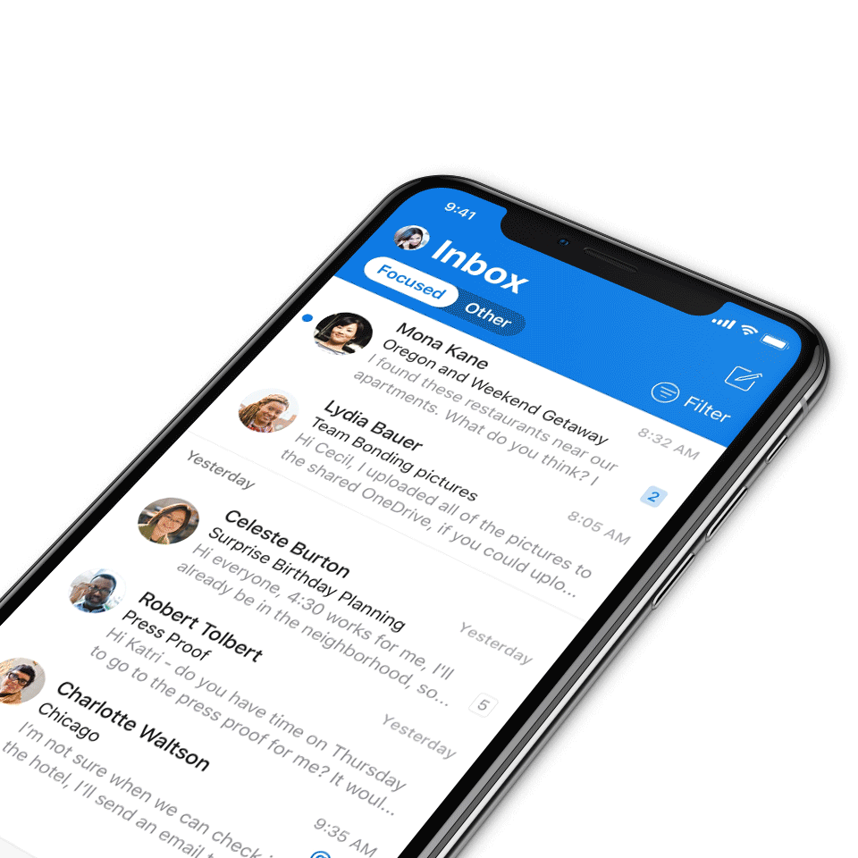
Digital Event Code of Conduct
Microsoft’s mission is to empower every person and every organization on the planet to achieve more. This includes all Microsoft events and gatherings, including on digital platforms, where we seek to create a respectful, friendly, fun and inclusive experience for all participants.​
We expect all digital event participants to uphold the principles of this Code of Conduct, which covers the main digital event and all related activities. We do not tolerate disruptive or disrespectful behavior, messages, images, or interactions by any party participant, in any form, at any aspect of the program including business and social activities, regardless of location.​
Microsoft will not tolerate harassment or discrimination based on age, ancestry, color, gender identity or expression, national origin, physical or mental disability, religion, sexual orientation, or any other characteristic protected by applicable local laws, regulations, and ordinances.​
We encourage everyone to assist in creating a welcoming and safe environment.
For more info, visit aka.ms/CodeofConduct.

Slide 4

Agenda
Announcements
Microsoft Teams Meetings Controls
Open discussion forum
Become a Champion today!
https://aka.ms/BecomeaChampion

Slide 5
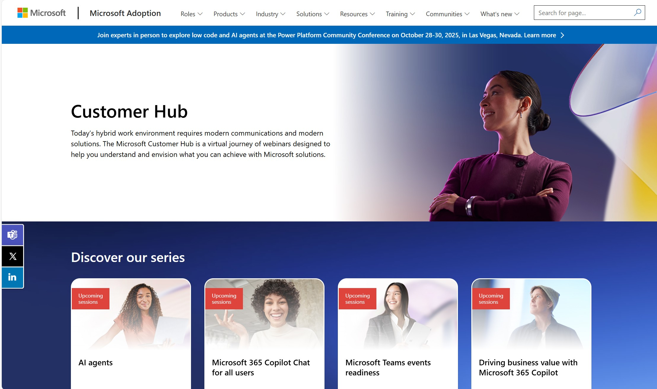
Customer Hub announcements
Customer Hub
Upcoming Microsoft 365 Copilot webinars
Have you attended our Customer Hub webinar sessions? In today's hybrid work environment, modern communication and solutions are essential. Our goal is to help you explore what you can achieve with Microsoft solutions.
Join us for one or more of our upcoming sessions, including the launch of several new Copilot series. We also have all past session recordings so you can watch any that you missed and download the presentation materials.
Visit aka.ms/CustomerHubSessions to sign up today.

Slide 6

Star in a Champion story
Microsoft 365 Copilot Adoption · CHAMPION STORIES
Sign up to get your experience driving Microsoft 365 Copilot adoption professionally filmed and edited by our studio team – a story worth sharing far beyond this call.
▶
★
▲
♥
Studio-produced
Featured by Microsoft
Grow your brand
Inspire your peers
We film and edit it all – you share your story.
Published on Microsoft socials, web and blogs as a best practice.
Keep the polished video for your own network and portfolio.
Show peers what great Copilot adoption really looks like.
Sign up for a Champion Story →
Notes:
Champion call talking points — Champion Stories sign-up (M365 Copilot adoption):
The ask: We want to feature YOUR real experience driving M365 Copilot adoption. Sign up and our studio team films and fully edits a short story — you don't need any production skills.
What you get:
- Studio-produced: our team handles filming and editing end to end.
- Featured by Microsoft: your story is published across Microsoft Social, Web and Blogs as an adoption best practice.
- Yours to keep: you can post the polished, edited video on your own networks (e.g. LinkedIn) and add it to your professional portfolio.
- Community impact: help peers everywhere see what great Copilot adoption looks like.
OWNER TO DO before presenting: replace 'link in the chat' with the actual sign-up form URL and/or drop a QR code on the slide. Add the submission deadline if there is one.

Slide 7
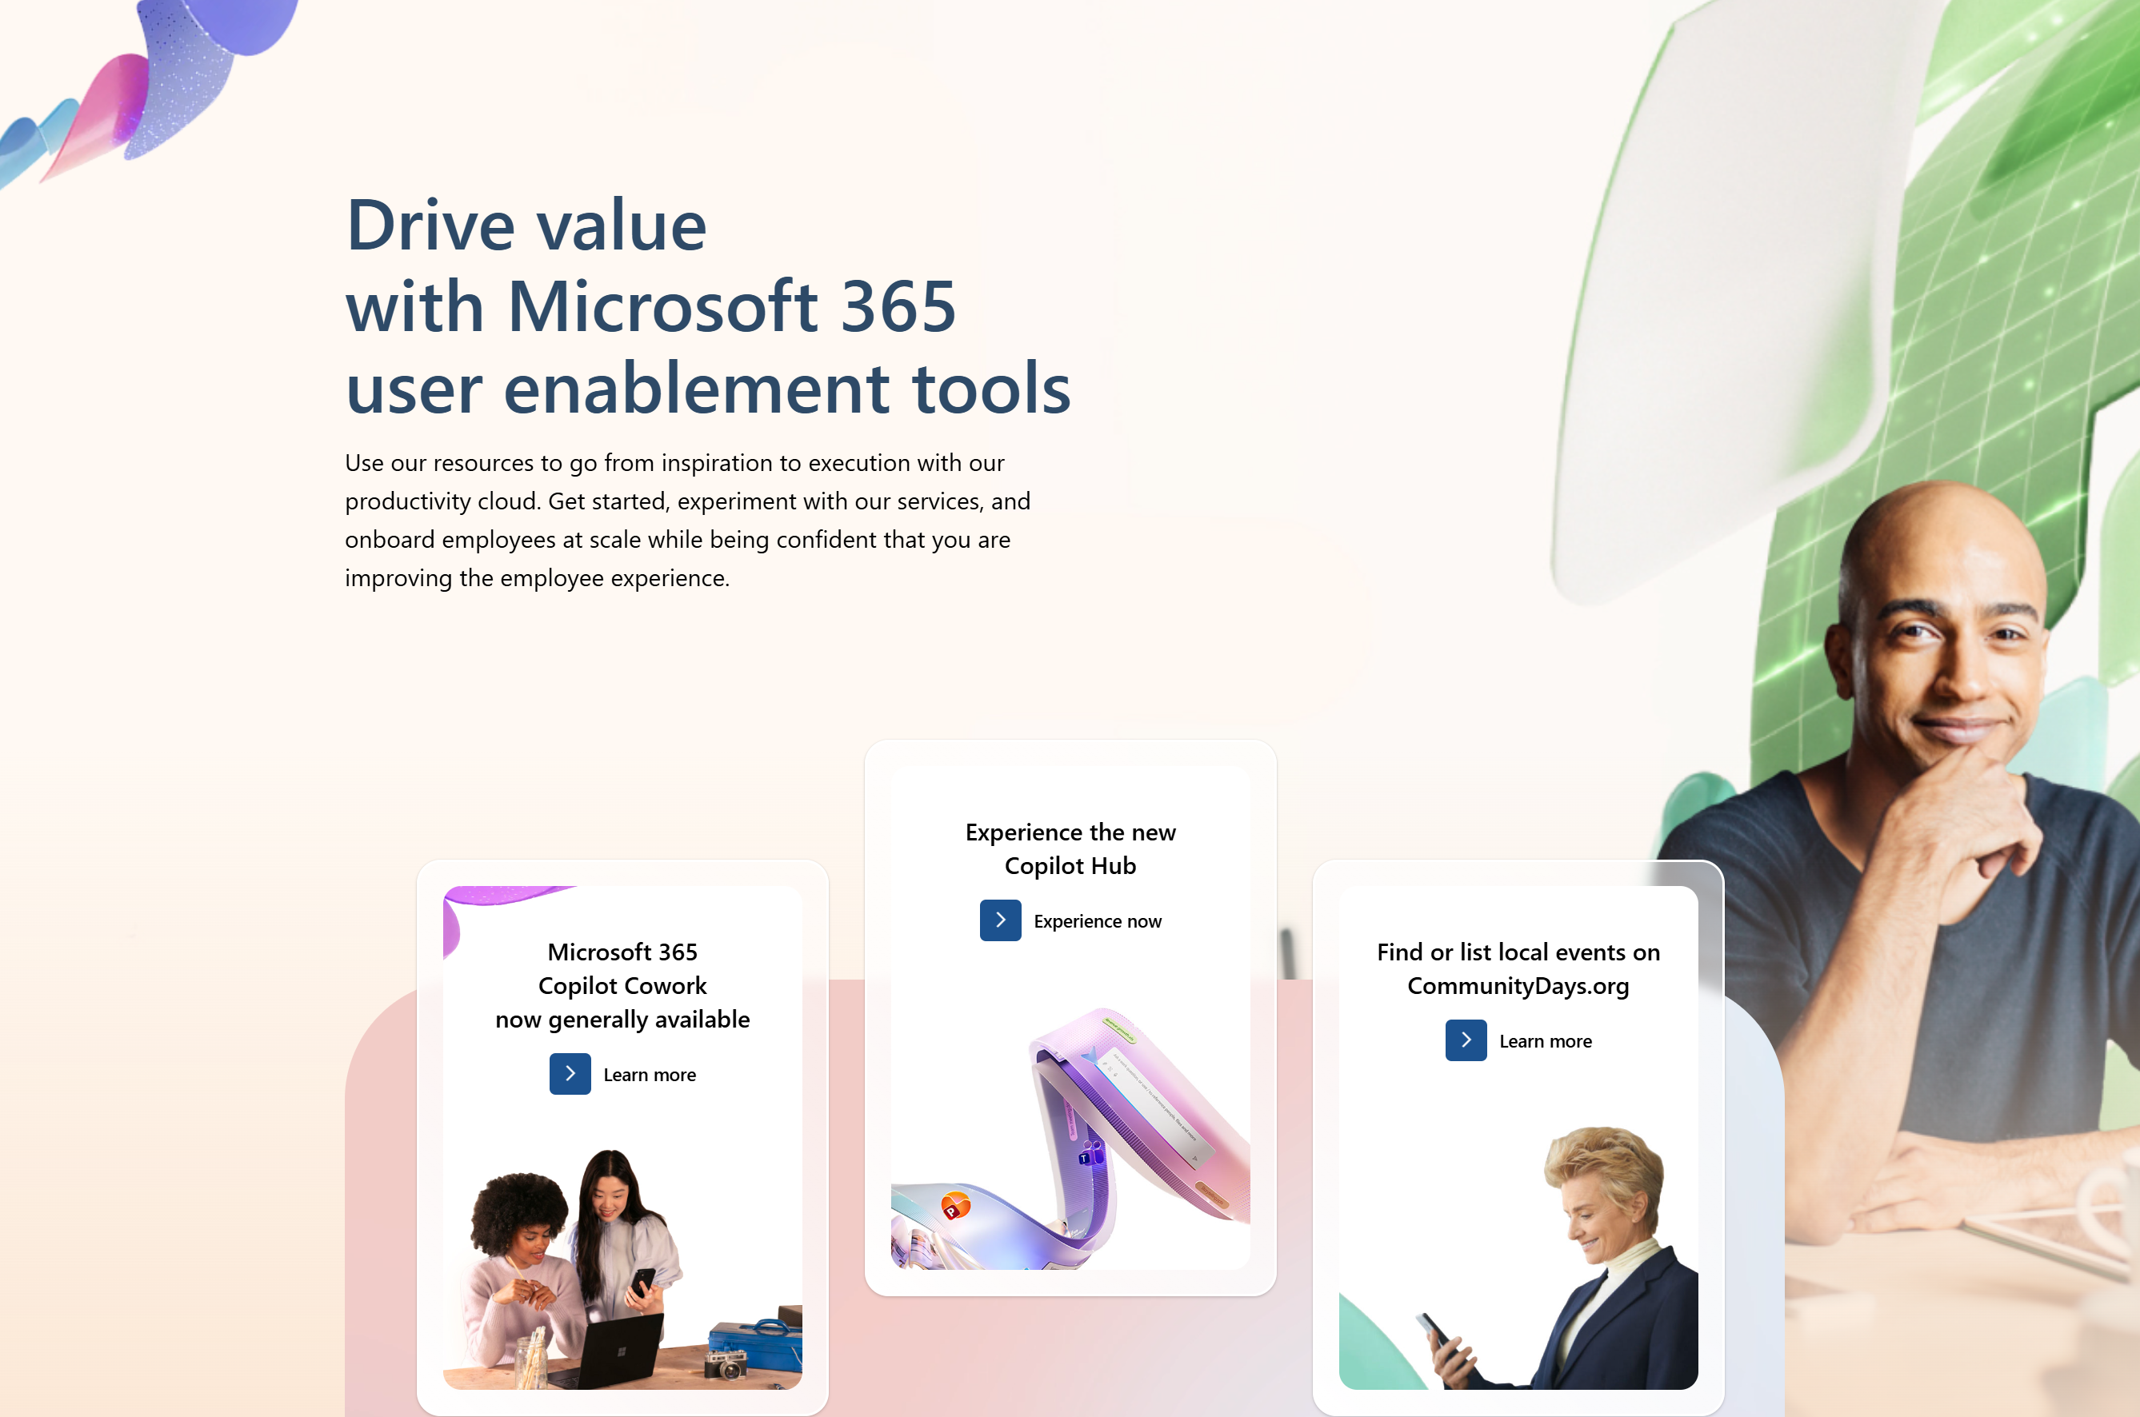
adoption.microsoft.com
Update highlights
Interactive Teams for FLW mobile demo – explore real-world scenarios and imagine what's possible for your teams
Learn more about the redesigned Teams Meeting controls
Copilot evaluation framework – practical guidance for measuring the real impact of Copilot in your organization
Watch the Copilot Cowork webinar and AMA on demand – understand how to maximize the value of Cowork and managing Copilot Credits
Copilot Cowork Task Packs added to the Cowork Hub
New prompts added to the Prompt Gallery
New stories added to Agent transformation stories page
Read or subscribe to our release notes for more updates.

Slide 8
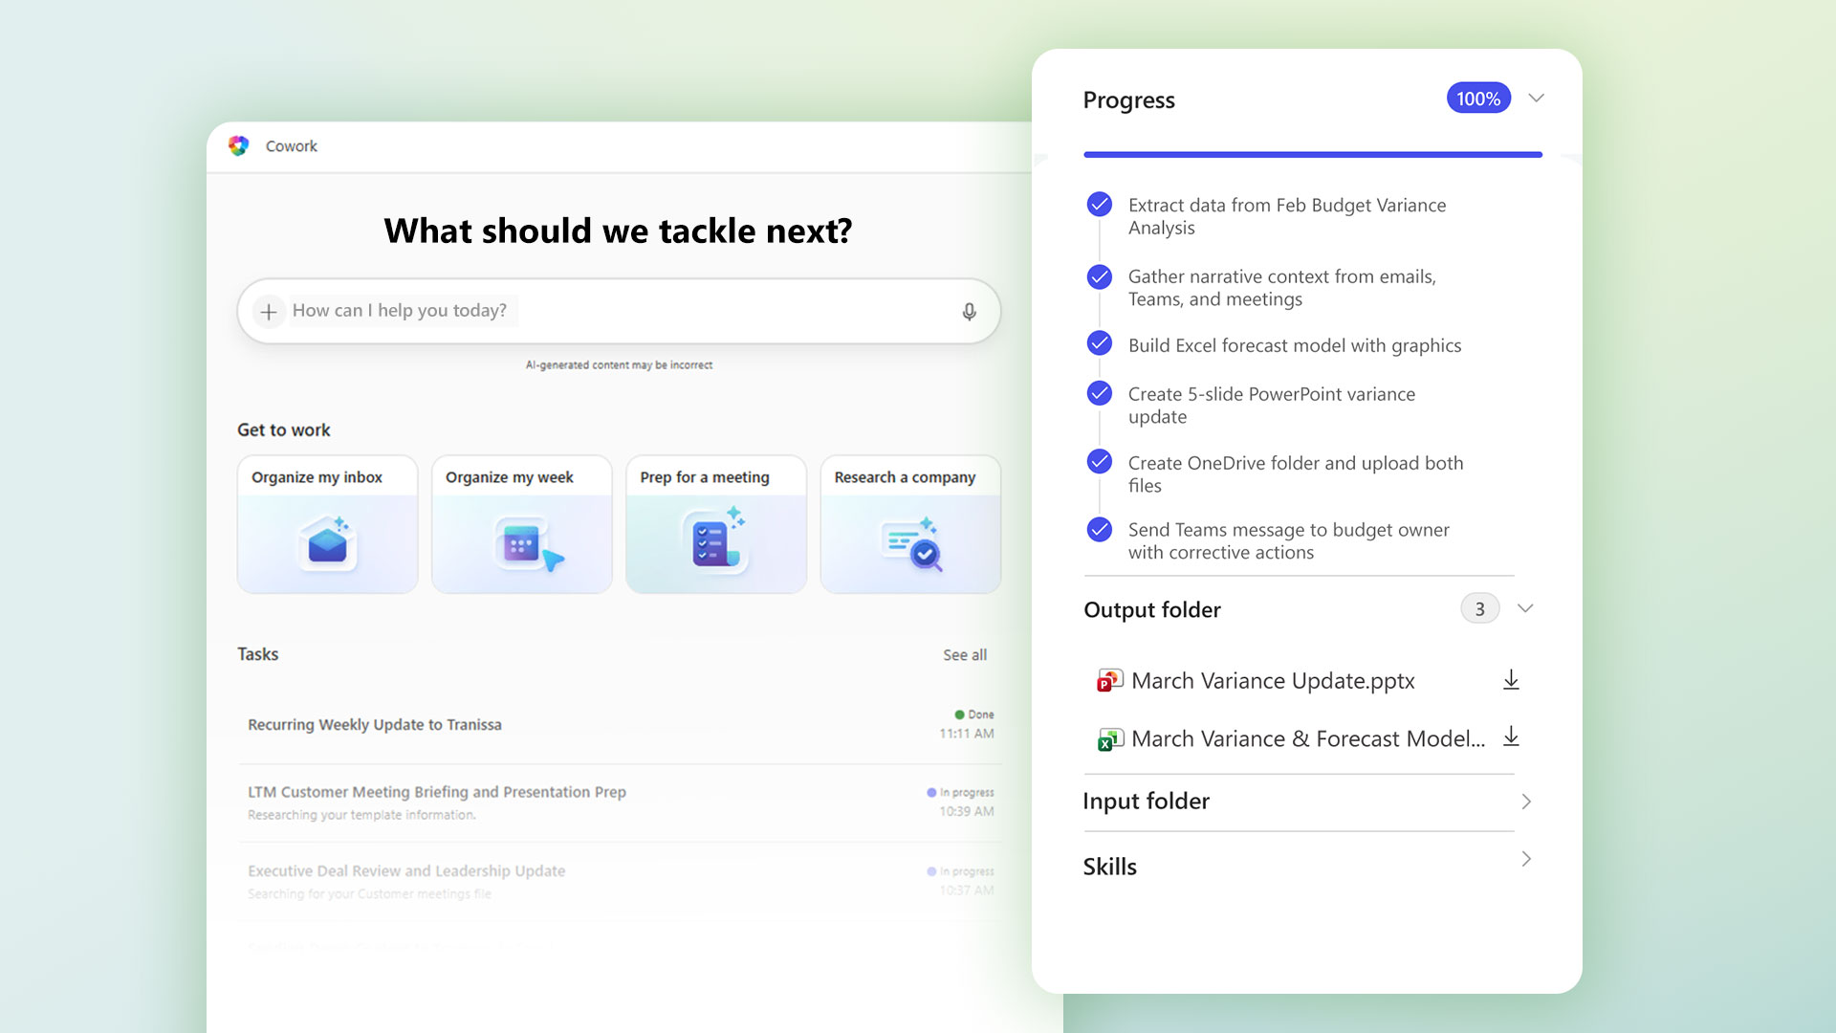
Top Microsoft 365 updates
Microsoft Copilot
Microsoft 365 Copilot Cowork is now generally available
Cowork coordinates long-running, multi-step workflows across your apps, files, and data and returns a completed result, not just a draft or a recommendation. Powered by Work IQ, it integrates signals from your work graph and applies task-appropriate models to produce context-aware results.
If you missed our "Understanding Copilot Cowork and managing Copilot Credits webinar and AMA", catch up on demand to learn more about who should be using Cowork, how to allocate and manage credits, best practices for adoption and governance, and strategies for scaling and managing Cowork. Watch on demand: https://aka.ms/CopilotCoworkAMA.

Slide 9
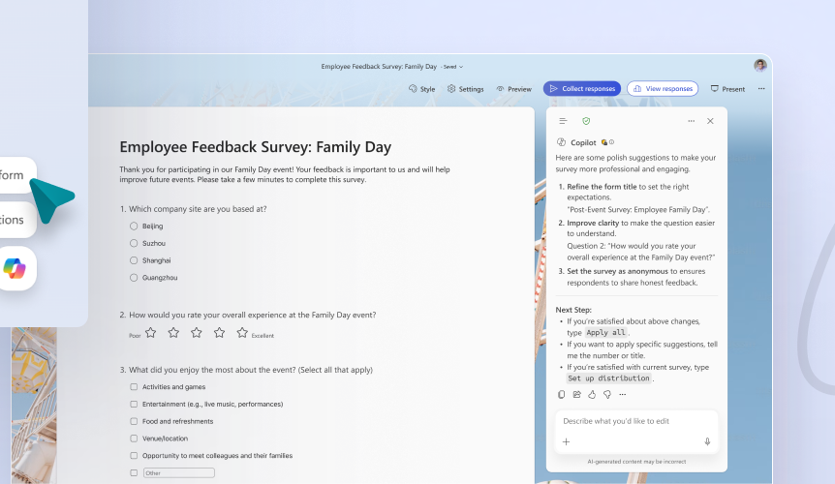
Top Microsoft 365 updates
Microsoft Forms
Evolving the Copilot experience in Microsoft Forms
We’re excited to introduce a major upgrade to Copilot in Microsoft Forms – now featuring seamless integration with the Copilot chat experience.
Smarter suggestions & refinements
Deeper analysis
More settings
Open-ended chat:
Basic branching
Availability: the new Copilot in Forms is rolling out to worldwide users now and will be available to users with Microsoft 365 commercial Copilot licenses. Consumer Copilot subscribers will continue to see the previous Copilot experience in Forms for now, which includes a Copilot refinement bar that supports AI-credit-based Copilot licenses.
Click here to learn more.
Notes:
Here are some examples of how chat can improve your workflow:
Review and suggest improvements to your form such as organizational layout, sectioning, missing questions, or settings that may conflict with your form’s purpose - such as enabling anonymous response or multiple responses per user.
Complete bulk edits like replacing a placeholder name with an updated one throughout the form, or changing multiple questions to required or not required.
Ask about specific drilldowns or summaries you’re seeking from your form results, to help you understand your data and unlock your next action.
Smarter suggestions & refinements: Get targeted recommendations to improve your form’s structure, clarity, and effectiveness. Copilot can also apply refinements directly to the form, so you can save time making edits – just describe what you want, and watch Copilot make it happen.
Deeper analysis: Copilot can now analyze your results in-depth to provide clear insights and actionable takeaways for you and your team. You can even ask follow-up questions to help parse and summarize your data and unlock your next step.
More settings: Review and update form settings with ease, such as applying custom thank-you messages and close dates, so your form is ready to send. You can also adjust question settings in bulk, such as making questions required.
Open-ended chat: Copilot chat gives you access to a broad world of capabilities, whether you’re seeking inspiration on survey topics or consulting on how to configure your form – the possibilities are broad with Copilot at your fingertips.
Basic branching: Apply basic branching logic directly through the agent. (Note that some complex scenarios are not yet supported, and you should continue to review your branching logic prior to sending your forms.)

Slide 10
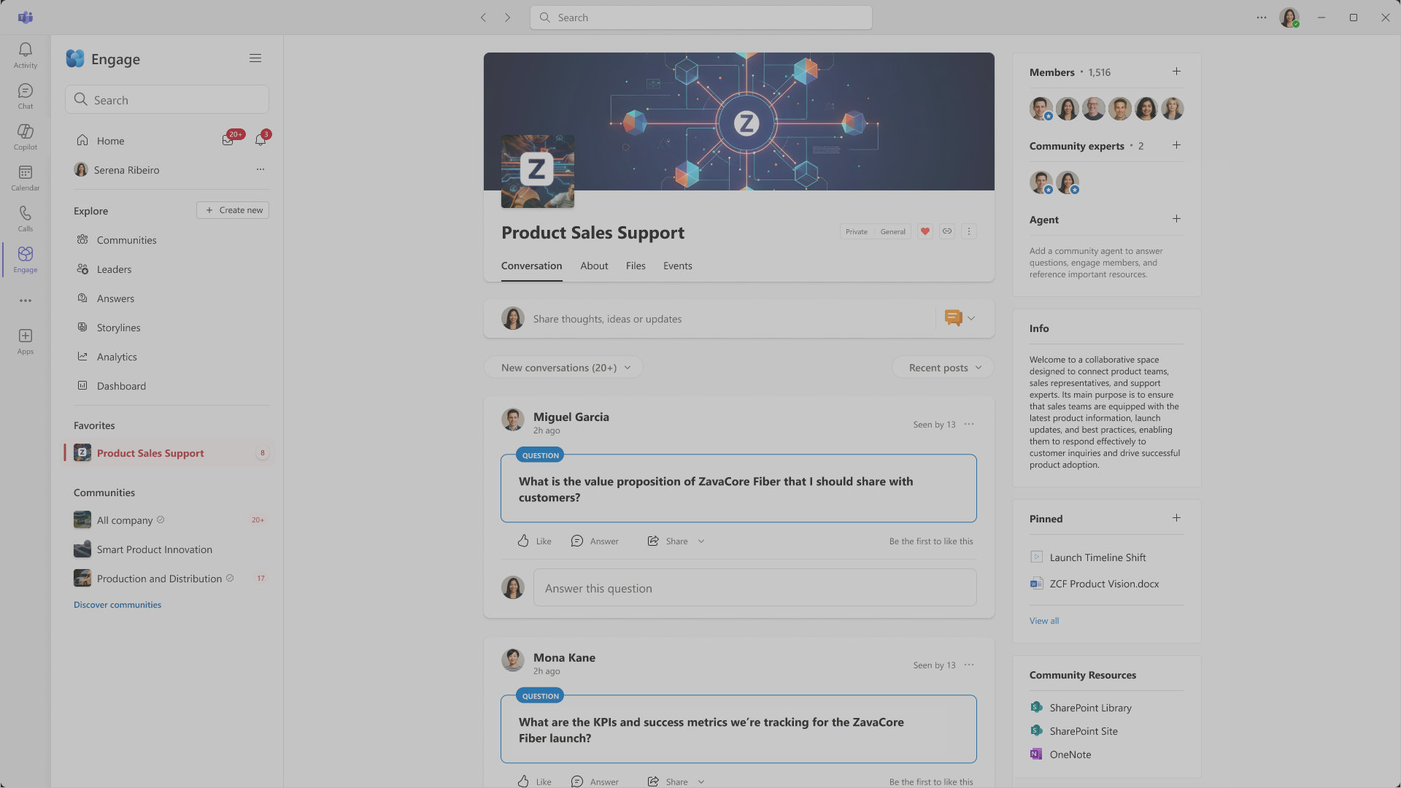
Top Microsoft 365 updates
Microsoft Engage
Agents in Viva Engage communities: Your AI-powered community expert
Microsoft 365 Copilot can give every Engage community its own agent, grounded in the conversations and content that matter most to your community. It’s designed to provide time-savings, facilitate trusted knowledge sharing, and make expertise readily available in organizations so that communities can thrive with less effort. Read on to discover how an AI-powered community expert can foster community engagement and growth.
Click here to learn more.
Notes:
Proactive answer generation
Agents in communities will proactively identify unanswered questions and use deep reasoning to draft responses, accelerating community connection and knowledge sharing. If the community admin chooses to require review before posting, agent suggestions will be ready in a queue so admins and experts can efficiently review, edit, and approve responses to meet the community's needs.
The agent monitors for open questions, helping communities stay responsive and get members the information they need. By proactively answering questions to support employee connection and knowledge, the agent helps overcome the challenge of starting on a blank page, so your community never stalls waiting for a response.
Grounded on community conversations and SharePoint*
By default, agents in communities are grounded in your community’s conversations and the associated SharePoint site. You can also specify additional SharePoint sites for even richer knowledge that the agent can source from
Expert verification and cited references in answers

Slide 11
Microsoft Teams Meeting controls
Michelle Maislen: Principal Product Manager
Ryan Miller: UX Researcher

Slide 12
Redesigned Meeting Controls overview

Slide 13
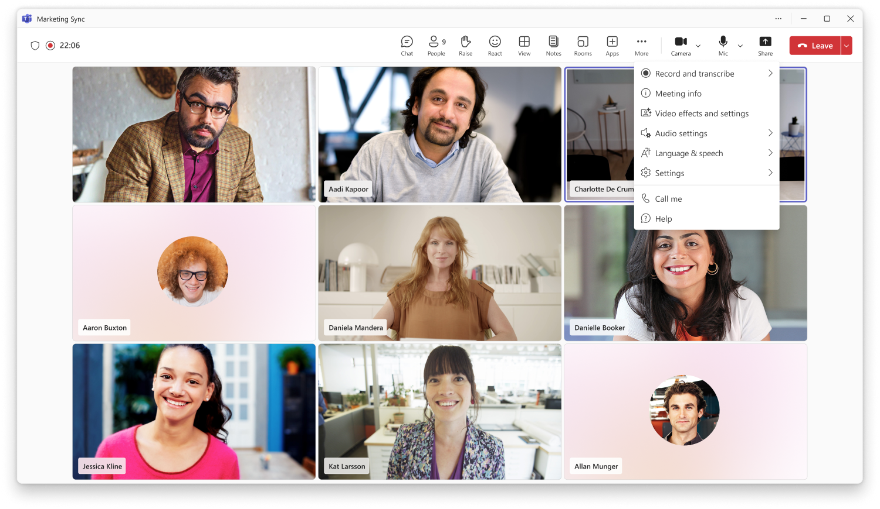
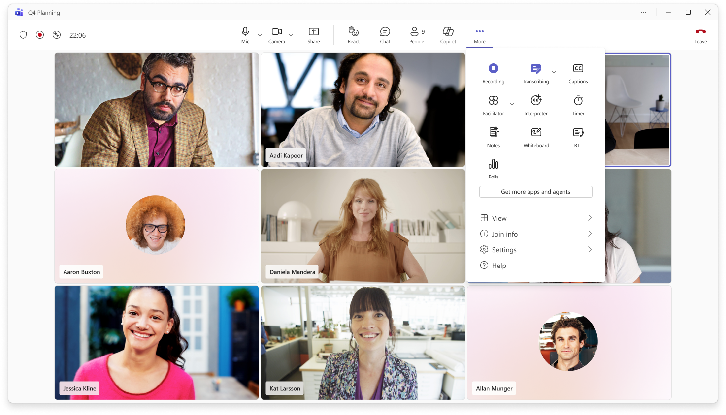
Overview: Cleaner layout for meeting controls
Current
Redesigned

Slide 14
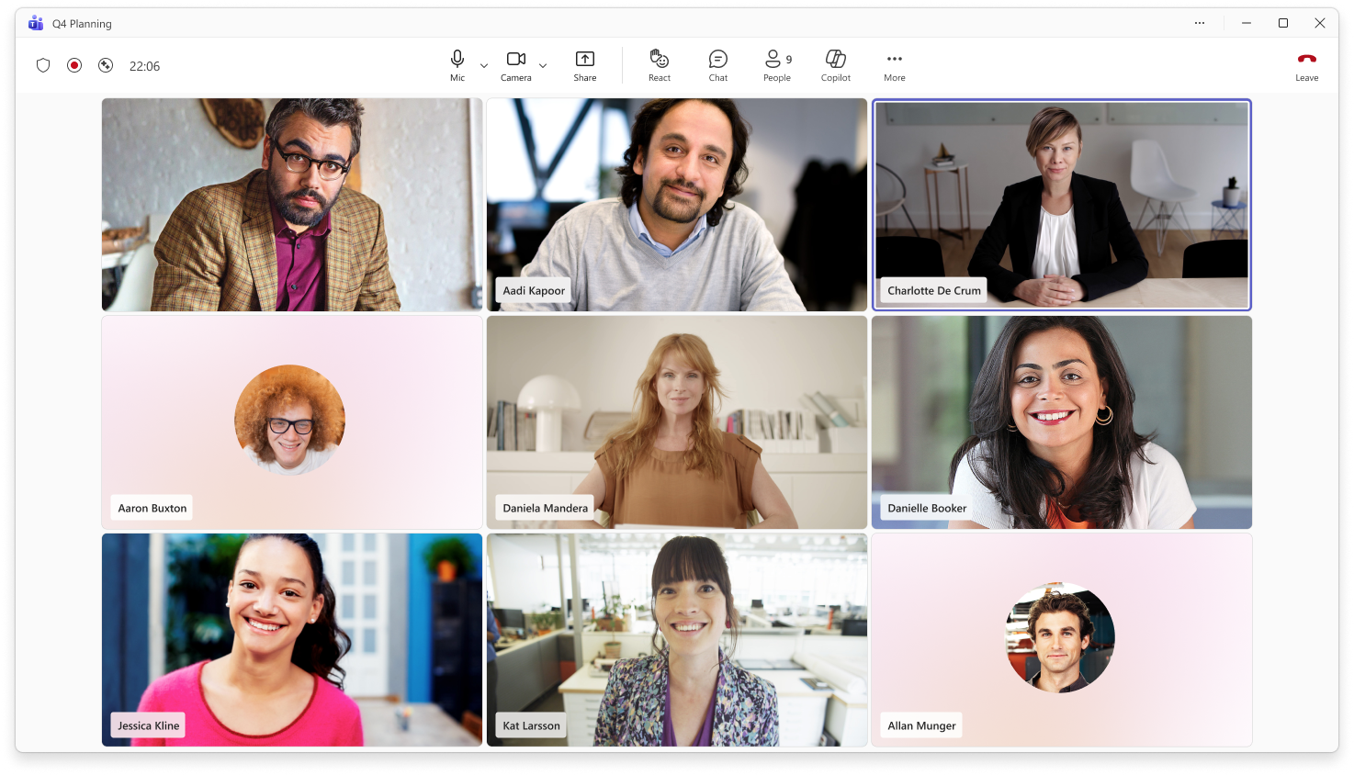
Overview: Cleaner layout for meeting controls
1
2
The redesigned meeting controls layout makes key actions easier to find and helps reduce accidental clicks.
1
Stay focused on the essentials
Mic, camera, and share are now centered, with mic placed before camera for a more predictable flow.
2
Find tools faster
Chat, reactions, apps, agents, and AI tools are grouped together for quick access during meetings.

Slide 15

Overview: Cleaner layout for meeting controls
3
3
Find tools faster
The More actions menu is now easier to scan, with related actions grouped into clear sections. Buttons turn purple when active, giving users a clear visual cue that a setting or action is currently on.
4
4
Access settings in one place
View, join, settings, and help options are grouped together at the bottom of the menu.

Slide 16
Overview: Cleaner layout for meeting controls
6
5
5
Avoid accidental exits
The Leave meeting control is separated on the far right to reduce the risk of leaving or ending a meeting unintentionally.
6
Keep meeting status visible
Meeting status indicators remain unchanged, including encryption, recording, transcription, AI status, and meeting timer.

Slide 17
What has moved?

Slide 18
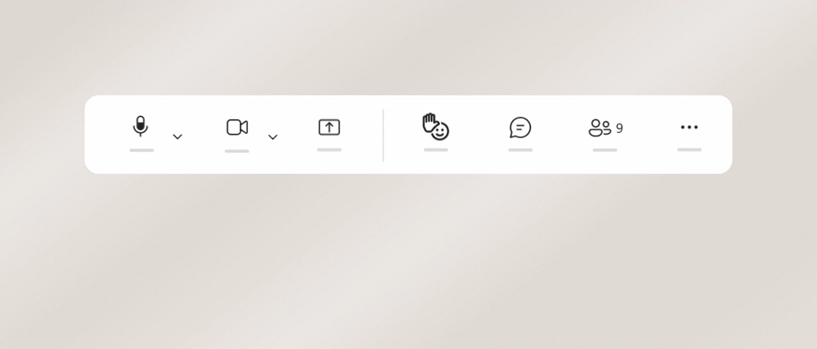
Raise hand is now in the React menu
Raise hand is now located in the React menu by default to help reduce accidental clicks.
Keep Raise hand within reach
If you use raise your hand often, drag it out of the React menu and pin it to the main meeting controls area.
Move it back anytime
To return Raise hand to the React menu, drag it back over More actions.

Slide 19
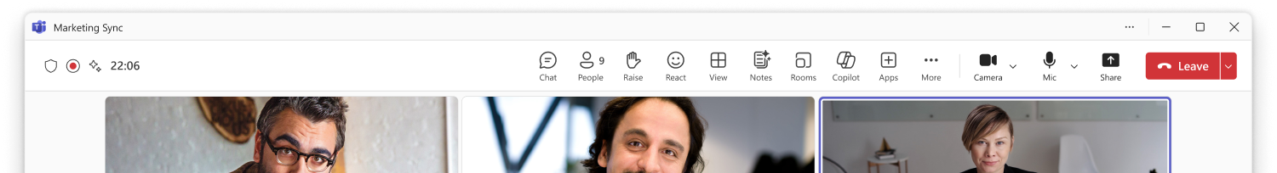
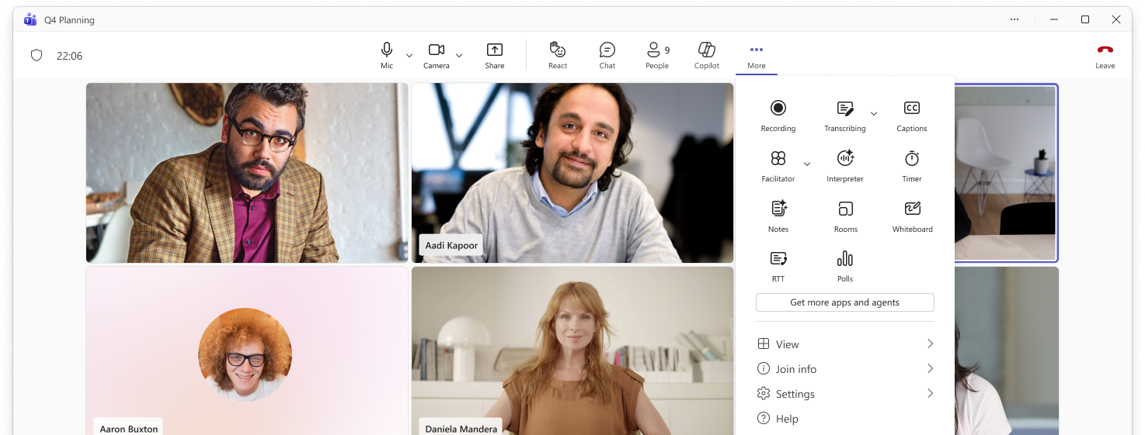
Meeting tools are now in More actions
1
1
Some controls have moved
Meeting tools such as View, Notes, Rooms, and Apps have moved into the More actions menu to keep the main meeting controls area cleaner and easier to scan.
2
2
Find tools in one place
Open More actions to find these meeting tools alongside apps, agents, and other meeting capabilities.

Slide 20
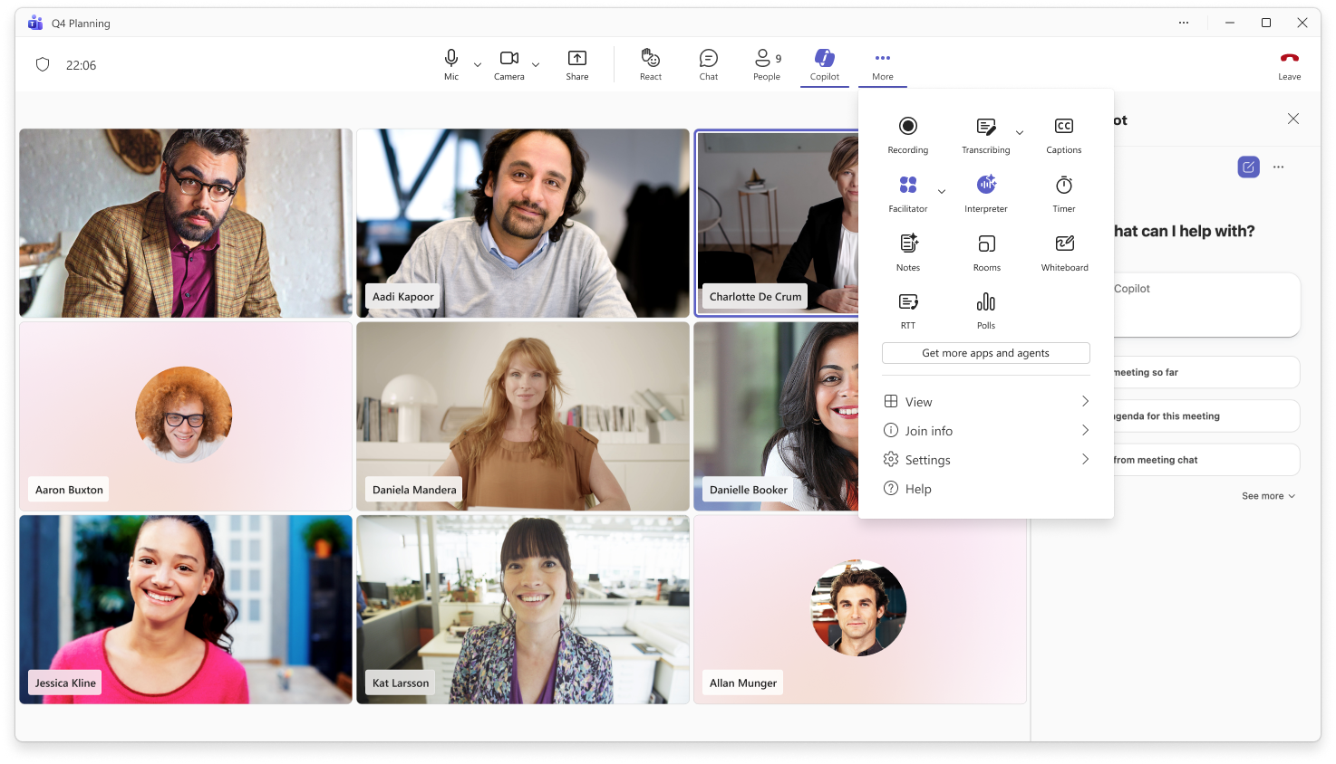
AI Tools are still easy to find
1
1
Access Copilot from the main controls
Copilot is available directly from the main meeting controls area.
2
2
Find more AI tools in More actions
Facilitator and Interpreter are available in the More actions menu alongside other meeting capabilities.

Slide 21
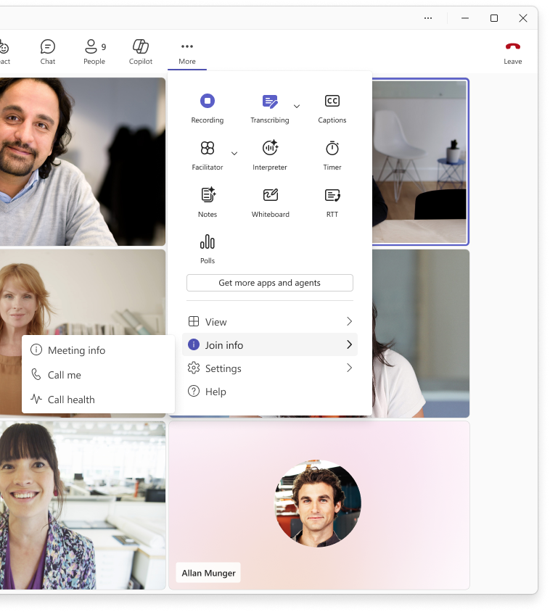
Meeting info is now in Join Info
1
Find join details in one place
Meeting info, Call me, and Call health are now grouped under Join info in the More actions menu.
1

Slide 22
What are the new features?

Slide 23
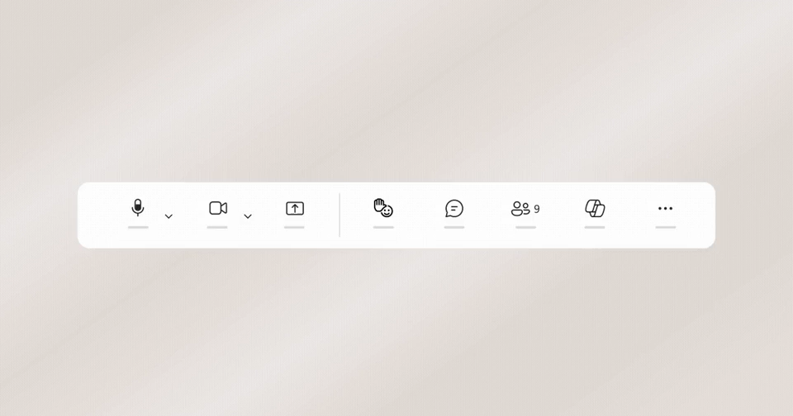
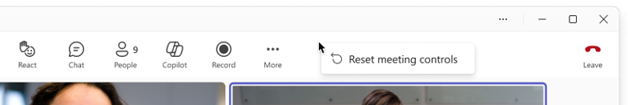
Customize your meeting controls with drag & drop
1
2
1
Pin tools for quick access
Drag controls from More actions to the main meeting controls area to access them quickly.
2
Rearrange your tools
Drag controls into the order that works best for you. Core meeting controls, like mic, camera, and share, stay fixed.
3
Reset anytime
To remove a pinned control, drag it back to More actions. You can also right-click to reset meeting controls to the default layout.
3

Slide 24
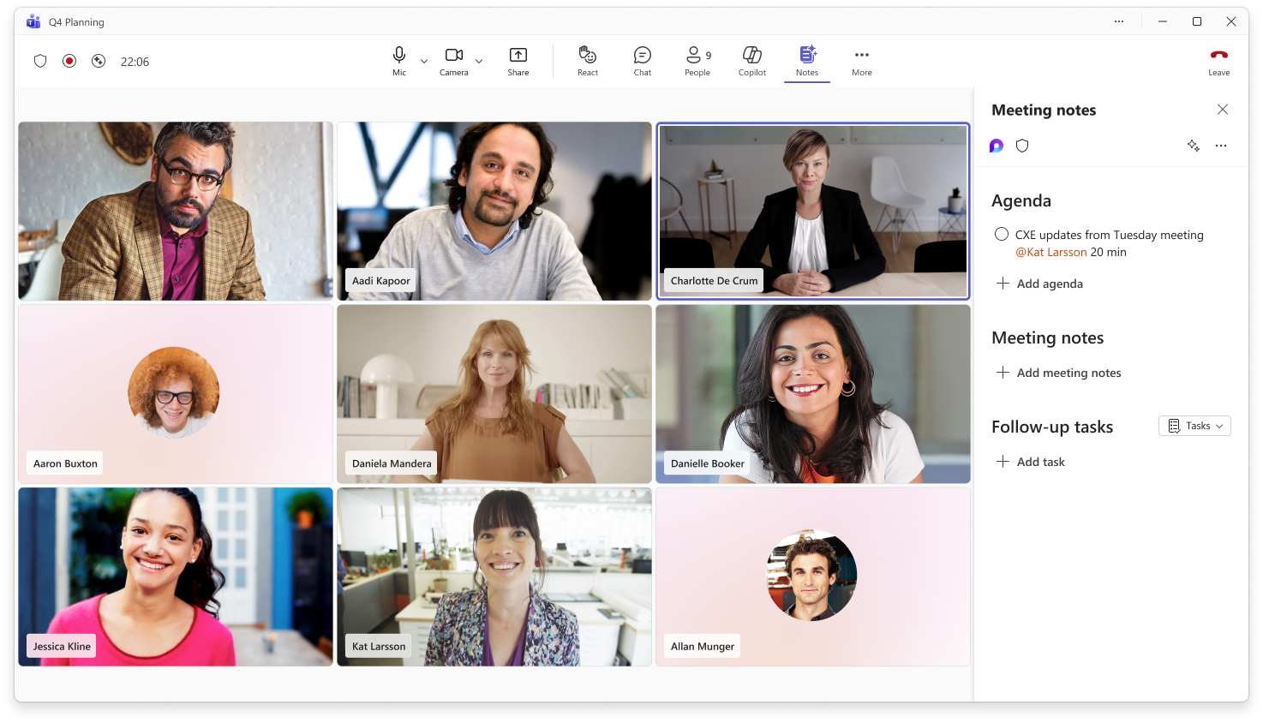
Get back to open panels faster
1
1
When you open certain meeting tools, like Notes, captions, timer, RTT, Whiteboard, or rooms, they appear in the main controls for that meeting so you can quickly return to their open panels without searching through More actions. They’re temporary and only show while open, keeping controls focused on what you’re using now.

Slide 25
Frequently asked questions: Meeting controls
Is there an admin policy to enable or disable the redesigned meeting controls, or to set the default layout?
There are no new admin policies for the redesigned meeting and sharing experience. Each user can make choices to optimize for how they work best, guided by the in-product onboarding.
Is there an admin policy to pin highly used apps to the main meeting controls area?
You can manage apps setup policies in the Microsoft Teams admin center. Any existing policies you have in place will be honored. Apps pinned in a meeting show at the top of the meeting window. If there are more than two apps, the other apps display under the More option
Do configuration changes persist between meetings?
Any changes a user makes to their meeting controls through drag and drop or pinning will be persist between meetings. The configuration settings will not roam across devices.
Do configuration changes persist between desktop and web?
Any changes a user makes to their meeting controls through the desktop will appear on the web and visa versa on the same device. The redesigned meeting controls are not supported on Mobile at this time.
Is the new experience supported in government clouds?
The Message Center and Roadmap will have details on timing for government clouds GCC, GCC High, DoD.

Slide 26
User onboarding & guidance

Slide 27
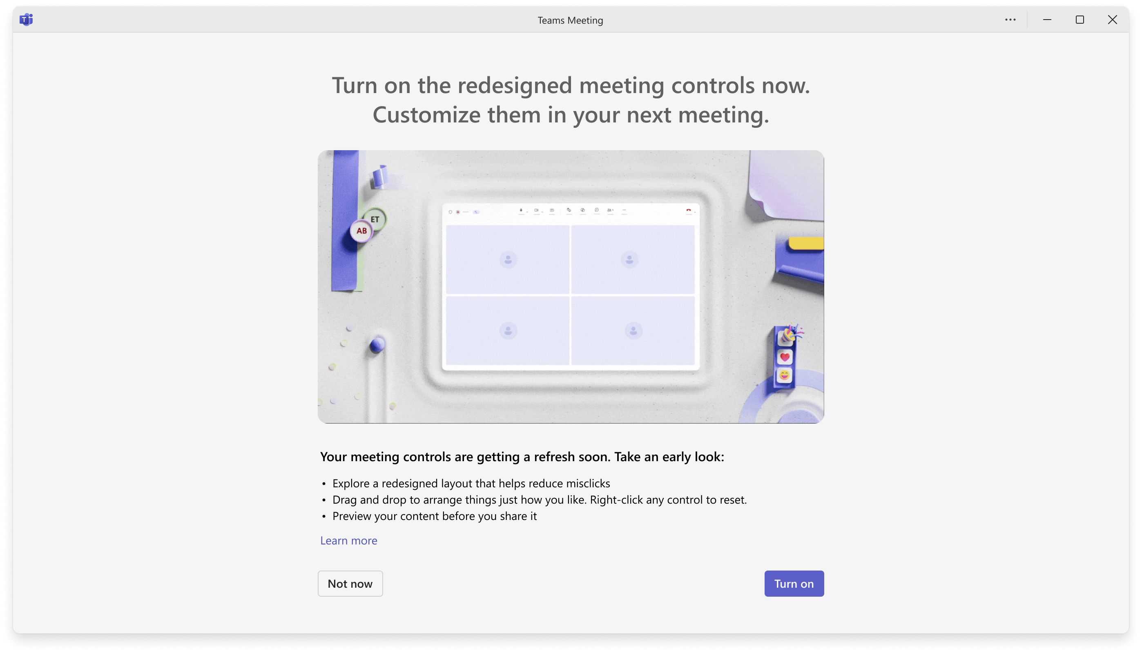
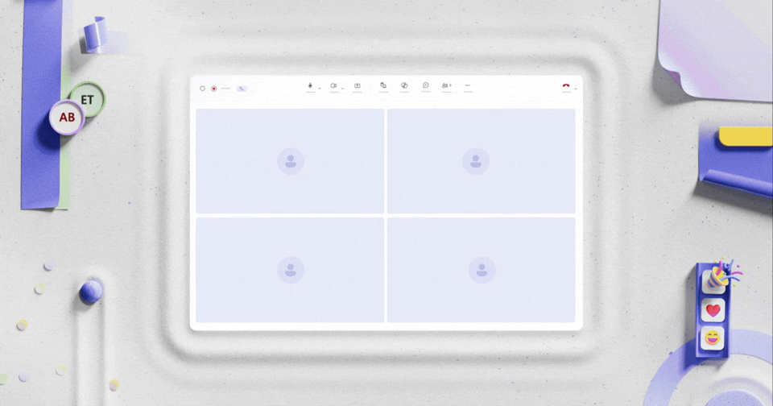
Opt into the redesigned meeting and sharing experience
Users may see an end-of-meeting prompt twice over a 10-day period, giving them the option to try the redesigned meeting controls.
If they choose Turn on, they’ll see the redesigned meeting controls the next time they join a meeting.
If they choose Not now, they’ll continue using the current meeting controls with no changes.

Slide 28
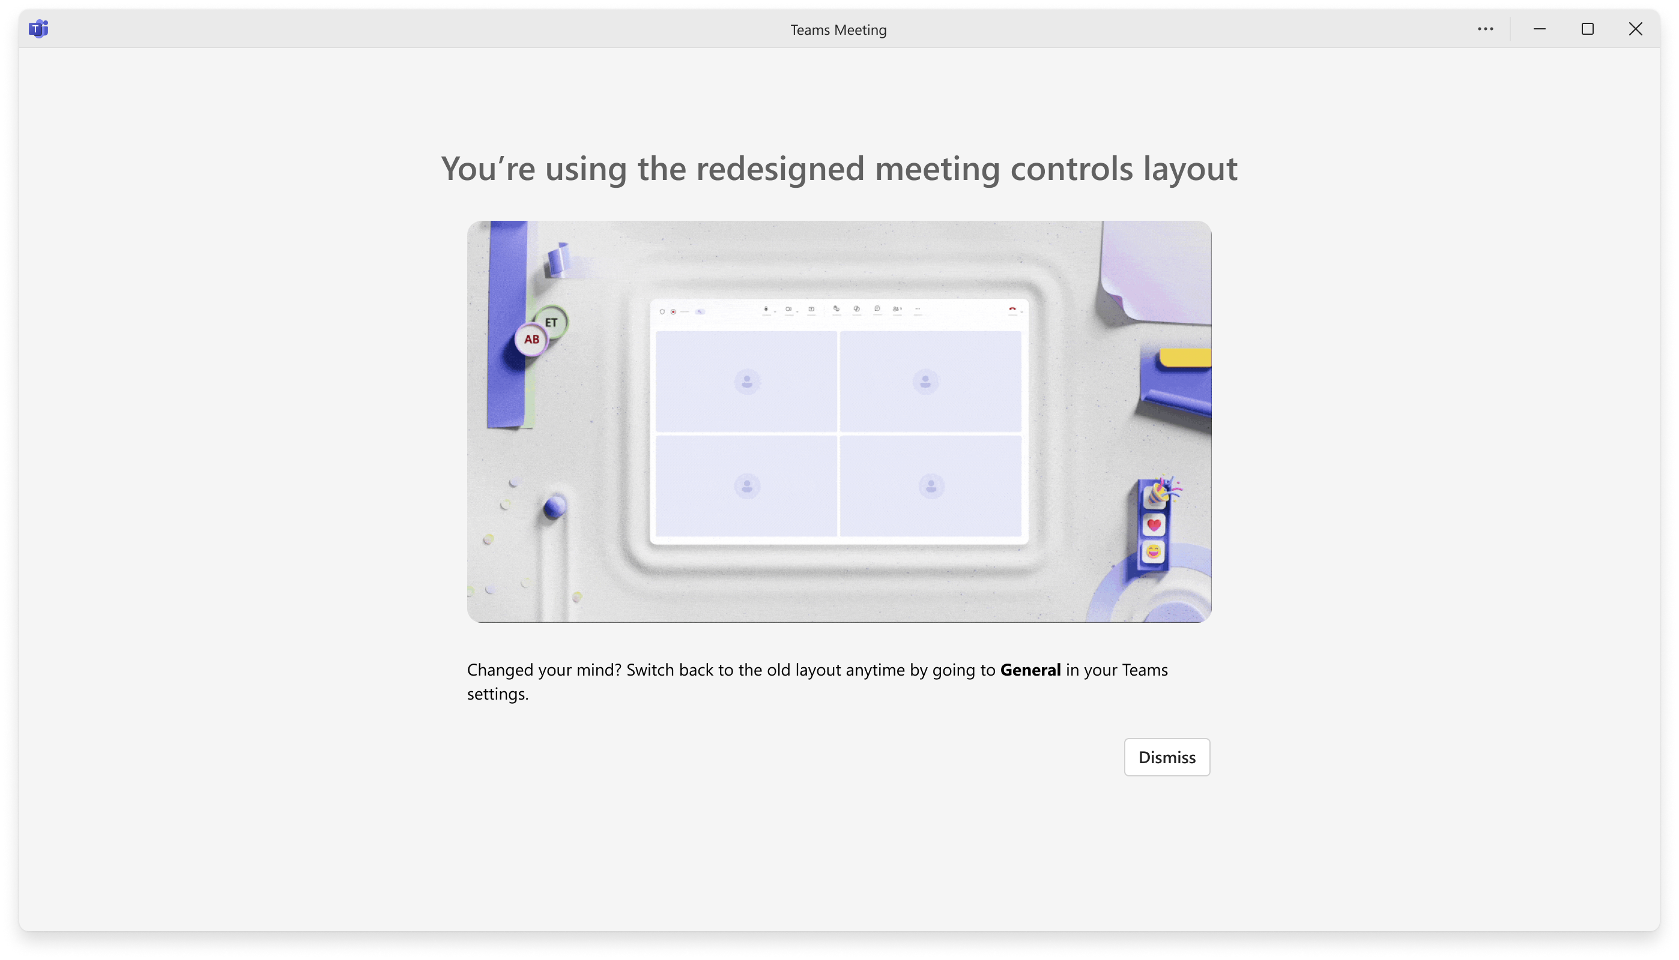
Automatic migration after 20 days
On day 20, users who haven’t already turned on the redesigned meeting controls will be automatically moved to the new experience.

Slide 29
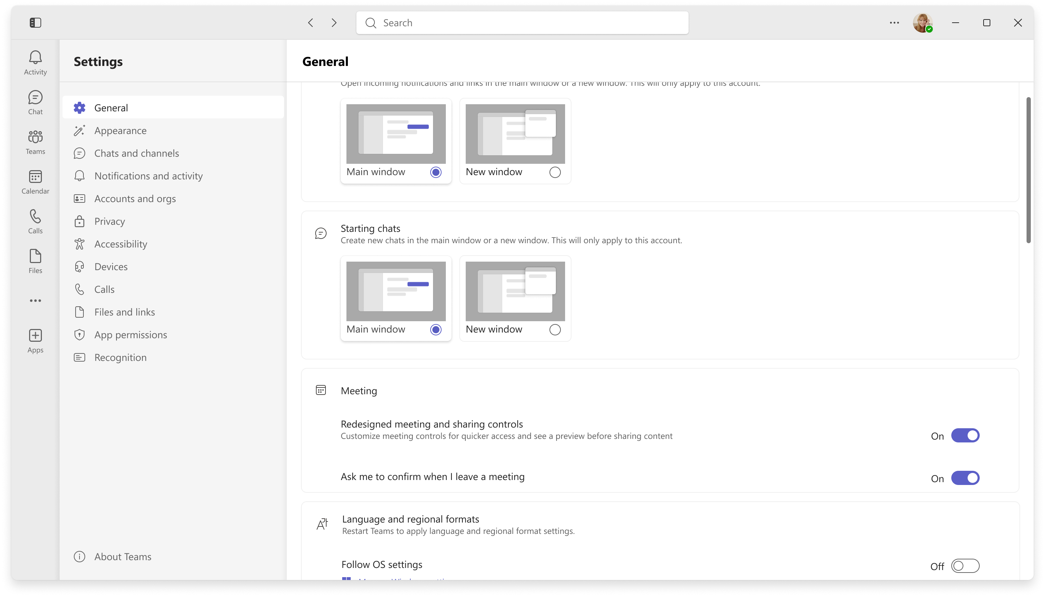
Users can temporarily switch back to the previous experience
After migration, users can temporarily switch back by going to Teams settings > General and turning off Redesigned meeting controls.
This option is available for a limited time. All users will eventually move to the new meeting controls experience.

Slide 30
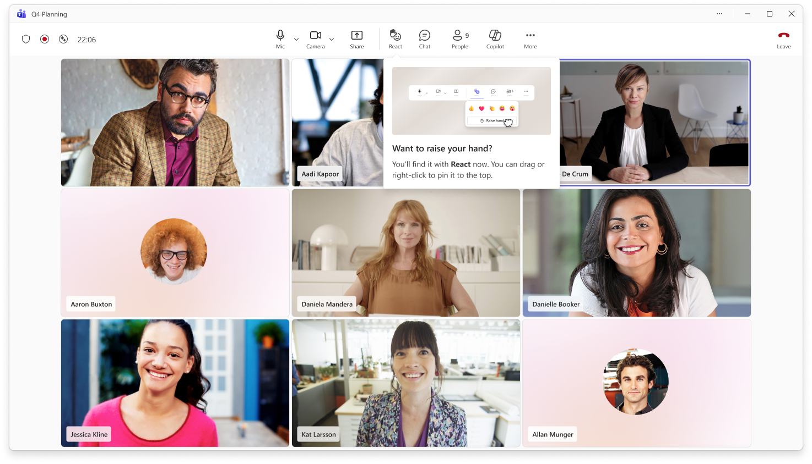
In-meeting Raise hand guidance
After users move to the new meeting controls, in-meeting guidance will help them find Raise hand in the React menu.
The guidance also shows users how to pin Raise hand to the main meeting controls area if they use it often.

Slide 31
Upcoming community events
M365 Community Days NYC | July 31 | New York, NY
TechCon 365 Seattle | August 24-28 | Seattle, WA
Vancouver Microsoft 365 Summit | September 3 | Vancouver, Canada
Community Day Nashville | September 11 | Nashville, TN
The AI-Native Workplace Summit | September 16 | Virtual
European Fabric + SQL Community Conference | September 28-October 1 | Barcelona, Spain
TechCon 360 Dallas | November 2-6 | Dallas, TX
Microsoft Ignite 2026 | November 17-20 | San Francisco, CA
ESPC 26 | November 30-December 3 | Amsterdam, Netherlands
Explore other Microsoft events here and a full list of community-led events can be found at CommunityDays.org

Slide 32
Open discussion
If viewing on-demand, drop your questions in the Microsoft Tech Community – Driving Adoption event page to engage with us!
Share your feedback for this call by visiting https://aka.ms/Microsoft365ChampionCallFeedback

Slide 33



What’s next
Share your feedback
https://aka.ms/Microsoft365ChampionCallFeedback
Next call:
We take a community break in August so no call next month. See you in September! ☺
Join the Driving Adoption community
https://aka.ms/DrivingAdoption
Invite colleagues to become a Champion
https://aka.ms/M365Champions

