Slide 1

We will begin the call at five minutes past the hour.
Microsoft 365 Champion Community Call
January 2026
Microsoft 365 Champion Community
Learn more. Do more. Achieve more, together.

Slide 2



Microsoft 365 Champion
community call
January 2026

Slide 3
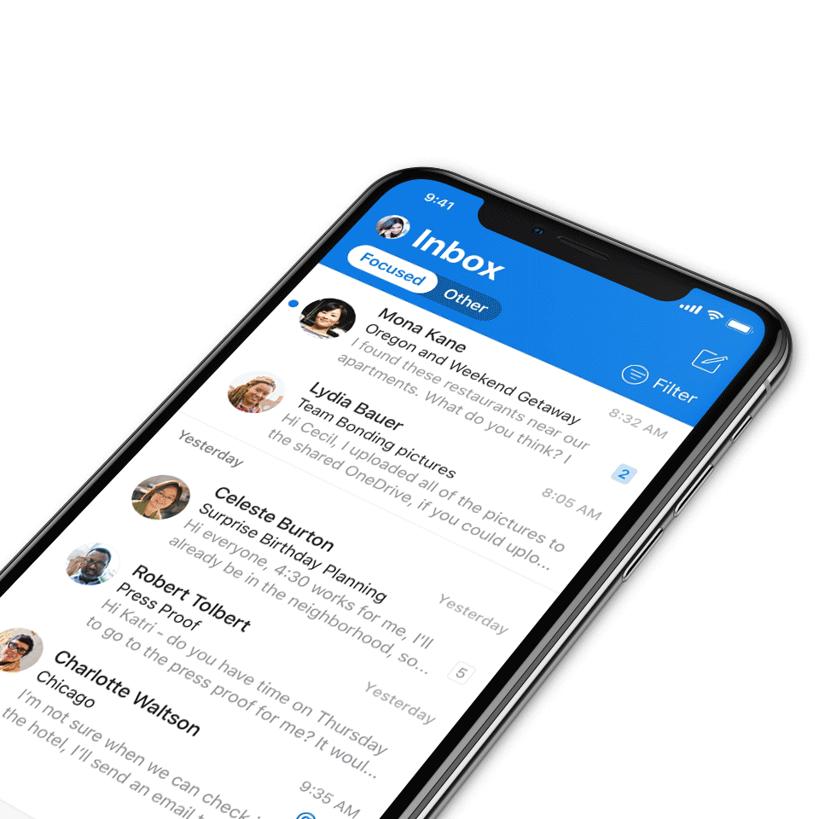
Digital Event Code of Conduct
Microsoft’s mission is to empower every person and every organization on the planet to achieve more. This includes all Microsoft events and gatherings, including on digital platforms, where we seek to create a respectful, friendly, fun and inclusive experience for all participants.​
We expect all digital event participants to uphold the principles of this Code of Conduct, which covers the main digital event and all related activities. We do not tolerate disruptive or disrespectful behavior, messages, images, or interactions by any party participant, in any form, at any aspect of the program including business and social activities, regardless of location.​
Microsoft will not tolerate harassment or discrimination based on age, ancestry, color, gender identity or expression, national origin, physical or mental disability, religion, sexual orientation, or any other characteristic protected by applicable local laws, regulations, and ordinances.​
We encourage everyone to assist in creating a welcoming and safe environment.
For more info, visit aka.ms/CodeofConduct.

Slide 4

Agenda
Announcements
Top Microsoft 365 updates
Topic: Copilot Pages
Open discussion forum
Become a Champion today!
https://aka.ms/BecomeaChampion

Slide 5
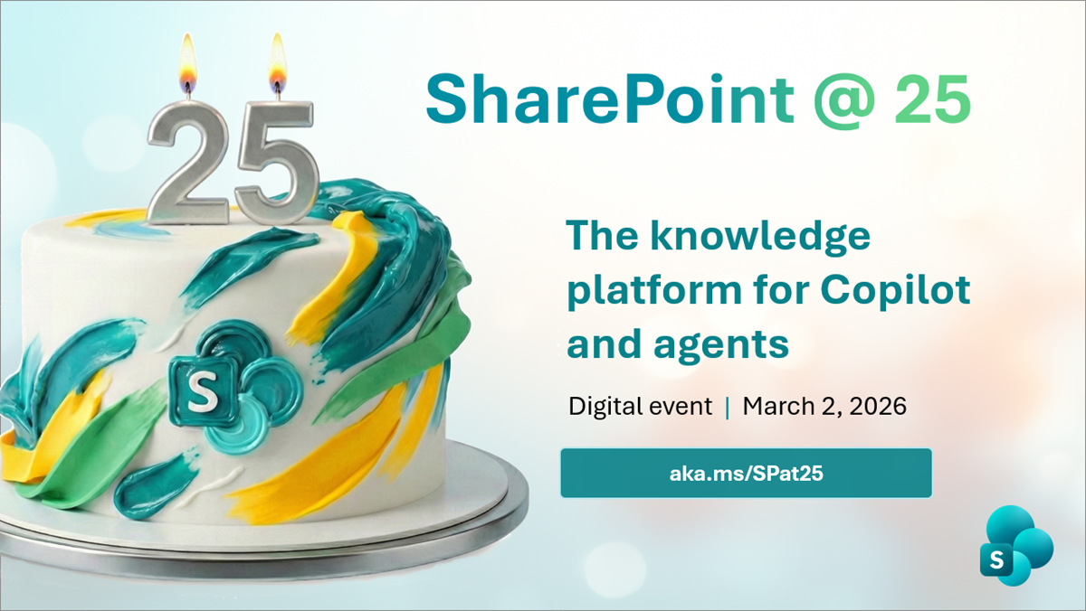
Announcements
Digital event
Join us for the SharePoint @ 25 birthday event
Join global leaders, innovators, and the SharePoint product team for a premier digital event that honors SharePoint’s evolution and its role as the knowledge platform for Copilot and agents, marking both a celebration and a look ahead at the future.
During the event, we’ll spotlight SharePoint’s most defining innovations while sharing a forward-looking view of the platform’s next chapter. One shaped by AI, Copilot, and agentic experiences designed for modern knowledge work.
Registration is open so claim your spot now!
Date: March 2, 2026
Time: 9:00 AM PT

Slide 6

Announcements
Community
The Microsoft 365 Community Conference: your front-row seat to the future of work
Join us in Orlando, Florida, on April 21-23, 2026, to discover how to harness the power of Microsoft technology to achieve more, together. From learning about the latest advancements in AI-driven tools and building skills you can use immediately, to connecting with Microsoft product-makers and executives, you’ll dive deep into big innovations and come home with actionable insights.
Click here to learn more and register today!

Slide 7
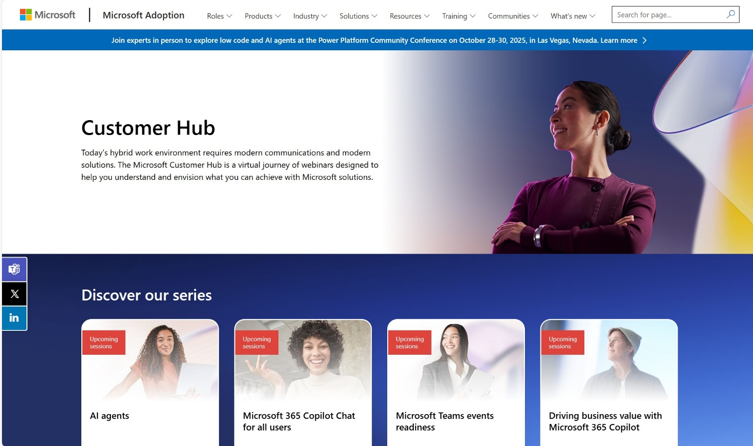
Announcements
Customer Hub
Upcoming Microsoft 365 Copilot webinars
Have you attended our Customer Hub webinar sessions? In today's hybrid work environment, modern communication and solutions are essential. Our goal is to help you explore what you can achieve with Microsoft solutions.
Join us for one or more of our upcoming sessions, including the launch of several new Copilot series. We also have all past session recordings so you can watch any that you missed and download the presentation materials.
Visit aka.ms/CustomerHubSessions to sign up today.

Slide 8
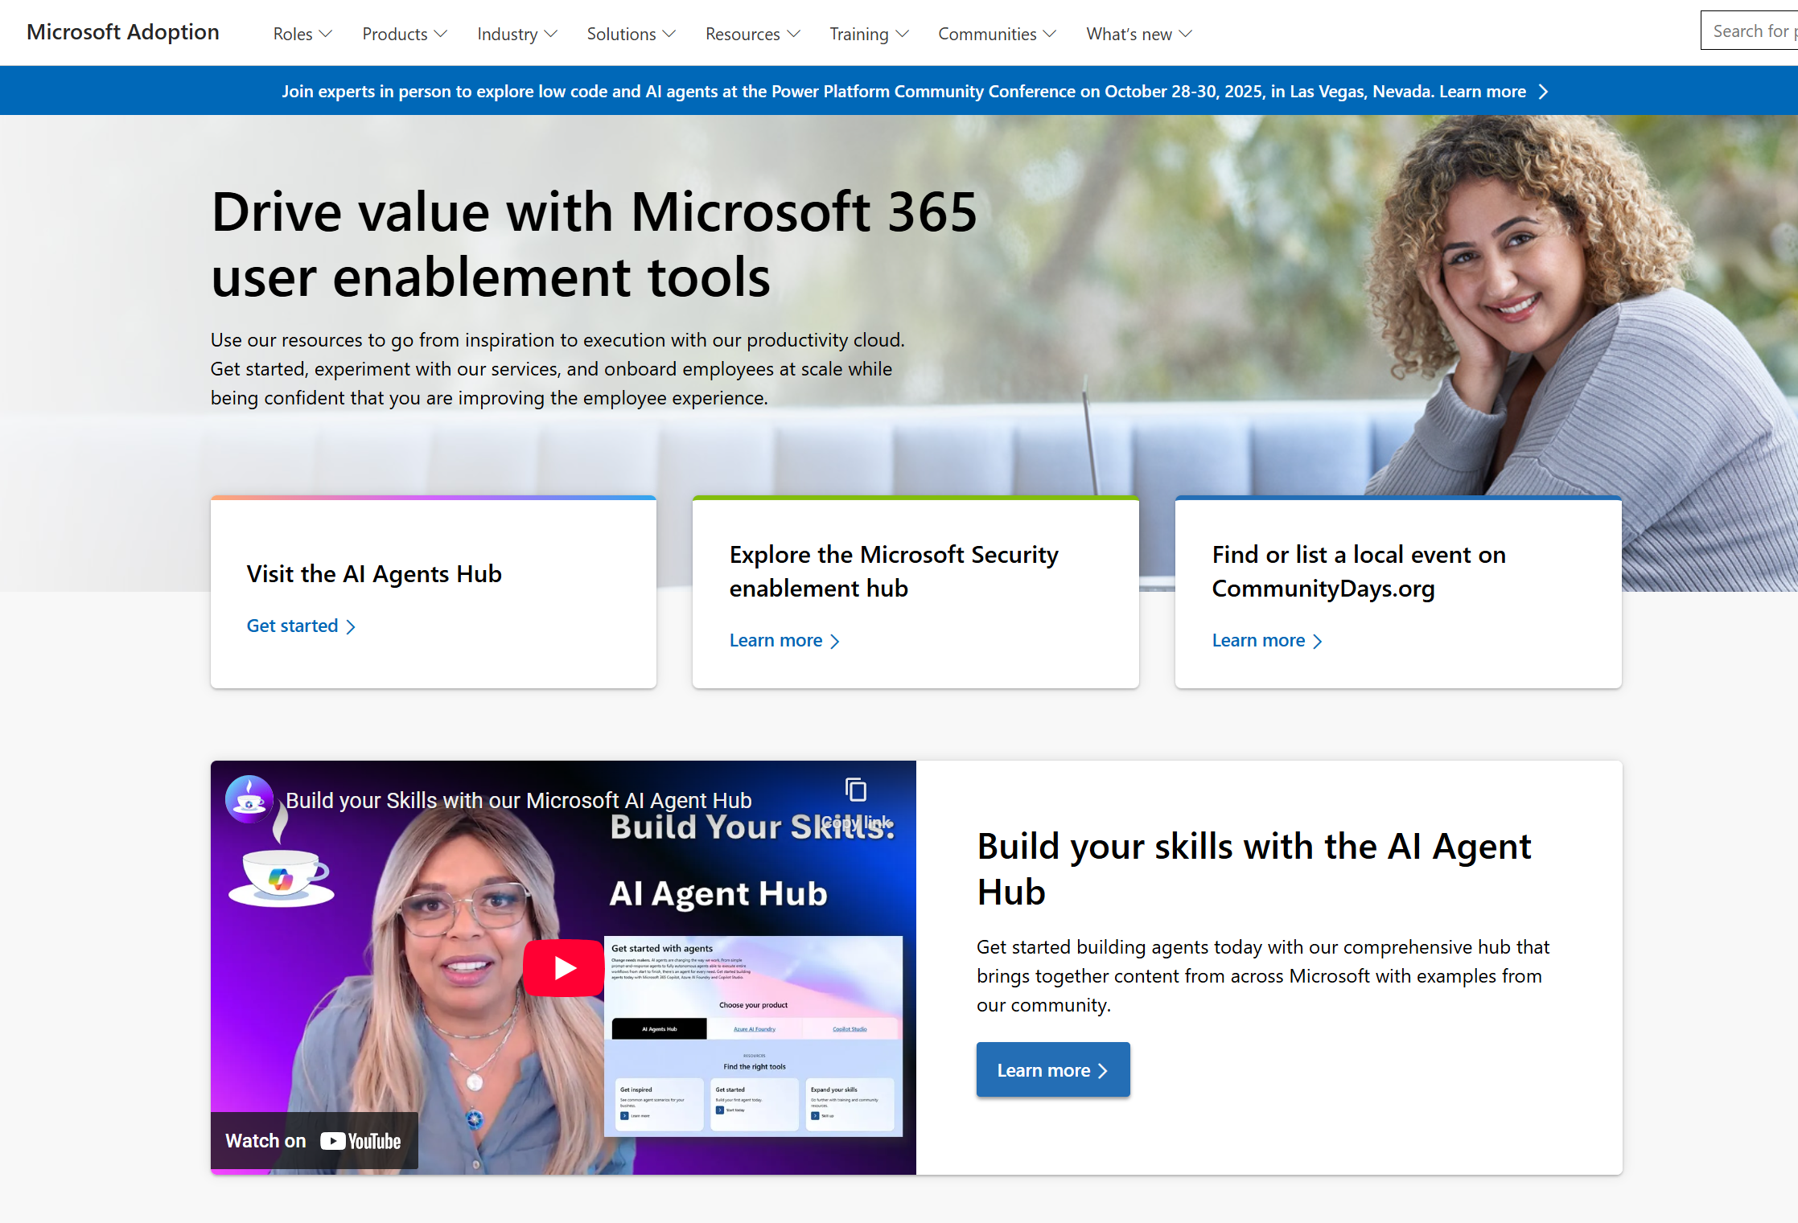
adoption.microsoft.com
Update highlights
New Copilot Scavenger Hunt activity to encourage hands-on engagement
Addition of Microsoft Management Customer Connection Program information to the Windows 365 page
Addition of new products to scenario pages and updated layouts in the Microsoft Scenario Library
Launch of the event page for SharePoint's 25th birthday event
Updated information on the Microsoft 365 Community Conference 2026 page
Addition of the Copilot Chat Administration guide to the Microsoft 365 Copilot Chat page
Read or subscribe to our release notes for more updates.

Slide 9
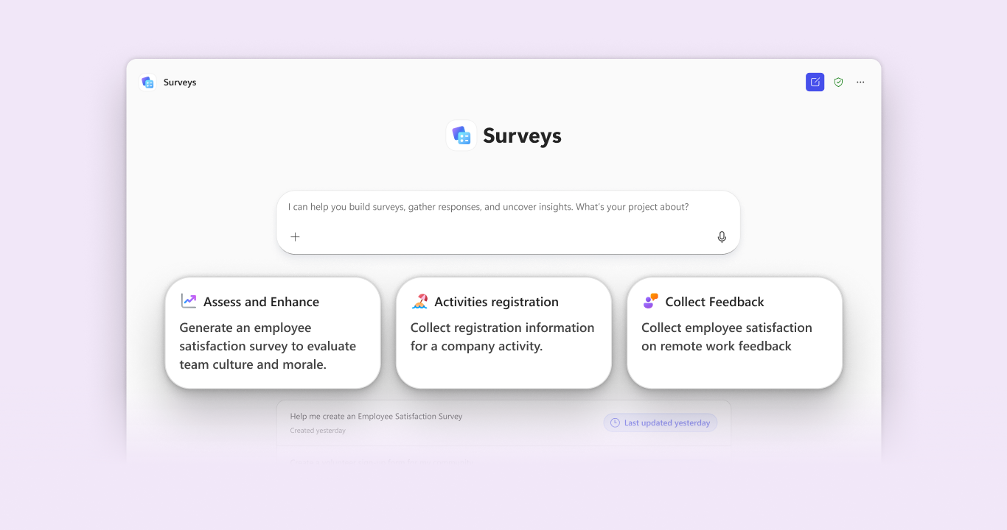
Top Microsoft 365 updates
Microsoft Forms
Now generally available: Surveys Agent in Microsoft 365 Copilot
We’re thrilled to announce that Surveys Agent – your intelligent assistant for managing surveys end-to-end – is now generally available to all commercial customers worldwide with a Microsoft 365 Copilot license.
Previously available through the Frontier preview program, Surveys Agent has helped early adopters streamline data collection and actionable insights for use cases like training sessions, employee engagement, and customer research.
Click here to learn more.
Notes:
Create surveys instantly in a shareable Microsoft Forms draft
Refine your survey to improve question clarity and structure
Plan launch timelines and distribution strategies
Send invitations and reminders to maximize responses
Monitor progress and keep you apprised via Outlook
Get status, summary of response and open in Excel for deep analysis

Slide 10
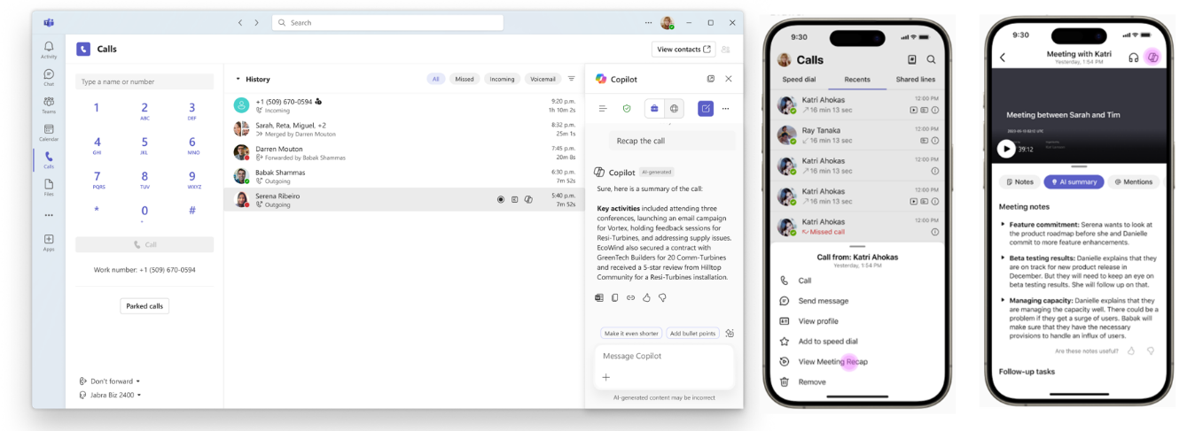
Top Microsoft 365 updates
Microsoft Teams
Copilot Chat in Teams calls app post-calling experience – Generally available
The post-call Copilot experience for Teams Phone on desktop and in mobile is now powered by Microsoft 365 Copilot Chat. After a call ends, users can open Microsoft 365 Copilot Chat as a side panel in the Teams ‘Calls’ app to generate summaries, surface key insights, and get suggested next steps. By using data from Microsoft Graph and the web—not just the call transcript—Microsoft 365 Copilot Chat delivers responses that are more personalized, relevant, and actionable, helping users quickly move from conversation to follow-up.
Click here to learn more.
Notes:
With this broader release, Surveys Agent is now accessible to all commercial Microsoft 365 Copilot users. You can find it in the Agent Store under Built by Microsoft, ready to help you build, run, and analyze surveys with less effort.
With general availability, we’ve also introduced several key enhancements to make Surveys Agent even more powerful and intuitive:
Grounding to your content: You can now connect Surveys Agent to Word, Excel, and PowerPoint files, as well as existing Microsoft Forms survey links, to help draft and refine surveys with richer context.

Slide 11
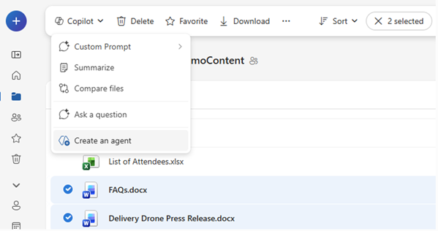
Top Microsoft 365 updates
Copilot in OneDrive
Agents in OneDrive
Agents in OneDrive are your personal AI project assistants, built directly from your own files and folders, allowing you to create an Agent that “knows” your content and delivers instant, tailored answers using different actions like:
Ask questions across those files
Get summaries and key decisions
Find deadlines, owners, and risks
Share the agent with your team so everyone can stay on the same page
Agents are saved as .agent files in OneDrive, just like any other document. Open one, and you’re in a full-screen Copilot experience tailored to that specific project or topic.
Click here to learn more.
Notes:
You’ll need a Microsoft 365 Copilot license and OneDrive on the web to get started. Create an agent by:
Using the “+ Create or upload” menu in OneDrive, then “Create an agent”
Or, selecting files and choosing “Create an agent” from the toolbar or right-click menu
Pick up to 20 files, name your agent, add instructions if you like, and save. Your agent appears as a .agent file in OneDrive.
You can use and share OneDrive agents much like any other file. To locate them, simply search in OneDrive and filter by the file type “Agent.” Once you open an agent, you can ask questions and receive answers instantly. You can also edit an agent at any time to add or remove files or update its instructions as your project evolves. If you need to collaborate, you can share an agent with your team just as you would share any other OneDrive file, ensuring that everyone has access to the source files so the agent can provide complete answers.

Slide 12
Getting more out of Copilot with Copilot Pages
Constance Gervais and Oby Omu

Slide 13
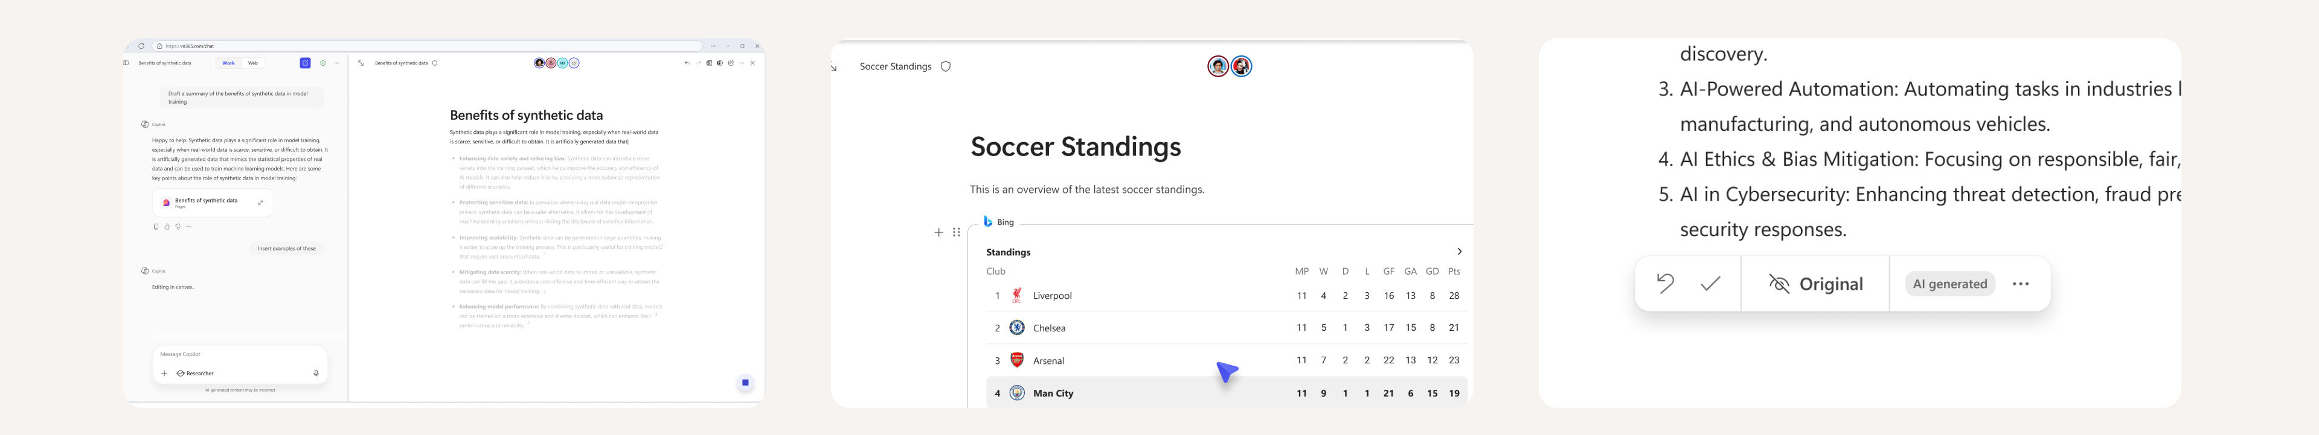
It starts with chat, continue iterating with Pages
Start in chat
Chat is the natural starting point for interacting with Copilot, but conversations alone don’t create deliverables
Pages seamlessly turn those conversations into tangible outputs
Dynamic canvas
Pages host diverse content types like dynamic stock tickers, code, and more
Copilot now can write code directly onto a Page, letting users create interactive reports, visualize concepts, and prototype new ideas
Collaborative by default
Pages are a space where human creativity and AI assistance coexist seamlessly
Whether it’s code or any other content, users can continue to iterate with Copilot using chat or directly on the page and share it with others

Slide 14
Prompt to try
Creating a page (“Create a page” )
Create a wiki for onboarding new team members that explains our team’s goals, key tools, workflows, and who to contact for help. Create this as a polished page with sections.
Based on our recent chat in the [Team/Project/Support] channel, create an FAQ page covering common questions and standard responses
Convert this message thread into a page with a table of decisions, rationale, and tasks. Flag unresolved questions. Post a 3‑bullet recap at the top for quick scan. Output directly on a Page.
Editing a page when page is open
Add an introduction section to the top of the Page, and a short table of contents based on the themes or headers
Update references from “2024” to “2025” and update headers to be collapsible
Turn the 3rd paragraph into a diagram with accessibility labels and a title
Generating visual content (“create an interactive UI”)
Make an interactive UI explaining Microsoft Environmental Strategy.
Create an interactive UI that helps me manage my weekly team scrum. It should randomize the order of participants, time everyone with 3 minutes to speak and remind them to mention achievements, help needed, and fun plans for the weekend.
Build an interactive UI seating chart that lets me explore different seating layouts based on the dimensions of the room and the number of people registered for my conference
Microsoft 365 Copilot
M365.cloud.Microsoft
Download Window app in App Store
Download Mac App in App Store
Rolling out &
Web only

Slide 15
Upcoming community events
Cloud Tech Tallinn 2026 | Jan 29-30 | Tallinn, Estonia
AI Community Days (AICD) Dubai 2026 | Feb 7 | Dubai, UAE
AI Community Days (AICD) Mahdia | Feb 14 | Rejiche, Tunisia
M365 Miami | Feb 6 | Miami, FL
Exchange Summit 2026 | Feb 24-25 | Wurzburg, Germany
Community Days Knoxville 2026 | Feb 26-27 | Maryville, TN
Experts Live Germany 2026 | Mar 3-4 | Leipzig, Germany
WIT Network Igniting Excellence Leadership Conference | Mar 10-12 | San Diego, CA
Microsoft Fabric Community Conference | Mar 16-20 | Atlanta, GA
Microsoft 365 Community Conference | Apr 21-23 | Orlando, FL
Explore other Microsoft events here and a full list of community-led events can be found at CommunityDays.org

Slide 16

Open discussion
If viewing on-demand, drop your questions in the Microsoft Tech Community – Driving Adoption event page to engage with us!
Share your feedback for this call by visiting https://aka.ms/Microsoft365ChampionCallFeedback

Slide 17



What’s next
Share your feedback
https://aka.ms/Microsoft365ChampionCallFeedback
Next call:
Windows 365 and the Cloud for Agents
Join the Driving Adoption community
https://aka.ms/DrivingAdoption
Invite colleagues to become a Champion
https://aka.ms/M365Champions

