Slide 1

We will begin the call at five minutes past the hour.
Microsoft 365 Champion Community Call
February 2026
Microsoft 365 Champion Community
Learn more. Do more. Achieve more, together.

Slide 2



Microsoft 365 Champion
community call
February 2026

Slide 3
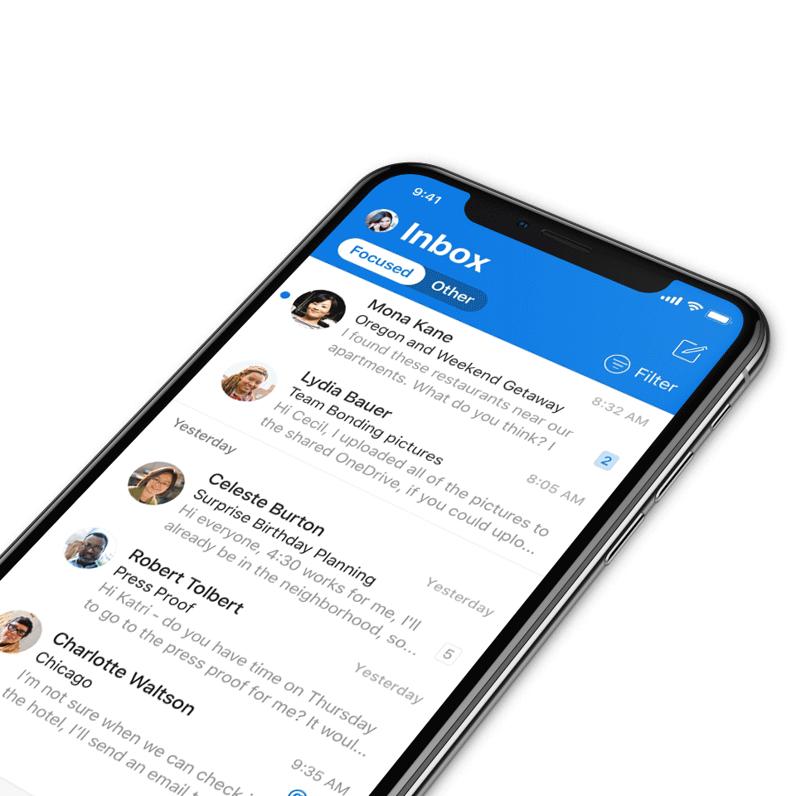
Digital Event Code of Conduct
Microsoft’s mission is to empower every person and every organization on the planet to achieve more. This includes all Microsoft events and gatherings, including on digital platforms, where we seek to create a respectful, friendly, fun and inclusive experience for all participants.​
We expect all digital event participants to uphold the principles of this Code of Conduct, which covers the main digital event and all related activities. We do not tolerate disruptive or disrespectful behavior, messages, images, or interactions by any party participant, in any form, at any aspect of the program including business and social activities, regardless of location.​
Microsoft will not tolerate harassment or discrimination based on age, ancestry, color, gender identity or expression, national origin, physical or mental disability, religion, sexual orientation, or any other characteristic protected by applicable local laws, regulations, and ordinances.​
We encourage everyone to assist in creating a welcoming and safe environment.
For more info, visit aka.ms/CodeofConduct.

Slide 4

Agenda
Announcements
Top Microsoft 365 updates
Topic: Word, Excel and PowerPoint Agents in Microsoft 365 Copilot
Open discussion forum
Become a Champion today!
https://aka.ms/BecomeaChampion

Slide 5

Event Announcements
Digital event
Join us for the SharePoint @ 25 birthday event
Join global leaders, innovators, and the SharePoint product team for a premier digital event that honors SharePoint’s evolution and its role as the knowledge platform for Copilot and agents, marking both a celebration and a look ahead at the future.
During the event, we’ll spotlight SharePoint’s most defining innovations while sharing a forward-looking view of the platform’s next chapter. One shaped by AI, Copilot, and agentic experiences designed for modern knowledge work.
Registration is open so claim your spot now!
Date: March 2, 2026 Time: 9:00 AM PT

Slide 6

Community Announcements
Community
The Microsoft 365 Community Conference: your front-row seat to the future of work
Join us in Orlando, Florida, on April 21-23, 2026, to discover how to harness the power of Microsoft technology to achieve more, together. From learning about the latest advancements in AI-driven tools and building skills you can use immediately, to connecting with Microsoft product-makers and executives, you’ll dive deep into big innovations and come home with actionable insights.
Click here to learn more and register today!

Slide 7
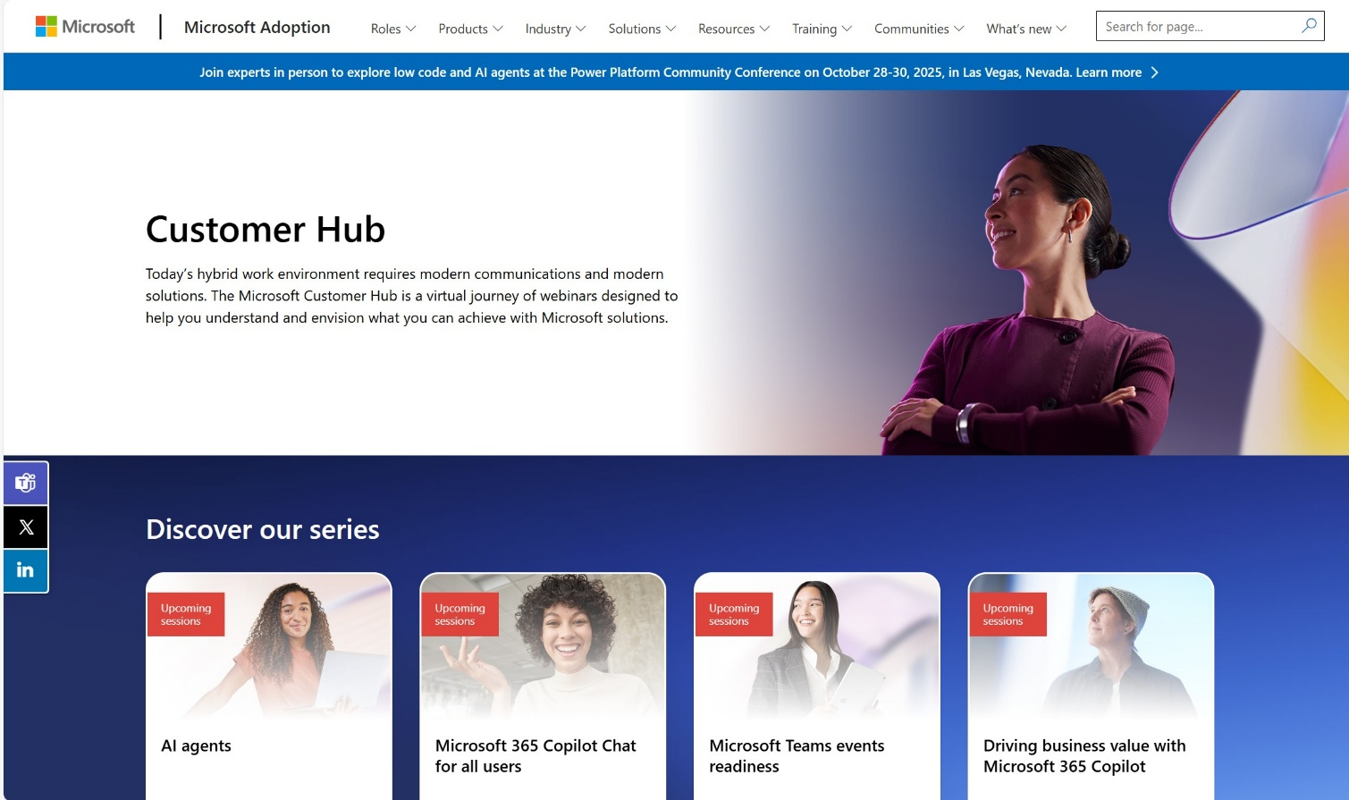
Customer Hub Announcements
Customer Hub
Upcoming Microsoft 365 Copilot webinars
Have you attended our Customer Hub webinar sessions? In today's hybrid work environment, modern communication and solutions are essential. Our goal is to help you explore what you can achieve with Microsoft solutions.
Join us for one or more of our upcoming sessions, including the launch of several new Copilot series. We also have all past session recordings so you can watch any that you missed and download the presentation materials.
Visit aka.ms/CustomerHubSessions to sign up today.

Slide 8
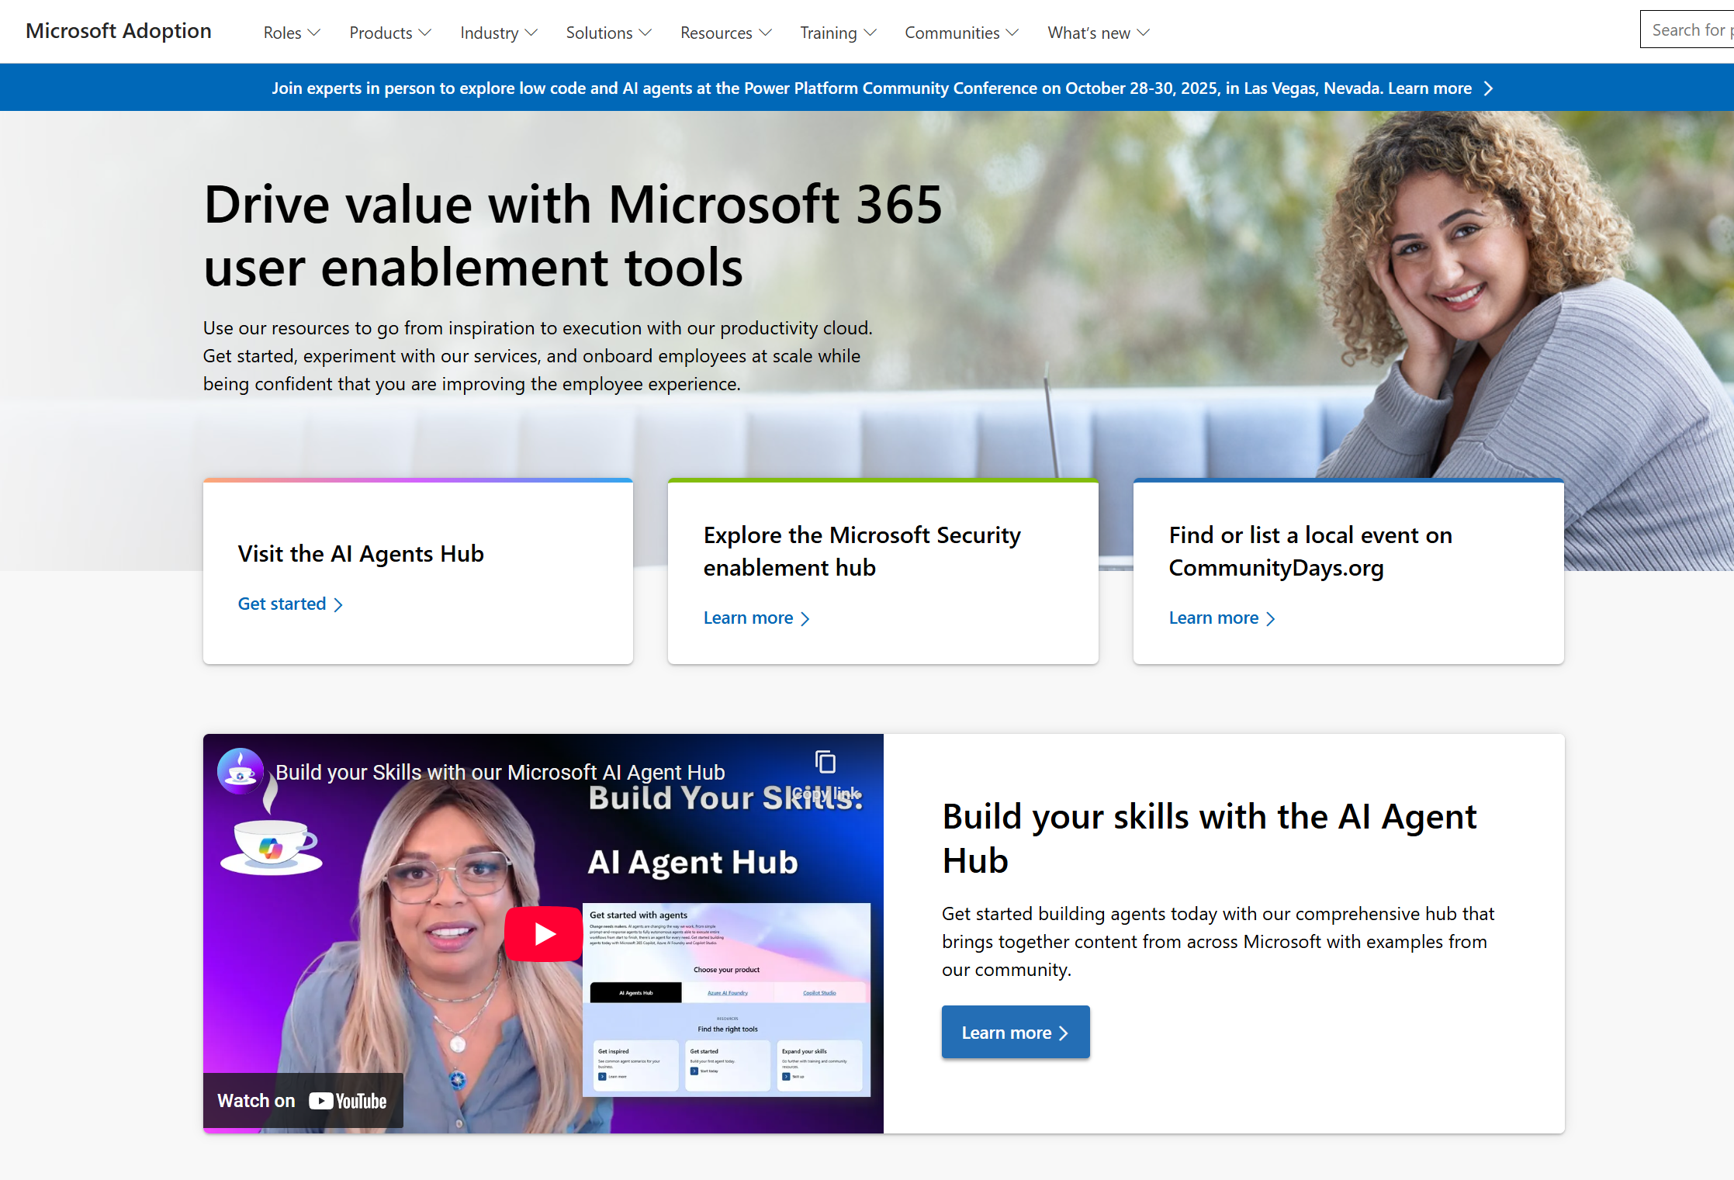
adoption.microsoft.com
Update highlights
Addition of Copilot and Agents spotlight series to the Customer Hub
Addition of a new on-demand session to the Microsoft 365 Copilot for all seasons series on the Customer Hub
Addition of the Copilot Chat Administration guide to the Microsoft 365 Copilot Chat page
Addition of Frontier product scenarios and Frontier Firm playbook to the Microsoft 365 Copilot page
Addition of the Copilot Chat Administration guide to the Microsoft 365 Copilot Chat page
Read or subscribe to our release notes for more updates.

Slide 9
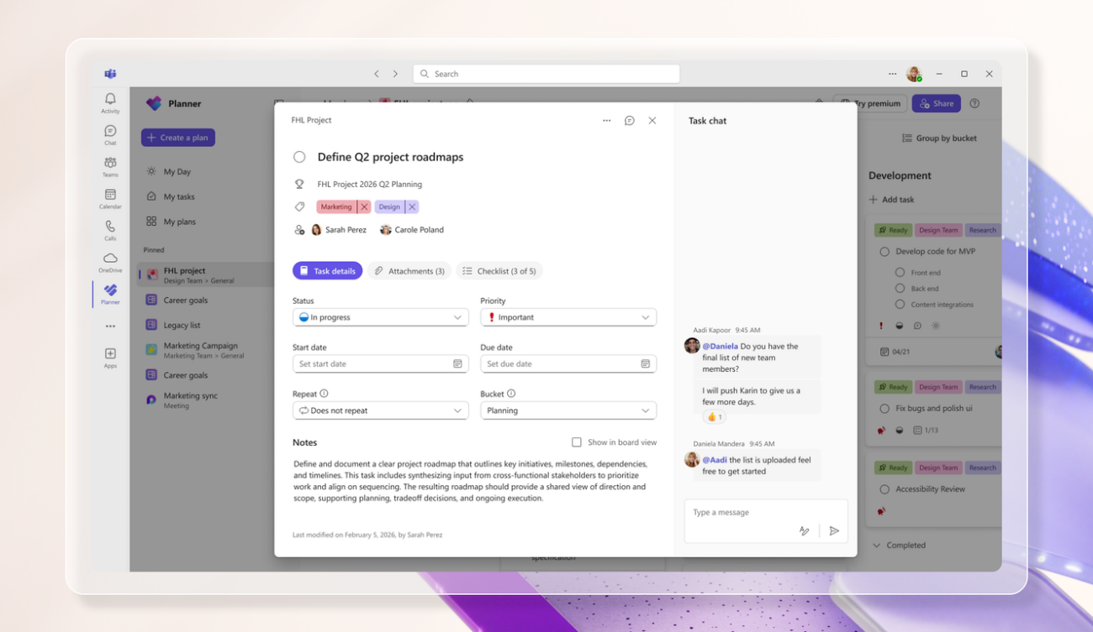
Microsoft Planner updates
Microsoft Planner
Introducing a refreshed design, task chat, and more in Microsoft Planner
We’re excited to announce that a modernized user interface and new features are now rolling out to basic plans in both Planner in Teams and Planner for the web. The updated design offers enhanced navigation, responsive layouts, a new goals view for setting objectives and priorities, and task chat—one of your most requested features—to enable real-time collaboration and @ mentioning team members.
Please note that not all users will see the new Planner interface at the same time. This refreshed interface, along with Task chat and Goals view, begins rolling out to basic plans 2/23 and will continue to roll out over the coming weeks.
Click here to learn more!
Notes:
Updates include: -A refreshed design: With this rollout, users will be able to manage their plans in a cleaner, more modern interface that offers faster performance and brings a more consistent planning experience across work.
-Task chat with @ mentions: A new task chat is coming to basic plans, bringing real-time, threaded conversations directly into tasks, including @ mentions, rich formatting, emojis, and notifications to help keep decisions tied to the specific task at hand. Plan members who are @ mentioned in a task will receive a notification in their Teams Activity feed and via email and can select the notification which takes them directly to the task card for additional context. Note that previously, users received notifications for every task comment, but as a result of customer feedback, we now only send notifications to mentioned users.

Slide 10
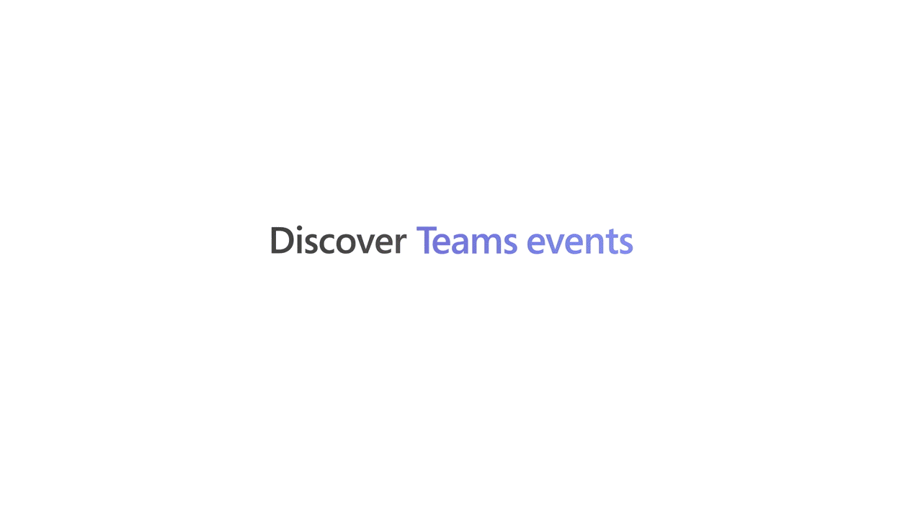
Microsoft Teams updates
Microsoft Teams
Teams events
The new Teams events experience brings discovery, creation, and management into a single, centralized workflow. Organizers can configure events through a flexible creation flow that supports a wide range of interaction, registration, and branding options without being constrained by event type. Available in public preview, the new Teams events experience helps unlock more control and flexibility for digital and hybrid events by simplifying creation and management for organizers and improving visibility and access for attendees.
Unified event creation flow
Centralized event discovery and tracking
Simplified event management
Learn more about Teams events.
Notes:
Managing events in Teams is easier than ever with the new Manage tab. No more searching through calendars or hidden menus to update presenter bios, adjust sharing functions, or track registrations. Teams events brings everything into one place for streamlined management.
Event pages are created automatically when an event is saved, and serve as the central location for settings, customization, and branding. After an event concludes, Teams events makes it easy to send attendees follow-up emails and recording notifications. Event organizers also have a single place to access registration data and recap tools designed for insights and continued engagement.
Starting April 1st, 2026, Teams events capabilities such as town hall and webinar, including advanced features, are available to all users licensed for Teams Enterprise and no longer require Teams Premium. This expanded access to Teams events enables more people in your organization to create high-quality, professional events. Along with these licensing changes, we also announced Attendee Capacity Pack licenses would be available to scale digital and hybrid events up to 100,000. For more information, please read our recent licensing announcement.

Slide 11
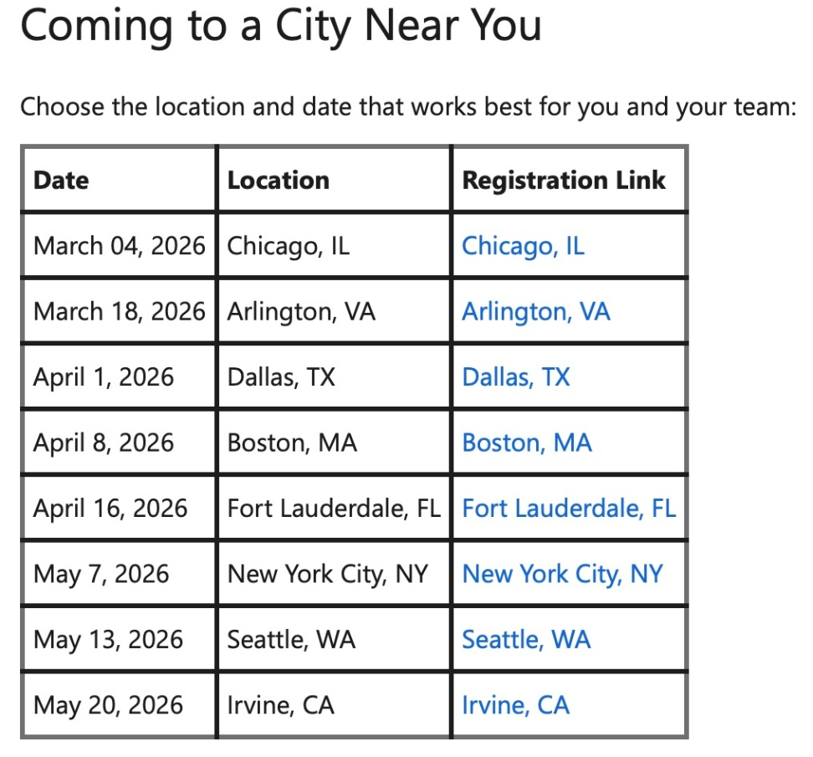
Copilot in Government updates
Copilot in Government
Microsoft 365 Copilot Government Events Are Hitting the Road & Coming to a City Near YOU
Generative AI is no longer a “future” conversation—it’s happening now across government. And there’s no better way to move from curiosity to confidence than getting hands on with M365 Copilot alongside peers and experts who understand your mission.
That’s why we’re excited to bring M365 Copilot Government in‑person experiences to cities across the United States! These immersive, collaborative events are designed to help government organizations build real skills, unlock immediate value, and accelerate their M365 Copilot journey—all within GCC guardrails and responsible AI practices.
Click here to learn more.
Notes:
Working in small teams, you’ll tackle realistic government scenarios using M365 Copilot across Word, Excel, PowerPoint, Teams, and Outlook. With guidance from Microsoft Cloud Solution Architects and specialists, you’ll experiment, iterate, and build workflows you can take back to your organization.

Slide 12
Word, Excel and PowerPoint Agents in Microsoft 365 Copilot
Alex Yang, Chelsea Fesik and Sangeeta Kulkarni

Slide 13




Introductions
Alex Yang
Product Manager
Excel Agent
Chelsea Fesik
Product Manager
Word Agent
Sangeeta Kulkarni
Lead Product Manager
WXP Agents

Slide 14
Knowledge work is going chat-first — but content creation hasn't kept up
75% of knowledge workers now use AI at work
Microsoft Work Trend Index 2025 — 31,000 people surveyed across 31 countries
The #1 productivity drop-off: the blank page
Documents, presentations, and spreadsheets are high-value artifacts — but the gap between intent and result is still too wide. Users know what they need but struggle to get started.
The industry is moving from blank canvas to conversation
Users expect AI to do work — create finished artifacts — not just answer questions. Going from intent to professional output in minutes is the new baseline.
Sources: Microsoft Work Trend Index 2025 | Microsoft 365 Copilot User Research | Internal WXP Agent Research, 2025
Notes:
Let's start with the why. According to our 2025 Work Trend Index — a study of 31,000 people across 31 countries — 75% of knowledge workers are now using AI at work. That's massive adoption. But here's the problem: the number-one productivity drop-off is still the blank page.
Documents, presentations, and spreadsheets are the high-value artifacts of knowledge work — they're what get shared with leadership, what close deals, what drive decisions. But there's still a painful gap between what people know they need and actually getting a professional result out the door. Users know what they want, they just struggle to get started.
The industry is moving from blank canvas to conversation. People expect AI to do the work — to take their intent and produce a finished, professional artifact in minutes. That's the new baseline.

Slide 15
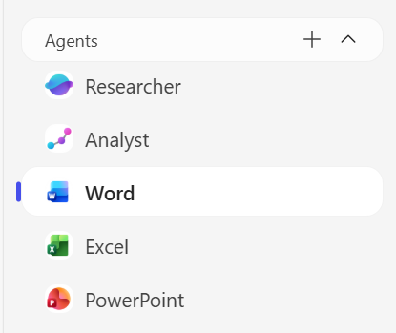
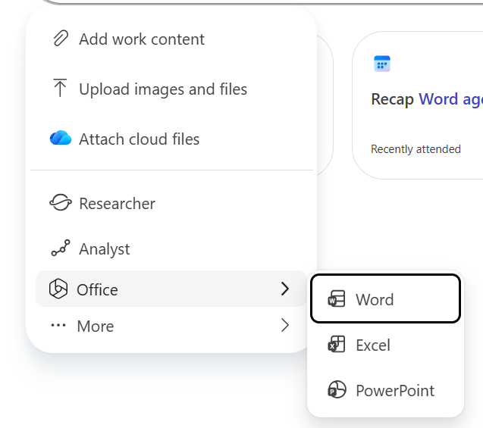
How We’re Solving the Problem: WXP Agents
We’re bringing powerful, task-specific agents directly into Microsoft 365 Copilot—making it easier to go from intent to professional output.
What WXP Agents Do (generic, cross-app)
Turn natural language into finished documents, workbooks, and presentations
Enterprise-quality output — professional layouts, themes, charts, and data visuals
Deep grounding in your enterprise data and the web
Iterate and refine through continued conversation
How to Access
From Chat — Call agents as tools directly in M365 Copilot chat and via @-mention
Search Agent – Pin on Left Nav — Pin the Word, Excel, or PowerPoint agents for persistent access
How it Works (3-step flow):
Access the Agent —Access the Word Agent, Excel Agent, and PowerPoint Agent in M365 Copilot.
Describe Your Need — Tell the agent what you need in natural language (topic, audience, purpose, key points, reference docs)
Review & Refine — Get a fully grounded, professionally designed artifact — then keep iterating
Notes:
So how are we solving this? We're bringing powerful, task-specific agents directly into Microsoft 365 Copilot — making it easier than ever to go from intent to professional output.
Here's what these agents do:
- Turn natural language into finished documents, workbooks, and presentations — not drafts, finished artifacts.
- Enterprise-quality output — professional layouts, themes, charts, and data visuals.
- Deep grounding in your enterprise data and the web. With a Copilot license, agents pull from organizational files, emails, chats, and meetings while respecting access policies.
- Iterate and refine through continued conversation — ask it to adjust tone, add sections, shorten content, whatever you need.
The flow is simple — three steps:
1. Access the agent — find the Word, Excel, or PowerPoint agent in M365 Copilot, either from chat or pinned in your left nav.
2. Describe your need — tell it what you want in natural language. Topic, audience, purpose, key points, reference docs.
3. Review and refine — get a fully grounded, professionally designed artifact saved to OneDrive, then keep iterating.
An important distinction: Copilot IN Word, Excel, or PowerPoint helps you work inside an existing file. These agents help you create a new file from scratch. They're complementary.

Slide 16
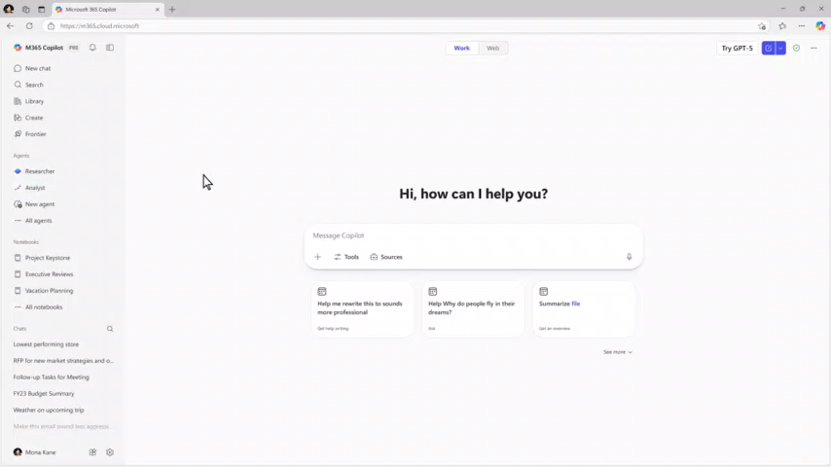
Word Agent
Notes:
1213 - Ignite 2025 WXP Word_11132025_V5.mp4 Now let me show you the Word Agent in action. The Word Agent focuses on long-form and structured writing — proposals, reports, guides, briefs. Watch how the user describes what they need in natural language and gets back a fully structured document with sections, headers, tables, and professional formatting.
[PLAY VIDEO]
As you saw, the Word Agent doesn't just dump text on a page. It understands document structure — sections, headings, tables, recommendations — and produces a complete .docx saved to OneDrive that you'd actually be comfortable sending to stakeholders. You can then follow up with things like "make it more executive" or "shorten to two pages" and it refines from there.

Slide 17
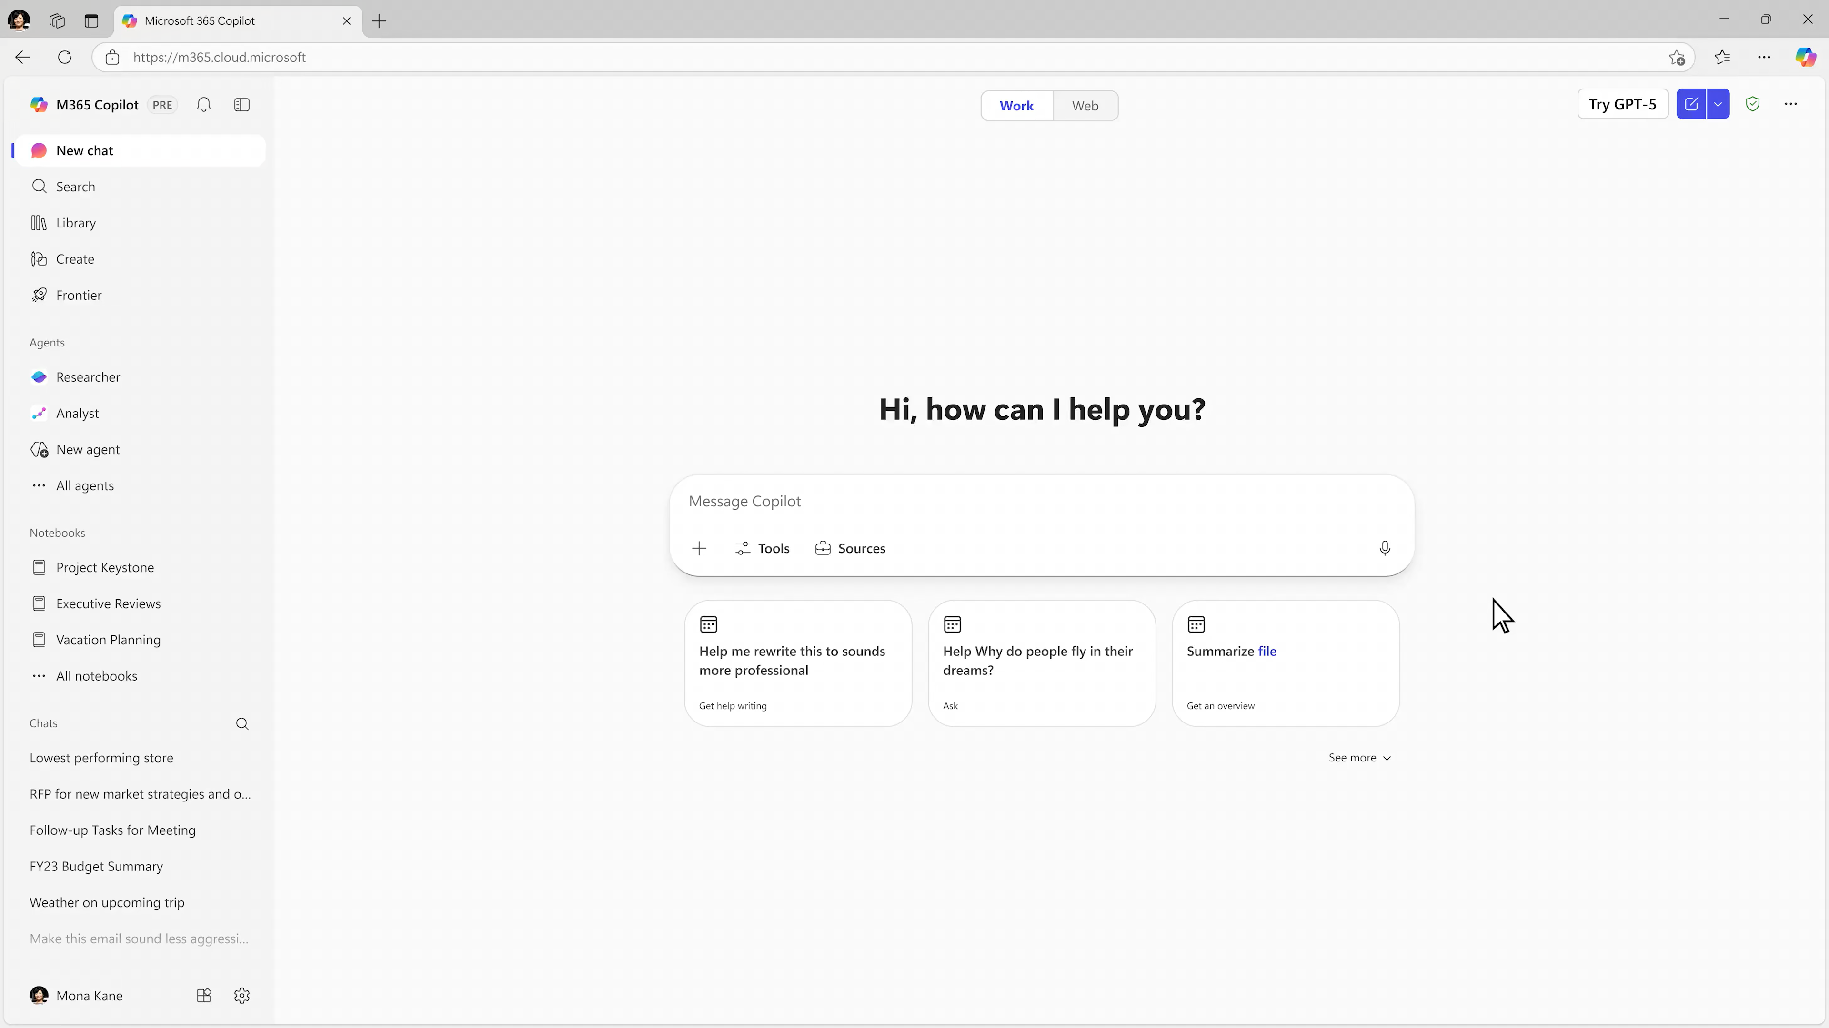
Excel Agent
Notes:
1213 - Ignite 2025 WXP Excel_11132025_V4 - POLISH No Claude.mp4

Slide 18
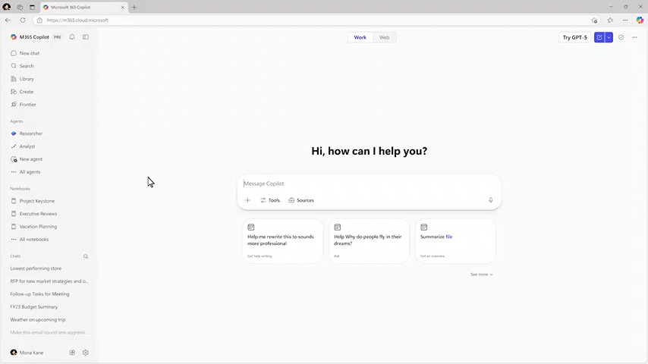
PowerPoint Agent
Notes:
1213-WXP-PPT-111325-POLISH-NoClaude-v7.mp4

Slide 19
Live Demos of Word, Excel and PowerPoint Agents
Notes:
Alright — those were the pre-recorded demos to give you a feel for the capabilities. Now let's get to the fun part. I'm going to do live demos of all three agents so you can see exactly how this works in real time and how the conversation flow lets you iterate and refine. Let's jump in.

Slide 20
Try These Scenarios
Sample prompts to test with your own data
"Create a 10-slide executive summary of our Q1 results using the attached financial report"
"Build a competitive analysis presentation comparing our product to the three competitors in this document"
"Create a progress report on Project X based on the latest transcripts from <ABC meeting series>”
"Research the impact of AI on IndustryName and make a primer for young professionals in the Discipline domain to get future-ready doc”
"Create a budget tracker spreadsheet with expense categories and a spending breakdown chart”
"Build a financial projection spreadsheet for the next 12 months with scenario comparisons"
Notes:
After what you've seen today, I encourage you to go try these agents yourself. Here are sample prompts to test with your own data:
- "Create a 10-slide executive summary of our Q1 results using the attached financial report" — great for PowerPoint Agent.
- "Build a competitive analysis presentation comparing our product to the three competitors in this document" — PowerPoint, grounded in your files.
- "Build a financial projection spreadsheet for the next 12 months with scenario comparisons" — Excel Agent.
- "Create a progress report on Project X based on the latest transcripts from your meeting series" — Word Agent, pulling from enterprise data.
- "Research the impact of AI on your industry and make a primer for young professionals" — Word Agent with web grounding.
- "Create a budget tracker spreadsheet with expense categories and a spending breakdown chart" — Excel Agent, practical and relatable.
Remember: these agents are available with or without a Copilot license — though organizational grounding requires the license. The more specific your prompt, the better the result. And all generated files save directly to OneDrive.

Slide 21
Questions?
Feedback?

Slide 22
Upcoming community events
Exchange Summit 2026 | Feb 24-25 | Wurzburg, Germany
Community Days Knoxville 2026 | Feb 26-27 | Maryville, TN
Experts Live Germany 2026 | Mar 3-4 | Leipzig, Germany
WIT Network Igniting Excellence Leadership Conference | Mar 10-12 | San Diego, CA
Microsoft Fabric Community Conference | Mar 16-20 | Atlanta, GA
Microsoft 365 Community Conference | Apr 21-23 | Orlando, FL
Explore other Microsoft events here and a full list of community-led events can be found at CommunityDays.org

Slide 23
Open discussion
If viewing on-demand, drop your questions in the Microsoft Tech Community – Driving Adoption event page to engage with us!
Share your feedback for this call by visiting https://aka.ms/Microsoft365ChampionCallFeedback

Slide 24



What’s next
Share your feedback
https://aka.ms/Microsoft365ChampionCallFeedback
Next call:
PowerPoint: Creation with Copilot and Agent Mode
Join the Driving Adoption community
https://aka.ms/DrivingAdoption
Invite colleagues to become a Champion
https://aka.ms/M365Champions

